Slide 1
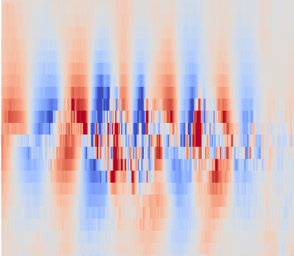

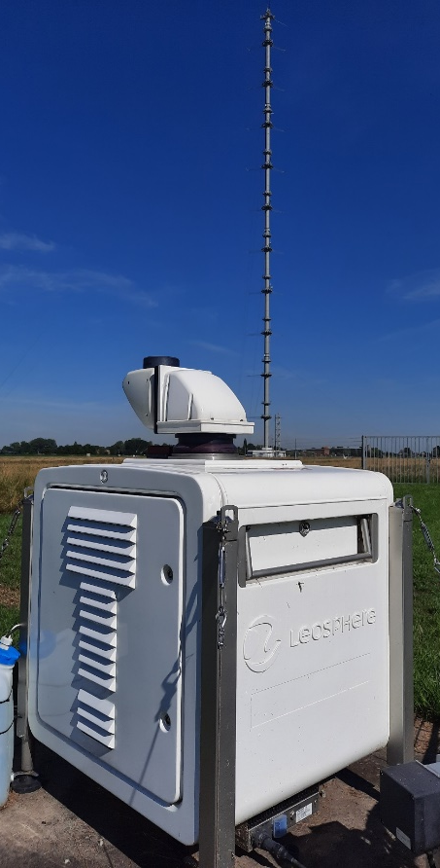


Doppler lidar vertical stare observation of a Kelvin-Helmholtz instability in the nocturnal boundary-layer
EMS2025-349
Steven Knoop¹, Jelle Assink¹, Christine Unal², Steven van der Linden², Bas van der Wiel²
¹ Royal Netherlands Meteorological Institute (KNMI)
² Delft University of Technology

Slide 2
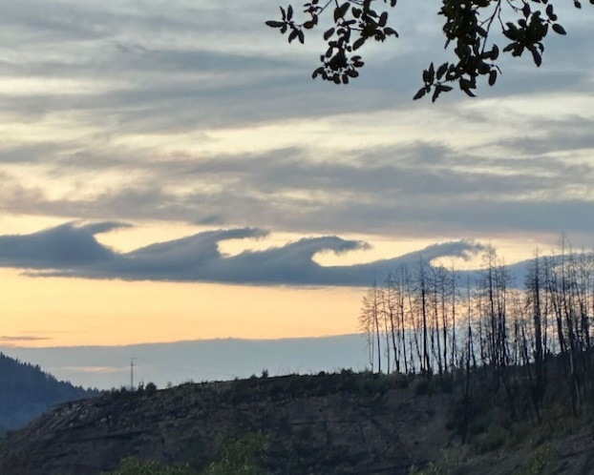
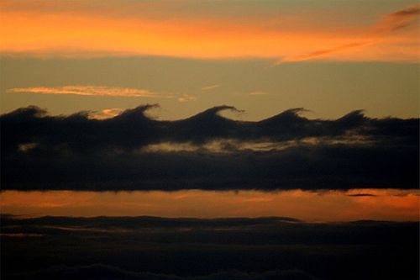
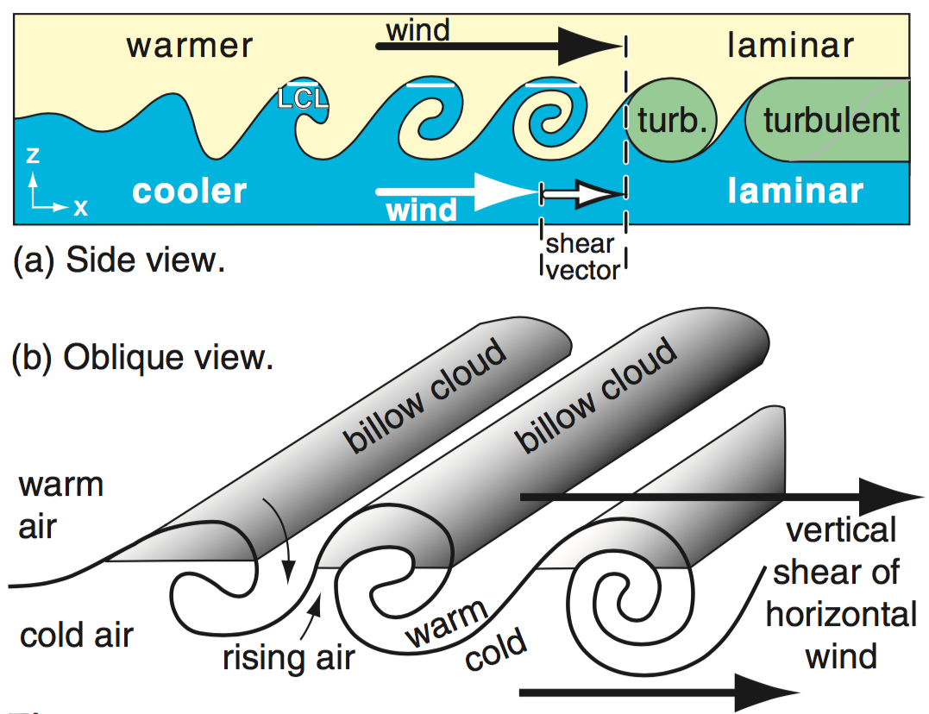
Kelvin-Helmholtz billows
Interface of two stable layers
Dynamic instability Ri=N²/S²<0.25
KH instability, waves, billows
(intermittent) turbulence in the stable atmosphere
vertical mixing
clear air turbulence (CAT)
Stull 1988 Fig. 5.18

Slide 3
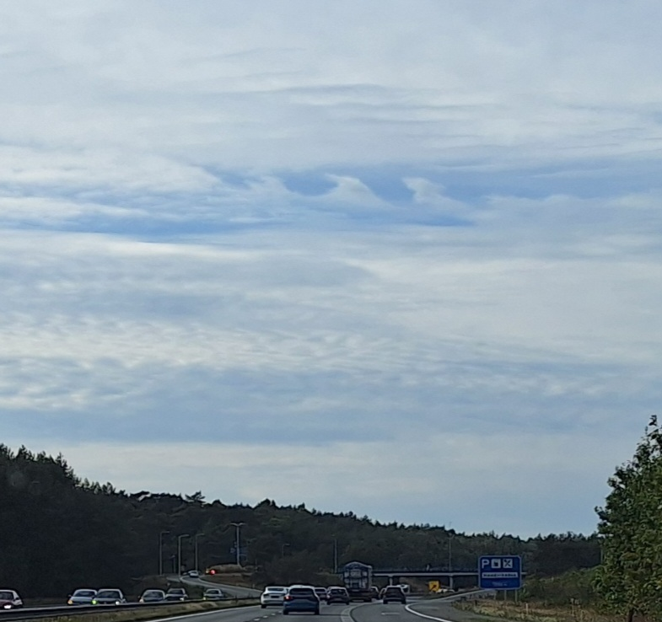
The Netherlands
A28 Zwolle => Amersfoort
2024-10-06 19:06 LT

Slide 4
Remote sensing observations of KH waves
Ground-based lidar, sodar, radar
Blumen et al 2001 Doppler lidar (RHI scan)
Minamihara et al 2023 PANSY radar
Kottayil et al 2024 VHF radar
Luce et al 2018 MU radar
Vertical velocity
Petenko et al 2023 Sodar

Slide 5
Doppler lidar vertical stare of the KH billows
KH instability: Doppler lidar wind profiles + NORA3 hindcast
Relevance for (offshore) wind energy (wake recovery)

Slide 6
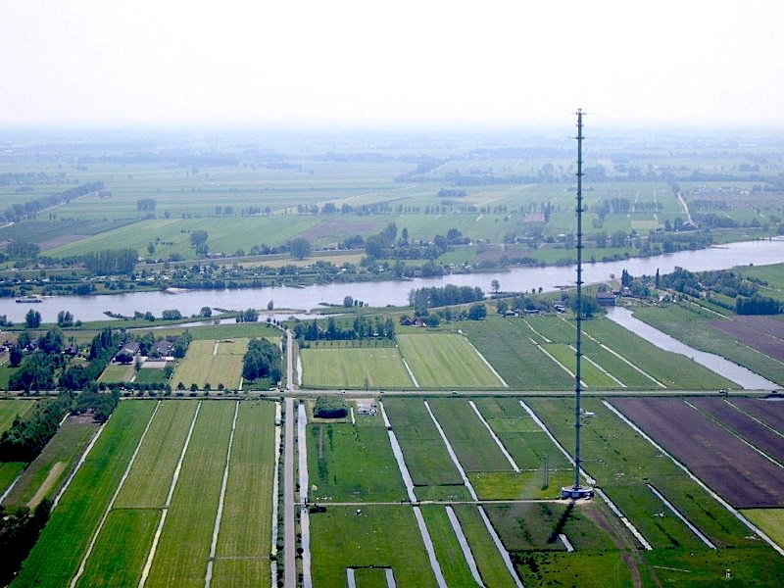
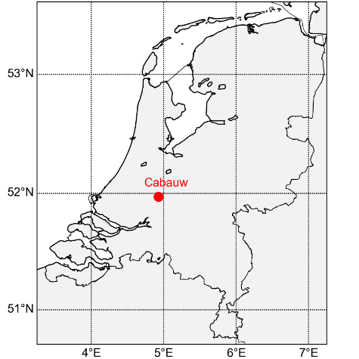
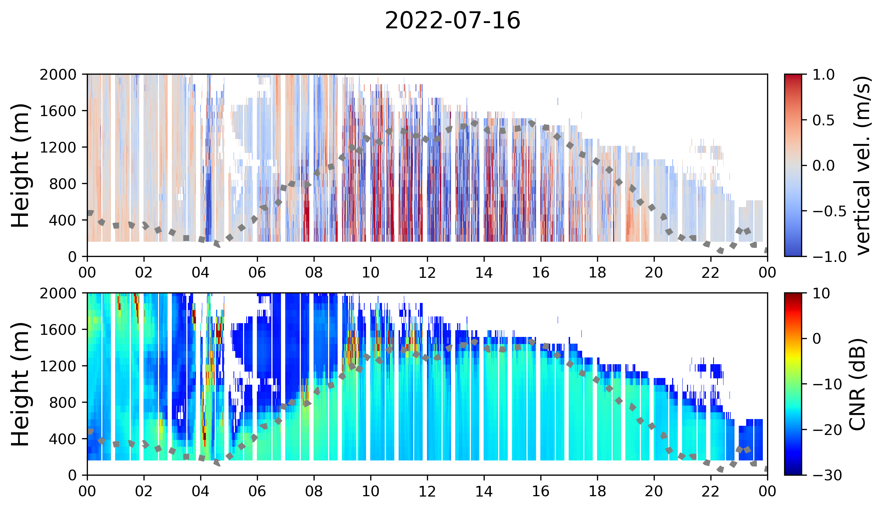
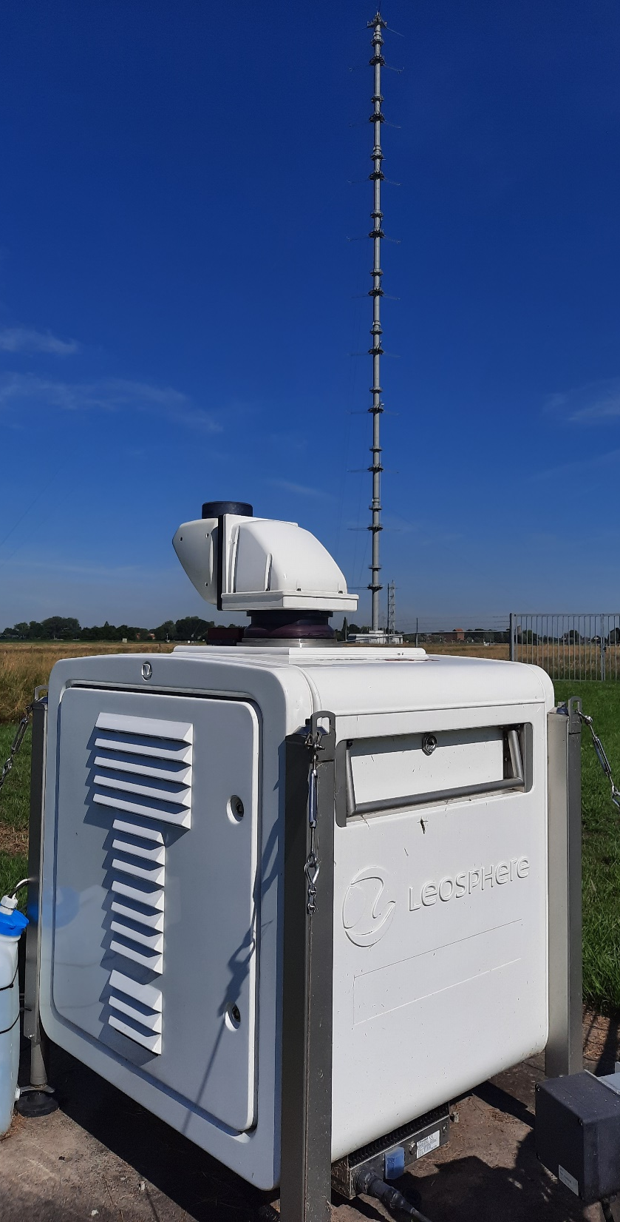
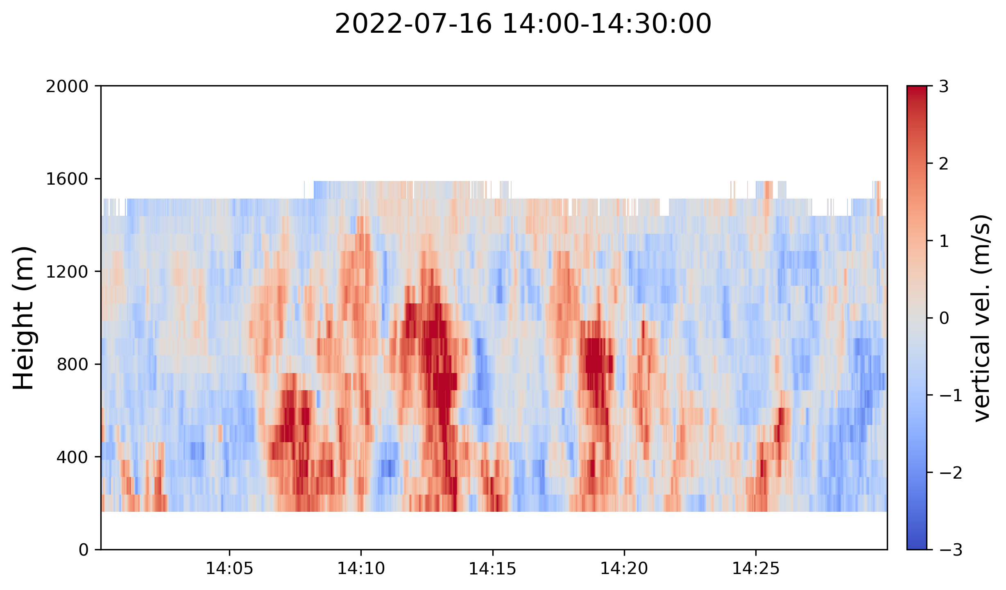
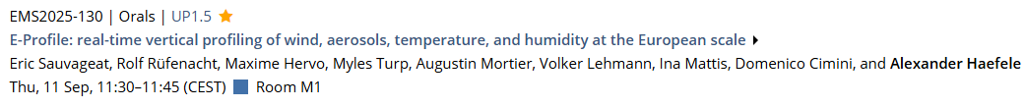
Vertical stare
EMS2023 Bratislava
ACTRIS Cloudnet (https://cloudnet.fmi.fi)
E-PROFILE (https://e-profile.eu)
Doppler lidar @ Cabauw
Windcube200S

Slide 7

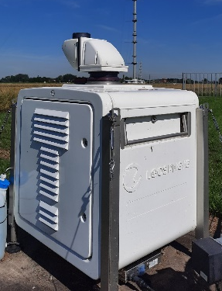
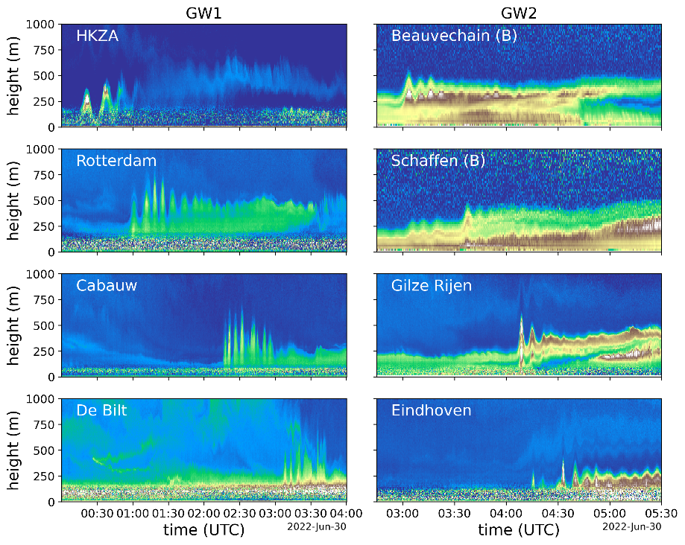
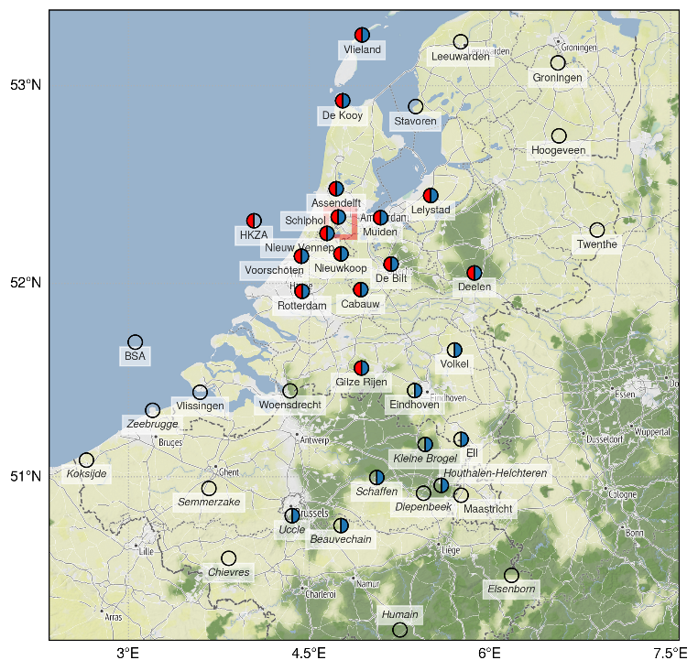
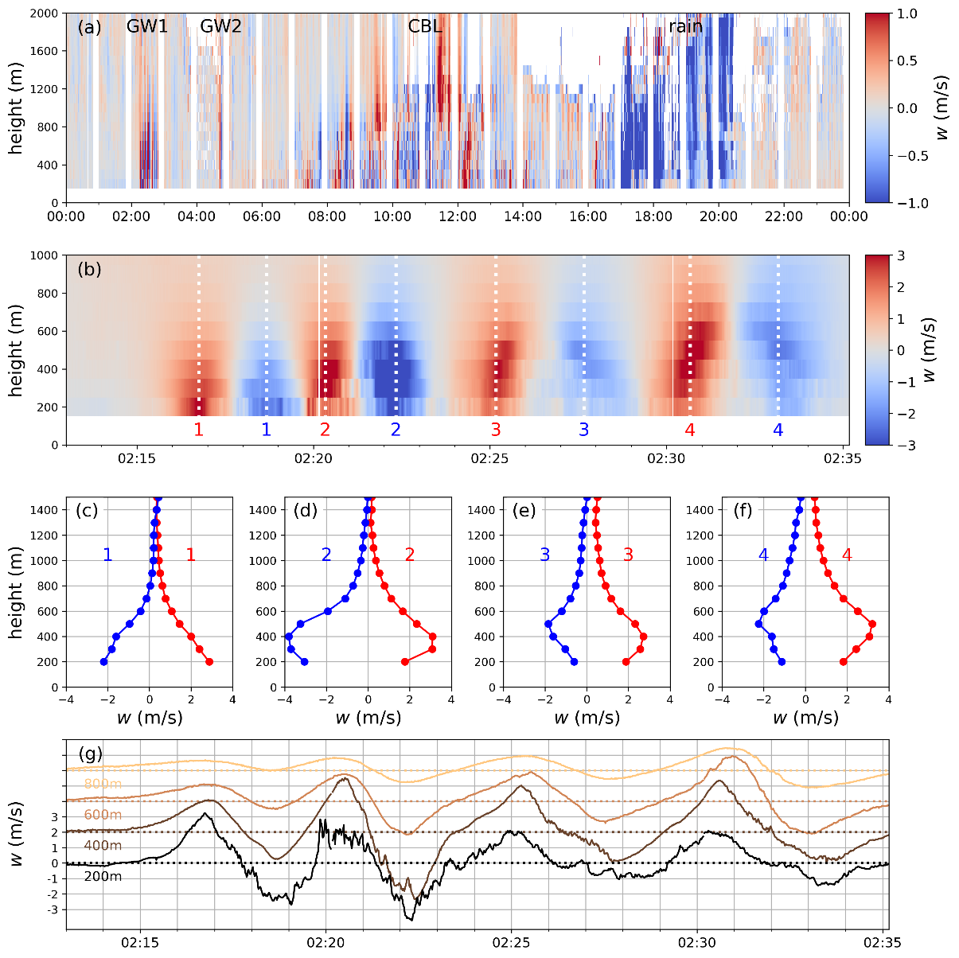
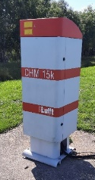
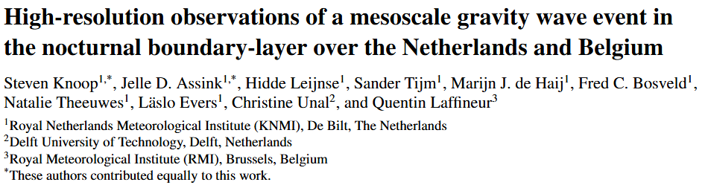
EMS2024 Barcelona
2022-06-30

Slide 8
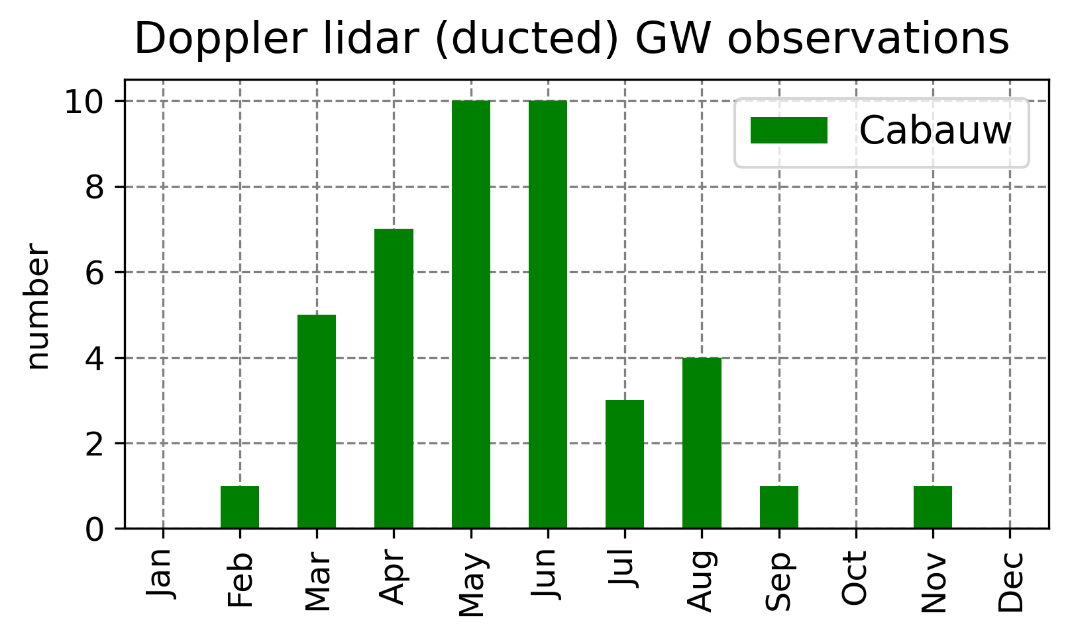

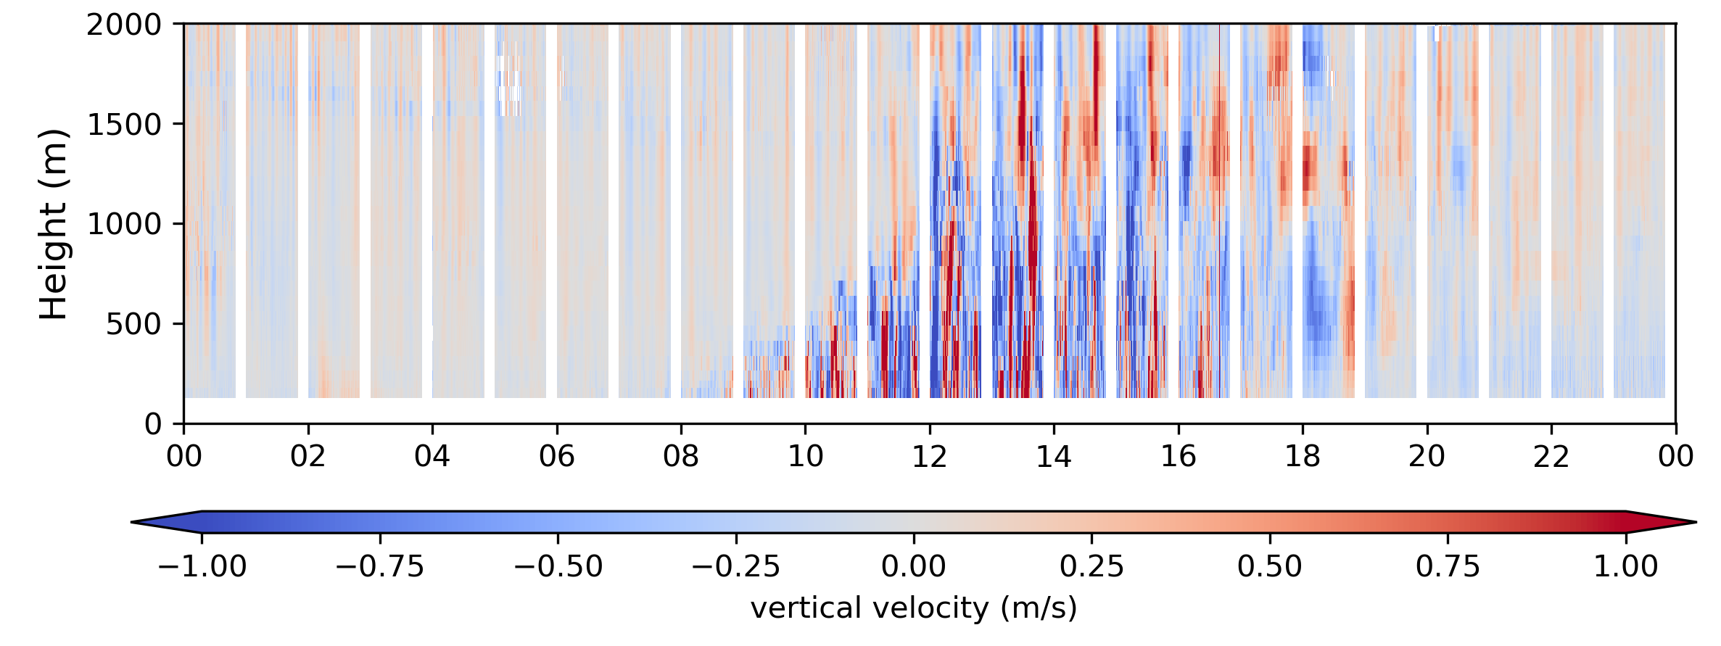
Doppler lidar wave observations
Ducted gravity waves
~40 cases since 2018
Mostly spring/summer
Nocturnal boundary layer
Convection waves
Convectively induced gravity waves
Above the convective boundary layer
Enough aerosols above CBL?
Kelvin-Helmholtz waves
2022-07-25
Local, rare event
Patches of intermittent turbulence more frequent

Slide 9
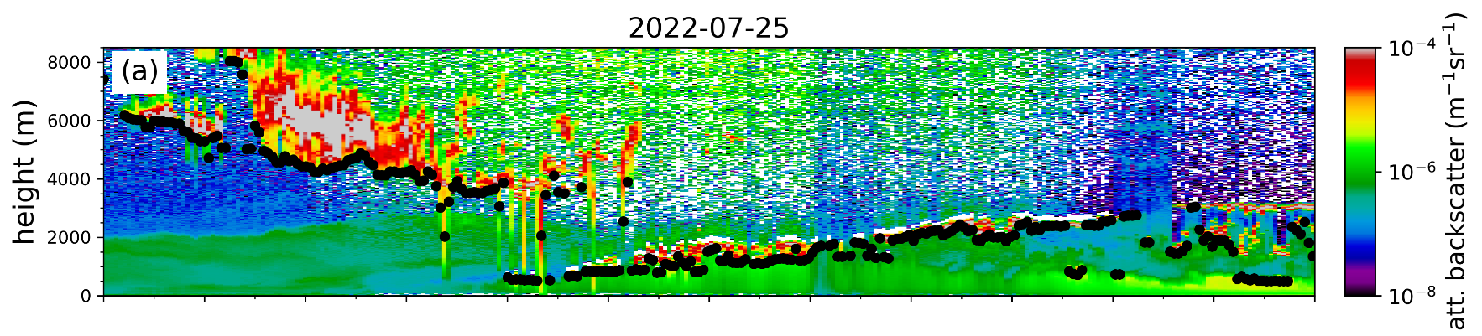


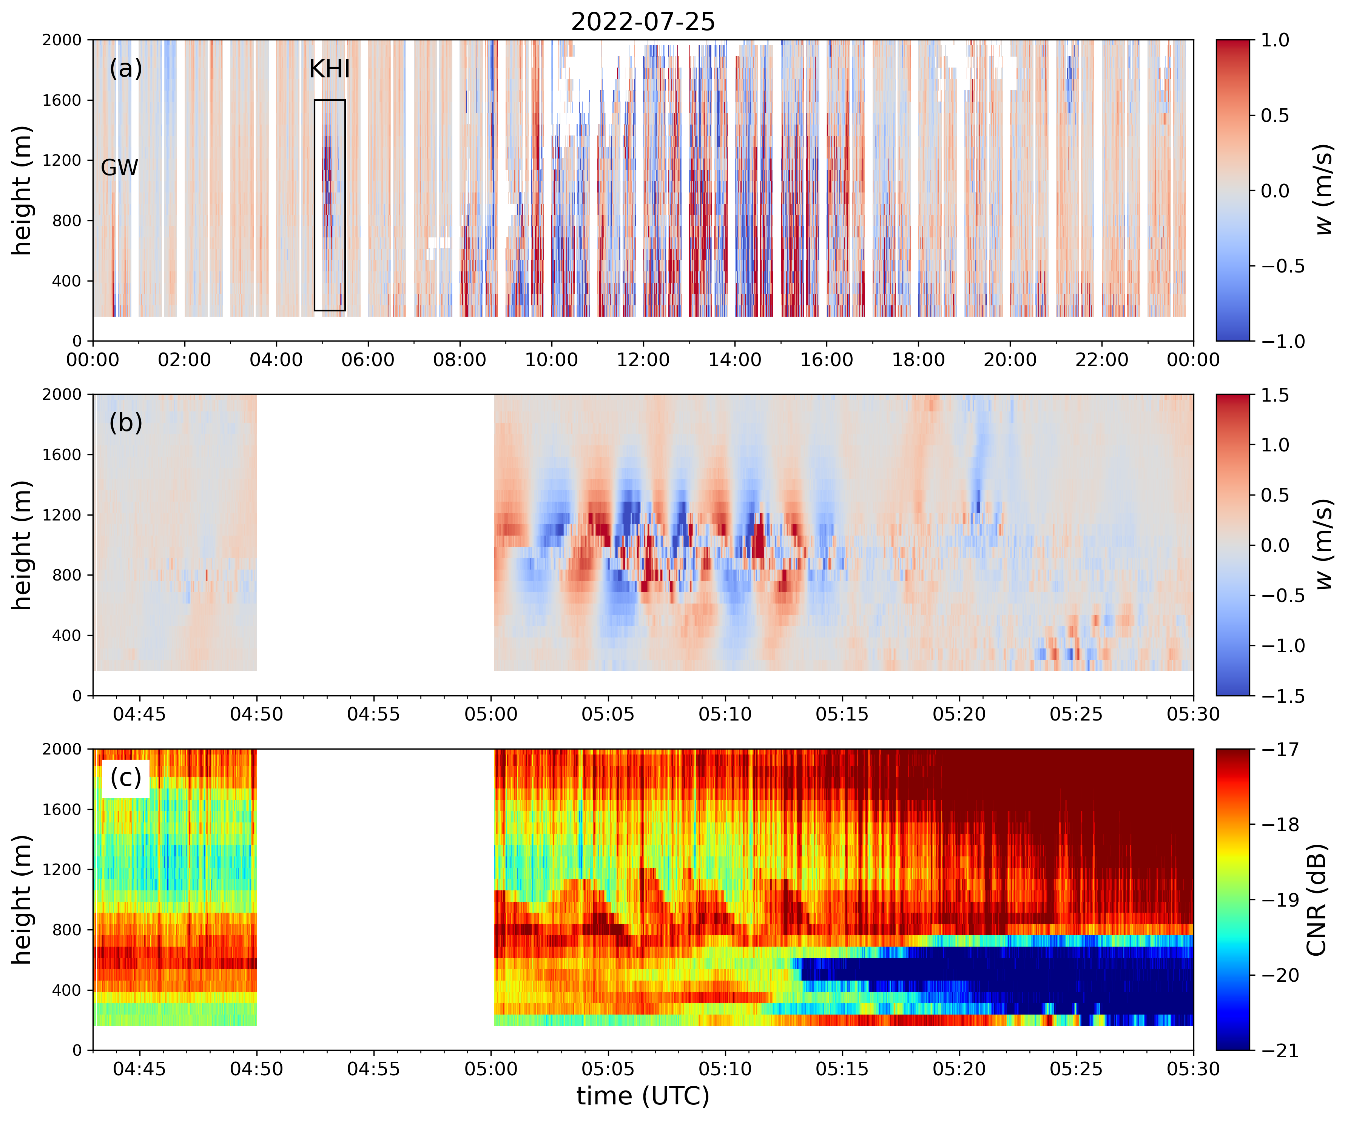
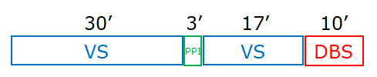
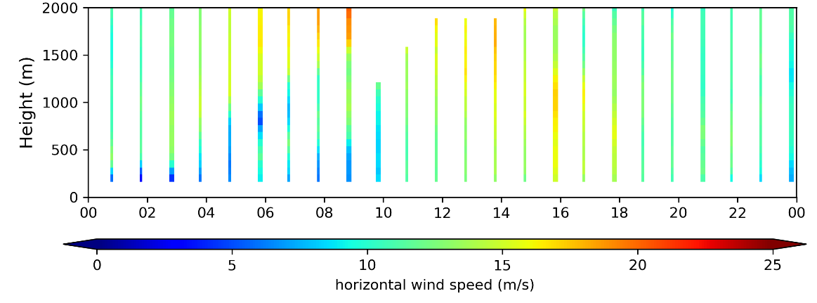
VS: vertical stare (1s, 75m)
DBS: Doppler beam swing

Slide 10
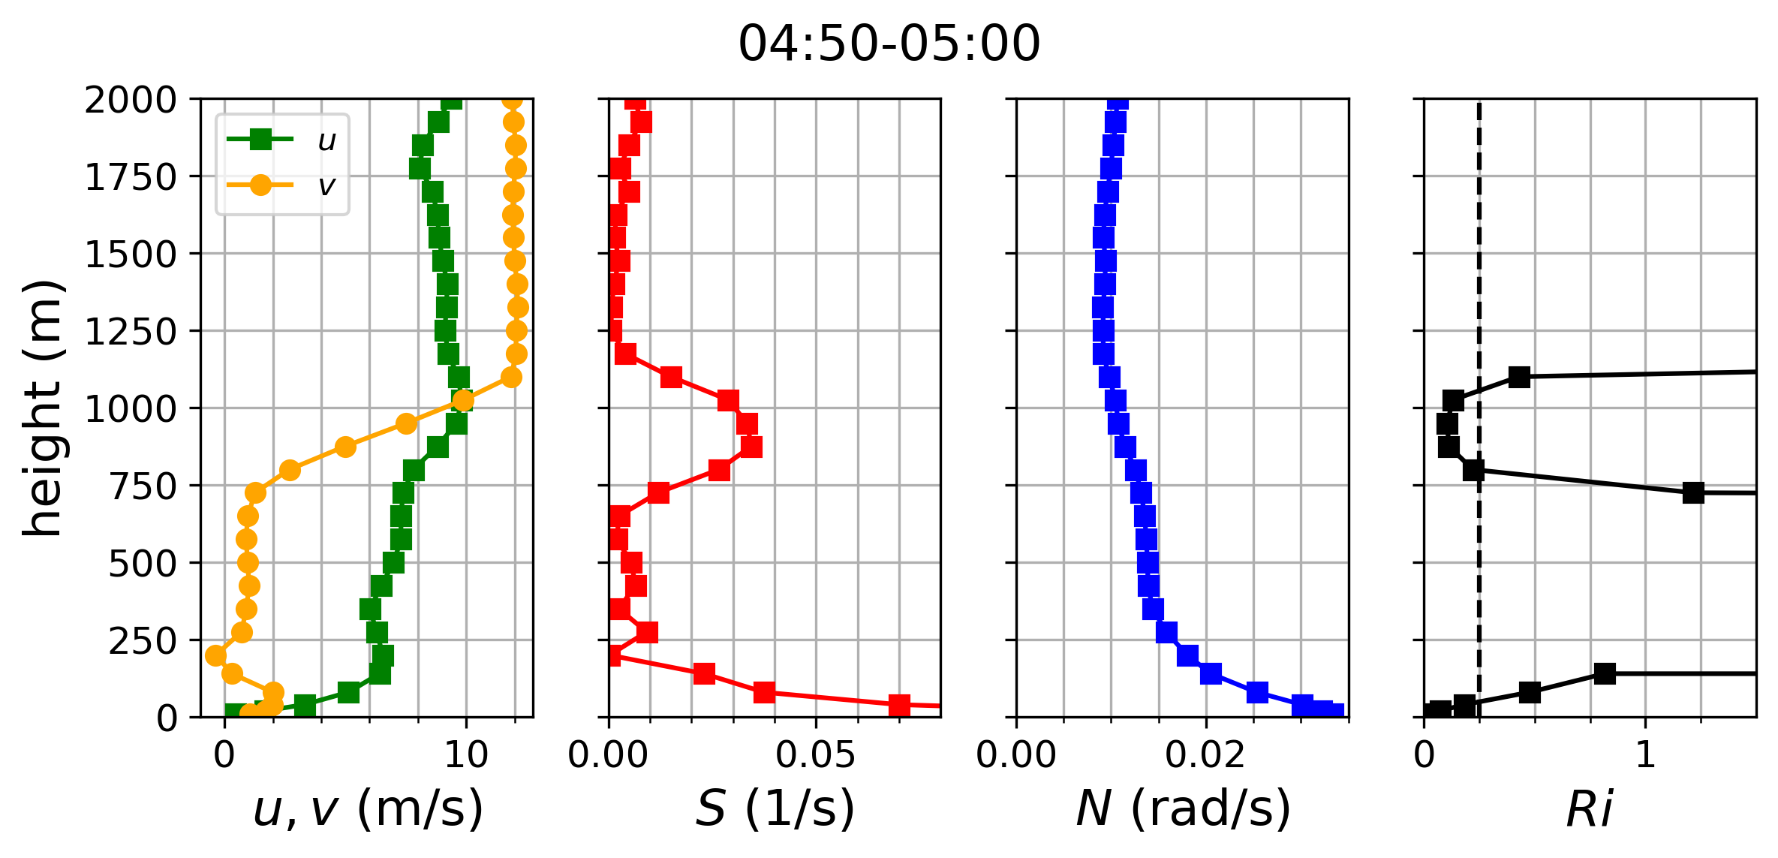

Δz
$$S=\sqrt{{\left(\frac{∂u}{∂z}\right)}^{2}+{\left(\frac{∂v}{∂z}\right)}^{2}}$$
= 2π Δz = 2π*300m ~1.8 km
= UT = 10 m/s*(5/15 min)~1.8 km
vector wind shear

Slide 11
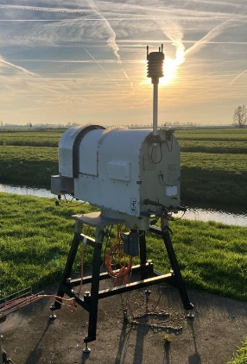


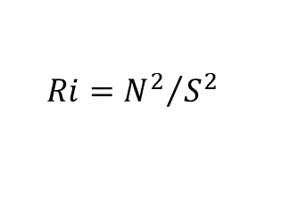
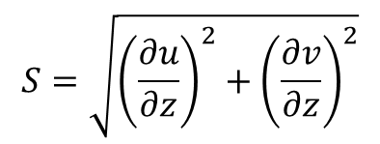
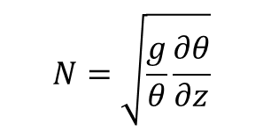
Kelvin-Helmholtz instability
Microwave radiometer (MWR)
RPG-HATRO-G5
$$S=\sqrt{{\left(\frac{∂u}{∂z}\right)}^{2}+{\left(\frac{∂v}{∂z}\right)}^{2}}$$
$$N=\sqrt{\frac{g}{θ}\frac{∂θ}{∂z}}$$
$$Ri={N^{2}}/{S^{2}}$$
S: vector wind shear
N: Brunt-Vaisala frequency
Ri: Richardson number

Slide 12

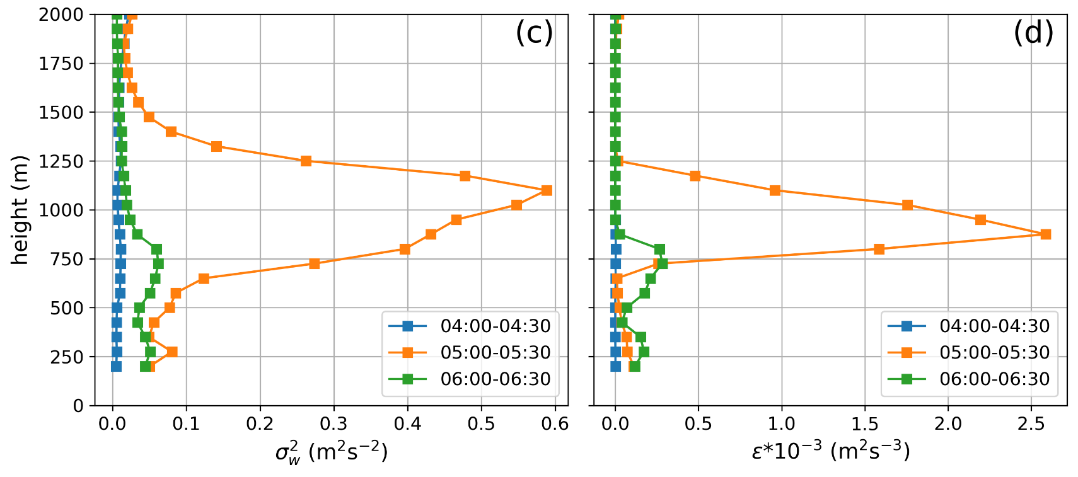
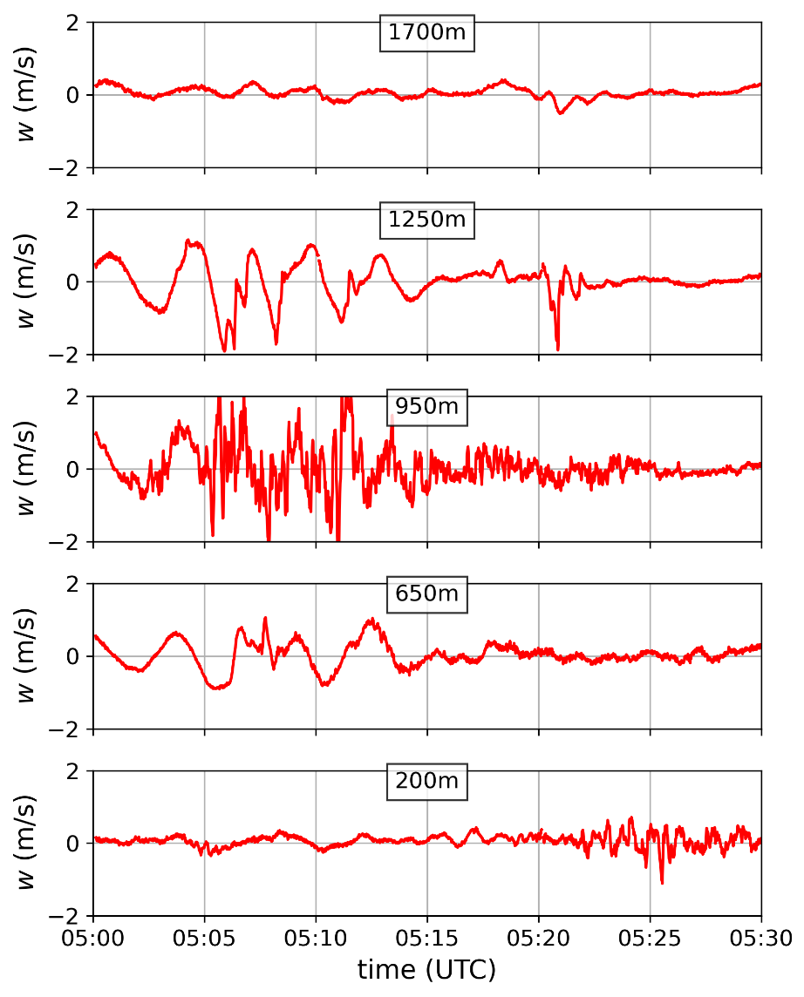

Turbulence
Vertical velocity variance σ²_{w}
Eddy dissipation rate (EDR) ε
Banakh et al, Remote Sensing, 2021

Slide 13
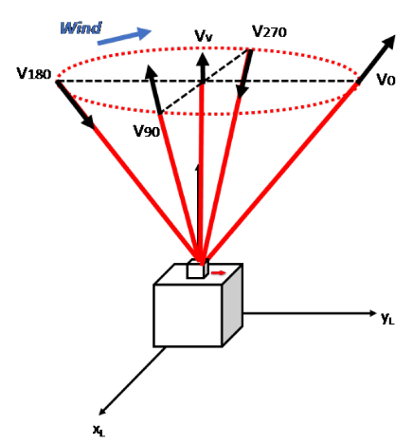
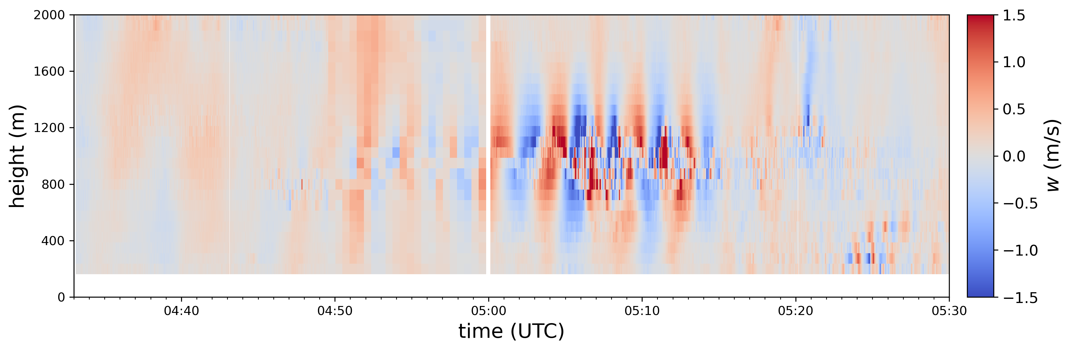
DBS

Slide 14



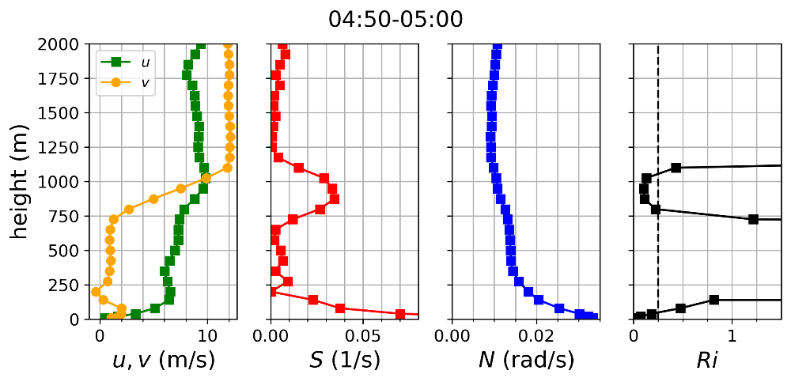
Conclusions & Outlook
Unique observation of Kelvin-Helmholtz waves in nocturnal boundary layer
Doppler lidar vertical stare
high resolution (1s) observation
KH waves
turbulence profiles
Doppler lidar wind profiling
wind shear
Synergy Doppler lidar and MWR
Ri profiles => dynamical instability
Ideal setup: 2x Doppler lidars + 1 MWR
“climatology”
related observations (elevated intermittent turbulence)
Linear Stability Analysis
LES

