Slide 1

ECMWF Open Data:
The Final Step of the Programme
Expanding Access to Weather & Climate Forecast Data
Alba Gomez Segura on behalf of Maartje Kuilman
Forecasts & Services Department
Alba.gomezsegura@ecmwf.int

Slide 2
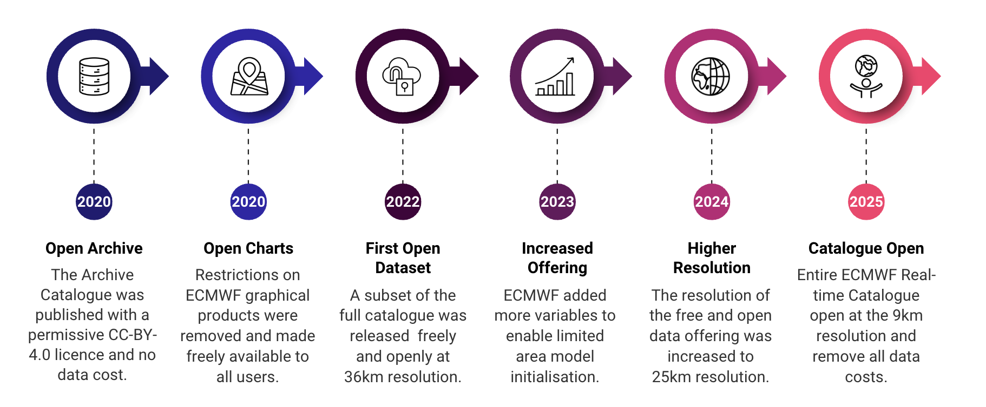
The Open Data Timeline

Slide 3
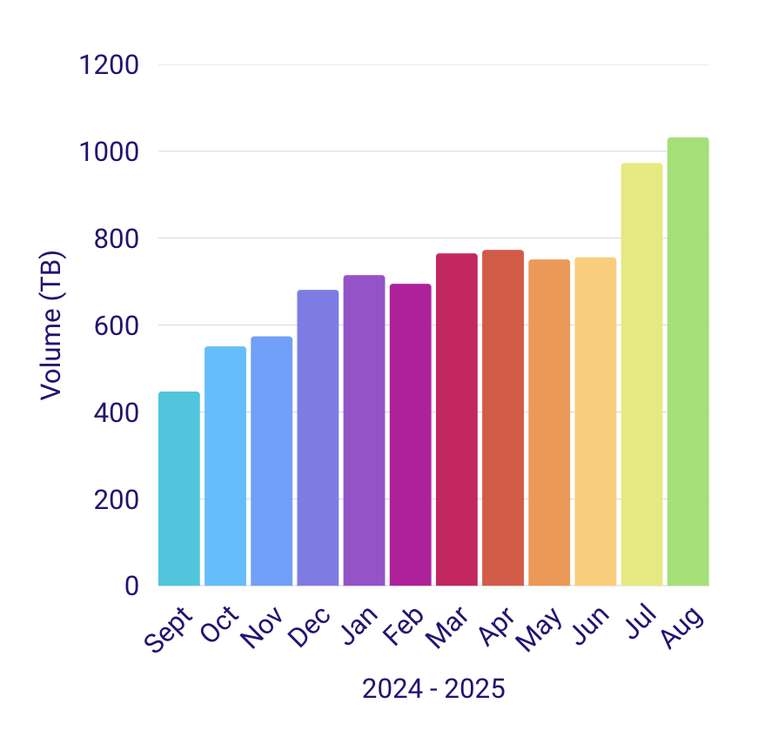
What is currently open?
Free & Open Data Uptake
ECMWF IFS 15-day Forecast (Ensemble & Control)
~31km resolution (0.25 degrees)
3h timesteps from 0 to 144
6h timesteps from 150 to 360
Variables sufficient to initialise limited area models
Available with 1h latency
ECMWF AIFS 15-day Forecast (Single and ENS)
Single at ~31km resolution (0.25 degrees)
ENS at ~31km resolution (0.25 degrees)
Same parameters as IFS open data
Available as soon as it’s ready
In August 2025, 1.032 PetaBytes downloaded.
The count of files retrieved was 127 million.

Slide 4
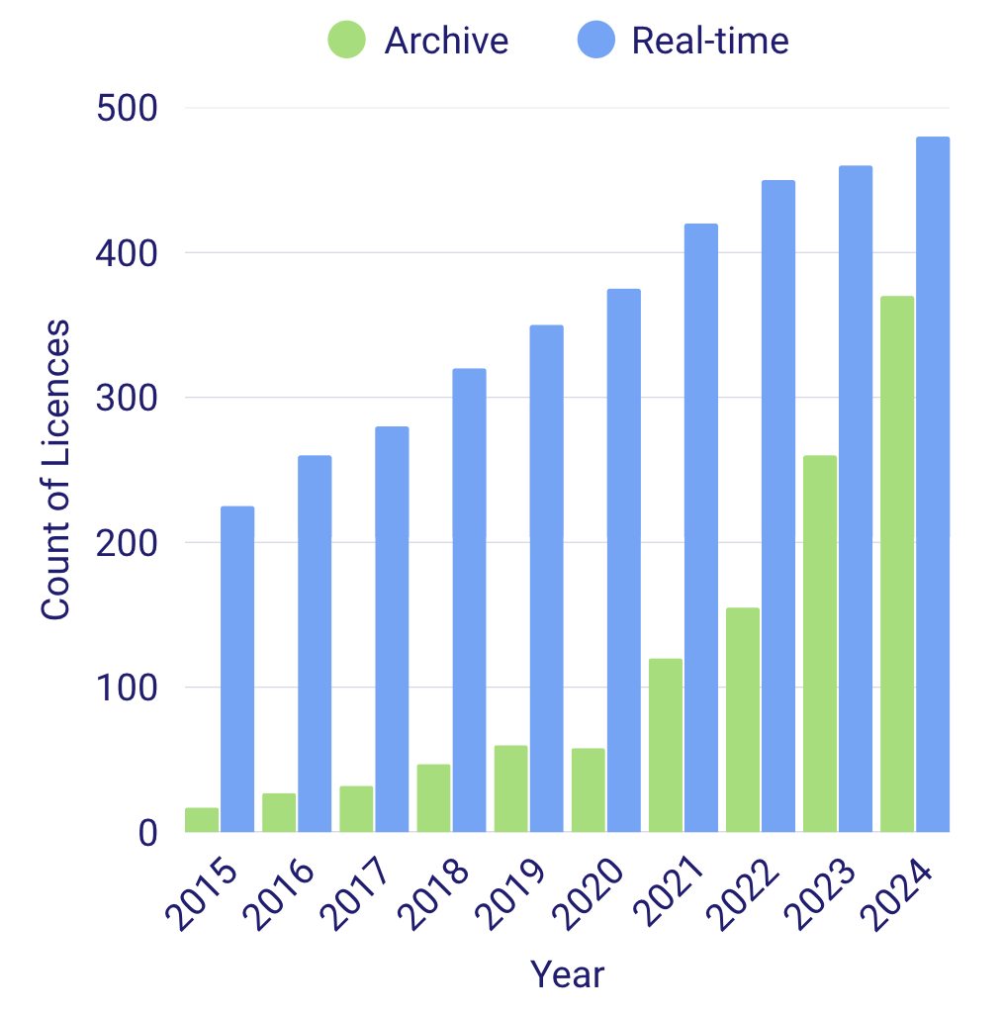
What is currently open?
Licensed User Uptake
ECMWF IFS 15-day Forecast (Ensemble & Control)
~31km resolution (0.25 degrees)
3h timesteps from 0 to 144
6h timesteps from 150 to 360
Variables sufficient to initialise limited area models
Available with 1h latency
ECMWF AIFS 15-day Forecast (Single and ENS)
Single at ~31km resolution (0.25 degrees)
ENS at ~31km resolution (0.25 degrees)
Same parameters as IFS open data
Available as soon as it’s ready

Slide 5
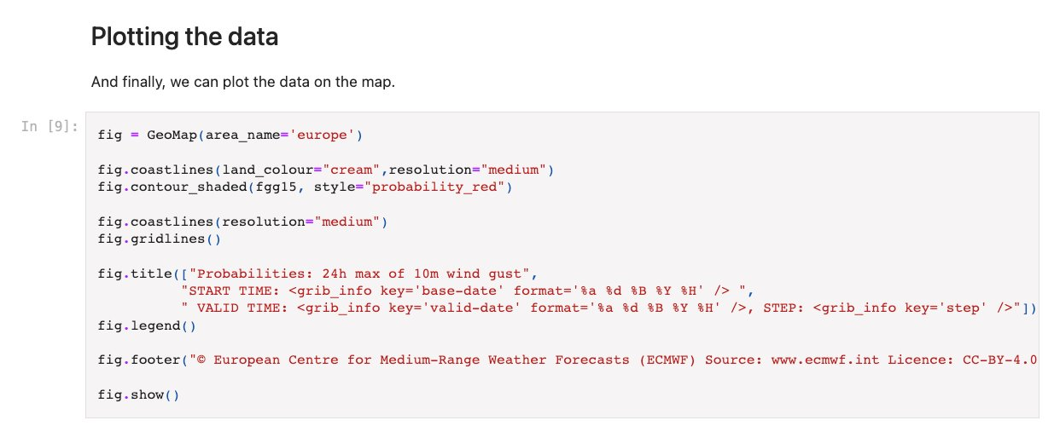
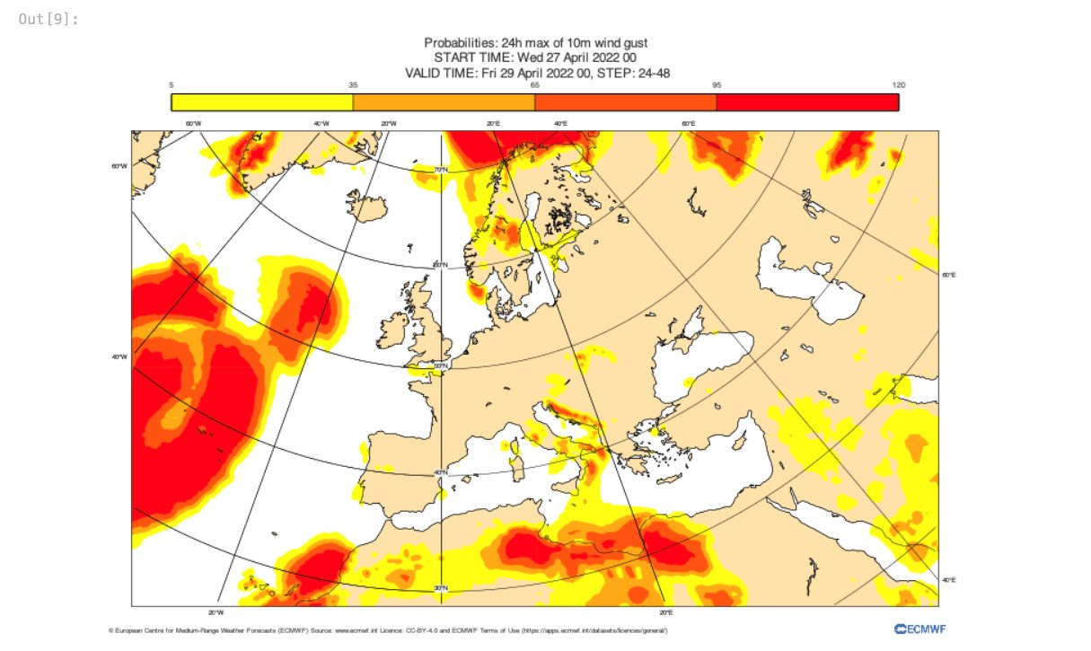

Making Data Accessible
ECMWF Open Data has an 88%
FAIR Score!
Compliance to “FAIR” = Findable, Accessible, Interoperable and Reusable: Jupyter Notebooks for open charts​
Design of an API to easily download the data​
Development of open-source Python libraries to process and visualise the data​
Development of Jupyter notebooks that showcase the use of libraries ​
and the data​
Updated and maintained user documentation to support increasing number of active users​​

Slide 6
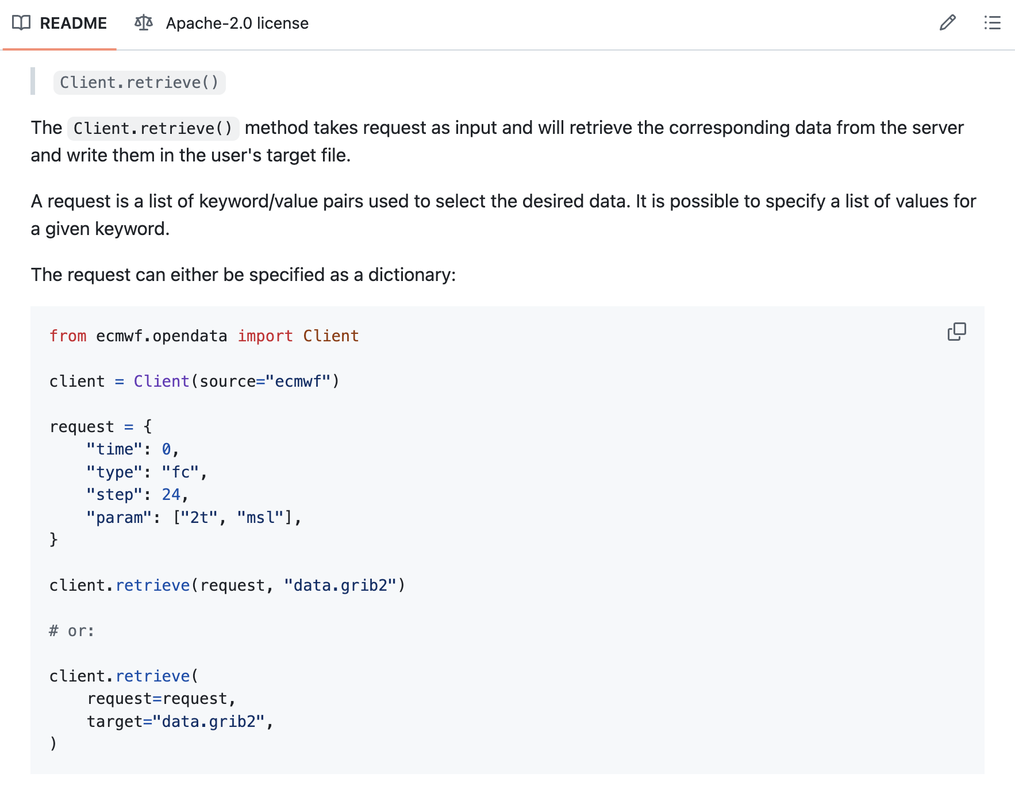
ECMWF Open Data Client
A common misunderstanding is that users need to take ALL of the products in a single file in order to access the parameter they require.
ECMWF has provided .index files that enable the client to retrieve exactly what you require.
More information can be found in the client documentation:
https://github.com/ecmwf/ecmwf-opendata

Slide 7
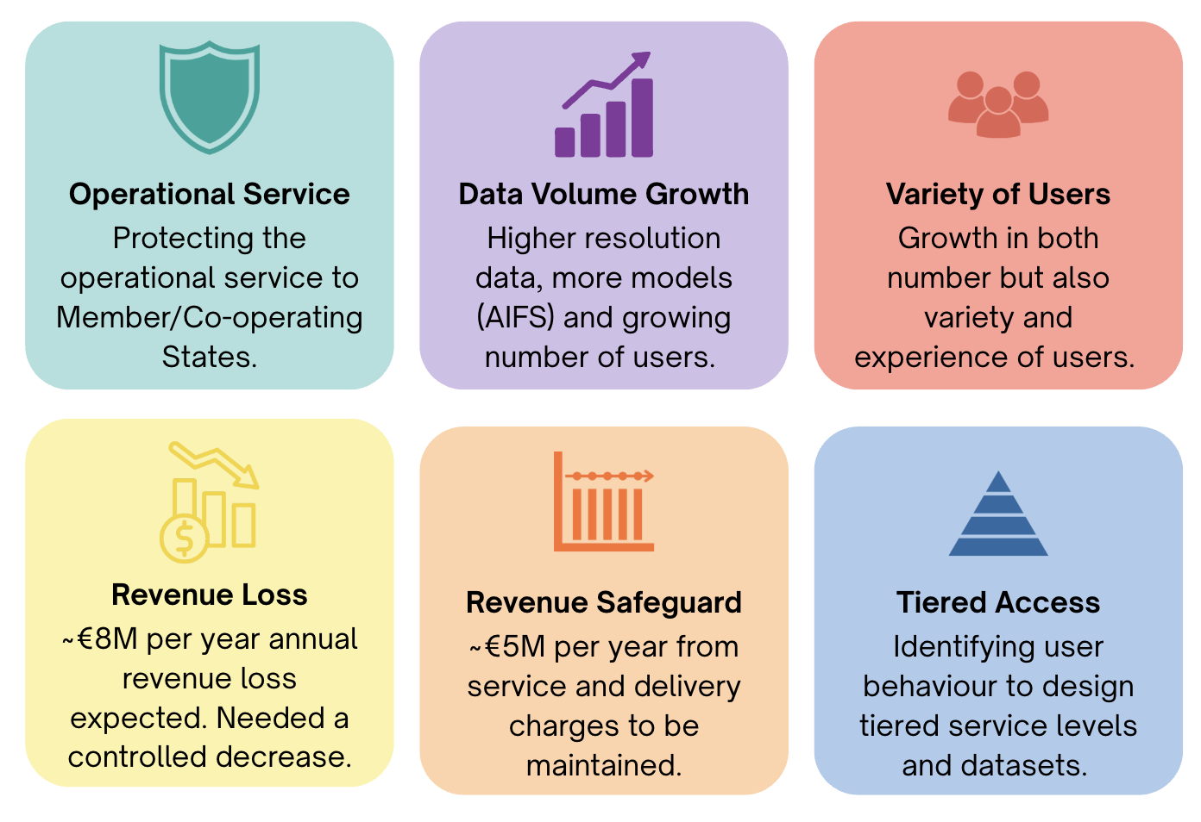
Challenges during the Open Data transition

Slide 8
What we’ve observed and learned
Huge uptake across services
Positive opinion of the open data offering
Increasing attribution over time (slowly)
Diversity of users (startups, NGOs, universities, beyond NWP)
Catalyst for innovation and re-use (apps, education, visualisations)
Raised ECMWF’s global visibility
Significant load on systems
Difficult to balance expectations with sustainability
Attribution often ignored
High support & documentation burden
Hard to measure downstream impact / benefit
Cultural shift inside ECMWF

Slide 9
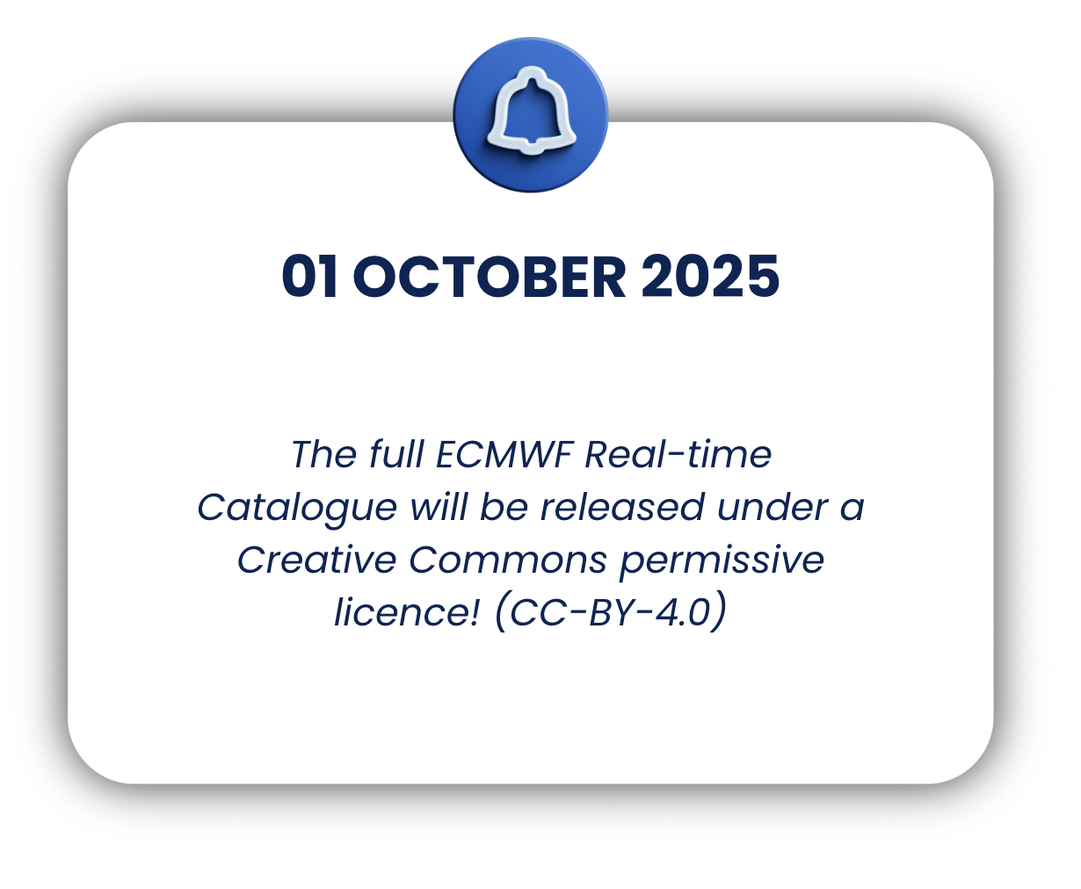

Big News!
21 days, 9 hours, 45 minutes to go…

Slide 10


Open vs Free Data vs Open and Free Data
Open data​
Data that can be used, modified, and shared by anyone for any purpose, but may be subject to delivery or service charges.​
Free data​
Data that can be accessed without charge but may be subject to certain restrictions on its use, modification, or sharing. ​
Free and open data​
Data that can be used, modified, and ​shared by anyone for any purposes, but may be subject to delivery or service charges.​​

Slide 11
ECMWF Data Policy in Summary
Free & Open Data:
Council-approved, WMO-compliant subset of the full ECMWF Real-time Catalogue
Free of all charges
1h latency at 0.25 degrees
No support provided
Open Data:
The full ECMWF Real-time Catalogue
Direct delivery to user
No data cost, but service charges may apply
Customisation of data delivery is possible and full support
Fee-waiver scheme:
Applicable to Council-approved use cases (i.e. Research, UN agencies, EU bodies, etc.) to access data without service charges, but subject to management approval.
Permitted only for Official Duty or Research Purposes.
Restricted Products:
Any product that is not formally part of the ECMWF Real-time Catalogue.
May be available for MS/CS evaluation before being added to the catalogue later.
No external access, unless approved by management.

Slide 12
Thank you for listening!
Questions?
Contact us for more information via the ECMWF Support Portal:
https://confluence.ecmwf.int/site/support
or engage with the community in the ECMWF Forum:
https://forum.ecmwf.int/
Notes:
We want to thank you for your time and attention today. As always, we are open to receiving feedback or questions via the portal or forum.
On the next slide, I will share some useful links and now I’m happy to answer questions.

Slide 13
Available Open Datasets
Real-time open data (https://www.ecmwf.int/en/forecasts/datasets/open-data)​
Open Charts (https://charts.ecmwf.int/)​
Archive data (licence required) (https://apps.ecmwf.int/archive-catalogue/)​
S2S Dataset (https://apps.ecmwf.int/datasets/data/s2s-realtime-daily-averaged-ecmf/levtype=sfc/type=cf/)
TIGGE Dataset (https://apps.ecmwf.int/datasets/data/tigge)​
CAMS and C3S, including CAMS global air quality analysis, forecast, and C3S seasonal forecast and reanalysis:​
- Atmosphere Data Store (https://ads.atmosphere.copernicus.eu)​
- Climate Data Store (https://cds.climate.copernicus.eu/) ​

