Slide 1



Predicting seasonal rainfall in East Africa through a teleconnection-based subsampling informed by AI models
Ljubljana, 7–12 September 2025
DEPARTMENT OF PHYSICS AND ASTRONOMY ‘AUGUSTO RIGHI’
ALBATROSS (Advancing knowledge for Long-term Benefits and climate Adaptation ThRough hOlistic climate Services and nature-based Solutions)
Sara Beltrami and Paolo Ruggieri
Notes:
Hybrid statistical-dynamical predictions in Sub-Saharan Africa

Slide 2
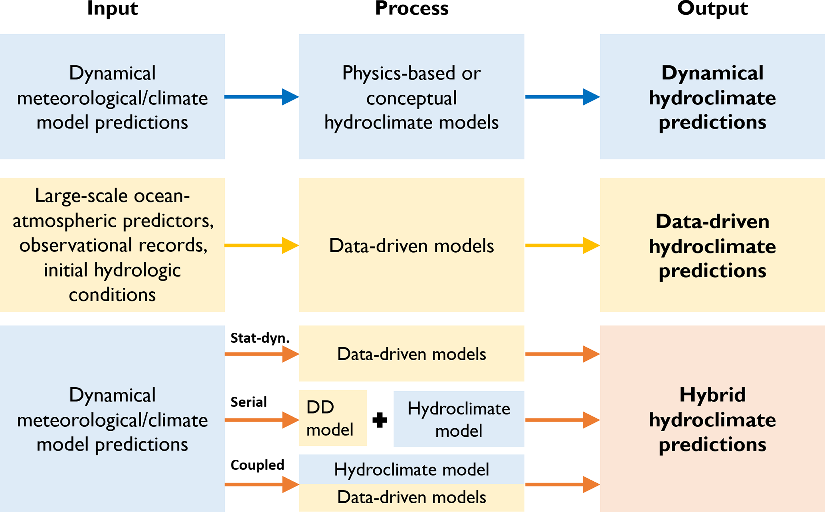
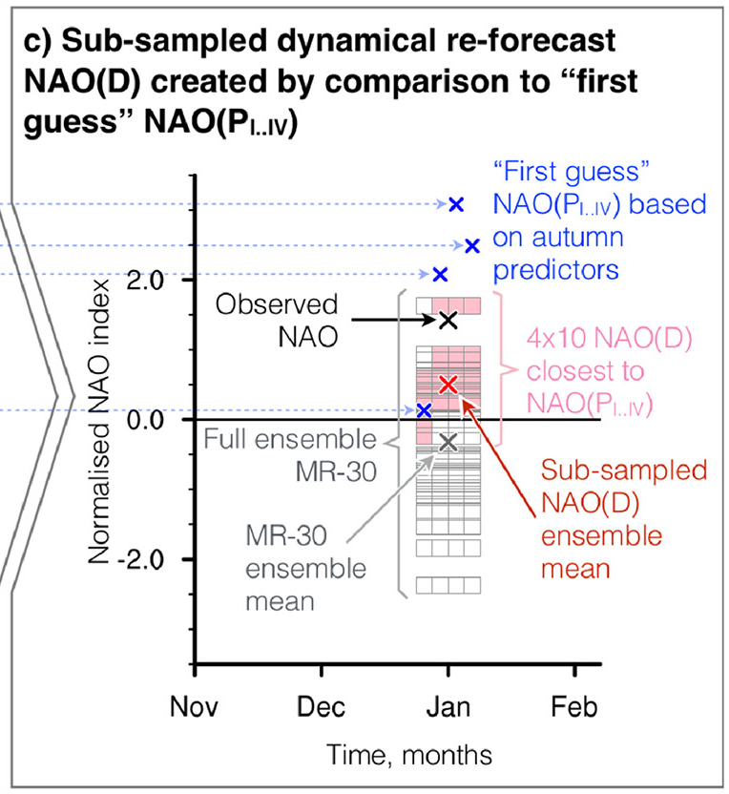
Hybrid statistical-dynamical prediction: teleconnection subsampling
Hybrid structure
Teleconnection subsampling
Adapted from^{[1]}
Signal-to-noise paradigm: Global Climate Models (GCMs) underestimate the predictable signal yet still provide useful predictive information.^{[2]}
Adapted from^{[3]}
[1] Slater et al. (2023)
[2] Smith et al. (2020) [3] Dobrynin et al. (2018)
Notes:
Qua forse aggiungi Smith et al 2020 ?
- the statistical-dynamical model, where the data-driven model is driven or conditioned with the dynamical one;

Slide 3
Our approach for teleconnection subsampling
Statistical Forecast
Surrogate series generated by adding Gaussian noise to observed teleconnection index (different σ).
Dynamical Forecast
Hybrid Forecast
Selection of ensemble members with smallest distance to statistical forecast.
Noise parameterized to reflect Convolutional Neural Network (CNN) predictive skill at different lead times of teleconnection index.^{[4]}
Euclidean distance computed between each ensemble member and the statistical forecast.
Subsample used to generate the hybrid forecast.^{[3],[5],[6],[7]}
Dynamical forecast of teleconnection index from a full GCM ensemble.
[4] Ham et al. (2019) [5] Famoos Paolini et al. (2025)
[6] Kowal et al. (2024) [7] Heinrich-Mertsching et al. (2023)
Notes:
My approach
ECMWF ensemble hindcast of teleconnection indices
Ham (2019) demonstrated that convolutional neural networks (CNNs), a class of deep learning tools widely used for image recognition and pattern extraction, can outperform traditional modelling techniques in predicting modes of variability, such as ENSO
The resulting synthetic forecast is then compared with the dynamical …. The comparison involve computing the Euclidean distance

Slide 4
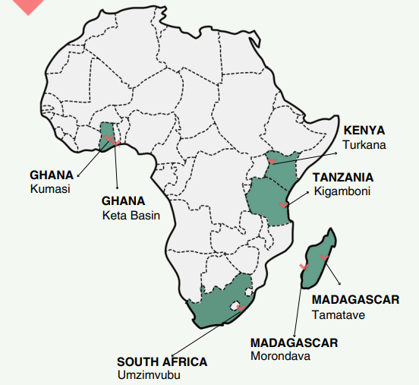


ALBATROSS project
Project Hubs
EU-funded project
14 African and European countries working in cooperation
7 African hubs
Provide climate services
Develop nature-based solutions
Coordinated by UNIBO prof. L.S. Leo and S. Di Sabatino
Notes:
Noi lo stiamo applicando a questo progetto
EU-funded project supporting climate adaptation in Sub-Saharan Africa. Works with local and national actors across five countries to address climate change.
Provides climate services to support informed decision-making.
Co-develops nature-based solutions with communities to enhance climate resilience.

Slide 5
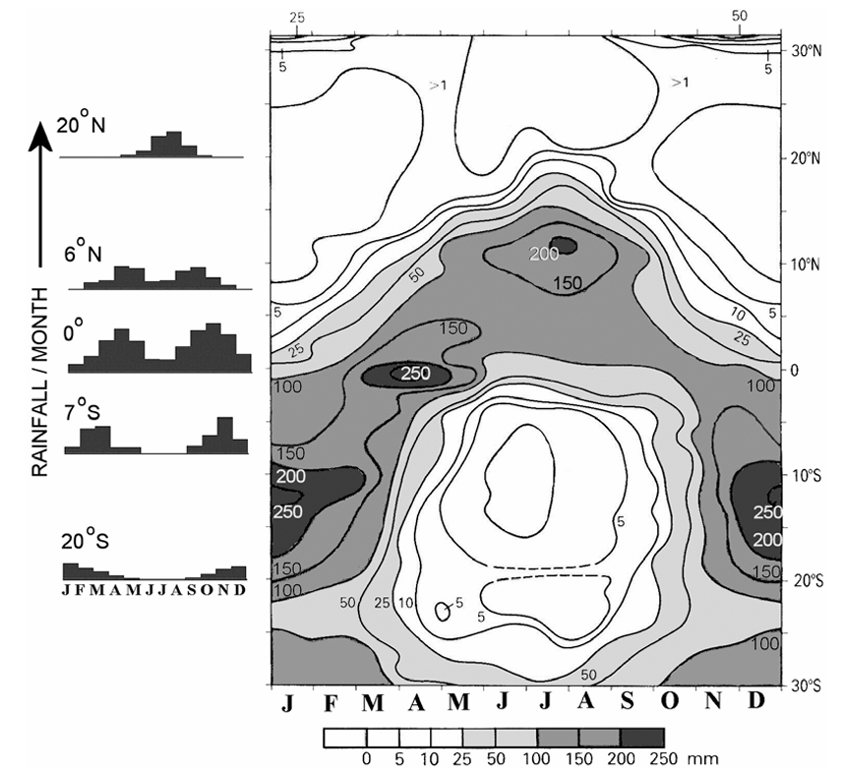
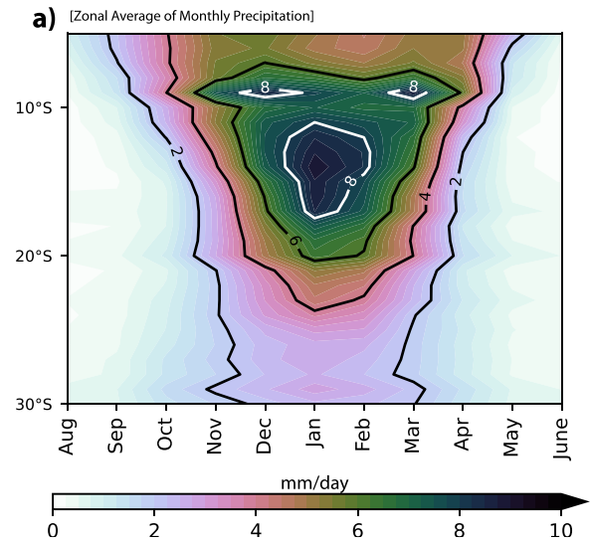
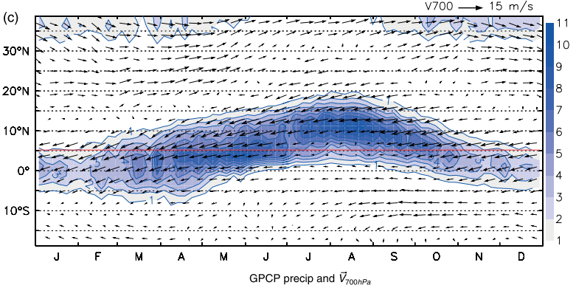
Precipitation phenomenology
East Africa (EA)
Bimodal rainfall regime: long-rains in March-May (MAM) and short-rains in October-December (OND) season. ^{[8]}
West Africa (WA)
Monsoon-driven rainfall: West African Monsoon in June-September (JJAS) season above 8°N, in April-June and September-November below 8°N. Two key drivers: hot Sahara and Atlantic cold tongue. ^{[9]}
South Africa (SA)
Extra-tropical rainfall regime:
summer rainfall in north and central-east (October–March);
winter rainfall in southwest (May–August); year-round rainfall along southern coast.
mm/day
Source of image^{[8]}
Source of image^{[9]}
Adapted from^{[10]}
[8] Nicholson (2018)
[9] Thorncroft et al. (2011) [10] Horan et al. (2024)
Notes:
- South Africa con caratteristiche extra-tropicali
- These regions are characterized by different precipitation phenomenology. Indeed, East Africa has a bimodal rainfall regime, with 2 rainy seasons, …; the West African rainfall is monsoon-driven and the West Africa monsoon (WAM) happens during JJAS season due to the convergence between harmattan winds (dry northeasterly) and moist southwest monsoon;
For the speech see pag. 4-5 research proposal
strong seasonal variability of precipitation across Africa, largely driven by the north-south displacement of the tropical rain belt
OSS: Over Africa no ITCZ but the meeting of the northeasterly and southwesterly monsoon flow (no ITCZ because the surface convergence zone and the rainfall maximum are not closely coupled → better to use the ‘tropical rain belt’)
West Africa: from Sahara the ‘harmattan winds’ (dry northeasterly), from the south the ‘moist southwest monsoon’
Red line: average coastal limit

Slide 6
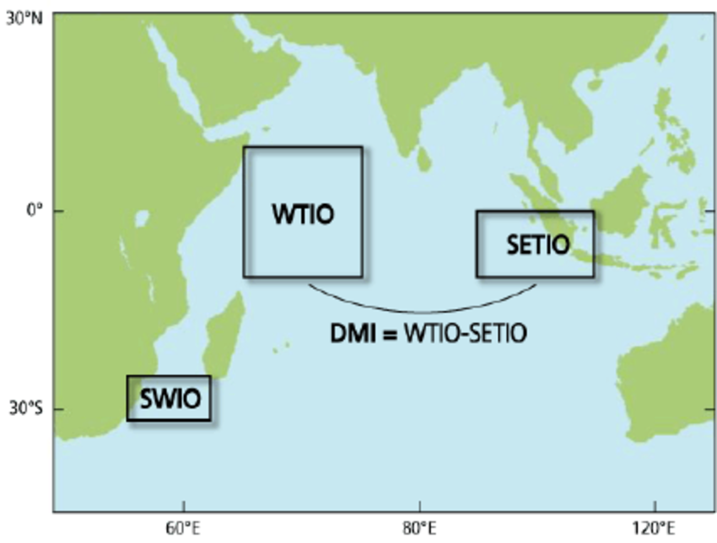
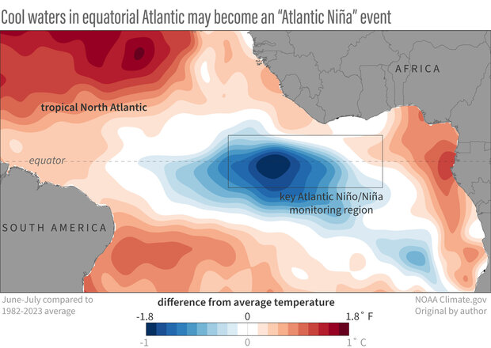
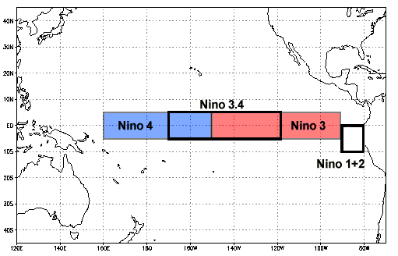
Teleconnections and impacts on precipitation
El Niño Southern Oscillation (ENSO)
ENSO increases rainfall during OND over EA.^{[11]}
ENSO increases rainfall during JJAS over WA.^{[12]}
ENSO reduces rainfall from December to March over SA.^{[13]}
Indian Ocean Dipole (IOD)
IOD increases rainfall during JJAS and OND over EA.^{[11]}
IOD reduces rainfall during OND over SA.^{[14]}
Atlantic Niño (ATL)
Atlantic Niño increases rainfall during JJAS over WA.^{[15]}
Atlantic Niño increases rainfall during JF over EA.^{[15]}
IOD index: Dipole Index (DI)
ATL index: ATL3
ENSO index: Nino 3.4
[11] Palmer et al. (2023) [12] Emmanuel (2022)
[13] Mpheshea et al. (2025) [14] Ogwang et al. (2021)
[15] Xing et al. (2024)
Notes:
Research proposal page 6
The El Niño-Southern Oscillation (ENSO) is a recurring climate pattern involving changes in the temperature of SST in the central and eastern tropical Pacific Ocean
The IOD is one of the leading modes of interannual climate variability in the tropical Indian Ocean, characterized by west–east contrasted sea surface temperature (SST) anomalies
The Atlantic Niño is the dominant mode of interannual climate variability in the equatorial Atlantic. It is characterized by prominent changes in SST, wind, and precipitation in the region, and typically peaks in boreal summer
OSS: ENSO increases rainfall during JJAS over WA.^{[6]} → is La Nina

Slide 7
Data and variables
HINDCAST | Institution | System version | Resolution | Ensemble size
 | ECMWF^{[16]} | Seas5 | 1°x1° | 25
OBSERVATION | Name and version | Type of data | Resolution | Conservative interpolation
 | ERA5^{[17]} | Reanalysis | 0.25°x0.25° | 1°x1°
Temporal features
Variables
Data | Period | Seasons | Lead time (hindcast)
Monthly mean | 1993/01 - 2016/12 | JF, MAM, JJAS, OND (East/West Africa) DJF, MAM, JJA, SON (South Africa) | Lead time 0,1,2 months for JF/JJAS (DJF/JJA) Lead time 0,1,2,3 months for MAM/OND (SON)
Variable | Spatial domain
Total precipitation rate [mm/day] | East Africa : 25°N, 20°E, 15°S, 51°E West Africa : 30°N, 17°W, 4°N,17°E South Africa : 20°S, 10°E, 34°S, 40°E
Sea Surface Temperature (SST) [K] | Nino 3.4 : 5°N, 170°W, 5°S, 120°W DI_{west} : 10°N, 50°W, 10°S, 70°E DI_{east} : 0°, 90°E, 10°S, 110°E ATL3 : 3°N, 20°W, 3°S, 0°
[16] Johnson et al. (2019)
[17] Hersbach et al. (2023)
Notes:
Testato tante combinazioni tc-regioni-stagioni. In questo talk vi faccio vedere un risultato particolare su East Africa …
Metodologia → togliere teleconnections
- Lead time : Initialization date of the hindcast’s run

Slide 8
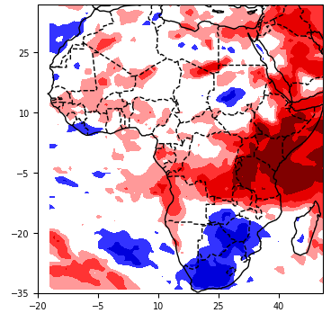
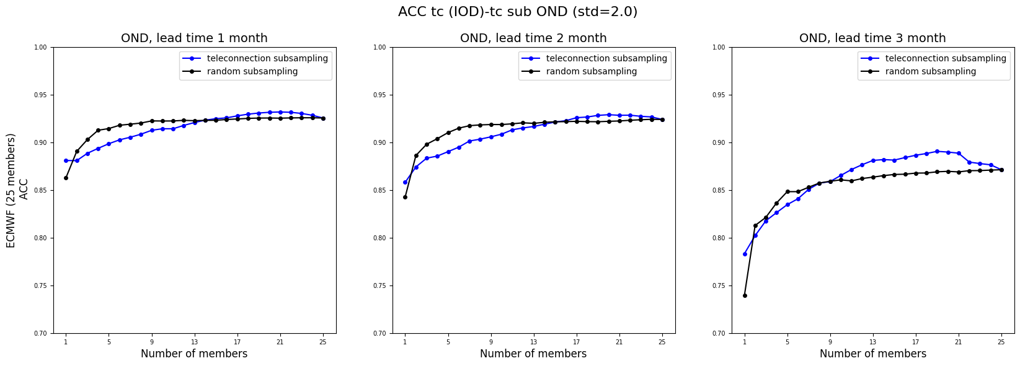
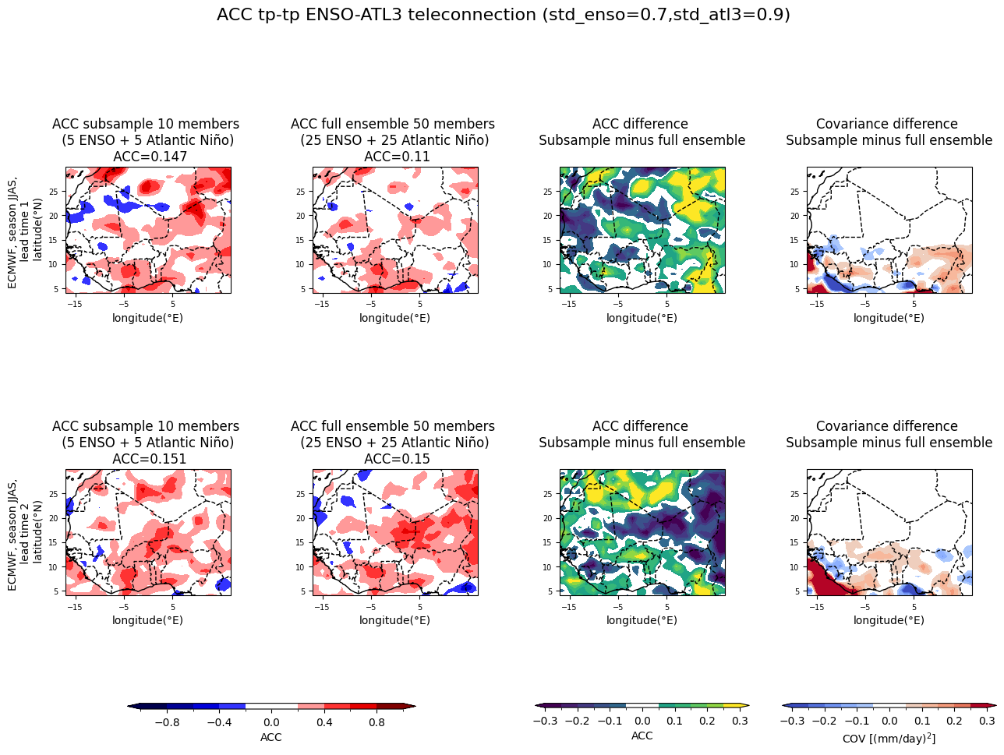
Results – East Africa
Correlation ERA5 IOD-teleconnection index vs total precipitation, OND season
Anomaly Correlation Coefficient (ACC)
observed IOD-teleconnection index vs
hybrid IOD-teleconnection prediction
Domain | East Africa
Teleconnection | IOD
Season | OND
Lead time | 3 months
σ | 2,0
CNN skill | 0,65^{[18]}
[18] Liu et al. (2021)
Notes:
Covarianza per escludere aree desertiche dove ACC rumoroso
ACC tc-tc grande
Modifica 4 plot
ACC tp-tp
Corr tra IOD index e precipitazione da far vedere: prevalente sulla costa e diminuisce man mano che si va nell’entroterra (che torna con i risultati ottenuti)
illustrates how the teleconnection-based subsampling methodology translates into an enhancement of the precipitation field. Specifically, it shows the correlation between the hybrid forecast of total precipitation and ERA5 observations. As already shown in Figure 5, the hybrid forecast outperforms the random subsampling technique, and Figure 7 demonstrates how this improvement translates into an enhanced seasonal rainfall forecast

Slide 9
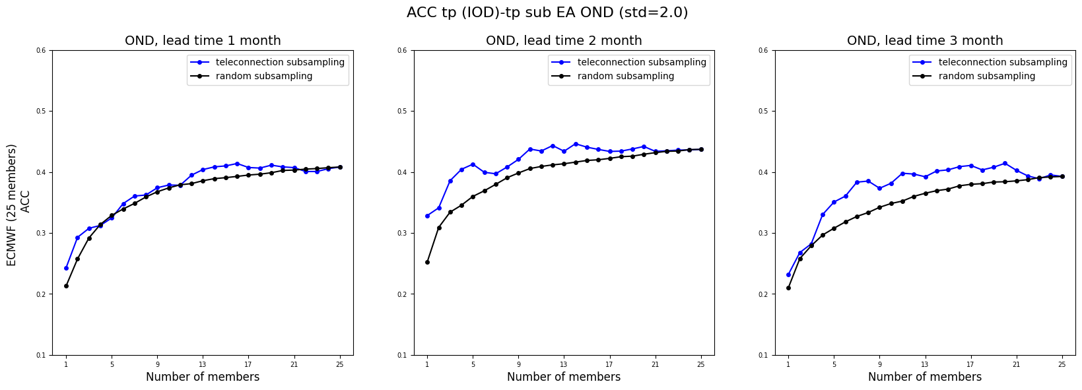
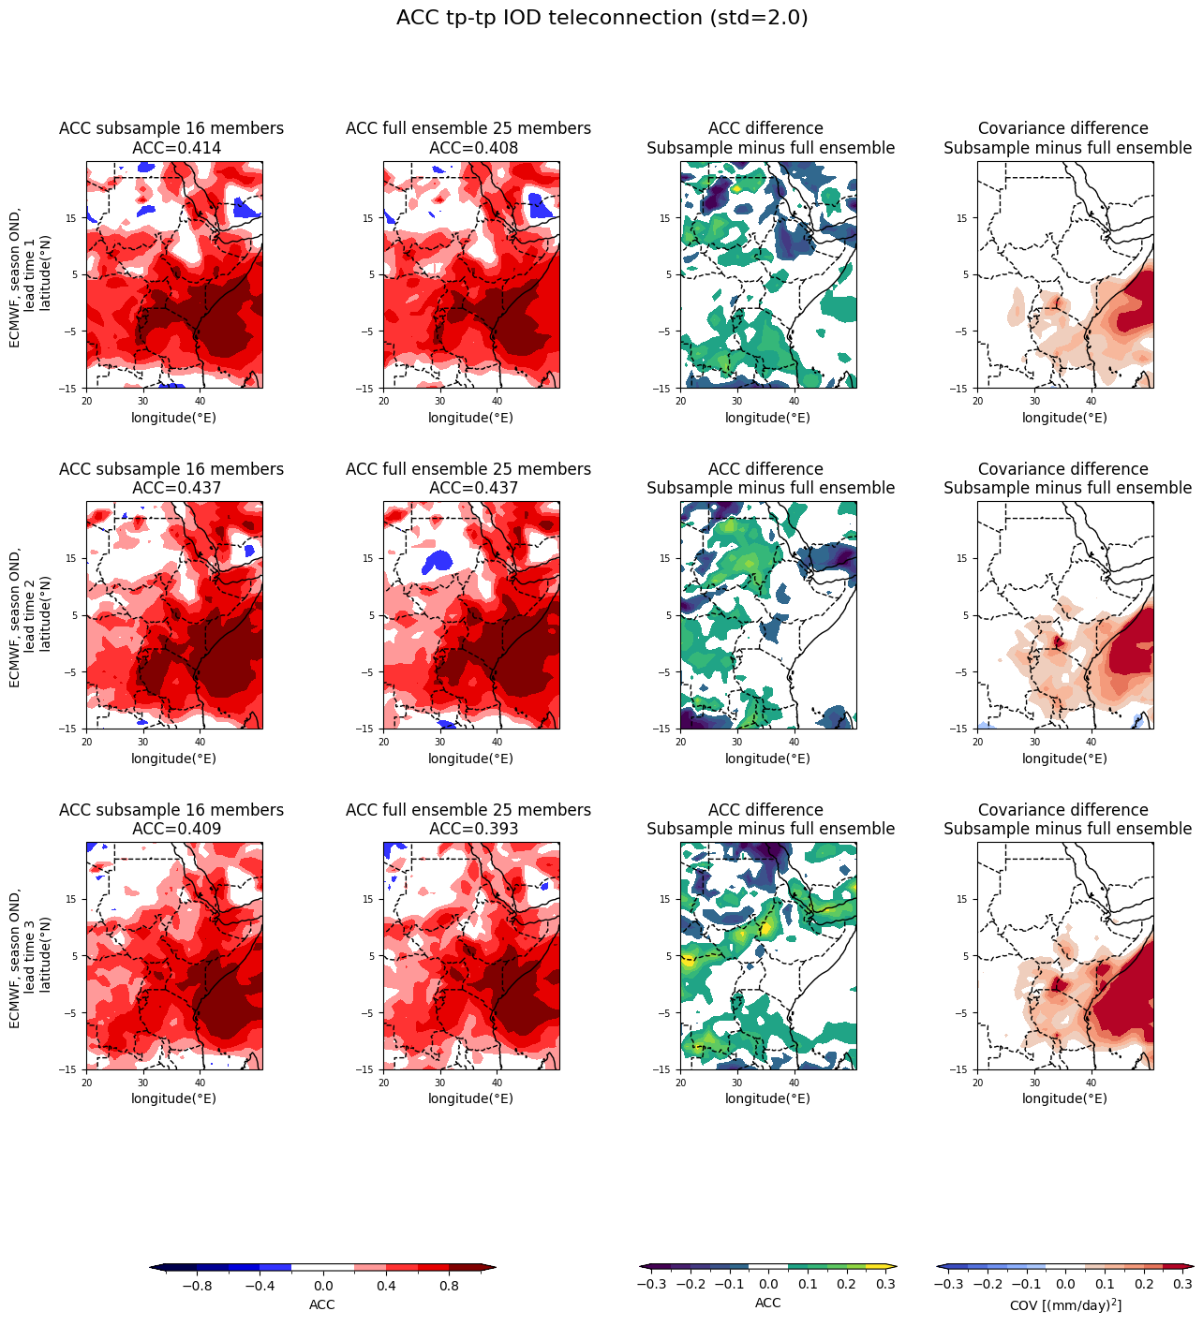
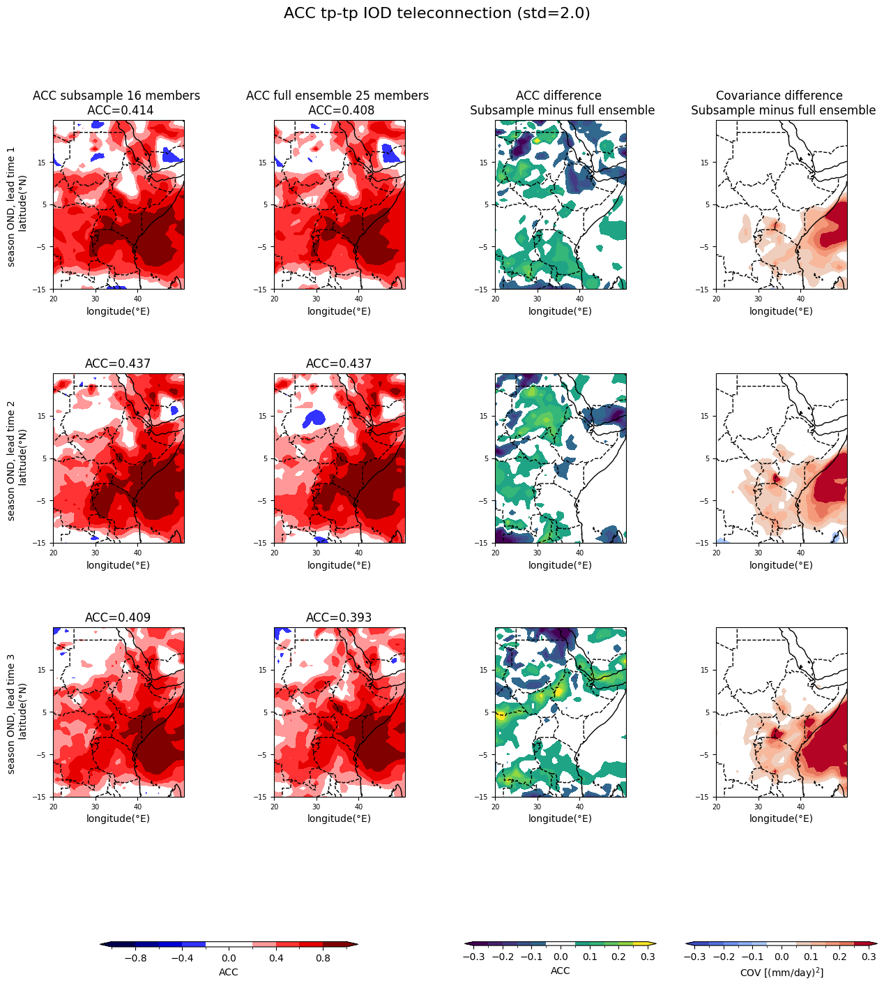
Results – East Africa
ACC observed rainfall vs
hybrid rainfall prediction
Notes:
Covarianza per escludere aree desertiche dove ACC rumoroso
ACC tc-tc grande
Modifica 4 plot
ACC tp-tp
illustrates how the teleconnection-based subsampling methodology translates into an enhancement of the precipitation field. Specifically, it shows the correlation between the hybrid forecast of total precipitation and ERA5 observations. As already shown in Figure 5, the hybrid forecast outperforms the random subsampling technique, and Figure 7 demonstrates how this improvement translates into an enhanced seasonal rainfall forecast

Slide 10
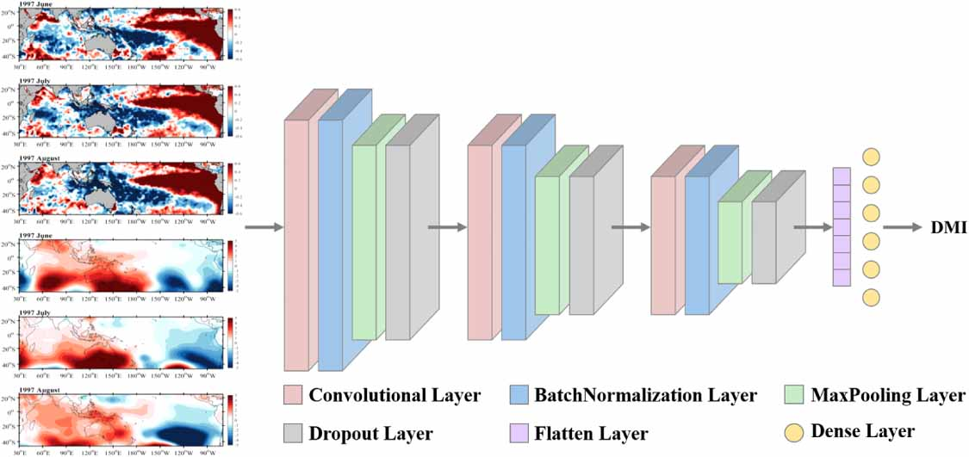
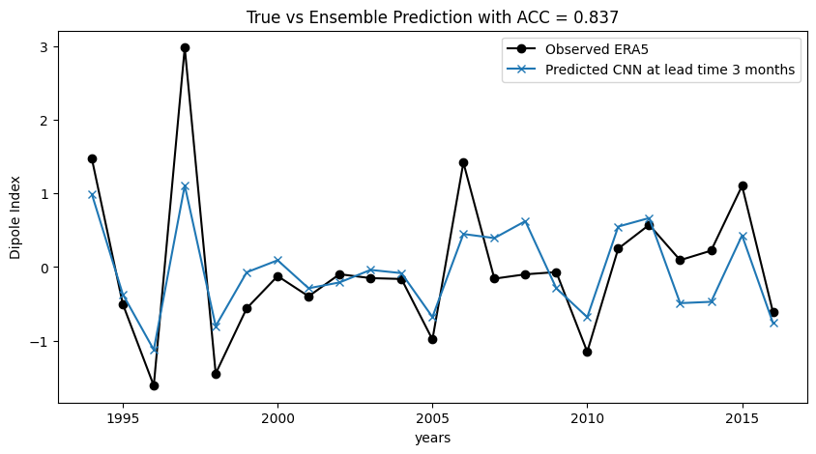
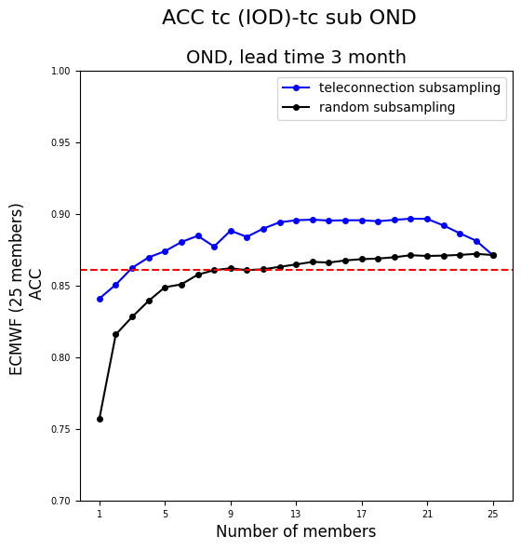
CNN Dipole Index prediction – OND season
 | Input/Target | Years | Dataset
TRAINING | Input | 1994-2016 | ERA5 July SST anomaly (Indian Ocean)
 | Target | 1994-2016 | ECMWF OND Dipole Index forecast at 3 months lead time
VALIDATION | Input | 1994-2016 | HadISST July SST anomaly (Indian Ocean)
 | Target | 1994-2016 | ERA5 OND observed Dipole Index
Adapted from^{[19]}
----
[19] Tao et al. (2024)
Notes:
Add obtained prediction → no cross validation
ERA5 OND observed Dipole Index

Slide 11
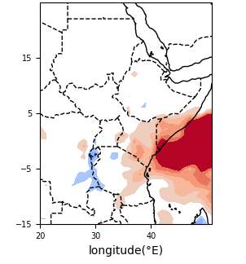
CNN cross validated results – East Africa
Covariance difference (Subsample – full ensemble)
CNN-based
Statistical-based
 | Input/Target | Years | Dataset
TRAINING | Input | Even years 1994-2016 | ERA5 July SST anomaly (Indian Ocean)
 | Target | Even years 1994-2016 | ECMWF OND Dipole Index forecast at 3 months lead time
VALIDATION | Input | Odd years 1994-2016 | HadISST July SST anomaly (Indian Ocean)
 | Target | Odd years 1994-2016 | ERA5 OND observed Dipole Index
Notes:
CNN anche cross-validata ottengo gli stessi risultati
Lascia solo plot Covarianza EA
CNN half years (cross-validation9

Slide 12
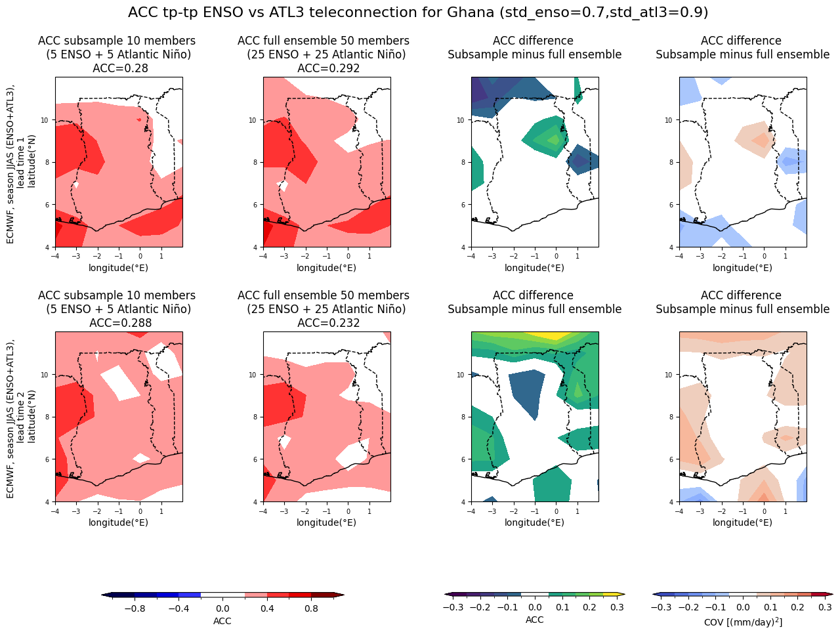
Results – West Africa
ACC subsample 10 members
Covariance difference
(subsample – full ensemble)
Domain | West Africa
Teleconnection | ENSO – ATL
Season | JJAS
Lead time | 2 months
σ | 0,7 – 0,9
CNN skill | 0,8^{[4]} – 0,65^{[20]}
ACC difference
[20] Bachèlery et al. (2025)
Notes:
Risultato che vale la pena evidenziare: no metodo ibrido con risultati buoni. Combinando 2 tc abbiamo trovato un risultato interessante. Da studiare

Slide 13
Conclusions
Crucial point: Hybrid IOD-based predictions show strong potential for forecasting the East African short rains.
Cross-validation of CNN is robust and encourages investigation to fully assess the predictive skill.
In West Africa, interesting results from combining both ENSO and Atlantic Niño teleconnections.
Notes:
Crucial point: hybrid IOD based on short rains
Cross validation tested robust and encourages more investigation to fully asess the comparative skill
Interesting results in West Africa with 2 tc
Dato che la hybrid forecast is better than the CNN prediction (4° grafico slide precedente) why don’t do the subsampling sul forecast ibrido?
Our work a good way to quantify the role of the teleconnection in the signal. How important the teleconnection is, how is it relevant.

Slide 14

Thank you

