Slide 1






Ljubljana 7–12 September 2025
EMS Annual Meeting 2025
UP3.5
Advancing understanding of Mediterranean climate
Towards very high resolution downscaling of climate scenarios for Mediterranean coastal areas
EMS2025-675
Alessandro Minigher, Carmela Cioffi, Cristina Moro, Dario Giaiotti, Elena Gianesini, Marco
Zampar, and Sara Bacer
ARPA FVG – CRMA Regional Center for Environmental Modeling
Palmanova, Italy
(dario.giaiotti@arpa.fvg.it)
Cankarjev Dom
7-12 September 2025
Ljubljana, Slovenia

Slide 2
Ljubljana 7–12 September 2025
Outline
Why to downscale global and regional climate scenarios to the local scale?
From global climate change to local scale climate response.
The essential role of simulation ensembles to explore future climate.
The methodology to generate ensembles of high resolution simulations at the local scale.
Concluding remarks.

Slide 3

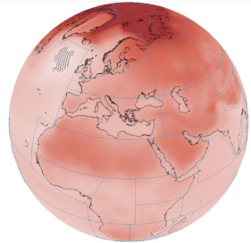
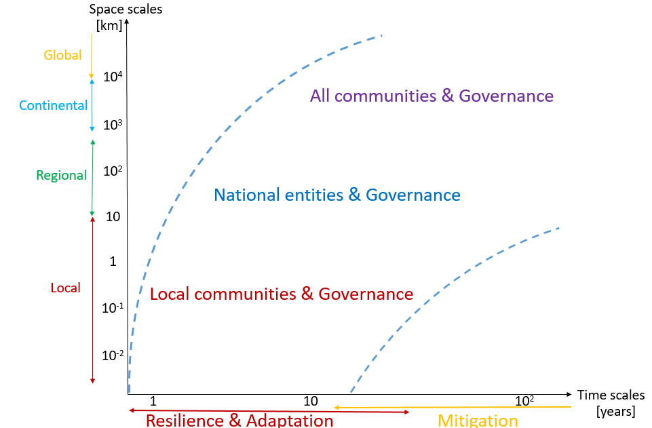
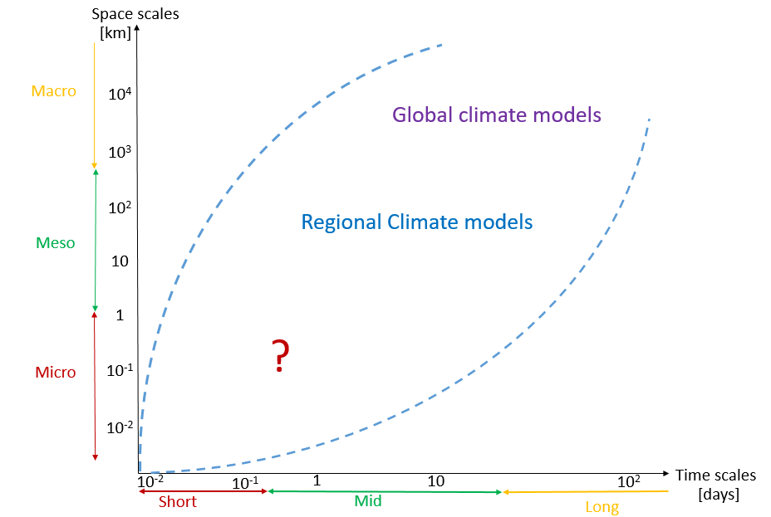
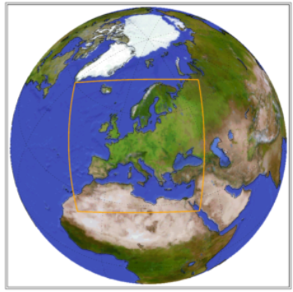
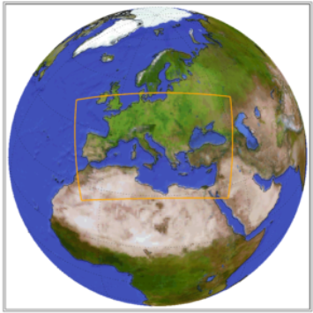

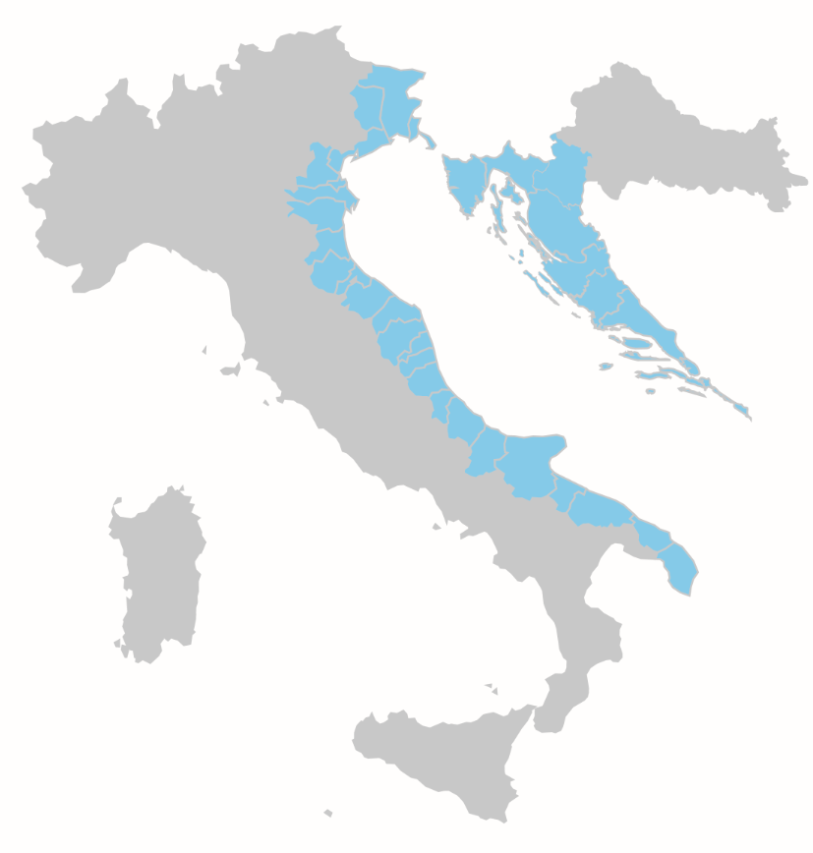
Ljubljana 7–12 September 2025
Climate change, stakeholders requests and available information
Stakeholder effectivity
Processes scales
and
models spectra
IPCC AR6 WGI Atlas shows CORDEX and CMIP5 have remarkably similar scaling relationships and robustness in the emergence of the climate change signal. These support the use of regional climate models in the context of global warming level studies.
Euro
Med
Local Scientific Entities
Univ.
Res. Inst

Slide 4
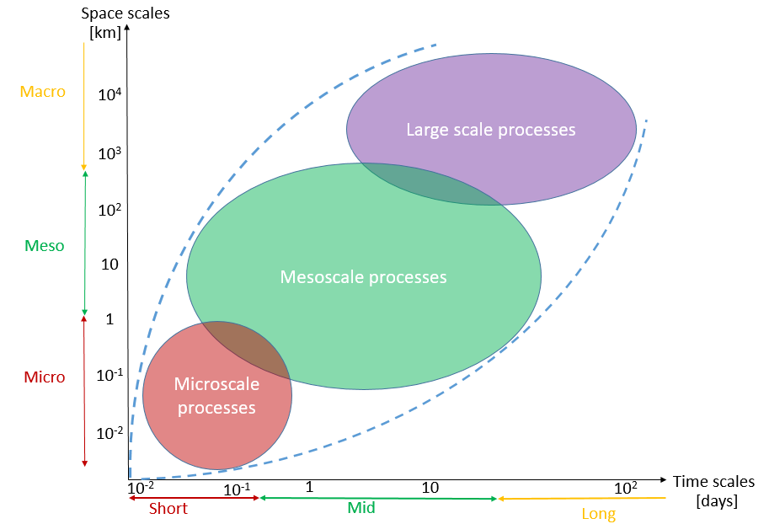
Ljubljana 7–12 September 2025
Environmental feedbacks and complexity simulation
Feedback across the scales are the reality.
Feedback is an essential element for complexity.
In climate downscaling for small domains, upward feedback is considered to be significantly weaker than boundary forcing.
One way model is a practical way to transfer the boundary signal into the simulation domain.
Forcing from boundary is expected too generate a reliable response at the local scale.

Slide 5
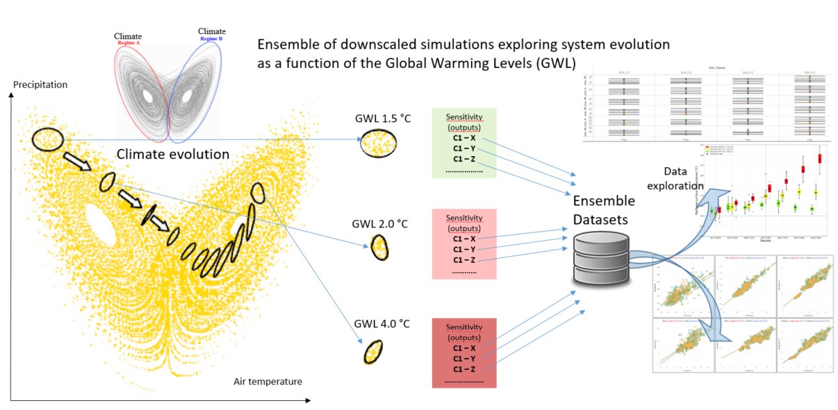
Ljubljana 7–12 September 2025
The importance of an ensemble of simulations
Complex system are described by many variables (fields of 3D environmental systems).
Dynamical evolution of complex systems is an orbit in a multidimensional state phase.
Nobody knows the orbit without uncertainty. So uncertainty is essential to analyze the system evolution.
Ensemble of simulations allows the exploration of the phase state areas (of uncertainty) in which the complex system lives.

Slide 6
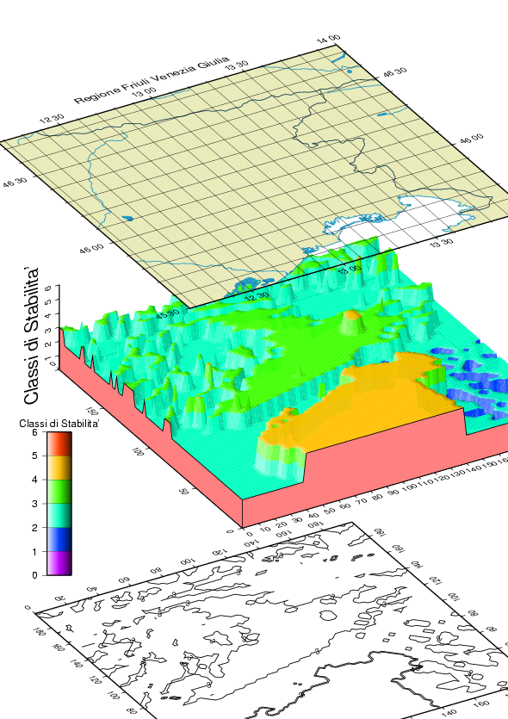
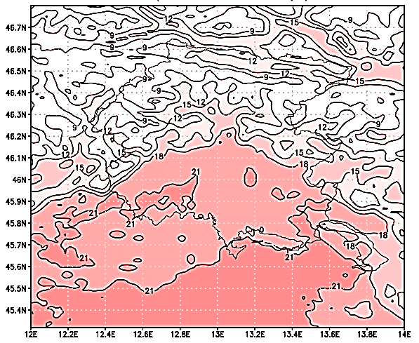
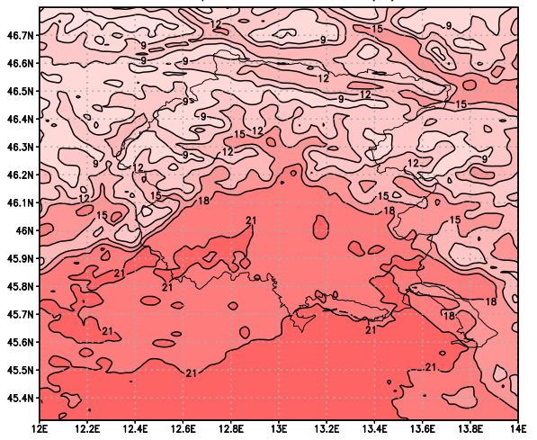
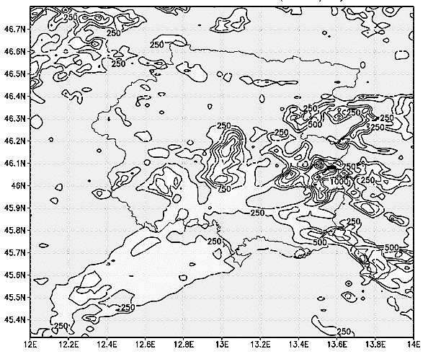
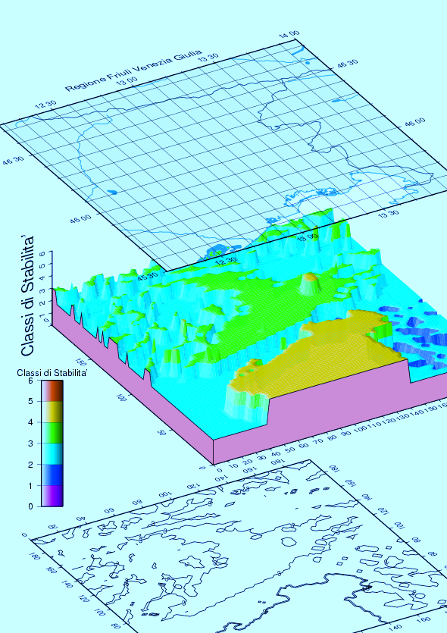
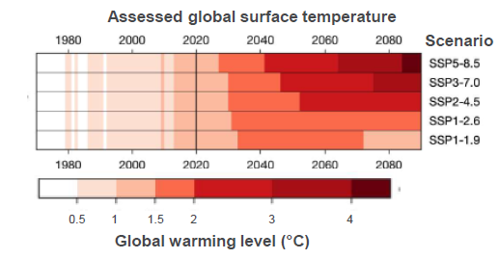
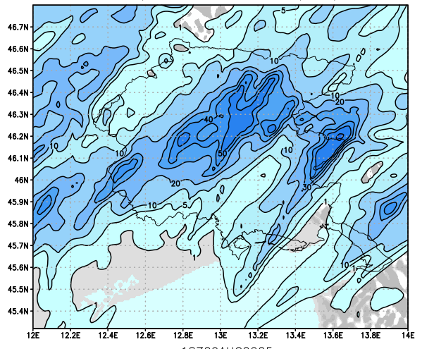

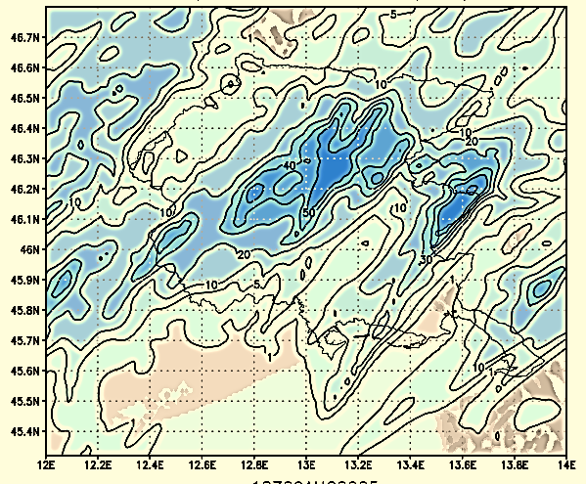
Ljubljana 7–12 September 2025
The elements: benchmark, perturbations and anomalies
GWL 2.0 °C
GWL 1.0 °C
Actual
boundary conditions
GWL 1.0 °C
-
=
Perturbed
boundary conditions
GWL 2.0 °C
Perturbation
Benchmark
Anomaly
Actual forcing
Perturbed forcing
The Benchmark
(the current state of the local climate)
The Perturbation
(the future state of the local climate)
GWL 1.0 °C
GWL 2.0 °C
Precipitation
Air temperature

Slide 7
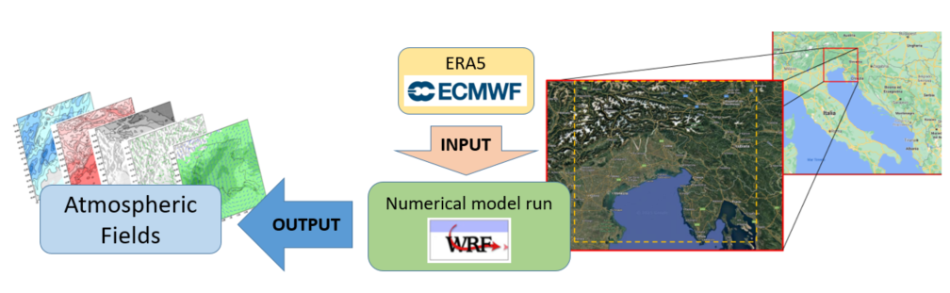
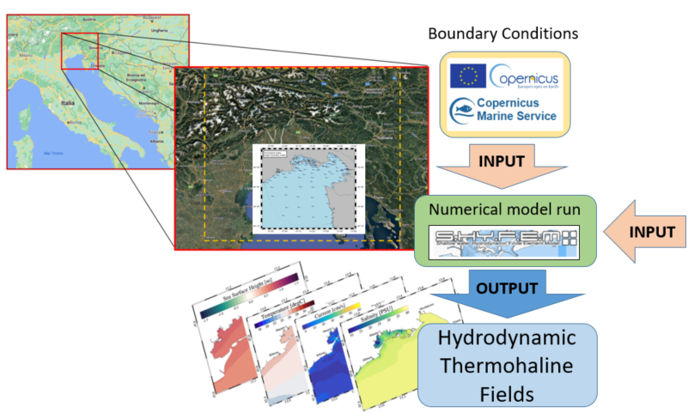
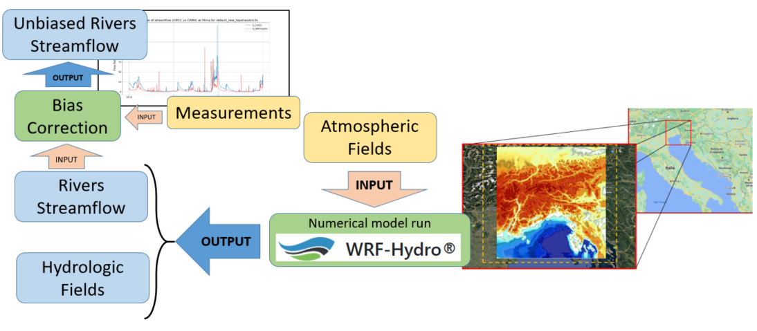
Ljubljana 7–12 September 2025
Benchmark generation
Atmospheric component
Hydrodynamic and Thermohaline component
Forcing
OUTPUT
Benchmark
(2011-2020)
Atmospheric Fields
Unbiased Rivers
Streamflow
Hydrodynamic
Thermohaline
Fields
Hydrologic component

Slide 8
Ljubljana 7–12 September 2025
The general logic of perturbed benchmark as future environmental state
The 10 year benchmark is considered as reference for the present climate (GWL 1.0 °C- 2011-2020) – ten years o hourly data
The 10 year perturbation is considered to describe the future climate (GWL X.Y °C- 20?? + 10) – ten years o hourly data
Perturbed Boundary Conditions
Forcing
Unbiased Rivers
Streamflow
Perturbed Rivers
Streamflow
Atmospheric Fields
Perturbed Atmospheric Fields
Benchmark
(10 years)
GWL 1.0 °C
2011-2020
Perturbed
(10 years)
GWL X.Y °C
20?? + 10

Slide 9
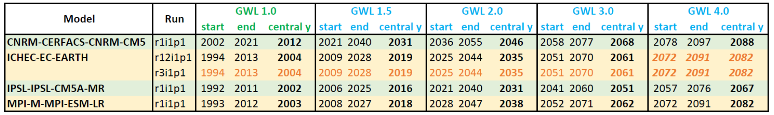
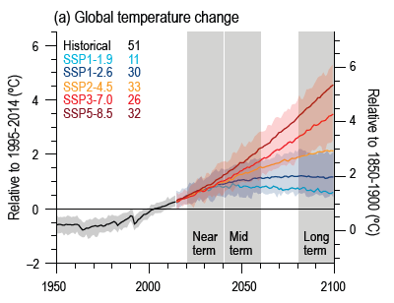
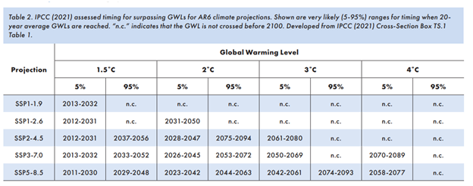
Ljubljana 7–12 September 2025
Perturbation according to Global Warming Levels (GWL)
GWLs global average temperature change levels: 1.5˚C, 2˚C, 3˚C, and 4˚C (relative to 1850-1900).
RCP 8.5
(5 simulations)
Global Warming Levels as defined in IPCC AR6
Scenario SSP5-8.5 allows to explore all GWLs. Care should be taken in considering the results valid for the other scenarios too. That is possible for local and global climate features strictly related to global scale air temperature only.
Global surface air temperature changes relative to the 1995–2014 average (left axis) and relative to the 1850–1900 average. From IPCC AR6, figure 4.2

Slide 10
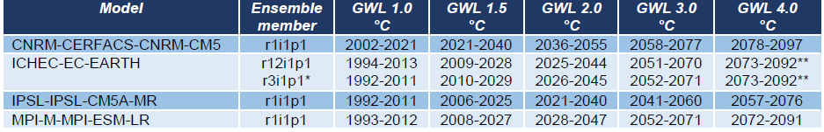
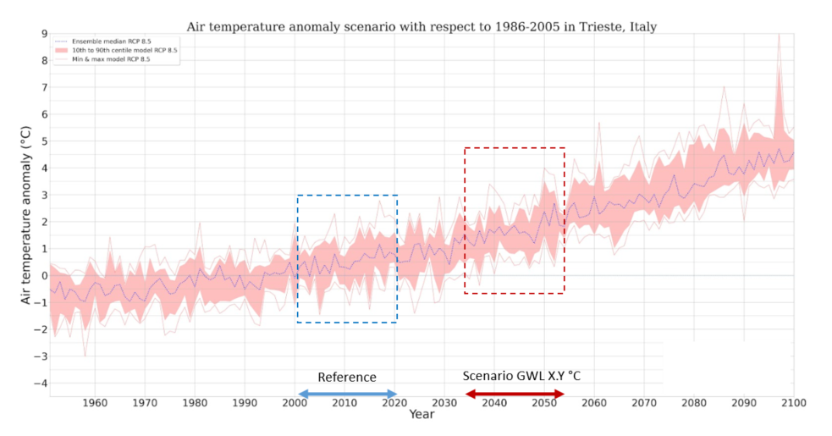
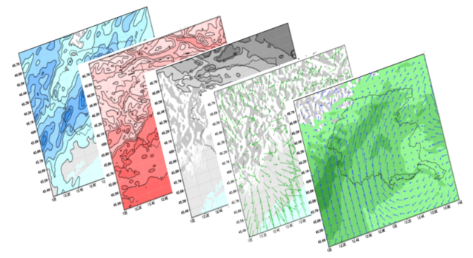
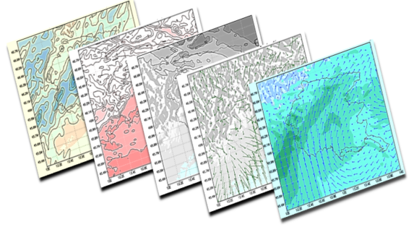
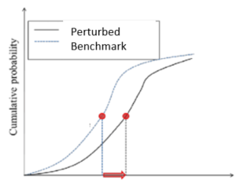
Ljubljana 7–12 September 2025
Atmospheric benchmark perturbation: how
The atmospheric fields are perturbed using the anomaly signal of lager scale simulations (EURO-CORDEX)
Statistical perturbation - fields independence
Scenario vs Reference anomaly
Monthly anomalies based on daily data over 20 years time window
Scenario GWL X.Y °C
Reference GWL 1.0 °C
Hourly temperature (anomaly)
Daily precipitation (relative anomaly)
Euro
Benchmark Fields
Reference GWL 1.0 °C
Benchmark Atmospheric Fields
Perturbed Fields
Scenario X.Y °C
Perturbed Atmospheric Fields
Quantile mapping

Slide 11
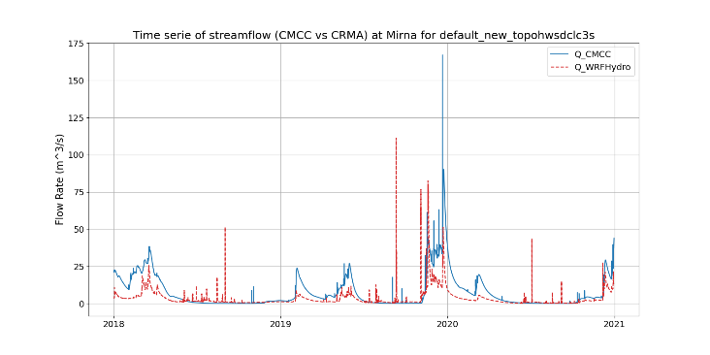
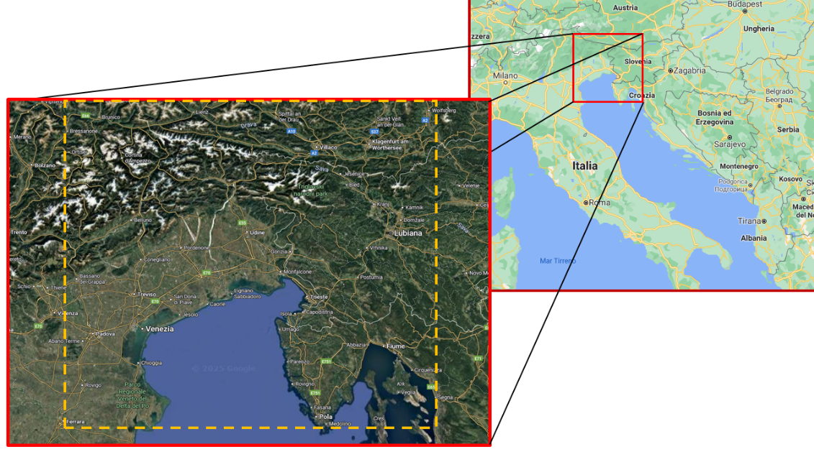
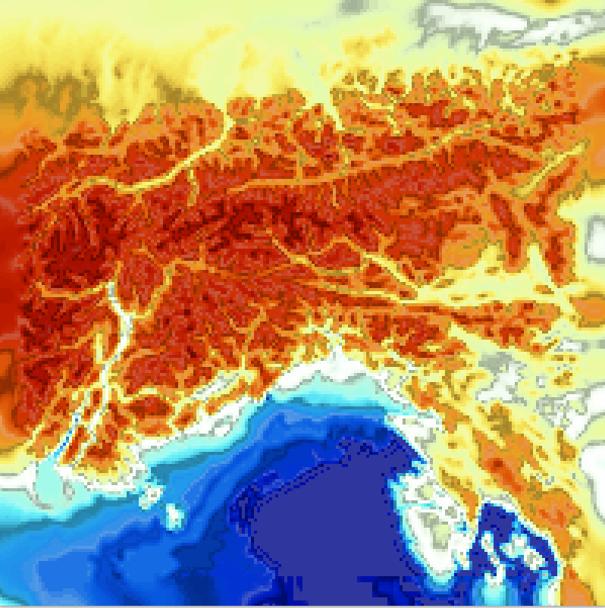

Ljubljana 7–12 September 2025
Hydrologic benchmark perturbation: how
Perturbed Rivers
Streamflow
The hydrologic fields and rivers streamflow are perturbed executing a WRF-Hydro run using perturbed atmospheric fields as inputs.
Dynamical perturbation - fields coherence
Scenario
GWL X.Y °C
OUTPUT
Bias Correction
Perturbed Atmospheric Fields
INPUT
Perturbed Rivers
Streamflow
INPUT
OUTPUT
Numerical model run
Perturbed Hydrologic
Fields
The Hydrologic fields simulation (1 km resolution ) by way of WRF-Hydro model

Slide 12
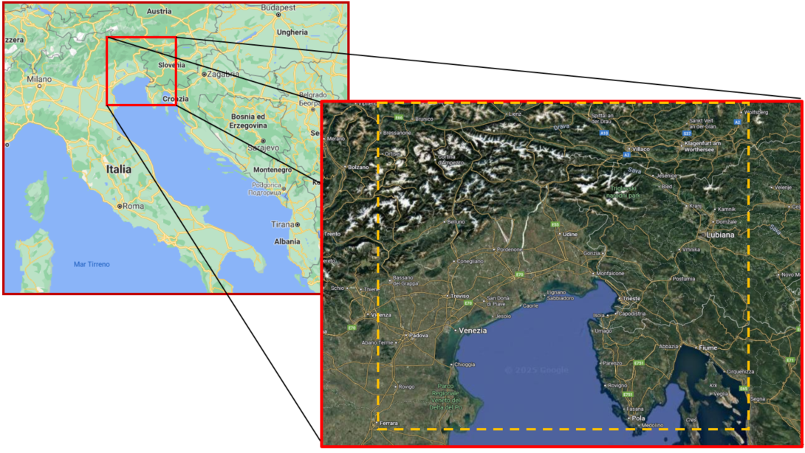


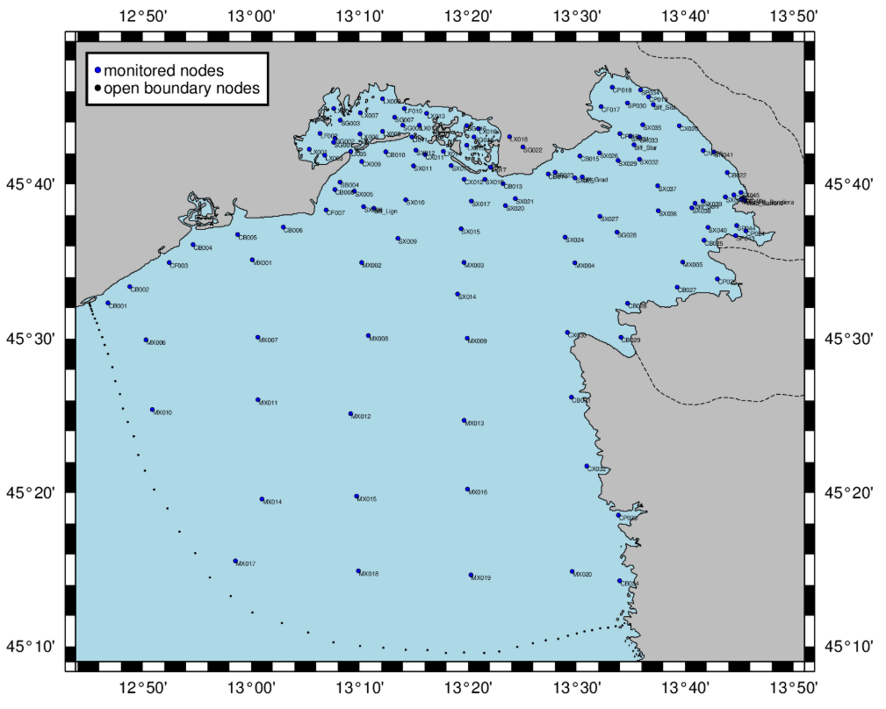

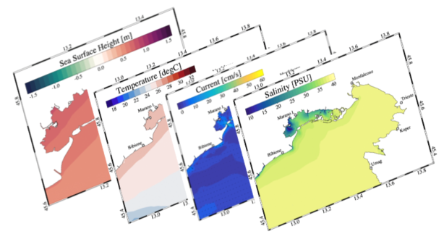
Ljubljana 7–12 September 2025
Hydrodynamic and Thermohaline benchmark perturbation: how
Perturbed
Boundary Conditions
Forcing
INPUT
Perturbed Atmospheric Fields
Numerical model run
INPUT
Perturbed Rivers
Streamflow
OUTPUT
Perturbed
Hydrodynamic Thermohaline
Fields
The Hydrodynamic and thermohaline fields simulation by way of SHYFEM model (https://github.com/SHYFEM-model)

Slide 13
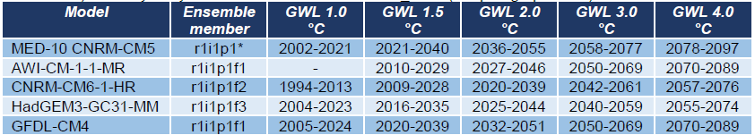
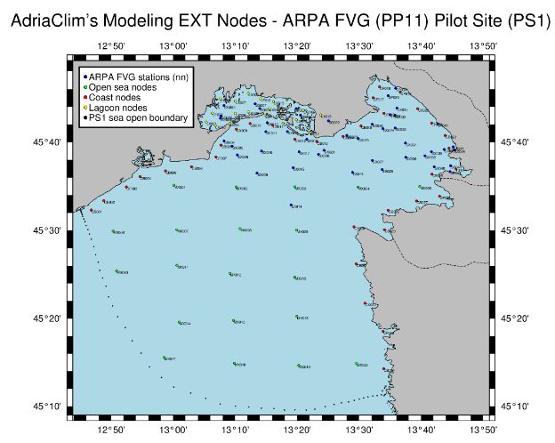
Ljubljana 7–12 September 2025
Perturbation of Hydrodynamic and Thermosteric boundary conditions: how
Boundary conditions to the computational domain are the perturbed Copernicus Marine Service boundary conditions
CMIP6
CORDEX
GCM A RCP 8.5
RCM X RCP 8.5
Scenario GWL X.Y °C
SHYFEM model computational domain
Reference GWL 1.0 °C
GCM B RCP 8.5
RCMY RCP 8.5
GCM D RCP 8.5
RCM Z RCP 8.5
………………..
………………..
Quantile mapping
Water Temperature
Water Salinity
Water Height

Slide 14
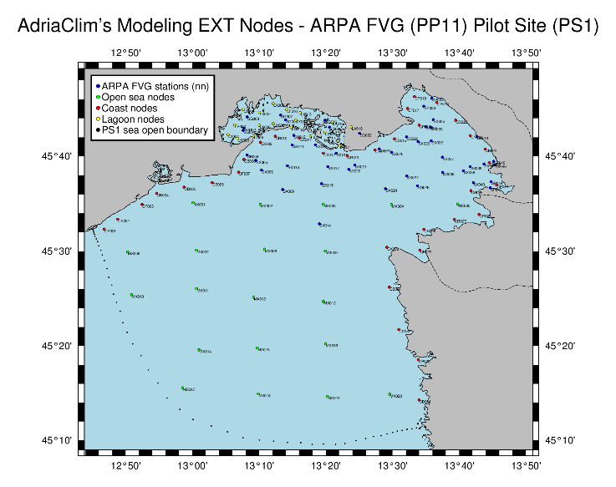
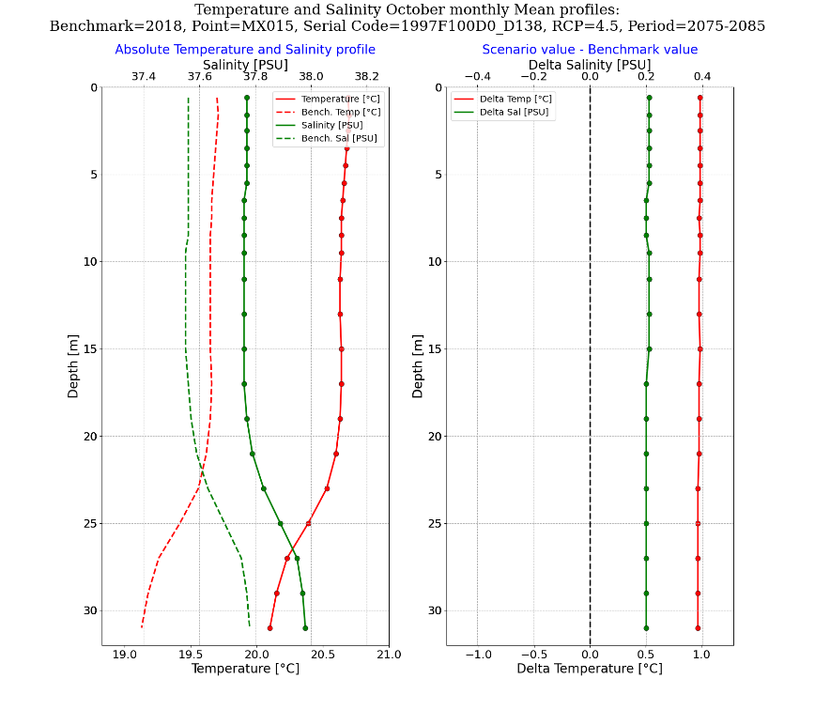
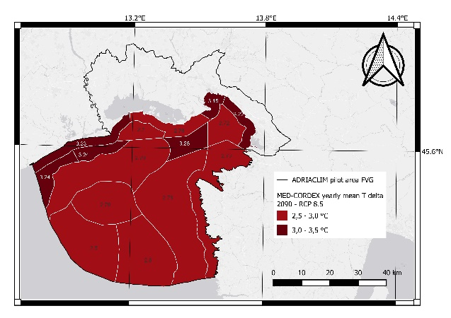
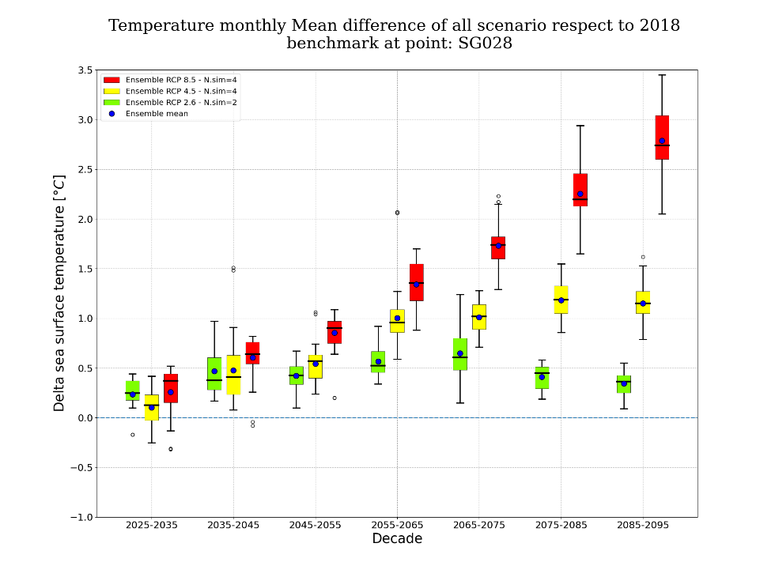
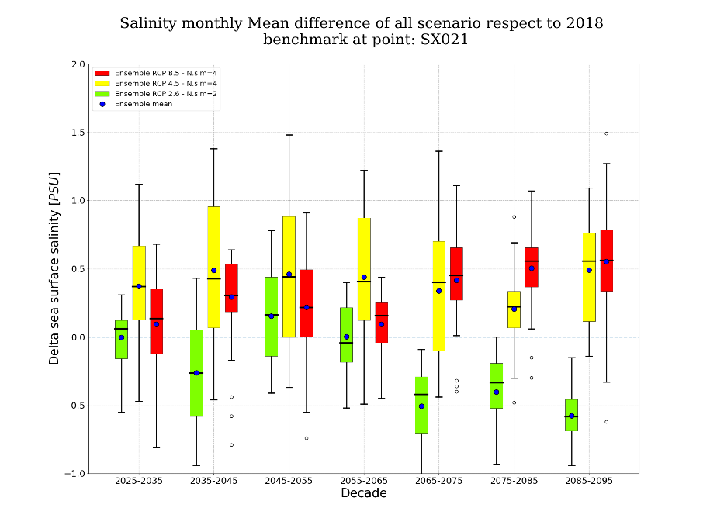
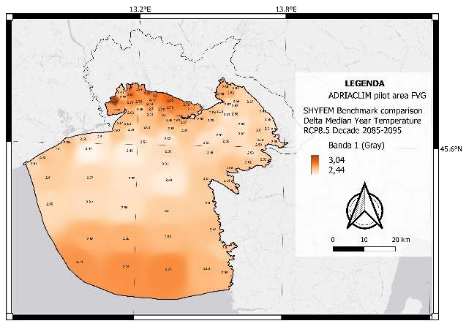
Ljubljana 7–12 September 2025
Ensemble of perturbed benchmark to answer questions on climate change
General framework: what are the differences between the future climate (GLW) and the current climate?
Field anomalies
Vertical profile anomalies
Point anomalies
14/16
14/16

Slide 15
Ljubljana 7–12 September 2025
SWOT analyses of the methodology to downscale climate scenarios at local scale
STRENGTHS +
WEAKNESSES –
Limited resources required
Relevant local processes included
High spatial resolution reached
Ensemble of simulations availability
Feedback across scales not fully included
Potential incongruence with respect to physical and principle constrains
Limited time window for extreme frequency analyses
INTERNAL FACTORS
OPPORTUNITIES +
THREATS –
Progressive increase of regional boundary conditions availability
New numerical models resolving local processes
Large set of statistical approaches suitable for main climate fields perturbation
Limited number of boundary conditions to be used for coherent air and sea perturbation
Unknown quality of future climate scenarios from which perturbations are computed
Stakeholder capability to exploit the plenty of information
EXTERNAL FACTORS

Slide 16




Ljubljana 7–12 September 2025

Slide 17
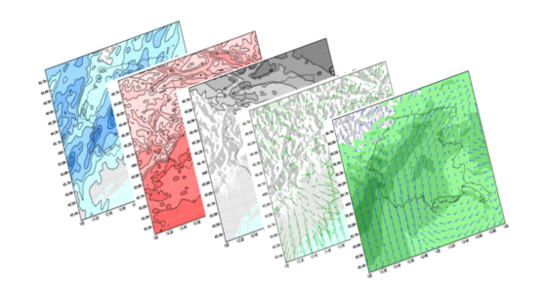


Ljubljana 7–12 September 2025
The Atmospheric fields dynamic downscale: from 25 km resolution to 2 km
ERA5
INPUT
Atmospheric Fields
OUTPUT
Numerical model run
Atmospheric fields dynamical downscale: from ERA5 25 km resolution to 2 km by way of WRF model (https://www.mmm.ucar.edu/models/wrf)

Slide 18
Ljubljana 7–12 September 2025
The Hydrologic fields simulation (1 km resolution )
Unbiased Rivers
Streamflow
OUTPUT
Bias Correction
Measurements
INPUT
Atmospheric Fields
INPUT
Rivers
Streamflow
INPUT
OUTPUT
Numerical model run
Hydrologic
Fields
The Hydrologic fields simulation (1 km resolution ) by way of WRF-Hydro model (https://ral.ucar.edu/projects/wrf_hydro)

Slide 19
Ljubljana 7–12 September 2025
The hydrodynamic and thermohaline fields simulation (from 4 km to 10 m)
Boundary Conditions
Forcing
INPUT
Atmospheric Fields
Numerical model run
INPUT
Rivers
Streamflow
OUTPUT
Hydrodynamic
Thermohaline
Fields
The Hydrodynamic and thermohaline fields simulation by way of SHYFEM model (https://github.com/SHYFEM-model)

