Slide 1






Ljubljana 7–12 September 2025
EMS Annual Meeting 2025
ES1.2
Weather and climate risks and associated impacts to society
A methodology to transfer the uncertainty on future sea level scenarios into the risk assessment of related impacts
Dario Giaiotti, Elena Gianesini, Alessandro Minigher, Federico Pittaro and Moira Pittis
ARPA FVG – CRMA Regional Center for Environmental Modeling
Palmanova, Italy
(dario.giaiotti@arpa.fvg.it)
Cankarjev Dom
7-12 September 2025
Ljubljana, Slovenia

Slide 2
Ljubljana 7–12 September 2025
Outline
Why is it needed to transfer the uncertainty from sea level hazard to impacts?
Basic information on future scenarios of sea level in the frame of climate change
The MedSeaRise methodology to transfer the sea level uncertainty into the risk assessment
Examples of methodology application

Slide 3
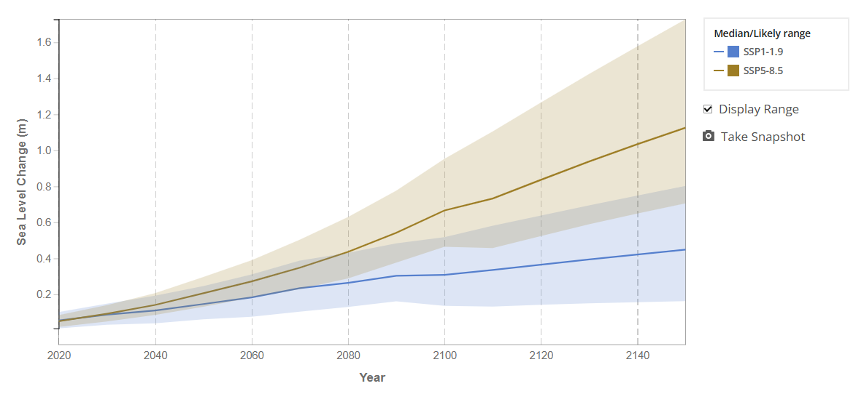

Ljubljana 7–12 September 2025
Uncertainty in scientific information and scientific data input in risk assessment
Some key points on data flow in the risk assessment approach
  All the inputs in the risk assessment logical framework are affected by uncertainty
  Usually the largest uncertainty is coming from hazards (at least this is the case of future sea level related impacts)
  It’s a common practice to use the worst hazard to identify the highest impact
V
E
H
Assess the risk at this time
Uncertainty
Hazard
Exposure
Vulnerability
Uncertainty
Risk
Source: https://sealevel.nasa.gov/ipcc-ar6-sea-level-projection-tool

Slide 4
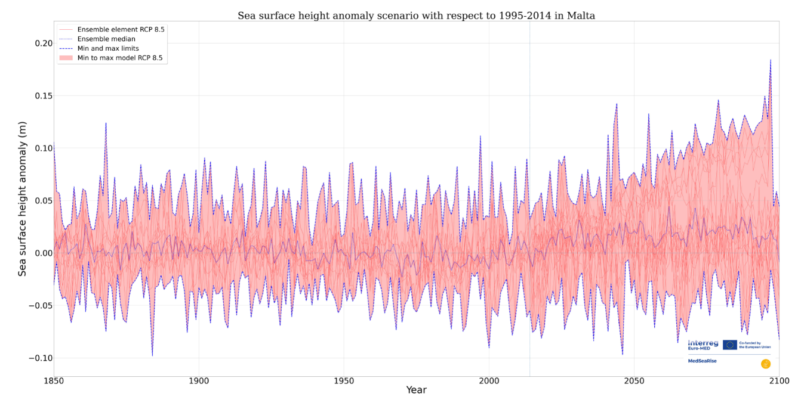
Ljubljana 7–12 September 2025
Uncertainty on hazard a richness to be exploited and not to be overlooked
Not considering hazard uncertainty let risk assessment to be prone to:
  To leave unknown the response of the impact to the hazard uncertainty (range of hazard signal and its distribution)
  To miss the potential non linear behavior of the impact (exponential, thresholds, saturation) to the hazard uncertainty
  To miss the possible existence of turning point in impact response to hazard changes
Impact
V
E
H
Saturation
Turning point
Risk
Exponential
Linear
Source: MedSeaRise Project https://medsearise.interreg-euro-med.eu/

Slide 5
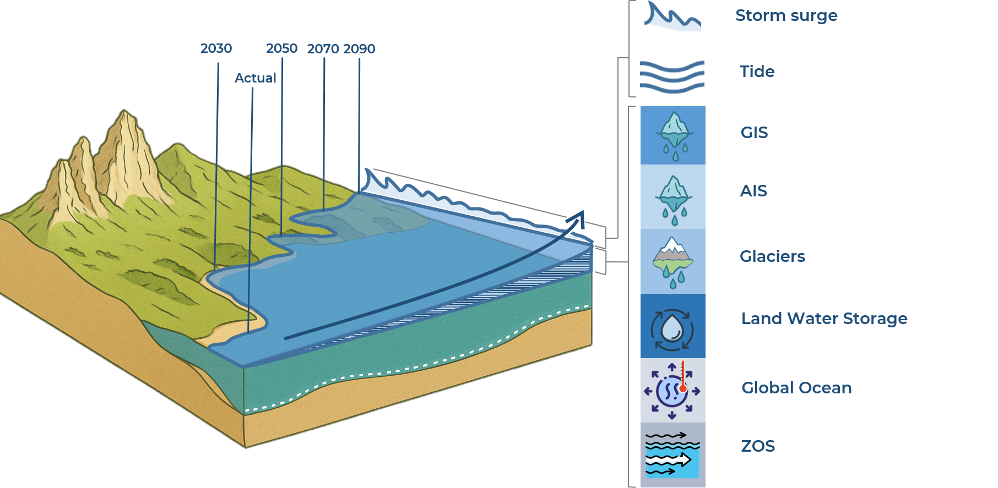
Ljubljana 7–12 September 2025
Components of the future scenarios on sea level and how we know about them
Measures and models
Measures and models
Models
Models
Models
Models
Models
Models

Slide 6

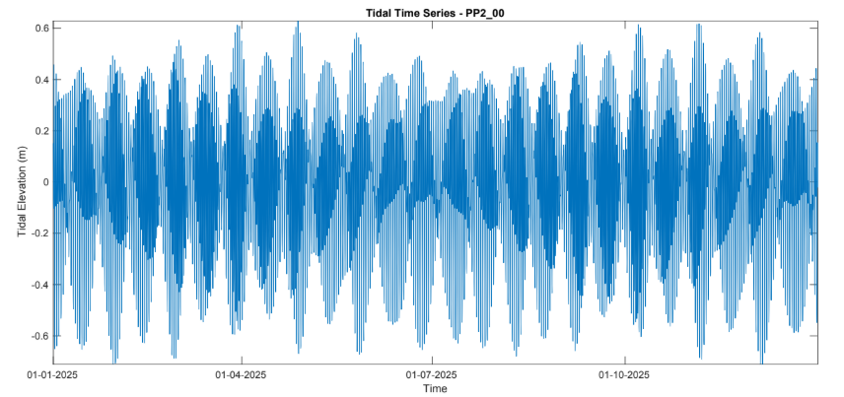
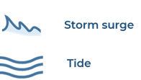
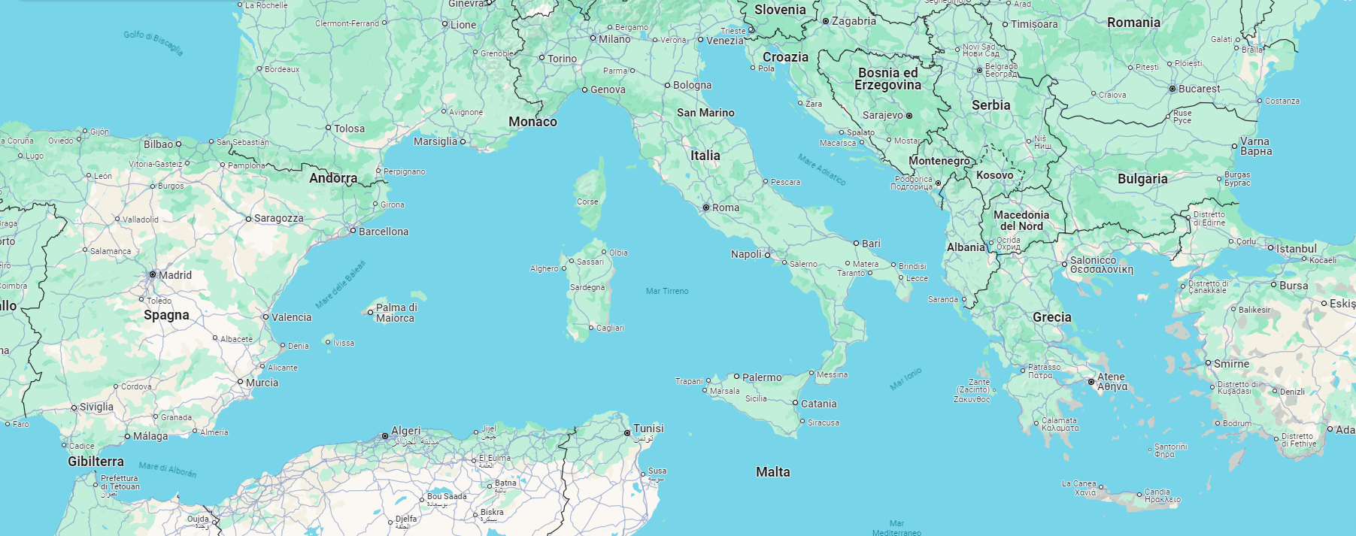
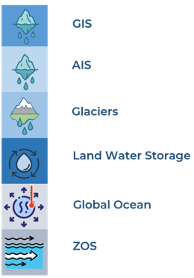
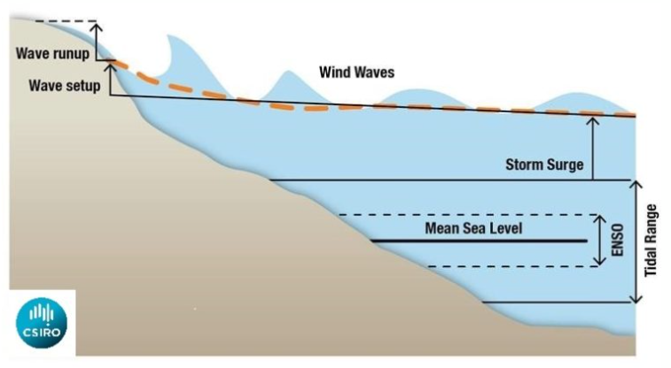
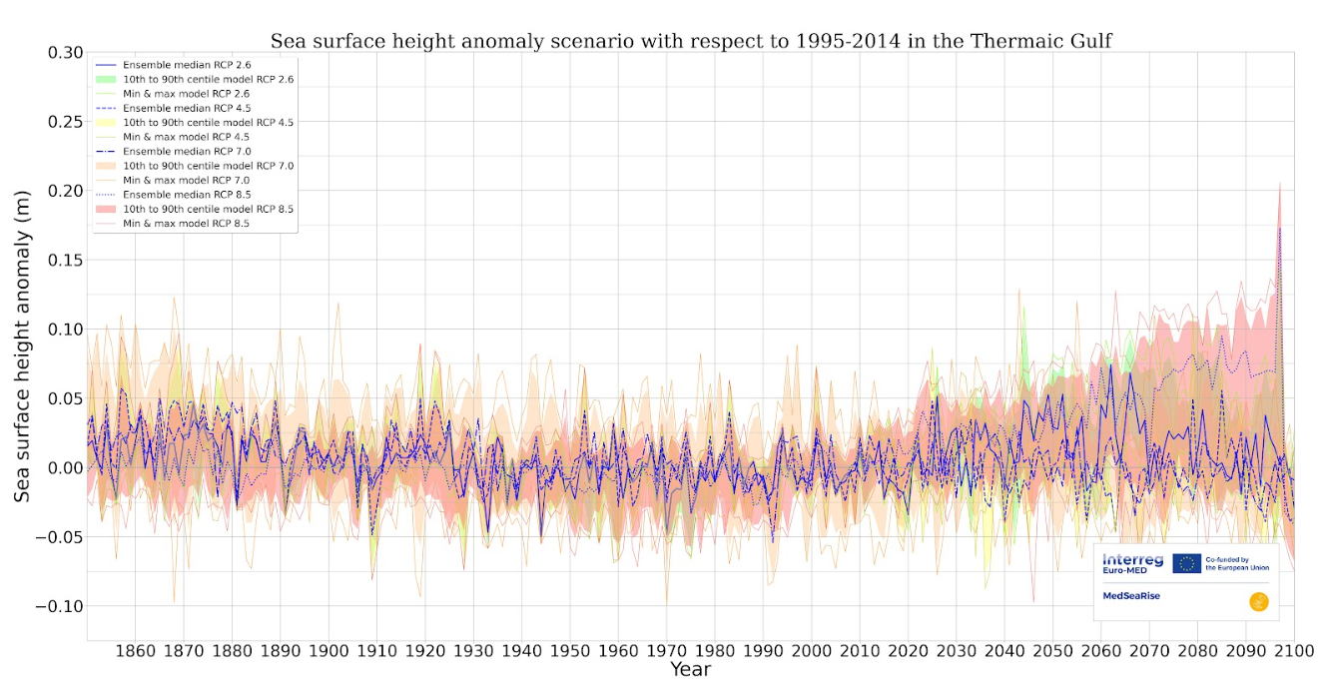
Ljubljana 7–12 September 2025
Components of total sea level (SL): global scales, local scales – ensemble, statistics
According to the spatial dependence, the SL contribution are: global scale or local scale
According to the uncertainty accessibility, the SL contribution are explored by: statistics or ensemble simulations
The importance of ensemble
Statistics
+
+
+
+
+
+
+
+
= Total sea level
Global
Local
Ensemble

Slide 7
Ljubljana 7–12 September 2025
Methodology to transfer the sea level uncertainty into the risk assessment
Define the impact you wish to focus on.
Identify the time scale of the sea level components related to the impact.
Retrieve the contributions to the extreme sea level at the identified time scale.
Chose one or more indicators describing the impact that are elements of an ordered set.
Evaluate or compute the impact indicators according to the sea level inputs.
Associate the probability of the sea level input to the impact.
Build the impact (risk) curves describing the impacts to the probability

Slide 8
Ljubljana 7–12 September 2025
Mandatory features of the impacts quantification
The identification of the impact requires the definition of one or more impact indicators (I). Each indicator can be:
a scalar quantity (e.g. damages cost, restoration cost, adaptation costs, time of transit stop, flooded surface, expected injuries, number of people isolated, number of abandoned buildings, length of eroded coasts, population of the affected species, number of threatened species, number of non-indigenous species, increase of salinity in waters, number of bloom events, fraction of exposed affected by the impact, etc.)
a class of impacts (e.g. minimal damage, sustainable damage, general damage, extended damage, disaster, or sensible decrease of population, relevant decrease of population, endangered species, tipping point for species, extinction in the area, etc.)
It is mandatory the impact indicator is an ordered set. This means:
I₀ < I₁ < I₂ < ….. < I_{n-1} < I_{n}
It is mandatory the impact indicator is clearly tied to the hazardous event. This means:
E_{j} I_{j} that is I_{j}(E_{j})

Slide 9
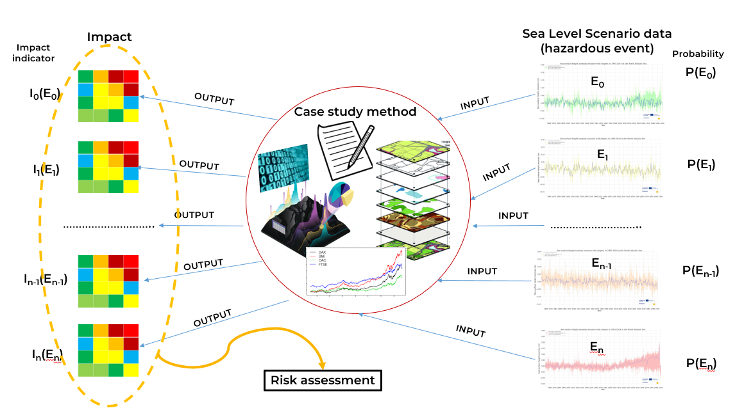
Ljubljana 7–12 September 2025
Hazards uncertainty transfer to impacts: the ensemble of impacts

Slide 10
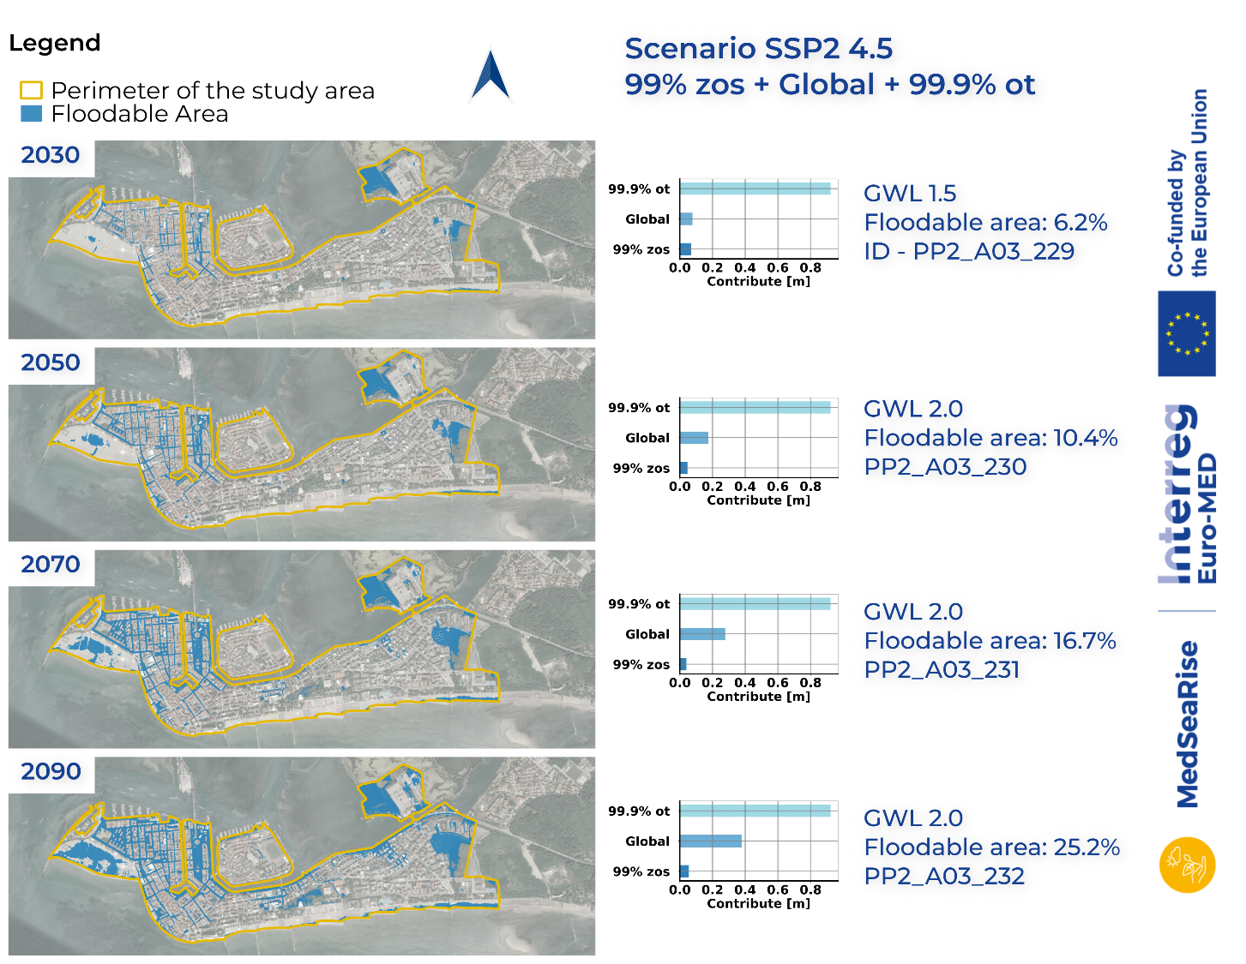
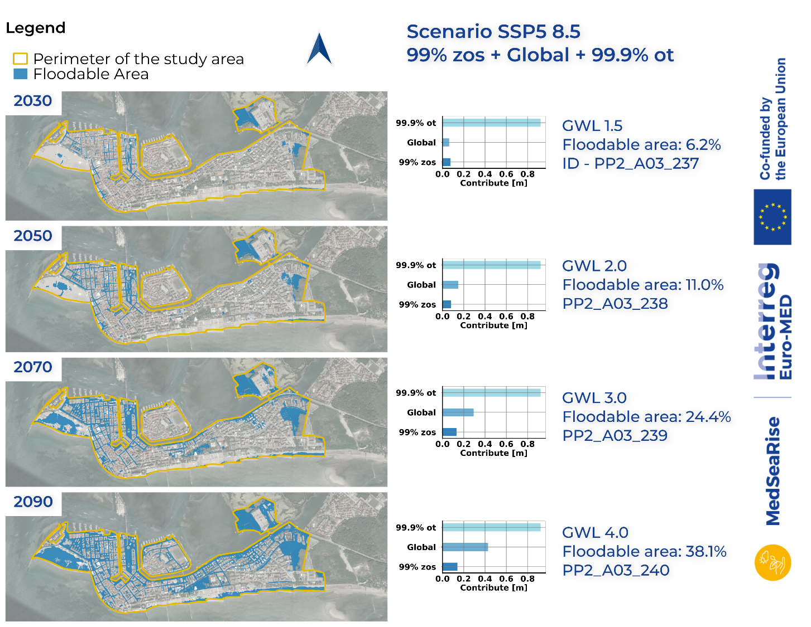
Ljubljana 7–12 September 2025
Grado town case: exploring the impact along the time, climate scenarios and GWLs
The method allows to analyze the response of the impact according to several points of view:
Time, Global Warming Levels (GWLs), Climate Scenarios (SSP-RCPs), Local/Global contributes, Sea Level components

Slide 11
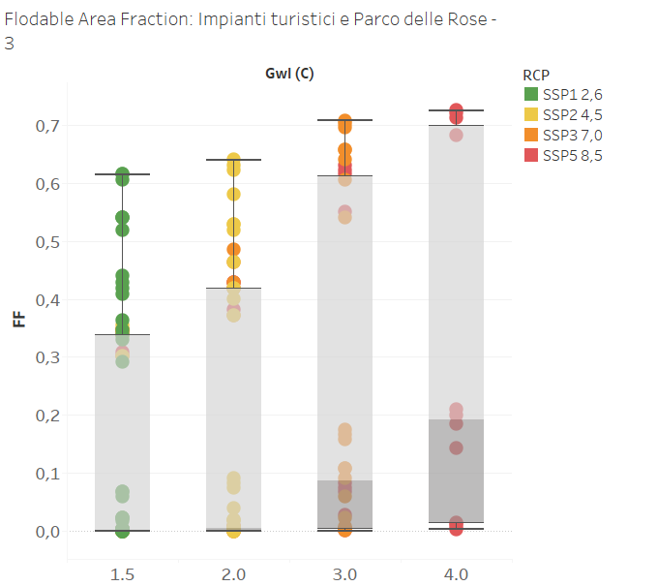
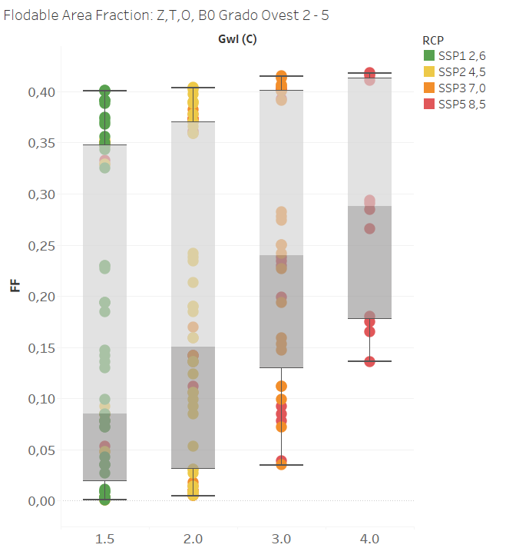
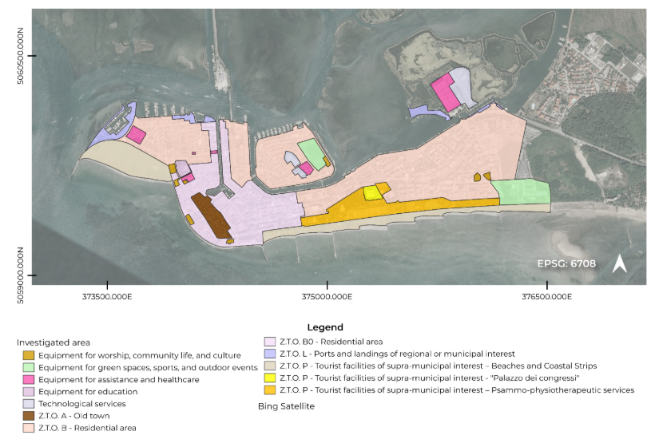
Ljubljana 7–12 September 2025
Grado town case: exploring the impact uncertainty according to the GWLs

Slide 12
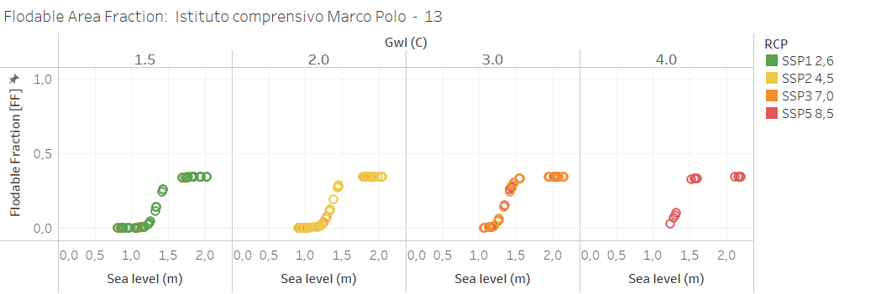
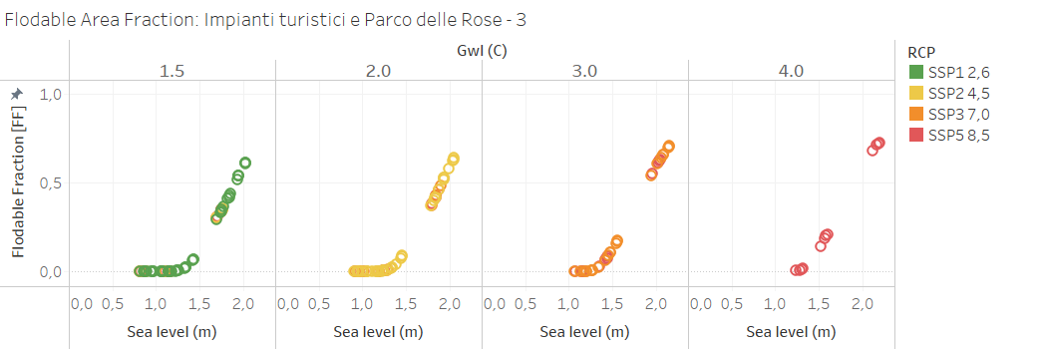
Ljubljana 7–12 September 2025
Grado town case: exploring the impact dependence on the SLR and the GWLs
Saturation
Turning point

Slide 13
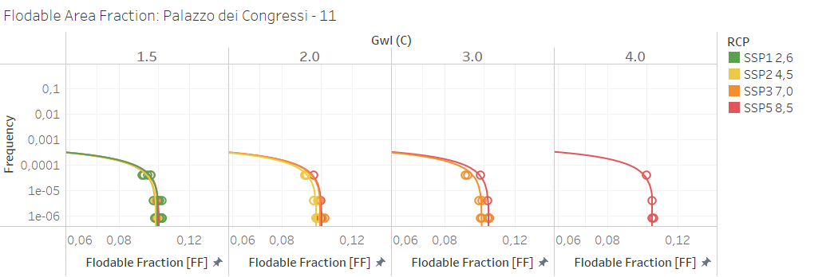
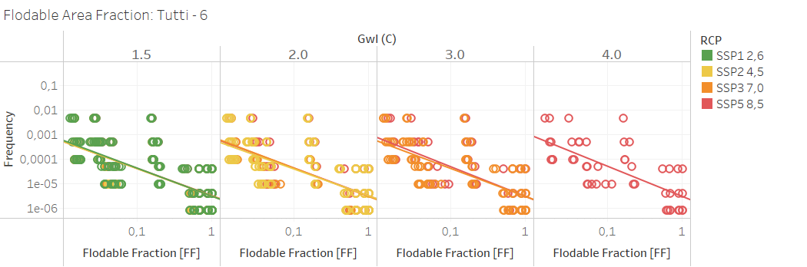
Ljubljana 7–12 September 2025
Grado town case: frequency of impact according to the GWLs and RCPs

Slide 14



Ljubljana 7–12 September 2025

Slide 15

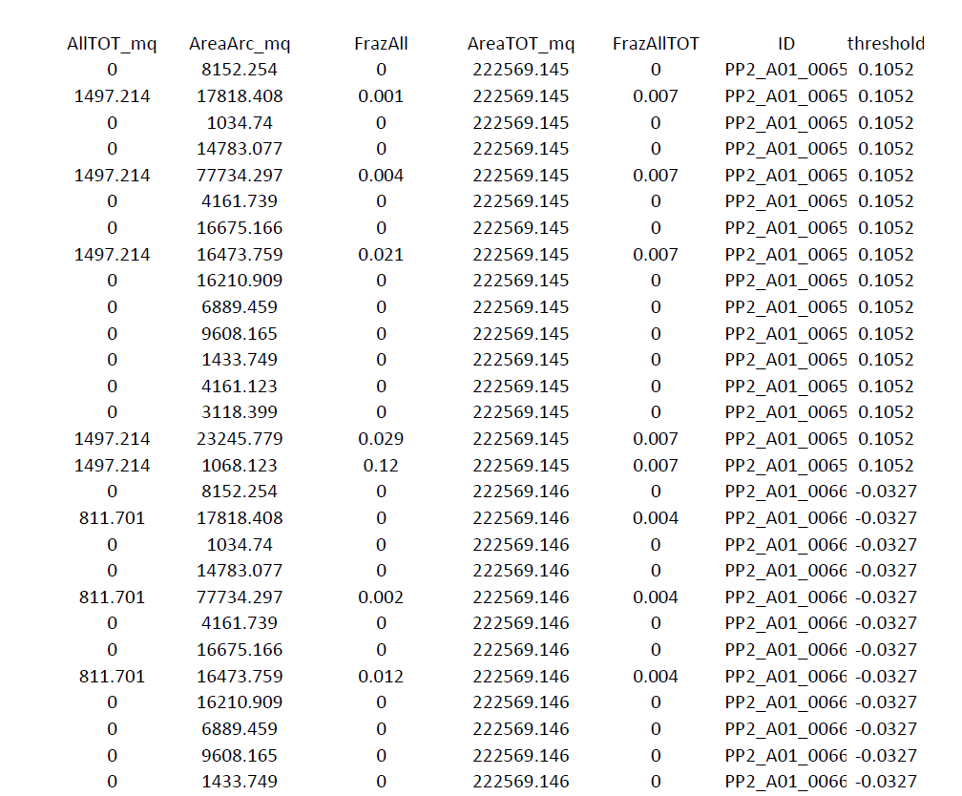
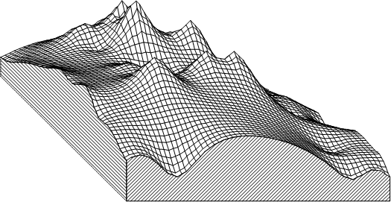


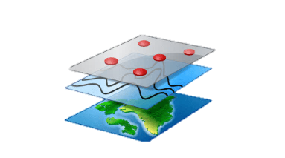



Ljubljana 7–12 September 2025
Supplemental information on simulations conduction
Text Calibri 18
Digital Terrain Model
Sea level rise values in respect to RCP and GWL scenarios
Digital map of studied assets

