Slide 1


Interannual-interdecadal variability of extreme low temperature in North Asia and its driving mechanisms
Gao Ya 2026.9

Slide 2
Contents
Dataset and method
Research Progress
Summary

Slide 3
Dataset and method
SST：NOAA (2.5°×2.5°)
Sea Ice：Hadley Center (1.0°×1.0°)
Snow cover：NOAA (2.5°×2.5°)
Wind and Pressure fields：NCEP (2.5°×2.5°)
Extreme low temperature data：TX10p data from HadEX3 data set is used to express extreme cold days, which is calculated the percentage of days in month when daily maximum temperature is below the 10th percentile based on the 1981-2010.
Study period: 1979-2017,DJF(12-2)
Data
Method: The data was used a 9-year high pass filter
Notes:
Daily maximum temperature; therefore, this study focuses primarily on daytime temperatures.

Slide 4
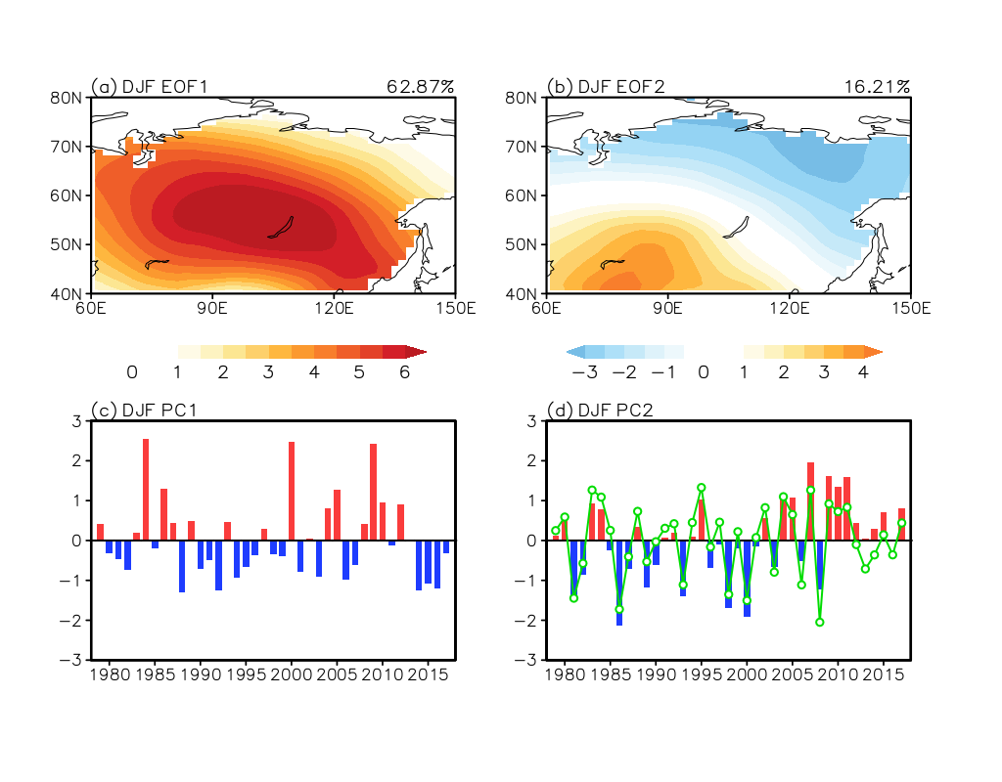
Spatio-temporal characteristics of the dominate modes of
the extreme cold days in North Asia
TX10p EOF1
TX10p EOF2
62.87%
16.21%
PC1
PC2
9 year high pass time series
EOF1
EOF2
Spatial: consistent changes
Spatial: northeast-southwest dipole pattern
Temporal: interannual variability
Temporal: interdecadal shift around 2000
Notes:
North Asia is a sensitive region to global climate change, the frequency of the extreme cold events have occurred frequently in this region, which have a significant impact on human health, agriculture, and industries

Slide 5
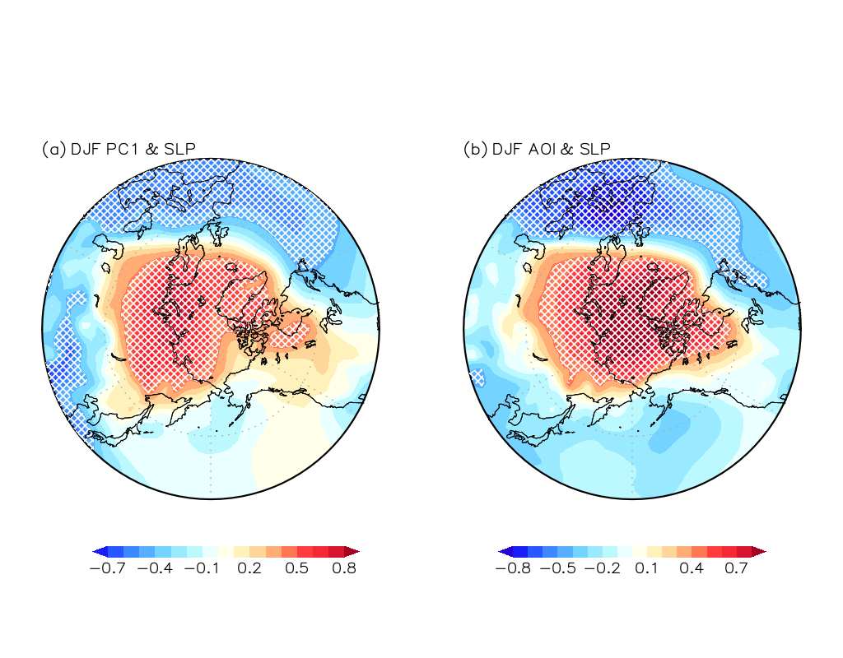
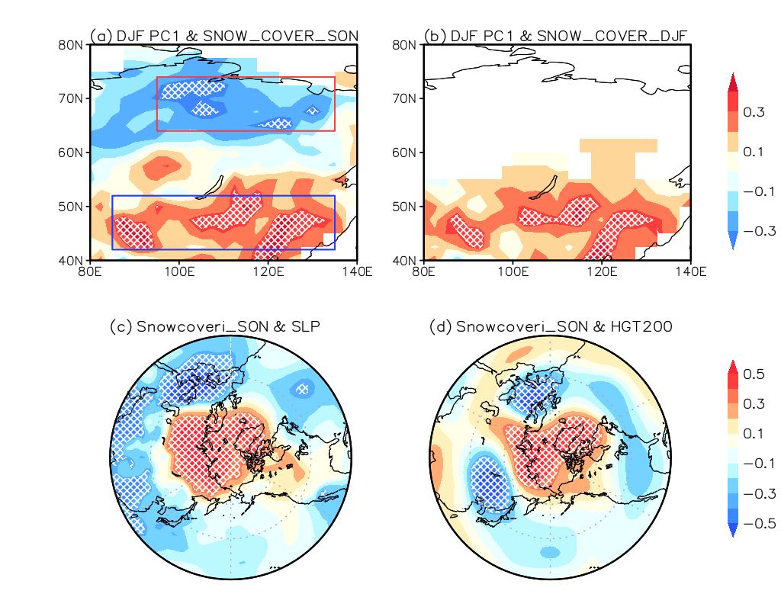
First mode impact mechanism
PC1 & SLP
PC1 & autumn snow cover
PC1 & winter snow cover
AOI & SLP
autumn snow cover index & SLP
autumn snow cover index & HGT200

Slide 6
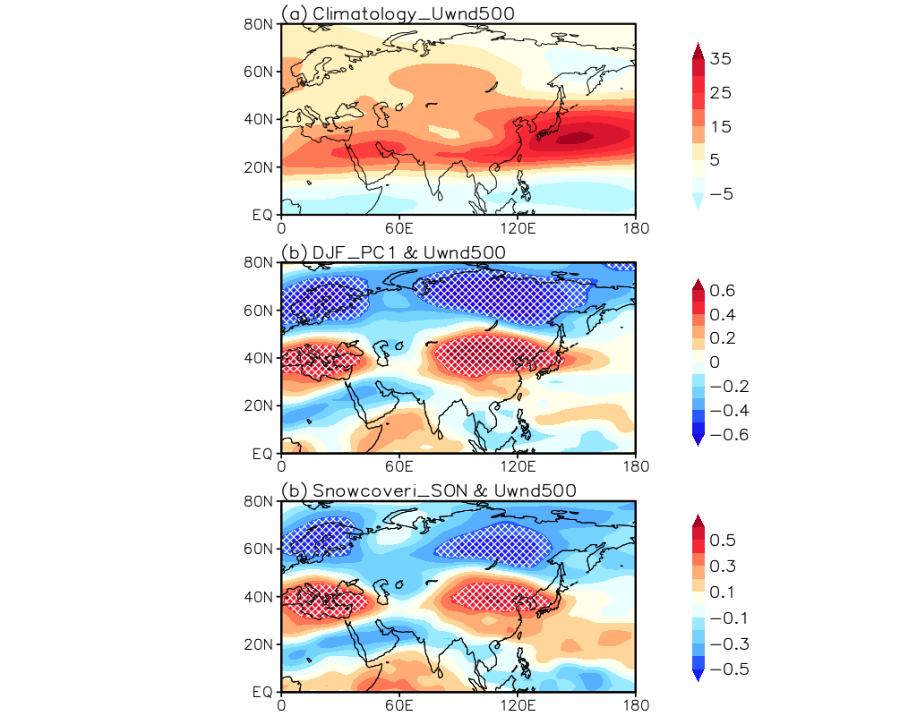
First mode impact mechanism
U500 Climatology
Less in north more in south SON_SC pattern~DJF
DJF AO negative phase
favors
Polar vortex
Meridional temperature gradient
PC1 & U500
favors
Westerly wind in mid-high latitude
Cold air leaving from the Arctic to mid-high latitudes
Autumn snow cover index & U500
Troughs and ridges
cold waves
In favor of increasing frequency of extreme cold days in North Asia

Slide 7
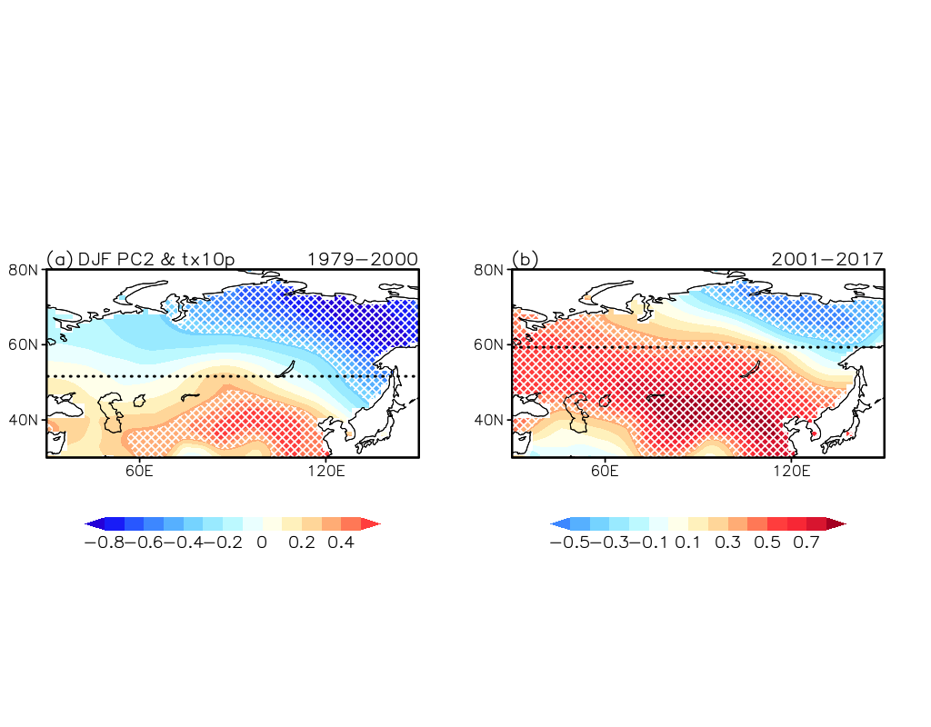
Second mode characteristics
P1: 1979-2000
P2: 2001-2017
Both spatial and temporal fields undergo interdecadal changes around 2000

Slide 8
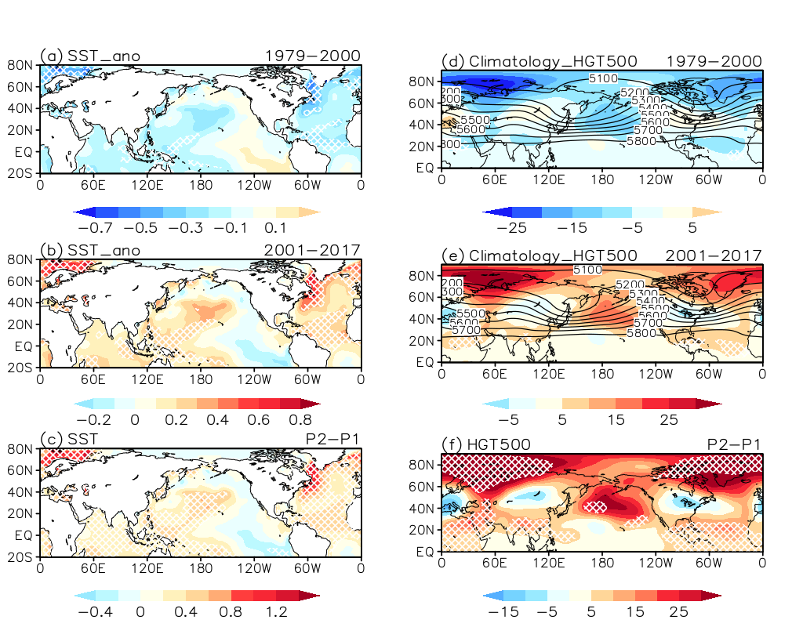
Interdecadal change of second mode impact mechanism
SSTA
P1:1979-2000
HGT500 Climatology
P2:2001-2017
P2-P1
AMO+
AMO+
PDO-
PDO-
AL-
AL-
The interdecadal changes of second mode
are mainly modulated by PDO and AMO

Slide 9
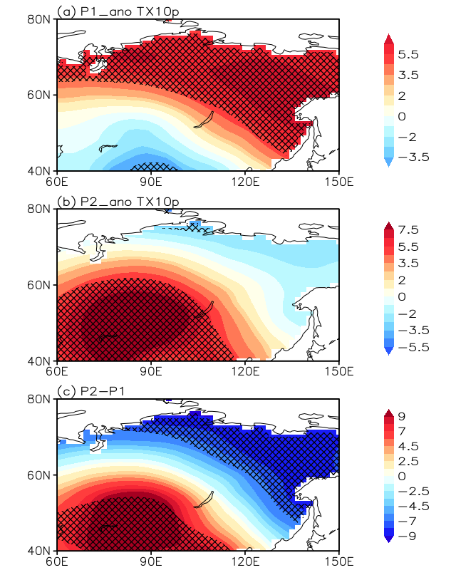
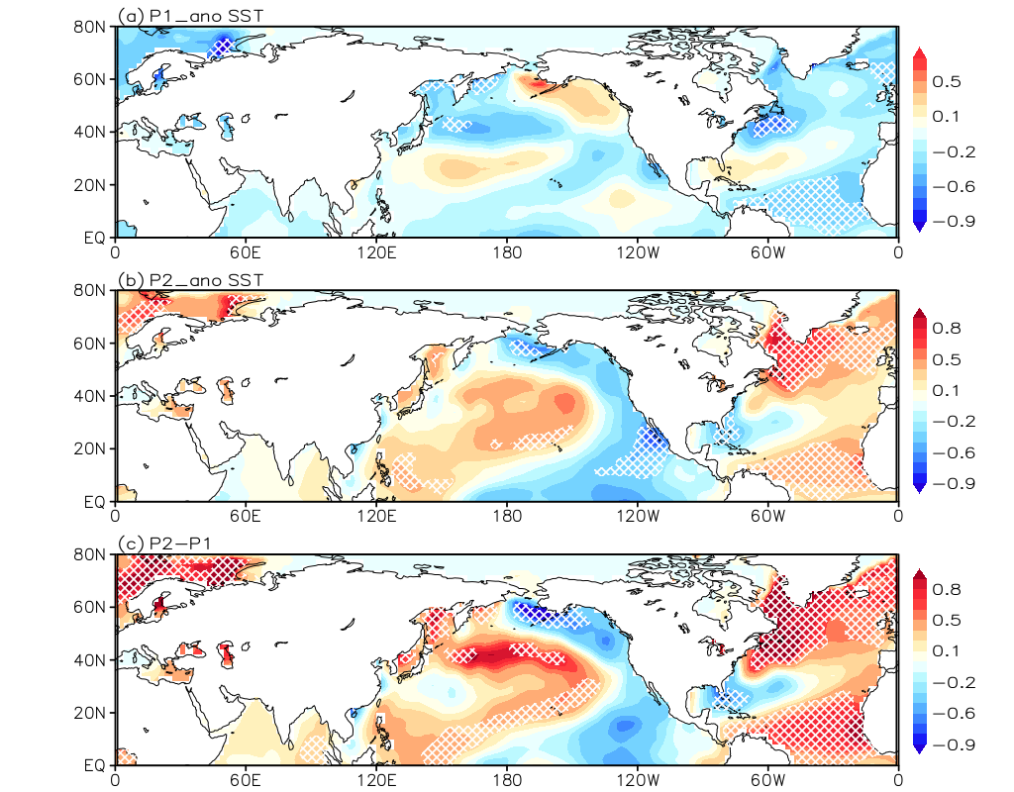
Second mode impact mechanism
TX10p second mode
  SST
P1
PDO+
AMO-
AMO+
P2
PDO-
P2-P1
Typical year composition based on TX10p (1 Standard)

Slide 10
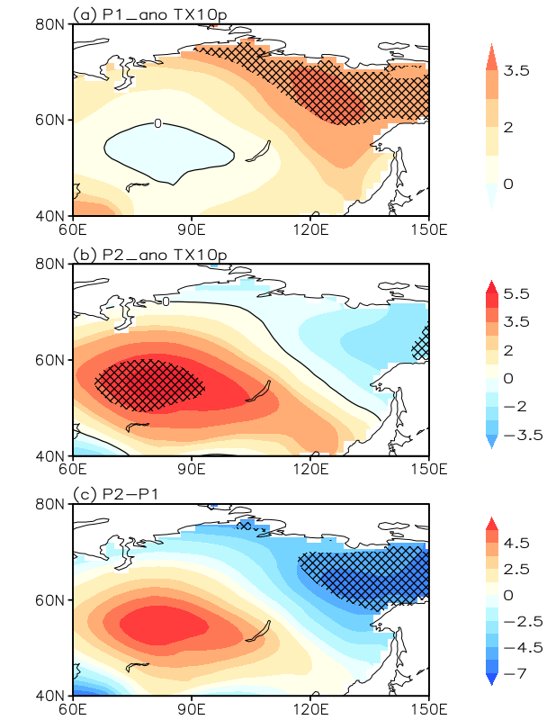
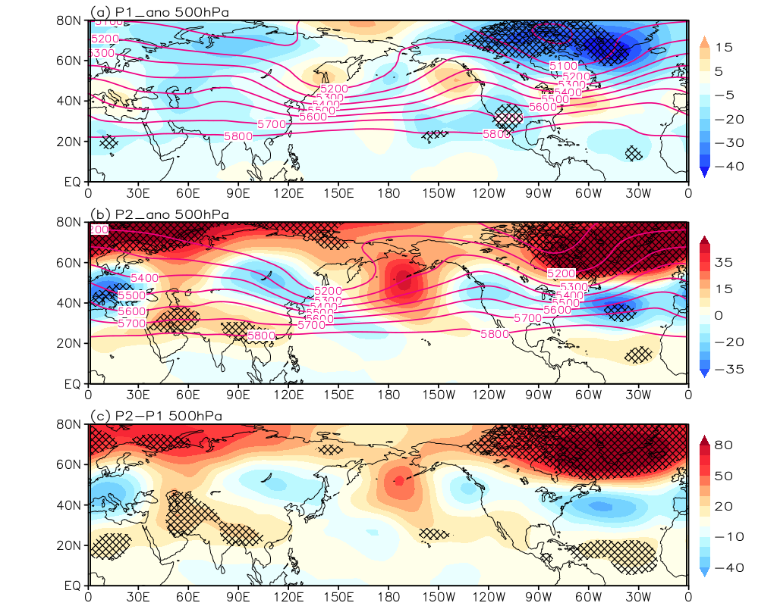
AMO impact mechanism
TX10p second mode
HGT500
  AMO-
  AMO+
P1
Typical year composition based on AMO(1 Standard)
High latitude low T, low pressure
Polar
vortex
favors
Cold air remain in high latitude
Cold days in high latitude
AMO-

Slide 11
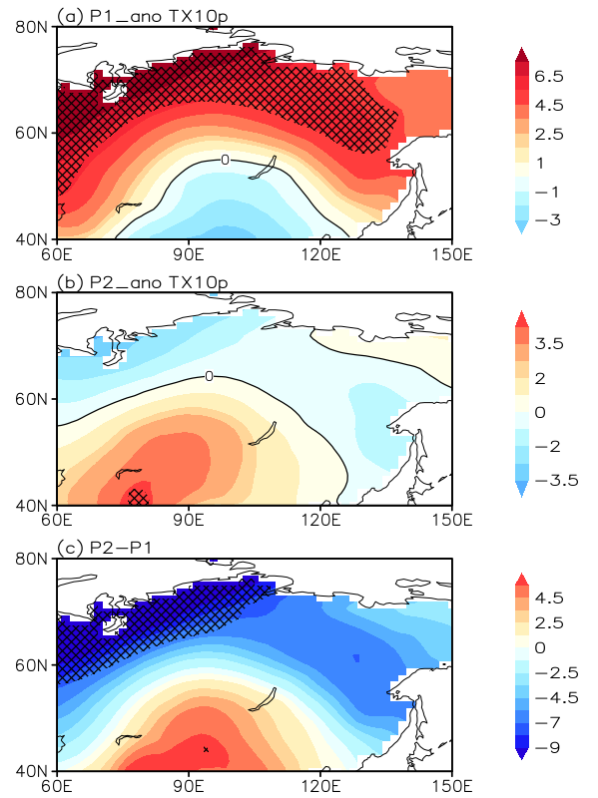
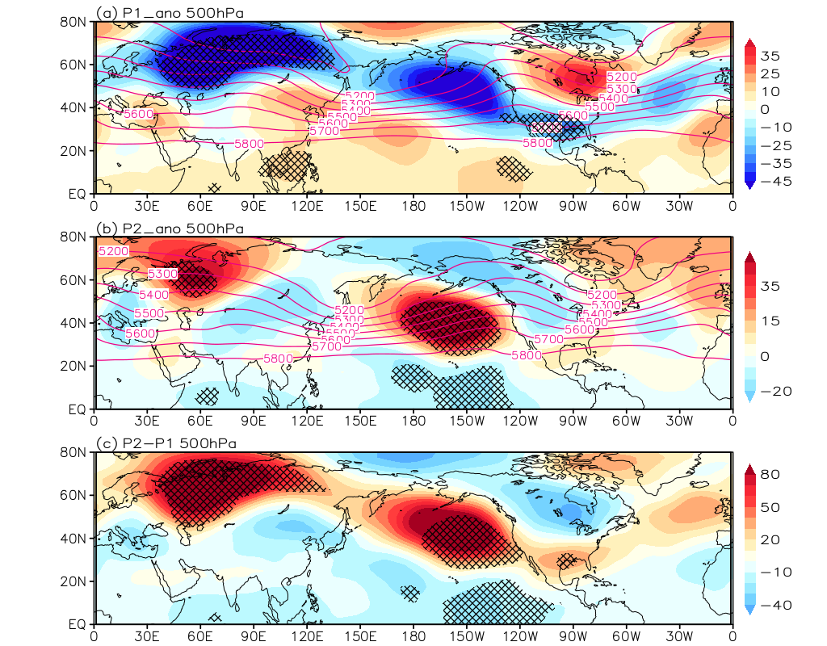
AMO impact mechanism
TX10p second mode
HGT500
  PDO+
  PDO-
Typical year composition based on PDO(1 Standard)
P2
Extreme cold days in the southwest of Lake Baikal mainly expands towards the northeast
AL
East Asian trough move westward
PDO-

Slide 12
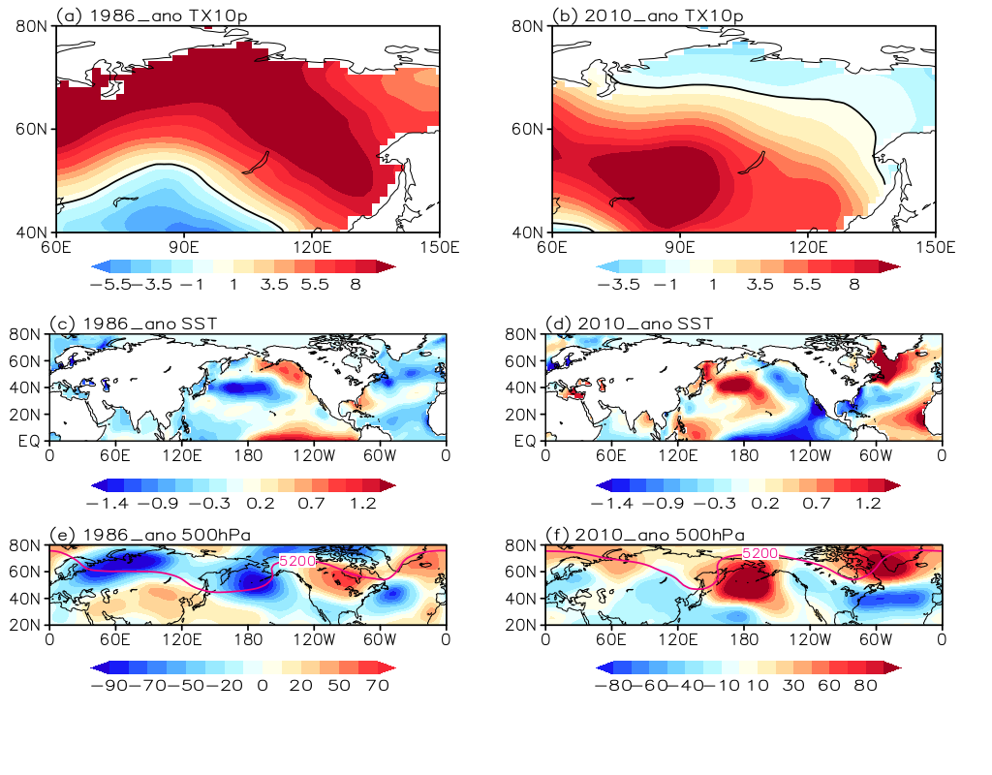
Typical year analysis
AMO-
AMO+
PDO+
PDO-

Slide 13
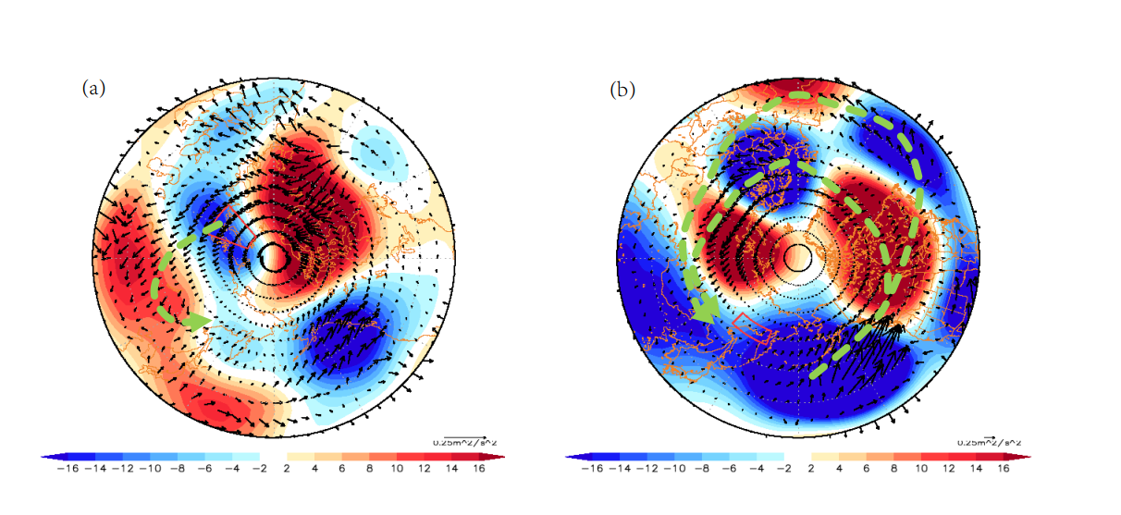
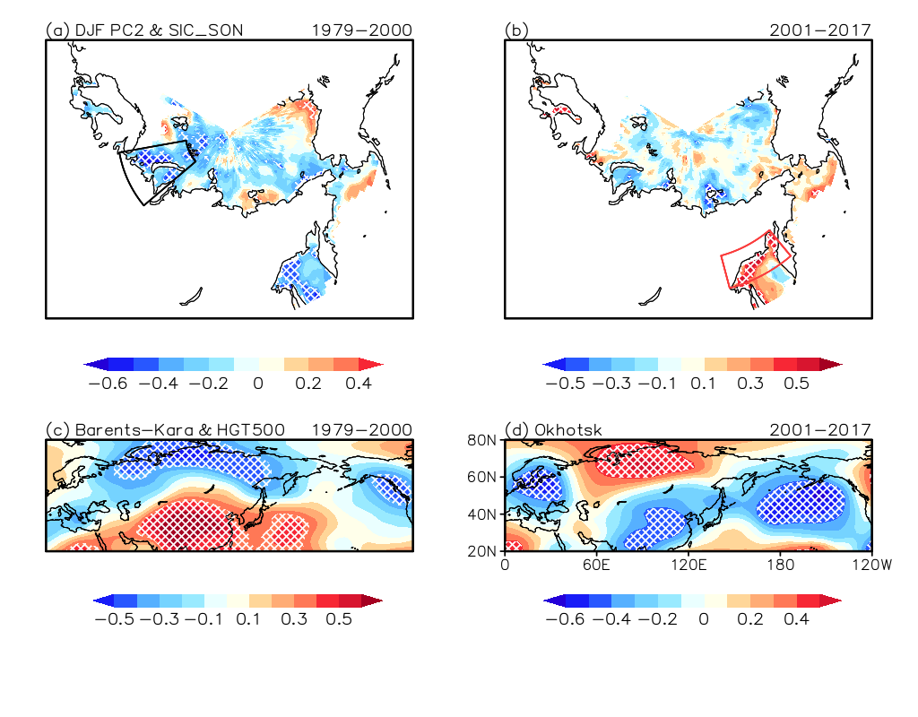
Interannual variability of second mode impact mechanism
P1
P2
Wave activity flux at 200 hPa P1
PC2 & autumn sea ice
PC2 & autumn sea ice
BK sea ice index & HGT500
Okhotsk sea ice index & HGT500
P2
Early period is influenced by sea ice in the Barents-Kara Seas and later period by sea ice in the Okhotsk Sea

Slide 14
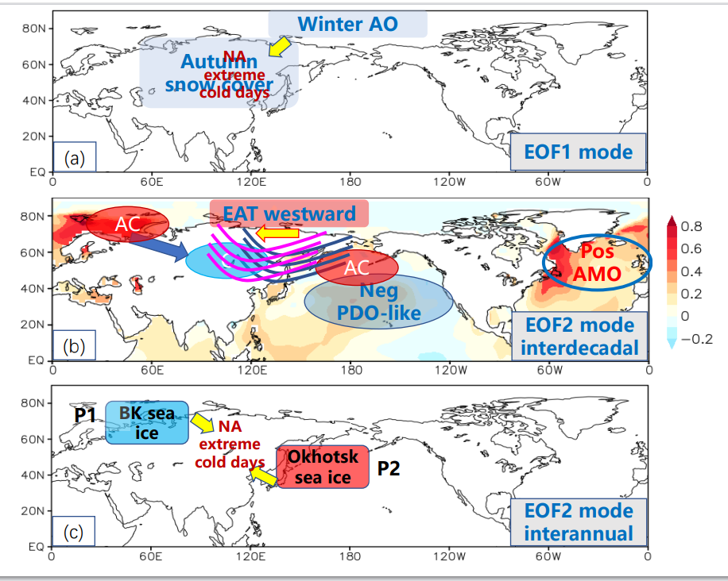
Summary
P1trough
P2trough
Interdecadal change
P2: Later stage
Interannual variability
Boundary of EOF2 Dipole mode moves southwest
AMO POS phase
Siberian High
East Asian
Trough westward
P1: Barents-Kara Seas sea ice
Frequency of cold days change
PDO-like NEG phase
Aleutian Low
P2: Okhotsk Sea
sea ice

Slide 15

Thanks for listening !

