Slide 1
Towards successful climate services –
What are the keys of success?
Sandrine Anquetin¹, Jérôme Servonnat²,
Benoit Hingray¹, Julie Jebeile³, Claire Nief⁴, Camille Parrod¹, Franz Cantarano⁴, Nathalie De Noblet², Bruno Joly⁴,Juliette Mignot⁵, Samuel Morin³, Isabelle Ruin¹, and Benjamin Sultan⁶
¹CNRS / IGE, Institut des Géosciences de l'Environnement, Grenoble
²CEA, CNRS, UVSQ, Univ. Paris Saclay, Laboratoire des Sciences du Climat et l’Environnement, Saclay, France
³Météo-France, CNRS, Centre National de Recherches Météorologiques, Toulouse, France
⁴Météo-France, Toulouse, France
⁵Sorbonne Univ., CNRS, IRD, Muséum Histoire Naturelle, Laboratoire d’Océanographie, Paris, France
⁶IRD, Univ. Montpellier, Espace-Dev, observation spatiale, modèles & sciences impliquée, Montpellier, France
Notes:
Hello everybody,
My name is Jérôme Servonnat and I’m here to present you our work « Towards… » on behalf of a large group of people, covering multiple disciplines including social sciences, philosophy and climate modelling.
I myself am from the climate modelling community so please forgive me if I can’t really answer questions that are more on the social sciences or philosophy aspects.

Slide 2

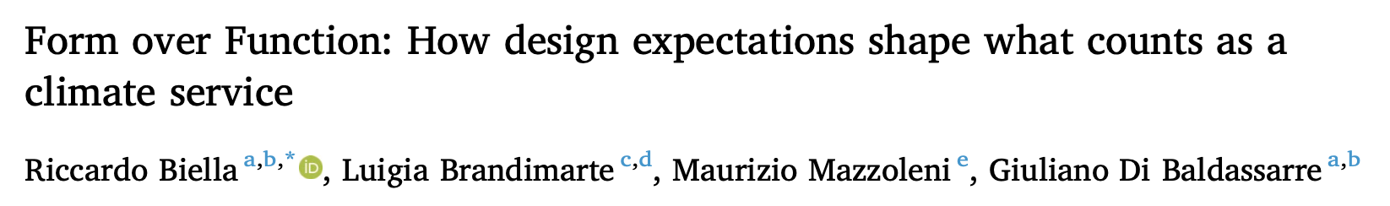

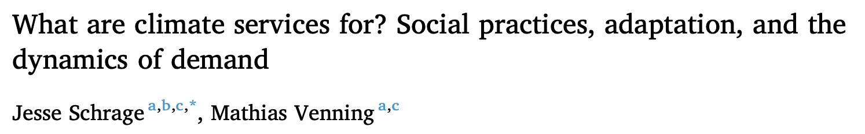
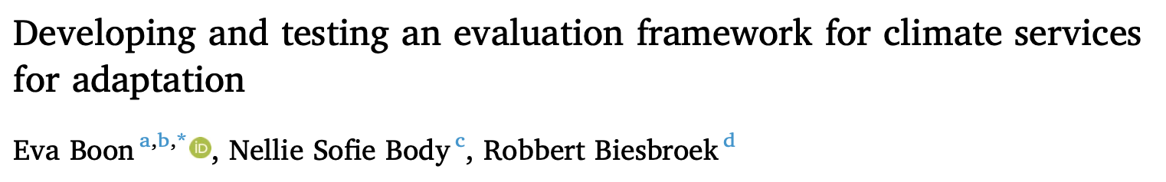
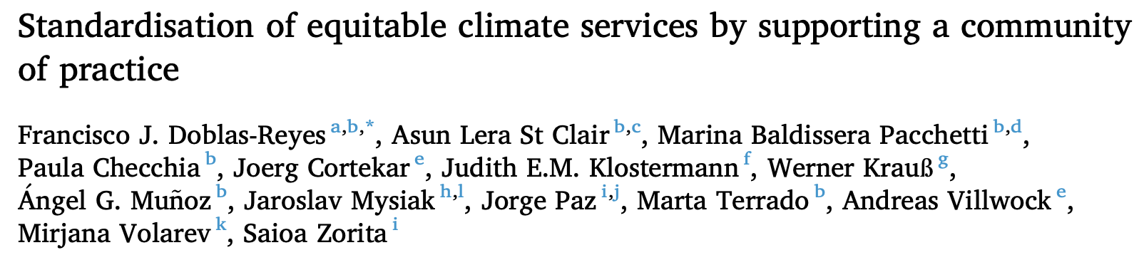


Defining a successful climate service and keys of success:
a lot of work is done on this subject right now
Notes:
Before we start, I wanted to stress that the subject of defining successful climate services and identifying the conditions for success is really developing now; these are some publications that have been published since we did our study.
So in short: we are surely not the only ones working on this subject, and what I will present you is our fair attempt at progressing on it and applying it in our context.

Slide 3


TRACCS
TRansformative Advances in Climate modelling for Climate Services
French national program
8 years
10-12 demonstrators
Notes:
This work is part of a French national program called TRACCS, for « Trans… ».
One of the goals of this program is to develop a dozen of climate services demonstrators, both for France and Western Africa countries.

Slide 4
How does TRACCS contribute to the development of « successful » climate services demonstrators?

Slide 5
How does TRACCS contribute to the development of « successful » climate services demonstrators?
What is
the landscape of climate services
in France?

Slide 6

Our landscape of climate services : a list of 135 services in France and the World identified by the TRACCS community
Notes:
The first step was to identify, within the TRACCS community, all the initiatives that we could identify as Climate Services, in France and in the world. We opened our research to the World because some of the climate services from abroad provide information for France.

Slide 7
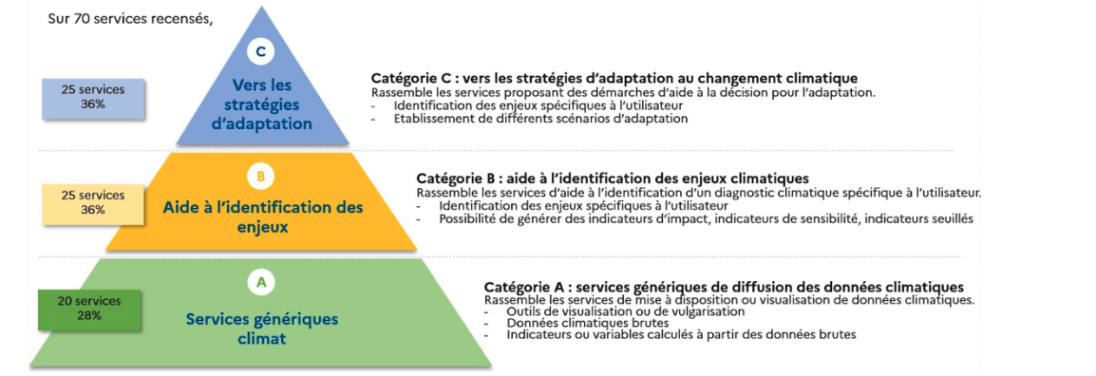
No universal definition of a climate service (Boon et al. 2025)
We use three categories to sort them, from data distribution to support for adaptation strategies
Category C: Toward adaptation strategies
Category B: Support for the identification of
climate-related issues/challenges
Category A: generic services of climatic data distribution

Slide 8
The climate service demonstrators in TRACCS are aimed at supporting decision-making for adaptation
Category C: Toward adaptation strategies
Category B: Support for the identification of
climate-related issues/challenges
Category A: generic services of climatic data distribution

Slide 9
What are the
keys of success?

Slide 10
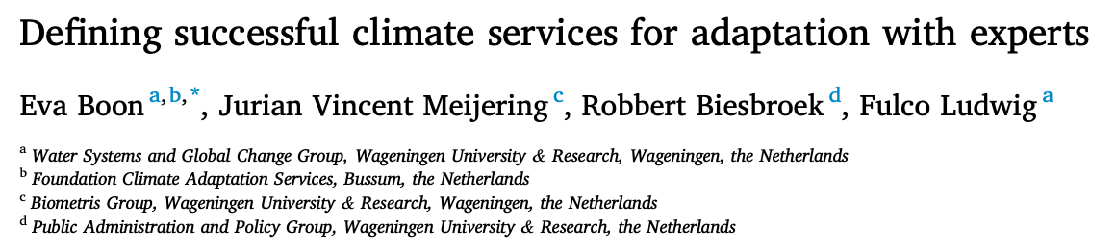

On the shoulders of Boon et al. (2024)

Slide 11
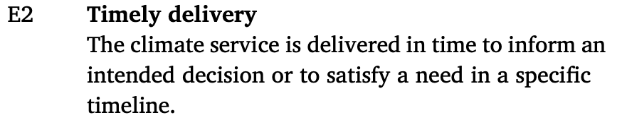
Boon et al. (2024): 12 elements identified as essential to define a successful climate service for adaptation
Can we use them in the development of on-going and coming demonstrators in TRACCS?

Slide 12
Take the elements from Boon et al. (2024) and see if we can use them in the context of TRACCS

Slide 13
Take the elements from Boon et al. (2024) and see if we can use them in the context of TRACCS
Round 1
Additions? Suggestions?
37 initial elements

Slide 14
Take the elements from Boon et al. (2024) and see if we can use them in the context of TRACCS
Round 1
Additions? Suggestions?
37 initial elements
Updated list
Round 2
Online Poll: essential?

Slide 15
Take the elements from Boon et al. (2024) and see if we can use them in the context of TRACCS
Round 1
Additions? Suggestions?
37 initial elements
Updated list
Round 2
Online Poll: essential?
Round 3 and 4
2-days workshop + Finalizing a list of essential elements

Slide 16
11 out of 12 elements from Boon et al. (2024)
+ 2 from initial list + 2 new elements + merging
= a new list of 12 elements

Slide 17
1. The development process of the climate service includes all relevant or concerned stakeholders
2. Users and producers develop a mutual understanding and engage in a durable dialog; they agree on the development approach of the climate service
3. The information in the climate service is based on up-to-date scientific and local knowledges
4. The information is relevant/salient, adapted to the decision context
5. Transparency of data, methods and results
6. The communication format is adapted/suitable to users
7. Follow up, evaluation and teaching/learning of the climate service
8. Timely delivery
9. The climate service contributes to a practical decision for adaptation
10. The climate service is fair (avoid negative impact)
11. The climate service is sustainable
12. The climate service reaches its target audience

Slide 18
NEW
1. The development process of the climate service includes all relevant or concerned stakeholders
2. Users and producers develop a mutual understanding and engage in a durable dialog; they agree on the development approach of the climate service
3. The information in the climate service is based on up-to-date scientific and local knowledges
4. The information is relevant/salient, adapted to the decision context
5. Transparency of data, methods and results
6. The communication format is adapted/suitable to users
7. Follow up, evaluation and teaching/learning of the climate service
8. Timely delivery
9. The climate service contributes to a practical decision for adaptation
10. The climate service is fair (avoid negative impact)
11. The climate service is sustainable
12. The climate service reaches its target audience
Boon et al. (2024)
NEW

Slide 19
1. The development process of the climate service includes all relevant or concerned stakeholders
2. Users and producers develop a mutual understanding and engage in a durable dialog; they agree on the development approach of the climate service
3. The information in the climate service is based on up-to-date scientific and local knowledges
4. The information is relevant/salient, adapted to the decision context
5. Transparency of data, methods and results
6. The communication format is adapted/suitable to users
7. Follow up, evaluation and teaching/learning of the climate service
8. Timely delivery
9. The climate service contributes to a practical decision for adaptation
10. The climate service is fair (avoid negative impact)
11. The climate service is sustainable
12. The climate service reaches its target audience
From the
developers point of view, the elements cover the life cycle of the Climate Service:
How the consortium works

Slide 20
1. The development process of the climate service includes all relevant or concerned stakeholders
2. Users and producers develop a mutual understanding and engage in a durable dialog; they agree on the development approach of the climate service
3. The information in the climate service is based on up-to-date scientific and local knowledges
4. The information is relevant/salient, adapted to the decision context
5. Transparency of data, methods and results
6. The communication format is adapted/suitable to users
7. Follow up, evaluation and teaching/learning of the climate service
8. Timely delivery
9. The climate service contributes to a practical decision for adaptation
10. The climate service is fair (avoid negative impact)
11. The climate service is sustainable
12. The climate service reaches its target audience
Development of the climate service
From the
developers point of view, the elements cover the life cycle of the Climate Service:

Slide 21
1. The development process of the climate service includes all relevant or concerned stakeholders
2. Users and producers develop a mutual understanding and engage in a durable dialog; they agree on the development approach of the climate service
3. The information in the climate service is based on up-to-date scientific and local knowledges
4. The information is relevant/salient, adapted to the decision context
5. Transparency of data, methods and results
6. The communication format is adapted/suitable to users
7. Follow up, evaluation and teaching/learning of the climate service
8. Timely delivery
9. The climate service contributes to a practical decision for adaptation
10. The climate service is fair (avoid negative impact)
11. The climate service is sustainable
12. The climate service reaches its target audience
From the
developers point of view, the elements cover the life cycle of the Climate Service:
Use of the climate service

Slide 22
1. The development process of the climate service includes all relevant or concerned stakeholders
2. Users and producers develop a mutual understanding and engage in a durable dialog; they agree on the development approach of the climate service
3. The information in the climate service is based on up-to-date scientific and local knowledges
4. The information is relevant/salient, adapted to the decision context
5. Transparency of data, methods and results
6. The communication format is adapted/suitable to users
7. Follow up, evaluation and teaching/learning of the climate service
8. Timely delivery
9. The climate service contributes to a practical decision for adaptation
10. The climate service is fair (avoid negative impact)
11. The climate service is sustainable
12. The climate service reaches its target audience
A dashboard to
frame the development of the climate services demonstrators
to match those elements
Description of the scope of the project
Measurement of stakeholders' engagement rate
List the documents and data on which the development of the climate service is based
Conducting user surveys
Implementation of monitoring indicators

Slide 23


Key messages
An adaptation of Boon et al. (2024) for practical use in TRACCS for the development of successful climate services
WORK IN PROGRESS: experiment the application of the guidelines in TRACCS demonstrators
This was a teaser! Come discuss with us!

Slide 24
For more information
ANR-22-EXTR-00xx

Slide 25
A USEFUL information (Cash et al. 2002) should be perceived as
Credible, Salient, Legitimate (and more)
J. Jebeile : if the criteria are met,
from the USERS point of view, they generate a feeling of
Confidence, Relevance, Justice

Slide 26
1. The development process of the climate service includes all relevant or concerned stakeholders
2. Users and producers develop a mutual understanding and engage in a durable dialog; they agree on the development approach of the climate service
3. The information in the climate service is based on up-to-date scientific and local knowledges
4. The information is relevant/salient, adapted to the decision context
5. Transparency of data, methods and results
6. The communication format is adapted/suitable to users
7. Follow up, evaluation and teaching/learning of the climate service
8. Timely delivery
9. The climate service contributes to a practical decision for adaptation
10. The climate service is fair (avoid negative impact)
11. The climate service is sustainable
12. The climate service reaches its target audience
From the
users
point of view, the elements generate a feeling of Confidence,
Relevance,
Justice
(Julie Jebeile, adapted from Cash et al. 2002)

Slide 27
For each element,
we have proposed ways to challenge them in practice
3. The information in the climate service is based on up-to-date scientific and local knowledges
➔ A review of the scientific methods and data used by a scientific commitee
➔ The inclusion of previously identified local knowledges

