Slide 1



Impact of Sea-Breeze Regimes on Wind Power Production at the Pecineaga Wind Farm (Romania)
Crina Radu, Ionut Lita, Georgeta Bandoc, and Adrian Dobre
Notes:
[Sources]
User-supplied EMS-26_Radu-et-al.pptx.

Slide 2
Romanian sea-breeze evidence remains limited
• Black Sea studies document circulation structure, aerosols and regional dynamics, but Romanian coastal evidence remains limited.
• Sea breezes alter wind, temperature, convection, air quality—and the operating wind seen by coastal turbines.
From Aristotle’s Meteorologica to >3,000 studies
(Radu et al, 2026)
• The open question is no longer whether they occur, but how often they matter for energy production.
Knowledge gap → quantify the energy relevance of objectively detected regimes.
Notes:
[Sources]
Radu, C., Bandoc, G., Degeratu, M., “Sea Breeze Occurrence on the Romanian Black Sea Coast”, user-supplied manuscript, Introduction and Fig. 1.

Slide 3
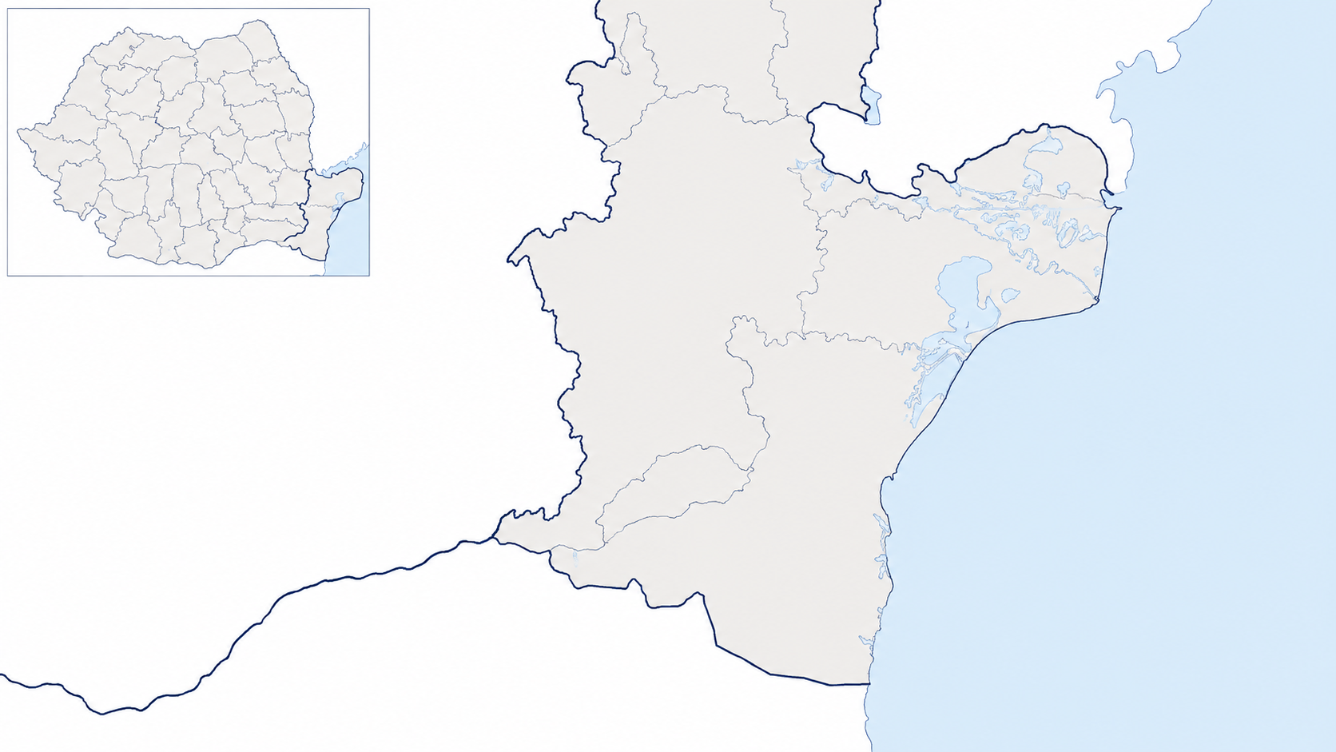

Pecineaga links coastal meteorology to operating turbines
SOUTH-EAST ROMANIA
Southern Dobrogea · Black Sea coastal sector
8
48 MW
Wind-farm / land reference: 43.9148°N, 28.4709°E
Marine reference: 43.8922°N, 28.6941°E
SG170 turbines
installed capacity
135 m
1999–2024
hub height
analysis period
The Pecineaga wind farm was officially inaugurated by Eurowind Energy on April 29, 2026.
Pecineaga wind farm localization
How much of the park’s production is associated with pure and embedded sea-breeze regimes?
Notes:
[Sources]
Pecineaga_energy_attribution_integrated(1).docx, Abstract and methodological rationale; productie brize Pecineaga W jul-26.xlsb.xlsx, sheets Foaie1 and all.

Slide 4
Detection evolved from expert screening to an objective hourly method
1
2
3
4
Empirical screening
Sea Breeze Index
Multi-parameter filter
Long-term application
Station wind and temperature · satellite fronts · synoptic fields
SBI compares synoptic wind forcing with the land–sea thermal gradient
Thermal contrast + marine wind rotation + speed response + synoptic consistency
Hourly classification transferred to the 1999–2024 Pecineaga dataset
Objective detection captures embedded regimes that manual screening tends to miss.
Notes:
[Sources]
Radu et al., user-supplied manuscript, Data and Methods; Pecineaga_energy_attribution_integrated(1).docx, methodological rationale.

Slide 5
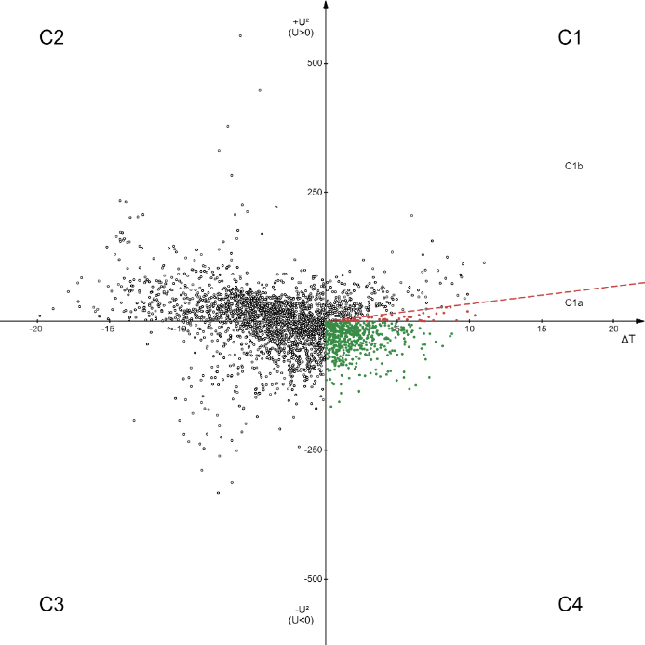
SBI separates thermal forcing from the synoptic-flow direction
• C1b — pure sea-breeze regime used in the Pecineaga analysis: thermal forcing overcomes weak opposing offshore flow.
• C4 — embedded sea breeze: onshore synoptic and thermal components act in the same broad direction.
• Other quadrants represent blocked or thermally inhibited conditions and are not counted as productive sea-breeze regimes.
Romanian-coast critical SBI: 3.4 m² s⁻² K⁻¹
SBI plot for 2018 cases (Radu et al, 2026)
Notes:
[Sources]
Radu et al., user-supplied manuscript, Theoretical Method and Fig. 4. Romanian-coast critical SBI value reported as 3.4 m² s⁻² K⁻¹.

Slide 6
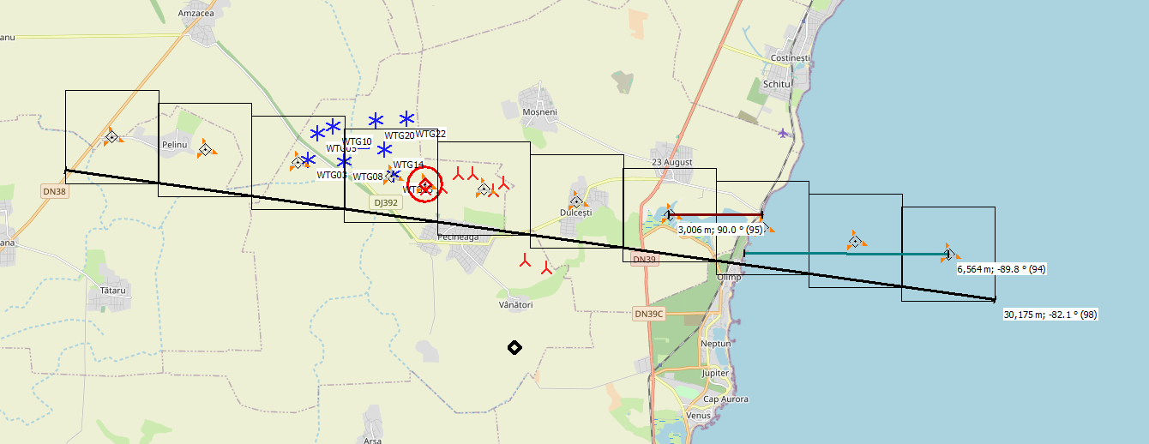
Initiation and inland advance are diagnosed separately
1
2
3
4
Marine baseline
Initiation
Front advance
Farm impact
Point 1
4–1
7–1
7–4
Fixed offshore reference
Near-coastal land–sea contrast
Primary inland propagation signal
Secondary sensitivity deeper inland
Meteo object, lidar
Events are retained only when SBI, thermal contrast and the wind response evolve coherently.
10
9
8
7
Existing wtg
6
5
4
3
2
1
New wtg
Spatial distribution of 3km era5 grid data used for analysis
Notes:
[Sources]
Pecineaga_energy_attribution_integrated(1).docx, “Methodological rationale for the selection of analysis points”.

Slide 7
Detect at 50 m; evaluate energy at the 135 m hub height
• ERA5-driven WRF (EMD), 3 km, hourly, 1999–2024
WindPRO production model
• Event detection at 50 m where the sea-breeze signature is strongest
8 × SG170 6.0 MW
Turbine-specific power curve
Air-density correction
Direction-dependent wake response
Hourly regime subsets
• Fixed event timestamps carried to 135 m through vertical extrapolation
• 2021 lidar, 15-minute data, used to assess shear and PBL structure (for vertical extrapolation)
The same production assumptions are retained for observed and counterfactual states.
Notes:
[Sources]
Pecineaga_energy_attribution_integrated(1).docx, “Extension of Sea-Breeze Analysis to Turbine Hub Height”; user-supplied Excel production workbooks.

Slide 8
Shapley allocation resolves nonlinear turbine response
Uₜₒₜₐₗ,t = UCG,t + USB,t
Two-component Shapley allocation
P(UCG + USB) ≠ P(UCG) + P(USB)
φSB,t = ½ [ESB,t + (Etotal,t − ECG,t)]
φCG,t = ½ [ECG,t + (Etotal,t − ESB,t)]
Near cut-in, two weak components can jointly produce power; opposing vectors can also reduce the resultant wind.
φSB,t + φCG,t = Etotal,t
Small negative residuals are treated as negligible calculation artefacts linked to the simplified PBL representation; final reporting uses aggregated contributions.
Notes:
[Sources]
Pecineaga_energy_attribution_integrated(1).docx, “Attribution of Wind Power Production under Mixed Synoptic–Sea-Breeze Conditions”; Shapley (1953).

Slide 9
Embedded sea breezes dominate productive regimes
7.3×
more embedded than pure hours
C1b: 3.1% of all hours
C4: 22.5% of all hours
Frequency—not event intensity alone—makes embedded regimes the main pathway to energy impact.
Notes:
[Sources]
Productie_Oara_Parc_Eolian_1999_2024.xlsx, “Date Orare (1999-2024)”; counts recomputed from hourly category labels.

Slide 10
Sea-breeze dynamics account for 15.65% of annual production
15.65%
mean share of annual production
28.29 GWh/year
mean sea-breeze-attributed energy
The percentage is calculated after aggregating hourly allocations—not by averaging unstable instantaneous ratios.
Notes:
[Sources]
Statistica_Briza_Marina_1999_2024.xlsx, “Sinteză & Extrema Briză”; Productie_Oara_Parc_Eolian_1999_2024.xlsx, “Rezumat Anual (AEP)”.

Slide 11
The relative contribution peaks in spring
March 29.12%
April 30.70%
monthly maxima
November 5.88%
December 6.04%
Thermal contrast and sufficiently productive winds overlap most effectively in spring.
Notes:
[Sources]
Statistica_Briza_Marina_1999_2024.xlsx, “Statistică Sezonieră” and “Statistică Lunară”.

Slide 12
Interannual variability requires a homogeneity check
MAX
2004
29.54%
MIN
2018
8.74%
The step after 2004 is flagged for sensitivity and PBL/decomposition checks—not interpreted as climate change.
Notes:
[Sources]
Statistica_Briza_Marina_1999_2024.xlsx, “Statistică Anuală Detaliată”. Interpretation treats the discontinuity as a method/data-homogeneity issue rather than a climatic trend.

Slide 13
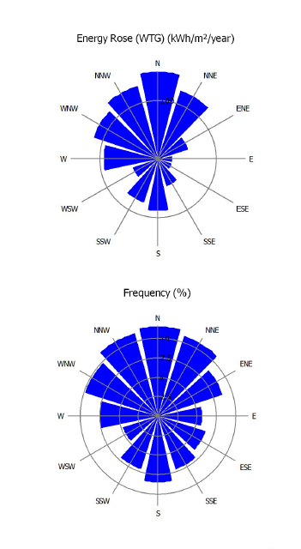
Embedded regimes modify the marine-sector production pattern
• Pure sea-breeze cases do not show a stable marine-sector signature because the background flow is weak and directionally variable.
• Embedded cases display clearer alignment with marine inflow and modulate the already productive northerly to north-easterly sectors.
• A sea-breeze contribution therefore need not appear as a distinct easterly peak in the park-level wind rose.
Mainly wind direction at Pecineaga wind farm
Sea breeze acts mainly as a modifier of the prevailing coastal wind climate.
Notes:
[Sources]
Pecineaga_energy_attribution_integrated(1).docx, directional-analysis interpretation and embedded figure “Energy Rose (C1b Shapley values) / Frequency (%)”.

Slide 14
Sea breeze is a recurring part of Pecineaga’s energy climate
CONCLUSIONS
1
Embedded regimes dominate
C4 occurs ~7 times more often than pure C1b conditions.
2
Energy relevance is material
The final mean attribution could reach around 28 GWh/year, or around 15% of annual production.
3
Seasonality matters
The contribution peaks in spring, when thermal forcing overlaps productive winds.
4
Method choice matters
Hourly Shapley allocation conserves energy; PBL-related negative residuals are treated as negligible artefacts.
Implication: coastal wind-resource assessment and forecasting should represent sea-breeze regimes explicitly.
Notes:
[Sources]
Synthesis of user-supplied manuscript, draft article and Excel statistics.

Slide 15
Thank you for atTention!

