Slide 1





Linking Variability in Baltic Sea Volume to Atmospheric Circulation
Piia Post¹, Mattias Rennel¹, Hannes Keernik¹, Andreas Lehmann²
¹ Institute of Physics, University of Tartu, Tartu, Estonia (piia.post@ut.ee)
² GEOMAR Helmholtz Centre for Ocean Research, Kiel, Germany
EMS Utrecht, September 2026

Slide 2
Motivation
The sea integrates atmospheric circulation variability and reflects long-term changes in circulation patterns.
The volume of the Baltic Sea and its exchange of water with the North Sea are strongly driven by atmospheric forcing.
Major Baltic Inflows bring saline North Sea water into the Baltic Sea and are essential for ventilating the deep basins, sustaining oxygen-rich conditions and supporting marine life.

Slide 3
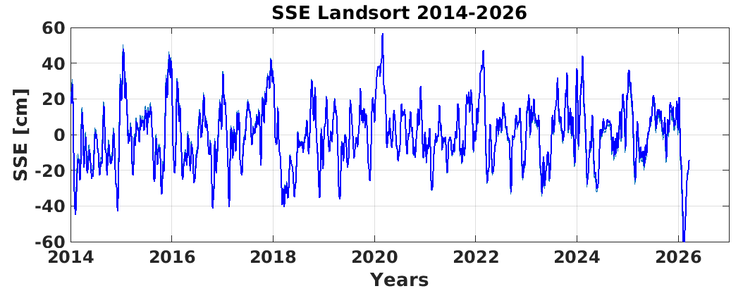
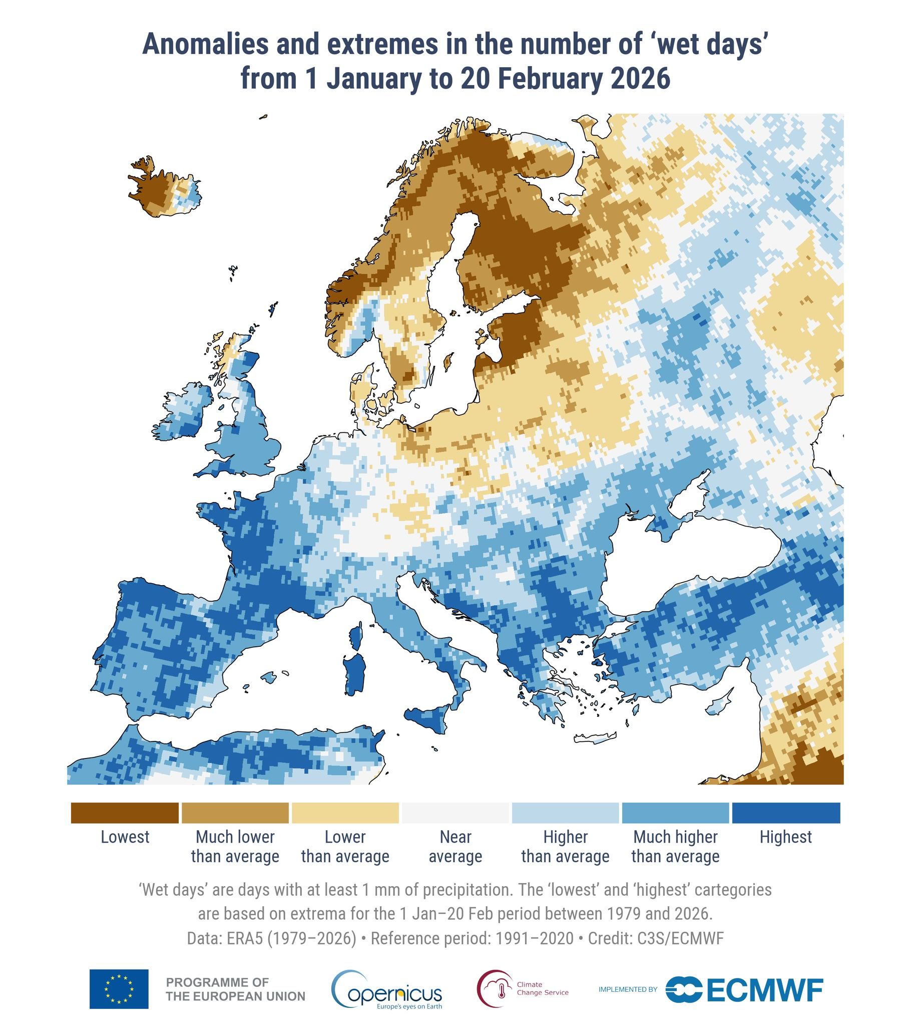
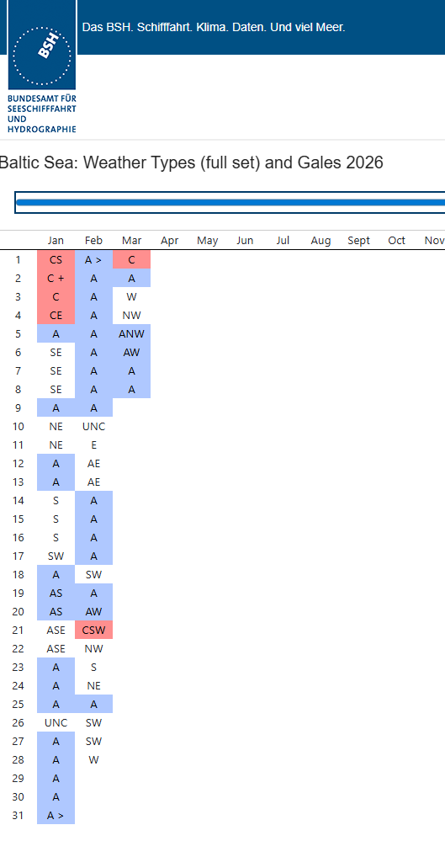
Wetterlagen- und Sturmklassifizierung
Datum Pegelstand Salzmenge
31. Januar 1937 - 61,5 cm 1,76 GT
11. Februar 1947 - 62,0 cm 1,57 GT
25. Februar 1954 - 61,2 cm 0,64 GT
12. März 1972 - 63,9 cm 2,77 GT
24. März 1980 - 61,2 cm 1,96 GT
5. Februar 2026 - 67,4 cm ??
This is the lowest water level ever observed at Landsort since continuous records began in 1886.
https://www.bsh.de/

Slide 4
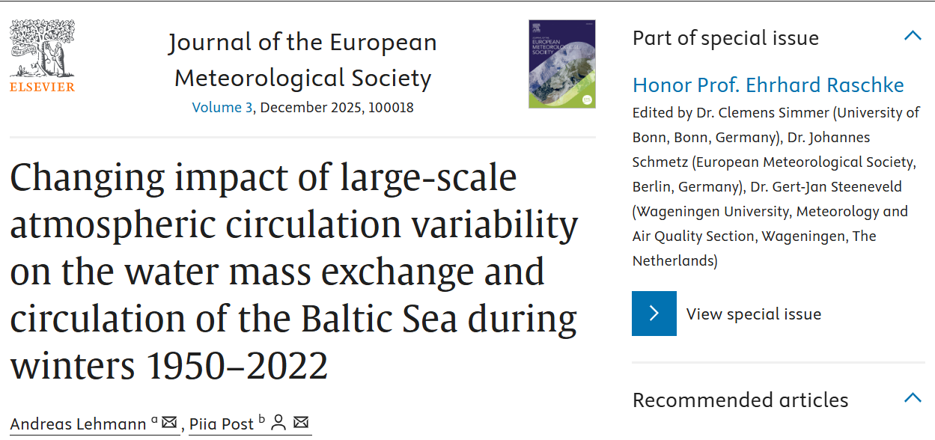
FRAMEWORK large-scale atmospheric circulation => regional scale atmospheric circulation => water mass exchange in the Baltic Sea
Mean sea level pressure (MSLP) from ERA5 for DJF 1950–2022

Slide 5
Jet stream
The jet core pipeline (Banderier et al., 2025) extracts upper-tropospheric jet axes as lines of maximum wind speed at the level of strongest flow, categorizes the extracted features into eddy-driven and subtropical categories using a Gaussian mixture model fitted in baroclinicity–potential temperature phase space, and tracks these jet objects over time based on longitudinal overlap and vertical distance thresholds.
Maps shown: Weekly (7-day) and monthly jet core occurrence frequency and occurrence frequency anomaly for the periods October 2014-January 2015 and January-April 2016, shown for the Euro-Atlantic sector (80°W-40°E, 25-85°N) and the extended Baltic Sea catchment region (10°W-40°E, 48-72°N).
Occurrence frequency: Fraction of 6-hourly timesteps during which a grid cell contained at least one EDJ core point (binary occupancy; only presence or absence is considered).
Occurrence frequency anomaly: Departure from the long-term calendar-matched climatological occurrence frequency.
Climatology: The climatology is derived from the jet dataset of Banderier et al. (2025) (6-hourly, 1959-2022). For each event period, all matching calendar months (or weeks) are used, excluding the event years.

Slide 6
Synoptic weather types (Jenkinson-Collison JCT)
10 = 8 directional flow types + cyclonic + anticyclonic
MSLP fields
1950-2022 ERA5

Slide 7
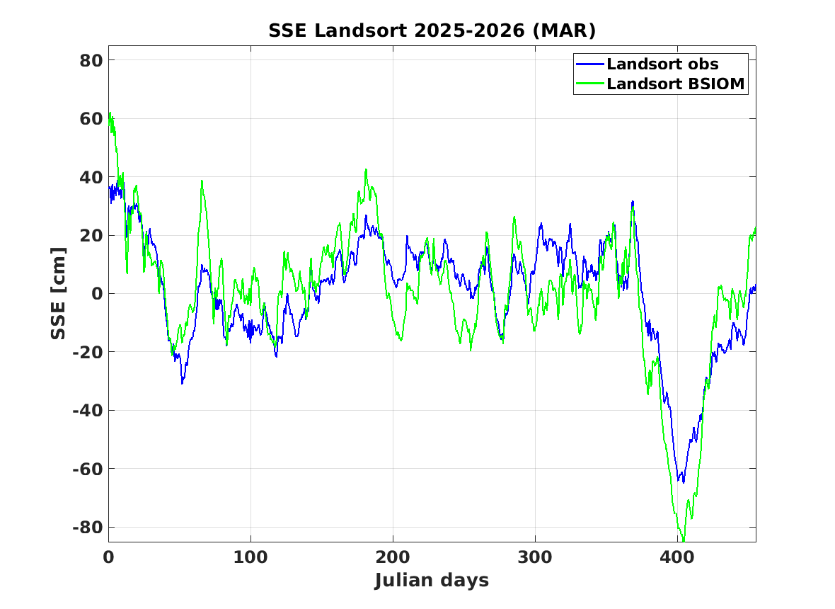
Landsort SSE shows the volume changes of the Baltic Sea
5th of February 2026 is the day 401

Slide 8
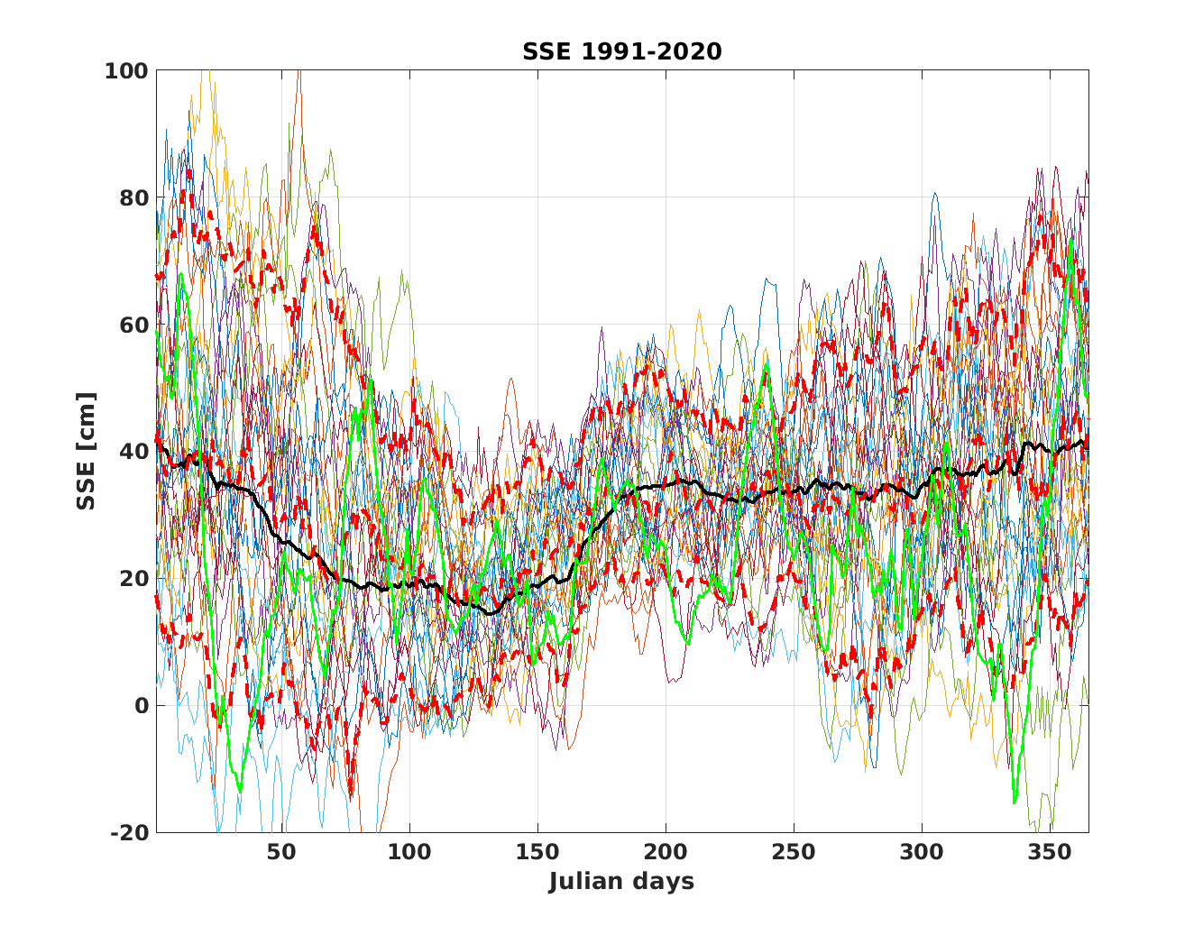
Annual cycle of Landsort sea level 1991-2020 overlayed by 10, 50 and 90% percentiles.
Maximum sea level in winter. Minimum values appear in April/May.

Slide 9
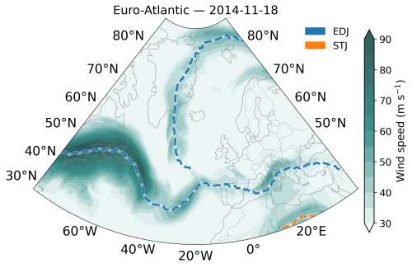
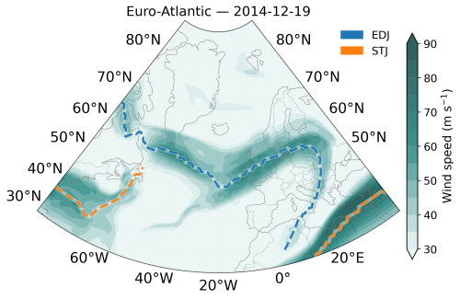
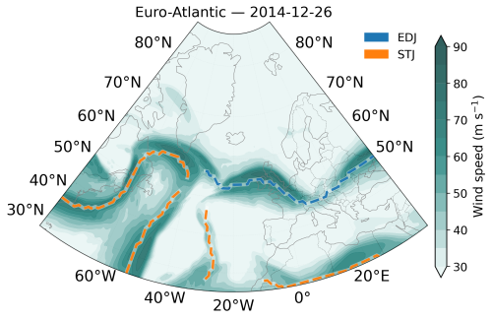
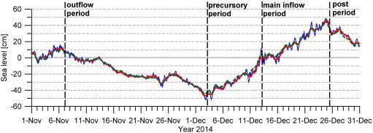
Jet streams: EDJ-Eddy Driven Jet, STJ-Subtropical Jet during the time of 2014 MBI
Banderier, et al 2025.
Observed hourly sea level at Landsort Norra (thin blue line) and low pass filtered time series, using a cutoff period of 3days (bold red line). The dashed green line depicts the sea level at Landsort Norra from the numerical model. (Mohrholz et al , 2015)

Slide 10
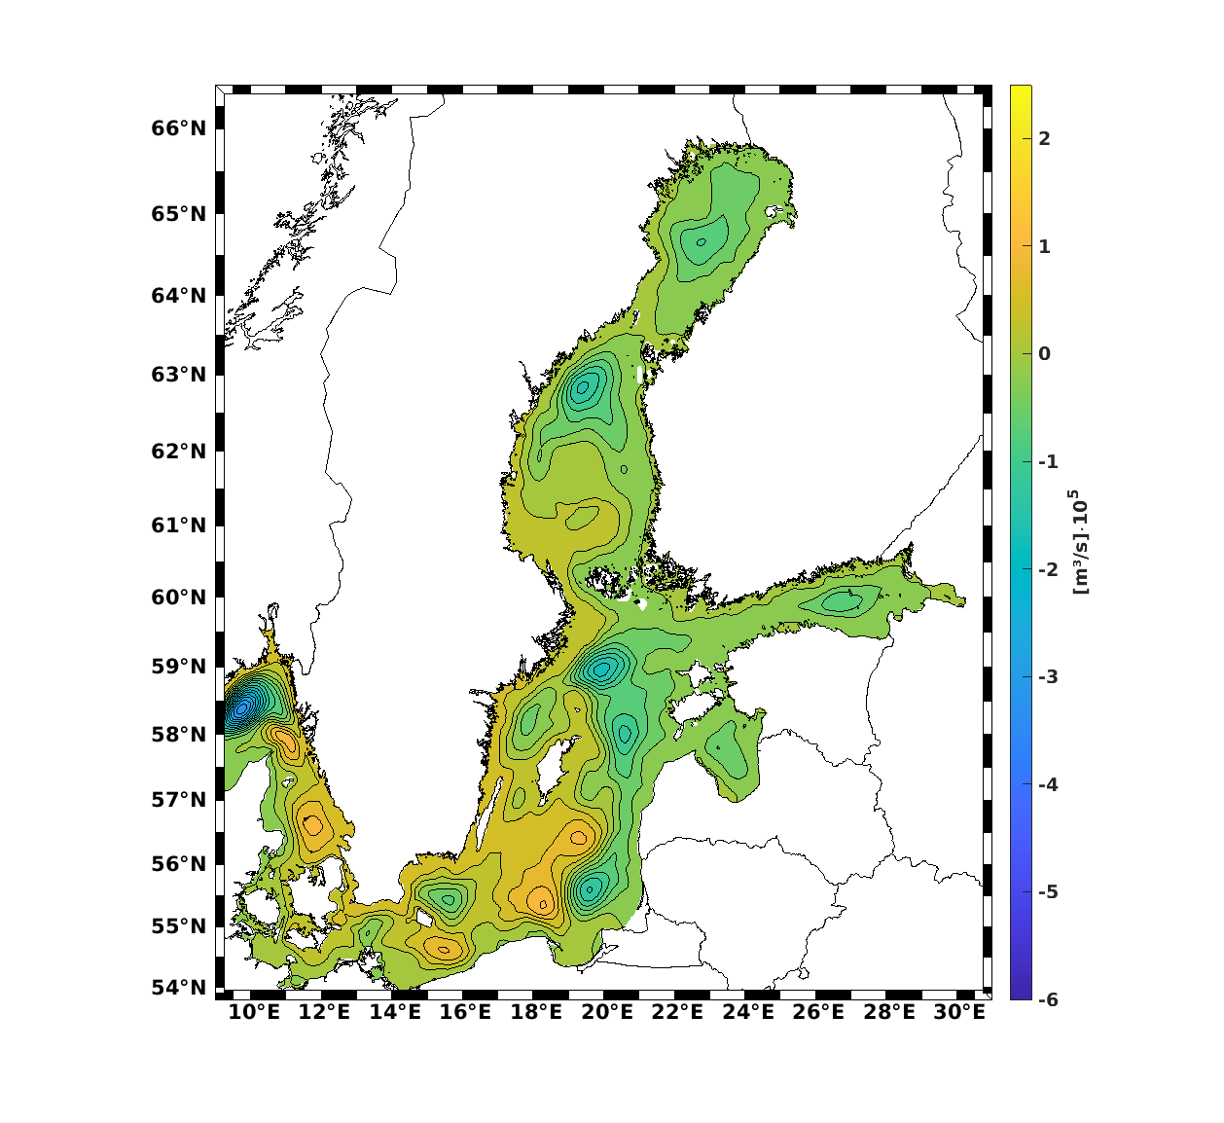
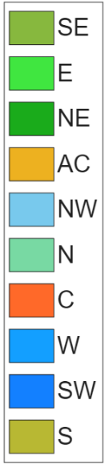
Nov 2014 - outflow
Observed hourly sea level at Landsort Norra (thin blue line) and low pass filtered time series, using a cutoff period of 3days (bold red line). The dashed green line depicts the sea level at Landsort Norra from the numerical model. (Mohrholz et al , 2015)

Slide 11
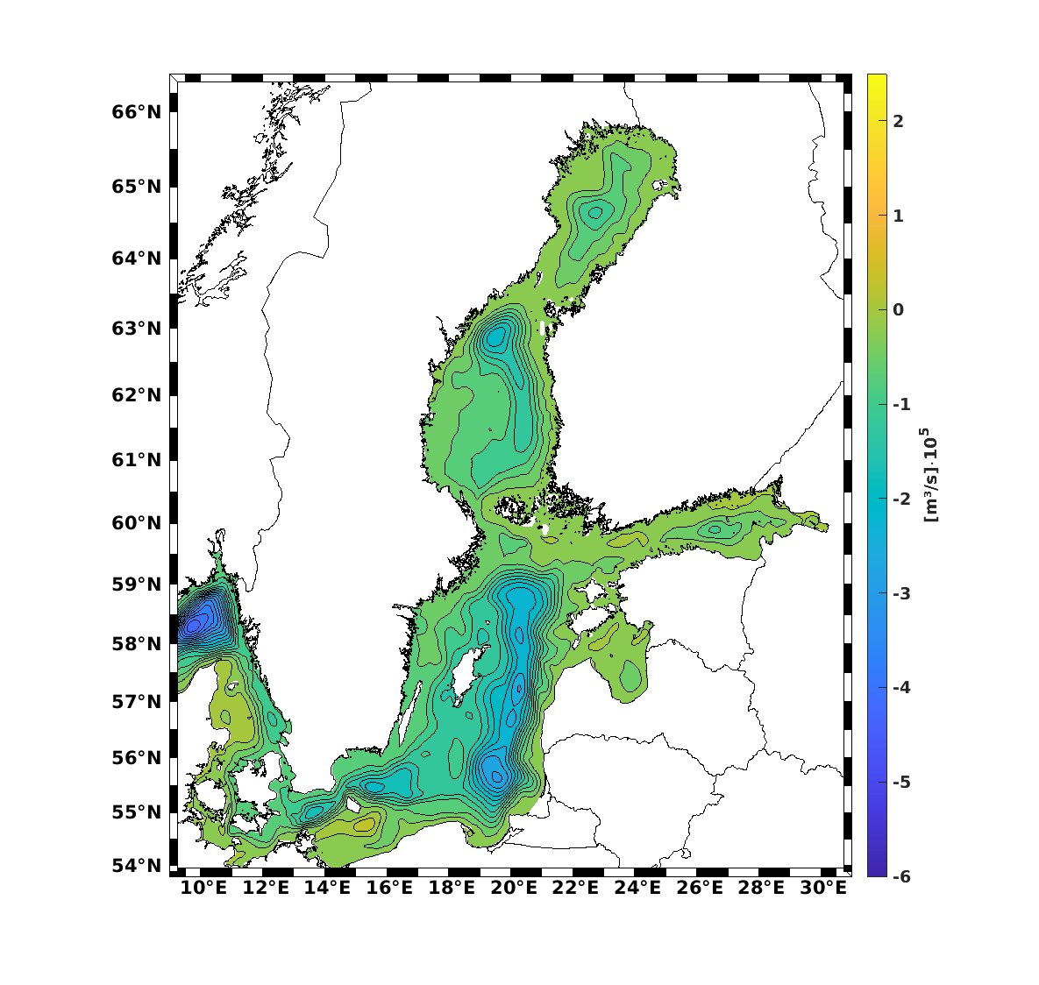
Dec 2014 – precursory+inflow
Observed hourly sea level at Landsort Norra (thin blue line) and low pass filtered time series, using a cutoff period of 3days (bold red line). The dashed green line depicts the sea level at Landsort Norra from the numerical model. (Mohrholz et al , 2015)

Slide 12
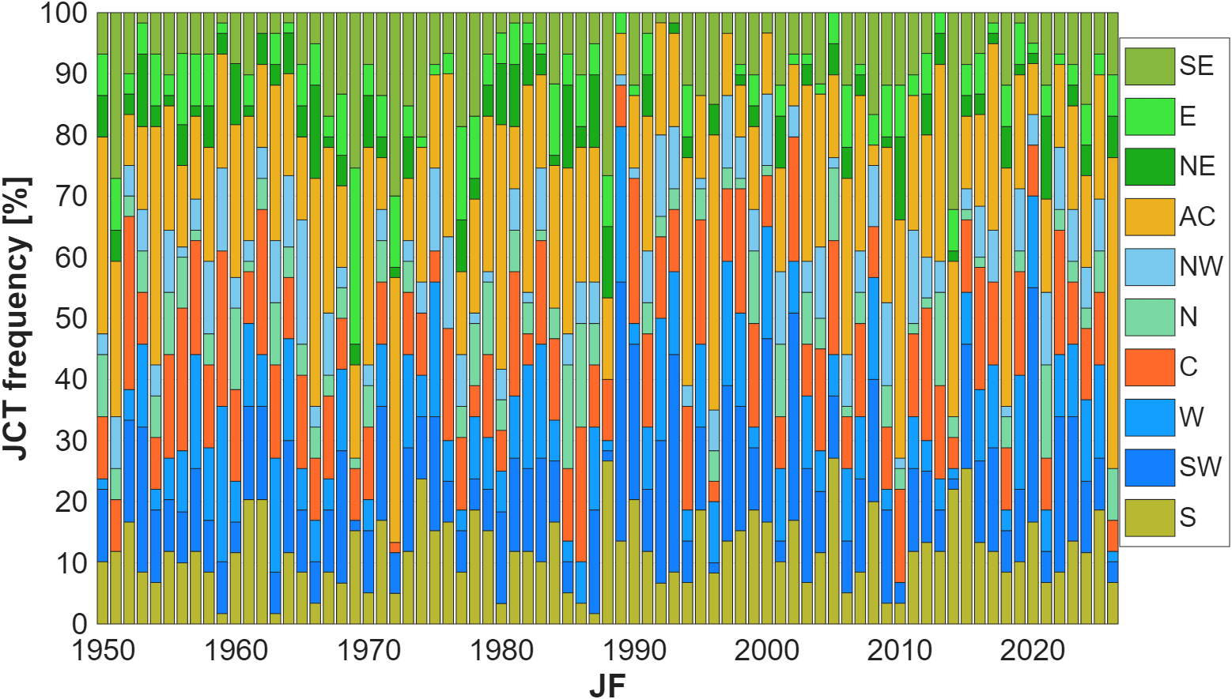
Large interannual variability centred 60N 20E
JCT relative frequencies JF 1950/51-2025/26
2026

Slide 13
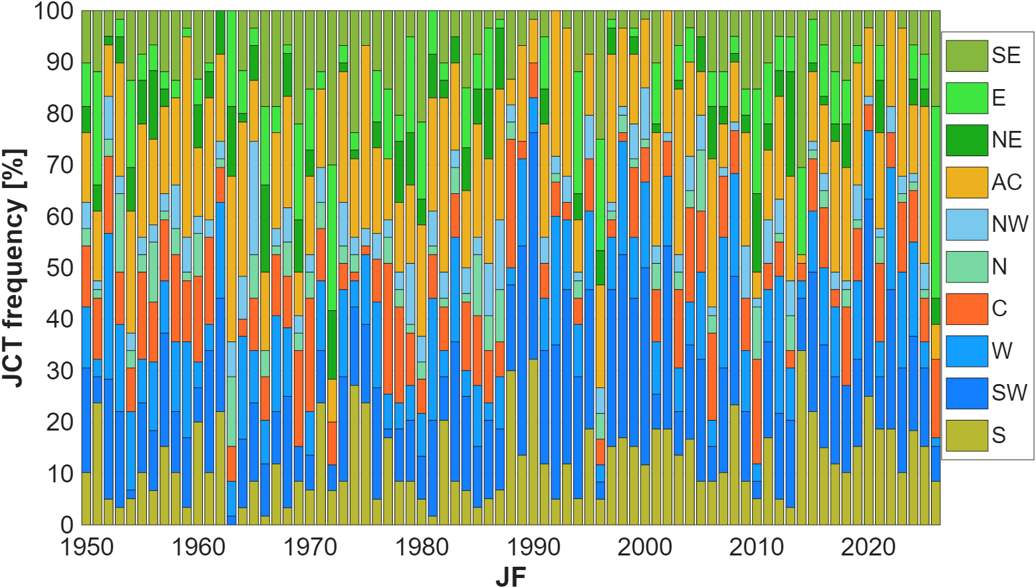
Large interannual variability centred 55N 10E
JCT relative frequencies JF 1950/51-2025/26
2026

Slide 14
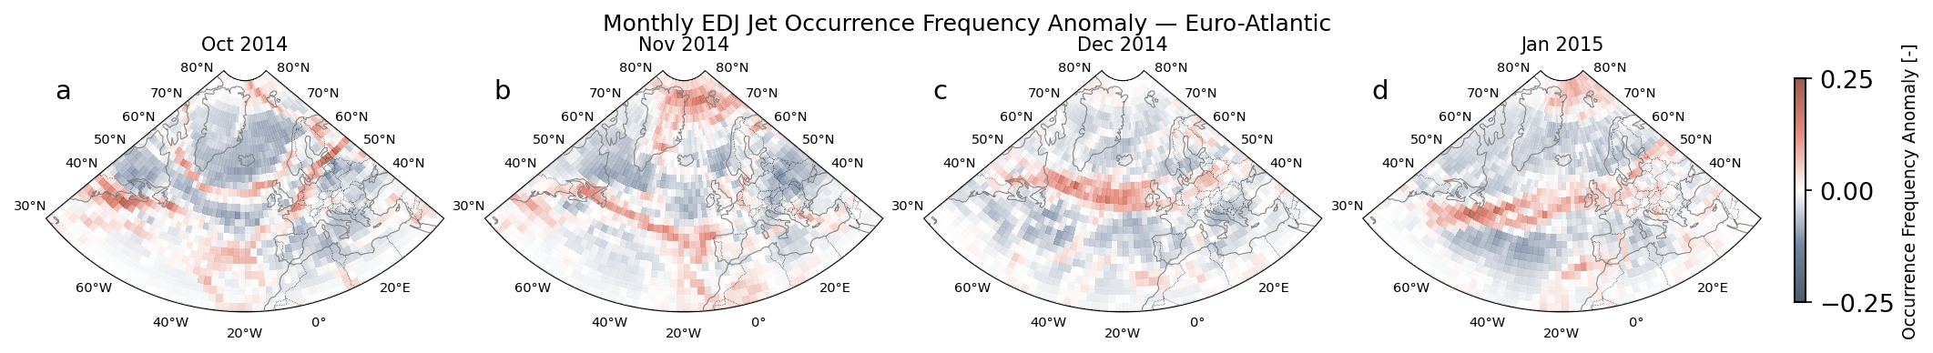
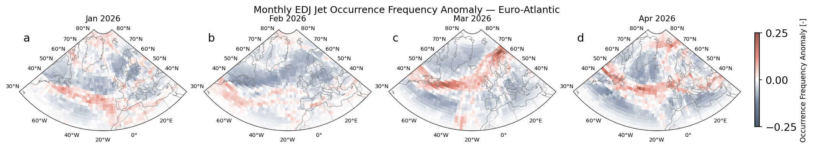
Monthly EDJ occurrence frequency anomaly over the Euro-Atlantic domain during the 2014/15 (top) and 2026 (bottom)

Slide 15
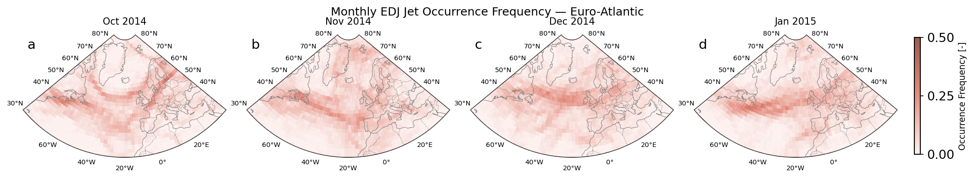
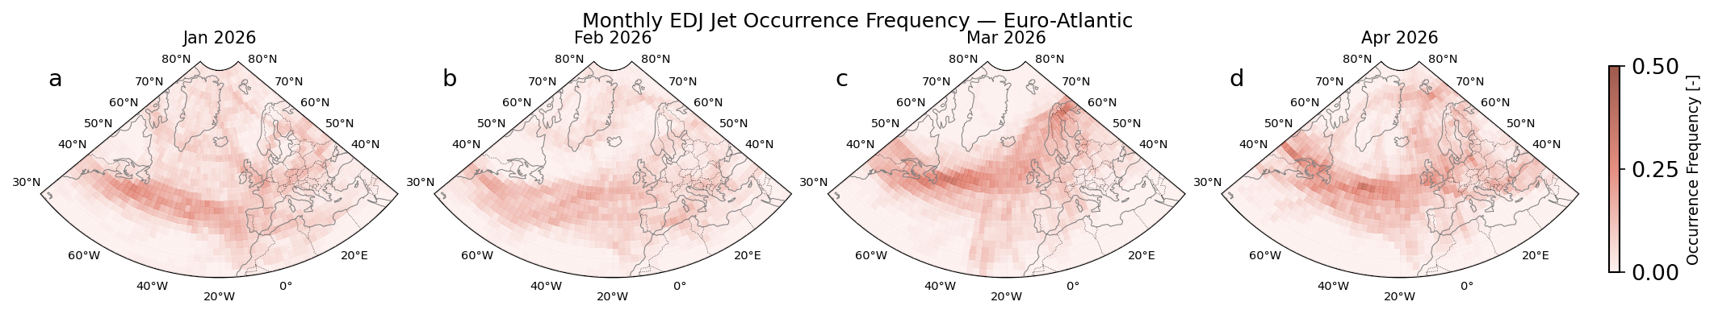
Monthly EDJ occurrence frequency over the Euro-Atlantic domain during the 2014/15 (topp) and 2026 (bottom)

Slide 16
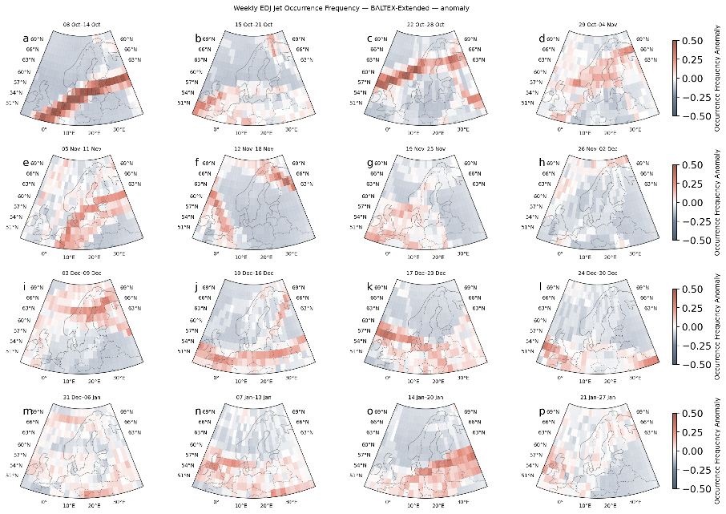
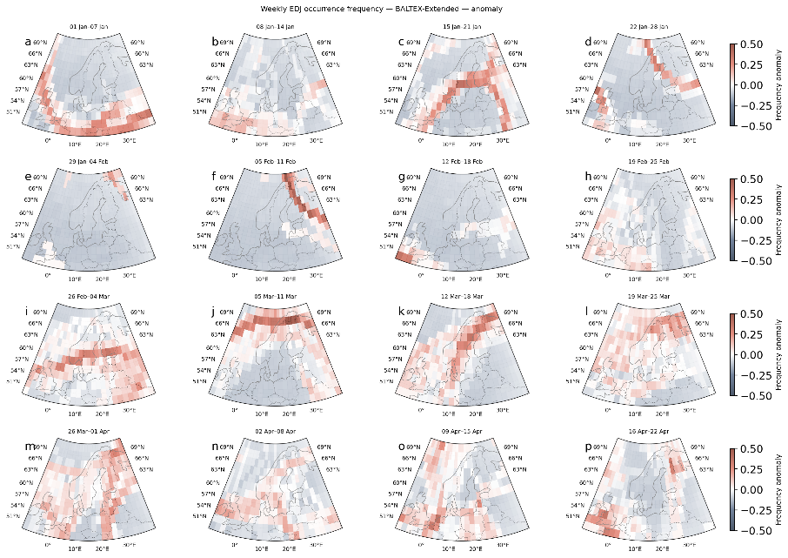
Weekly jet core occurrence frequency anomaly over the extended Baltic Sea catchment domain during the 2014/15 (left) and 2026 (right)

Slide 17
Conclusions
The beginning of the 2026 was very extraordinary from the side of synoptic scale atmospheric circulation.
Jet stream position and JCT classes show long blocking period =>
Over the central Baltic Sea anticyclonic type (AC) was prevailing, while over the Danish straits eastern flow (E)
The volume of the sea was extremely low, that prepares well for strong water inflow from the North Sea,
but the jet stream position did not support right westerly/cyclonic pattern
=> no MBI
Contact: piia.post@ut.ee

Slide 18




The work was partially funded by the project
“Implementation of national climate change adaptation activities in Estonia” (LIFE21-IPC-EE-LIFE-SIP AdaptEst/101069566), which is supported by the environmental projects’ co-funded programme LIFE of the Member States of the European Union, and the Estonian state from the revenues of trading greenhouse gas emission allowances. Neither the European Union nor the granting authorities are responsible for the accuracy and use of the information contained in the research.

