Slide 1
Evolving Systematic Errors in Precipitation Forecasts from ECMWF
Tim Hewson (ECMWF)
Fatima Pillosu (Reading University & Oxford University)

Slide 2
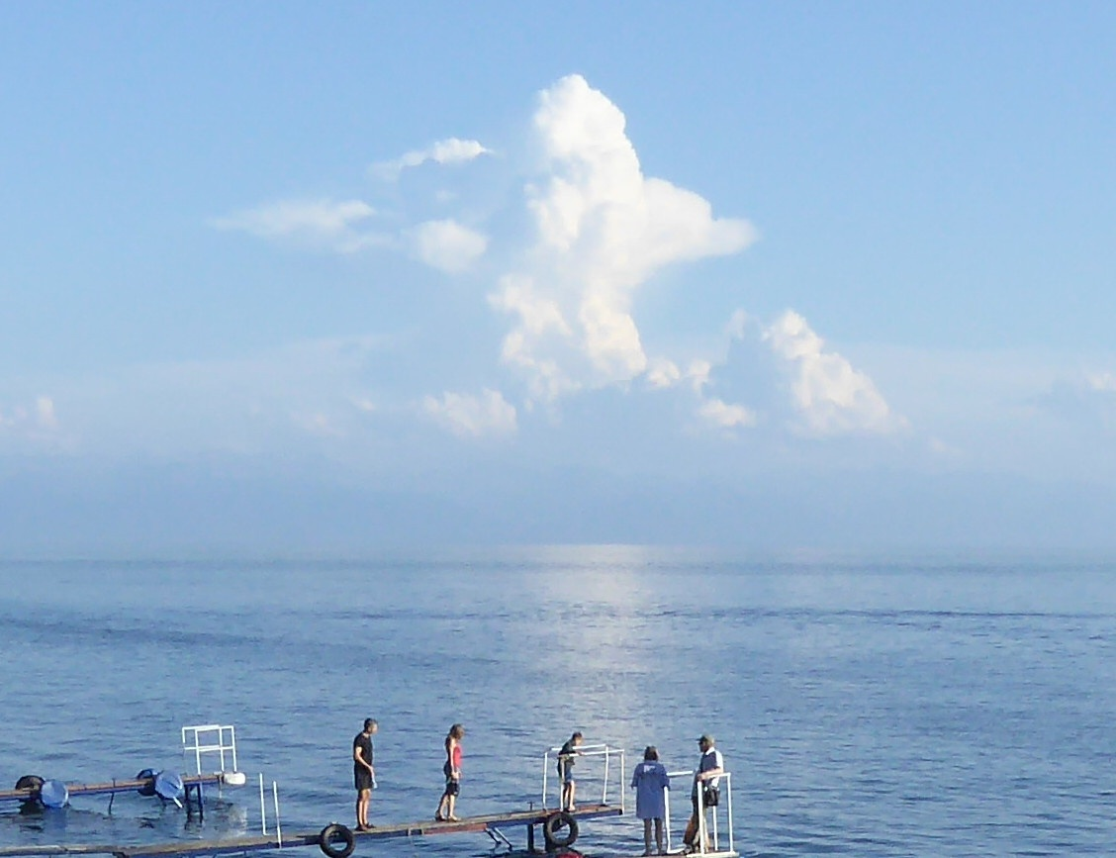
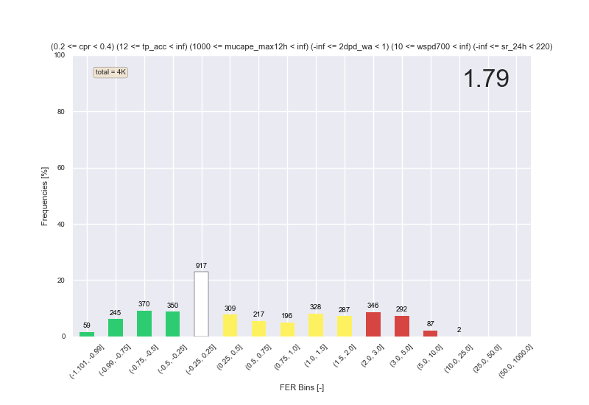
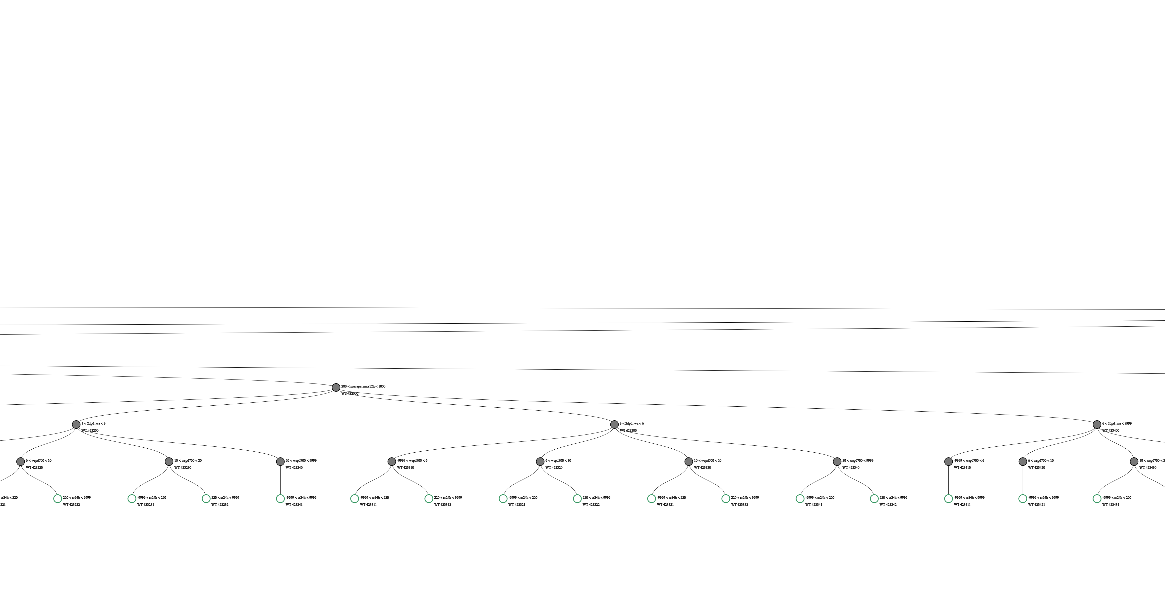
Main Objectives
To examine how systematic errors in the ECMWF IFS changed in 2026: cycle 50r1 replaced 49r1 on May 11th
  Involved substantial changes in the handling of convection, targeting long standing issues (upslope / coastal)
The analysis tool will be post-processing software (the ecPoint method)
Two modes of operation:
  Identifying situation-dependant biases (using calibration software)
  Using knowledge gained from 1 to effect changes to real-time forecasts (creating improved products for forecasting)
We will also use a problematic European convective case (11 May 2026) when the two model cycles ran in parallel, for illustration
Focal point of the case will be convection near mountains (marine convection has already had a good press!)

Slide 3
Outline
How has the physics changed in the convection scheme ?
What does the calibration software tell us about systematic biases in the new cycle, 50r1 ?
Case study
How do we improve the case study forecast by post-processing using knowledge from the calibration ?
    Vital role of transfer learning
How do bias-corrected gridbox forecasts verify against gauge-based observations ?
Product examples
Summary

Slide 4
1. Physics changes in 50r1

Slide 5
Schematic of SST-triggered convection
Cells move
Cloud/rain relatively static
Cloud relatively static
0ºC
Reality
49r1
50r1

Slide 6
Schematic of topographic triggering/augmentation of convection
Cells move
Cloud/rain relatively static
Cloud relatively static
0ºC
Reality
49r1
50r1

Slide 7
2. Systematic Biases in 50r1

Slide 8
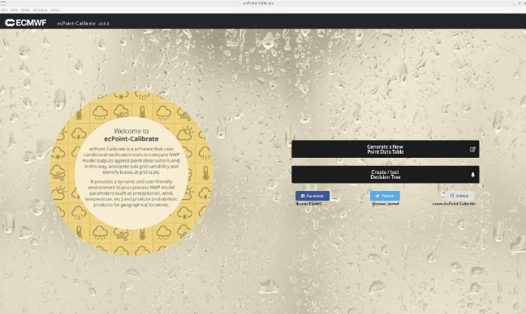
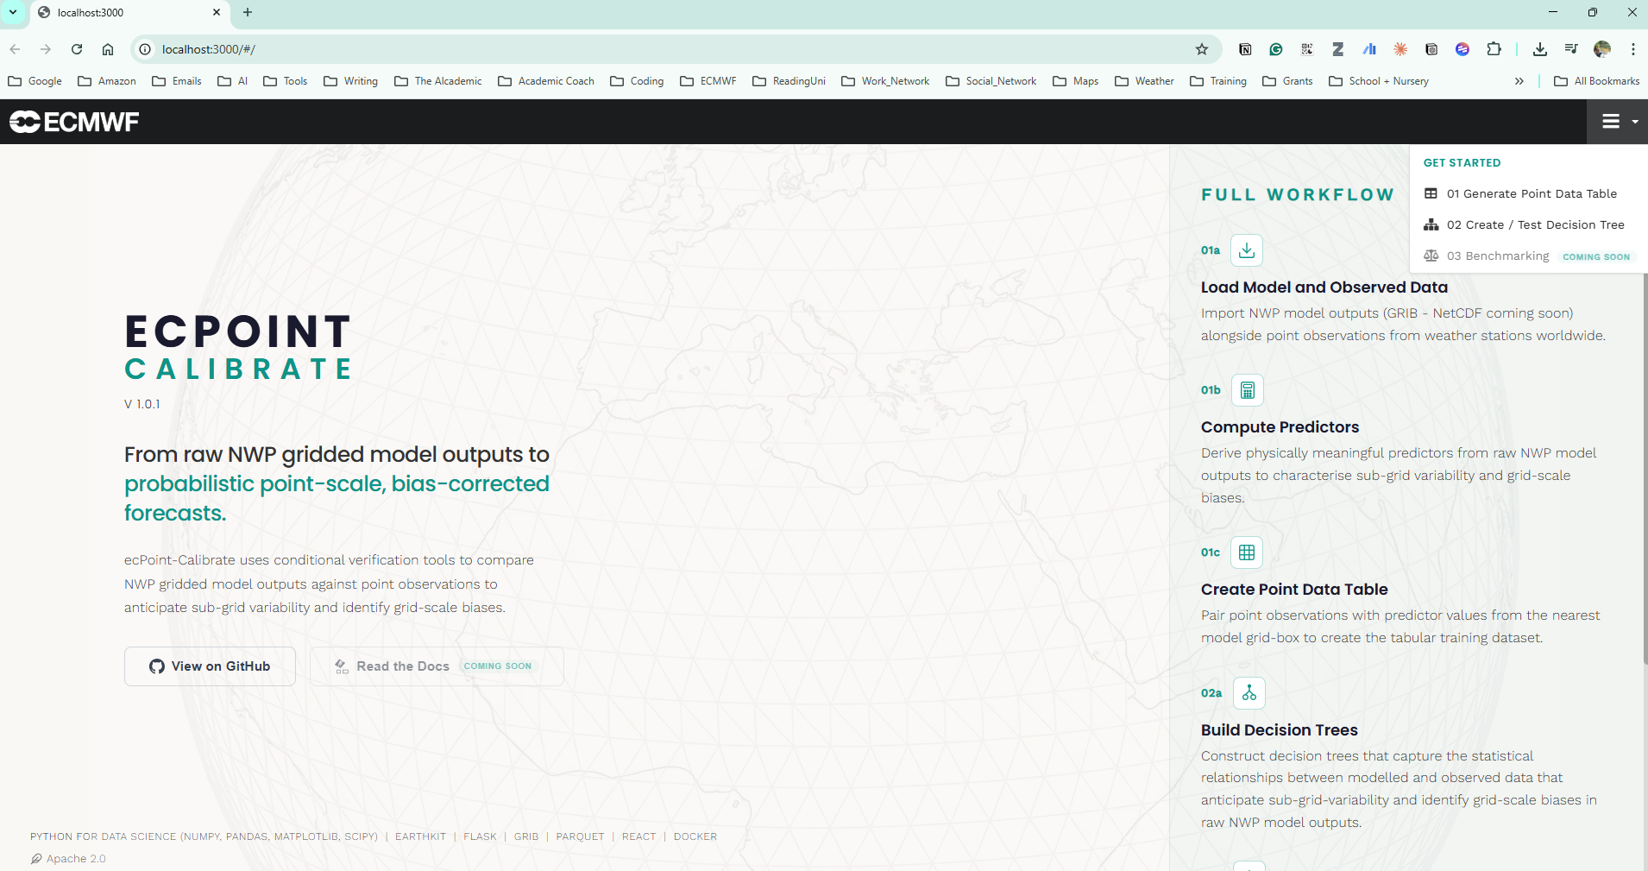
Agentic AI used to upgrade calibration tool (a few months ago)
https://github.com/FatimaPillosu/ecpoint-calibrate
Made the following analysis much more tractable!
SCALE
TOKEN USAGE (total ~ 1 million)
11
256
60k
21
8+10
days
User prompts
Lines of code by Claude
commits
features + fixes
Context replay 60%
Understanding the code 20%
Code fixing 15%
Code gen. 5%
TOOLS
COST COMPARISON
Claude Code
(Opus 4.6)
Whisper
Gemini 2.5 Flash
GitHub
£90
£250
£15,000
Code generation
& debugging
Voice-to-text
Inputs for higher speed
In-app AI-based dynamic conditional verification plots
“Claude Max”
subscription/month
(flat rate)
“Pay-as-you-go” estimated API cost
(for Opus 4.6)
Estimate for UK contractor for 11 full working days
Version control
& CI/CD
Overall summary, cost, and lessons learnt

Slide 9
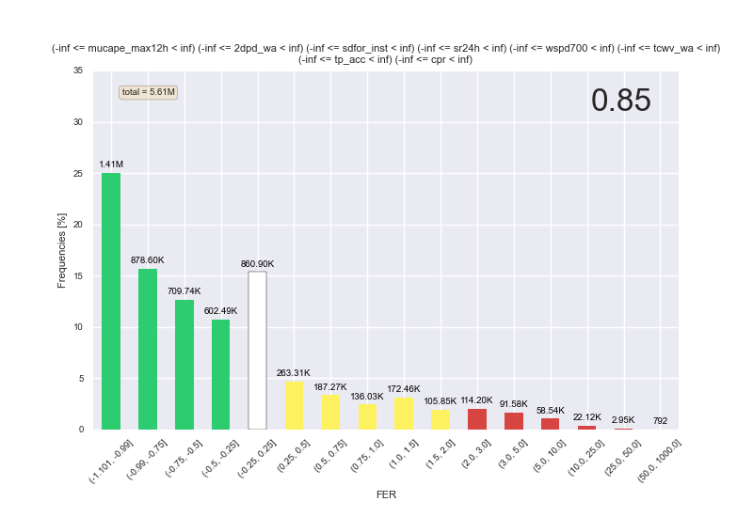
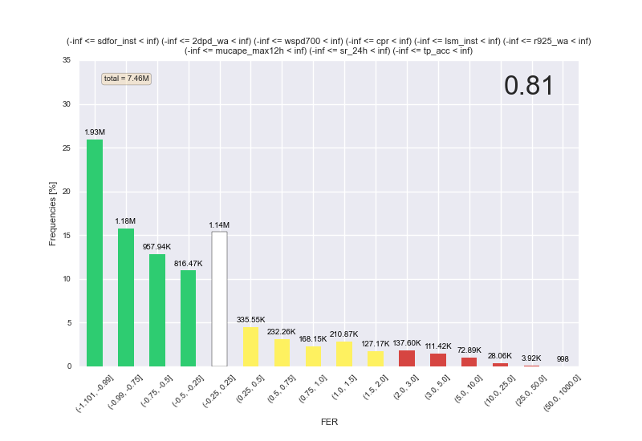
Calibration output => Mapping Functions
Mapping Functions Explained
(Average FER) + 1 = a measure of bias
ecPoint learns from a 1-year calibration period
50r1 short range control forecasts are compared with raingauge obs
FER (forecast error ratio) = (O/F) -1 for each ob
Histograms show FER frequency in 1 year:
Green = over-prediction
White = OK
Yellow = under-predicton
Red = big under-prediction
50r1
49r1
ALL CASES
(millions)

Slide 10
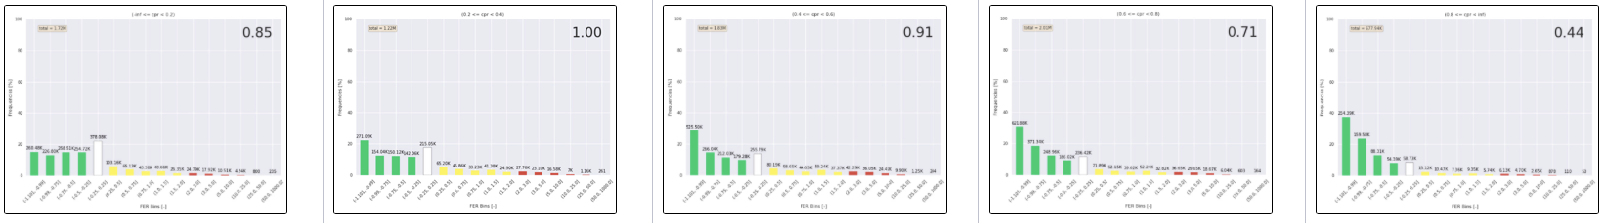
Cases subdivided by ”Values of Governing Variables” (in forecasts) – examples:
Total precipitation forecast: larger
Convective precipitation ratio (cp/tp): larger
Dewpoint depression: larger

Slide 11
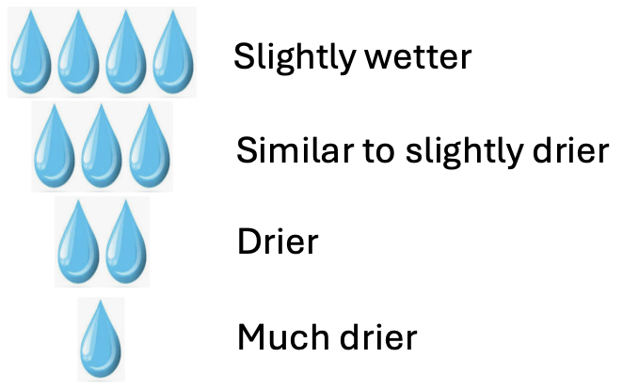

Results from ecPoint Calibration
How does observed rainfall compare with forecast?
In 50r1 a strong dependance on “weather type” has been identified, for bias (and for sub-grid variability)
Components of a “weather type”
 | Convective ppn ratio = (cp/tp) | Total precipitation forecast | Max MUCAPE | 2m dewpoint depression | Local solar time | 700mb wind speed | Clear sky direct solar radn
Large
Small
12-24
0-12
Multi-factor dependencies tend to be rather linear !
11

Slide 12
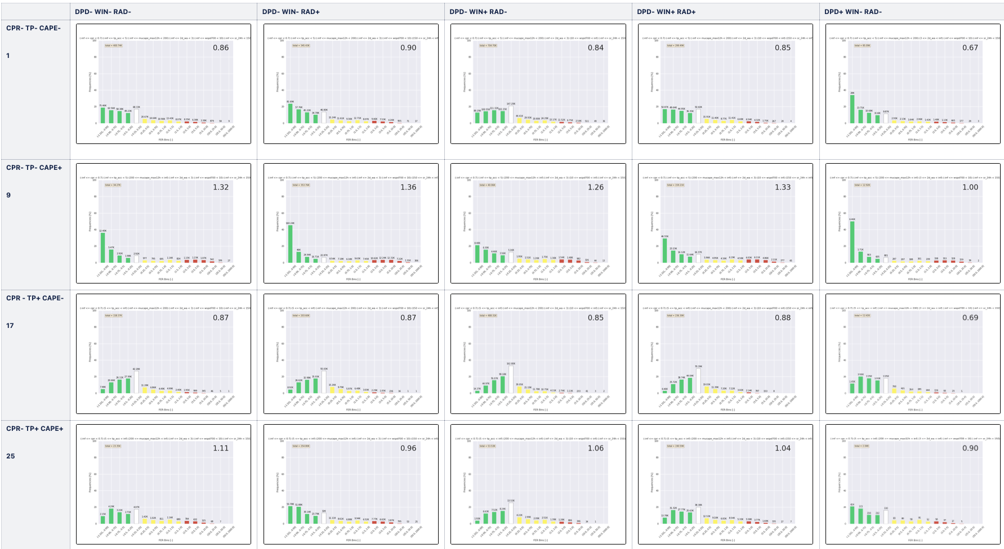
Multi-factor dependance also examined… (basis for post-processing decision tree)
Bias correction multipliers range from about
0.2 to 3.0
This is a BIG range!
There is still work to do with the physics, and similarly there is lots we can correct for now!
Mostly large scale rainfall
Small values of total precipitation
Large CAPE
Small dewpoint depression
Light winds
Summer solar radiation

Slide 13
3. Case Study overview

Slide 14
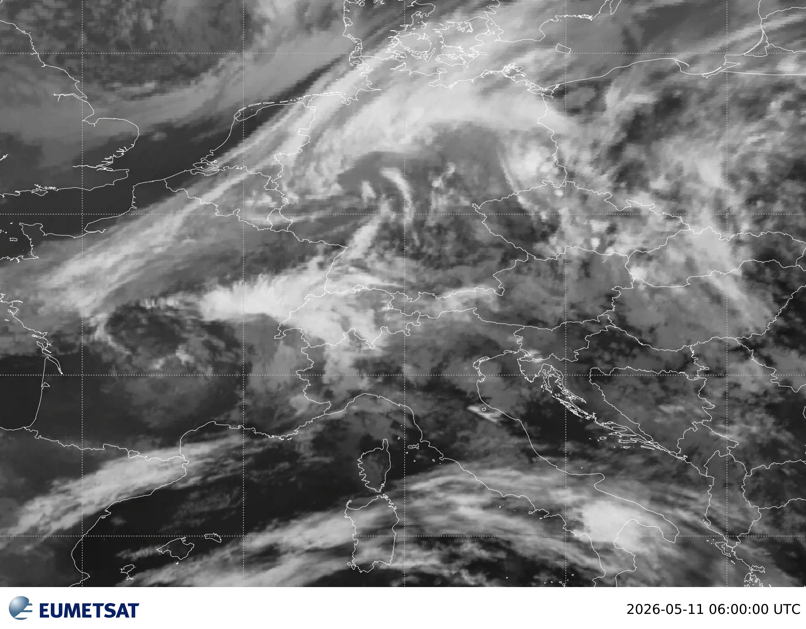
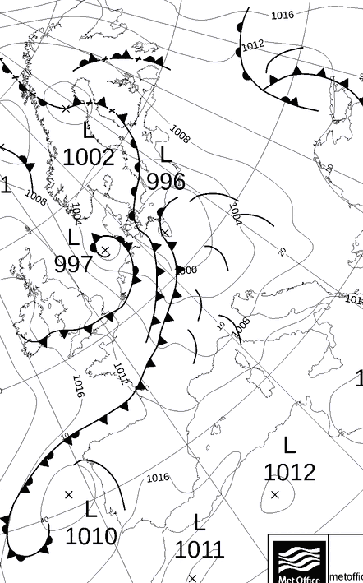
Synoptic Overview of 11 May case
Convective activity in warm sector
12UTC 11 May 2026
6-18 UTC

Slide 15
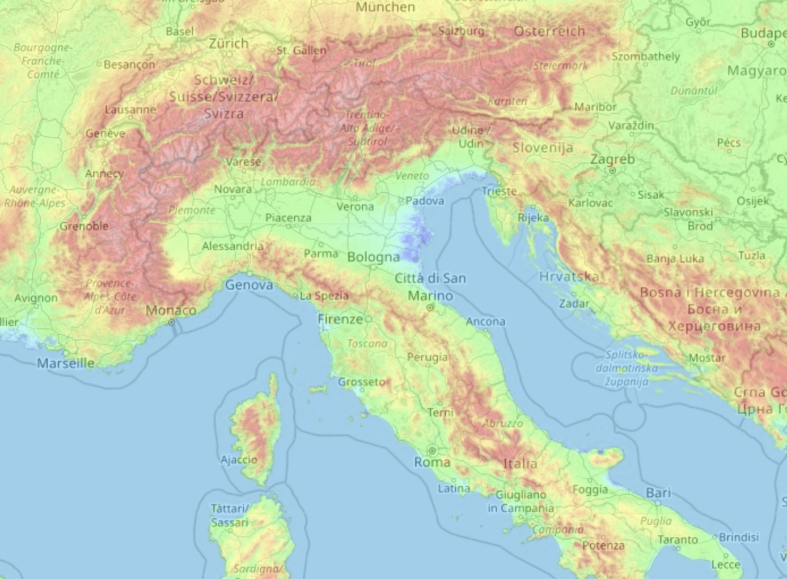
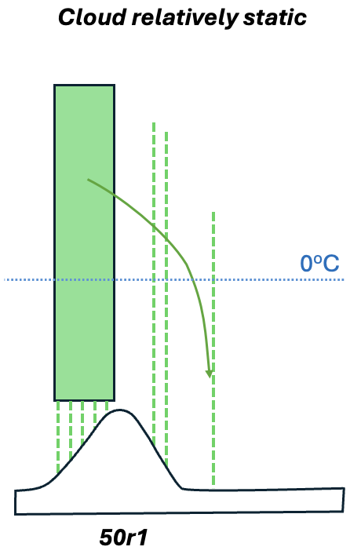
Some locations where the mountain scenario might be witnessed in potentially unstable W to SW flow

Slide 16
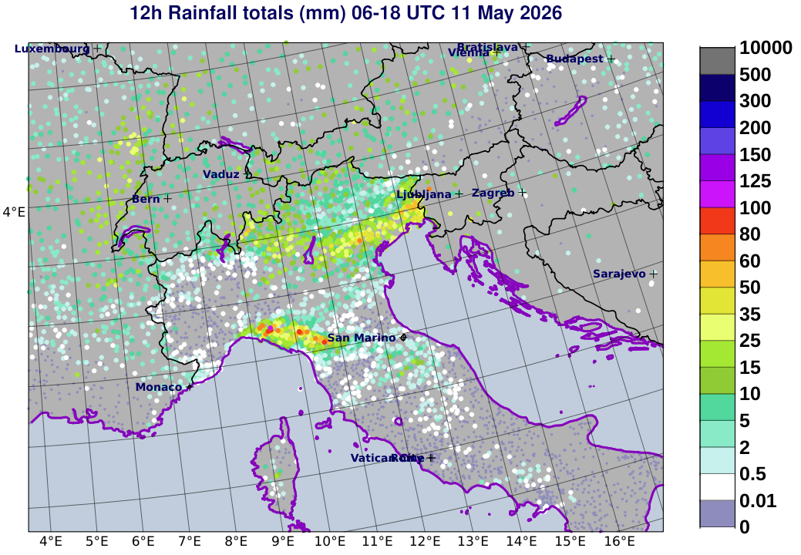
Rainfall
Convective activity in warm sector
12UTC 11 May 2026

Slide 17
4. Post-processed forecasts for the case
Tool to show where and how the many different systematic biases are playing out

Slide 18
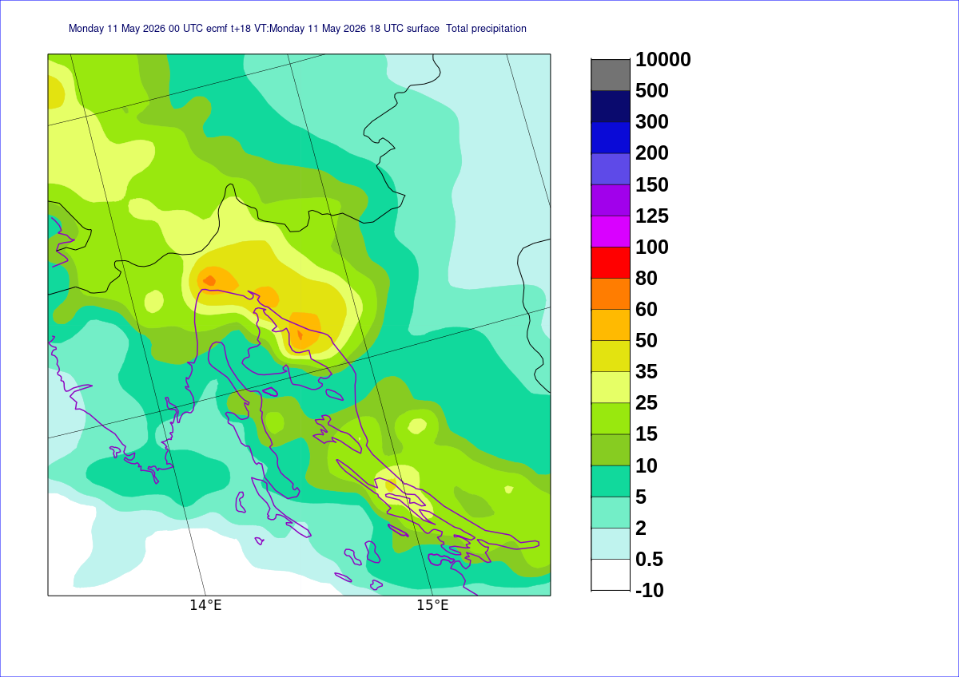
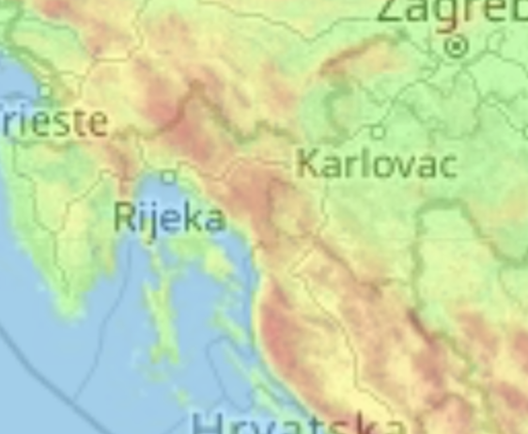
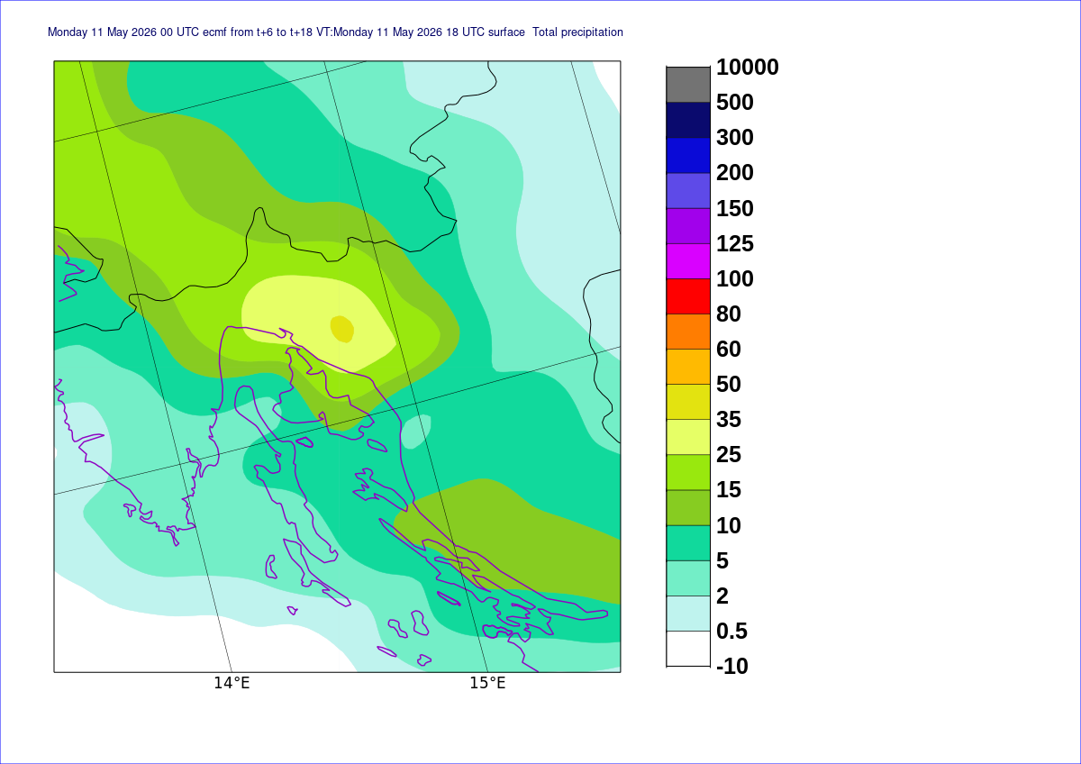
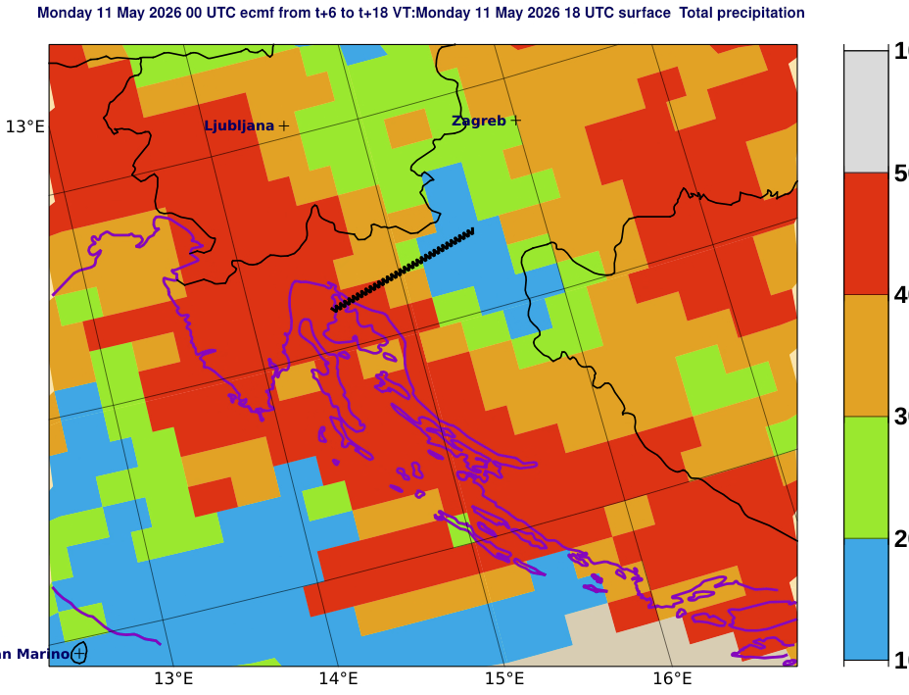
Focus on Control Forecast for DT 00Z 11 May case – 12h rainfall – T+6-18
ecPoint
bias-corrected
Krk
Raw Model (50r1)
Weather Types – mainly convective to mainly large scale
Consider cross section line
Why the difference?

Slide 19
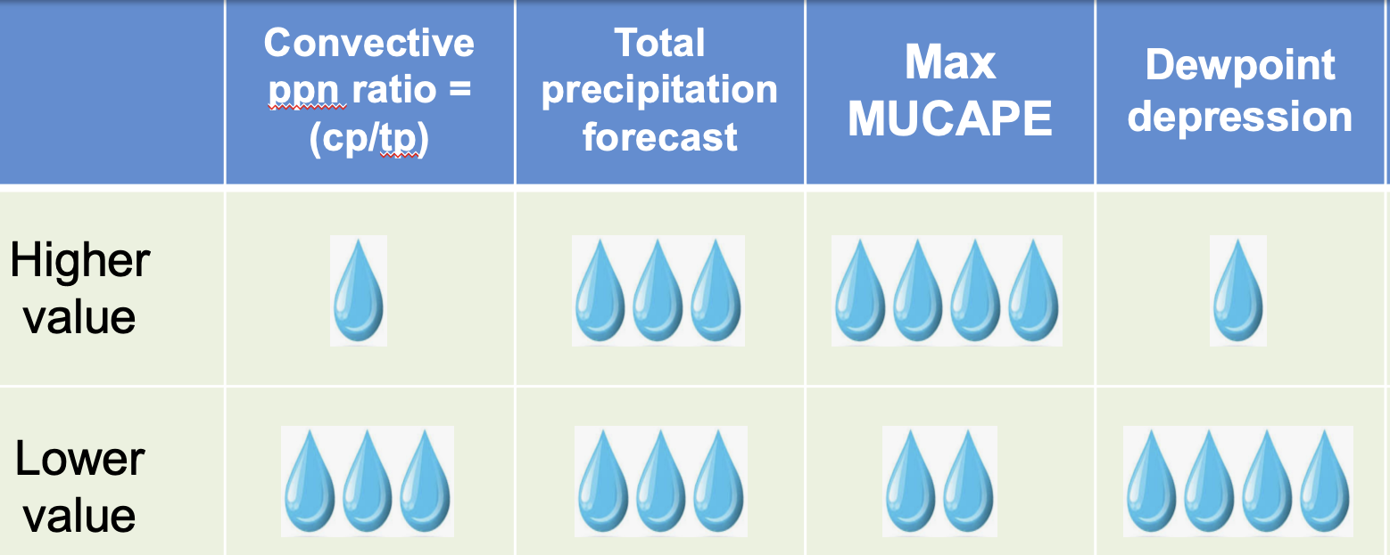
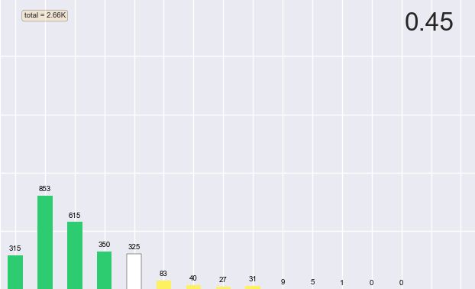
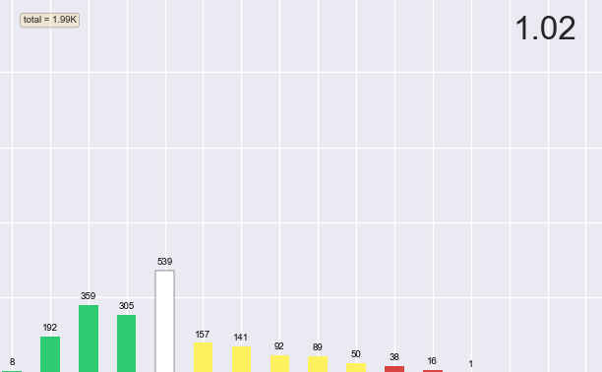
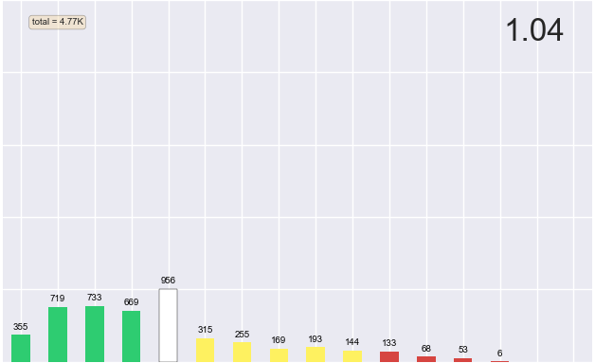
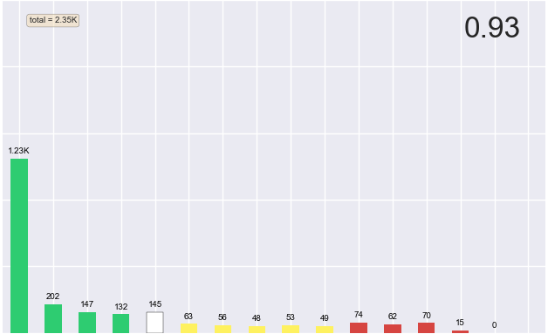
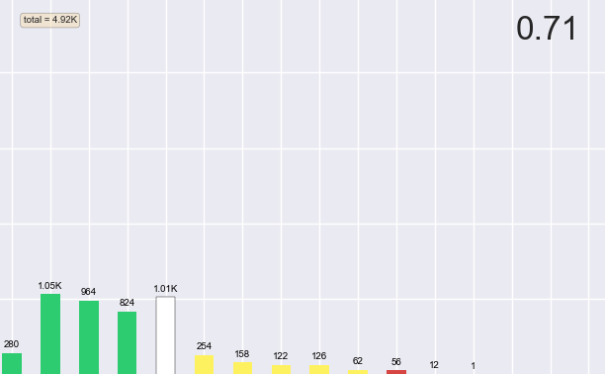
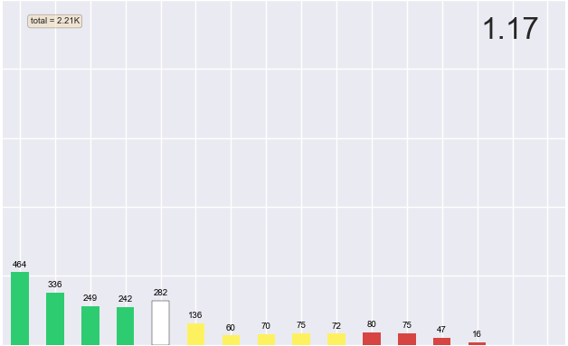
50r1 baseline bias correction = 0.81

Slide 20
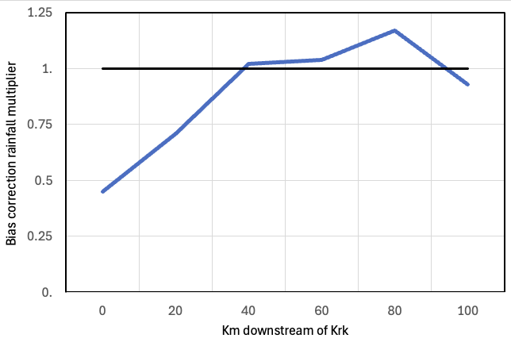
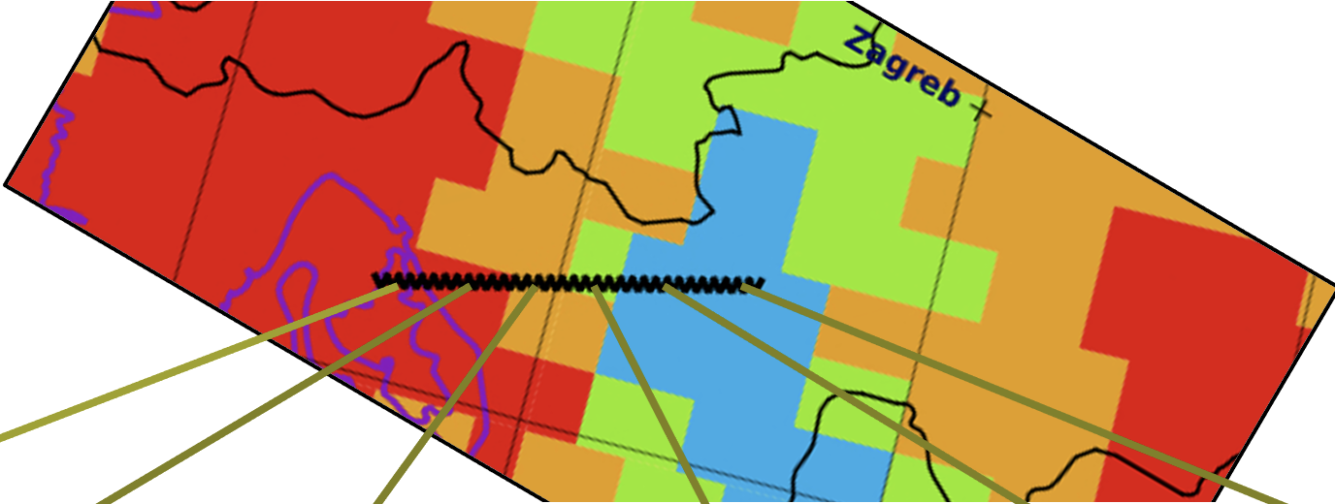
Impact of the bias correction component of ecPoint
This rainfall total modulation curve shifts the raw model rainfall signal downstream across mountains
This is mainly a function of:
Downward then upward trend in dewpoint depression downstream
A change from mainly convective to mainly large-scale precipitation downstream
And in turn this is because model gridscale biases are heavily dependant on these factors
50r1 baseline bias correction = 0.81
Krk

Slide 21
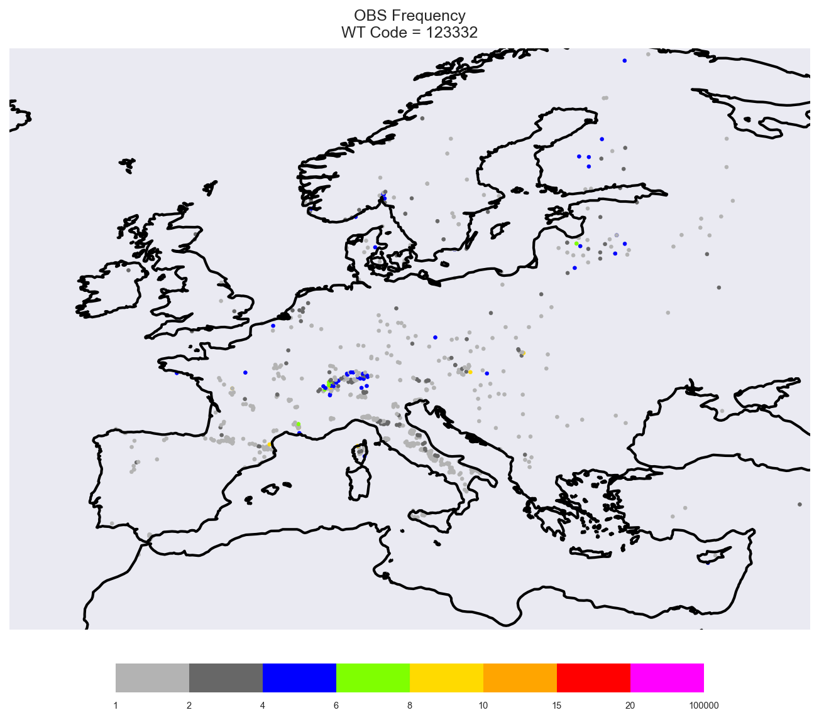
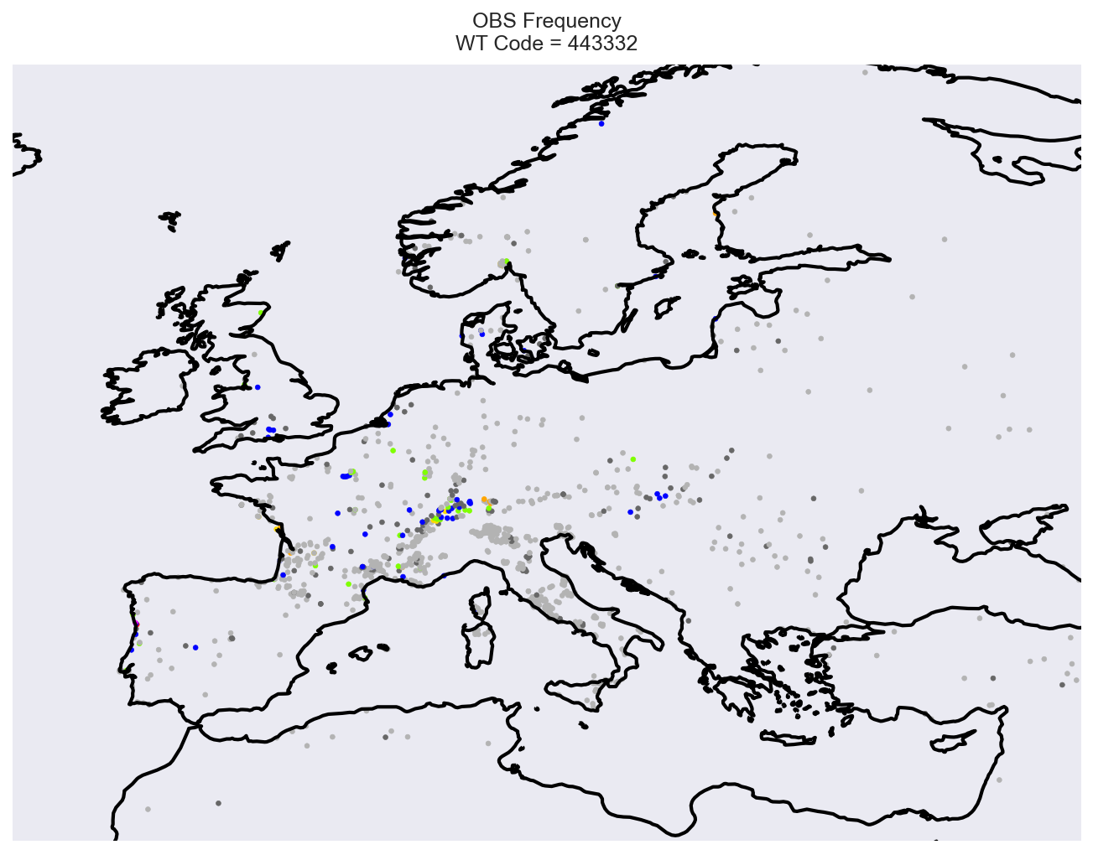
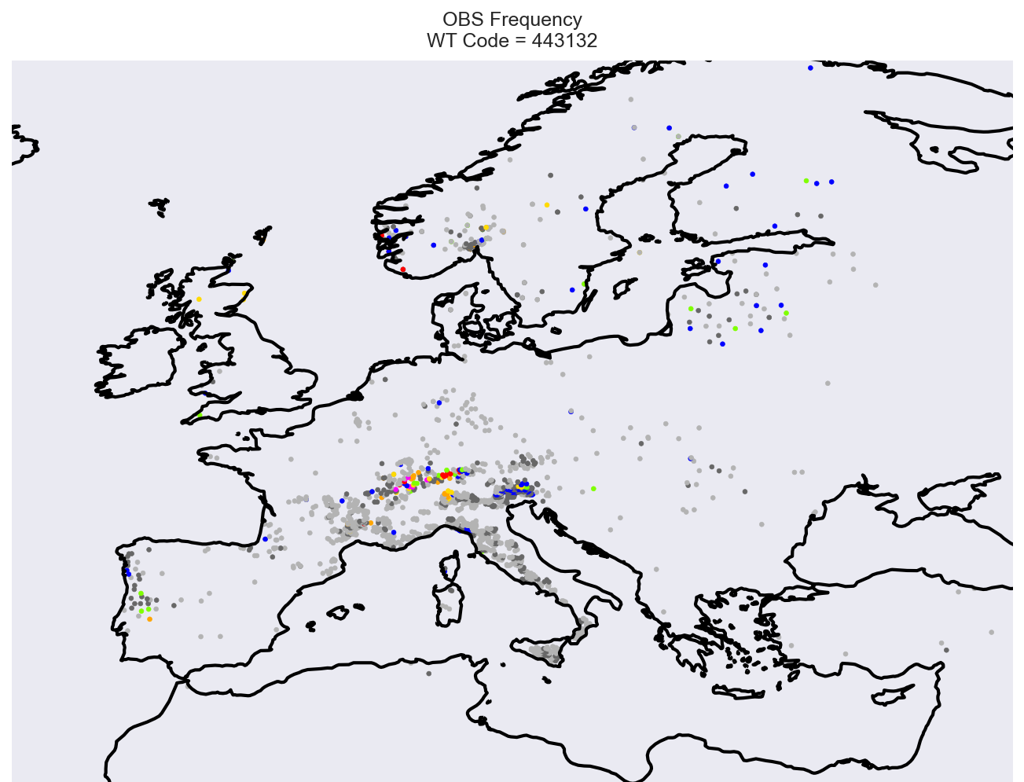
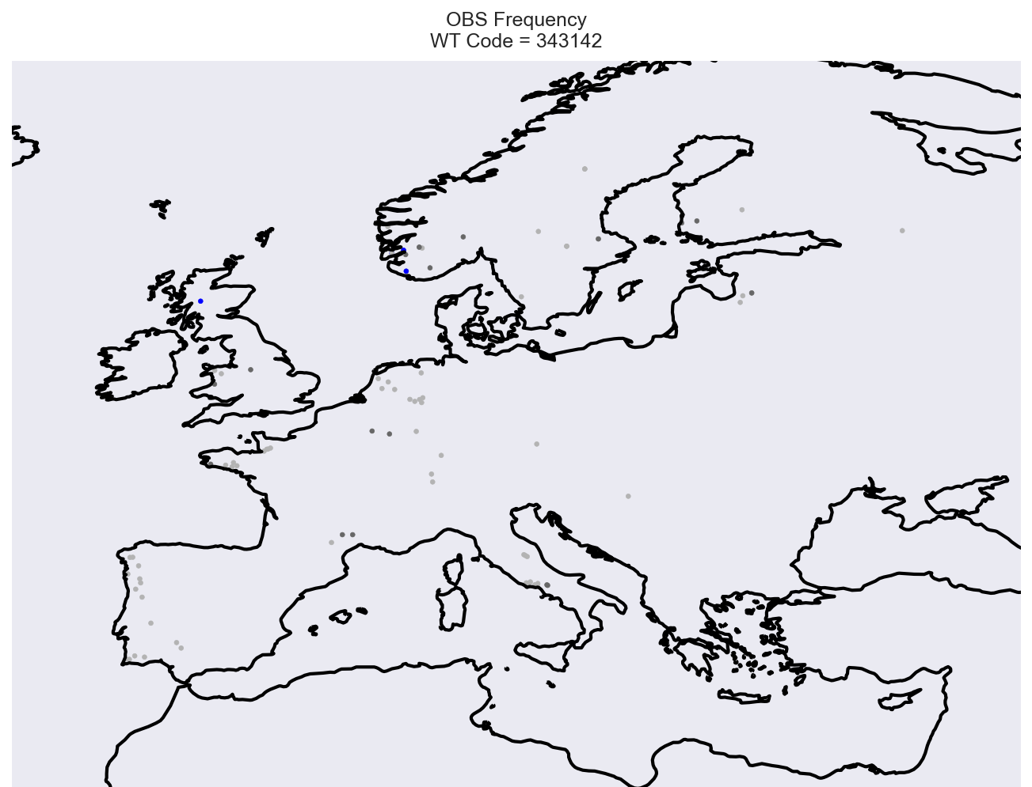
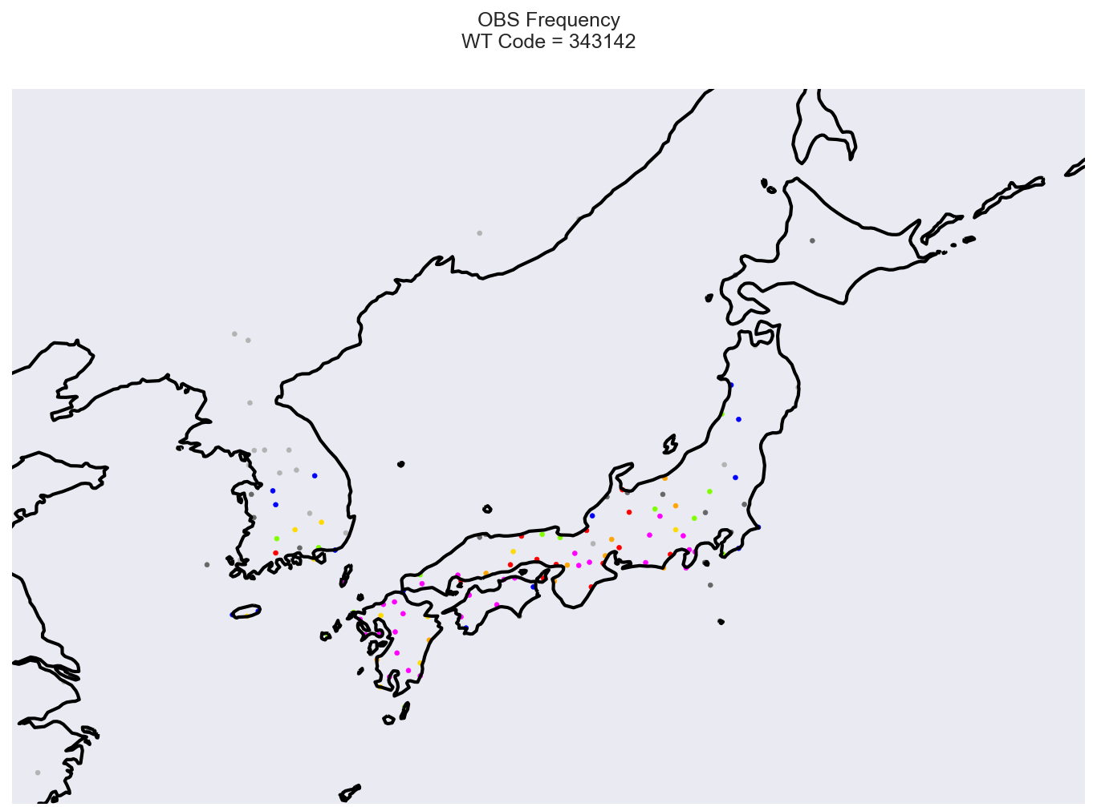
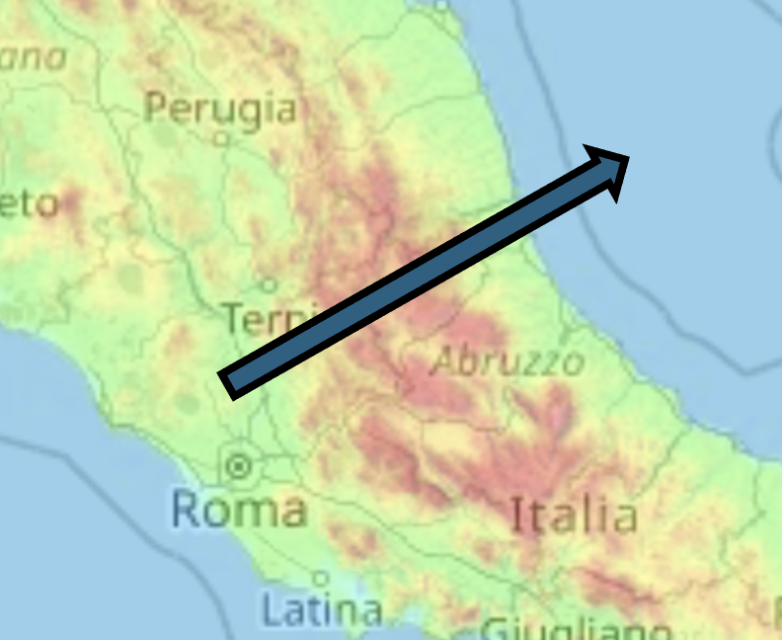
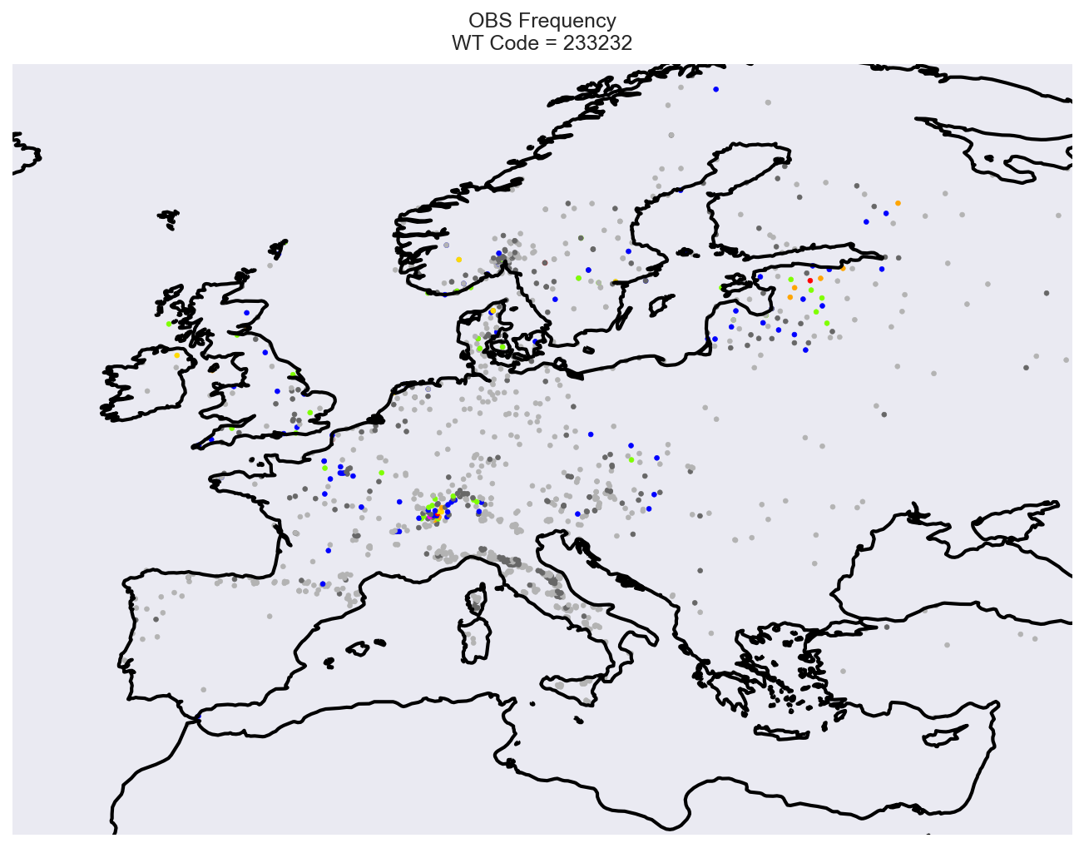
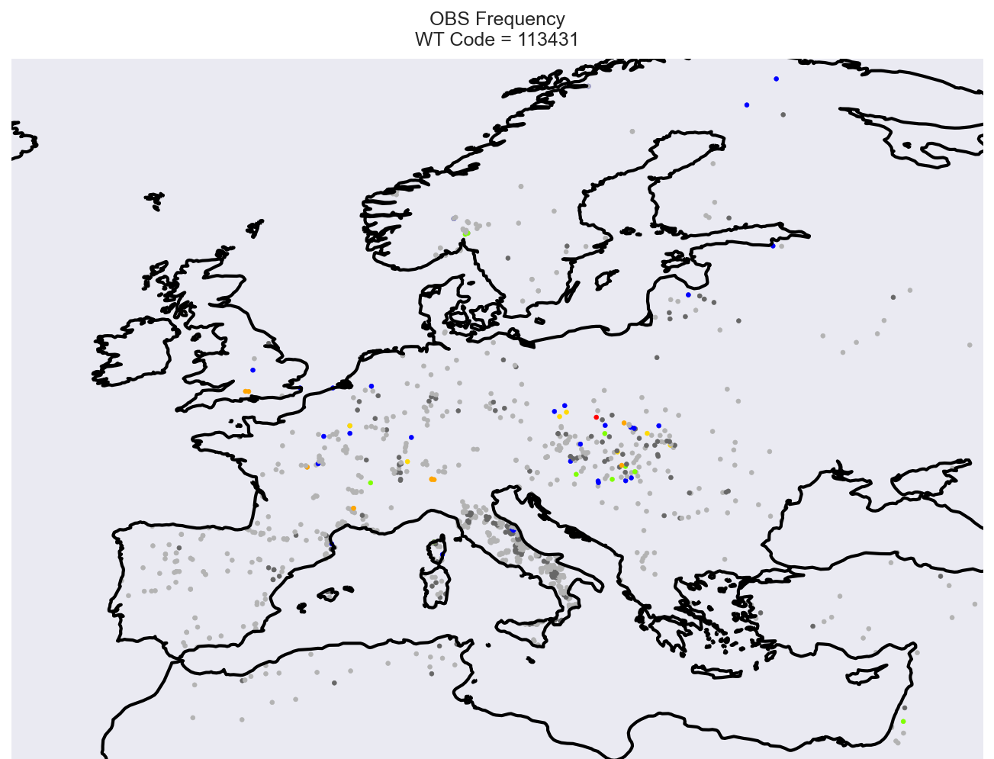
Where did the training data come from (in Europe)?
Frequency of site usage for the 6 cited weather types:
1 2 3 4 5 6
1
2
3
4
5
6

Slide 22
Features to note from calibration data source regions
There is strong evidence of ‘transferred learning’ where the remote calibration seems to pick up on similar scenarios in high CAPE, strong flow situations across the Appenines, from the upwind on to the downwind side, and use this for the Croatia predictions in this case
Small dewpoint depression scenario learnt from Alpine areas in particular (+ Japan)
An absence of high dewpoint depression cases over the Alps, when CAPE is high, presumably relates to disproportionately high moisture fluxes in complex topography (snowmelt etc) quelling that possibility

Slide 23
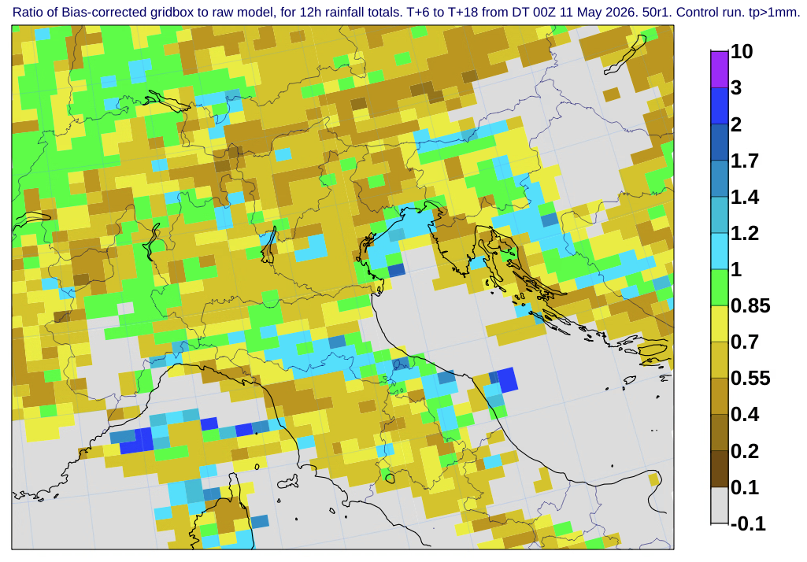
Bias-correction multiplying factors applied in this case
Control run

Slide 24
5. Verification

Slide 25
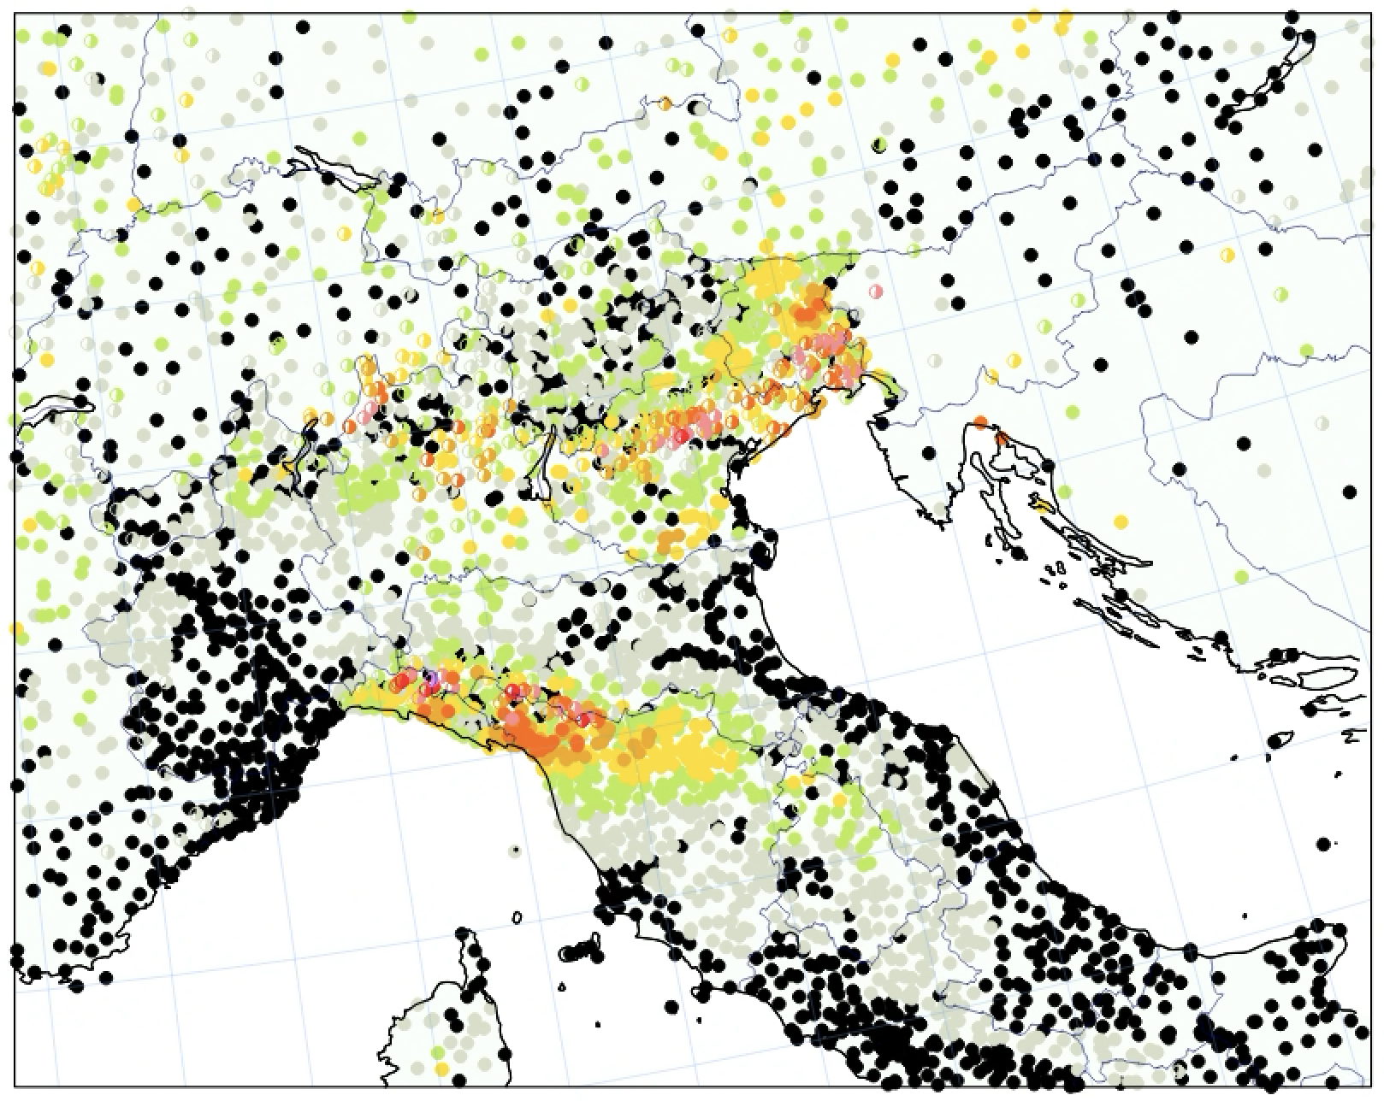
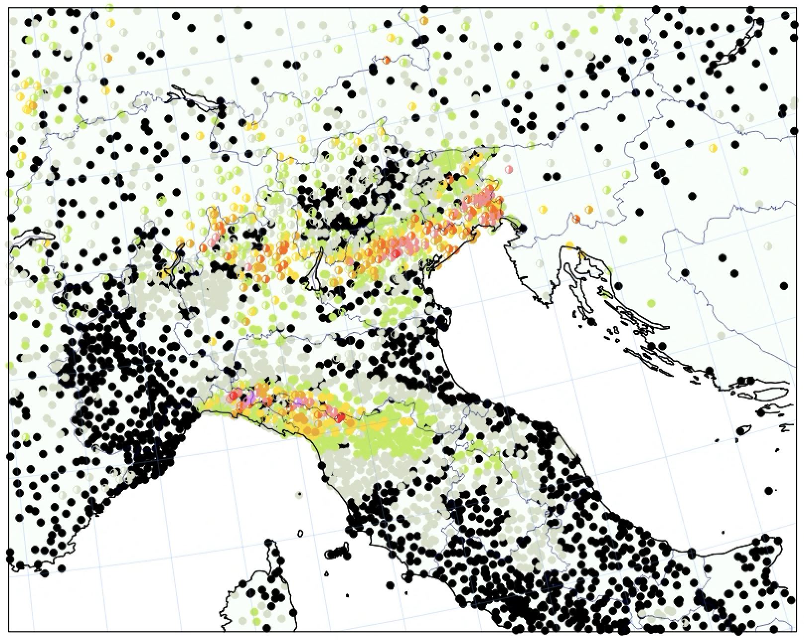
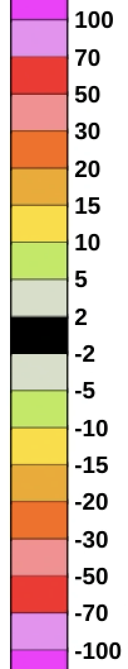
Control run 12h rainfall forecast verified – forecast errors in mm
Case study
T+6-18
Half circles for underprediction
Full circles for overprediction
Black full => errors <2mm
The forecast with ecPoint gridscale bias-correction is
VISIBLY better
RAW MODEL
BIAS-CORRECTED

Slide 26
And more generally, across the world, many more cases…?

Slide 27
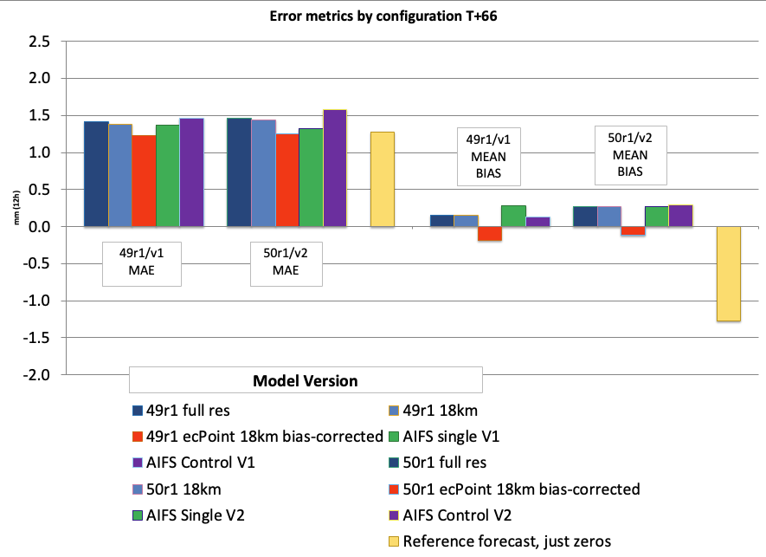
Verification for when 49r1 and 50r1 were running in parallel
6 days May 2026
12 runs
About 300,000 obs
QC applied to obs
Day 3 forecasts
“Deterministic” runs
ecPoint better than alternatives
More “value added” in 50r1 than in 49r1

Slide 28
6. (New) Product Examples

Slide 29
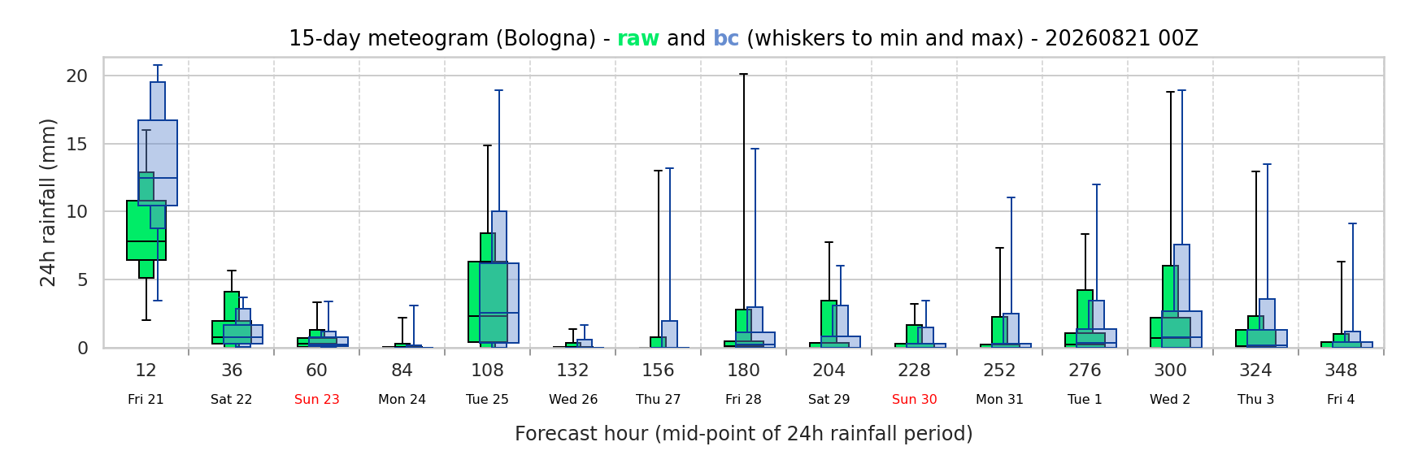
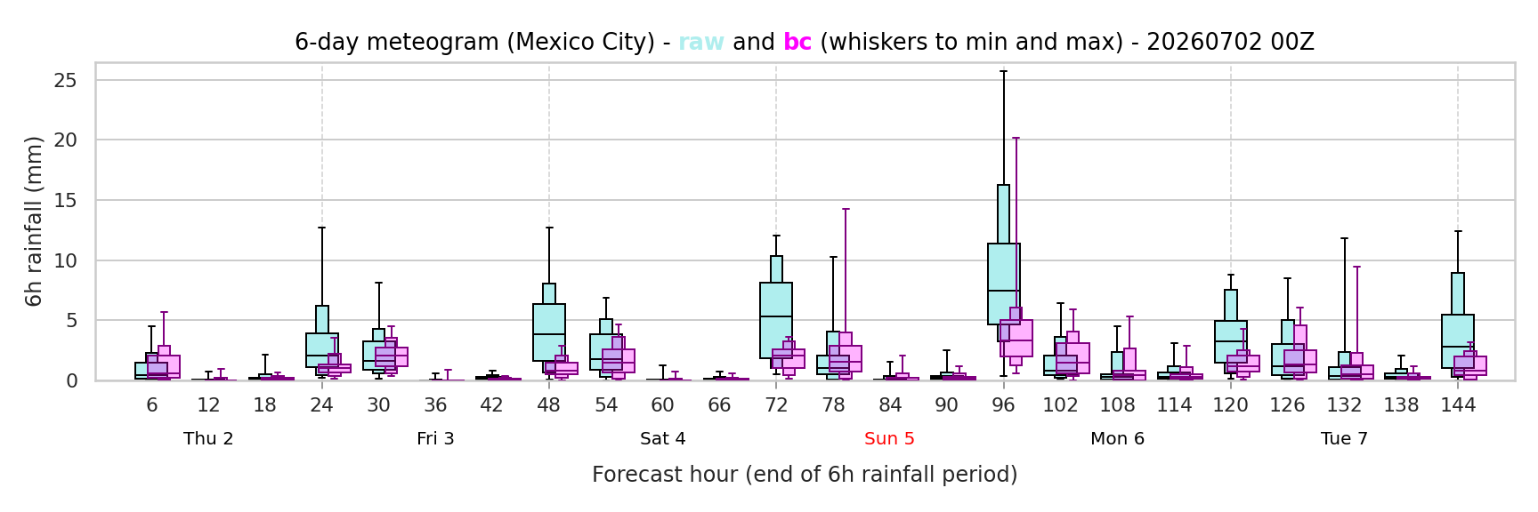
Bologna (24-h) raw bias-corrected
Mexico City (6-h)
raw bias-corrected

Slide 30
7. Summary

Slide 31
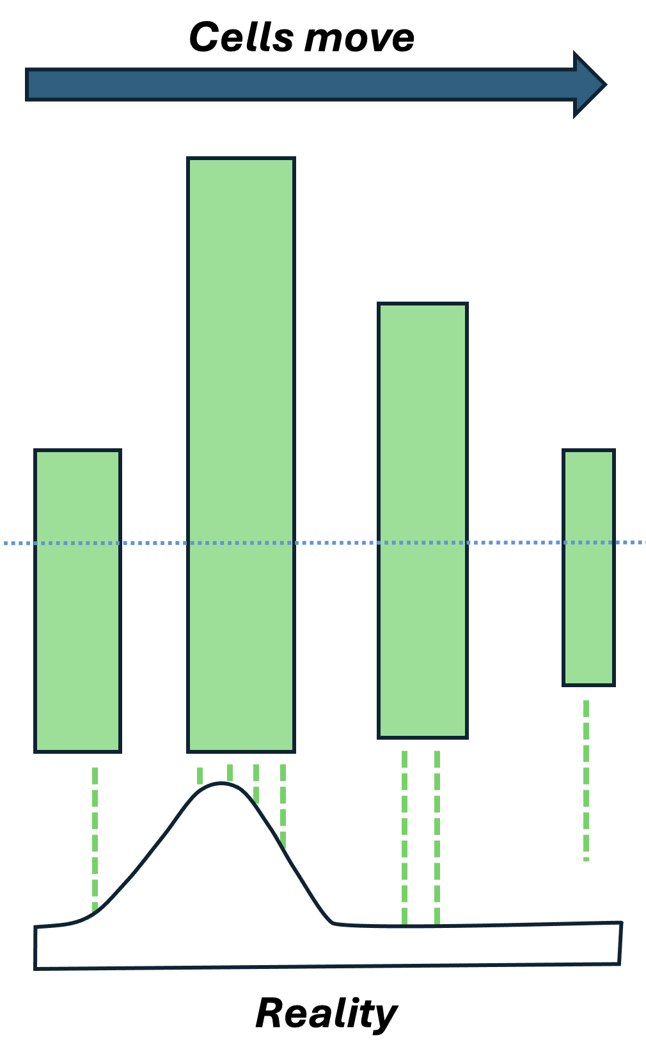
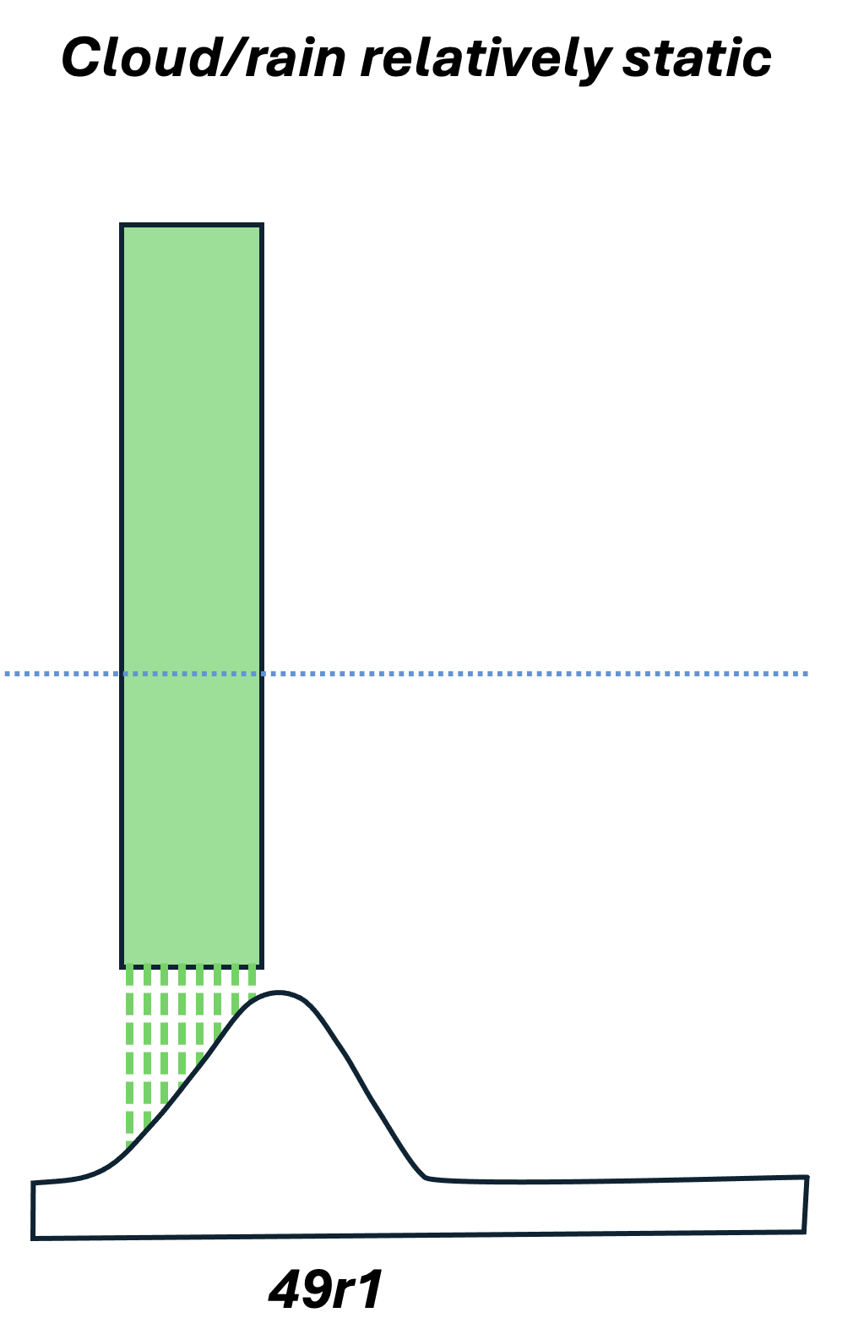
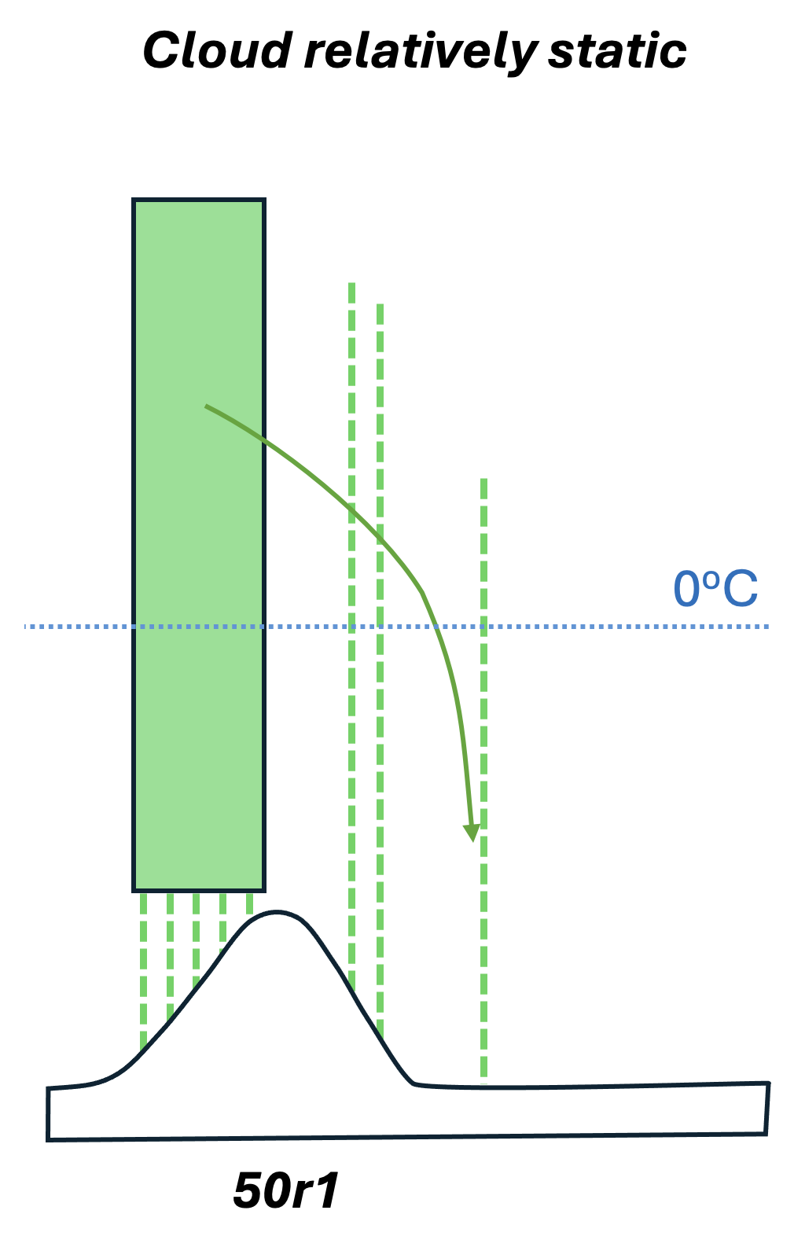
Summary
Physics changes in IFS cycle 50r1 push surface-triggered convective rainfall downstream of coasts, and mountain upslopes. This is more realistic, and is exemplified in a European heavy rainfall case from May 2026.
Large biases can still exist however, especially on the windward side (strong over-prediction)
ecPoint exhibits value in correcting for these persisting gridscale errors, transferring learning from disparate sites around the world, correctly shifting the rainfall downstream
Topographic influence can be captured by ecPoint without explicit reference to the topography: dewpoint depression is a convenient proxy (smaller high up)
New-style ecPoint meteograms are attractive to users and have great predictive potential
ecPoint is also very successful in representing different levels of sub-grid variability, not discussed today
Hewson, T.D., Pillosu, F.M. A low-cost post-processing technique improves weather forecasts around the world (2021). Commun Earth Environ 2, 132 (2021). https://doi.org/10.1038/s43247-021-00185-9
Pillosu, Fatima M.; Hewson, Timothy D.; Gascón, Estíbaliz; Vučković, Milana; Prudhomme, Christel ; Cloke, Hannah. 2026 Bridging the scale gap: enhancing point-scale rainfall estimates by post-processing ERA5. Bulletin of the American Meteorological Society. 10.1175/BAMS-D-25-0019.1

Slide 32
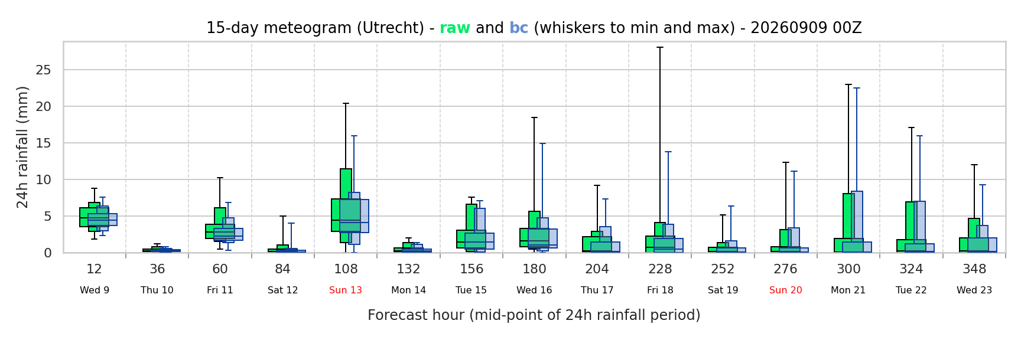
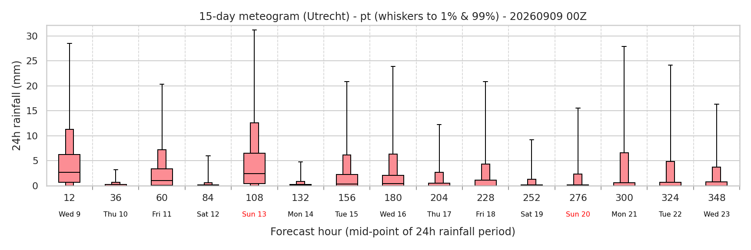
Utrecht forecasts from 00Z Wed raw bias-corrected (gridscale) point scale

