Slide 1


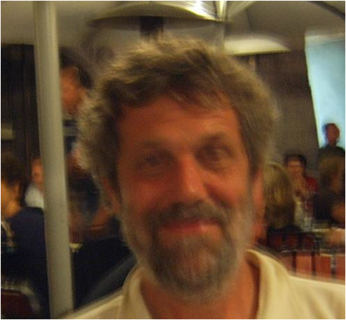
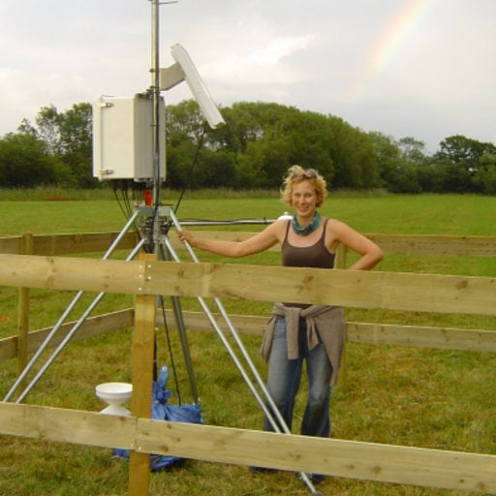
EMS record? Authors are 60 and 83 years old = 143 together
On how BSRN data reveal poorly understood features of
land-atmosphere interaction during the morning transition.
Yarnton mead floodplain
Near Oxford, 2012
EMS 2006
Henk de Bruin¹ and Anne Verhoef²
¹Meteorology and Air Quality Group, Wageningen University (emeritus)
²Department of Geography and Environmental Science, The University of Reading, Reading, UK

Slide 2
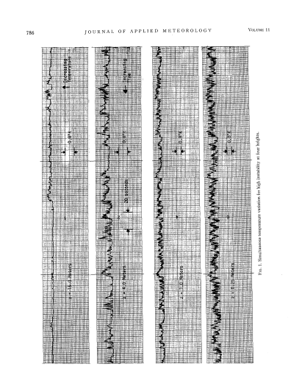
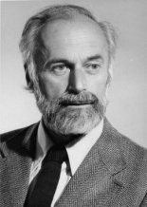

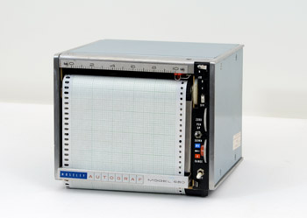
Tillman, 1972
J.B (1935-2024)
J.T. (1933-2023)
15 m
0.25 m
The mentors, Joost Businger and Jim Tillman taught HdB:
Plot experimental data and ask questions and try to find an answer or application

Slide 3

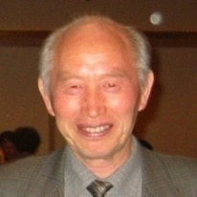

Example of a successful case
Flux-variance method
15 m
0.25 m

Slide 4
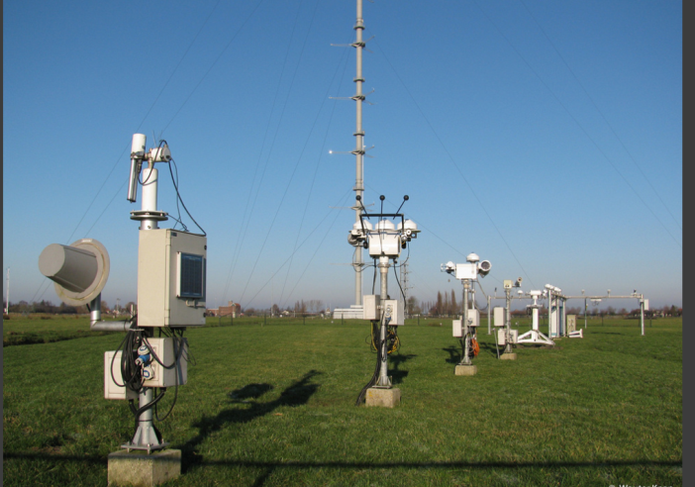
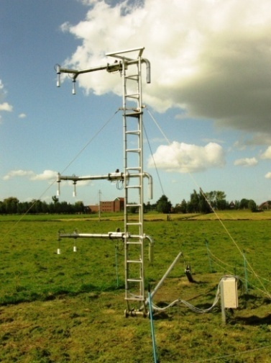
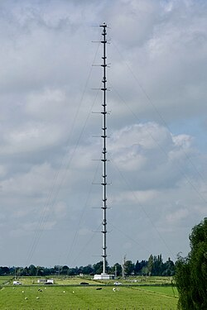
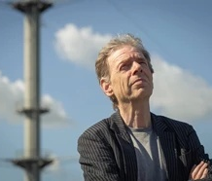



As a tribute to Cabauw Ruisdael Observatory data base of 50 years, we plotted
Cabauw data of BSRN incoming longwave radiation (LWD), air temperatures and humidity
BSRN Cabauw
Wouter Knap
A
B
C
Fred Bosveld
Psychrometer mast
Mariska Koning
Also a tribute to others like Jens Bange and Frank Beyrich (Assman Obs.) for their innovative and continuous experimental work
Un. of Tübingen
EMS Award 2021

Slide 5

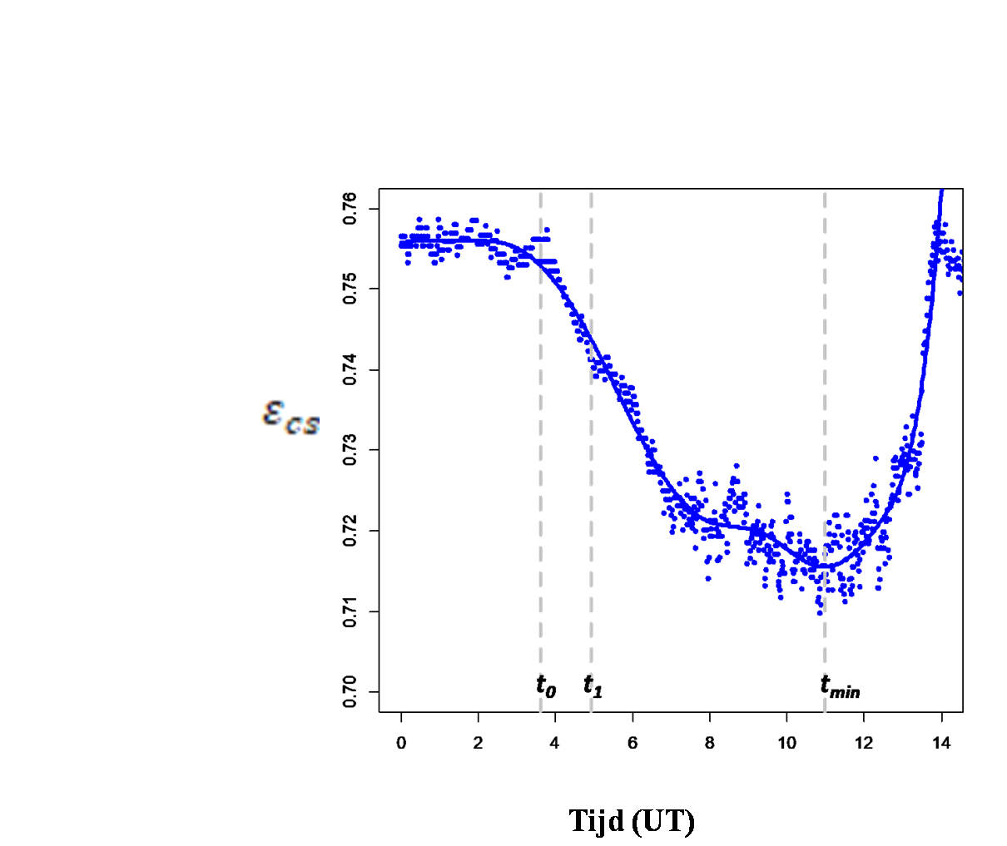


First plot concerns
= Clear sky effective atmospheric emissivity
stable
Sunrise at t₀
Time (UT)
Question: what causes sudden dip in ε_{cs} after sunrise
Explanation : T₂ is increasing faster than incoming long wave radiation (LWD) after sunrise, between t_{o} and t_{min}
Note that between t_{o} and t₁ conditions are stable

Slide 6
Poorly understood feature 1 revealed
Z_{eff}
T_{eff}
Effective air layer determining
incoming long wave radiation
Apparently, just after sunrise a decoupling takes place of two layers
T₂
Shallow Surface layer
This implies that all empirical formulas published in literature are violated during morning transition

Slide 7
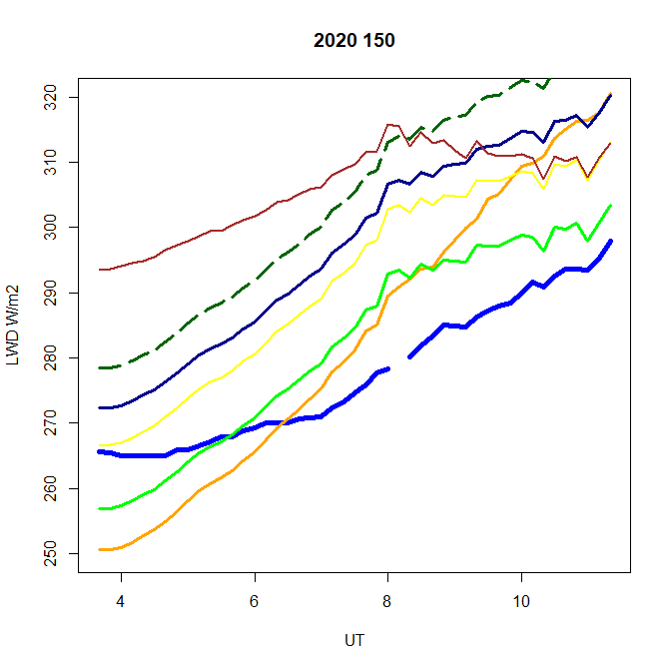
Feature 1 implies that all empirical formulas based on temperature and/or humidity observed at 2 m published in literature cannot hold universally during morning transition
Shakespeare
Brunt NL
LWD (W/m²)
Prata
Brunt FAO
Brutaert
observed
Swinbank
Time
Question: how is LWD just after sunrise estimated in LES and other numerical models?
Question: who has time and expertise to write a review paper on radiation schemes in meteorological models with validation against Cabauw BSRN observations?

Slide 8
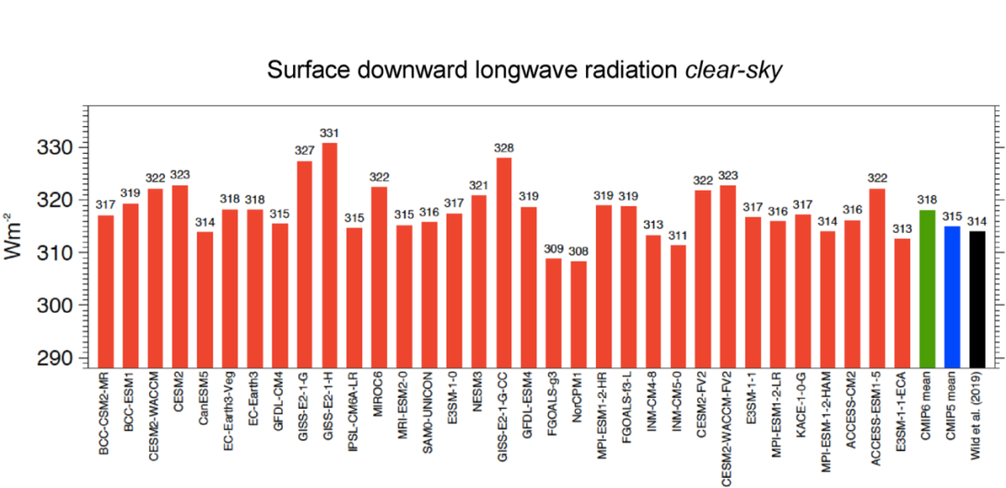
Notes:
Bosveld et al. (2014) replaced LWD in 19 LES models with an ad hoc empirical estimate for all models
In Dutch LES DALES nowadays RTE+RRTMGP is used
ECMWF usse ecRad, radiative transfer scheme with large time steps
Shakesspeare and Roderic (2021) derived best formule from MODTRAN, but for stationary conditions
In 2020 climate models has different LWD schemes which has systematic biases, Martin Wild et al. (2020 )
Martin Wild et al. (2020 ) LWD_{cs} in climate model

Slide 9



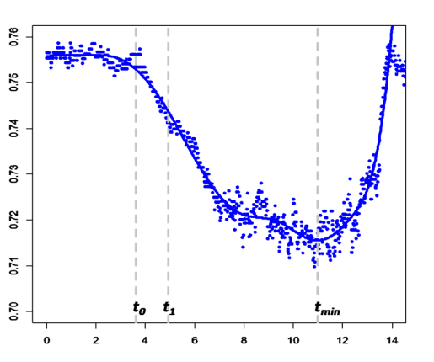
Question: z_{eff} and T_{eff}?
Answer: Alternative for
Z_{eff}
T_{eff}
Effective air layer determining
incoming long wave radiation
T₂
Shallow Surface layer

Slide 10
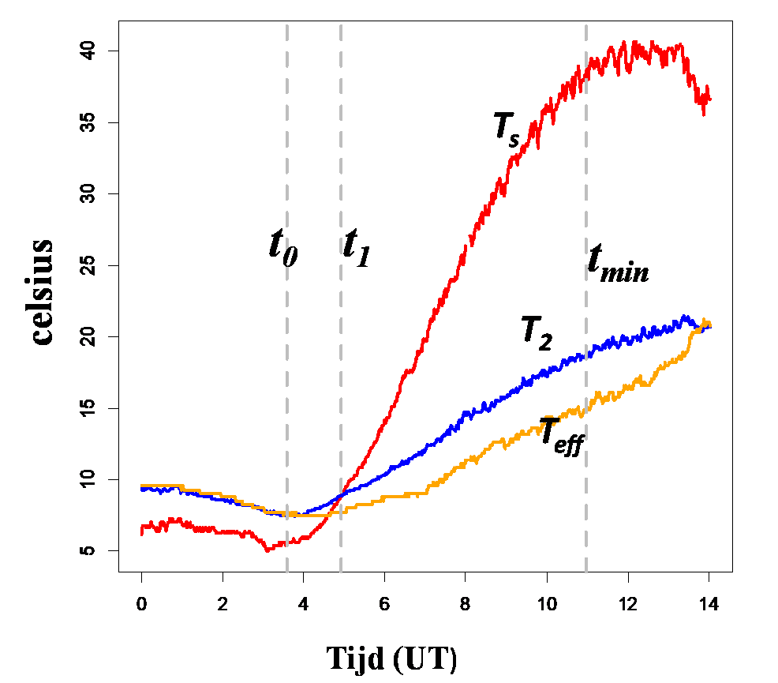
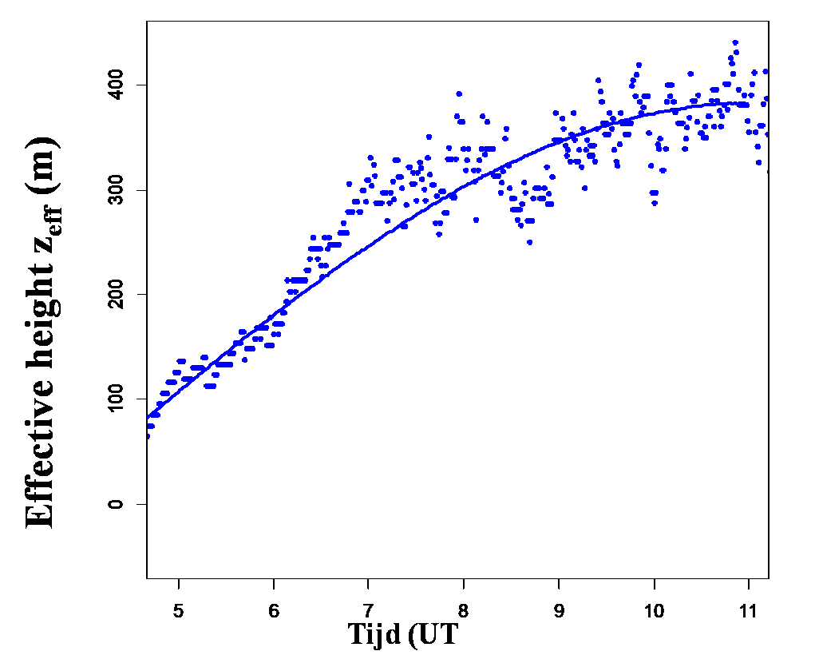
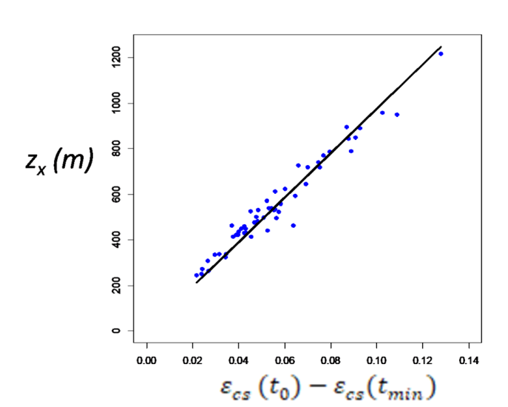
Poorly understood Feature 2: z_{eff} > 200 and is not a constant
Z_{x} for 50 clear sky days
Between 2016-2020
Question: is z_{eff} linked to large scale meteorological variables at greater heights?

Slide 11
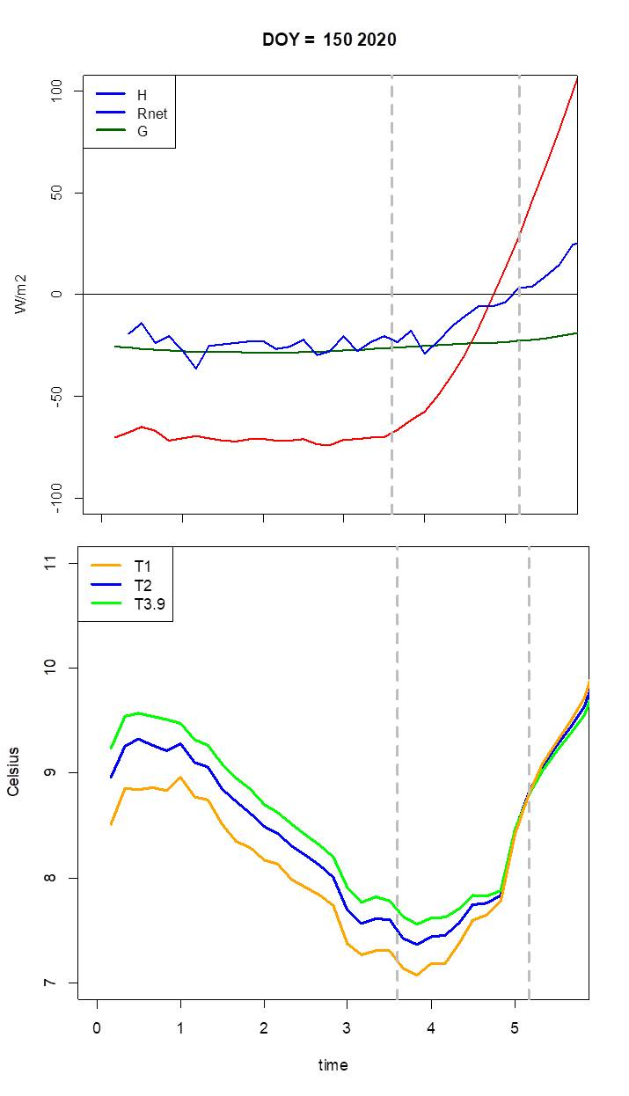

Plot of T-data of psychrometer mast at 1, 2 and 3.9 m
stable
sunrise
W'Tv'>0
Poorly understood Feature 3
Just after sunrise air temperature close to the ground
increases while conditions are still stable
Question: who can explain this?
Note: Reported earlier by Angevine et al. (2001), see also Bosvald et al. (2014)

Slide 12
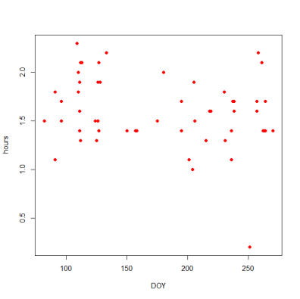
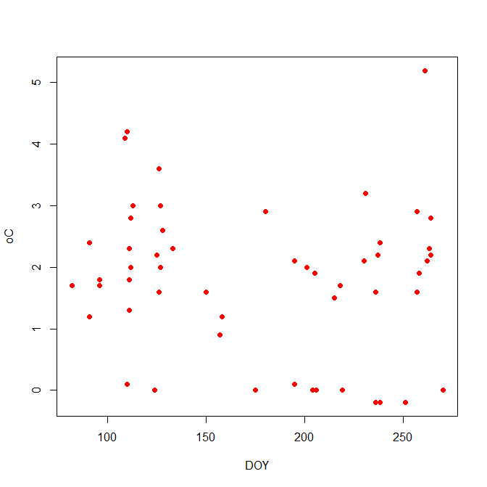
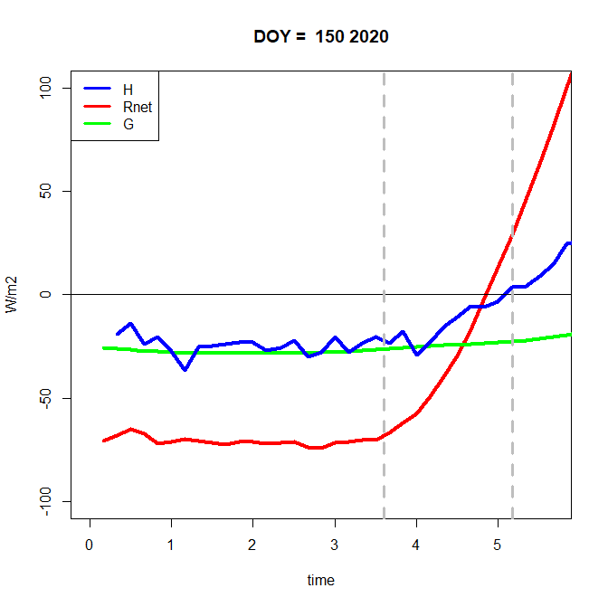
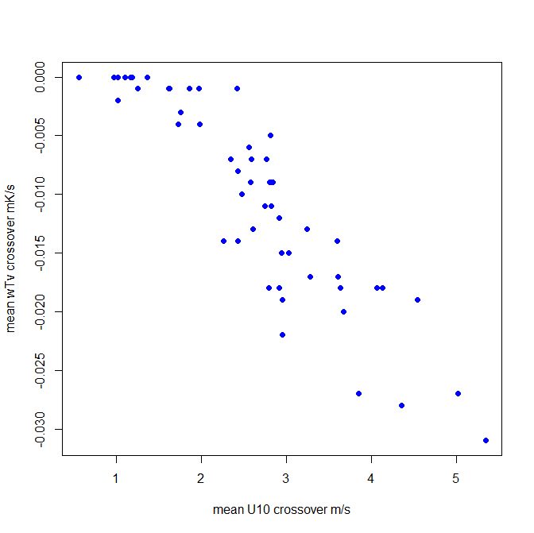
Data of stable crossover period of 50 clear sky days 2016-2020 shows
DT=T₂(t₁)-T₂(t₀)
Duration stable crossover
⁰C
Hour
DOY
DOY
stable
H
G
Rnet
sunrise
Net radiation is still negative
Wind speed U10 (M/s)
Question: what is final explanation for increase T during stable crossover?

Slide 13
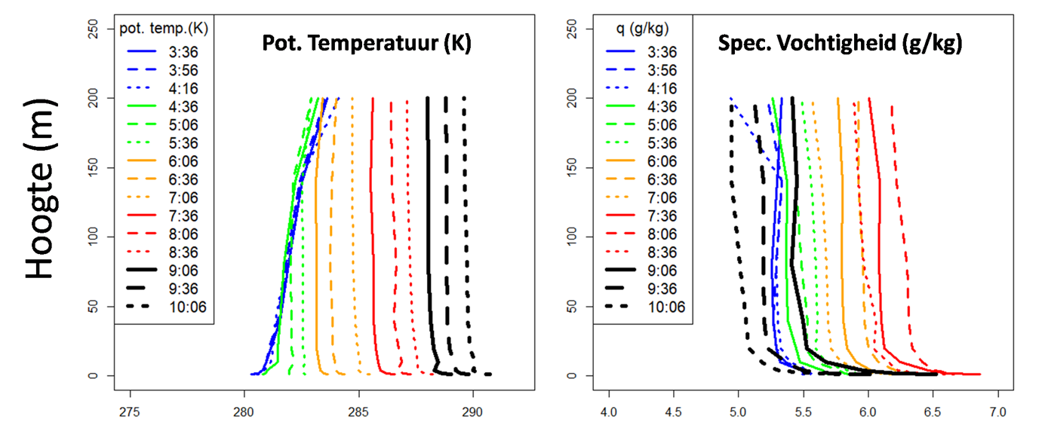
Last example of Cabauw data plot of
Vertical profiles after sunrise of potential temp. and specific hum.
Spec. Humidity g/kg
Z
Reveals well known feature: entrainment of warme dry air at top of atmospheric affects surface layer by which MOST is violated. See papers by MAQ, Wageningen
Question: why is MOST used in most meteorological models

Slide 14
The End
Our talk was meant to encourage young scientists to plot (Cabauw) data in order to reveal other still poorly understood features of land atmosphere interactions.
Atmosphere interactions is mainly about atmospheric turbulence and turbulence is still an unsolved topic in physics. To understand atmospheric turbulence innovative experimental meteorology is still strongly needed.
AI will not provide solutions.

Slide 15
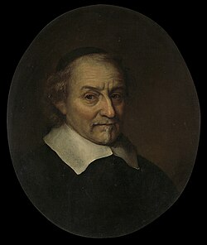
Time for some Dutch culture
Poem by Joost van den Vondel
on The severe storm of 28 February 1665
That hit the summer residence of the Landlord of Kabau
Cornelis de Nobelaer
J vd Vondel
TANTAS AUDETIS TOLLERE MOLES?
Een Europeesche Orkaen eischt hooftzom en de renten
Al teffens op een' sprong, en waerschuwt met den slagh.
Hy baert zijn kracht op vaste en drijvende elementen*
En juist in Sprokkelmaent den allerjongsten dagh.
Kabau in Hofvliet riep: oubollige kabouter
Wat spooktge? hou uw rust, of streef mijn' hof voorby
De storm, hier door geterght, verhief zijn kracht noch stouter
En heftiger: zoo ploft de steene Gallery
Met eenen smak aen gruis en puin en stof ter neder.
Toen docht de hofheer: och ter werrelt staet niets vast.
Dit Spook verblaest ook steen, gelijk een lichte veder
Geen toorens houden stant, wanneer het van zich tast
Betrou geen galery, noch dikke steene muuren:
Wie Godt zijn rust betrout, kan d'eeuwigheit verduuren
*drijvende elementen = weather at Cabauw

