Slide 1
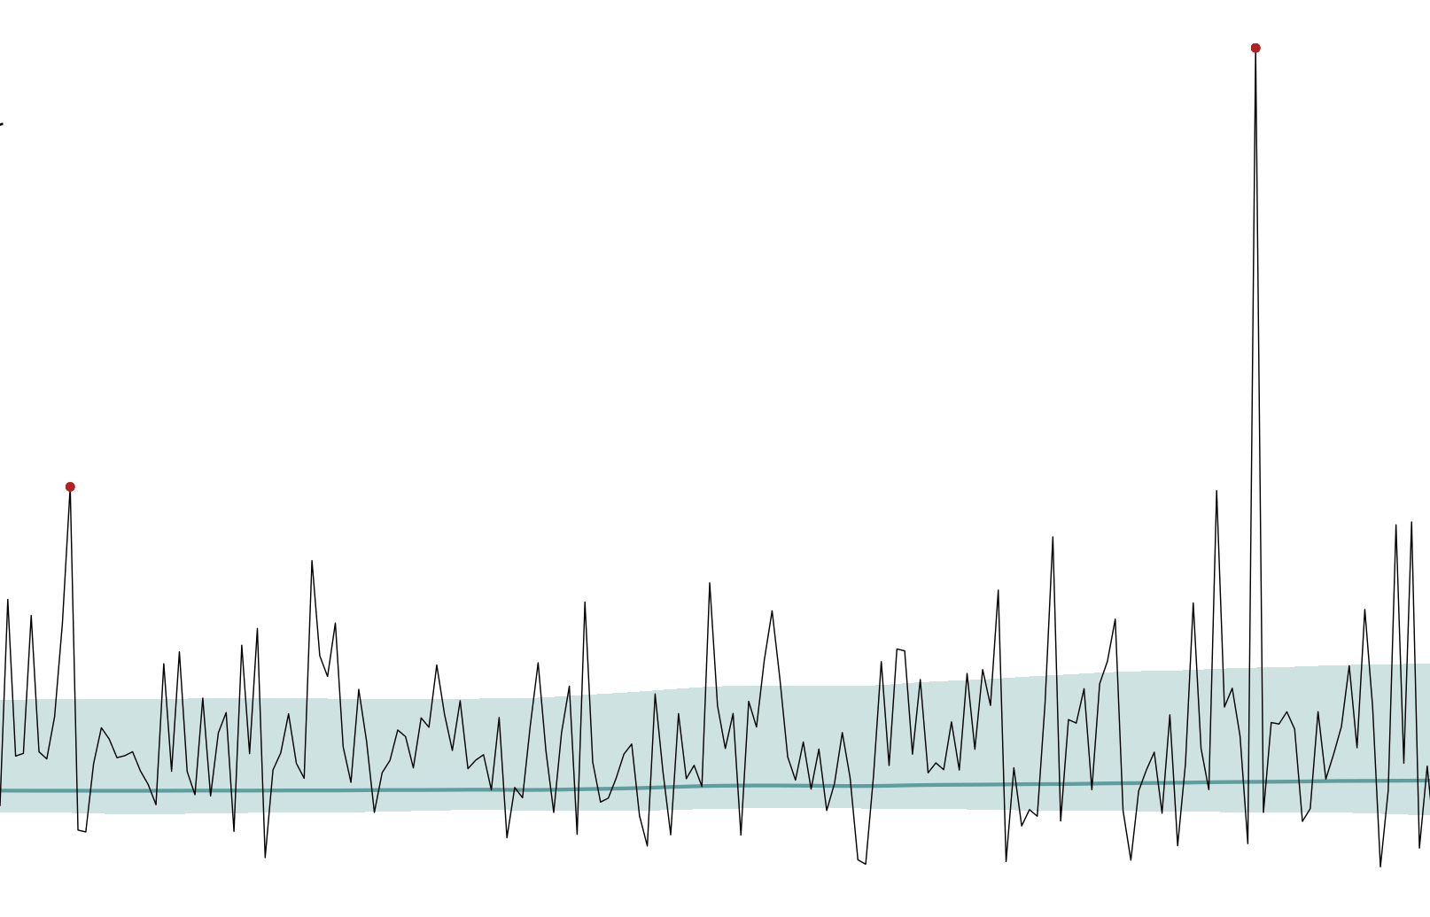
Most at-risk regions for near-term surprise extremes
Iris de Vries [Uni Graz], Erich Fischer [ETH Zurich], Luke Harrington [Uni Waikato], Raphaël Huser [KAUST], Sebastian Sippel [Uni Leipzig]
Notes:
Notes for me:
Orig data is ERA5 at 0.25 deg resolution, here I do POOLING for both rx1d and tx5d, and rx1d is nonstat in mu and sigma. Tx5d is only nonstat in mu.
SEAS is at 1 degree, so different. For this, the pooling becomes prohibitively aliasing, so, do just regridded era5 and SEAS5 WITHOUT pooling, and tx5d is ofc still mu only nonstationary.
Then do comparison with naive 1deg data and seas ensemble data.

Slide 2
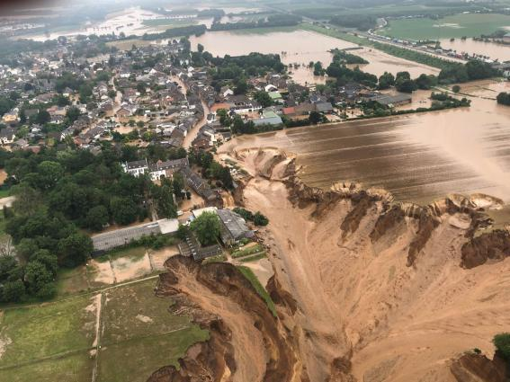
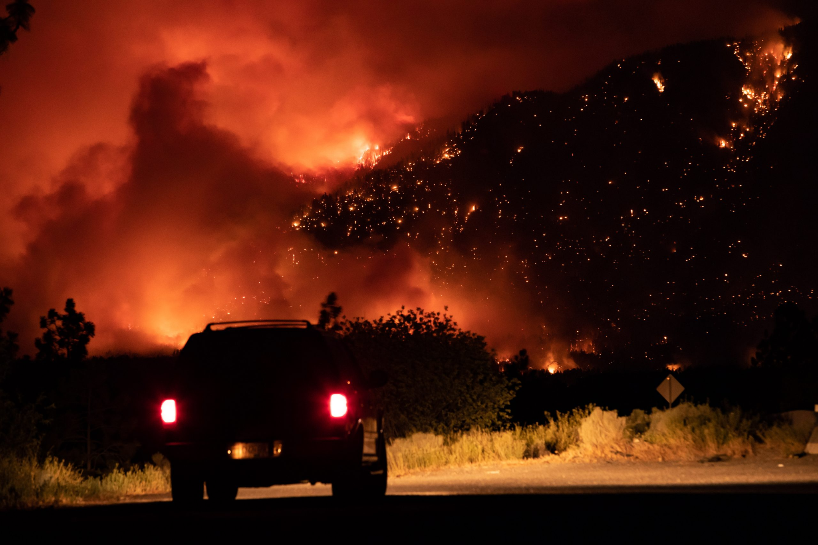

Record-breaking extremes
Unprecedented → unknown impacts
Not predictable
Not fully random either → find relatively riskier regions
Germany, July 2021, WMO
Lytton, June 2021, CityNews Toronto
Western Europe, last June, Euronews
Notes:
Records are relevant for impacts, because they are unseen, there is no experience.
Naturally, also severe but seen events are relevant for impacts, but records are a clean, well defined event type that is unequivocally tied to unknown consequences.
Therefore, it would be helpful to know where the chances of record-extreme occurrence are high.
As you all know, record event occurrence, or any specific event occurrence, is a stochastic game, so we cannot expect to forecast records at lead times much larger than weather forecasts, but we can create specific maps of relative record risk, which can be of help in prioritisation and adaptation decisions.

Slide 3
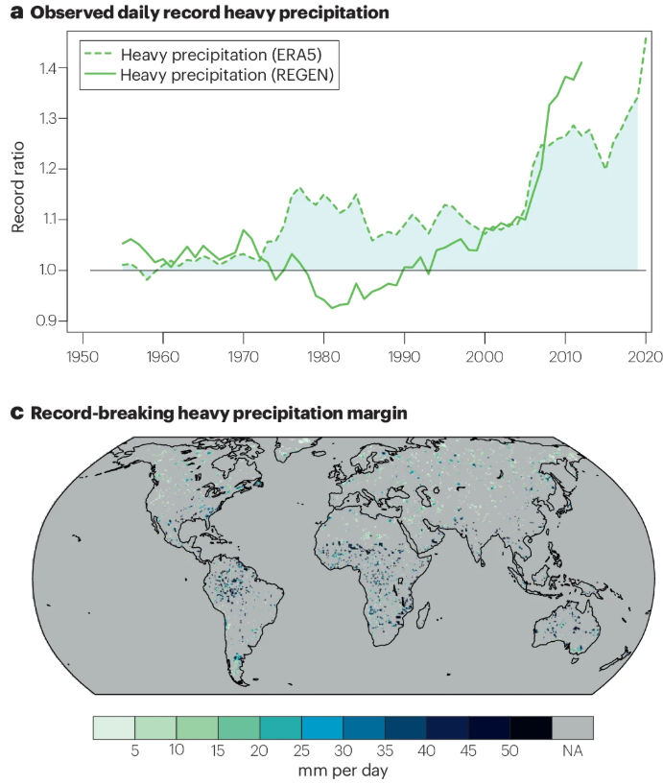
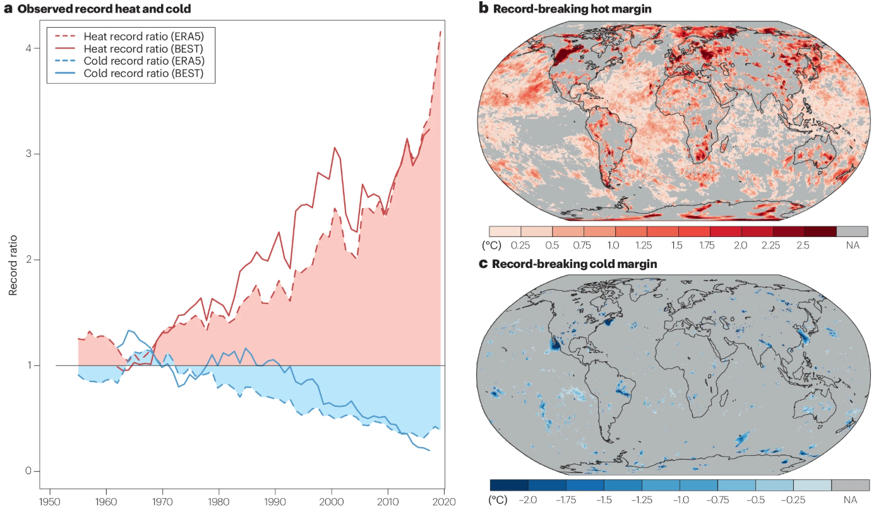
Observed record breaking
Temperature
Precipitation
Fischer et al. (2025)
see also e.g. Rahmstorf & Coumou (2011), Coumou et al. (2013), Lehmann et al. (2015, 2018), Fischer et al. (2021), De Vries et al (2024)
Notes:
First some record breaking background:
Record rates are increasing – show plot global temp or precip records
As climate warms, records become more likely.
We often look at records in two different ways, diagnostic: we count the number of records. In order to obtain probability measures, we have to aggregate over space to get a timeseries of record likelihoods. Or, for single events: we might do counterfactuals to obtain an assessment of increased likelihood of a formerly unseen event, which is not strictly record-breaking probability but related
Or prognostic: we count future records in models, or we compute changes in distributions to determine the marginal probability of record-breaking. In a case sense, we might do single-event studies like Ed’s → the worst-case historical event will break a record in a warming climate, or we assess single-event type distribution shifts. Again, very useful, but not strictly probabilities

Slide 4
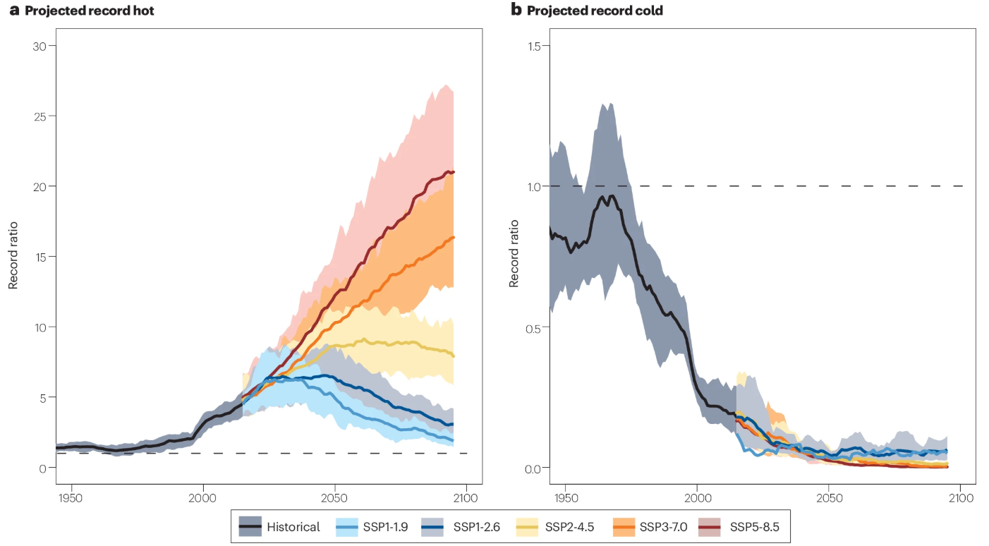
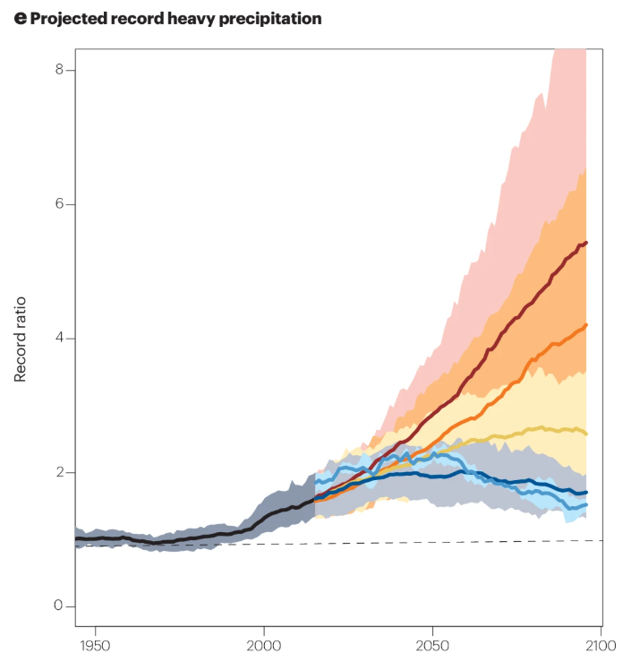
Projected record breaking
Temperature
Precipitation
Fischer et al. (2025)

Slide 5
Projected record breaking
Temperature
Precipitation
Prepare for more record events
Now
Now
Fischer et al. (2025)

Slide 6
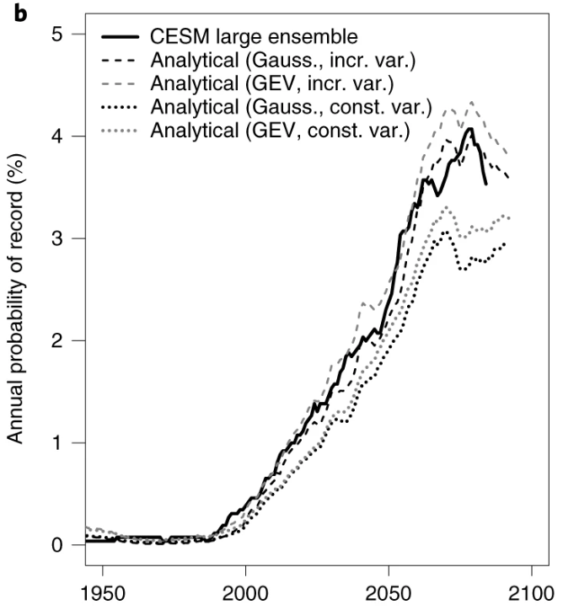
Estimating record-breaking probabilities
Empirical: # record-breaking gridcells / N
  Spatial aggregation
Analytical: shifting probability distributions
  “Temporal aggregation”
Result: smooth marginal probabilities
Reflecting gradual “unlocking of new potential”
But which record are we breaking?
Fischer et al. (2021)

Slide 7
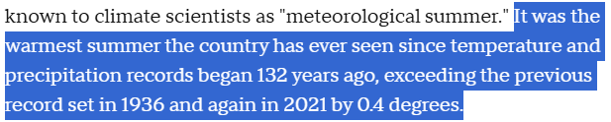
But which record are we breaking?
The Guardian
CBS news
The Guardian

Slide 8
History-aware record-breaking estimates are useful
Natural variability: long-term (multidecadal) masking/amplification
  Low record = high record-breaking probability and vice versa
Psychological risk awareness component

Slide 9
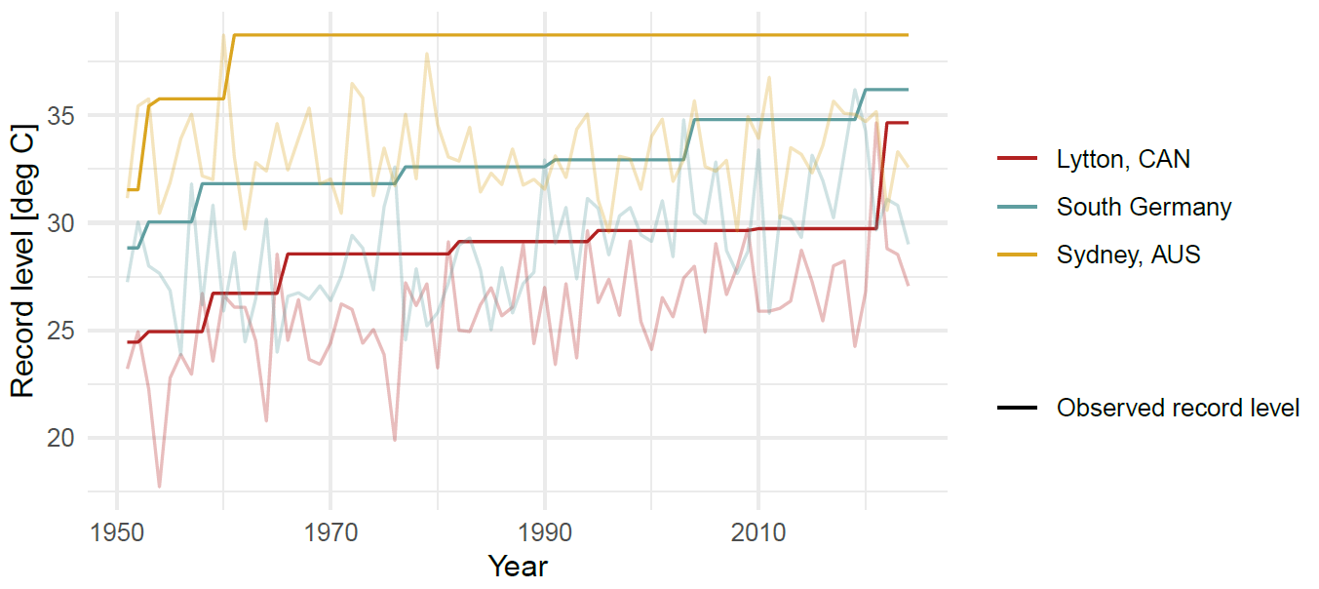
History-aware record-breaking estimates are useful
Natural variability: long-term (multidecadal) masking/amplification
  Low record = high record-breaking probability and vice versa
Disaster memory component
ERA5 Tx5d
PNW heatwave

Slide 10
Estimating record-breaking probabilities
Aggregated/mean record probabilities → marginal / unconditional
  Probability of breaking a record
  Indicator of shifts in extreme intensity and likelihood
→ Unused information: which record are we breaking?
  Past observations and experience matter for probability and risk
Specific, local record probabilities → conditional
  Probability of breaking the current record
  Indicator of near-term likelihood of an event worse than ever* experienced
*within observed period
Notes:
One thing that all the probability methods I mentioned have in common, is that they use some form of aggregation to obtain smooth probability estimates/distributions: they either aggregate data spatially, or distributions are fitted to obtain overall probabilities of breaking any record . I will refer to this as “marginal probabilities”: the overall, unconditional probability of record breaking is determined.
What is missing from these approaches, is the acknowledgement of our experience: we experience a record when the event is more extreme than the specific event that set the previous record. That specific record can differ greatly from the mean expected record, and therefore also local record-breaking probabilities can greatly differ from the marginal estimate. What I mean by that, is that natural variability can lead to prolonged periods without high records [EX FIG] or to one or a few very high records. In case of absence of high records, the probability of breaking the standing record is high, whereas, in the other case where high records have been set, the probability of breaking the record is lower. In addition, despite disaster resilience efforts, we are often prepared for what we have experienced, and not for the unknown. This adds an exposure/vulnerability aspect: wherever records are low or absent in recent history, risk perception and preparedness might be low, and vulnerability high.

Slide 11
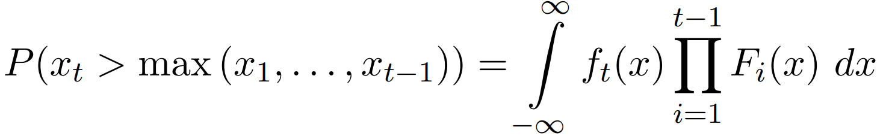
Estimating record-breaking probabilities
Observed records
True non-stationary observational distribution → bottleneck
  Fit distributions with GMST covariate(s) to observations
  Estimate forced response in observations + assumed/estimated variability
Marginal RBP
Conditional RBP
t = timestep F(x) = CDF f(x) = PDF

Slide 12
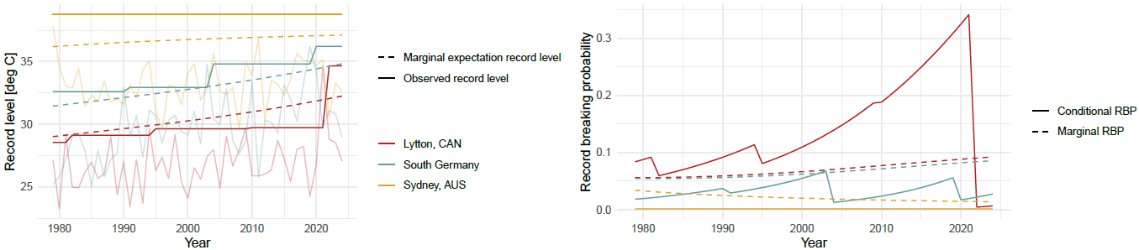
Conditional v. marginal record breaking
ERA5 Tx5d

Slide 13
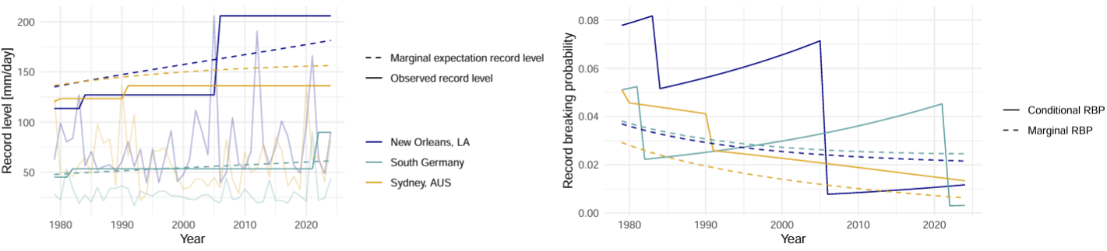
Conditional v. marginal record breaking
ERA5 Tx5d
PNW heatwave
ERA5 Rx1d
Katrina
European Floods

Slide 14
Conditional v. marginal record breaking
Observed records: update stepwise
Marginal expected records: gradual shift with forced response
When observed record lags behind expected record, local conditional record-breaking probability is high
Low current record + strong climate change →
high near term record-breaking probability

Slide 15
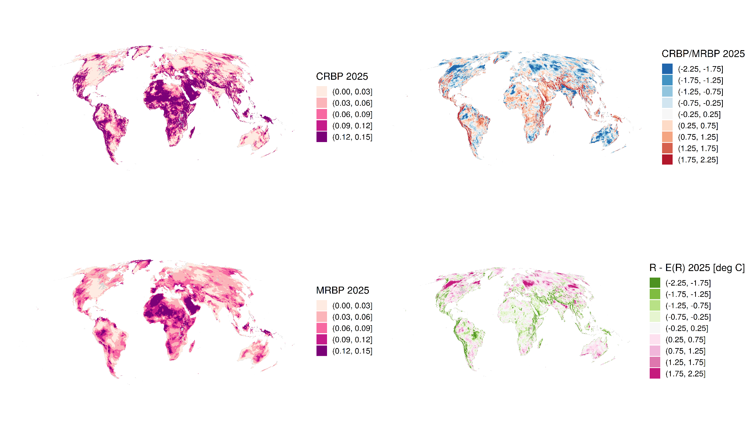
Global record breaking probabilities - Tx5d
log( )
Conditional RBP much more spatial detail
Climatological signatures (tropics v. mid lats)
Natural variability: recent heat waves
Biases

Slide 16
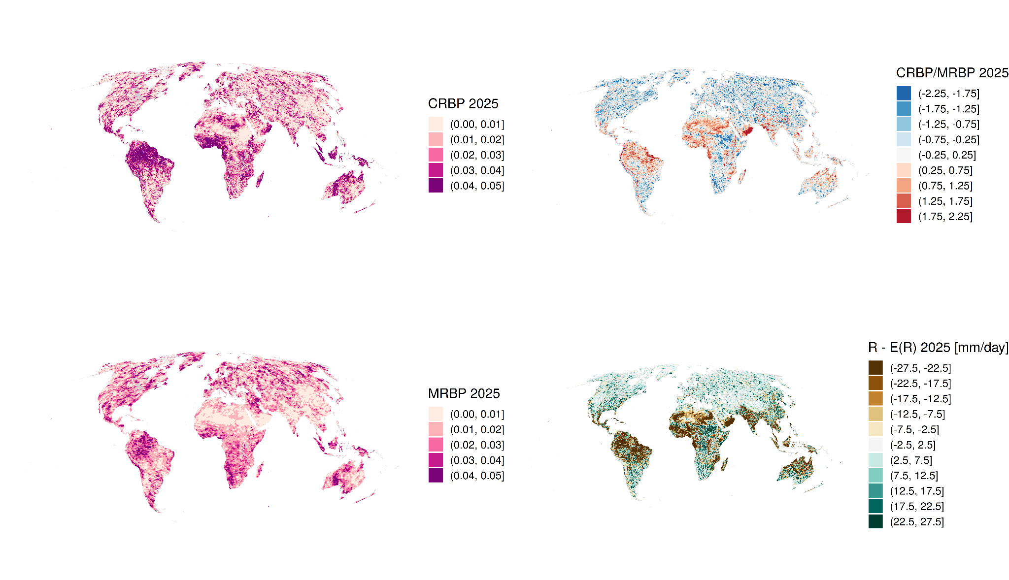
Global record breaking probabilities - Rx1d
log( )
High spatial variability
Climatological signatures
Biases

Slide 17
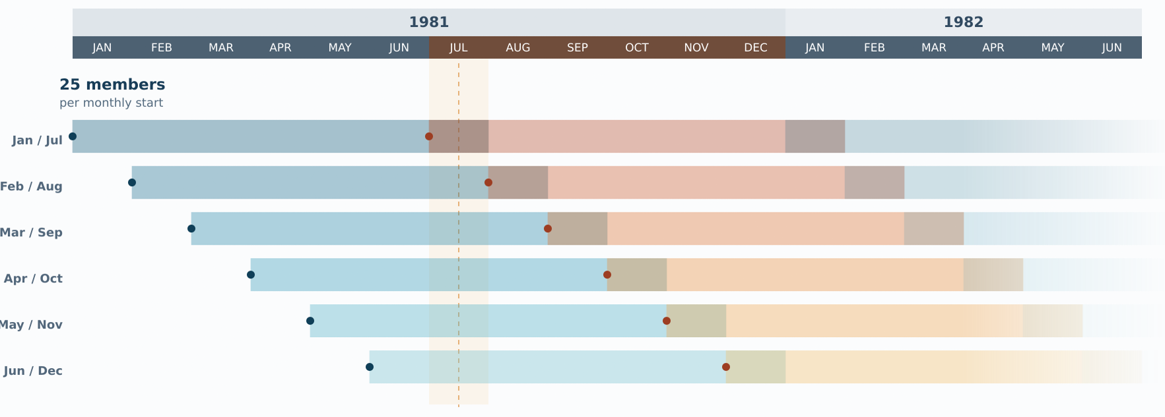
Can we do better?
Problem: distributions too sensitive to short observed record
Solution:
  Find more observations → SEAS5 re-forecasts (Johnson et al. 2019)
  Remove natural variability statistically: Fischer et al. (in prep)

Slide 18
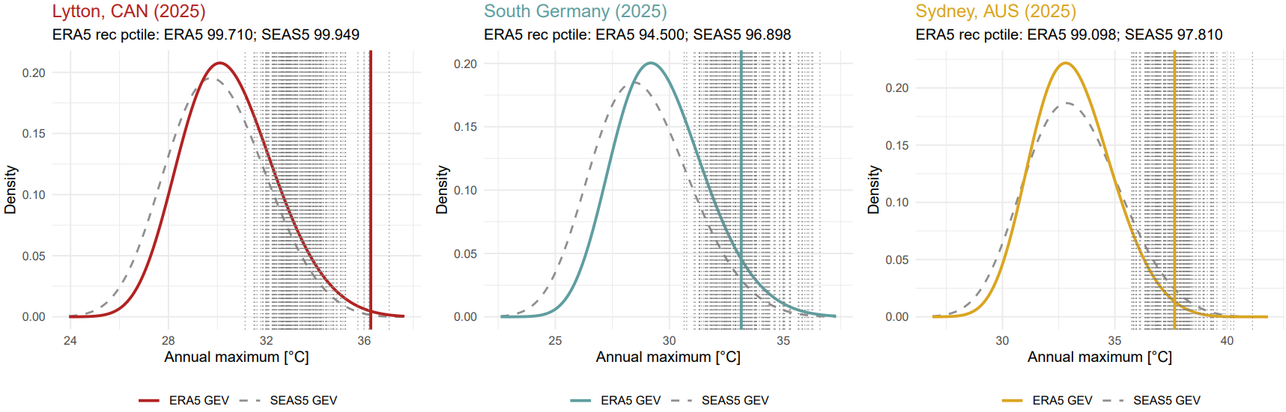
Preliminary SEAS5 results – Tx5d
Contains events > observed maxima
More constrained record percentile (1 – exceedance prob) estimate

Slide 19
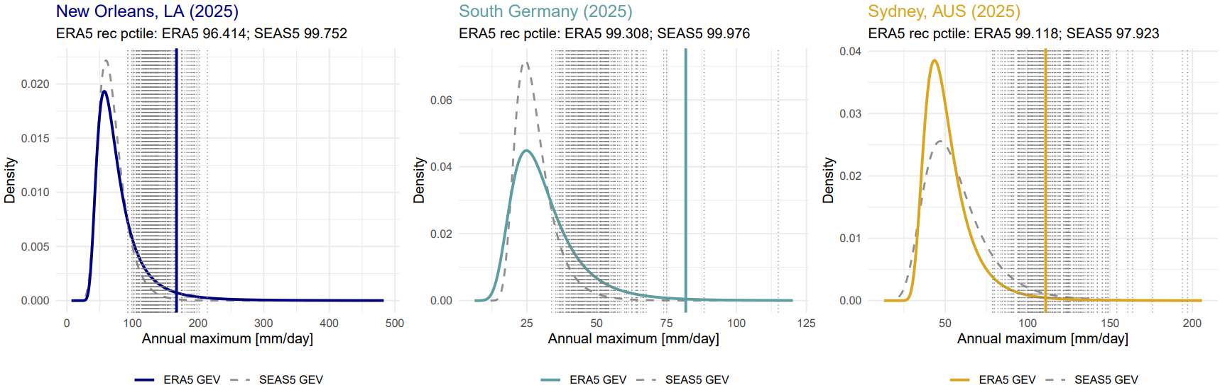
Preliminary SEAS5 results – Rx1d
Contains events > observed maxima
More constrained record percentile (1 – exceedance prob) estimate

Slide 20
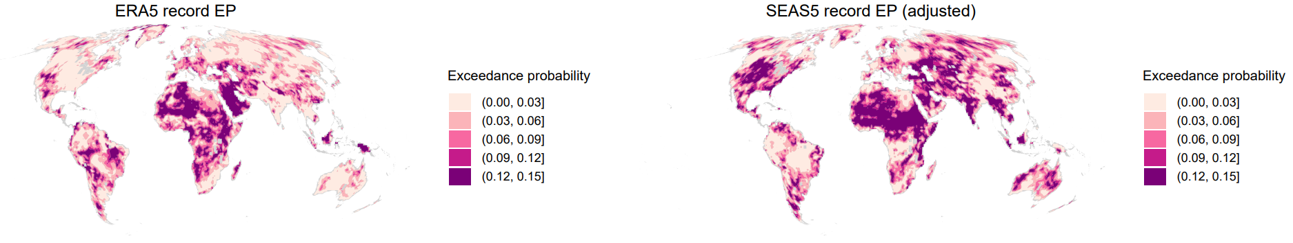
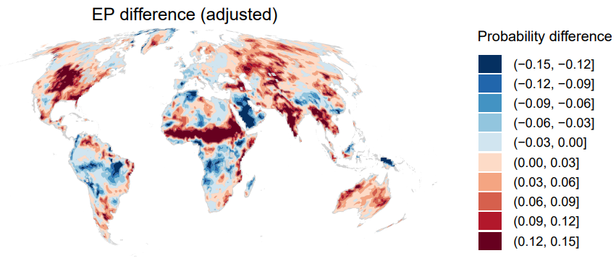
Preliminary SEAS5 results - Tx5d
CRBP .
CRBP .
CRBP .
Clear hotspots:
  US warming hole
  Central Asia, India, SE Asia
  Sahel
TBD: which is less wrong?
CRBP

Slide 21
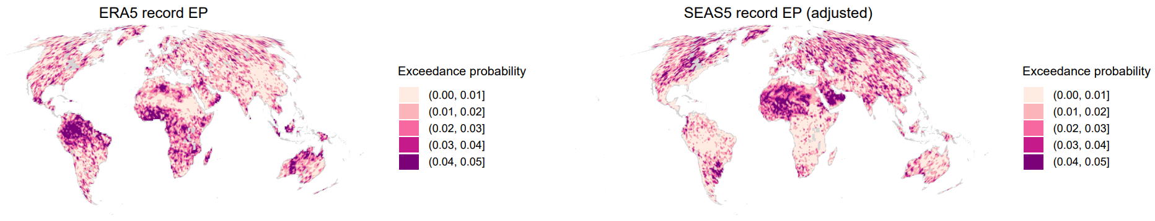
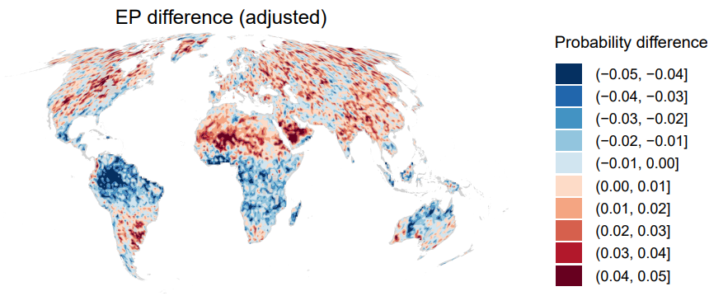
Preliminary SEAS5 results - Rx1d
CRBP .
CRBP .
Large modifications conditional RBP
CRBP .
Reduced tropical risk
Increased mid-latitude risk
Some hotspots
CRBP

Slide 22
Can we do better?
Problem: distributions too sensitive to short observed record
Solution:
  Find more observations → SEAS5 re-forecasts (Johnson et al. 2019)
  Remove natural variability statistically: Fischer et al. (in prep)

Slide 23
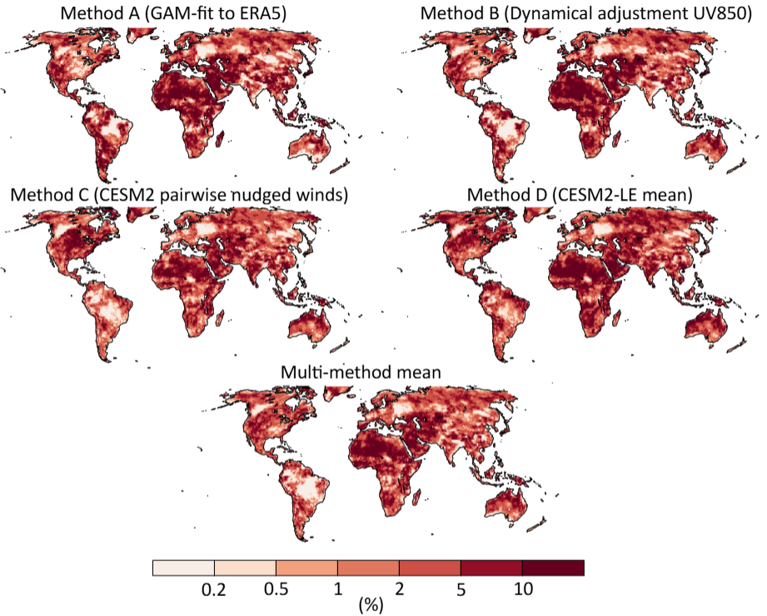
Comparison across methods - Tx5d
Overall good agreement
Key areas need more research
GEV based
Forced-response + constant variability
(Fischer et al. (in prep))
ERA5-only GEVs

Slide 24
Final notes – preparing for the unexpected
Conditional RBP: specific, near-term indication of “worst-ever” event likelihood
Pinpoint priorities for risk assessment and management
“Record forecast skill” is high, but sensitive to small sample*
True distribution estimation is main caveat
  Re-forecasts: theoretically the solution, but biases seem large
  Statistical magic
→ Many important open questions!
Notes:
Questions such as:
What was the true probability
If no record happened, why?
What could break a record?
How do we estimate vulnerability?

Slide 25
Iris de Vries iris.de-vries@uni-graz.at [Uni Graz], Erich Fischer [ETH Zürich], Luke Harrington [Uni Waikato], Raphaël Huser [KAUST], Sebastian Sippel [Uni Leipzig]
Conditional RBP: specific, near-term indication of “worst-ever” event likelihood
Pinpoint priorities for risk assessment and management
“Record forecast skill” is high, but sensitive to small sample*
True distribution estimation is main caveat
  Re-forecasts: theoretically the solution, but biases seem large
  Statistical magic
→ Many important open questions!

Slide 27
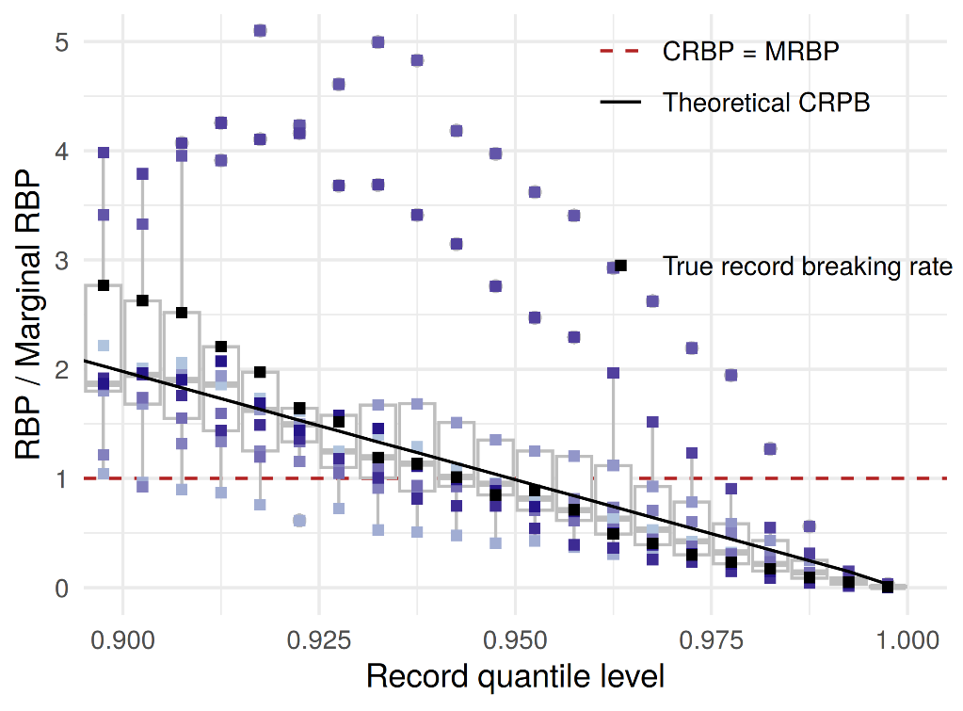
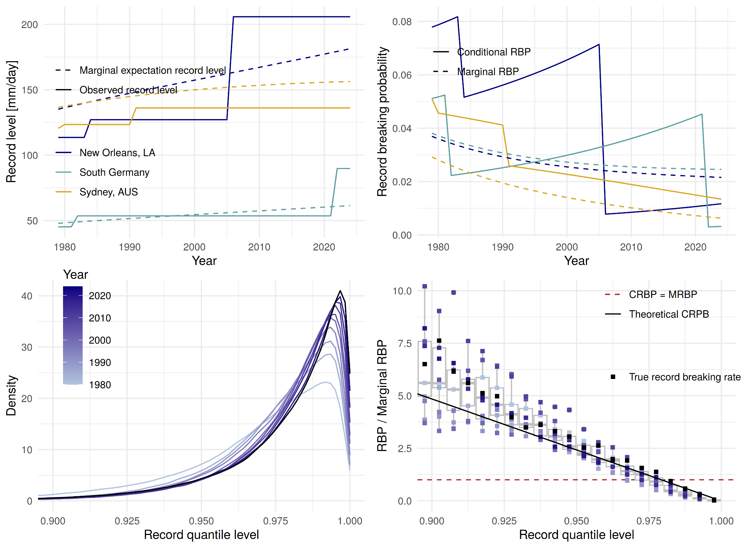
Forecast skill – ERA5
ERA5 conditional record prediction matches true record breaking rate
Marginal record prediction non-specific
GEV-biases largest for Rx1d – sensitive tails
2005 & 2010 Tx5d stand out → distinct events
Notes:
This is perfect evaluation with distribution fitted to full sample
Fit distribution to data up to year i-1, so that we have quasi-real info: how is the prediction into the unknown.
Separate global/ tropics v extratropics? ENSO effect on tropics
Plus add for temperature : forced response + const var around FR
Local Rx1d mean covratire for LENS models, FR is locally specific

Slide 28
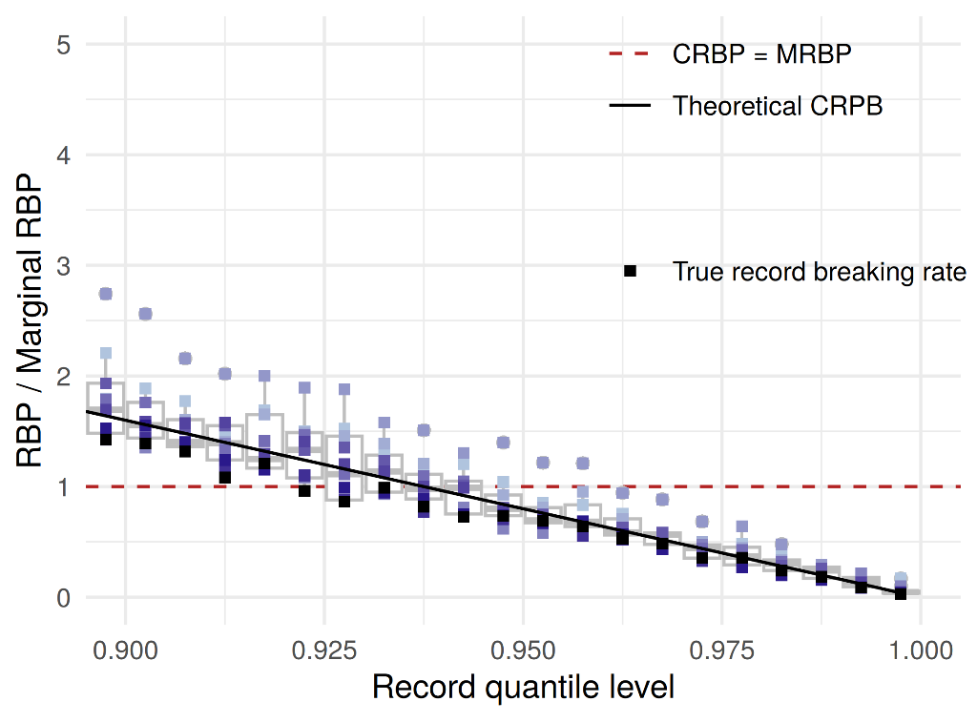
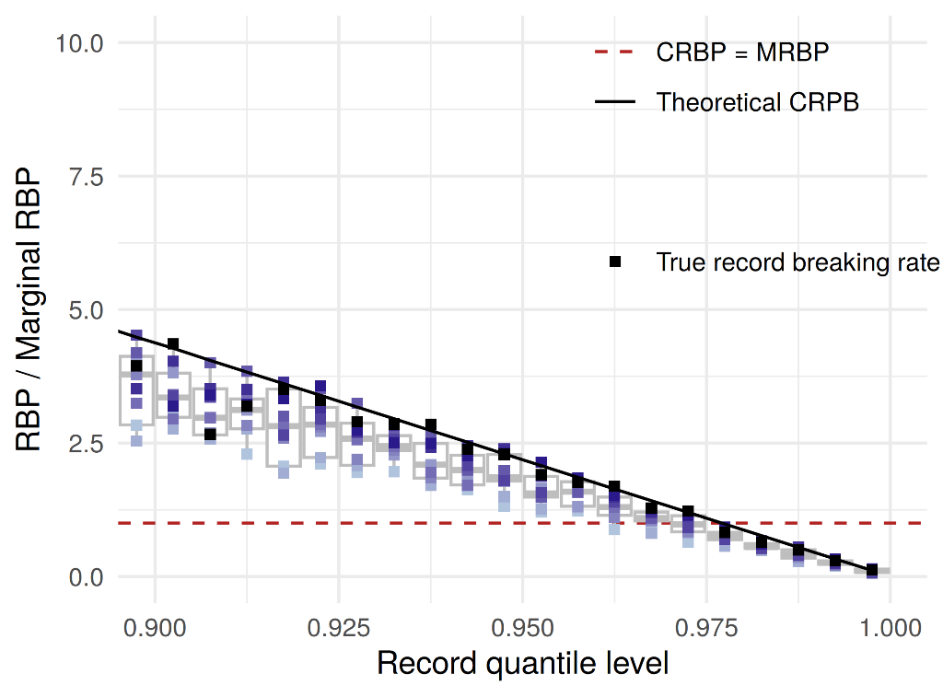
Forecast skill – model verification
Model verification CanESM5 50 member ensemble – “true” GEVs
Tighter agreement and lower record ratios
Some remaining biases – likely GEV-related

Slide 29
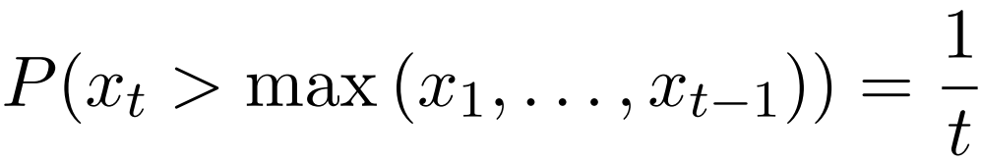
Record-breaking probabilities
Stationary climate
Non-stationary climate
RBP = record-breaking probability t = timestep F(x) = CDF f(x) = PDF
Marginal RBP
Conditional RBP

Slide 30
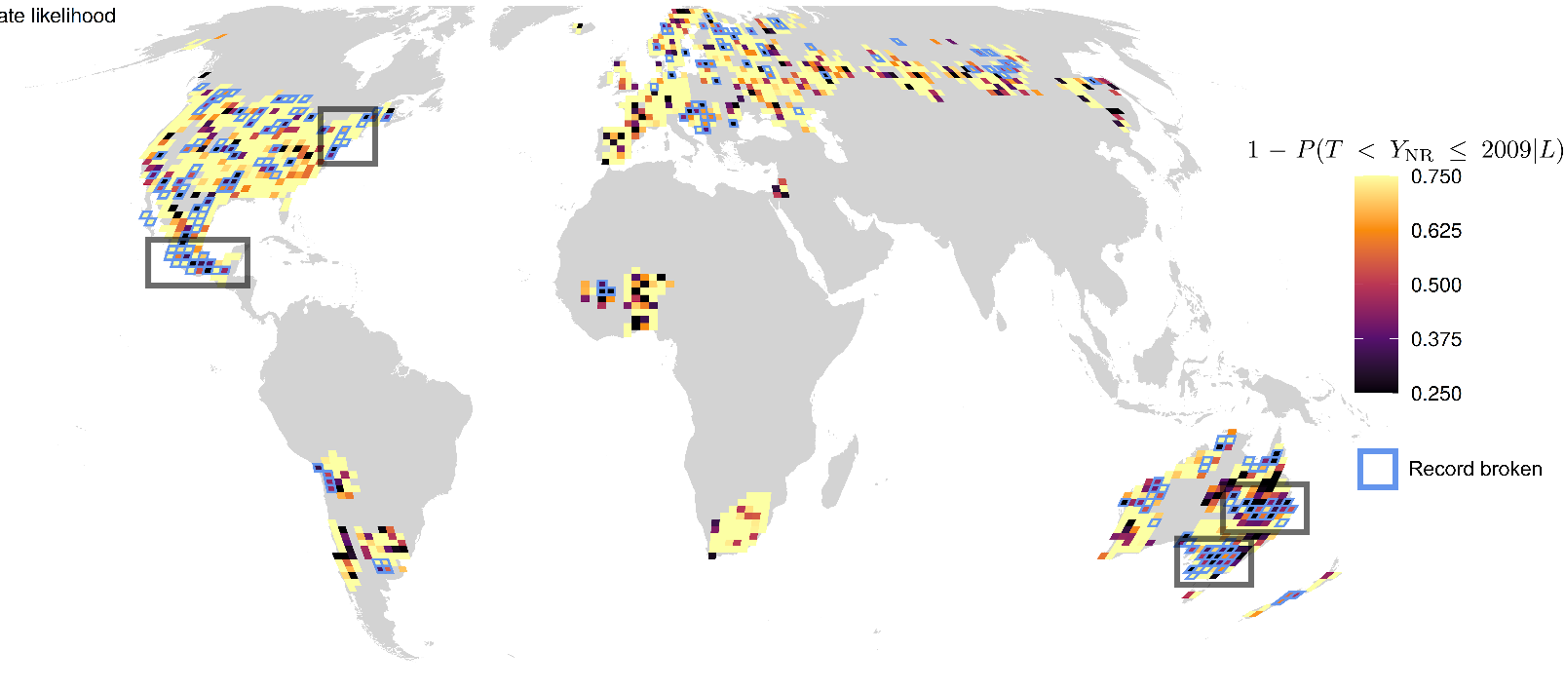
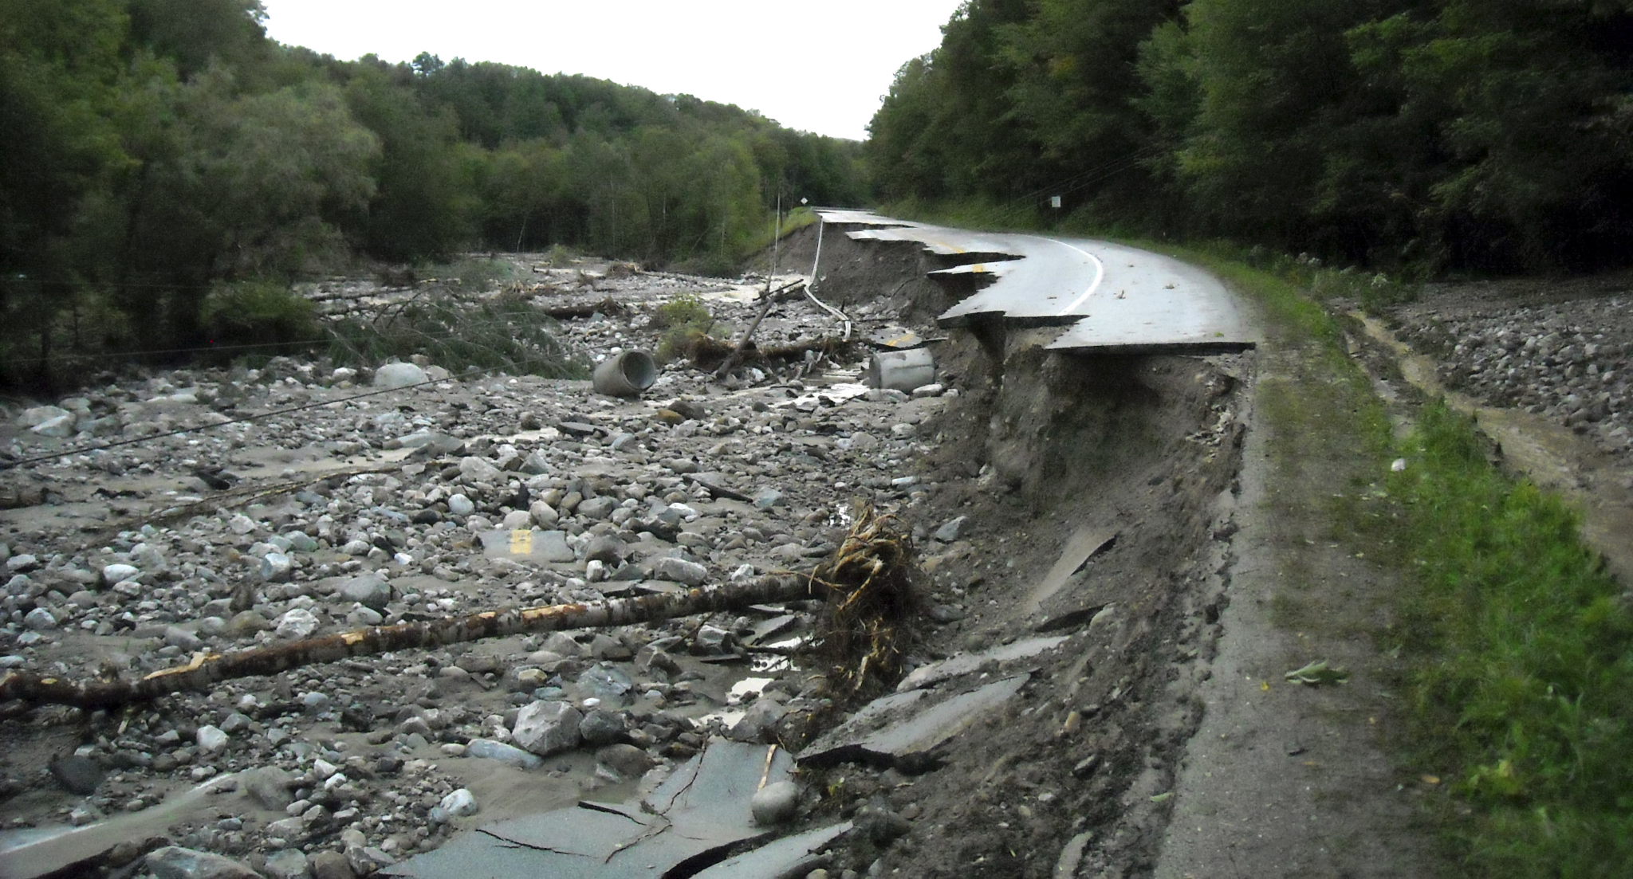
Disaster memory and risk perception
“Irene brings Vermont worst flooding in a century, governor says”
Washington Post, August 2011
State likelihood (“preparedness”)
De Vries et al. (2026)

Slide 31
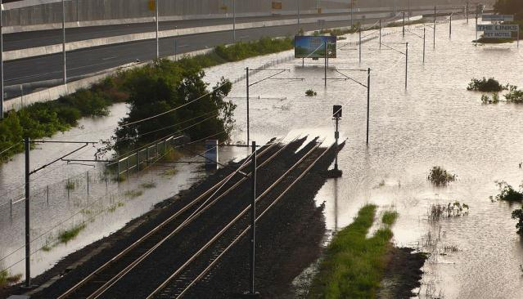
Disaster memory and risk perception
“the disastrous floods which struck south-east Queensland [...] were unprecedented, in many places completely unexpected, and struck at so many points at once that no government could be expected to have the capacity to respond seamlessly and immediately everywhere, and in all ways needed.”
Queensland Floods Commission of Inquiry
Final Report, March 2012
State likelihood (“preparedness”)
De Vries et al. (2026)

