Slide 1
BRAMS:
a Belgian Am-Pro collaboration to detect and characterize meteors with radio techniques
Hervé Lamy
Belgian Institute for Space Aeronomy
Brussels, Belgium

Slide 2
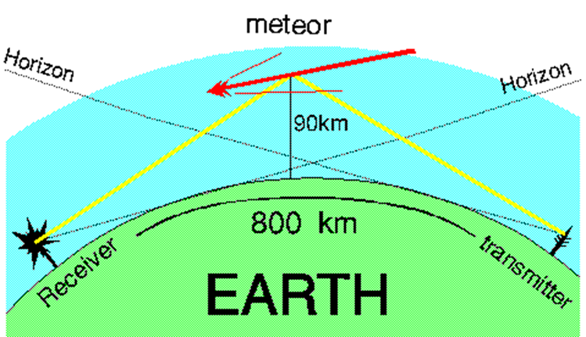
Meteor forward scattering

Slide 3
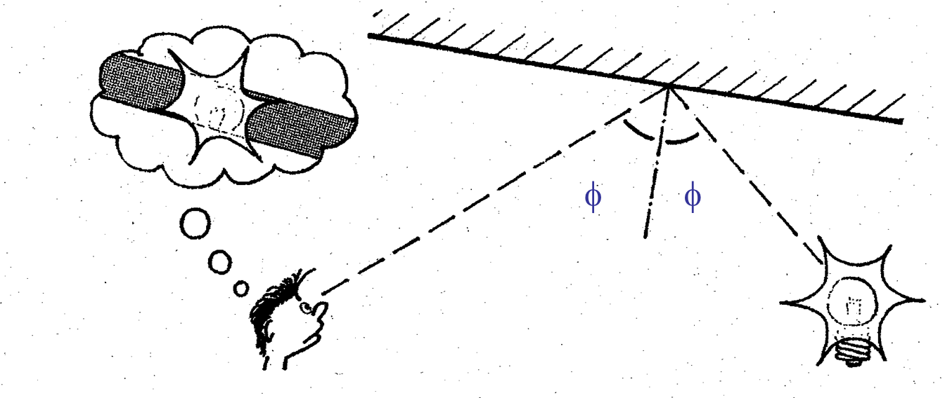
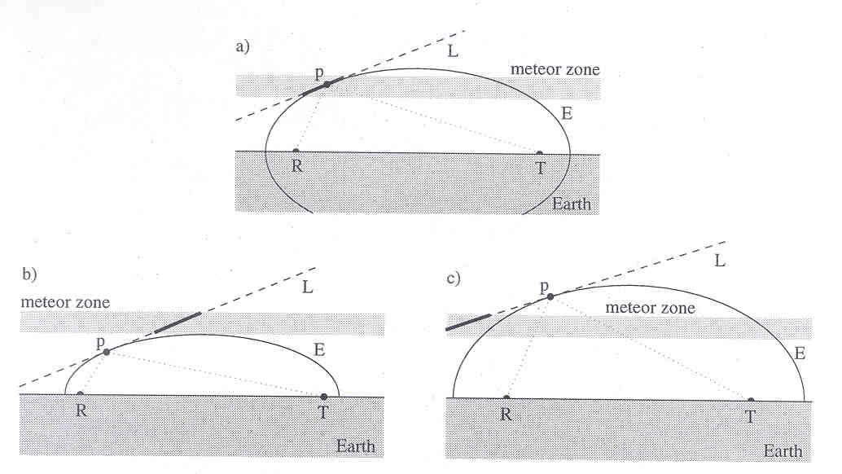
Specular reflection

Slide 4
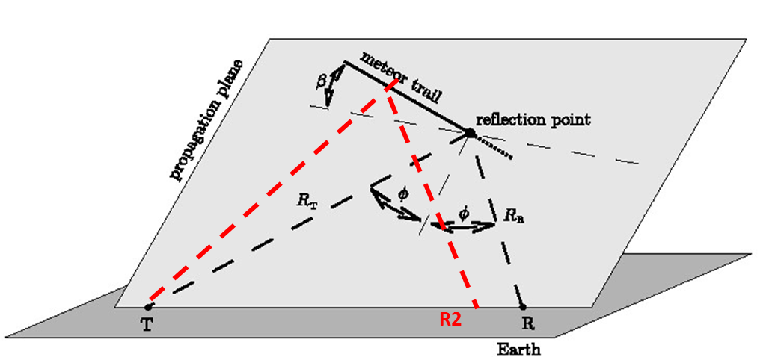
Retrieval of trajectory

Slide 5
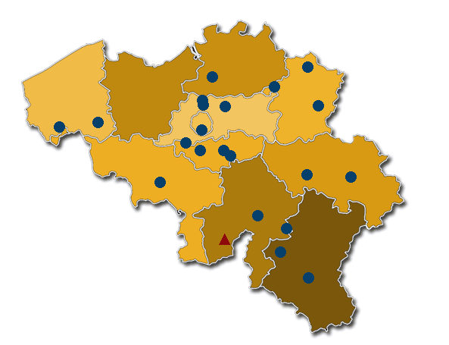
The BRAMS network

Slide 6
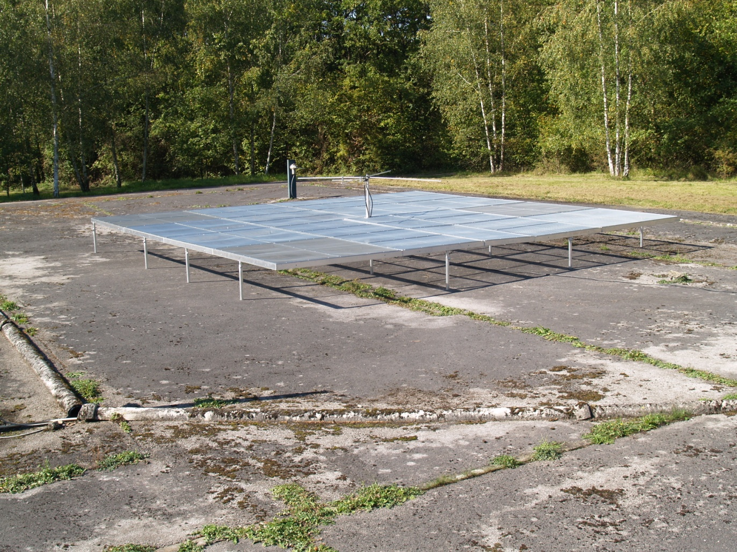
BEACON
49.97 MHz
150 W
Right-handed circularly polarized

Slide 7
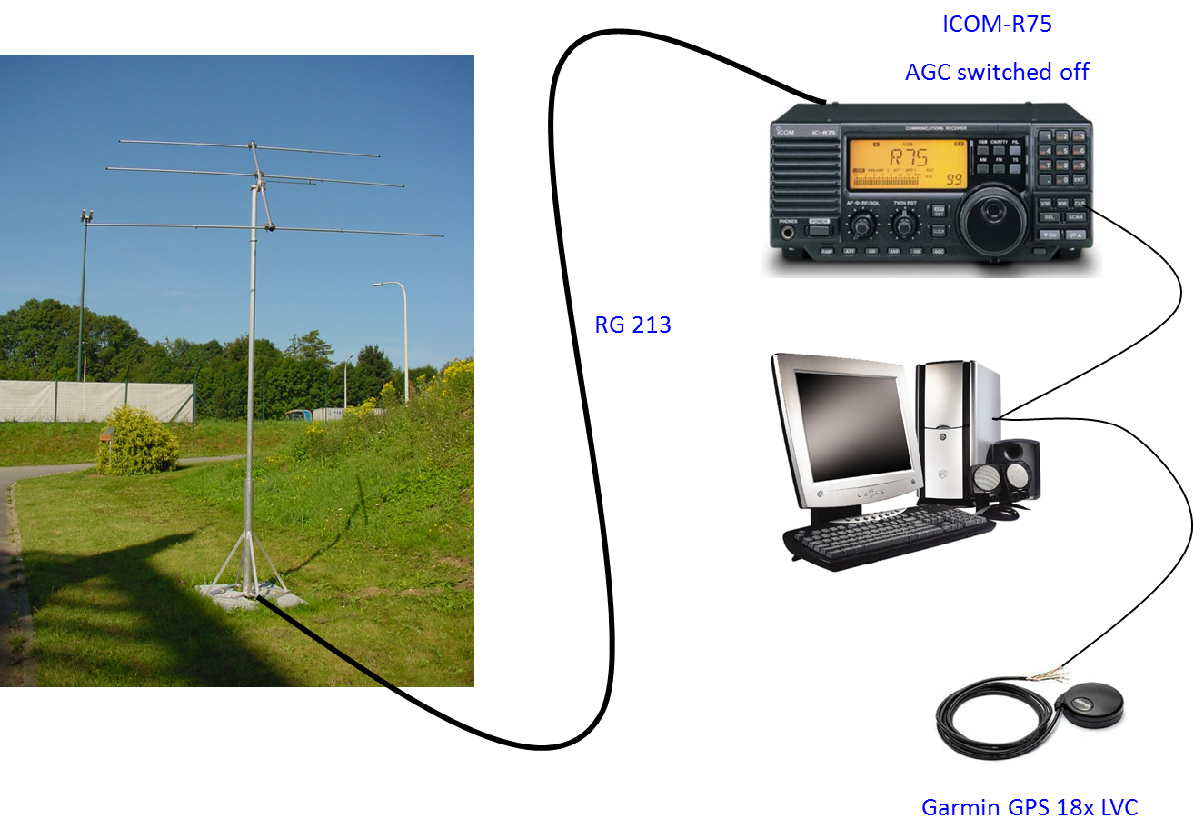
A typical receiving station

Slide 8
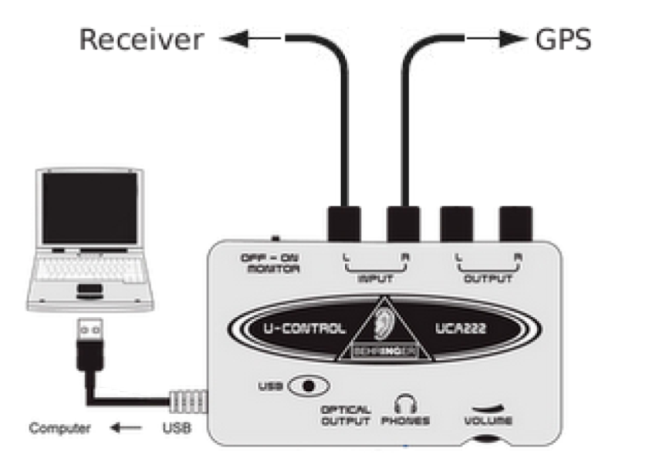
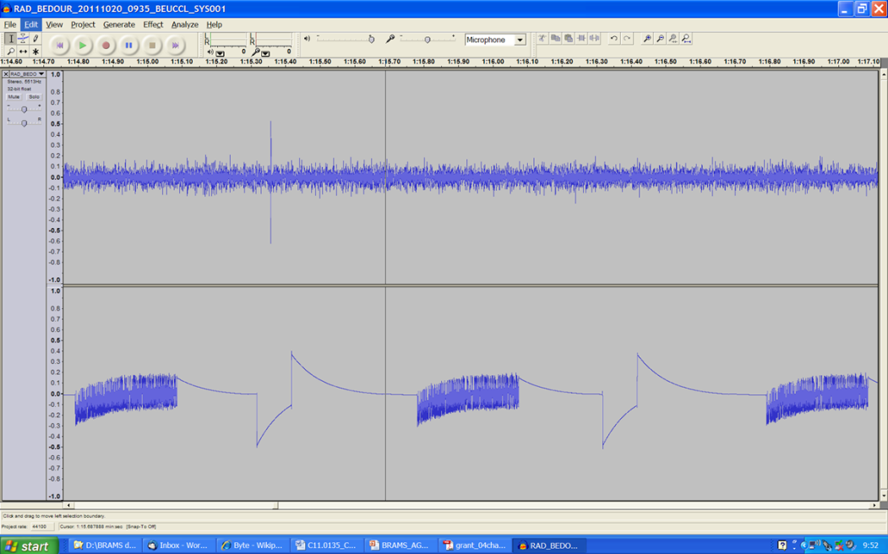
A typical receiving station
Data are saved in audio WAV files every 5 minutes

Slide 9
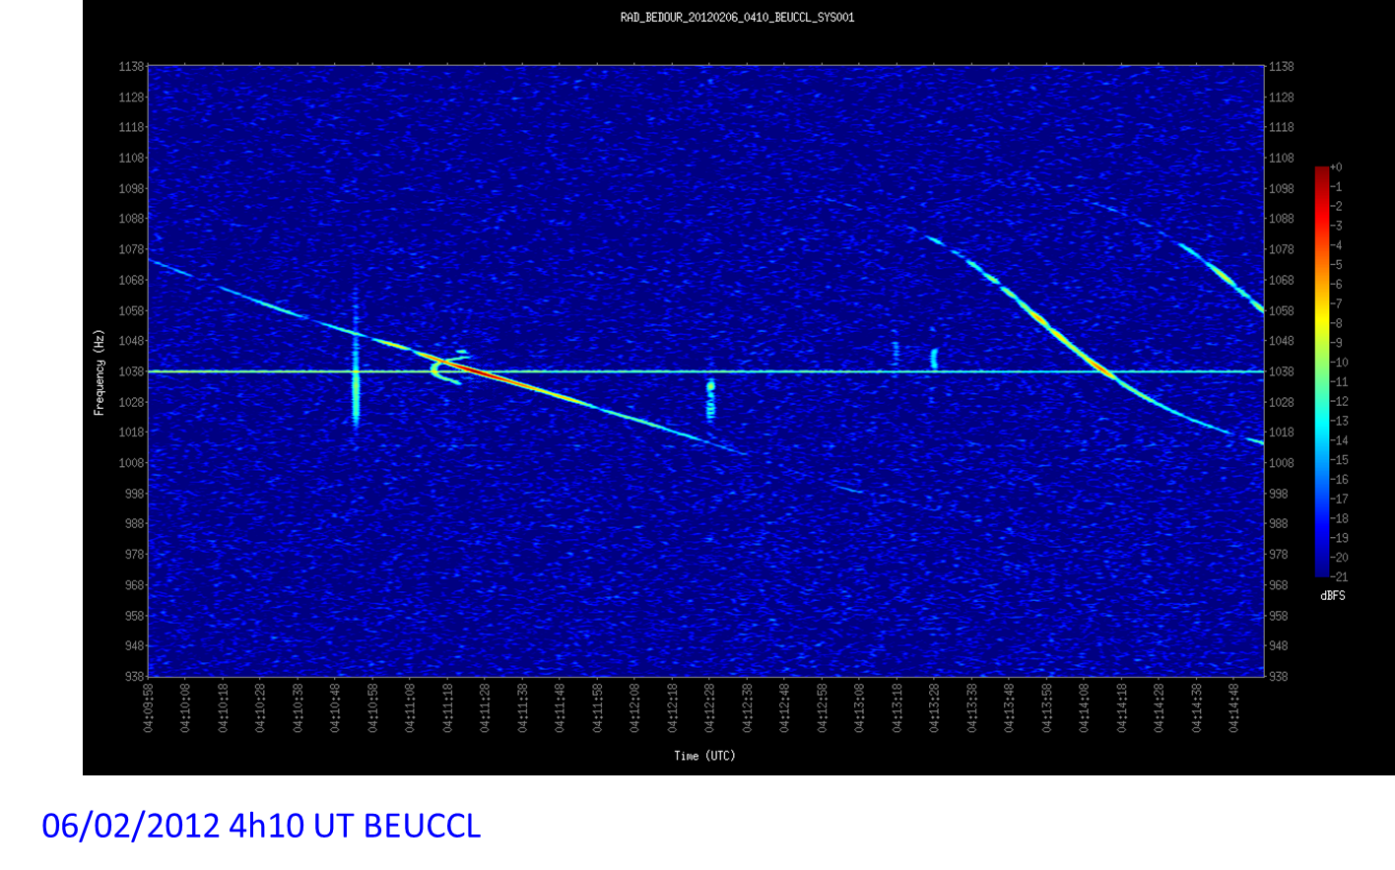
Signal analysis : spectrograms

Slide 10
What does BRAMS provide to amateurs?
Provide all material for free (identical in all stations)
Access to data from all stations & archive of the data
Real-time observations to show to the public
A possibility to educate the public to meteors & radio science (BISA provides posters and articles)

Slide 11
What do amateurs provide to BRAMS ?
Host of most of BRAMS stations
Save data locally on hard disks & make a copy on USB sticks (64 GB) sent every month to BISA for archiving
Electricity bill supported by BRAMS participants
Multi-stations observations allowing to retrieve meteor trajectories
Participation to some projects (e.g. automatic detection of meteors in spectrograms)

Slide 12
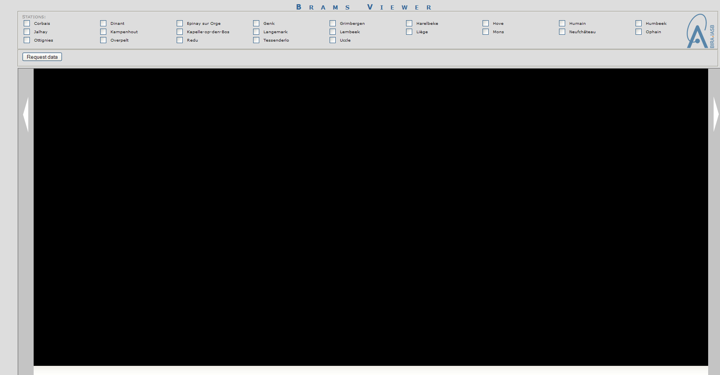
BRAMS viewer

Slide 13
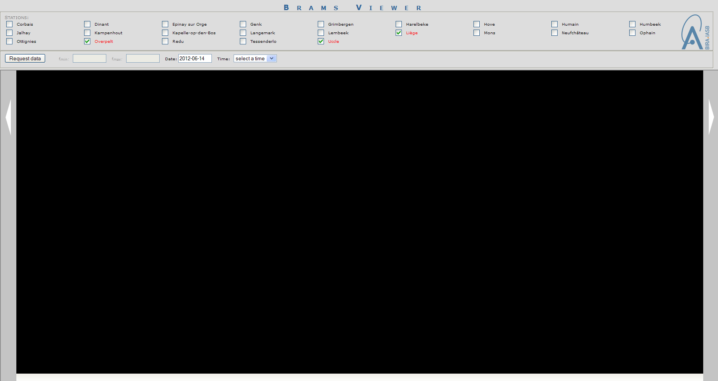
BRAMS viewer

Slide 14
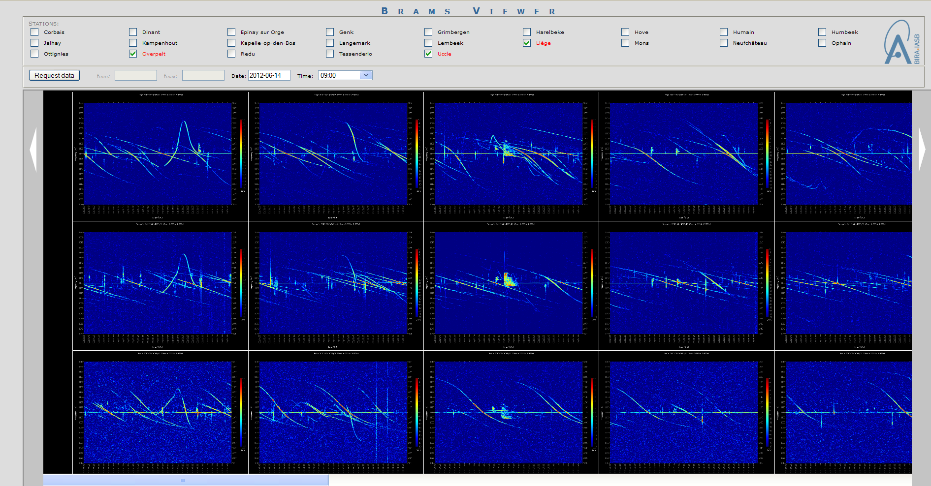
BRAMS viewer

Slide 15
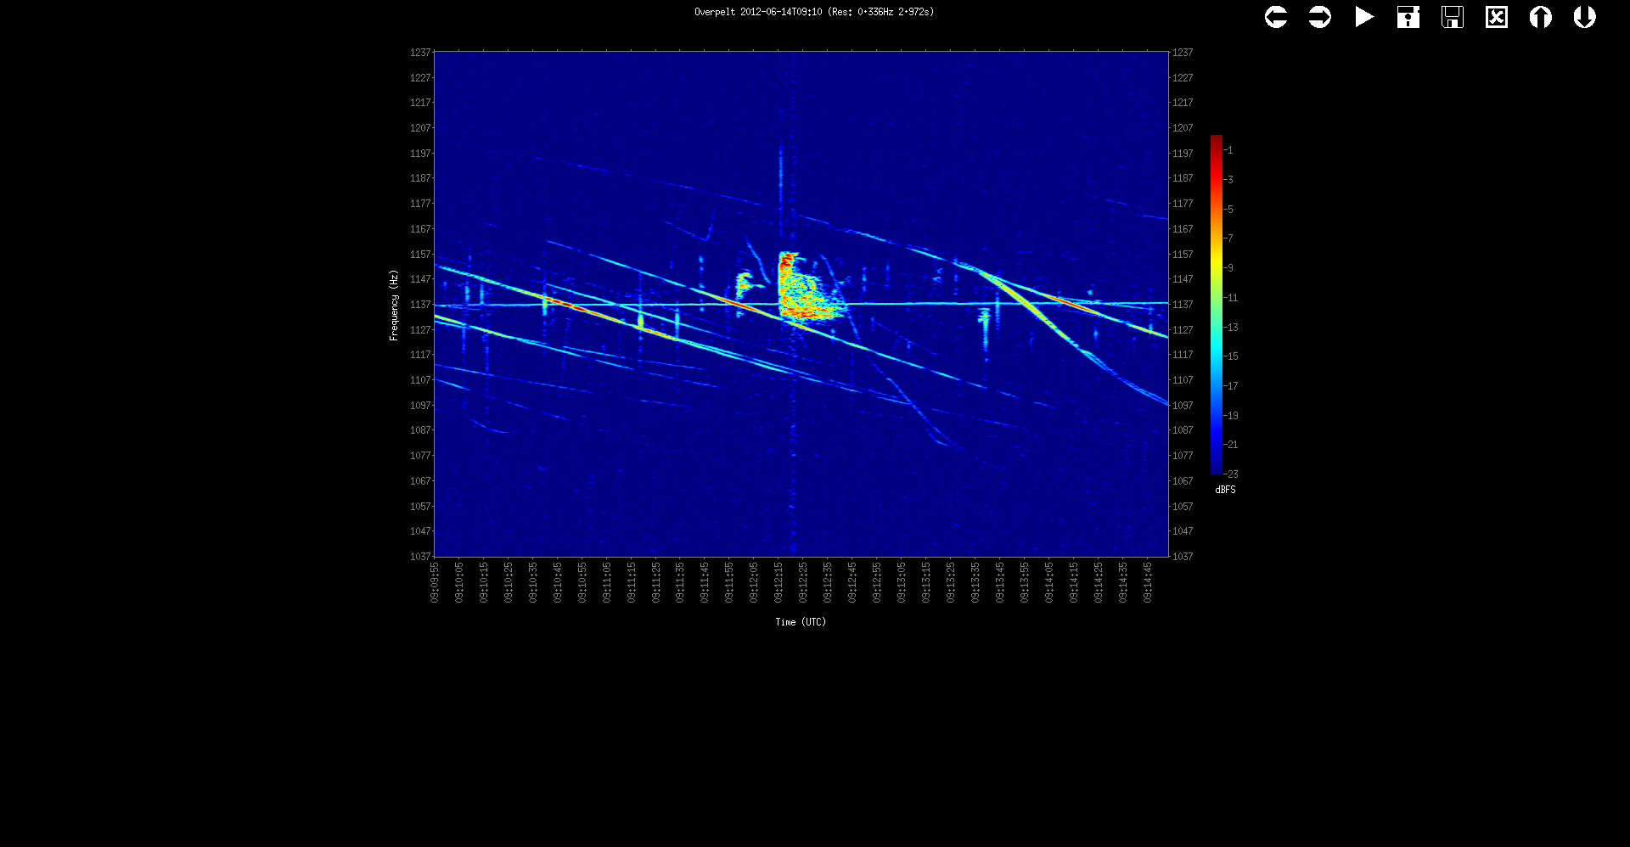
BRAMS viewer

Slide 16
Summary
BRAMS is a new tool to observe & characterize meteors
It is the result of an active Pro-Am collaboration with mutual benefit
In the future BRAMS should be extended outside of Belgium as meteors do know anything about frontiers …

Slide 17
Website
brams.aeronomy.be
THANKS !

