Slide 1
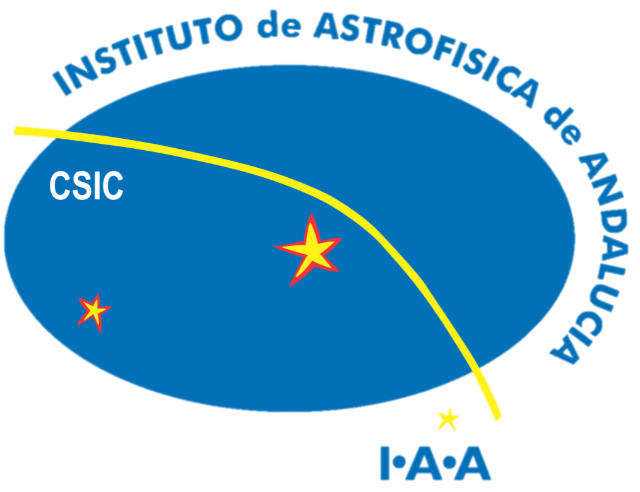
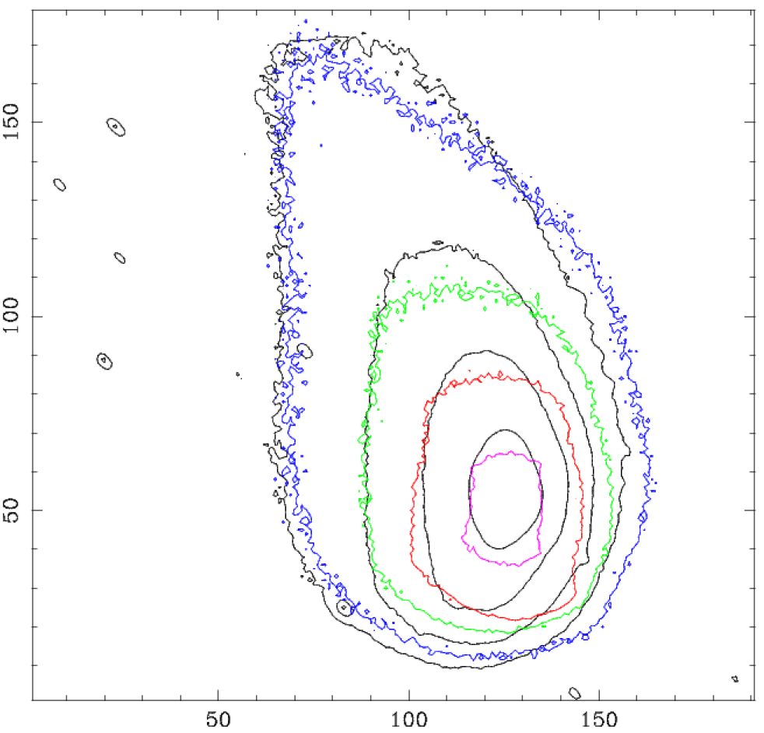
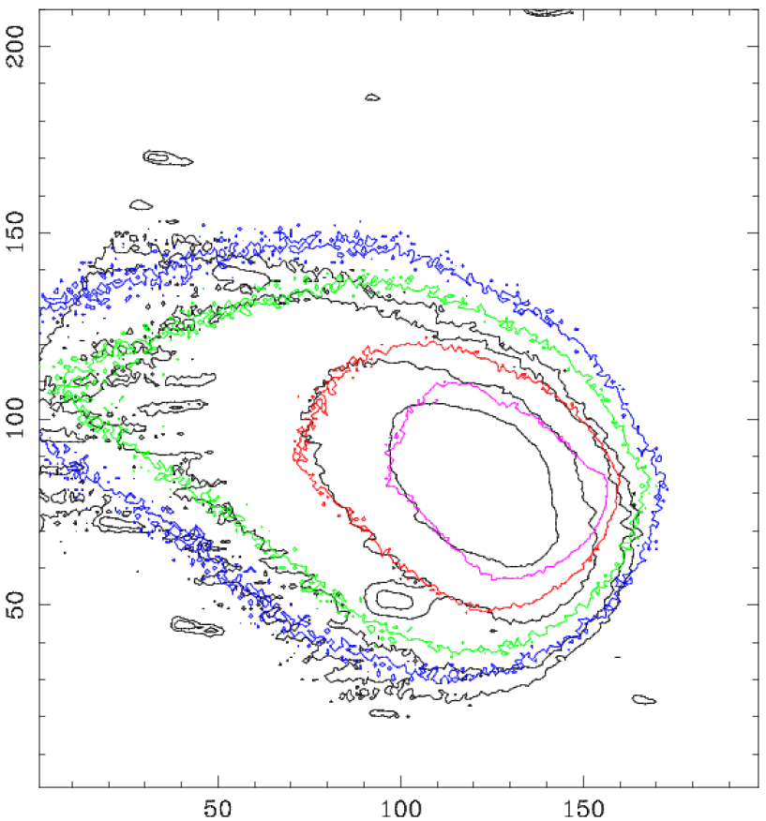
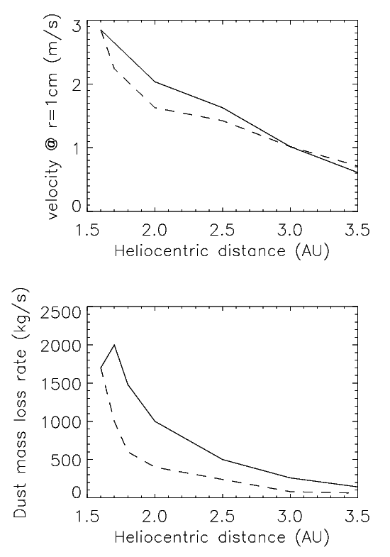
The Dust Environment of Comet 81P/Wild 2
F. Pozuelos (1), F. Moreno(1) , F. Aceituno (1), V. Casanova (1), A. Sota (1) J. Castellano(2) and E. Reina (2)
Instituto de Astrofísica de Andalucía, CSIC, PO Box 3004, 18008 Granada, Spain.
Amateur Association Cometas-Obs
Abstract
In this work we present a optical observations and Monte Carlo model of the dust environment of comet 81P/Wild 2. We run more than 8000 parameters combination for isotropic particle emission pattern in a first step but an anisotropic ejection model is required to fit the complex structure shown by the comet. We include a rotating nucleus with active areas on it. In addition, we also include the asymmetry in the dust parameters respect to perihelion.
The observations of the comet were taken by 1.52m telescope of Sierra Nevada Observatory (OSN) in Granada, Spain. We also benefited from amateur observations carried out by astronomical association Cometas-Obs, providing us a CCD lightcurve and AFρ measurements as a function of heliocentric distance
Fig. 1 81P/Wild 2. Anisotropic and asymmetric model. Thin (black) contours are the observations and thick (colored) contours, the model. The image corresponds to the 2010 apparition,
and were taken at Sierra Nevada Observatory. The observation date are 2010-04-08 (right) and 2010-04-20 (left).
Results
-Only preliminary results are reported because the work is still going on.
-The nucleus size near Rn=2.1Km and geometric albedo is Pv=0.04[6].
-With an isotropic and symmetrical particle emission model we obtain the dust loss rate in range 1000-2000 Kg/s, a maximum size of particle around 1-3 cm, and ejection velocities for particles of 1 cm between 2-4 m/s at perihelion.
-An anisotropic and asymmetrical ejection model will be implemented to improve the results. We include a rotating nucleus with active areas on it with a rotation period of 13.7 hours [7]. The fit shown in figure 1 corresponds to rotational parameters ф=180 ̊and I=-30 ̊ with an active area located between 0 ̊- 30 ̊ and characterized by a constant power index of -3
Fig. 2. 81P/Wild 2.
Lower panel: Dust mass
loss rate vs heliocentric
distance.
Upper panel: ejection
velocity of r=1 cm
glassy carbon spheres
as a function of heliocentric distance. In both panel,
the solid line corresponds
to pre-perihelion,
and the dashed line
to post-perihelion.
References
[1] Ishiguro, M., Sarugaku, Y., Ueno, M., Miura, N., Usui, F., Chun, M.-Y., and Kwon, S.M., 2007, Icarus, 189, 169
[2] Lamy, P.L., Toth, I., Jorda, L.,Groussin, O., A'Hearn, M.F, Weaver, H.A., 2002, Icarus, 156, 442
[3] Lowry, S.C., Weissman, P.R., 2003, Icarus, 164, 492
[4] Davis, J.K., Sykes, M.V., Reach, W.T., et al., 1997, Icarus, 127, 251
[5] Sykes, M.V., & Walker, R.G., 1992, Icarus, 95, 180
[6] Brownlee, D.E., et al., 2004, Science, 304, 1764
[7] Muller, B.E.A., et al., 2010, BAAS, 42, 966

