Slide 1
Closing in on Compositions of Highly-Irradiated Exoplanet Atmospheres
M. Hollis, G. Tinetti; UCL
M. Swain, P. Deroo; JPL

Slide 2
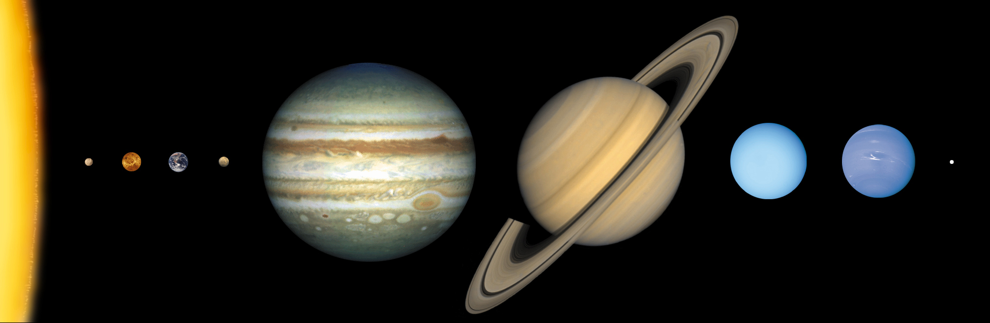
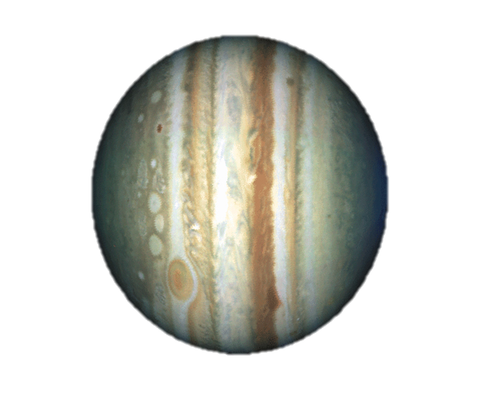
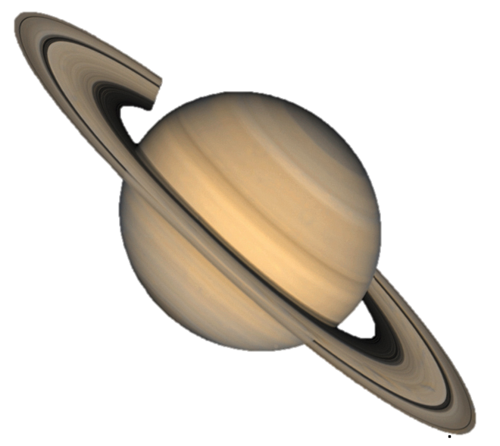
CONTENTS
Probing classes of hot-Jupiters
- atmospheric chemistry
- unresolved degeneracies
- a new methane line list
Application – HD189733b
- constraining abundances
3. Application – WASP-12b
- a new transmission spectroscopy code
- birth of the Super-hot Jupiter class?

Slide 3
PROBING CLASSES OF HOT-JUPITERS

Slide 4
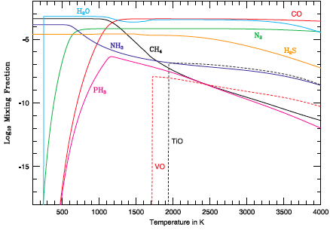
Atmospheric chemistry
Equilibrium Chemistry
IRIS / Voyager R = 4.3 cm-1
Voyager /UVS
e.g. Hubeny et al. (2003);
Fortney et al. (2008)
Sharp & Burrows (2007)

Slide 5
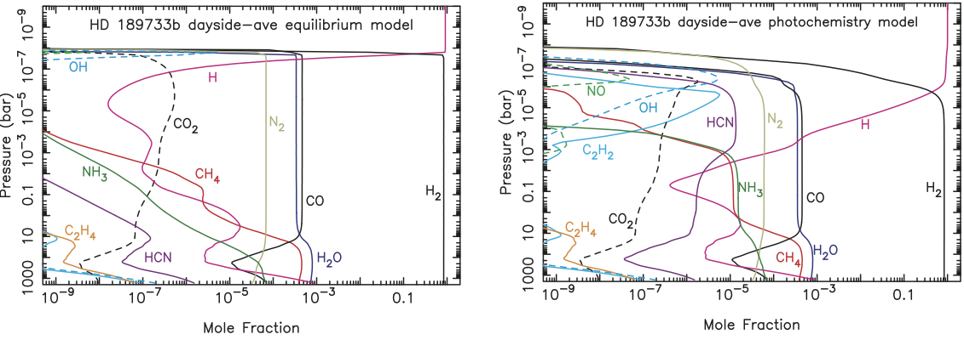
Atmospheric chemistry
HD189733b
Moses et al. (2011)
Also: Liang et al. (2003), Line et al. (2011), Venot et al. (2012)

Slide 6
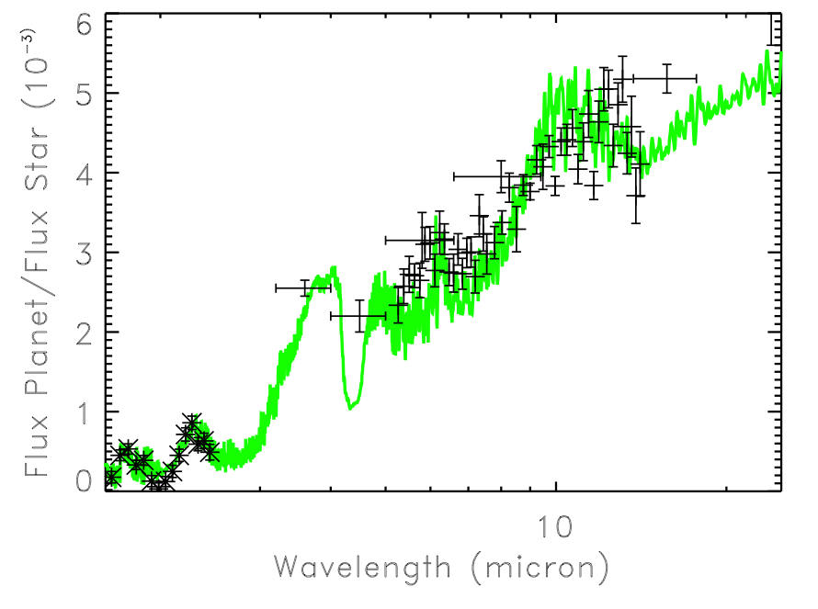
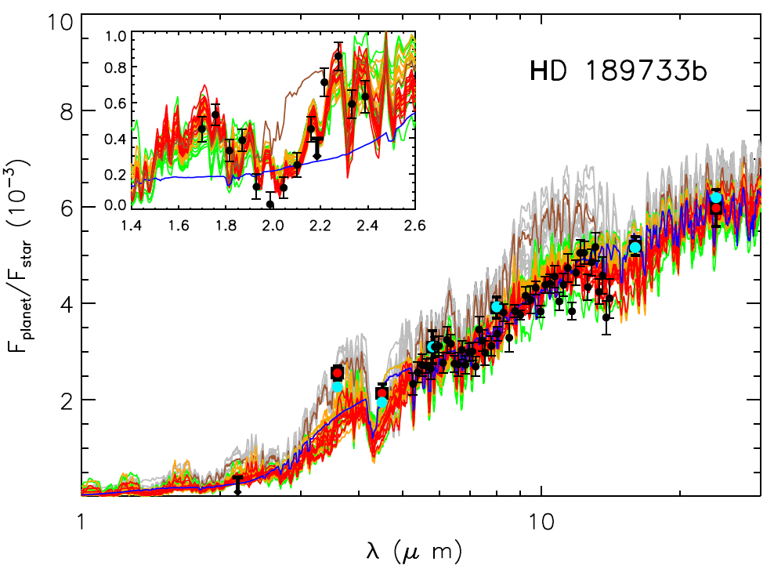
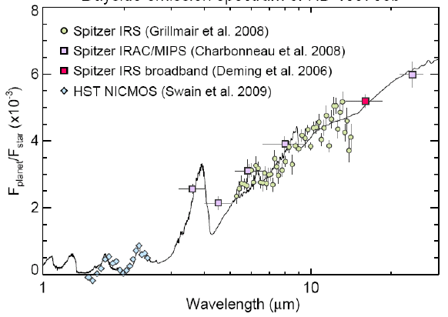
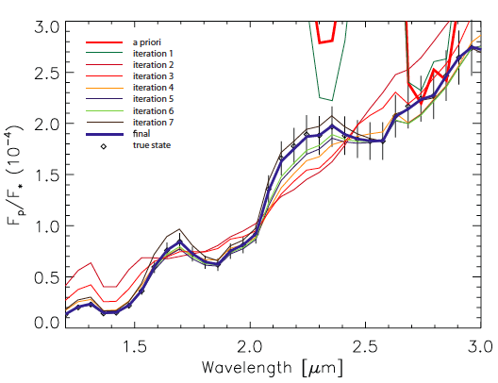
Observations: spectroscopy
HD189733b, day-side
CO₂
CH₄
H₂O
Model: S10
Model: M09
Model: Lee12
Model: Line12
Swain et al. (2010); Madhusudhan et al. (2009); Lee et al. (2012); Line et al. (2012)

Slide 7
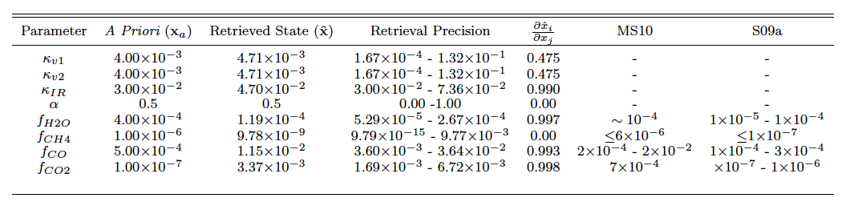
Observations: spectroscopy
HD189733b, HD209458b …
Models agree on composition, differences in mixing ratios are often due to different line lists
Madhusudhan et al. (2010); Swain et al. (2009a)
H₂O, CH₄, CO, CO₂

Slide 8
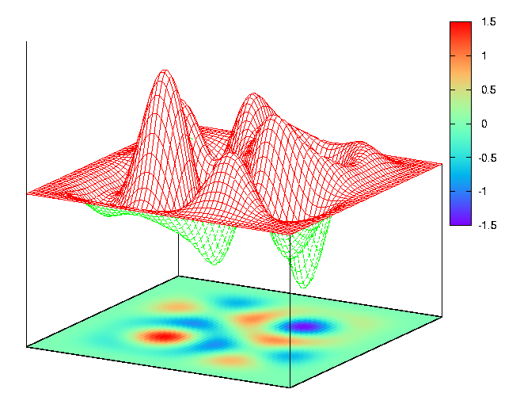
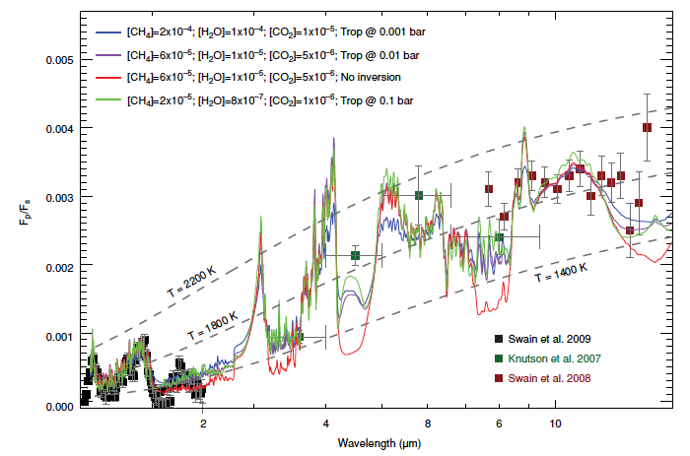
Exploring parameter space
DEGENERACIES
T-P profiles/inversions
radii
abundances (mixing ratio retrieval)
HD209458b, dayside
Swain et al. (2009b)

Slide 9
Degeneracy: radii, abundances
What is R_{p} @ 1 bar?
Degeneracy with mixing ratios!

Slide 10
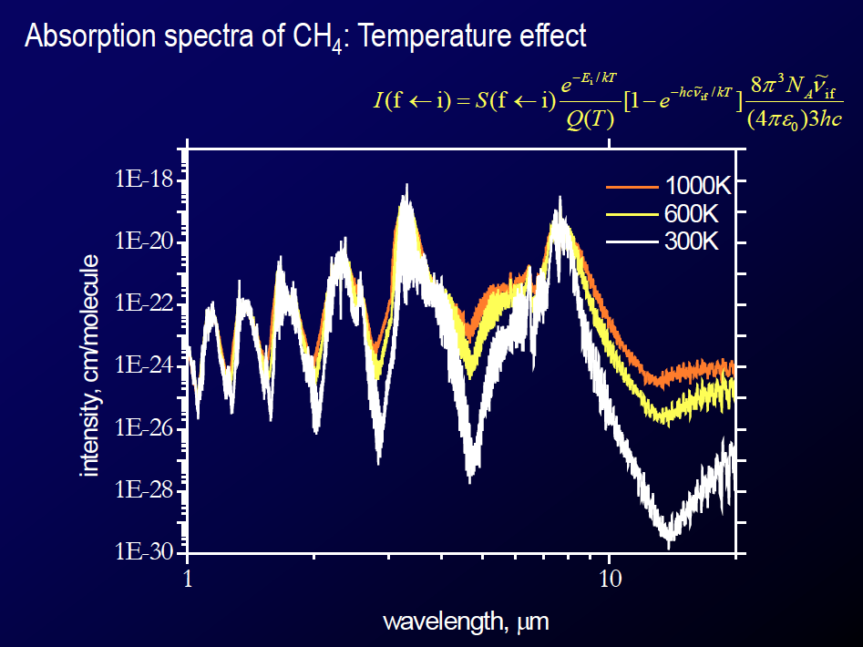
A new methane line list
S. Yurchenko et al. (in prep.)

Slide 11
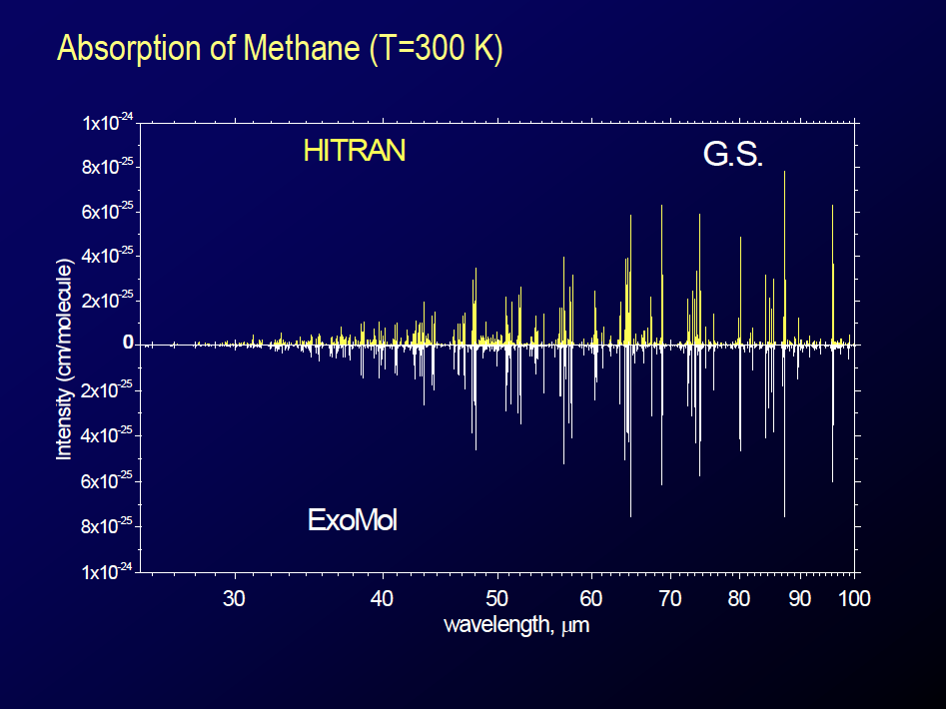
A new methane line list
S. Yurchenko et al. (in prep.)

Slide 12
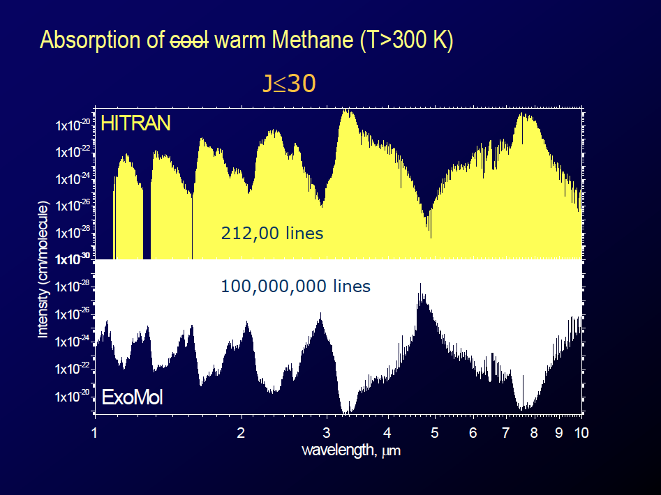
A new methane line list
S. Yurchenko et al. (in prep.)

Slide 13
Application: HD189733b

Slide 14
APPLICATION: WASP-12b
Hebb et al. (2009)

Slide 15
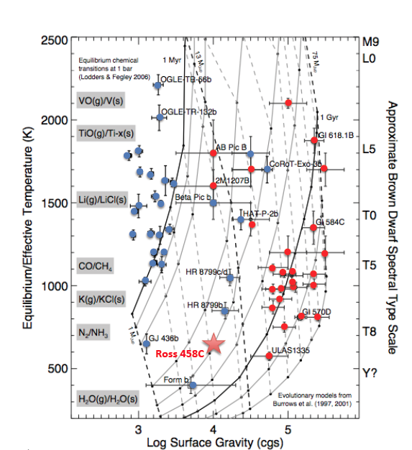
Application: WASP-12b
WASP-12b
M ≈ 1.4 M_{Jup}
R ≈ 1.7 R_{Jup}
a ≈ 0.02 AU
T_{eq} ≈ 2500K
EGPs
see e.g. Torres et al. (2008),
Marois et al. (2008)
BDs
see e.g. Kirkpatrick et al. (2001),
Wilson et al. (2001)
Burgasser (2011)

Slide 16
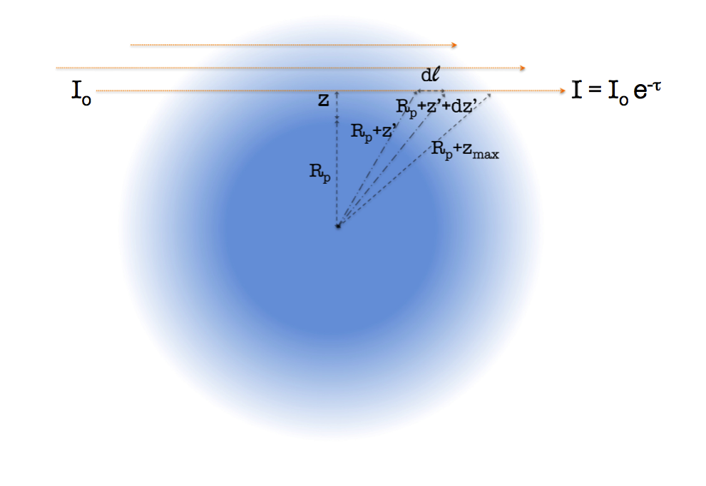

Transmission spectroscopy
Line-by-line radiative transfer
Inputs: atmospheric T-P profile, absorption cross-sections, basic system parameters, modelled abundances
Output: absorption depth, κ(λ)
Assume cloud-free, but include Rayleigh (Liou, 2002) and H2-H2
  CIA (Borysow, 2002)
see Hollis et al. (in prep.)

Slide 17
Application: WASP-12b
Swain et al. (sub.)

Slide 18
Application: WASP-12b
Swain et al. (sub.)

Slide 19
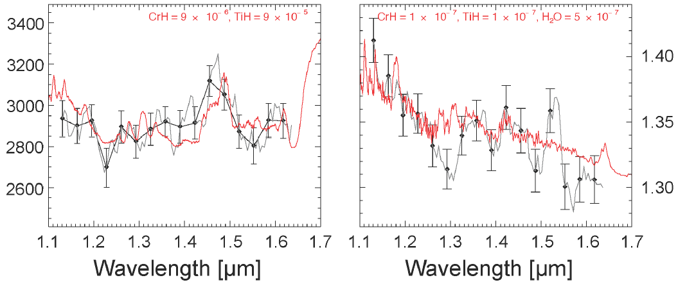
Application: WASP-12b
Swain et al. (sub.)
day-side terminator
Metal hydrides? T inversion?

Slide 20

Conclusions
H₂O, CH₄, CO, CO₂ present in most Hot-Jupiters analysed with T < 1500 K.
Degeneracies exist between interpretations, mixing ratios, radii, thermal profiles.
More data at higher resolution/SNR, and over broader wavelength range, desirable to break the degeneracy (also better line lists for methane, metal hydrides, hydrocarbons etc.)
Super-hot Jupiters, with more exotic compositions towards L- and T-dwarfs (‘pM’ and ‘pL’ class planets e.g. Fortney et al. (2008))?

Slide 21
References
Sharp et al., ApJ.SS. 168 (2007)
Hubeny et al., ApJ. 594 (2003)
Fortney et al., ApJ. 678 (2008)
Moses et al., ApJ. 737 (2011)
Liang et al., ApJ. 596 (2003)
Line et al., ApJ. 738 (2011)
Venot et al., arXiv:1208.0560 (2012)
Swain et al., Nature 463 (2010)
Madhusudhan et al., ApJ. 707 (2009)
Lee et al., MNRAS 420 (2012)
Line et al., ApJ. 749 (2012)
Madhusudhan et al., ApJ. 725 (2010)
Swain et al., ApJ.L. 690 (2009a)
Tennyson et al., MNRAS sub.
Swain et al., ApJ. 704 (2009b)
Waldmann et al., (submitted)
Marley et al., arXiv:0803.1476 (2008)
Yurchenko et al., (in prep.)
Rothman et al., App.Opt. 26 (1987)
Hebb et al., ApJ. 693 (2009)
Burgasser, PASP 450 (2011)
Torres et al., ApJ. 677 (2008)
Marois et al., Science 322 (2008)
Kirkpatrick et al., ApJ.SS. 197 (2001)
Wilson et al., AJ. 122 (2001)
Swain et al., (Icarus sub.)

