Slide 1
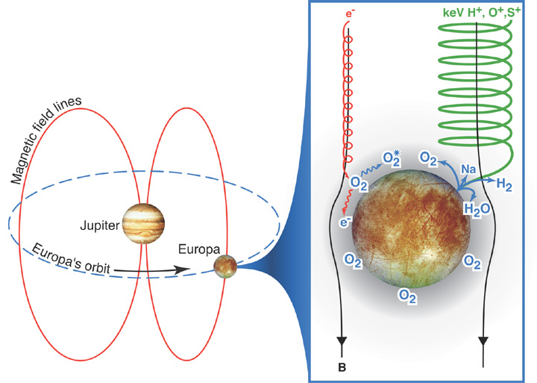
Sputtering at Europa
History and Outlook
Tim Cassidy, with help from Fran Bagenal, Ben Teolis, Chris Paranicas

Slide 2
Europa’s O₂ atmosphere is created by ion sputtering of its surface.
Ions eject H₂O, O₂ & H₂ but only the O₂ sticks around.
To get the sputtering rate, multiply ion flux by sputtering yield.
S ion flux
S ion sputtering yield
Energetic ions
“Cold” ions (~100 eV Maxwellian)
most of the flux comes from these
Notes:
introduce hot/cold.

Slide 3
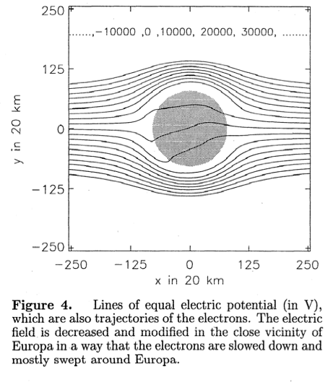
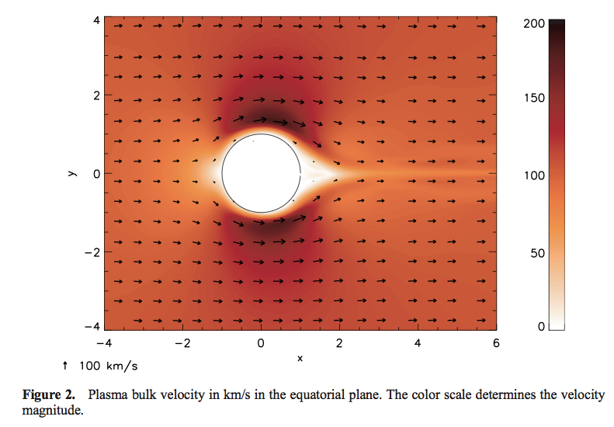
But that ion flux shown above assumes that the ions flow straight onto Europa’s surface…
which modeling suggests does not happen: cold ions are diverted around Europa
Saur et al. (1998)
Schilling et al. (2008)

Slide 4
Some plasma must reach surface to produce the observed O₂ atmosphere.
Is it a feedback?:
Plasma (ions) creates exosphere
Plasma (electrons) creates ionosphere from exosphere
Ionosphere limits plasma bombardment
Some equilibrium is reached

Slide 5
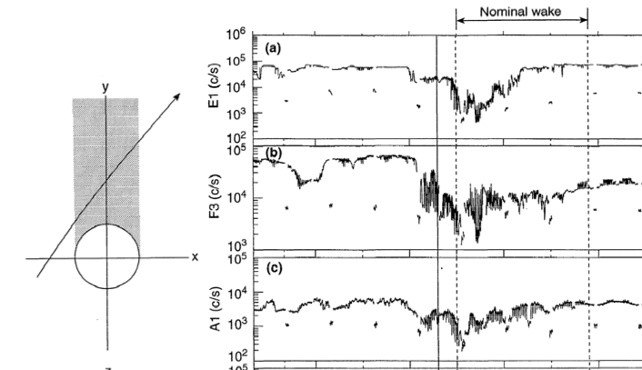
Or maybe O₂ is created energetic particles that are less affected by plasma diversion?
Energetic (10s – 100s keV) electron & ion wake:
suggests that these energetic particles are absorbed by body
Paranicas et al., 2000

Slide 6
To figure this out we need to understand the sputtering yield (number of ions ejected per incident particle).
What creates O₂? Cold ions? Energetic ions? Which species? O, S, H?
We are now in a position to address this problem because of recent breakthroughs in sputtering.
spoiler: “cold” ions, mostly O^{n+}, produce the O₂ exosphere

Slide 7
A little history:
Brown et al. (1978) discover electronic sputtering, that ice is very effectively eroded by energetic ions
Johnson et al. (1982) predict that the result will be an O₂ exosphere: sputtering ejects mostly H₂O from ice, along with a small fraction of H₂ and O₂. But the O₂ will stick around to make an exosphere while the H₂O freezes to the surface and the H₂ escapes.
This paper also introduced the idea of a self-limiting exosphere:
the exosphere will build up until ion/neutral collisions stop sputtering
Hall et al. (1995) OI emission from O₂ detected

Slide 8
Then came actual models of the O₂ atmosphere, what did they use for ion flux and sputtering yields?
The O₂ production was assumed to be some fraction of the total sputtering yield (which is mostly H₂O)
Total yields were estimated by Shi et al. (1995) and others. The total H₂O yield is dominated by energetic S ions, which have low flux but large sputtering yields.
S ion flux
S ion sputtering yield
Energetic ions
“Cold” ions (~100 eV Maxwellian)
most of the flux comes from these

Slide 9
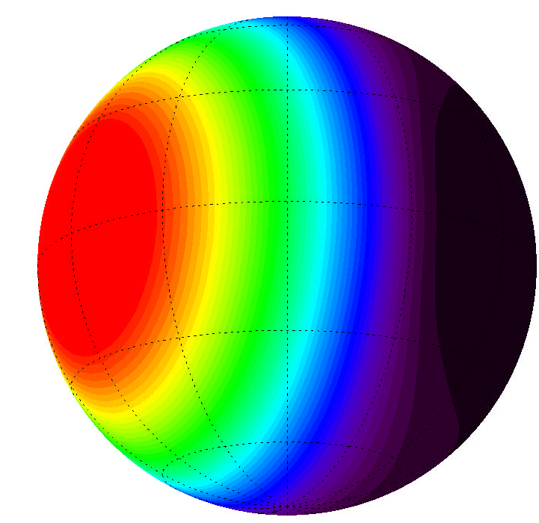
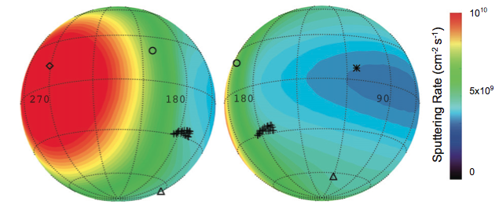
Side note: they assumed that the pattern of sputtering followed the ‘bullseye’ of cold ion bombardment (E.g., Pospieszalska and Johnson, 1989)
Partial list of papers based on
this picture of O₂ production:
Ip (1996)
Saur et al. (1998)
Smyth and Marconi (2006)
Cassidy et al. (2007)
Schilling et al. (2008)
Plainaki et al. (2012)
But energetic ions hit the surface more uniformly so the sputtering rate actually looks like this:
Cassidy et al., 2012

Slide 10
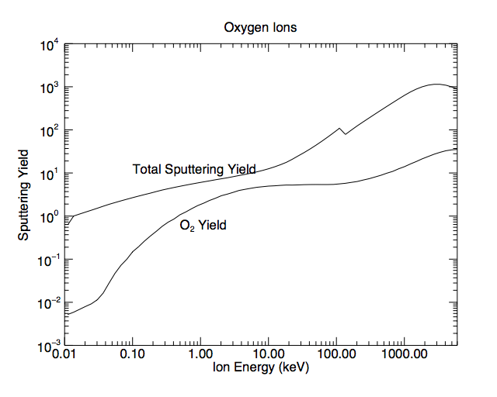
Then Teolis et al. (2010) showed that the O₂ yield is not a fixed fraction of the total yield:
O₂ yield plateaus where total yield takes off

Slide 11
Here is the resulting sputtering rate (O₂ only this time):
“Cold” ions (~100 eV Maxwellian)
“Hot”/non-thermal ions
Conclusion: Cold ions (especially oxygen ions) responsible for O₂ production

Slide 12
The O₂ sputtering rate with the new O₂ sputtering yields, calculated assuming that Europa is electromagnetically inert, is
10²⁶ s⁻¹
which is really quite small, an order of magnitude smaller than previous estimates (e.g., Saur et al., 1998, Smyth and Marconi, 2006).
These cold ions are also susceptible to flow diversion/slowing will only make this smaller.
Schilling et al. (2008)

Slide 13
Saur et al. (1998) estimated that only 1/5th of these cold ions reach the surface.
So we have an interesting feedback process:
cold ions create the exosphere but they also divert/slow plasma flow because they create the ionosphere.
O₂ sputtering yield by O ions
Cold ions hit with this energy, slowing flow will lower yield
But how do we get enough O₂ to account for observations? 10²⁶ s⁻¹ is probably likely the upper limit (since it was calculated without diversion/slowing)
Lower loss rates?
Re-sputtering?

Slide 14
Conclusions
With new O₂ sputtering yields (Teolis et al., 2010) we have a clear idea of what species create Europa’s exosphere.
We are now in a position to model a fascinating system:
Plasma flux creates the exosphere and limits plasma flux. This interesting idea has not been adequately explored.
But the modeling community is divided between people who
work on plasma (Kabin et al., Schilling et al., Lipatov et al.)** and assume static atmospheres
&
people who work on atmospheres (Shematovich et al., Cassidy et al., Plainaki et al.,) but assume static plasma.
**Saur et al. (1998) is an exception

Slide 16
Extra slides

Slide 17
That’s the pattern of the dominant cold ions, but the energetic ions have much larger sputtering yields
Hydrogen
Helium
Nitrogen
Oxygen
Total sputtering yield
Blue: Fama (2008)
Red: Johnson (2004, 2009)
Sputtering Yield
Sulfur
Argon
Ion Energy (eV)
Cassidy et al., 2012

Slide 18
“Cold” ions (~100 eV Maxwellian)
“Hot”/non-thermal ions

Slide 19
Cumulative plot indicates that 100 keV to several MeV ions do most sputtering
“Cold” ions (~100 eV Maxwellian)
“Hot”/non-thermal ions
Cold ion contribution: a slight bump to the cumulative sputtering rate.

Slide 20
The cumulative plot shows that it’s the cold ions
Steep slope means that most of the sputtering takes place around 1 keV, the cold ion ram energy
By comparison the hot ions only produce about 1/5th that much O₂.

