Slide 1
EnVision
Taking the Pulse of our Twin Planet

Slide 2
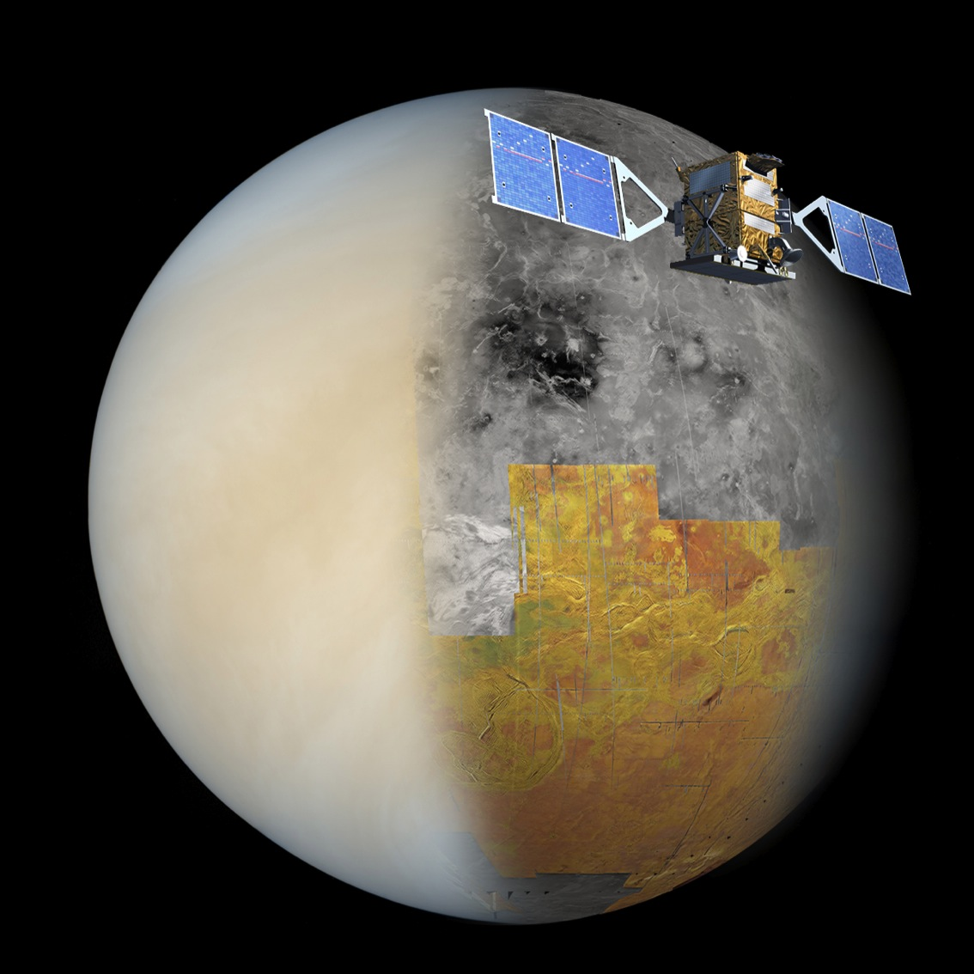
The History of EnVision
EnVision is the European Venus InSAR Mission
Proposed in response to the 2010 ESA Medium Class mission call.
Originally planned to launch in 2021 or 2023.
Designed to operate for 5 years, and possibly up to 10 years.
A fully European mission but open to collaboration.
Based primarily on Sentinel-1 technology.
Showcases ESA’s capability in Earth Observation.

Slide 3
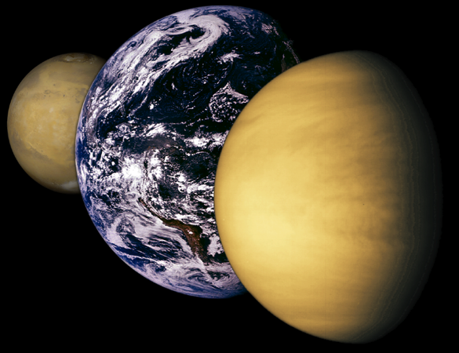
Why Return to Venus?
On launch, EnVision will be the first radar to return to Venus in the 30 years since Magellan, and will be as transformative as Mars Express was to Viking.
In the search for life (exo-Earth’s), Mars has had unprecedented attention but new missions to the red planet now bring only an incremental change in understanding.
EnVision offers paradigm-changing new data using technological advances in Earth Observation applied cost effectively to Venus.
It will help reveal whether newly discovered exo-Earth’s are more similar to Venus than Earth.
EnVision will answer many of the remaining unknowns about our nearest and strangest twin.
NASA/JPL

Slide 4
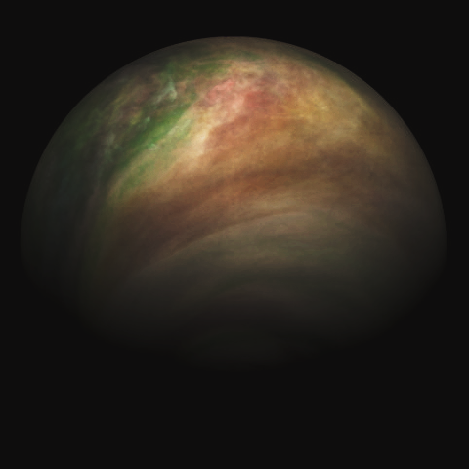
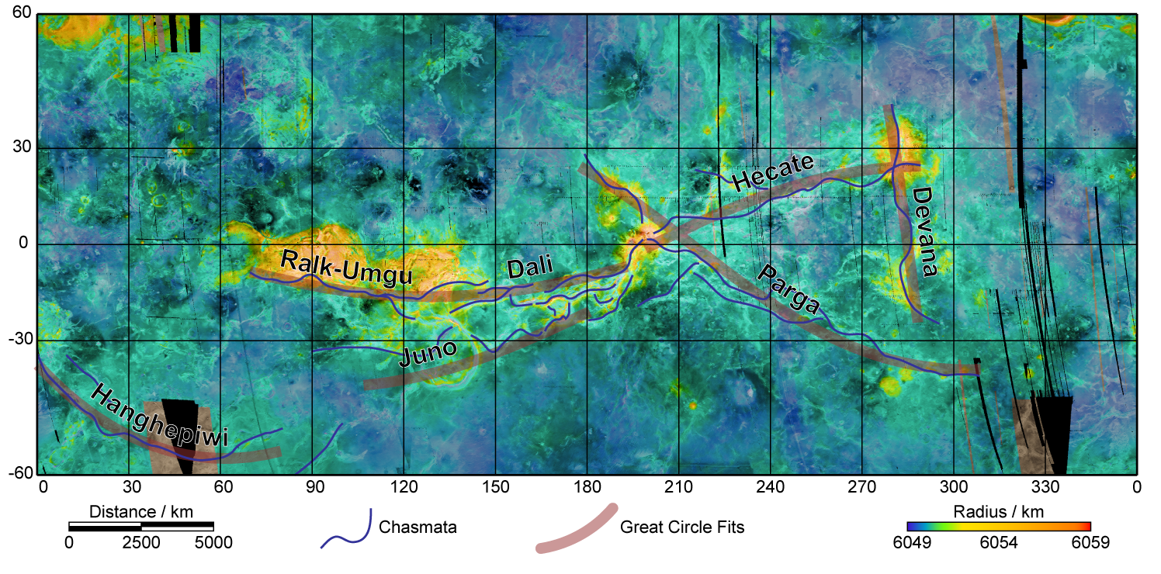
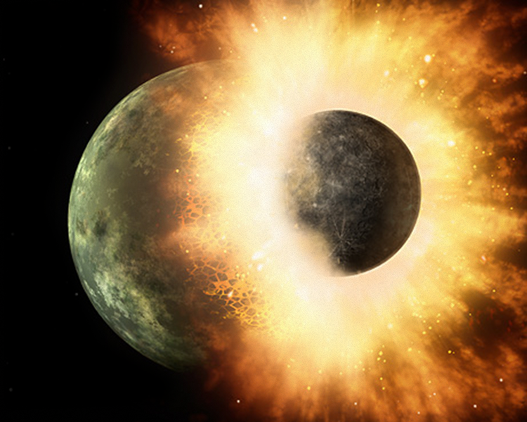
The Mystery Lady
Venus South Polar Vortex, Venus Express (ESA)
NASA

Slide 5
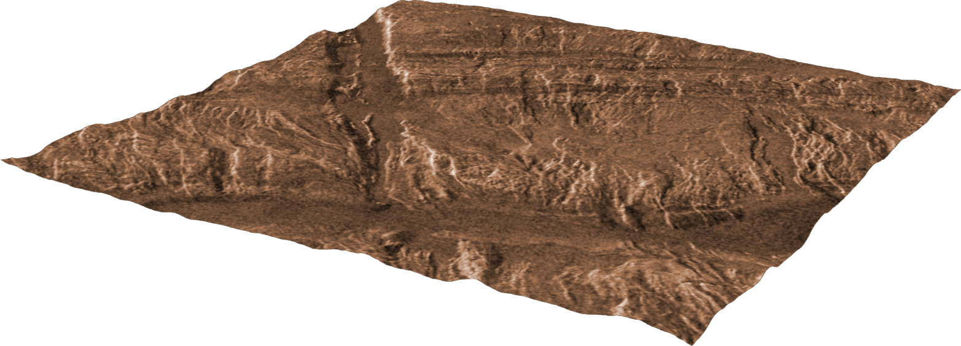
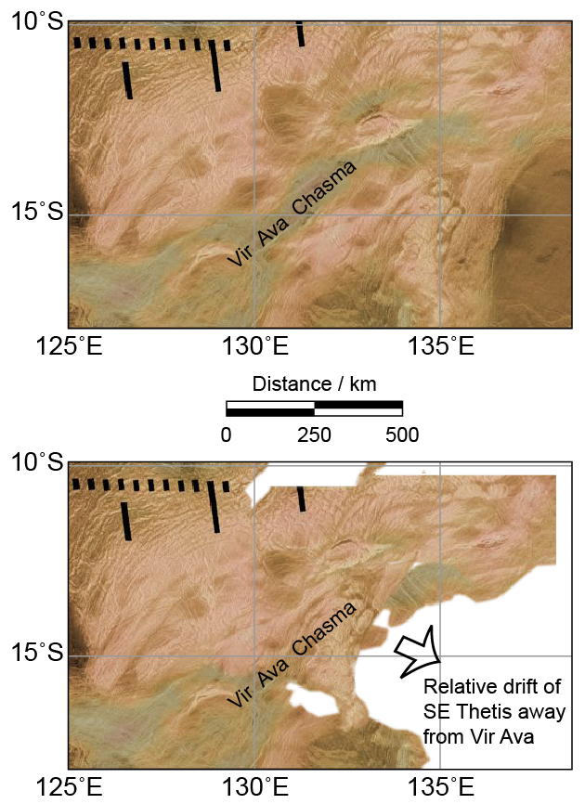
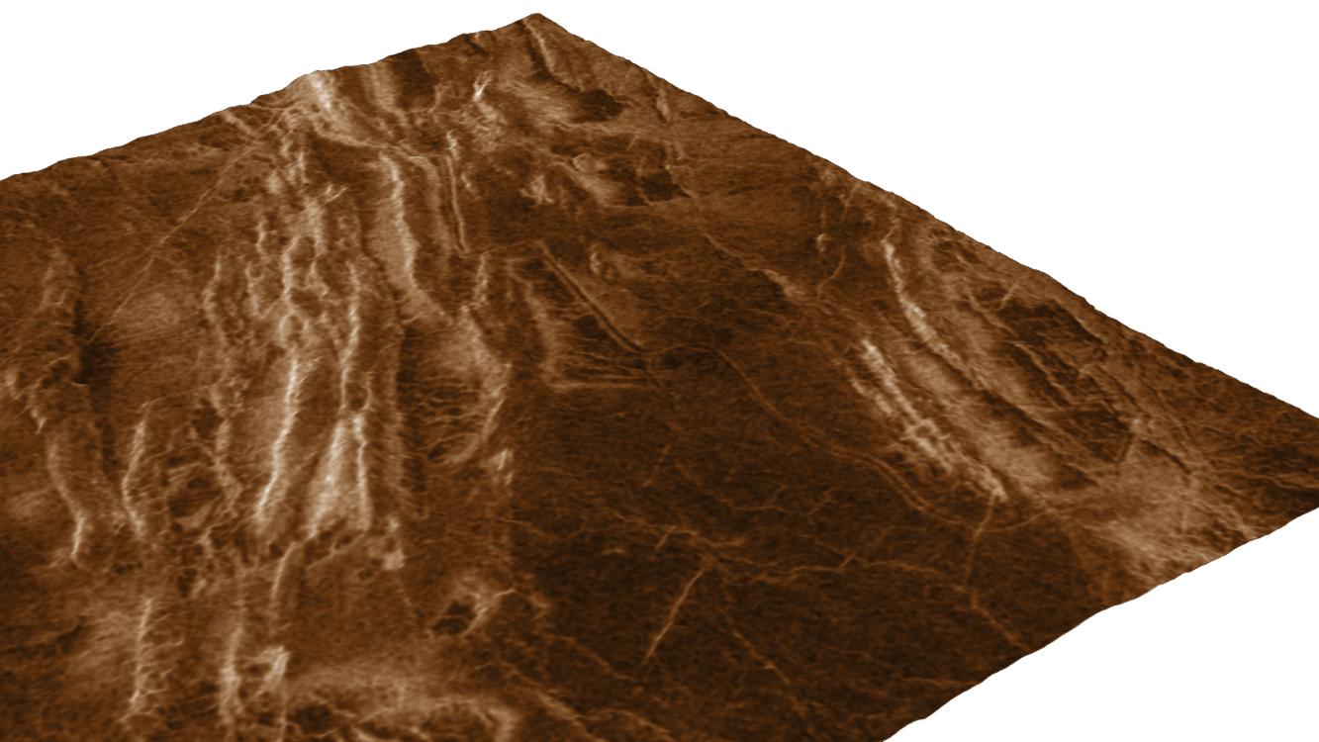
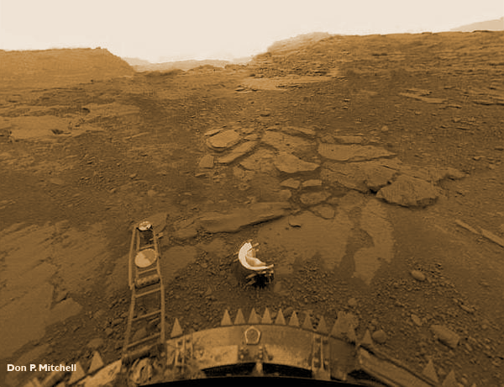
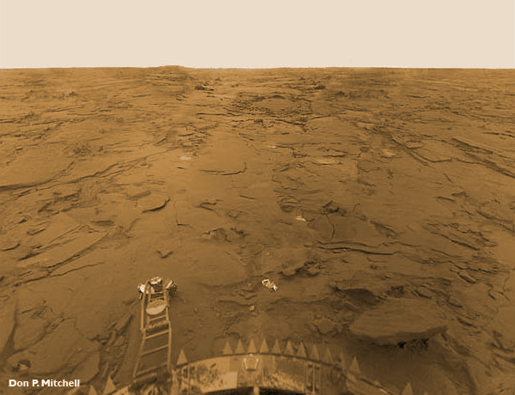
How Active is Venus?
Venera 13
Venera 14

Slide 6
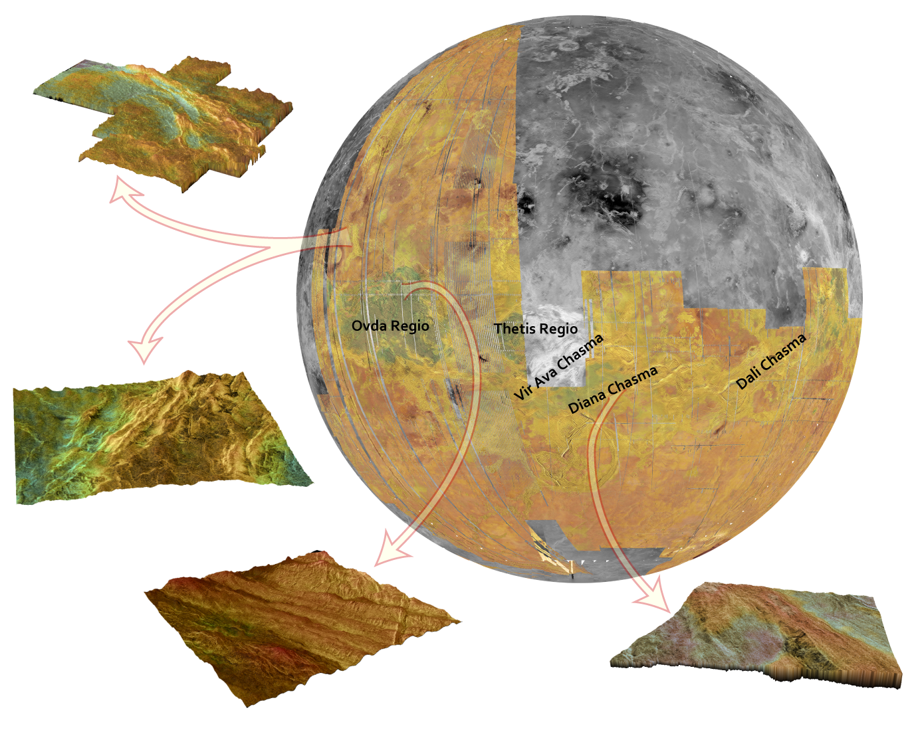
Change Detection
EnVision’s primary aim is to determine rates of change and their causes; solar, atmospheric and geological.
At its core is an InSAR system that will:
Obtain repeated 30-m resolution InSAR imaging;
Produce interferometric baseline DEMs with millimetric vertical accuracy;
Detect surface elevation changes of a few mm over a 5 year period;
Estimate rates of weathering and surface alteration from InSAR decoherence data.

Slide 7
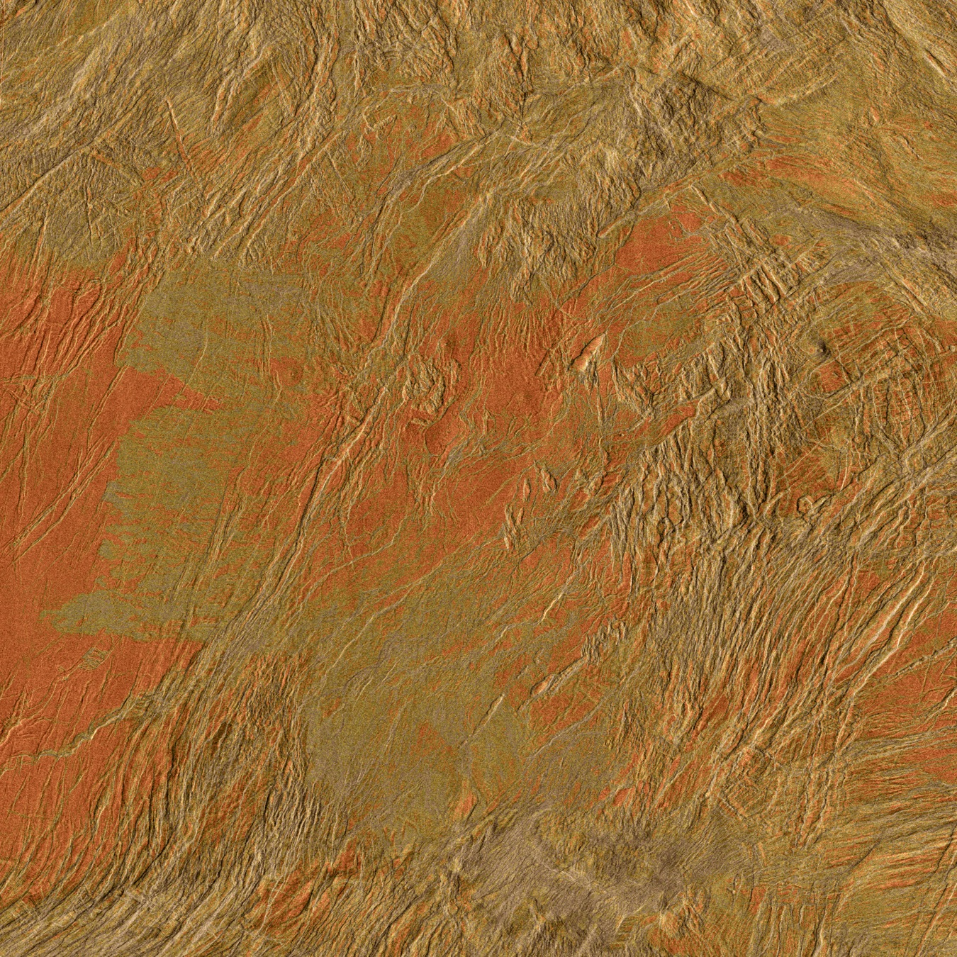
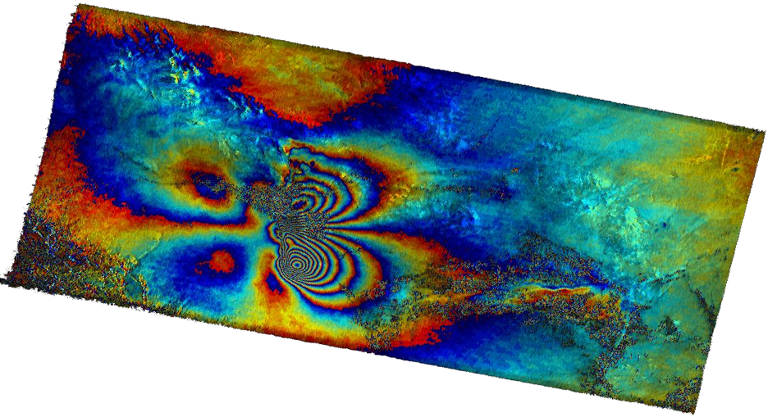
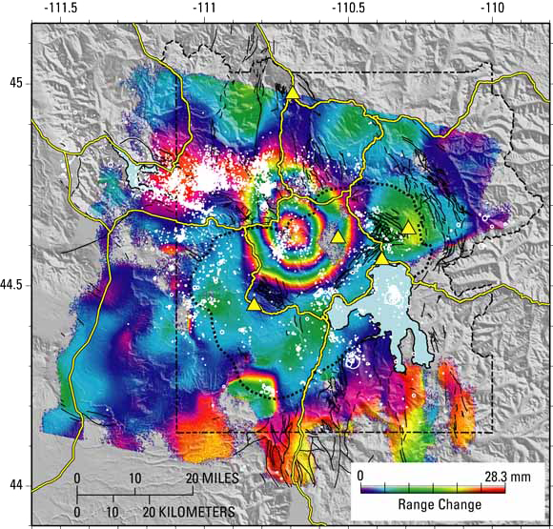
What Can InSAR Do?
The principal benefit of InSAR is that it can detect very small changes in the relative position of the ground over a wide area and over many years.
The Yellowstone National Park caldera is clearly visible using InSAR data as a rising dome.
The movie shows periodic inflation and deflation of Mount Etna during its eruption cycles.
© ESA / Envisat ASAR
InSAR spots fault line deformation associated with the Bam earthquake, Iran, while wind-blown sand is detected as decoherent features.
ESA/NASA/JPL-Caltech
© USGS
Magellan SAR image of volcanic deposits in Aphrodite Terra

Slide 8
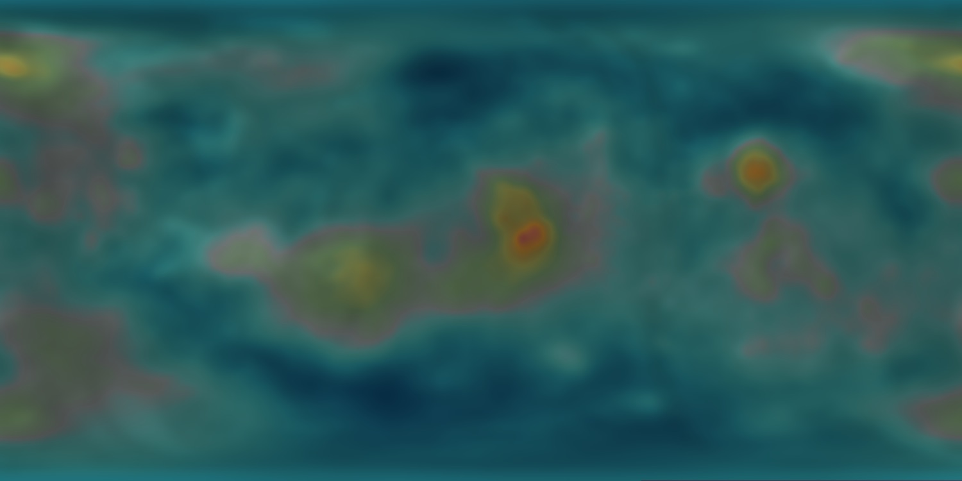
EnVision is an holistic mission
A double Langmuir probe, neutral ion spectrometer and a triaxial magnetometer, will continuously monitor the space environment from EnVision’s unique 300-km circular orbit
UV, IR and Lidar will resolve cloud topography, structure and wind speed, day and night
ESA
ESA
SAR altimetry, imaging and tracking will provide geologically-meaningful gravity and geoid data
Synthesised illustration of improvement in goeid

Slide 9
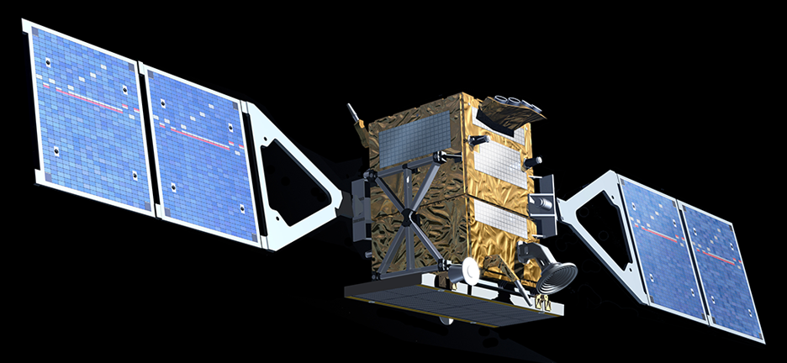
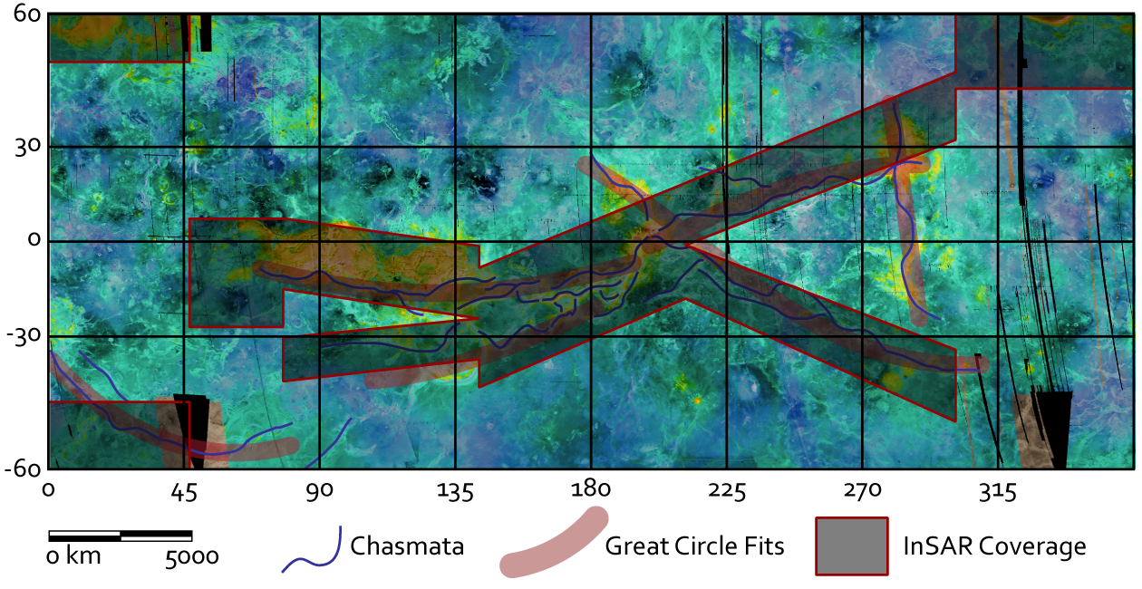
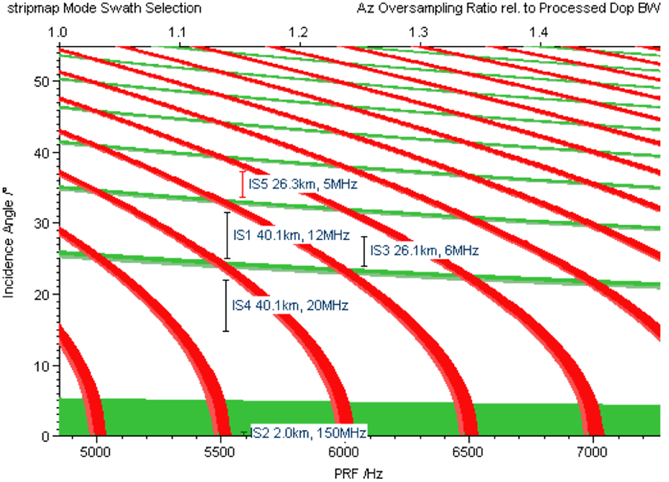
ESA Review of the M3 Proposal
Technical issues raised include the use of aerobraking to circularise the orbit, cooling of the InSAR to permit global coverage, and the high data return rates.
However, it raised a lot of interest in the M3 science review and with spare mass and plentiful power, your suggestions and involvement are very welcome.

Slide 10
Opportunities
Europe is a global leader in radar remote sensing but InSAR has never been attempted around another planet.
EnVision will demonstrate Europe’s leading scientific, technological and logistical capabilities.
EnVision is intended to be a comprehensive, holistic mission dedicated to understanding our nearest ‘exo-Earth’.
A new proposal is planned in response to the next call, expected in 2014.
Now is the time to put forward suggestions, wish-lists and instruments:
Get involved and make this mission a European success story

