Slide 1
Comparative global energy budgets for Earth, Mars and Venus
P. L. Read, S. Chelvaniththilan, P. G. J. Irwin,
S. Knight, S. R. Lewis, J. Mendonça,
L. Montabone and the MCD Team.

Slide 2
Global energy budgets and climate
Climate, weather and global circulation in a planetary atmosphere are largely determined by the amount and distribution of incoming radiation from the Sun.
In equilibrium, OLR (mostly in the thermal infrared) must balance the absorbed solar radiation (ASR), but circulation couples the two in ways that may differ greatly between different planetary atmospheres.
The global energy flow through the Earth’s climate system has been studied and quantified for many years
Now based on satellite and in situ measurements, and numerical model simulations (e.g. Trenberth et al. 2009) to around ±1 W m⁻².
Global energy budgets for other planets of the Solar System have received rather less systematic attention, however.
Available estimates (based primarily on limited available observations) are so far at best incomplete.
New estimates of the key globally averaged fluxes for both Mars and Venus derived from state-of-the-art global climate models
Verified as closely as possible with available observations.

Slide 3
Data Sources
Earth
Based on combinations of ERBE and CERES satellite data and atmosphere-ocean reanalyses (Trenberth et al 2009), averaged globally and over the years 2000-2004
Mars
Derived from version 5 of the ESA Mars Climate Database, based on comprehensive global climate model simulations that represent detailed radiative transfer and dynamical processes.
Cases analysed for the climatological mean state outside major dust storms and a high dust loading typical of a planet-encircling dust storm (visible optical depth τ_{v} ~ 5) around perihelion.
Venus
Derived from a new and detailed atmospheric circulation model for Venus’s atmosphere (Mendonca 2013)
Radiative transfer computed across the visible and infrared spectrum using a correlated-k scheme (Mendonca 2013) based on radiative computations of Venus’s atmosphere, including clouds, by Lee & Richardson (2011)
Gridpoint dynamical core based on Lee et al. (2007), extended to take into account the temperature dependence of C_{p}.
Simulations run for 25,000 Earth days and statistics were averaged over
the last 5 Venus sols

Slide 4
Total shortwave reflected to space
102 W m⁻²
Incoming
Solar
radiation
(shortwave)
341 W m⁻²
Earth
Outgoing Infrared radiation
(longwave)
239 W m⁻²
Scattered by clouds and atmosphere
79 W m⁻²
Absorbed by
atmosphere
78 W m⁻²
Absorbed by atmosphere
Longwave flux from surface to space 40 W m⁻²
Emitted by atmosphere to space
Absorbed by atmosphere
Thermals
17 W m⁻²
Shortwave
flux
to surface
184 W m⁻²
Longwave emitted by atmosphere to surface 333 W m⁻²
Evapo-transpiration
80 W m⁻²
Reflected by surface to space
23 W m⁻²
Longwave flux emitted by surface 396 W m⁻²
Absorbed by surface
161 W m⁻²
Absorbed by surface
333 W m⁻²

Slide 5
Total shortwave reflected to space
30
Incoming
Solar
radiation
(shortwave)
100
Earth
Outgoing Infrared radiation
(longwave)
70
Scattered by clouds and atmosphere
23
Absorbed by
atmosphere
23
Absorbed by atmosphere
Longwave flux from surface to space 12
Emitted by atmosphere to space
Absorbed by atmosphere
Thermals
5
Shortwave
flux
to surface
54
Longwave emitted by atmosphere to surface 98
Evapo-transpiration
23
Reflected by surface to space
7
Longwave flux emitted by surface 116
Absorbed by surface
47
Absorbed by surface
98

Slide 6
Incoming
Solar
radiation
(shortwave)
148 W m⁻²
Mars
(clear)
Outgoing Infrared radiation
(longwave)
110 W m⁻²
Total shortwave reflected to space
38 W m⁻²
Absorbed by atmosphere
Emitted by atmosphere to space
Longwave emitted by atmosphere to surface 29 W m⁻²
Reflected by atmosphere to space
Absorbed by
atmosphere
14 W m⁻²
Absorbed by atmosphere 23 W m⁻²
Reflected by surface to space
29 W m⁻²
Reflected by surface to space 2 W m⁻²
Shortwave
flux
to surface
125 W m⁻²
Longwave flux emitted by surface 123 W m⁻²
Absorbed by surface
95 W m⁻²
Absorbed by surface
28 W m⁻²

Slide 7
Incoming
Solar
radiation
(shortwave)
100
Mars
(clear)
Outgoing Infrared radiation
(longwave)
74
Total shortwave reflected to space
26
Absorbed by atmosphere
Emitted by atmosphere to space
Longwave emitted by atmosphere to surface 20
Reflected by atmosphere to space
Absorbed by
atmosphere
14 W m⁻²
Absorbed by atmosphere 15
Reflected by surface to space
20
Reflected by surface to space 1
Shortwave
flux
to surface
84
Longwave flux emitted by surface 83
Absorbed by surface
64
Absorbed by surface
19

Slide 8
Total shortwave reflected to space
43 W m⁻²
Incoming
Solar
radiation
(shortwave)
147 W m⁻²
Mars
(dusty)
Outgoing Infrared radiation
(longwave)
106 W m⁻²
Emitted by atmosphere to space
Absorbed by atmosphere
Longwave emitted by atmosphere to surface 78 W m⁻²
Absorbed by
atmosphere
81 W m⁻²
Reflected by atmosphere to space
Absorbed by atmosphere 48 W m⁻²
Reflected by surface to space
7.5 W m⁻²
Shortwave
flux
to surface
33 W m⁻²
Reflected by surface to space 4 W m⁻²
Longwave flux emitted by surface 100 W m⁻²
Absorbed by surface
25 W m⁻²
Absorbed by surface
74 W m⁻²

Slide 9
Total shortwave reflected to space
29
Incoming
Solar
radiation
(shortwave)
100
Mars
(dusty)
Outgoing Infrared radiation
(longwave)
72
Emitted by atmosphere to space
Absorbed by atmosphere
Longwave emitted by atmosphere to surface 53
Absorbed by
atmosphere
55
Reflected by atmosphere to space
Absorbed by atmosphere 33
Reflected by surface to space
5
Shortwave
flux
to surface
22
Reflected by surface to space 3
Longwave flux emitted by surface 68
Absorbed by surface
17
Absorbed by surface
50

Slide 10
Total shortwave reflected to space 543 W m⁻²
Incoming
Solar
radiation
(shortwave)
697 W m⁻²
Venus
Outgoing Infrared radiation
(longwave)
160 W m⁻²
Absorbed by
atmosphere
154 W m⁻²
Scattered by clouds
539 W m⁻²
Emitted by atmosphere
to space
158 W m⁻²
Reflected by atmosphere to space
Emitted by deep atmosphere to space 2 W m⁻²
Longwave emitted by atmosphere to surface 19007 W m⁻²
Longwave flux emitted by surface and absorbed by atmosphere 19015 W m⁻²
Reflected by surface
0.5 W m⁻²
Shortwave
flux
to surface
6.5 W m⁻²
Absorbed by surface
6 W m⁻²
Absorbed by surface
19007 W m⁻²

Slide 11
Total shortwave reflected to space 78
Incoming
Solar
radiation
(shortwave)
100
Venus
Outgoing Infrared radiation
(longwave)
23
Absorbed by
atmosphere
22
Scattered by clouds
77
Emitted by atmosphere
to space
23
Reflected by atmosphere to space
Emitted by deep atmosphere to space 0.3
Longwave emitted by atmosphere to surface 2727
Longwave flux emitted by surface and absorbed by atmosphere 2728
Reflected by surface
0.14
Shortwave
flux
to surface
1
Absorbed by surface
0.86
Absorbed by surface
2727

Slide 12
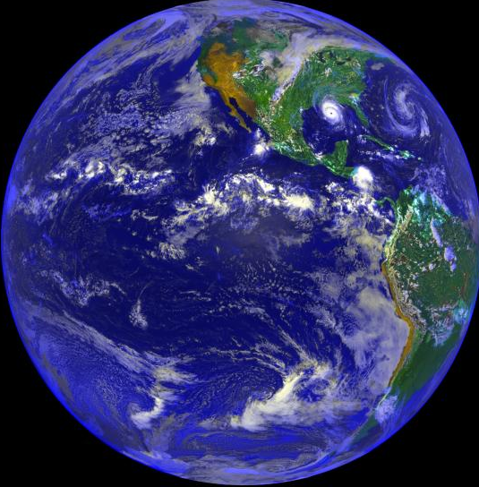
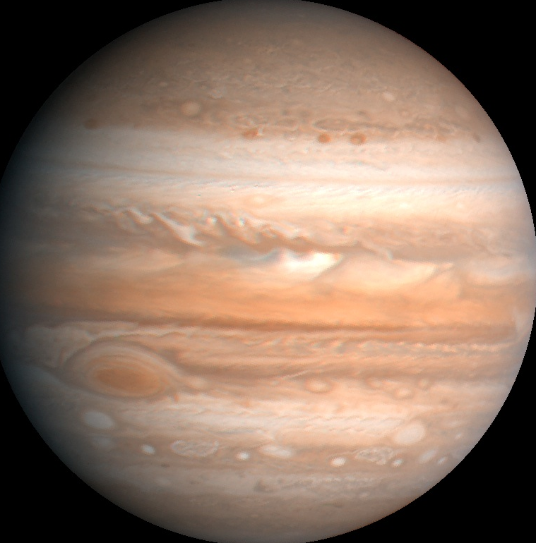
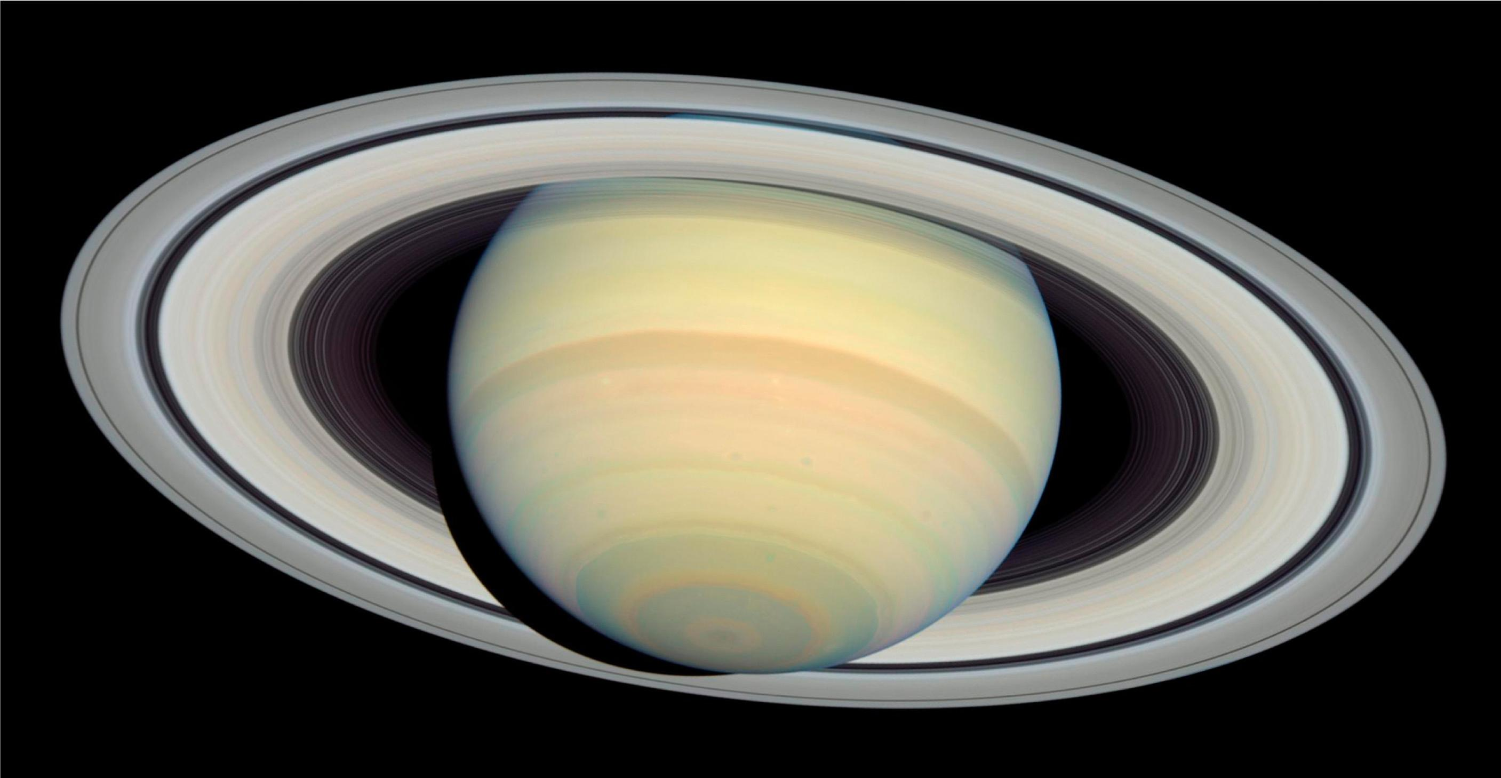
Conclusions/future work
Comprehensive GCMs with accurate RT schemes provide a good approach for computing detailed global energy budgets
Verified against observations where possible [use of Mars reanalysis in progress]
Energetically self-consistent
Easy to compare different planets
Places Earth in context
Mars surface strongly coupled to TOA and space except during major dust storms
Venus surface & deep atmosphere almost decoupled energetically from middle atmosphere
Surface energy budget dominated by thermal emission to/from atmosphere
Middle atmosphere heated directly by sunlight and cools directly to space
Earth in intermediate situation with surface, deep and middle atmosphere closely coupled
Complex and hard to model and predict accurately!
Other planets?
Titan
Gas and ice giants (Jupiter, Saturn, Uranus, Neptune…..)

