Slide 1
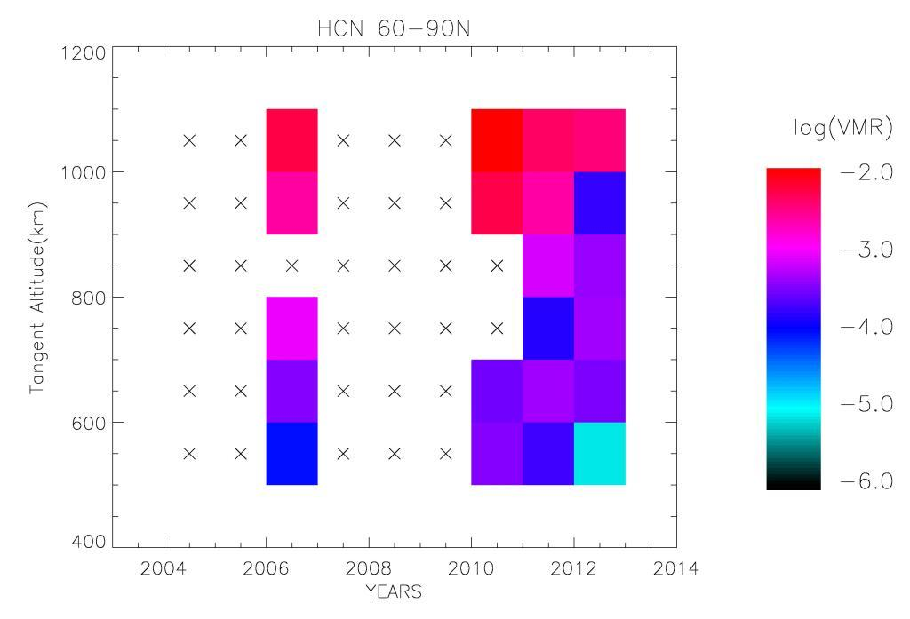
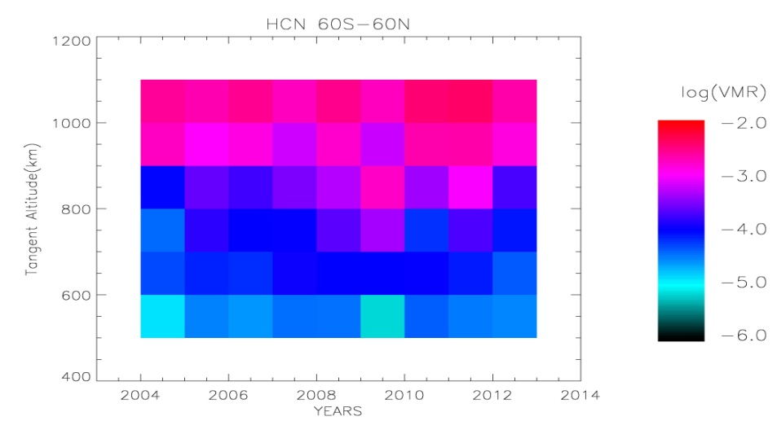
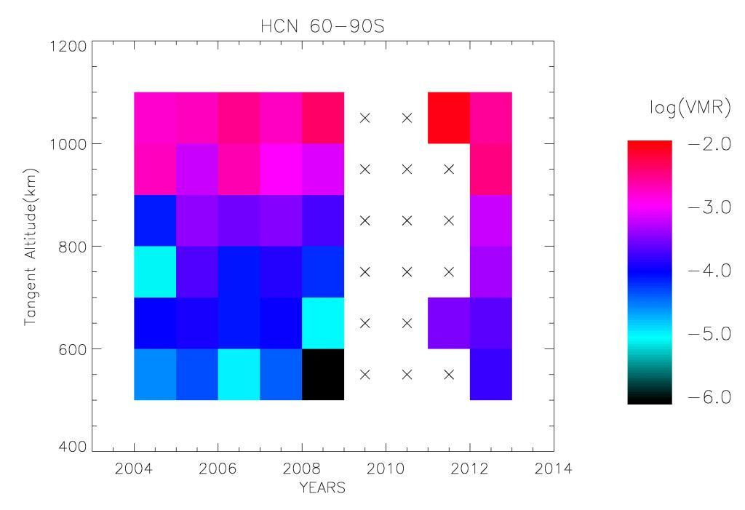
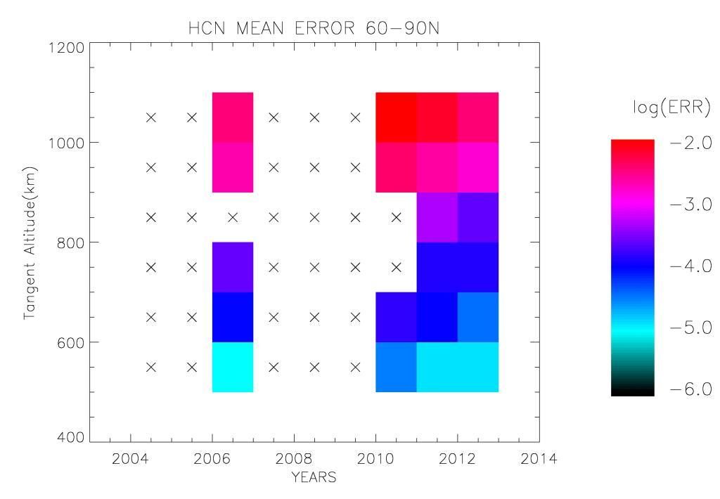
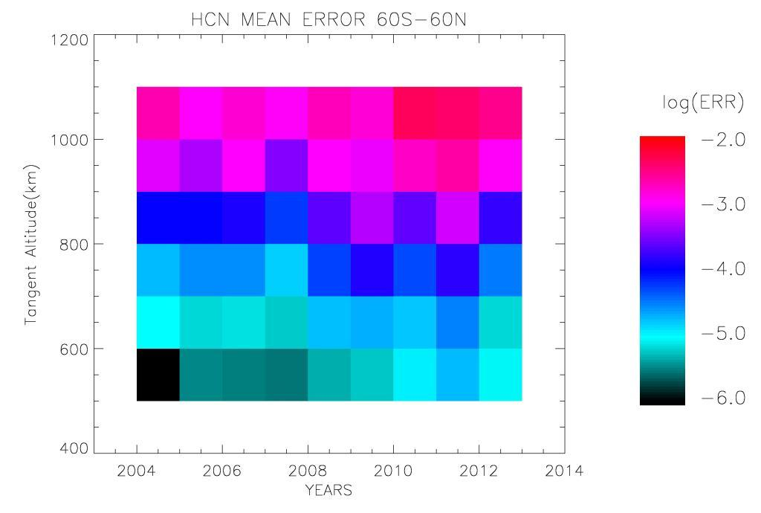
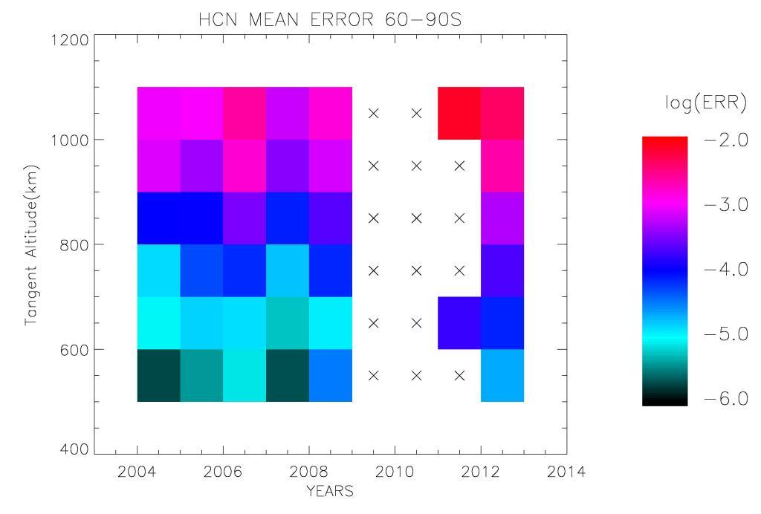
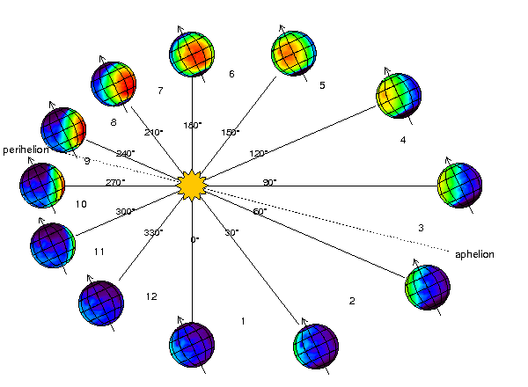
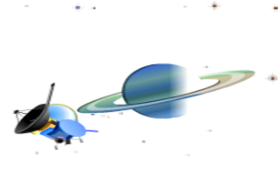
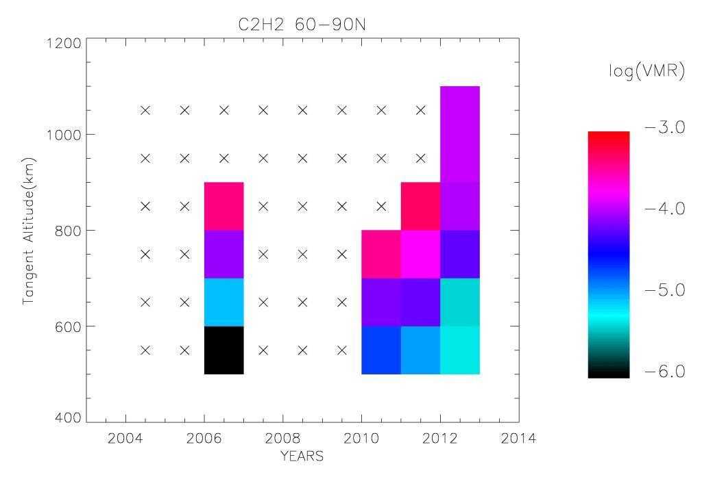
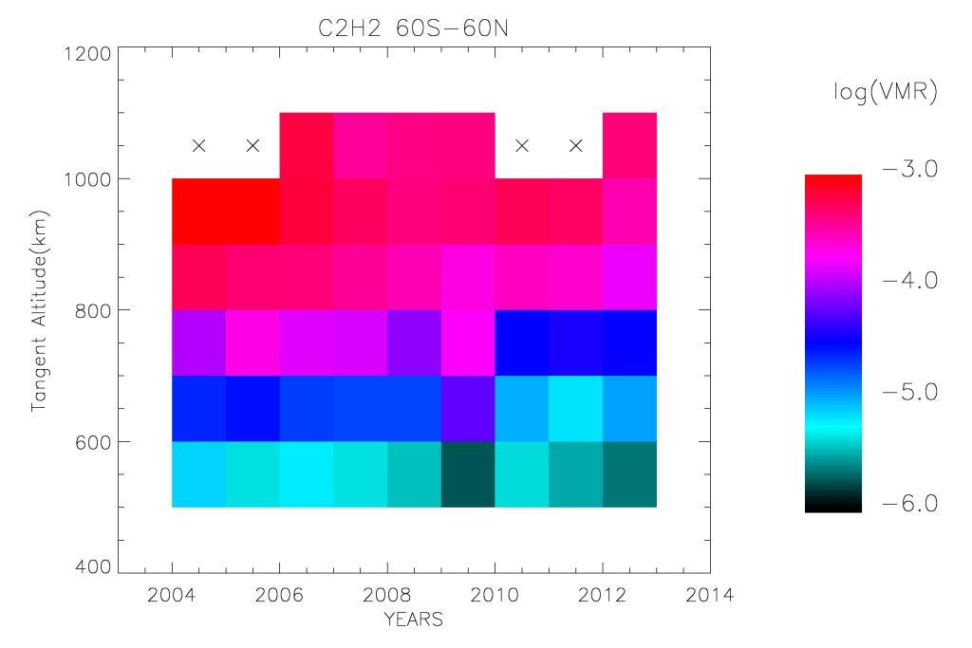
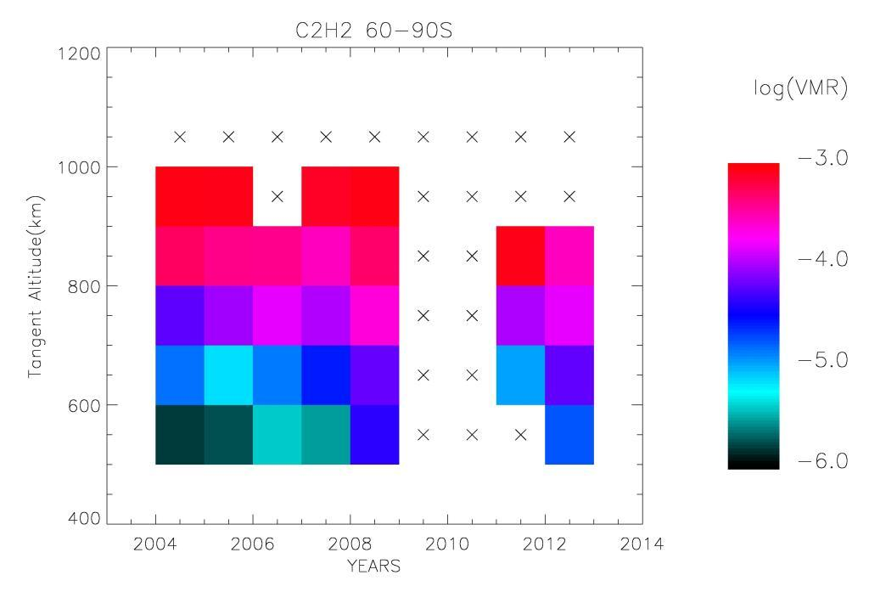
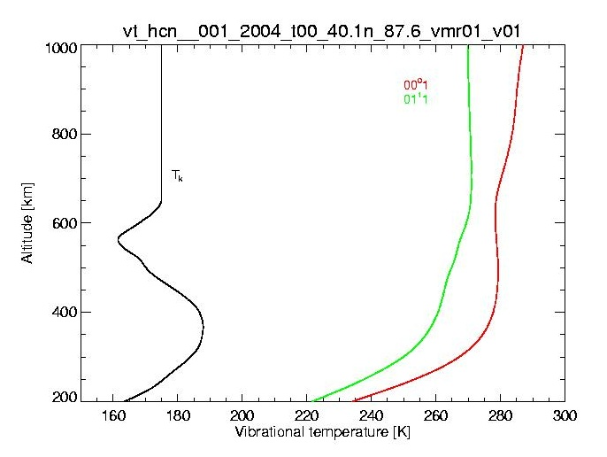
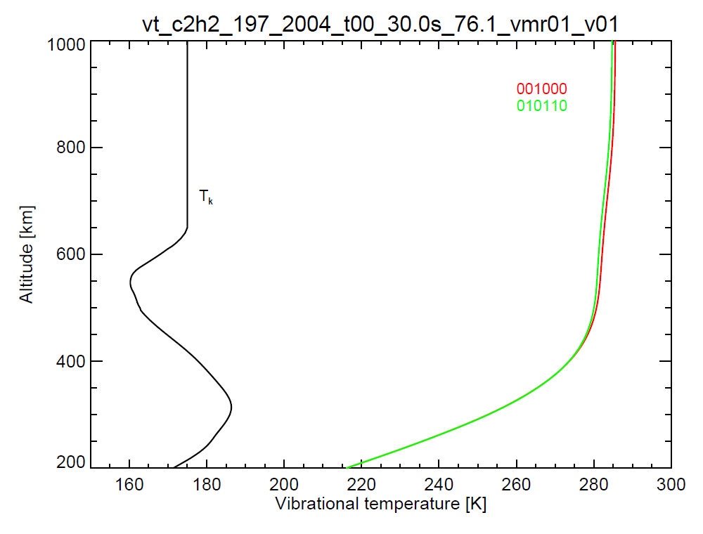
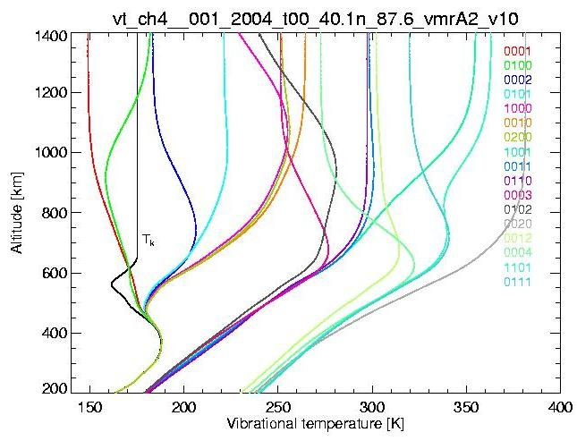
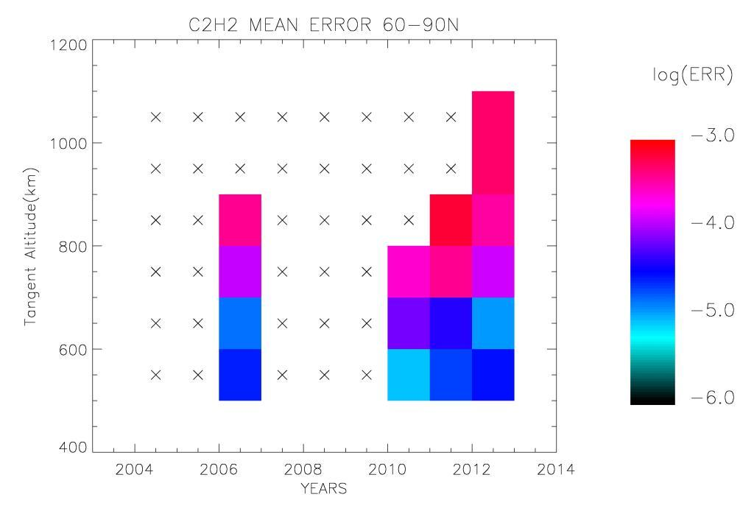
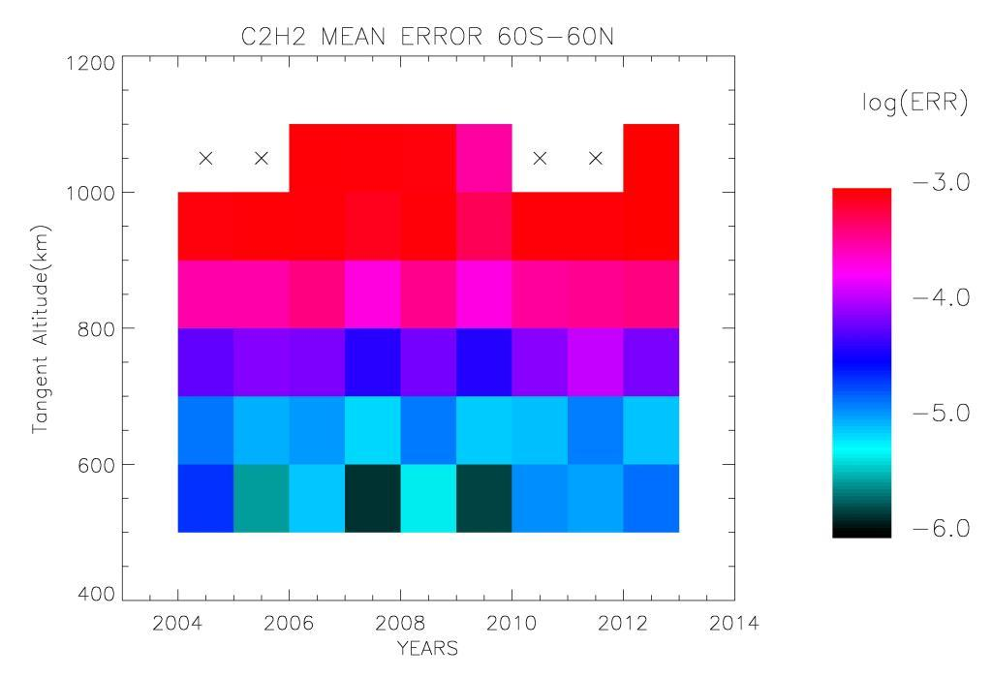
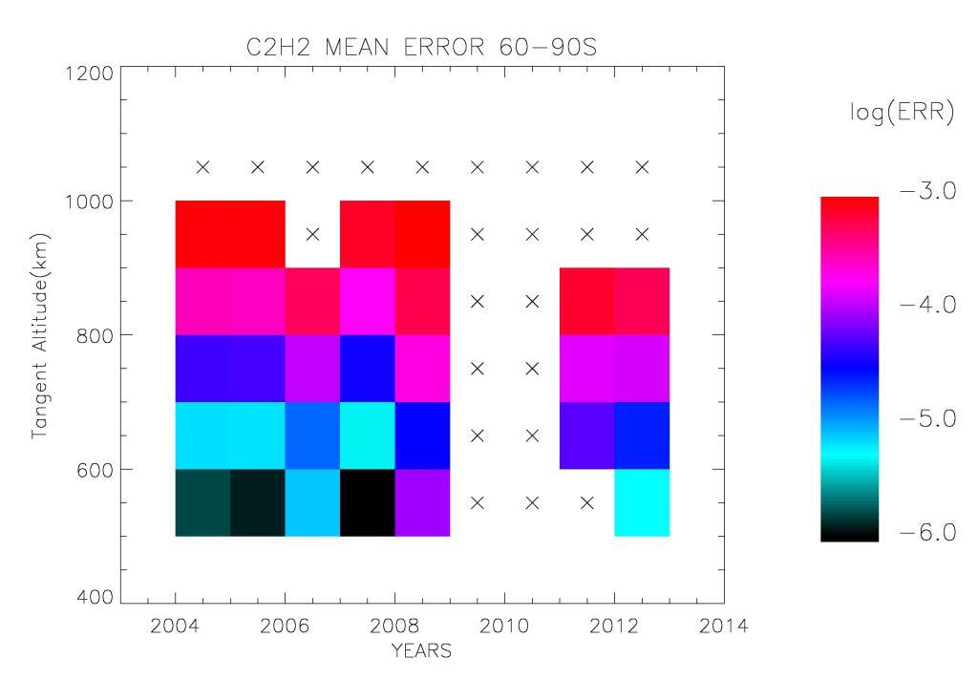
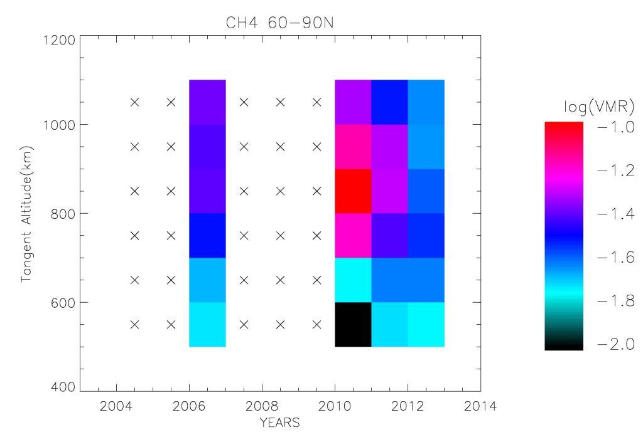
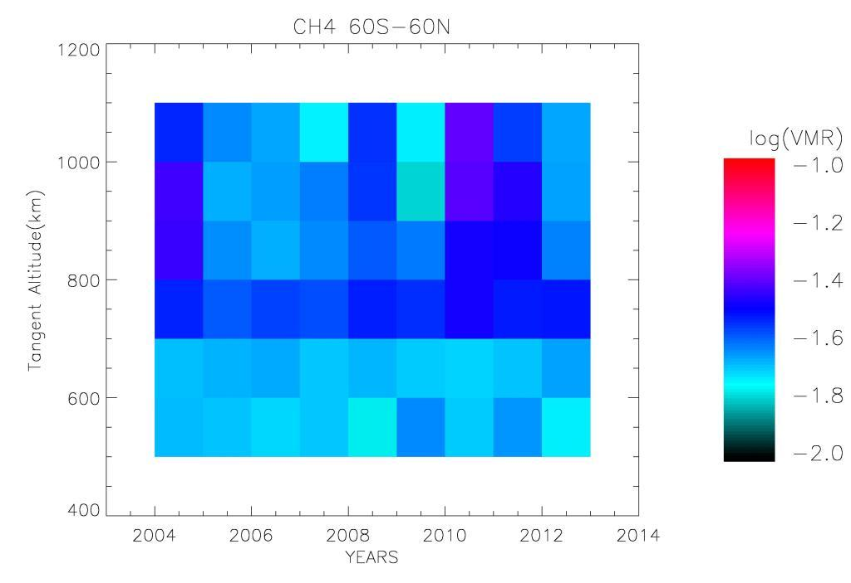
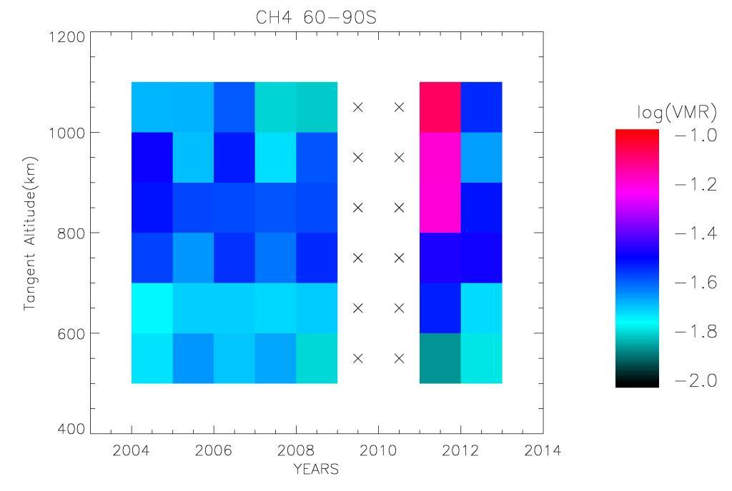
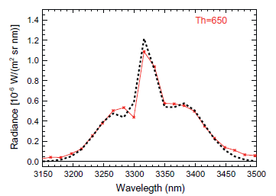
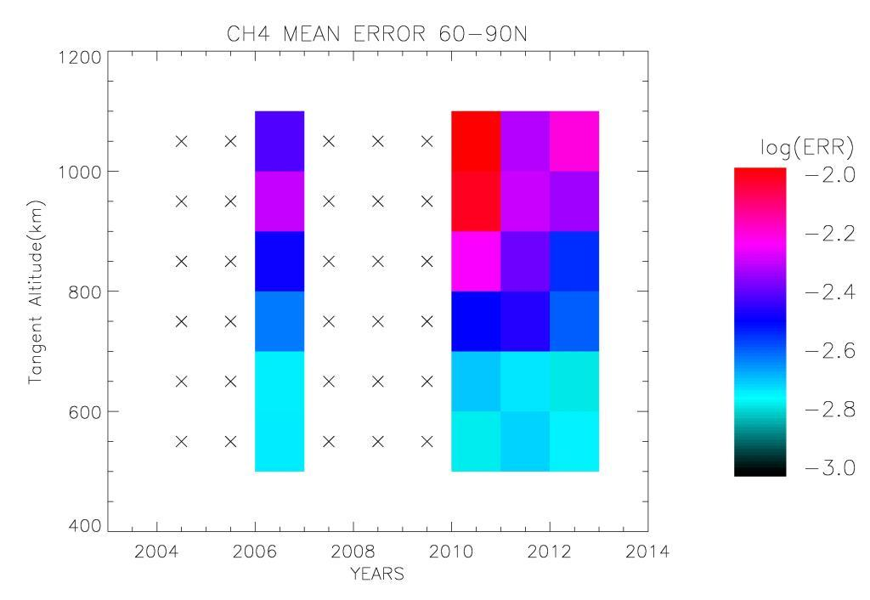
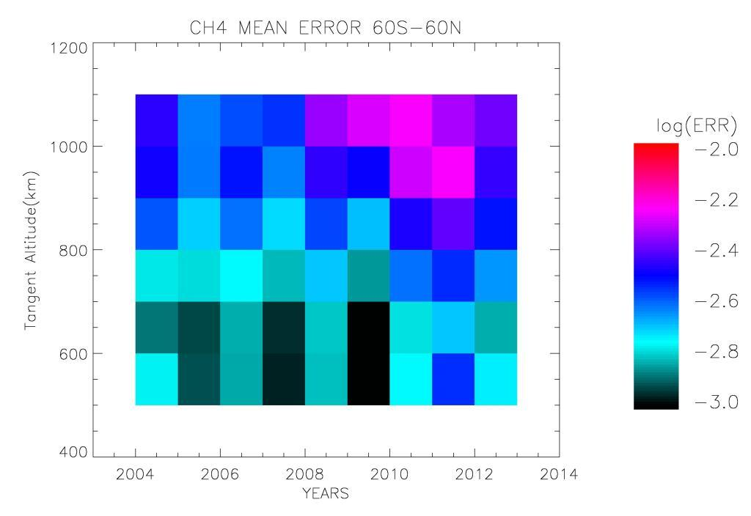
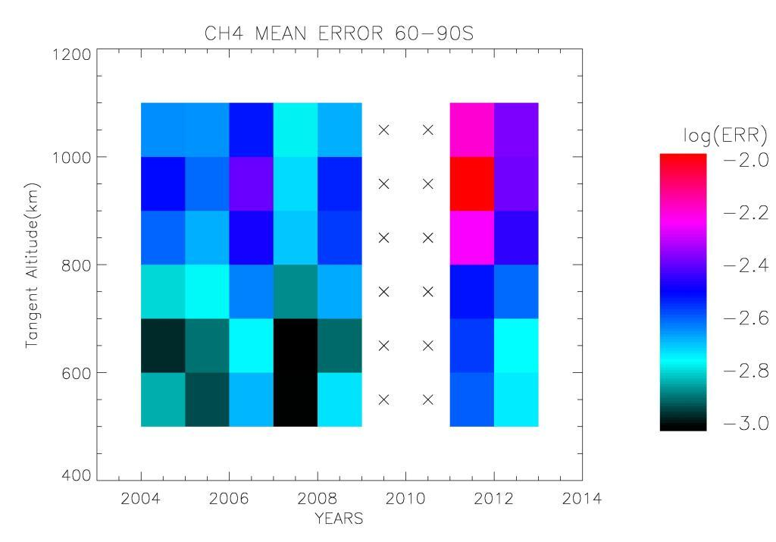
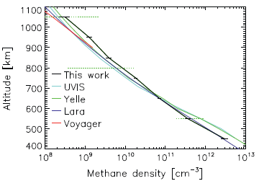
Climatological study in the Titan upper atmosphere for
HCN, C₂H₂ and CH₄ gas concentration
A. Adriani,¹ M. L. Moriconi,² B. M. Dinelli,² M. López-Puertas,³ B. Funke,³ M. García-Comas,³ E. D’Aversa,¹ and F. Fabiano²
¹ I.A.P.S.- INAF - Istituto di Astrofisica e Planetologia Spaziale, Roma, Italy.
² I.S.A.C.- CNR - Istituto di Scienza dell’Atmosfera e del Clima, Bologna - Roma, Italy.
³ I.I.A.- CSIC - Instituto de Astrofísica de Andalucía, Granada, Spain.
Summary
A preliminary study on the climatology of the HCN, C₂H₂ and CH₄ concentrations in Titan upper atmosphere has been carried based on the retrievals from their non-LTE emissions in the 3.0-3.5 µm range as measured by Cassini/VIMS (García-Comas et al.,2011; Adriani et al.,2011). Results of this study are presented here for the period 2004-2012.
Dataset
Upper Atmosphere Seasonal Variations
In the panels below HCN,C₂H₂ and CH₄ volume mixing ratios (VMR) and their relative averaged errors (ERR) have been mapped for northern (90N-60N - left), equatorial (60N-60S - center) and southern (60S-90S - right) regions of Titan thermosphere (500-1100 km) , for the 2004-2012 time period. Latitudinal boundaries have been set accounting for the polar vortex position (Teanby et al., 2010). In the maps, missing data due to insufficient information in the measurements and a lack of FOV coverage are labeled by a cross. The plots report the logarithm of the averaged VMR for each region (top) along with the respective ERR (bottom).
YEAR | SEQ | FLYBY | FILENAME | PHASE (°) | LS (°)
2004 | S05 | TA | V1477459118_1 | 13.3 | 297.2
2005 | S09 | T4 | V1490948671_2 V1490955139_2 | 57.0 | 303
2006 | S21 S23 | T15 T17 | V1530471051_1 V1536397418_1 | 60.6 63.0 | 319.8 322.3
2007 | S32 S33 | T34 T35 | V1563524168_1 V1563524658_1 V1563525149_1 V1567269485_1 | 60 26 | 333.7 335.2
2008 | S38 S40 | T41 T44 | V1582444145_1 V1590707892_1 V1590616570_1 | 66 89 95 | 341.4 344.8 344.8
2009 | S47 | T50 | V1612658738_1 V1612664166_1 | 70 | 353.6
2010 | S59 S60 | T67 T69 | V1649210753_1 V1649227483_1 V1654449711_1 | 15 18 31 | 8.1 8.1 10.1
2011 | S66 S67 | T74 T75 | V1676803273_1 V1681937300_1 | 31 16 | 18.7 20.6
2012 | S71 S72 | T80 T81 | V1704257066_4 V1706671551_1 V1708368320_1 | 58 22 61 | 29.1 30 30.6
Though Cassini did many close encounters with Titan, not all of them had suitable limb observing conditions that provided useful non-LTE emissions. In fact, given the low energies involved, high S/N (signal to noise) values were necessary, achieved only with long integration time(>=600 ms). Moreover, the FOV (field of view) of each observation has to cover a large percent of sky with phase angles <=90º. The Table at left lists the observations that fulfill all these constraints for the 2004-2012 period.
HCN
Northern Fall Equinox 1995 November
At right a Cassini mission sketch connecting the date of the observations, in the J2000 reference system, with the Titan year through the LS solar longitude coordinate.
Northern Winter Solstice 2002 October
Northern Summer Solstice 2017 May
HCN VMR in the upper thermosphere doesn’t show any definite seasonal cycle. But in the lower thermosphere, after the equinox, we can see a slightly positive gradient from North toward the South in VMR values. Similarly, southern values show an increasing trend since before up to after equinox time. Jointly these results suggest a seasonal variation of the HCN VMR, in agreement with the Teanby et al. findings (2010,2012), possibly coupled to the lower atmospheric processes. VMR values in the intermediate region don’t display a clear trend.
SOI 2004 July 1st
Prime Mission
Solstice Mission
C₂H₂
Northern Spring Equinox 2009 August
2012
Equinox
Non-LTE and Inversion
Above -These figures show‚ from left to right‚ typical vibrational temperatures for the energy levels of HCN, C₂H₂ and CH₄ that originate the emissions measured by VIMS, for the case of TA flyby, in correspondence of 40°N (HCN and CH₄) and 30°S (C₂H₂). The kinetic temperature profile is also shown. The temperature profiles were built from the co-located pressure-temperature (p-T) profiles measured by CIRS (Achterberg et al., 2008) from the surface up to about 500 km, and extended upwards, hydrostatically consistent, with the p-T profile used in previous studies (García-Comas et al.,2011; Adriani et al.,2011). The vibrational temperatures of CH₄ and HCN are based on the models described by García-Comas et al. (2011), and Adriani et al. (2011), respectively. For C₂H₂, a new non-LTE model has been developed similar to those for CH₄ and HCN.
C₂H₂ VMR are generally in agreement to the HCN findings. On the whole, concentration differences between upper and lower thermosphere look like bigger in the C₂H₂ than in the HCN case.
CH₄
HCN, C₂H₂ and CH₄ concentrations have been retrieved using the optimal estimation technique (Rodgers, 2000). The retrieval code includes the GBB forward model, upgraded for VIMS characteristics and non-LTE computations. The retrieval procedure minimizes the cost function through the Gauss Newton iterative procedure. At left an example of the best fit of the CH₄ non-LTE 3.3 µm emission at 650 km (top), and the number density profile retrieved and compared to previous measurements and calculations (bottom).
CH₄ show an increased VMR in the upper thermosphere immediately after the equinox in the polar regions (left and right panels). However these variations cannot be attributed to a seasonal cycle (same variations in both poles) and can be possibly attributed to a transient in the interaction between Titan’s ionosphere and Saturn’s magnetosphere that affects methane NLTE emission only (Ulusen et al., 2012).
Conclusions
The preliminary results of the study on the HCN, C₂H₂ and CH₄ concentration variations in Titan upper atmosphere for the 2004-2012 period seem to exclude a seasonal impact in high thermosphere. Though episodic variations are present, they cannot be connected to a periodic cycle. Some indication of a possible seasonal impact on the lower thermosphere can instead be found in the HCN and C₂H₂ concentrations at high latitudes, where VMR are consistent with the polar vortex tracer-enriched air mass revealed by CIRS measurements (Teanby et al., 2010,2012). Future tasks point to increase the VMR datasets and to find other sources for VMR variations in high thermosphere.
References
Acknowledgements
García-Comas et al., Icarus, volume 214, 571-583, 2011
Adriani et al., Icarus, volume 214, 584-595, 2011
Rodgers, Inverse Methods for Atmospheric Sounding: Theory and Practice, Taylor,F.W. (ed.),2000.
Teanby et al., JGRE, volume 113, doi:10.1029/2008JE003218,2010
Teanby et al., Nature, doi:10.1038/nature11611
Ulusen et al., Icarus, volume 217, 43-54,2012
This work has been developed thanks to the financial support of the Italian Space Agency. Special thanks are due to Dr. Gianrico Filacchione IAPS-INAF for the support in data calibrations. The IAA team was supported by the Spanish MICINN under Projects AYA2008-03498/ESP, CSD2009-00038, and EC FEDER funds. This work is a preliminary outcome of the NASA/CDAPS proposal # N1-CDAP11-0045 on the seasonal variability of the chemical composition of Titan upper atmosphere. We wish to thank J. Tennyson and C. Hill at University College London for providing HCN spectroscopic data.
Corresponding author: alberto.adriani@iaps.inaf.it

