Slide 1
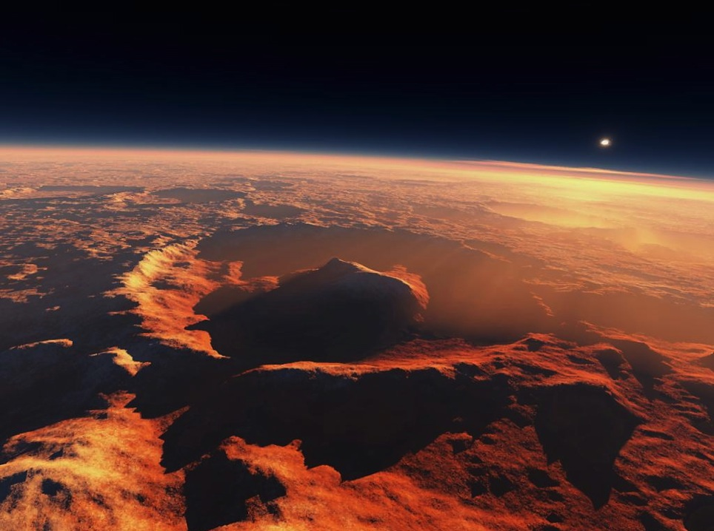







Constraining the MSL-SAM Methane Detected Source Location Through Mars Regional Atmospheric Modeling System (MRAMS)
Jorge Pla-García^{1,2,3}, Scot C.R. Rafkin²
¹Centro de Astrobiología (CSIC-INTA), Madrid, Spain
²Space Science Institute, Boulder, CO, USA
³Southwest Research Institute, Boulder, CO, USA
jpla@cab.inta-csic.es
European Planetary Science Congress (EPSC)
MSL sol 1820 (Ls62), Sept. 19th 2017

Slide 2
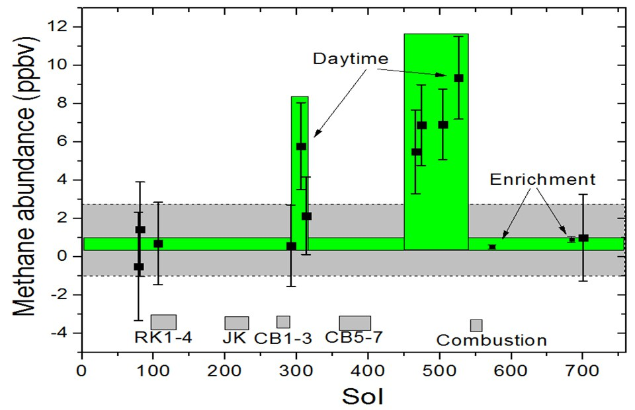
Ls55-82,
sols 466-526
Ls328-340,
sols 292-313
Ls195-211,
sols 79-106
Ls158,
Sol 684
Mars methane detection and variability at Gale crater
(Webster et al., 2015)

Slide 3
6 DIFFERENT MRAMS METHANE SCENARIOS
  Instantaneous emission scenarios:
    Scenario 1: small area emission inside Gale (close to the rover)
    Scenario 2: medium area emission outside Gale (NW)
  Steady emission scenarios:
    Scenario 3: small area emission inside Gale (close to the rover)
    Scenario 4: medium area emission outside Gale (NW, NE, SW, SE)
    Scenario 5: large area emission at Mumma’s detection area (Terra Sabae + Nili Fossae + Syrtis Major)
  Motivation to select the epochs:
    Ls270: high mixing epoch, MSL sol 1521
    Ls90: representative of the rest of the year to be compared vs Ls270 and because it is the season of the peak methane observation by SAM (sol 526)
    Ls155: because it is the season of the peak methane observation by Mumma et al. 2009

Slide 4
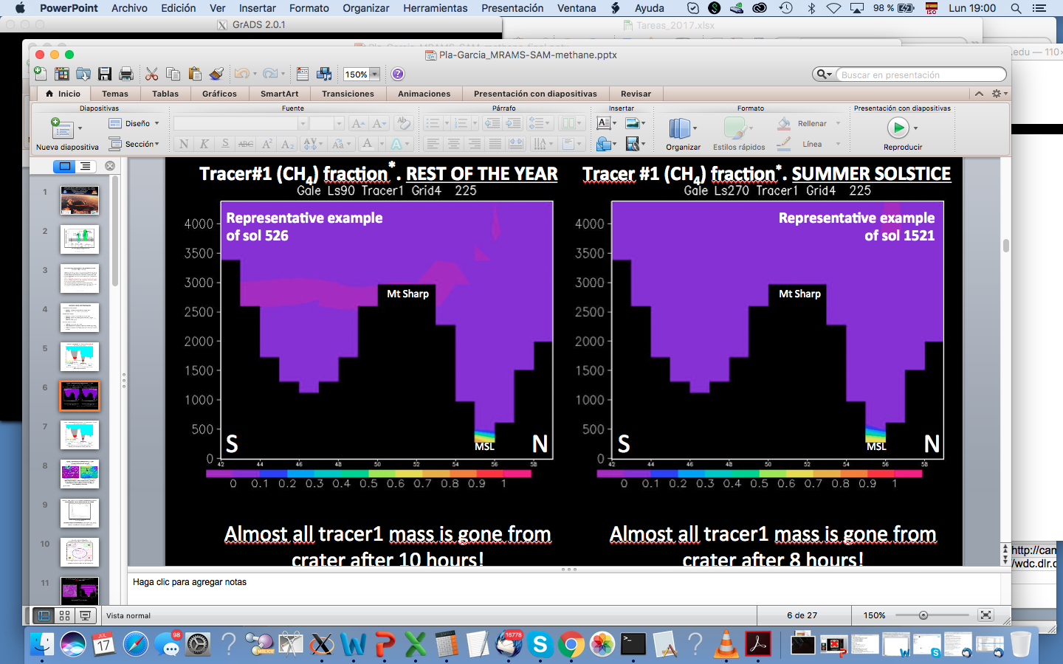
Scenario 1#: instantaneous CH₄ release emission inside Gale
Crater mixing timescale. Initial time (02:25 LMST)
REST OF THE YEAR
SUMMER SOLSTICE
  Ls270 is the greatest exchange between air inside and outside crater during Mars year (Pla-Garcia et al. 2016, Rafkin et al. 2016).
  What about the rest of the year?

Slide 5
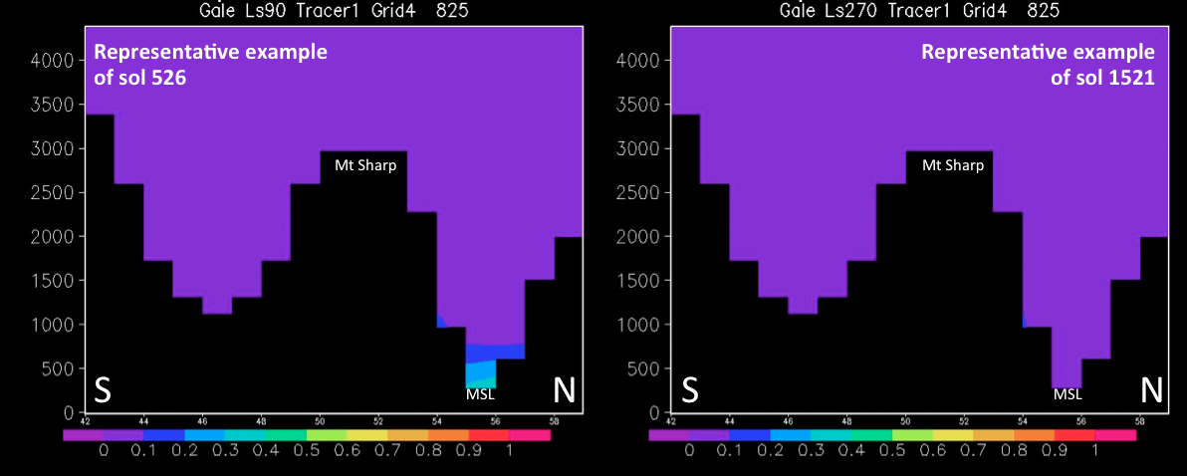
Scenario 1#: instantaneous CH₄ release emission inside Gale
Crater mixing timescale. 6 hours later (08:25 LMST)
REST OF THE YEAR
SUMMER SOLSTICE
~50% of methane stays in crater after 6 hours
All methane is gone from crater after 6 hours!

Slide 6

Scenario 1#: instantaneous CH₄ release emission inside Gale
Crater mixing timescale. 8 hours later (10:25 LMST)
REST OF THE YEAR
SUMMER SOLSTICE
All methane is gone from crater after 8 hours!
All methane is gone from crater after 6 hours!
  Although the rest of the year the mixing is more limited, there is also exchange (crater is not completely isolated!)

Slide 7
Scenario 2#: instantaneous CH₄ release emission outside Gale
Dispersion of a local methane release upstream of the crater
Initial release (northwest crater)
After 12 hours
Log10 of tracer #1 fraction (methane)
Log10 of tracer #1 fraction (methane)
Methane tracer diluted by ~6 orders of magnitude inside crater after 12 hours, regardless of the season. With an instantaneous release 1 part per billion (ppb) of methane at rover location requires 1 part per mil (insane huge!) of methane at release site!
Rover location

Slide 8
Steady CH₄ release in a small area inside Gale (scenario 3#)
and a medium size areas (NW-NE-SW-SE) emission outside Gale (scenario 4#)
MRAMS CH₄ flux rate from ground is 1.8x10⁻⁶ kg m⁻² s⁻¹
(derived from Gloesener et al. MAMO17 clathrates fluxes)
NW
NE
Inside Gale
SW
SE
All release areas outside Gale crater have the same size
Methane in MRAMS is not predictive per se but notional, that is, one can adjust the flux knob in order to get a proportional answer (e.g. multiplying flux in MRAMS by 200 we get a 200 times higher methane value)

Slide 9
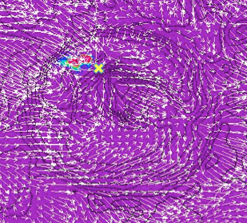
Scenario 3#: steady CH₄ release in a small size area emission inside Gale in Ls270. Timing for SAM measurements is very important!
Sol 2 Sol 4 Sol 6 Sol 8 Sol 10
Using Gloesener et at. clathrates fluxes, we get 200 times lower CH₄ values around rover location than SAM did. Should we multiply Gloesener fluxes by 200? or enlarge the releasing area? Or move release area closer to rover location? Or all of them?

Slide 10
Scenario 4: steady CH₄ release in a medium size area emission NW outside Gale in Ls270. Timing for SAM measurements is very important!
Sol 2 Sol 4 Sol 6 Sol 8 Sol 10
Timing for SAM measurements is important due to the mixing (increases and drops) of CH₄ inside crater. Daily variability with peaks orders of magnitude higher depending on the hour. Nighttime (dynamic) downslope flows entering through rims have an impact into the CH₄ levels.
With a bigger (but further away) release area compared to scenario 3# (inside Gale) we get similar CH4 values around rover location, so distance to source is also important!

Slide 11
Scenarios 3 and 4: steady CH₄ release in a small and medium area emission mimicking clathrates fluxes
Inside Gale
Steady release in
a small area emission
Outside (close to) Gale. Steady release in a medium area emission
NW
NE
SW
SE
.035 ppbv
.012 ppbv
.03 ppbv
.06 ppbv
.035 ppbv
Ls90
.033 ppbv
.045 ppbv
.011 ppbv
.027 ppbv
.00018 ppbv
Ls270
High daily variability in ALL scenarios
As expected, CH₄ steady emission at SW Gale in Ls90 and NW Gale in Ls270 are the higher values due to global mean circulation (Pla-Garcia et al. 2016, Rafkin et al. 2016)
Inside release reach a similar max value even though being a smaller release area
Surprisingly, Ls90 (SAM’s high-methane abundance period) seems to have in general higher CH₄ values than Ls270

Slide 12
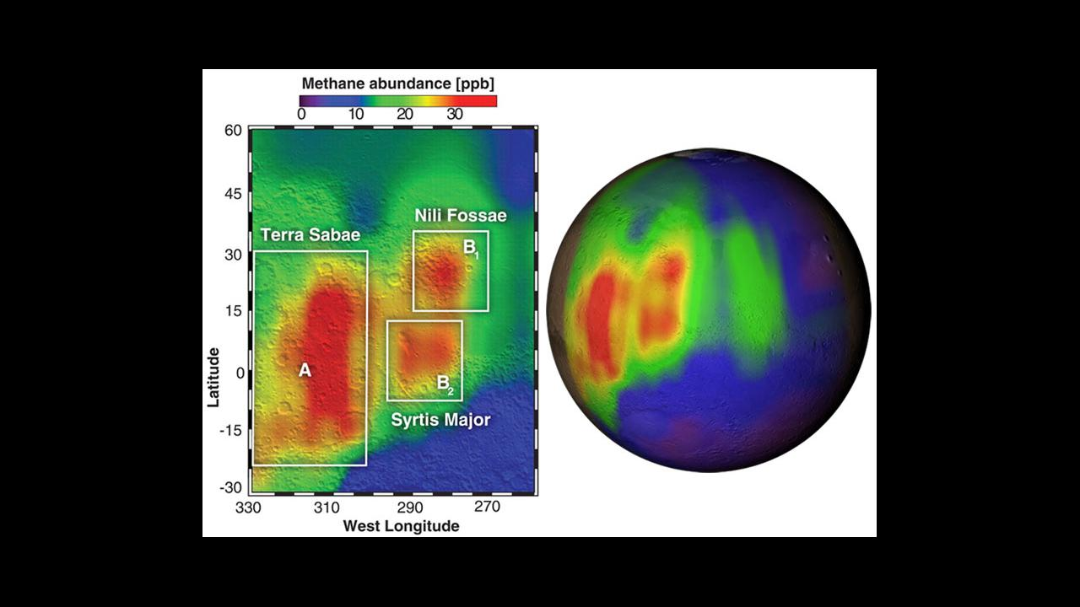
Scenarios 3# and 4# (steady emission) show very localized CH₄ in contrast with Mumma et al. 2009. Scenario 5#: steady CH₄ emission in a larger release area (Mumma’s detection area).
Mumma et al. 2009

Slide 13
Scenario 5: steady CH₄ release in a large area emission at Mumma’s detection area in Ls270. CH₄ ppbv values at rover location
Mumma’s B2 area (just Syrtis)
vs full Mumma’s A+B1+B2 area
Still
increasing!!
Sol 1 Sol 2 Sol 3 Sol 4 Sol 5 Sol 6 Sol 7 Sol 8
Sol 2 Sol 4 Sol 6 Sol 8 Sol 10
* CH₄ is building up around MSL location just 2-3 sols after being released >3,000 km away!
* 4 sols after being released CH₄ reach higher values than scenario 3# (small emission inside Gale)
* With a bigger release area (full Mumma) we get 30 times more CH₄ around MSL location after 8 sols compared to limited Mumma B2 release area and only 12 times lower than SAM values. Should we multiply fluxes by 12? Or enlarge the releasing area? Or move release area closer to rover location? Or all of them?

Slide 14
Scenario 5: steady CH₄ release in a large area emission at full Mumma’s A+B1+B2 area in Ls90, Ls155 and Ls270. CH₄ ppbv at rover location
Sol 1 Sol 2 Sol 3 Sol 4 Sol 5 Sol 6 Sol 7
Sol 1 Sol 2 Sol 3 Sol 4 Sol 5 Sol 6
Sol 2 Sol 4 Sol 6 Sol 8 Sol 10
Although Ls155 is the season of the peak methane observation by Mumma, the highest CH₄ value in the Mumma’s experiment is reached in Ls270 (one order of magnitude higher), that is, in the high mixing epoch.

Slide 15
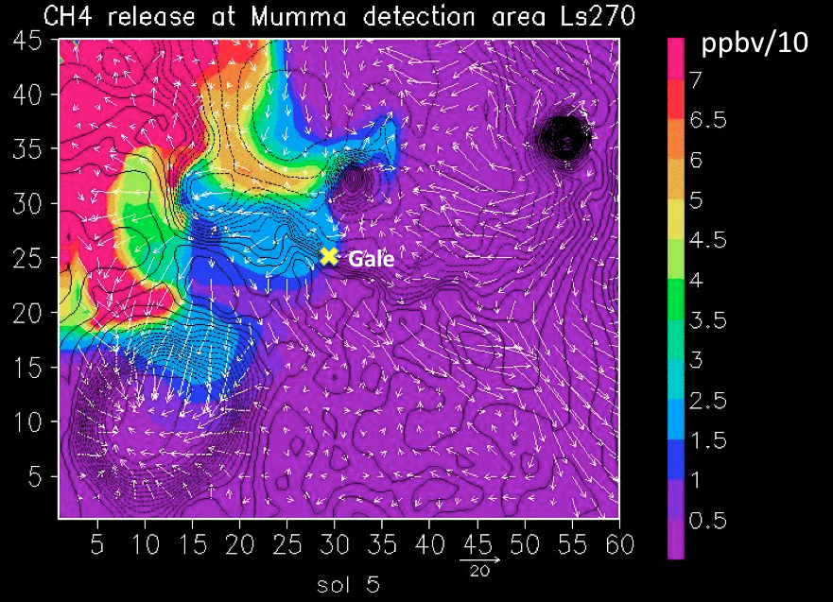
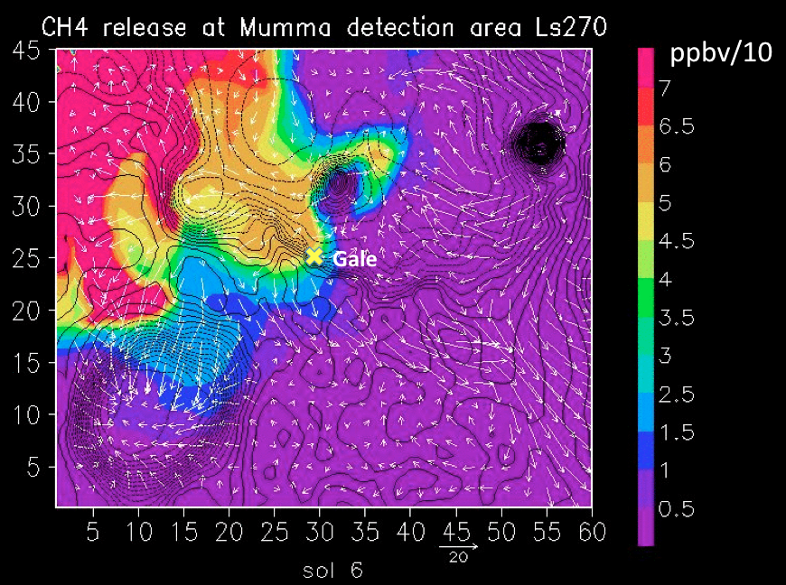
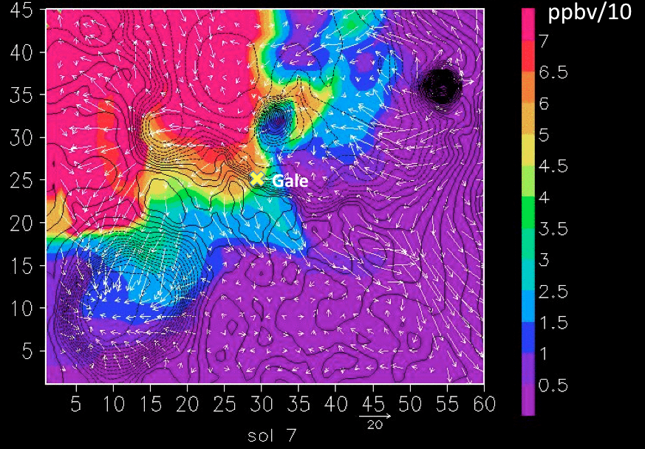
Scenario 5: steady CH₄ release in a large area emission at full Mumma’s A+B1+B2 area in Ls270. CH₄ ppbv at MSL location
CH₄ is building up around MSL location in sol 4# after being released over full Mumma detection region (>3,000 km away from Gale!!)
Only 4 sols after being released, CH₄ reach higher values than scenario 3#!! (steady CH₄ release in a small emission inside Gale).

Slide 16
MRAMS instantaneous methane release scenarios conclusions
* Timescale of mixing in MRAMS experiments is on the order of 1 sol regardless of season. Much faster than previously estimated in Pla-Garcia et al. 2016, Rafkin et al. 2016.
* Duration of CH₄ peak detected by SAM is 100 sols (assuming no high frequency variations). Then:
  There is a steady release inside the crater to counteract mixing, or
  There is a very large magnitude steady release outside the crater
MRAMS steady methane release scenarios conclusions
* Timing is important for SAM measurements (high daily variability with peaks in all scenarios)
* SW_Ls90 and NW_Ls270 outside Gale emissions are the higher values due to global circulation
* With a smaller (but closer to rover) inside Gale release area compared to outside we get similar CH₄ values (0.04ppbv) around rover, so distance to source is also important!
* Ls90 (SAM’s high-CH₄ abundance period) seems to have higher CH₄ values than Ls270
* Release inside or close to Gale show very localized CH₄ in contrast with Mumma et al. detection
* In scenario 5#, with a bigger release area we get 30 times more CH₄ around rover compared to smaller release area (just Syrtis) and only 12 times lower CH₄ values detected by SAM.
* Although Ls155 is the season of the peak CH₄ observation by Mumma, the highest value in our scenario 5# is reached in Ls270 (one order of magnitude higher!), that is, in the high mixing epoch, indeed the highest value of ALL experiments (0.6 ppbv)
* With our initial conditions, SAM should not be capable (or very difficult) to detect CH₄ but if we multiply flux, increase release area or move it closer to rover (or all of previous), we would get CH₄ values that SAM should be capable to detect doesn’t matter where it comes from: inside Gale, outside (close to) Gale or far away from Gale

Slide 17
Backup Slides

Slide 18
Scenario 3#
With our initial conditions (flux rates, release area size and distance to MSL),
SAM should not be capable (or very difficult) to detect CH4
Scenario 4#
SAM X 200
SAM X 150
Scenario 5#
SAM X 12
If we multiply flux by 12, increase release area or move it closer to MSL, we would get values that SAM should be capable to detect doesn’t matter where it comes from: inside Gale, outside (close to) Gale or far away from Gale

Slide 19
Ls270 (Ls225-Ls315) season at Gale is a high mixing period with NW winds scouring the crater floor
  Is a period when the air mass in crater mixes completely with the external atmosphere due to strong, flushing, northerly downslope flow and breaking mountain waves (Pla-Garcia, Rafkin et al. 2016; Rafkin, Pla-Garcia et al. 2016).
  The regional northwest winds from northern lowlands scour the very bottom of the crater floor.
  Ls270 is the greatest exchange between air inside and outside crater during Mars year. Although the rest of the year the mixing is more limited, there is also exchange (crater is not completely isolated!)
  Crater circulation is pushed and extended dramatically to the south.
  This is not just air flowing through topographic passes like Peace Valles; rather it is a wholesale inundation of the crater from the air to the northwest

Slide 20
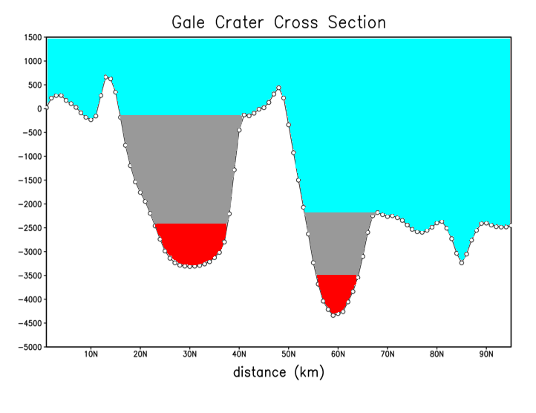
Scenario 1: instantaneous CH₄ release emission inside Gale
Tracer 1 (methane): < 200 meters high, close to MSL
Tracer 2: 200 – 500 meters high
Tracer 3: 500 – 2000 meters high
Tracer 4: elsewhere
MSL landing site
South
North
Scenario 1: four gas tracers included into Gale crater
atmospheric simulations

Slide 21
Scenario 2: instantaneous CH₄ release emission outside Gale in Ls270 (~sol 1521)
Tracer 1 (methane): < 200 meters
Tracer 2: 200 – 500 meters
Tracer 3: 500 – 2000 meters
Tracer 4: elsewhere
MSL landing site
South
North
Scenario 2: three gas tracers included into Gale crater
with tracer 1# outside the crater (north rim).

Slide 22
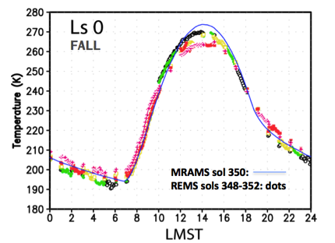
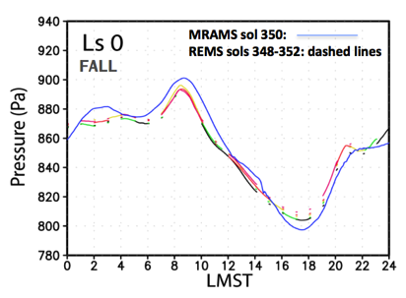
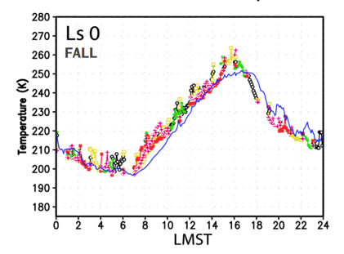
(1) Introduction (2) Experiment design (3) Validation (4) Interpretations (5) Conclusions
Model validation: MRAMS vs REMS
Ground temperature
Pressure
Air temperature
More details at
Pla-Garcia et al. 2016

Slide 23
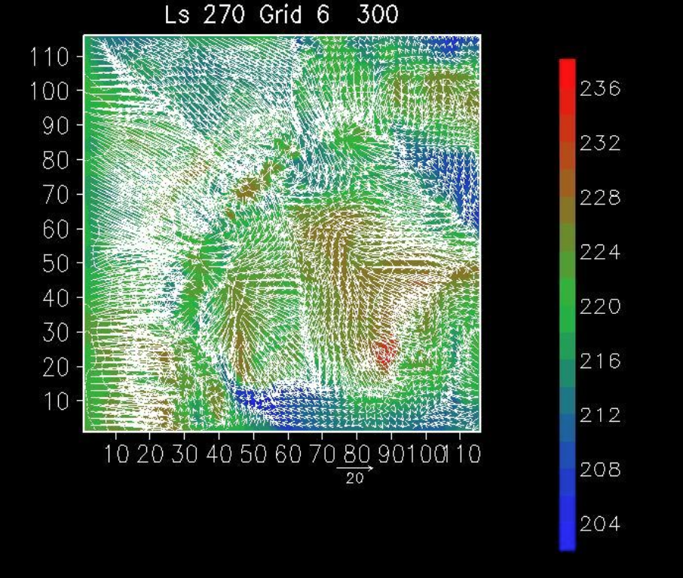
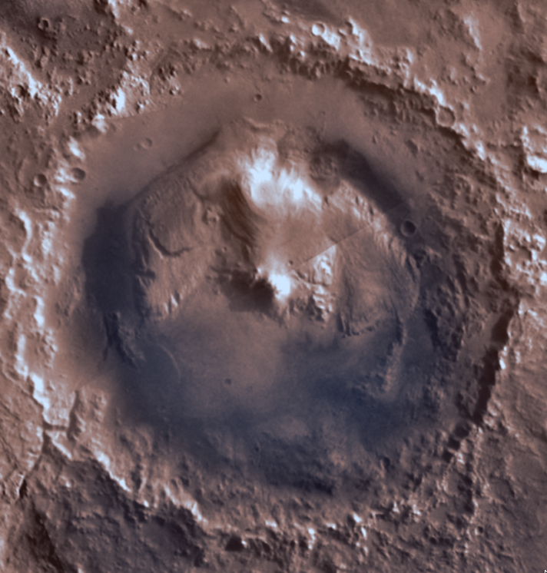
The Atmospheric Circulation
Representative example
of sol 1521
S
Potential Temperature
(Pla-Garcia, Rafkin et al. 2016; Rafkin, Pla-Garcia et al. 2016)

Slide 24
The Atmospheric Circulation
Representative example
of sol 1521
S
Potential Temperature
is strongly 3D!
(Pla-Garcia, Rafkin et al. 2016; Rafkin, Pla-Garcia et al. 2016)

Slide 25
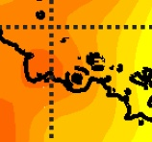
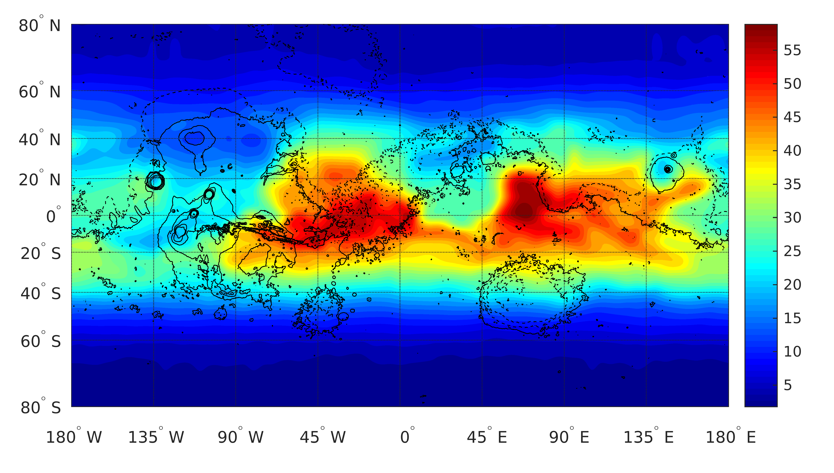
Scenarios 3 and 4: continuous CH4 release mimicking clathrates fluxes
Gale crater HSZ 40-45m
Depth (m) of the beginning of hydrate stability zone (HSZ) in present-day martian subsurface for CH4-rich clathrates formed from a gas phase with 90% of methane (Gloesener et al. MAMO17)

Slide 26
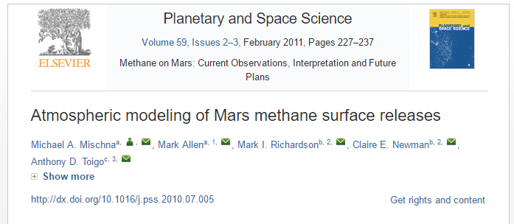
Some previous Methane Release Studies
Mischna et al. 2011
The accuracy of their conclusions is limited by the uncertainties inherent in GCM simulations
GCMs poorly resolve or are completely incapable of resolving mesoscale/microscale circulations that can only be simulated by a model with significantly greater spatial and temporal resolution.

