Slide 1
ASIME 2016 White Paper: Answers to Questions from the Asteroid Miners
J.L. Galache
Aten Engineering, Inc.
@JLGalache @AtenEngineering
A. Graps
University of Latvia; PSI; Baltics in Space
+30 International Co-Authors!

Slide 2
What Is ASIME?
Asteroid
Science
Intersections with (In-Space)
Mine
Engineering

Slide 3
The Way Things Were

Slide 4
The Plan
The Miners would drill the Scientists for answers, allowing the scientists to identify Science Knowledge Gaps

Slide 5
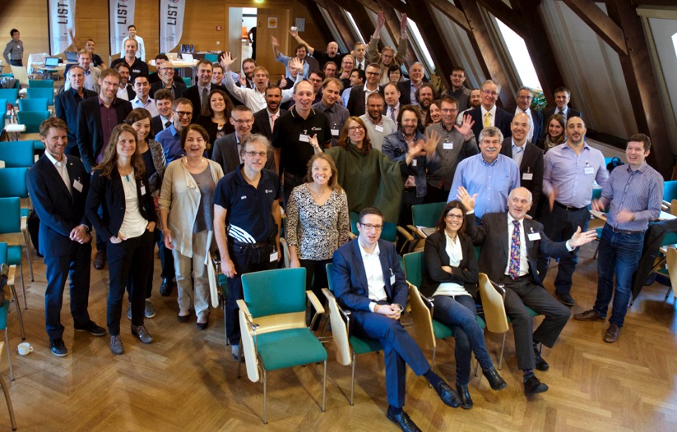
It Happened!
21-22 Sept, 2016, Luxembourg City
The workshop was supported by Europlanet 2020 RI, the
Luxembourg Ministry of the Economy, SpaceResources.lu and ESA.
3 Asteroid mining companies
Few dozen scientists
Some engineers
Others! (Policy, business, finance…)
All leading to identifying
6 Science Knowledge Gaps

Slide 6
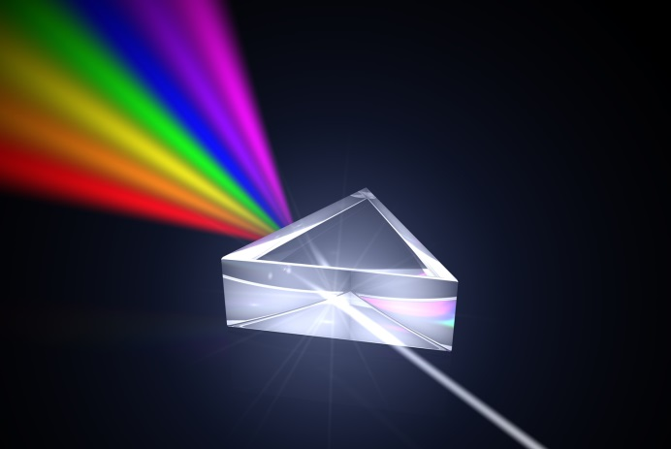
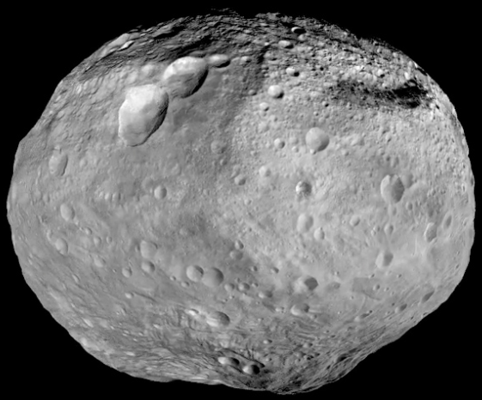
Science Knowledge Gap #1
Mapping asteroids to meteorite spectra

Slide 7
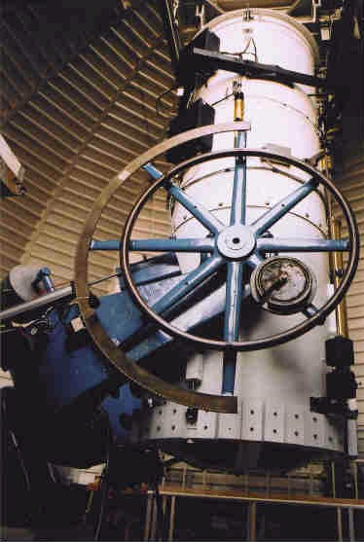
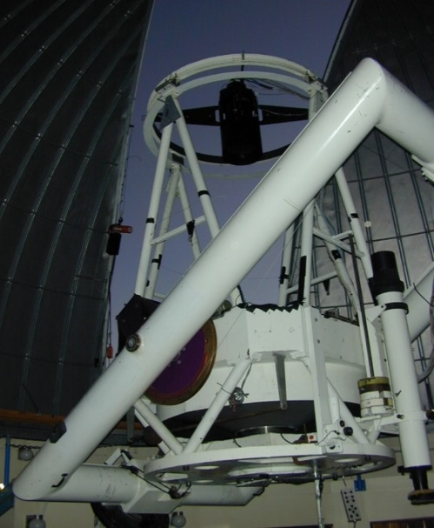
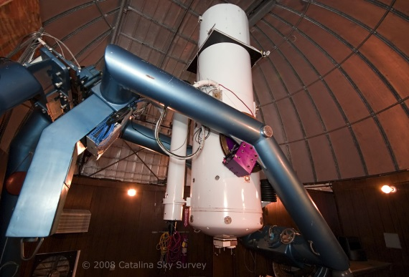
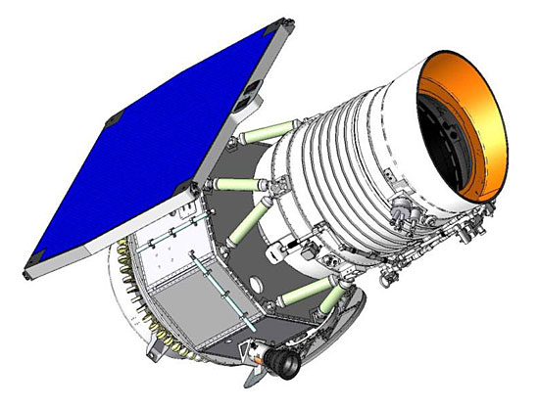
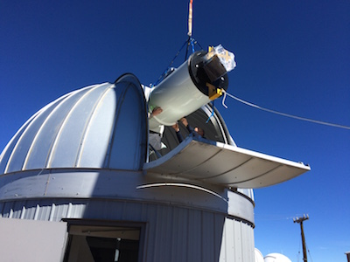
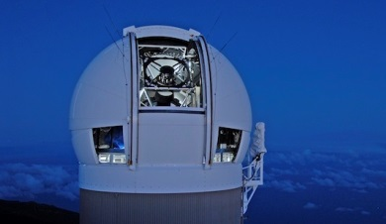
Science Knowledge Gap #2
The need for dedicated characterisation telescopes (for asteroid mining purposes!)
Catalina G96
Catalina 703
Spacewatch
ATLAS
Pan-STARRS
NEOWISE

Slide 8
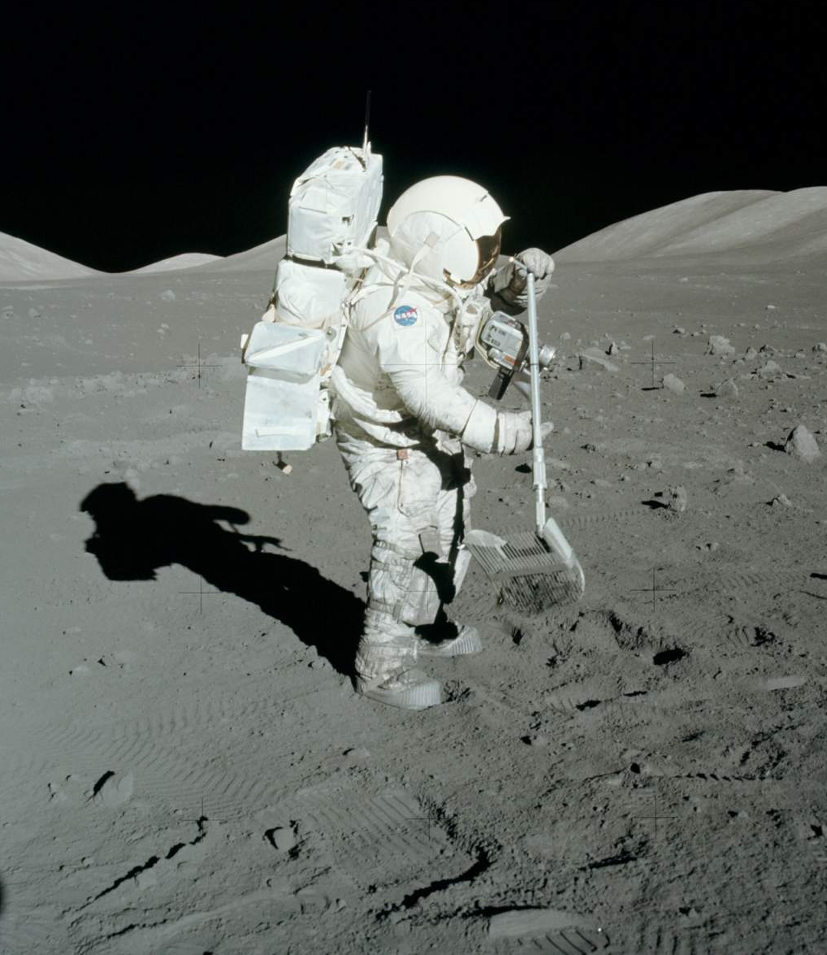
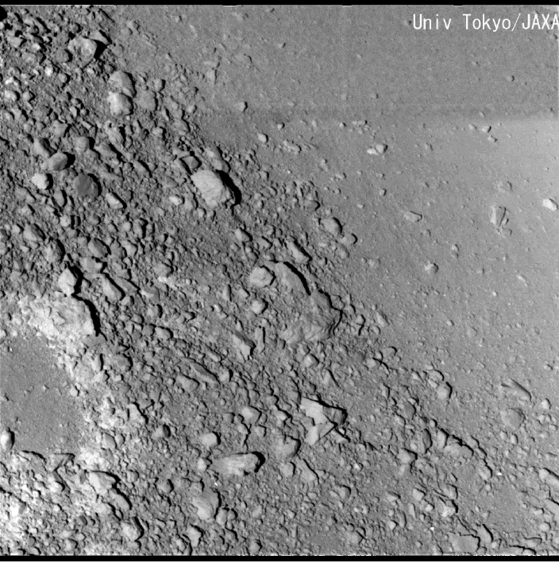
Science Knowledge Gap #3
Understanding regolith dynamics in micro-gravity within a space mining environment
DOWNHILL

Slide 9
Science Knowledge Gap #4
Identifying the mineable Near Earth Asteroids (low: Δv, synodic period, albedo)

Slide 10
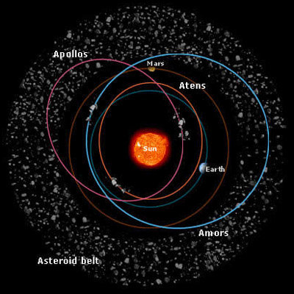
Science Knowledge Gap #5
Can Main Belt origin location of Near Earth Asteroids determine their composition?

Slide 11
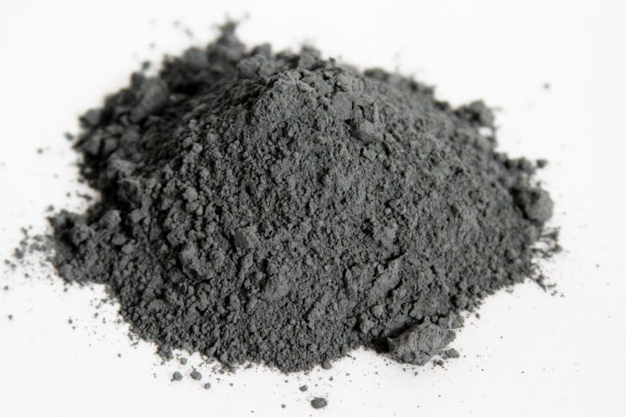
Science Knowledge Gap #6
To improve regolith simulants, need to understand asteroid (sub)surface regolith

Slide 12
Thank You!
Read the Whitepaper!
Graps et al. 2016: https://arxiv.org/abs/1612.00709
Philippe Blondel Grant Bonin Daniel Britt Simone Centuori Marco Delbo Line Drube Rene Duffard Martin Elvis Daniel Faber Elizabeth Frank J.L. Galache Amara Graps Simon F. Green Jan Thimo Grundmann Henry Hsieh Akos Kereszturi | Pauli Laine Anny-Chantal Levasseur-Regourd Philipp Maier Philip Metzger Patrick Michel Migo Mueller Thomas Mueller Naomi Murdoch Alex Parker Petr Pravec Vishnu Reddy Joel Sercel Andy Rivkin Colin Snodgrass Paolo Tanga

Slide 13
Science Knowledge Gaps
Mapping meteorites to asteroid spectra.
Dedicated NEO characterisation equipment/facilities.
Regolith dynamics in micro-gravity within a space mining environment.
Identify the low Δv, low synodic period, low albedo NEOs.
Establish if MBA source regions can determine spectral characteristics of NEOs (especially for small objects).
In order to improve asteroid simulants, need to know characteristics of asteroid regolith from surface and sub-surface.

