Slide 1
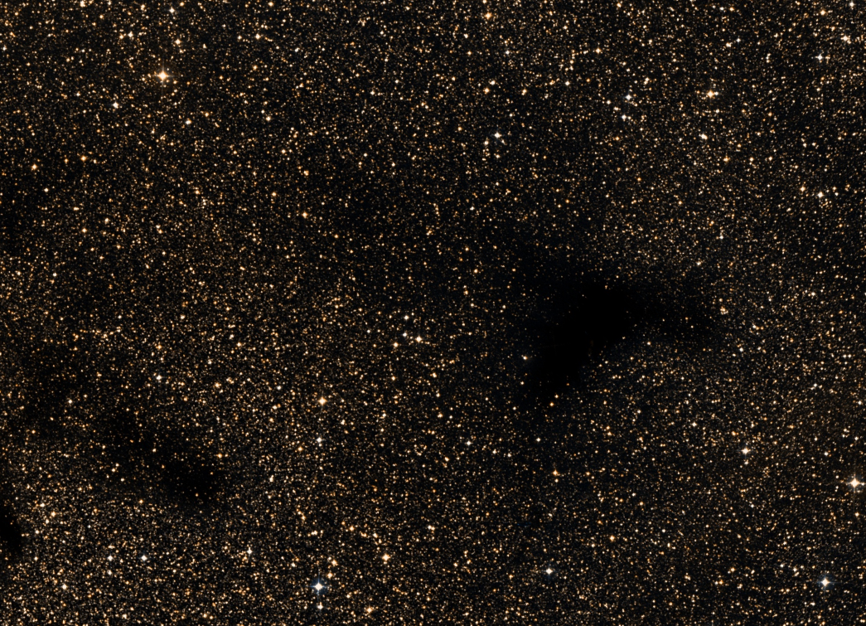

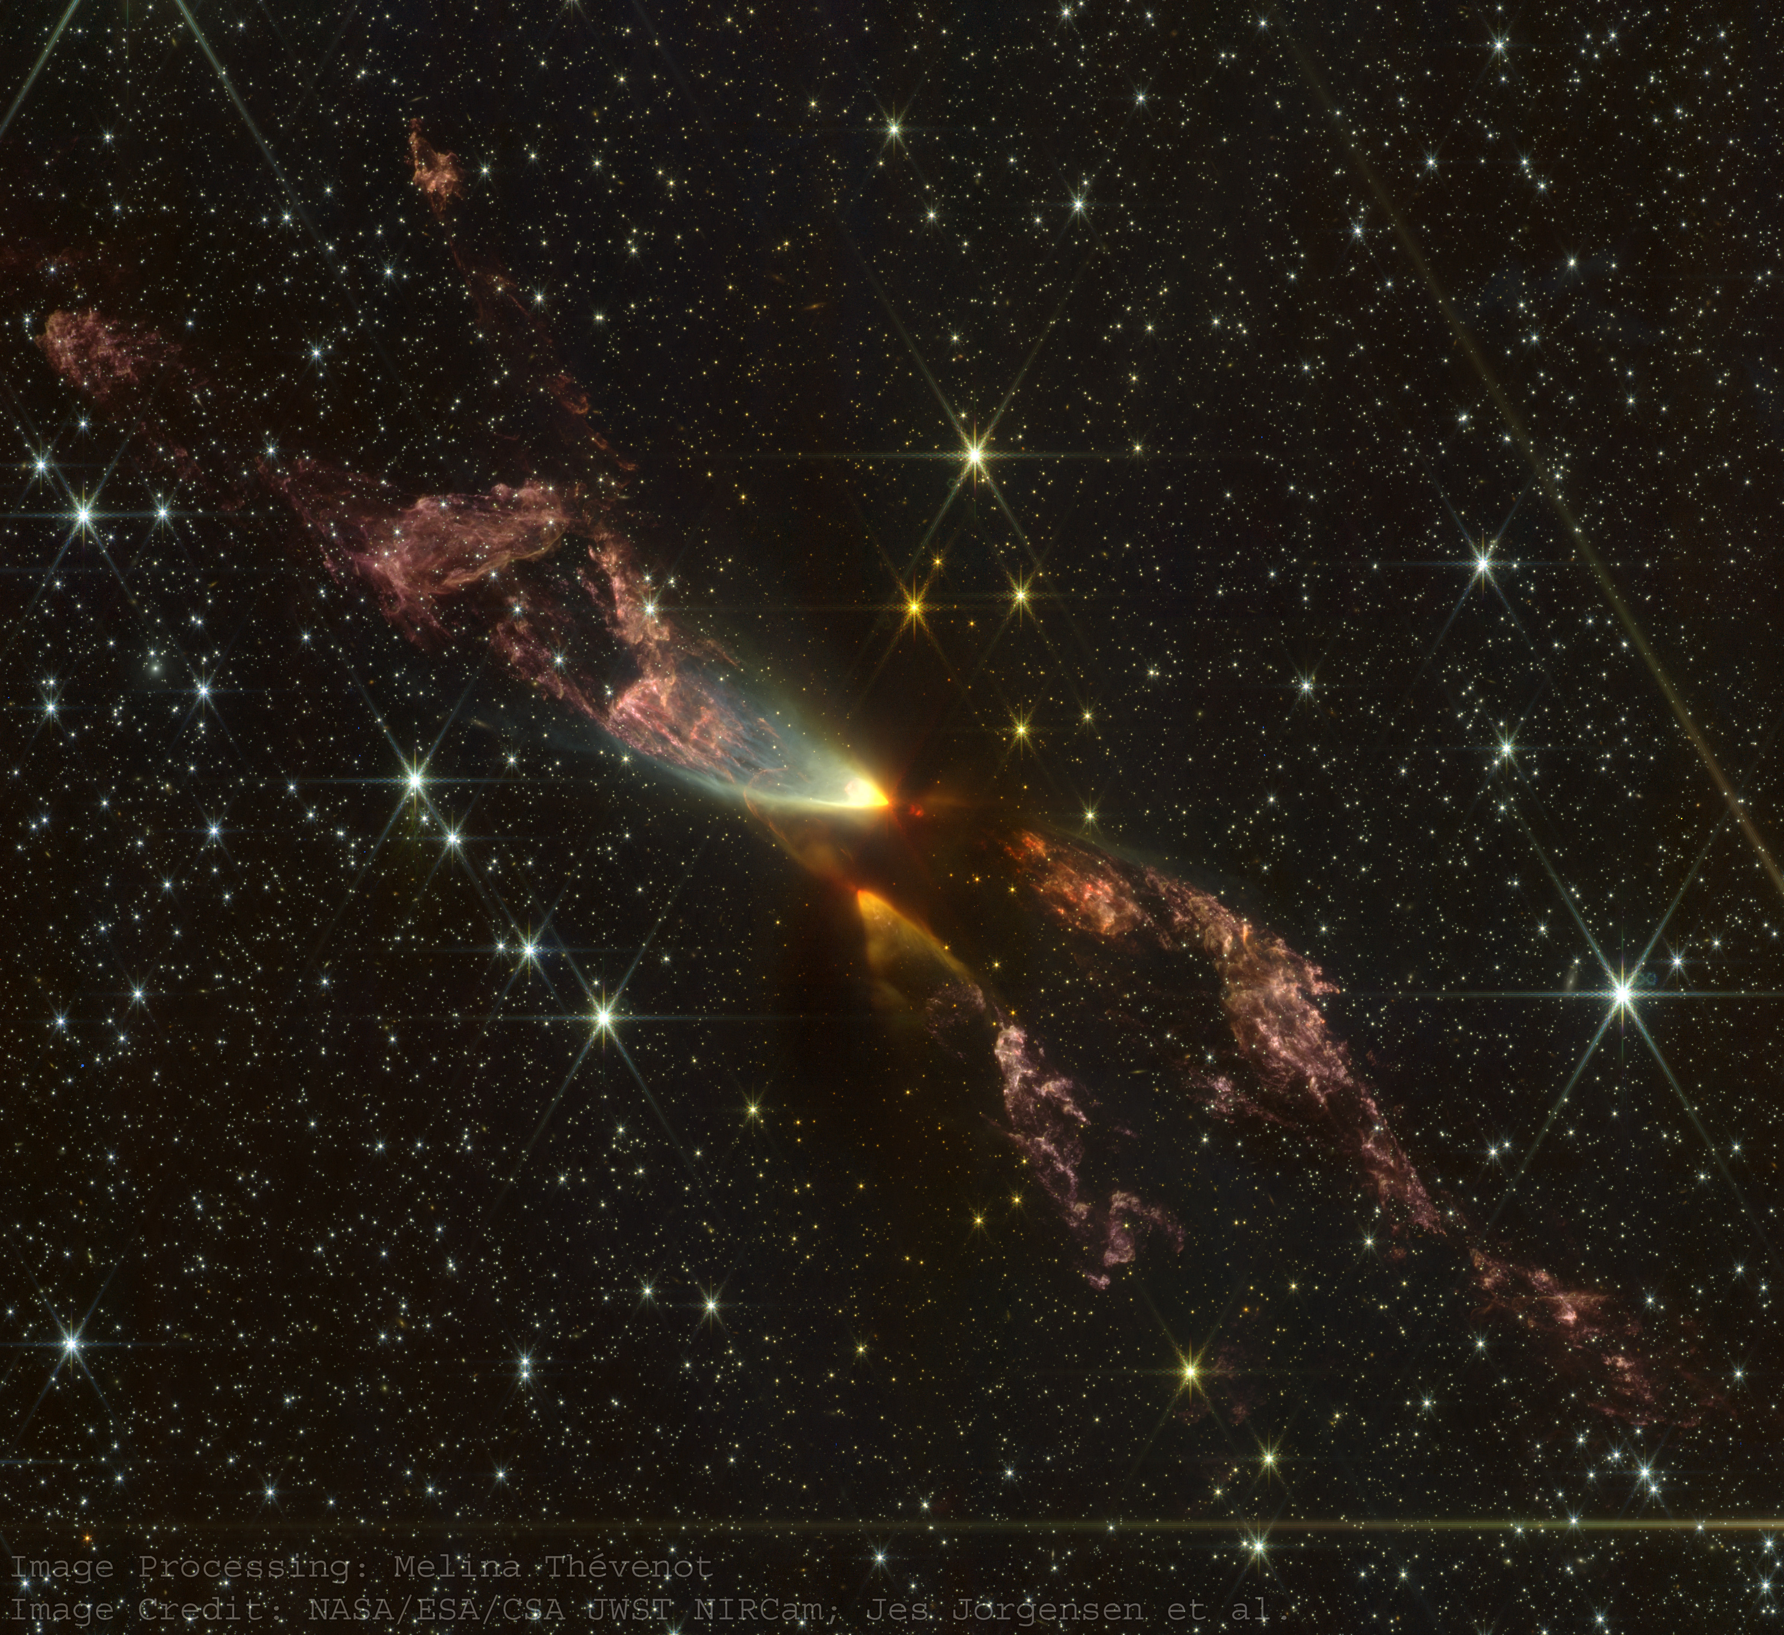
Dust launching and destruction in the protostellar jet
NIRCam (GO5552; PI: Jorgensen)

Slide 2
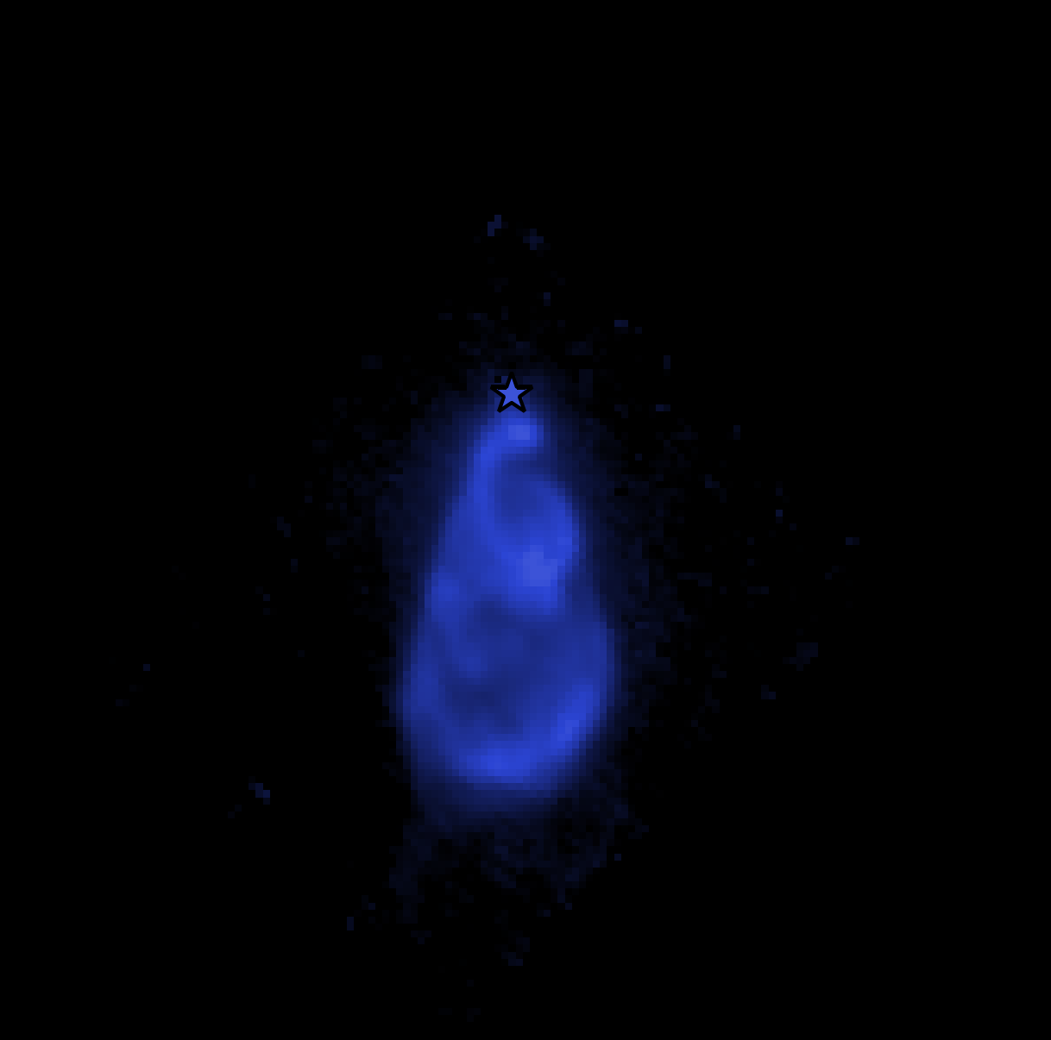
`Tobin+2019
Dust launching and destruction in the protostellar jet
H2 S(7)
500 au
NIRCam (GO5552; PI: Jorgensen)
Tychoniec et al. 2026

Slide 3
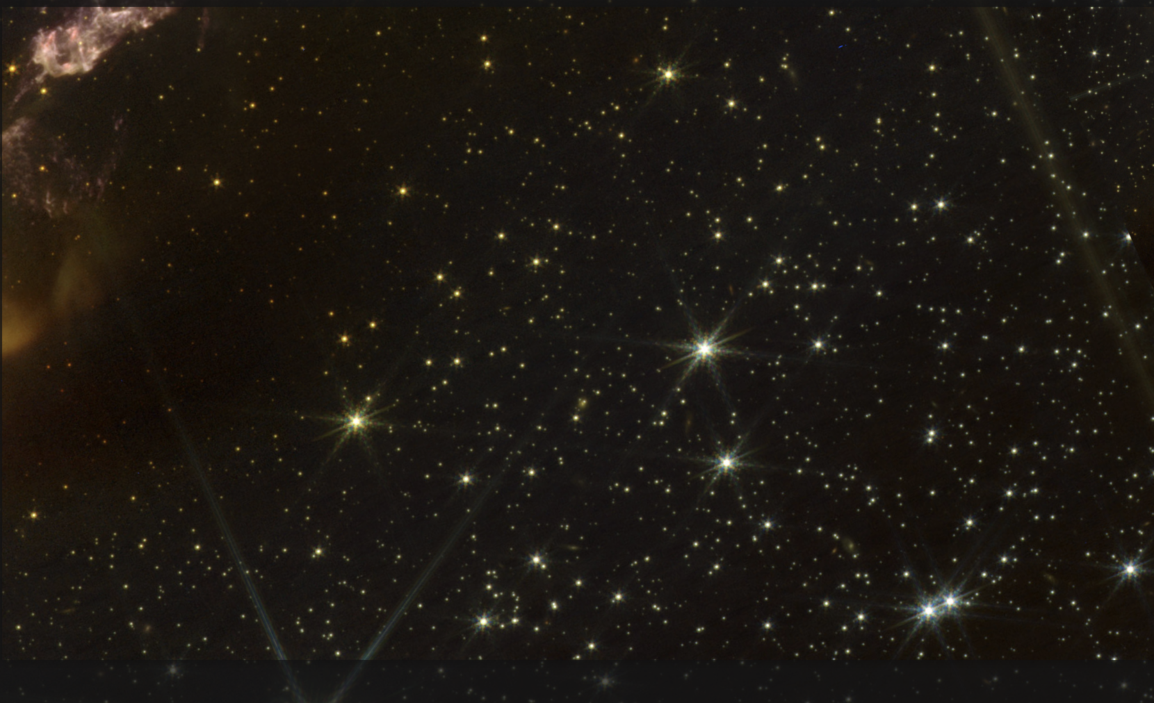
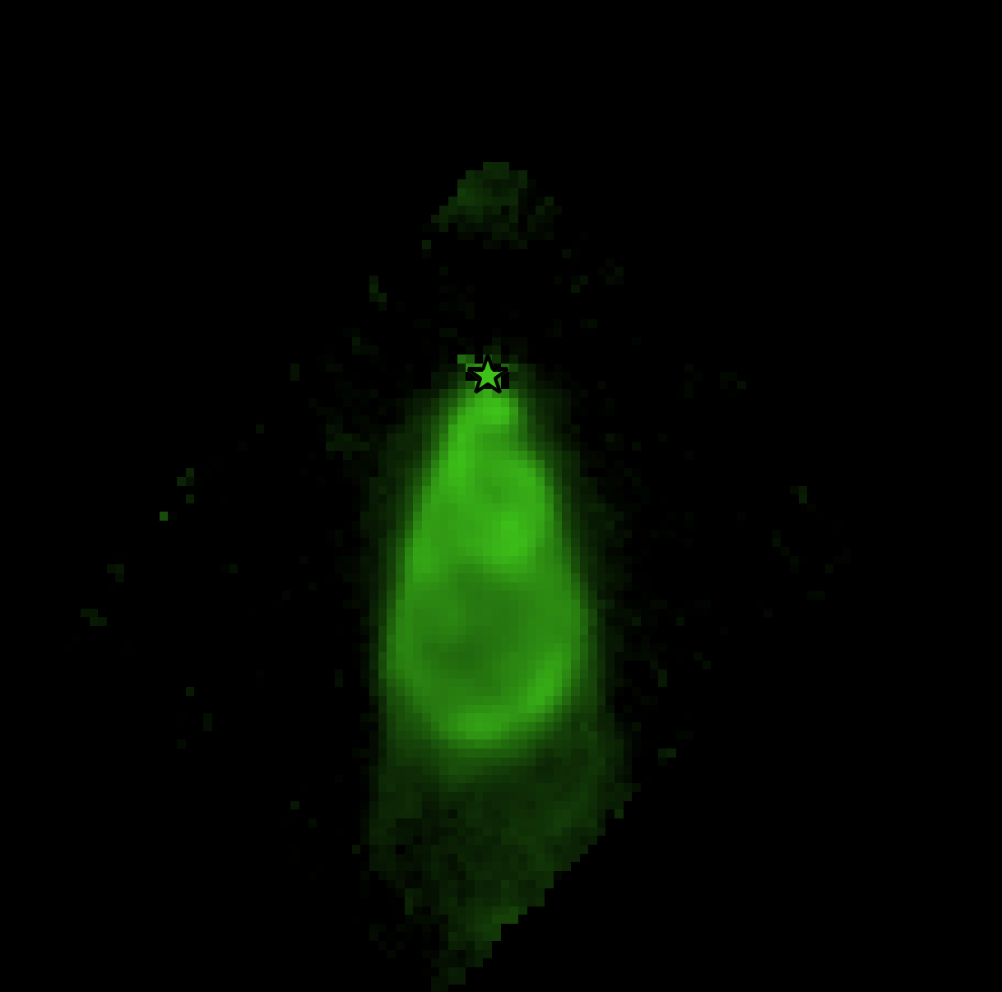
`Tobin+2019
Dust launching and destruction in the protostellar jet
H2 S(5)
500 au
NIRCam (GO5552; PI: Jorgensen)
Tychoniec et al. 2026

Slide 4
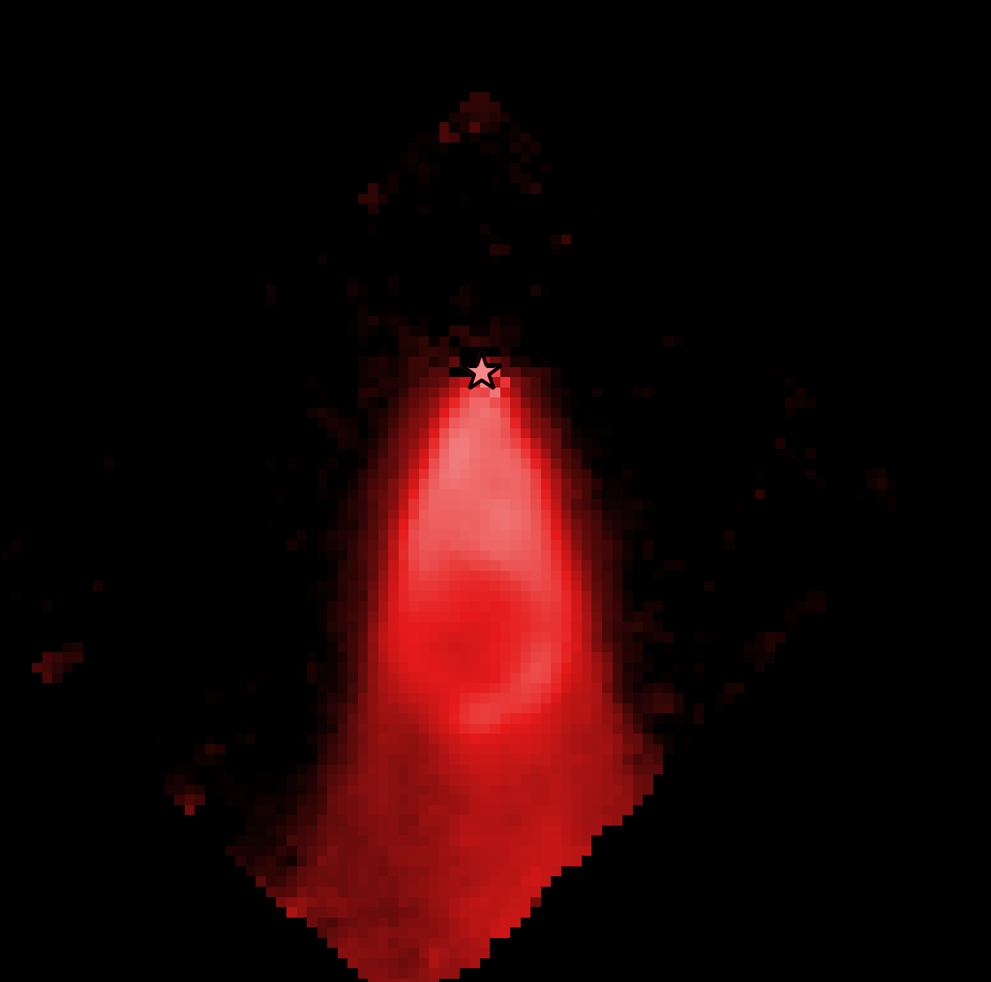
`Tobin+2019
Dust launching and destruction in the protostellar jet
H2 S(1)
500 au
NIRCam (GO5552; PI: Jorgensen)
Tychoniec et al. 2026

Slide 5
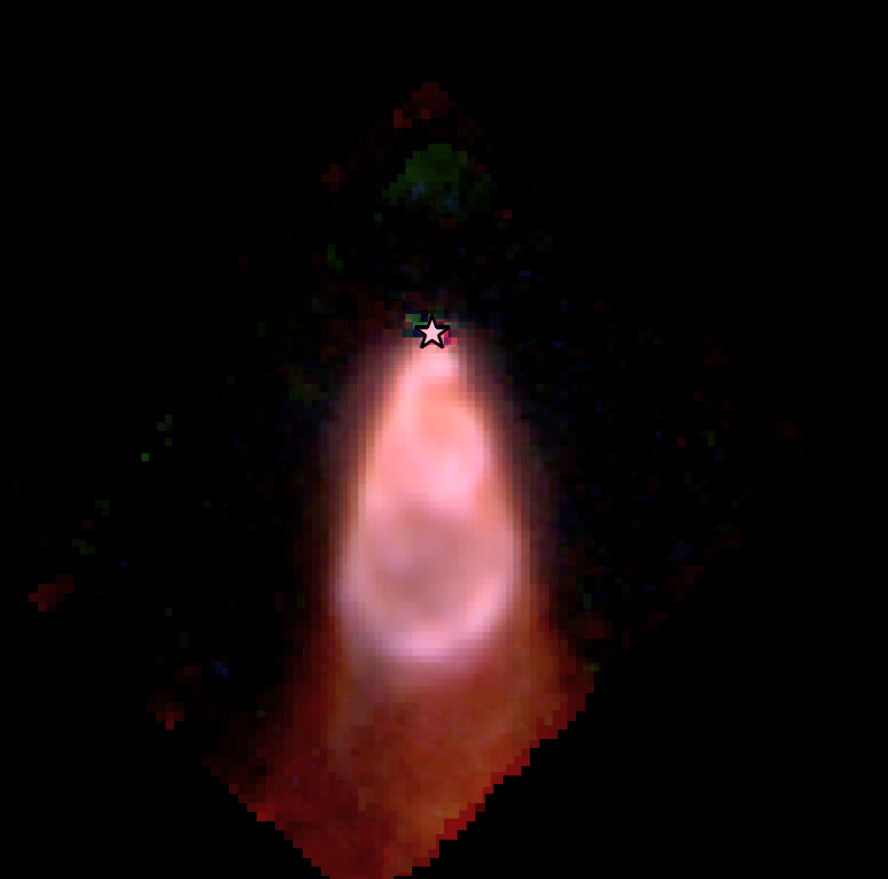
`Tobin+2019
Dust launching and destruction in the protostellar jet
H2 - S(7), S(5), S(1)
500 au
NIRCam (GO5552; PI: Jorgensen)
Tychoniec et al. 2026

Slide 6
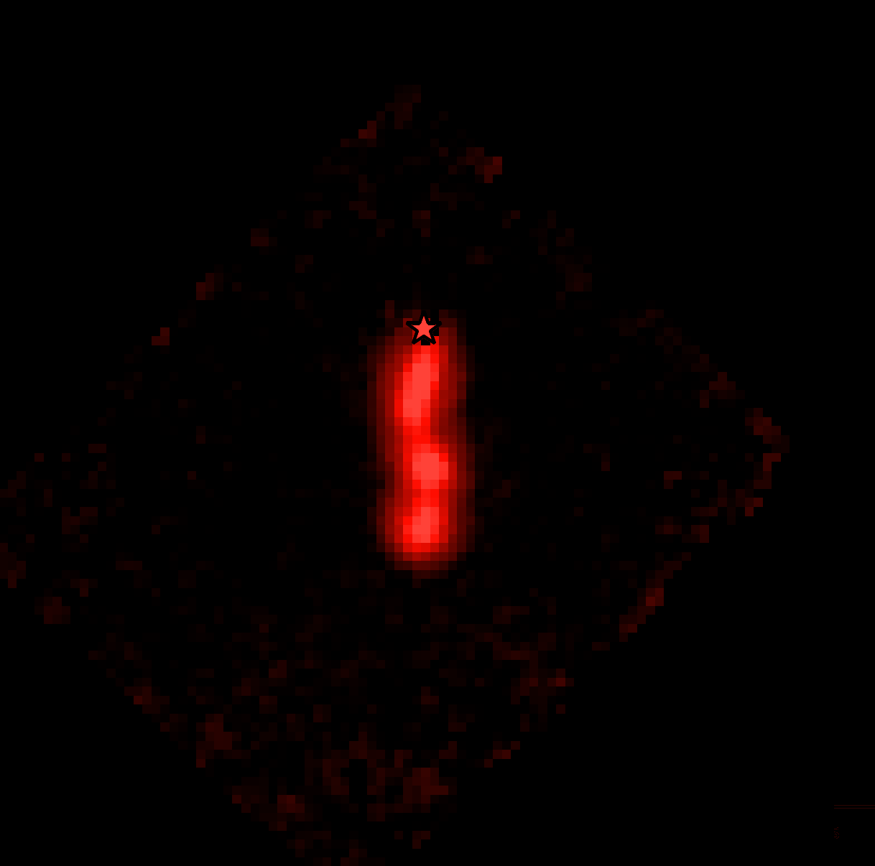
`Tobin+2019
Dust launching and destruction in the protostellar jet
[Ne II]
500 au
NIRCam (GO5552; PI: Jorgensen)
Tychoniec et al. 2026

Slide 7
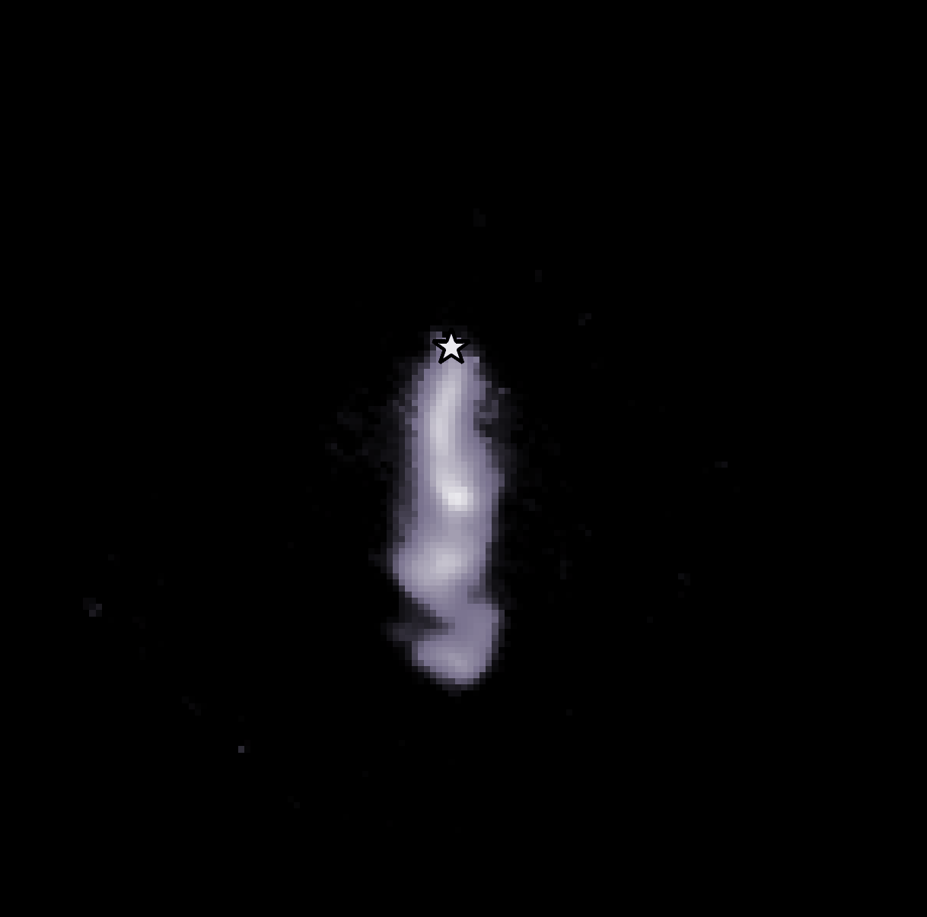
`Tobin+2019
Dust launching and destruction in the protostellar jet
[Fe II]
500 au
NIRCam (GO5552; PI: Jorgensen)
Tychoniec et al. 2026

Slide 8
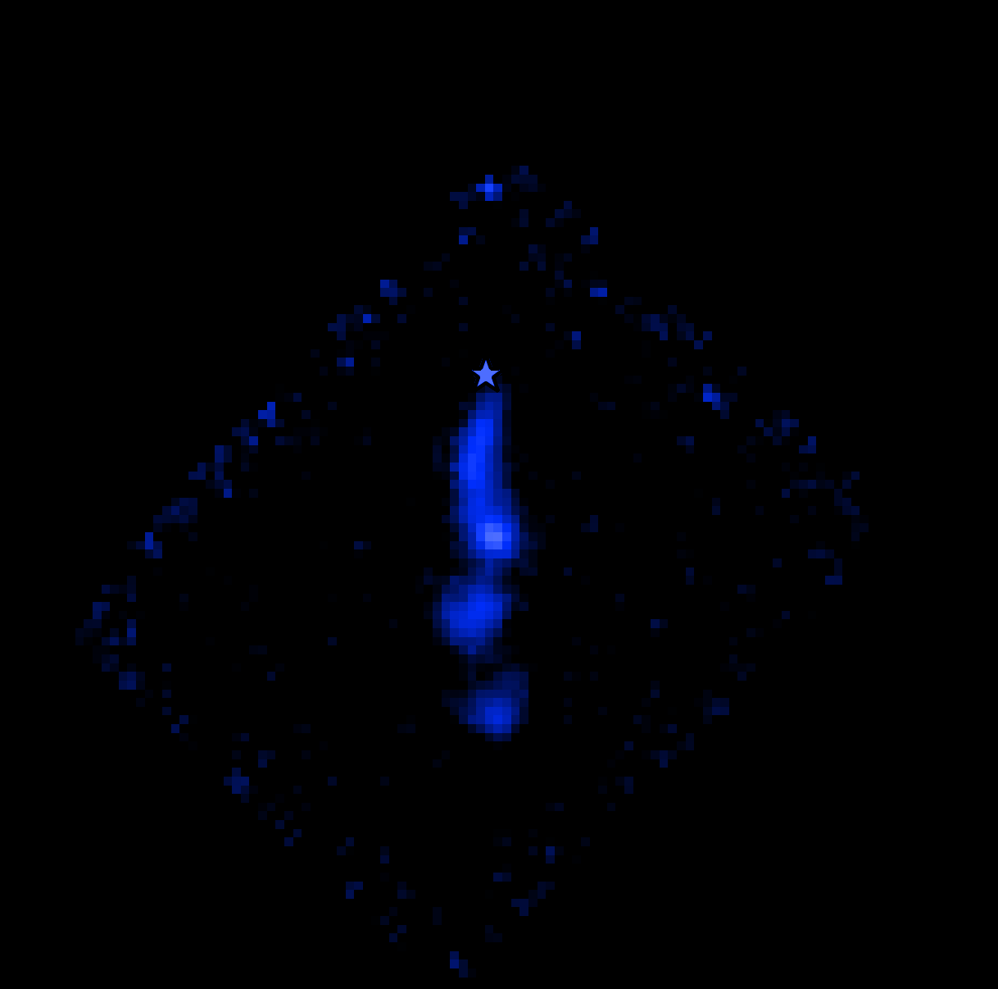
`Tobin+2019
Dust launching and destruction in the protostellar jet
[Co II]
500 au
NIRCam (GO5552; PI: Jorgensen)
Tychoniec et al. 2026

Slide 9
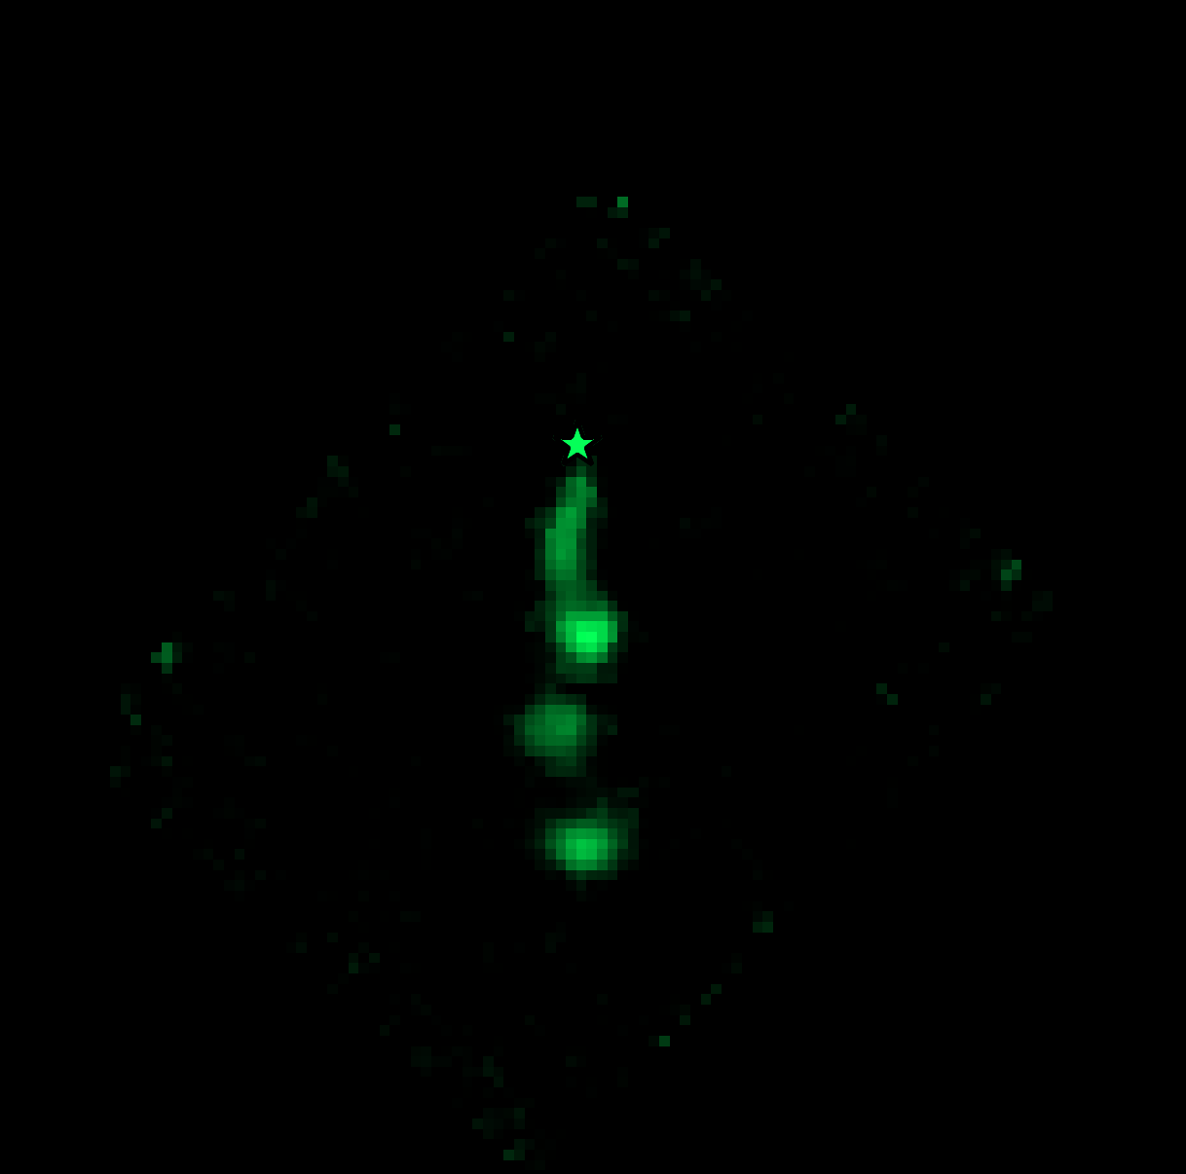
`Tobin+2019
Dust launching and destruction in the protostellar jet
[Cl I]
500 au
NIRCam (GO5552; PI: Jorgensen)
Tychoniec et al. 2026

Slide 10
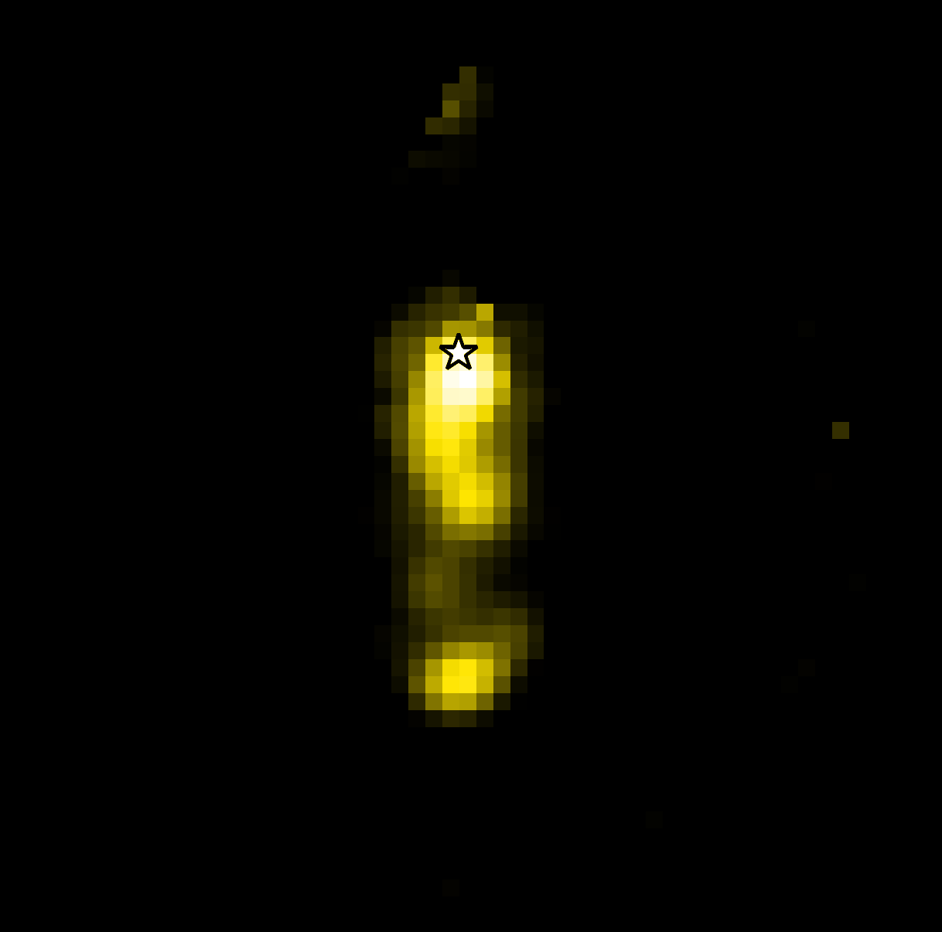
`Tobin+2019
Dust launching and destruction in the protostellar jet
[S I]
500 au
NIRCam (GO5552; PI: Jorgensen)
Tychoniec et al. 2026

Slide 11
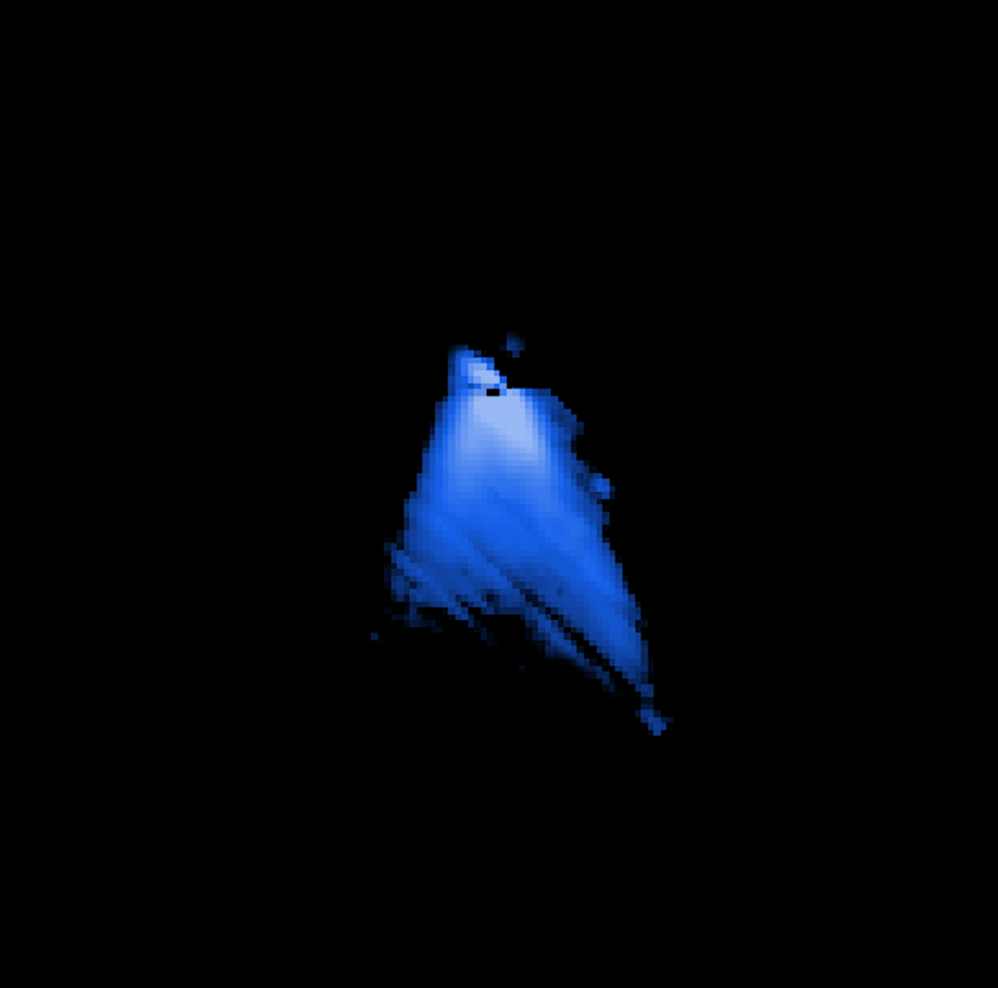
`Tobin+2019
Dust launching and destruction in the protostellar jet
Dust - 6.3 μm
500 au
NIRCam (GO5552; PI: Jorgensen)
Tychoniec et al. 2026

Slide 12
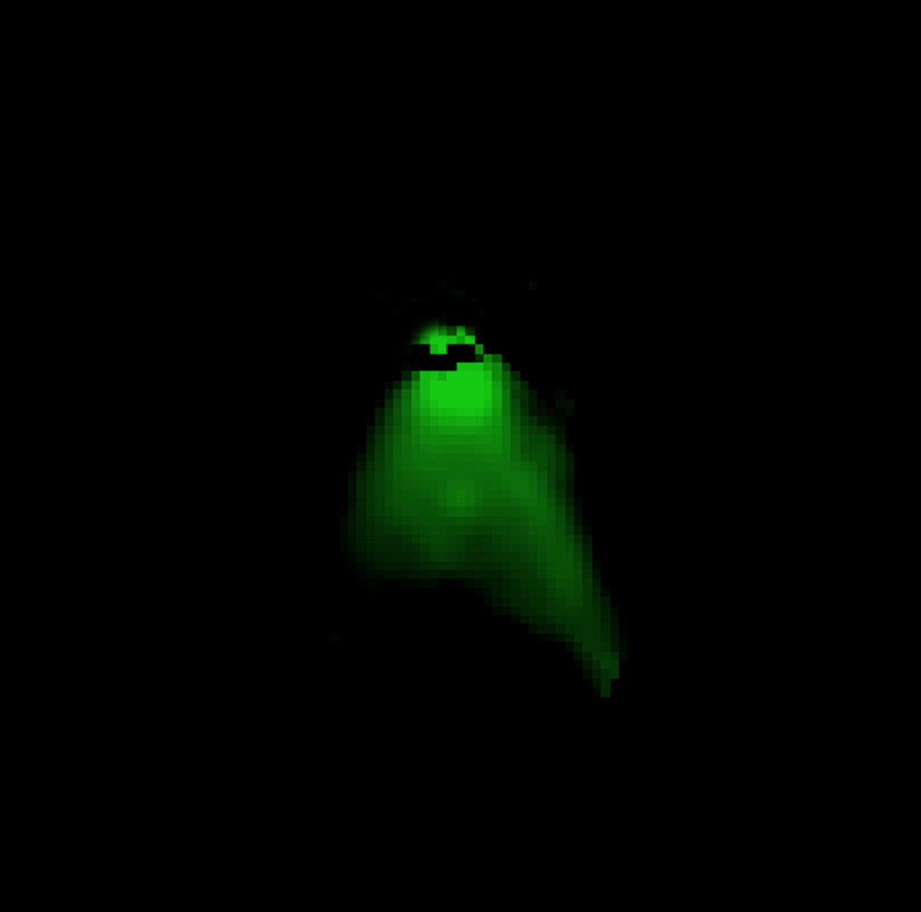
`Tobin+2019
Dust launching and destruction in the protostellar jet
Dust - 13.7 μm
500 au
NIRCam (GO5552; PI: Jorgensen)
Tychoniec et al. 2026

Slide 13
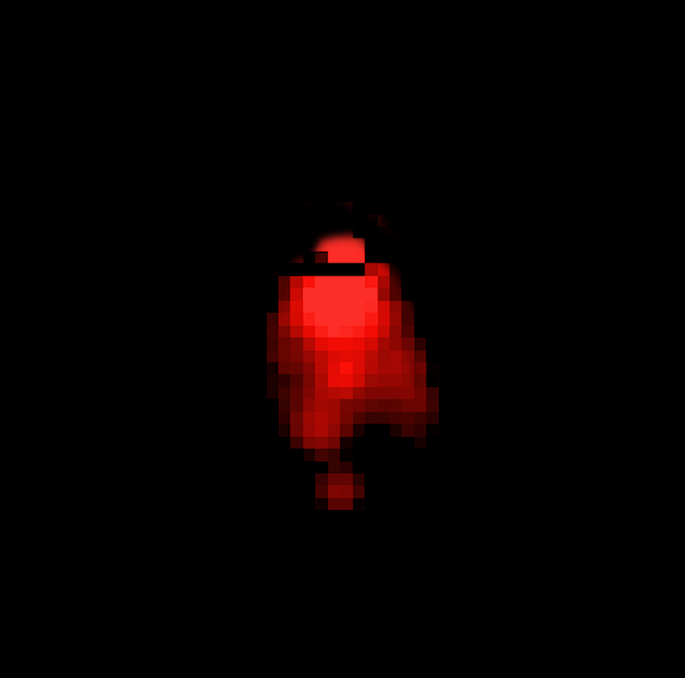
`Tobin+2019
Dust launching and destruction in the protostellar jet
Dust - 19.6 μm
500 au
NIRCam (GO5552; PI: Jorgensen)
Tychoniec et al. 2026

Slide 14
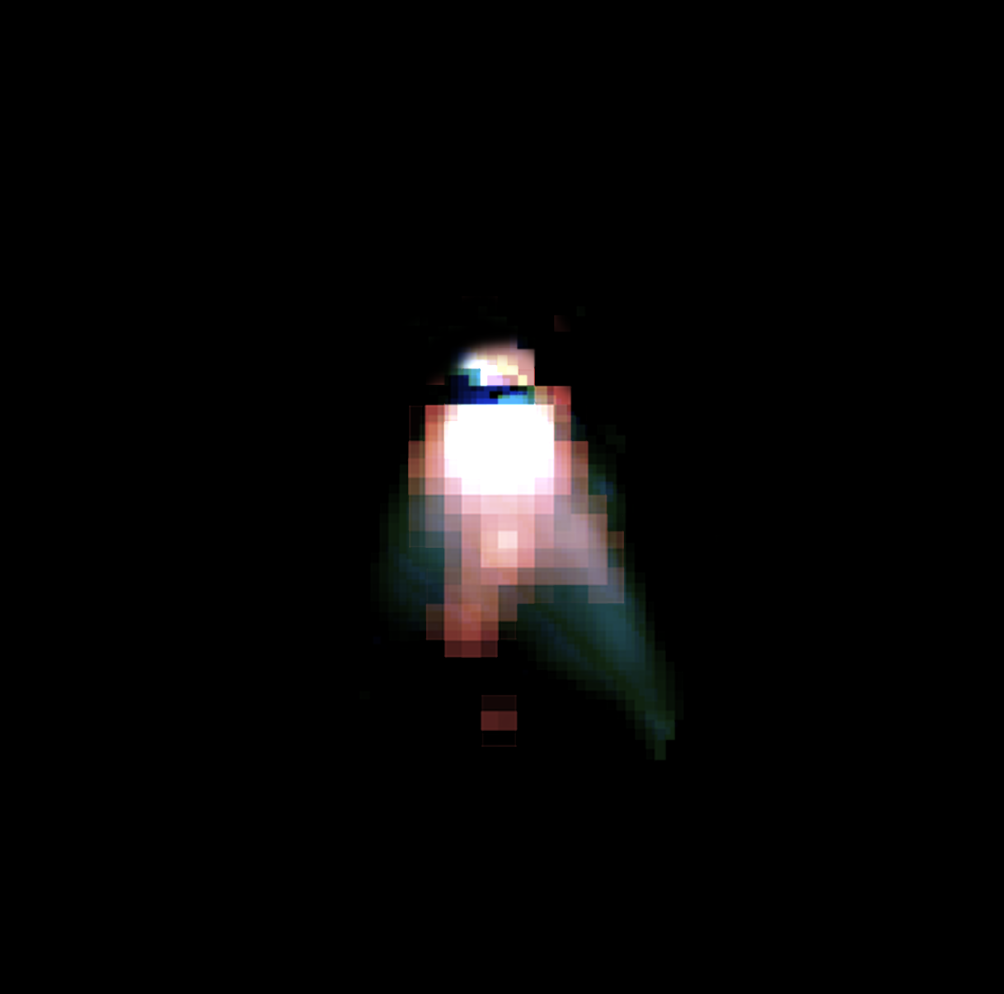
`Tobin+2019
Dust launching and destruction in the protostellar jet
Dust - 6.3, 13.7, 19.6 μm
500 au
NIRCam (GO5552; PI: Jorgensen)
Tychoniec et al. 2026

Slide 15
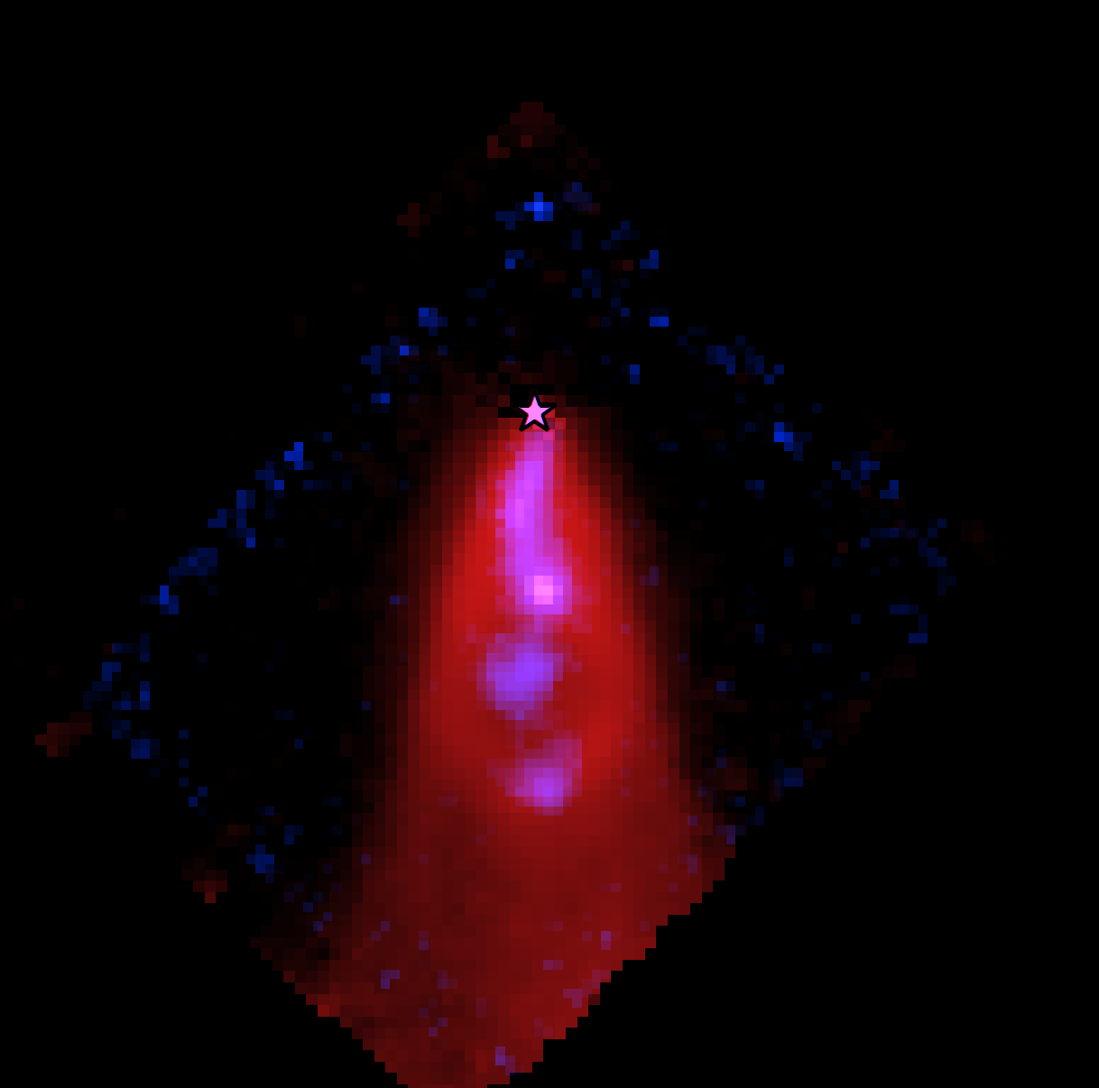
`Tobin+2019
Dust launching and destruction in the protostellar jet
H2 17.01 μm, [Co II]
500 au
NIRCam (GO5552; PI: Jorgensen)
Tychoniec et al. 2026

Slide 16
`Tobin+2019
Dust launching and destruction in the protostellar jet
[Ne II]
[Cl I]
[Co II]
[Fe II]
Dust 19.6 μm
500 au
[S I]
Dust - 6.3, 13.7, 19.6 μm
H2 17.01 μm, [Co II]
H2 S(1)
500 au
NIRCam (GO5552; PI: Jorgensen)
Tychoniec et al. 2026

