Slide 1
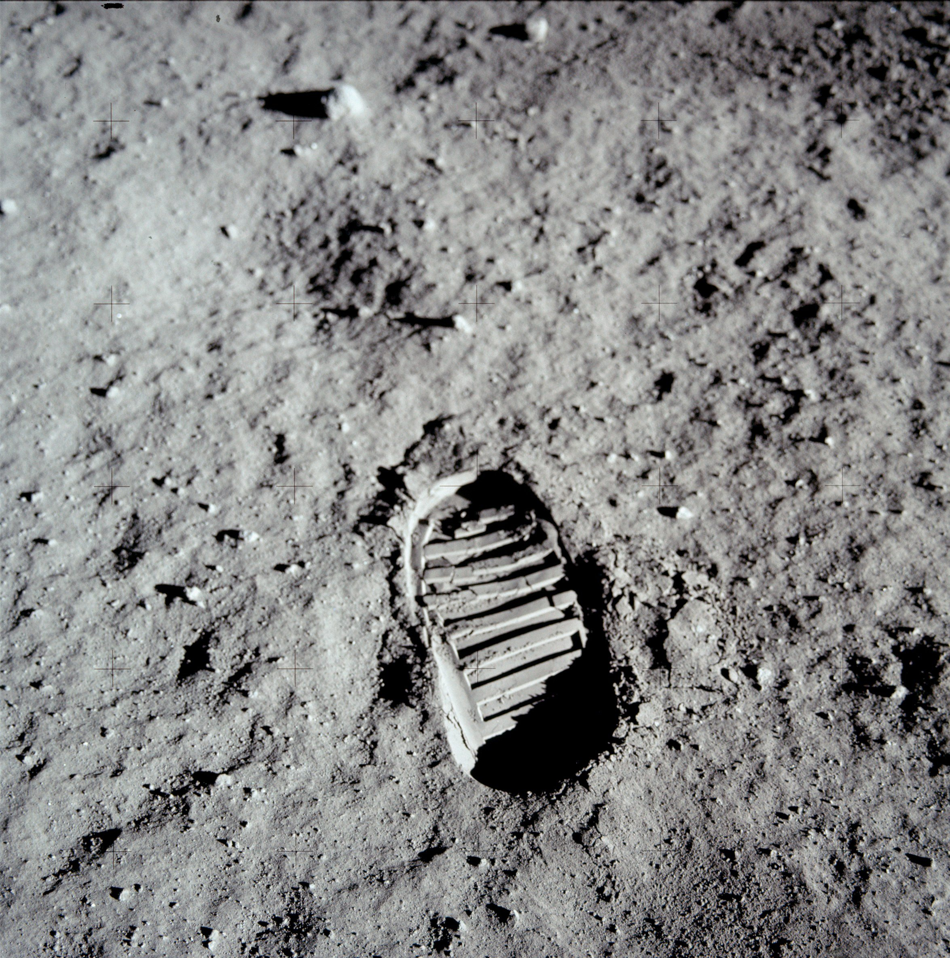
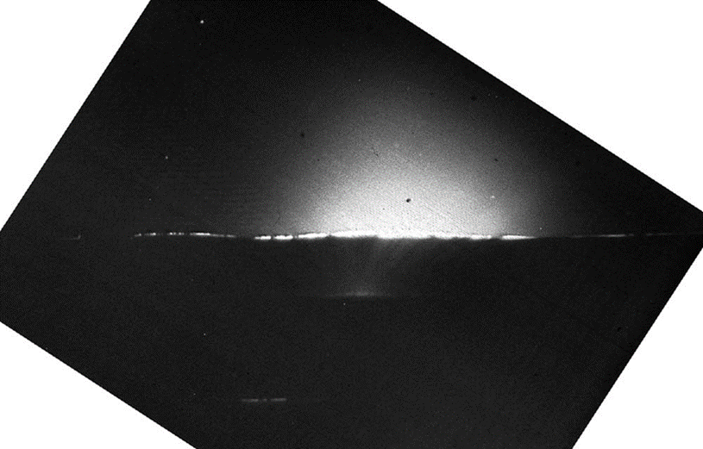



LUNAR DUST DETECTION WITH LASER OPTICAL IMAGING EXPERIMENT
Keval Dabhi^{A,B}, Christian Althaus^{B}, Prof. Dr. Jürgen Schmidt^{A}, Dr. Matthias Grott^{B}, Dr. Ralf Srama^{C}, Dr. Yanwei Li^{C}
^{A} Department of Planetary Sciences, FU Berlin
^{B} Planetary Sensor Systems, DLR, Berlin
^{C} University of Stuttgart
BACKGROUND:
Fine lunar dust is hazardous to surface operations because it can be electrically mobile, adhesive, abrasive, and optically active
Solar radiation and plasma interactions charge the lunar surface and dust particles, potentially lofting dust into the near-surface environment
However, particle-scale optical signatures of suspended dust remain poorly constrained.
Aim: Test whether pulsed laser backscattering can detect and characterize suspended 10–30 µm lunar-dust analogs under controlled laboratory conditions
Footprint of Buzz Aldrin in Lunar Regolith
(Source: NASA Public Domain)
Surveyor 6 image showing a glow on the western lunar horizon after sunset, NASA^{[4]}

Slide 2
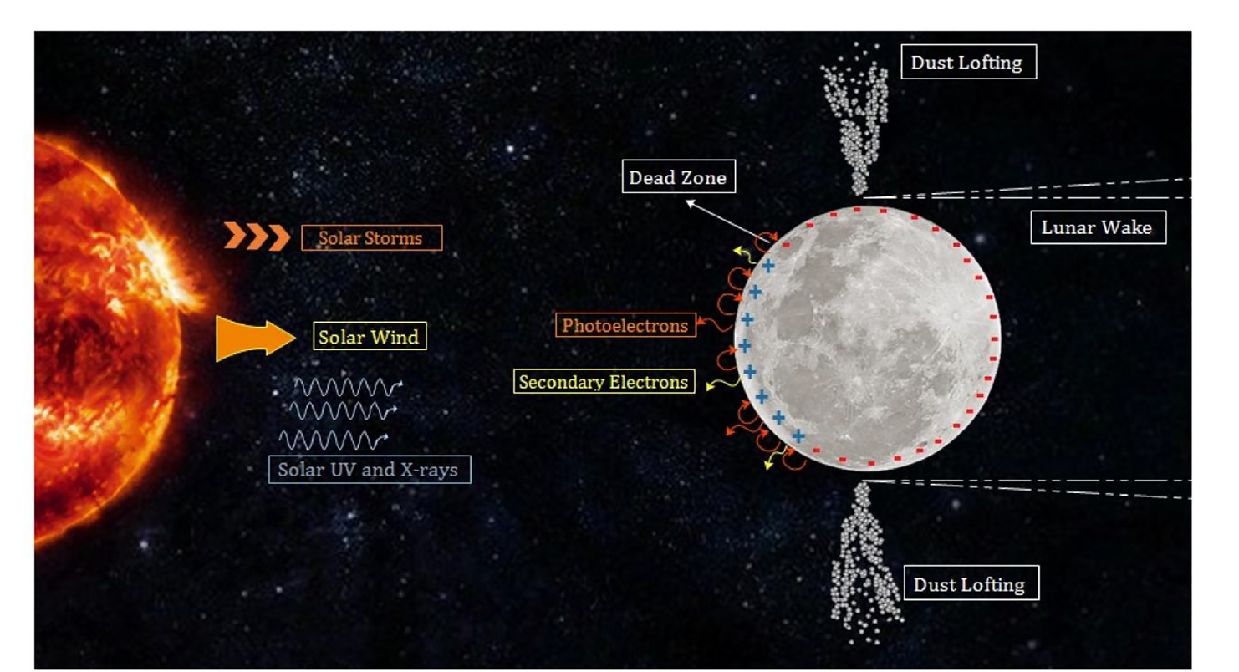
LUNAR PLASMA ENVIRONMENT
Lunar surface charging and lofted dust cloud representation. Orger et al. (2018) ^{[3]}
Potential Difference between the dayside and nightside drives the dust lofting

Slide 3
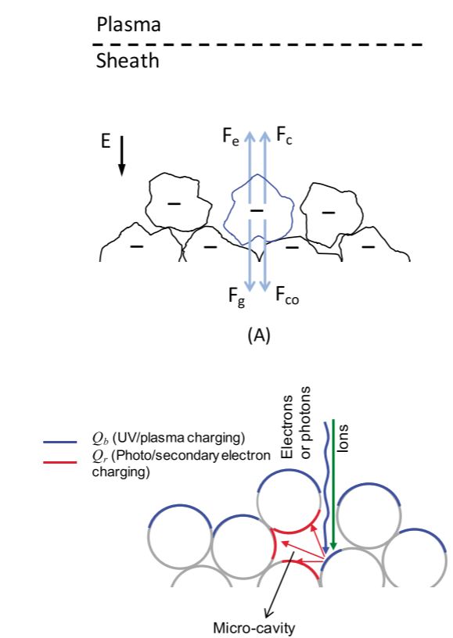
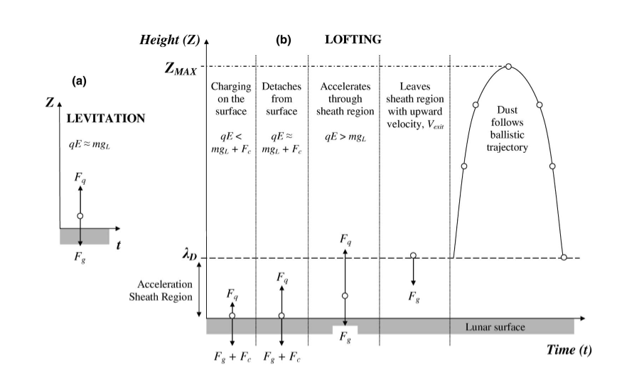
DUST LOFTING MECHANISMS
(a) Static Levitation concept, (b) Motion of a dust grain in a Fountain Model Stubbs et al. (2006) ^{[1]}
Charges and forces on a dust particle (A) Particles under electric field E become negatively charged. Forces acting are Fe=QE, the sheath electric force, Fc, particle-particle repulsive force, Fg; gravitational force and Fco; cohesion between contacting particles, (B)
Patched Charge model,
(Wang et al. 2016) ^{[2]}

Slide 4
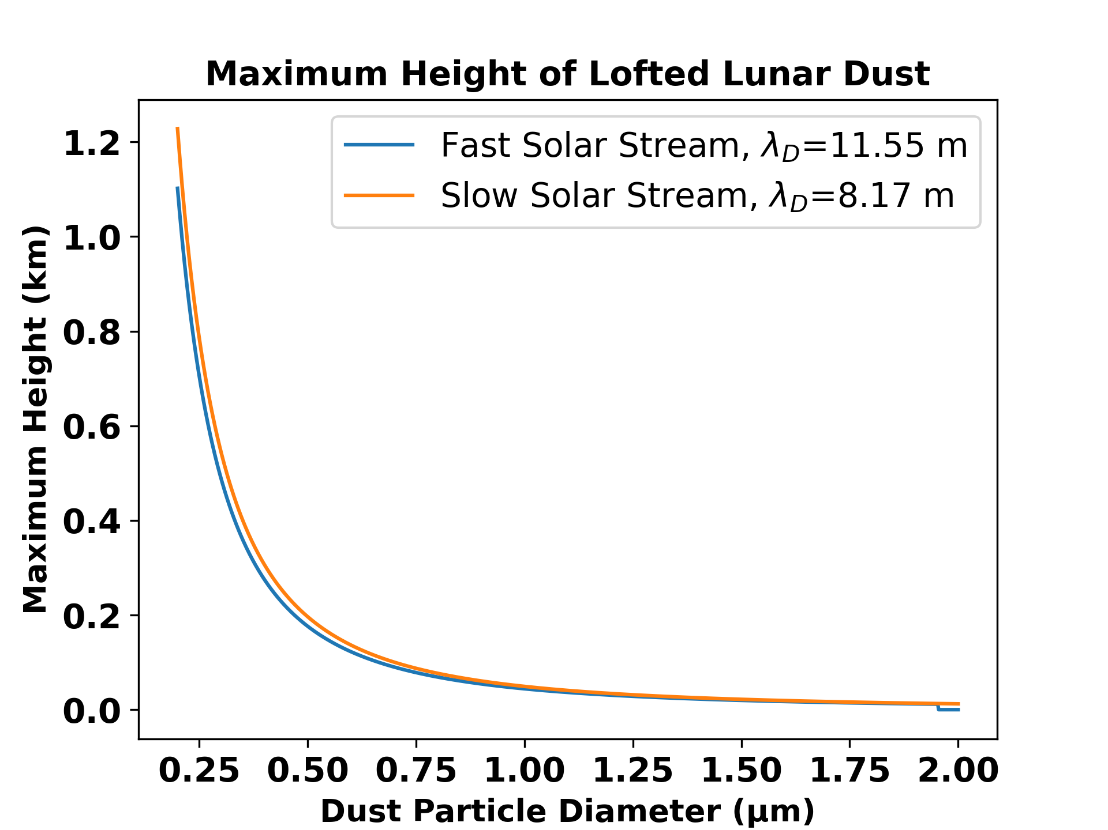
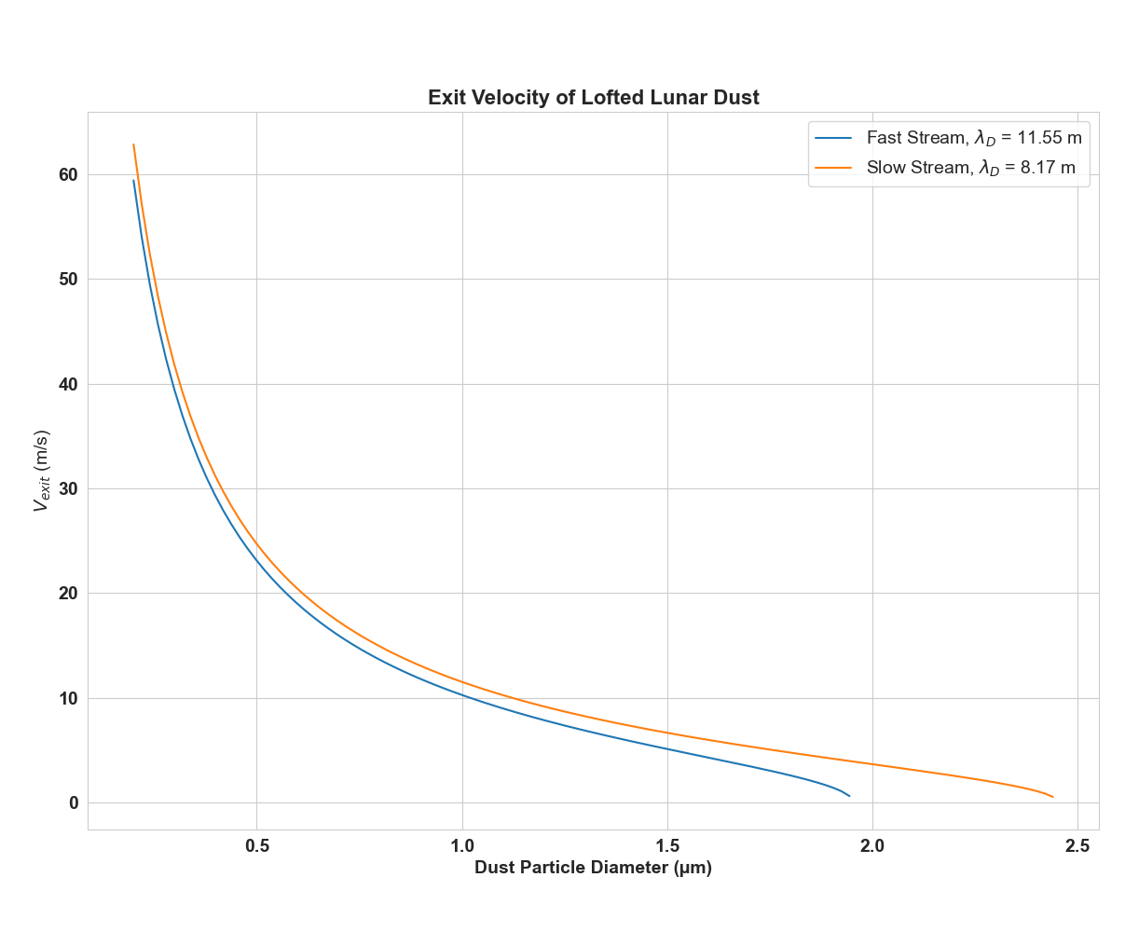
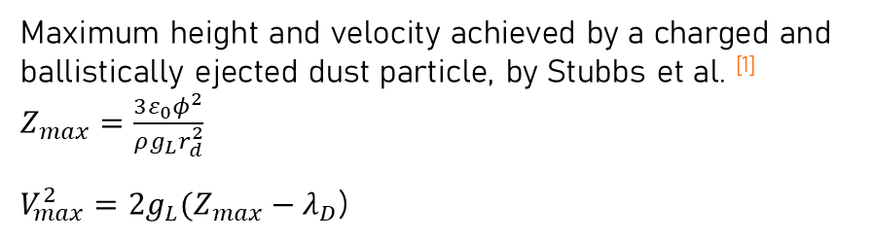
THEORATICAL RESERACH AND MODELS
Maximum height and velocity achieved by a charged and ballistically ejected dust particle, by Stubbs et al. ^{[1]}
$Z_{max}=\frac{3ε_{0}φ^{2}}{ρg_{L}r_{d}^{2}}$
$V_{max}^{2}=2g_{L}(Z_{max}−λ_{D}$)

Slide 5
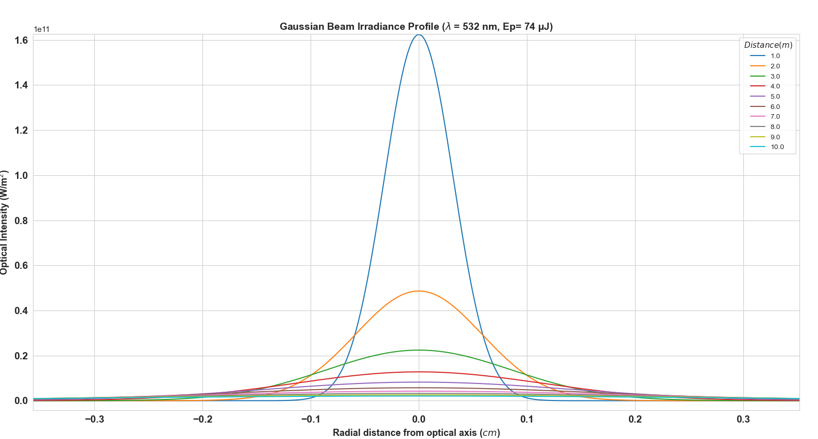
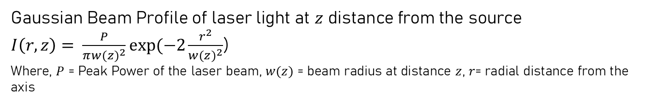
THEORATICAL RESEARCH AND MODELS
Gaussian Beam Profile of laser light at $z$ distance from the source
$I\left(r,z\right)= \frac{P}{π{w(z)}^{2}}exp⁡(−2\frac{r^{2}}{{w(z)}^{2}}$)
Where, $P$ = Peak Power of the laser beam, $w(z)$ = beam radius at distance $z$, $r$= radial distance from the axis

Slide 6
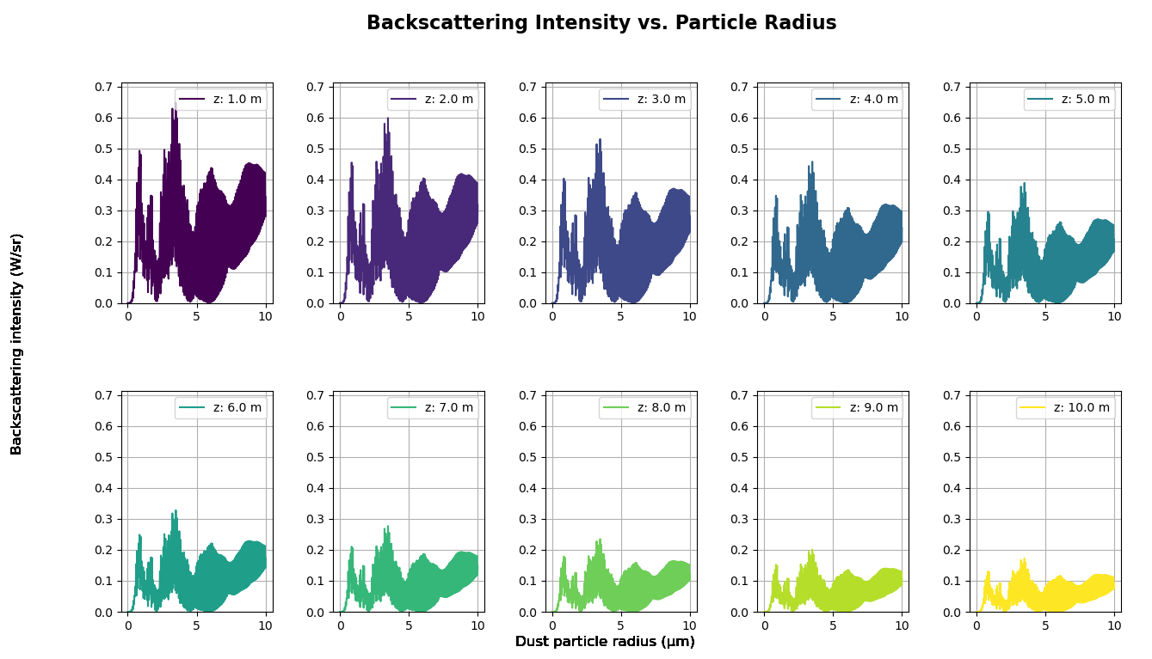
THEORATICAL RESEARCH AND MODELS
Recorded backscattering at the detector depends heavily on the nature of the particle (refractive index $m$) and the distance from the detector ($z$)

Slide 7
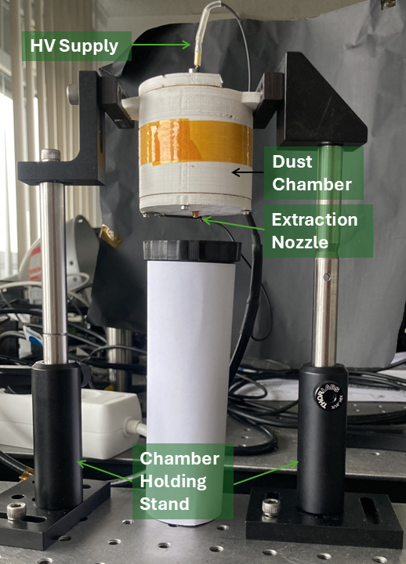
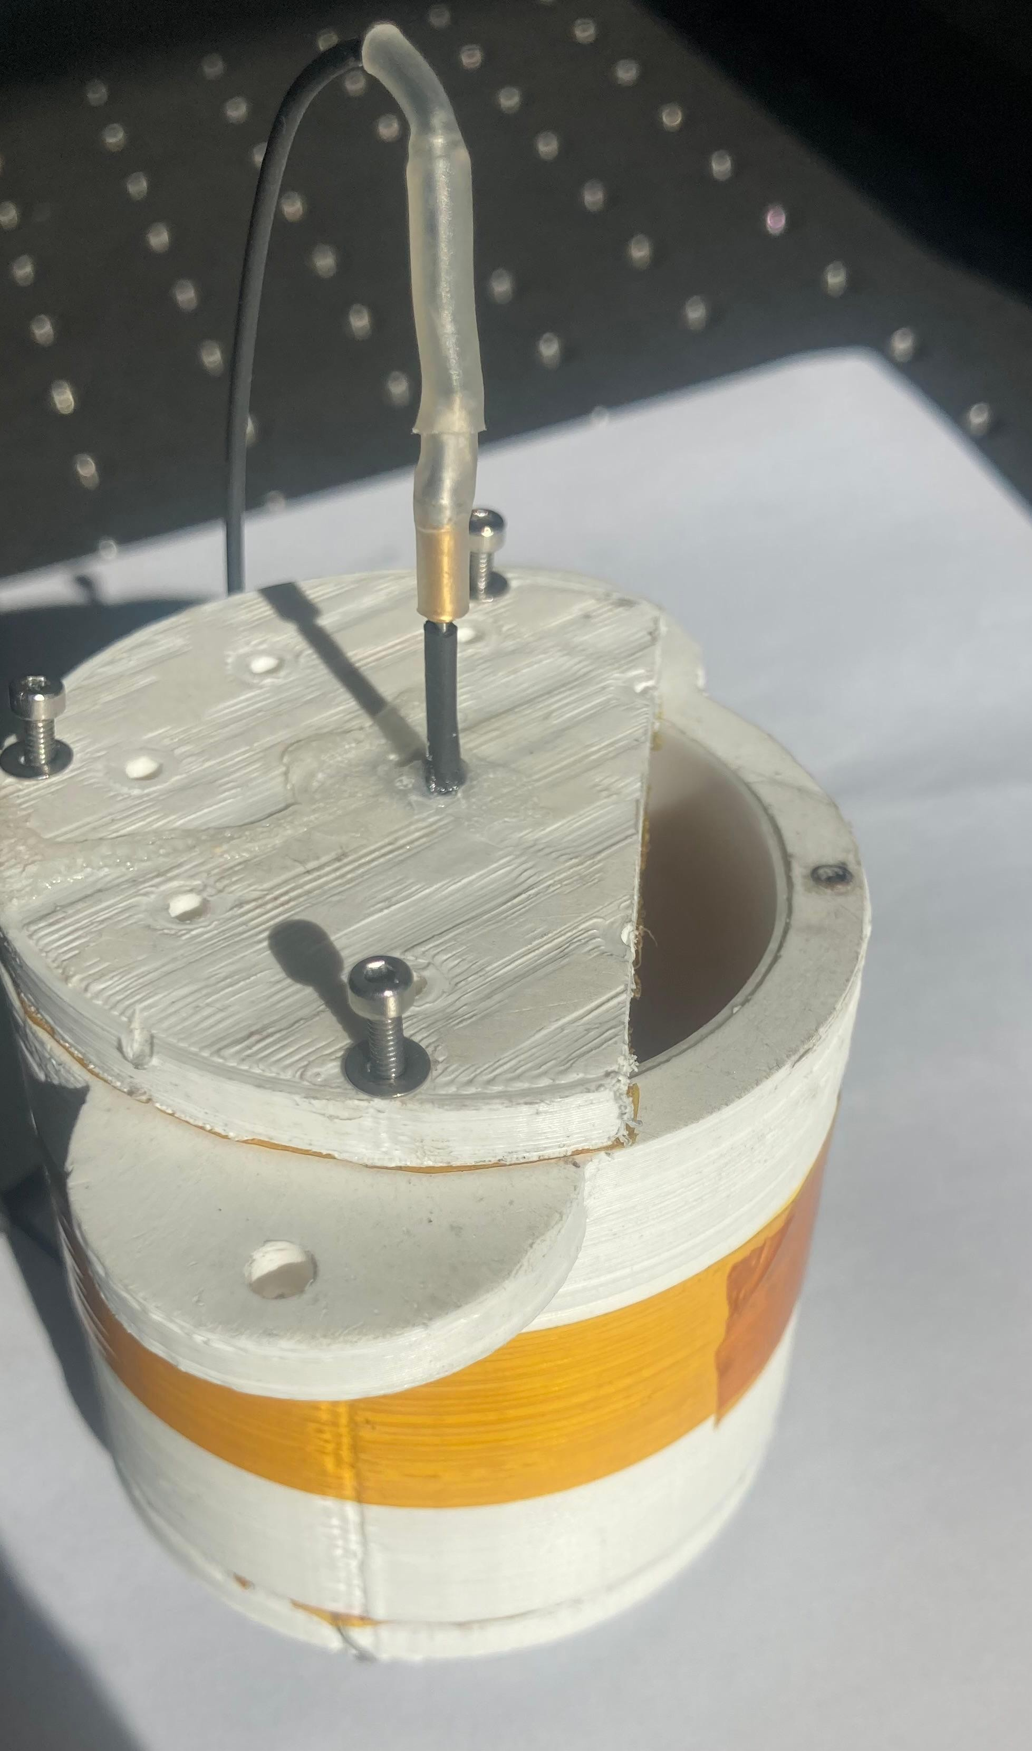
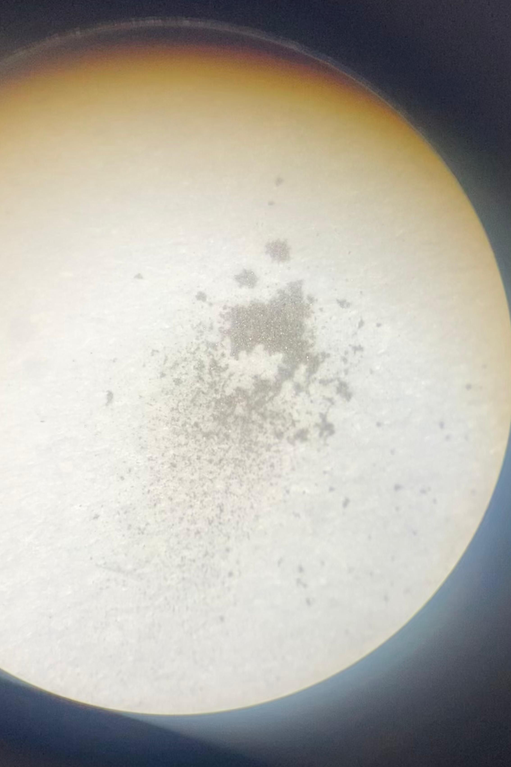
EXPERIMENTAL SETUP: APPROACH A
HV Needle + Grounded Grid = Corona Discharge
Spark over at ~ 2 kV → Chaotic ejection
Back corona prevented stable stream
agglomerated discharge of particles
collected in a cup and looked under microscope

Slide 8
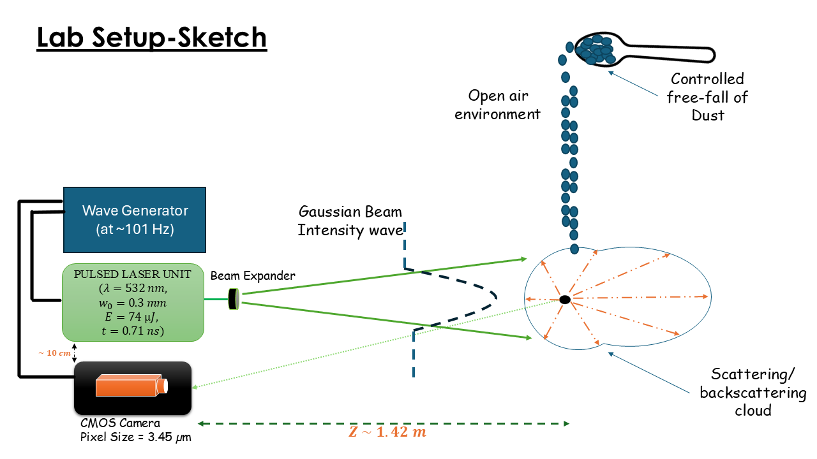
EXPERIMENTAL SETUP: APPROACH B

Slide 9
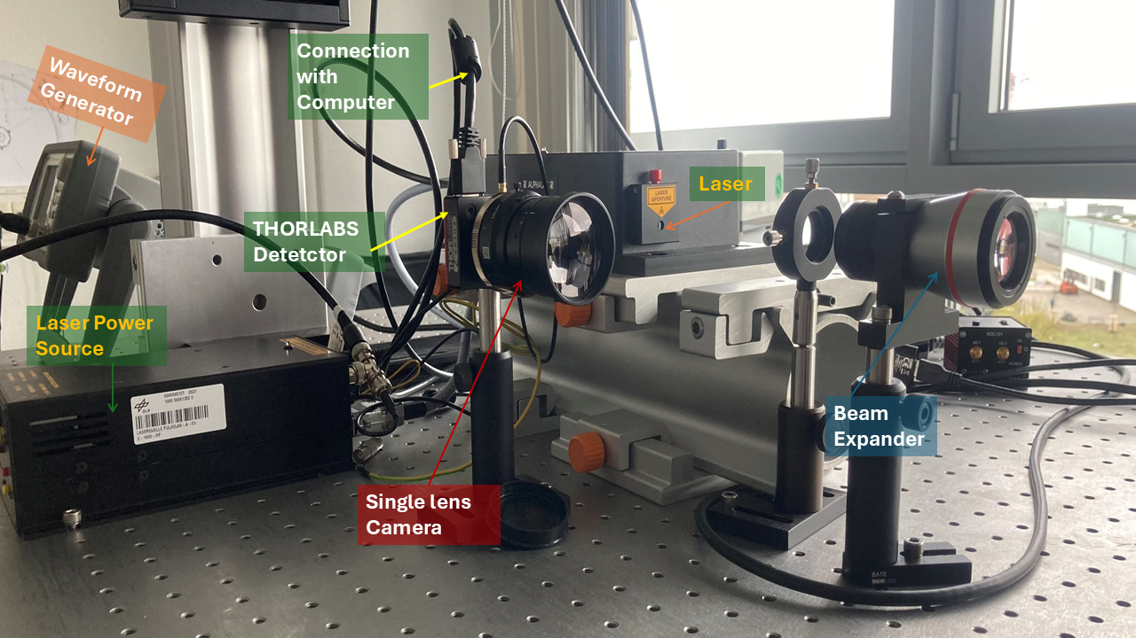

Slide 10
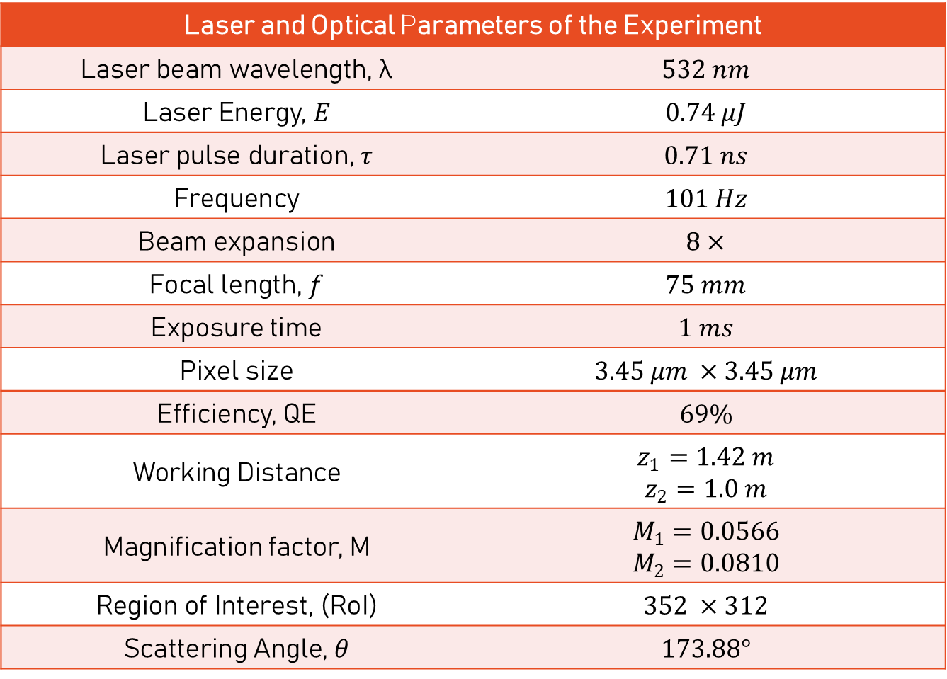
Laser and Optical Parameters of the Experiment
Laser beam wavelength, λ | $$532 nm$$
Laser Energy, $E$ | $$0.74 μJ$$
Laser pulse duration, $τ$ | $$0.71 ns$$
Frequency | $$101 Hz$$
Beam expansion | $$8×$$
Focal length, $f$ | $$75 mm$$
Exposure time | $$1 ms$$
Pixel size | $$3.45 μm ×3.45 μm$$
Efficiency, QE | $$69\%$$
Working Distance | $$z_{1}=1.42 m$$ $$z_{2}=1.0 m$$
Magnification factor, M | $$M_{1}=0.0566$$ $$M_{2}=0.0810$$
Region of Interest, (RoI) | $$352 ×312$$
Scattering Angle, $θ$ | $$173.88°$$

Slide 11

DUST FREE FALLING
Dust detection demonstration

Slide 12
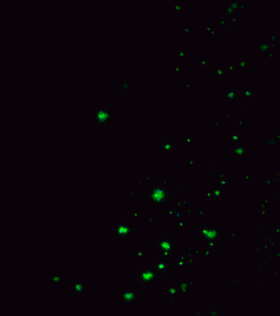
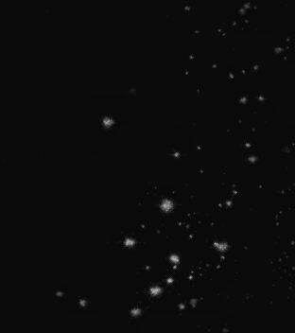
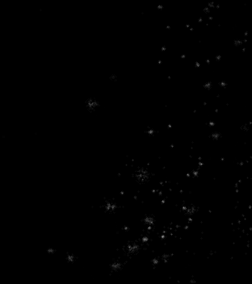
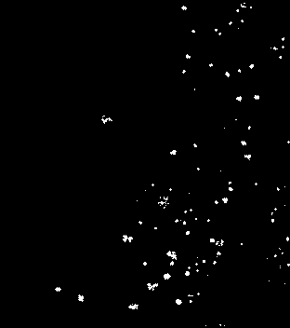
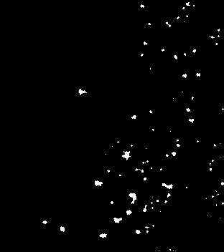
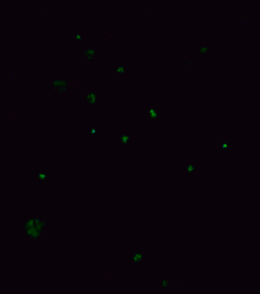
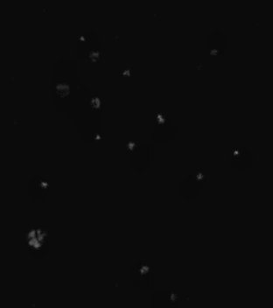
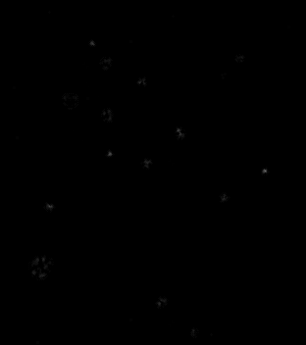
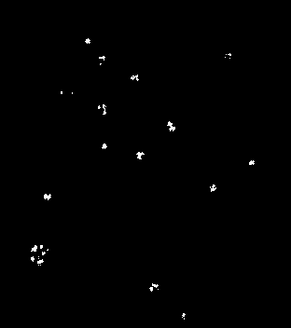
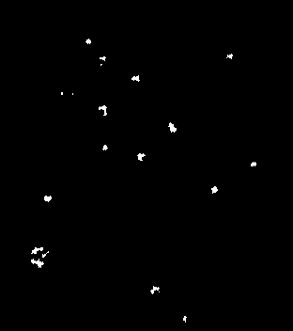
DATA ANALYSIS PIPELINE: FROM RAW IMAGES TO PARTICLE DATA
CLAHE contrast + enhancement
Background Subtraction
Otsu Thresholding
Morphological Cleaning
Raw image
$10 μm$ Silica (Ag coated) particles at $z=1.4 m$
$30 μm$ Silica Copper particles at $z=1.4 m$

Slide 13
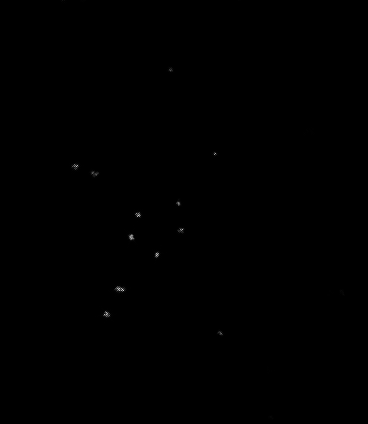

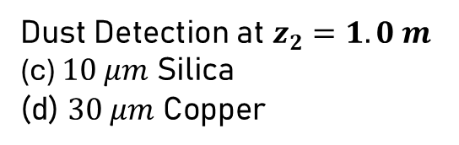
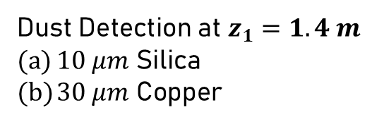
PARTICLE DETECTION
Dust Detection at $z_{2}=1.0 m$
(c) $10 μm$ Silica
(d) $30 μm$ Copper
Dust Detection at $z_{1}=1.4 m$
$10 μm$ Silica
$30 μm$ Copper

Slide 14
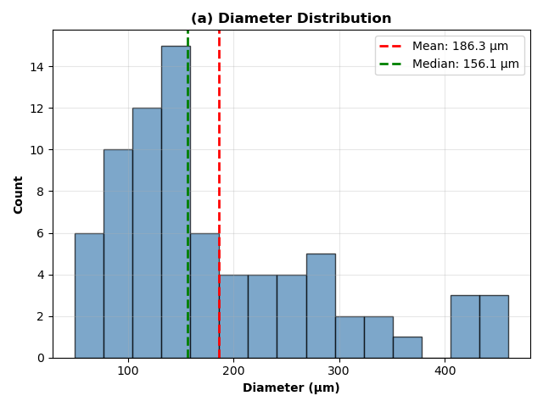
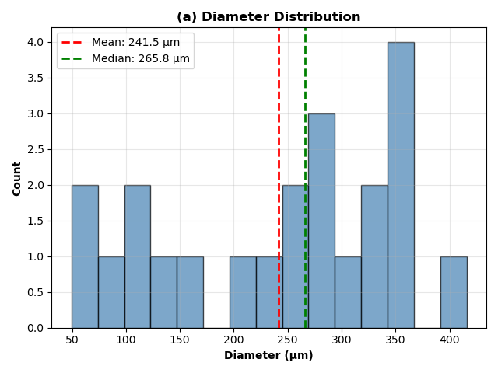
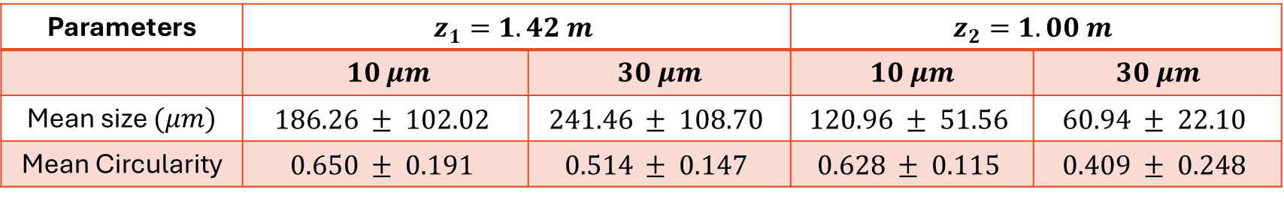


SINGLE FRAME VS BATCH ANALYSIS
(a) $10 μm$ Silica
Size Distribution Histogram z=1.42 m
(b) $30 μm$ Copper
Parameters | $$z_{1}=1.42 m$$ |  | $$z_{2}=1.00 m$$
 | $10 μm$ | $30 μm$ | $10 μm$ | $30 μm$
Mean size $(μm)$ | $$186.26 ± 102.02$$ | $$241.46 ± 108.70$$ | $$120.96 ± 51.56$$ | $$60.94 ± 22.10$$
Mean Circularity | $$0.650 ± 0.191$$ | $$0.514 ± 0.147$$ | $$0.628 ± 0.115$$ | $$0.409 ± 0.248$$

Slide 15
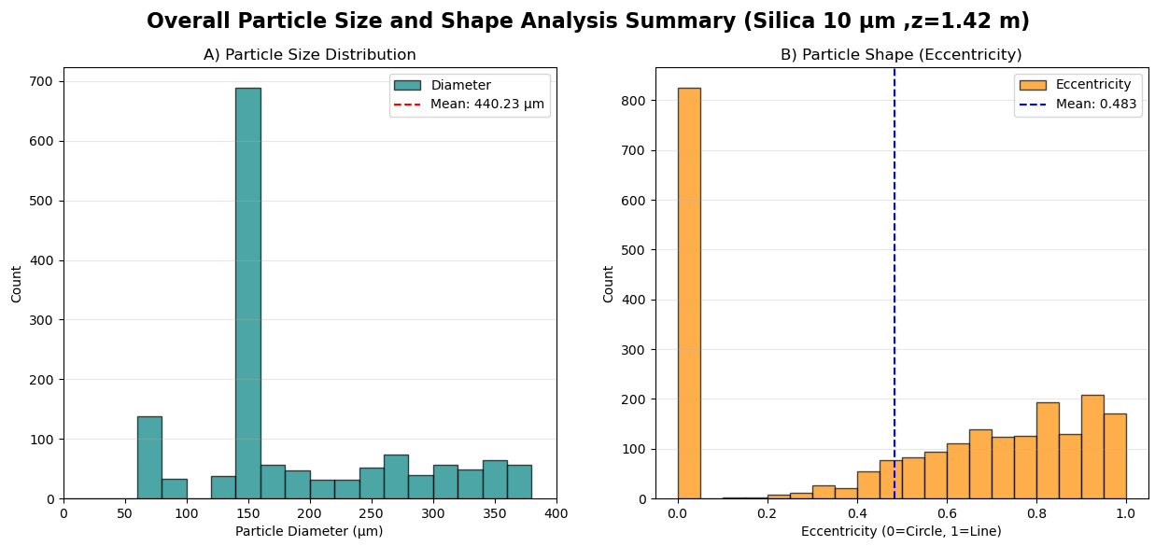
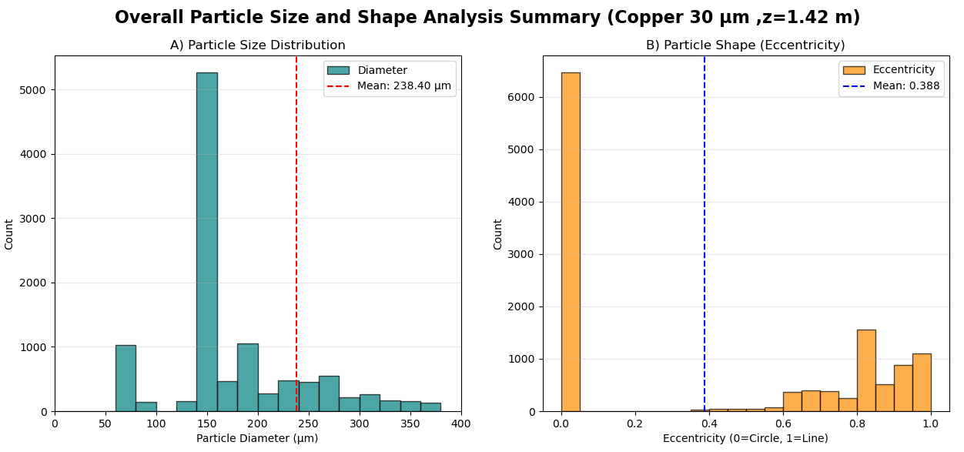
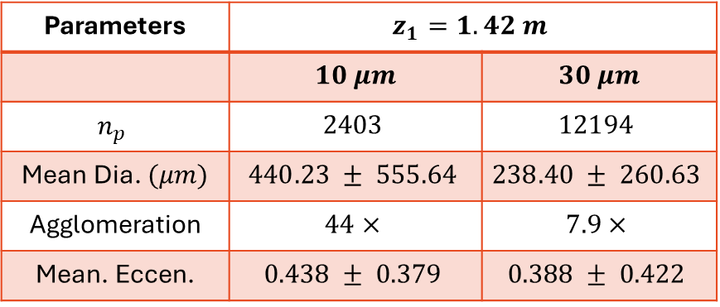
SINGLE FRAME VS BATCH ANALYSIS $(z=1.42 m)$
Parameters | $$z_{1}=1.42 m$$
 | $10 μm$ | $30 μm$
$$n_{p}$$ | $$2403$$ | $$12194$$
Mean Dia. $(μm)$ | $$440.23 ± 555.64$$ | $$238.40 ± 260.63$$
Agglomeration | $$44×$$ | $$7.9×$$
Mean. Eccen. | $$0.438 ± 0.379$$ | $$0.388 ± 0.422$$

Slide 16
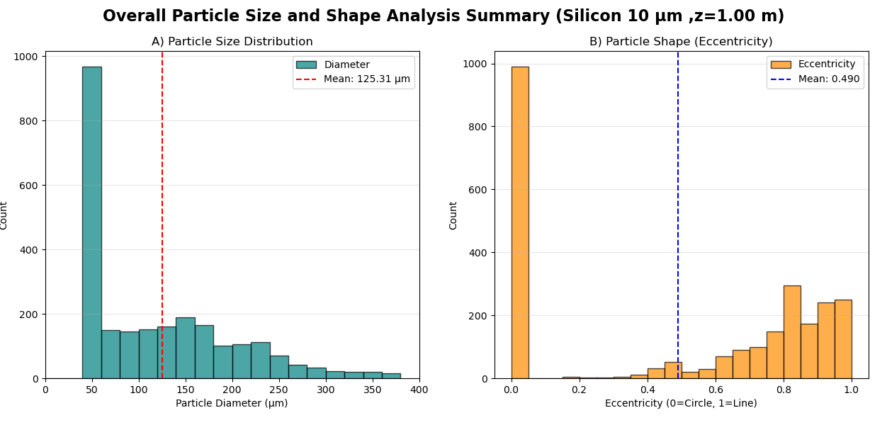
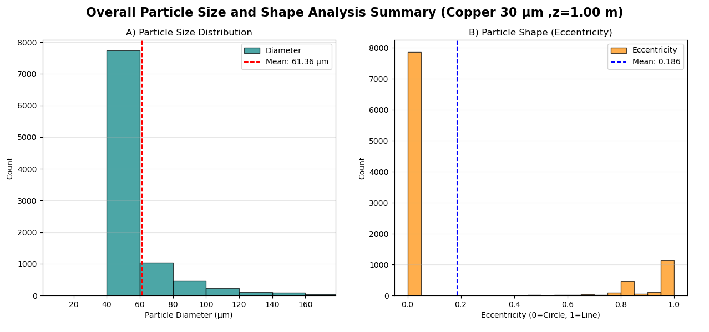
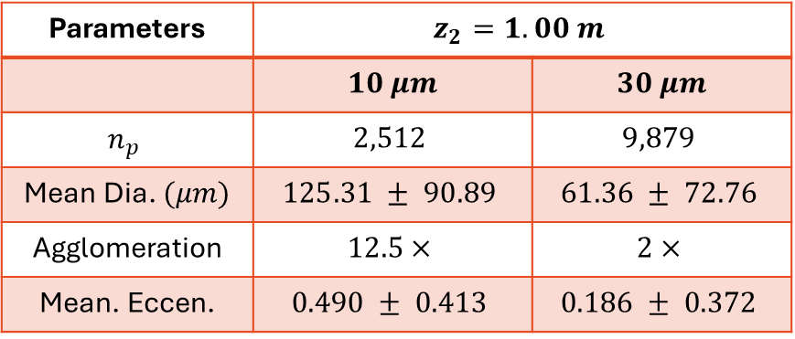
SINGLE FRAME VS BATCH ANALYSIS $(z=1.00 m)$
Parameters | $$z_{2}=1.00 m$$
 | $10 μm$ | $30 μm$
$$n_{p}$$ | $$2,512$$ | $$9,879$$
Mean Dia. $(μm)$ | $$125.31 ± 90.89$$ | $$61.36 ± 72.76$$
Agglomeration | $$12.5×$$ | $$2×$$
Mean. Eccen. | $$0.490 ± 0.413$$ | $$0.186 ± 0.372$$

Slide 17
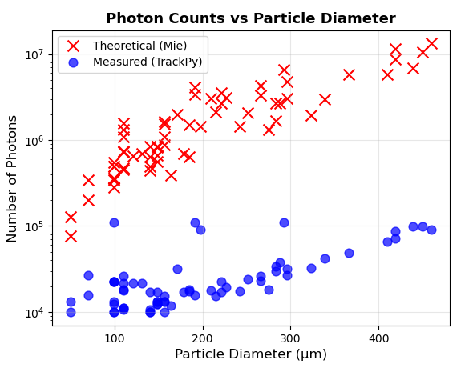
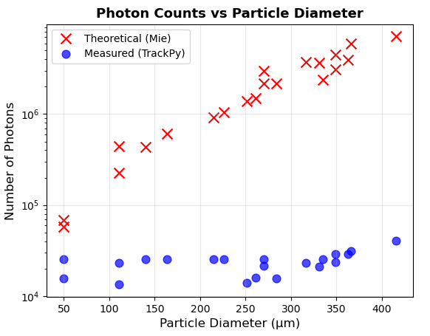
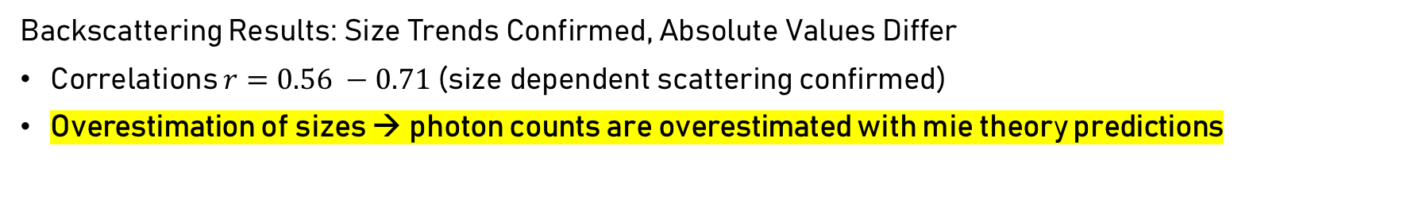
MIE THEORY: QUALITATIVE SUCCESS, QUANTITATIVE GAP
Backscattering Results: Size Trends Confirmed, Absolute Values Differ
Correlations $r=0.56 −0.71$(size dependent scattering confirmed)
Overestimation of sizes → photon counts are overestimated with mie theory predictions
Comparison of theoretical and recorded number of photons back at the detector z = 1.42 m

Slide 18
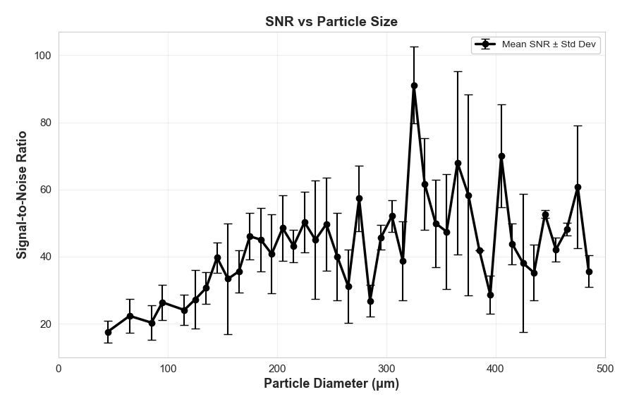
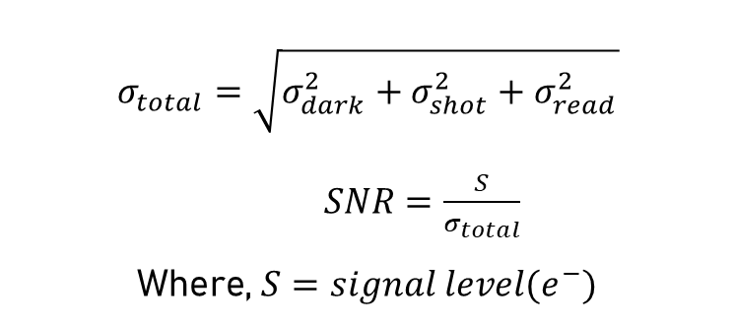
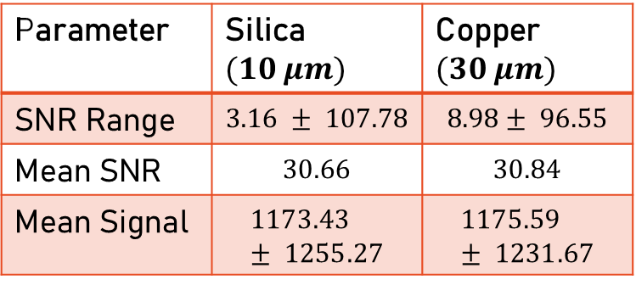
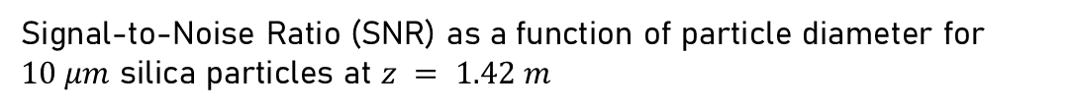
SIGNAL-TO-NOISE RATIO
$$σ_{total}=\sqrt{σ_{dark}^{2}+σ_{shot}^{2}+σ_{read}^{2}}$$
$SNR=\frac{S}{σ_{total}}$
Where, $S=signal level(e^{−})$
Parameter | Silica $(10 μm)$ | Copper $(30 μm)$
SNR Range | $$3.16 ± 107.78$$ | $$8.98± 96.55$$
Mean SNR | $$30.66$$ | $$30.84$$
Mean Signal | $$1173.43 ± 1255.27$$ | $$1175.59 ± 1231.67$$
Signal-to-Noise Ratio (SNR) as a function of particle diameter for $10 μm$ silica particles at $z = 1.42 m$

Slide 19

BIBLIOGRAPHY
[1] T.J. Stubbs et al. “Dependence of lunar surface charging on solar wind plasma conditions and solar irradiation”. In: Planetary and Space Science 90 (Jan. 2014), pp. 10–27. ISSN:00320633. DOI: 10.1016/j.pss.2013.07.008
[2] X. Wang et al. “Dust charging and transport on airless planetary bodies”. In: Geophysical
Research Letters 43.12 (2016), pp. 6103–6110. ISSN: 19448007. DOI: 10.1002/2016GL069491
[3] - Necmi Cihan Orger et al. “Lunar dust lofting due to surface electric field and charging within Micro-cavities between dust grains above the terminator region”. In: Advances in Space Research 62.4 (Aug. 2018), pp. 896–911. ISSN: 18791948. DOI: 10.1016/j.asr.2018.05.027.
[4] Joshua E. Colwell et al. “Lunar Dust Levitation”. In: Journal of Aerospace Engineering 22.1 (Jan. 2009), pp. 2–9. ISSN: 0893-1321. DOI: 10.1061/(asce)0893-1321(2009)22:1(2).
Scan the QR code for the full thesis document ☺

