Slide 1




$$\frac{∂(RΩ)}{∂z}=0$$
Dust
Barotropic Disc
Gas
$$ρ$$
$$z$$
$$Ω_{\text{Dust}}>Ω_{\text{Gas}}$$
Azimuthal Velocity
0

Slide 2
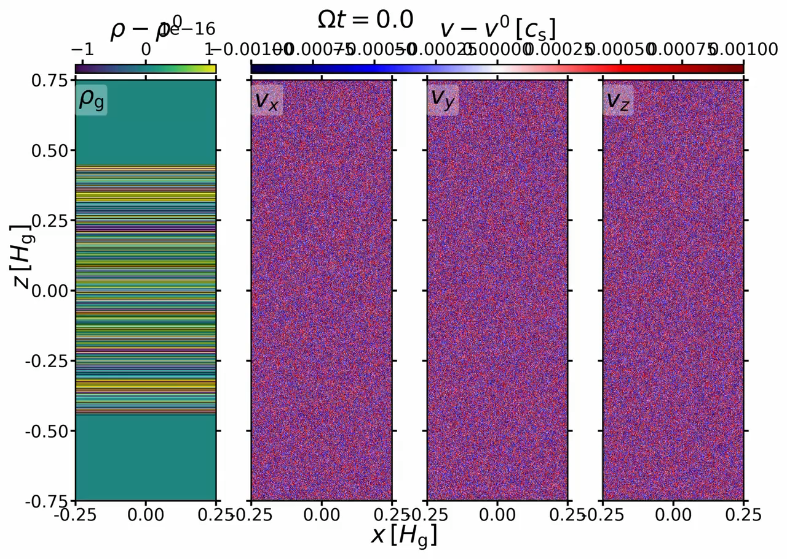
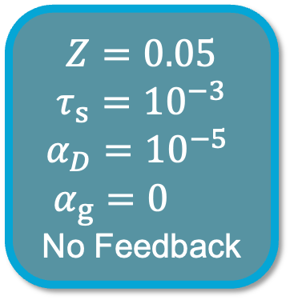
(Matthijsse et al. submitted)
Dust-Driven
Vertical Shear
Instability (DVSI)
Heatmap: Perturbed gas density and velocity
$Z=0.05$
$τ_{s}={10}^{−3}$
$α_{D}={10}^{−5}$
$α_{g}=0$
No Feedback
$η=0.05$; $N_{grid}=2048 px/H_{g}$; $L_{R,z}=\left[0.5×4\right] H_{g}$
1

