Slide 1



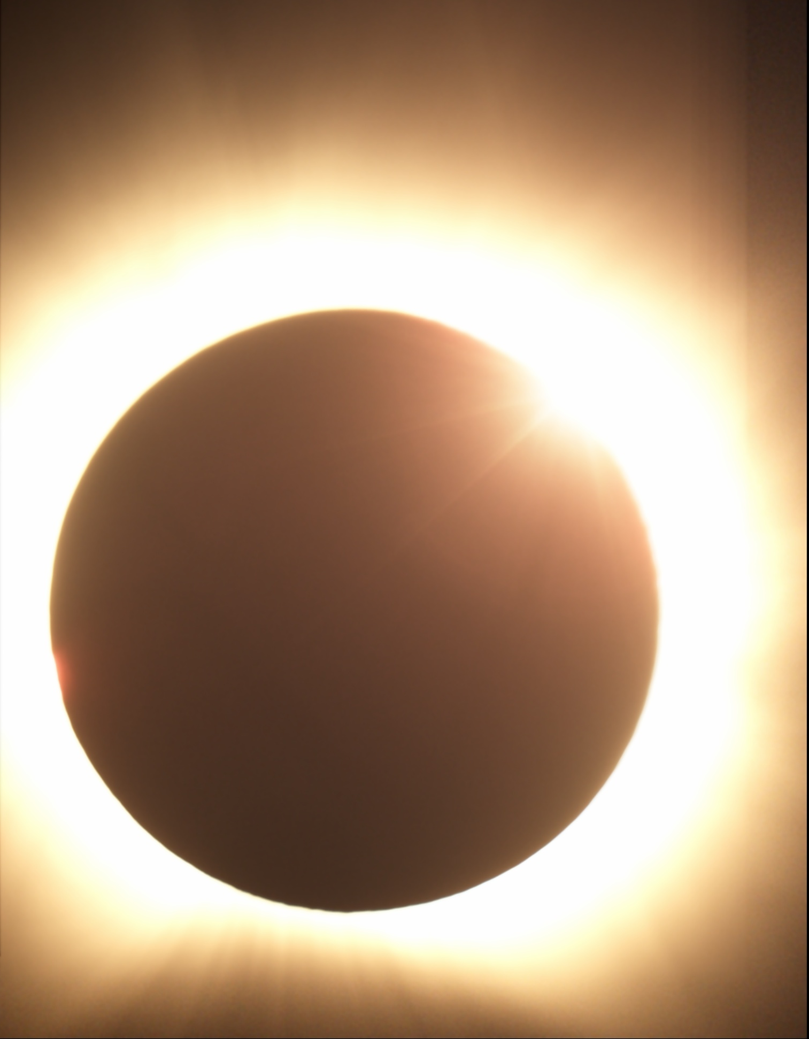
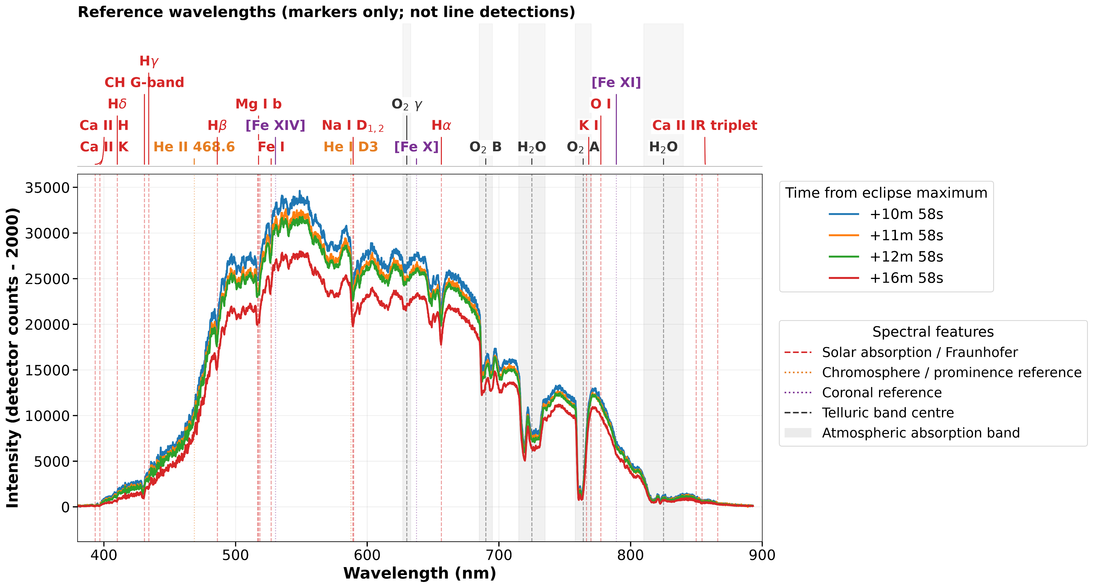
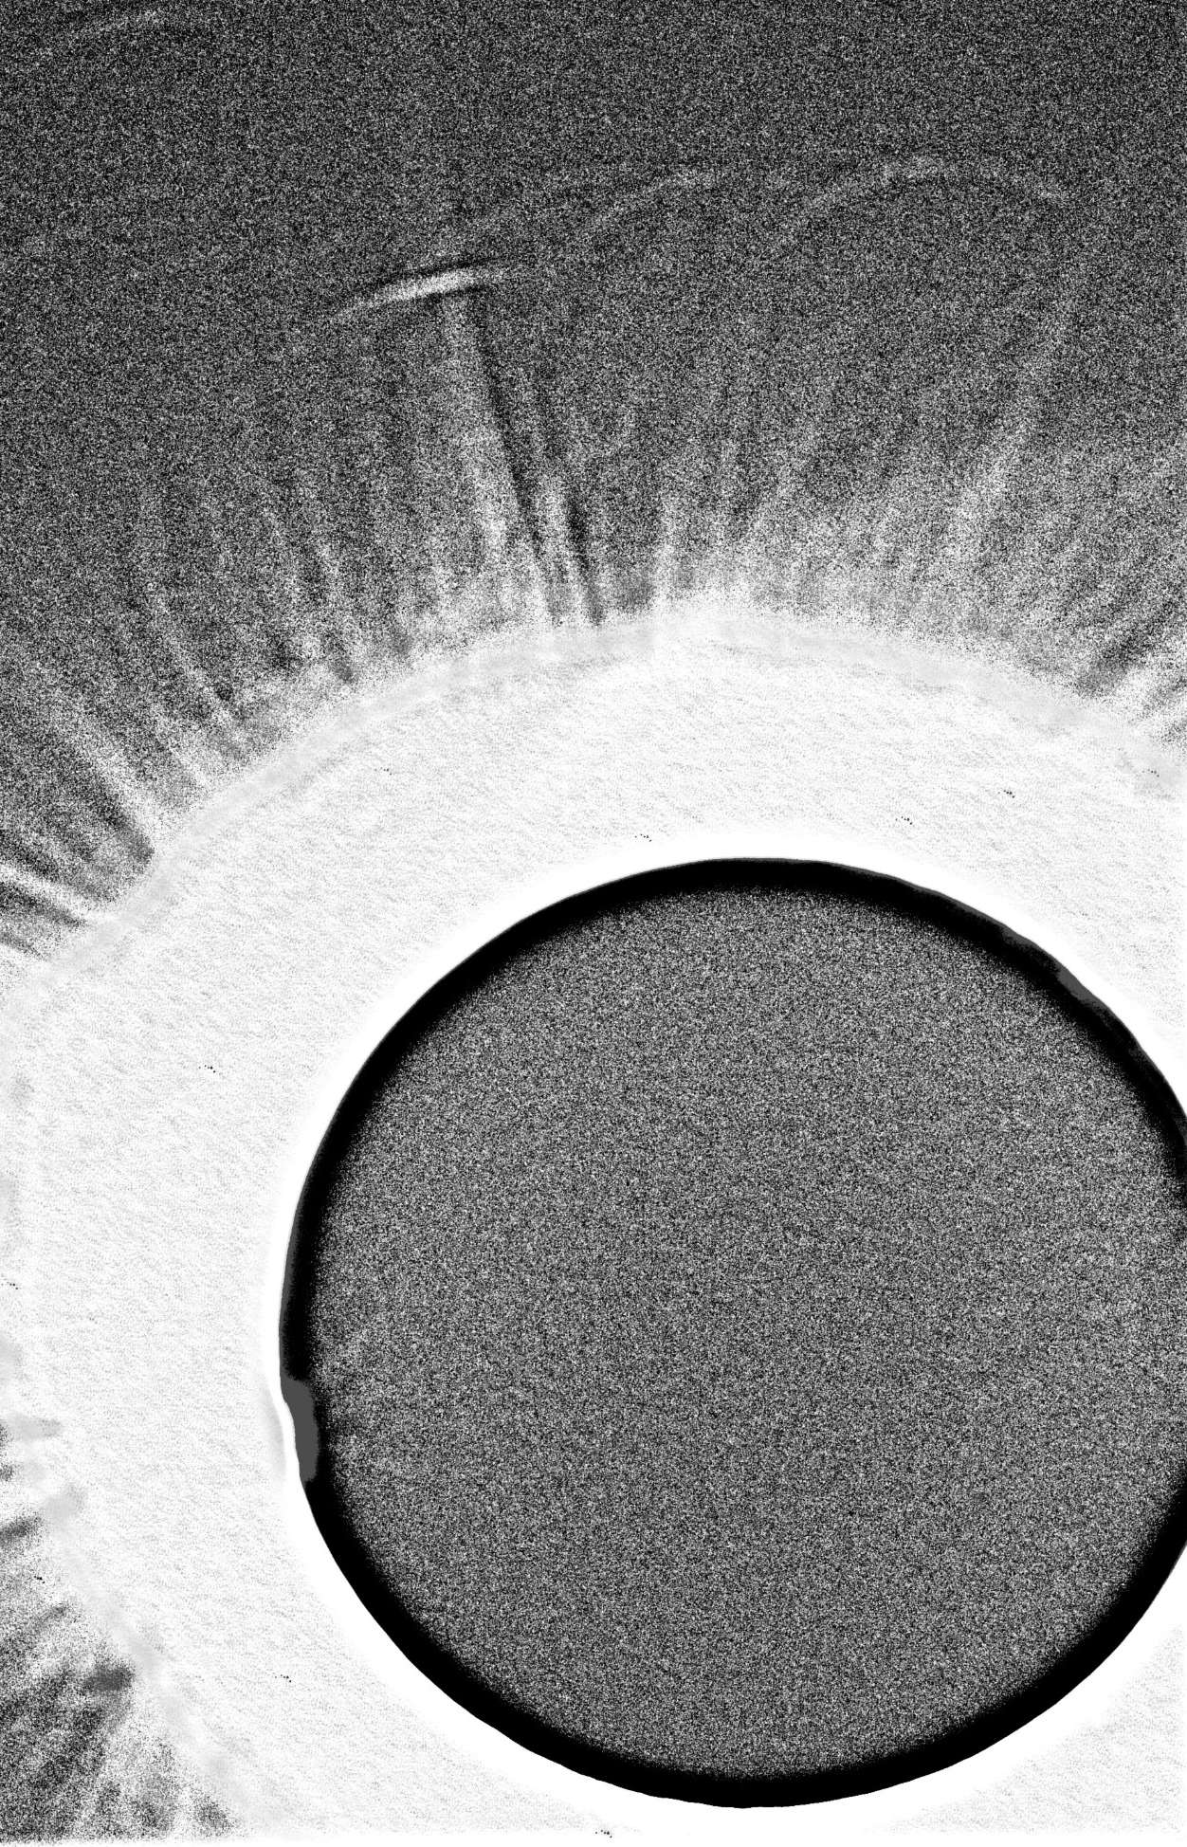
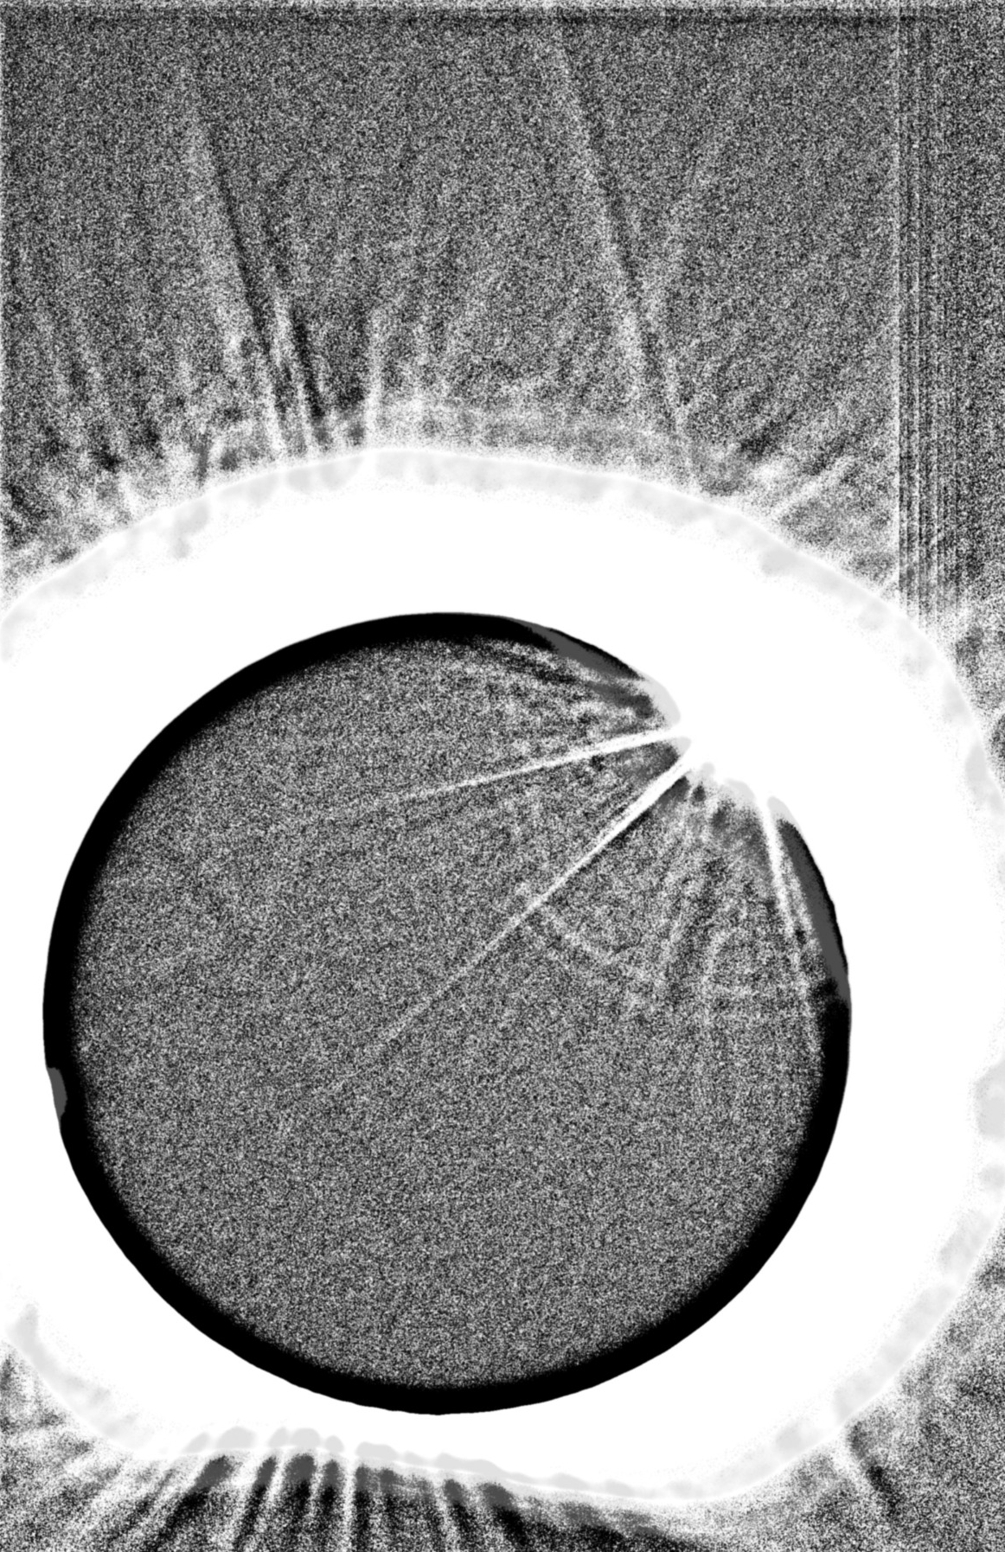
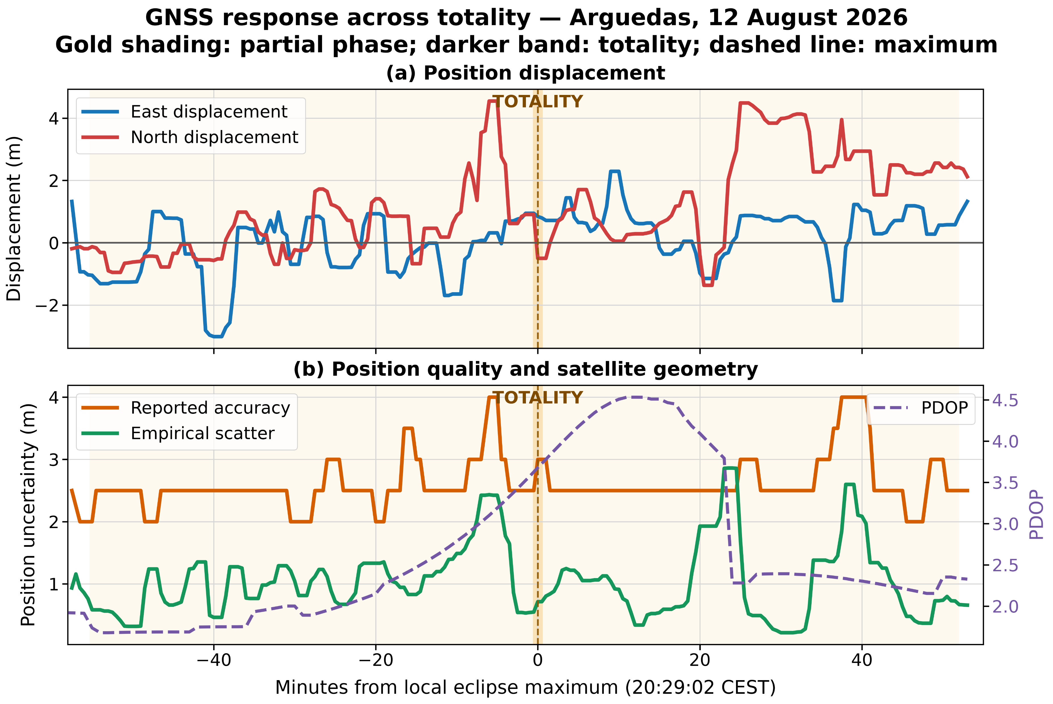
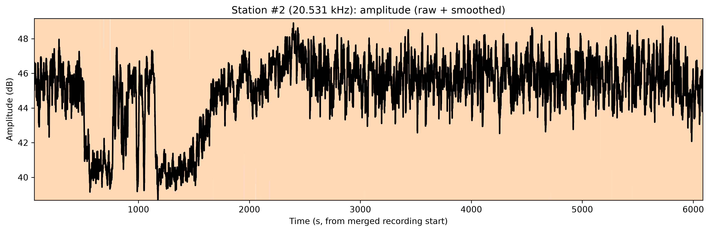
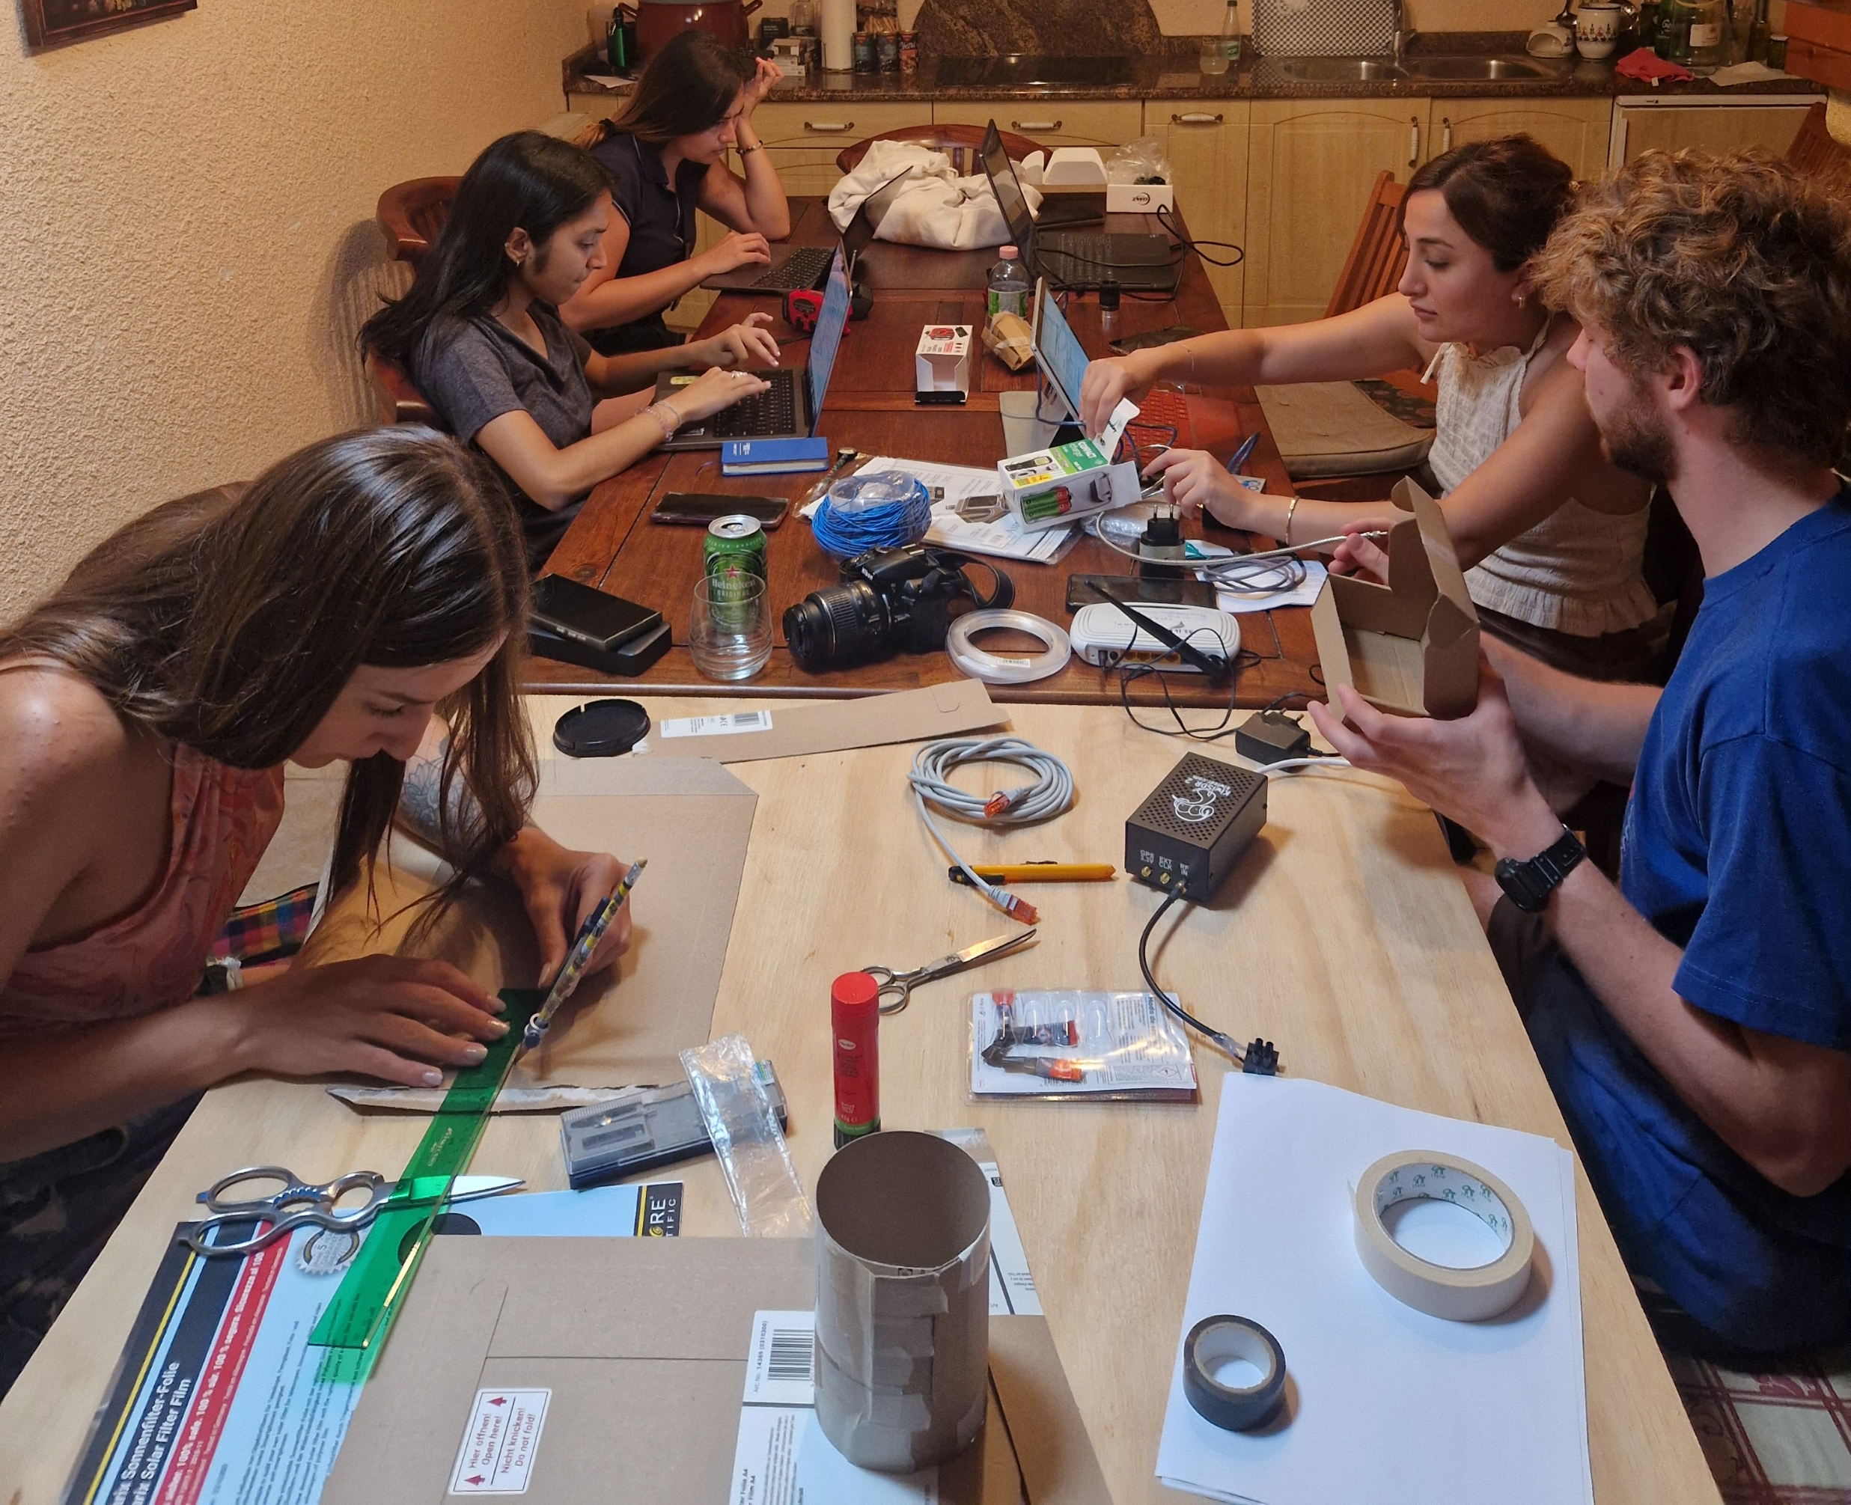
EPSC2026-241 · EARLY-CAREER MULTIWAVELENGTH OBSERVATIONS & OUTREACH
EGU LUNEX 2026 Total Solar Eclipse Campaign in Spain: Early Career Scientist Multiwavelength Observations and Outreach
EUROPLANET SCIENCE CONGRESS 2026 · THE HAGUE · F3.75
K. Nagainis¹˒³, B. Foing¹˒²˒³, B. Schmieder²˒⁴˒⁵, T. Baratashvili⁵, S. Poedts⁵, A. Lani⁵, H. Wang⁵, S. Ansari²˒⁷, S. Zeegers²˒³, J. Pascual²˒⁸, R. Nahum², A. Gomez de Castro⁹, A. Heras¹⁰, P. P. Priga¹³, I. Albert¹², S. Ravishankar³˒⁴, G. Ismayilova², G. Fong^{2,14}, A. Razquin¹¹, T. Fox¹¹, J. Alnis¹
¹ University of Latvia, Faculty of Science and Technology, Riga, Latvia; ² LUNEX COSPAR EuroSpaceHub, Noordwijk, the Netherlands; ³ Leiden Observatory, Leiden University, Leiden, the Netherlands; ⁴ LIRA, Observatoire de Paris, Université PSL, CNRS, Sorbonne Université, Meudon, France; ⁵ Centre for Mathematical Plasma Astrophysics, KU Leuven, Leuven, Belgium;⁷ University of Vienna, Vienna, Austria; ⁸ Kosmica Institute, Santiago de Compostela, Spain; ⁹ Universidad Complutense de Madrid, Madrid, Spain; ¹⁰ European Space Astronomy Centre (ESA/ESAC), Madrid, Spain; ¹¹ University of Graz, Graz, Austria; ¹² University of Murcia, Murcia, Spain; ¹³ Riga Stradiņš University, Riga, Latvia; ¹⁴ International Space University, Illkirch-Graffenstaden, France
01
Introduction
04
Sky spectroscopy
Totality reveals the faint solar corona, normally hidden by the bright photosphere
It is still unclear how exactly the corona is heated to 1 MK, the origins of slow solar wind, and the overall magnetic structures [5]
The sudden reduction in solar radiation affects Earth’s atmosphere and radio wave propagation
Allows studies of the ionosphere
Provides a unique opportunity for coordinated multiwavelength observations
Ocean Optics spectrometer · 400–900 nm
SCIENTIFIC QUESTION
Fiber spectroscopy, shortly after totality
Photospheric light dominated spectrum
Multiple Fraunhofer absorption features were identified, including hydrogen Balmer lines, Mg I b, Fe I and Na I D [8]
Strong telluric O₂ and H₂O absorption bands present [8]
No coronal forbidden line emission detected: [Fe XIV], [Fe X] or [Fe XI] [3,4]
Can complementary, accessible instruments resolve eclipse driven changes in the corona, sky spectrum and ionosphere?
02
White light imaging
ARGUEDAS, SPAIN · 12 AUG 2026 · PROCESSED COLOUR IMAGE
05
GNSS experiment
THE CAMPAIGN IN ONE VIEW
10 FPS · 18 FPS
Key outcomes
Setup: Meade LXD75 telescope (15 cm), manual altazimuth mount, CMOS ASI 385 MC Color, focal reducer (0.8x)
Exposures: 5/10/18 FPS, video stacks, dark and flat field corrected
Overexposed inner corona, well defined middle corona
Structures: low brightness coronal region, prominence, streamers
WL
≈4–5 dB
2.8 meters
Recovered middle corona brightness structures
VLF decrease
partial phase
GNSS positional shift
After totality
Single measurement with app GNSS logger
Clear displacement after ~30min of +2.8 m
Supported by lack of reported decrease from internal accuracy and PDOP
Future: combining data from all participants
PRIMARY INTERPRETATION
Totality provides a unique natural experiment linking the solar corona with the response of Earth’s atmosphere and ionosphere
Coordinated white light, spectroscopic, VLF radio and GNSS observations provide complementary measurements across multiple wavelengths
An early career led campaign using accessible instruments can deliver valuable data, outreach and preparation for future eclipses
03
Radio measurements
06
Team & logistics
KiwiSDR2 · 45 m wire antenna · Station #1 at 23.397 kHz
4-5 dB amplitude decrease, 2.8 m displacement and middle corona observations
Radio observations at the VLF range
DHO38 station: German Navy transmitter, stable signal
Clear 4-5 dB amplitude dip shortly after the eclipse began
Signal unchanged during or after totality
The behavior of signal is difficult to predict, it can increase or decrease [1,2] due to various reasons (receiver location, interference)
Our measurements will be compared with other measurements close to Arguedas
07
Arguedas eclipse timeline (CEST)
8 early career scientists from 6 countries
Part of the official program in Navarra municipality event in Arguedas (2000 participants)
Outreach talks reached nearly 100 listeners
Demonstrations, projections, posters available to participants on site
C1
C2
MAX
C3
C4
19:33:43
20:28:26
20:29:02
20:29:39
21:21:01
Conclusions & next steps
References · acknowledgements
Multi-wavelength observations during total eclipse allow to better understand coronal morphology and Earth’s atmosphere
White light imaging is the most insightful about the morphology of corona. Our measurements have an overexposed inner corona, but valuable insight about the middle corona
Radio measurements and GNSS indicate changes in the ionosphere, but the times differ. This is due to the different layer responses within the ionosphere [1,2,6]
Spectroscopy can clearly indicate spectral lines of the photosphere, but it lacks coronal lines due to lack of measurements during totality
There is large interest from the general public about the unique event of totality, and it is a great place to cultivate interest in astronomy
This was excellent preparation for the 2nd August 2027 total eclipse in North Africa, where totality will last up to 6 min 23 s [7]
[1] Pal et al. (2012), Adv. Space Res. 50, 196–204.
[2] Maurya et al. (2014), JGR Space Physics 119.
[3] Pasachoff et al. (2018), Front. Astron. Space Sci. 5:37.
[4] Muro et al. (2023), Solar Phys. 298:75.
[5] Cranmer & Winebarger (2019), ARA&A 57, 157–187.
[6] Coster et al. (2017), Geophys. Res. Lett. 44, 12041–12048.
[7] Espenak, NASA/GSFC, Total Solar Eclipse of 2027 Aug 02.
[8] Kurucz et al. (1984), Solar Flux Atlas 296–1300 nm, NSO.
In preparation: Nagainis et al., Multiwavelength observations of the 2026 total solar eclipse from Arguedas.
Abstract: doi:10.5194/epsc2026-241 · EGU26-1542
Funding: Latvia ERDF 1.1.1.5/2/24/A/004 · LUNEX.
Notes:
[Sources]
- Central eclipse photograph supplied by the user: ef9689ed-62c8-49d3-8586-3c90e5a68dda.png.
- Scientific values and conclusions are intentionally editable placeholders; replace them with verified campaign results and citations.
[/Sources]
[Sources]
- EPSC2026 poster guidelines: https://www.epsc2026.eu/guidelines/presenter-guidelines/poster-presentation-guidelines.html
- EPSC2026-241 abstract and programme metadata: https://meetingorganizer.copernicus.org/EPSC2026/EPSC2026-241.html
- Abstract DOI: https://doi.org/10.5194/epsc2026-241
- User-supplied annotated spectrum plot: valid_spectra_plot_annotated.png.
- User-supplied 23.397 kHz radio-amplitude plot: WhatsApp Image 2026-09-03 at 22.22.35.jpeg.
- User-supplied processed eclipse image: 25p_BW_sharpened.jpg.
- User-supplied processed eclipse image: 75p_18fps_bw_stacked_sharpened.jpg.
[/Sources]
[Sources]
- User-supplied processed colour eclipse image: 2026-08-12-1829_6-U-G-Jup_pipp_lapl6_ap1_processed_colored_cut.jpg.
[/Sources]

