Slide 1
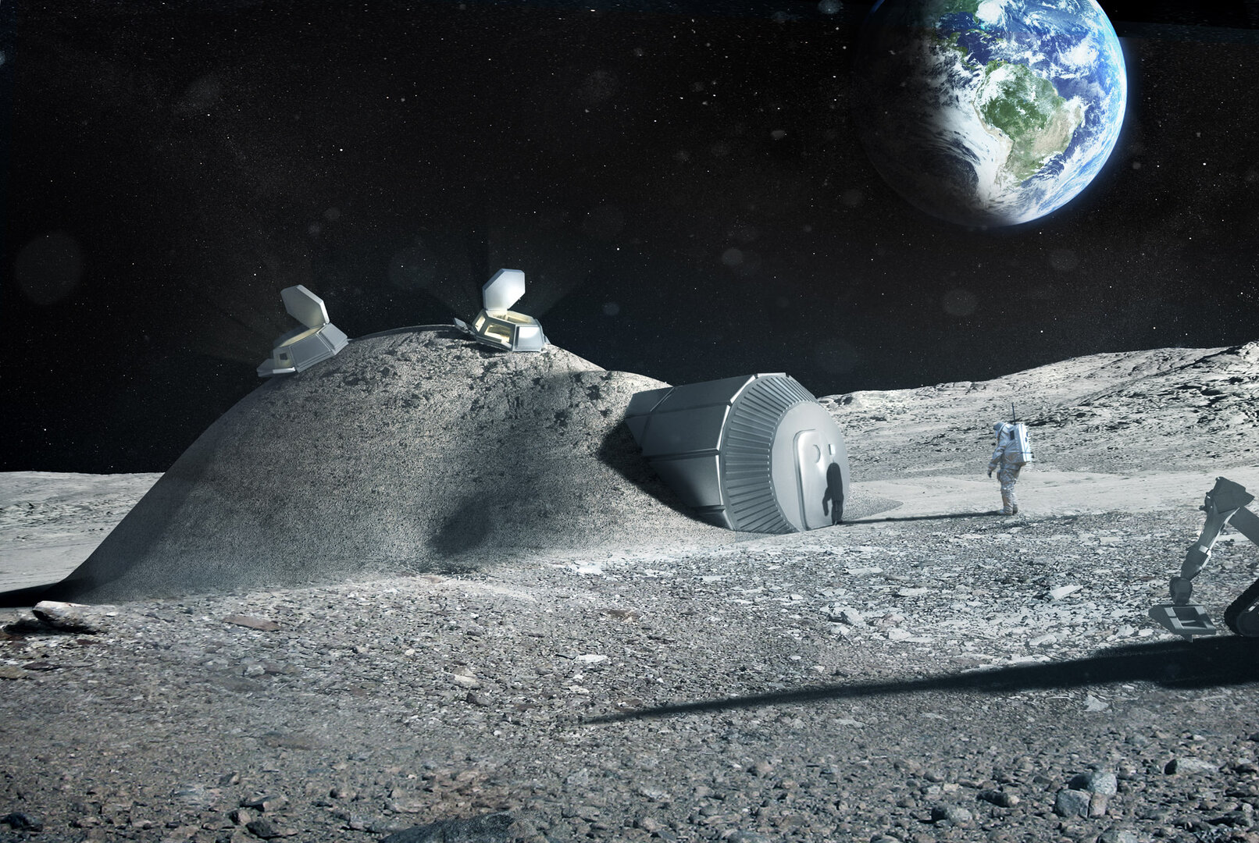




Simulating Radiation and Thermal Cycling Effects in Lunar Construction Materials
Adrija Bhowmick
PhD Student – Institute of Physics
University of Debrecen
Research Assistant
HUN-REN Atomki
Supervisor:
Prof. Nigel J. Mason

Slide 2
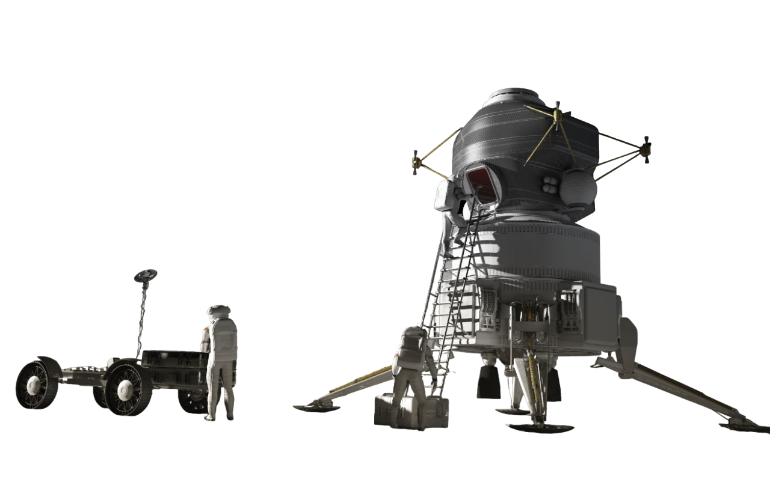
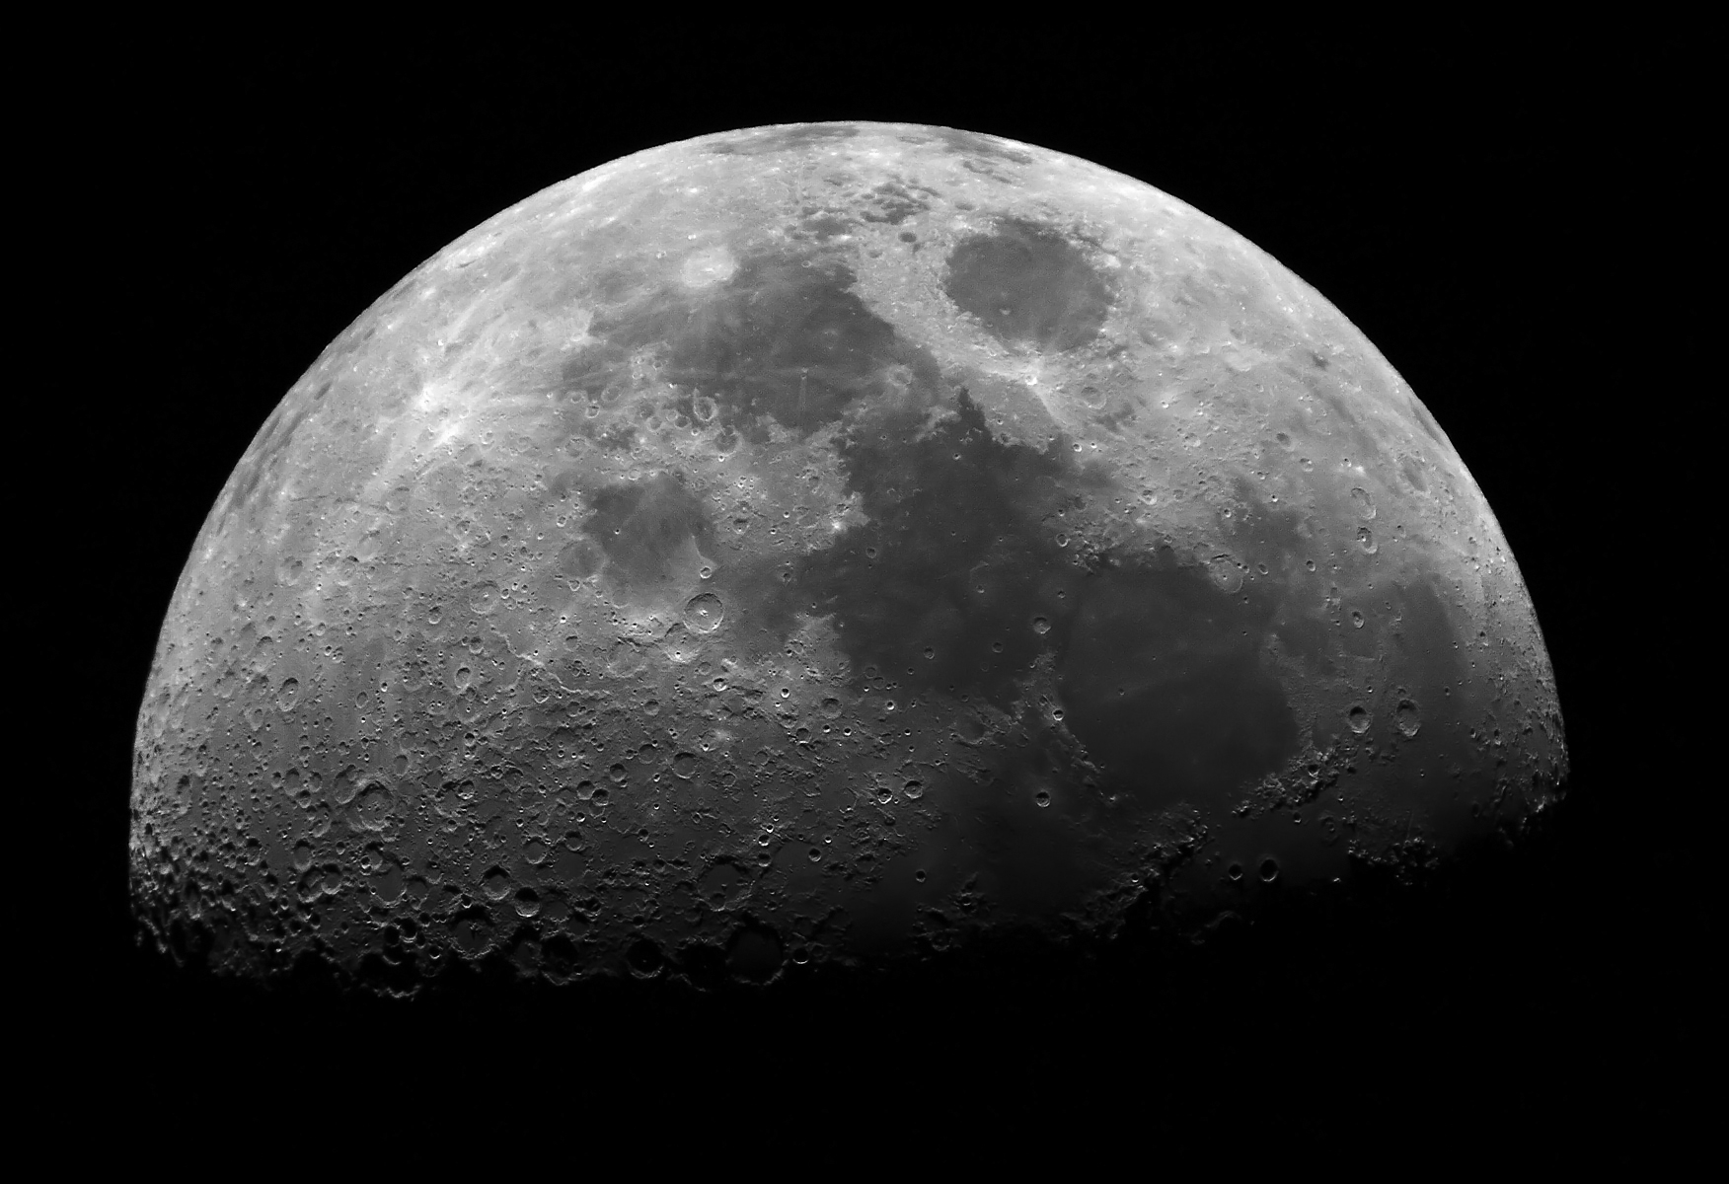
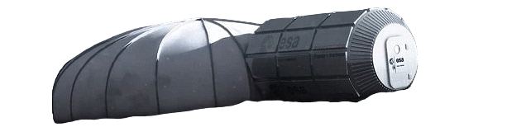
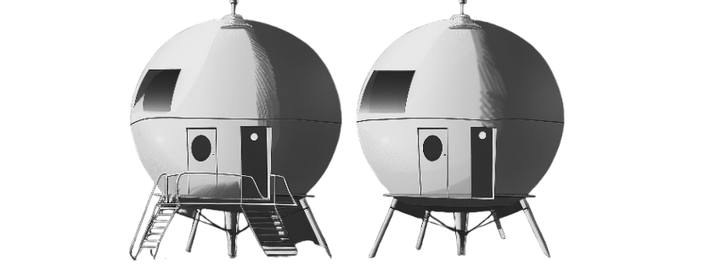















Settlement
Notes:
As we enter the era where space exploration has stepped onto the Moon (our natural satellite), new plans and missions are developed almost every day, driven by the urge to expand human presence beyond Earth which leads to establishing permanent bases in space premises. Now for constructing any bases, it is crucial to have materials that can endure and perform reliably under the harsh conditions of space and materials science becomes a fundamental aspect of space exploration.

Slide 3
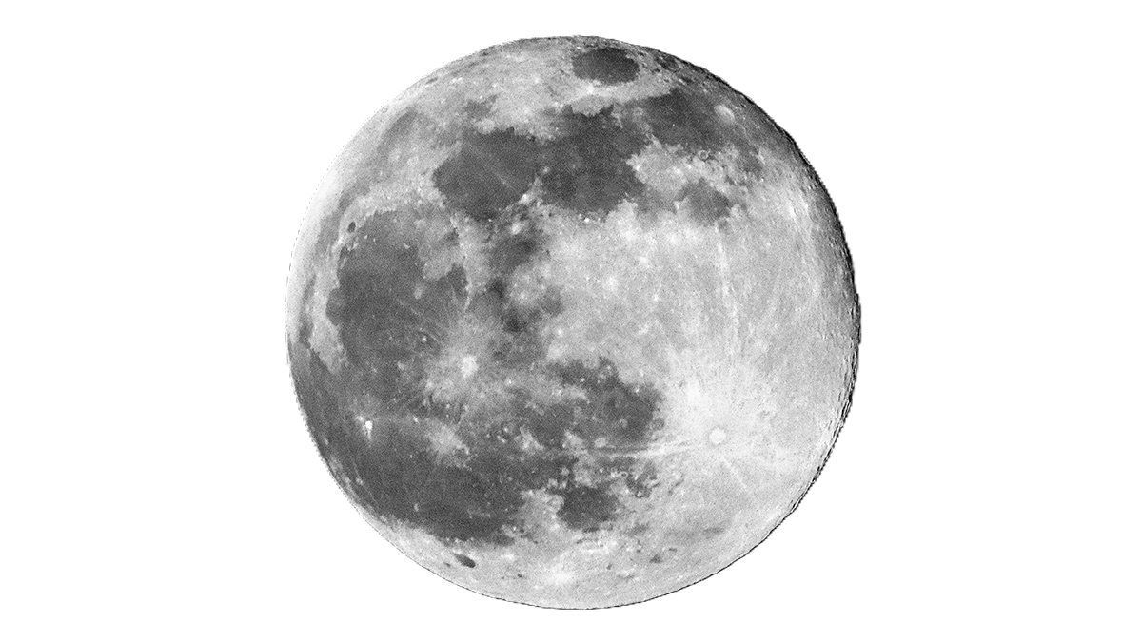
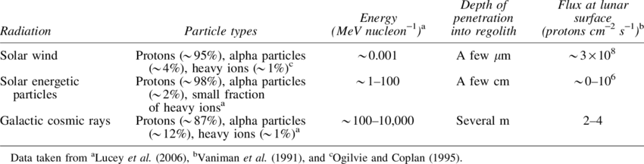
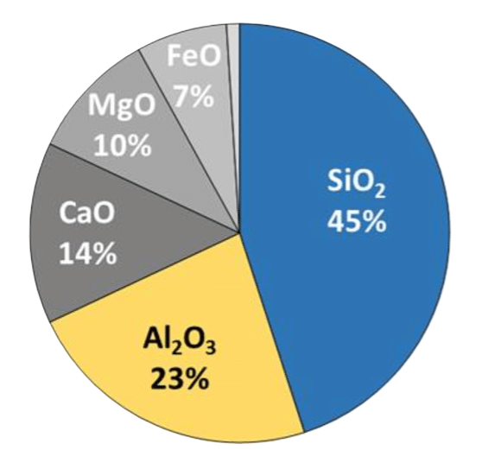
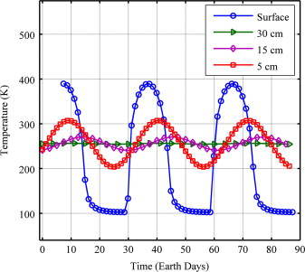

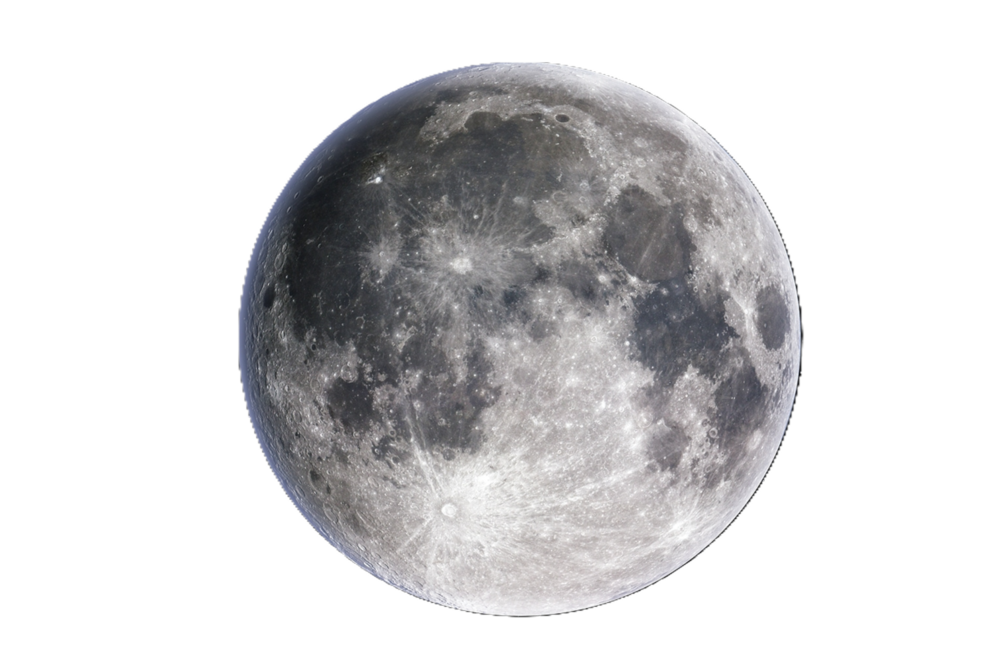

Lunar Conditions
Solar Wind Simulator, AQUILA
ISRU-based materials for Lunar Habitat
Regolith
Composition:
Challenges:
Temperature
Radiation
+
+
+
100 K
400 K
Malla, Ramesh B.; Brown, Kevin M. (2015).

Slide 4
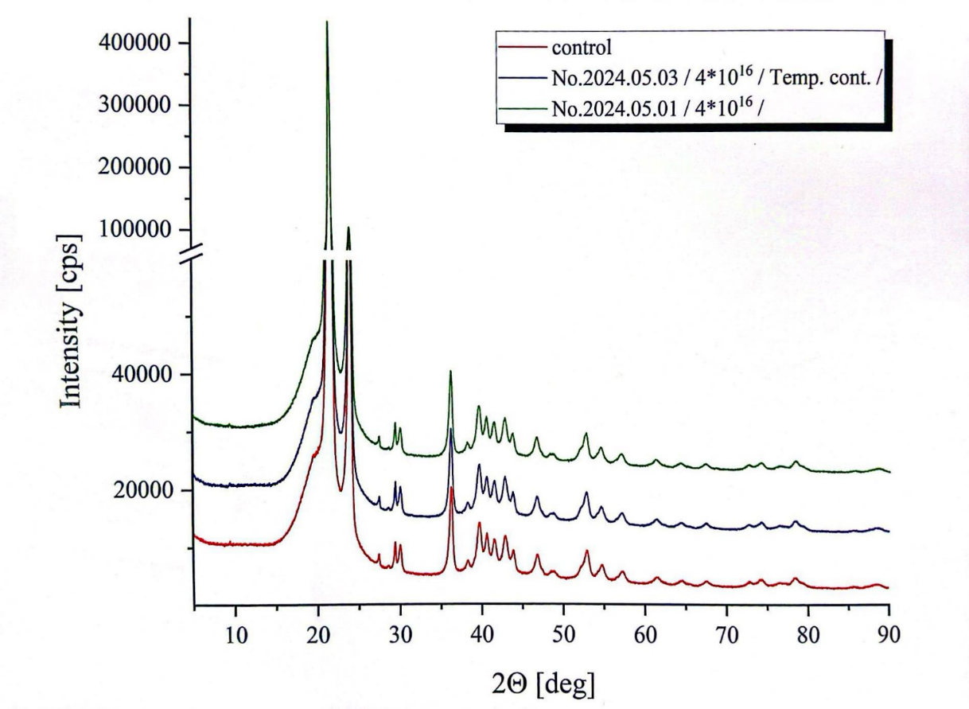
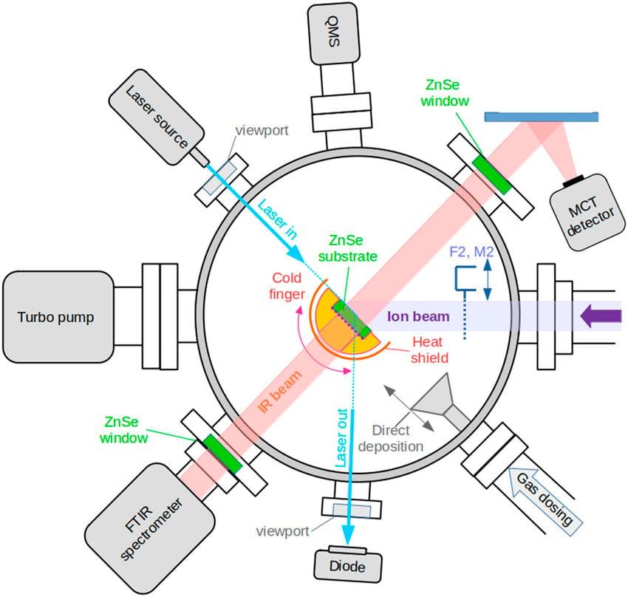
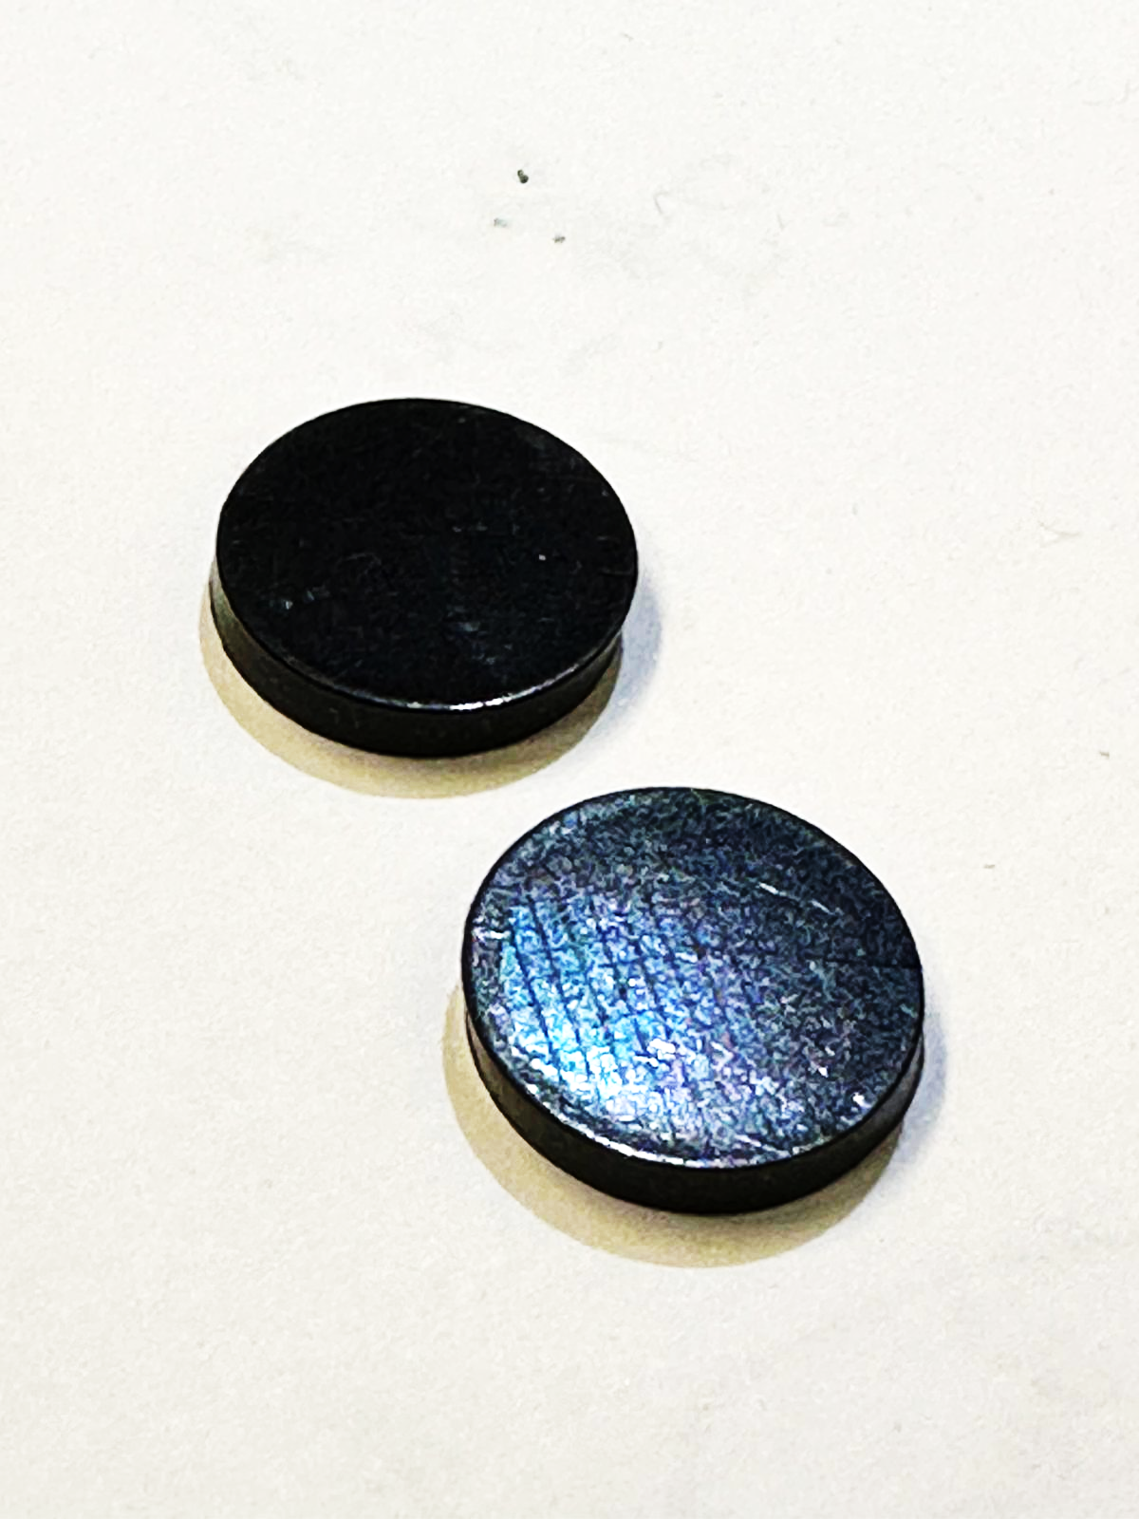
Research Framework
1. Experiments: Ion Irradiation and Temperature Cycling
1.1. Samples
HDPE with a density of 0.95 g cm^{–3}.
15 mm in diameter.
2 mm in thickness.
1.2. Experimentation
Irradiation: 2x10¹⁶ ions cm^{–2}, 10 keV protons, at 300 K.
Temperature cycling: 200K ←→ 350 K.​
Irradiation + temperature cycling.
1.3. Results Obtained
Structural analysis.
Scanning Electron Microscopy (SEM).
X-ray Diffraction (XRD).
Energy-Dispersive X-ray Spectroscopy (EDS)
Experiments were performed by J. Cousins, University of Kent, at HUN-REN ATOMKI, Hungary.

Slide 5
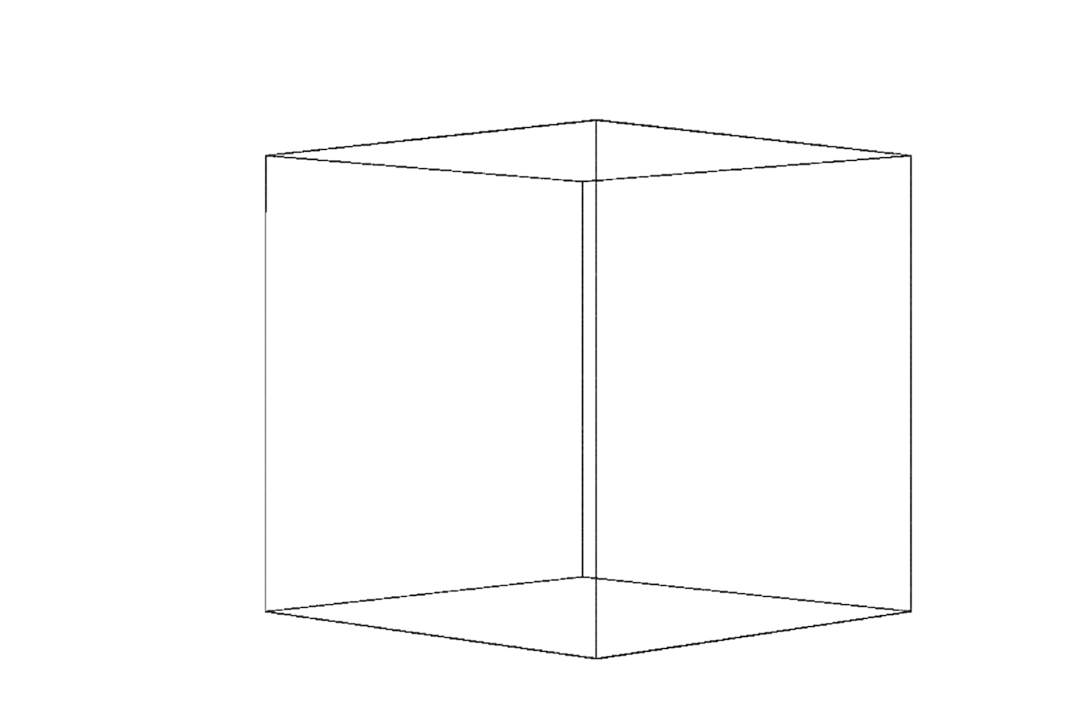
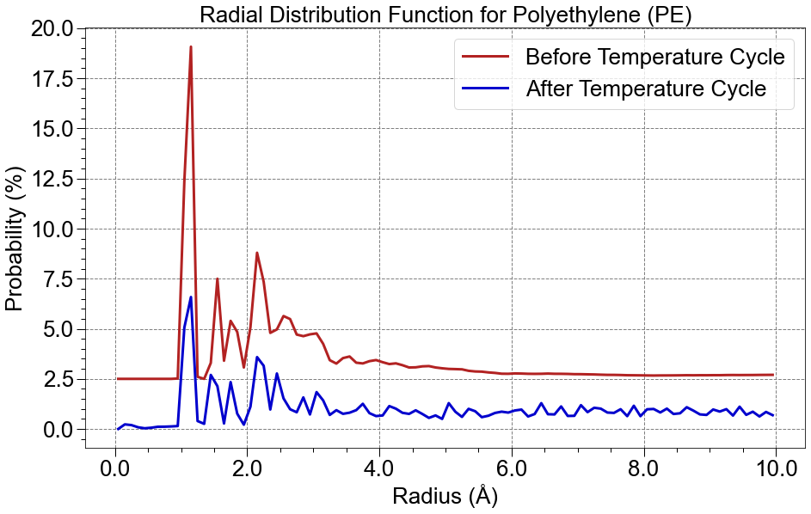
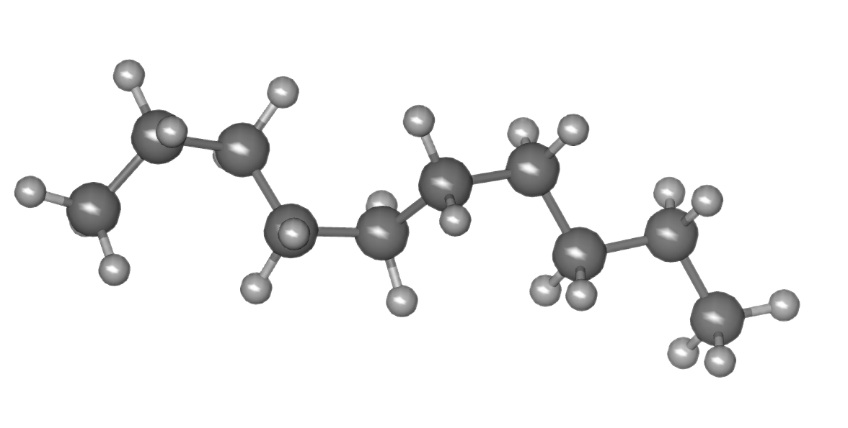
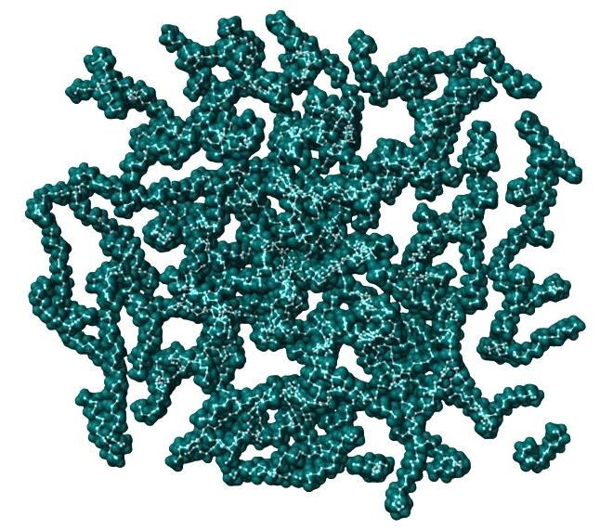
Research Framework
2. Modelling: Molecular Dynamics (MD) Simulation
2.1. Model Construction
Amorphous PE model made using CHARMM-GUI [5].
Optimised using MBN Explorer [6].
SiO₂ optimised using the Tersoff potential [7,8].
2.2. Simulations
Temperature cycling performed between
100 and 400 K.
Repeated over 8 cycles.
2.3. Results Obtained
Structural analysis.
Radial distribution function (RDF) analysis.
100–400 K

Slide 6
Research Framework
1. Experiments: Ion Irradiation and Temperature Cycling
2. Modelling: Molecular Dynamics (MD) Simulation
3. Validation & Integration
Compare simulation outputs with experimental results.
Refine models and parameters.
Experimental Feedback
Model Refinement

Slide 7
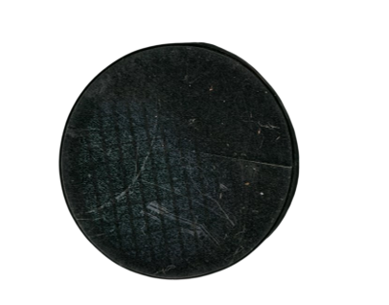
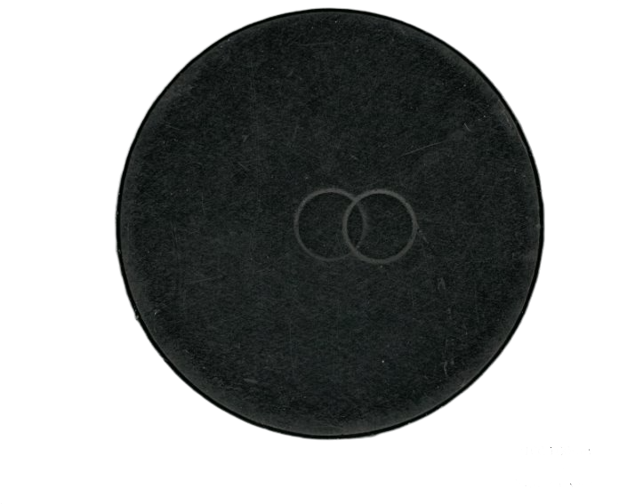
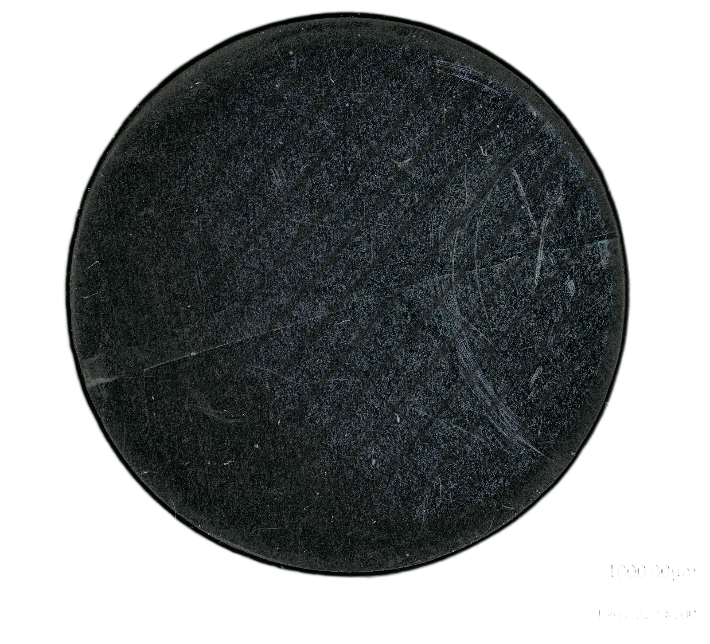
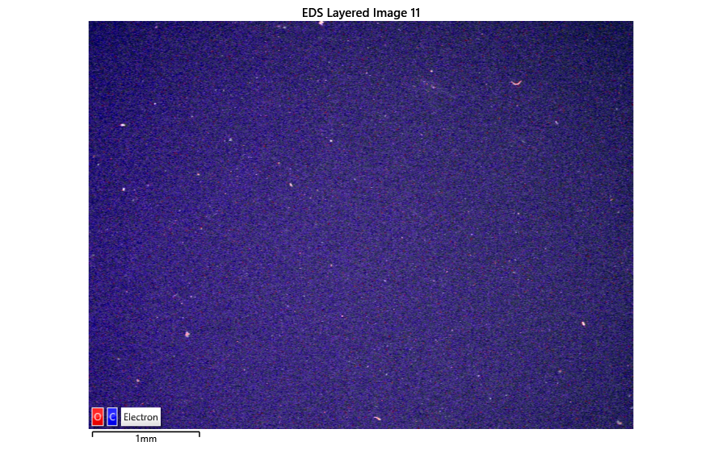
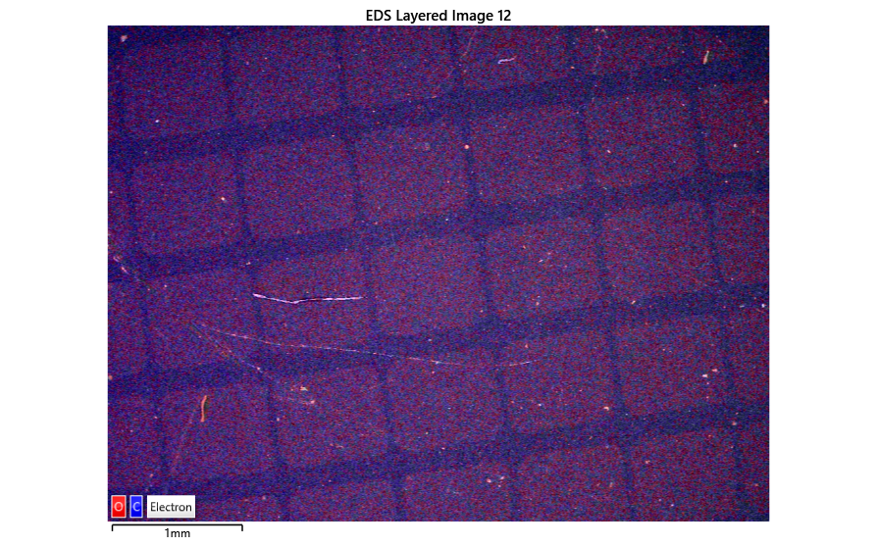
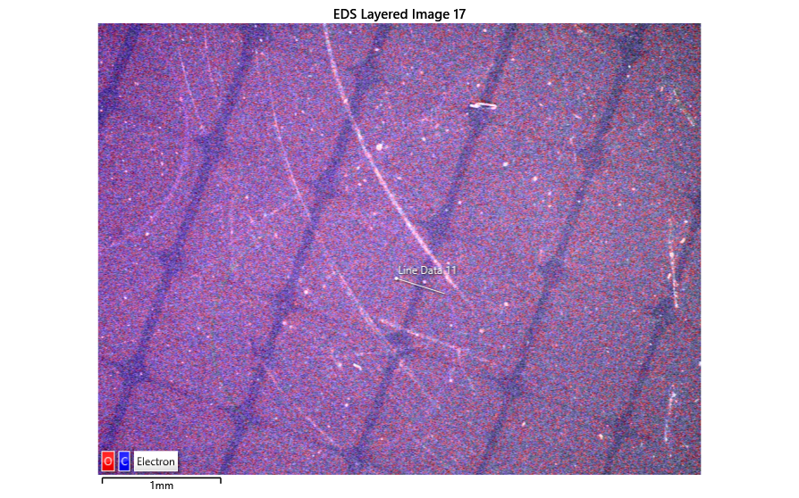
Preliminary Results & Remarks
1. Experiments: Ion Irradiation and Temperature Cycling
1.1. High Density PE
a) After Temperature Cycle:
b) After Irradiation:
c) After Irradiation + Temperature Cycle:

Slide 8
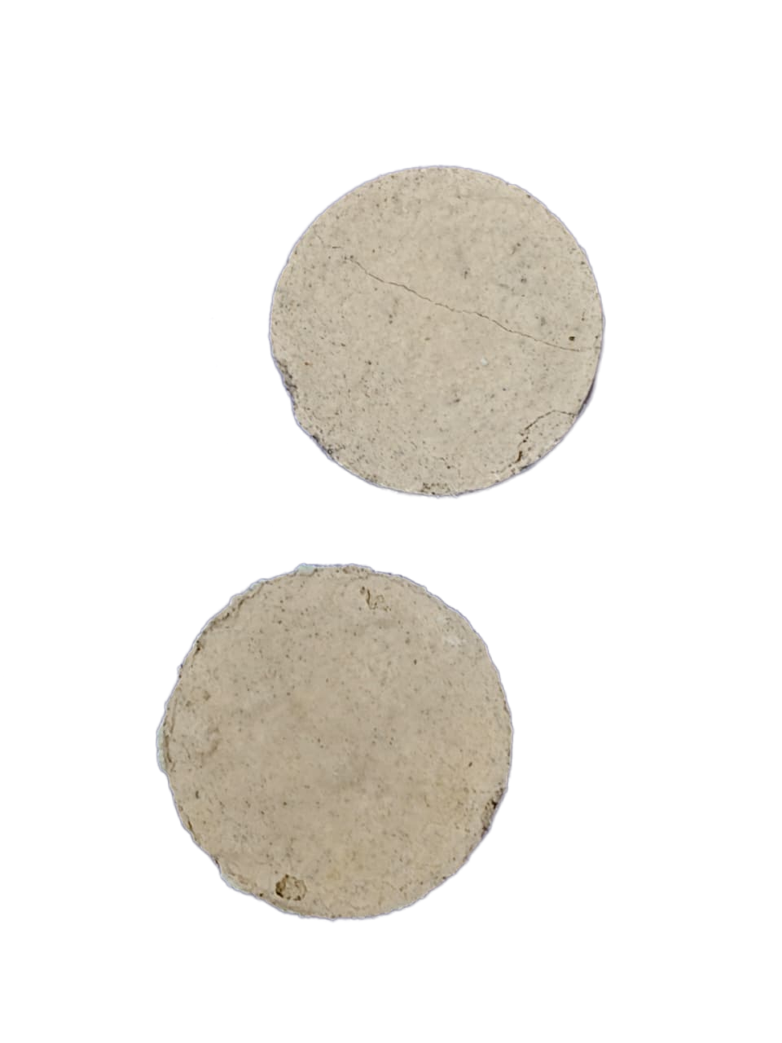
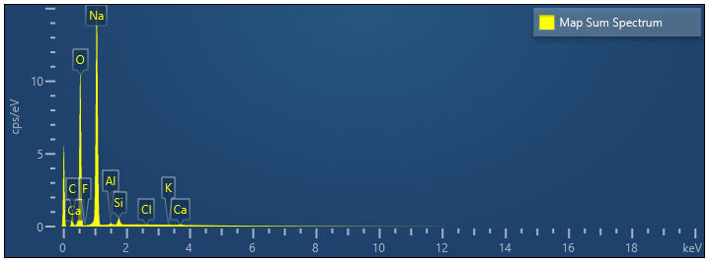
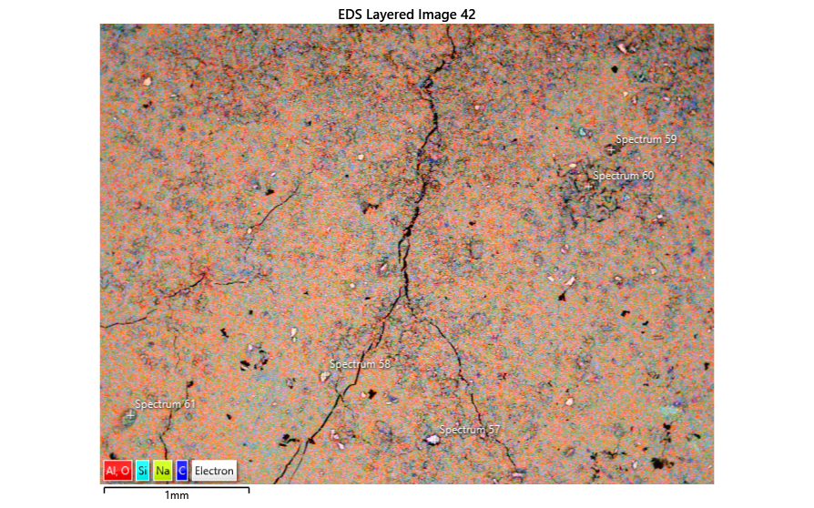
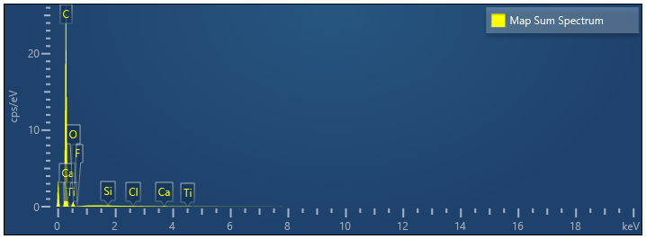
Preliminary Results & Remarks
1. Experiments: Ion Irradiation and Temperature Cycling
1.2. Concrea (Lunar Regolith + Urea)
a) Before Irradiation:
Energy-Dispersive X-ray Spectroscopy (EDS) Spectrum
b) After Irradiation:

Slide 9
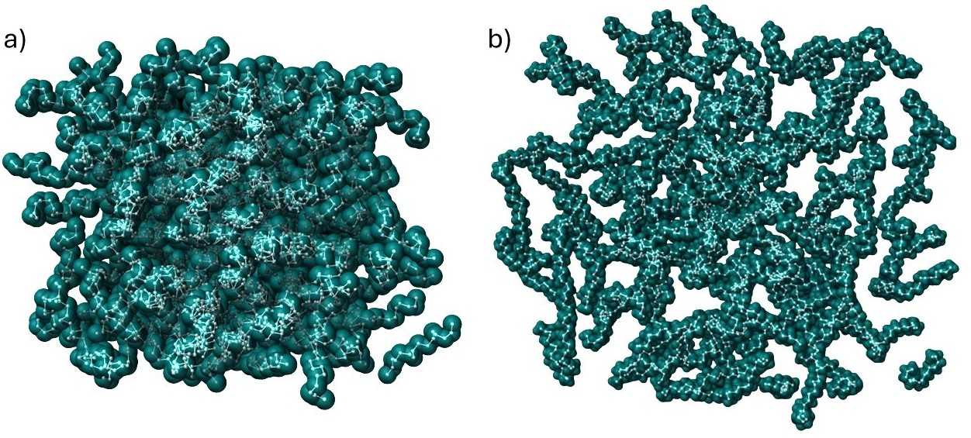
Preliminary Results & Remarks
2. Modelling: MD Simulation
2.1. Amorphous PE
a) Before Temperature Cycle:
b) After Temperature Cycle:
Combining irradiation experiments with atomistic modelling provides a pathway toward understanding and predicting material performance under the coupled radiation–thermal environment of the Moon.

Slide 10
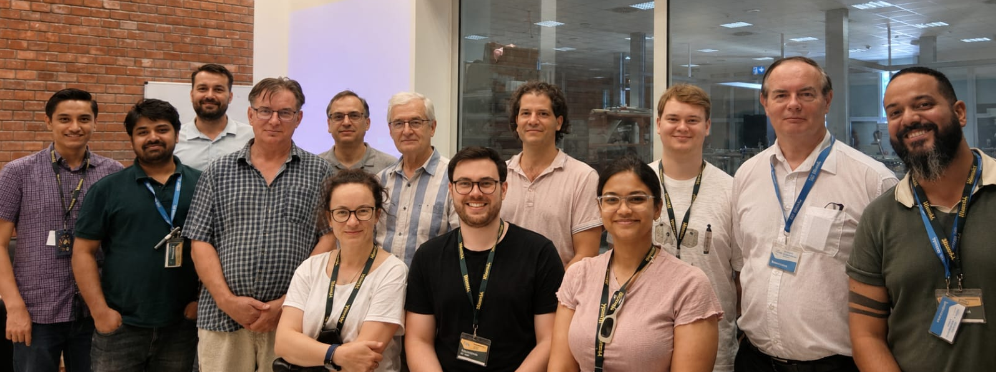








Thank You For Your Attention
Experimental Molecular Physics Research Group
adrija.bhowmick@atomki.hu
Poster: F2.55

