Slide 1
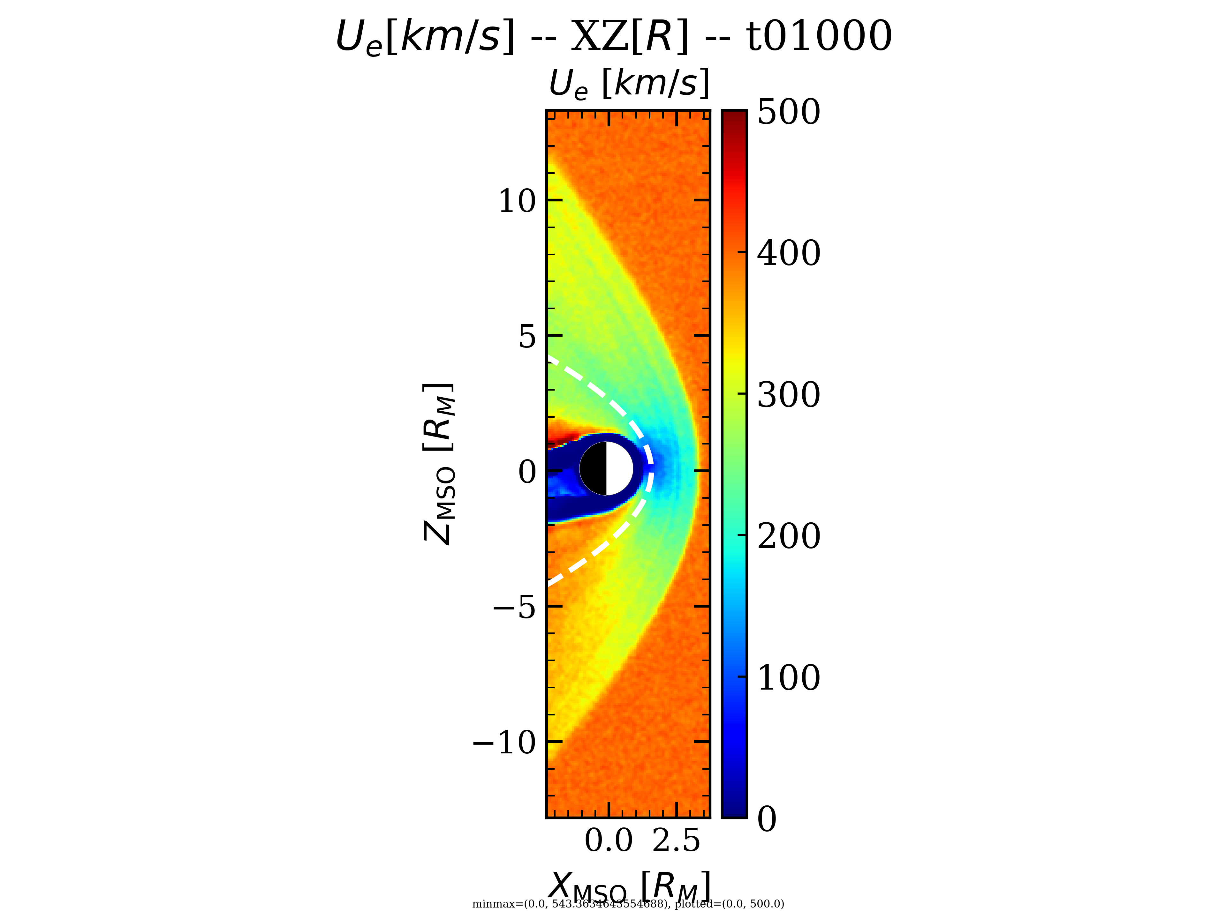
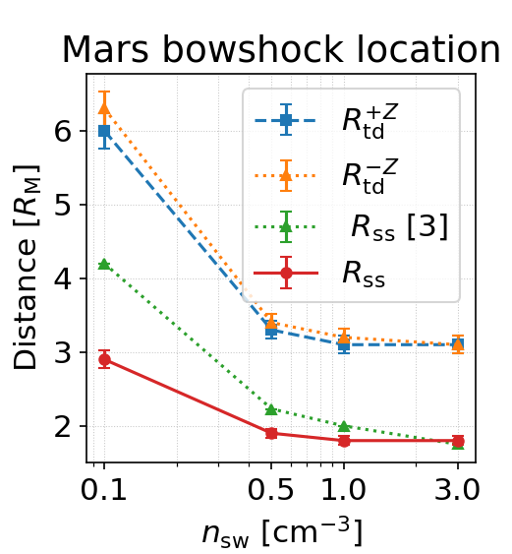
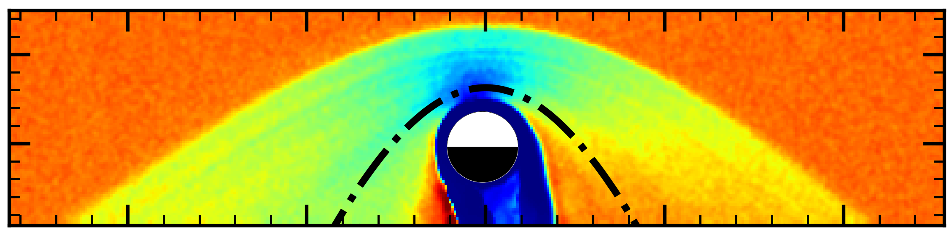
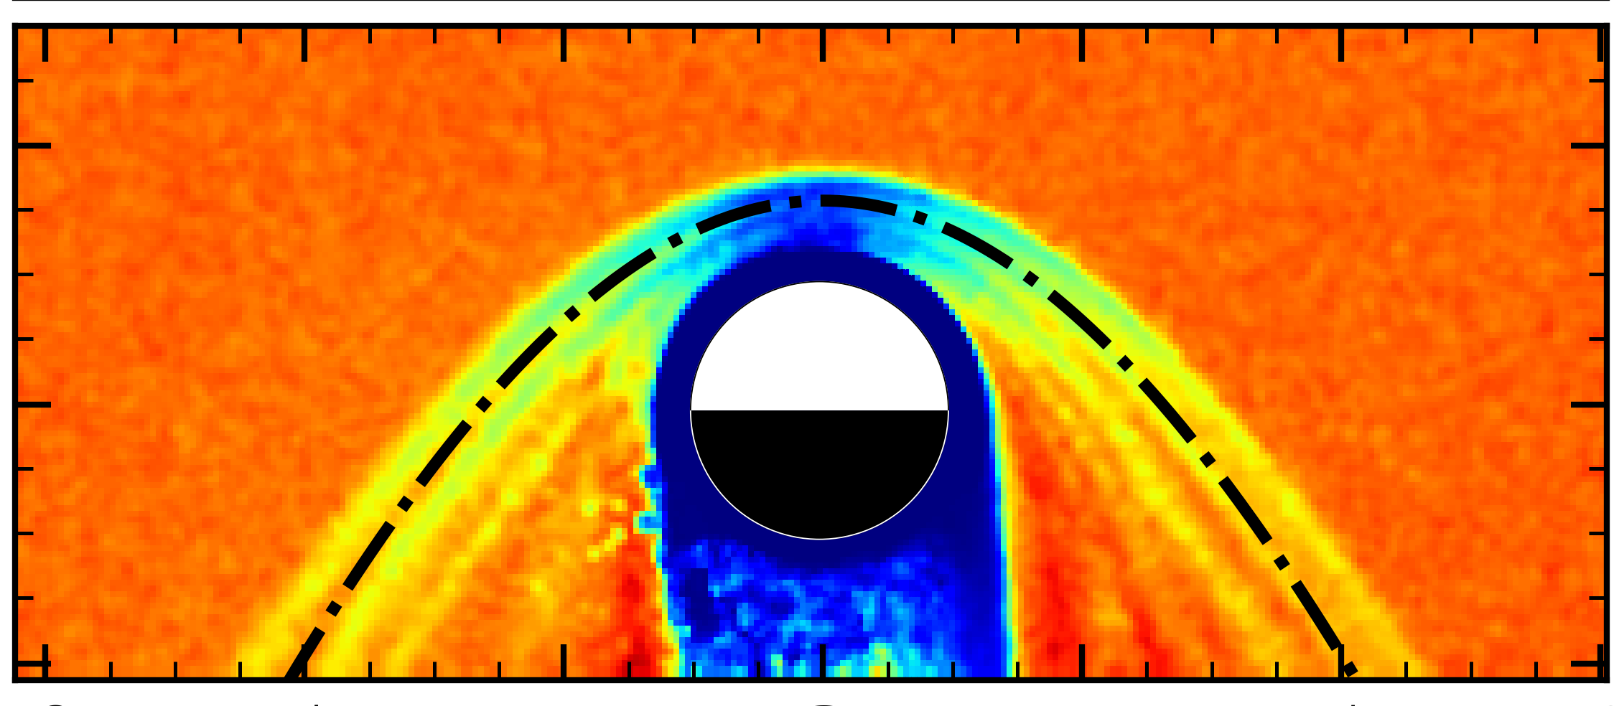

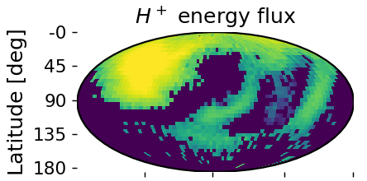
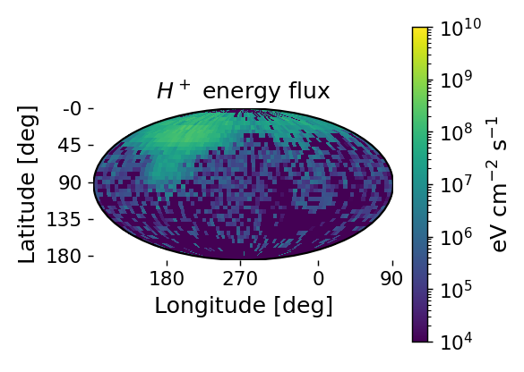
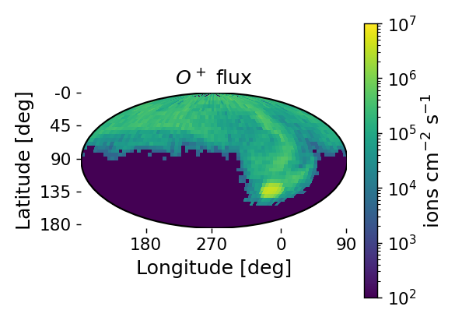
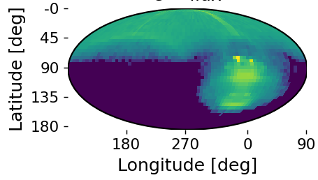


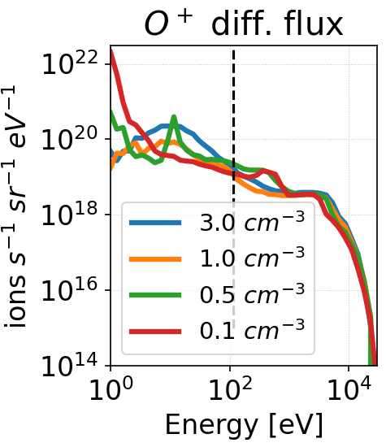
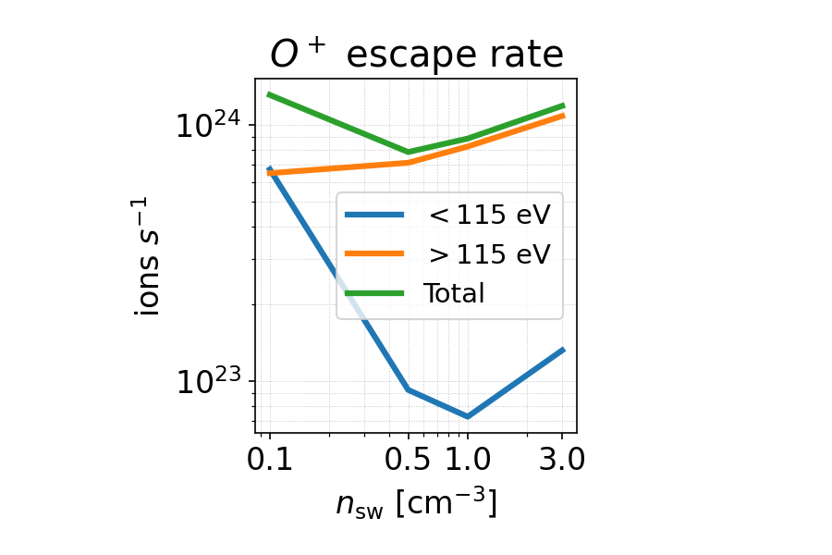





Martian Atmospheric Ion Energization And Escape During The 2022 Disappearing Solar Wind Event: A Hybrid Simulation Study
Matías Notonica¹, Ronan Modolo¹, Quentin Nénon¹, Norberto Romanelli^{2,3}, Laura Morales⁴, Eduard Dubinin⁵, Jean-Yves Chaufray¹, François Leblanc¹, César Bertucci⁴
¹Laboratoire Atmosphères et Observations Spatiales (LATMOS) – UVSQ, INSU, SU, CNRS – France ²Dept. of Astronomy, Univ. of Maryland – USA ³Planetary Magnetospheres Laboratory, NASA/GFSC - USA ⁴Instituto de Astronomía y Física del Espacio - Argentina ⁵Max-Planck-Institut für Sonnensystemforschung - Deutschland
Abstract
Mars has suffered substantial atmospheric loss, largely because the absence of a global magnetic field leaves its upper atmosphere exposed to the solar wind. This interaction drives ion escape, contributing to the planet’s climate evolution and the loss of surface liquid water. Extreme solar wind events—including CMEs, CIRs, and radial IMF—can dramatically reshape Mars’ plasma environment and enhance atmospheric escape [1]. Such conditions were likely more common in the early Solar System, making them key to understanding Mars’ atmospheric evolution.This work investigates the response of O⁺ ions during the remarkable 2022 “Disappearing Solar Wind” (DSW) event, when solar wind density plunged by more than an order of magnitude. Using the latest Latmos Hybrid Simulation (LatHyS) model, we examine how this extreme drop, from n_{sw} = 3.0 to 0.1 cm⁻³, affects ion energization, transport, escape, and precipitation. The DSW event provides a rare natural experiment to probe Mars–solar wind coupling under extraordinarily low-density conditions and to reveal processes that may have driven atmospheric escape during Mars’ early history.
Context
Results
On December 26th, 2022, the solar wind density arriving at Mars dropped from ∼3.0 to ∼0.1 cm⁻³ [2].
During the DSW event, the bowshock expanded so much that no spacecraft could take measurements from the upstream solar wind.
Multifluid simulations show a non-linear correlation between solar wind density and ion escape rates [3].
0
100
200
300
400
500
U_{bulk} [km/s]
3.0 cm⁻³
2
_{To Sun}
X_{MSO} [R_{M}]
0
+E
B_{IMF}
0.1 cm⁻³
-2
2.5
X_{MSO} [R_{M}]
Methodology
0.0
10
5
0
-5
-10
To simulate the DSW event, the Latmos Hybrid Simulation (LatHyS) framework [4] was used:
Ions are represented by macro-particles that allow a kinetic description. This is a key distinction from MHD frameworks.
Electrons are modelled as an inertialess fluid.
Ionization of the upper atmosphere is produced by photoionization, electron impacts and charge exchange.
A simplified model of ionosphere chemistry is included.
Crustal magnetic fields were not included.
We vary n_{sw} while keeping solar wind speed, population temepratures and IMF constant.
Figure 1: Bowshock standoff distance (Rss) and terminator distance (R_{td}) as a function of solar wind density.
Figure 2: Bulk ion speed in km/s in the XZ plane of MSO coordinates for n_{sw}=0.1cm⁻³ (left) and n_{sw}=3.0cm⁻³ (right). The white dashed line is the average bowshock boundary from Edberg et al., 2008.
Figures 1 and 2 show an expansion of the bowshock as n_{sw} decreases. Since crustal fields were included in the MHD simulations of [3], it is enhanced by them. Terminator distance is similarly influenced by n_{sw}.
SIMULATION PARAMETERS
IONOSPHERE
U_{sw} = 400 km/s
SOLAR WIND
To Sun
n_{sw} = 3.0 → 0.1 cm⁻³
β_{H} = 8.4 → 0.3
β_{He} = 0.44 → 0.015
β_{e} = 4.4 → 0.15
Figure 3: Global coordinate maps. The top row corresponds to n_{sw}=3.0cm⁻³ and the bottom row to n_{sw}=0.1cm⁻³. On the left, energy deposition of solar wind H⁺ into the planet at an altitude of 300km above the surface of Mars. On the right, O⁺ escape flux away from the planet at an altitude of 1 R_{M} .
3nT
M_{alfven} = 12 → 2.2
M_{sonic} = 3.9 → 3.9
M_{fast} = 3.7 → 1.9
H⁺, CO₂⁺, O⁺, O₂⁺
c/ω_{pH} = 131 → 717 km
Ω_{H+}⁻¹ = 3.45 → 3.45 s
From Figure 3, we observe the following:
  The solar wind introduces less energy into the system for lower solar wind densities;
  The global O⁺ escape doesn’t seem to change significantly in both morphology and dominance when solar wind density is lower.
dx = 150 → 220 km
95% H⁺, 5% He⁺⁺, e
Conclusions & Next Steps
Low-energy (<115 eV) O⁺ escape span over up to 4 orders of magnitude compared to high-energy (>115 eV), as show in Figure 4. As a result, Figure 5 shows a monotonic decrease for high-energy escape compared to the non-linear profile from low-energy ions. Moreover, despite total escape varying within one order of magnitude, it shows a local caused by the low-energy O⁺ escape rate.
Bowshock morphology is heavily dependent on both n_{sw} and crustal magnetic fields. For future simulations, the latter will be included in order to further characterize its effects.
Despite solar wind H⁺ energy deposition being directly dependent on n_{sw}, changes on the global morphology of O⁺ escape channels are less evident. A more thorough study is needed to understand channel changes.
Thanks to the ion kinetic description of LatHyS, a threshold of 115 eV for O⁺ energy has been observed to significantly affect O⁺ escape rates. These need further study.
Figure 4: O⁺ differential flux as a function of ion energy for different solar wind densities. The dashed line is 115 eV,
Figure 5: O⁺ escape rate as a function of solar wind density, while distinguishing distinct ion energies.
References
[1] Jakosky et al., (2018). Loss of the Martian atmosphere to space: Present-day loss rates determined from MAVEN observations and integrated loss through time. Icarus, 315. https://doi.org/10.1016/j.icarus.2018.05.030.
[2] Halekas, J. S. et al. (2023). The day the solar wind disappeared at Mars. Journal of Geophysical Research: Space Physics, 128, e2023JA031935. https://doi.org/10.1029/2023JA031935
[3] Ma, Y., et al. (2025). Multi-fluid MHD study of the disappearing solar wind event observed by MAVEN: Effects of solar wind density. Journal of Geophysical Research: Space Physics, 130, e2025JA033997. https://doi.org/10.1029/2025JA033997
[4] Modolo, R., et al. (2016), Mars-solar wind interaction: LatHyS, an improved parallel 3-D multispecies hybrid model, J. Geophys. Res. Space Physics, 121, 6378–6399, doi:10.1002/2015JA022324.
Contact
Notonica M. - PhD Student
✉ matias.notonica@latmos.ipsl.fr
+33 6 32 40 91 13
4, place Jussieu, Paris, Sorbonne Université UPMC Tours 45-46, 3e et 4e étage
Abstract

