Slide 1
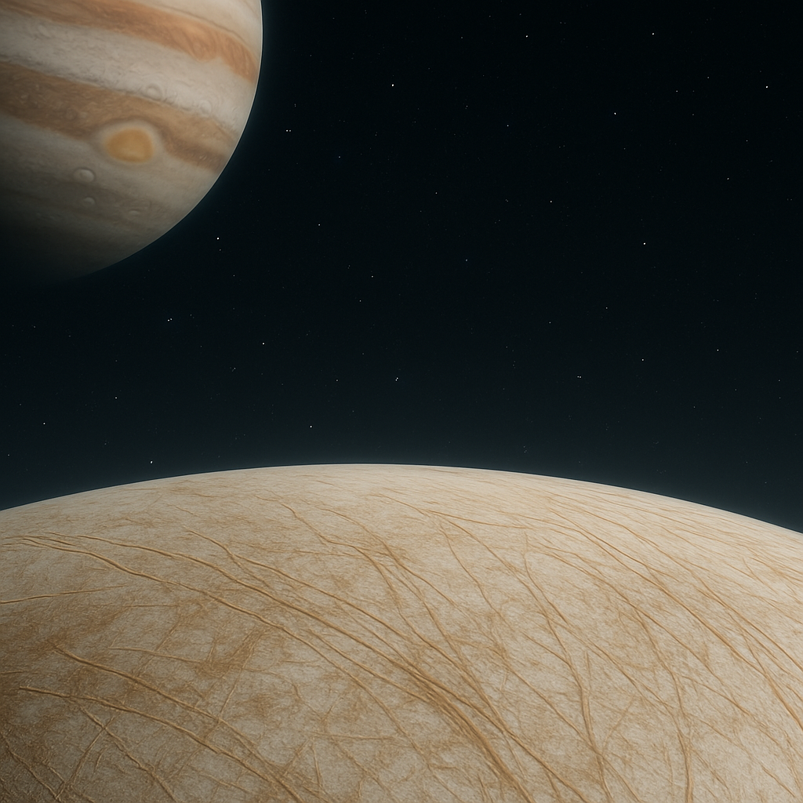



Transport and Mixing of Salts in Europa’s Ice Shell:
A Geodynamic Perspective
Grellan Lambert^{1,2}, Ana-Catalina Plesa²
¹Nantes Université,
²German Aerospace Center (DLR), Institute of Planetary Research

Slide 2
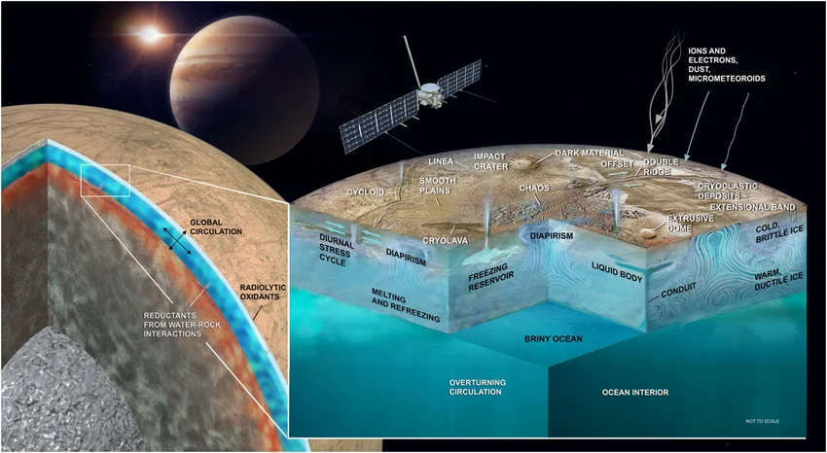
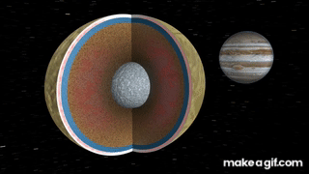
INTRODUCTION
Europa is an icy moon of Jupiter with:
  A subsurface salty, liquid water ocean, above a silicate mantle
  A convective ice shell.
Complex molecules at surface:
  O₂ - Solar wind interactions
  NaCl - Irradiated salts
All of the above important for habitability
Credit: Vance et al. 2023
Credit: NASA/JPL
Notes:
First of all, what is Europa?
Europa is an icy moon of Jupiter with a subsurface salty, liquid water ocean in contact with a rocky mantle, which is beneath a potentially convective ice shell.
Why potentially? Ra scales with D³ , ice shell thickness is poorly constrained
Europa sustains this liquid ocean due to tidal heating from gravitational interactions with Jupiter, as you can see in the gif
Furthermore, we have detected complex molecules at the surface, such as oxygen and salt.
All of these things are important for constraining Europa’s habitability.

Slide 3
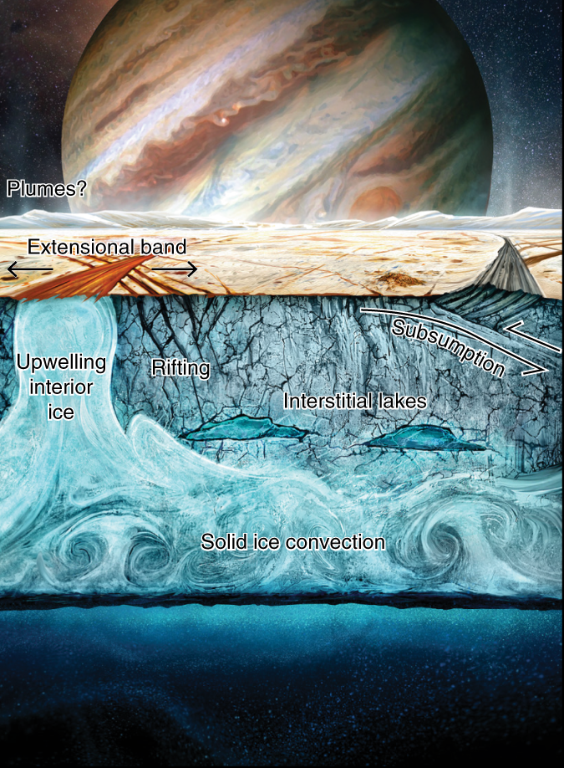
INTRODUCTION
Europa is an icy moon of Jupiter with:
  A subsurface salty, liquid water ocean, above a silicate mantle
  A convective ice shell.
Complex molecules at surface:
  O₂ - Solar wind interactions
  NaCl - Irradiated salts
All of the above important for habitability
Under what conditions are these molecules transported to the subsurface?
“Surface mobilisation”
  Ice shell strongly convects, breaking surface layer, transporting material
  What are the dynamics? How does the ice shell evolve with these salts?
Credits: NASA/JPL/Jeff Nentrup
Notes:
In this internship we try to answer the question of how these molecules are transported from the surface to the interior
We call this surface mobilisation, which can occur when the ice shell strongly convects, breaking the surface layer and transporting material.

Slide 4
INTERNSHIP OBJECTIVES
To model the transport of salts inside Europa’s ice shell using the GAIA numerical code by varying the initial conditions, e.g:
  Grain size
  Brine distribution
  Ice salinity
  Surface yield stress

Slide 5
INTERNSHIP OBJECTIVES
To model the transport of salts inside Europa’s ice shell using the GAIA numerical code by varying the initial conditions, e.g:
  Grain size
  Brine distribution
  Ice salinity
  Surface yield stress
To assess under which of these conditions surface mobilisation occurs

Slide 6
INTERNSHIP OBJECTIVES
To model the transport of salts inside Europa’s ice shell using the GAIA numerical code by varying the initial conditions, e.g:
  Grain size
  Brine distribution
  Ice salinity
  Surface yield stress
To assess under which of these conditions surface mobilisation occurs
To improve on previous GAIA models of brine transport [Plesa 2020]
Notes:
Previous GAIA models did not conserve mass of salt between the different distributions as was done here. Also only tested step, exponential and linear cases. No brine pocket distributions were tested

Slide 7
METHODS
The GAIA Model Setup

Slide 8
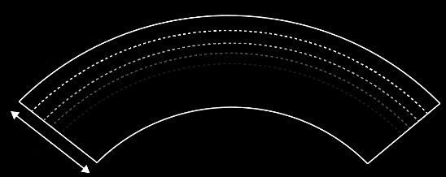
METHODS: Model Setup
GAIA is a finite-volume fluid flow solver that solves conservation equations in mass, energy and momentum on a fixed computational grid [Hüttig et al., 2013].
Solid-state convection (no liquid)
2D cylindrical geometry
Free-slip conditions at top and bottom
30 km shell depth; ~ 218 km lateral extent
Linear initial temperature profile; random initial perturbation
T_{surf} = 110 K
T_{bot} = 270 K
30 km
Notes:
Read points from slide, briefly describe figure with top and bottom temperatures

Slide 9

METHODS: Viscosity Laws and Ice Rheology
We adopt Ice I rheology, which can be described the following relationships [Goldsby & Kohlstedt, 2001]:
Stress (Pa)
Grain size (m)
Viscosity (Pa.s)
Strain rate (s⁻¹)
v
Grain size exponent
Stress exponent
Notes:
To account for the ice rheology, which refers to how it deforms under stress, the model takes the following law into account, where the strain rate of the ice is proportional to the magnitude of the stress applied and the grain size of the ice.
The stress exponent n is determined by how the ice deforms under stress - or the deformation mechanism
This law can also be written in terms of viscosity, which tells us that the lower the ice grain size, the lower the effective viscosity of the ice, and the more easily it convects

Slide 10
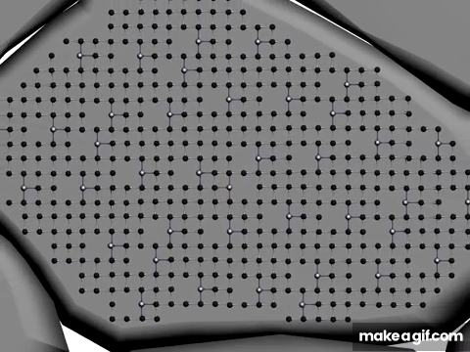
METHODS: Viscosity Laws and Ice Rheology
We account for 4 main deformation mechanisms (composite rheology):
Diffusion creep (n=1): Atoms move incrementally in the direction of stress

Slide 11
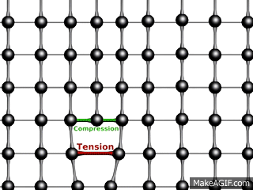
METHODS: Viscosity Laws and Ice Rheology
We account for 4 main deformation mechanisms (composite rheology):
Diffusion creep (n=1): Atoms move incrementally in the direction of stress
Dislocation creep (n=4): Atoms move via lattice defects in the ice crystal

Slide 12
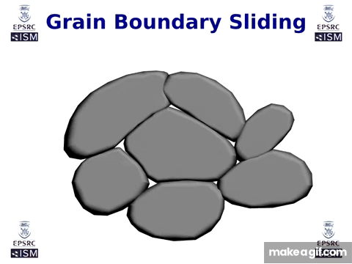
METHODS: Viscosity Laws and Ice Rheology
We account for 4 main deformation mechanisms (composite rheology):
Diffusion creep (n=1): Atoms move incrementally in the direction of stress
Dislocation creep (n=4): Atoms move via lattice defects in the ice crystal
Grain boundary sliding (n=1.8): Ice grains slide past each other along the grain edge

Slide 13
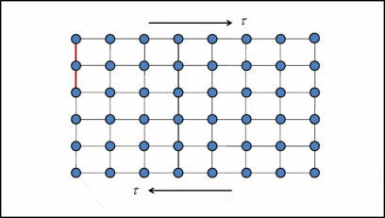
METHODS: Viscosity Laws and Ice Rheology
We account for 4 main deformation mechanisms (composite rheology):
Diffusion creep (n=1): Atoms move incrementally in the direction of stress
Dislocation creep (n=4): Atoms move via lattice defects in the ice crystal
Grain boundary sliding (n=1.8): Ice grains slide past each other along the grain edge
Basal slip (n=2.4): Ice deforms along the basal plane of the crystal lattice

Slide 14

METHODS: Viscosity Laws and Ice Rheology
We account for 4 main deformation mechanisms (composite rheology):
Diffusion creep (n=1): Atoms move incrementally in the direction of stress
Dislocation creep (n=4): Atoms move via lattice defects in the ice crystal
Grain boundary sliding (n=1.8): Ice grains slide past each other along the grain edge
Basal slip (n=2.4): Ice deforms along the basal plane of the crystal lattice
Effective viscosity results from combining all of the above deformation mechanisms
Notes:
We do a harmonic average of GBS and BS. they do not act in parallel like the other mechanisms, they occur together in sequence

Slide 15
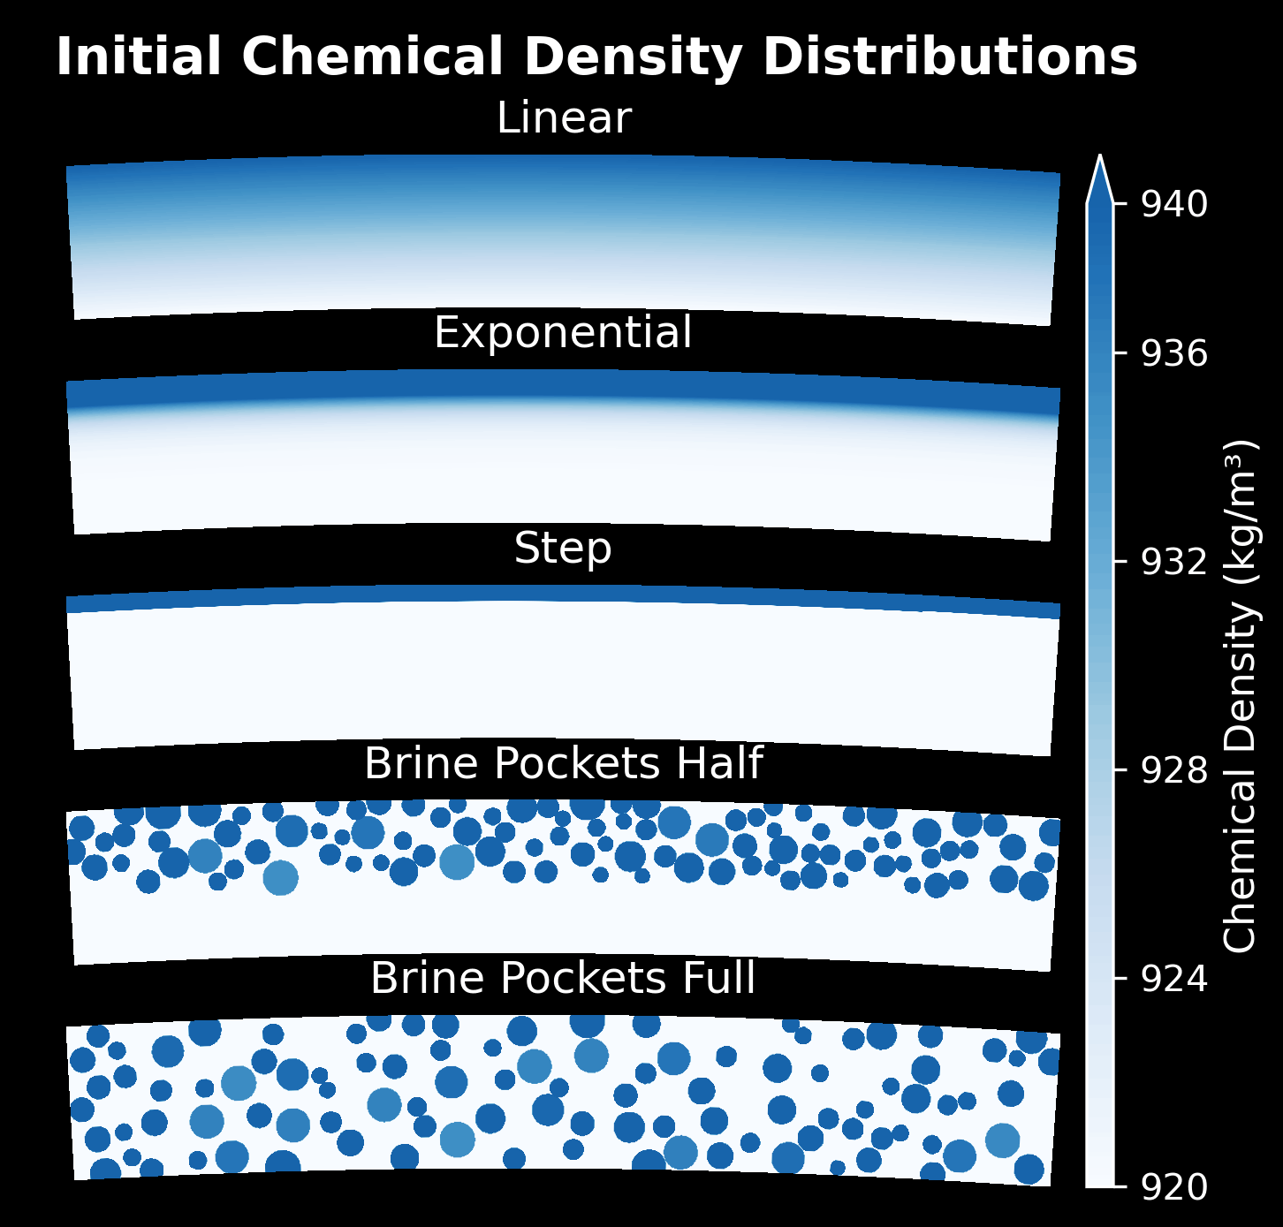
METHODS: Variable Parameters
150 simulations varying:
Brine distribution:
Linear, exponential, step, brine pockets
Grain size:
0.1, 1 and 10 mm
Ice Salinity:
1x and 4x Earth’s ocean salinity (~35 g of salt per kg of water)
Surface yield stress (σ₀):
15, 20, 80, 180 kPa
Notes:
The mass of salt is conserved across all distributions, so they are comparable
Explain surface yield stress briefly: the stress we impose where the surface layer breaks

Slide 16
RESULTS
Surface Mobilisation at:
1x Earth ocean salinity
1 mm grain size
15 kPa surface yield stress

Slide 17
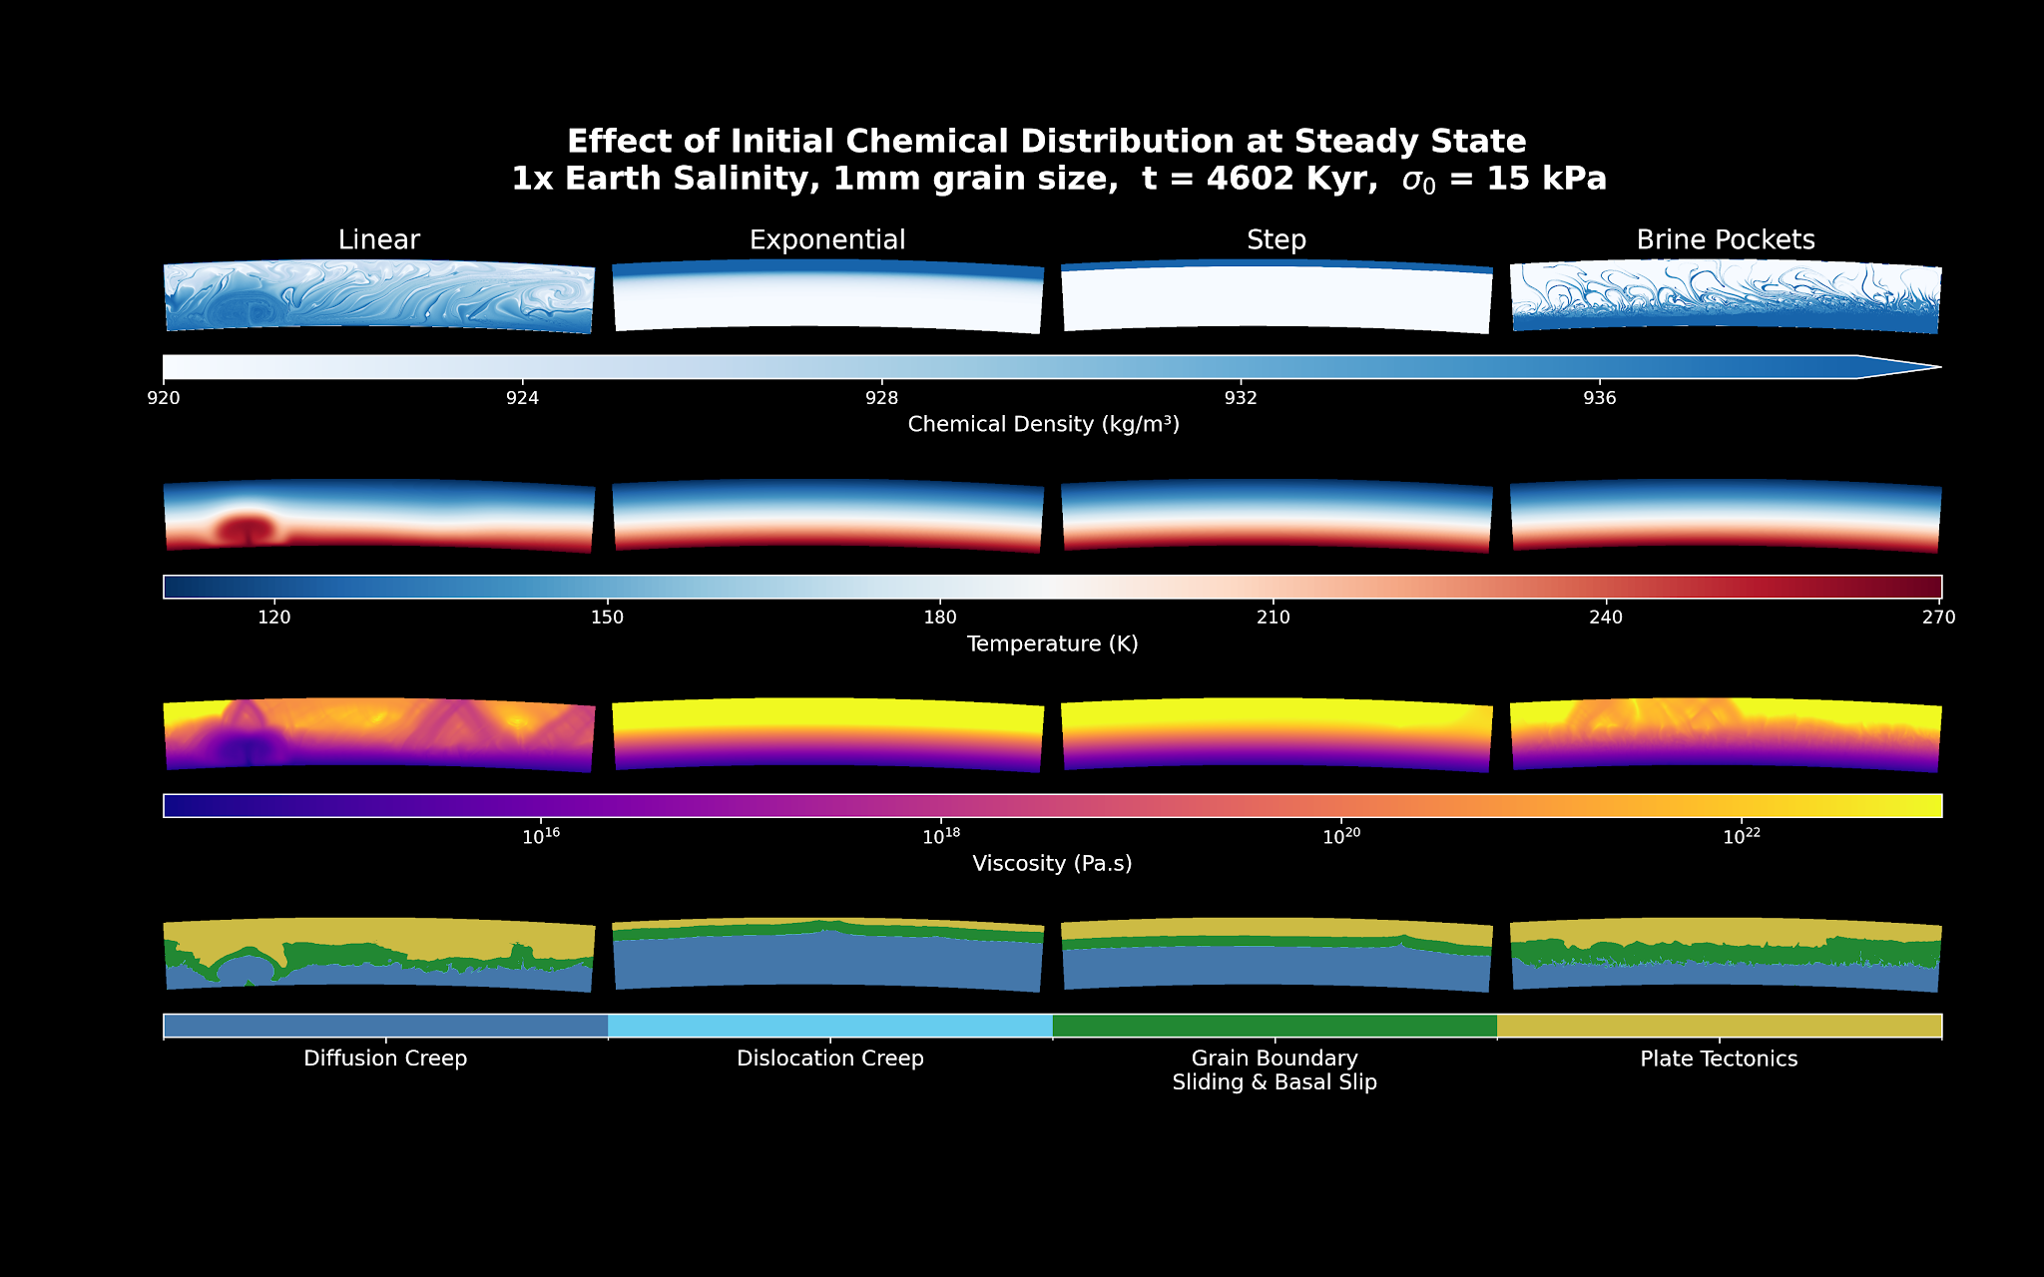
Ice Shell Dynamics at 1 mm: Surface Mobilisation
Notes:
Here we show the 1mm grain size case at 1x earth salinity and 15 kPa surface yield stress, where surface mobilisation has occurred. It is at a late evolution time of around 4.6 million years.
We show four fields:
Chemical density in kg/m3
Temperature in K
Viscosity in Pa.s
Deformation mechanism
The step and exponential cases do not show surface mobilisation here, so lets focus in on the linear and brine pocket cases

Slide 18
Ice Shell Dynamics at 1 mm: Surface Mobilisation

Slide 19
Ice Shell Dynamics at 1 mm: Surface Mobilisation
Chemical Density
Temperature
Viscosity
Notes:
In the linear case, we see that most of the material has moved from its initial position in the top of the ice shell, to the bottom. This is called a density overturn, which occurs due to the gravitational instability caused by the dense salt overlying the less dense pure ice.
There is a large active basal plume, which is moving material from the middle to the bottom
Brine trails have formed that spread over the entire domain, many of which are in low viscosity zones

Slide 20
Ice Shell Dynamics at 1 mm: Surface Mobilisation
Chemical Density
Temperature
Viscosity
Notes:
In the brine pocket case, we see that a similar overturn has taken place, where the brine has escaped the stagnant lid and sunk to the bottom of the ice shell.
Brine trails have been left behind forming some low viscosity zones.
No basal plume is seen here and we are at a steady state.

Slide 21
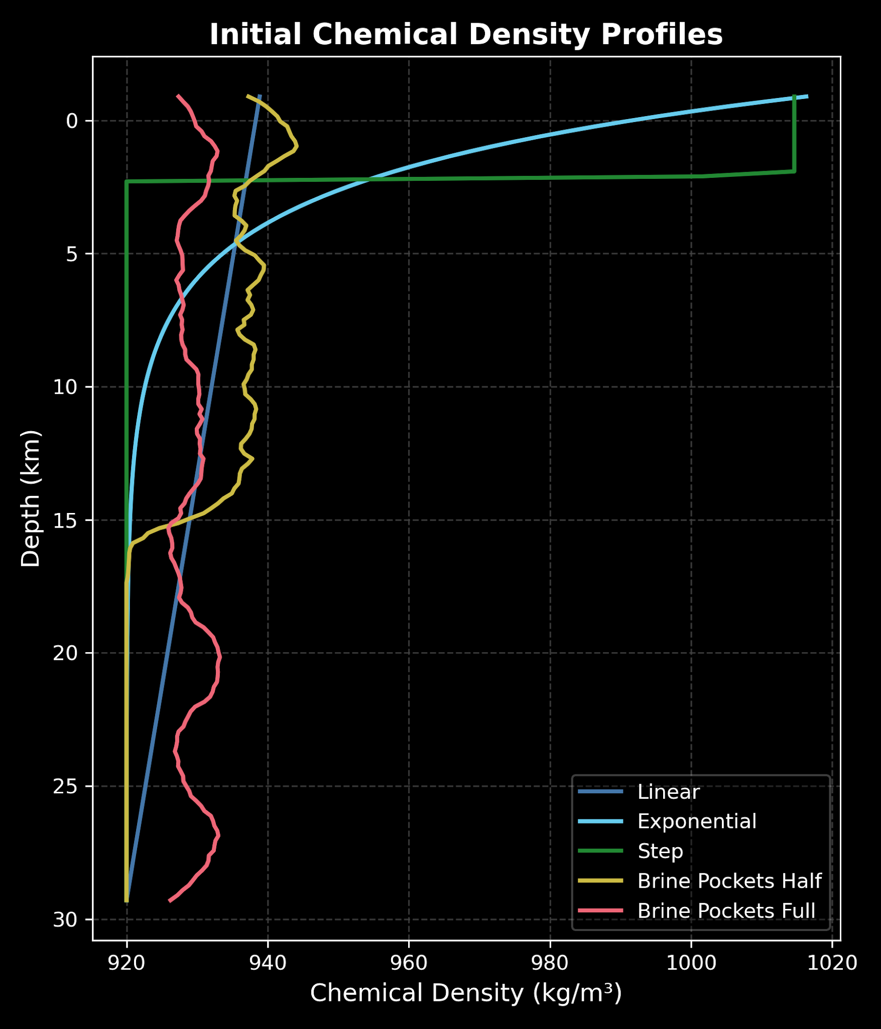
Ice Shell Dynamics at 1 mm: Surface Mobilisation
Notes:
This figure shows the initial average chemical density profile of each distribution

Slide 22
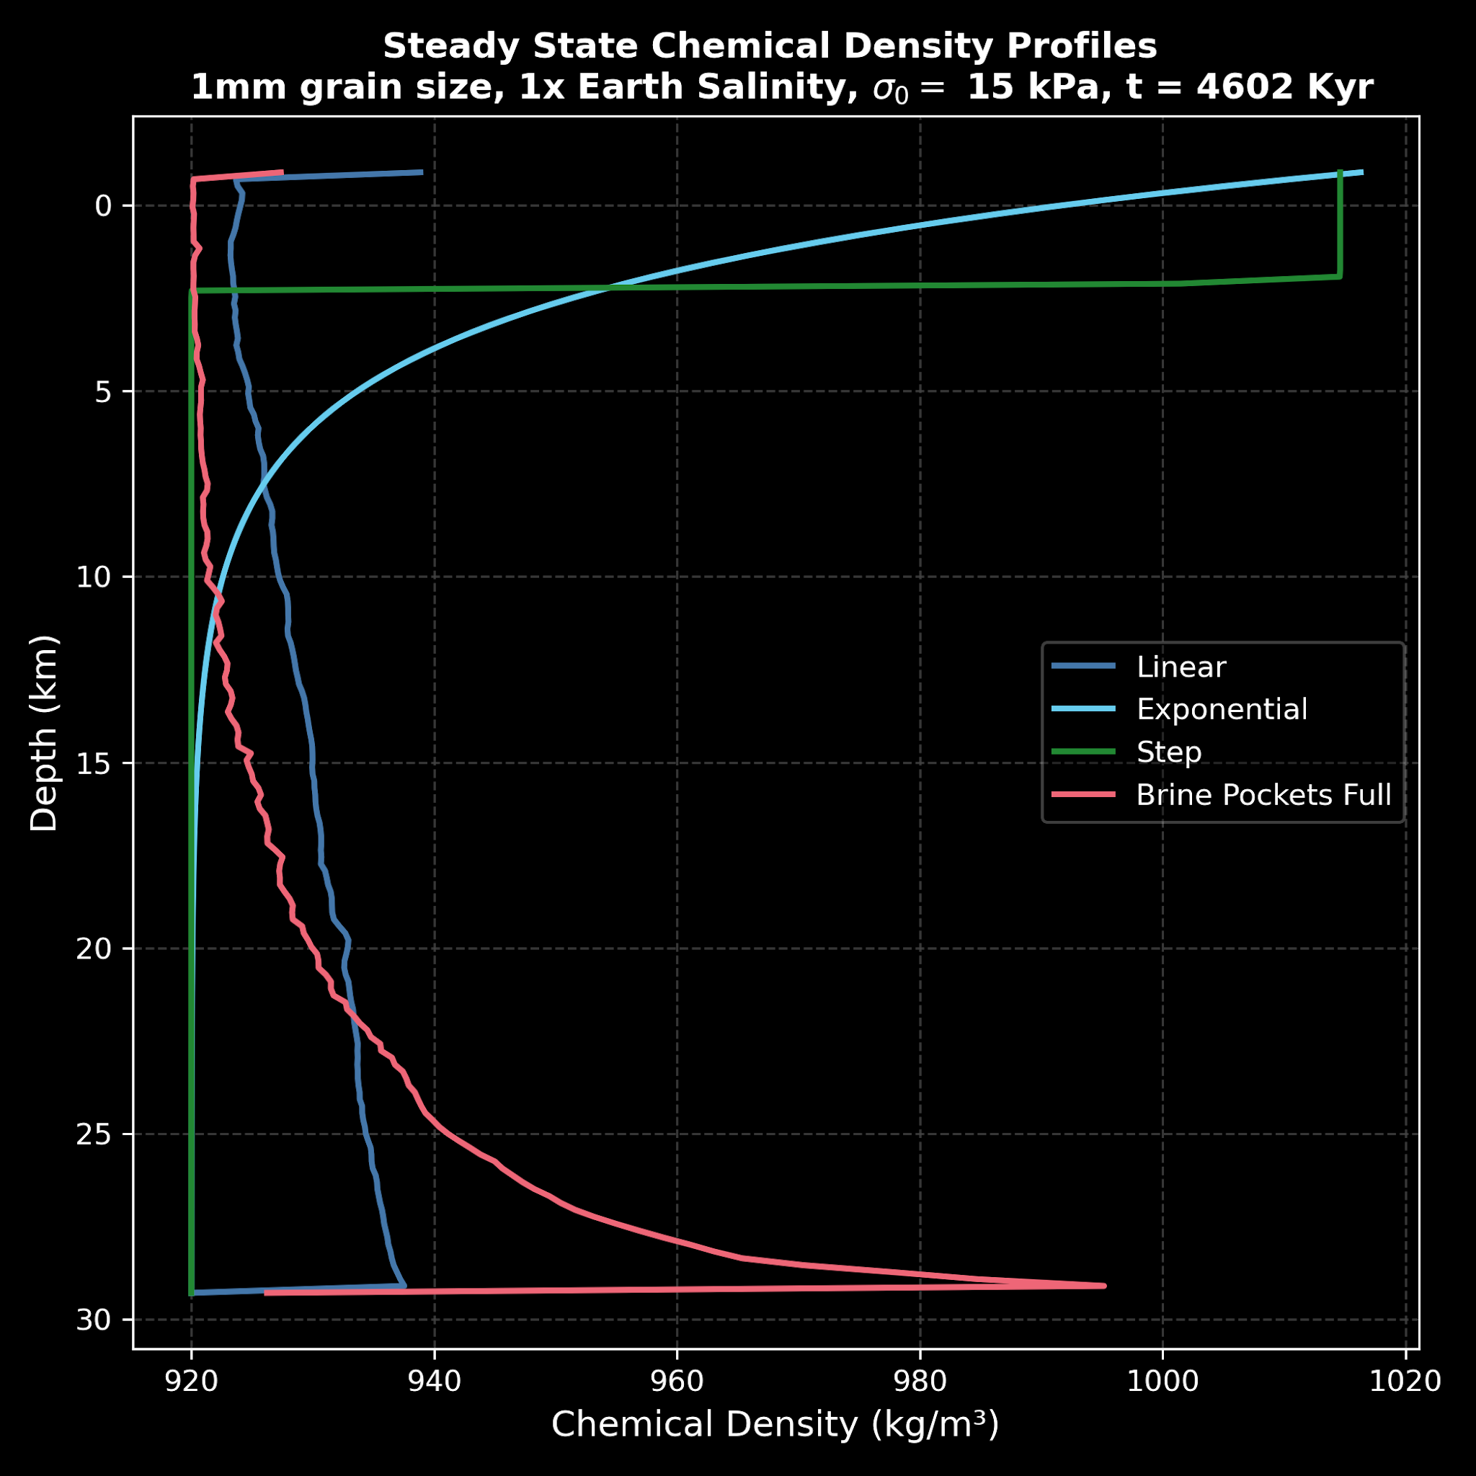
Ice Shell Dynamics at 1 mm: Surface Mobilisation
Linear and pockets - Density overturn
  Gravitational instability
  Brine layer forms at base
  Top half depletes
Notes:
And here we can see the density profiles for the linear and brine pocket cases after surface mobilisation takes place. Again, we can see that most of the brine has sunk to the bottom of the ice shell.

Slide 23
Ice Shell Dynamics at 1 mm: Surface Mobilisation
Linear and pockets - Density overturn
  Gravitational instability
  Brine layer forms at base
  Top half depletes
Brine pockets
  Pockets completely dispersed
  Convective stresses weaken lid
  Brine transported lid → interior.

Slide 24
Ice Shell Dynamics at 1 mm: Surface Mobilisation
Linear and pockets - Density overturn
  Gravitational instability
  Brine layer forms at base
  Top half depletes
Brine pockets
  Pockets completely dispersed
  Convective stresses weaken lid
  Brine transported lid → interior.
Linear
  Large basal plume
  Extensive brine trails
  Non-steady state at t = 4602 kyr

Slide 25
What Happens When
Ice Salinity Increases?

Slide 26
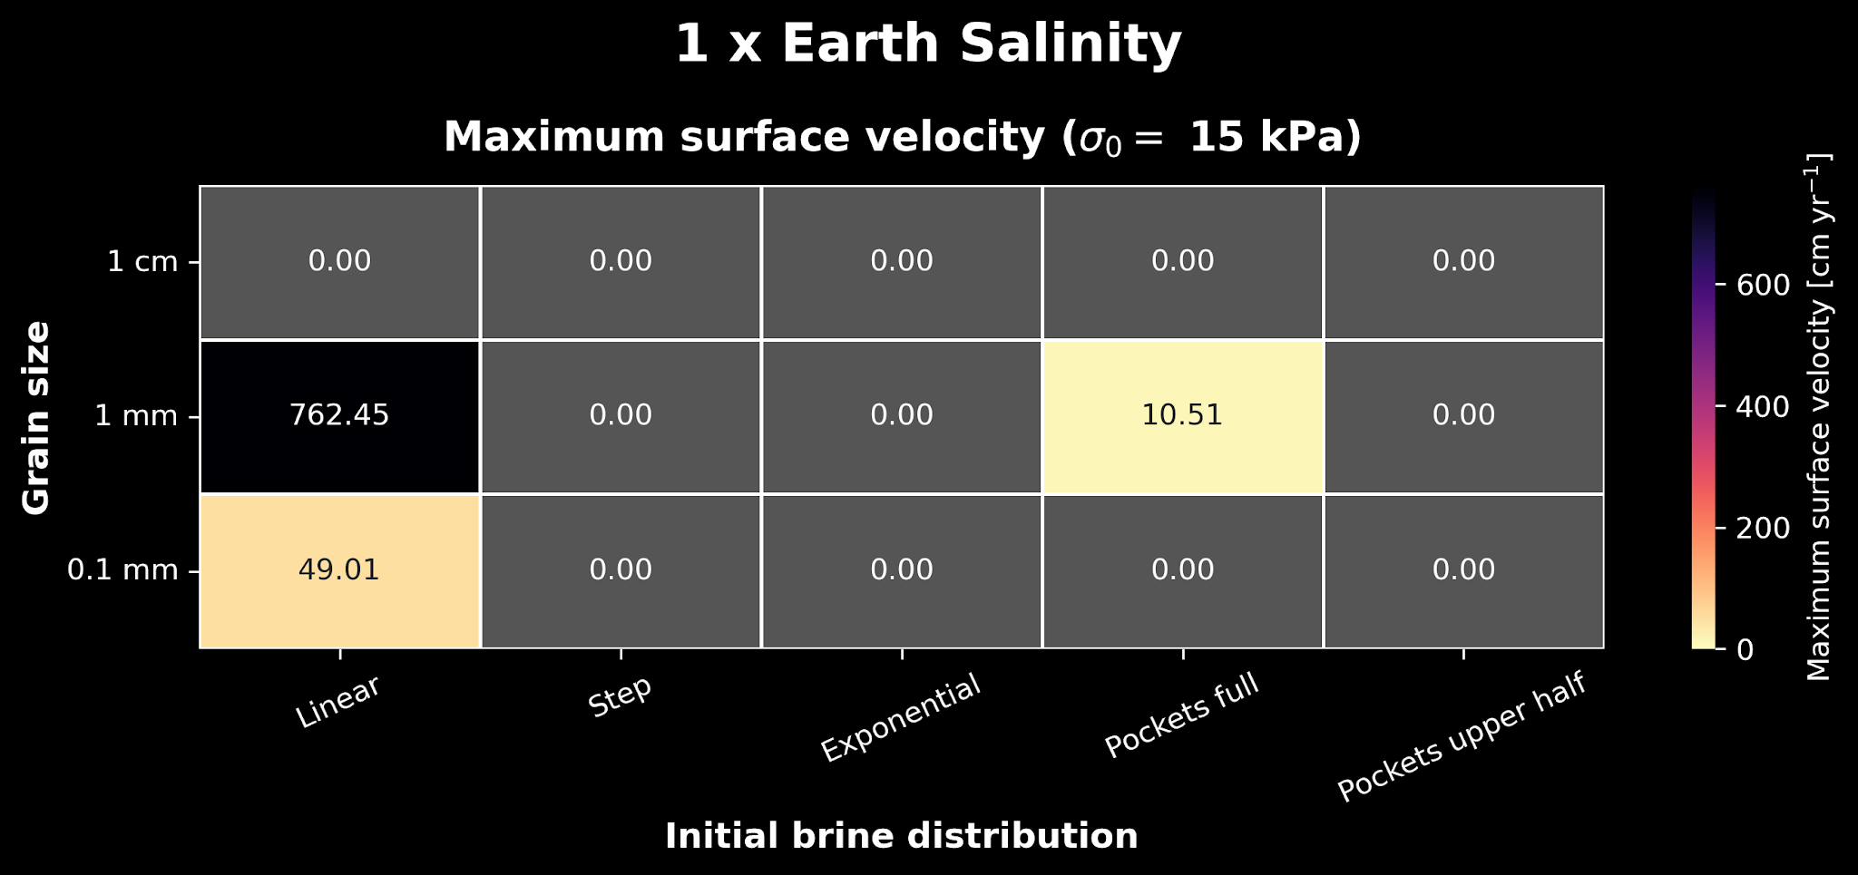
The Effect of Increasing Ice Salinity
Notes:
This figure shows a heat map of the surface velocities IN CM/YR for all the distributions and grain sizes at a surface yield stress of 15 kPa at 1x EARTH OCEAN SALINITY
We see three cases where the velocity is above 0, with the linear case having the highest velocity.

Slide 27
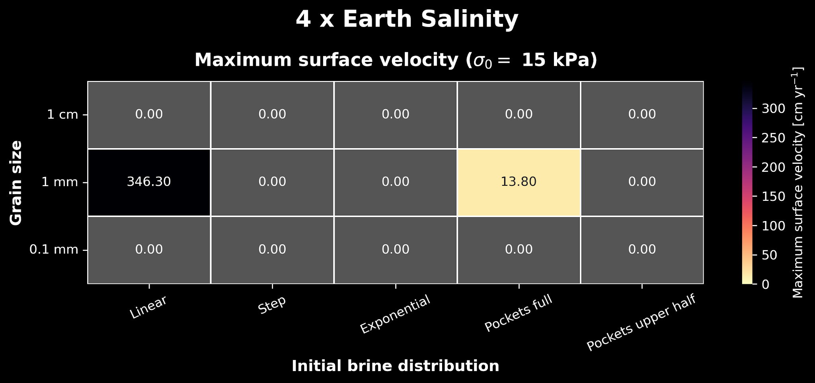
The Effect of Increasing Ice Salinity
Notes:
When we increase the salinity to 4x we notice that the surface velocity for the linear case at 1mm decreases by half, whereas for the brine pockets case it increases by 3 cm/yr

Slide 28
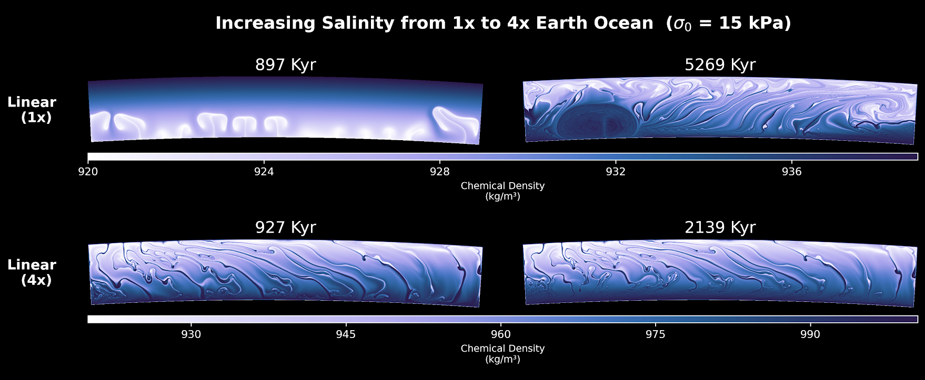
The Effect of Increasing Ice Salinity at 1 mm: Linear Case
Notes:
Here we have a comparison of the 1mm linear case at 1x and 4x salinity, at both early and late evolution times
We expect that for an increased salinity, the likelihood of surface mobilisation increases because
the material available is more dense, meaning
The convective stresses are higher and the shell is broken more easily
However, another effect of increasing salinity is that a stable, stratified density layer forms, preventing dynamics later on. So in the 4x case we dont see a large basal plume form as before

Slide 29
CONCLUSION & FUTURE WORK
Across 150 simulations, only 5 had surface mobilisation
  More simulations needed to assess immobile cases

Slide 30
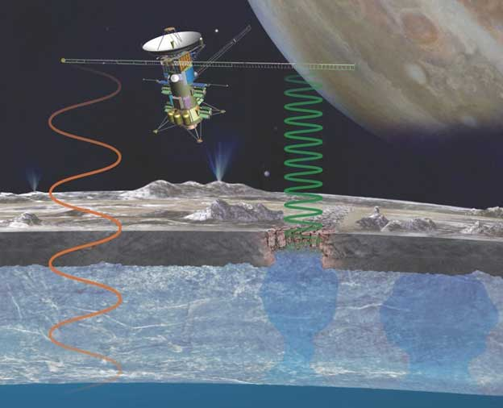
CONCLUSION & FUTURE WORK
Across 150 simulations, only 5 had surface mobilisation
  More simulations needed to assess immobile cases
Linear and pocket cases are most dynamically active.
  Some brine trails lead from surface to ice shell base
  Need future radar and gravity data of evolved subsurface to compare with results

Slide 31
CONCLUSION & FUTURE WORK
Across 150 simulations, only 5 had surface mobilisation
  More simulations needed to assess immobile cases
Linear and pocket cases are most dynamically active.
  Some brine trails lead from surface to ice shell base
  Need future radar and gravity data of evolved subsurface to compare with results
Future simulations could implement:
  Tidal heating
  3D shell models
  Impacts
  Liquid-state brine dynamics

Slide 32

Thank you for your attention!
1x Earth salinity, Linear, 1 mm, 15 kPa

Slide 33
References
Vance et al.(2023, Nov). “Investigating Europa’s Habitability with the Europa Clipper”. Space Science Reviews 219(8), 81
Plesa et al. (2020). “Compositional convection in Europa’s ice shell”. In Europlanet Science Congress (EPSC) 2020, pp. EPSC2020–1038. Copernicus Meetings.
Hüttig et al. (2013). “An improved formulation of the incompressible Navier–Stokes equations with variable viscosity”. Physics of the Earth and Planetary Interiors 220, 11–18
Goldsby, D. L. & D. L. Kohlstedt (2001). “Superplastic deformation of ice: Experimental observations”. Journal of Geophysical Research: Solid Earth 106(B6), 11017–11030

Slide 34
BACKUP SLIDES

Slide 35
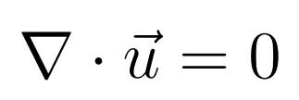
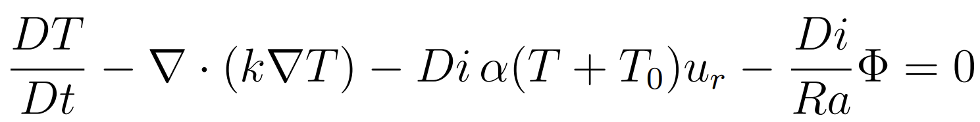
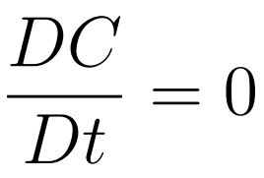
METHODS: The Conservation Equations

Slide 36
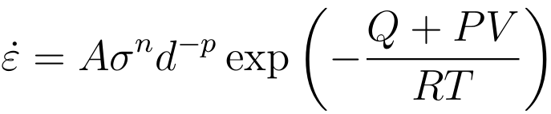
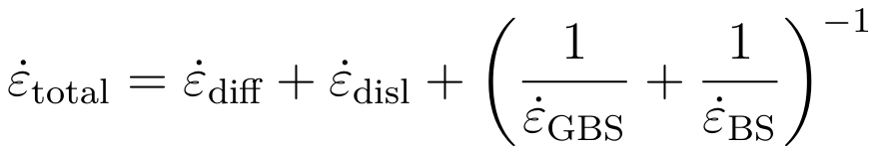
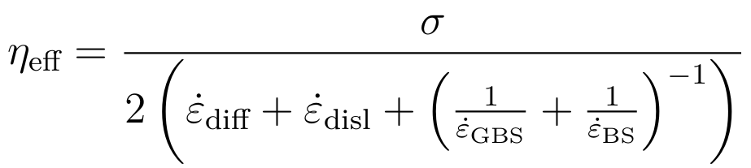
METHODS: Arrhenius Equations

Slide 37
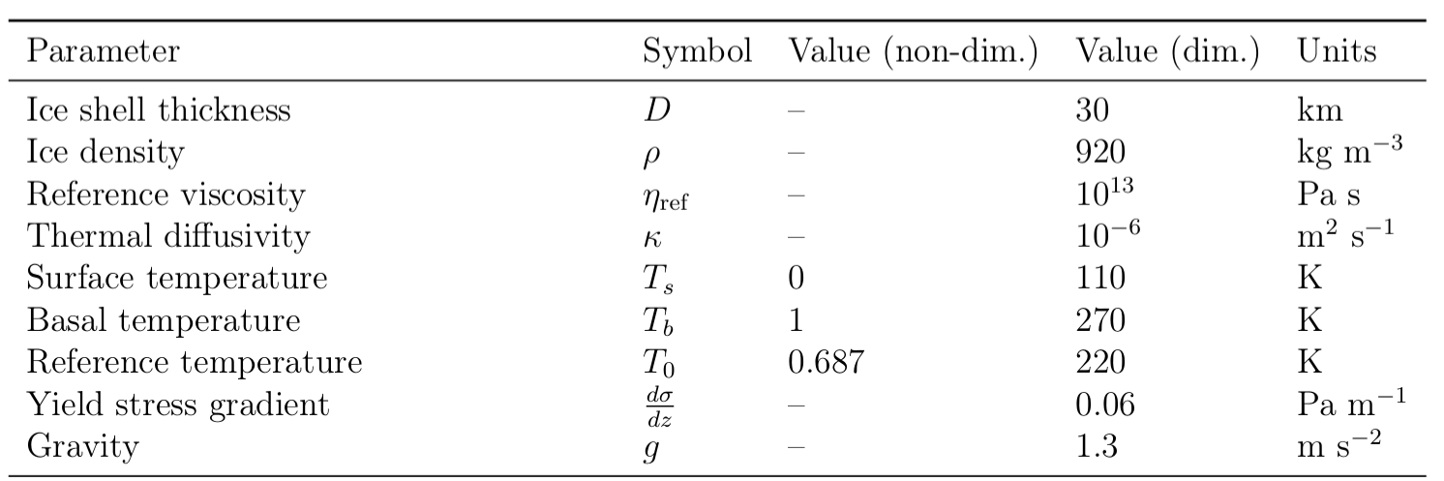
Fixed Physical Parameters

Slide 38
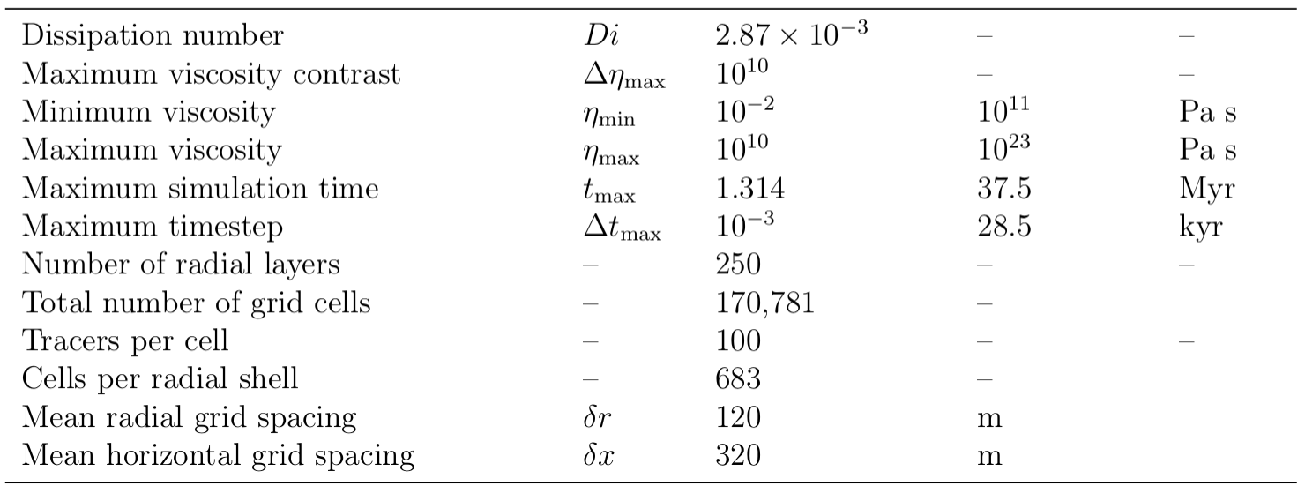
Fixed Model Parameters

Slide 39
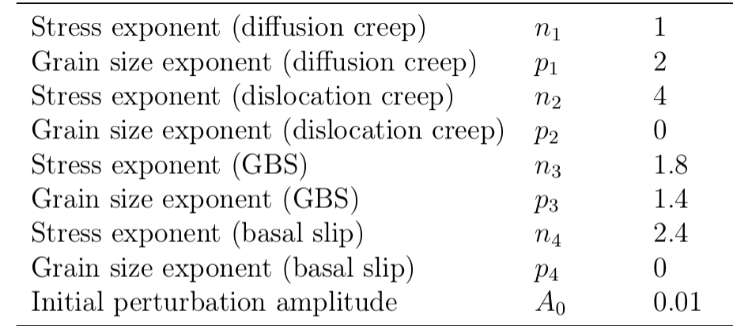
Fixed Model Parameters

Slide 40
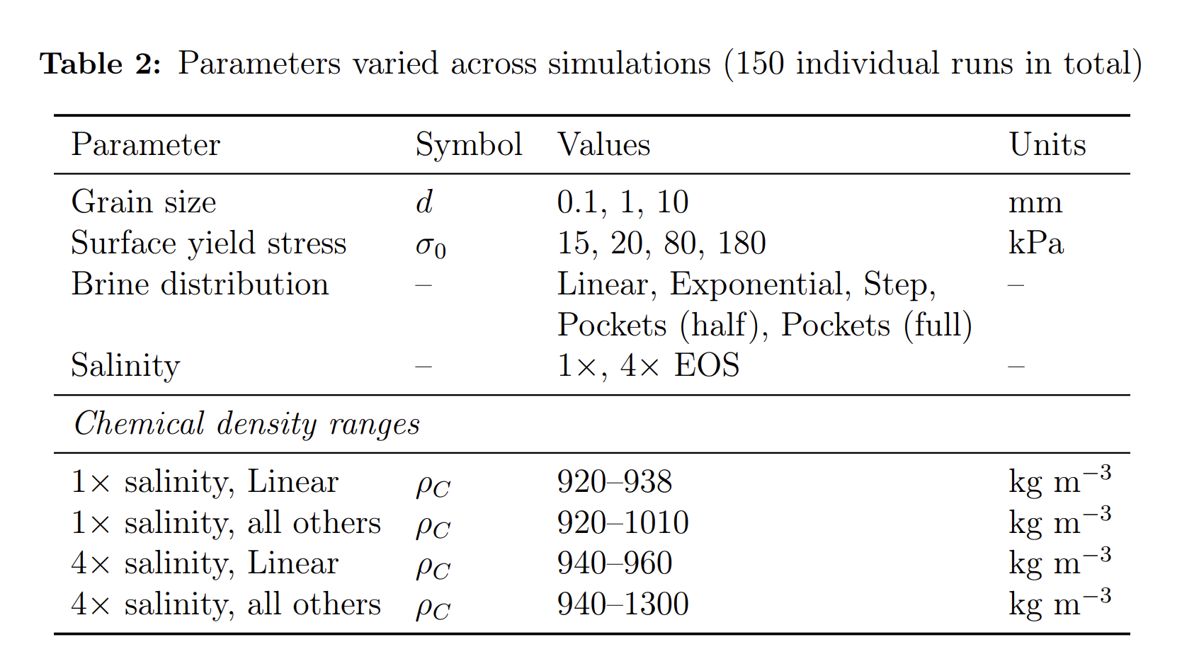
Variable Physical Parameters

Slide 41
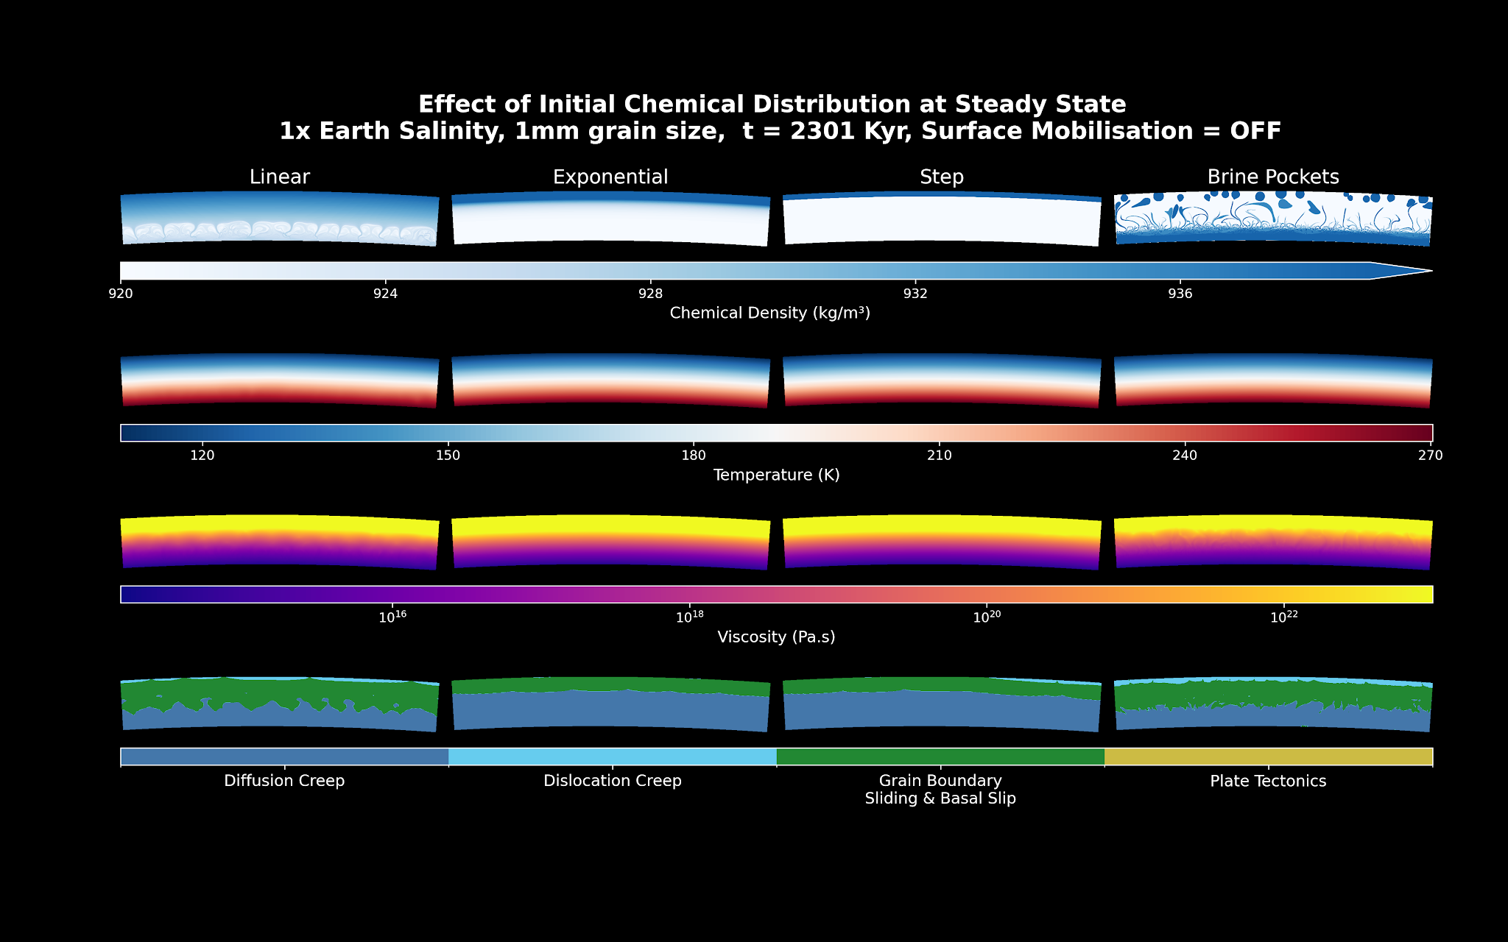
Ice Shell Dynamics at 1 mm: Stagnant Lid

Slide 42
Ice Shell Dynamics at 1 mm: Stagnant Lid

Slide 43
Ice Shell Dynamics at 1 mm: Stagnant Lid

Slide 44
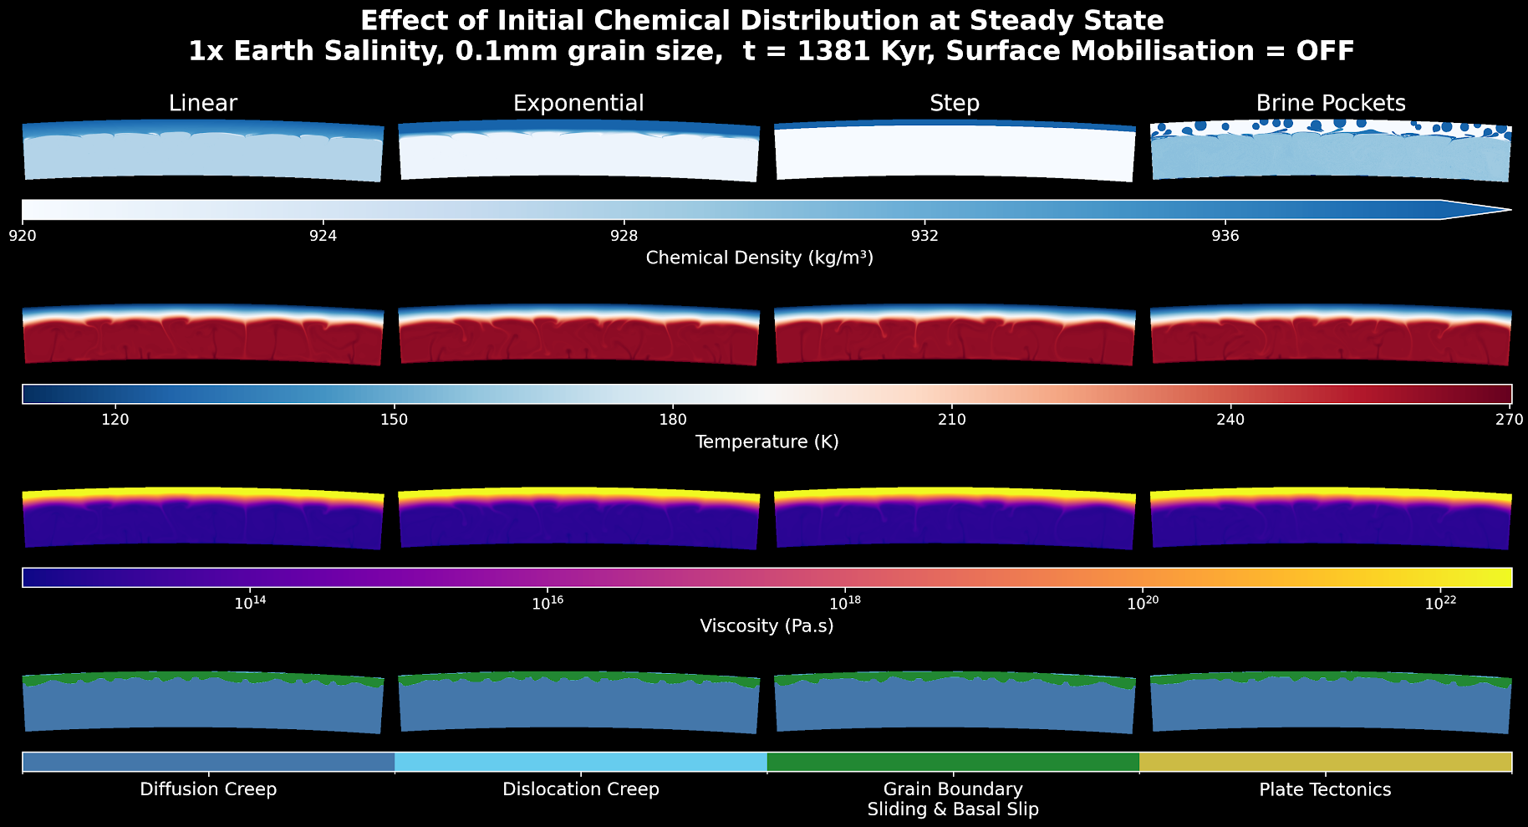
0.1 mm Steady State, Stagnant Lid

Slide 45
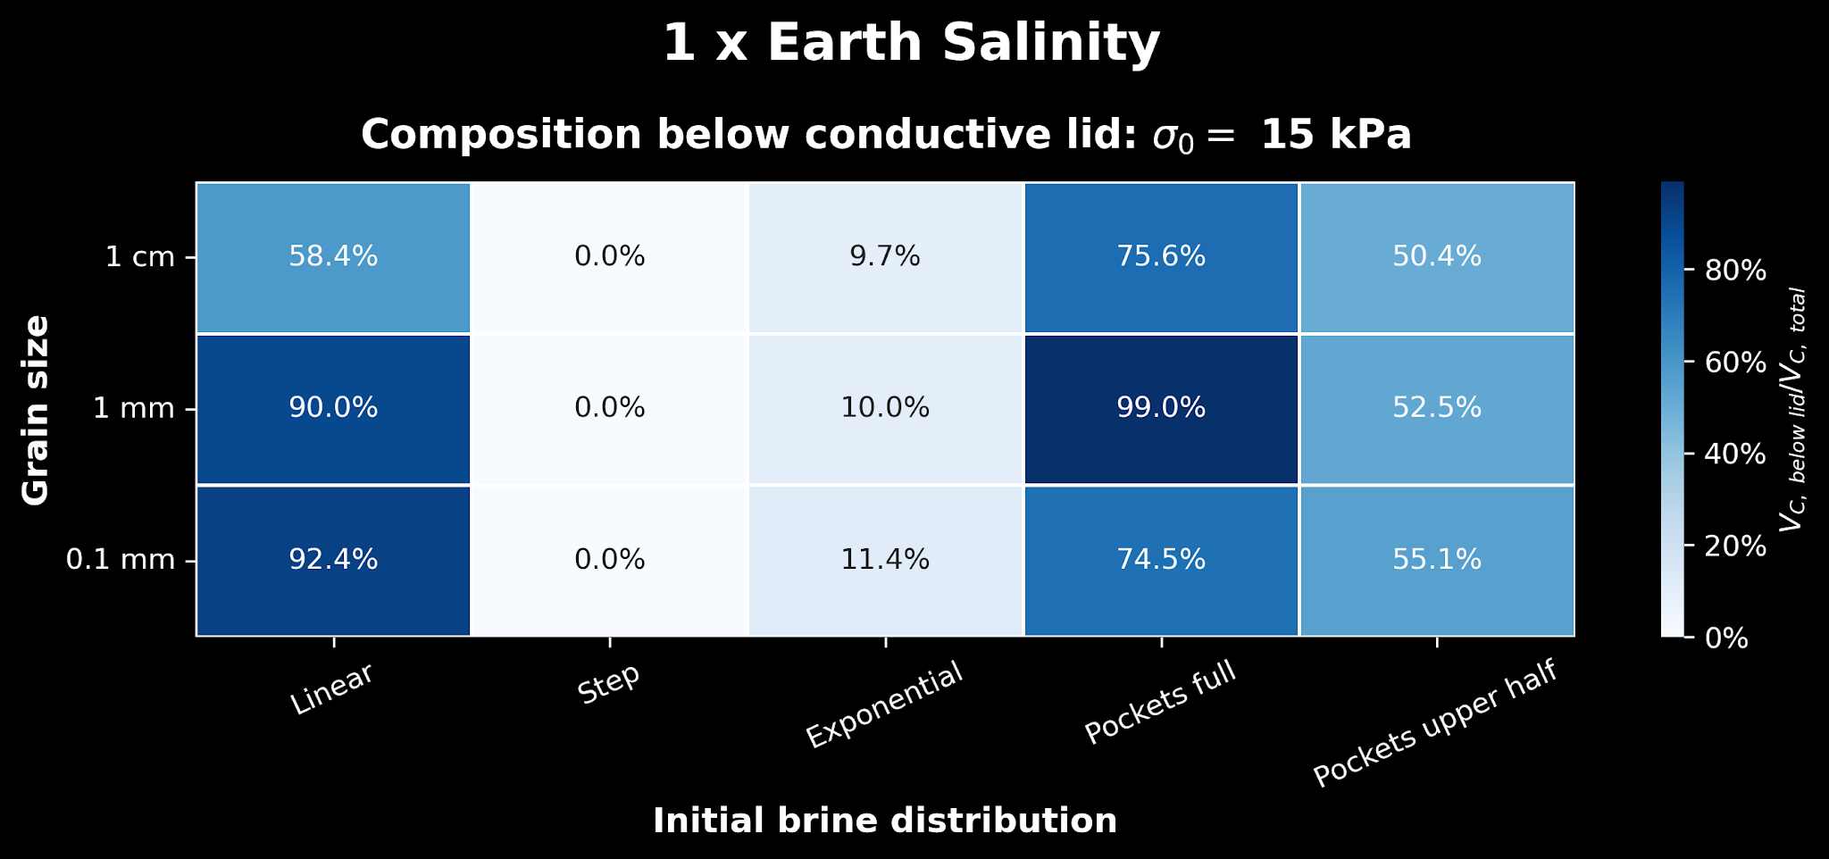
The Effect of Increasing Ice Salinity

Slide 46
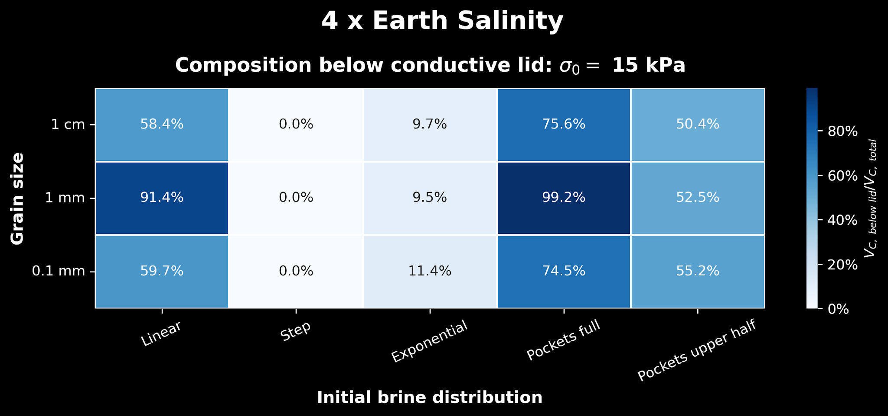
The Effect of Increasing Ice Salinity

Slide 47
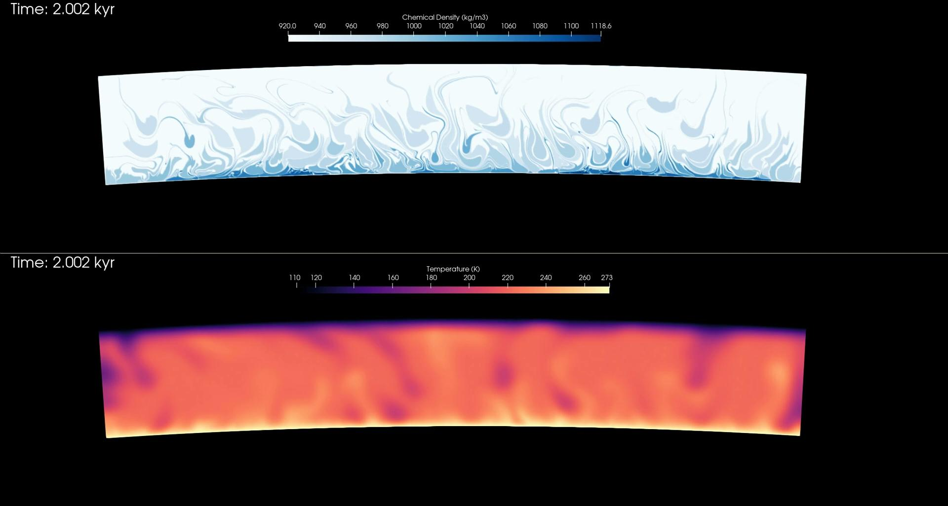
1x Earth salinity, Brine Pockets, 0.1 mm, 15 kPa

Slide 48
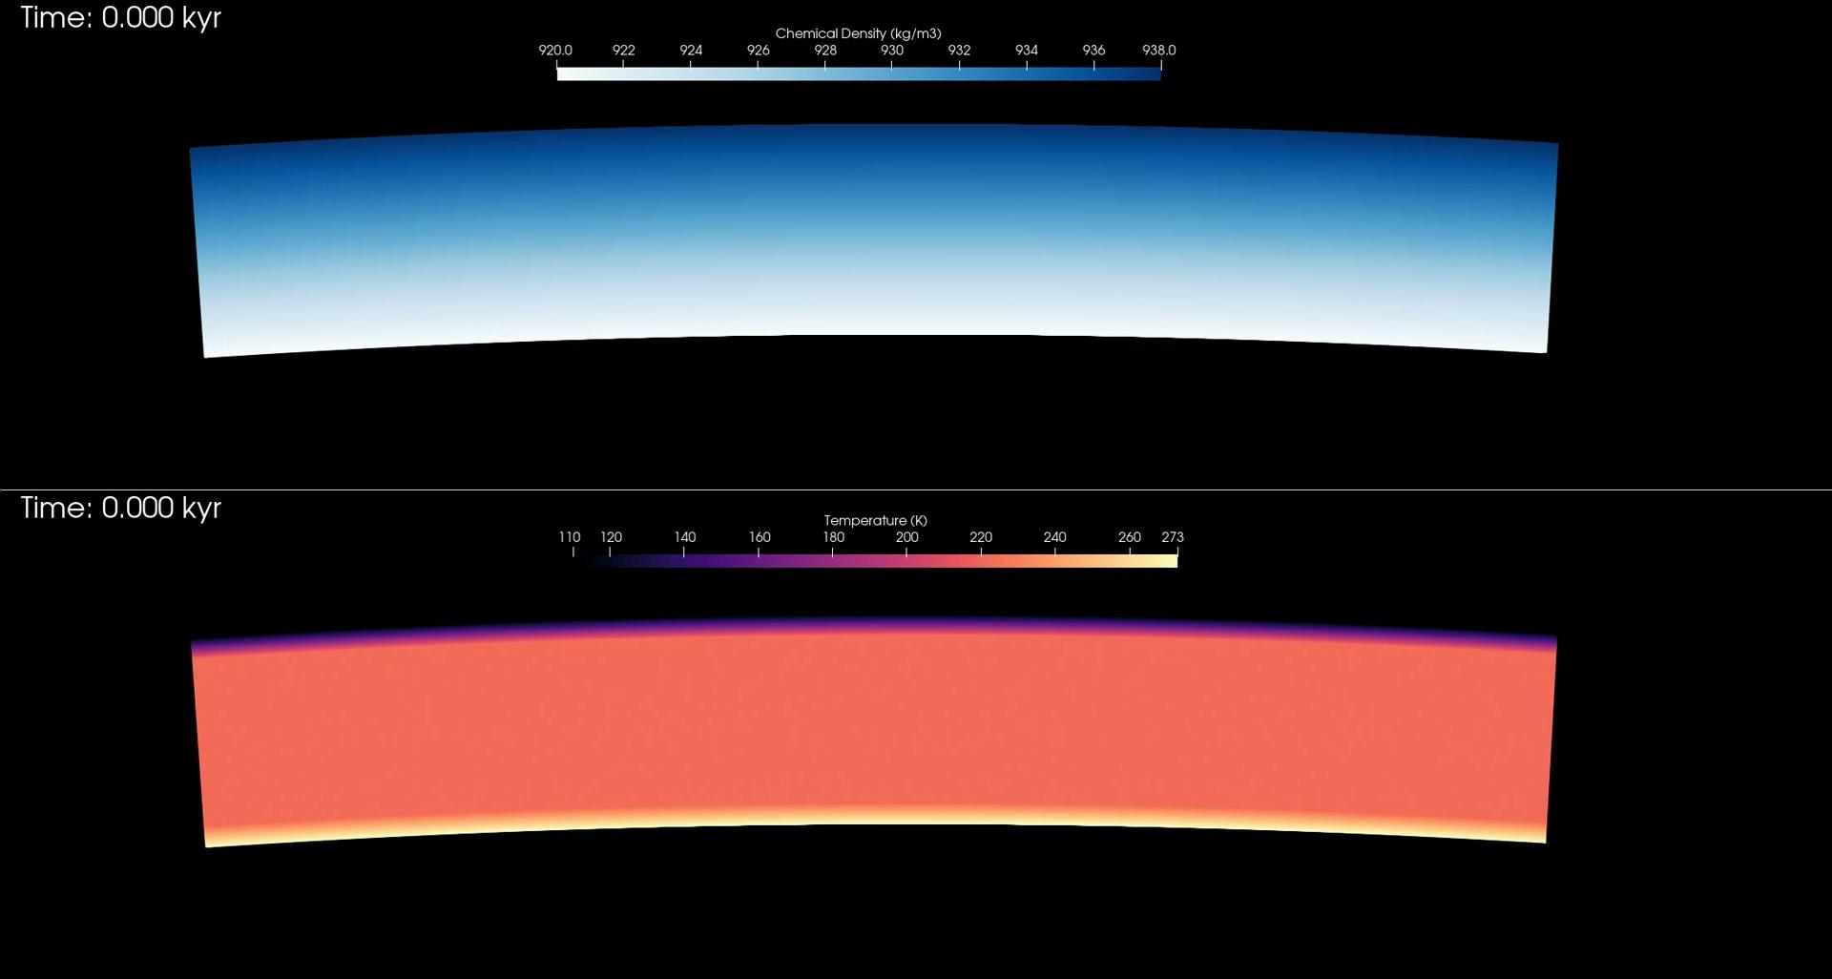
1x Earth salinity, Linear, 0.1 mm, 15 kPa

Slide 49
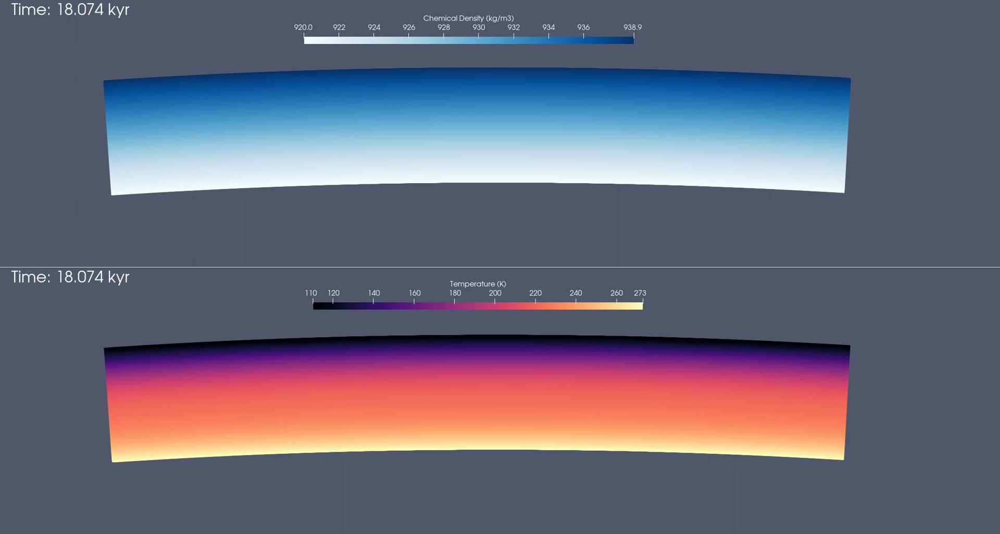
4x Earth salinity, Linear, 0.1 mm, 15 kPa

Slide 50
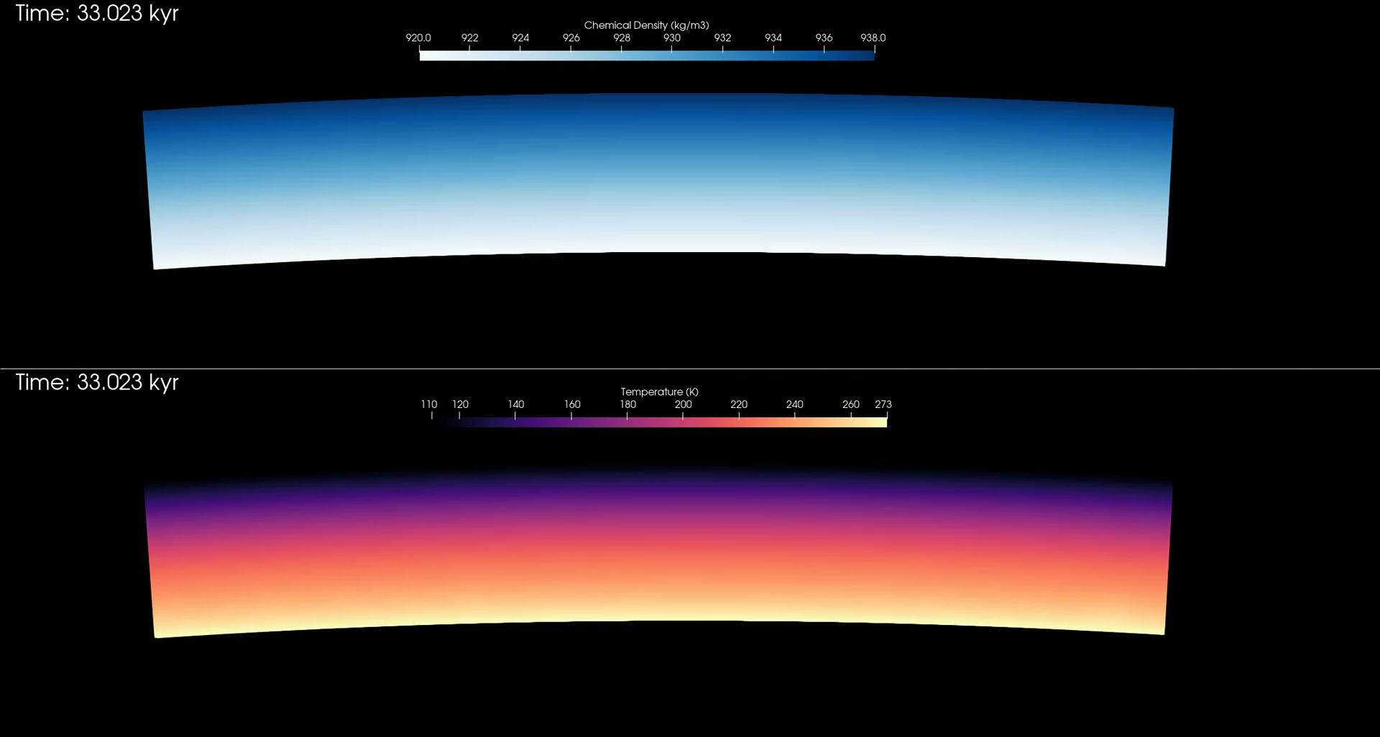
1x Earth salinity, Linear, 1 mm, 15 kPa

