Slide 1
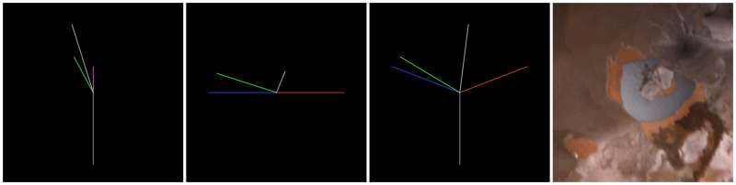
Loki Patera’s specular surface by JunoCam image data
EPSC2026-882, accepted in TP9 – Planetary volcanism, tectonics, and seismicity
Gerald Eichstädt
Stuttgart, Germany
Anton Ermakov
Stanford University
Stanford, California, USA
Michael Ravine
Malin Space Science Systems
San Diego, California, USA
Scott Bolton
Southwest Research Institute
San Antonio, Texas, USA
view parallel to
sun-nadir plane
projection onto
surface tangential plane
projection onto
sun-nadir plane
grey: nadir normal vector
red: vector to Sun
blue: solar specular vector
green: vector to Juno
Viewing geometry matters
white: facet normal vector

Slide 2
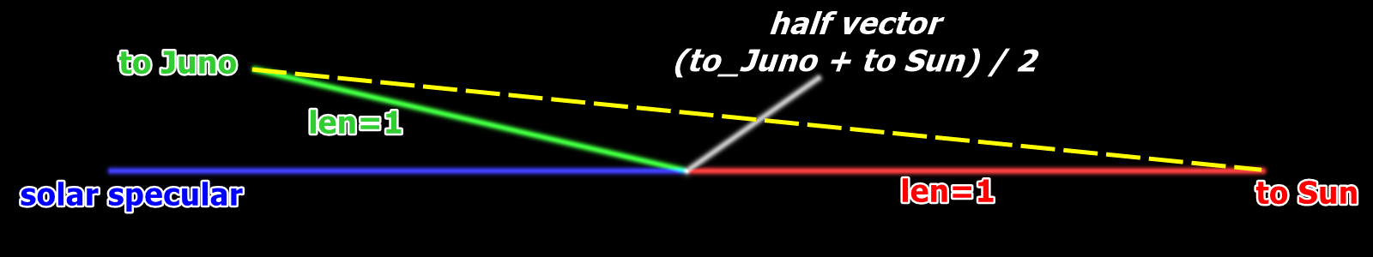
projection on surface tangential plane
view parallel to sun-nadir plane
proj. onto sun-nadir plane
grey: nadir normal vector
red: vector to Sun
blue: solar specular vector
green: vector to Juno
Viewing geometry matters
white: facet normal vector

Slide 3
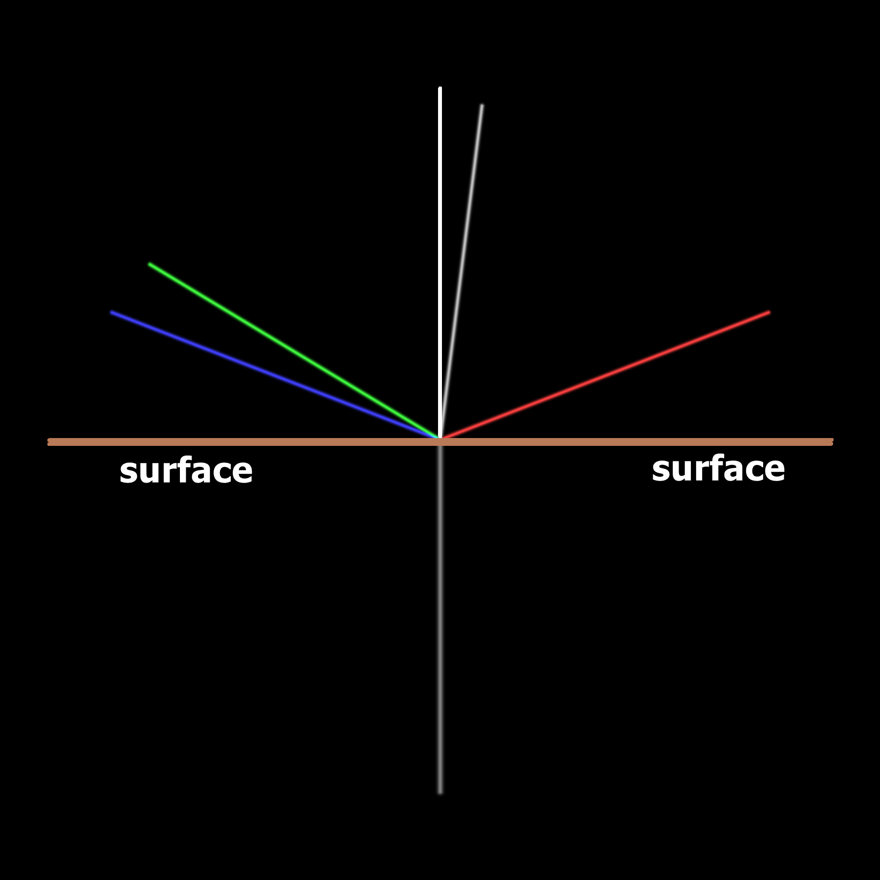
Backplanes
Provide cropped cylindrical map of the Loki Patera lava lake, together with vector backplanes for each pixel:
Surface normal,
Surface point – Sun (solar incidence vector),
Surface point – Juno (emission vector).
Derive backplanes:
Cosine of the solar incidence angle (for Lambertian)
Solar specular vector,
(deviation angle, azimuth) , zero azimuth: Sun – surface point – bulk surface normal plane
  Juno relative to specular vector,
  half angle between solar incidence vector and emission vector relative to surface normal.

Slide 4
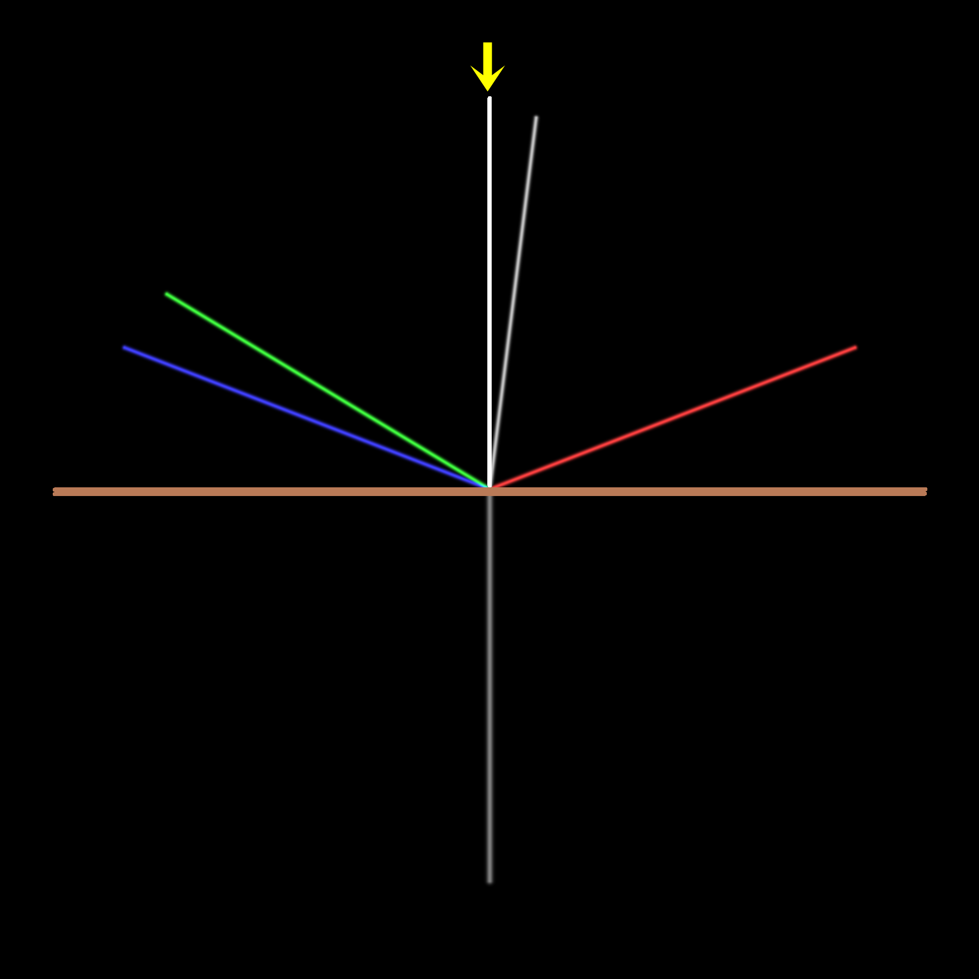
Backplanes
Provide cropped cylindrical map of the Loki Patera lava lake, together with vector backplanes for each pixel:
Surface normal,
Surface point – Sun (solar incidence vector),
Surface point – Juno (emission vector).
Derive backplanes:
Cosine of the solar incidence angle (for Lambertian)
Solar specular vector,
(deviation angle, azimuth) , zero azimuth: Sun – surface point – bulk surface normal plane
  Juno relative to specular vector,
  half angle between solar incidence vector and emission vector relative to surface normal.

Slide 5
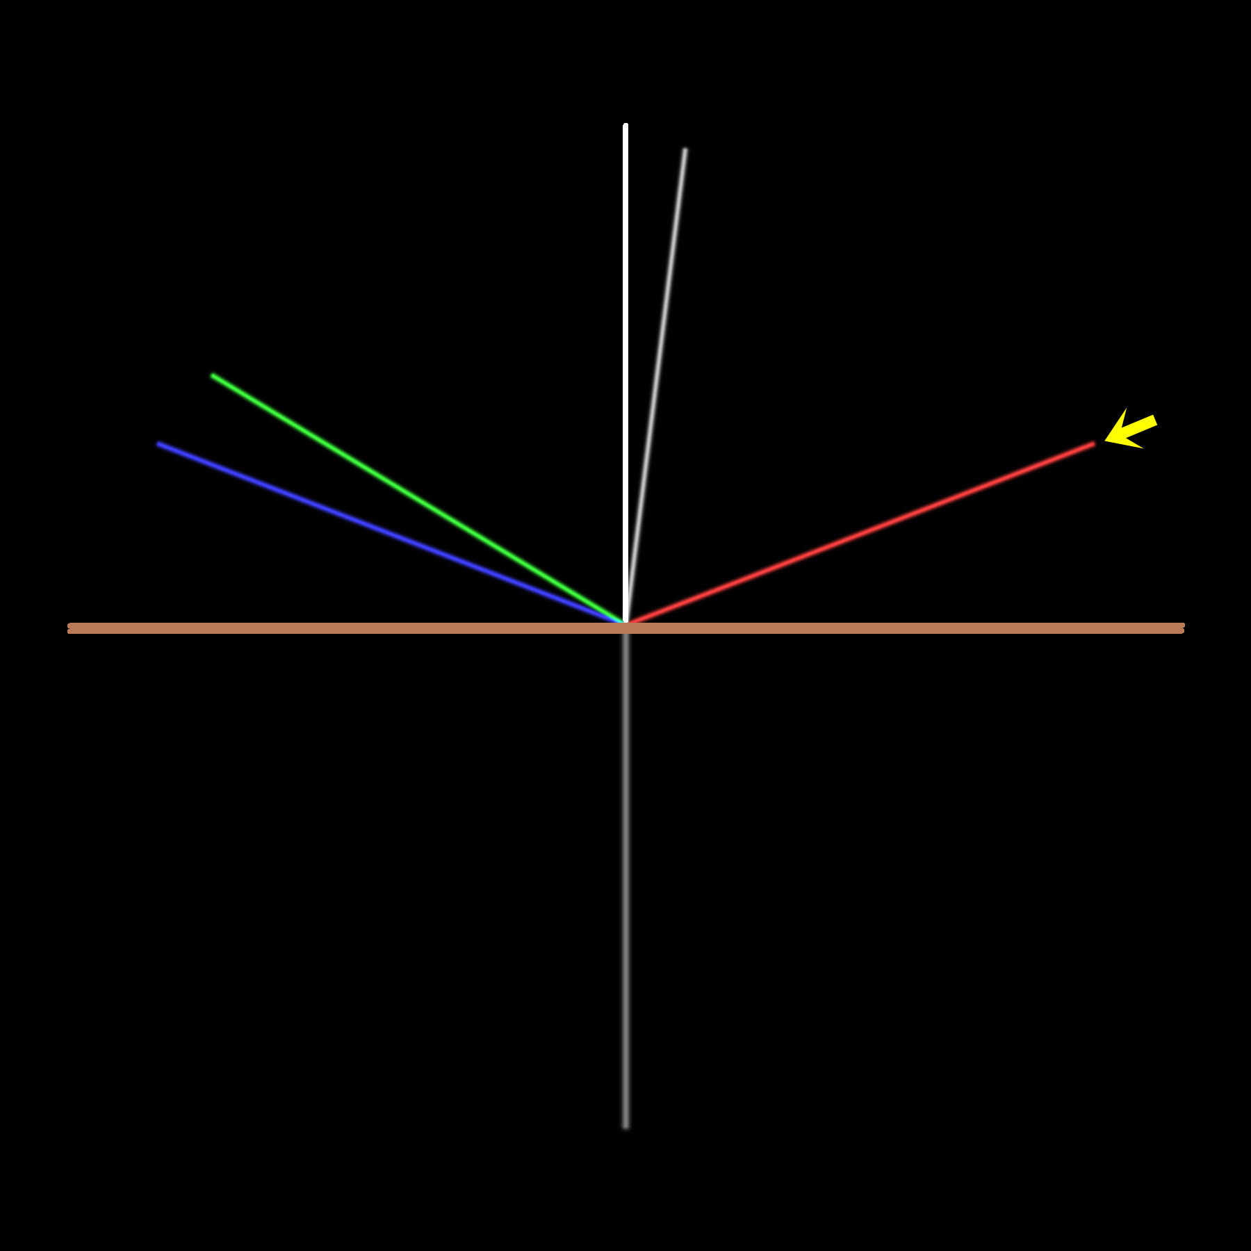
Backplanes
Provide cropped cylindrical map of the Loki Patera lava lake, together with vector backplanes for each pixel:
Surface normal,
Surface point – Sun (solar incidence vector),
Surface point – Juno (emission vector).
Derive backplanes:
Cosine of the solar incidence angle (for Lambertian)
Solar specular vector,
(deviation angle, azimuth) , zero azimuth: Sun – surface point – bulk surface normal plane
  Juno relative to specular vector,
  half angle between solar incidence vector and emission vector relative to surface normal.

Slide 6
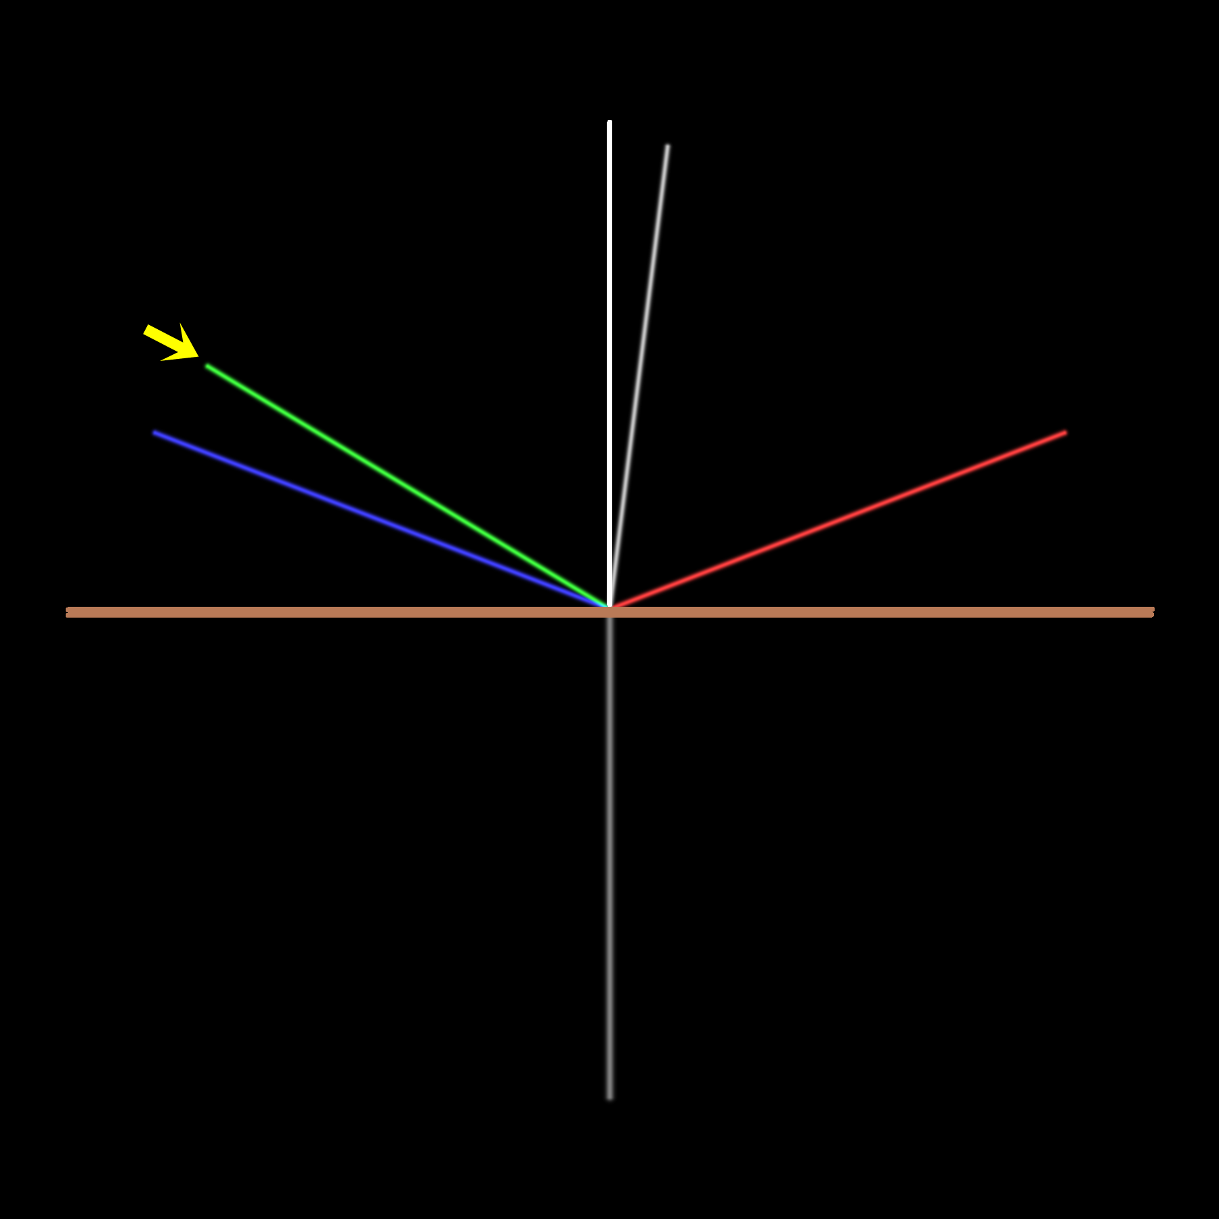
Backplanes
Provide cropped cylindrical map of the Loki Patera lava lake, together with vector backplanes for each pixel:
Surface normal,
Surface point – Sun (solar incidence vector),
Surface point – Juno (emission vector).
Derive backplanes:
Cosine of the solar incidence angle (for Lambertian)
Solar specular vector,
(deviation angle, azimuth) , zero azimuth: Sun – surface point – bulk surface normal plane
  Juno relative to specular vector,
  half angle between solar incidence vector and emission vector relative to surface normal.

Slide 7
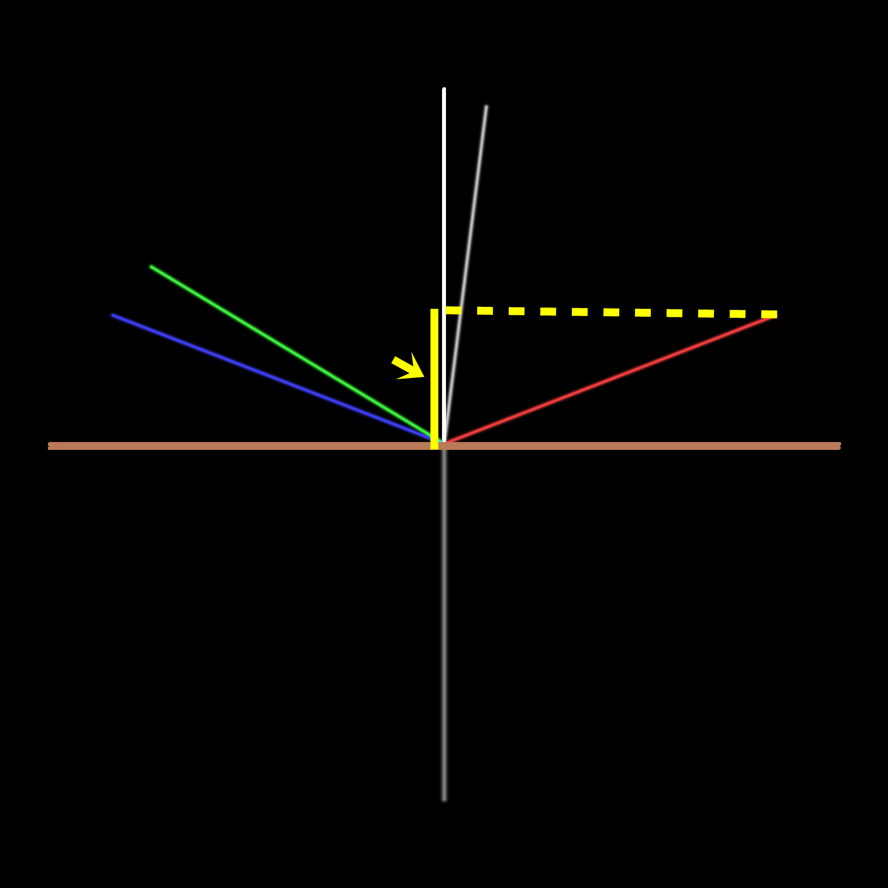
Backplanes
Provide cropped cylindrical map of the Loki Patera lava lake, together with vector backplanes for each pixel:
Surface normal,
Surface point – Sun (solar incidence vector),
Surface point – Juno (emission vector).
Derive backplanes:
Cosine of the solar incidence angle (for Lambertian)
Solar specular vector,
(deviation angle, azimuth) , zero azimuth: Sun – surface point – bulk surface normal plane
  Juno relative to specular vector,
  half angle between solar incidence vector and emission vector relative to surface normal.

Slide 8
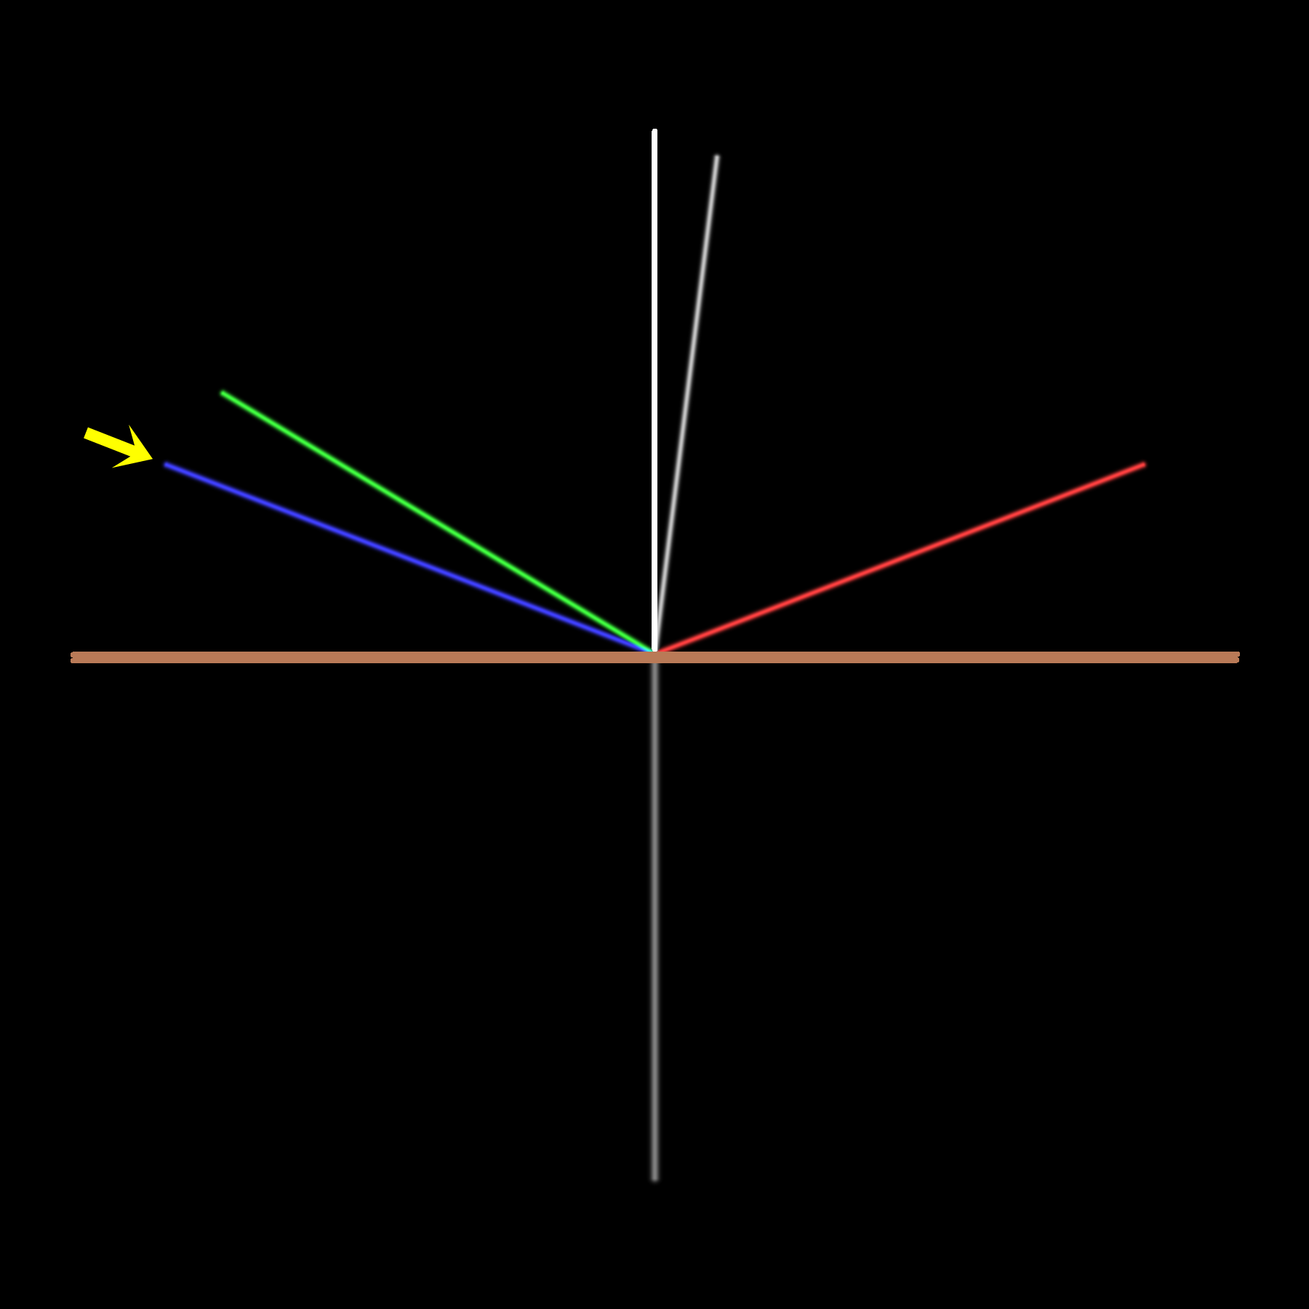
Backplanes
Provide cropped cylindrical map of the Loki Patera lava lake, together with vector backplanes for each pixel:
Surface normal,
Surface point – Sun (solar incidence vector),
Surface point – Juno (emission vector).
Derive backplanes:
Cosine of the solar incidence angle (for Lambertian)
Solar specular vector,
(deviation angle, azimuth) , zero azimuth: Sun – surface point – bulk surface normal plane
  Juno relative to specular vector,
  half angle between solar incidence vector and emission vector relative to surface normal.

Slide 9
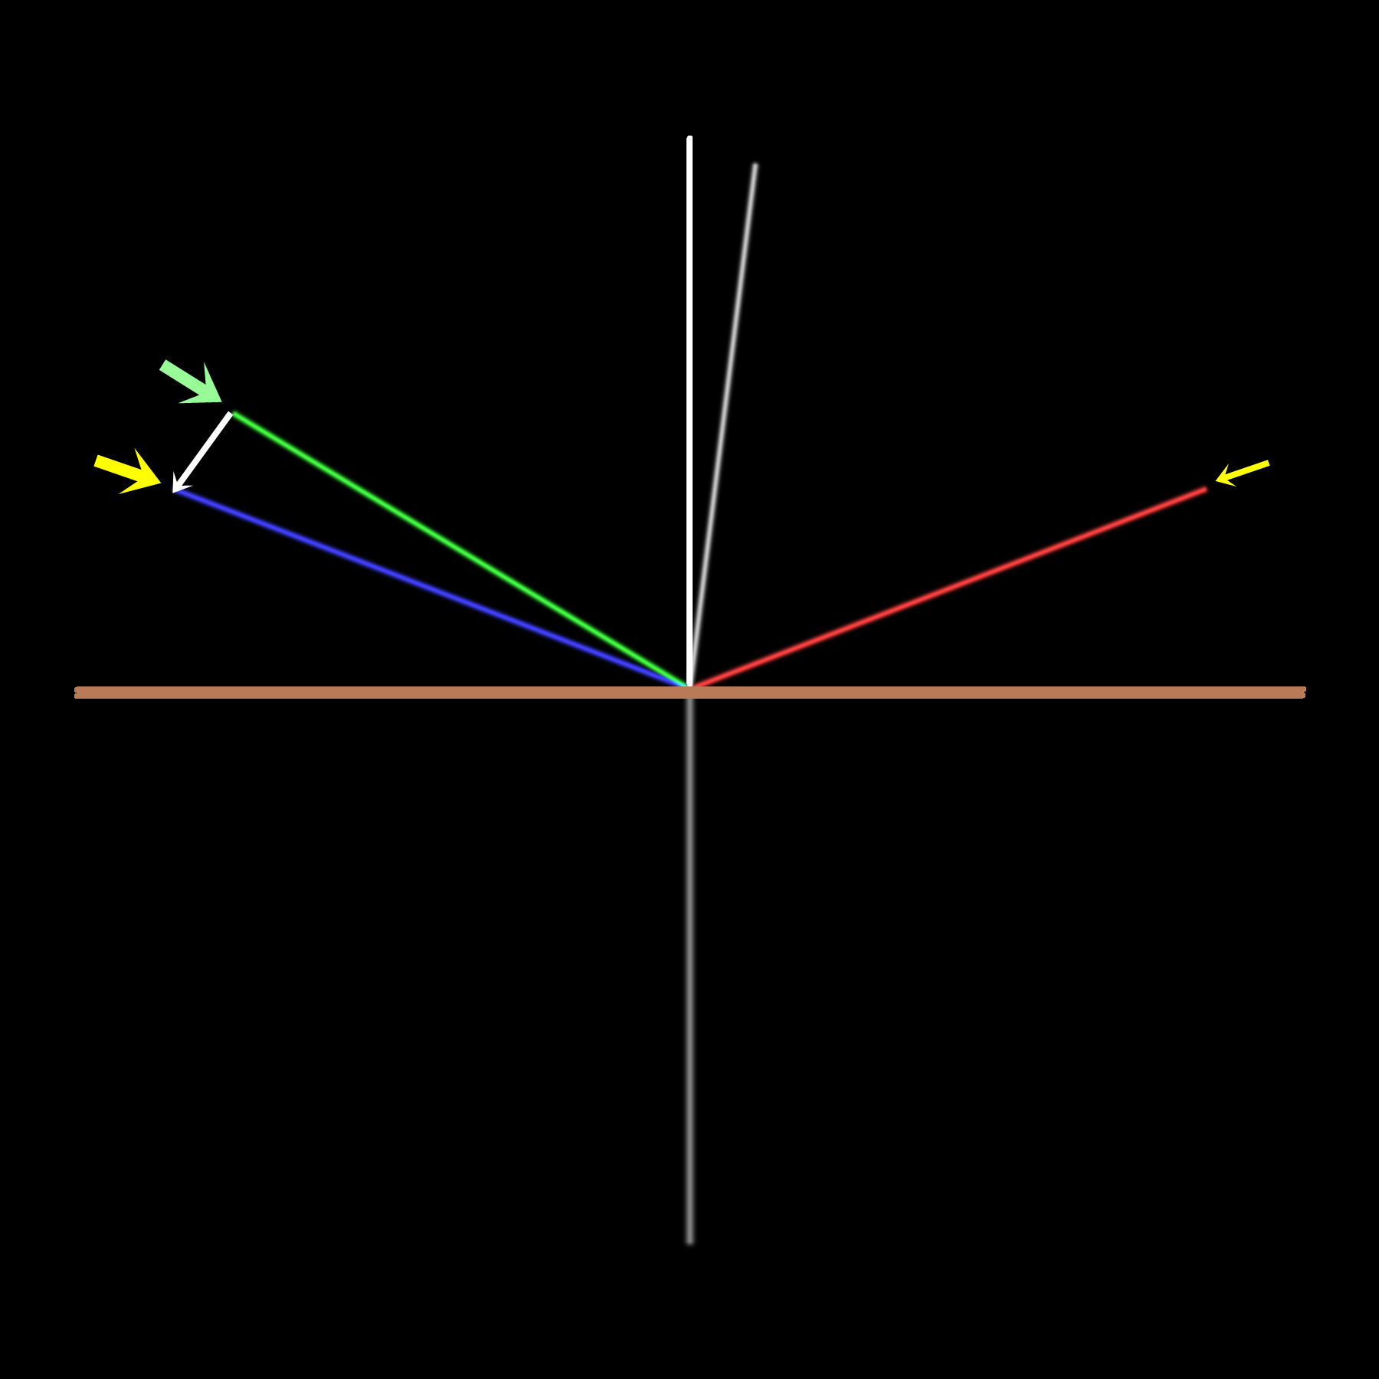
Backplanes
Provide cropped cylindrical map of the Loki Patera lava lake, together with vector backplanes for each pixel:
Surface normal,
Surface point – Sun (solar incidence vector),
Surface point – Juno (emission vector).
Derive backplanes:
Cosine of the solar incidence angle (for Lambertian)
Solar specular vector,
(deviation angle, azimuth) , zero azimuth: Sun – surface point – bulk surface normal plane
  Juno relative to specular vector,
  half angle between solar incidence vector and emission vector relative to surface normal.

Slide 10
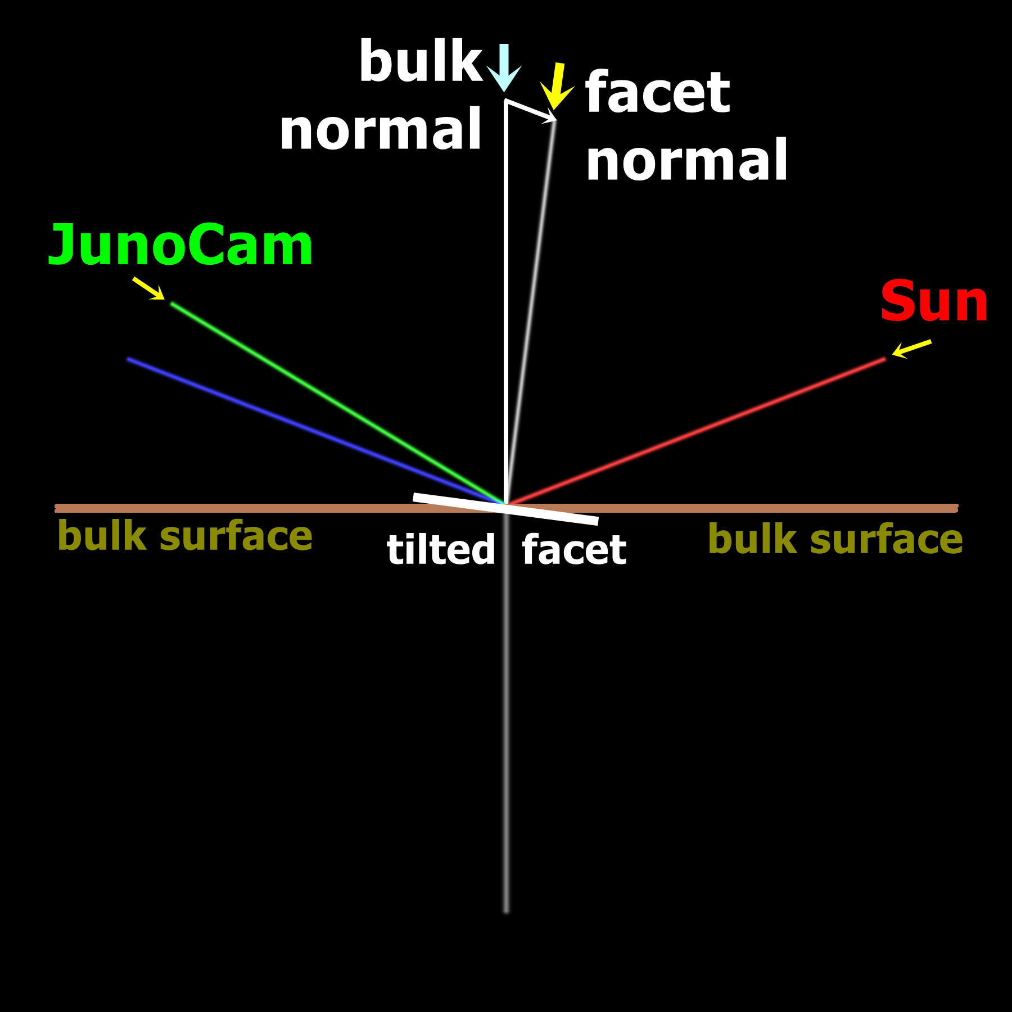
Backplanes
Provide cropped cylindrical map of the Loki Patera lava lake, together with vector backplanes for each pixel:
Surface normal,
Surface point – Sun (solar incidence vector),
Surface point – Juno (emission vector).
Derive backplanes:
Cosine of the solar incidence angle (for Lambertian)
Solar specular vector,
(deviation angle, azimuth) , zero azimuth: Sun – surface point – bulk surface normal plane
  Juno relative to specular vector,
  half angle between solar incidence vector and emission vector relative to surface normal.

Slide 11
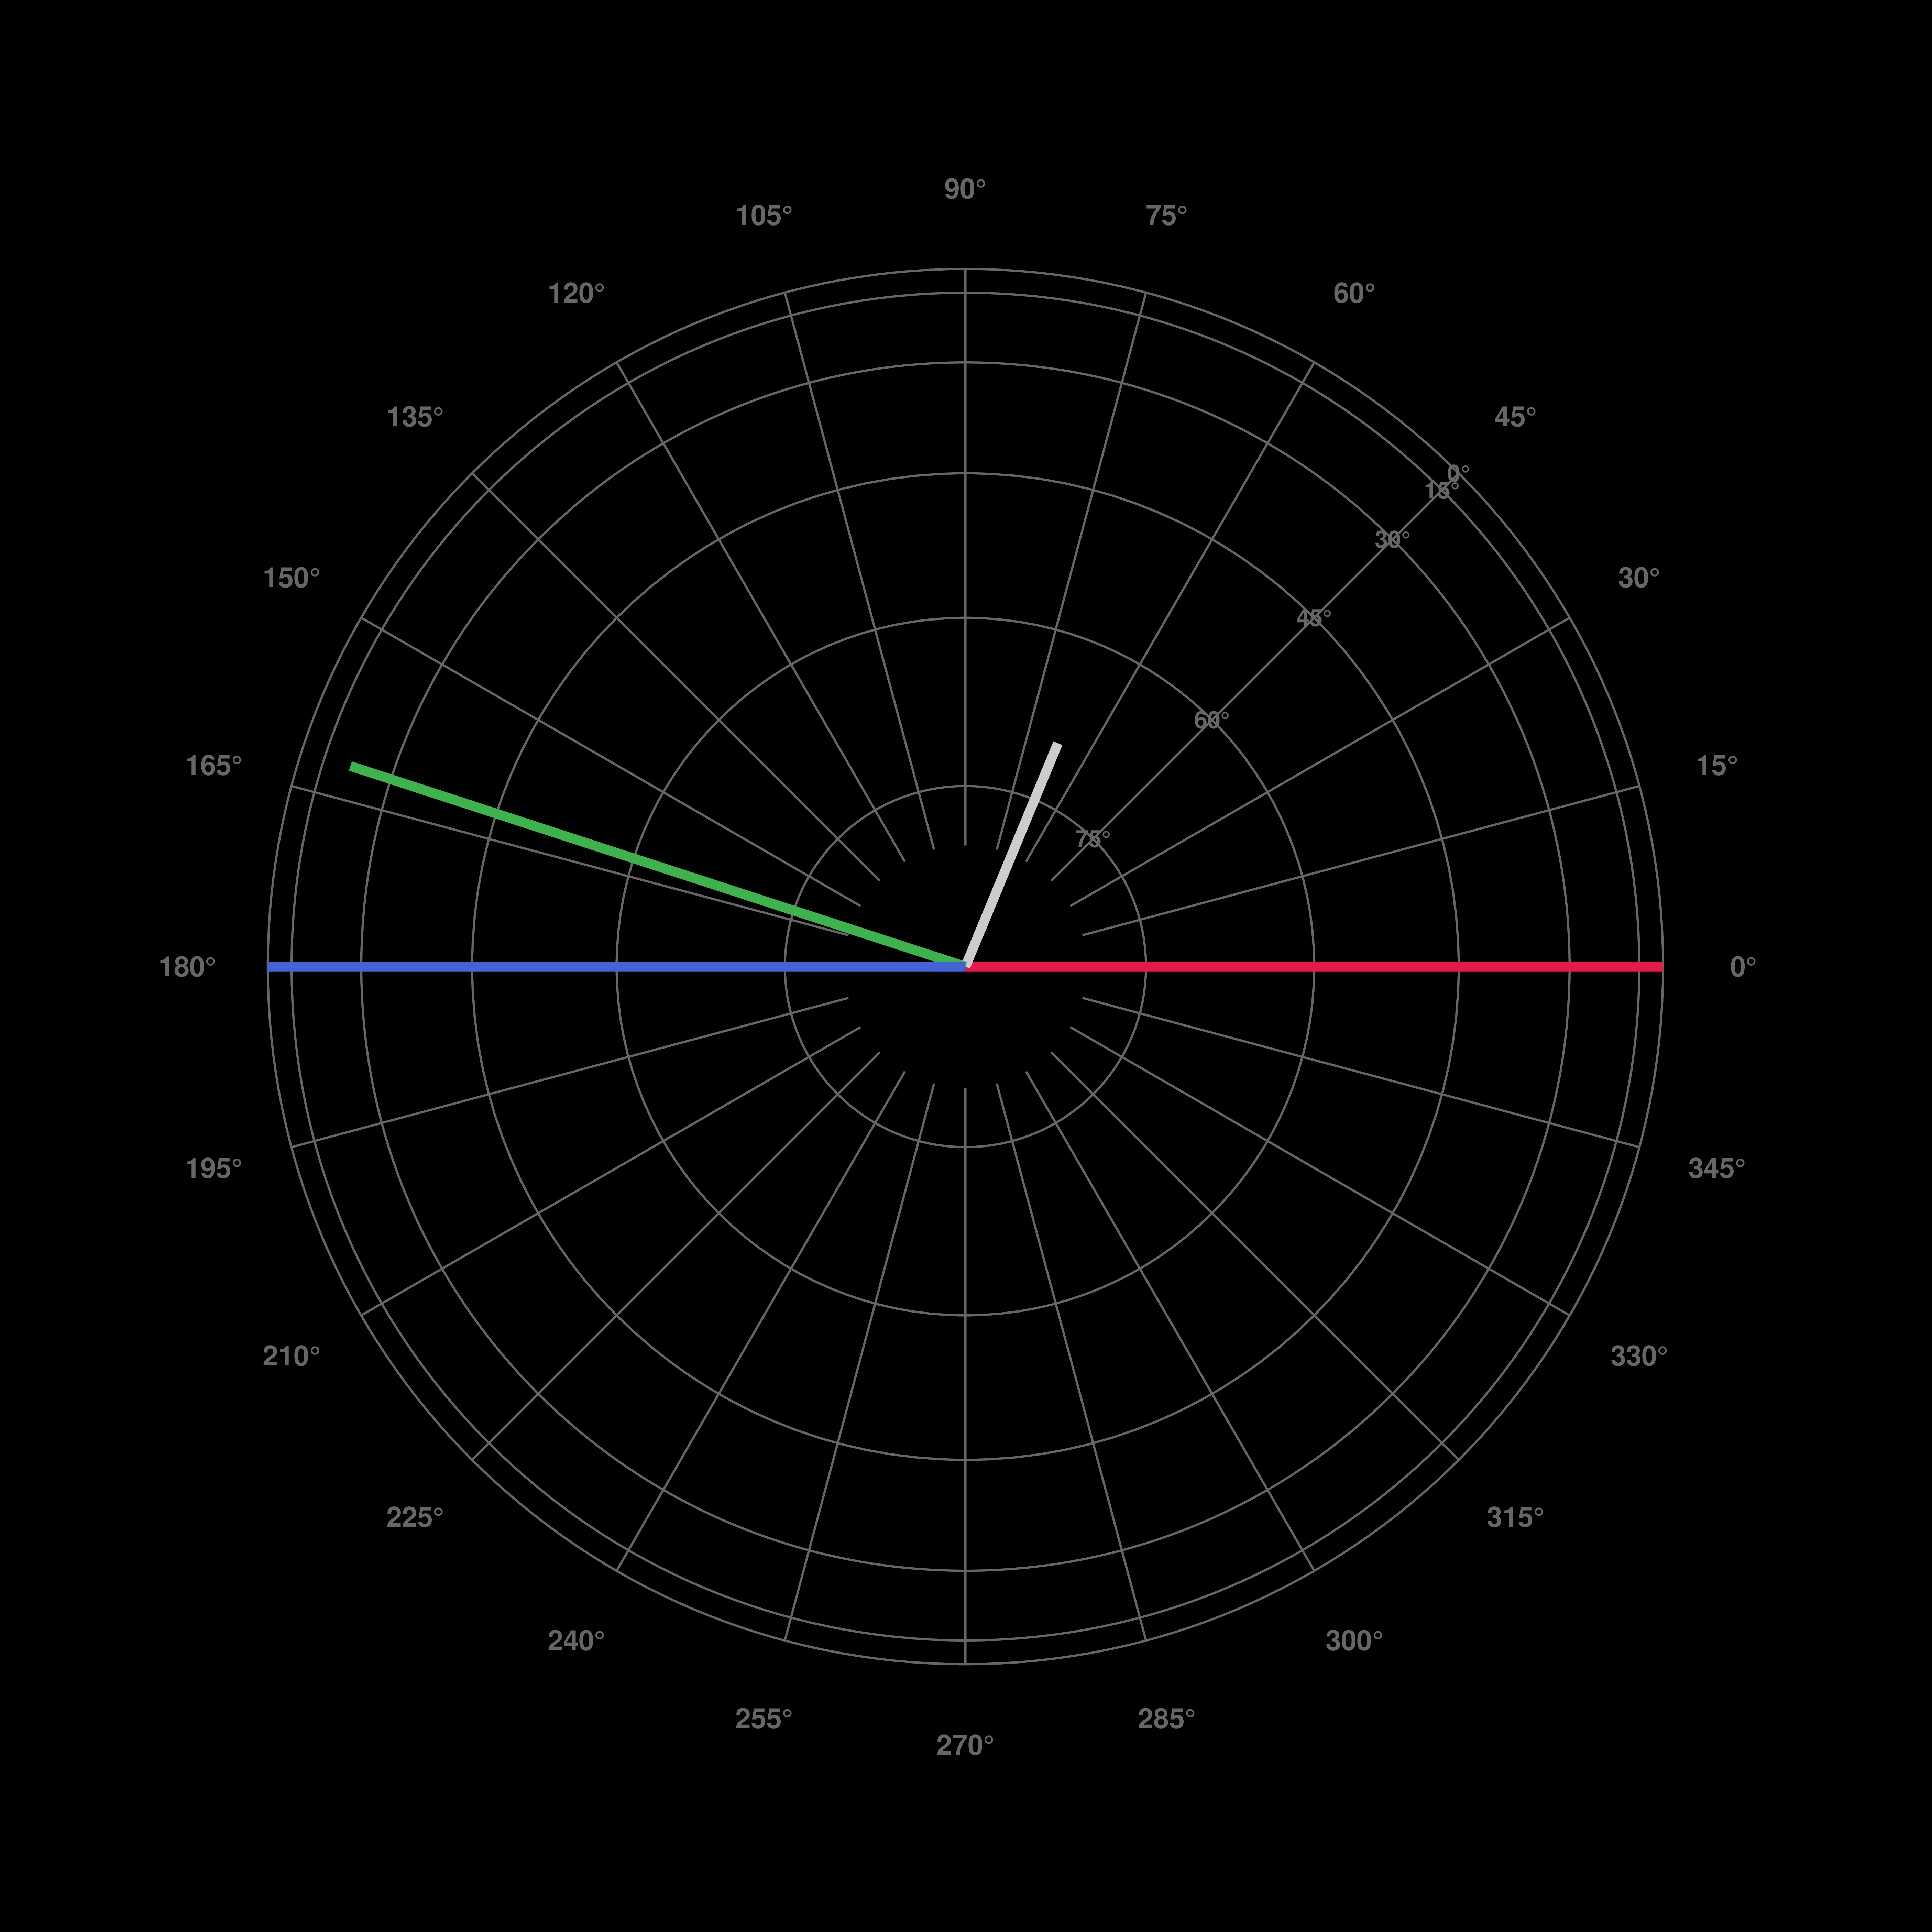
Backplanes
Provide cropped cylindrical map of the Loki Patera lava lake, together with vector backplanes for each pixel:
Surface normal,
Surface point – Sun (solar incidence vector),
Surface point – Juno (emission vector).
Derive backplanes:
Cosine of the solar incidence angle (for Lambertian)
Solar specular vector,
(deviation angle, azimuth) , zero azimuth: Sun – surface point – bulk surface normal plane
  Juno relative to specular vector,
  half angle between solar incidence vector and emission vector relative to surface normal.
(Gemini-AI-assisted drawing)

Slide 12
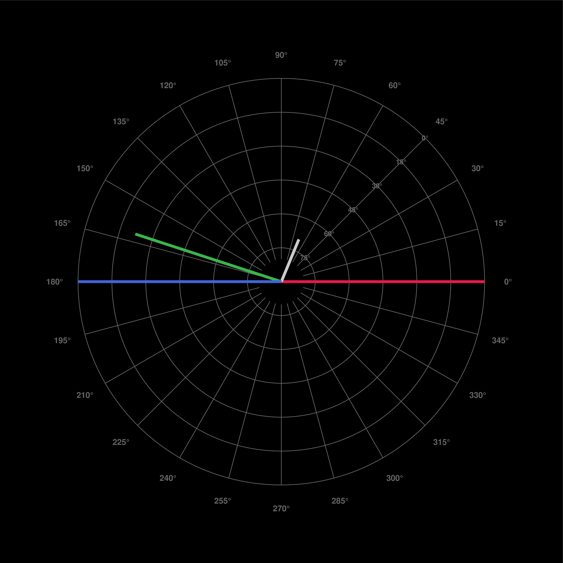
Backplanes
Provide cropped cylindrical map of the Loki Patera lava lake, together with vector backplanes for each pixel:
Surface normal,
Surface point – Sun (solar incidence vector),
Surface point – Juno (emission vector).
Derive backplanes:
Cosine of the solar incidence angle (for Lambertian)
Solar specular vector,
(deviation angle, azimuth) , zero azimuth: Sun – surface point – bulk surface normal plane
  Juno relative to specular vector,
  half angle between solar incidence vector and emission vector relative to surface normal.
(Gemini-AI-assisted drawing)

Slide 13
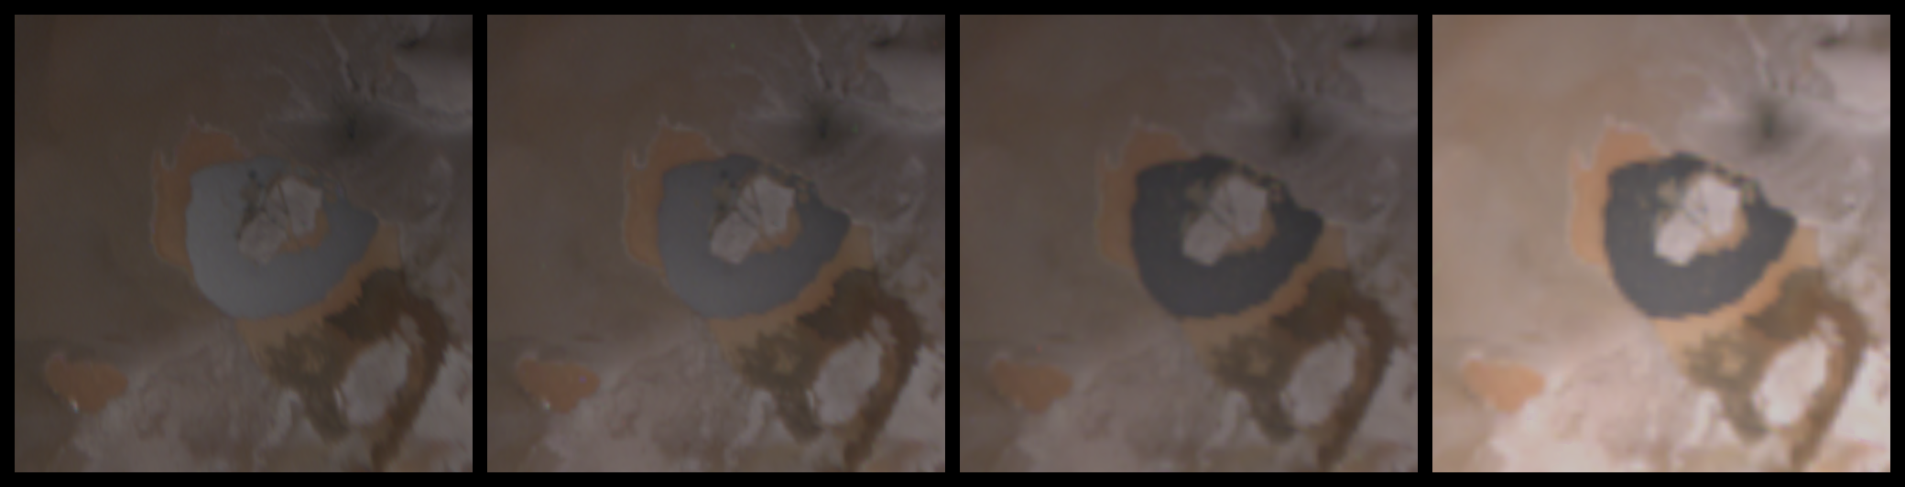
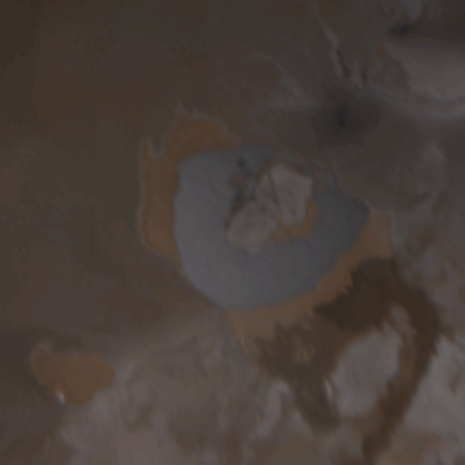
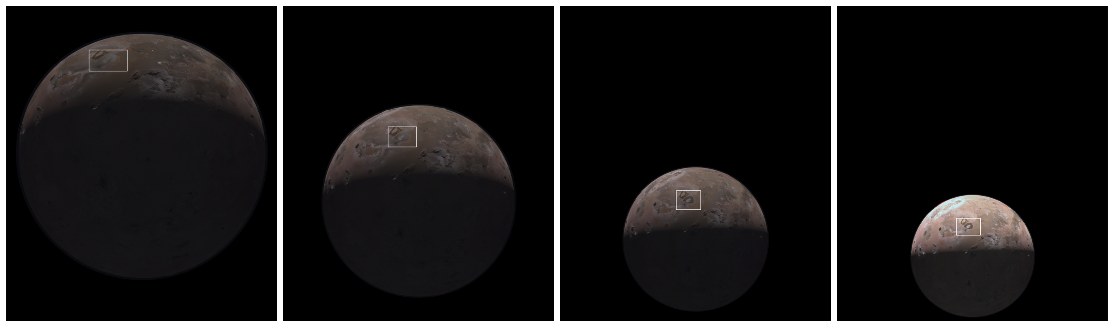

Slide 14
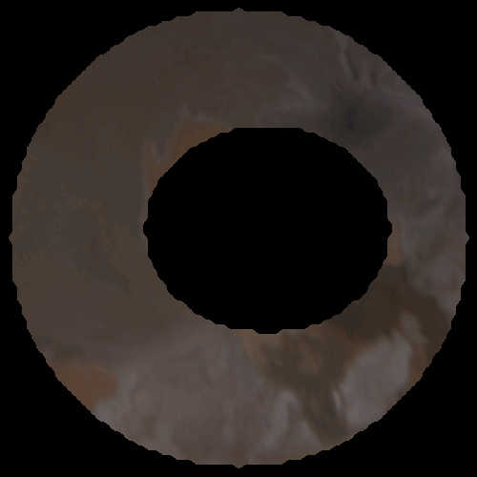
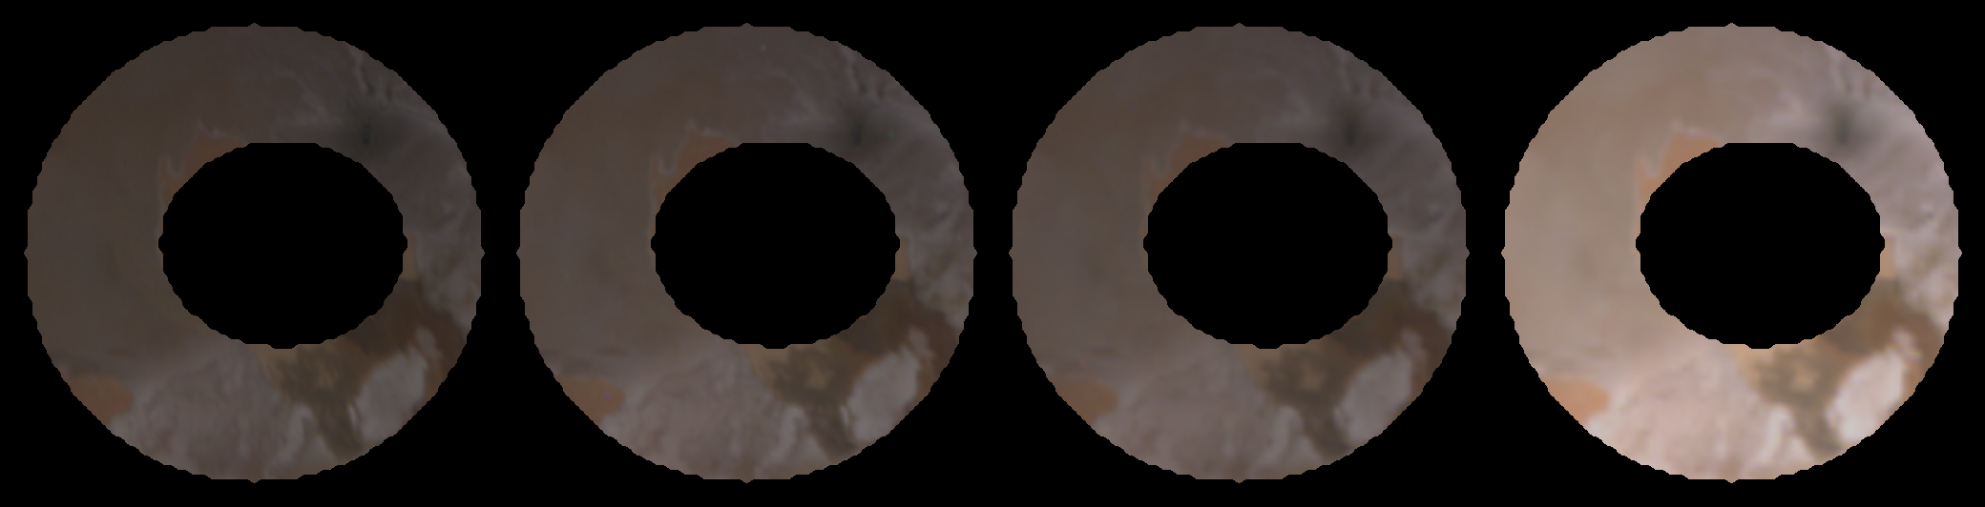

Slide 15
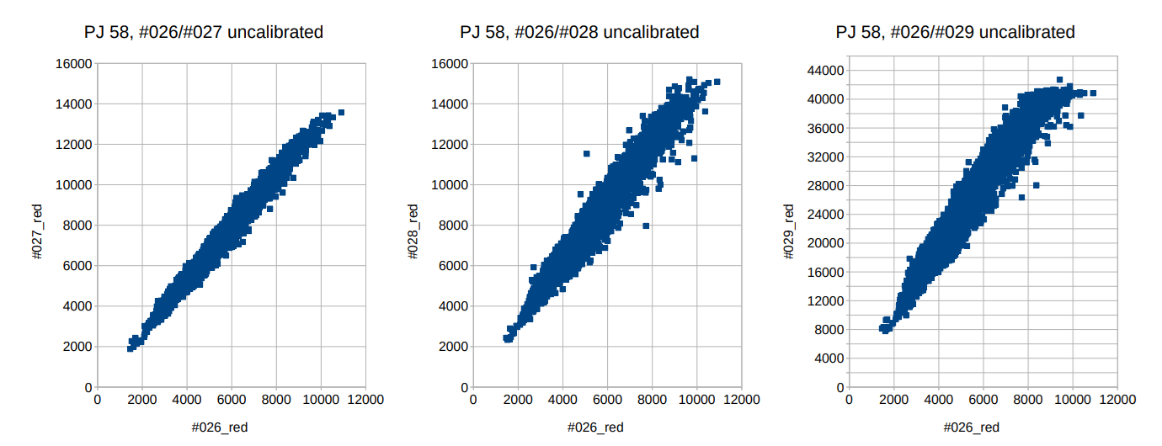
Linear least square
regression, red channel:
#27 = 1.3163977 #26 + 11.7268
#28 = 1.4468953 #26 + 475.6558
#29 = 4.3071908 #26 + 2529.3617
green, blue slope off by < 2%

Slide 16
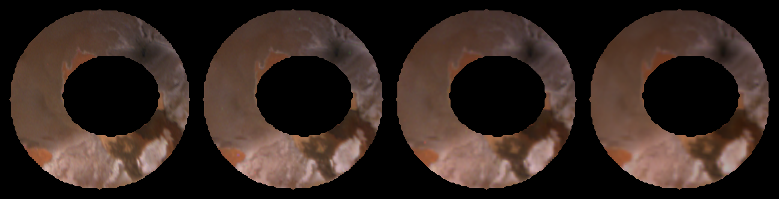
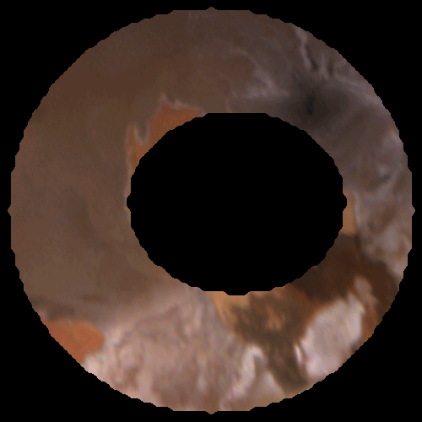
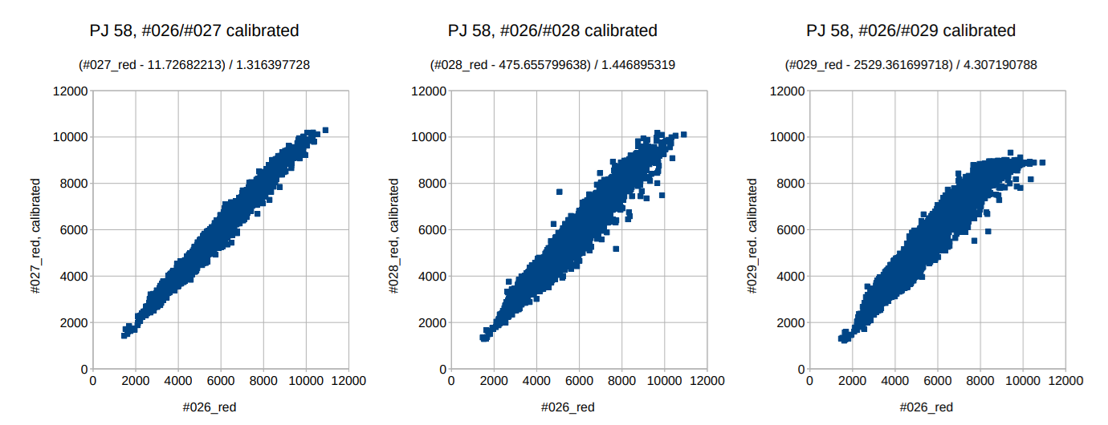

Slide 17
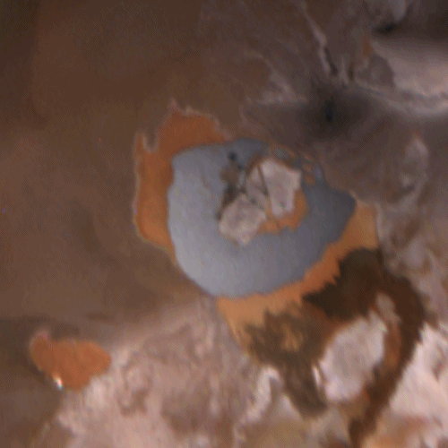
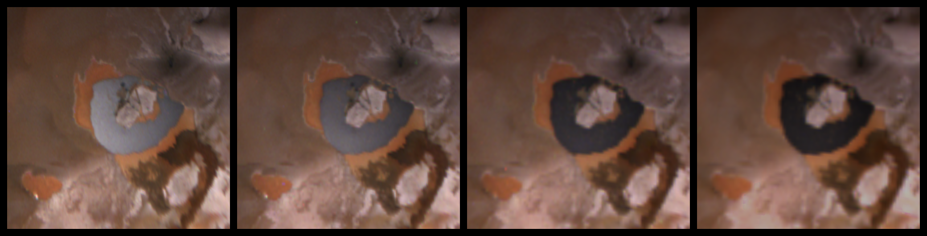

Slide 18
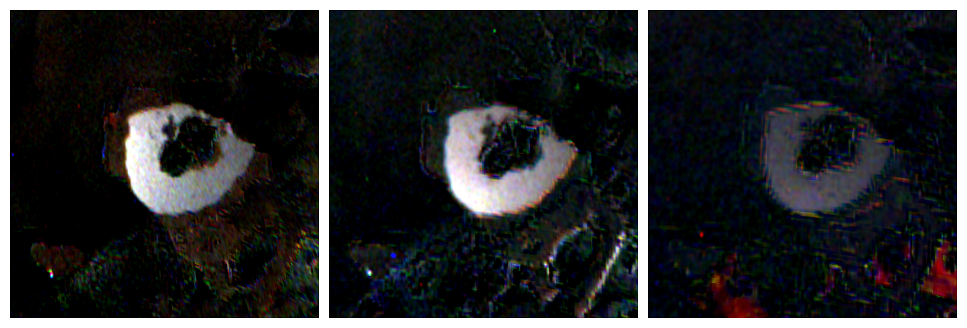

Slide 23
Historical approach:
Intensity parameterized by the deviation from
the solar specular vector.
(in azimuthal coordinates)
Historically this approach was used for the
unphysical Phong model in computer graphics.
For this presentation, we’ll skip this approach.

Slide 24
A very similar approach can be persued
that estimates a facet normal distribution function (NDF).
Intensity is parameterized by the physical
deviation of the microfacet normal vectors from the surface normal
rather than by the deviation of the emission vector
from the solar specular vector.
The solar grazing angle range for Loki Patera is ~18.0° to ~23.3°,
mean (in cylindrical map) = 21.198° +/- 0.002°,
in the Perijove 58 image sequence.

Slide 25
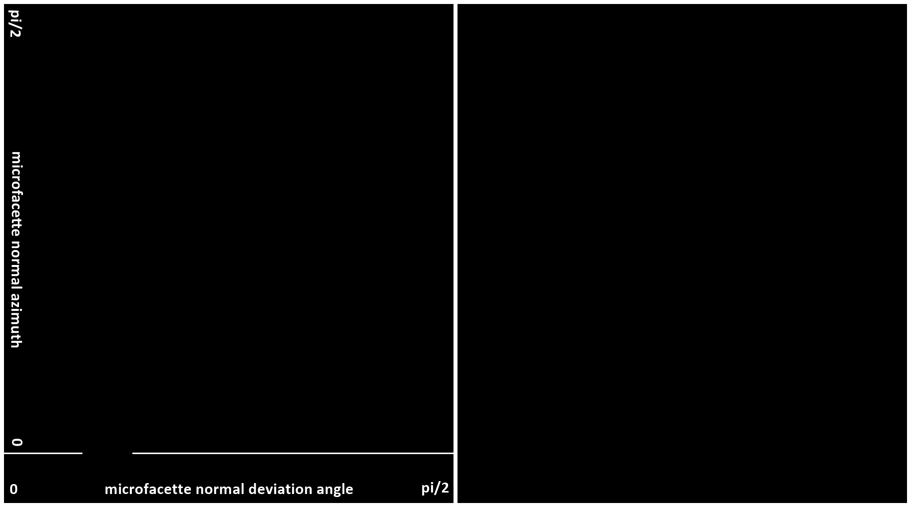

Slide 26
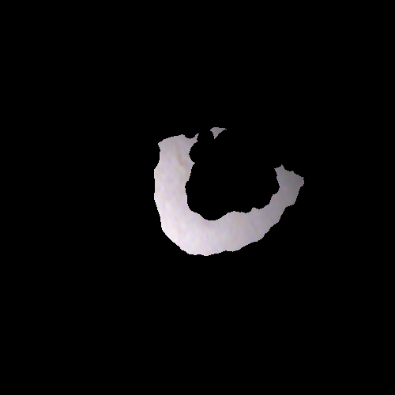
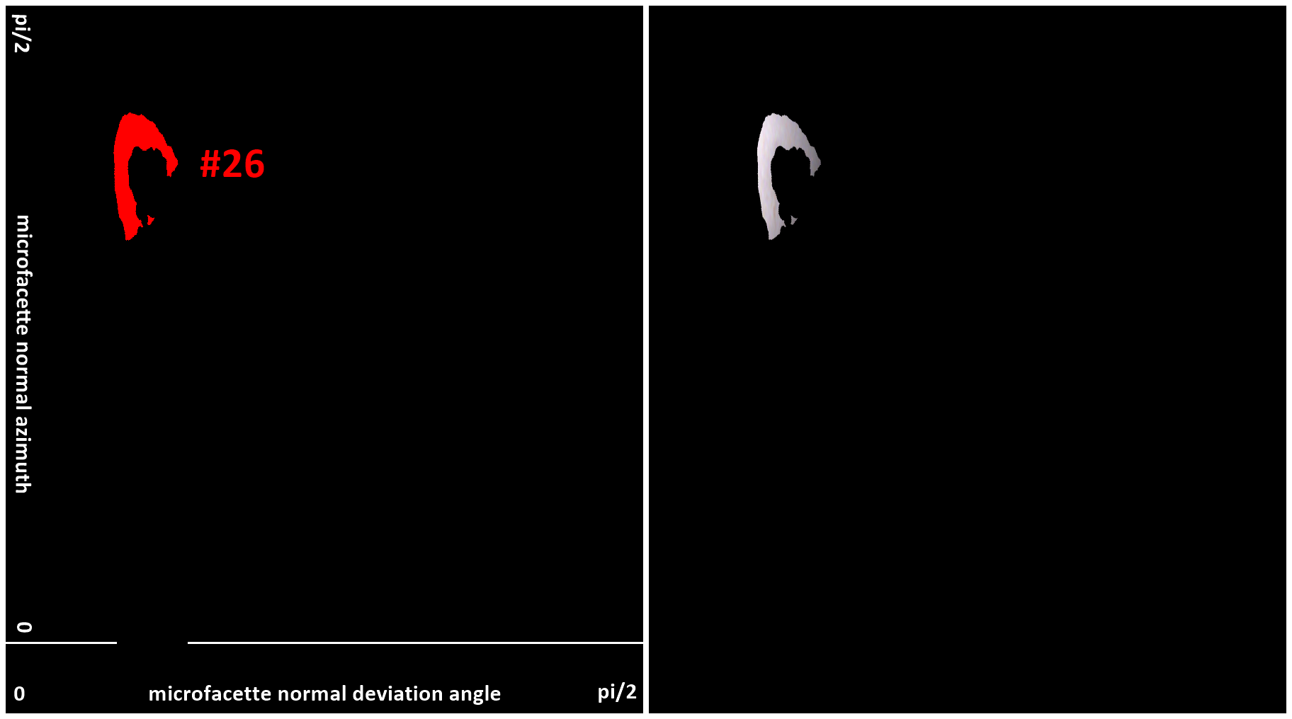

Slide 27
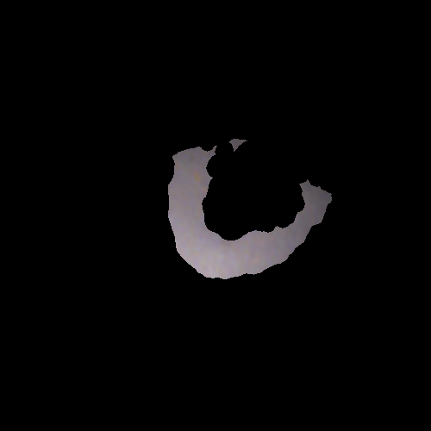
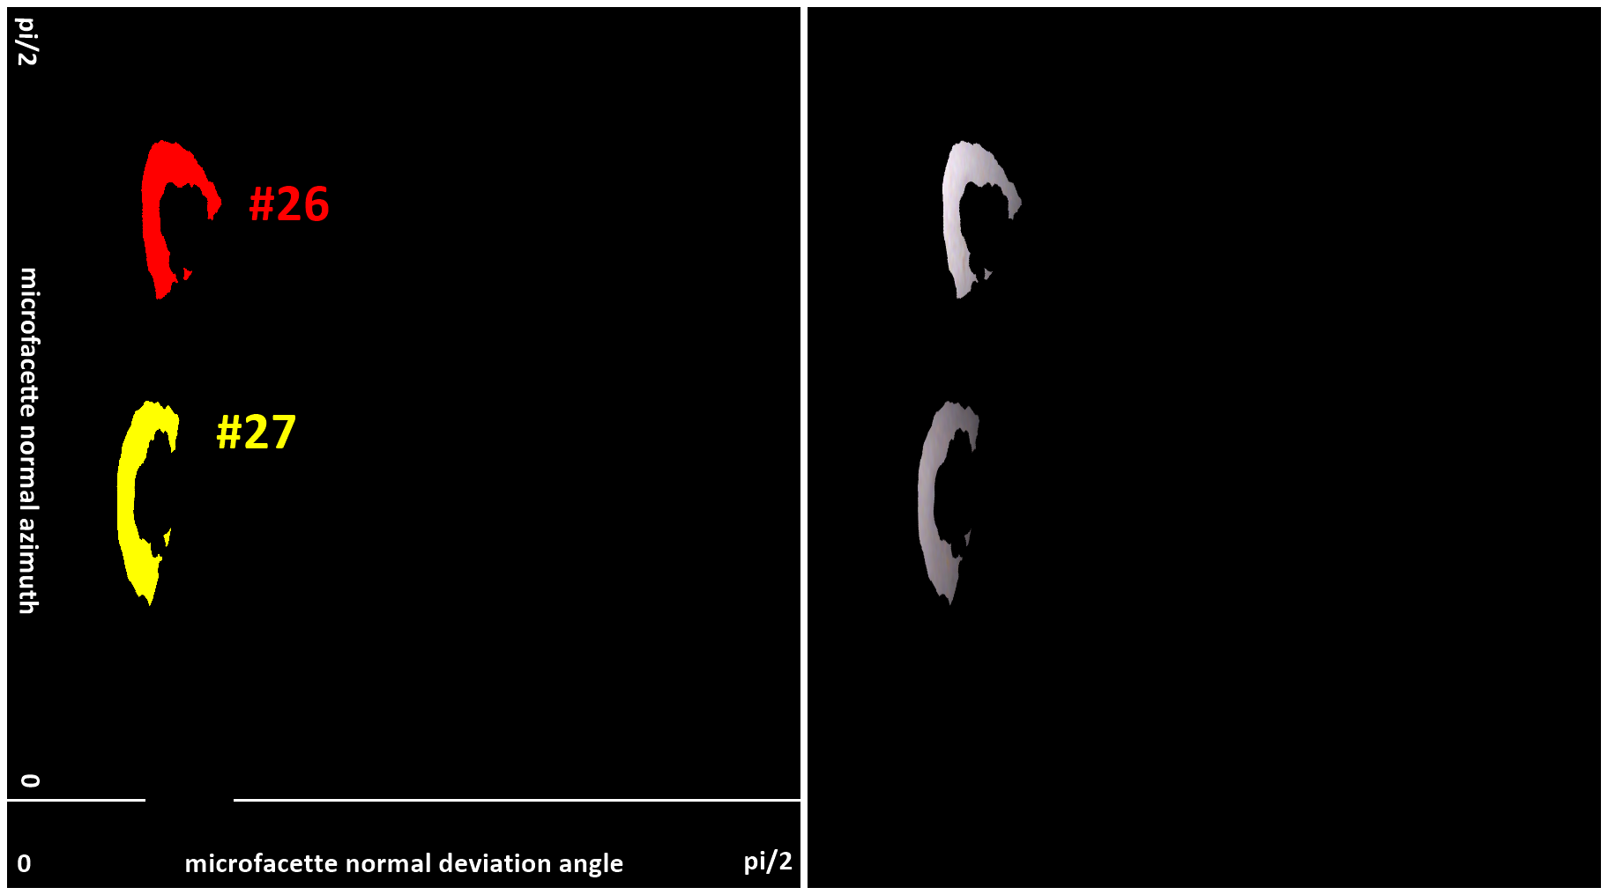

Slide 28

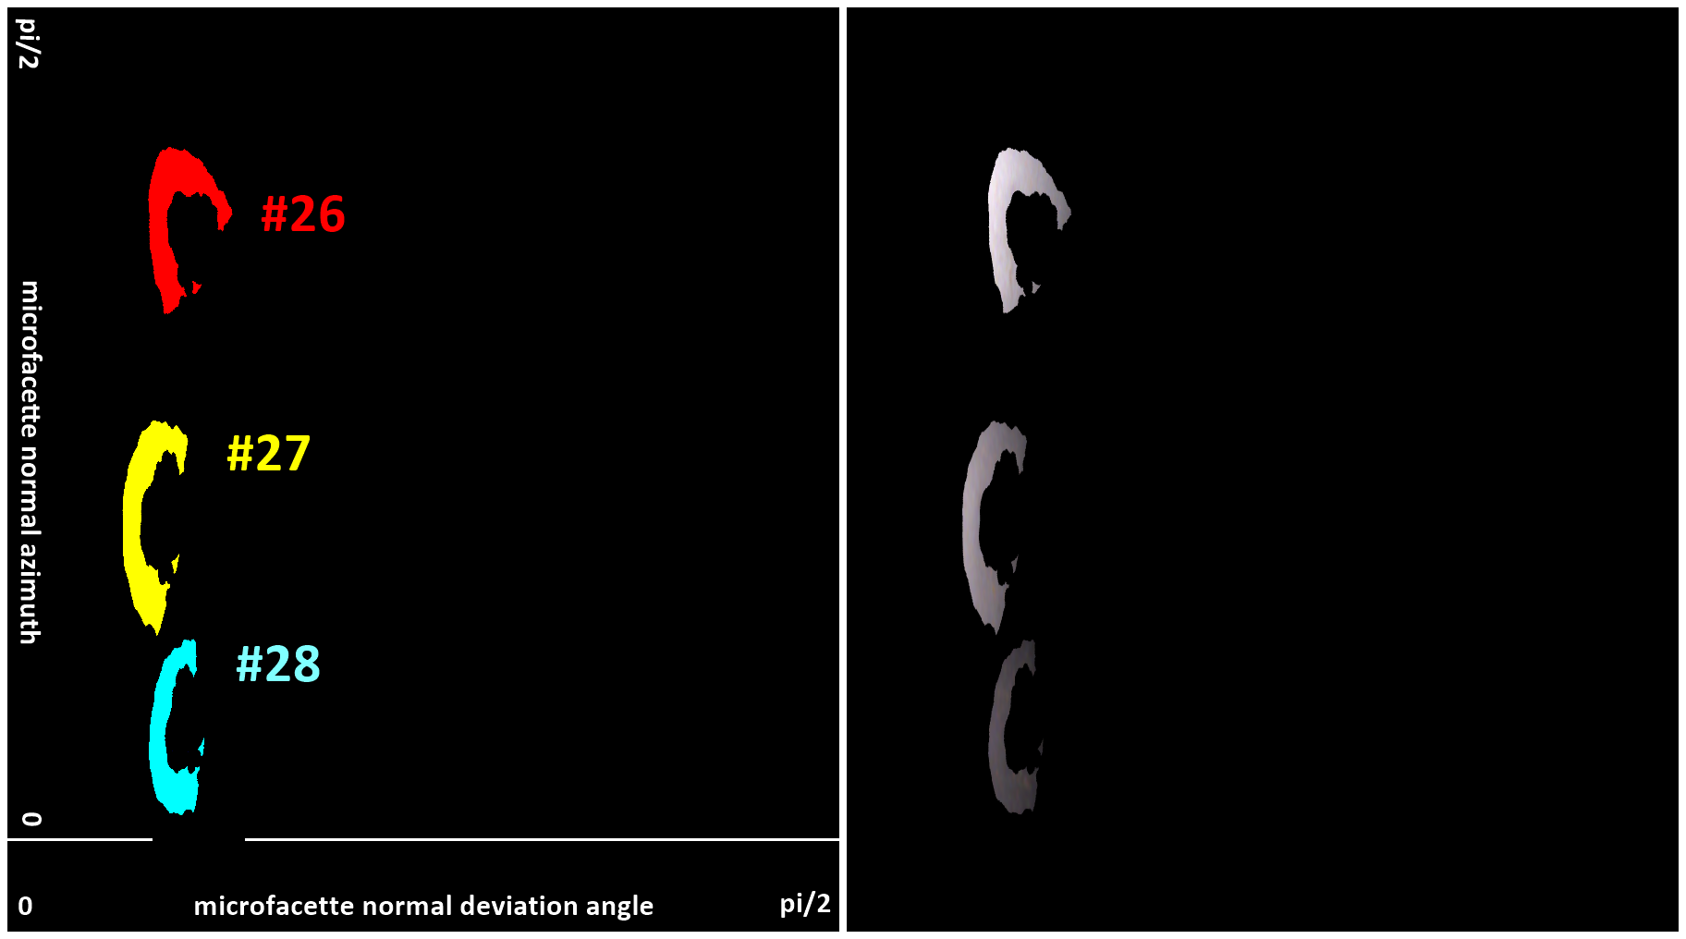

Slide 29
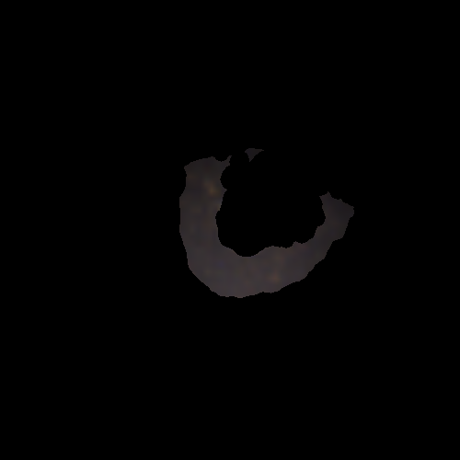


Slide 30
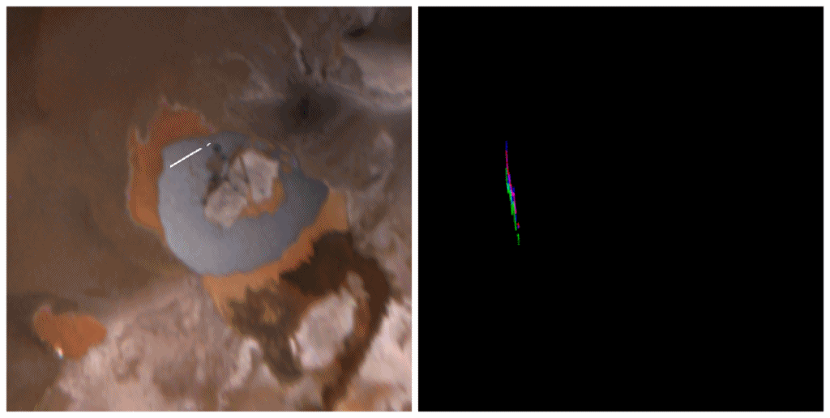
Perijove 58, image #26, linearized,
cylindrically map-projected, north to the right, cropped
0
pi/2
RGB intensity as a function of facet normal deviation angle
looping over facet normal azimuth [1.025..1.300] step 0.025

Slide 31

Perijove 58, image #26, linearized,
cylindrically map-projected, north to the right, cropped
0
pi/2
RGB intensity as a function of facet normal azimuth looping
over facet normal deviation angle [0.27..0.42] step 0.01

Slide 32

Regression planes for red channel, restricted to masked caldera:
#26: -28274 a - 1963 b + 17088 +/- 129,
#27: -15845 a - 3437 b + 2636 +/- 140,
#28: -7465 a - 1553 b + 7002 +/- 139,
#29: -5332 a - 1343 b + 5271 +/- 134,
with a: solar specular deviation angle in radians,
and b: solar specular azimuth in radians, windowed to [-pi;pi].
Data numbers calibrated relative to #26, linearized to [0; 255²] for decompanding table range.
Errors are +/- 1 residual standard deviation.
Planes have been determined via standard linear least square regression of red, green, blue as functions of a and b.
Regression planes mapped to latitude/longitude range of cropped caldera maps of PJ58 images #26 to #29.

Slide 33

Blink between cylindrical map-projected regression planes
and data (cropped caldera maps of PJ58 images #26 to #29).

Slide 34
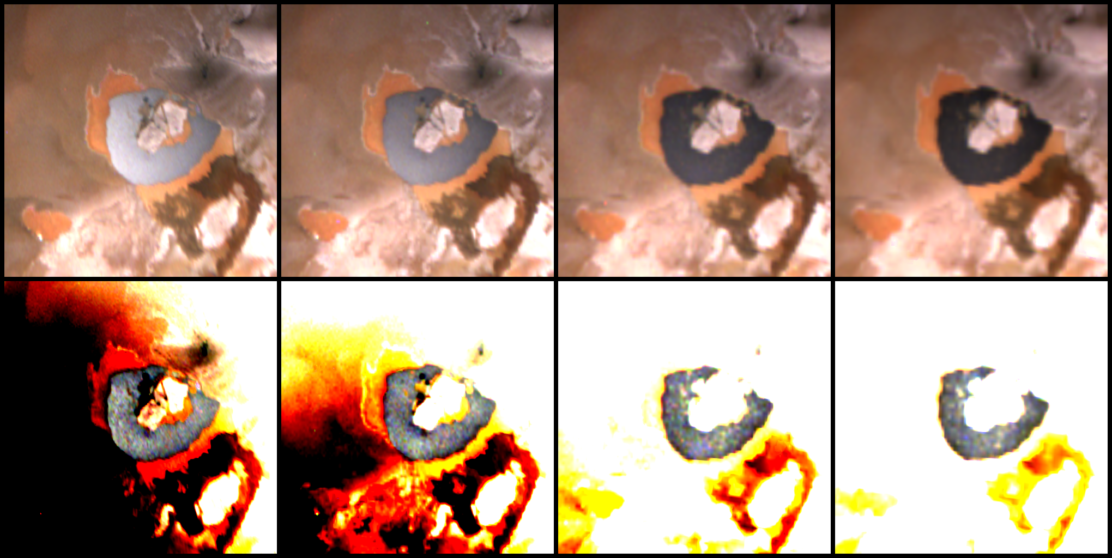
data before linear minimal square regression over normal facet deviation and azimuth, and residuals
regression residuals scaled to +/- 4-times standard deviations of caldera samples

Slide 35
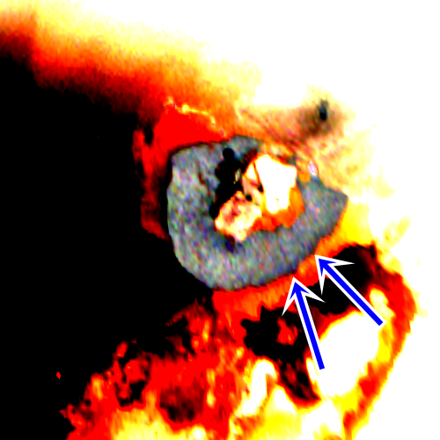
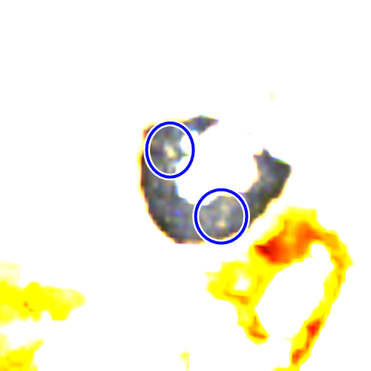
Serendipitious observations (derived from similar historical approach)
fractures in lava lake extend those of peninsula
subpixel shells appear to float on lava lake

Slide 36
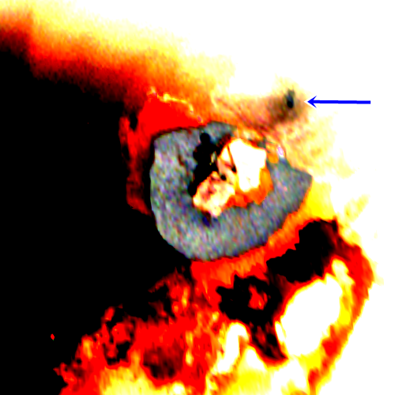
Serendipitious observations (derived from similar historical approach)
potential small lava feature outside caldera (brightess similar to lava lake)

Slide 37
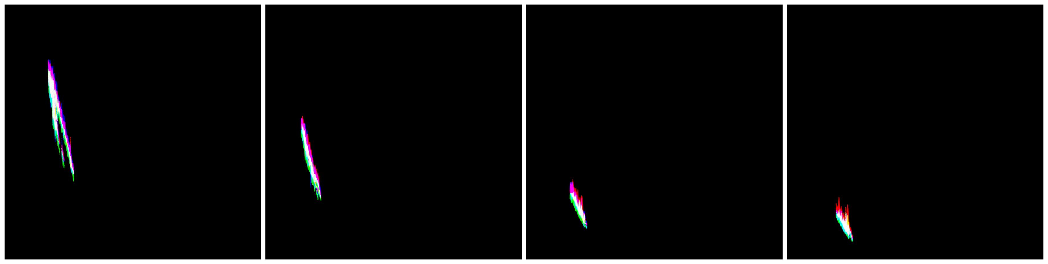
Calibrated R,G,B values of masked caldera region correlated to facet normal deviation angle.
#26
#27
#28
#29

Slide 38
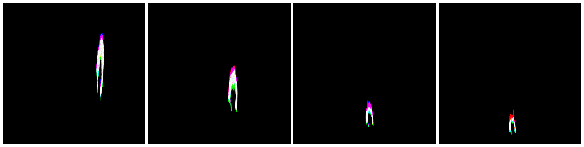
Calibrated R,G,B values of masked caldera region correlated to facet normal azimuth.
#26
#27
#28
#29

Slide 39
Central points of the regression planes restricted to masked caldera
Image | #26 | #27 | #28 | #29
mean deviation angle | 0.324330732 | 0.266250154 | 0.310436775 | 0.34097725
mean azimuth [0;2pi] | 1.182967498 | 0.60938716 | 0.192121833 | 0.081991005
red mean | 5925.823837468 | 4213.46849469 | 2264.982751515 | 1582.173846249
red slope wrt deviation | -26007.817207269 | -25610.668807894 | -14473.507684406 | -10545.991862116
red slope wrt azimuth | 4541.167128654 | 1299.335330266 | -162.127376431 | -587.446542836
green mean | 5627.798861425 | 3895.491713247 | 2052.364280801 | 1384.341527281
green slope wrt deviation | -24846.44722981 | -23925.374058568 | -12773.64613598 | -9655.135543133
green slope wrt azimuth | 4549.872384246 | 1293.137080249 | -130.305023712 | -554.301015283
blue mean | 5912.490292536 | 4133.269937248 | 2215.684211925 | 1437.931179506
blue slope wrt deviation | -25343.264516119 | -24900.040175929 | -14165.324520462 | -10363.695423364
blue slope wrt azimuth | 4959.962056163 | 1450.809985997 | -97.509249506 | -446.183893968
One general approach to find a non-linear function that approximates the data
uses the center of the masked caldera in all four available PJ58 JunoCam images.
This provides four function values, together with partial derivatives (slopes) in those points.
They can either be used for interpolation or for a best fit, with a self-calibration option.

Slide 40
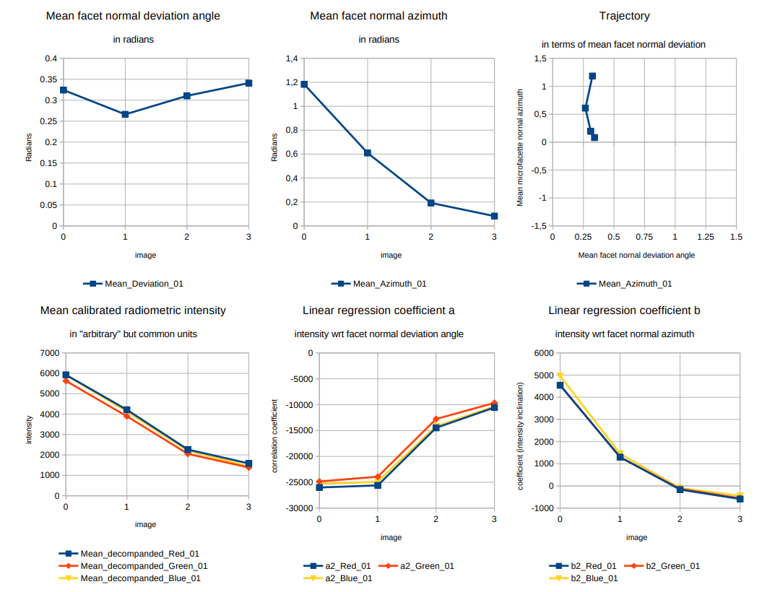
Charts
by image

Slide 41
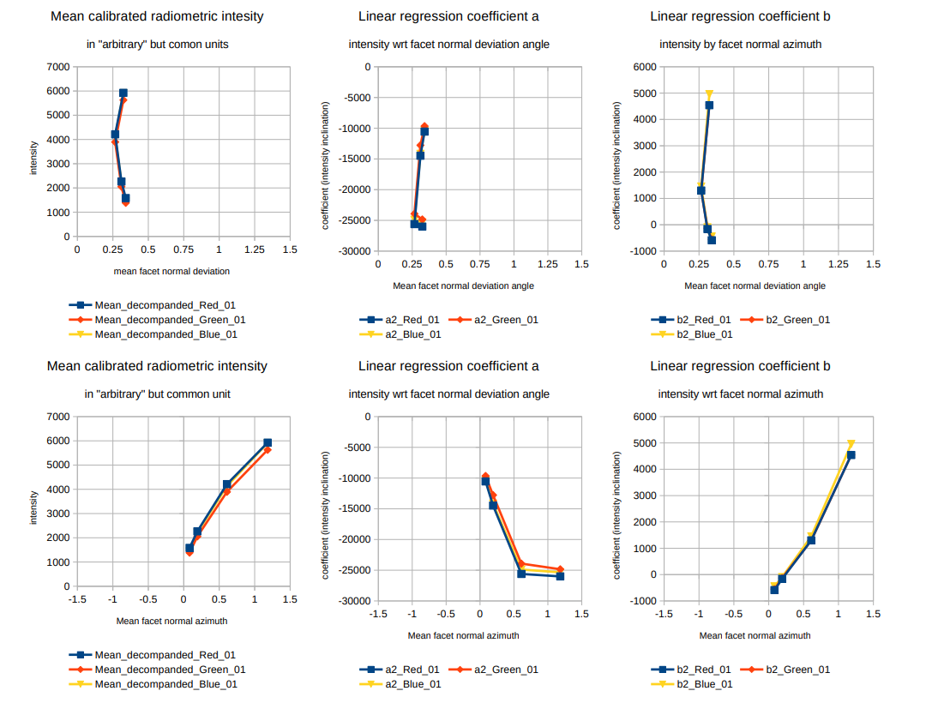
Charts
by facet normal
deviation angle
and azimuth

Slide 42
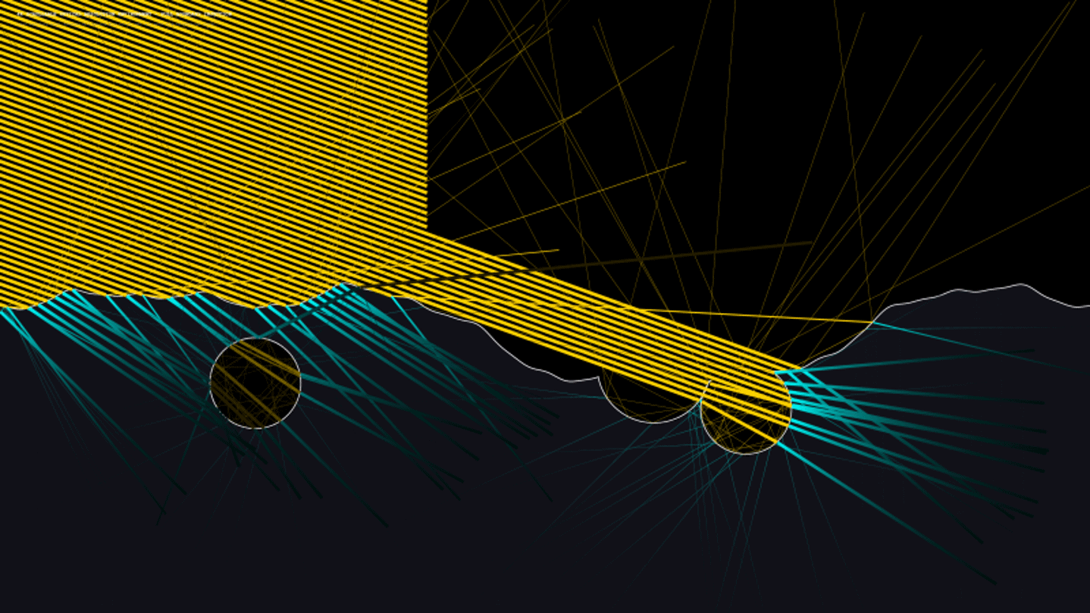
Ray tracer examples:
Fixed surface topography (and roughness),
refractive index varying between 1.30 and 2.05
(Gemini-AI-assisted modeling, preliminary)

Slide 43
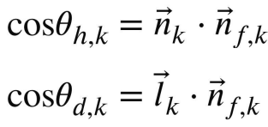
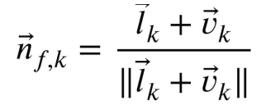
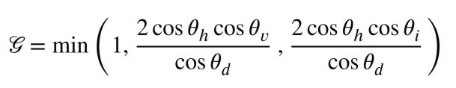
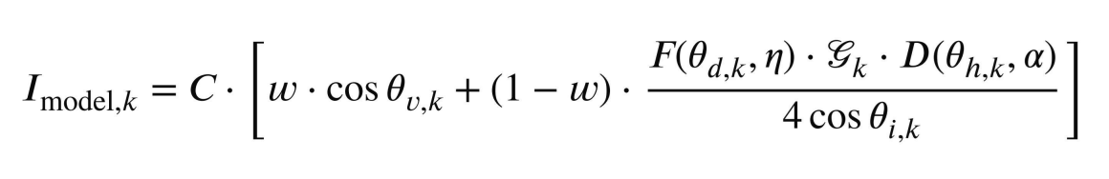
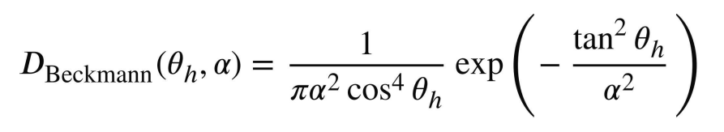
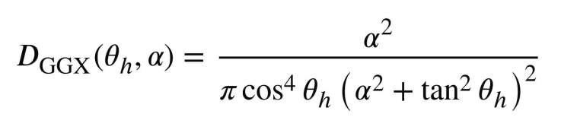
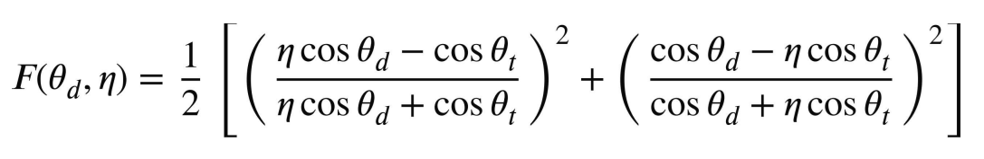
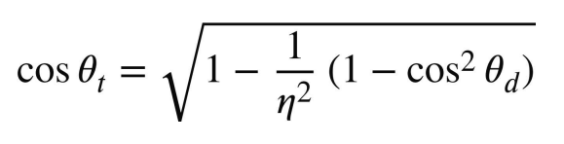
Surface roughness (RMS slope) α and refractive index η
Cook-Torrance Microfacet BRDF forward model
(Gemini-AI-assisted search, preliminary)
bulk normal
vector
vector
to Sun
vector
to camera
(Surface brightness values should be without factor cos θv)
emission
angle
solar incidence angle
instrument
gain
clean volcanic glass
fractional area
data point
Lambertian
fractional area
self-calibration
option

Slide 44
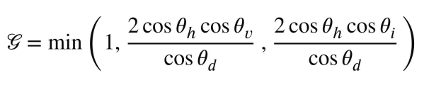



Standard Cook-Torrance attenuation factor
(Gemini-AI-assisted search, preliminary)
[
]
geometric
idea:

Slide 45




Fresnel reflection
(Gemini-AI-assisted search, preliminary)
[partially verified]
[
]
(Average of Fresnel equations for parallel and perpendicuarly polarized light, refractive index of vacuum set to 1.)
idea:
(η sin θt = sin θd rewritten: cos θt = sqrt(1 - sin² θt), and sin² θt = (sin θd / η)² = 1 - cos² θd / η²)

Slide 46

Refractive index of selected volcanic glasses (Gemini-AI-assisted search, preliminary)

Slide 47
Summary
The science hidden is in viewing geometry,
and in camera calibration.
Juno’s Perijove 58 provides four images of Io’s Loki Patera with a common solar vector, and with a changing emission vector to the camera.
Changing observational conditions result in a drastic change of Loki Patera’s apparent brightness, induced by Lava Lake specularity.
Idea:
Fit data into a BRDF that is a function of surface roughness and refractive index.
Use refractive index to infer mineralogy.
Thank you!

Slide 48
Backup slides

Slide 49


Slide 50


Slide 51


Slide 52
Kontext road map
Given: JunoCam images of Io’s Loki Patera lava lake.
Science objective: Mineralogic composition of the caldera’s volcanic glass.
Provide cropped cylindrical maps of the Loki Patera lava lake, together with a bunch of geometrical backplanes.
Calibrate and linearize data in terms of radiometric intensity relative to a selected reference image.
Define the lava lake area.
For each image: Fit least squares regression planes through the lava lake RGB intensity channels.
Use regression planes relative to the solar specular vector to derive a non-physical Phong approach.
Use regression planes relative to the bulk surface normal vector to fit a draft physical microfacet normal distribution function (NDF).
Decompose the draft NDF into a heterogeniously weighted Lambertian component and a specular component.
Describe the cleaned specular NDF (Torrance-Sparrow 1967) component by surface roughness (Beckmann-Spizzichino 1963 / Trowbridge-Reitz 1975 aka GGX) and refractive index (Fresnel 1823) in the interval [1.45; 1.80].
Map the refractive index to the percentage p in the chart for p SiO + (1-p)(MgO + FeO + TiO).(Gladstone-Dale 1863, Young-Finn 1940, Langford 1984, Piontek & al. 2021)
Residuals ~ white noise? Further model refinements, adjustments required?

Slide 53
Kontext road map
Given: JunoCam images of Io’s Loki Patera lava lake.
Science objective: Mineralogic composition of the caldera’s volcanic glass.
Provide cropped cylindrical maps of the Loki Patera lava lake, together with a bunch of geometrical backplanes.
Calibrate and linearize data in terms of radiometric intensity relative to a selected reference image.
Define the lava lake area.
For each image: Fit least squares regression planes through the lava lake RGB intensity channels.
Use regression planes relative to the solar specular vector to derive a non-physical Phong approach.
Use regression planes relative to the bulk surface normal vector to fit a draft physical microfacet normal distribution function (NDF).
Decompose the draft NDF into a heterogeniously weighted Lambertian component and a specular component.
Describe the cleaned specular NDF (Torrance-Sparrow 1967) component by surface roughness (Beckmann-Spizzichino 1963 / Trowbridge-Reitz 1975 aka GGX) and refractive index (Fresnel 1823) in the interval [1.45; 1.80].
Map the refractive index to the percentage p in the chart for p SiO + (1-p)(MgO + FeO + TiO).(Gladstone-Dale 1863, Young-Finn 1940, Langford 1984, Piontek & al. 2021)
Residuals ~ white noise? Further model refinements, adjustments required?

Slide 54
Kontext road map
Given: JunoCam images of Io’s Loki Patera lava lake.
Science objective: Mineralogic composition of the caldera’s volcanic glass.
Provide cropped cylindrical maps of the Loki Patera lava lake, together with a bunch of geometrical backplanes.
Calibrate and linearize data in terms of radiometric intensity relative to a selected reference image.
Define the lava lake area.
For each image: Fit least squares regression planes through the lava lake RGB intensity channels.
Use regression planes relative to the solar specular vector to derive a non-physical Phong approach.
Use regression planes relative to the bulk surface normal vector to fit a draft physical microfacet normal distribution function (NDF).
Decompose the draft NDF into a heterogeniously weighted Lambertian component and a specular component.
Describe the cleaned specular NDF (Torrance-Sparrow 1967) component by surface roughness (Beckmann-Spizzichino 1963 / Trowbridge-Reitz 1975 aka GGX) and refractive index (Fresnel 1823) in the interval [1.45; 1.80].
Map the refractive index to the percentage p in the chart for p SiO + (1-p)(MgO + FeO + TiO).(Gladstone-Dale 1863, Young-Finn 1940, Langford 1984, Piontek & al. 2021)
Residuals ~ white noise? Further model refinements, adjustments required?

Slide 55
Kontext road map
Given: JunoCam images of Io’s Loki Patera lava lake.
Science objective: Mineralogic composition of the caldera’s volcanic glass.
Provide cropped cylindrical maps of the Loki Patera lava lake, together with a bunch of geometrical backplanes.
Calibrate and linearize data in terms of radiometric intensity relative to a selected reference image.
Define the lava lake area.
For each image: Fit least squares regression planes through the lava lake RGB intensity channels.
Use regression planes relative to the solar specular vector to derive a non-physical Phong approach.
Use regression planes relative to the bulk surface normal vector to fit a draft physical microfacet normal distribution function (NDF).
Decompose the draft NDF into a heterogeniously weighted Lambertian component and a specular component.
Describe the cleaned specular NDF (Torrance-Sparrow 1967) component by surface roughness (Beckmann-Spizzichino 1963 / Trowbridge-Reitz 1975 aka GGX) and refractive index (Fresnel 1823) in the interval [1.45; 1.80].
Map the refractive index to the percentage p in the chart for p SiO + (1-p)(MgO + FeO + TiO).(Gladstone-Dale 1863, Young-Finn 1940, Langford 1984, Piontek & al. 2021)
Residuals ~ white noise? Further model refinements, adjustments required?

Slide 56
Kontext road map
Given: JunoCam images of Io’s Loki Patera lava lake.
Science objective: Mineralogic composition of the caldera’s volcanic glass.
Provide cropped cylindrical maps of the Loki Patera lava lake, together with a bunch of geometrical backplanes.
Calibrate and linearize data in terms of radiometric intensity relative to a selected reference image.
Define the lava lake area.
For each image: Fit least squares regression planes through the lava lake RGB intensity channels.
Use regression planes relative to the solar specular vector to derive a non-physical Phong approach.
Use regression planes relative to the bulk surface normal vector to fit a draft physical microfacet normal distribution function (NDF).
Decompose the draft NDF into a heterogeniously weighted Lambertian component and a specular component.
Describe the cleaned specular NDF (Torrance-Sparrow 1967) component by surface roughness (Beckmann-Spizzichino 1963 / Trowbridge-Reitz 1975 aka GGX) and refractive index (Fresnel 1823) in the interval [1.45; 1.80].
Map the refractive index to the percentage p in the chart for p SiO + (1-p)(MgO + FeO + TiO).(Gladstone-Dale 1863, Young-Finn 1940, Langford 1984, Piontek & al. 2021)
Residuals ~ white noise? Further model refinements, adjustments required?

Slide 57
Kontext road map
Given: JunoCam images of Io’s Loki Patera lava lake.
Science objective: Mineralogic composition of the caldera’s volcanic glass.
Provide cropped cylindrical maps of the Loki Patera lava lake, together with a bunch of geometrical backplanes.
Calibrate and linearize data in terms of radiometric intensity relative to a selected reference image.
Define the lava lake area.
For each image: Fit least squares regression planes through the lava lake RGB intensity channels.
Use regression planes relative to the solar specular vector to derive a non-physical Phong approach.
Use regression planes relative to the bulk surface normal vector to fit a draft physical microfacet normal distribution function (NDF).
Decompose the draft NDF into a heterogeniously weighted Lambertian component and a specular component.
Describe the cleaned specular NDF (Torrance-Sparrow 1967) component by surface roughness (Beckmann-Spizzichino 1963 / Trowbridge-Reitz 1975 aka GGX) and refractive index (Fresnel 1823) in the interval [1.45; 1.80].
Map the refractive index to the percentage p in the chart for p SiO + (1-p)(MgO + FeO + TiO).(Gladstone-Dale 1863, Young-Finn 1940, Langford 1984, Piontek & al. 2021)
Residuals ~ white noise? Further model refinements, adjustments required?

Slide 58
Kontext road map
Given: JunoCam images of Io’s Loki Patera lava lake.
Science objective: Mineralogic composition of the caldera’s volcanic glass.
Provide cropped cylindrical maps of the Loki Patera lava lake, together with a bunch of geometrical backplanes.
Calibrate and linearize data in terms of radiometric intensity relative to a selected reference image.
Define the lava lake area.
For each image: Fit least squares regression planes through the lava lake RGB intensity channels.
Use regression planes relative to the solar specular vector to derive a non-physical Phong approach.
Use regression planes relative to the bulk surface normal vector to fit a draft physical microfacet normal distribution function (NDF).
Decompose the draft NDF into a heterogeniously weighted Lambertian component and a specular component.
Describe the cleaned specular NDF (Torrance-Sparrow 1967) component by surface roughness (Beckmann-Spizzichino 1963 / Trowbridge-Reitz 1975 aka GGX) and refractive index (Fresnel 1823) in the interval [1.45; 1.80].
Map the refractive index to the percentage p in the chart for p SiO + (1-p)(MgO + FeO + TiO).(Gladstone-Dale 1863, Young-Finn 1940, Langford 1984, Piontek & al. 2021)
Residuals ~ white noise? Further model refinements, adjustments required?

Slide 59
Kontext road map
Given: JunoCam images of Io’s Loki Patera lava lake.
Science objective: Mineralogic composition of the caldera’s volcanic glass.
Provide cropped cylindrical maps of the Loki Patera lava lake, together with a bunch of geometrical backplanes.
Calibrate and linearize data in terms of radiometric intensity relative to a selected reference image.
Define the lava lake area.
For each image: Fit least squares regression planes through the lava lake RGB intensity channels.
Use regression planes relative to the solar specular vector to derive a non-physical Phong approach.
Use regression planes relative to the bulk surface normal vector to fit a draft physical microfacet normal distribution function (NDF).
Decompose the draft NDF into a heterogeniously weighted Lambertian component and a specular component.
Describe the cleaned specular NDF (Torrance-Sparrow 1967) component by surface roughness (Beckmann-Spizzichino 1963 / Trowbridge-Reitz 1975 aka GGX) and refractive index (Fresnel 1823) in the interval [1.45; 1.80].
Map the refractive index to the percentage p in the chart for p SiO + (1-p)(MgO + FeO + TiO).(Gladstone-Dale 1863, Young-Finn 1940, Langford 1984, Piontek & al. 2021)
Residuals ~ white noise? Further model refinements, adjustments required?

Slide 60
Kontext road map
Given: JunoCam images of Io’s Loki Patera lava lake.
Science objective: Mineralogic composition of the caldera’s volcanic glass.
Provide cropped cylindrical maps of the Loki Patera lava lake, together with a bunch of geometrical backplanes.
Calibrate and linearize data in terms of radiometric intensity relative to a selected reference image.
Define the lava lake area.
For each image: Fit least squares regression planes through the lava lake RGB intensity channels.
Use regression planes relative to the solar specular vector to derive a non-physical Phong approach.
Use regression planes relative to the bulk surface normal vector to fit a draft physical microfacet normal distribution function (NDF).
Decompose the draft NDF into a heterogeniously weighted Lambertian component and a specular component.
Describe the cleaned specular NDF (Torrance-Sparrow 1967) component by surface roughness (Beckmann-Spizzichino 1963 / Trowbridge-Reitz 1975 aka GGX) and refractive index (Fresnel 1823) in the interval [1.45; 1.80].
Map the refractive index to the percentage p in the chart for p SiO + (1-p)(MgO + FeO + TiO).(Gladstone-Dale 1863, Young-Finn 1940, Langford 1984, Piontek & al. 2021)
Residuals ~ white noise? Further model refinements, adjustments required?

Slide 61
Kontext road map
Given: JunoCam images of Io’s Loki Patera lava lake.
Science objective: Mineralogic composition of the caldera’s volcanic glass.
Provide cropped cylindrical maps of the Loki Patera lava lake, together with a bunch of geometrical backplanes.
Calibrate and linearize data in terms of radiometric intensity relative to a selected reference image.
Define the lava lake area.
For each image: Fit least squares regression planes through the lava lake RGB intensity channels.
Use regression planes relative to the solar specular vector to derive a non-physical Phong approach.
Use regression planes relative to the bulk surface normal vector to fit a draft physical microfacet normal distribution function (NDF).
Decompose the draft NDF into a heterogeniously weighted Lambertian component and a specular component.
Describe the cleaned specular NDF (Torrance-Sparrow 1967) component by surface roughness (Beckmann-Spizzichino 1963 / Trowbridge-Reitz 1975 aka GGX) and refractive index (Fresnel 1823) in the interval [1.45; 1.80].
Map the refractive index to the percentage p in the chart for p SiO + (1-p)(MgO + FeO + TiO).(Gladstone-Dale 1863, Young-Finn 1940, Langford 1984, Piontek & al. 2021)
Residuals ~ white noise? Further model refinements, adjustments required?

Slide 62
Kontext road map
Given: JunoCam images of Io’s Loki Patera lava lake.
Science objective: Mineralogic composition of the caldera’s volcanic glass.
Provide cropped cylindrical maps of the Loki Patera lava lake, together with a bunch of geometrical backplanes.
Calibrate and linearize data in terms of radiometric intensity relative to a selected reference image.
Define the lava lake area.
For each image: Fit least squares regression planes through the lava lake RGB intensity channels.
Use regression planes relative to the solar specular vector to derive a non-physical Phong approach.
Use regression planes relative to the bulk surface normal vector to fit a draft physical microfacet normal distribution function (NDF).
Decompose the draft NDF into a heterogeniously weighted Lambertian component and a specular component.
Describe the cleaned specular NDF (Torrance-Sparrow 1967) component by surface roughness (Beckmann-Spizzichino 1963 / Trowbridge-Reitz 1975 aka GGX) and refractive index (Fresnel 1823) in the interval [1.45; 1.80].
Map the refractive index to the percentage p in the chart for p SiO + (1-p)(MgO + FeO + TiO).(Gladstone-Dale 1863, Young-Finn 1940, Langford 1984, Piontek & al. 2021)
Residuals ~ white noise? Further model refinements, adjustments required?

Slide 63
Kontext road map, mostly implemented
Given: JunoCam images of Io’s Loki Patera lava lake.
Science objective: Mineralogic composition of the caldera’s volcanic glass.
Provide cropped cylindrical maps of the Loki Patera lava lake, together with a bunch of geometrical backplanes.
Calibrate and linearize data in terms of radiometric intensity relative to a selected reference image.
Define the lava lake area.
For each image: Fit least squares regression planes through the lava lake RGB intensity channels.
Use regression planes relative to the solar specular vector to derive a non-physical Phong approach.
Use regression planes relative to the bulk surface normal vector to fit a draft physical microfacet normal distribution function (NDF). [NDF grid points determined via least squares linear regression]
Decompose the draft NDF into a heterogeniously weighted Lambertian component and a specular component.
Describe the cleaned specular NDF (Torrance-Sparrow 1967) component by surface roughness (Beckmann-Spizzichino 1963 / Trowbridge-Reitz 1975 aka GGX) and refractive index (Fresnel 1823) in the interval [1.45; 1.80].
Map the refractive index to the percentage p in the chart for p SiO + (1-p)(MgO + FeO + TiO).(Gladstone-Dale 1863, Young-Finn 1940, Langford 1984, Piontek & al. 2021)
Residuals ~ white noise? Further model refinements, adjustments required?

Slide 64
Kontext road map, test & debugging
Given: JunoCam images of Io’s Loki Patera lava lake.
Science objective: Mineralogic composition of the caldera’s volcanic glass.
Provide cropped cylindrical maps of the Loki Patera lava lake, together with a bunch of geometrical backplanes.
Calibrate and linearize data in terms of radiometric intensity relative to a selected reference image.
Define the lava lake area.
For each image: Fit least squares regression planes through the lava lake RGB intensity channels.
Use regression planes relative to the solar specular vector to derive a non-physical Phong approach.
Use regression planes relative to the bulk surface normal vector to fit a draft physical microfacet normal distribution function (NDF). [NDF grid points determined via least squares linear regression]
Decompose the draft NDF into a heterogeniously weighted Lambertian component and a specular component.
Describe the cleaned specular NDF (Torrance-Sparrow 1967) component by surface roughness (Beckmann-Spizzichino 1963 / Trowbridge-Reitz 1975 aka GGX) and refractive index (Fresnel 1823) in the interval [1.45; 1.80].
Map the refractive index to the percentage p in the chart for p SiO + (1-p)(MgO + FeO + TiO).(Gladstone-Dale 1863, Young-Finn 1940, Langford 1984, Piontek & al. 2021)
Residuals ~ white noise? Further model refinements, adjustments required?

Slide 65
Kontext road map, theory mostly clear
Given: JunoCam images of Io’s Loki Patera lava lake.
Science objective: Mineralogic composition of the caldera’s volcanic glass.
Provide cropped cylindrical maps of the Loki Patera lava lake, together with a bunch of geometrical backplanes.
Calibrate and linearize data in terms of radiometric intensity relative to a selected reference image.
Define the lava lake area.
For each image: Fit least squares regression planes through the lava lake RGB intensity channels.
Use regression planes relative to the solar specular vector to derive a non-physical Phong approach.
Use regression planes relative to the bulk surface normal vector to fit a draft physical microfacet normal distribution function (NDF).
Decompose the draft NDF into a heterogeniously weighted Lambertian component and a specular component.
Describe the cleaned specular NDF (Torrance-Sparrow 1967) component by surface roughness (Beckmann-Spizzichino 1963 / Trowbridge-Reitz 1975 aka GGX) and refractive index (Fresnel 1823) in the interval [1.45; 1.80].
Map the refractive index to the percentage p in the chart for p SiO + (1-p)(MgO + FeO + TiO).(Gladstone-Dale 1863, Young-Finn 1940, Langford 1984, Piontek & al. 2021)
Residuals ~ white noise? Further model refinements, adjustments required?

Slide 66
Kontext road map, literature available
Given: JunoCam images of Io’s Loki Patera lava lake.
Science objective: Mineralogic composition of the caldera’s volcanic glass.
Provide cropped cylindrical maps of the Loki Patera lava lake, together with a bunch of geometrical backplanes.
Calibrate and linearize data in terms of radiometric intensity relative to a selected reference image.
Define the lava lake area.
For each image: Fit least squares regression planes through the lava lake RGB intensity channels.
Use regression planes relative to the solar specular vector to derive a non-physical Phong approach.
Use regression planes relative to the bulk surface normal vector to fit a draft physical microfacet normal distribution function (NDF).
Decompose the draft NDF into a heterogeniously weighted Lambertian component and a specular component.
Describe the cleaned specular NDF (Torrance-Sparrow 1967) component by surface roughness (Beckmann-Spizzichino 1963 / Trowbridge-Reitz 1975 aka GGX) and refractive index (Fresnel 1823) in the interval [1.45; 1.80].
Map the refractive index to the percentage p in the chart for p SiO + (1-p)(MgO + FeO + TiO).(Gladstone-Dale 1863, Young-Finn 1940, Langford 1984, Piontek & al. 2021)
Residuals ~ white noise? Further model refinements, adjustments required?

Slide 67
Kontext road map, TBD
Given: JunoCam images of Io’s Loki Patera lava lake.
Science objective: Mineralogic composition of the caldera’s volcanic glass.
Provide cropped cylindrical maps of the Loki Patera lava lake, together with a bunch of geometrical backplanes.
Calibrate and linearize data in terms of radiometric intensity relative to a selected reference image.
Define the lava lake area.
For each image: Fit least squares regression planes through the lava lake RGB intensity channels.
Use regression planes relative to the solar specular vector to derive a non-physical Phong approach.
Use regression planes relative to the bulk surface normal vector to fit a draft physical microfacet normal distribution function (NDF).
Decompose the draft NDF into a heterogeniously weighted Lambertian component and a specular component.
Describe the cleaned specular NDF (Torrance-Sparrow 1967) component by surface roughness (Beckmann-Spizzichino 1963 / Trowbridge-Reitz 1975 aka GGX) and refractive index (Fresnel 1823) in the interval [1.45; 1.80].
Map the refractive index to the percentage p in the chart for p SiO + (1-p)(MgO + FeO + TiO).(Gladstone-Dale 1863, Young-Finn 1940, Langford 1984, Piontek & al. 2021)
Residuals ~ white noise? Further model refinements, adjustments required?

Slide 68
Backplanes
Provide cropped cylindrical map of the Loki Patera lava lake, together with vector backplanes for each pixel:
Surface normal,
Surface point – Sun (solar incidence vector),
Surface point – Juno (emission vector).
Derive backplanes:
Cosine of the solar incidence angle (for Lambertian)
Solar specular vector,
(deviation angle, azimuth) , zero azimuth: Sun – surface point – Juno plane
  Juno relative to specular vector,
  half angle between solar incidence vector and emission vector relative to surface normal.

Slide 69


Slide 70


Slide 71


Slide 72


Slide 73


Slide 74

Perijove 58, image #26, linearized,
cylindrically map-projected, north to the right, cropped
0
pi/2
RGB intensity as a function of solar specular deviation angle
looping over solar specular azimuth [0.70..1.25] step 0.05

Slide 75

Perijove 58, image #26, linearized,
cylindrically map-projected, north to the right, cropped
-pi
+pi
RGB intensity as a function of solar specular azimuth
looping over specular deviation angle [0.28..0.40] step 0.02

Slide 76

Regression planes for red channel, restricted to masked caldera:
#26: -28274.166112423 a - 1963.210920428 b + 17087.64788476 +/- 129.30533414271,
#27: -15845.215931851 a - 3437.217719532 b + 12635.895504254 +/- 139.860646551219,
#28: -7465.728295093 a - 1552.538391644 b + 7001.938709913 +/- 139.049095452121,
#29: -5332.158868908 a - 1342.696660609 b + 5271.508281566 +/- 134.320624623116,
with a: solar specular deviation angle in radians,
and b: solar specular azimuth in radians, windowed to [-pi;pi].
Data numbers calibrated relative to #26, linearized to [0; 255²] for decompanding table range.
Errors are +/- 1 residual standard deviation.
Planes have been determined via standard linear least square regression of red, green, blue as functions of a and b.
Regression planes mapped to latitude/longitude range of cropped caldera maps of PJ58 images #26 to #29.

Slide 77
Regression planes for red channel, restricted to masked caldera:
#26: -28274 a - 1963 b + 17088 +/- 129,
#27: -15845 a - 3437 b + 2636 +/- 140,
#28: -7465 a - 1553 b + 7002 +/- 139,
#29: -5332 a - 1343 b + 5271 +/- 134,
with a: solar specular deviation angle in radians,
and b: solar specular azimuth in radians, windowed to [-pi;pi].
Data numbers calibrated relative to #26, linearized to [0; 255²] for decompanding table range.
Errors are +/- 1 residual standard deviation.
Planes have been determined via standard linear least square regression of red, green, blue as functions of a and b.
Regression planes mapped to latitude/longitude range of cropped caldera maps of PJ58 images #26 to #29.

Slide 78

Blink between cylindrical map-projected regression planes
and data (cropped caldera maps of PJ58 images #26 to #29).

Slide 79

data before linear minimal square regression over solar specular deviation and azimuth, and residuals
regression residuals scaled to +/- 4-times standard deviations of caldera samples

Slide 80
Serendipitious observations
fractures in lava lake extend those of peninsula
subpixel shells appear to float on lava lake

Slide 81
Serendipitious observations
potential small lava feature outside caldera (brightess similar to lava lake)

Slide 82

One of the pending tasks:
Find one or more (nonlinear functions) that fit globally all four caldera images.
Calibrated R,G,B values of masked caldera region correlated to solar specular deviation angle.
#26
#27
#28
#29

Slide 83

One of the pending tasks:
Find one or more (nonlinear functions) that fit globally all four caldera images.
Calibrated R,G,B values of masked caldera region correlated to solar specular azimuth.
#26
#27
#28
#29

Slide 84
Central points of the regression planes restricted to masked caldera
Image | #26 | #27 | #28 | #29
mean deviation angle | 0.324146982 | 0.445382673 | 0.607831303 | 0.677531598
mean azimuth [0;2pi] | 1.01712884 | 0.397194039 | 0.128211066 | 0.05707046
red mean | 5925.823837468 | 4213.46849469 | 2264.982751515 | 1582.173846249
red slope wrt deviation | -28274.166112423 | -15845.215931851 | -7465.728295093 | -5332.158868908
red slope wrt azimuth | -1963.210920428 | -3437.217719532 | -1552.538391644 | -1342.696660609
green mean | 5627.798861425 | 3895.491713247 | 2052.364280801 | 1384.341527281
green slope wrt deviation | -27092.037369217 | -14833.406214097 | -6596.154081111 | -4887.534231571
green slope wrt azimuth | -1768.754992566 | -3117.130408186 | -1350.595236817 | -1251.467152063
blue mean | 5912.490292536 | 4133.269937248 | 2215.684211925 | 1437.931179506
blue slope wrt deviation | -27735.911713006 | -15467.83419739 | -7328.638230487 | -5258.465416969
blue slope wrt azimuth | -1639.758180629 | -3116.308247449 | -1428.599411958 | -1129.592076192
One general approach to find a non-linear function that approximates the data
uses the center of the masked caldera in all four available PJ58 JunoCam images.
This provides four function values, together with partial derivatives (slopes) in those points.
They can either be used for interpolation or for a best fit, with a self-calibration option.

Slide 85

Charts
by image

Slide 86

Charts
by solar
specular
deviation angle

Slide 87
Regression planes for red channel, restricted to masked caldera:
#26: -28274.166112423 a - 1963.210920428 b + 17087.647884766 +/- 129.30533414271,
#27: -15845.215931851 a - 3437.217719532 b + 12635.895504254 +/- 139.860646551219,
#28: -7465.728295093 a - 1552.538391644 b + 7001.938709913 +/- 139.049095452121,
#29: -5332.158868908 a - 1342.696660609 b + 5271.508281566 +/- 134.320624623116,
with a: solar specular deviation angle in radians,
and b: solar specular azimuth in radians, windowed to [-pi;pi].
Data numbers calibrated relative to #26, linearized to [0; 255²] for decompanding table range.
Errors are +/- 1 residual standard deviation.
Planes have been determined via standard linear least square regression of red, green, blue as functions of a and b.
Regression planes mapped to latitude/longitude range of cropped caldera maps of PJ58 images #26 to #29.

