Slide 1
MIT’s Compass for the Future:
The Future of Libraries Task Force Report
Laura Hanscom
25 October 2017

Slide 2
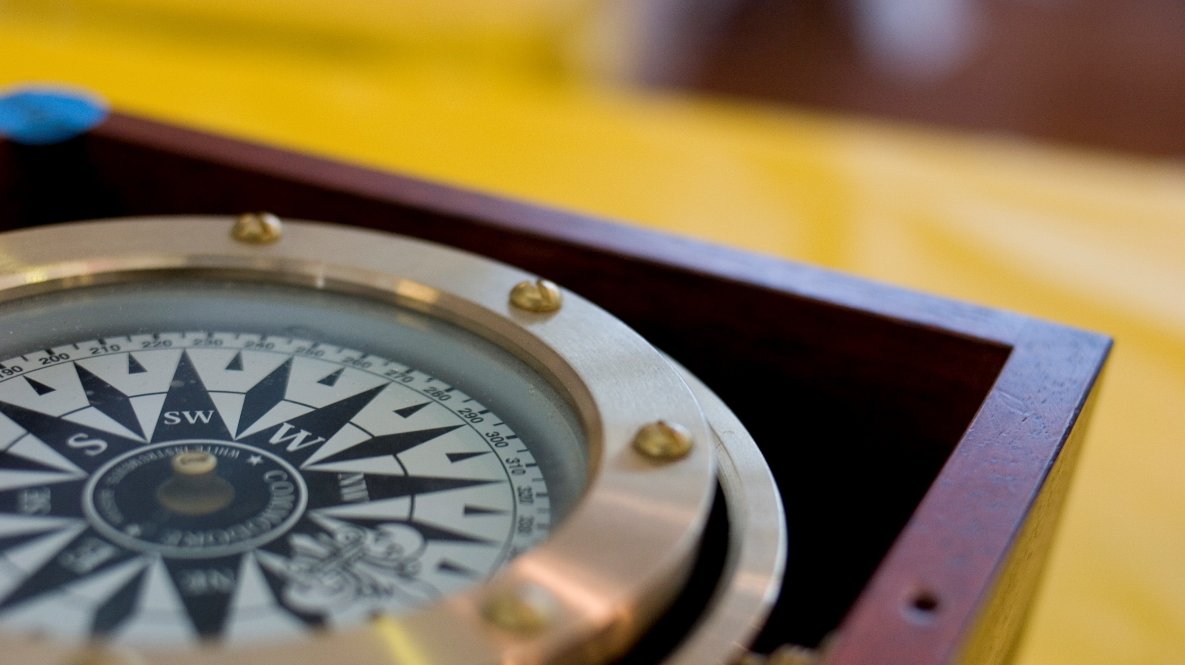
Notes:
https://www.flickr.com/photos/csb13/184057163/in/photolist-hgkMn-gW2td5-qALf6P-qACvcu-dxnob7-aAFzpU-9NtWtb-qQTQfG-dzG82V-MD1s-6J91J4-8hZoRK-bRX14i-8uMmfH-rAp1Go-8CATmQ-apgpCT-4cUNBm-cCcRY-byZJF3-d8muf-8zGRD5-4uZPyK-euT7Qm-5EPcxw-qh2xr2-8d3cF-eqfA6n-9QjYDH-8UoQsU-8jBbcX-fJsNQW-kdQKa-aqEsmt-4FkBvQ-o5aXtG-8uUnsE-9pdt6c-nsE3b1-adssy-ubiod-4FkCbS-4Fgn4a-5UQBJ7-4B4xda-3CYFU-5CsUyY-6X4mfq-bPHTS-q2LZSc

Slide 3
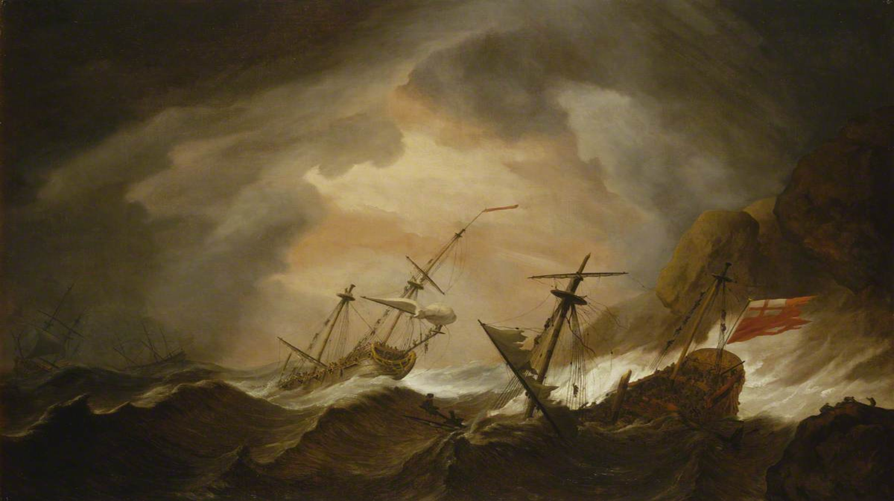
It is rough out there…
Notes:
http://artuk.org/discover/artworks/two-english-ships-wrecked-in-a-storm-on-a-rocky-coast-175886/search/keyword:ship-storm--termsadminqireference:storm-644/page/6

Slide 4
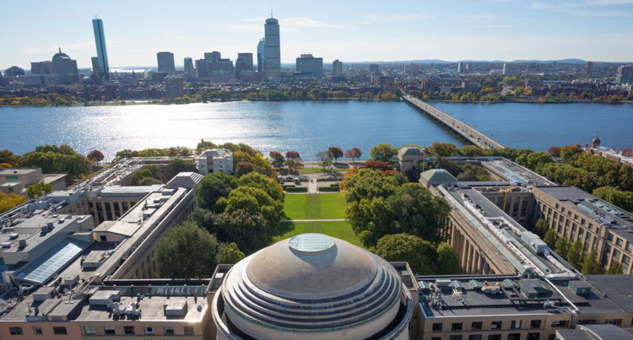
Notes:
http://blockchain.mit.edu/

Slide 5
To Support MIT’s Mission
As MIT embarks on a Campaign for a Better World, we are reminded of the importance of ensuring that the fruits of research and teaching—at MIT and beyond—are radically more available to all those who might benefit from and contribute to them. A world in which anyone might consume and create new ideas, knowledge, and understandings is one that will lead us to solutions to the world’s great challenges.

Slide 7
Community and Relationships
The Libraries must conceive of their community as a global one, embracing openness, diversity, global social justice, and critical thinking in their relationships with those communities, in their spaces, and in their educational programming.

Slide 8
Discovery and Use
The Libraries must develop and facilitate the creation of content platforms and tools that encourage the open dissemination of MIT research and that facilitate new methods of discovering and using information.

Slide 9
Stewardship and Sustainability
The Libraries must be leaders in the long-term stewardship of MIT content and in the development of collaborative models for the long-term stewardship of all parts of the scholarly record.

Slide 10
Research and Development
The Libraries must become a center for research and development, fueling bold experimentation and new answers to the grand challenges facing research libraries and scholarly communication.

Slide 11
For the MIT Libraries, the better world we seek is one in which there is abundant, equitable, meaningful access to knowledge and to the products of the full life cycle of research.
Enduring global access to knowledge requires sustainable models for ensuring that past and present knowledge is available long into the future. Moreover, access to knowledge must be fluid, interactive, contextualized, participatory, programmable, and comprehensive in order to fully enable citizens and scholars to integrate across disciplines, timescales, geographies, languages, and cultures.

Slide 12
Notes:
http://blockchain.mit.edu/

Slide 13
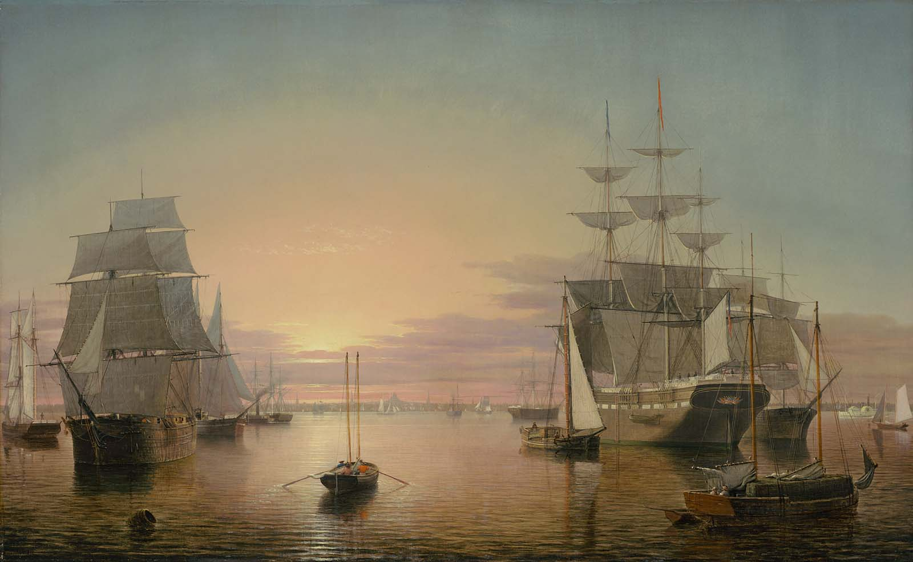
Thank you! Fair Winds and Following Seas….
Notes:
http://www.mfa.org/collections/object/boston-harbor-33972

Slide 14
Questions or Comments?

Slide 15
Image Credits
https://www.flickr.com/photos/csb13/184057163/in/photolist-hgkMn-gW2td5-qALf6P-qACvcu-dxnob7-aAFzpU-9NtWtb-qQTQfG-dzG82V-MD1s-6J91J4-8hZoRK-bRX14i-8uMmfH-rAp1Go-8CATmQ-apgpCT-4cUNBm-cCcRY-byZJF3-d8muf-8zGRD5-4uZPyK-euT7Qm-5EPcxw-qh2xr2-8d3cF-eqfA6n-9QjYDH-8UoQsU-8jBbcX-fJsNQW-kdQKa-aqEsmt-4FkBvQ-o5aXtG-8uUnsE-9pdt6c-nsE3b1-adssy-ubiod-4FkCbS-4Fgn4a-5UQBJ7-4B4xda-3CYFU-5CsUyY-6X4mfq-bPHTS-q2LZSc
Image:http://artuk.org/discover/artworks/two-english-ships-wrecked-in-a-storm-on-a-rocky-coast-175886/search/keyword:ship-storm--termsadminqireference:storm-644/page/6
Image: http://blockchain.mit.edu/
Image: https://www.pubpub.org/pub/future-of-libraries (adapted by LH)
Image: http://www.mfa.org/collections/object/boston-harbor-33972

