Slide 1



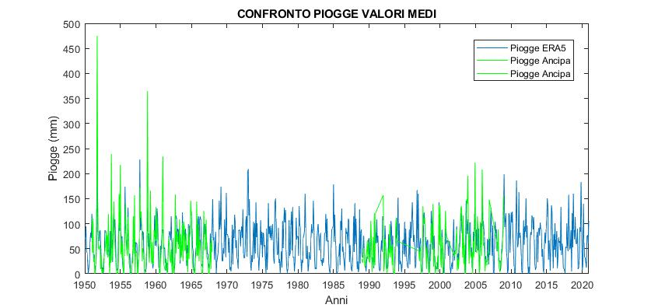
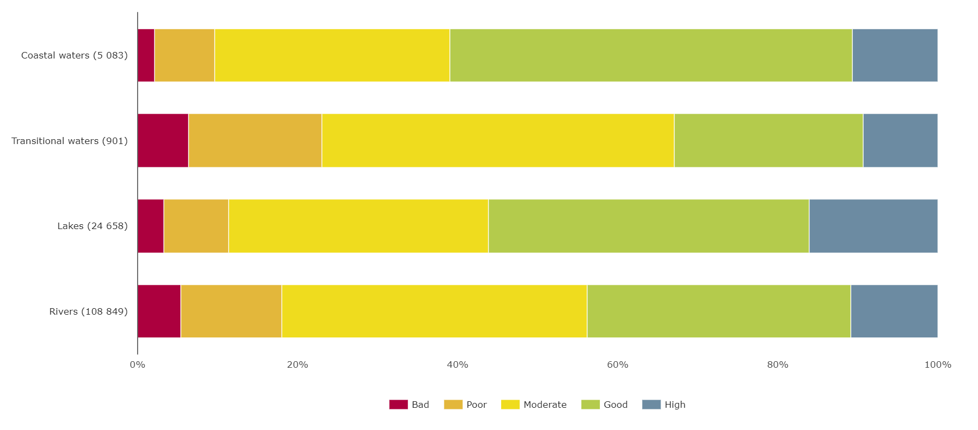
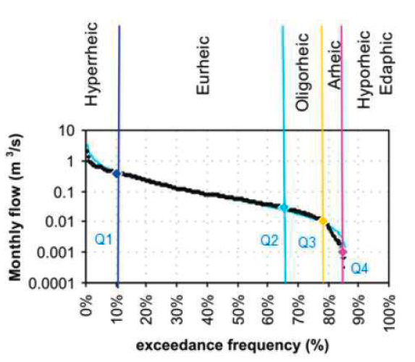
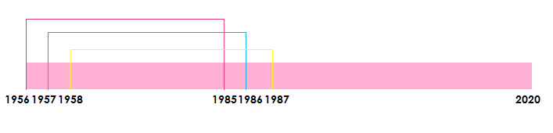
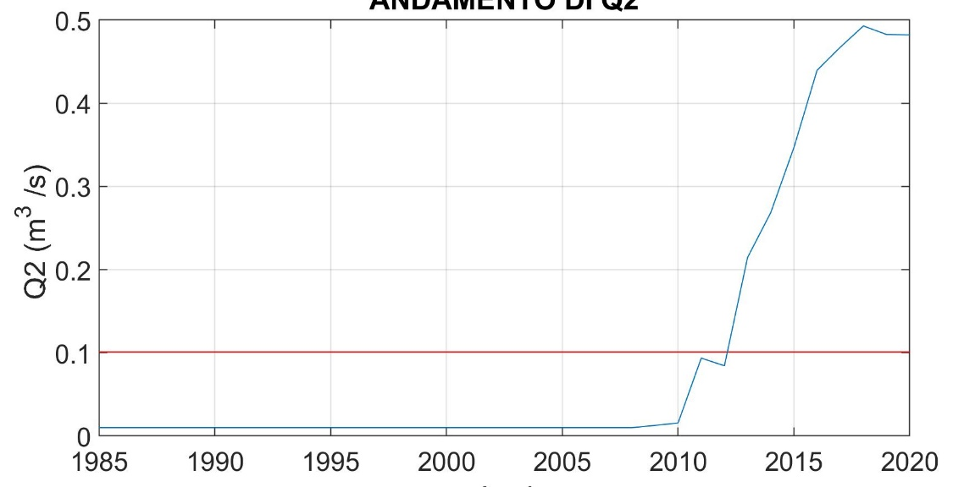
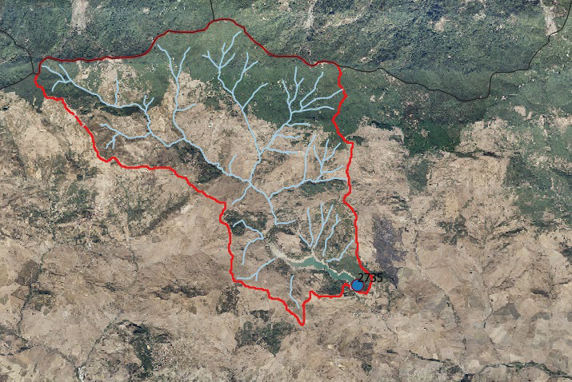
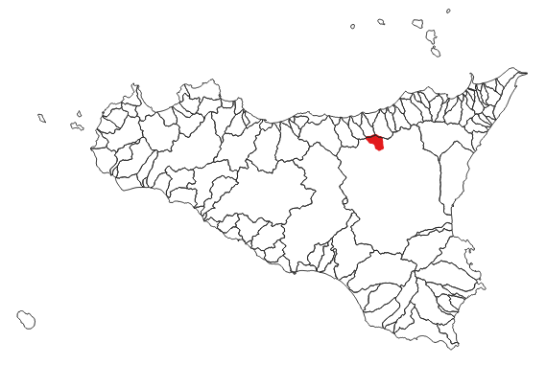
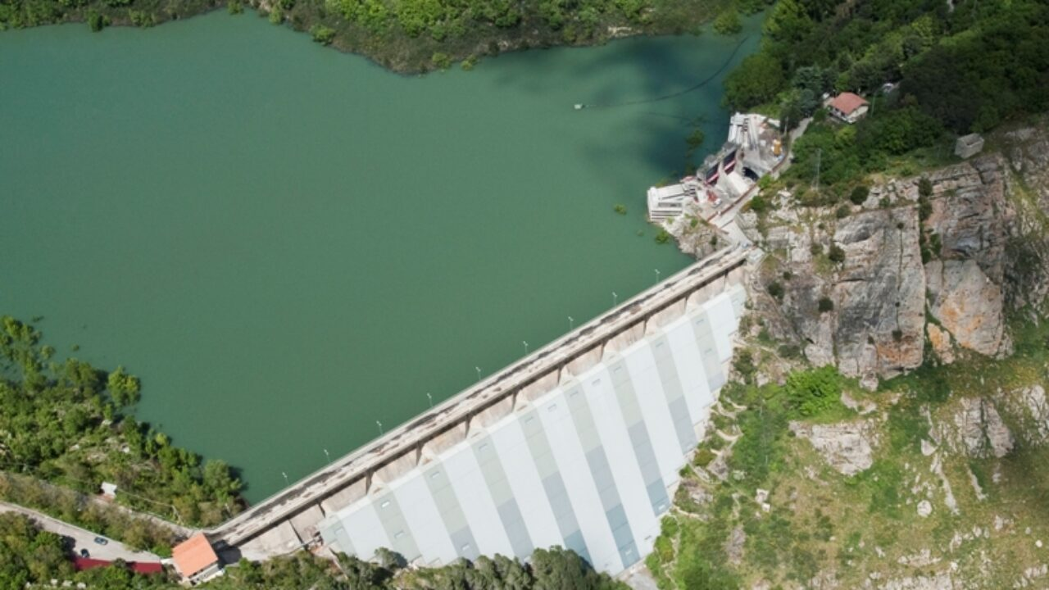
Ecological flow assessment in a non-perennial river under climate variability: the case study of the Lake Ancipa
8th Galileo Conferences
Brunella Bonaccorso and Claudia Iannello
Department of Engineering, University of Messina, Messina, Italy
Corresponding author: bbonaccorso@unime.it
OUTLINE
The Water Framework Directive 2000/60 has introduced a new legislative approach to water resources management aiming to:
  Prevent qualitative and quantitative deterioration of water resources
  Improve water status by pursuing environmental objectives
  Ensure sustainable water use
Good ecological status had been achieved for around 40% of surface waters (rivers, lakes and transitional and coastal waters) by 2015.
The EU Blueprint to Safeguard Europe's Water Resources (2012) introduces the concept of Ecological Flow (EF) as the hydrological regime which, in a hydraulically homogeneous stretch of a watercourse, complies with the achievement of the environmental objectives as defined by the WFD.
A methodological approach for the determination of EF has been proposed (DDG STA MATTM n. 30/2017).
AIM OF THE STUDY
Testing the methodology for evaluating EF downstream of a reservoir in non-perennial rivers.
Analysis of the effect of climate variability on particular values ​​of ecological runoff.
CASE STUDY
THRESHOLD VALUES EVALUATION FOR EF RELEASES
EFFECTS OF CLIMATE VARIABILITY ON THRESHOLD VALUES
CONCLUSIONS
Flow threshold values ​​can be used for establishing water release for environmental purposes (EF) by respecting the natural variability of the flows downstream of a reservoir
Application on nonstationary time series can lead to too high (low) threshold values, implying a significant reduction (increase) of water for off-stream uses
CONCLUSIONI
I risultati dell’analisi di incertezza nella stima dell’indice SPI, in relazione alla lunghezza del campione, hanno mostrato che in presenza di un trend lineare nella media, lo stimatore è distorto ed è, inoltre, possibile determinare una lunghezza del campione in corrispondenza alla quale l’RMSE è minimo.
Si è poi osservato che la procedura di rimozione del trend può dar luogo ad RMSE maggiori per campioni la cui dimensione risulti al di sotto di un certo valore, in funzione della pendenza del trend effettivo. Ciò si deve al fatto che la stima di un trend non noto introduce ulteriori fonti di incertezza, sopratutto per campioni di dimensione limitata e per piccole pendenze del trend.
Ulteriori indagini sono in corso al fine di poter ricavare le proprietà campionarie dell’indice SPI in funzione dei valori stimati dei parametri del trend.
DATA COLLECTION
DATA | Period of observation
Monthly rainfall data at Troina at Ancipa station | 1951-2008
ERA-5 monthly mean temperature and rainfall | (1951-2020)
Monthly inflow at Ancipa lake | (1956-2002)
CLIMATE DATA PRE-PROCESSING AND GAP FILLING
Rainfall (mm)
___ Observed
___ Reanalysis
INFLOW PREDICTION THROUGH NEURAL NETWORKS
Inflow (mm)
Inflow (mm)
NSE (calibration) | 0.70
NSE (validation) | 0.68
RATING CURVE ASSESSMENT AND DERIVATION OF THRESHOLD VALUES FOR EF RELEASE
(Q₁ = Q₁₀, Q₂ corresponding to the inflection point of the rating curve,
Q₃ = minimum Q≠0, Q₄ =0)
Observed
Gamma
Lognorm.
Thresholds [m³/s]
Q₁ | 4.80
Q₂ | 0.10
Q₃ | 0.01
Q₄ | 0.00
Probability
  Fig. 1. Distribution of ecological status or potential of classified rivers, lakes, coastal and transitional waters, by count of water bodies by 2015 (European Environment Agency Report, 2018)
Discharge [m³/s]
Fig. 4. Methodological flow chart and related results
Thresholds | [m³/s] | [Mm³/month] | [Mm³ ]
Q₁ | 4.80 | 12.45 | 37.35 (3 months)
Q₂ | 0.10 | 0.26 | 1.56 (6 months)
Frequency F
Ancipa lake water use | Period | Water needs [Mm³/year]
Hydropower | Fall/Winter | 16÷50
Irrigation | Spring/Summer | 3÷14
Drinking water | All the year | 7
Months
Fig. 5. Mean monthly exceedance frequency F of threshold values (e.g. Q_{i}>Q₁ with F>0.2 for about 3 months per year)
Inflow Q_{i} | Ecological flow EF
Q_{i}>Q₁ | EF≥Q₁
Q₁>Q_{i}>Q₂ | Q₃<EF≤Q₂
Q₂>Q_{i}>Q₃ | Q₃<EF≤Q₄
Q₃>Q_{i}>Q₄ | Q₄<EF≤0
Q₁ and Q₂ are derived from rating curves computed on 30-year subseries selected by a 1-year overlap moving window
a)
b)
Original Q₁
Original Q₂
  Fig. 2. Hydrologic approach for the EF assessment in non-perennial flow based on Aquatic States. On the left: mean rating curve (computed on at least 20 years of monthly flows) for the derivation of threshold values associated with the aquatic states. On the right: suggested rule for EF release downstream a reservoir
c)
d)
e)
Mean rainfall (mm)
Mean temperature (°C)
Evaporation (mm/moth)
Troina at Ancipa river basin
Area [km²] | 50.46
Perimeter [km] | 46.93
Maximum height [m a.s.l.] | 1661
Minimum height [m a.b.s.l.] | 875
Ancipa lake
Regulation capacity [Mm³] | 27
Fig. 6. Temporal changes of Q₁ (a), Q₂ (b), mean rainfall (c), temperature (d) and evaporation (e) evaluated through a 30-year moving window
Fig. 3. Troina at Ancipa dam river basin. Lake Ancipa is used for both drinking water and agricultural supply and hydropower production

