Slide 1
How to quantify regional hydrological change impact? some examples from France
Part of the results were achieved by:
Julien Boé, CNRS Cerfacs
Rémy Bonnet IPSL during its PhD
Pierre Salmon during its M2 internship
Antoine Sobaga during its PhD
Bertrand Decharme CNRS CNRM
Jérôme Molénat & Esco team
The Aqui-FR team www.geosciences.ens.fr/recherche/projets/aqui-fr
How to disentangle climate change impact to natural variability or anthropogenic impact ?
florence.habets@ens.fr
@florencehabets

Slide 2
How to quantify regional hydrological change impact? some examples from France
Illustration of a long term simulation of river flows:
Annual maximum of daily flows for the Seine at Paris
Observation
Simulation by Aqui-FR with regional long term atmospheric analysis
Simulation Aqui-FR with reference atmospheric analysis (SAFRAN)
R=0.89
Vergnes et al. HESS 2020 The AquiFR hydrometeorological modelling platform…
R=0.92
Bonnet et al., 2020, HESS “Influence of multidecadal variability on high and low flows”

Slide 3
How to quantify regional hydrological change impact? some examples from France
Illustration of a long term simulation of river flows:
Annual maximum of daily flows for the Seine at Paris
Observation
Simulation with regional long term atmospheric analysis
Simulation with reference atmospheric analysis (SAFRAN)
R=0.89
Vergnes et al. HESS 2020 The AquiFR hydrometeorological modelling platform…
R=0.92
Bonnet et al., 2020, HESS “Influence of multidecadal variability on high and low flows”
The model is not miles away from the obs, although it includes over the period constant land use and human water abstraction
Is there compensating error ?
Is the anthropogenic factor less important than climatic factor ?
➔ Are we able to project the future with climate change ?

Slide 4
Illustration of anthropogenic influence
1. Land use change in the Seine basin
Paris
Beef /dairy cattle
Beef cattle
unclear
Mixed farming cattle
Mixed farming cereals
Arable crops
Arable crops – Cereals
Cereal – arable crops
Mignolet et al., 2008, STOTEN
Not integrated into the model

Slide 5
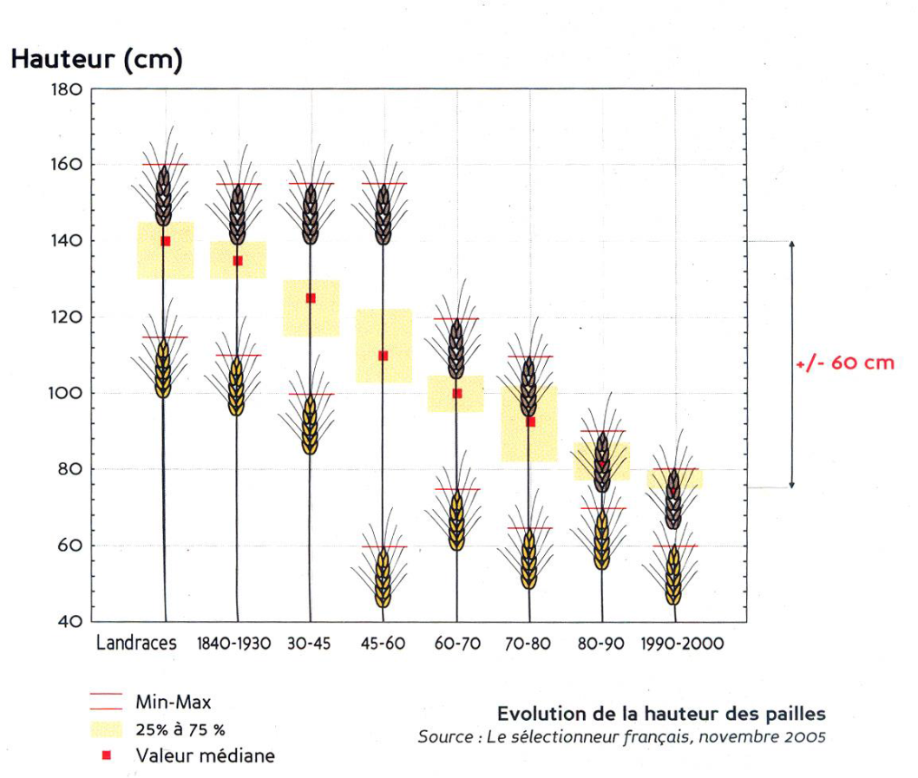
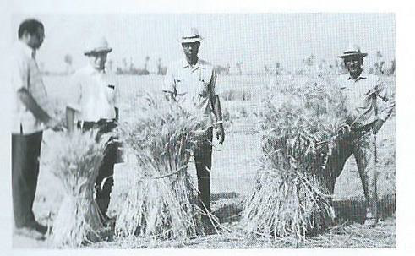
Illustration of anthropogenic influence
2. Change at the field scale: evolution of the wheat
Variety of wheat and agricultural practices have changed over time
Height of wheat (cm)
-60 cm
No input
With N input
With N & P
inputs
Source: le sélectionneur français, 2005, taken from a ppt from réseau Rhin Meuse Moselle
Semences paysannes et citoyennes
Source: M Aquil Khan
The World Wheat Book, 2nd edtion, Lavoisier 2011
Not integrated into the model

Slide 6
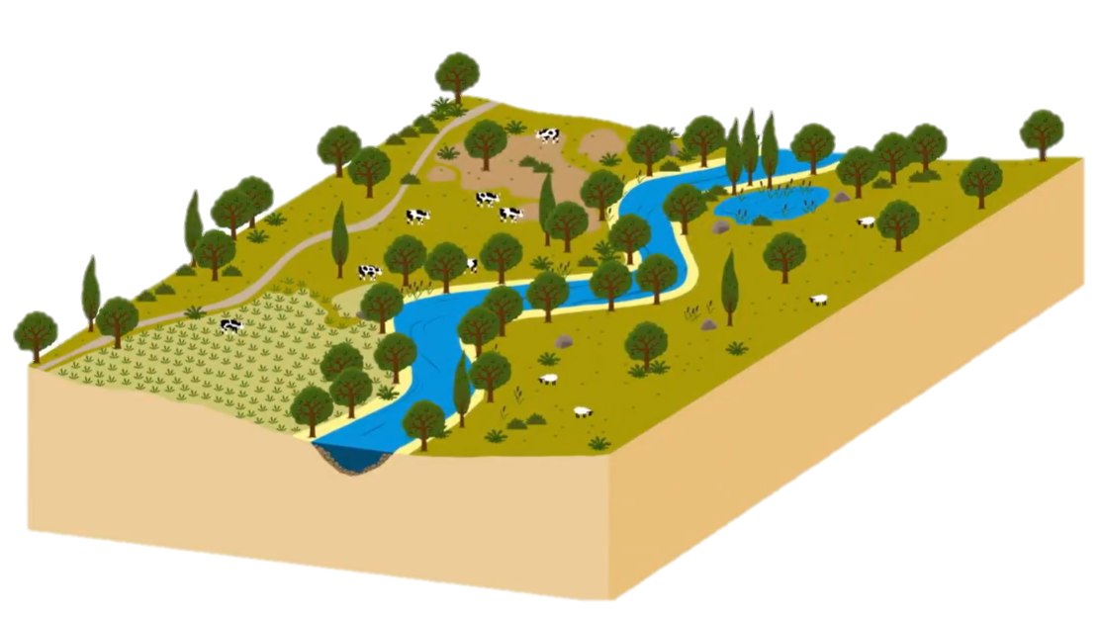
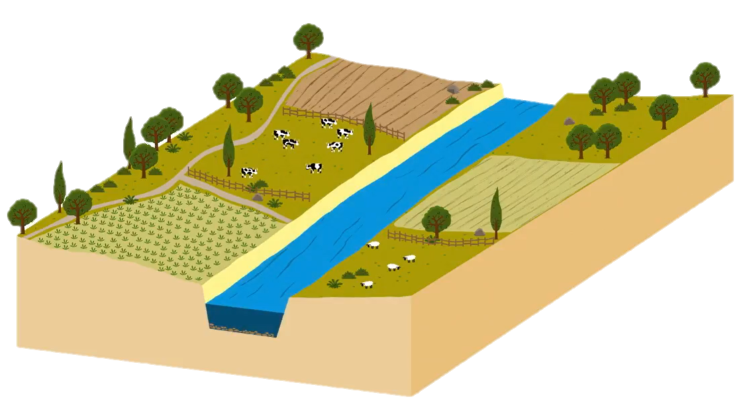
Illustration of anthropogenic influence
3 . Change of the river course
Associated with field drainage
Decrease water storage capacity in the basin (soil and aquifer)
More rapid flow
Not integrated into the model

Slide 7
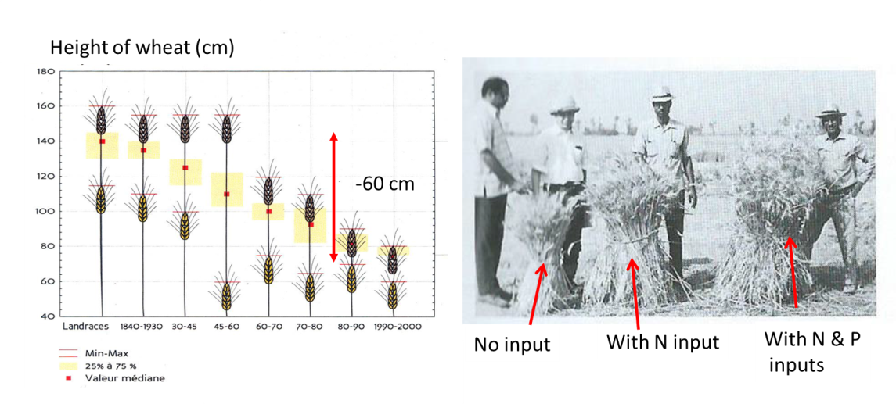
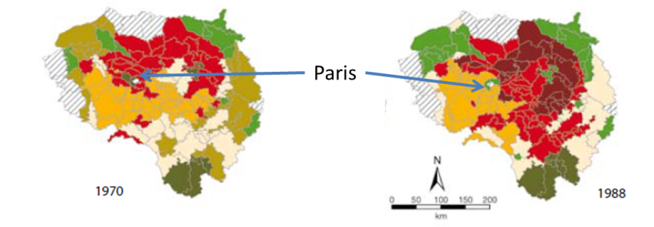
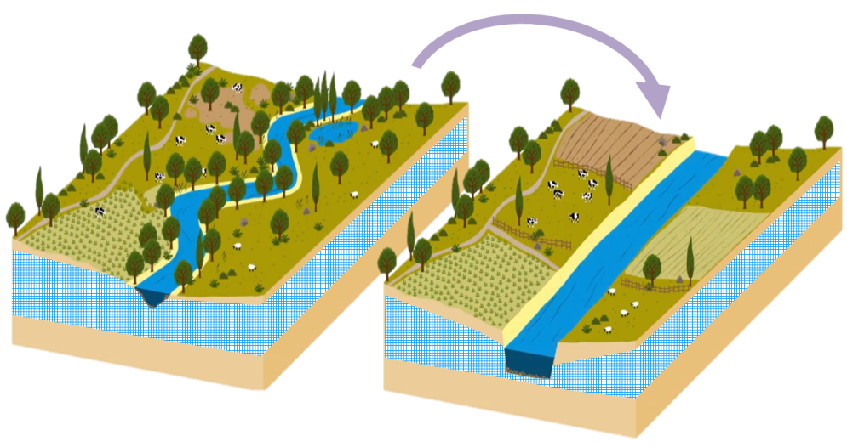
How to quantify regional hydrological change impact? some examples from France
it’s difficult for the model to account for these changes
Only the analyses of combined observations may help to understand what’s happening:
Examples with river flows, lysimeters and small reservoirs

Slide 8
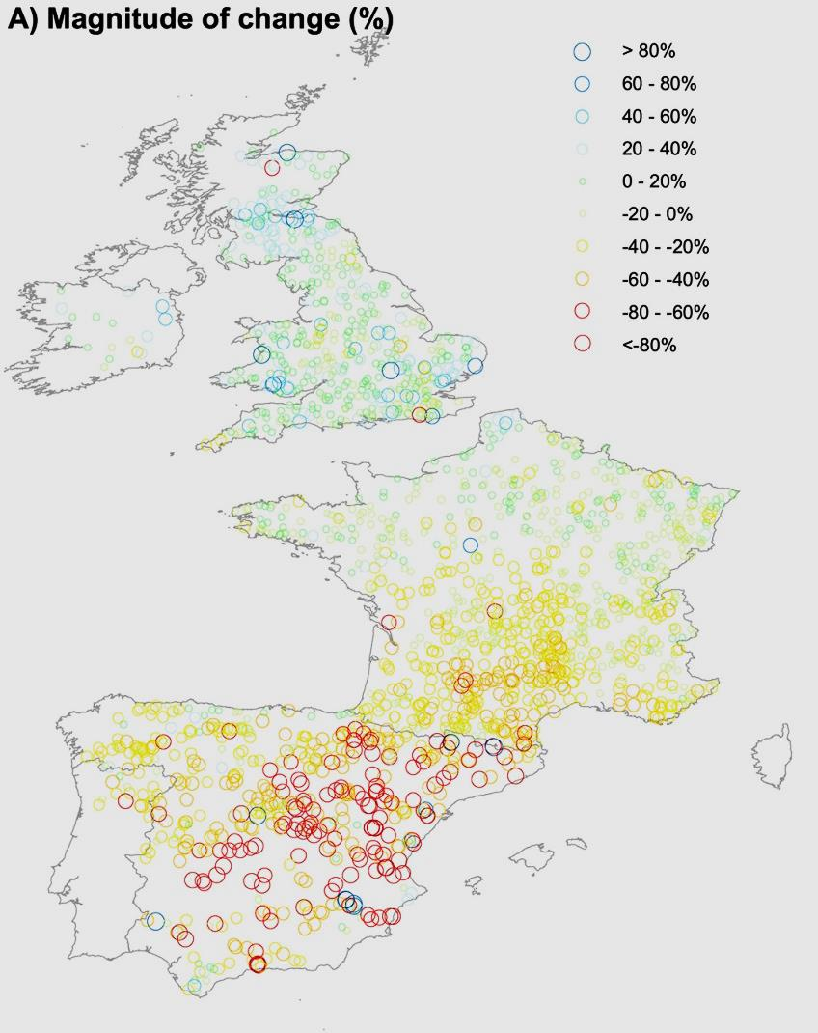
Learning from long river flow series
Estimated trends using obs and reconstructed river flows from 1961 to 2012.
Vicente‐Serrano, et al, 2019

Slide 9
Learning from long river flow series
Estimated trends using obs and reconstructed river flows from 1961 to 2012.
Increase
decrease
Vicente‐Serrano, et al, 2019

Slide 10
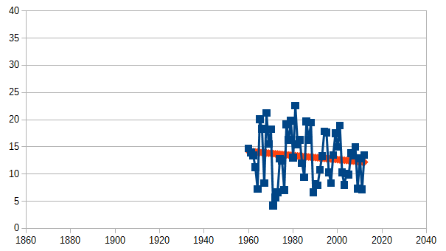
Learning from long river flow series
Estimated trends using obs and reconstructed river flows from 1961 to 2012.
Increase
Armançon at Aisy sur Armançon (1 350 km² )
Annual river flows
decrease
Vicente‐Serrano, et al, 2019

Slide 11
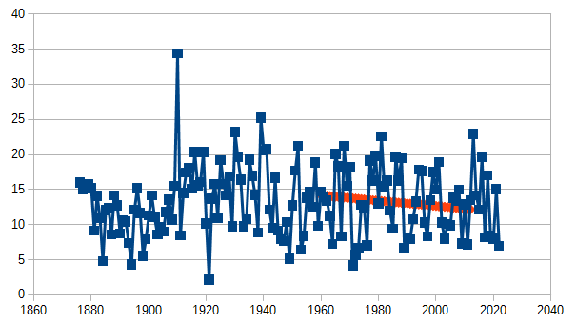
Learning from long river flow series
Estimated trends using obs and reconstructed river flows from 1961 to 2012.
Increase
Armançon at Aisy sur Armançon (1 350 km² )
Annual river flows
Over the full period of observation
decrease
Vicente‐Serrano, et al, 2019

Slide 12
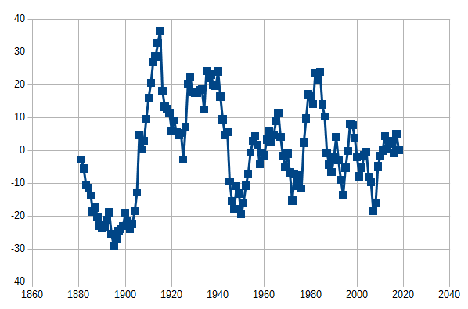
Learning from long river flow series
Armançon at Aisy sur Armançon (1 350 km² )
Annual river flows
Simple running average provides different view of the temporal variation
+20%
average
-20%

Slide 13
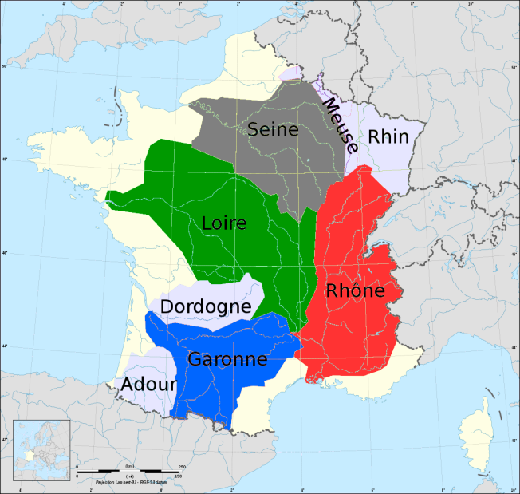
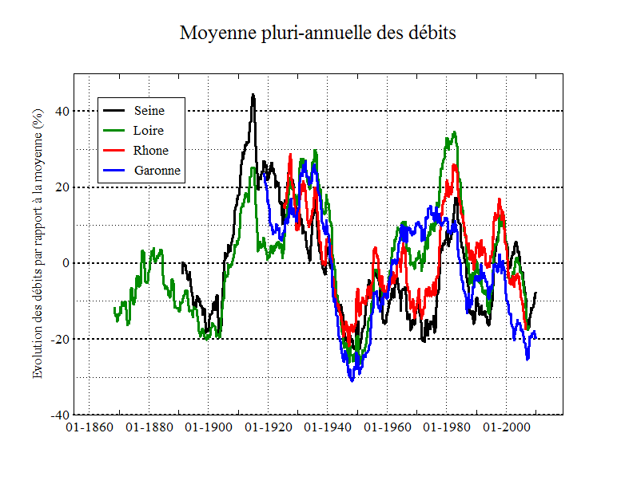
Learning from long river flow series
Simple running average provides different view of the temporal variation
+20%
average
Similar variations are found for the 4 main French rivers
From south to north
-20%

Slide 14
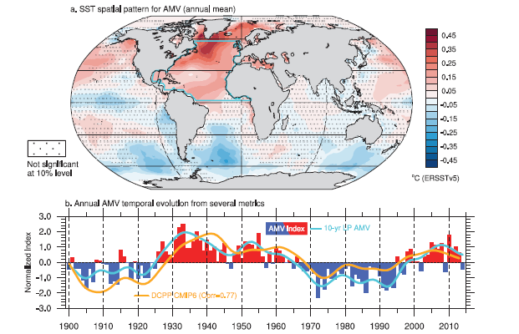
Learning from long river flow series : Multi decadal variability
Linked to the Atlandic Multidecal Variability (AMV)
Cassou et al.2021 IPCC AR6

Slide 15
Learning from long river flow series : Multi decadal variability
Linked to the Atlandic Multidecal Variability (AMV)
Cassou et al.2021 IPCC AR6
larger than the average
lower than the average
River flows of 38 available stations
1910-30 1938-58 1965-85 1995-2012
Boé et Habets, HESS 2014 « Multi-decadal river flow variations in France”

Slide 16
Learning from long river flow series : Multi decadal variability
Linked to the Atlandic Multidecal Variability (AMV)
Cassou et al.2021 IPCC AR6
Associated to about 1° T increase and
30% less precipitation
in spring
larger than the average
lower than the average
River flows of 38 available stations
1910-30 1938-58 1965-85 1995-2012
Boé et Habets, HESS 2014 « Multi-decadal river flow variations in France”
Boé et Habets, HESS 2014 « Multi-decadal river flow variations in France”

Slide 17
Learning from long river flow series : Multi decadal variability
Linked to the Atlandic Multidecal Variability (AMV)
Cassou et al.2021 IPCC AR6
on the Seine basin (Bonnet et al 2020):
Evidence that high flows are 3 times more frequent during cold AMV phase
A ~ 10 years lag between AMV and precipitation
Associated to about 1° T increase and
30% less precipitation
in spring
larger than the average
lower than the average
River flows of 38 available stations
1910-30 1938-58 1965-85 1995-2012
Boé et Habets, HESS 2014 « Multi-decadal river flow variations in France”
Boé et Habets, HESS 2014 « Multi-decadal river flow variations in France”

Slide 18
Learning from long river flow series : Multi decadal variability
Linked to the Atlandic Multidecal Variability (AMV)
Cassou et al.2021 IPCC AR6
on the Seine basin (Bonnet et al 2020):
Evidence that high flows are 3 times more frequent during cold AMV phase
A ~ 10 years lag between AMV and precipitation
Associated to about 1° T increase and
30% less precipitation
in spring
larger than the average
lower than the average
River flows of 38 available stations
1910-30 1938-58 1965-85 1995-2012
Boé et Habets, HESS 2014 « Multi-decadal river flow variations in France”
Boé et Habets, HESS 2014 « Multi-decadal river flow variations in France”

Slide 19
Learning from long river flow series: evolution of the evapotranspiration
Data rescue on the Seine basin: reconstitution of long chronicles
Ability to check the consistency of the data, including modification of the river bed
The reconstruction both of regional past climate and river flows made it possible to estimate the long term evolution evapotranspiration :
Evapotranspiration ~ Precipitation – River Flow
(Bonnet et al; 2020)

Slide 20
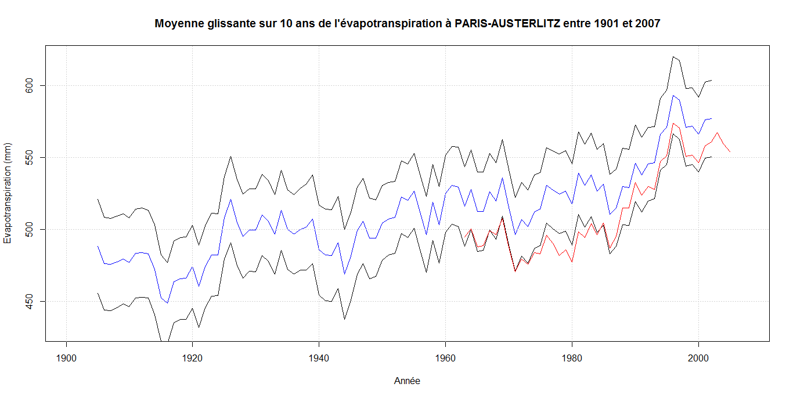
Learning from long river flow series: evolution of the evapotranspiration
Data rescue on the Seine basin: reconstitution of long chronicles
Ability to check the consistency of the data, including modification of the river bed
The reconstruction both of regional climate and river flows made it possible to estimate the long term evolution evapotranspiration :
Evapotranspiration ~ Precipitation – River Flow
(Bonnet et al; 2020)
Max
600 -
Evapotranspiration derived from P-Q on the Seine basin at Paris
average
Min
Evapotranspiration (mm)
500 -
(Salmon internship, 2017)
1900
1950
2000

Slide 21
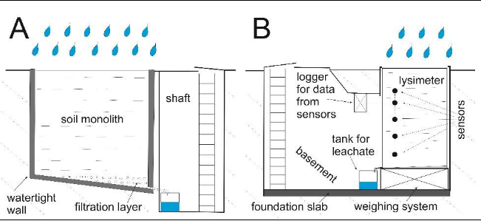
Learning from Lysimeters
Lysimeter
Lysimeters provide a direct observation of deep infiltration ~ groundwater recharge
Ψ _{i},ω_{i}
Sołtysiak & Rakoczy 2019

Slide 22
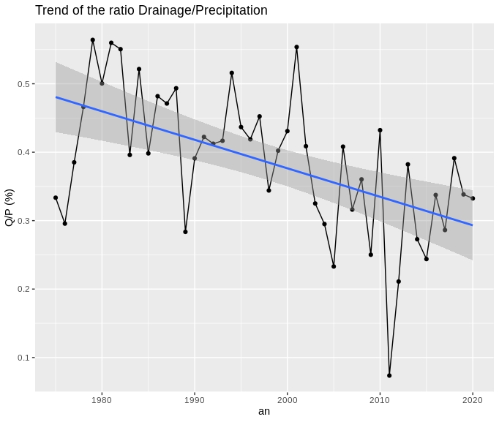
Learning from Lysimeters : Long term evolution of evapotranspiration
Clear impact also visible on the basin using lysimeter data
Lysimeter
Lysimeters provide a direct observation of deep infiltration ~ groundwater recharge
Ψ _{i},ω_{i}
Sołtysiak & Rakoczy 2019
In Fagnières (Inrae) East part of the Seine basin
Decrease of the part of the precipitation that leads to recharge ➔ consistent with the increase of evapotranspiration
Bare soil lysimeter
Sobaga et al in prep

Slide 23
Learning from Lysimeters: impact of intense precipitations & vegetation
On the Fagnières site: no significant change of the intense daily precipitation, nor clear evolution on the contribution to the recharge

Slide 24
Learning from Lysimeters: impact of intense precipitations & vegetation
On the Fagnières site: no significant change of the intense daily precipitation, nor clear evolution on the contribution to the recharge
But recharge from Intense precipitations depends on vegetation cover
Bare soil grass vine short crop rotation
In summer time
Intensity of the precipitation larger than a threshold
Long crop rotation
Even with catch crop if the crop is beet
Duration of the event is
larger than a threshold
Long crop rotation
Only If the plant cover in the rotation is Barley
Antecedent precipitation larger than a threshold
Sobaga et al in prep

Slide 25
Learning from Lysimeters: interest of long duration network
Fully instrumented lysimeter long duration network such as Tereno soil can (Pütz et al. 2016)
help understandf how and why groundwater recharge vary
Soil properties and their temporal evolution
Climate
Vegetation

Slide 26
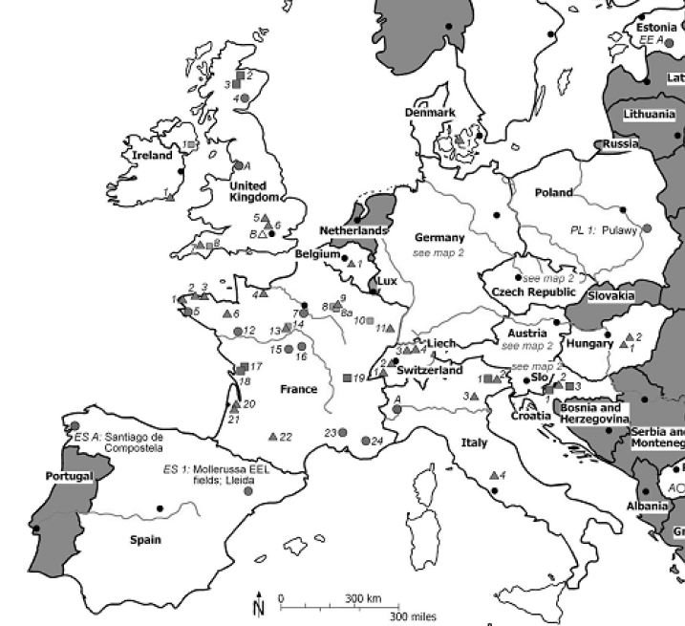
Learning from Lysimeters: interest of long duration network
Fully instrumented lysimeters long duration network such as Tereno soil can (Pütz et al. 2016)
help understand how and why groundwater recharge vary
Soil properties and their temporal evolution
Climate
Vegetation
Objective: to build a French network of lysimeters using still existing sites:
➔ Data rescue and accessibility
real time access to be available for management and forecast purposes.
and possibly new sites from ANAEE or OZCAR observatories
Lanthaler & Fank 2005

Slide 27
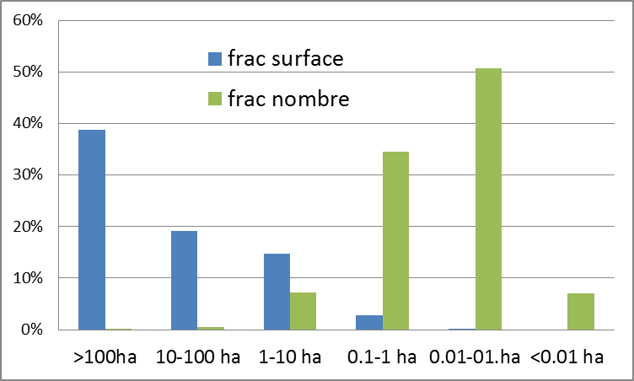
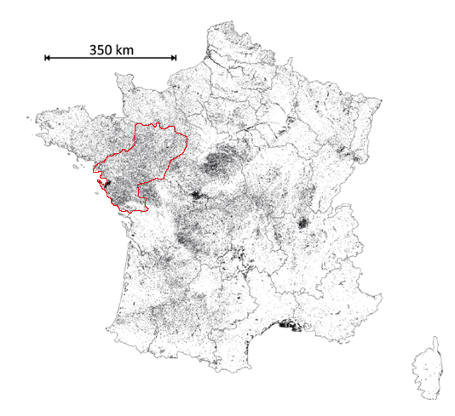
Monitoring the numerous water reservoirs
Around ~600 000 water reservoirs in France
98% man made
Total surface around 0.8% de la France
→ Almost a third of the irrigated surface water
Partition of the reservoirs
Most of the reservoirs are located directly on source or on the river.
In such case, they can fill-up several times during a year: the volume of the reservoir is not enough to anticipate their impact..
Terasmaa et al., Heliyon, 2019

Slide 28
Monitoring the numerous water reservoirs
As small reservoirs (less than 1 million m³) are numerous
It is important to consider their accumulated impact on the river flow
Review on the accumulated impact, estimated based on: direct observation, comparison between 2 contrasted basins, simulations
Few reservoirs, large precipitation ➔ weak impact?
Numerous reservoirs, few precipitation ➔ large impact?
Habets, Molénat et al., HESS, 2018 The cumulative impacts of small reservoirs on hydrology: A review

Slide 29
Monitoring the numerous water reservoirs
As small reservoirs (less than 1 million m³) are numerous
It is important to consider their accumulated impact on the river flow
Review on the accumulated impact, estimated based on: direct observation, comparison between 2 contrasted basins, simulations
The impacts can be large :
A decrease of river flows from 7 to 35%
But there is no direct relation with density and precipitation
➔ It depends on how the reservoirs are used…
Habets, Molénat et al., HESS, 2018 The cumulative impacts of small reservoirs on hydrology: A review

Slide 30
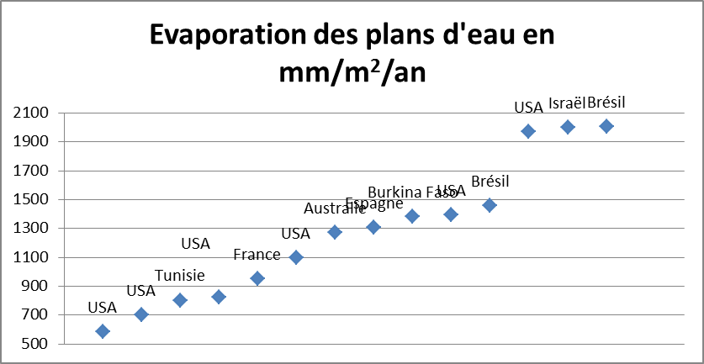
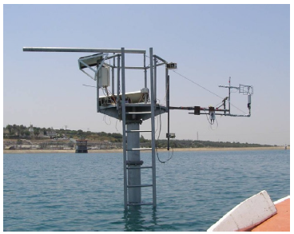
Monitoring the numerous water reservoirs
Evaporation loss from reservoirs are not easy to estimate: water balance, isotopic approach
flux tower
Estimation varies by a factor of 4 sometimes close or far larger than PET
Tanny et al., (2011).
The loss of evaporation by the reservoir is expected to increase with climate change
The number of reservoir are expected to increase as an adaptation to water shortage…
Habets, Molénat et al., HESS, 2018 The cumulative impacts of small reservoirs on hydrology: A review

Slide 31
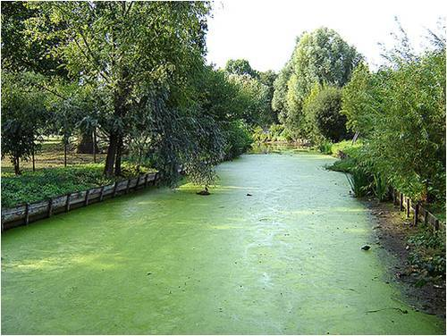
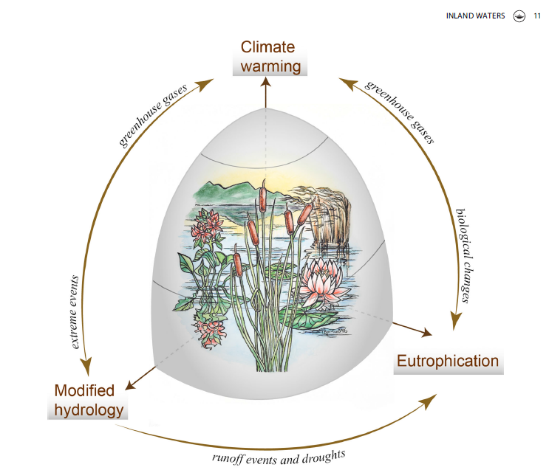
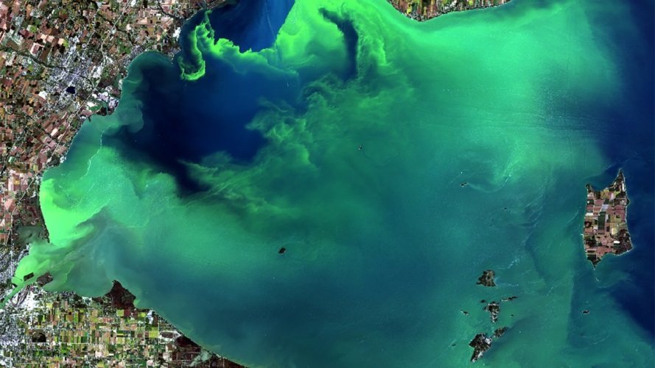
Monitoring the numerous water reservoirs
Monitoring should include qualitative aspect, as eutrophication
Meerhof et al. 2022, Inland Waters

Slide 32
How to quantify regional hydrological change impact? some examples from France
It is still difficult to quantify the contribution of each change (climate, land cover, dam) to regional hydrology
It’s still needed to
Save and better take advantage of old data
Complete operational monitoring limited today to meteorology , river, groundwater with other compartments: soil, recharge, lakes…
Improve the collaboration with the critical zone research community

