Slide 1
Towards an Open Digital Twin of Soil-Plant System
Yijian Zeng (y.zeng@utwente.nl)
Bob Su (z.su@utwente.nl)
Department of Water Resources
ITC Faculty of Geo-Information Science and Earth Observation
University of Twente, the Netherlands
Notes:
Good morning, my name is Yijian Zeng, and together with Bob Su, we are currently working towards a digital twin of soil-plant system.
Here, I would like to highlight “towards”, so there are still quite some distances before we can have a fully functional soil-plant digital twin.

Slide 2
What is a Digital Twin? and … a Digital Twin Earth?
Notes:
Before I started, i would like to use this short video to introduce the concept of digital twin in industry.

Slide 3
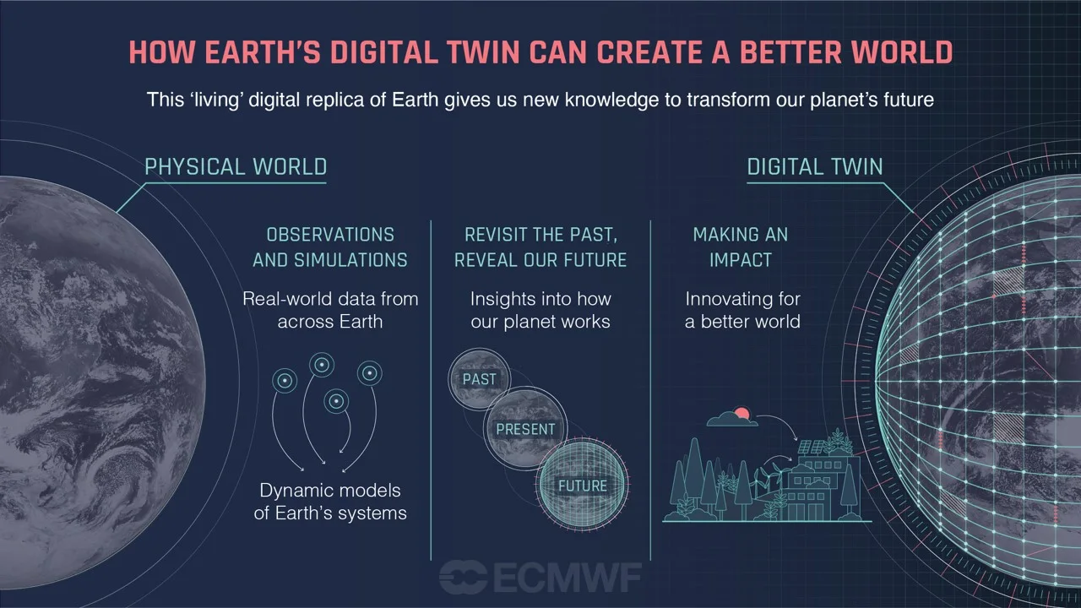
What is a Digital Twin? and … a Digital Twin Earth?
Digital Twin is a digital representation of product or process that is built using real time sensor data and algorithm.
Digital Twin can virtually simulate everything that will happen in the physical world, thus providing valuable insights for future planning and development.
This also allows testing and better understanding of product in early stage, thus minimizing downtime and reducing cost.
Notes:
Ok, sorry that I have to stop the music. So, according to the definition of GeoSpatial World:
a Digital Twin is a digital representation of product or process that is built using real time sensor data and algorithm.
And it can virtually predict everything that will happen in the physical world, thus providing valuable insights for future planning and development.
And as such, this also testing and better understanding of product in early stage, thus minizing downtime and reducing cost.
the definition of Digital Twin Earth is almost identical to the general definition of Digital Twin.
For example, “real-world data from across Earth” can be referred to “real time sensor data”, and the “Dynamic Models of Earth’s Systems” can be referred to the ‘algorithm’.
And then, the Earth system’s simulation of the past, present, and future can provide insights for future planning and development, and allow testing and better understanding of the Earth in an early stage.
As such, the digital twin Earth can create a better world, minimizing downtime and reducing cost.

Slide 4
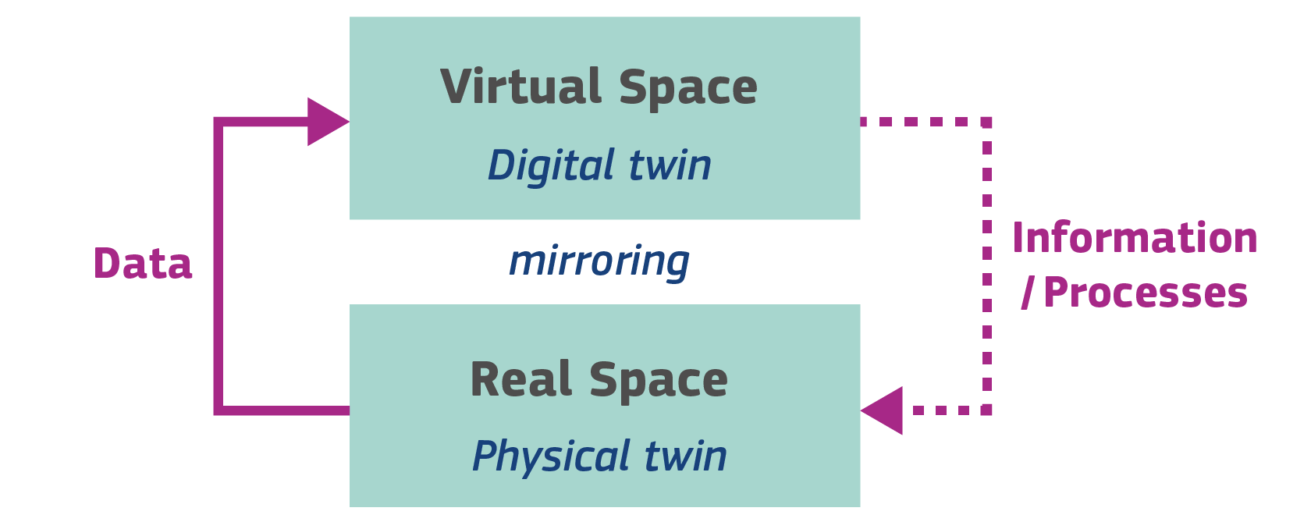
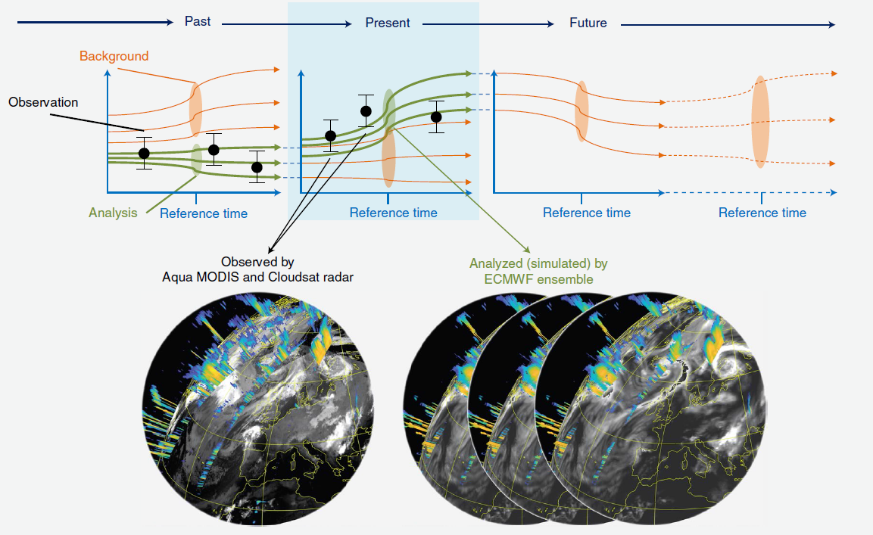
What is a Digital Twin? and … a Digital Twin Earth?
Data assimilation as the core of the Digital Twin Engine.
Digital Twin is a digital representation of product or process that is built using real time sensor data and algorithm.
Digital Twin can virtually simulate everything that will happen in the physical world, thus providing valuable insights for future planning and development.
This also allows testing and better understanding of product in early stage, thus minimizing downtime and reducing cost.
ESM simulation without assimilating observations
ESM simulation assimilating observations
(Bauer et al. 2021)
Notes:
So, the key workflow of a digital twin Earth can be represented by this simple diagram, which pointing to the importance of data assimilation as the core of the Digital Twin Engine.

Slide 5
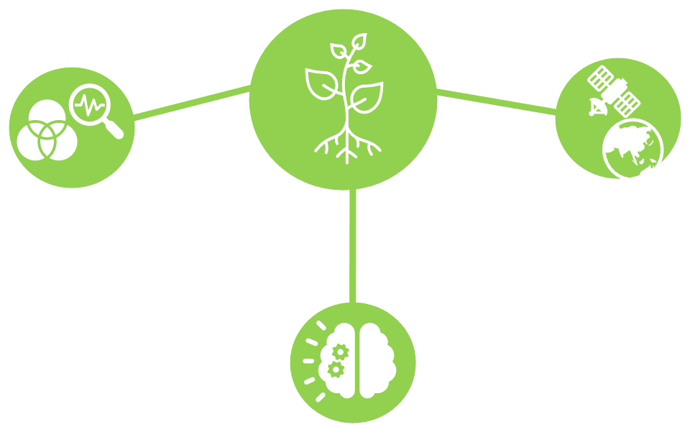
A Digital Twin for Soil-Plant System based on STEMMUS-SCOPE
Coupling two models for a Digital Representation of the soil-plant system
Data assimilation to incorporate Earth Observation data
Physics-aware machine learning to approximate the coupled model
Notes:
To build a digital twin for soil-plant system, we basically need three parts.
We will couple the soil and plant model for a digital representation of the soil-plant system.
Apply the physics-aware machine learning to approximate the coupled model
And using the data assimilation technique to incorporate Earth Observation Data

Slide 6
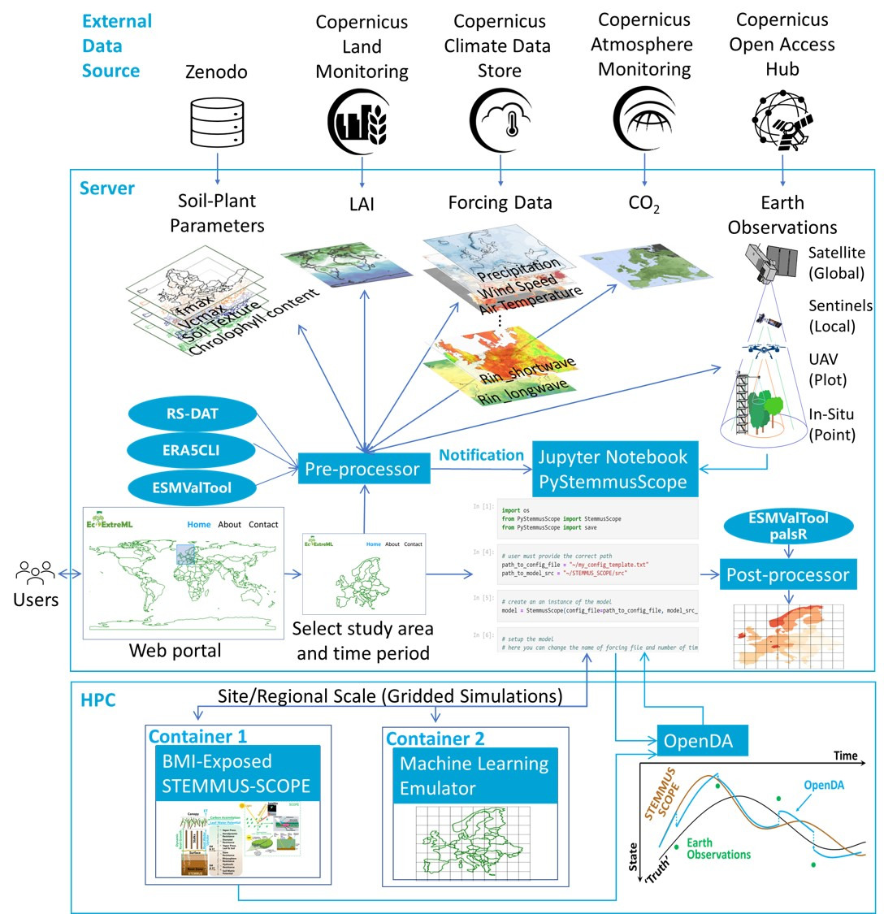
Digital Infrastructure Following FAIR Principles
The external data source including the static soil-plant parameters, dynamic forcing data, and Earth observation data.
The server hosting the user interface/front-end (e.g., web portal, Jupyter notebook), the pre-processor, and the post-processor.
The HPC facility hosting the containers of the STEMMUS-SCOPE model, the machine learning emulator, and the data assimilation workflow.
Notes:
To realize the above Soil-Plant Digital Twin, we need to design the digital infrastructure following FAIR principles.
And with colleagues from the Netherlands eScience center, we are currently constructing this soil-plant digital twin.

Slide 7
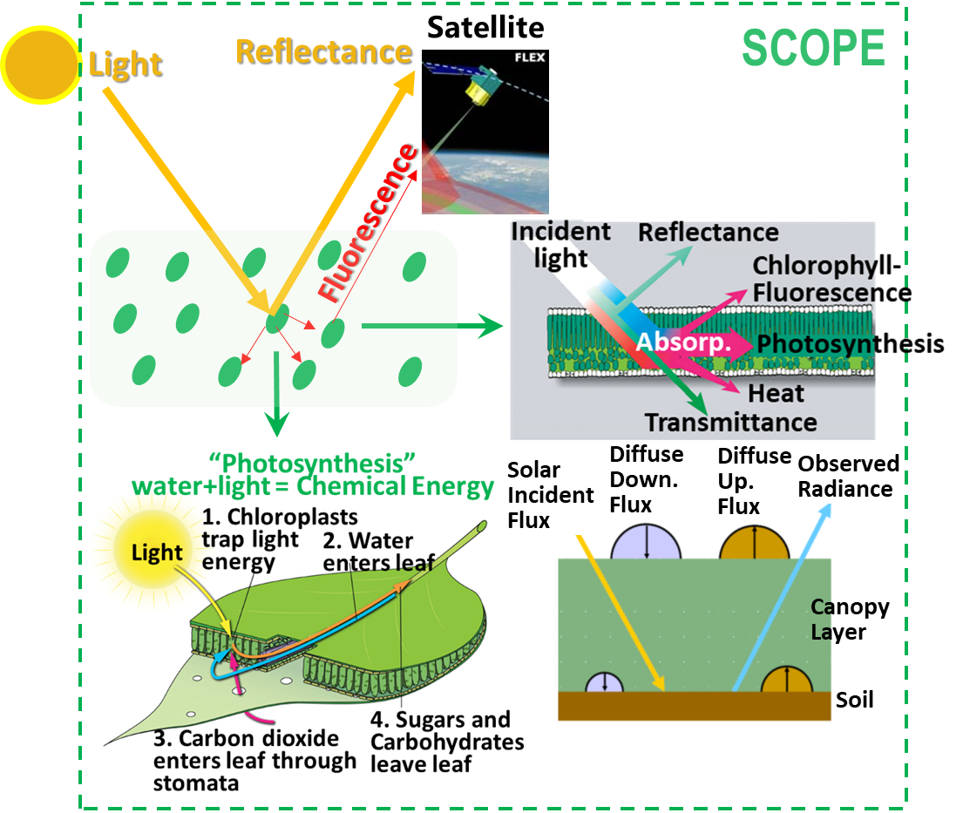
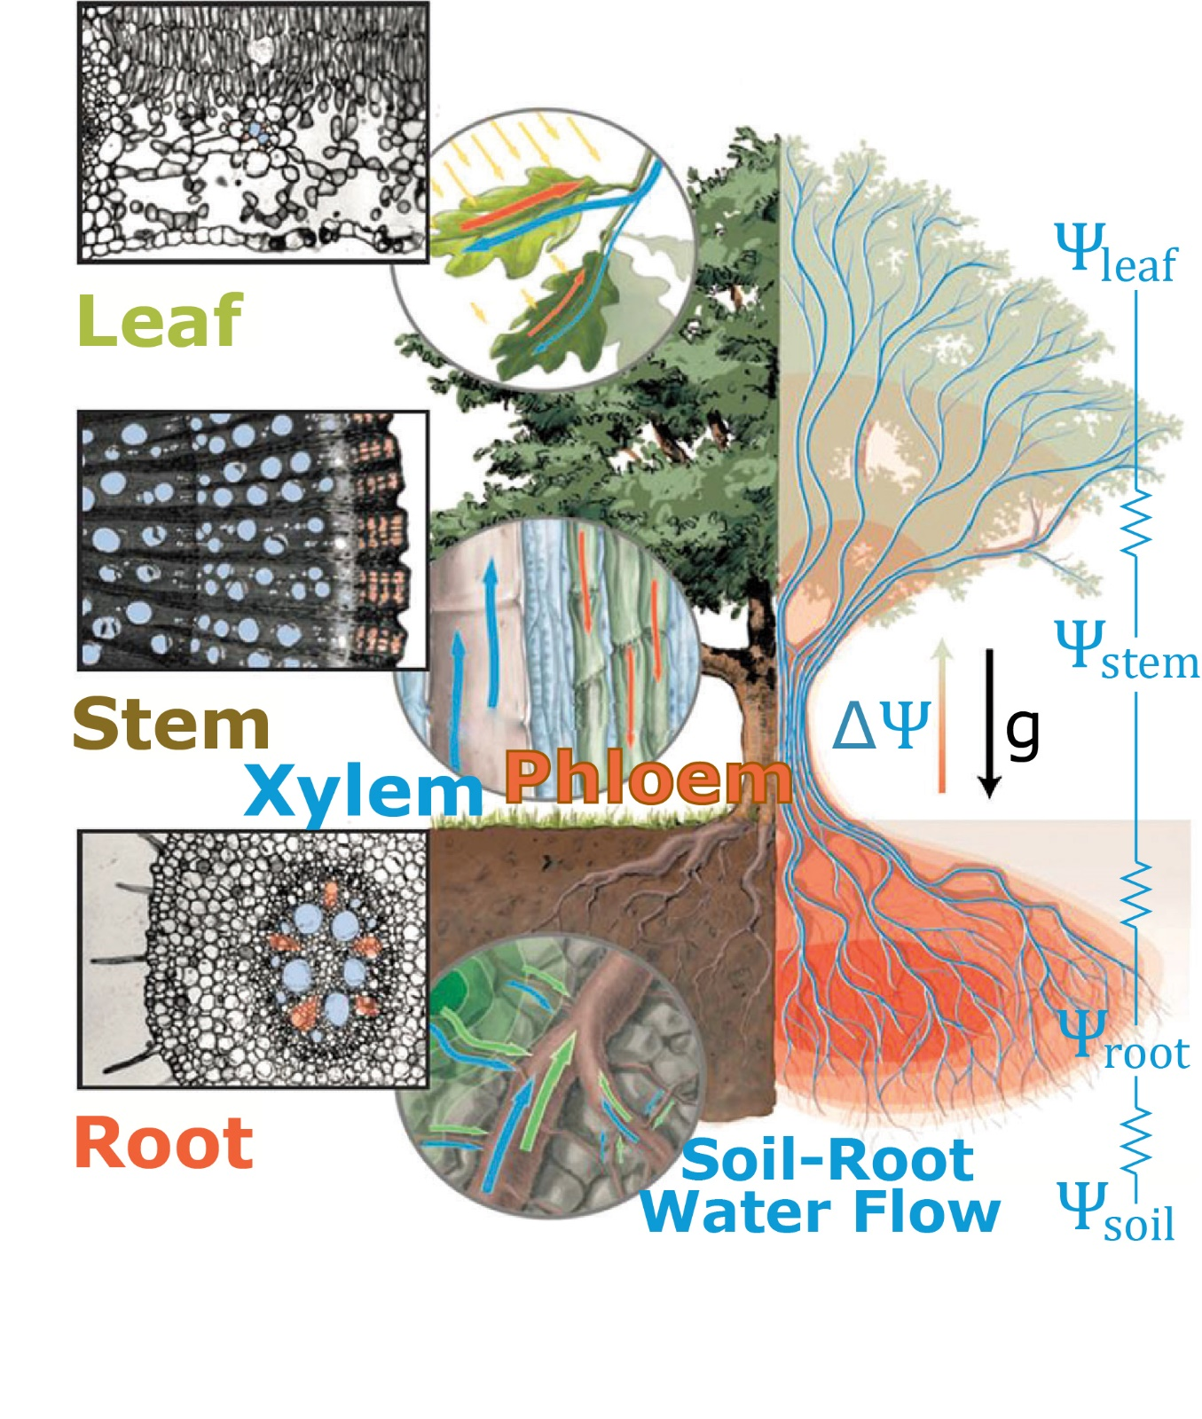
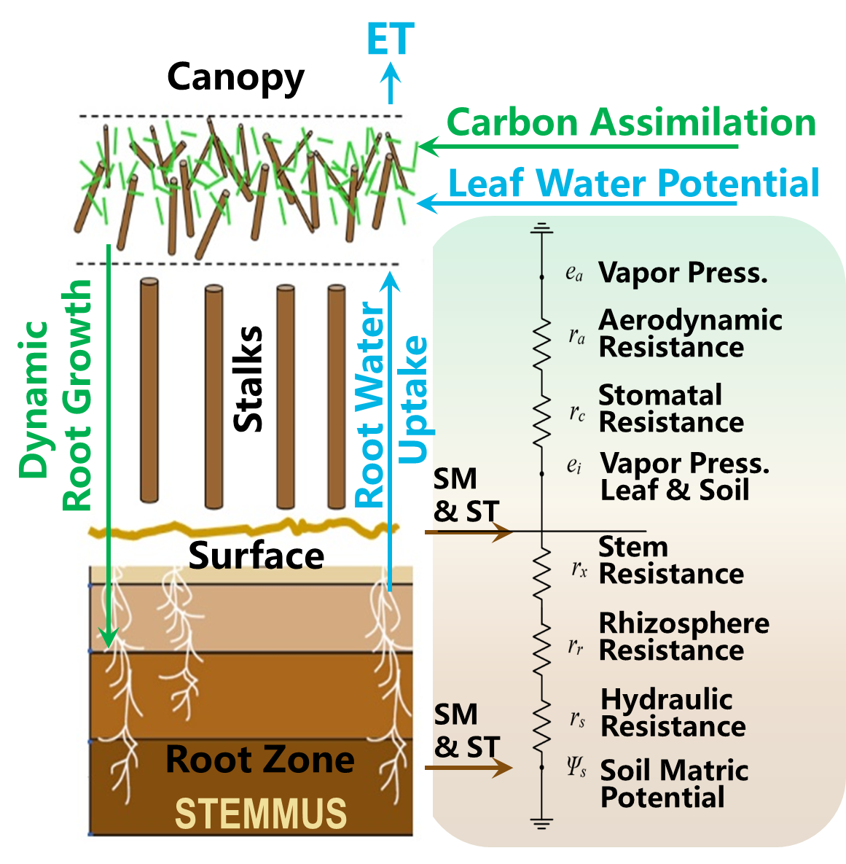
A Digital Twin for Soil-Plant System based on STEMMUS-SCOPE
STEMMUS-SCOPE:
Integrated modelling of canopy photosynthesis, fluorescence,
and the transfer of energy, mass, and momentum in
the SPAC continuum.
Linking SIF (Solar-Induced Fluorescence)
to Soil-Water-Plant-Energy Interactions
Notes:
So, as mentioned, we are going to develop this digital twin based on STEMMUS-SCOPE model.
The STEMMUS-SCOPE model includes two part: one for vegetation, and one for soil.
For vegetation, we are using SCOPE model, which considers the photosynthetic processes, energy balance, and radiative transfer processes, and can serve as a forward simulator to simulate reflectance and fluorescence.
For soil, we use the STEMMUS model, which considers simultaneous transfer of liquid, vapor, dry air, and heat. It calculates soil moisture, soil temperature, soil matric potential in a coupled manner. And provide these soil states to calculate the hydraulic resistance scheme.
As such, the STEMMUS-SCOPE link the Solar-Induced Fluorescence to the soil-water-plant-energy interactions.

Slide 8
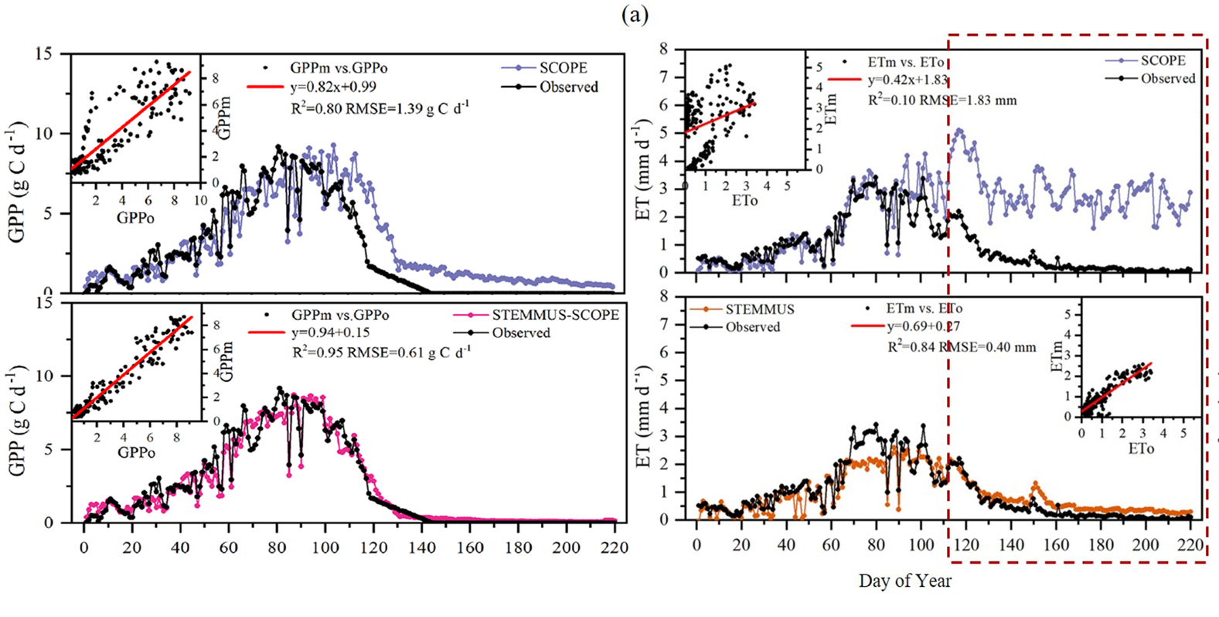
STEMMUS-SCOPE for Understanding Drought Responses
Fluxnet site: US-Var (Grassland)
Without considering soil water stress, the water and carbon fluxes are overestimated during dry period;
Notes:
So just a quick example showing the performance of STEMMUS-SCOPE over a dry grassland site in the United States.
The top panel shows that without the coupling, the soil water stress is not considered, and the simulation of water and carbon fluxes are overestimated during dry period.
However, using the coupled STEMMUS-SCOPE model, both GPP and ET can be captured very well.

Slide 9
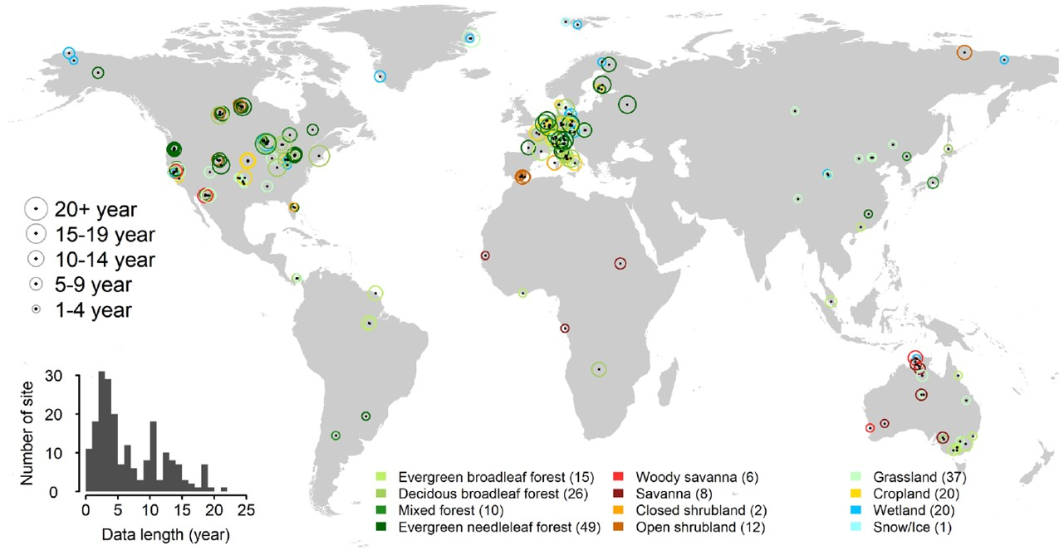
GEWEX - PLUMBER2 (Land Surface Model Benchmarking Evaluation Project )
STEMMUS-SCOPE: ~1.5 walltime hour, for 1 month simulation period
(i7-8700CPU 3.70GHz, 32GB RAM)
FLUXNET2015 DATA:
1532 site-yrs $×$ 18 (computer hr) = 27576 hr = 1149 days
And then Globally (at 1km resolution):
150 x 10⁶ km² $×$ $1yr×$ 18 (computer hr) = 2700 x 10⁶ hr = 308 219 yr
FLUXNET2015 DATA:
1532 site-yrs $×$ 18 (computer hr) = 27576 hr = 1149 days
EcoExtreML + NLeScience = 5 days
1149/5 = 230 times faster ~
Notes:
And then we run STEMMUS-SCOPE for 170 Fluxnet sites.
So the original version of STEMMUS-SCOPE needs 1.5 walltime hour to finish 1 month simulation period.
And the FLUXENET 2015 data includes 1532 site-years, and it needs more than 3 years to finish the model running. And if we want to run STEMMUS-SCOPE globally at 1km resolution, then it is ridiculously more than 300 thousand years.
But now with the digital infrastructure as I mentioned above, we can finish the running in 5 days, which is already 230 times faster.

Slide 10
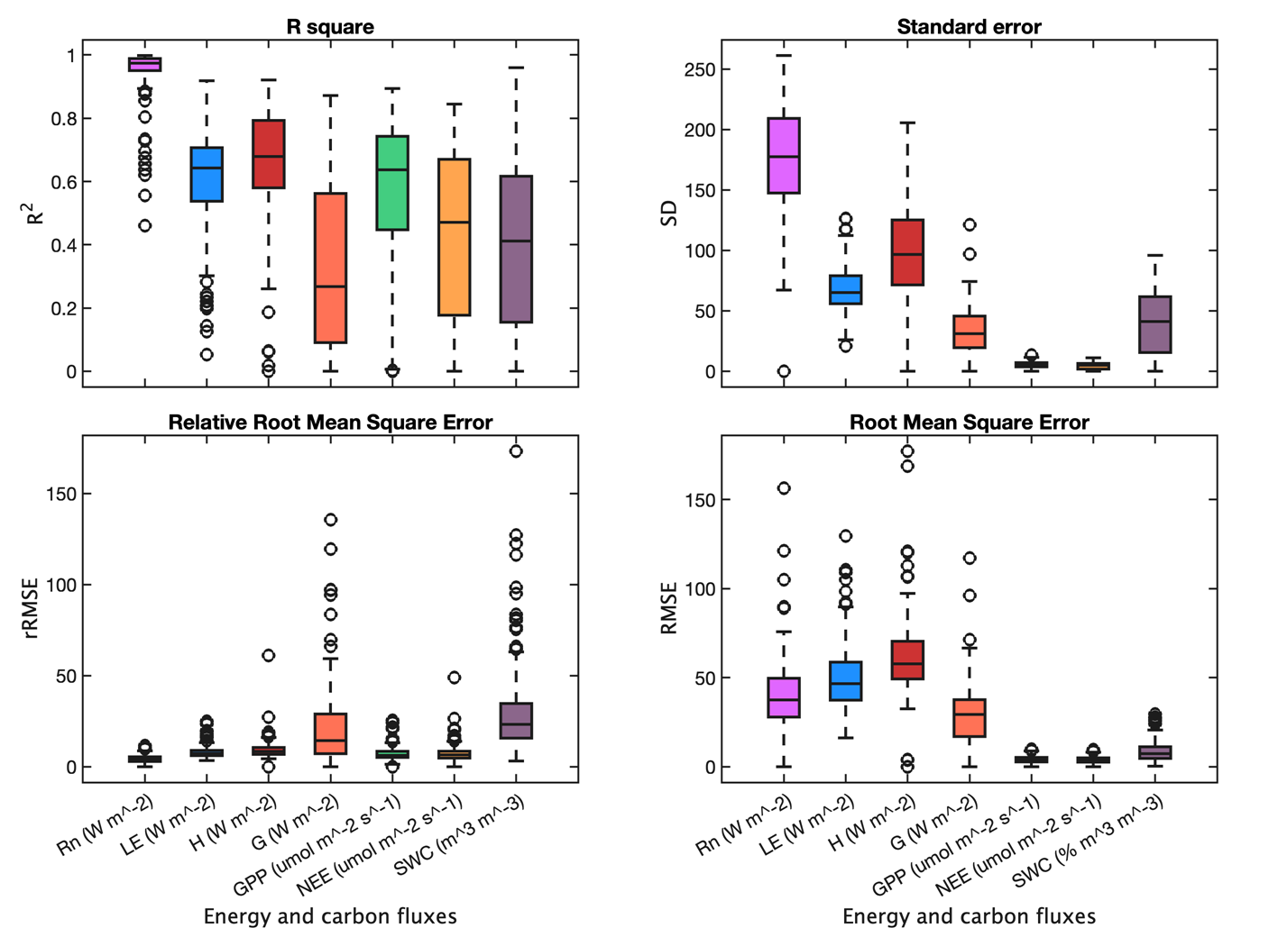
STEMMUS-SCOPE for GEWEX-PLUMBER2
(Wang et al. 2022, unpublished)
General performance of STEMMUS-SCOPE in simulating energy-carbon fluxes and soil water content.
Model Inputs/Driving:
MODIS LAI
ERA5 & PLUMBER2
Soil Hydraulic Parameters (Montzka et al. 2017)
SoilGrids
… …
Without tunning … …
Notes:
So, this is the general performance of STEMMUS-SCOPE for 170 Fluxnet sites.
You see this is the R square, and this is relative root mean square error, we see quite reasonable performance.
One thing I want to highlight here is that, we are using global available datasets as the model inputs without tunning the model.

Slide 11
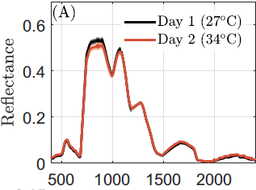
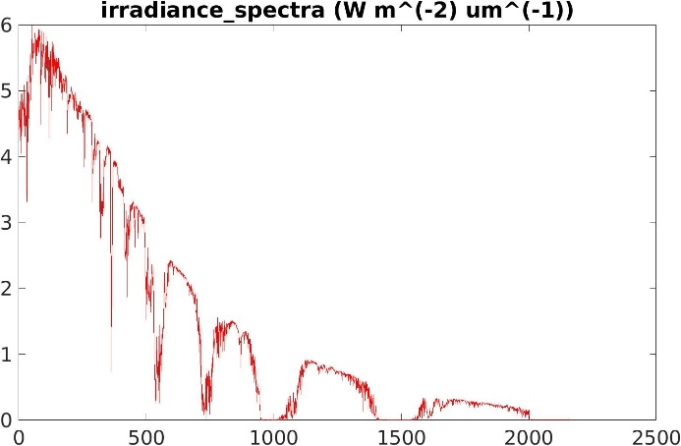
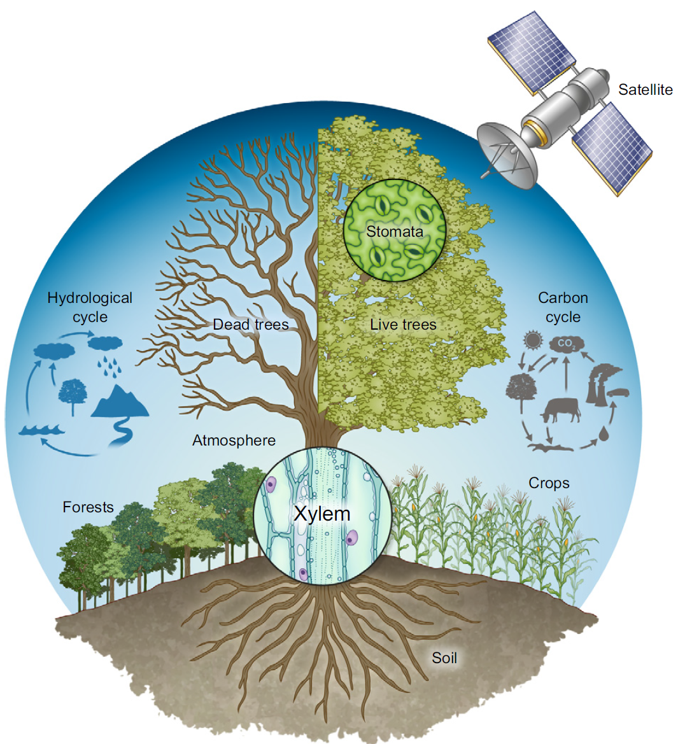
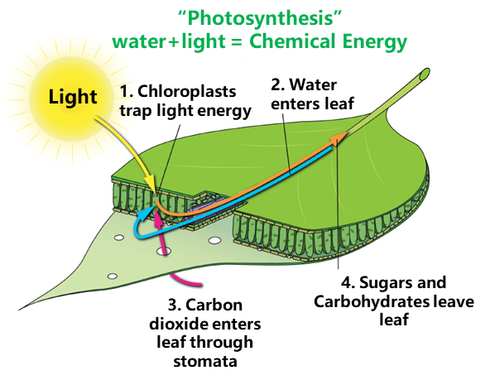
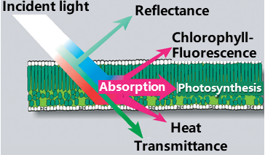
STEMMUS-SCOPE: a ‘Digital Twin’ Coupling Water-Energy-Carbon Processes
STEMMUS-SCOPE links satellite observables in the visible, infrared, and thermal domains to water-energy-carbon processes above- and below-ground. (OSSEs - Observation System Simulation Experiments)
Top of Canopy Solar-Induced Fluorescence (SIF)
Notes:
Ok, furthermore, as mentioned above, STEMMUS-SCOPE can simulate fluorescence and reflectance, as such, linking satellite observables in the visible, infrared, and thermal domains to water-energy-carbon processes above- and below-ground.
This is an example of fluorescence spectrum, this is the reflectance, and the irradiance spectra.
As such, we can design so-called “Observation System Simulation Experiments” to understand the satellite signal and the soil-plant processes.

Slide 12
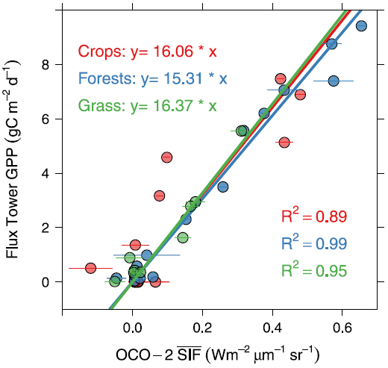
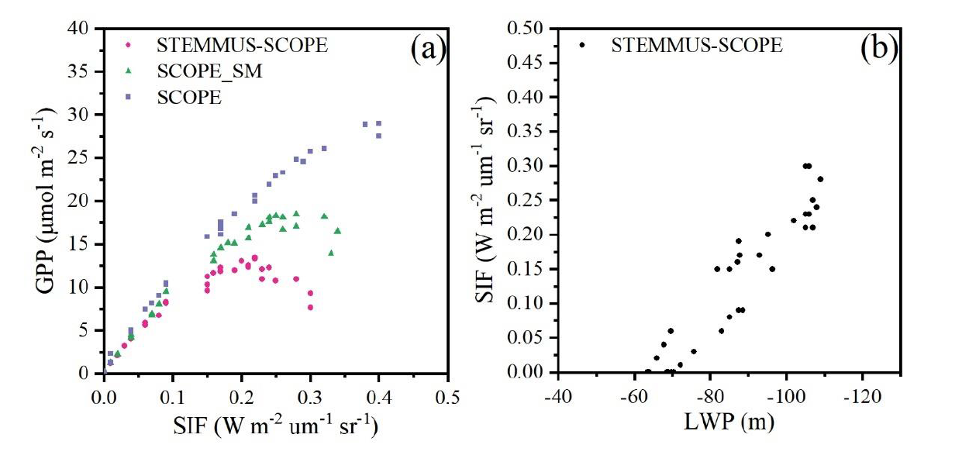
What is SIF? - from the relationship between SIF and GPP
(Sun et al. 2017)
$$GPP=PAR×fAPAR×{LUE}_{Photochemistry}$$
$$SIF=PAR×fAPAR×{LUE}_{Fluorescence}$$
STEMMUS-SCOPE shows that this apparent linear “SIF vs. GPP” is valid when there is no water stress
When the plant is water stressed, “SIF vs. GPP” appears nonlinear.
There seems a linear relationship “SIF vs. Leaf Water Potential”
The apparent linear “SIF vs. GPP” between flux tower GPP and SIF has stimulated the development of SIF remote sensing.
Notes:
Currently, when one compares the satellite SIF with tower GPP, you can find a very good linear relationship. And from these two light use efficiency equations for GPP and for SIF, it seems such linear relationship is further affirmed. In fact, this apparent linear SIF-GPP relationship has stimulated the development of SIF remote sensing. Particularly, ESA is going to launch the Flex mission for monitoring SIF.
Such linear relationship can be simulated by STEMMUS-SCOPE as well. However, what we found is that, this linear relationship is only valid when there is no water stress. Under water stress condition, the SIF-GPP relationship is actually non-linear. On the other hand, we do find that there is a linear relathioship between SIF and leaf water potential, either it is water stressed or not.

Slide 13
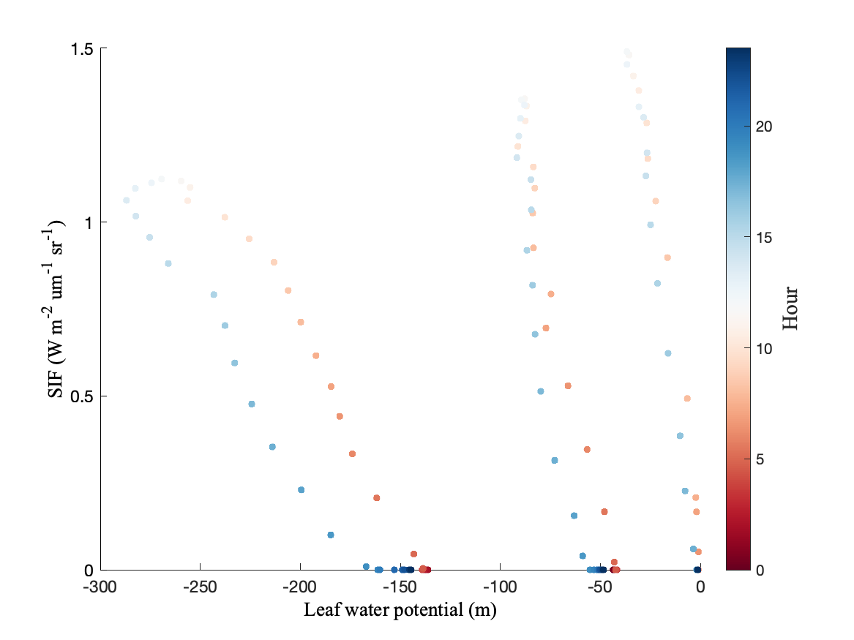
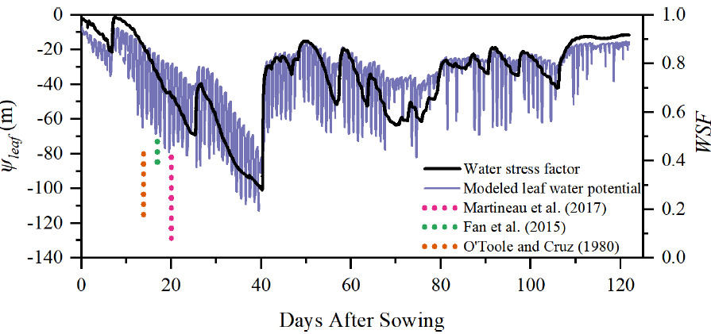
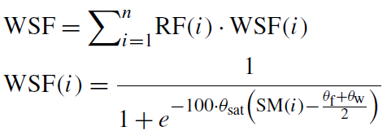
From soil water potential to leaf water potential (LWP)
Non-Stressed
Stressed
GPP and SIF are regulated by electron transport rate and rubisco catalytic activity.
[STEMMUS-SCOPE uses Jmax = 2.68*Vcmax @20 °C & Vcmax= Vcmax0*WSF]
Soil water potential & VPD co-regulate leaf water potential.
Role of Soil-Plant Hydraulics is critical in better explaining SIF-GPP relationship.
RF- root length fraction
Notes:
The question here is then what is the physical explanation for this linerality between SIF and leaf water potential?
If we can see here, the leaf water potential is very much regulated by the water stress factor, and since the SIF is regulated by mutiplying Vcmax with this water stress factor, and then you can see this apparent linerality between SIF and leaf water potential.
It is to note that there is a hysteresis effect on the relationship between SIF and leaf water potential, and this is particularly the case when the soil is water-stressed.
Another question we may ask here is why leaf water potential is regulated by water stress factor. If we see the equation here, water stress factor is a function of soil water content and the root length fraction. This means there is a coordination between leaf water potential and soil water potential.
And this highlights the important role of soil-plant hydraulics in better explaining the SIF-GPP relationship.
__________________________
Another note is that the Jmax, the maximum electron transport rate, in STEMMUS-SCOPE is tightly linked with Vcmax as well. As such, the water stress factor impacts both electron transport rate and rubisco catalytic activity, which subsequently regulate both the SIF and the GPP.
And this is calling for the Plant Hydrauclis approach, as demonstrated by this diagram here.

Slide 14
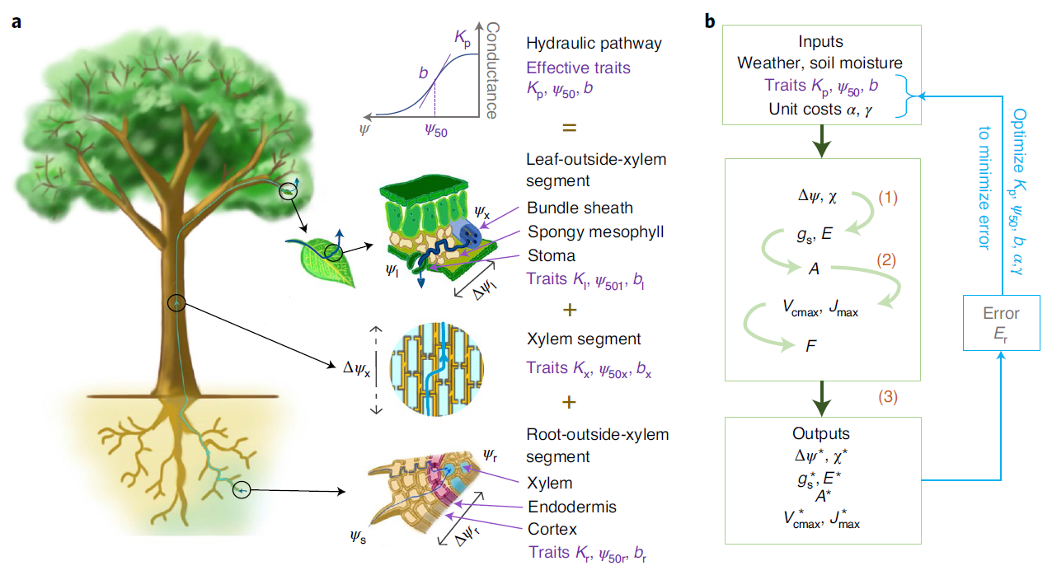
Some Final Notes … …
A trait-based optimality theory that unifies plant photosynthesis and hydraulics
Purple labels indicate the three hydraulic traits that determine the conductance to water flow in each of the three segments of the water pathway within the plant.
The model takes three effective whole-plant hydraulic traits as inputs together with two cost parameters (the unit costs of photosynthetic and hydraulic capacities).
The optimal outputs were calculated using the optimality theory.
Joshi, J., Stocker, B.D., Hofhansl, F. et al. Towards a unified theory of plant photosynthesis and hydraulics. Nat. Plants 8, 1304–1316 (2022). https://doi.org/10.1038/s41477-022-01244-5

Slide 15
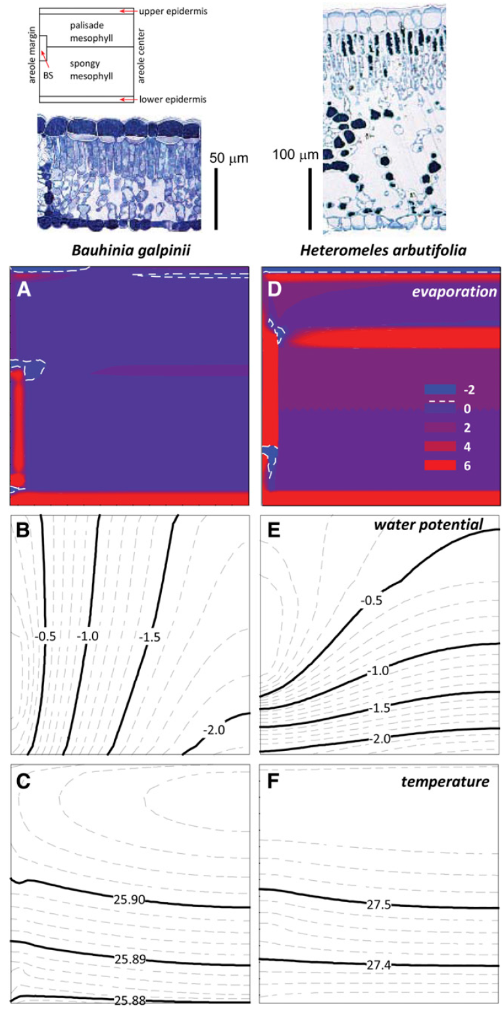
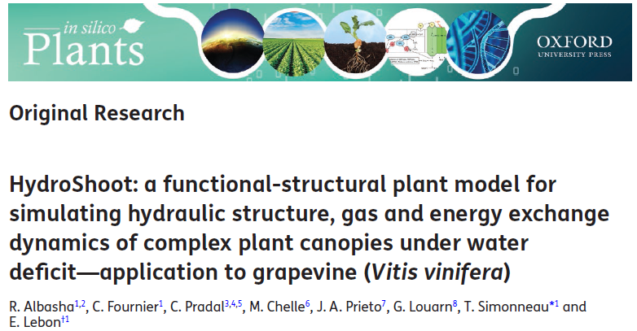
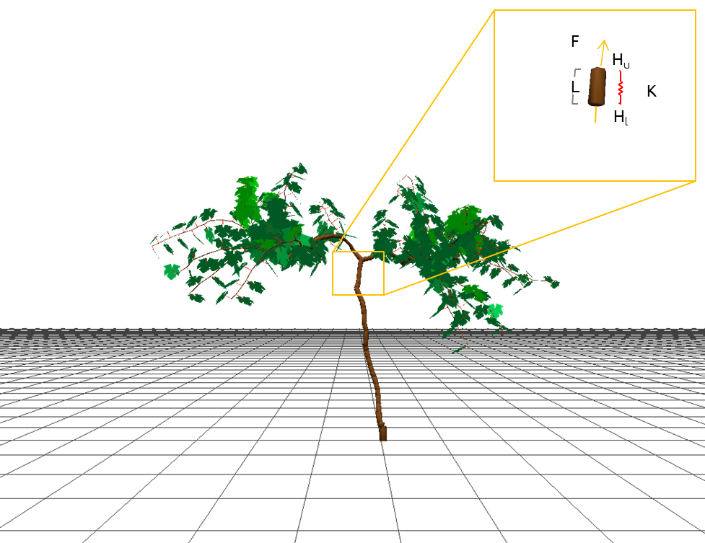
Some Final Notes … …
Simulating both the hydraulic structure of the shoot together with the energy budget of individual leaves, and then scaling-up leaf to canopy gas exchange rates
Notes:
There were also studies proposing the functional-structural plant model, for example, the HydroShoot model, which simulates both the hydraulic structure of the shoot together with the energy budget of individual leaves, and then scaling-up leaf to canopy gas exchange rates.
Another interesting study is by Thomas Buckley, on the sites of evaporation within leaves, using the coupled heat and molecular transport model.

Slide 16
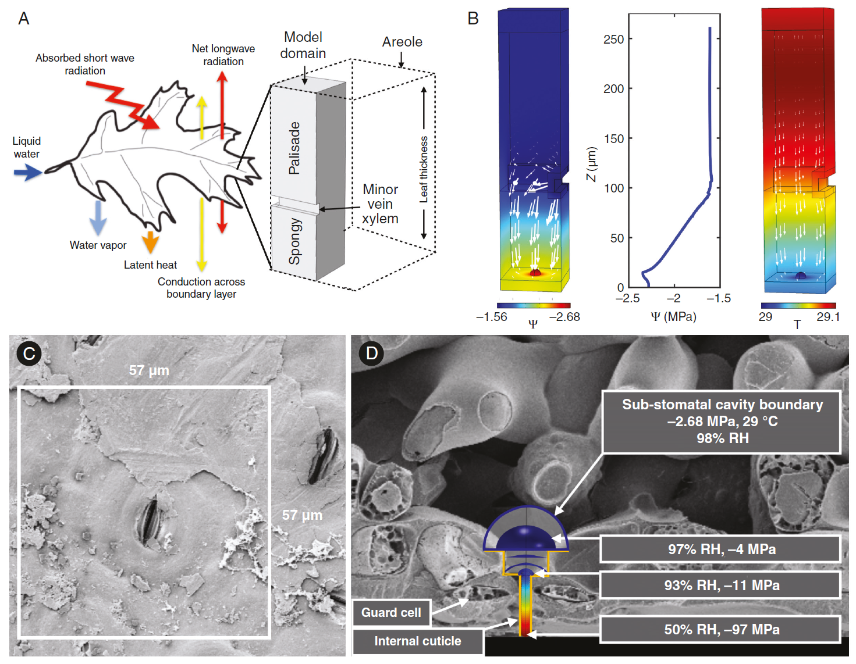
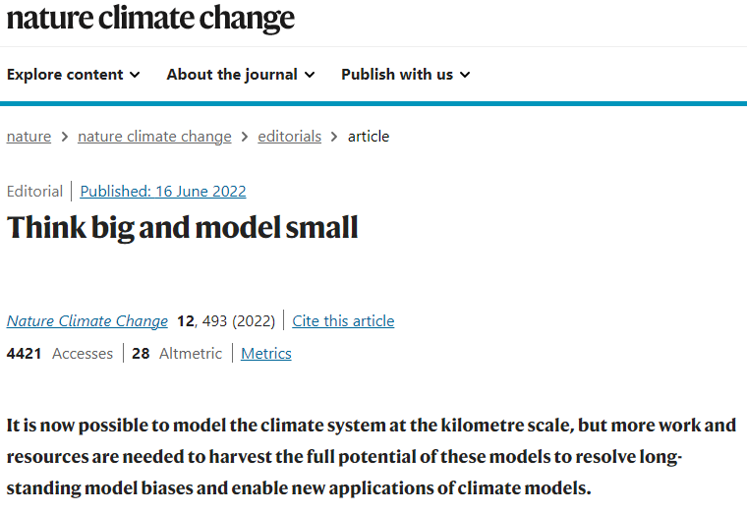
Some Final Notes … …
Questioning one of the foundational assumptions of leaf gas exchange analysis, that leaf air spaces are effectively saturated with water vapour at leaf surface temperature (“Kelvin’s Effect”).
3D Coupled Heat and Molecular Transport Model
Integrate such detailed 3D Coupled Heat and Molecular Transport Model into LSM?
Notes:
And then in this invited review, Rockwell used the 3D coupled heat and molecular transport model to investigate the extreme undersaturation in the intercellular airspace of leaves, which calls into question one of the foundational assumptions of leaf gas exchange analysis, which basically assume the local equilibrium of water vapor based on Kelvin’s effect.
(zero-wall resistance between the symplast, cell wall and air space)
The question and challenge here is how should we integrate such detailed 3D coupled heat and molecular transport model into LSM? Or perhaps we should not think of this direction at all? I think this deserves some debates.
Not long ago, Nature Climate Change published an editorial article, and advocates to ‘Think Big and Model Small’, although the context was on convection-resolving cloud model for a Digital Twin Earth, I think the same can be advocated here for land surface model.

Slide 17
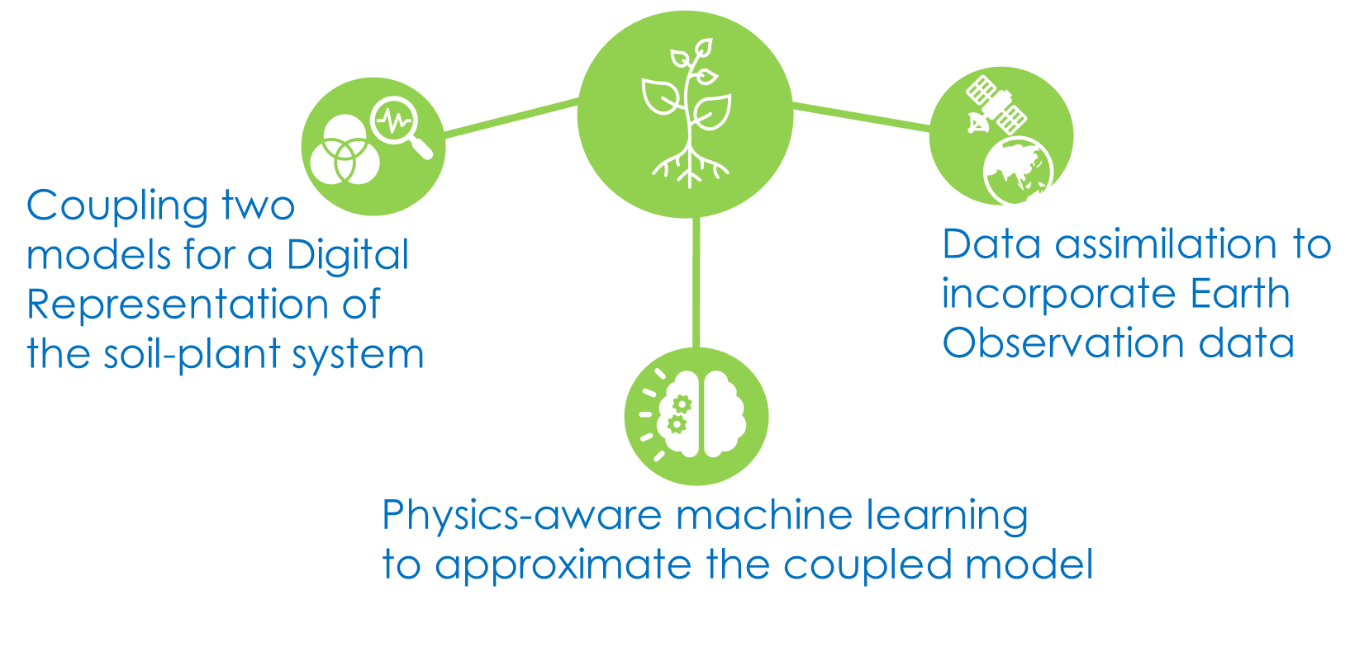
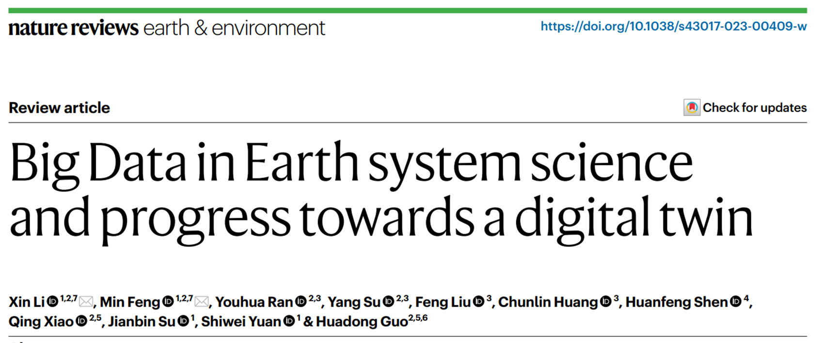
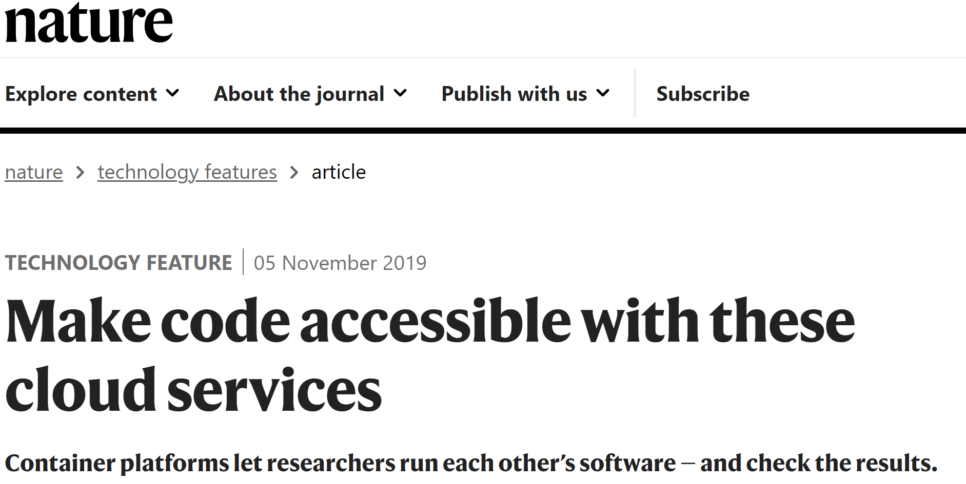
Old wine in new bottles?
With the “Digital Twin Infrastructure Template” and Big Data, we can have many Digital Twins - (‘Think Big and Model Small’ using ‘Containers’)
Notes:
So, in any case, when we are talking about soil-plant digital twin, we may wonder is it the ‘old wine in new bottles’, considering we’ve been doing modelling, data assimilation, and machine learning for quite some time, as we’ve seen in the past few days’ presentations.
On the other hand, I think the “digital twin concept” does help to move forward the development of ecohydrological modelling, in terms of process understanding (so how much details we can represent soil-plant processes).
And the application of the ‘digitalization technology’, this is not only about model, but also about good practice in programming, and how to make our code more accessible with everyone, for example, using the container platforms to let researchers run each other’s models and check the results
And this will certainly need big data, which is another challenge in ecohydrological modelling and monitoring, as we see in Prof. Xin Li’s talk.

Slide 18
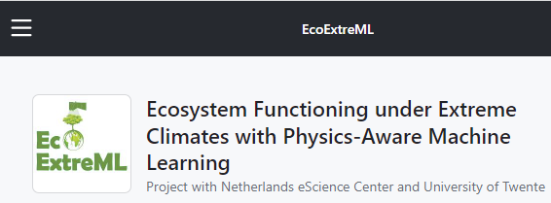
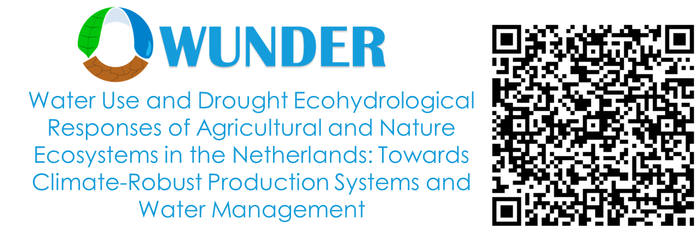
STEMMUS-SCOPE Open-Source
Yijian Zeng (y.zeng@utwente.nl)
Bob Su (z.su@utwente.nl)
Notes:
Ok, we’d made the STEMMUS-SCOPE open source, and you are welcomed to visit our github webpage.
And I want to acknowledge these two projects, which support our development of soil-plant digital twin.

Slide 19
Session Title:
H034. Challenges and Opportunities in Representing Soil Processes in Earth System Models
Conveners: Yijian Zeng, Katherine E Todd-Brown, Jingyi Huang, Alexandre A. Renchon, Salini Sasidharan
Soil is vital in regulating the water, energy, and biogeochemical cycles. However, there are challenges in representing soil information and processes in Earth System Models (ESMs) due to the limitation/uncertainty in soil data, the high nonlinearity, and multi-scale heterogeneity issues arising from field/lab-observed soil processes to relatively coarse ESM grid. Unravelling the specific role of soil processes is crucial for evaluating the impact of climate change and adaptation strategies. The International Soil Modelling Consortium (ISMC) and Global Energy and Water Exchanges Program (GEWEX) has launched the SoilWat initiative to identify the most pressing challenges in representing soil and subsurface processes in climate models. In this session, we aim to bring together modelers from diverse backgrounds, such as critical zone and hydrology, soil biogeochemical cycle, terrestrial ecosystem, geophysics, climate, and ESM modelers, to discuss approaches, challenges, and unresolved issues in representing and parameterizing soil processes in ESMs.
https://www.agu.org/Fall-Meeting
Notes:
And last but not least, a small advertisement, at AGU this year, together with colleagues from International Soil Modelling Consortium and GEWEX, we are organizing a session on the ‘Challenges and Opportunities in Representing Soil Processes in Earth System Models’, and you are welcomed to submit abstracts to this session, and help disseminate within your network.
Many thanks.

Slide 20
Back-Up Slides

Slide 21
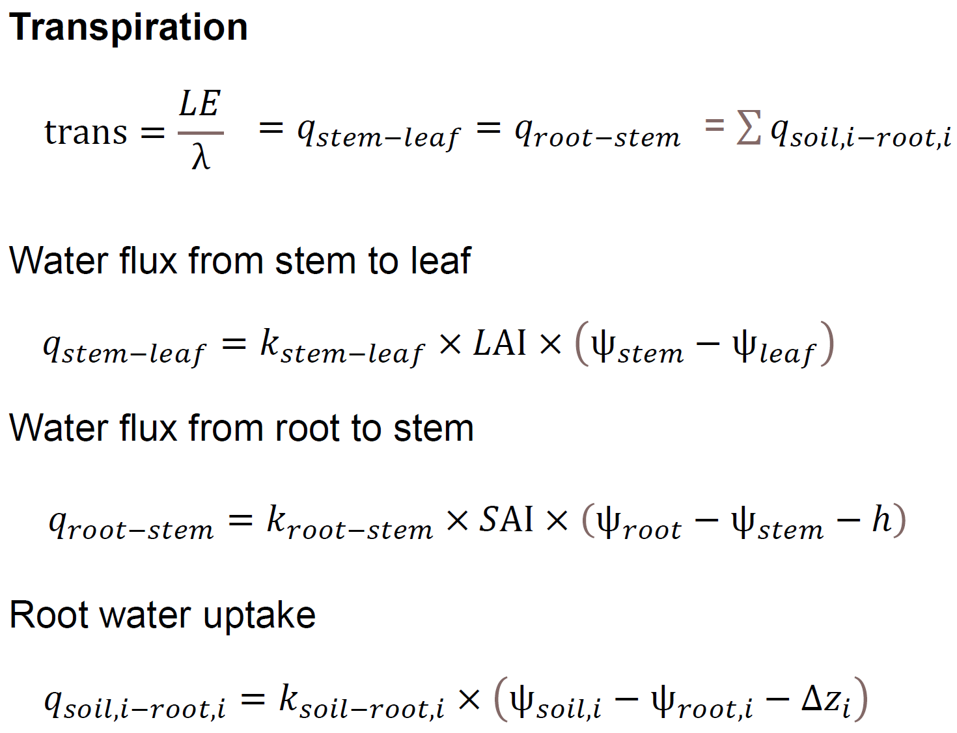
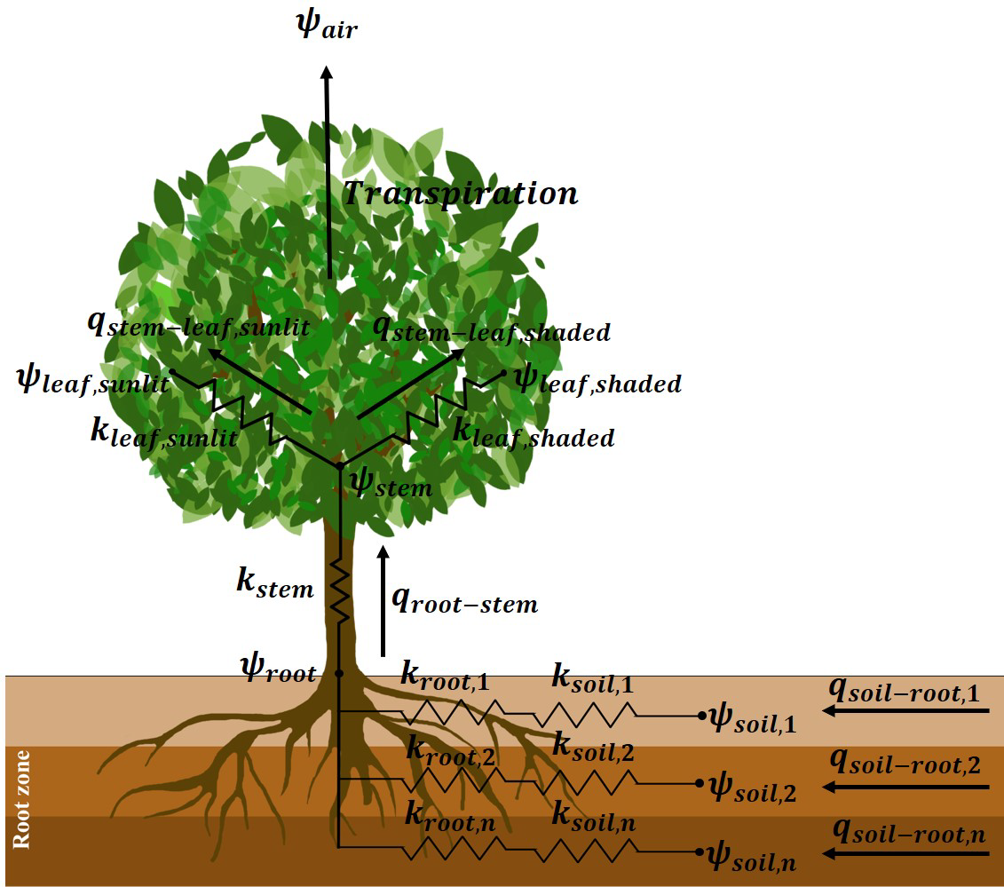
STEMMUS-SCOPE with Plant Hydraulics

Slide 22
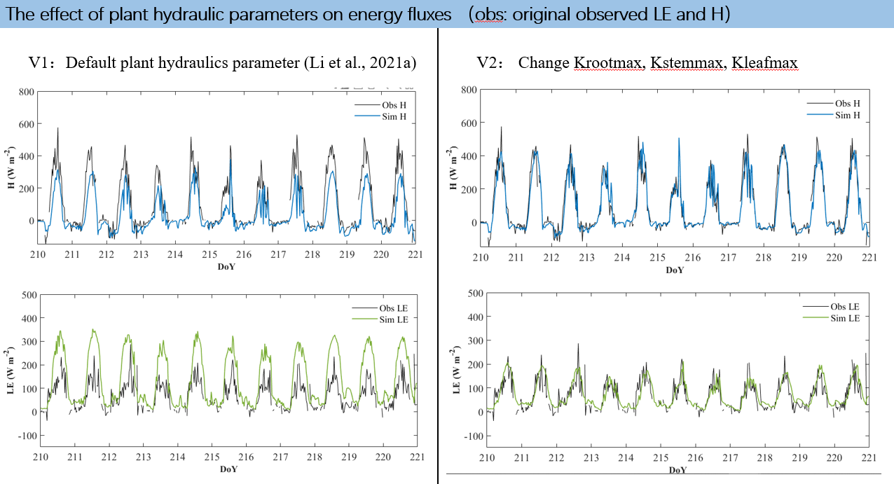
STEMMUS-SCOPE with Plant Hydraulics

Slide 23
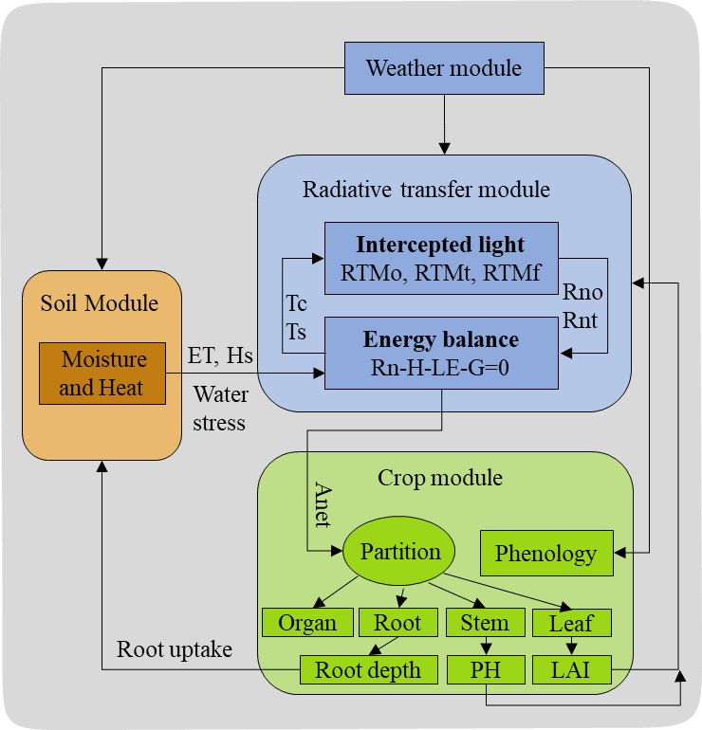
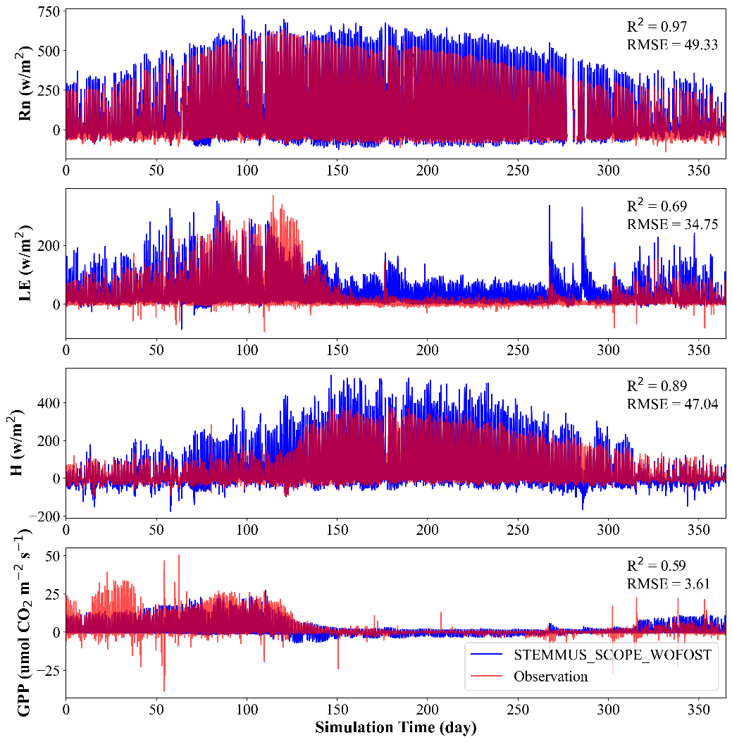
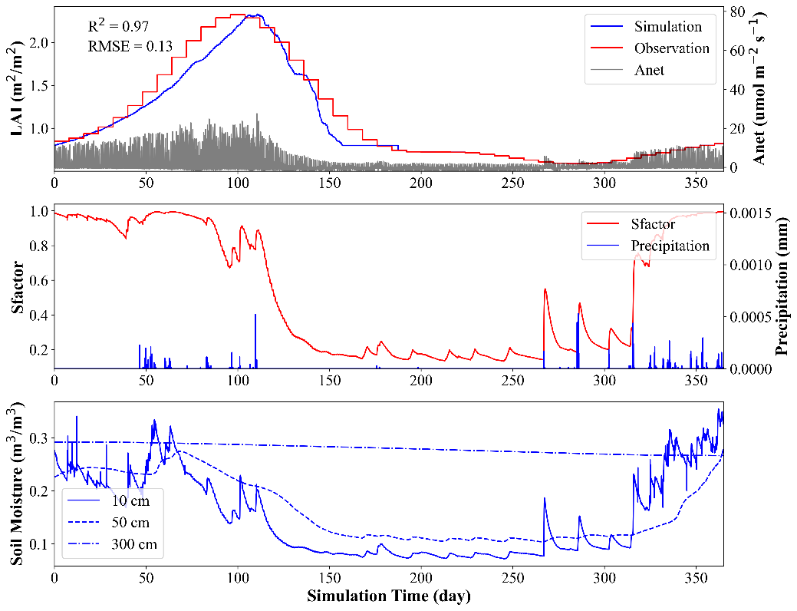
STEMMUS-SCOPE with WOFOST
Fluxnet site: US-Var (Grassland)
SCOPE
STEMMUS
WOFOST

Slide 24
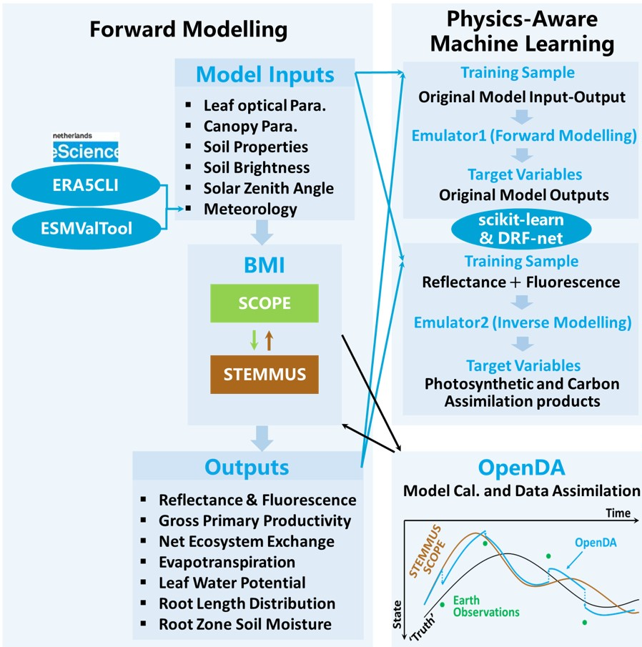
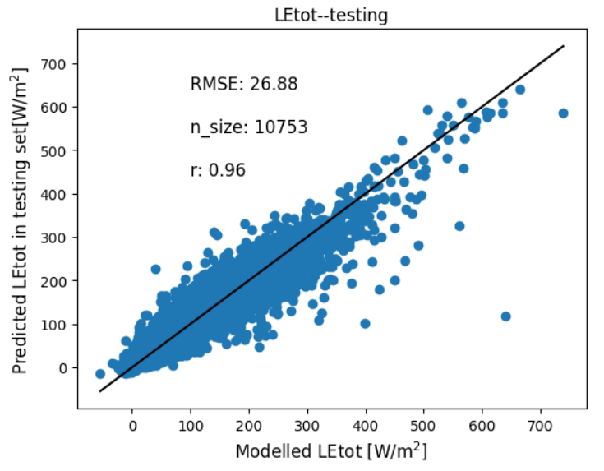
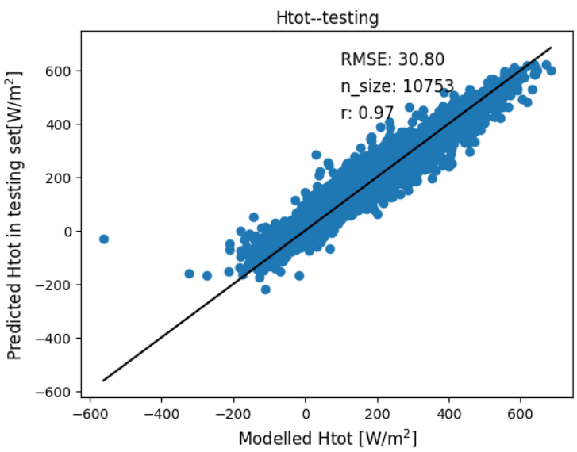
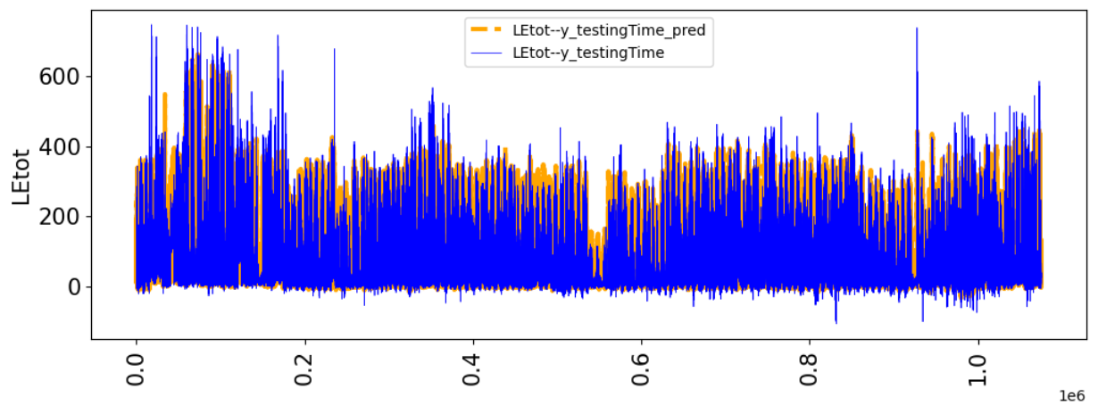
STEMMUS-SCOPE: Machine Learning-based Emulator

