Slide 1
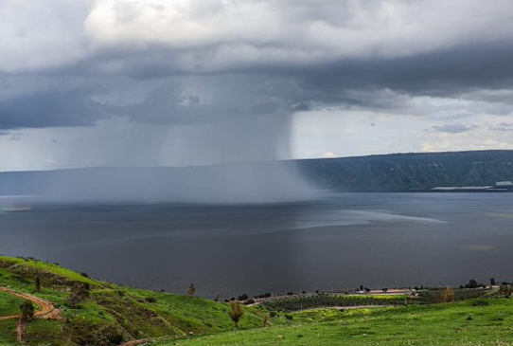
Quantifying global-warming-induced changes in spatial and temporal patterns of heavy precipitation events and the implications to flood properties in Mediterranean catchments
Moshe Armon, Yair Rinat, Efrat Morin
Galileo Conference
A European vision for hydrological observations and experimentation
NAPLES | ITALY | 12–15 JUNE 2023
Oshri Vizman

Slide 2
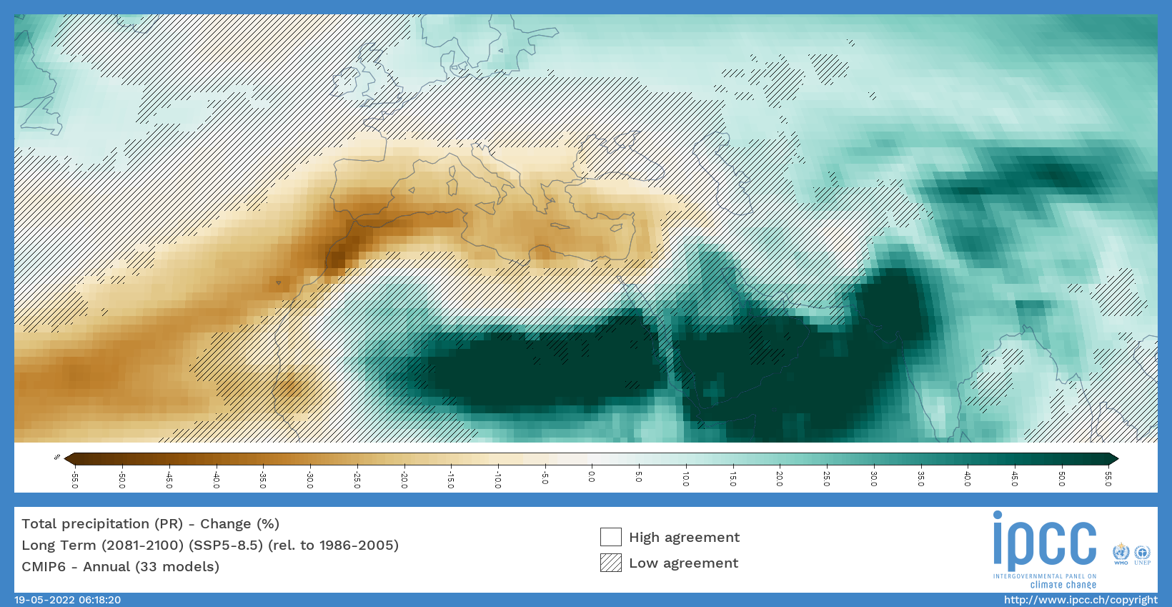
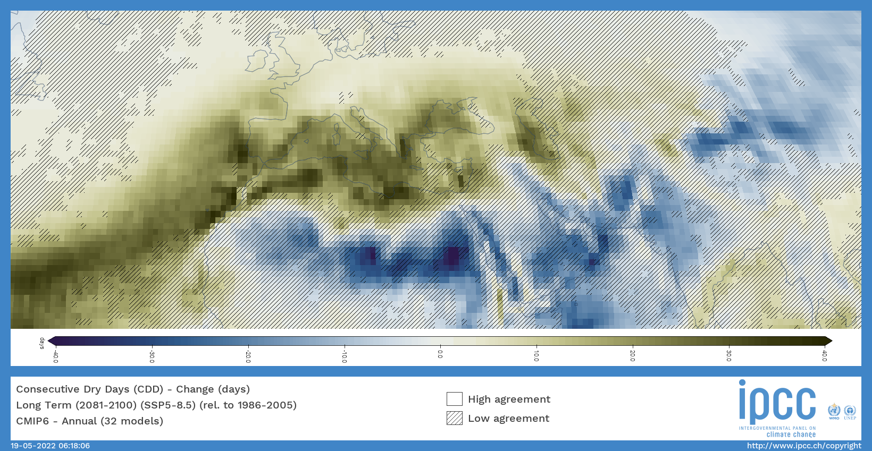
Background, motivation and goal
End of the century compared to its beginning, SSP5-8.5
Total precipitation
Consecutive dry days
IPCC Interactive Atlas, 2021
The eastern Mediterranean region gets drier with reduced total precipitation, fewer rainy days, and longer dry periods.
Research questions:
What are the expected changes in space-time properties of storm rainfall?
How these changes are expected to affect flood properties?
Our focus is on Heavy Precipitation Events (HPEs) in the Eastern Mediterranean

Slide 3
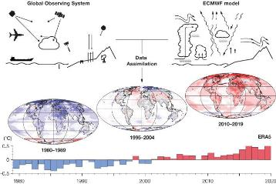
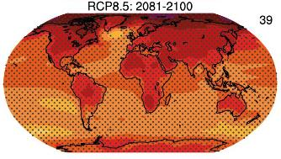
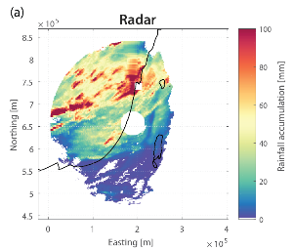
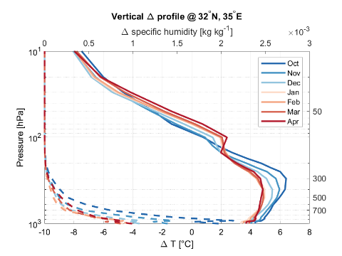
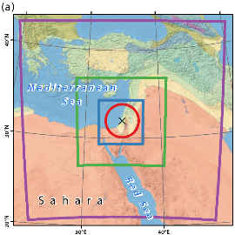
Projection of heavy precipitation events (HPEs)
29 CMIP5 models:
SLP, T, wind, moisture
41 historical HPEs
Image source: ECMWF
Atmospheric conditions in historical HPEs from reanalysis
Change in atmospheric conditions, CMIP5, end 21st century, RCP8.5
WRF model (CPM)
Pseudo Global Warming (PGW)
41 historical – future HPE pairs
with 1-km, 10-min resolution
1-km, 10-min rainfall maps
Armon et al., 2020; Armon et al., 2022

Slide 4
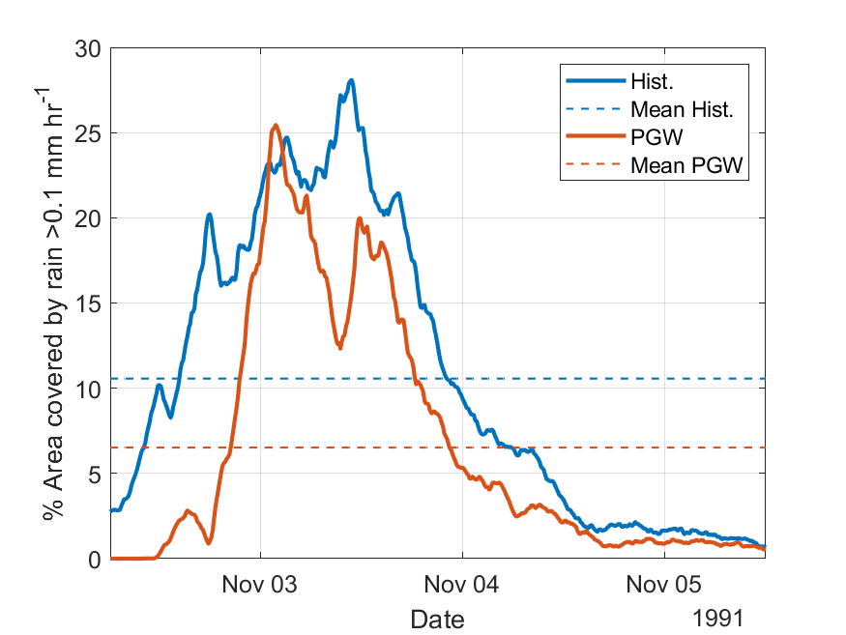
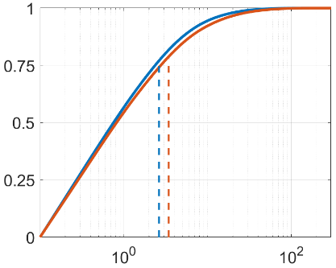
Projection of heavy precipitation events (HPEs)
Historical
Future
Single storm analysis
HPE #1
(November 1991)
Mean areal rainfall
Historical 21.9 mm
Future 17.5 mm
-20%
+30%
Conditional rain rate
Storm duration
-24%
Areal coverage
-38%
Armon et al., 2020; Armon et al., 2022

Slide 5
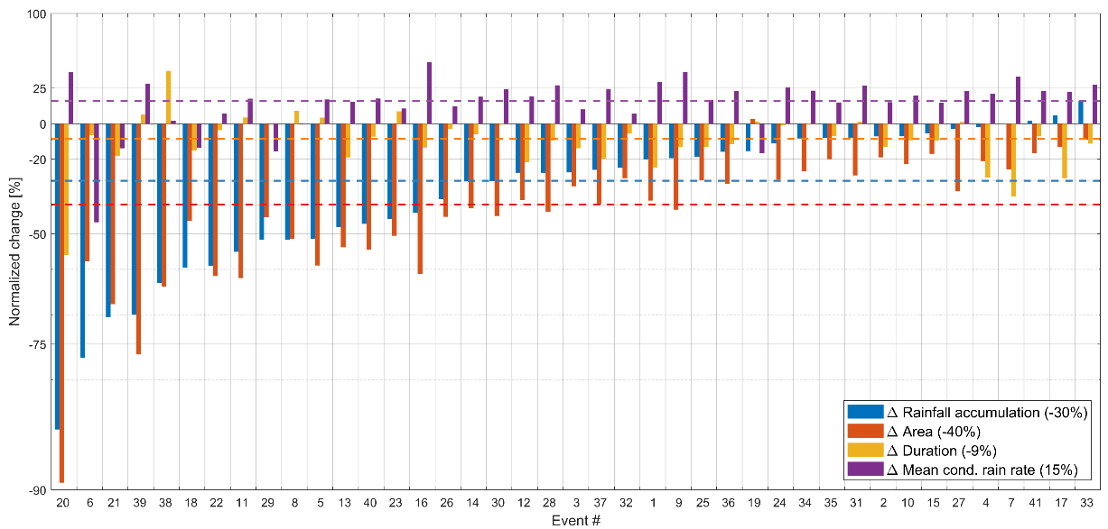
Projection of heavy precipitation events (HPEs)

Slide 6
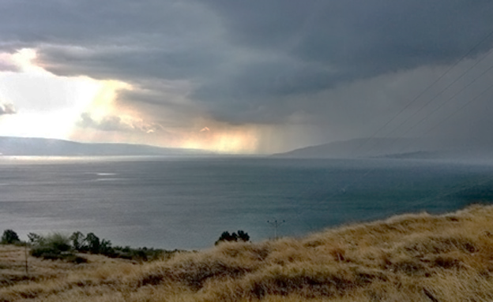
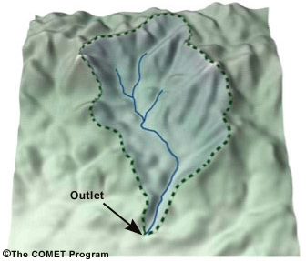
Historical
Future
Avi Arish
Oshri Vizman
What are the expected changes in flood properties?

Slide 7
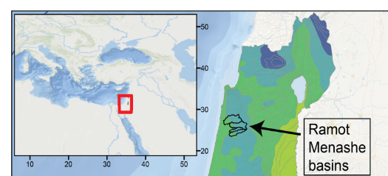
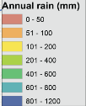
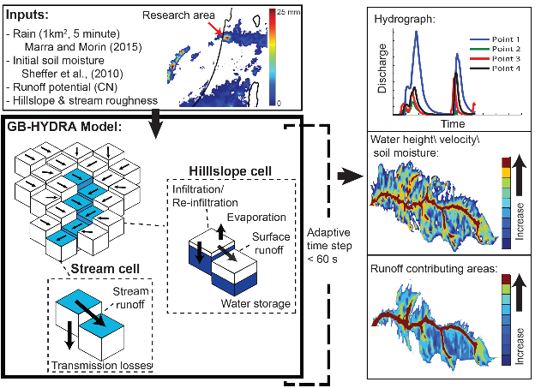
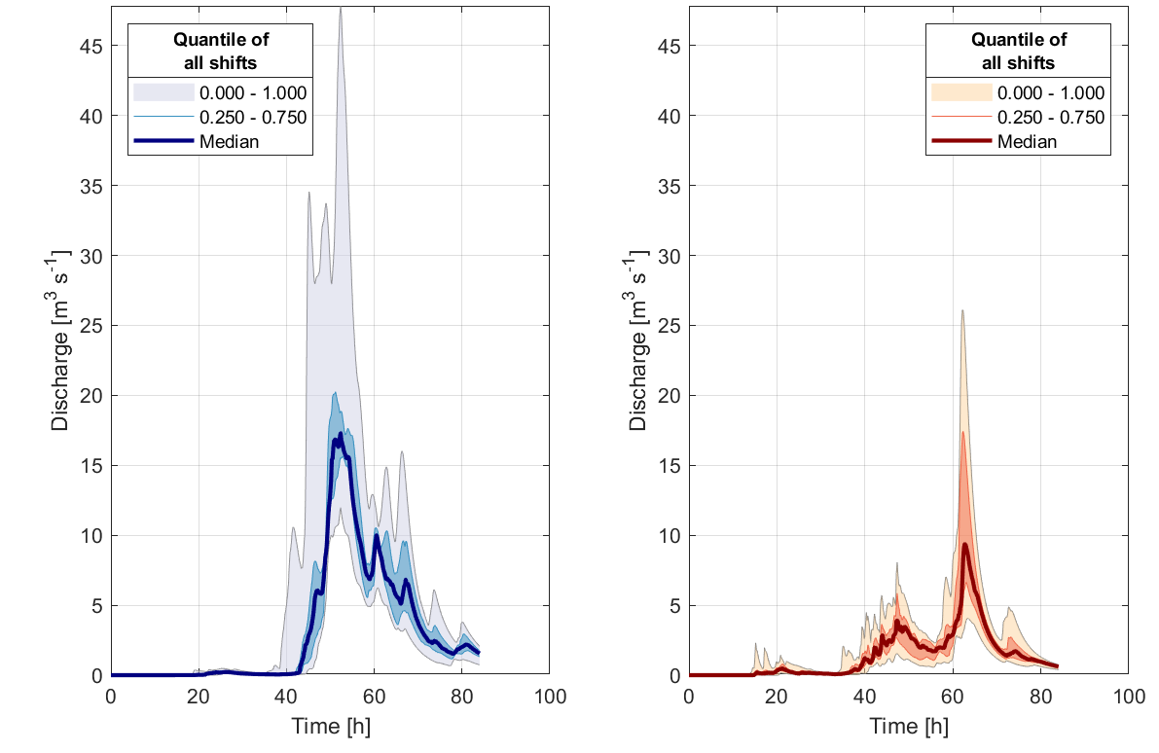
Projection of streamflow
Mostly agricultural,
Mediterranean basins
18-70 km²
41 historical – future HPE pairs
with 1-km, 10-min resolution
For each HPE and period: 43 south-north storm translations, -21 to +21 km, 1 km intervals
Historical
Future
Hydrological model
Rinat et al., 2018; Rinat et al., 2021
Rinat, Armon and Morin, in preparation. Results are not final.

Slide 8
Projection of streamflow
Areal rain depth
Flood volume
Flood peak discharge
X 10⁶
Future
Future
Future
X 10⁶
Historical
Historical
Historical
A significant decrease in event rain depth (-24%)
A significant decrease in event streamflow volume (-27%)
A non-significant decrease in event streamflow peak discharge (-20%)
*Results are presented for a 42 km² basin
*Changes in land-use and initial soil moisture are not yet included
Rinat, Armon and Morin, in preparation. Results are not final.

Slide 9
Summary
The eastern Mediterranean becomes drier, but space-time changes at the storm scale and the expected effect on floods are yet to be quantified.
Future heavy precipitation events (HPEs) in the eastern Mediterranean are expected to be drier and more spatiotemporally concentrated: lower rain amounts (-30%), shorter (-9%), reduced area (-40%), and higher conditional rain rates (+15%).
On-going research (not final): Future floods from HPEs in the Ramot Menashe region (mainly agricultural, Mediterranean basins 18-70 km²) are expected to have a lower total volume (-27%) and a lower peak discharge (-20%).
Research is still ongoing to examine:
intra-basin changes (are there scales where flood peak increases rather than decreases?),
the effect of initial soil moisture (the soil is drier at storm’s beginning)
the effect land use changes (more built area).
Thanks for your attention

