Slide 1
WATer isotopeS in the critical zONe: from groundwater recharge to plant transpiration (WATSON)
www.watson-cost.eu

Slide 2
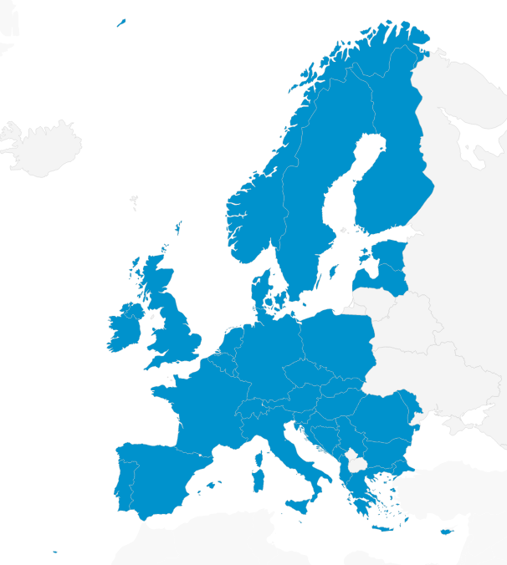
WATSON COST Action
EU funded network of researchers and stakeholders
Sept. 2020 – Sept. 2024
Currently:
227 members
37 COST countries
International observers outside Europe

Slide 3
WATSON COST Action
WATSON collects, integrates, and synthesizes current interdisciplinary scientific knowledge on the partitioning and mixing of water in the critical zone taking advantage of the unique tracing capability of stable isotopes in the water molecule
Drawning by Emel Zeray Öztürk

Slide 4
Challenges addressed by WATSON
https://watson-cost.eu

Slide 5
WATSON Working Groups (WGs)

Slide 6
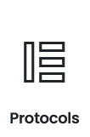
WATSON Activities and Grants
Capacity building and networking activities
Meetings, workshops, etc.
Training schools
Short Term Scientific Missions
→ foster communication and collaboration
Research coordination
Databases of isotope-based studies in the critical zone
Define protocols, standardized sampling procedures, and analysis techniques
Compare isotope-based methods and models

Slide 7
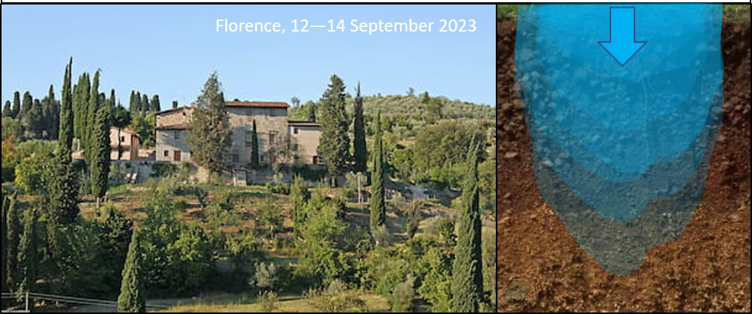
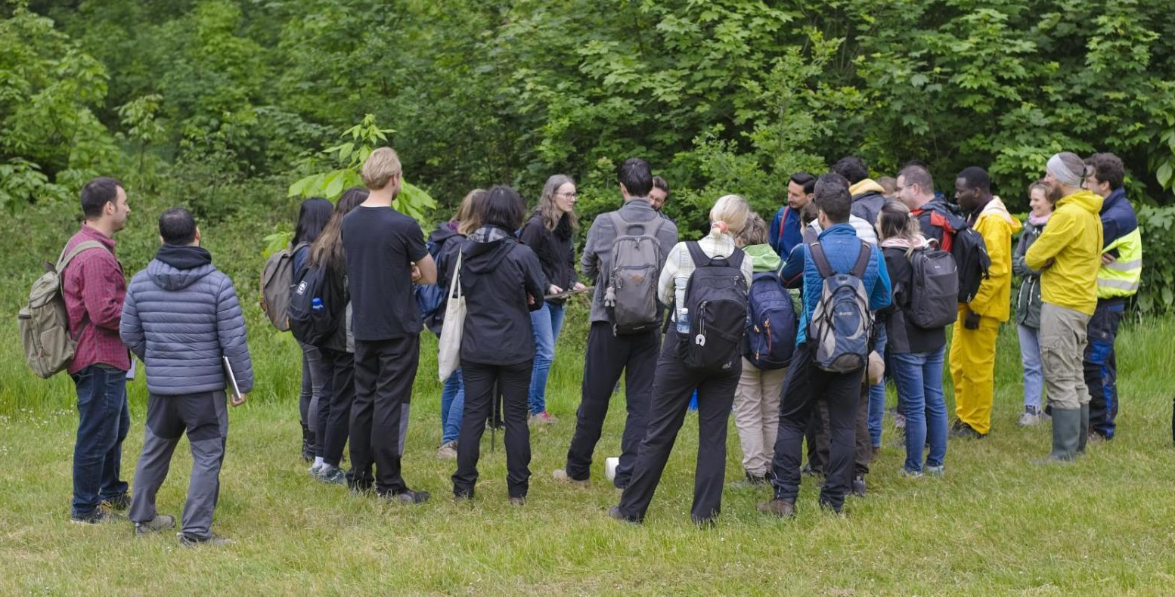
WATSON Activities: recent/ongoing initiatives
Two training schools:
Isotopic tracer and labeling experiments (Florence, Sept. 2023)
Water sampling, extraction, and isotopic analyses techniques for plant water use investigation (Jűlich, May 2023)
Three review papers in preparations
A data map of isotopes in different waters sampled in Europe
One sampling campaign of tree water sources across Europe (27 EU countries)
Stakeholder meeting (Sept. 2023)
Julich, 22-26 May 2023

Slide 8
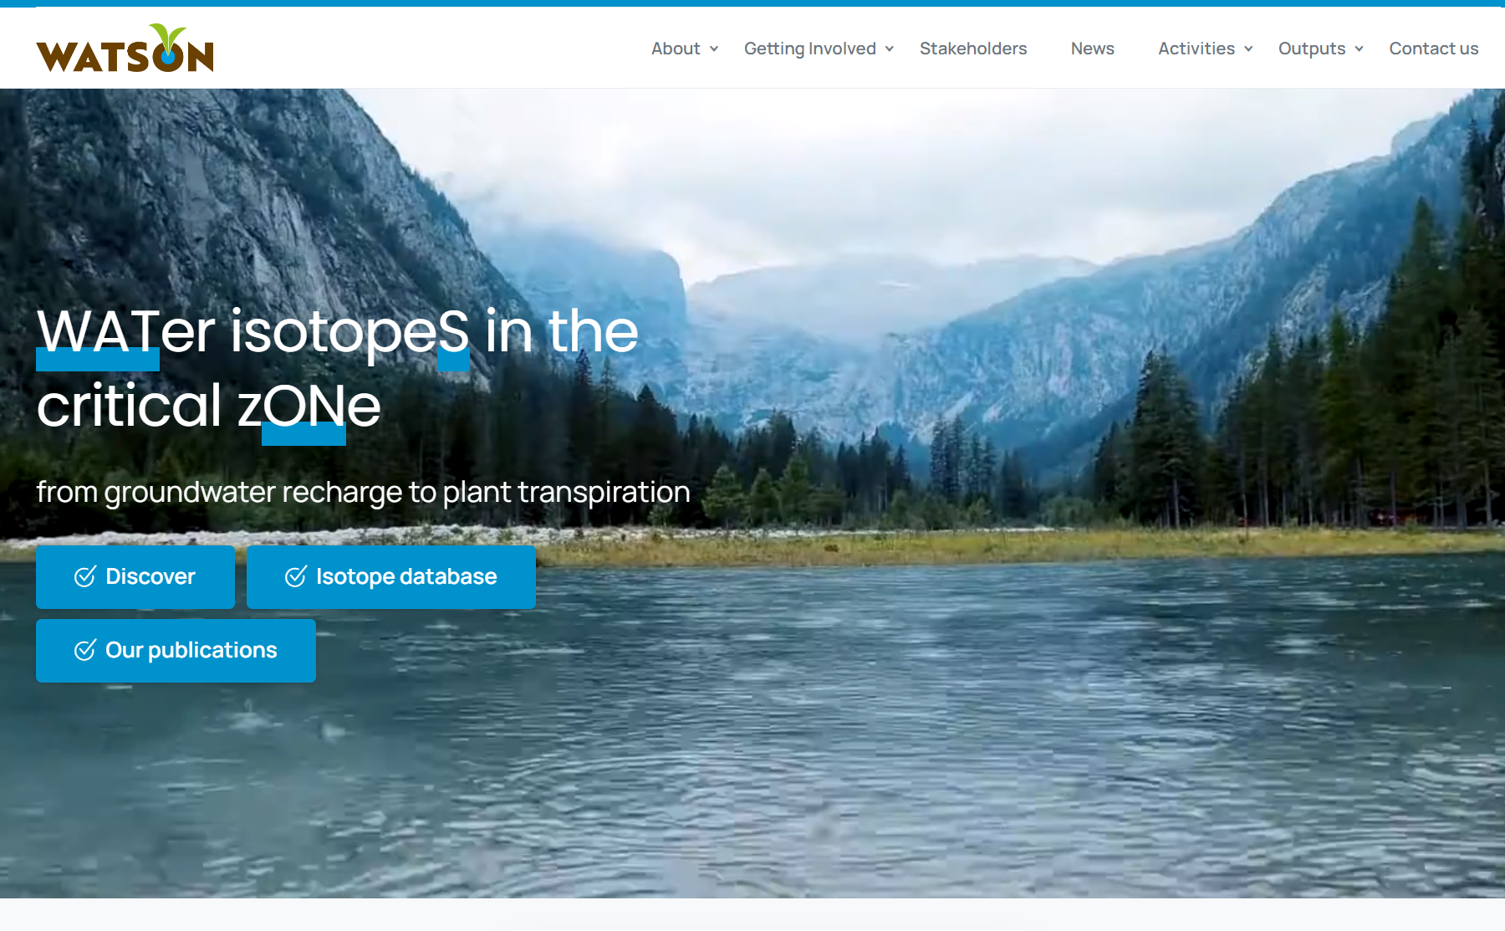
You can join us!
WATSON webpage: www.watson-cost.eu
EU-webpage: www.cost.eu/actions/CA19120/
Twitter: @ca19120
Research Gate
You-Tube

Slide 9
www.watson-cost.eu

