Slide 1




Christian Moeck^{a,}, Andrea Popp^{a,b}, Matthias Brennwaldª, Rolf Kipfer^{a,b,c} Mario Schirmer^{a,d}
^{Christian.moeck@eawag.ch} ª Department of Water Resources and Drinking Water, Eawag, Swiss Federal Institute of Aquatic Science and Technology, Dübendorf, Switzerland
^{b} Department of Environmental Systems Science, ETH Zurich, Zurich, Switzerland
^{cc} Department of Earth Sciences, ETH Zurich, Zurich, Switzerland
^{dd} Centre of Hydrogeology and Geothermics (CHYN), University of Neuchâtel, Neuchâtel, Switzerland
Combined use of multiple tracers to identify water flow dynamics and pollutant transport

Slide 2

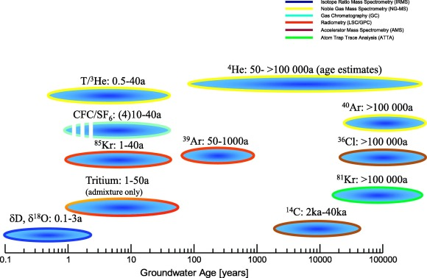
Introduction
Majority of groundwater contamination has occurred in recent times (<100 a).
New developments in portable field-operated GE-MIMS system provides a unique opportunity to measure dissolved gas concentrations, such as ⁴He, in groundwater systems
Radiogenic ⁴He is a by-product of the ³H/³He method and used as an additional indicator for older groundwater
Suckow, A. (2014). The age of groundwater–Definitions, models and why we do not need this term. Applied Geochemistry, 50, 222-230.

Slide 3
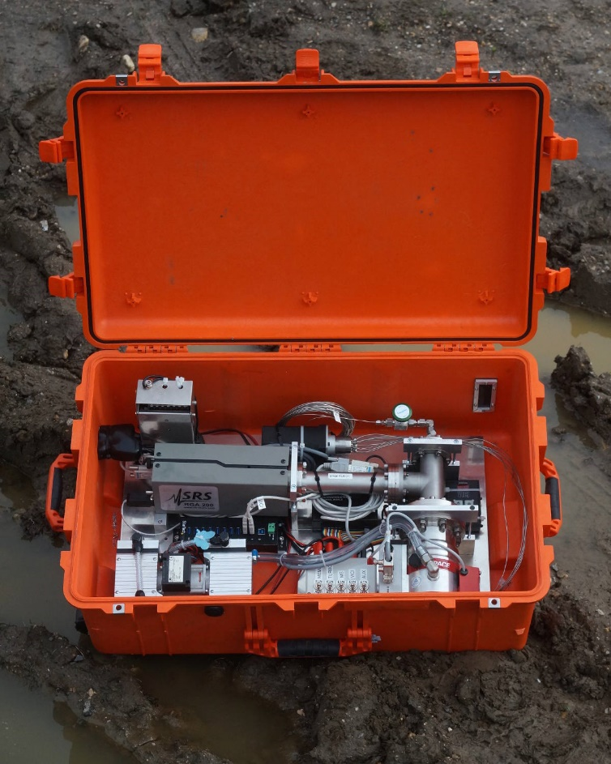

Laboratory & On-site Mass Spectrometer (MS)
Laboratory-based MS
Portable gas equilibrium membrane inlet MS (GE-MIMS)
Analytical precision
Small amount of water is needed
Capable of providing an apparent age
High cost (acquisition, operation, and maintenance)
Labor- and time-intensive
Comparatively inexpensive
Relatively easy to operate
High-throughput
Lower analytical precision
Impact of environmental conditions (e.g. temperature cycles) on performence
Relatively large amount of water (stream of water)
Not capable of providing an apparent age

Slide 4
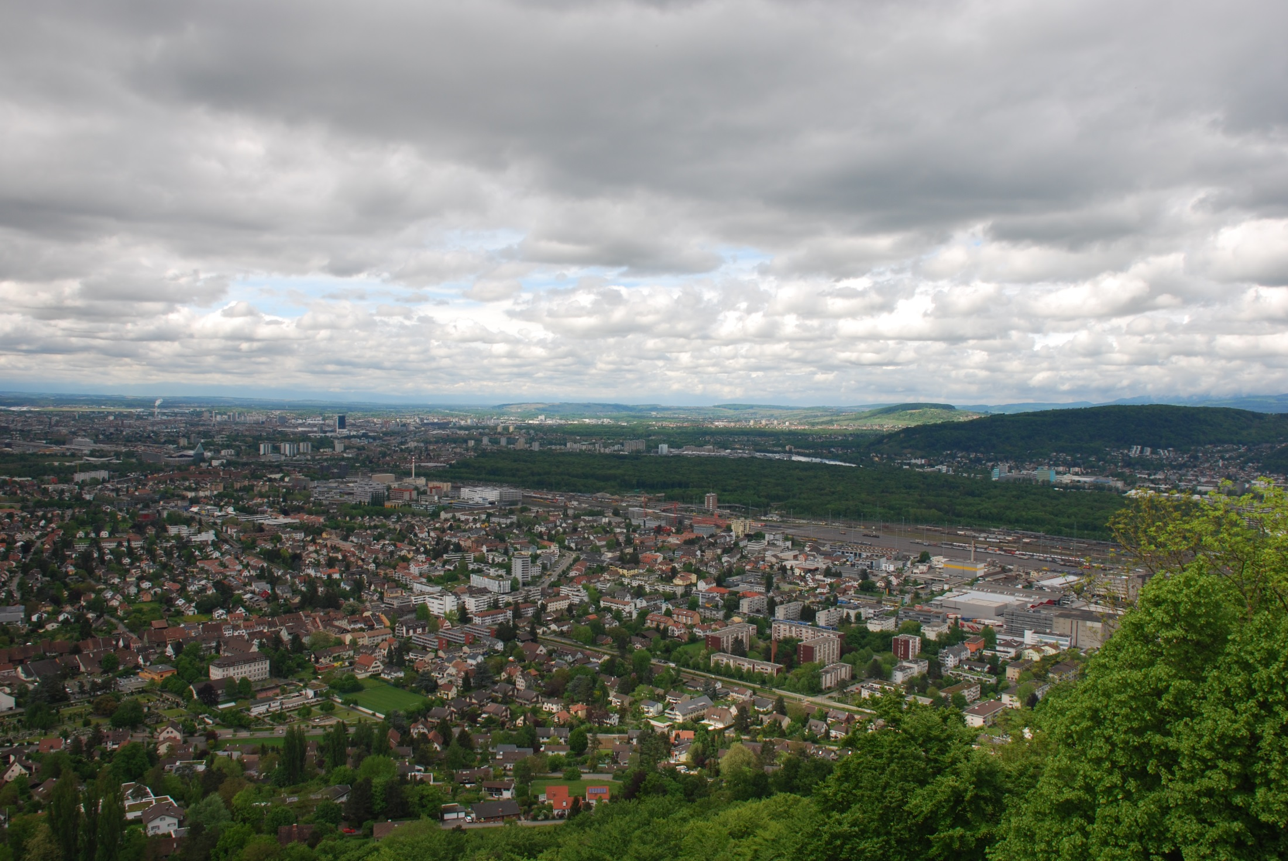
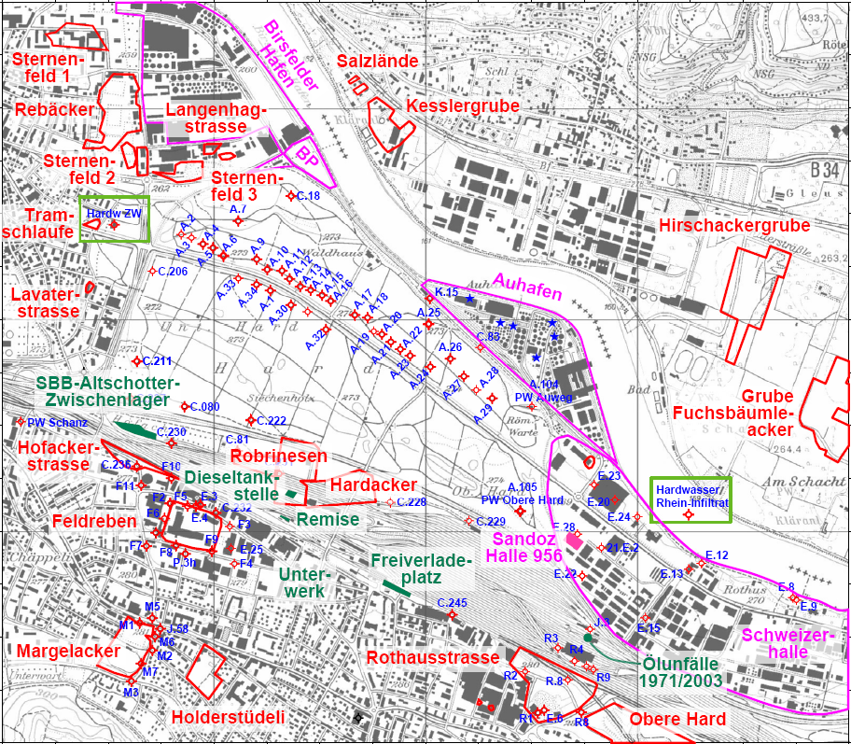
Study Area
Important water supply site
Drinking water supply combined with artificial infiltration
  Artificial Infiltration 95.000 (m³ d⁻¹)
  Pumping rates 45.000 (m³ d⁻¹)
Study Site History
  Contaminated areas
Avoiding regional groundwater water
Two main aquifers:
i) Overlying Sand-Gravel aquifer
ii) Bedrock: Kartisfied limestone aquifer
0
1.2 km
Regional sampling
to determine surface-groundwater dynamics using event samples
Rhine river

Slide 5
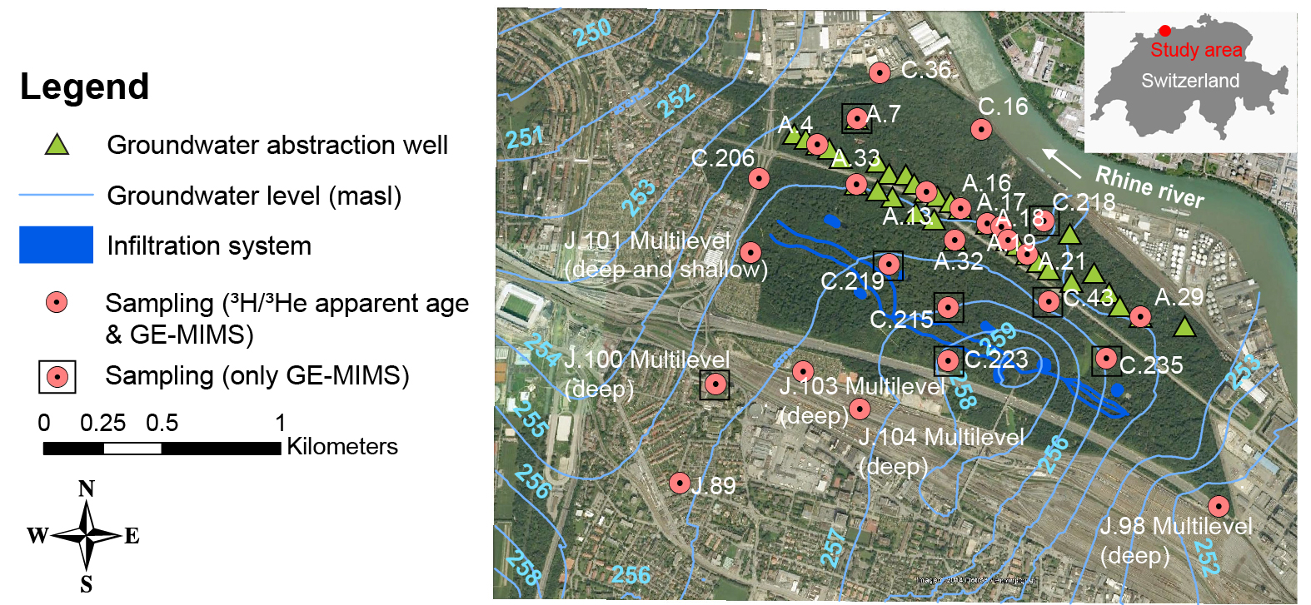
Sampling

Slide 6
Relationship between ³H/³He apparent ages and GE-MIMS measurements
Linear relationship between field-measured ⁴He concentrations collected with the GE-MIMS system and the estimated laboratory ³H/³He apparent ages.
Apparent ages can be predicted for sampling locations where only ⁴He concentration from the GE-MIMS measurements are available.

Slide 7
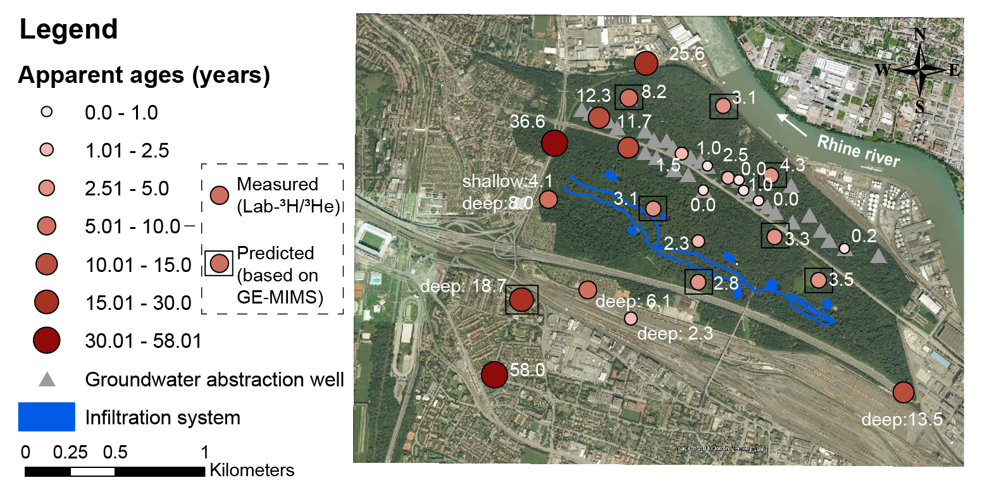
Spatial Distribution Apparent Ages
Relatively young water → close to the artificial infiltration system.
Oldest water → in the south and at western edge.
Multilevel wells → increasing trend with increasing depth.
Pumping wells → older ages at wells located at the western edge.

Slide 8
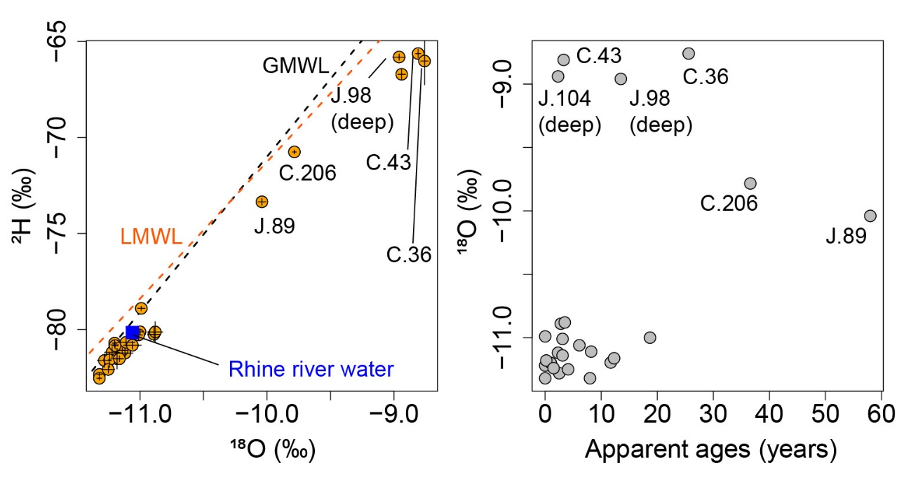
Apparent Ages and Stable Water Isotopes
Stable water isotopes (¹⁸O and ²H) ranged from -11.32 to -8.76‰ & -82.54 to ‑65.63‰.
Locations in the south and at the western edge → enriched isotope composition, indicating different water origins.
South & western edge
South & western edge

Slide 9
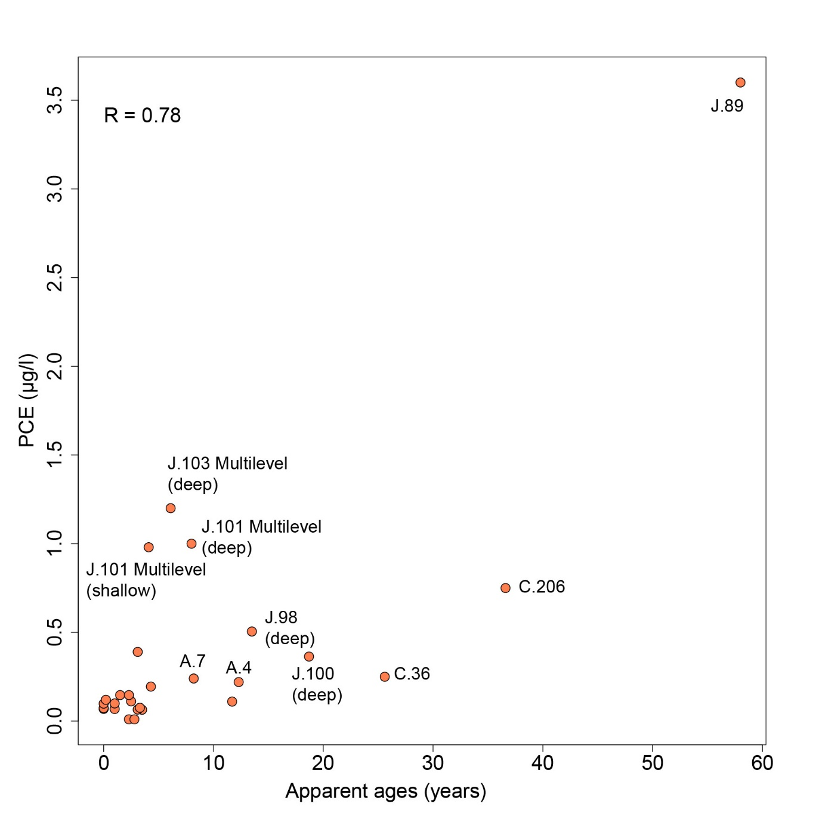
Apparent Ages and PCE
Highest concentration PCE → oldest groundwater.
PCE concentration decreases with decreasing age.
Most multilevel wells with deeper sampling depths indicate higher concentrations of PCE.
Pumping wells in the western part of the pumping well gallery (e.g. A.4 and A.7) show higher concentrations of PCE.

Slide 10
Conclusion
GE‐MIMS system → unique opportunity to measure dissolved gas concentrations relatively quickly and inexpensively.
Results of the simpler GE‑MIMS system are as satisfactory as those of the highly sophisticated lab-based method.
Combination with stable water isotopes helps to develop a sound site characterization.
The applicability of the method is assured when radiogenic helium is accumulated in the aquifer by radioactive decay of U and Th within the aquifer matrix
  ⁴He concentration is controlled by the residence time of the groundwater in the aquifer.
Combined use opens up new opportunities in site characterization, even though laboratory data are still required to establish this relationship.

Slide 11

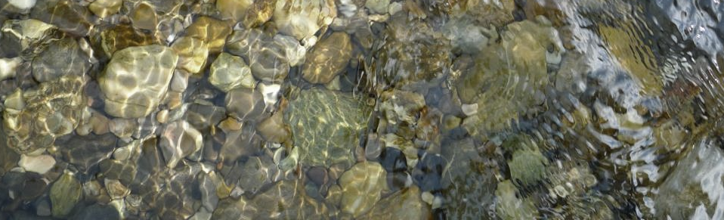
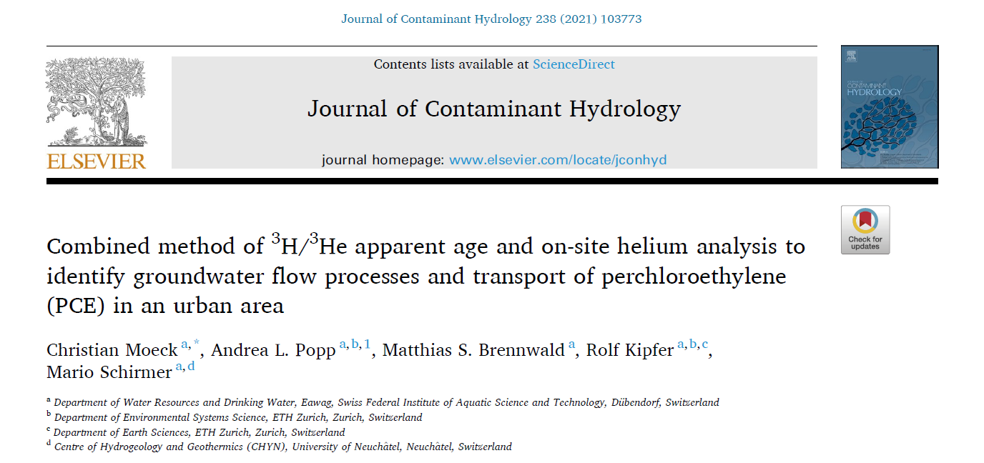

Contact: Christian.moeck@eawag.ch
Thank you for your attention
The authors acknowledge the financial support of
the Canton Basel-Landschaft, Switzerland, in the framework of the RWBL 21 project
internal Eawag Discretionary Funding

Slide 12
Objective and Study Area
⁴He accumulation rates are often obtained from ³H/³He ages.
→ We aimed to determine the relationship between field-measured ⁴He concentrations analyzed with a GE-MIMS system and lab-based apparent ³H/³He ages.

Slide 13
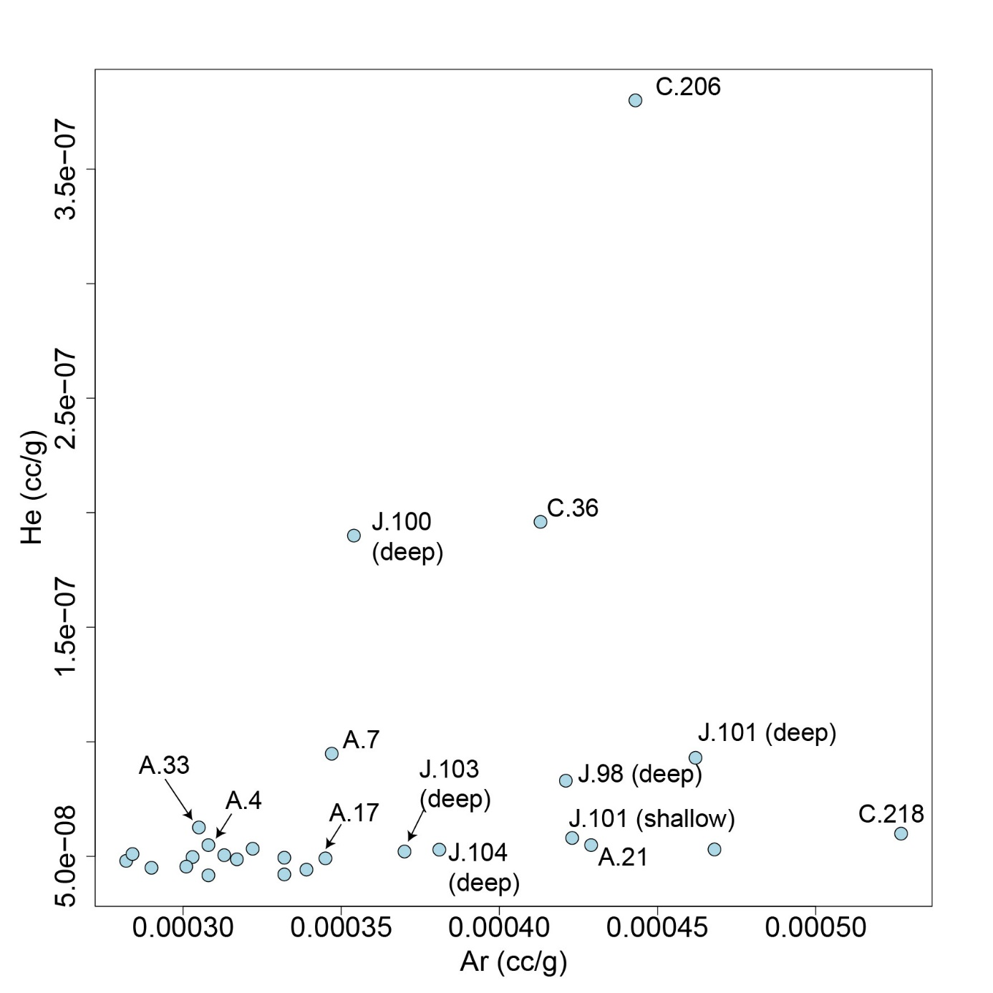
Why both measurements correlate?
Applicability: Radiogenic helium is accumulated in the aquifer by radioactive decay of U and Th within the aquifer matrix → ⁴He concentration is controlled by the residence time of the groundwater.
But excess air can also explain the relationship.
Approach: Ar concentration is not affected by ⁴He accumulation in the aquifer, but only by excess air processes.
Correlation between Ar and He → excess air is controlling the relationship.
Ar does not vary with the He concentration, then the ⁴He accumulation in the aquifer leads to the ³H/³He–⁴He relation.

Slide 14
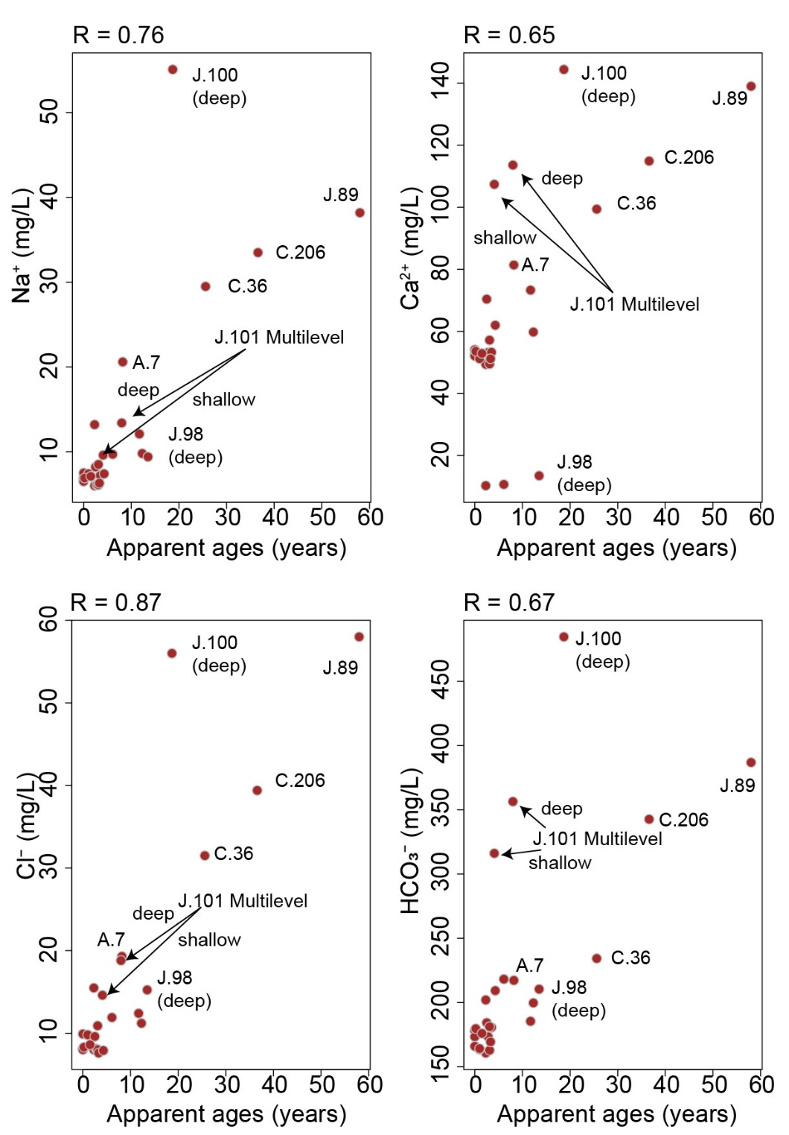
Apparent Ages and Hydrochemistry
Trend between hydrochemical data and the apparent age.
Muschelkalk water has significantly different hydrochemistry than the artificial infiltrated surface water, including an increase in Ca²⁺, Na⁺, Cl⁻, SO₄^{2‑}, and HCO₃^{-.}
At pumping wells where the impact of artificial infiltration is low (e.g. A.7), a higher concentration can be observed.
Older groundwater → higher concentration (~Muschelkalk water).

Slide 15
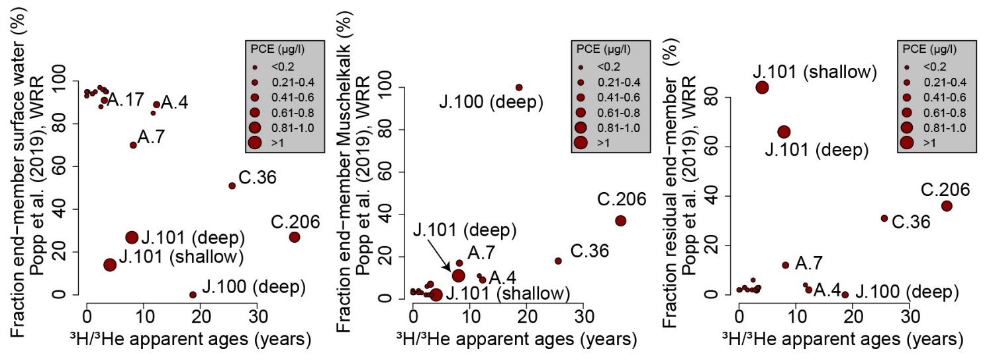
Groundwater Mixing
Use of a Bayesian groundwater-mixing model (Popp et al., 2019)
End-members:
Infiltrated surface water
Regional groundwater
(Unknown) residual end-member
Notes:
Pumping wells with a slightly smaller fraction of surface water (e.g. A.7) → apparent age and PCE concentrations increase.
High ratio of unknown water source (Flexure zone) suggests that faults can play a role as preferential flow paths for the transport of old groundwater and elevated PCE concentration.
Highest PCE concentration → well J.89 having the oldest age (58 years) and is located in the direct vicinity to a former landfill.

Slide 16
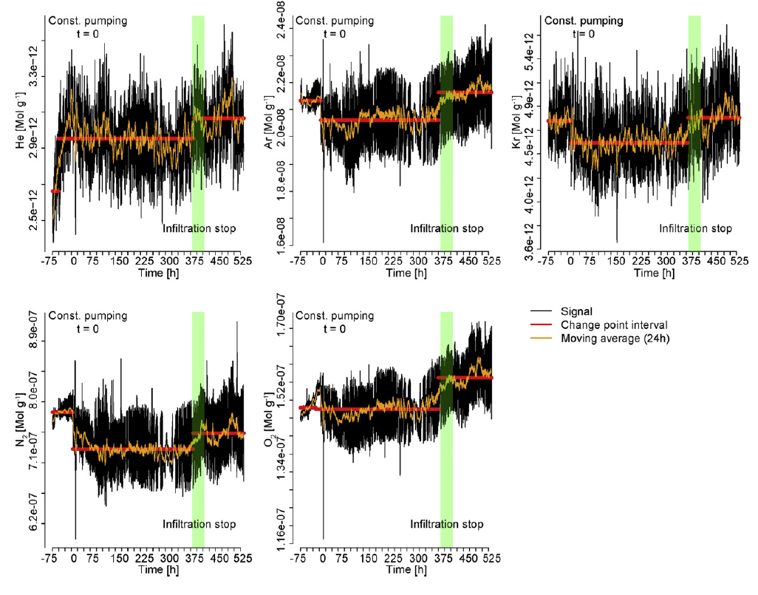
Changing pumping rates
On-site stand-alone system GE-MIMS.
Change-point analysis.
Detection of three stages related to boundary changes.
Notes:
Pumping wells with a slightly smaller fraction of surface water (e.g. A.7) → apparent age and PCE concentrations increase.
High ratio of unknown water source (Flexure zone) suggests that faults can play a role as preferential flow paths for the transport of old groundwater and elevated PCE concentration.
Highest PCE concentration → well J.89 having the oldest age (58 years) and is located in the direct vicinity to a former landfill.

Slide 17
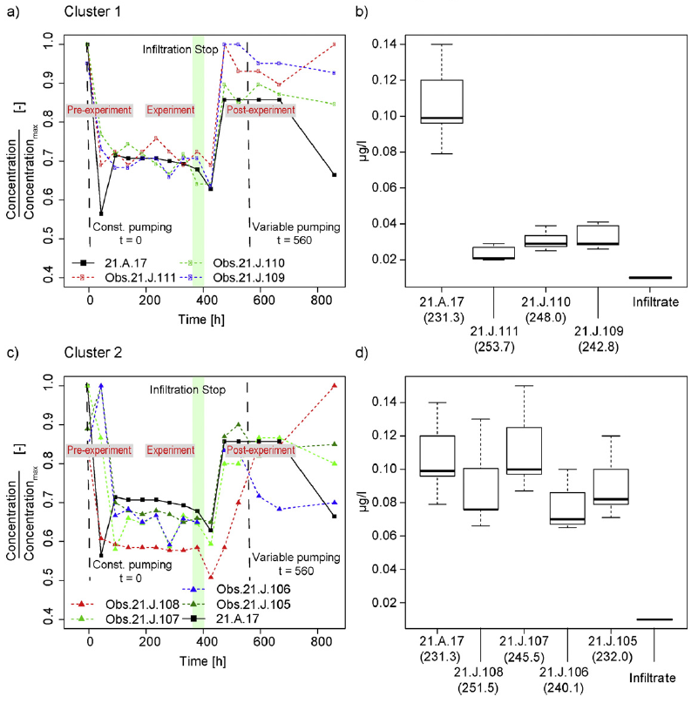
Changing pumping rates
Detection of three stages related to boundary changes.
Constant pumping is leading to concentration decrease.
Concentration increase with increasing fraction of regional groundwater.
Lowest concentration in Infiltrate
Lowest concentration in GW in Cluster 1 (close to infiltration system)
Notes:
Pumping wells with a slightly smaller fraction of surface water (e.g. A.7) → apparent age and PCE concentrations increase.
High ratio of unknown water source (Flexure zone) suggests that faults can play a role as preferential flow paths for the transport of old groundwater and elevated PCE concentration.
Highest PCE concentration → well J.89 having the oldest age (58 years) and is located in the direct vicinity to a former landfill.

