Slide 1
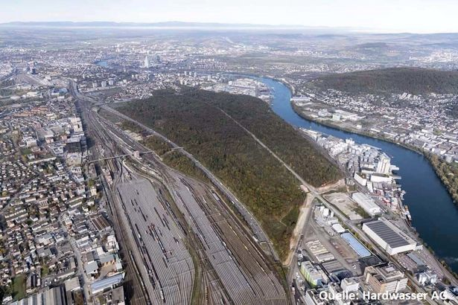
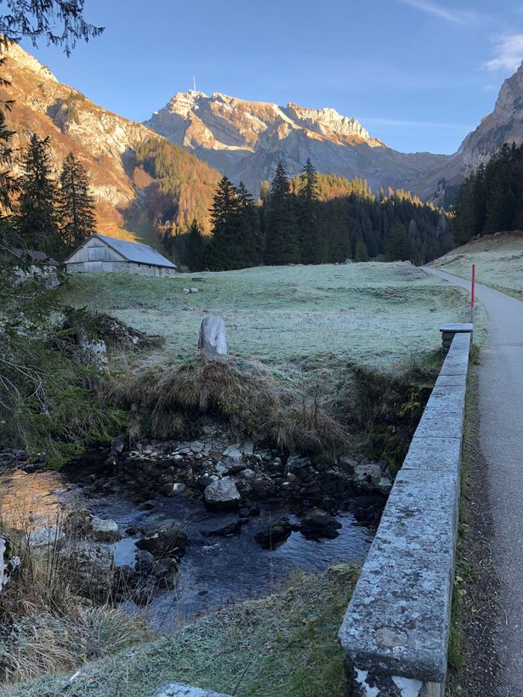
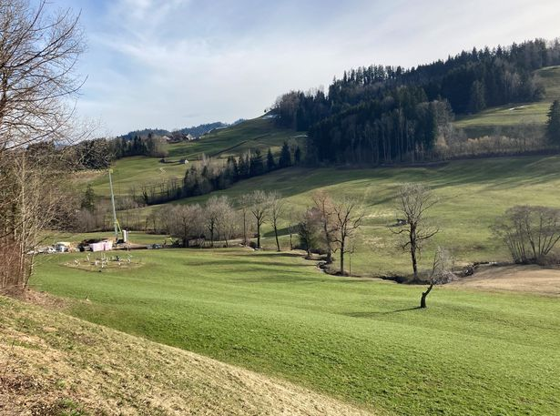
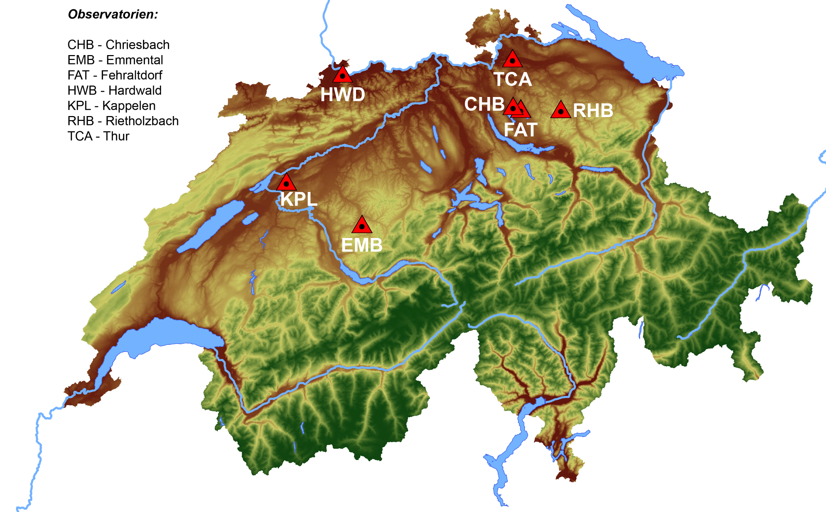
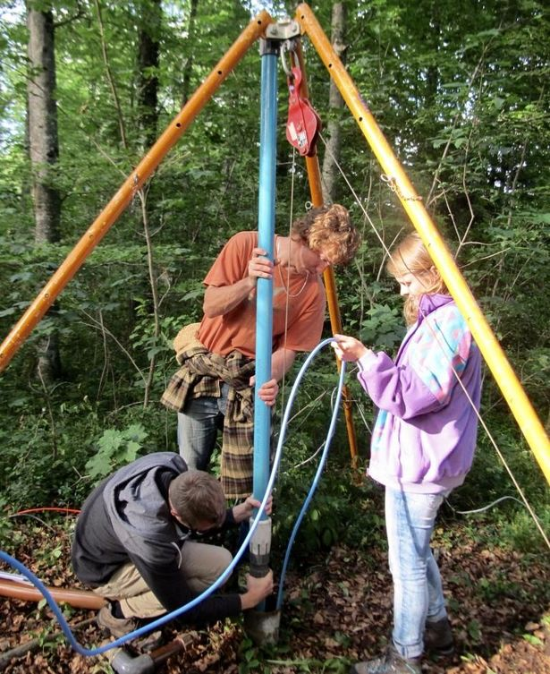
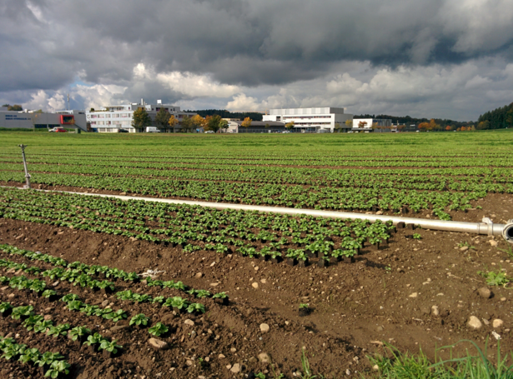
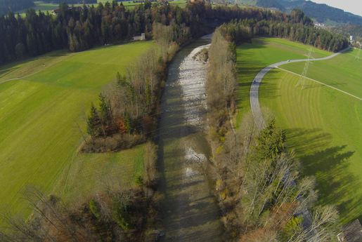
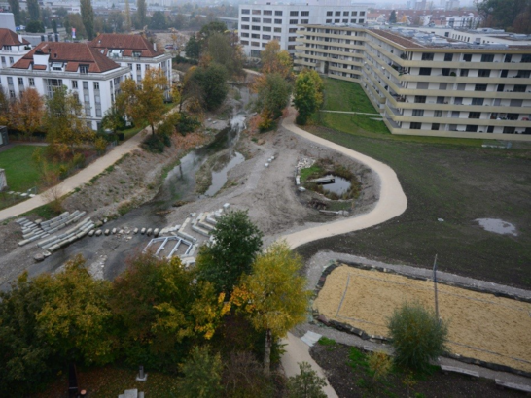
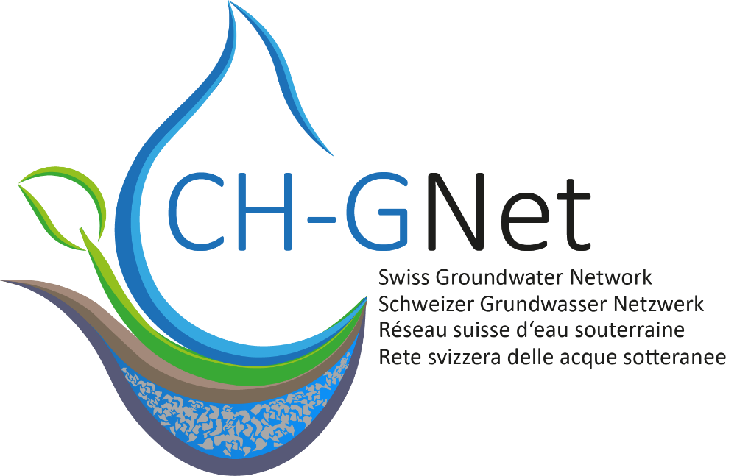
A Swiss-wide network of hydro(geo)logical observatories
Christian Moeck [Christian.moeck@Eawag.ch]; on behalf of all Partners
Vision and Goals
In recent years, important water-relevant research results have been achieved and numerous emerging issues have been identified. The posed challenges have to be elaborated, and solutions and measures must be developed. In this context, there is a great need to ensure continuous competence building and to promote an exchange of results, protocols, infrastructure, and equipment as well as hydrological data. For this reason, hydrogeological observatories are more necessary than ever.
Several existing, long-term hydrogeological observatories within Switzerland are currently being organized into a long-term hydrogeological observatory network with the support of the Swiss Groundwater Network (CH-GNet; www.swissgroundwaternetwork.ch)
HWD
TCA
RHB
Urban contamination and managed aquifer recharge (MAR). Developing of field methods and numerical modeling approaches.
.
Groundwater - surface water interaction and climate change impact studies, development of tracer and monitoring methods, revitalization and influence on habitat water, sediment dynamics and water quality.
Hydrogeologic process understanding for a pre-alpine natural system and process studies of energy and water exchange at the land surface.
KPL
FAT
Groundwater flow and transport, including microbial transport, in multilayered porous aquifers
(Urban) water management, measurement network (real-time measurements).
EMB
CHB
Groundwater – surface water interaction and tracer development used in fully integrated models.
Urban water management, river restoration and water protection.
.
Observatories
The current hydrogeologic observatories are complementary in terms of elevation, geology, use, and scientific as well as practical objectives. These observatories are managed by research groups or practice partners to ensure long-term operability.
The observatories are heavily instrumented for long-term hydraulic and chemical water monitoring and are supplemented by field experiments and investigations, as well as their use for teaching activities.
.
Partners

