Slide 1


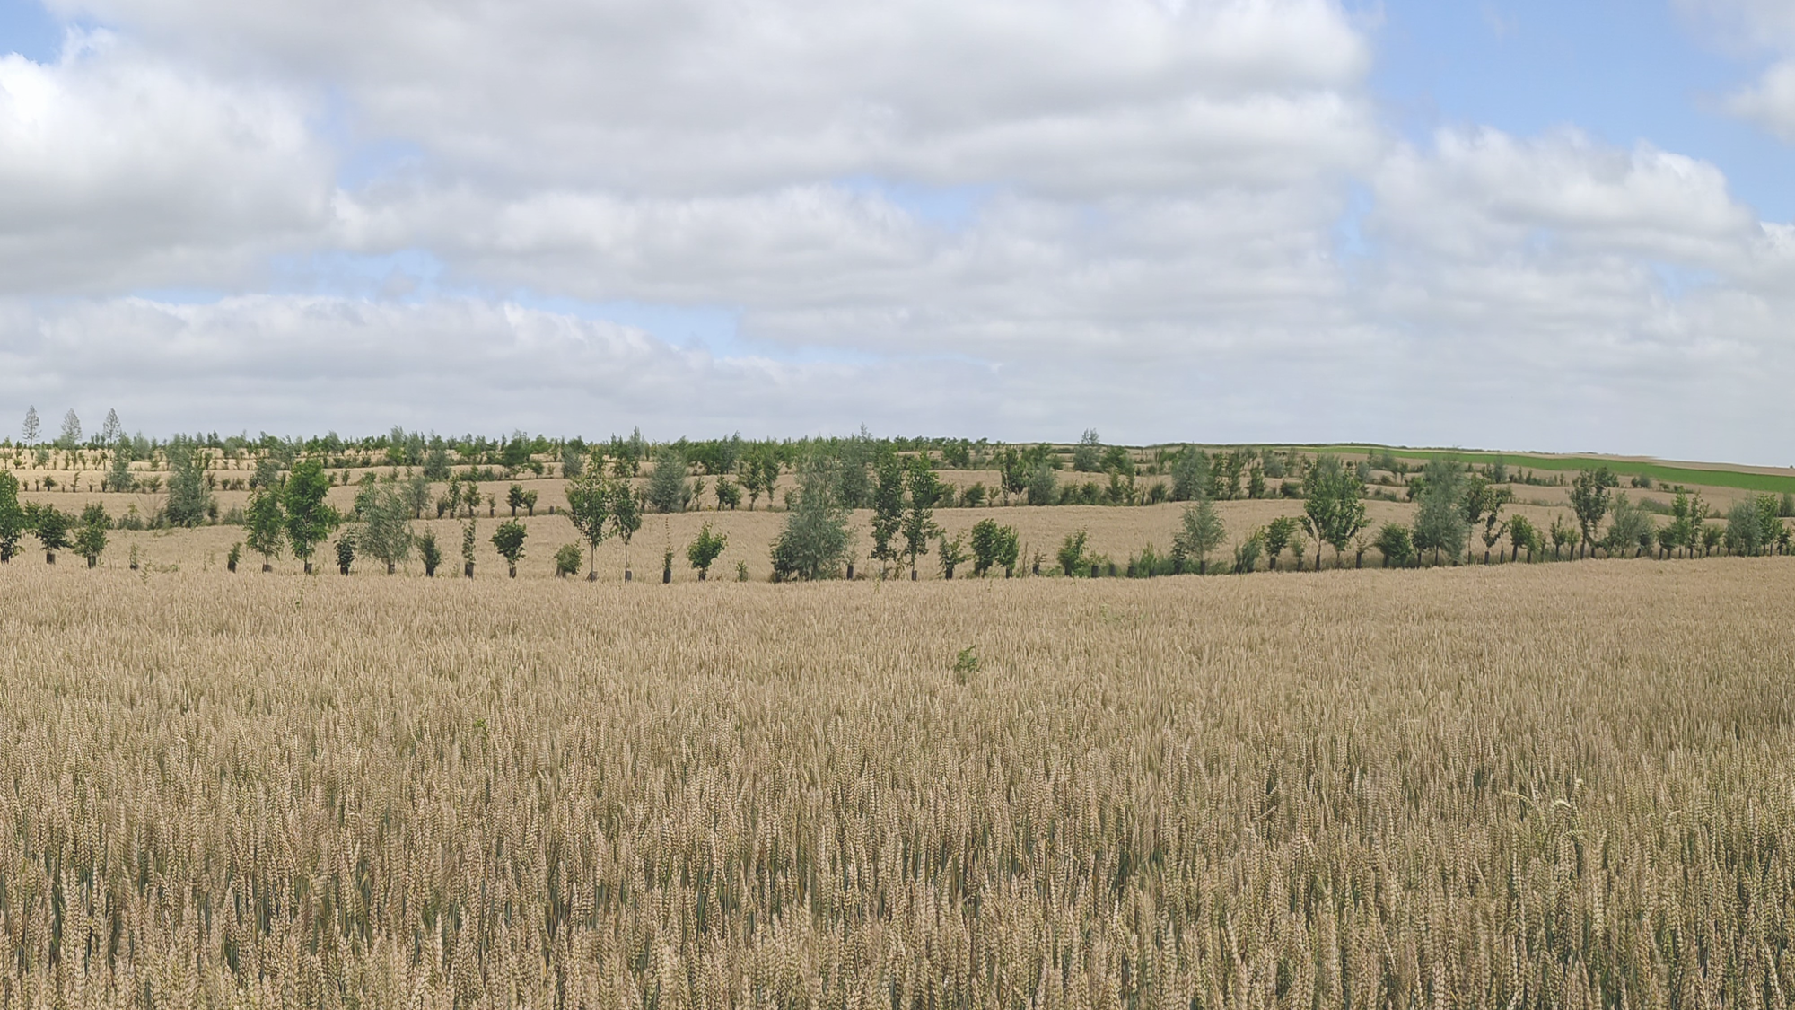





How do four-year-old intercropped trees share soil water with wheat in temperate alley-cropping experimental site:
Evidence from ²H₂O artificial labeling
O’CONNOR C.¹, Ndiaye A.¹, CHOMA C.¹, DELBENDE F.², ZELLER B.³, Manouvrier B.⁴, DESMYTTERE H.⁴, WATERLOT C.³, SIAH A.¹, ANDRIANARISOA K. S.¹
A European vision for hydrological observations and experimentation
NAPLES | ITALY | 12–15 JUNE 2023
Notes:
Agroforestry system
Through this presentation I will show you how

Slide 2
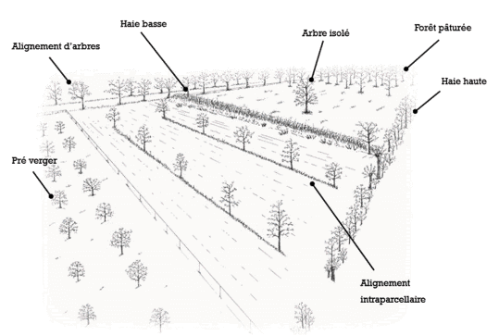
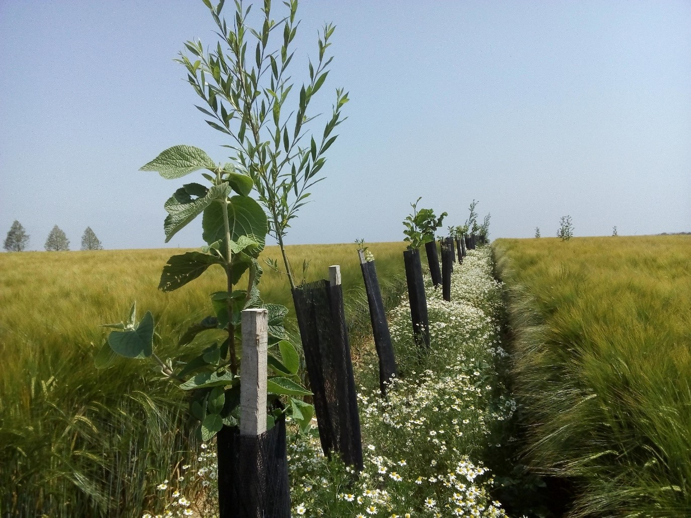
Agroforestry
Context and objectives
Conclusion
Methodology
Results
Low hedge
Association of trees and agricultural production on a same area :
livestosk (sylvopastoralism) or crop (agrosylviculture)
Isolated tree
Pastured forest
Tree rows
Tall hedge
Orchard meadows
(Mosquera-Losada et al. 2009)
ALLEY CROPPING
Alley cropping
Modified from Labant 2009
Notes:
Where tree rows are planted within the plot to create alleys where agricultural crops are produced.
Despite of severals ecosystems sevices offer by AF, belowground interactions may be negative

Slide 3
Tree root growth in alley-cropping systems and competition for water
Context and objectives
Conclusion
Methodology
Results
Dupraz and Liagre, 2008
Complementarity between tree and crop roots contributing to a better use of water resource (Huo et al., 2020)
Overlapping of tree and crop roots leading to competition and a risk of water stress (José et al., 2000)
AIM: to explore the water share between crops and trees after four years of tree establishment in alley-cropping
Notes:
Some studies showed…
However it is not always the case, in some systems tree and crop roots may overlapped and compete for water.
Studies in AC were mainly conducted on adult stands but the share of water at the early stage of tree establishment has been poorly examined. Early investigations of these mechanisms are necessary to provide optimum strategies for managing intercropping systems.

Slide 4
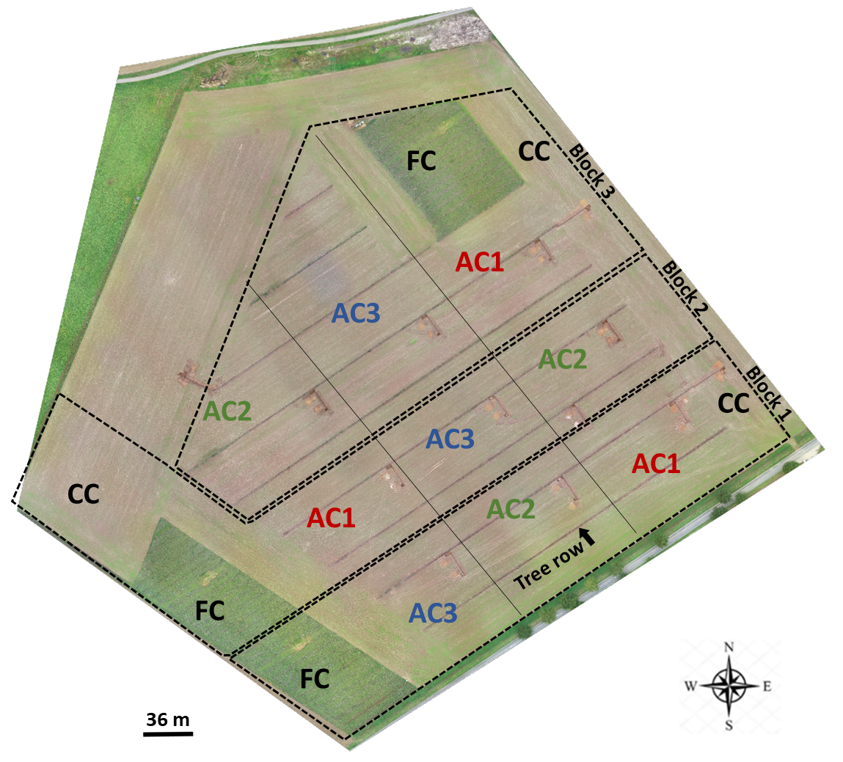
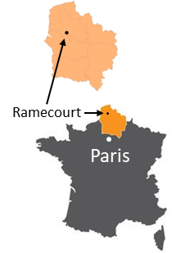
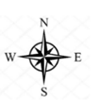
Context and objectives
Conclusion
Methodology
Results
Description of experimental site and ²H labeling
18 ha, loamy soil (depth > 2 m)
4 years old
Tested factors :
Tree species : alder, hornbeam, wild cherry
Labeling depths: 30, 50,100 cm
Types of systems: AC, FC, CC
Labeling date: from May 10th to 20th, 2021, GS 33 (jointing ; Zadoks et al., 1974)
2 deposits per tree of 300 mL (hole : 63 cm Ø) of water 10% enriched of ²H at 1,5 m from tree
AC1 (alley-cropping) : Oak/Hornbeam
AC2 : Walnut/Alder/Wild cherry
AC3 : Block locust/Alder
FC (Forest control) / CC (Crop control)
Notes:
We conducted our experiments in an alley-cropping experimental site located at Ramecourt in the north of France, the plot has an area of 18 ha with a deep loamy soil
Trees were 4 years old at the time of the experiment
The plot was divided in 3 blocks
Deuterium labeling experiment was done
GS 33: 2-3 nœud
To increase the probability that a tree root can access enriched water
There is 3 modalities of AC which differ according to the associated tree species
pH 7,9; OM 2,1 % ; clay 15 %

Slide 5
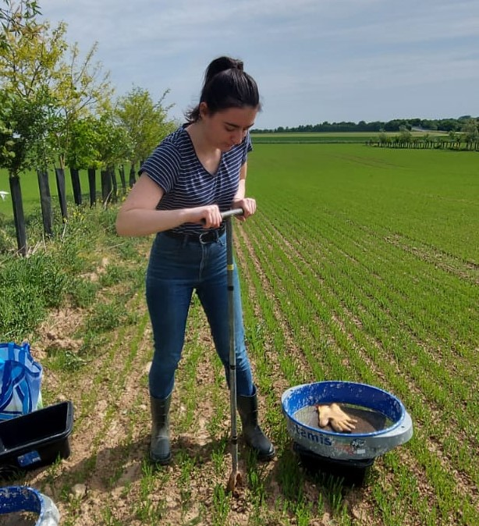
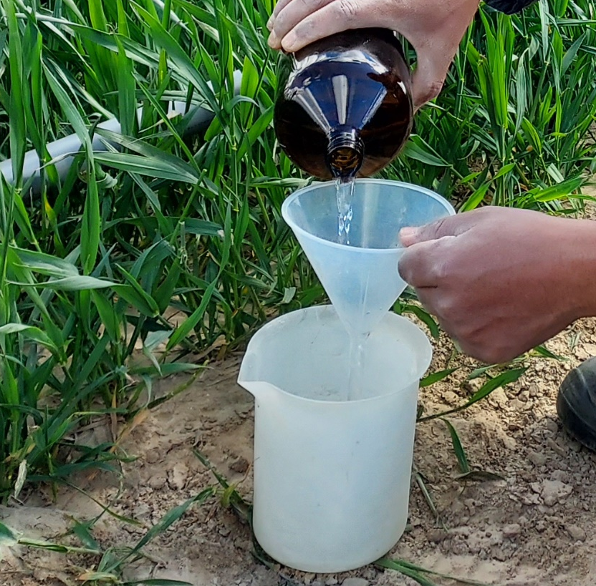
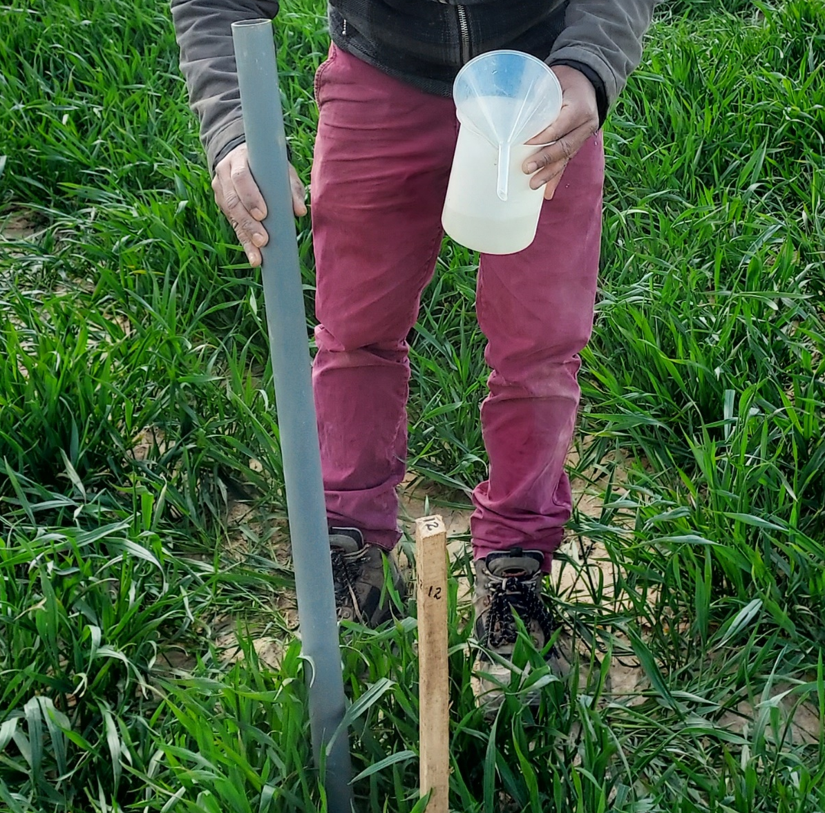
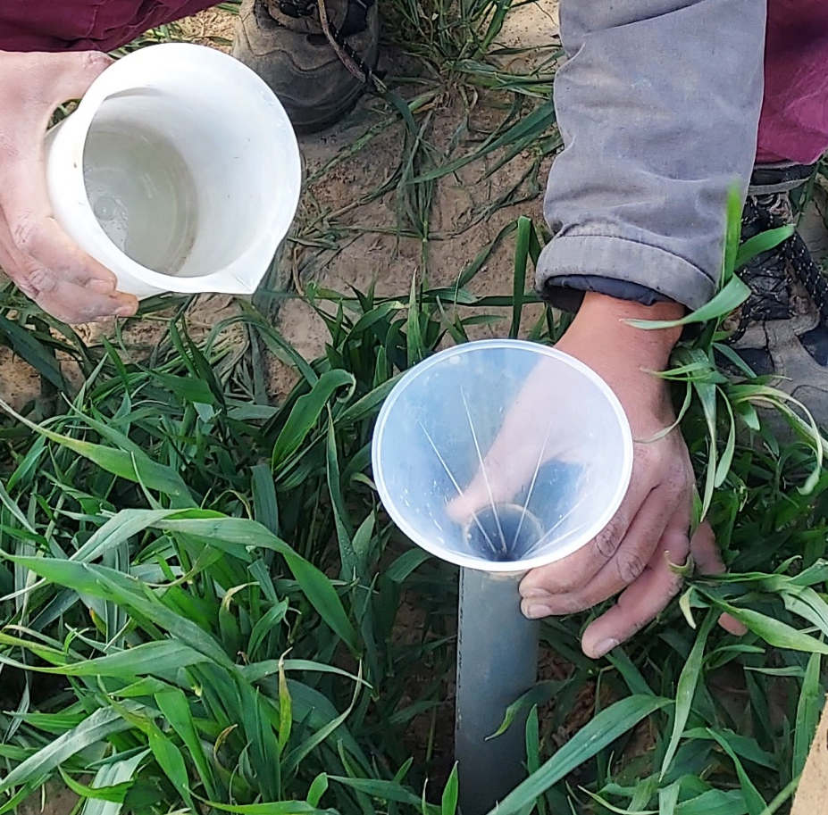
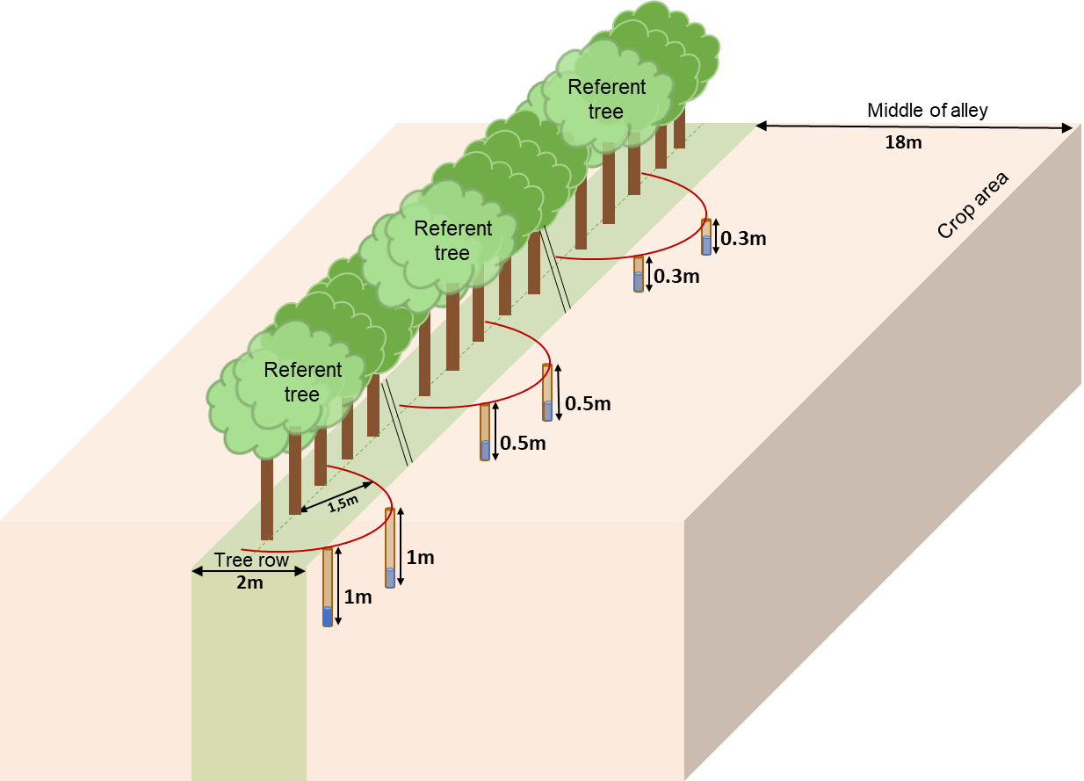

Context and objectives
Conclusion
Methodology
Results
²H labeling experiment
Auger hole
300 mL ²H₂O dosage
PVC pipe insertion
300 mL ²H₂O deposit
Plant sampling:
Every 15 days until October 2021
10 tree leaves and 4 wheat tillers (labeled areas and unlabeled controls)
Static vacuum cryogenic distillation and EA-IRMS analysis
$δ^{2}H\left(‰\right)=\frac{R_{ech}− R_{standard}}{R_{standard}} ×1000$
R = ²H/¹H
Notes:
Different steps during the labeling and the location of labeled water deposits
After the labeling periode we collected samples every 15 days
The water of samples was extracted by…and analysed by…
Then we calculated δ²H of all samples

Slide 6
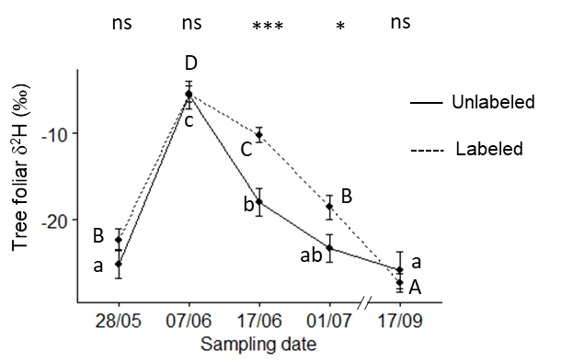
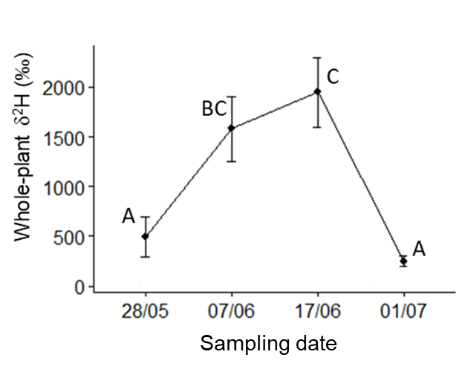
Context and objectives
Conclusion
Methodology
Results
Artificial ²H signature of wheat and trees
Wheat in labeled area
Trees
GS55#
heading
GS61#
beginning of anthesis
GS68#
end of anthesis
Sampling date (dd/mm)
Sampling date (dd/mm)
Wheat took up ²H enriched water despite the small volume of labeled water injected (wheat natural abundance δ²H = -45‰)
Young trees share water with wheat (Huo et al., 2020; Wang et al., 2023)
Delay in labeled water uptake by trees compared with wheat
(#Zadoks et al., 1974)
Notes:
Regarding results on Artificial ²H signature of wheat, we can see the values of whole-plante δ²H on Y AXIS according to sampling dates
We observed a Positive isotope enrichment indicating that the…
Water uptake peak one month after labeling, suggesting an increasing need for water until wheat flowering, then the decrease indicated that the deuterium must have been diluted or dissipated (130 mm of rain fell between the two last sampling dates)
Little difference of δ²H between labeled and unlabeled: either by that there was no tree roots where the enriched water was deposited or by that trees took up water in the row and not at 1,5m or by that all enriched water has been taken up by the wheat
However low isotopic values were consistent with those obtained by other authors on tree samples after isotopic labeling and we evidenced higher tree water uptake from 17/06 to 1st July showing that young trees…but that there was a delay in…

Slide 7
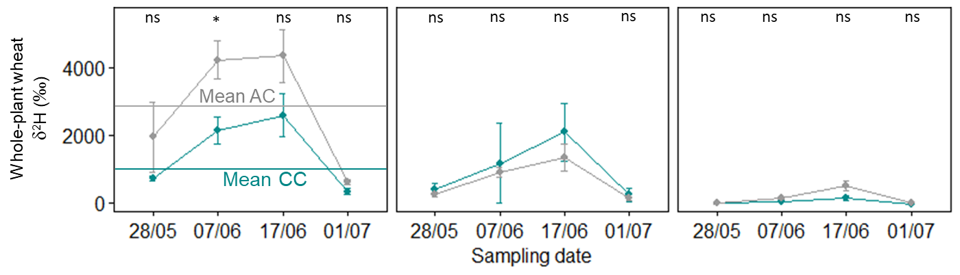
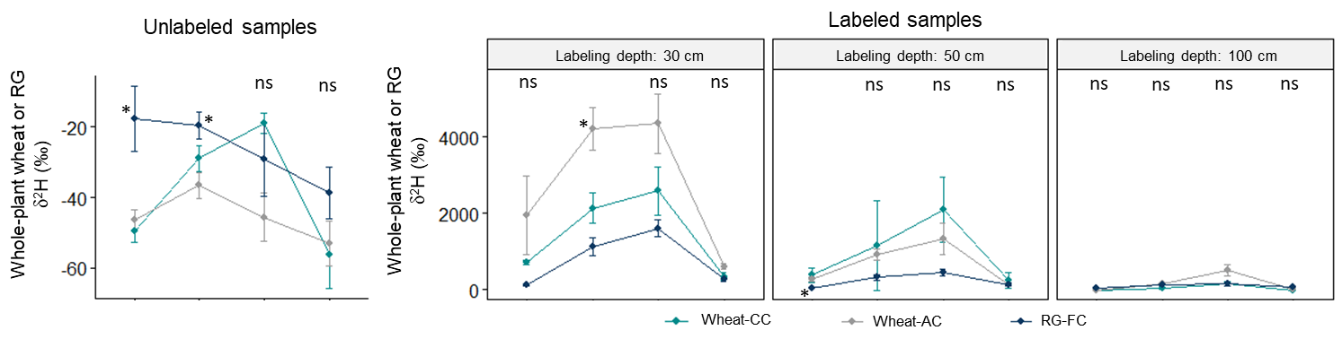
Context and objectives
Conclusion
Methodology
Results
Variation of ²H in wheat according to labeling depths
Labeling depth: 30 cm
Labeling depth: 50 cm
Labeling depth: 100 cm
Sampling date (dd/mm)
Trees promoted superficial water uptake by wheat
Notes:
Regarding the Variation of ²H in wheat according to labeling depths
Here are the results at 30 cm labeling depth…
We observed a higher water uptake of wheat in AC than the wheat in CC at a depth of 30 cm which can be explained by the low soil water content in CC which may have forced the wheat to uptake water in deep soil layer
Absorption d'eau par le blé se situait principalement entre 20 et 70 cm de profondeur entre la montaison (GS31) et l'épiaison (GS55) (Ma and Song 2018)
Pas de compétition en saison de pluies (Everson 2009)

Slide 8
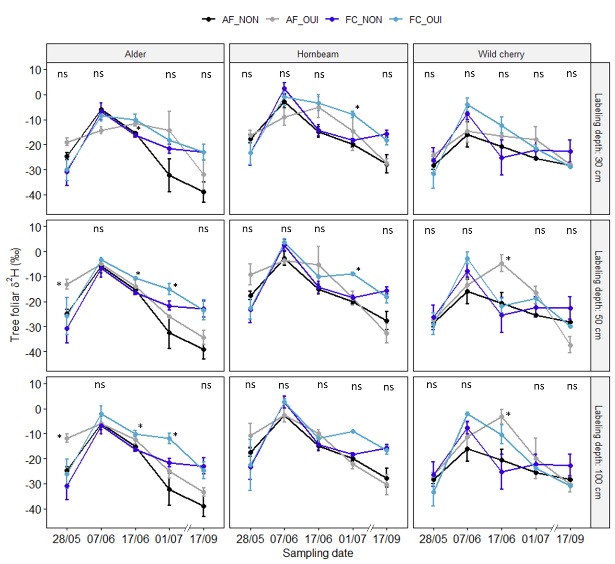
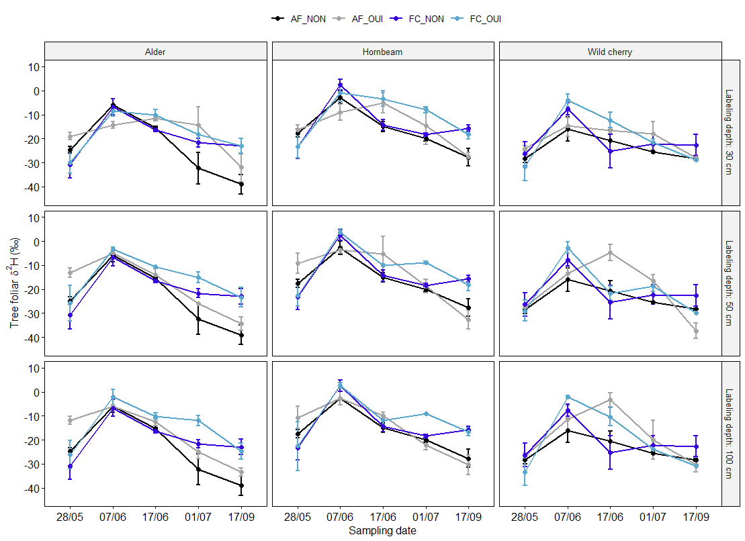
Context and objectives
Conclusion
Methodology
Results
Variation of ²H in trees according to labeling depths
Hornbeam
Wild cherry
The three species behaved differently :
Labeling depth: 30 cm
Hornbeam took up water at 30 and 50 cm depths
Wild cherry took up water at 50 and 100 cm depths in both AC and dry periods
AC Unlabeled
AC Labeled
Tree foliar δ²H (‰)
Labeling depth: 50 cm
FC Unlabeled
FC Labeled
Wild cherry and alder were able to flexibly shift their water source to the deep layer early in their growth stage by contrast to hornbeam
Labeling depth: 100 cm
Sampling date (dd/mm)
Notes:
Finally regarding the Variation of ²H in trees
We have results at 30 cm…labeling depth
Water absorption during tree growth and heat periods
Le labour a pu limiter le développement des racines dans la zone cultivée et favoriser l'absorption d'eau dans les 30 cm de profondeur mais dans la bande de végétation du sous-canopée.

Slide 9
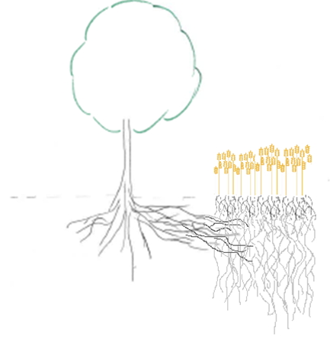
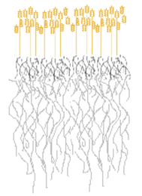
Context and objectives
Conclusion
Methodology
Results
Four-year-old intercropped trees share
water with wheat mainly at 30 cm depth
Trees promoted superficial water uptake by wheat
Wild cherry and alder were able to flexibly shift their water source to the deep layer
Hornbeam
H₂O
Alder
Wild cherry
H₂O
Notes:
To answer our assumptions we saw that…
Additional research by analysing…and using Bayesian mixing model would allow to determine the contributions of soil water from different layers for each plant

Slide 10
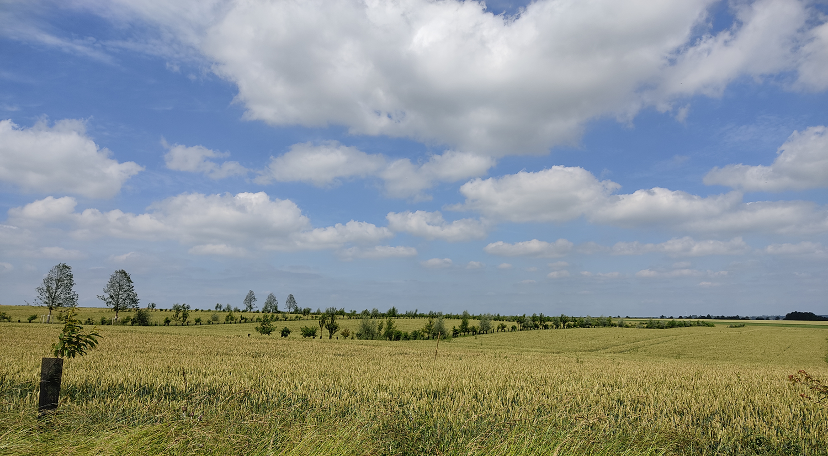


THANK YOU for your attention
Thanks to our partners
Notes:
Travail mené grâce à la collaboration avec partenaires, financeurs, collègues, stagiaires, photo

Slide 11
REFERENCES
Dupraz, C., Liagre, F., 2008. Agroforesterie: des arbres et des cultures. Ed. Fr. Agric. Paris
Huo, G., Zhao, X., Gao, X., Wang, S., 2020. Seasonal effects of intercropping on tree water use strategies in semiarid plantations: Evidence from natural and labelling stable isotopes. Plant Soil 453, 229–243. https://doi.org/10.1007/s11104-020-04477-5
Jose, S., Gillespie, A.R., Seifert, J.R., Biehle, D.J. 2000a. Defining competition vectors in a temperate alley cropping system in the midwestern USA; 2. Competition for water. Agrofor Syst 48: 41–59.
Mosquera-Losada, M.R., Mcadam, J.H., Romero-Franco, R., Santiago-Freijanes, J.J., Rigueiro-Rodríguez, A. 2009. Definitions and Components of Agroforestry Practices in Europe. Agroforestry in Europe. 3-19
Wang, S., Gao, X., Yang, M., Huo, G., Song, X., Siddique, K.H.M., Wu, P., Zhao, X., 2023. The natural abundance of stable water isotopes method may overestimate deep-layer soil water use by trees. Hydrol. Earth Syst. Sci. 27, 123–137. https://doi.org/https://doi.org/10.5194/hess-27-123-2023
Zadoks, J.C., Chang, Konzak, C.F., 1974. A decimal code for the growth stages of cereals J. Weed Res. 14, 415–421. https://doi.org/10.1111/j.1365-3180.1974.tb01084.x

Slide 12
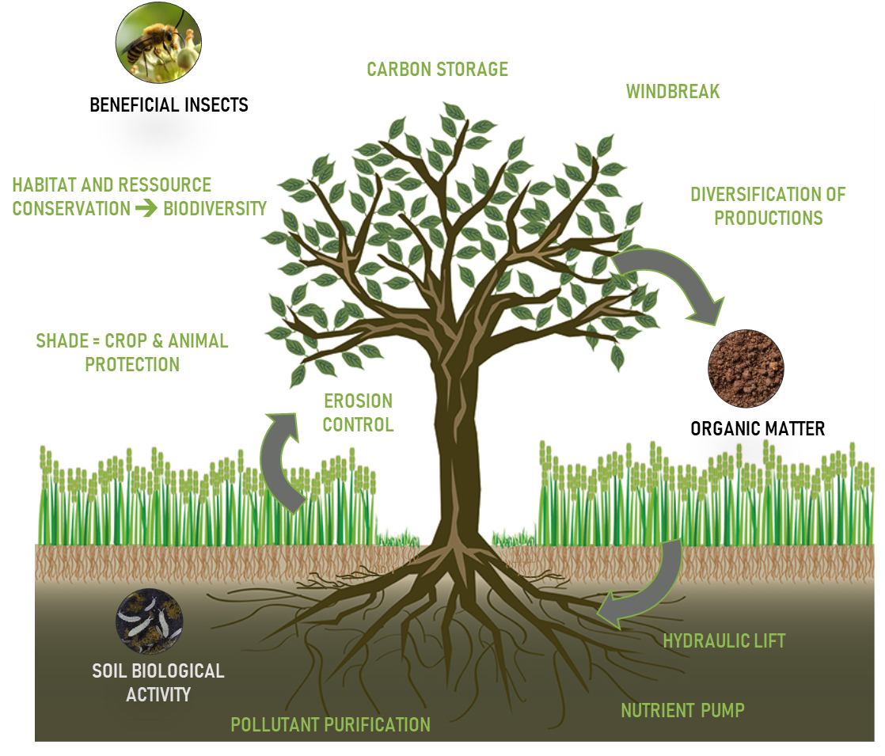
Context and objectives
Conclusion
Methodology
Results
Agroforestry
Association of trees and agricultural production on a same area :
livestosk (sylvopastoralism) or crop (agrosylviculture)
(Mosquera-Losada et al. 2009)
H₂O
Modified from French Agroforestry Association and Mareike Jäger, AGRIDEA, Janvier 2017
Notes:
In this system the cohabitation and the competition…
This cohabitation may induce a competition for W and N absorption but TREE ROOTS may also be an input of…

Slide 13
Context and objectives
Conclusion
Methodology
Results
Description of alley-cropping experimental site
18 ha, loamy soil (depth > 2 m)
Plantation November 2018
Tree rows oriented N-S
3 blocks with 5 modalities
AC1 (alley-cropping) : Oak/Hornbeam
AC2 (alley-cropping) : Walnut/Alder/Wild cherry
AC3 (alley-cropping) : Block locust/Alder
FC (Forest control)
CC (Crop control)
Crop succession: sugar beet, barley, witloof chicory, wheat (sown October 15, 2020)
FC : ryegrass sown in spring 2019
Notes:
To verify our assumptions, we carried out experiments in an alley-cropping experimental site located at Ramecourt in the north of France, the plot has an area of 18 ha with a deep loamy soil, a mean pH of…
Trees were planted in…with a N-S…
The plot was divided in
There is 3 modalities of AC which differ according to the associated tree species
Since the plantation, the cultivated crop were
; pH 7,9; OM 2,1 % ; clay 15 %)

Slide 14
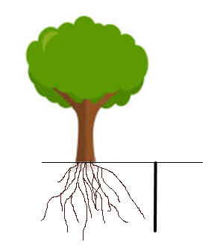
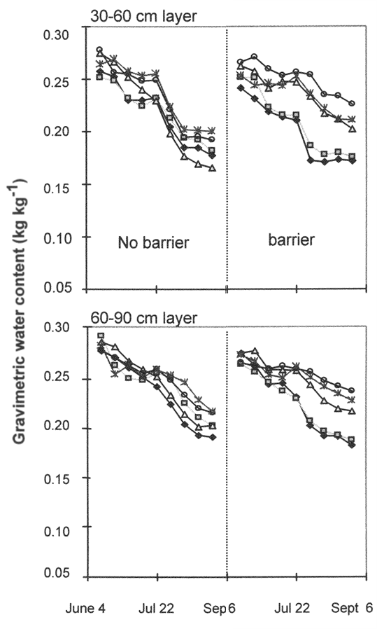
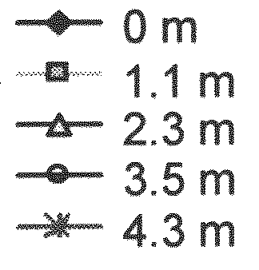
Tree root growth in alley-cropping systems and competition for water
Context and objectives
Conclusion
Methodology
Results
Mulia and Dupraz, 2006
Dupraz et Liagre, 2008
José et al., 2000a
Different spatial repartition between walnut and wheat roots
Overlapping roots of trees and crops
Trees compete for water
Notes:
Despite of severals ecosystems sevices offer by AF, belowground interactions between trees and crops may be negative
Some studies showed a different spatial repartition between tree and crop roots, for example in a study of M&D walnut roots remained close to the row and wheat roots in the crop area
However it is not always the case, in some systems tree and crop roots may overlapped and compete for water.
José et al compared SWC where a polypropylene barrier was inserted at 1.2 m from tree up to 1m depth. They showed that in the barrier system, the SWC was lower close to the row than in the crop area

Slide 15
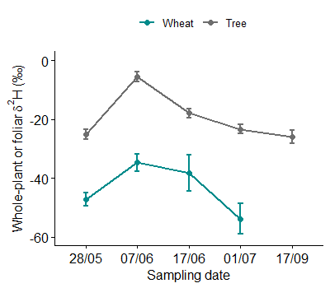
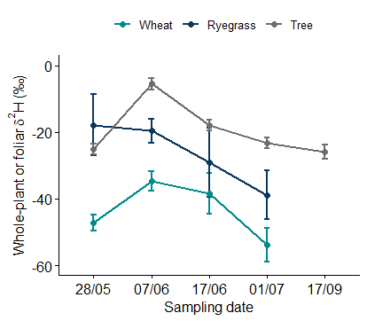

Context and objectives
Conclusion
Methodology
Results
Variation in wheat and tree ²H natural abundance
$δ^{2}H\left(‰\right)=\frac{R_{sample}− R_{standard}}{R_{standard}} ×1000$
C
B
R = ²H/¹H
AB
Mean tree
R_{sample} = ²H/¹H of the sample
R_{standard} = ²H/¹H standard (V-SMOW; IAEA, 1995)
A
A
b
ab
ab
Mean wheat
Different water absorption profiles according to species:
Wheat took up water in deep soil layer
Trees took up water in upper soil layer
a
Sampling date (dd/mm)
Wheat and trees modulated their water source according to it availability in soil layers
No effect of trees on wheat water uptake
Notes:
Once all data were measured we analyzed the value of δ²H beginning with natural abundance
Axe y : negative natural abundance: consistent with values found in other studies analyzing water from crops, trees and soil
δ²H decreases with soil depth, due in particular to surface evapotranspiration, which favor losses in 1H
Water in the plant reflects water in the soil, as there is no isotope fractionation during water uptake (i.e. no preference)
We observed first an increase which occurred during a dry period and may indicated a water uptake in topsoil affected by strong evaporation fractionation
then the decrease of δ²H observed whereas there was still only few rainfall suggested a water uptake in deep soil layer

Slide 16
Context and objectives
Conclusion
Methodology
Results
Variation of ²H in trees according to labeling depths
Alder
Hornbeam
Wild cherry
The three species behaved differently :
Labeling depth: 30 cm
Alder took up water throughout soil profile, but mainly at 50 and 100 cm depths
Hornbeam took up water at 30 and 50 cm depths
Wild cherry took up water at 50 and 100 cm depths in both AC and dry periods
AC Unlabeled
AC Labeled
Tree foliar δ²H (‰)
Labeling depth: 50 cm
FC Unlabeled
FC Labeled
Wild cherry were able to flexibly shift their water source to the deep layer early in their growth stage by contrast to hornbeam
Labeling depth: 100 cm
Sampling date (dd/mm)
Notes:
Water absorption during tree growth and heat periods
Le labour a pu limiter le développement des racines dans la zone cultivée et favoriser l'absorption d'eau dans les 30 cm de profondeur mais dans la bande de végétation du sous-canopée.

Slide 17
Context and objectives
Conclusion
Methodology
Results
Four-year-old intercropped trees share
water with wheat mainly at the 30 cm
Trees promoted superficial water uptake by wheat
Wild cherry and alder were able to flexibly shift their water source to the deep layer
Hornbeam
H₂O
Alder
Wild cherry
H₂O
Perspectives
Analyze ²H et ¹⁸O in soil and calculate the contributions of soil water from different layers for each plant using Bayesian mixing model
Notes:
To answer our assumptions we saw that…
Additional research by analysing…and using Bayesian mixing model would allow to determine the contributions of soil water from different layers for each plant

Slide 18

Context and objectives
Conclusion
Methodology
Results
²H labelling experiment
Auger hole
300 mL ²H₂O dosage
PVC pipe insertion
300 mL ²H₂O deposit
Plant sampling:
Every 15 days until October 2021
10 tree leaves and 4 wheat and ryegrass tillers (labeled areas and unlabeled controls)
Static vacuum cryogenic distillation and EA-IRMS analysis
$δ^{2}H\left(‰\right)=\frac{R_{sample}− R_{standard}}{R_{standard}} ×1000$
R_{sample} = ²H/¹H of the sample
R_{standard} = ²H/¹H standard (V-SMOW; IAEA, 1995)
Notes:
Different steps during the labeling :
We collected samples every 15 days
The water was extracted by…and analysed by…
With these results we calculated the ²H delta according to the isotopic ratio between ²H et ¹H of the sample and of the Vienna Standard Mean Ocean Water
²H/¹H = 155,76 ± 0,1 ppm

Slide 19
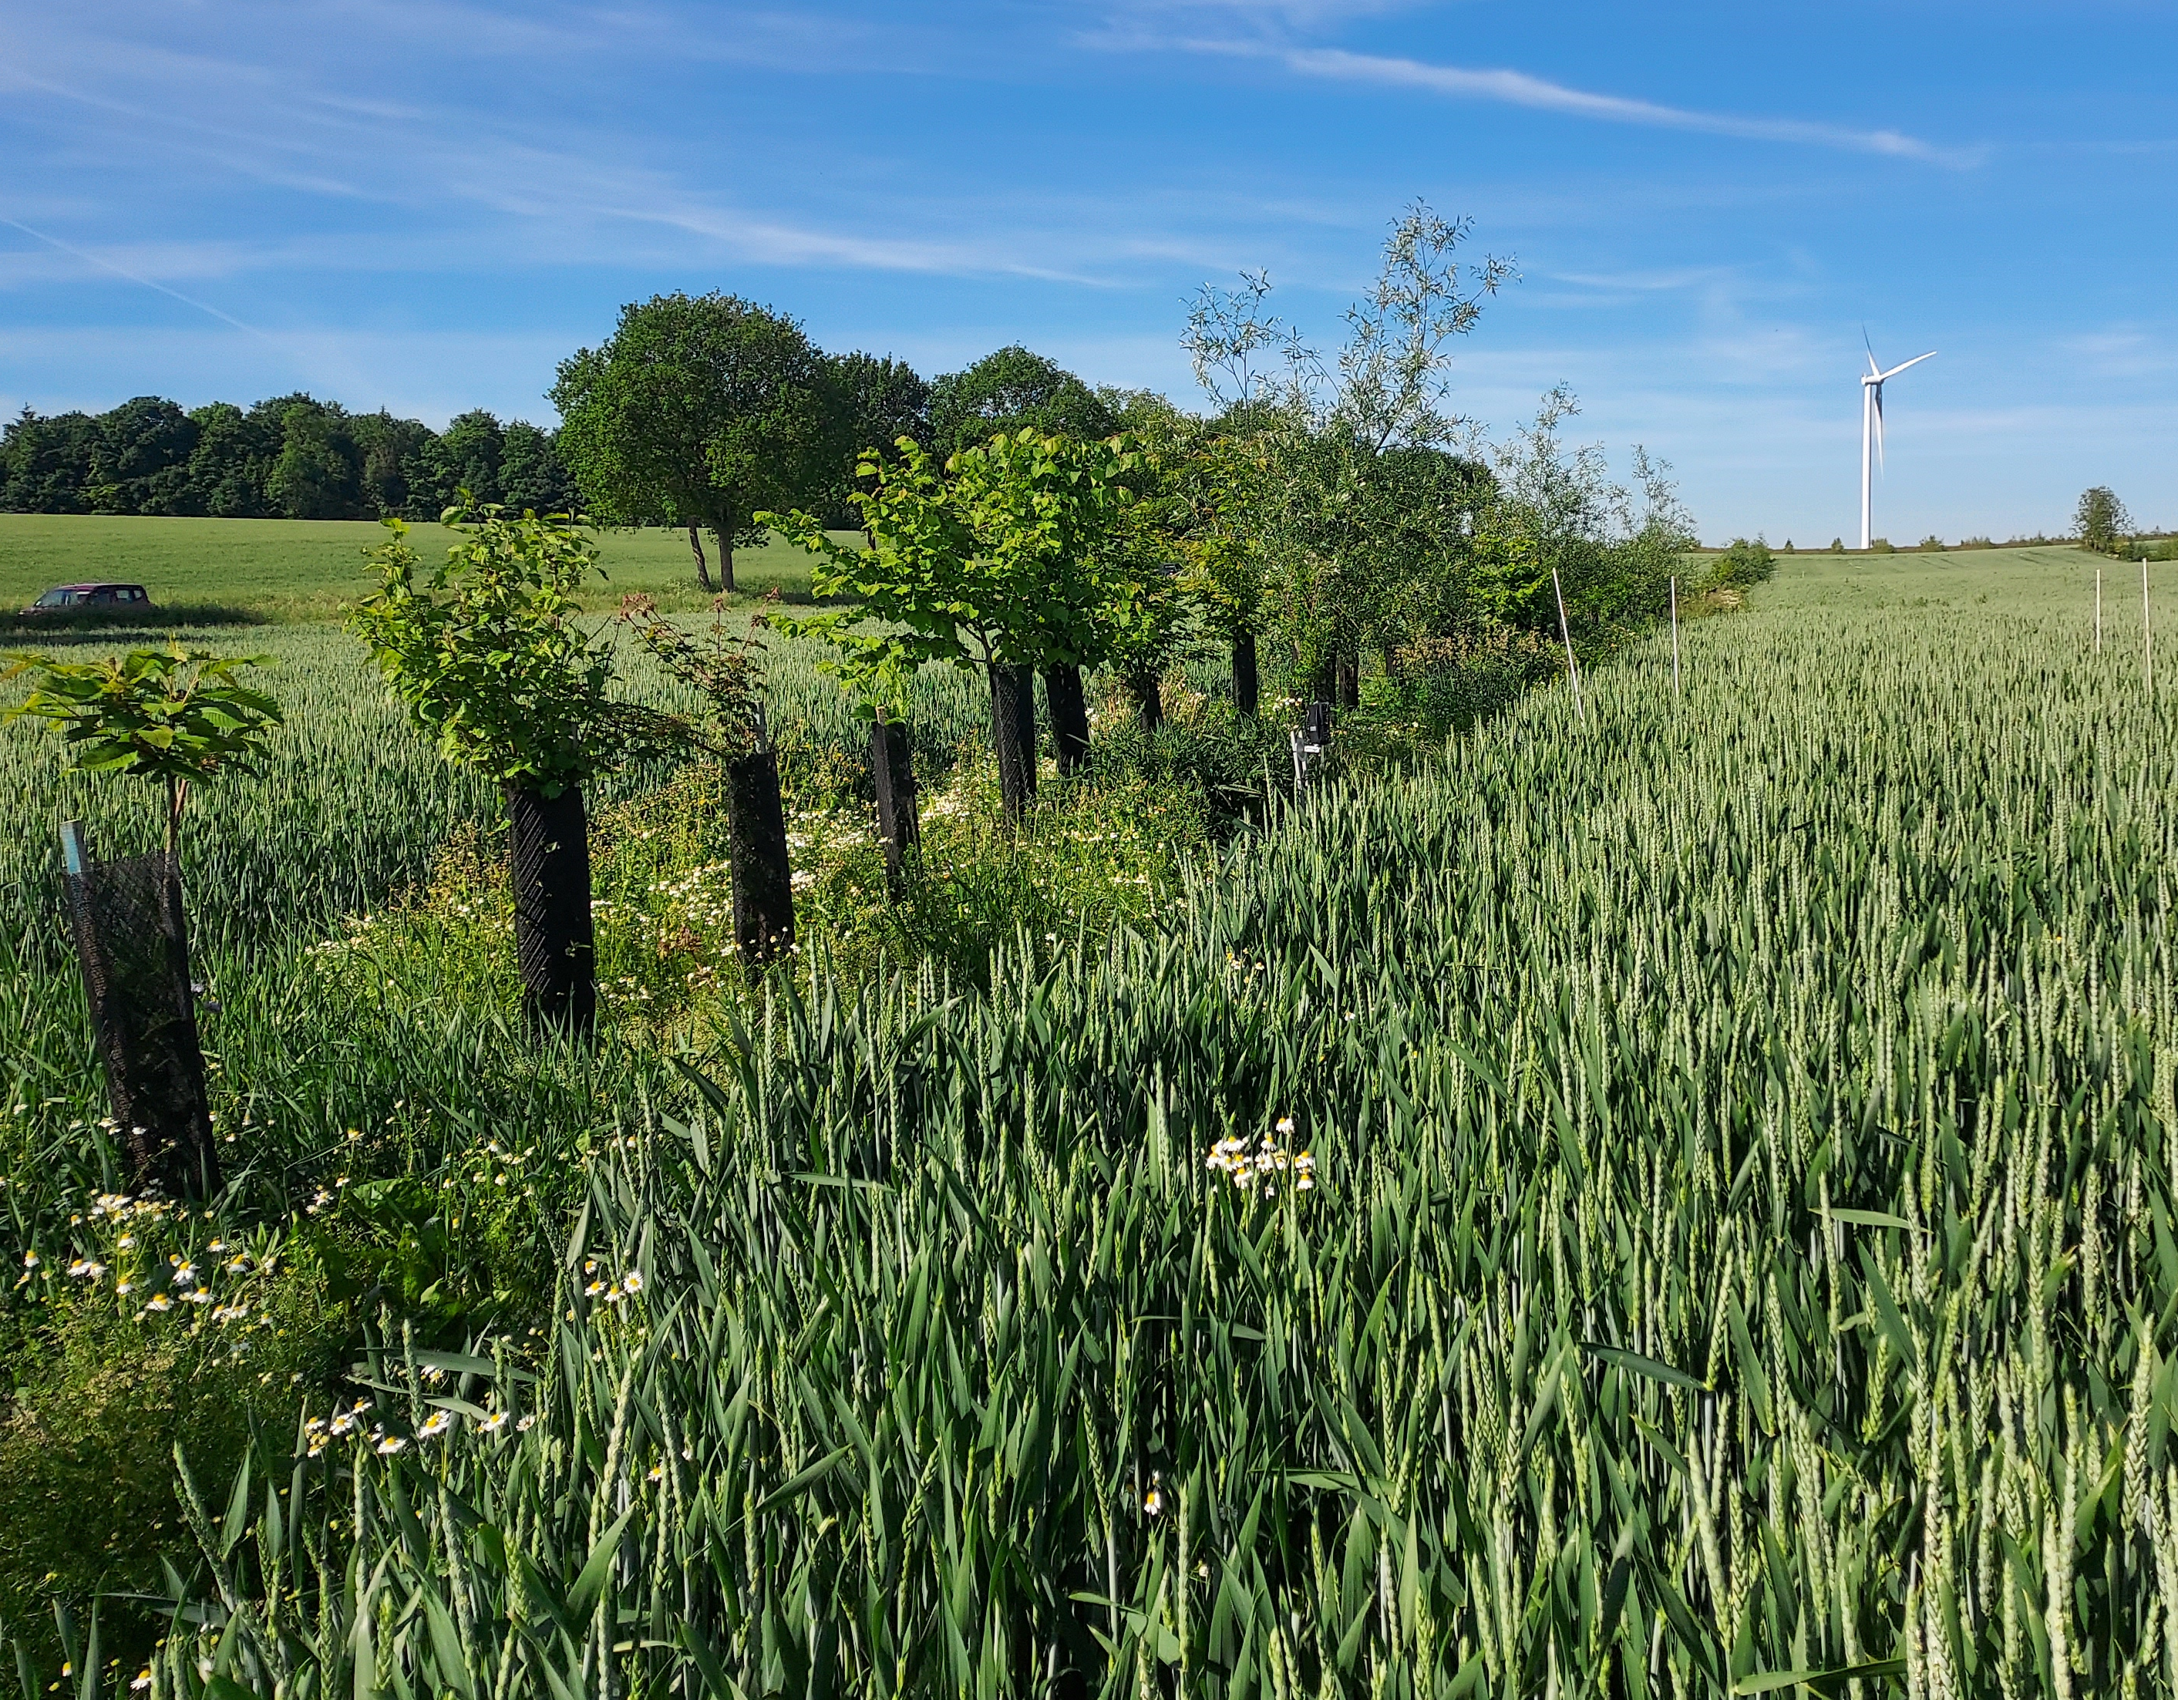
Context and objectives
Conclusion
Methodology
Results
Perspectives
Quantify the amount of water taken up by two associated species
Analyze ²H et ¹⁸O in soil and calculate the contributions of soil water from different layers for each plant using Bayesian mixing model
Continue water monitoring throughout tree growth to determine from what age trees would negatively impact crop water uptake mainly uptake water out of the crop rooting zone and become complementary with them
Notes:
Additional research by extending the chronosequence would allow to confirm…
And Further study are necessary to test if tree roots from their young age compete for water and nitrogen with the crop and at what depth appeared a competition.

