Slide 1
Assimilation of Sentinel-1 backscatter data into AquaCrop v7
for soil moisture and biomass updating over Europe
Authors: Shannon de Roos*, Michel Bechtold, Louise Busschaert, Zdenko Heyvaert, Sujay Kumar, Hans Lievens, Jonas Mortelmans, Dirk Raes, Samuel Scherrer, Maxime Van den Bossche, Elias Fereres, Margarita Garcia-Vila, Pasquale Steduto, Theodore Hsiao, Lee Heng, Maher Salman, Gabrielle De Lannoy
* contact: Shannon.deroos[at]kuleuven.be

Slide 2
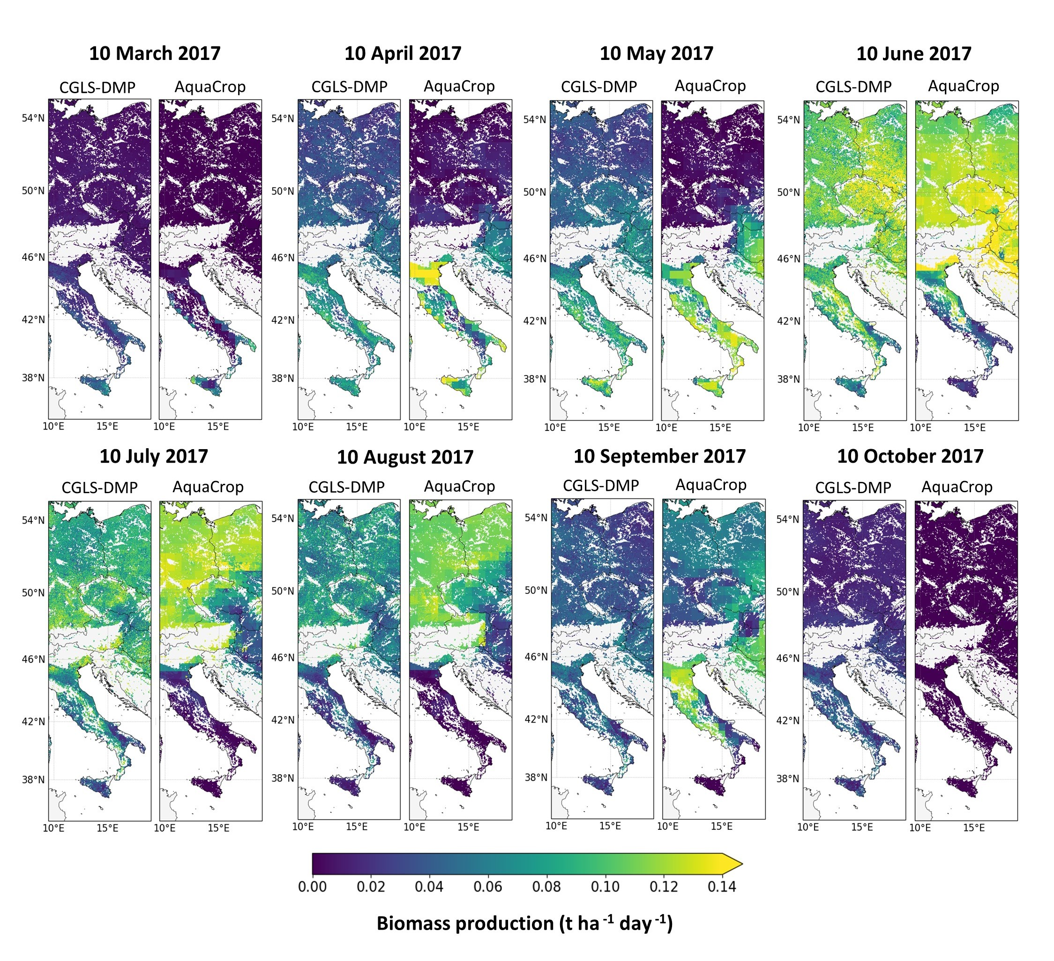
Regional monitoring of agricultural production
seasonal and inter-annual changes in
soil moisture and crop biomass production
Large scale applications → European continent
Spatial resolution: 1-km
Temporal resolution: daily
Introduction of errors by
general input and model assumptions
Use of independent observations to update model simulations via data assimilation
de Roos et al. (2021), Geosci. Model Dev., doi: 10.5194/gmd-14-7309-2021

Slide 3
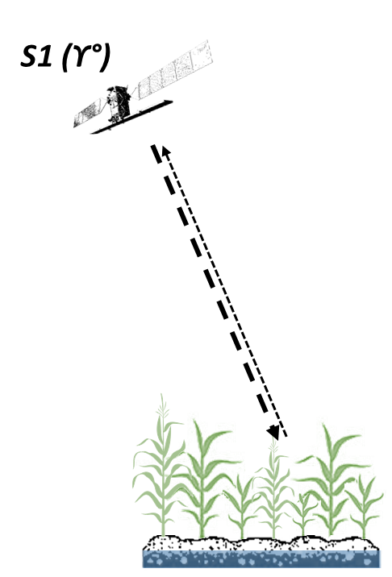
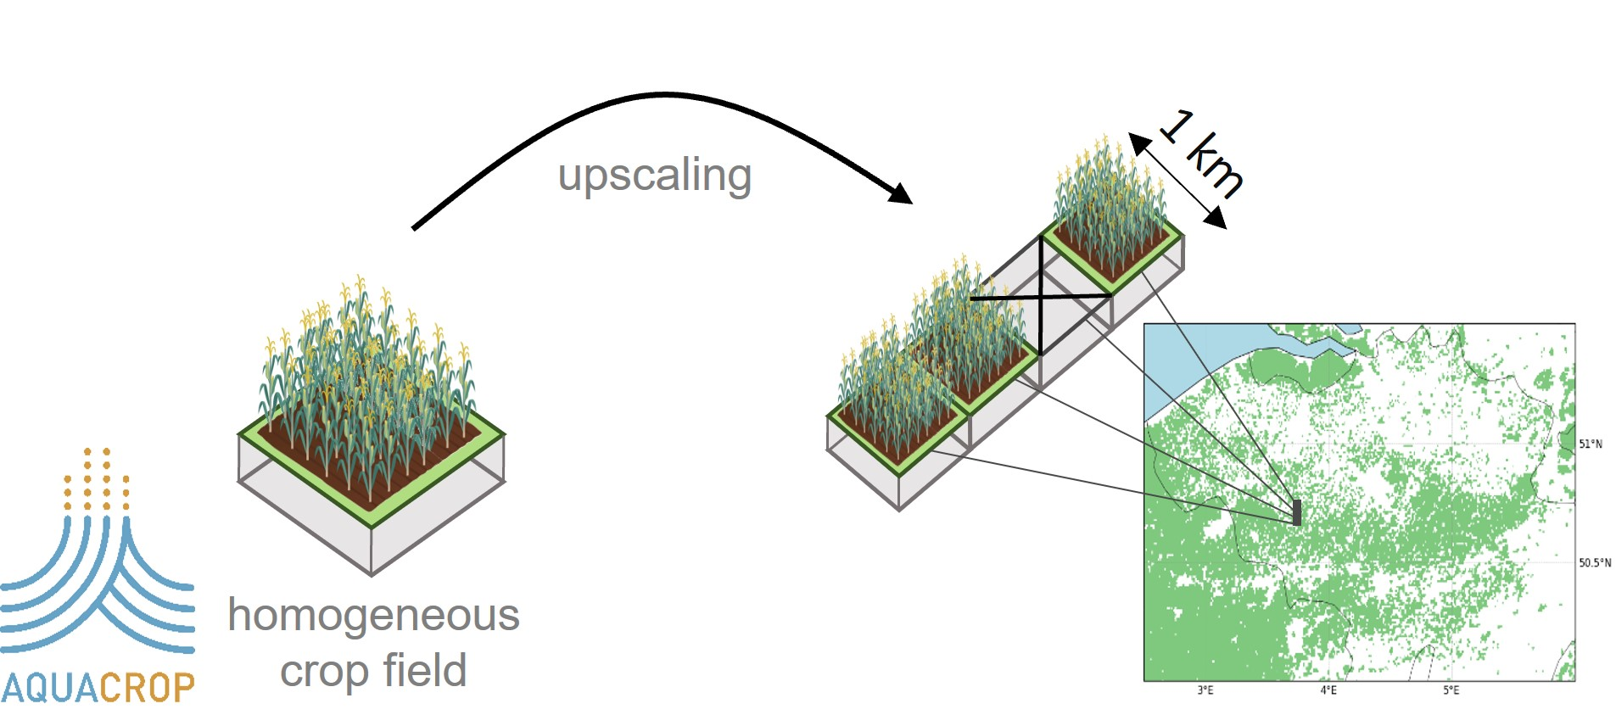
model
observations
Regionally gridded AquaCrop v7
MERRA-2 re-analysis forcings [50km → 1km]
STATSGO/FAO soil textural classes [1 km]
Generic C₃ crop w/ annual growth cycle
Rainfed agriculture (no irrigation)
Sentinel-1 (S1)
CSAR (5.4 GHz)
Co-polarisation; VV & cross-polarisation; VH
1 km spatial resolution
Temporal resolution: ~3 days
→ Simulations of soil moisture (m³/m³) & crop dry biomass (ton/ha)
→ Total backscatter signal (ϒ°; dB) contains information on soil moisture and vegetation

Slide 4
The data assimilation (DA) set-up
Step 1: AquaCrop biomass & soil moisture to backscatter signal (dB)
dry biomass (ton ha⁻¹)
wet biomass (-)
soil moisture (m³m⁻³)
WATER CLOUD MODEL
ϒ°_{AquaCrop} (dB)
ϒ°_{S1} (dB)
de Roos et al.(2023), Remote Sens Environ., doi: 10.1016/j.rse.2023.113621

Slide 5
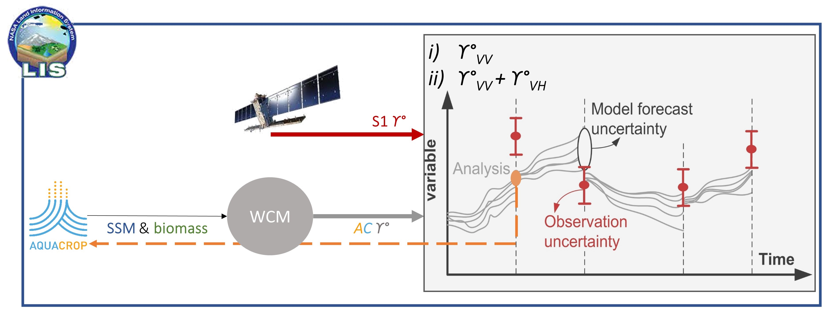
The data assimilation (DA) set-up
Step 2: backscatter data assimilation for AquaCrop soil moisture and biomass updating
24
ensemble members
EnKF

Slide 6
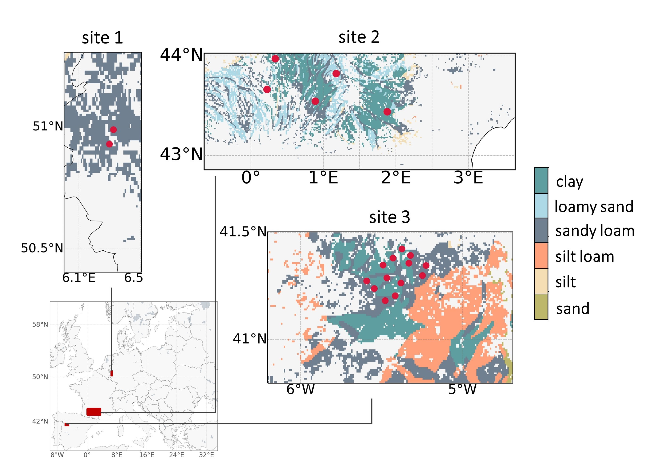
Experiments data assimilation (DA)
Site 1: West Germany
Site 2 : South France
Experiment 1 ϒ° _{VV} to update soil moisture
→ perturb meteorological input (rainfall, temperature, ET_{o})
→ perturb soil moisture
Experiment 2 ϒ° _{VV} + ϒ° _{VH} to update soil moisture and biomass
→ perturb meteorological input (rainfall, temperature, ET_{o})
→ perturb soil moisture & biomass
Site 3 : NW Spain
ISMN soil moisture in situ points

Slide 7
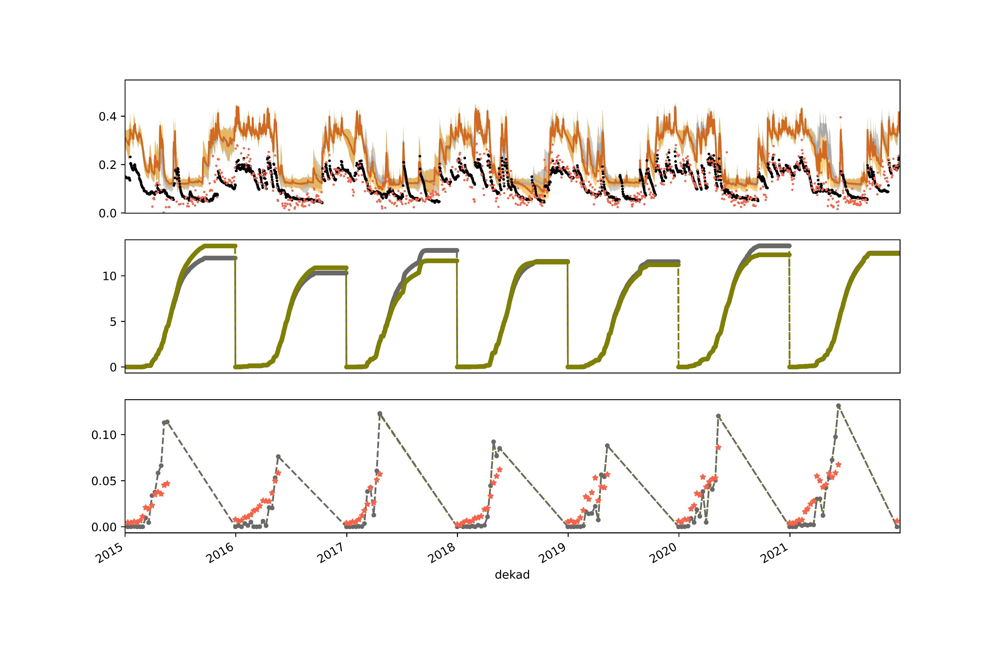
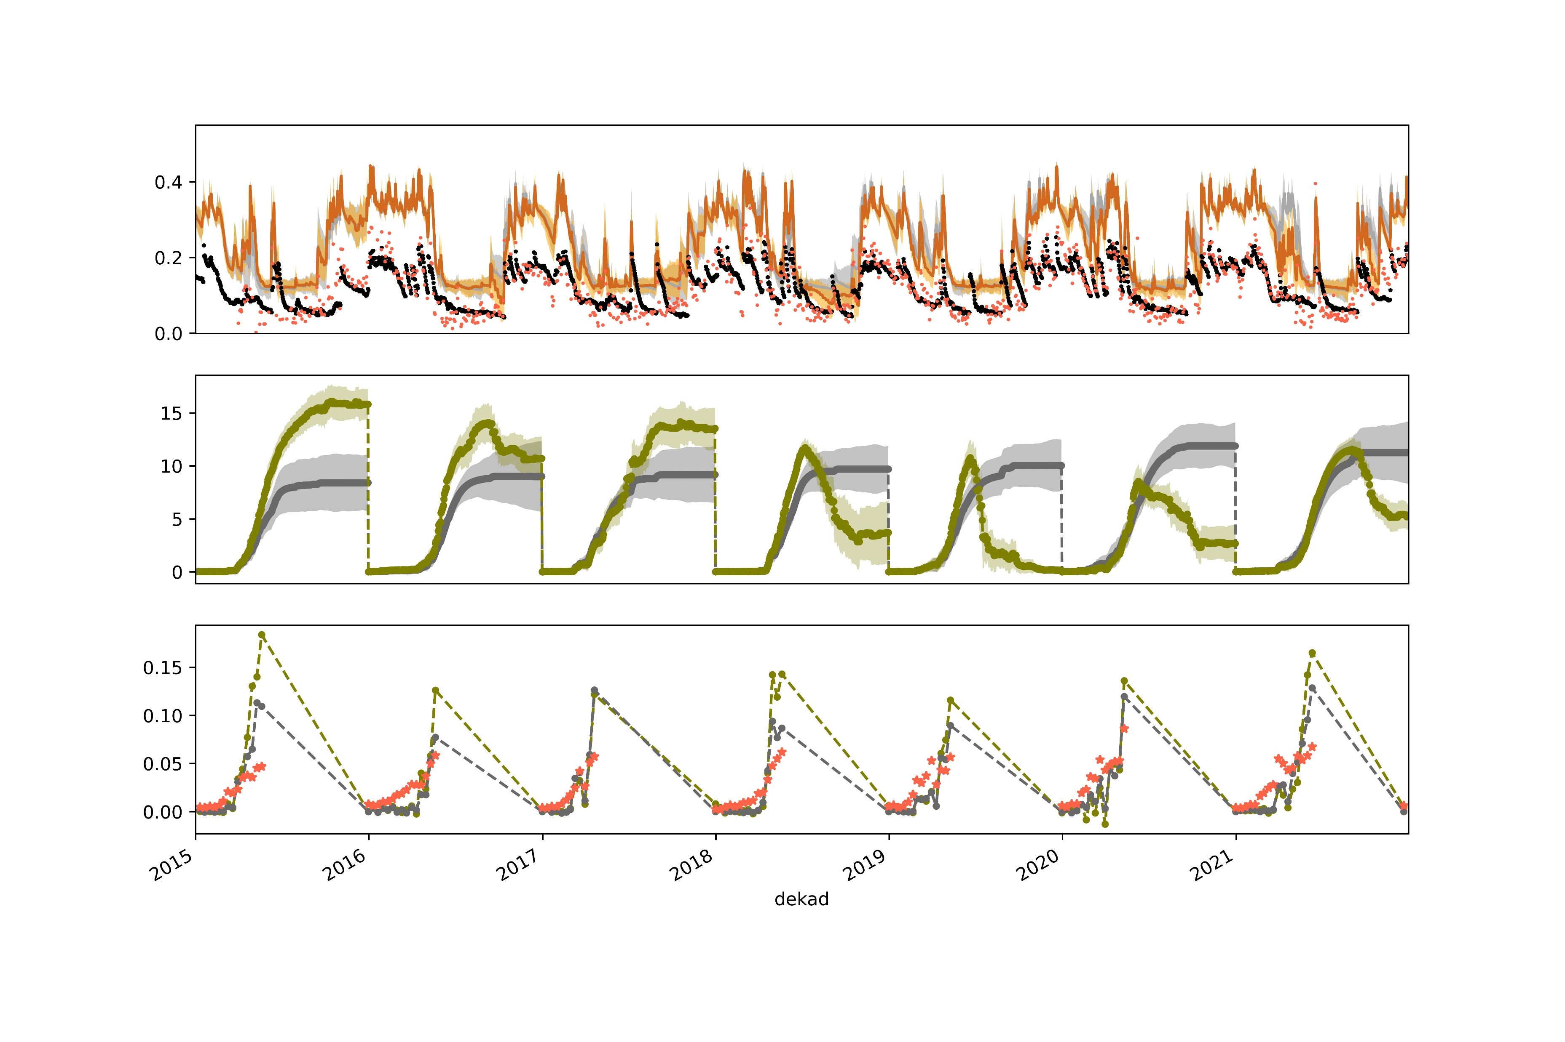
Results: DA impact
Experiment 1 – ϒ° _{VV}
to update surface soil
moisture (SSM)
Site 3 (NW-Spain)
0.5
OL DA
in situ
SMAP
SSM
[m³ m⁻³]
0
10
OL
DA
Biomass
[ton ha⁻¹]
Cumulative B→ daily B
0
0.10
OL
DA
DMP
2018-07-30
DMP
[ton ha⁻¹ day⁻¹]
0
2018
2016
2019
2017
2020
2015
2021
Experiment 2 – ϒ° _{VV} + ϒ° _{VH}
to update SSM & Biomass (B)
Site 3 (NW-Spain)
0.5
OL DA
in situ
SMAP
SSM
[m³ m⁻³]
0
15
OL
DA
Biomass
[ton ha⁻¹]
0
0.15
OL
DA
DMP
2018-07-30
DMP
[ton ha⁻¹ day⁻¹]
0
2017
2019
2015
2018
2020
2016
2021

Slide 8
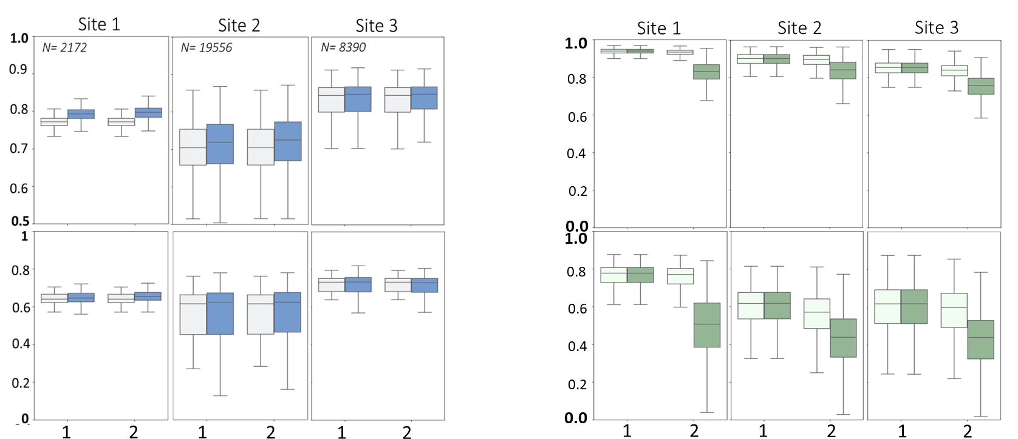
Results: soil moisture and vegetation updating
Small improvements in correlations for SSM with SMAP 1km for both experiments
Updating of biomass does not improve daily biomass production compared to Dry Matter Productivity
SSM: AquaCrop vs. SMAP
Biomass: AquaCrop vs. DMP
R [-]
Anomaly R [-]
OL DA
OL DA

Slide 9
Summary and outlook
SAR assimilation to update AquaCrop variables holds potential
Further research needed for biomass updating:
Compare updates to other vegetation products to explore full potential
Model framework needs improvements:
Better representation of soil properties
Need for more detailed crop information

Slide 10
References
Publications:
de Roos, S. and De Lannoy, G. J. M. and Raes, D.(2021). Performance analysis of regional AquaCrop (v6.1) biomass and surface soil moisture simulations using satellite and in situ observations, Geoscientific Model Development 14 (12), doi:10.5194/gmd-14-7309-2021
de Roos, S., Busschaert, L., Lievens, H., Bechtold, M., and De Lannoy, G. J. M.(2023). Optimisation of AquaCrop backscatter simulations using Sentinel-1 observations, Remote Sensing of Environment, 294, doi: 10.1016/j.rse.2023.113621
Evaluation datasets:
SMAP 1-km: Fang, B., Lakshmi, V., Cosh, M., Liu, P.-W., Bindlish, R., and Jackson, T. J.(2022). A global 1-km downscaled SMAP soil moisture product based on thermal inertia theory. Vadose Zone Journal, doi:10.1002/vzj2.20182.
DMP: Wolfs, D., Swinnen, E., Van Hoolst, R., and Toté, C.(2022). Copernicus global land operations “vegetation and energy”“cglops-1” product user manual: Dry matter productivity (dmp)–gross dry matter productivity (gdmp)–collection 300m–version 1.1.
ISMN: Dorigo, W. A., Wagner, W., Hohensinn, R., Hahn, S., Paulik, C., Xaver, A., Gruber, A., Drusch, M., Mecklenburg, S., van Oevelen, P., Robock, A., and Jackson, T.(2011) The international soil moisture network: a data hosting facility for global in situ soil moisture measurements. Hydrology and Earth System Sciences, doi: 10.5194/hess-15-1675-2011

