Slide 1
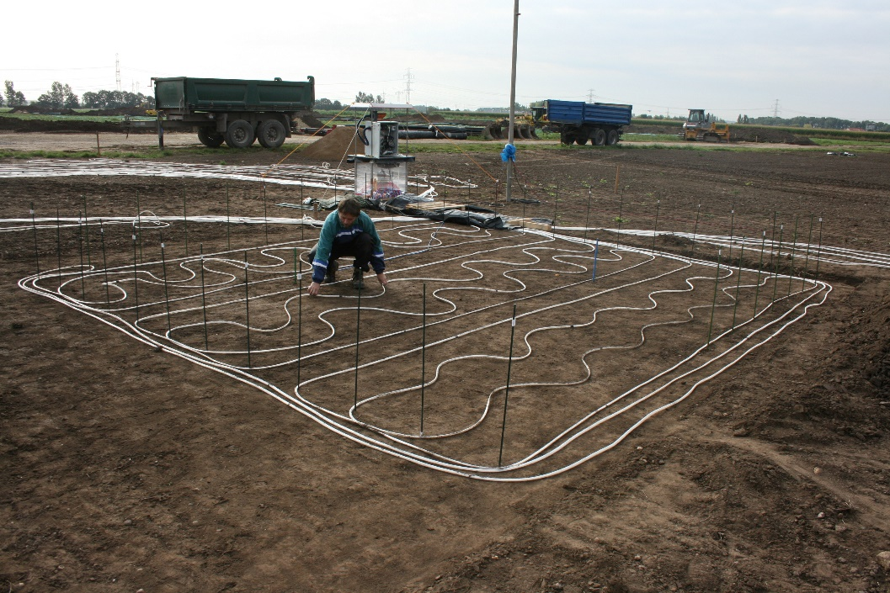
An innovative membrane-based sensor technology for large-scale measurements of gas concentrations in the subsurface
Detlef Lazik
Gerrit H. de Rooij
Mohammad R. Hashar

Slide 2
Measurement principle: exchange of gases between a buried gas-permeable tube and the surrounding soil changes the gas pressure in the tube
Conditioning step: Flush the tube with a reference gas until the tube wall has steady-state diffusive fluxes
Measurement step: Close the tube at both ends and let the target gas diffuse into it
Gases in soils: N₂, O₂, CO₂, H₂O
The tubular membrane should be much more permeable for the target gas than for the other gases.
For CO₂: polydimethylsiloxane. 5 to 10 times more permeable to CO₂ than to N₂ and O₂, very permeable to H₂O.
Diffusive exchange between the soil and the tube
Gas-permeable tubular membrane
filled with reference gas
Surrounding soil with the target gas in the gas-filled pore space

Slide 3
Measurement principle: Do not wait for equilibrium, but use the initial pressure change inside the tube instead!
After the conditioning step, the concentration profile of the target gas in the membrane constituting tube wall is steady.
When valves close both ends of the tube at t = 0, the pressure inside the tube starts to change. In the initial stage, the changes in partial pressures inside the tube $p_{k}^{i}$ are proportional to the soil partial pressures $p_{k}^{a}$of the various gases ($k∈\left\{1,…,n\right\}$).
The concentration $C_{k}^{i}$ ($C_{k}^{a}$) of gas k at the inside (outside) of the tube wall equals ${S_{k}p}_{k}^{i(a)}/RT$ (with $S_{k}$ the solubility of gas k in the tube wall).
Gas-permeable tubular membrane
Gas movement through the tube wall is governed by the diffusion equation:
with $D_{k}$ the diffusion coefficient (L²T⁻¹)
The solution for early times (approximately steady-state):
The geometry factor $g$ (L⁻²) accounts for $R_{i}$ and$R_{a}$.
$$\frac{∂C_{k}}{∂t}=\frac{1}{r}\frac{∂}{∂r}\left(rD_{k}\frac{∂C_{k}}{∂r}\right)$$
0
R_{i}
R_{a}
r
$$p_{k}^{i}$$
t > 0
$$\lim_{t↓0}{\frac{\text{d}p^{i}}{\text{d}t}}=g\sum_{k=1}^{n}{S_{k}D_{k}\left(p_{k}^{a}−p_{k}^{i}\right)}$$
$$C_{k}$$
$$C_{k}^{a}$$
t = 0
$$p_{k}^{a}$$
$$C_{k}^{i}$$
R_{i}
R_{a}
r

Slide 4
Measurement principle: Installing multiple tubes eliminates the need for calibration
Soil air Soil air RH 100%
Ideally, the tube material is only permeable to the target gas. In that case, the entrance of the target gas into the tube proportionally dilutes the gases comprising the reference gas mixture. The solution simplifies to a linear equation with calibration constants $b_{0}$ and $b_{1}$:
Calibration can be avoided by flushing a second tube with air enriched with the target gas. A third (reference) tube is in a gas-tight casing open on either end to provide a reference pressure. All tubes are installed together to ensure similar $p^{a}$ and temp.
For CO₂ measurements, the effect of water vapor needs to be accounted for by exposing the reference tube to air saturated with water vapor (RH = 100%). Combining pressure differences allows to separate the signals of H₂O and CO₂.
$$p^{a}=b_{0}+b_{1}\frac{\text{d}p^{i}}{\text{d}t}$$
Air Air + CO₂ Air
$$∆p^{i}$$

Slide 5
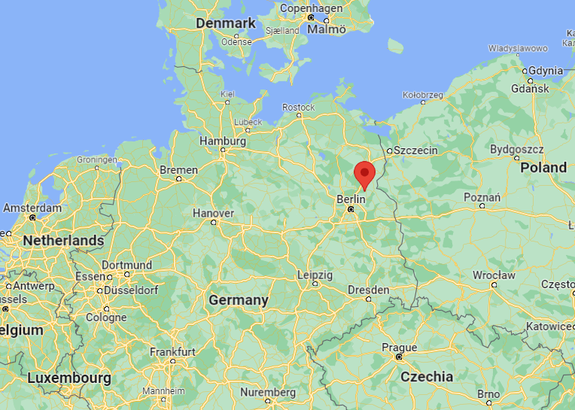
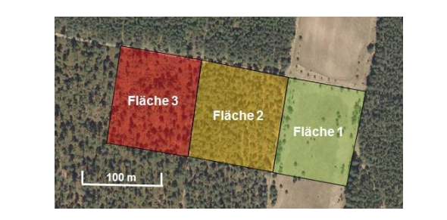
Study Site in Brandenburg, Germany
Mixed forest
Pine forest
Wooded meadow
Google maps
Google maps

Slide 6
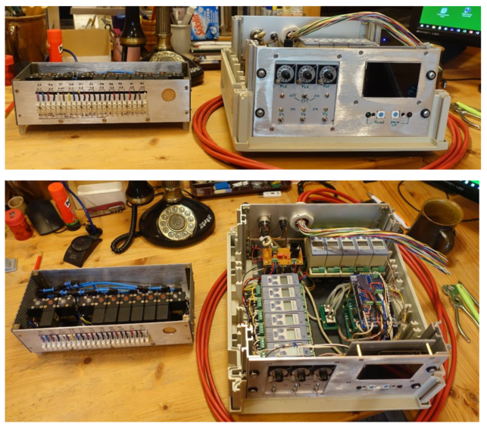
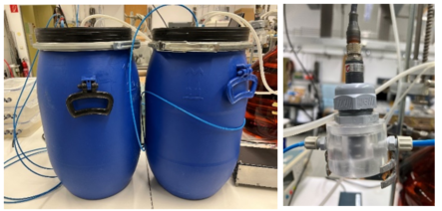
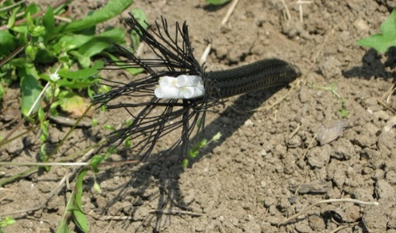
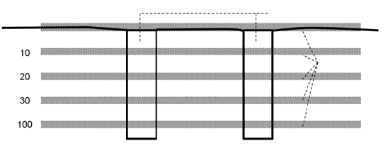
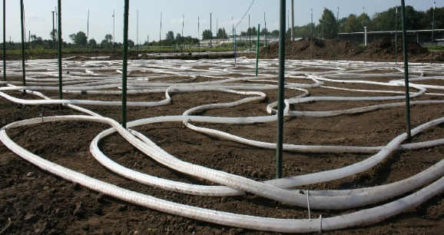
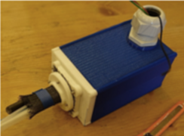
Schematic set-up of a gas-sensor in the field
Purge gas vessels with pressure gauges
Valve cascades
Air
Pressure sensors
Air+CO₂
Air
Pits for side drilling
Soil surface
Gas-permeable tubes
Actuator box
Tubes before covering with soil material
Scheme for laying the gas-permeable tubes in the soil
Above-ground control Buried gas-permeable tubes

Slide 7
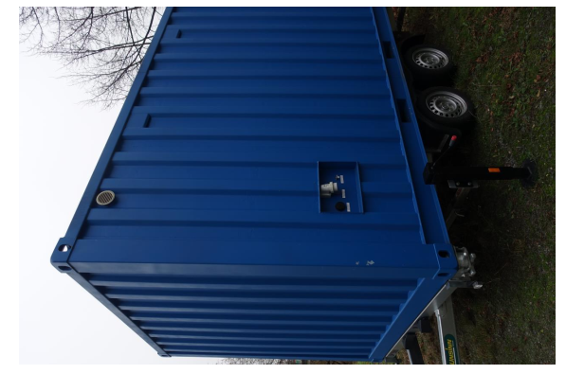
The system is being set up in the field
The control hardware, electronics, and the purge gas system will be housed in a hut (a modified container) with permanent power supply.
Mixed forest
Pine forest
Wooded meadow
Electrical wires (to drive the valves and various sensors) and gas-tubing (to flush the buried tubes) run from the housing to the three fields.
The centralized purge gas supply system forces us to design a system that can deliver purge gas to different gas-sensors at different distances in such a way that they all receive their purge gas at equal pressure. We are designing and testing a system with parallel valves (valve cascades) to achieve the needed pressure with high precision.

Slide 8
Transient response (top) and steady-state control response (down)
CO₂ concentration in vessel 2
Gas pressure (P1) in vessel 1
Gas pressure (P2) in vessel 2

Slide 9
Thank you for your attention

Slide 10
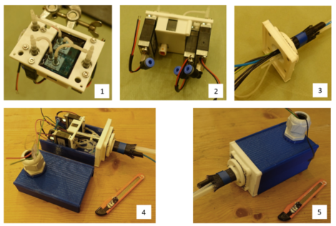
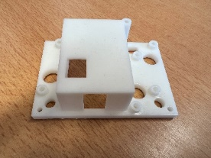
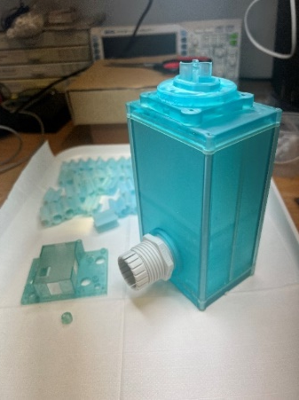
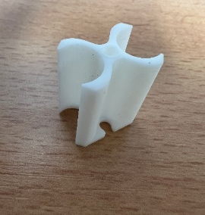
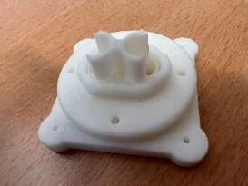
Development of the housing system for gas-sensors
3
1
2
4
5
Components of the housing system produced using the MSLA process with a 3D printer (Elegoo Saturn 2), (1) mounting plate (2) mounting flange (3) connector (4) spacer (5) actuator box
Mechanical structure of the first sample for an actuator box. Pressure sensors (1) and valves (2) are fixed on a mounting plate. Fittings are used to connect the pressure measurement to the gas-tubing, which, including cables and tubes, are fed through the mounting flange (3) into the actuator box. (4) shows an actuator box assembled except for the media connection, and (5) shows the final closed box.

