Slide 1

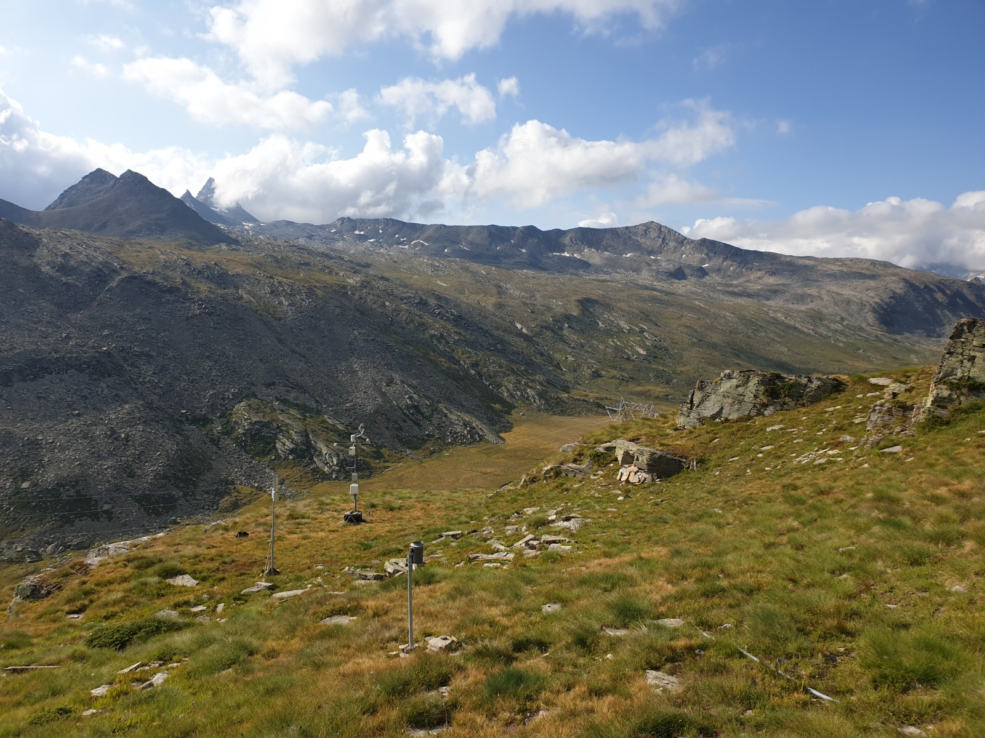
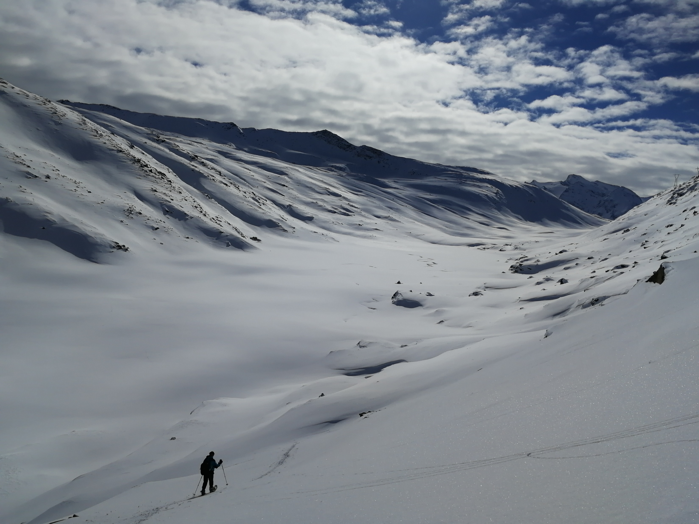

GC8-Hydro
NAPLES | ITALY | 12-15 JUNE 2023
Session 4 – Using O-H stable isotopes for studying hydrological process understanding and the history of flowing waters
Reproducing in-situ measurements over a high-elevation grassland using HYDRUS-1D and a snow isotope model
Alessio Gentile¹, Davide Gisolo¹, Davide Canone¹, and Stefano Ferraris¹
¹Interuniversity Department of Regional and Urban Studies and Planning (DIST), Politecnico and Università degli Studi di Torino, Torino, Italy
https://doi.org/10.5194/egusphere-gc8-hydro-40

Slide 2
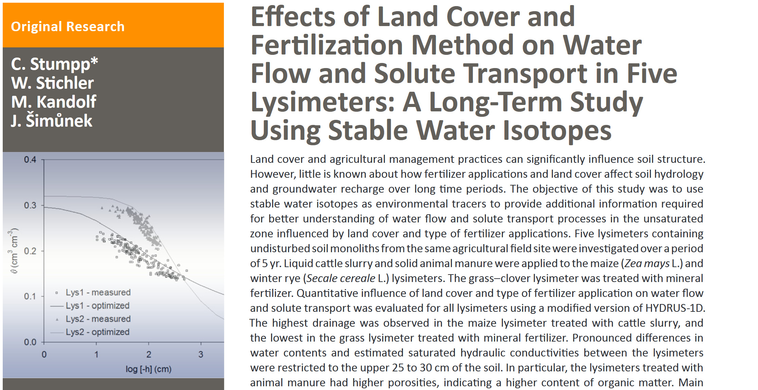
Introduction
Methods
Results and Discussion
Conclusions
Research question
Can we reliably model water flow and solute transport in a remote natural soil profile where soil water dynamics are strongly influenced by snow melt ?
“Main discrepancies between simulated and measured values can be generally attributed to uncertainties related to infiltration during snow melt. The actual quantity and timing of infiltrating water often remain unknown in soils where soil frost, snow cover, and snow melt may play a crucial role. Snow drift and irregular thawing of soil may produce differences in the infiltration pattern.”
Session 4 – Using O-H stable isotopes for studying hydrological process understanding and the history of flowing waters
1/15

Slide 3
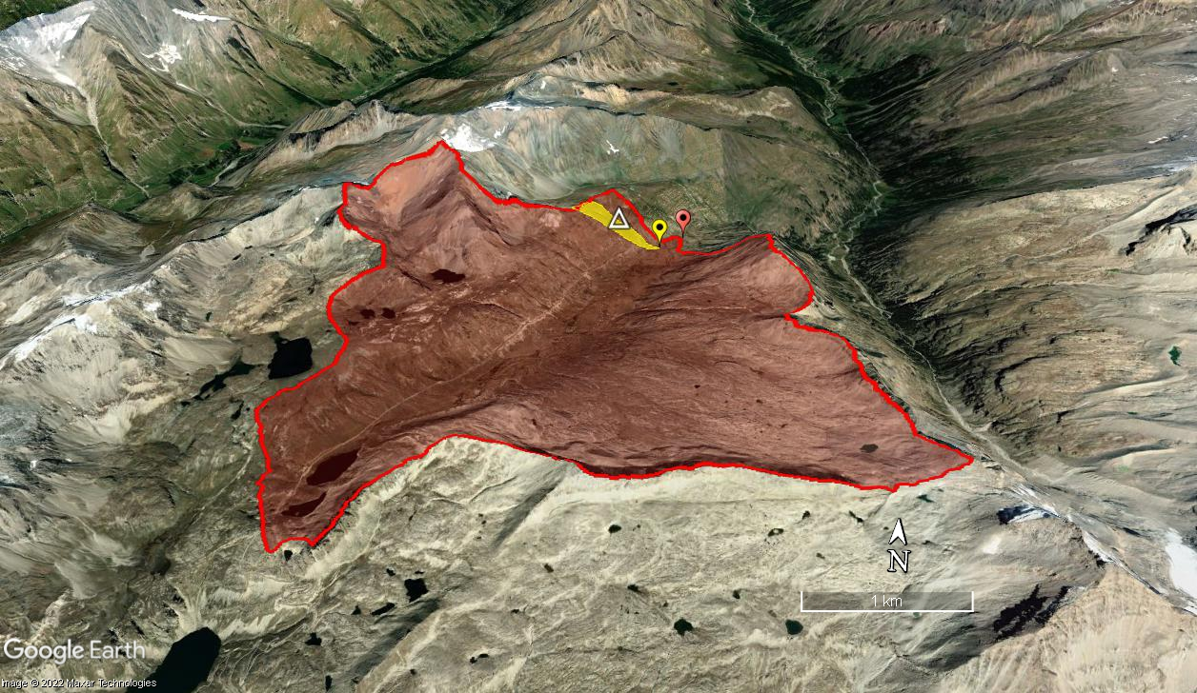
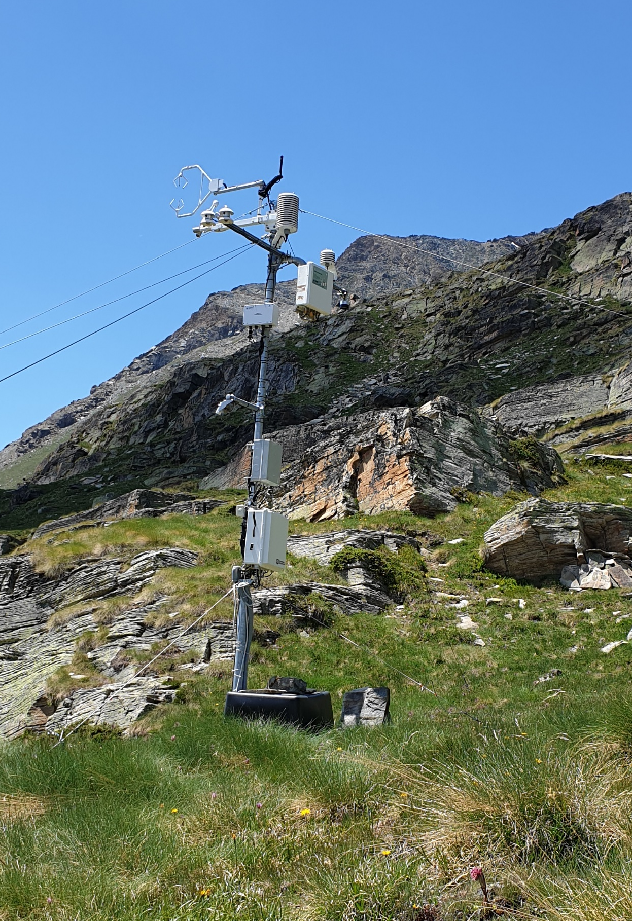
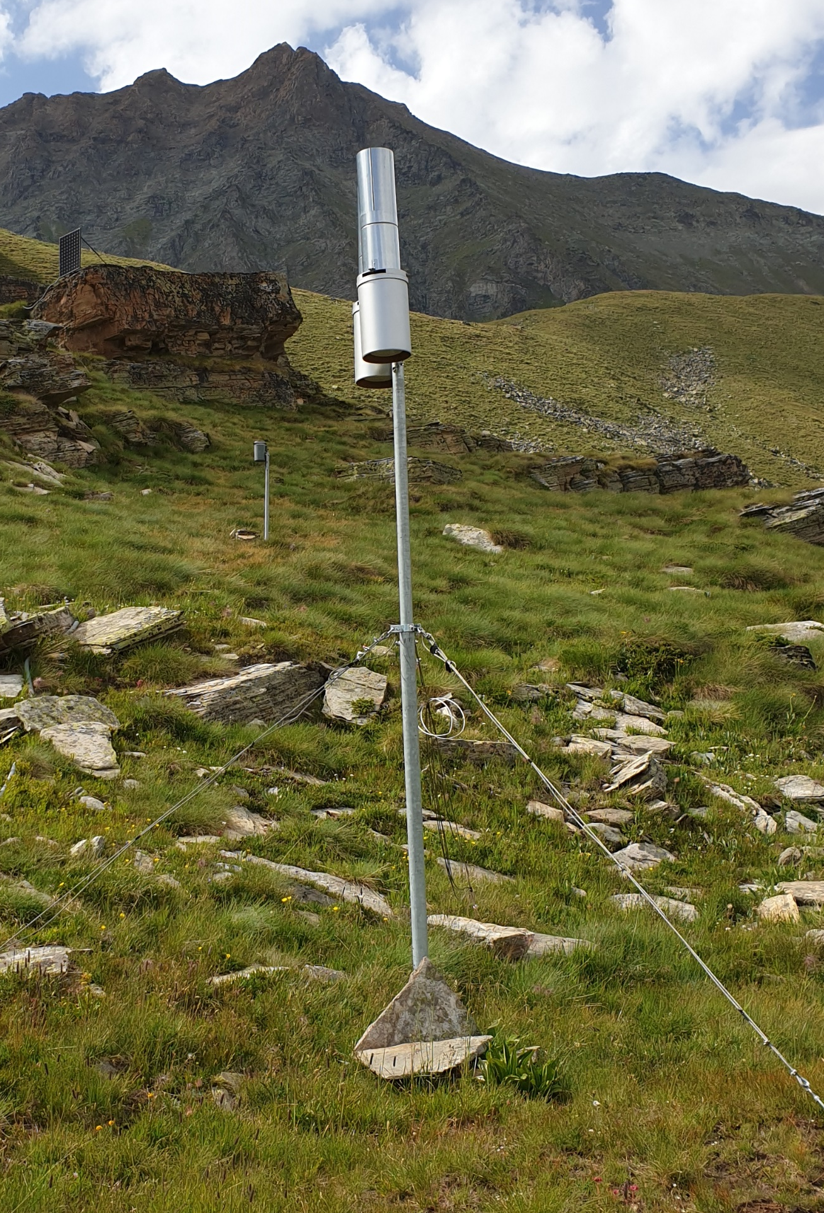

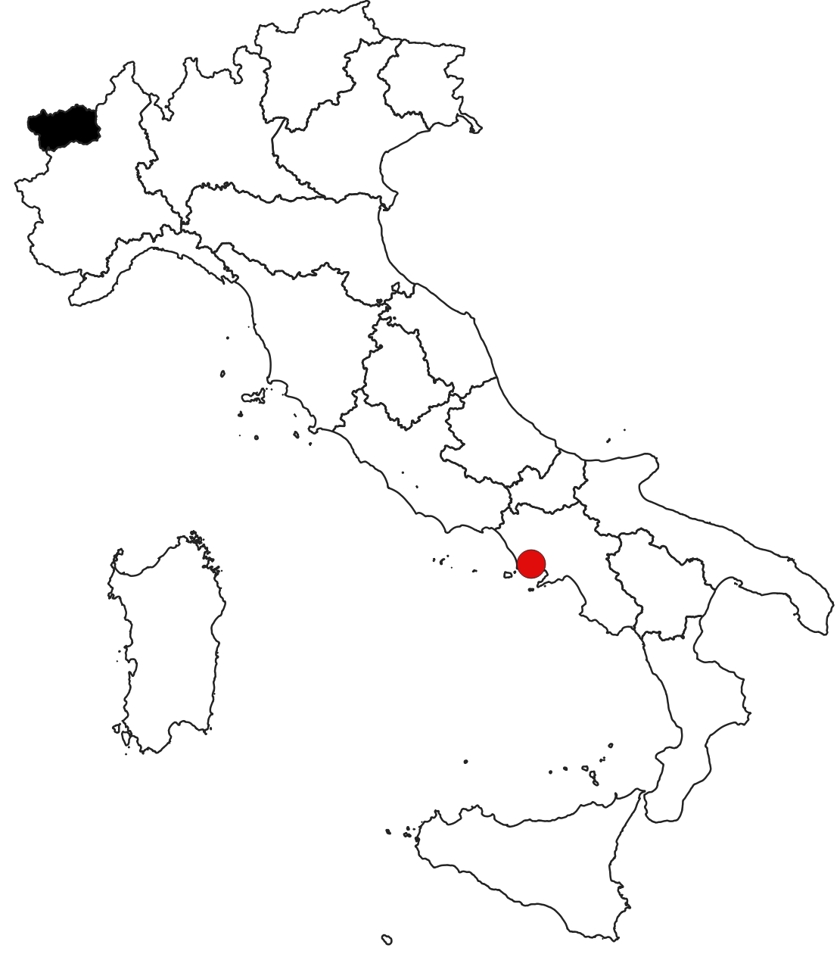
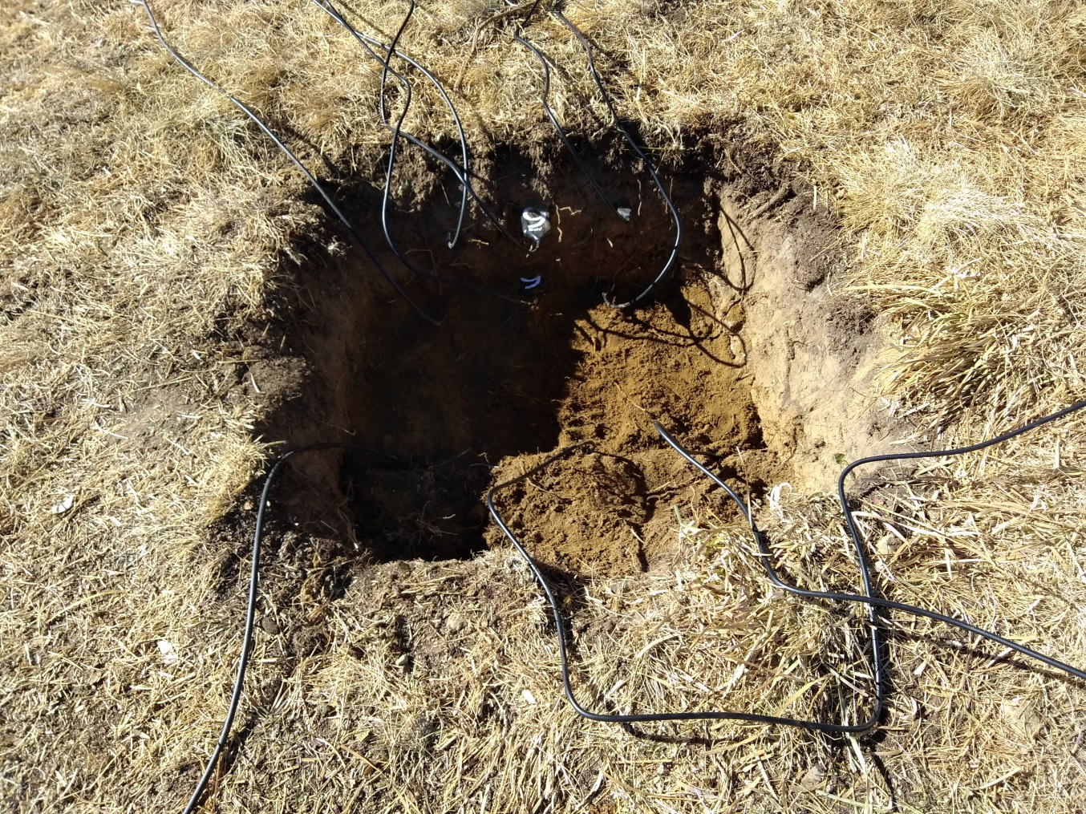
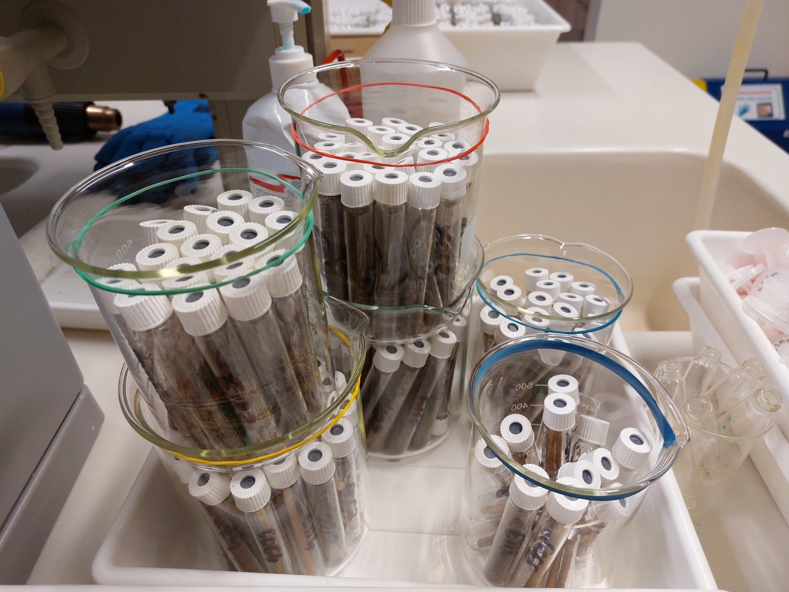
Introduction
Methods
Results and Discussion
Conclusions
Study site: a high-elevation grassland
^{Google Earth ©}
Dora del Nivolet outlet point
Aosta Valley
Eddy covariance station
Precipitation isotope sampler
Elevation: 2711 (2390-3430) m a.s.l. Area: 16.99 km²
Naples
Soil moisture probes
(10,20,40 cm)
Soil and vegetation samples for isotopic analysis
Session 4 – Using O-H stable isotopes for studying hydrological process understanding and the history of flowing waters
2/15

Slide 4
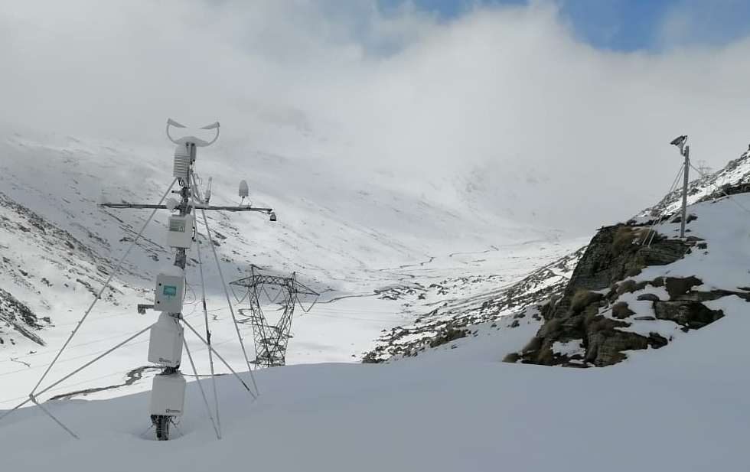

Introduction
Methods
Results and Discussion
Conclusions
…A bit more about the monitoring station
Real weather sensor
Webcam
Snow depth doppler
Cosmic Ray
Session 4 – Using O-H stable isotopes for studying hydrological process understanding and the history of flowing waters
3/15

Slide 5
Introduction
Methods
Results and Discussion
Conclusions
Study site: a high-elevation grassland
Dora del Nivolet catchment during summer (July, 2019)
Dora del Nivolet catchment during winter (January, 2018)
Session 4 – Using O-H stable isotopes for studying hydrological process understanding and the history of flowing waters
4/15

Slide 6

Introduction
Methods
Results and Discussion
Conclusions
Dual-isotope plot and fractionation
Benettin et al. (2018)
Stream water isotopes:
Gentile et al. 2022, accepted, HESS
https://egusphere.copernicus.org/preprints/2022/egusphere-2022-921/
mean evaporation slope = 3.07
Session 4 – Using O-H stable isotopes for studying hydrological process understanding and the history of flowing waters
5/15

Slide 7
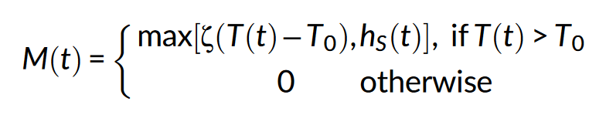
Introduction
Methods
Results and Discussion
Conclusions
Snow accumulation and melt model (Ceperley et al. 2020)
Snow accumulation is simulated with a linear transition between liquid and solid precipitation as a function of air temperature
Precipitation falls as snow at temperatures below a minimum threshold (T_{crit1}) and as rain at temperatures above a maximum threshold (T_{crit2})
SNOW ACCUMULATION
(Harpold et al., 2017;
Hock, 2003)
Parameter | Value
T_{crit1} [°C] | -2
T_{crit2} [°C] | 2
Default value in H1-D
The accumulated snow begins to melt when the air temperature rises above a given temperature threshold, T₀ :
Parameter | Value
T₀ [°C] | 0
ζ [mm/°C/d] | 4.3
SNOWMELT
(Schaefli et al., 2014)
where M(t) [mm/d] is the daily snowmelt, ζ [mm/°C/d] is the degree-day factor and h_{S} (t) is the snow water equivalent [mm w.e.] at time t.
Default value in H1-D
Snow accumulation and melt are computed per elevation band
Session 4 – Using O-H stable isotopes for studying hydrological process understanding and the history of flowing waters
6/15
Notes:
Air temperature is linearly interpolated to mean band elevation with a constant temperature lapse rate per study catchment (see Section 3), whereas precipitation is kept constant.

Slide 8
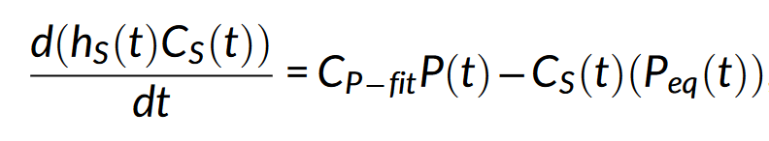
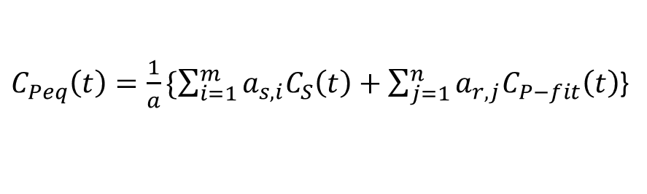
Introduction
Methods
Results and Discussion
Conclusions
“the isotope content of infiltrating water from the melting snow layer remains unknown” (Stumpp et al. 2012)
Snow isotope model (Ceperley et al. 2020)
Assumptions:
The isotopic composition of snowmelt (C_{S}) is computed based on the following mass balance:
Water in the snowpack is fully mixed.
Any rainfall on a pre-existing snowpack also mixes with the water stored in the snowpack.
h_{s} is the snow water equivalent
C_{P−fit} is the sine curve fitted to observations
P_{eq} is the equivalent precipitation (i.e., rain + snowmelt).
The initial condition is C_{S}(t₀)=C_{P − fit}(t₀).
The isotopic composition in the equivalent precipitation (C_{Peq}) at each time-step can be obtained as:
a_{S,i} is the area of the snow-covered
elevation band i
a_{r,j} is the area of the non-snow-covered
elevation band j
$C_{Peq}\left(t\right)=\frac{1}{a}\{\sum_{i=1}^{m}{a_{s,i}C_{S}\left(t\right)}+\sum_{j=1}^{n}{a_{r,j}C_{P−fit}\left(t\right)}$}
Total catchment area
Session 4 – Using O-H stable isotopes for studying hydrological process understanding and the history of flowing waters
7/15
Notes:
Water in the snowpack is fully mixed: is a rough approximation during early snowmelt or intermittent snowpack events (Rücker, Boss, Kirchner, & von Freyberg, 2019), but which is a better approximation for seasonal snowpack during the peak snowmelt season when the snowpack is isothermal (Beria et al., 2018), and has been validated with snow lysimeter data (Ala-Aho et al., 2017)
Rainfall mixes with water in the snowpack: In this formulation, all rainfall mixing with an existing snowpack is assumed to exit during the same time step and neglects any water holding capacity of the snowpack or temporary refreezing (e.g., Schaefli et al., 2014).

Slide 9
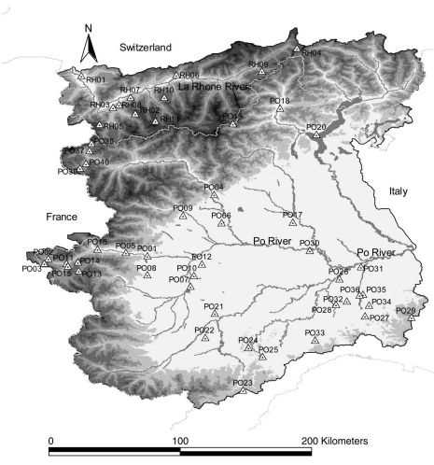
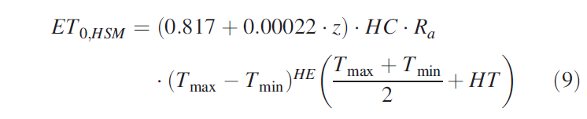



Introduction
Methods
Results and Discussion
Conclusions
Potential Evapotranspiration (ET₀), Transpiration (T_{P}), Evaporation (E_{P})
Ravazzani et al. (2012)
e.g. Nasta et al. (2013)
$$E_{P}=ET_{0}e^{−k LAI}$$
Aosta Valley
$$T_{P}=ET_{0}−E_{P}$$
R_{a} = extraterrestrial radiation (mm/day)
T_{max} = daily maximum air temperature (°C)
T_{min} = daily minimum air temperature (°C)
HC = empirical coefficient (HC = 0.0023)
HE = empirical exponent (HE = 0.5)
HT = a factor needed to convert units of Fahrenheit to Celsius (HT = 32/1.8 = 17.8)
Z = station elevation (m a.s.l.)
Where k = 0.463 (Ritchie, 1972) LAI is the Leaf Area Index calculated from MODIS/061/MCD15A3H collection in GEE .
Spatial resolution: 500 m
Temporal resolution: 4 days
Session 4 – Using O-H stable isotopes for studying hydrological process understanding and the history of flowing waters
8/15

Slide 10



Introduction
Methods
Results and Discussion
Conclusions
HYDRUS 1-D set up
Upper Boundary Condition
- Atmospheric BC
with Surface Runoff
- Concentration Flux BC
Grass
Parameters
θ_{R} [-]
θ_{S} [-]
α [cm⁻¹]
N [-]
K_{S} [cm d⁻¹]
L [-]
λ_{L} [cm]
Ρ [g cm⁻³]
1
Initial condition:
- In pressure head
- in liquid phase concentrations
Roots
distribution
Water Flow
parameters
60 cm
Sandy
Loam
Solute transport
parameters
0
Lower Boundary Condition
- Free drainage
Parameters in red are calibrated by using soil moisture and soil isotope (corrected from fractionation) measurements
- Zero Concentration Gradient
Session 4 – Using O-H stable isotopes for studying hydrological process understanding and the history of flowing waters
9/15

Slide 11
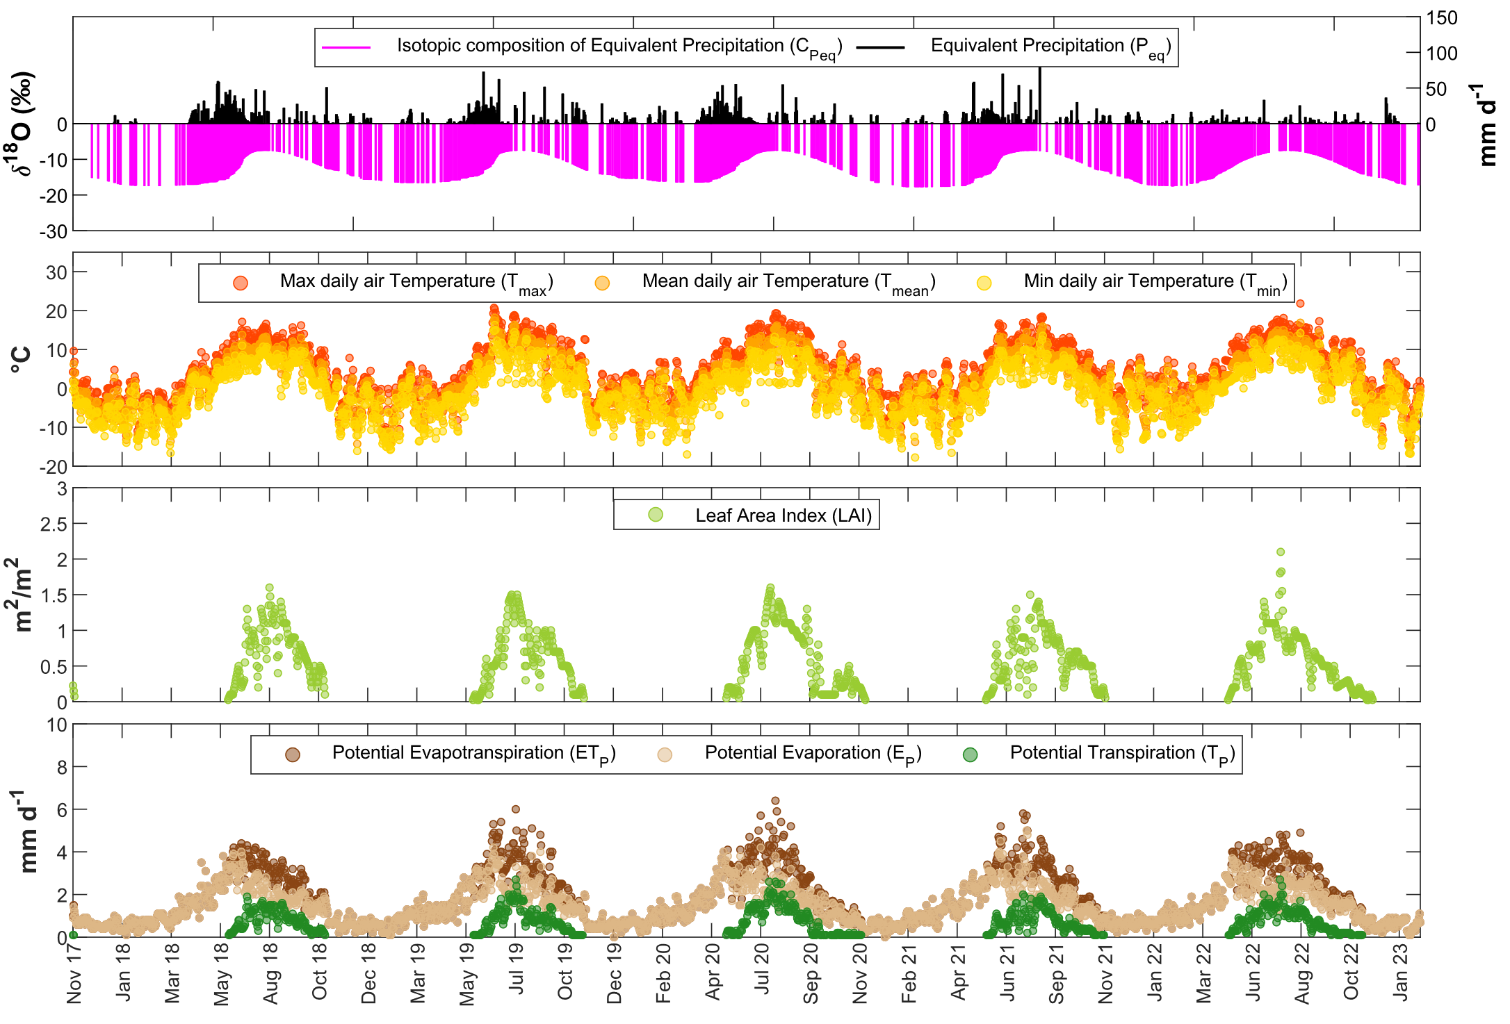
Introduction
Methods
Results and Discussion
Conclusions
Time Variable Boundary Conditions
Session 4 – Using O-H stable isotopes for studying hydrological process understanding and the history of flowing waters
10/15

Slide 12
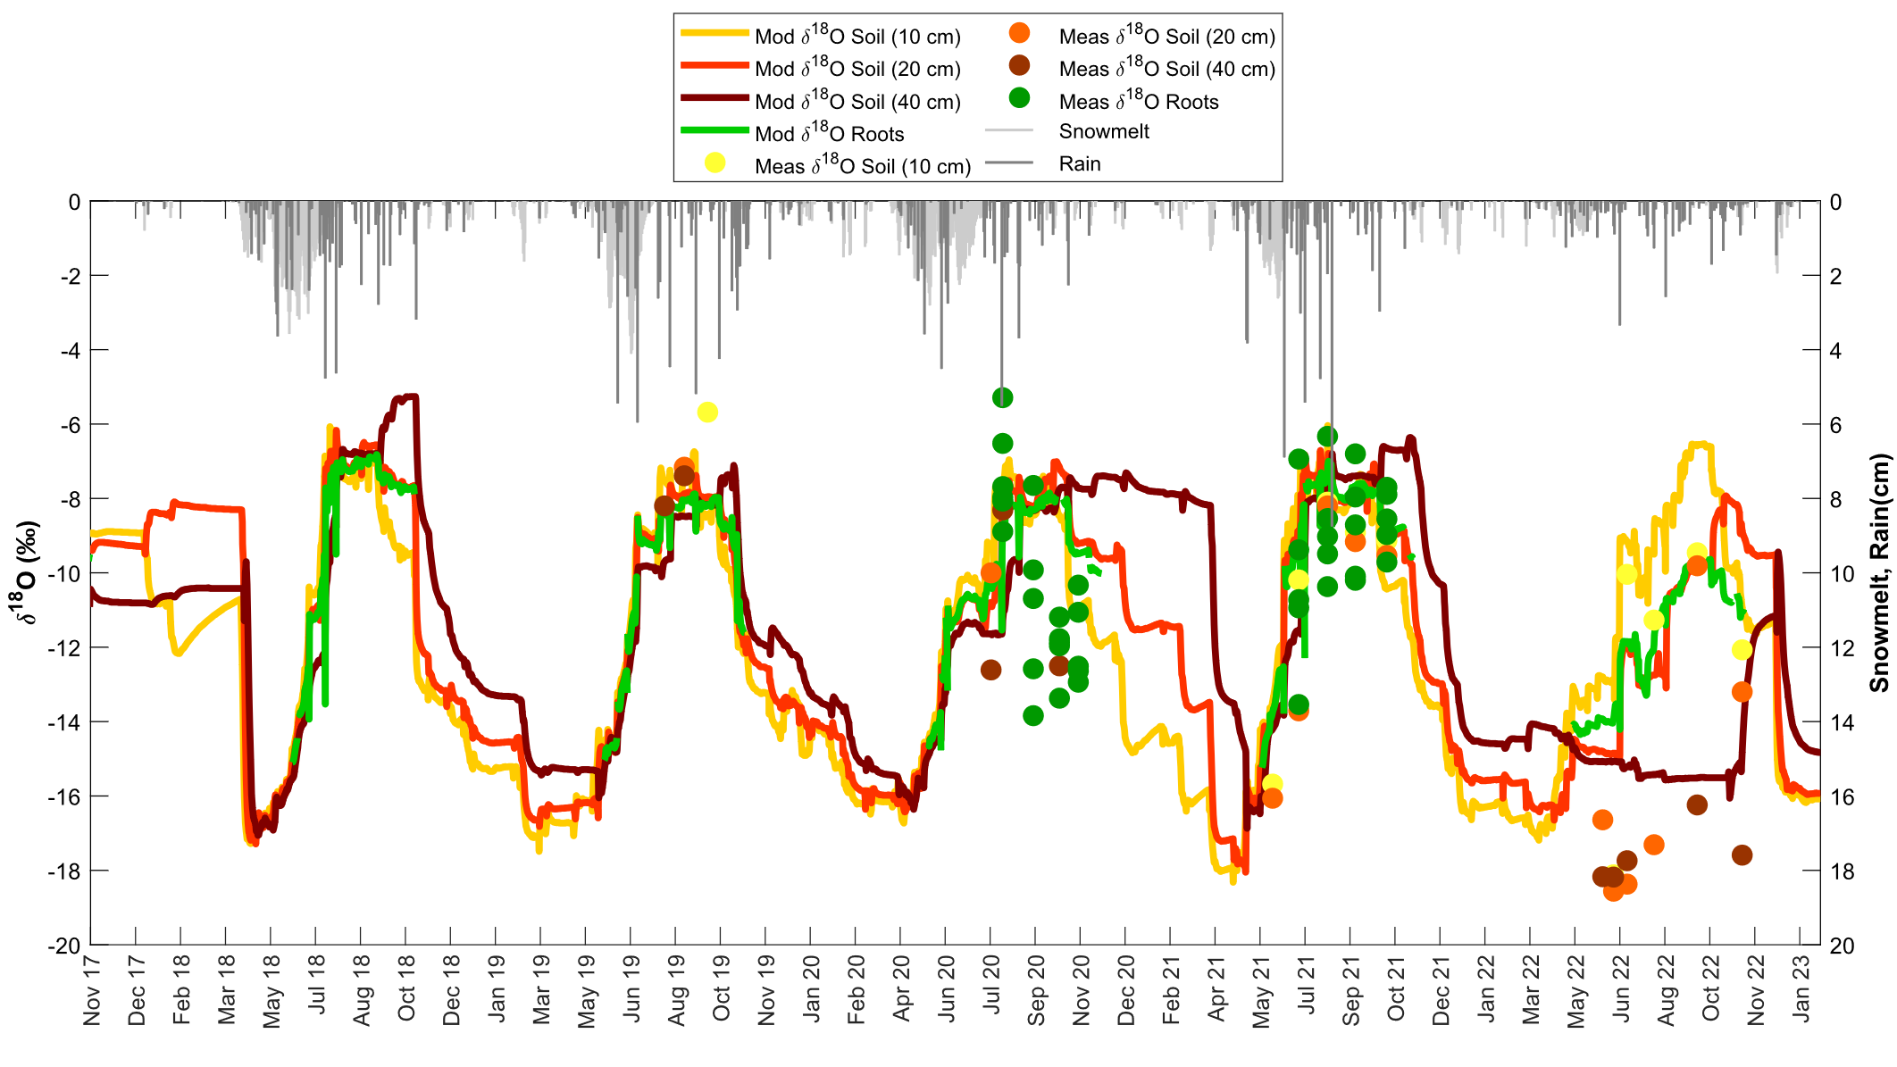
Introduction
Methods
Results and Discussion
Conclusions
Soil and xylem water isotopic composition
Session 4 – Using O-H stable isotopes for studying hydrological process understanding and the history of flowing waters
11/15

Slide 13
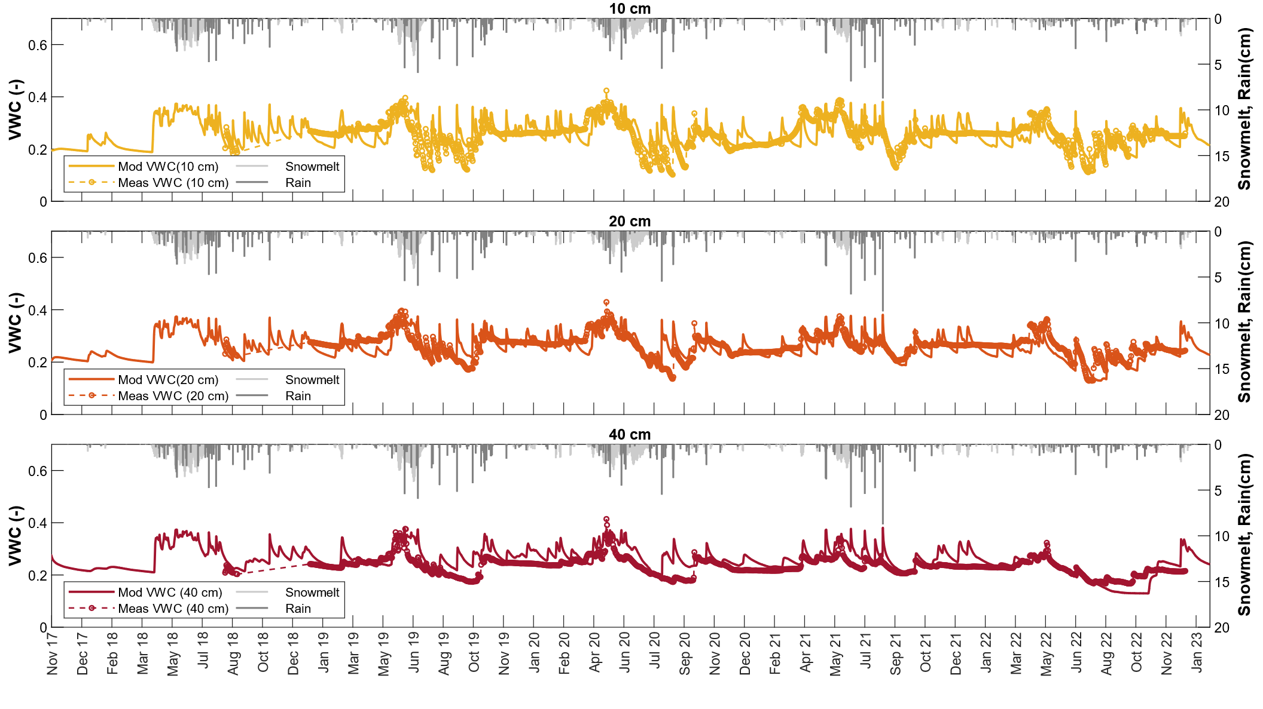
Introduction
Methods
Results and Discussion
Conclusions
Soil water content
Session 4 – Using O-H stable isotopes for studying hydrological process understanding and the history of flowing waters
12/15

Slide 14
Introduction
Methods
Results and Discussion
Conclusions
Actual Evapotranspiration and parameters
Parameters | Value
θ_{R} [-] | 0.11±0.001
θ_{S} [-] | 0.39
α [cm⁻¹] | 0.059
n [-] | 1.48
K_{S} [cm d⁻¹] | 31.23±0.26
L [-] | 0.5
λ_{L} [cm] | 1.56±0.32
ρ [g cm⁻³] | 1.5
Session 4 – Using O-H stable isotopes for studying hydrological process understanding and the history of flowing waters
13/15

Slide 15
Introduction
Methods
Results and Discussion
Conclusions
Conclusions
By using a classical snow melt/accumulation model and a snow isotope model under simplifying assumptions, H1-D closely reproduces soil moisture and soil water isotope measurements.
Actual evapotranspiration derived from H1-D has been compared with actual evapotranspiration measurements derived from the eddy-covariance station demonstrating very good correspondence with the actual measurements.
Water flow calibrated parameters are quite close to the H1-D pedotransfer values, while it is difficult to find past works, excluding Stumpp et al. (2012), that provide isotope longitudinal dispersivity values for comparison purposes.
Main discrepancies between model output and measurements can be due to:
uncertainties related to the timing and amount of snowmelt
assumptions of the snow isotope model
Modelled soil water content reveals a high-sensitivity to winter snowmelt events.
Session 4 – Using O-H stable isotopes for studying hydrological process understanding and the history of flowing waters
14/15

Slide 16
Main References
Benettin, P., Volkmann, T. H. M., von Freyberg, J., Frentress, J., Penna, D., Dawson, T. E., and Kirchner, J. W.: Effects of climatic seasonality on the isotopic composition of evaporating soil waters, Hydrology and Earth System Sciences, 22, 2881–2890, https://doi.org/10.5194/hess-22-2881-2018, 2018.
Ceperley, N., Zuecco, G., Beria, H., Carturan, L., Michelon, A., Penna, D., Larsen, J., and Schaefli, B.: Seasonal snow cover decreases young water fractions in high Alpine catchments, Hydrological Processes, 34, 4794–4813, https://doi.org/10.1002/hyp.13937 , 2020.
Nasta, P. and Gates, J. B.: Plot-scale modeling of soil water dynamics and impacts of drought conditions beneath rainfed maize in Eastern Nebraska, Agricultural Water Management, 128, 120–130, https://doi.org/10.1016/j.agwat.2013.06.021, 2013.
Ravazzani, G., Corbari, C., Morella, S., Gianoli, P., and Mancini, M.: Modified Hargreaves-Samani Equation for the Assessment of Reference Evapotranspiration in Alpine River Basins, Journal of Irrigation and Drainage Engineering, 138, 592–599, https://doi.org/10.1061/(ASCE)IR.1943-4774.0000453, 2012.
Stumpp, C., Stichler, W., Kandolf, M., and Šimůnek, J.: Effects of Land Cover and Fertilization Method on Water Flow and Solute Transport in Five Lysimeters: A Long-Term Study Using Stable Water Isotopes, Vadose Zone Journal, 11, https://doi.org/10.2136/vzj2011.0075 , 2012.
Session 4 – Using O-H stable isotopes for studying hydrological process understanding and the history of flowing waters
15/15

Slide 17

GC8-Hydro
NAPLES | ITALY | 12-15 JUNE 2023
Session 4 – Using O-H stable isotopes for studying hydrological process understanding and the history of flowing waters
Thank you for your attention!
Alessio Gentile¹, Davide Gisolo¹, Davide Canone¹, and Stefano Ferraris¹
¹Interuniversity Department of Regional and Urban Studies and Planning (DIST), Politecnico and Università degli Studi di Torino, Torino, Italy
https://doi.org/10.5194/egusphere-gc8-hydro-40

