Slide 1
Optimizing irrigation parameters to improve land surface model irrigation simulations: an example over the Po Valley, Italy
Sara Modanesi¹, Gabriëlle J. M. De Lannoy², Michel Bechtold², Louise Busschaert² and Christian Massari¹
¹ Research Institute for Geo-hydrological Protection, National Research Council, Via Madonna Alta 126, 06128 Perugia, Italy
² Department of Earth and Environmental Sciences, KU Leuven, Heverlee, Belgium.
sara.modanesi@irpi.cnr.it
GC8-Hydro
Session 3
Data assimilation, artificial intelligence, and hydrological observations
Backgroung image: Sentinel-2 from © Sentinel Hub

Slide 2
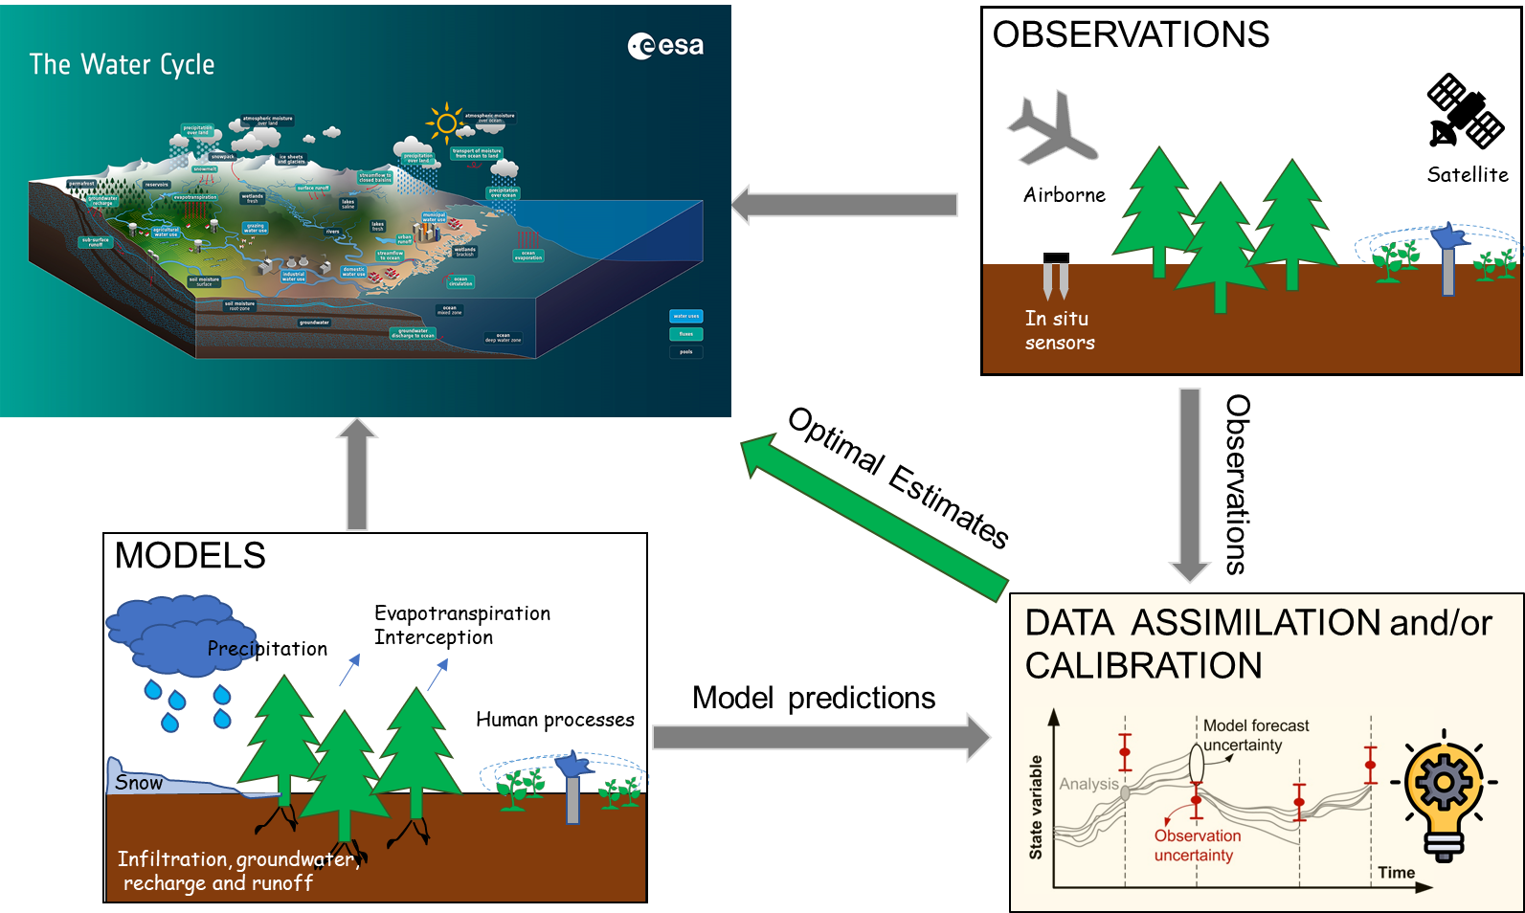
INTRODUCTION
THE “NEW” WATER CYCLE IN THE ANTHROPOCENE
Importance to estimate human water uses
STEP 2
STEP 1
1

Slide 3
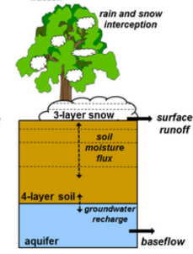
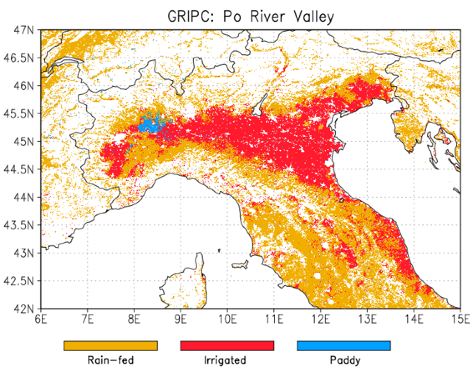
COMBINING LSM AND IRRIGATION
CAN WE PROVIDE A BETTER CLOSURE OF THE WATER CYCLE?
EXPERIMENT SETUP
1 km spatial resolution
Model spinup: 1982-2015
Model run: 2015-2020
MERRA-2 reanalysis meteorological forcing
PROBA-V land cover map
Sprinkler irrigation
NOAH-MP LSM
Sprinkler irrigation (Ozdogan et al. 2010; 10.1175/2009JHM1116.1) needs 3 conditions:
Where irrigated croplands are located (GRIPC)
Growing season, defined at each grid cell
Root zone soil moisture availability (MA<SM_{th})
Modanesi et al. 2021
https://doi.org/10.5194/hess-25-6283-2021
$$MA=\frac{\left(SM−{SM}_{WP}\right)}{\left({SM}_{FC}−{SM}_{WP}\right)}$$
$${SM}_{th}={SM}_{FC}∗0.5$$
User-set parameter
http://dx.doi.org/10.1016/j.jag.2015.01.014
2

Slide 4
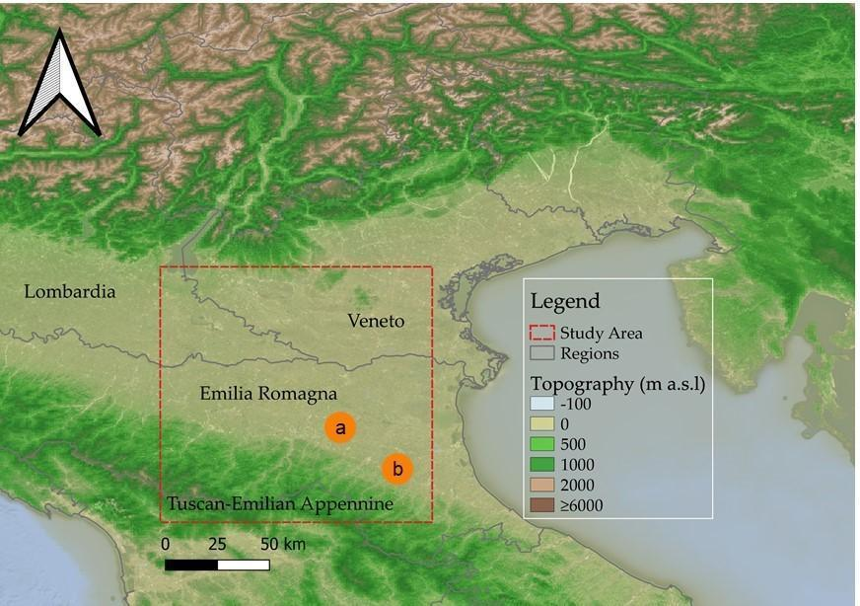
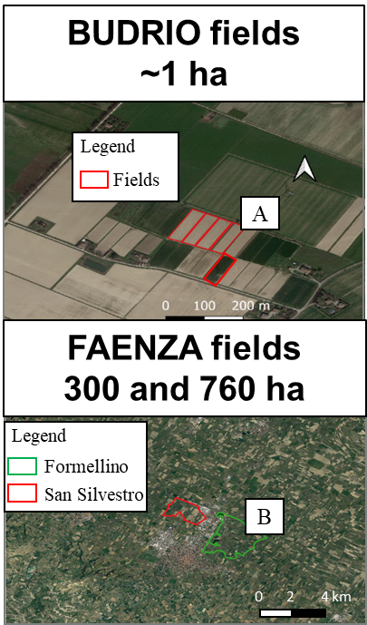
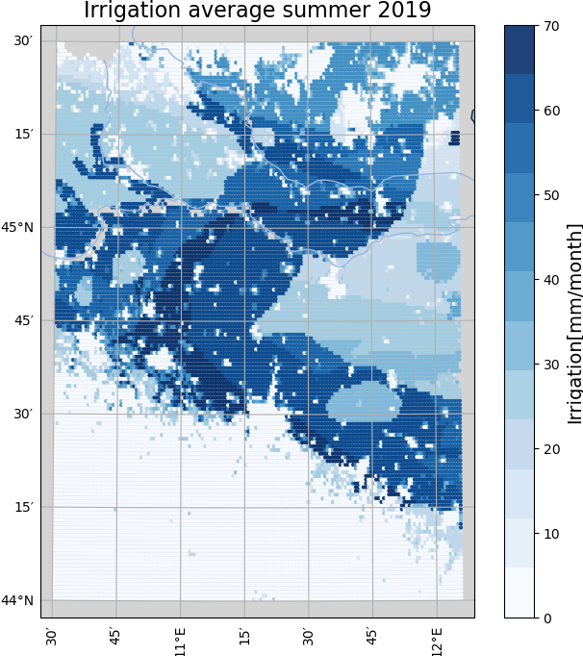
COMBINING LSM AND IRRIGATION
RESULTS
The study area is located in the Po river valley, an intensively irrigated area. Irrigation data are available at two test sites:
The Budrio farm (less than 1 ha);
Two districts close to Faenza (Faenza test sites; ~300 ha and ~700 ha).
BUDRIO: RMSE [mm/15 days]=31.10; R=0.74; bias [mm/15 days]=11.15
Modanesi et al. 2021
https://doi.org/10.5194/hess-25-6283-2021
FAENZA: RMSE [mm/15 days]=40.98; R=0.78; bias [mm/15 days]=18.08
Large Overestimations
3

Slide 5
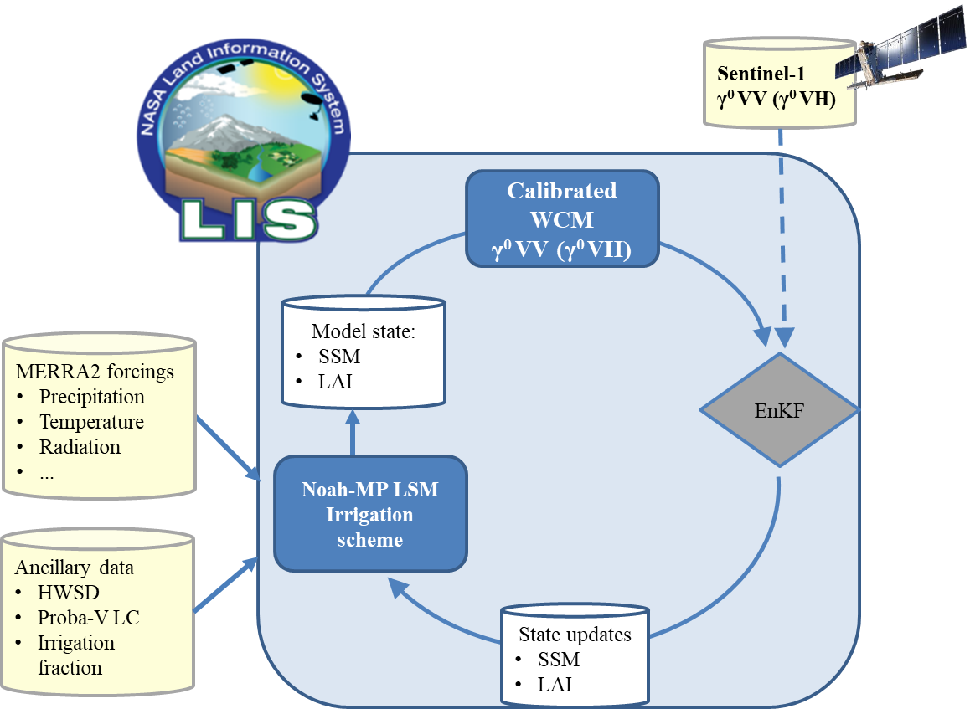
SENTINEL-1 BACKSCATTER DATA ASSIMILATION
NEW DEVELOPMENTS TO IMPROVE AGRICULTURAL WATER USES
Added components:
Sprinkler irrigation
Calibrated Water Cloud Model (WCM, https://doi.org/10.1029/RS013i002p00357)
$σ^{0}={AV}_{1}\cos{θ}\left(1−t^{2}\right)$+ $t^{2}\left(C+D∗SM\right)$
Modanesi et al. 2021
https://doi.org/10.5194/hess-25-6283-2021
Modanesi et al. 2022
https://doi.org/10.5194/hess-26-4685-2022
$σ$⁰_{veg}
$σ$⁰_{soil}
Ensemble Kalman Filter DA
$\hat{x_{i}^{+}}=\hat{x_{i}^{−}}+K_{i}\left[y_{obs,i}−h_{i}\left(\hat{x_{i}^{−}}\right)\right]$
Double interaction between soil moisture and irrigation
Sentinel-1 γ⁰VV and γ⁰VH DA to update SM and LAI
4

Slide 6
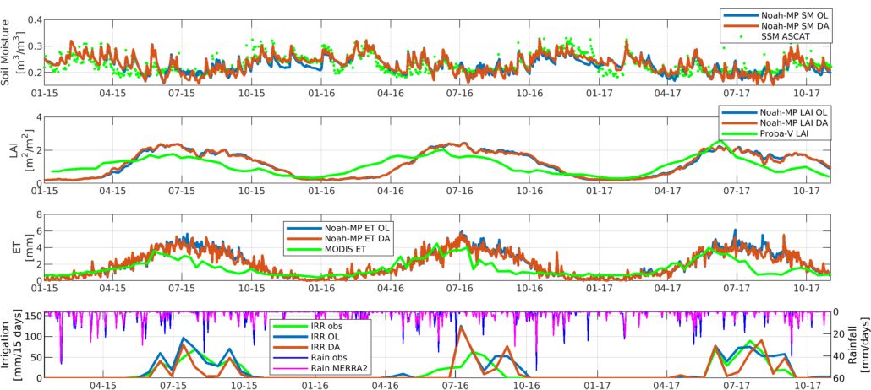
SENTINEL-1 BACKSCATTER DATA ASSIMILATION
RESULTS
Pearson-R: SSM OL vs ASCAT= 0.74; SSM DA vs ASCAT=0.78
BUDRIO
Soil Moisture
[m³/m³]
Budrio test site
Pearson-R: LAI OL vs PROBA-V= 0.69; LAI DA vs PROBA-V=0.71
LAI
[-]
Irrigation data averaged over five fields (0.4 ha each)
Pearson-R: ET OL vs MODIS=0.7; ET DA vs MODIS=0.72
Modanesi et al. 2022
https://doi.org/10.5194/hess-26-4685-2022
ET
[mm/day]
AMOUNT OF IRRIGATION
Obs=917.2 mm
OL= 1220.1 mm
DA=842.5 mm
Irrigation
[mm/15 days]
Pearson-R:
IRR OL vs OBS=0.78
IRR DA vs OBS=0.65
Rainfall
[mm/day]
DA improves model state simulations but it deteriorates Pearson-R when irrigation is simulated
DA improves irrigation bias
Method’s improvement: Busschaert et al. 2023 (https://doi.org/10.22541/essoar.167590826.62059121/v1)
5

Slide 7
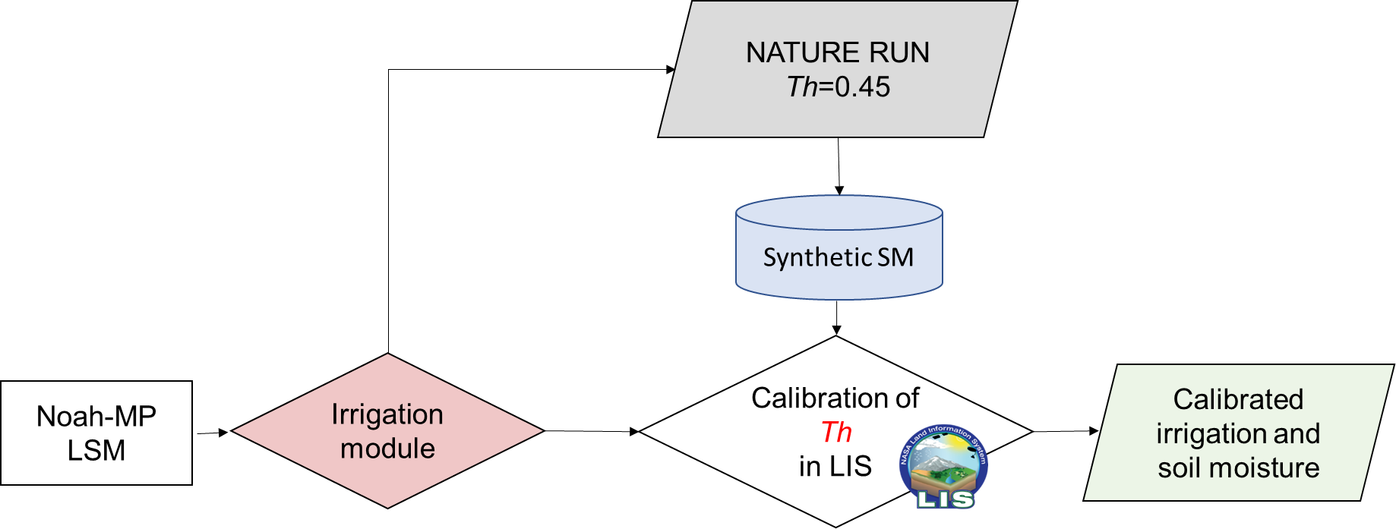
OPTIMIZATION OF IRRIGATION PARAMETERS
TOWARDS A BETTER CLOSURE OF THE WATER CYCLE?
Sprinkler irrigation (Ozdogan et al., 2010)
CALIBRATION SETUP:
Genetic Algorithm (GA)
Least square (LS) objective fuction
First synthetic experiment using simulated soil moisture (Th set to 0.45)
Calibration: Jan. 2015 – Nov. 2015
Initial Th set to 0.35
Th range: 0.25-0.60
$$MA=\frac{\left(SM−{SM}_{WP}\right)}{\left({SM}_{FC}−{SM}_{WP}\right)}$$
NOAH-MP LSM
$${SM}_{th}={SM}_{FC}∗Th$$
CALIBRATION
6

Slide 8
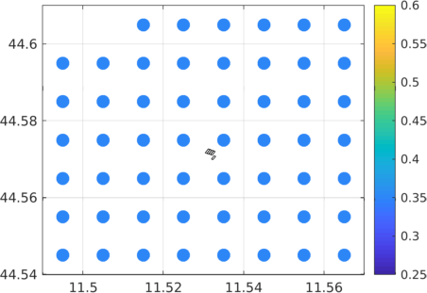
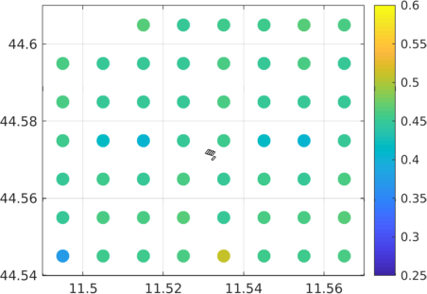
OPTIMIZATION OF IRRIGATION PARAMETERS
RESULTS
BUDRIO
Findings:
Soil moisture and irrigation are well reproduced
Some small peaks are present meaning that the calibration options still need to be optimized
Generally the tuned SM_{th} parameters are close to the best convergence (i.e., Th=0.45)
Work in progress!
Soil Moisture
[m³/m³]
Irrigation
[mm/hr]
CALIBRATED PARAMETER First generation
CALIBRATED PARAMETER Second generation
CALIBRATED PARAMETER Last generation
Th [-]
Th [-]
Th [-]
Budrio fields
7

Slide 9
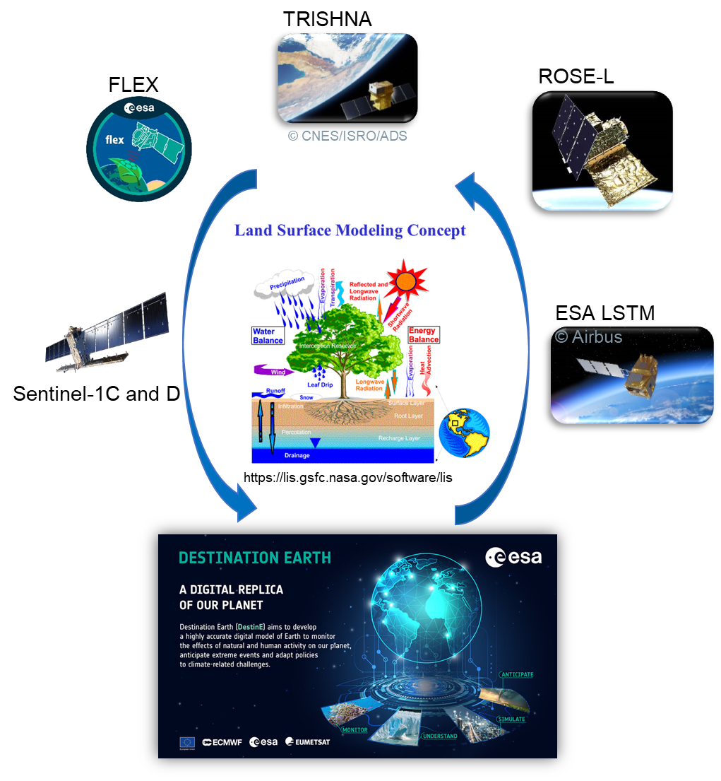
TAKE HOME MESSAGES
Simulating irrigation in models is crucial to improve estimates of agricultural water uses
Models have limitations and satellite observations can provide useful information about the true state of the Earth surface
Combining LSM and Sentinel-1 SAR observations partly improves the water cycle description but the limitation of the WCM to reproduce vegetation-related features can affect DA performances
Model calibration to optimize irrigation parameters seems worth to be explored for a better estimate of agricultural water uses
Combining LSM and multiple RS products (i.e., thermal, optical and MW observations) through DA and/or calibration can be advantageous to build a digital replica of the our planet
Thank you for your attention!
8

