Slide 1
From observations towards operational site-specific soil moisture ensemble forecasting
8th Galileo conference | session 3
14/06/2023
R. Hoffmann^{1,2}, K. Görgen^{1,2}, H. Bogena¹ and H.-J. Hendricks-Franssen^{1,2}
¹Institute of Bio- and Geosciences: Agrosphere (IBG-3), Forschungszentrum Jülich GmbH, Germany
²Centre for High-Performance Scientific Computing in Terrestrial Systems (HPSC TerrSys), Forschungszentrum Jülich
GmbH, Germany

Slide 2
Motivation
Trend in future?
Annual
precipitation
Water
availability
Need for
irrigation
Objective:
Development of protocols to couple observations and models to improve real-time management of water resources
Yield loss
Costs for
irrigation systems
Water demand
How can models
help?

Slide 3
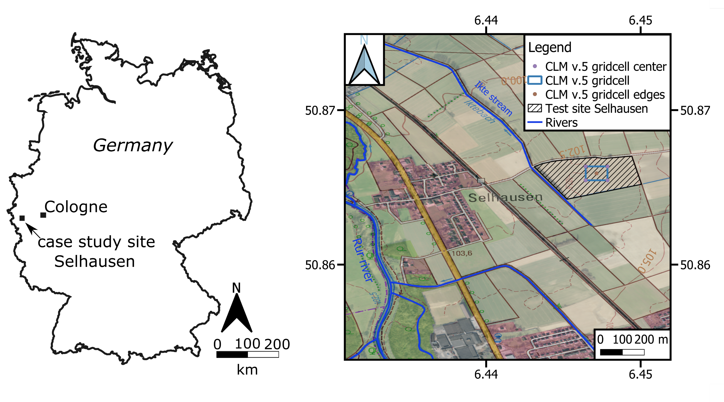
Agricultural research station Selhausen
Framework idea:
Assimilation of soil moisture using measurements from a Cosmic Ray Neutron Sensor (CRNS) and a site-specific model developed using the Community Land Model (CLM v.5, Lawrence et al. 2019).
=> Operational site-specific soil moisture forecasts for the next 10 days

Slide 4
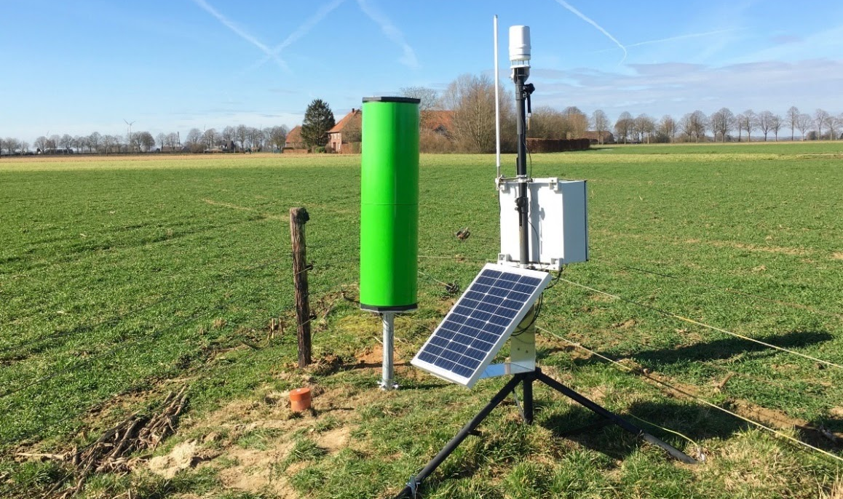
In-situ measurements
Eddy covariance (EC) station
All-in-one weather station (ATMOS-41)
Cosmic Ray Neutron Sensor
Soil moisture and temperature sensors
Sensors host Narrow band IoT modems (Wireless sensor network) that allow near real-time data access.
CRNS

Slide 5
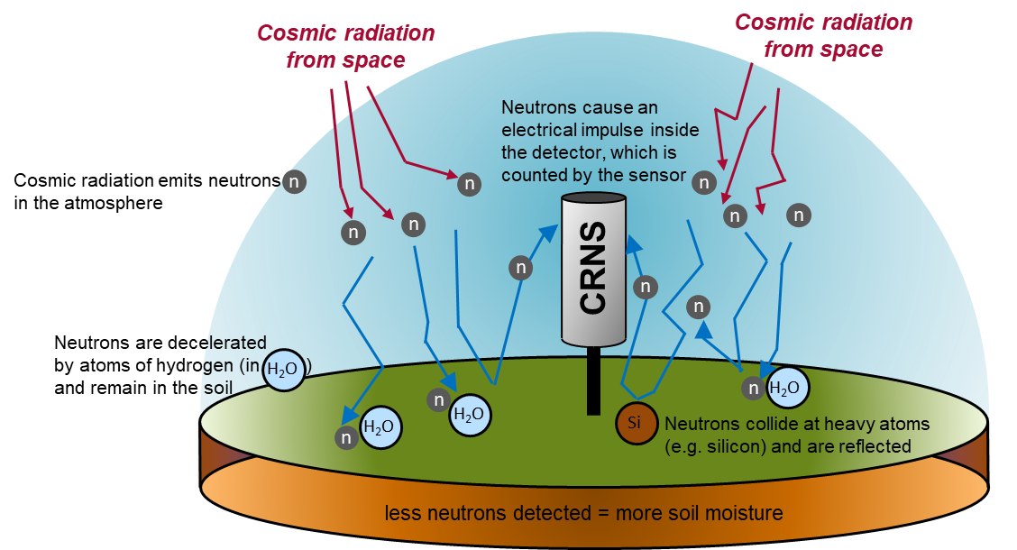
Cosmic Ray neutron Sensor
Soil moisture [%]
~ 500 – 2500
Neutron counts
measuring a soil moisture area with a radius of ~250 m

Slide 6
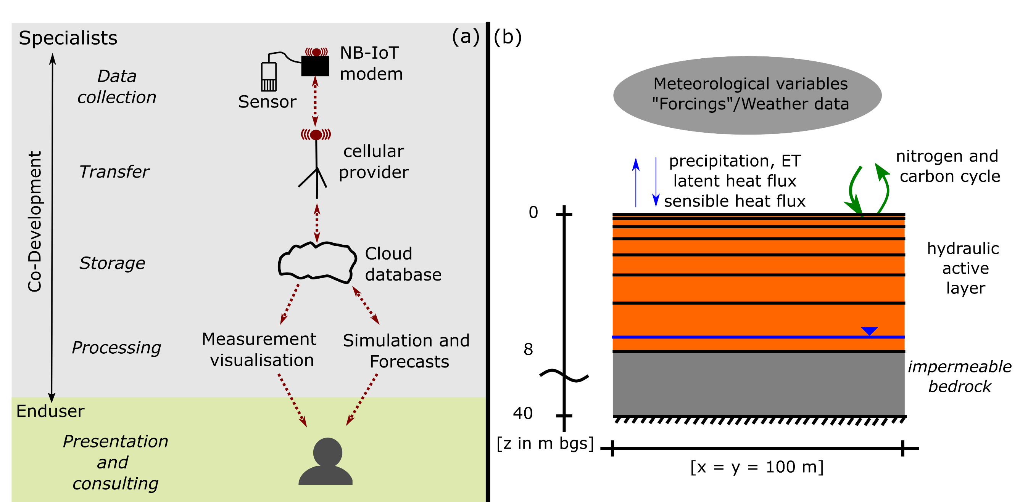
coupling CLM5 and in-situ measurements

Slide 7
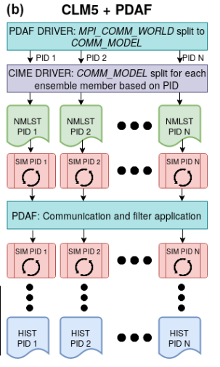
Modeling framework using CLM5pdaf
50 ensemble members by perturbing meteorological on-site measurements
Atmospheric Forcings | Perturbation | Mean | Standard deviation
Precipitation | Multiplicative normal distribution | 1.0 | 0.5
Global Radiation | Multiplicative normal distribution | 1.0 | 0.3
Air Temperature | Additive normal distribution | 0.0 | 1.0
CLM5-PDAF (“Parallel Data Assimilation Framework) uses a specific measurement operator to link CRNS measurements to several soil layers and their soil moisture content (Ref. to Strebel et al. 2022).
CLM5PDAF: Strebel et al. 2022

Slide 8
Modeling framework using CLM5pdaf
IC: Initial Condition
(Hoffmann et al, in prep., GMD)

Slide 9
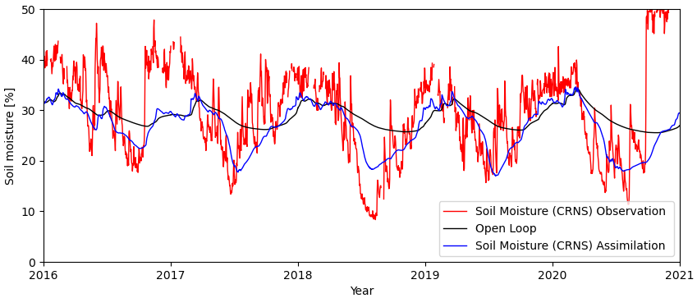
Soil moisture assimilation: 50 Ensemble MemberS
Open Loop: Simulations without data assimilation

Slide 10
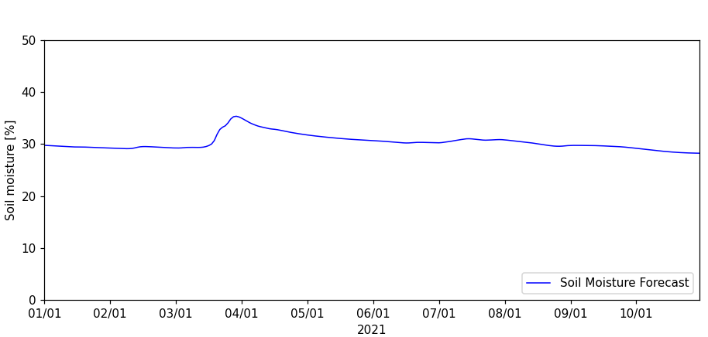
soil moisture forecast
Atmospheric forcings: official weather prediction
Potential use:
Optimizing irrigation systems and minimizing costs by using predictions produced with physically based models

Slide 11
Conclusion
Toolbox (Jupyter Notebooks) for coupling observations and models (soil moisture assimilation) in near-real time
CRNS measurements are used to have soil moisture simulations closer to reality
Site-specific ensemble weather forecasts improve simulations of soil moisture dynamics and other variables
(e.g., crop states) at sites.
These site-specific forecasts can contribute to quantitative, long-term water resource management in near real-
time, e.g., support management operations like irrigation scheduling (as on-demand service).

Slide 12
Thank you very much for your Attention
Contact: Dr. Richard Hoffmann ∙ Institute of Bio- and Geosciences | Agrosphere (IBG-3)
Forschungszentrum Jülich GmbH ∙ 52425 Jülich | Germany
This project has received funding from the European Union’s Horizon 2020 research and innovation programme under Grant Agreement No 858375.

Slide 13
Automated pipeline | Toolbox
(Hoffmann et al, in prep., GMD)

