Slide 1
Event water fractions in overland flow and shallow subsurface flow in a pre-Alpine headwater catchment in Switzerland
Anna Leuteritz
Hydrology & Climate
University of Zurich
anna.leuteritz@geo.uzh.ch

Slide 2
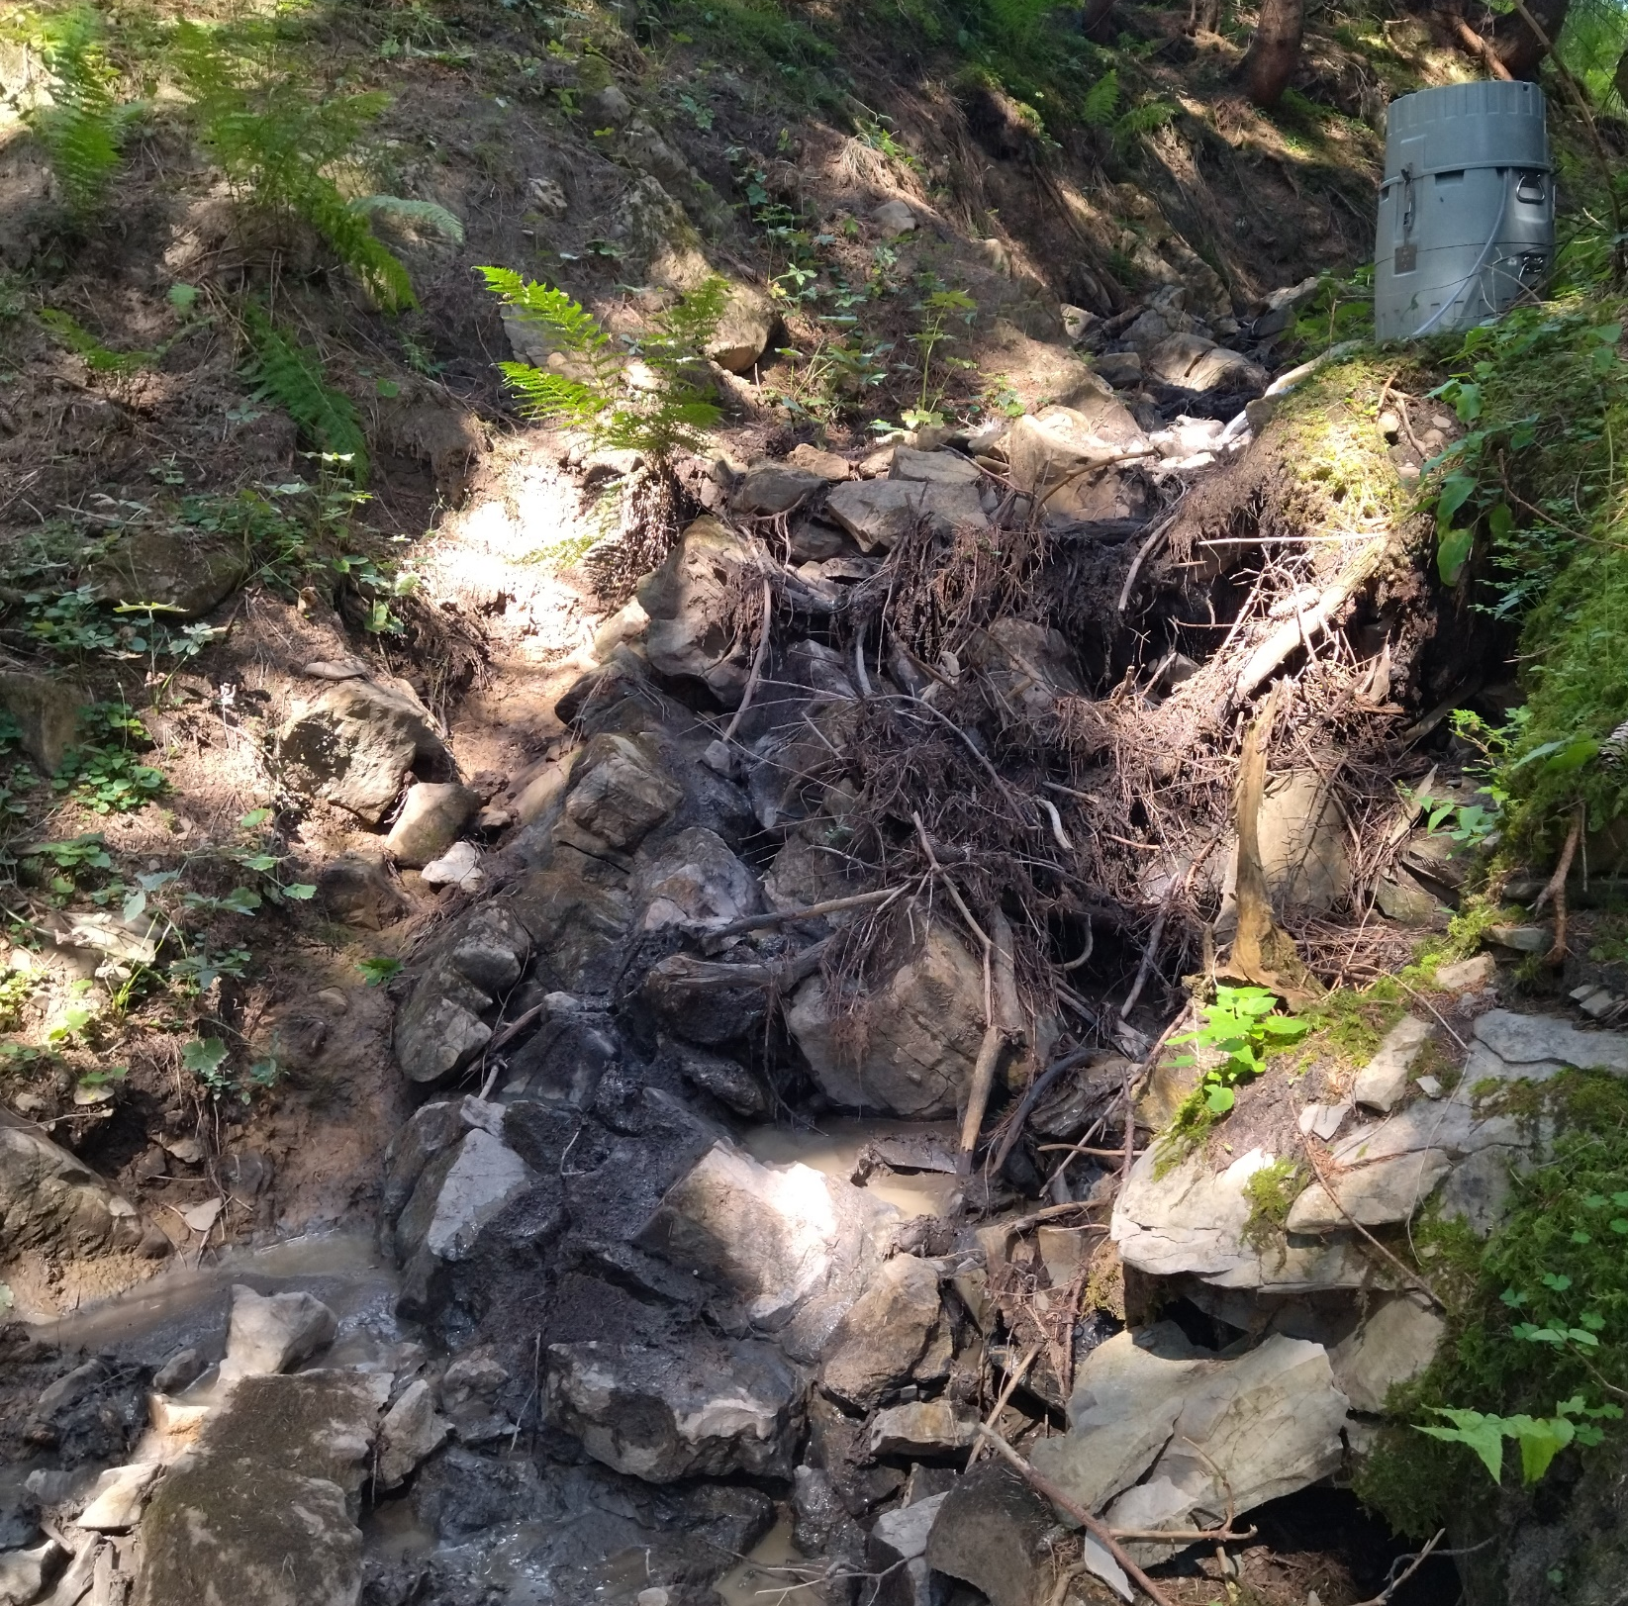
Introduction
August, 4 2022
Headwater streams (first and second order)
make up 70% - 80% of the total channel length of the river network worldwide (Downing et al., 2012)
spatially and temporally variable due to short flow paths & small contribution areas (Wohl, 2017)
more responsive

Slide 3
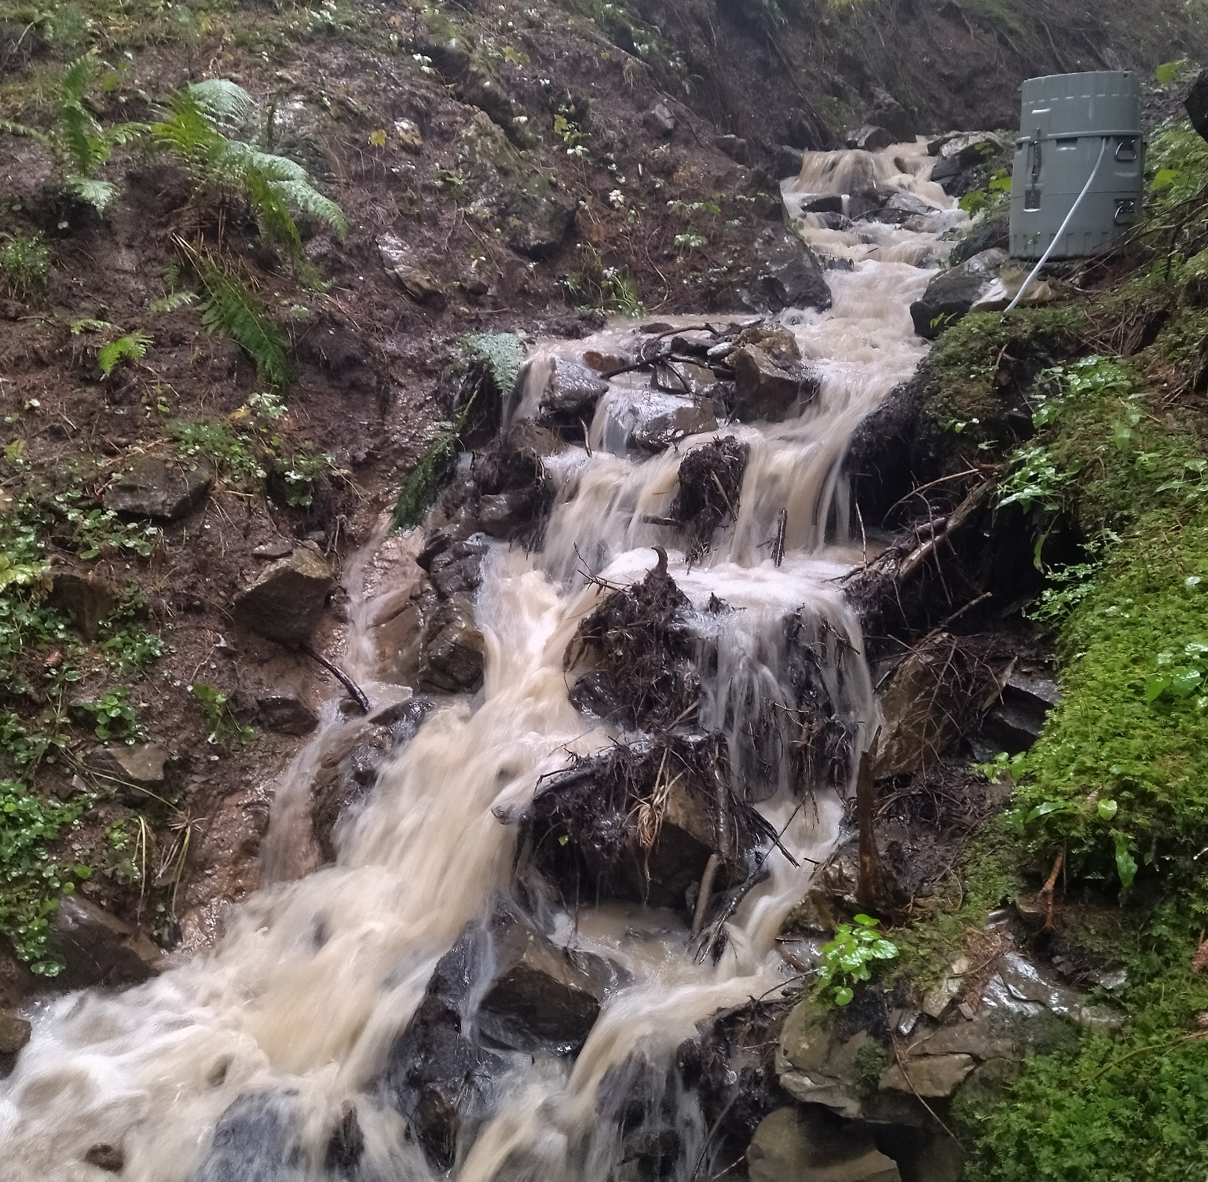
Introduction
August, 20 2022
Headwater streams (first and second order)
make up 70% - 80% of the total channel length of the river network worldwide (Downing et al., 2012)
spatially and temporally variable due to short flow paths & small contribution areas (Wohl, 2017)
more responsive
→ Overland flow (OF) & shallow subsurface flow (SSF)

Slide 4
Introduction
August, 20 2022
→ Overland flow (OF) & shallow subsurface flow (SSF)
lack of data on spatial and temporal variability in isotopic composition in OF & SSF
contributions and interactions of flow pathways with source areas (i.e., soil water & groundwater)
mixing processes in the catchment
stable water isotopes (¹⁸O, ²H) as conservative tracer
How do rainfall event- and site characteristics affect mixing of rainwater and soil water in OF & SSF?

Slide 5
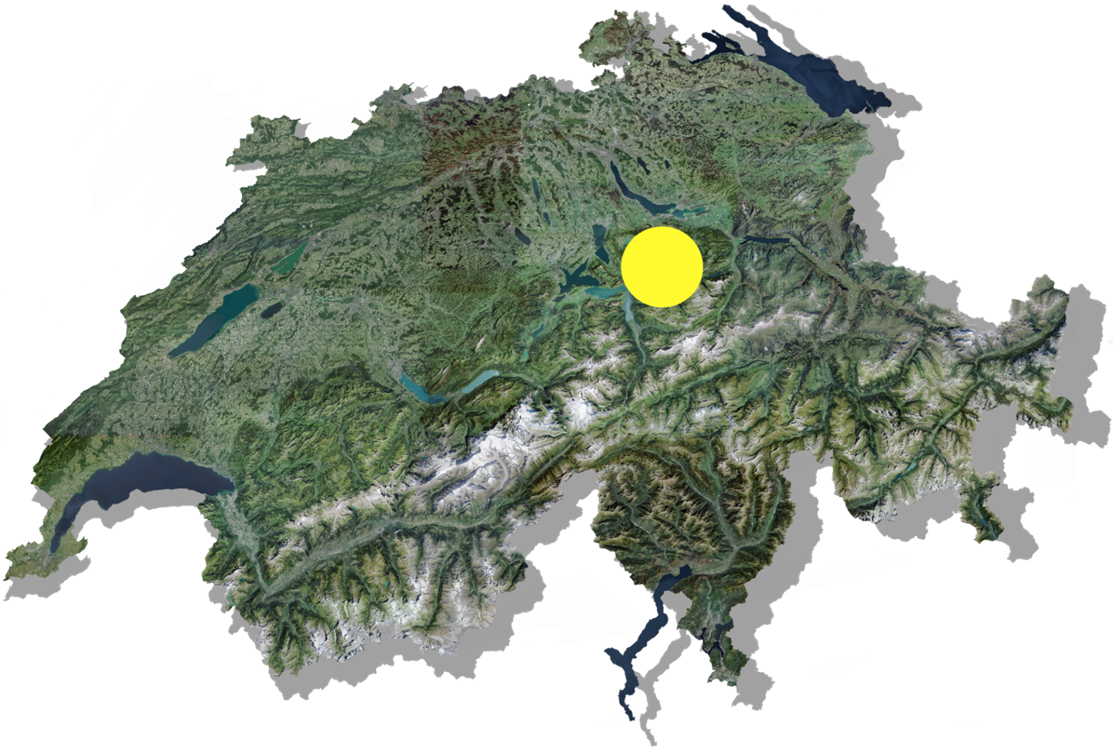
Study area
pre-Alpine region of Switzerland
humid, temperate climate
annual precipitation: 2300 mm/y
20 ha
steep hillslopes (20-40°)
open forests, meadows and wetland areas
low permeability gleysols, with more conductive topsoil layer
soil depth: 0.5 - 2.5 m
Flysch bedrock
Florian Lustenberger

Slide 6
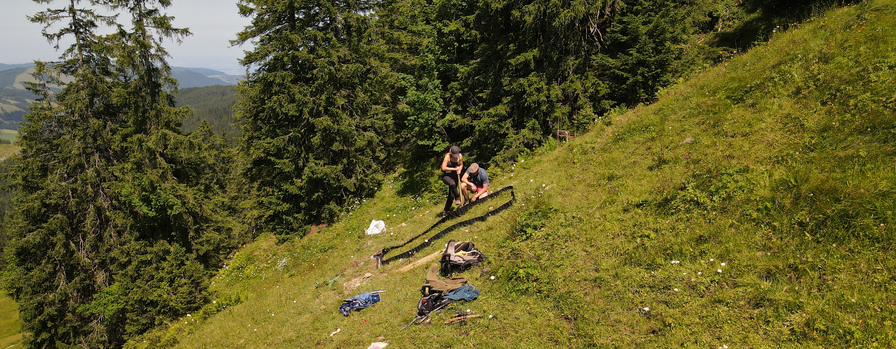
Runoff plot installation
three sub-catchments (C2, C3, C5)
14 small runoff plots (3 m²)
slope: 8 – 38°
TWI: 3.4 – 6.7
forest, grassland, wetland
$TWI=ln⁡(\frac{α}{tanβ}$)
α… local upslope contributing area
β… local slope
Stream network
C2
C5
Runoff plot
C3
Rainfall sampler
Stream gauge
Florian Lustenberger

Slide 7
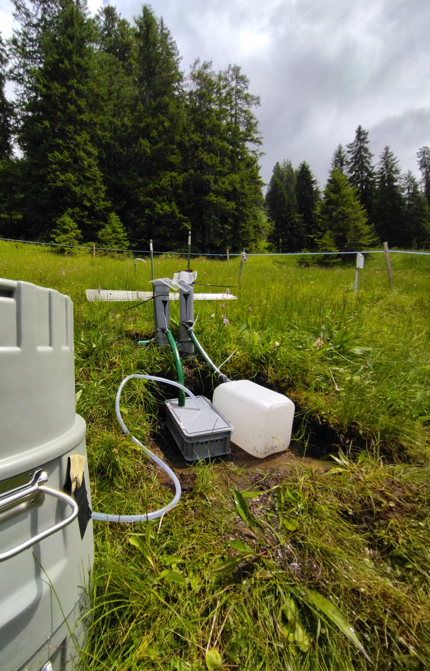
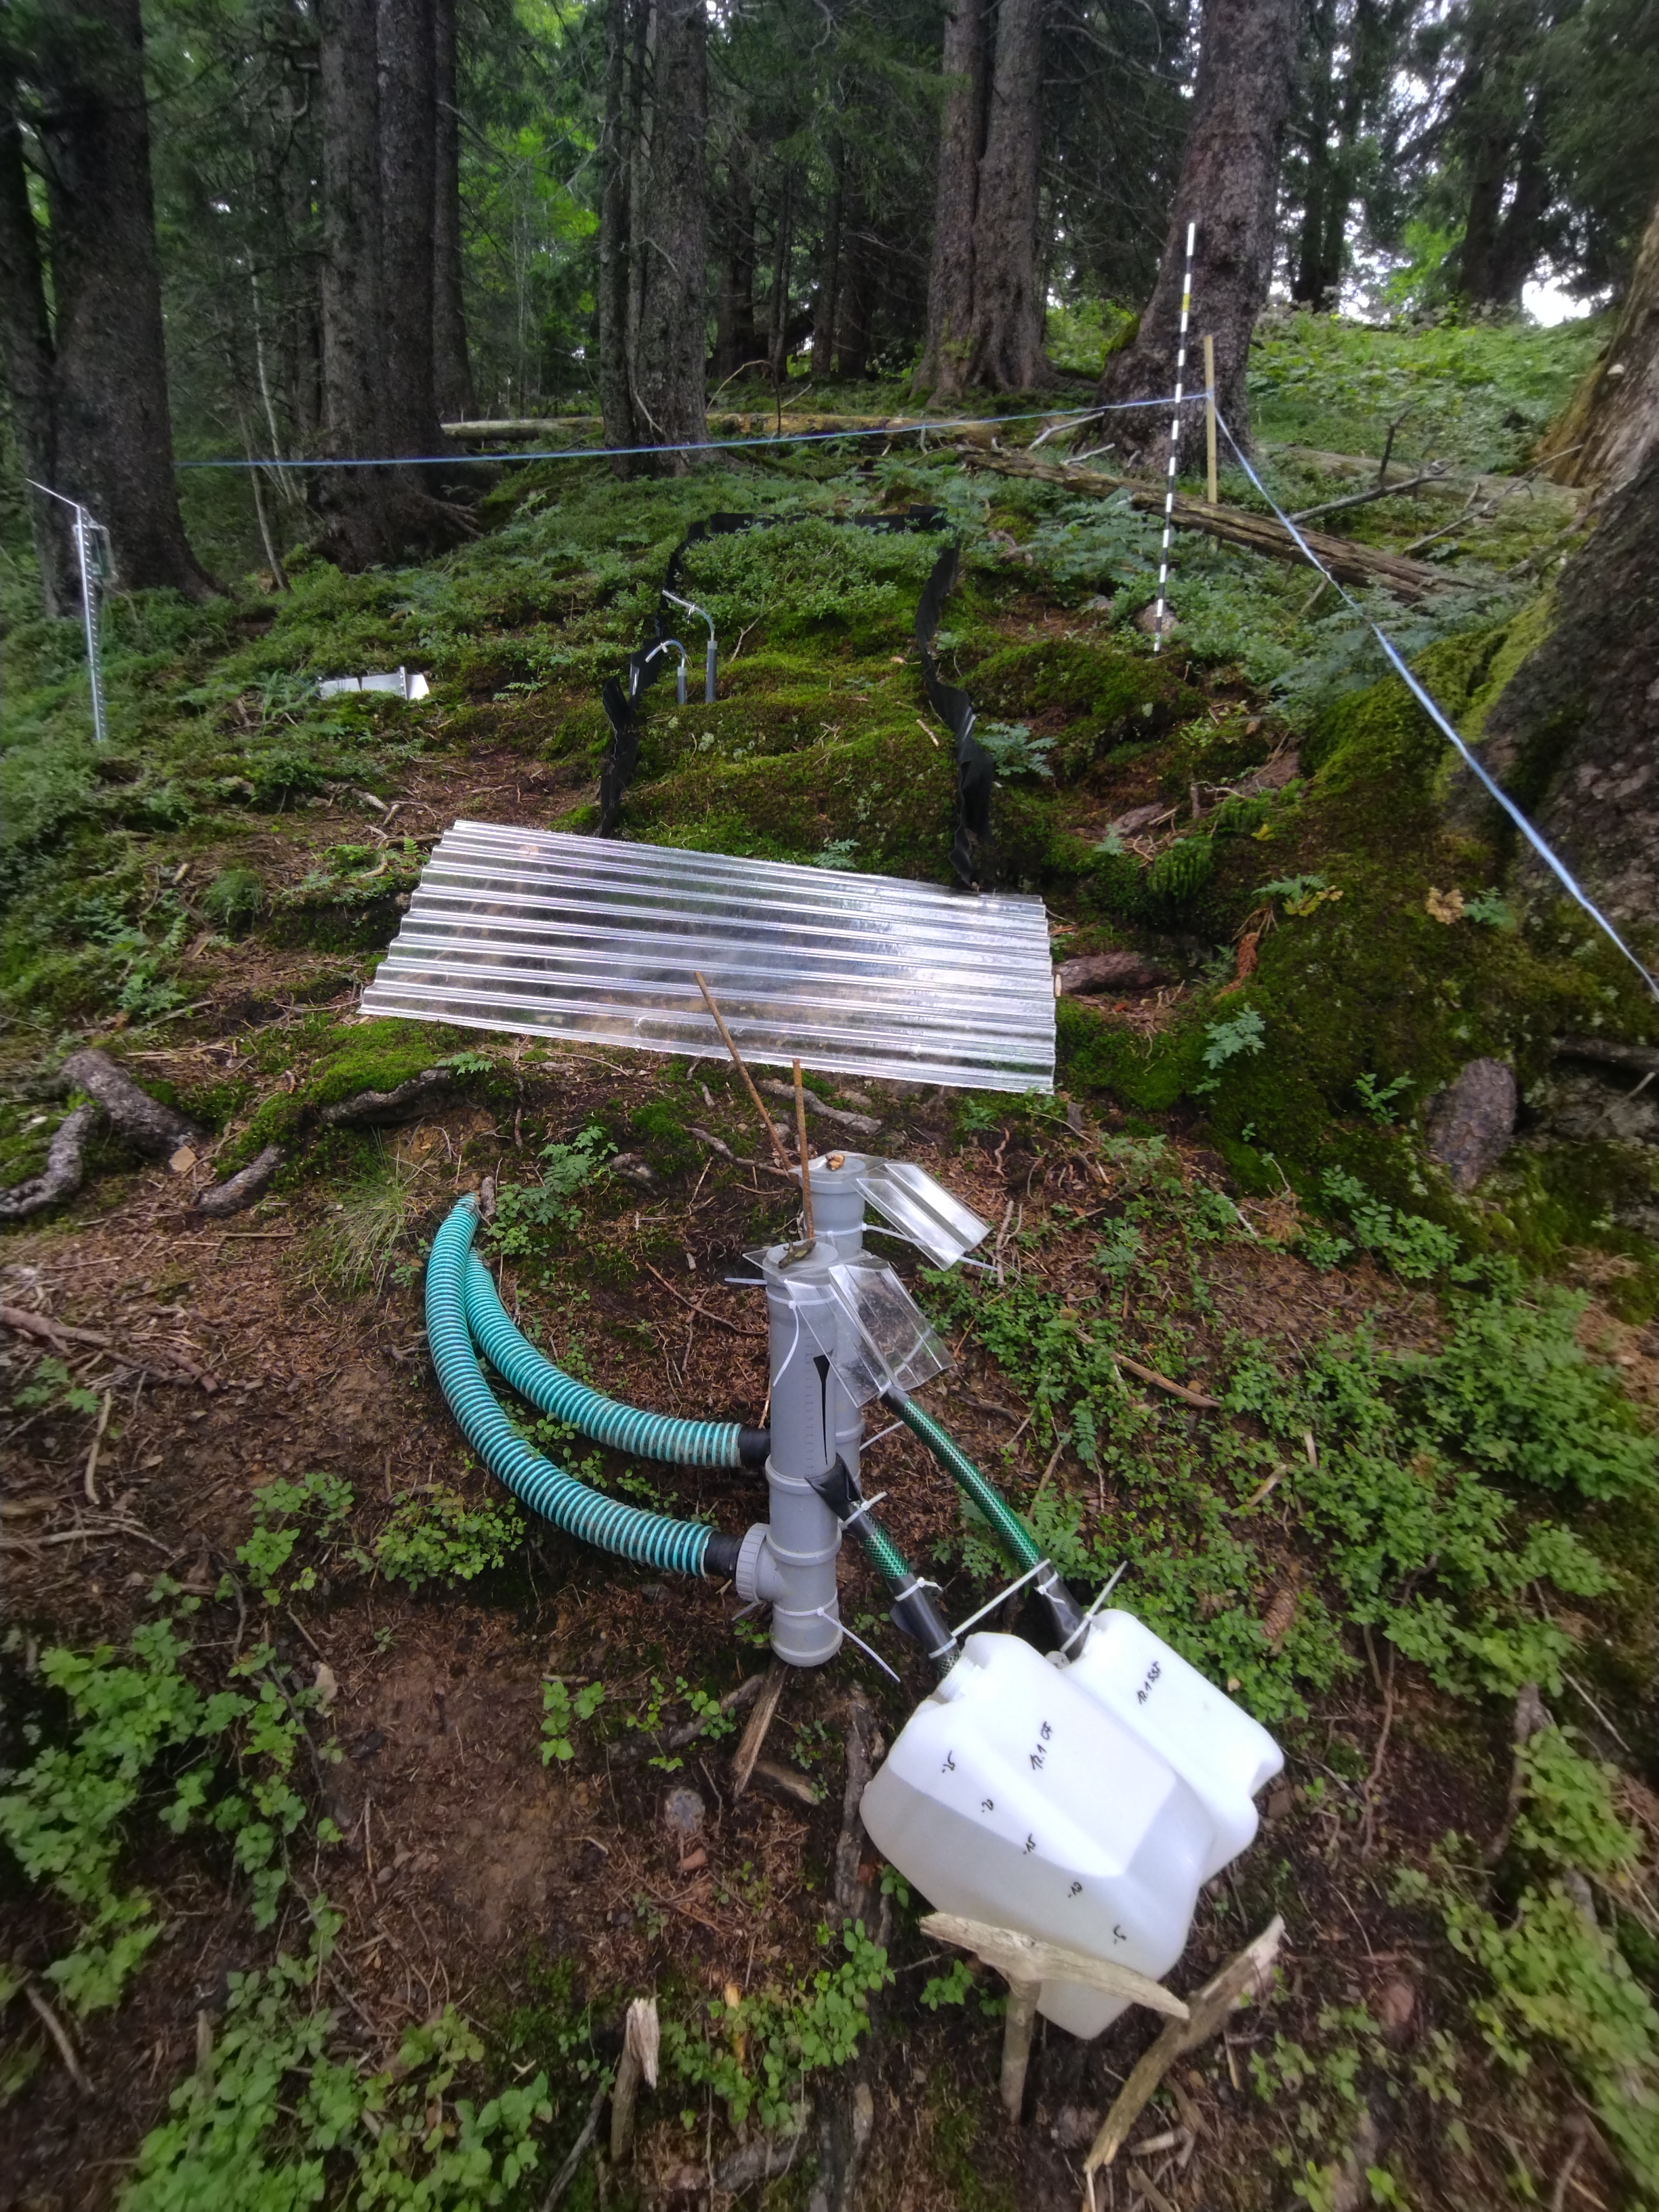
Sampling of OF & SSF
Event-based sampling:
OF and SSF sampled for 12 selected events in summer season of 2021 and 2022
Sampling between rainfall events:
Soil water
Groundwater
… at each runoff plot location
Event size: 9.4 – 131 mm
Maximum intensity: 3.1 – 17.5 mm/h
Duration: 16 – 92 hrs

Slide 8
Isotope hydrograph separation with δ18O
Event water
Pre-event water
Rainfall
Groundwater
Soil water
Antecendent moisture conditions
Landscape position:
Slope
TWI
Rainfall event characteristics:
Event size
Duration
Intensity
Overland flow
&
Subsurface flow

Slide 9
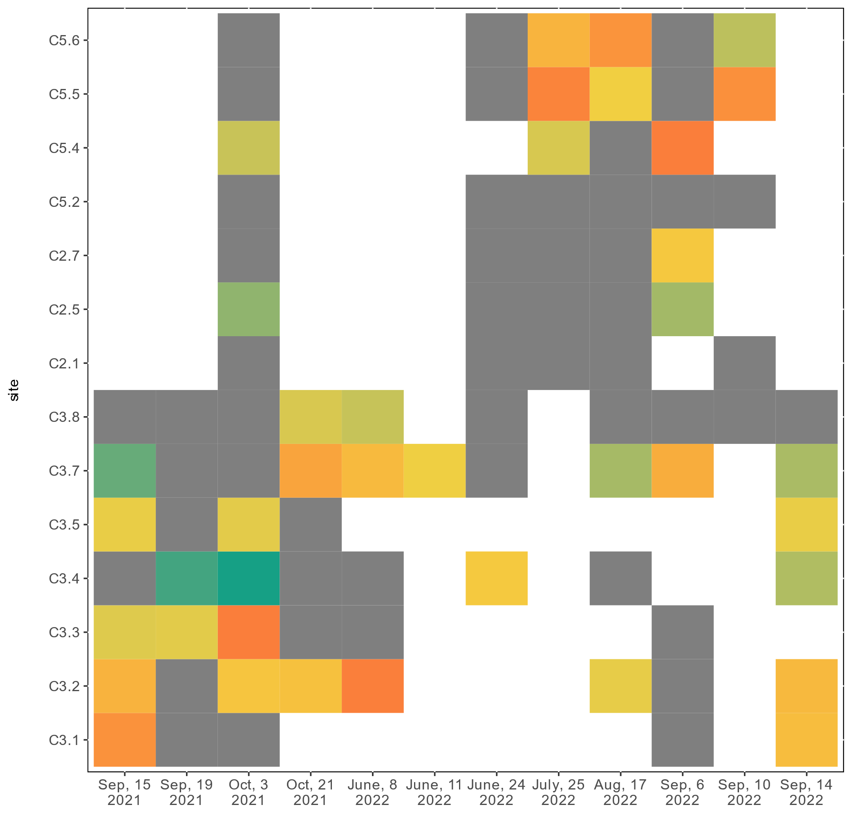
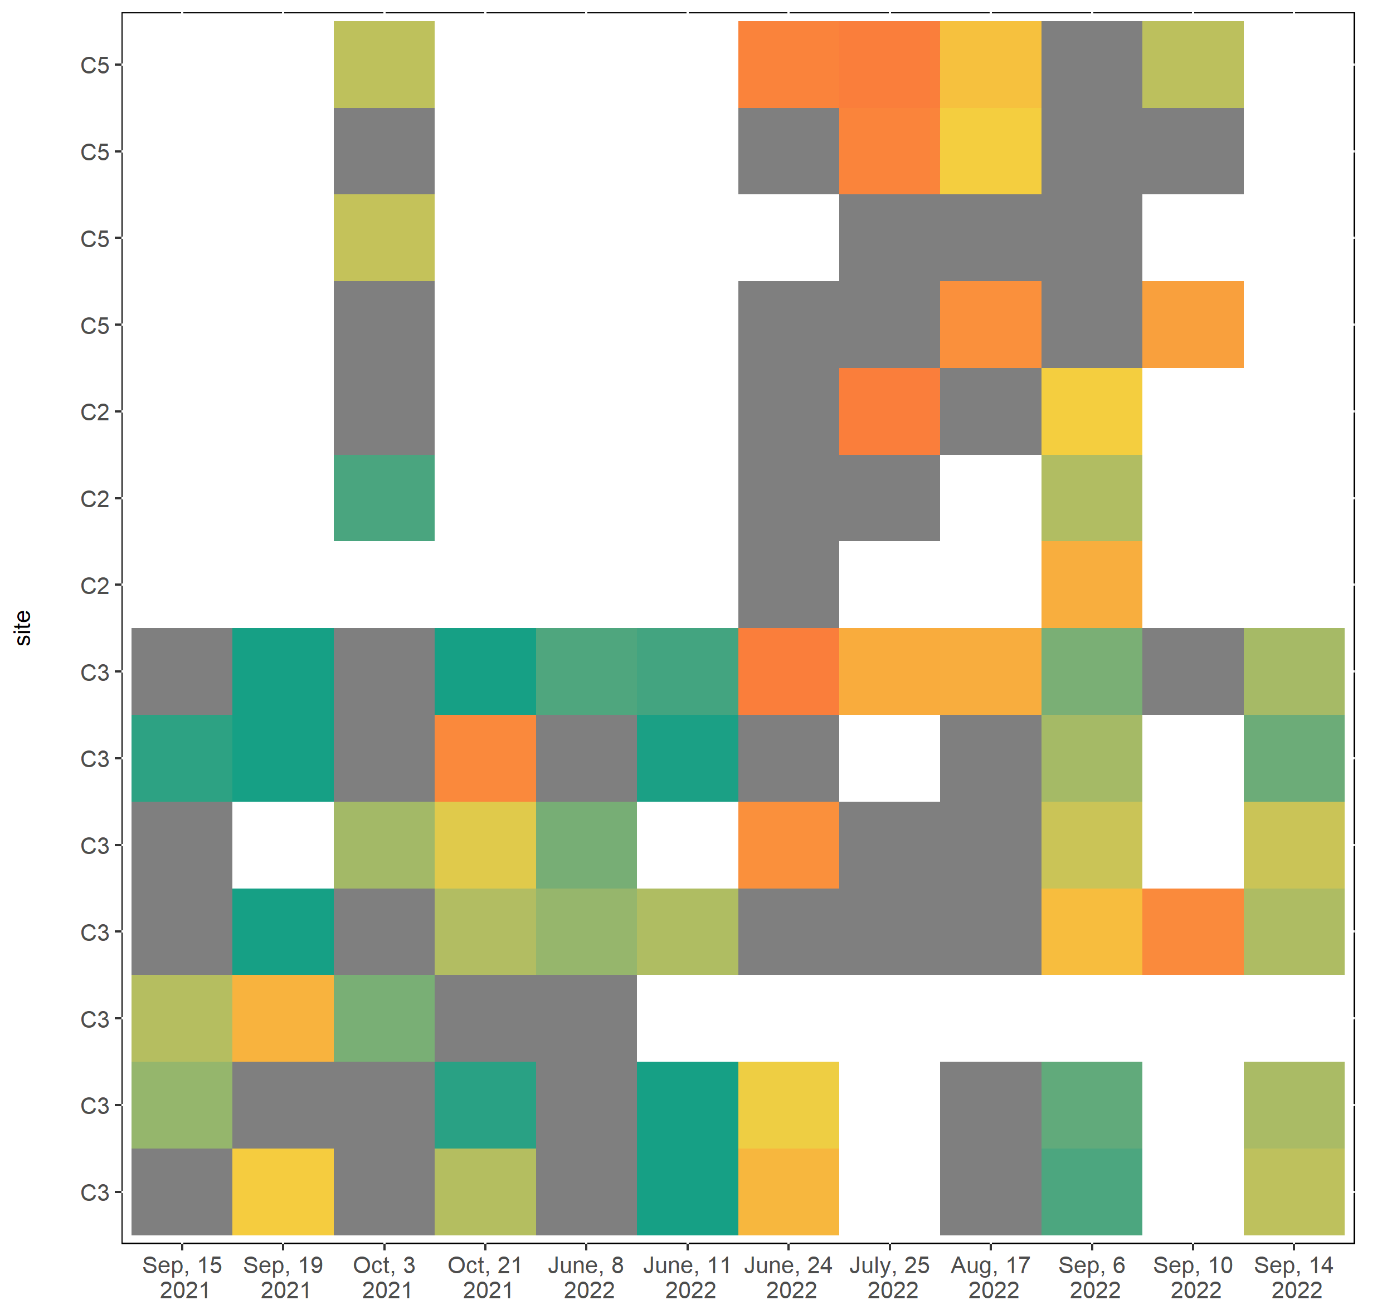
Event water fractions in OF & SSF - temporal and spatial variability
Overland flow
Subsurface flow
Event water fraction
sites
not valid
events
not sampled

Slide 10
Event water fractions in OF & SSF - temporal and spatial variability
Overland flow
Subsurface flow
Event water fraction
sites
not valid
not sampled

Slide 11
Event water fractions in SSF - temporal variability
Maximum rainfall intensity (mm/h)
15.00
10.00
Event water fraction
5.00
0.00
Antecedent soil moisture content (m³/m³)
0.500
0.475
0.450
0.425
not valid
C3.8
not sampled
2021
2022

Slide 12
Spatial & temporal variability in event water fractions - Correlations
Spatial parameters: TWI, local slope, profile & plan curvature, soil depth → no clear relationship
Temporal parameters:
Event size
Maximum intensity
Mean intensity
Duration
Rainfall event characteristics
Positive for SSF
(sites = 6, $\overline{r }$= 0.67)
Negative for SSF
(sites = 6, $\overline{r }$= -0.32)
Antecedent soil moisture conditions
Mean soil water content
Antecedent precipitation index
Positive for OF
(sites = 3, $\overline{r }$= 0.78)

Slide 13
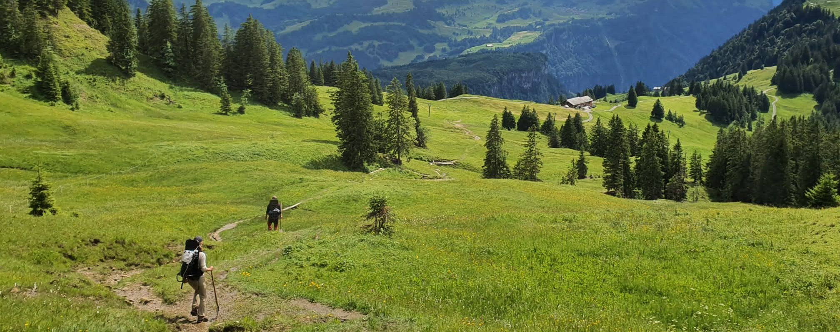
Take Home Messages
OF & SSF can be observed for a wide range of rainfall events and are very variable across space
event water fractions in OF & SSF at a plot vary with
More information on our project & contact
Antecedent soil moisture: OF (+) & in SSF (-)
Rainfall intensity: SSF (+)

Slide 14
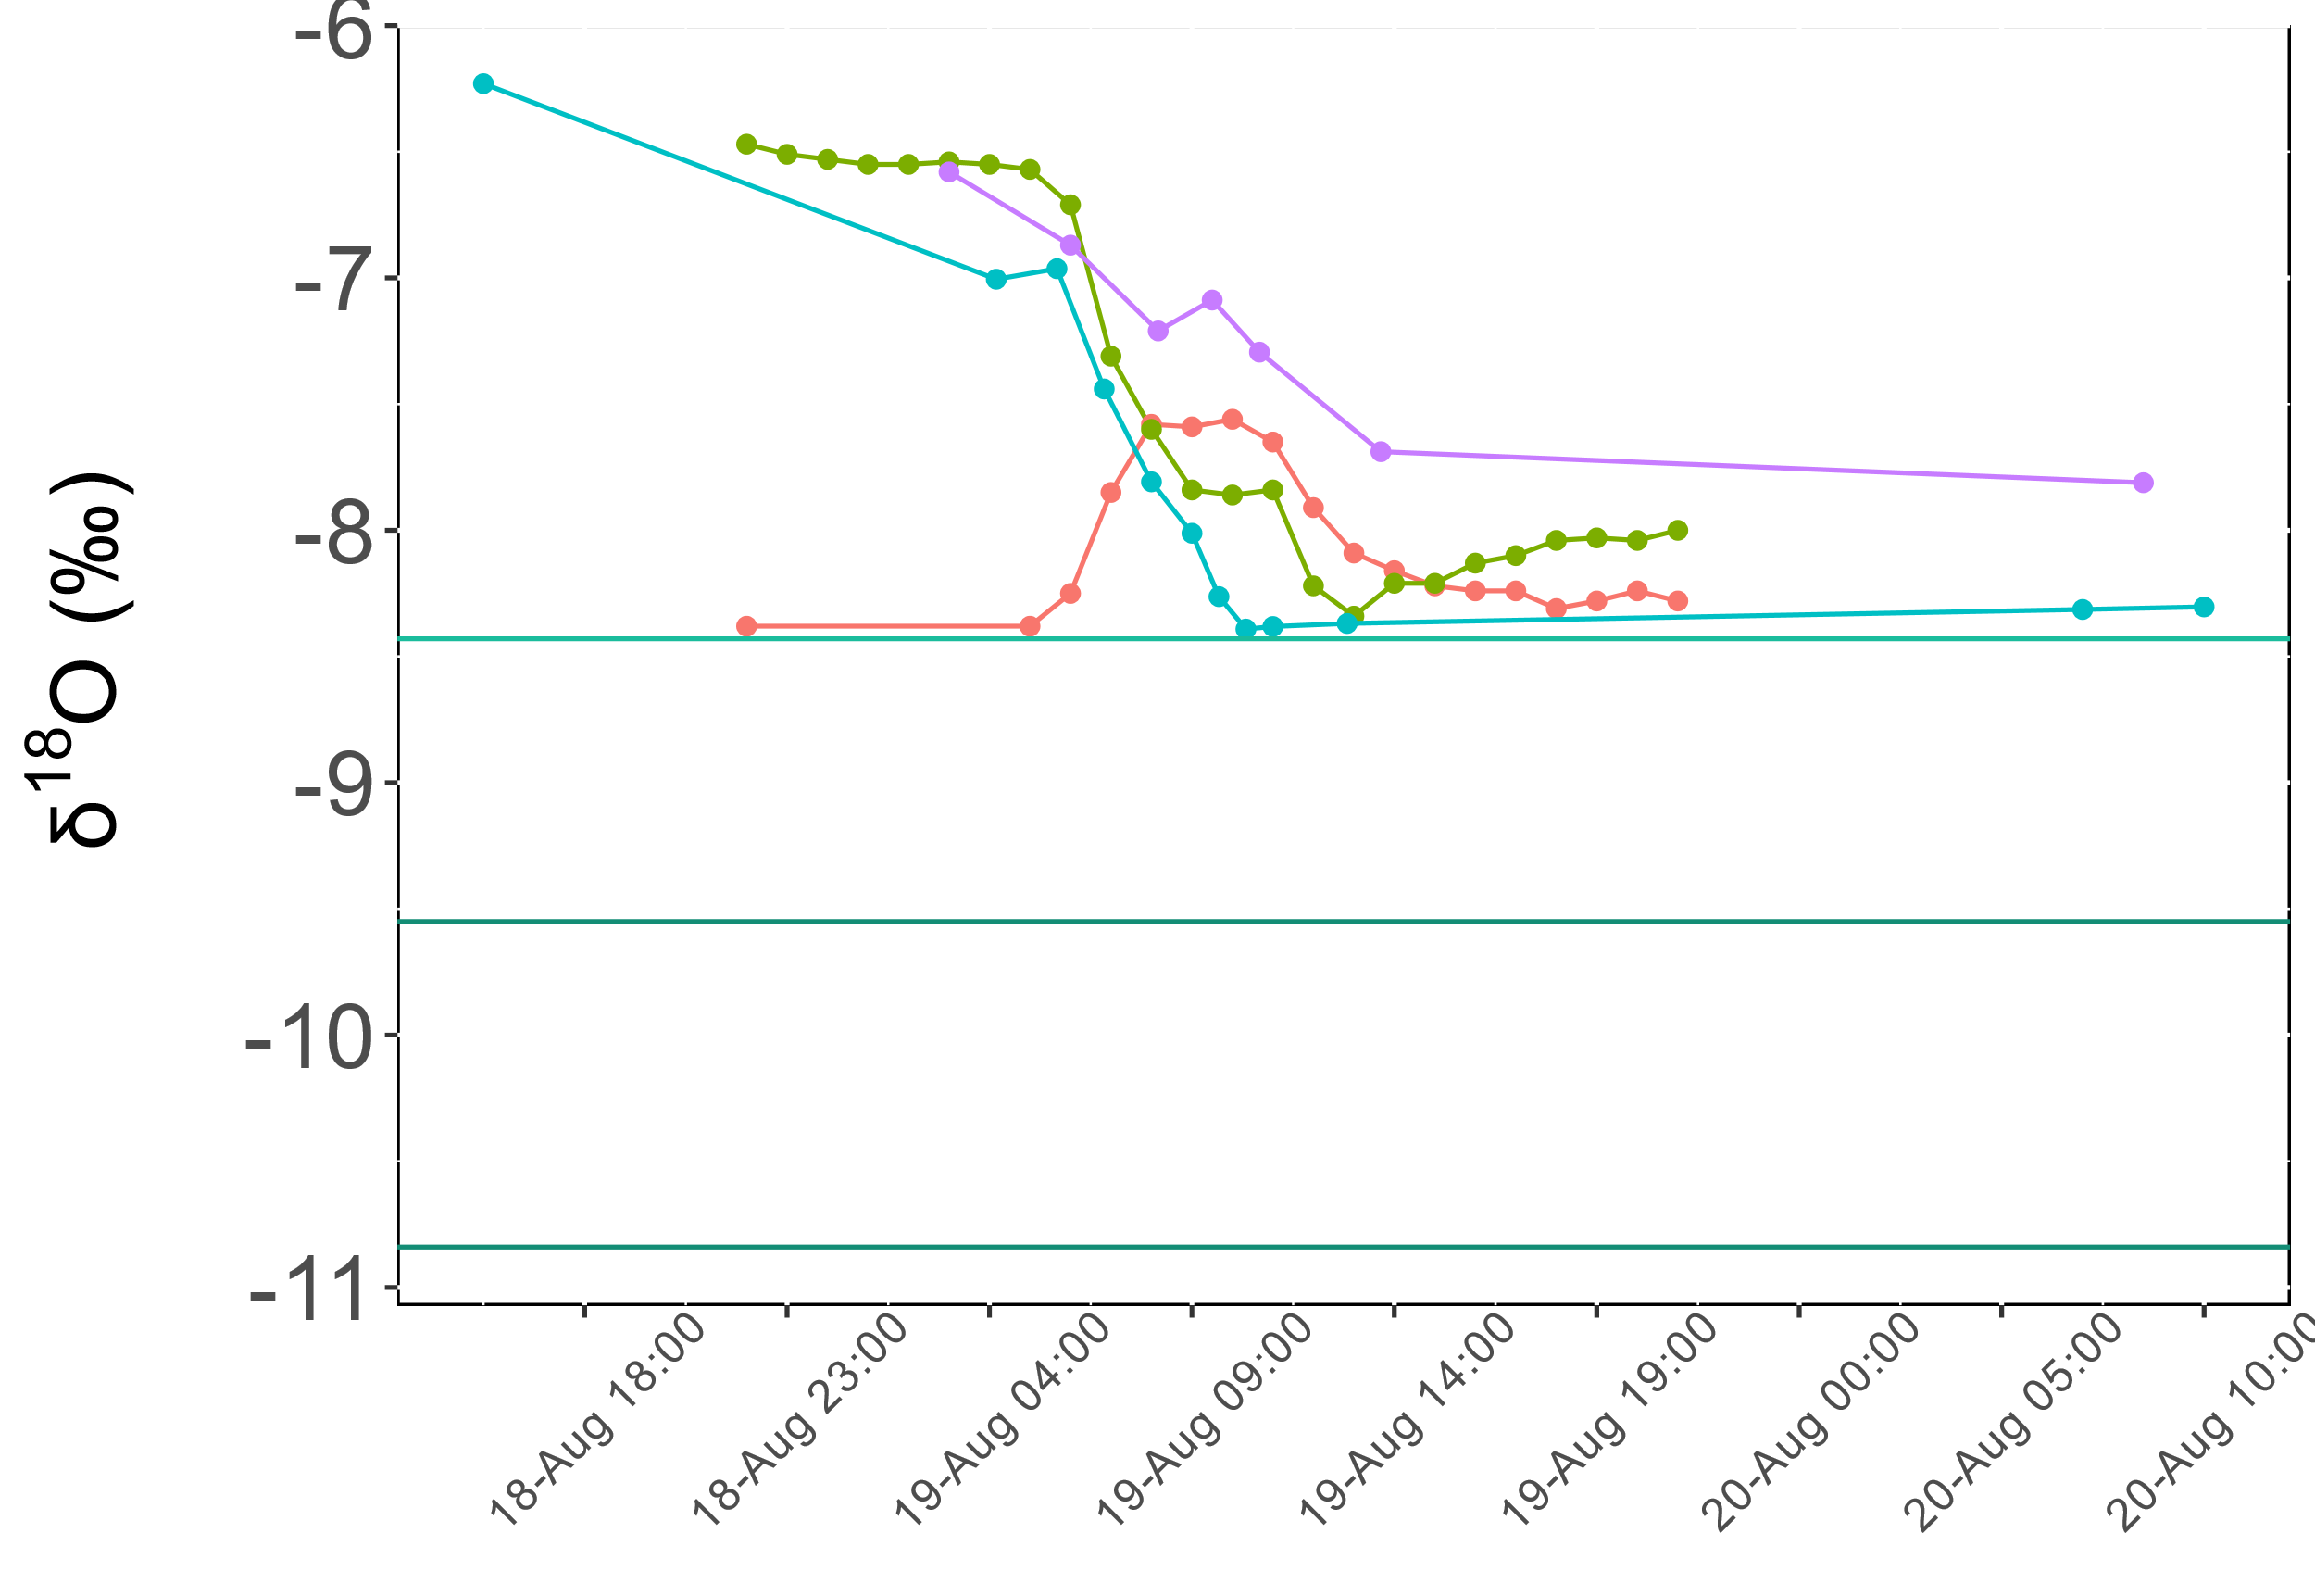
Event water fractions in OF & SSF - intra-event variability
SSF in site 21
SSF in site 32
Soil water in 21
Rain sampler 21
Rain sampler 32
Groundwater in 32
Soil water in 21
Groundwater in 21

Slide 15
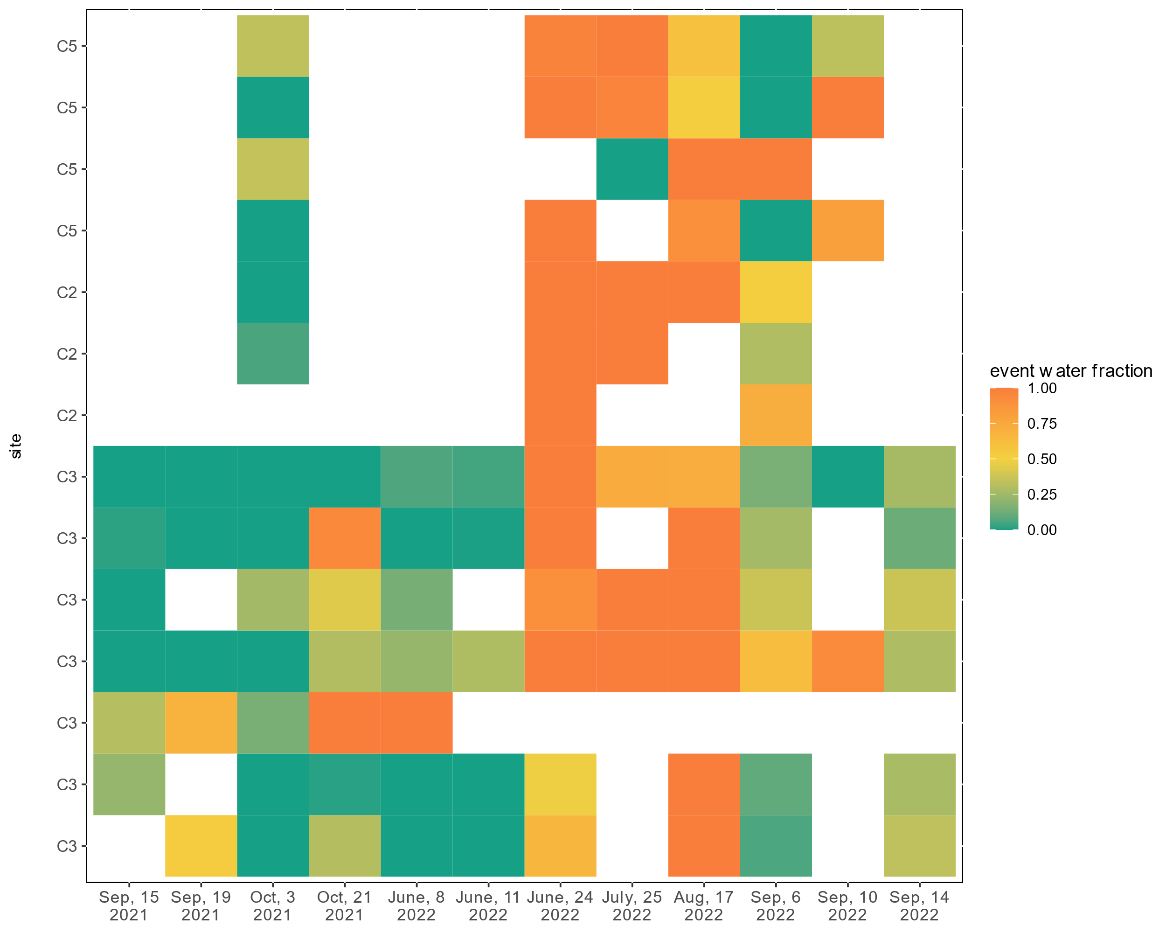
Overland flow
Subsurface flow
Event water fraction
not sampled
Notes:
All «invalid» event water fractions are allowed:
EF > 1 → 1
EF < 0 → 0
Pre-event water signal: soil water (mean of subcatchment)

