Slide 1
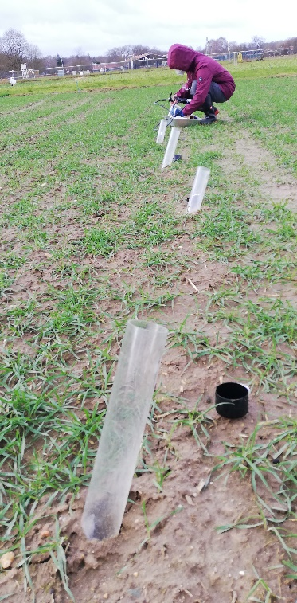
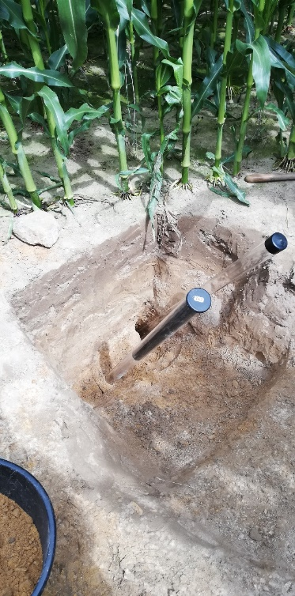
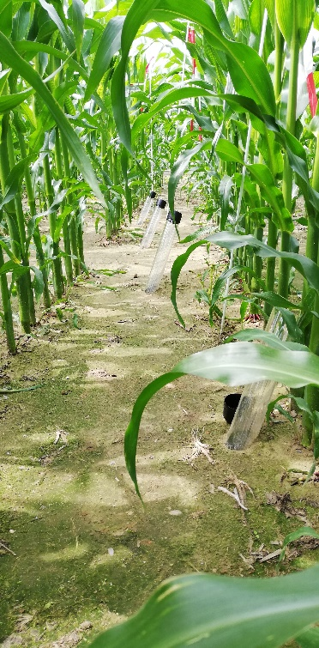
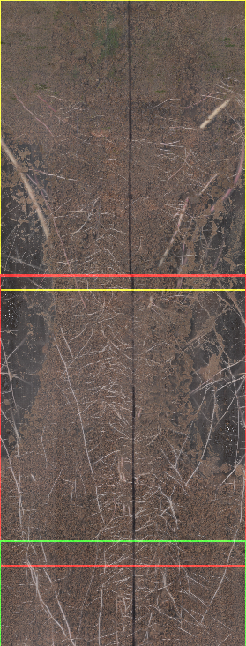
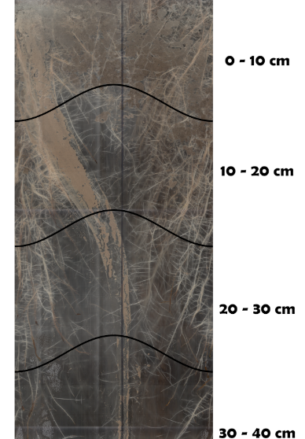

Observing spatio-temporal variations in rooting depth and density as a control factor for soil moisture dynamics

Slide 2
Motivation – warum so wichtig, in welcher Tiefe Wurzeln wachsen?
Vertical root distribution is important to calculate actual evapotranspiration and soil moisture with micrometeorological and hydrological models.
There is a lack of robust field data to improve and validate calculation schemes for rooting depth and its seasonality.
Regular observations of the root zone with mini-rhizotrons over the growing season will facilitate a more reliable parameterization of rooting depth and distribution.

Slide 3
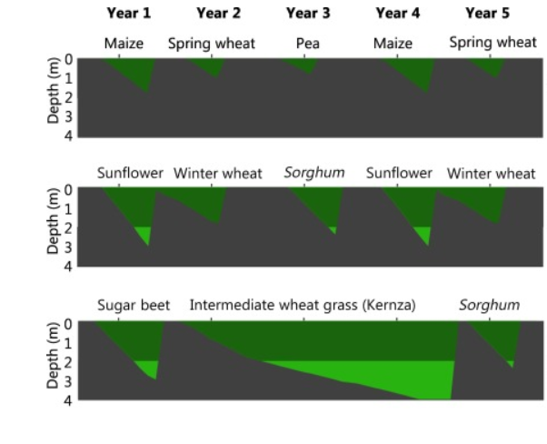
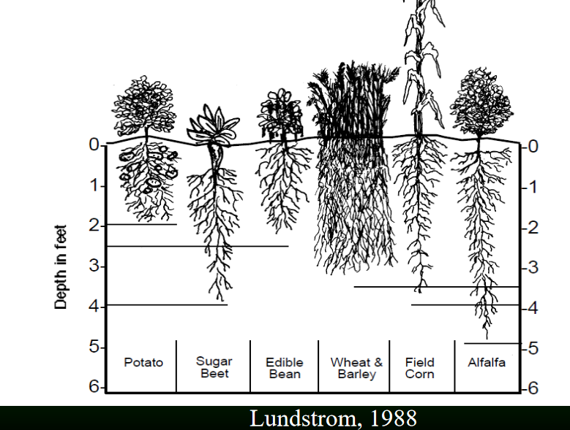
Traditional assumptions on rooting depth in hydrological models:
Species-specific, fixed depth?
Continuous seasonal growth?
Thorup-Kristensen et al. 2020
Thorup-Kristensen et al. 2020. Digging Deeper for Agricultural Resources, the Value of Deep Rooting. Trends in Plant Science 25: 406-417 (DOI:https://doi.org/10.1016/j.tplants.2019.12.007)

Slide 4
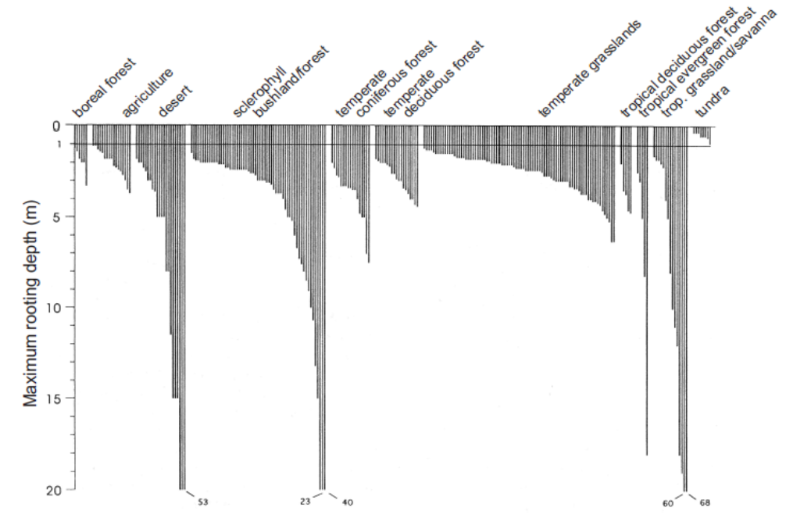
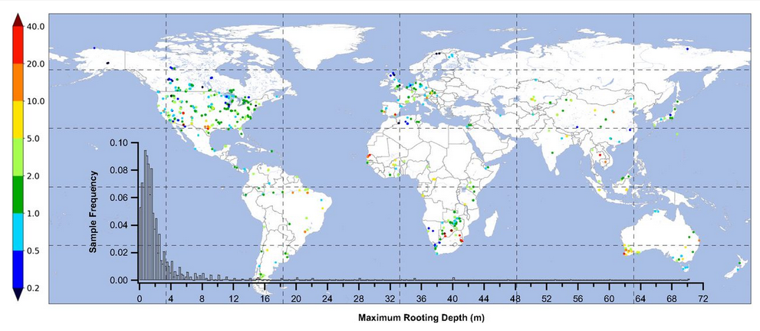
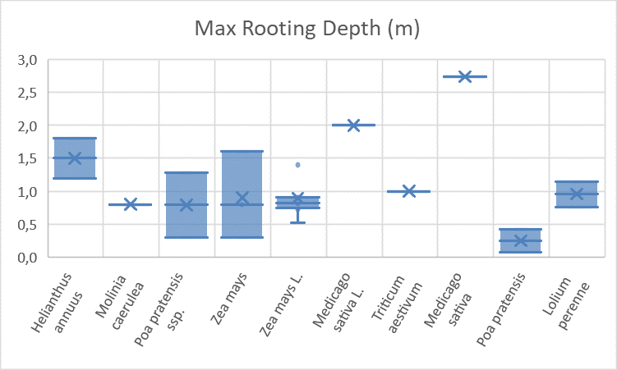
Durchwurzelungstiefen (DWT) weltweit…
Large variability even within plant functional types
Fan Y, Miguez-Macho G, Jobbagy EG, Jackson RB, Otero-Casal C. 2017. Hydrologic regulation of plant rooting depth. Proceedings of the National Academy of Sciences of the United States of America 114: 10572–10577
Fan et al. 2017 PNAS (Fig.2 & S.1)

Slide 5
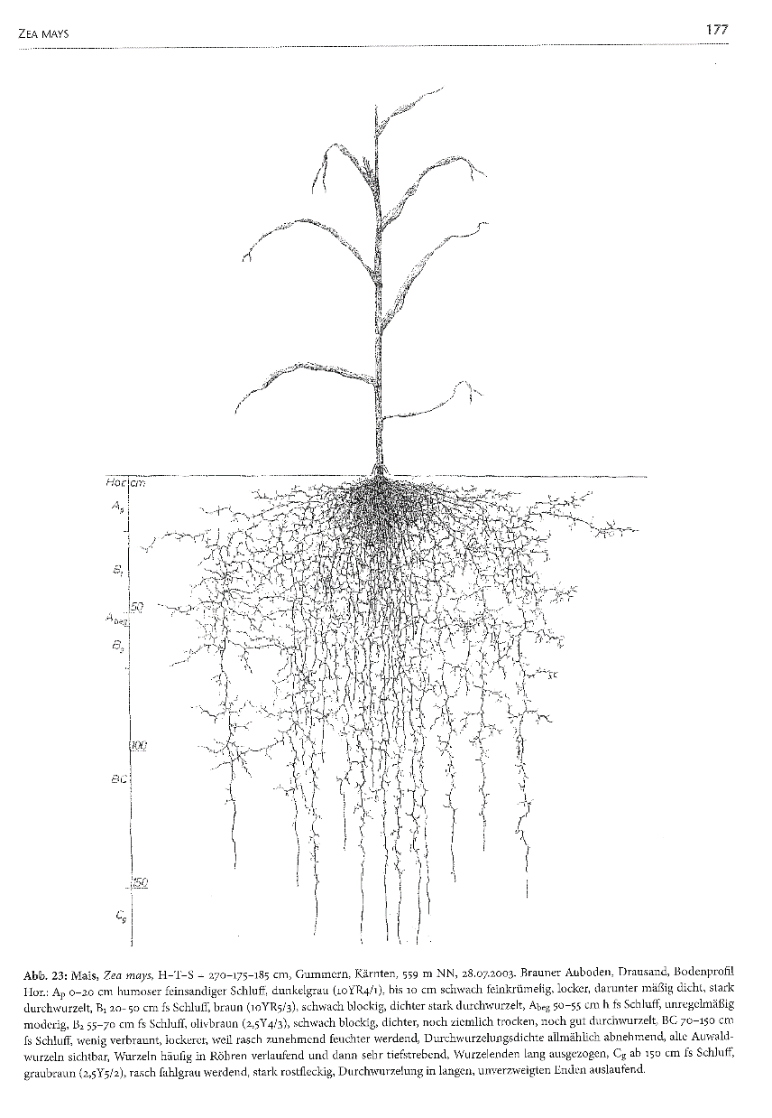
Suggestion for an alternative model
New approach for croplands is based on a maximum rooting depth, depending on plant species and soil properties.
Position of maximum root density, and time when maximum depth is reached, are related to above-ground phenology.
Network of regular field observations using mini-rhizotrons will enable robust calibration and validation.
Example: Maize

Slide 6
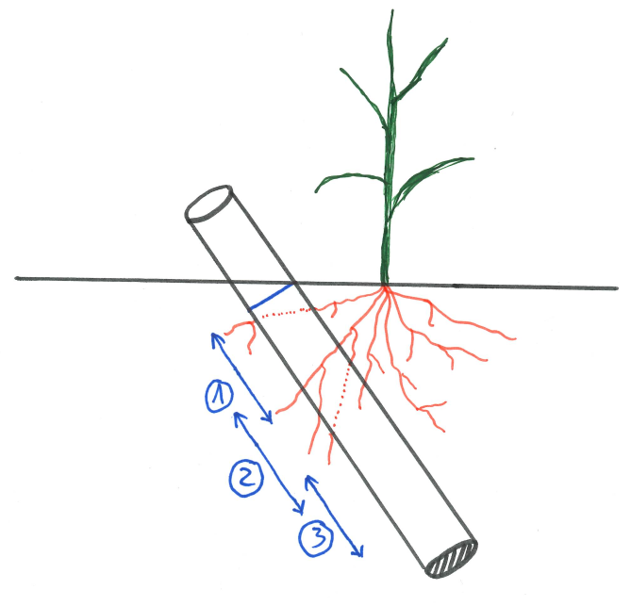
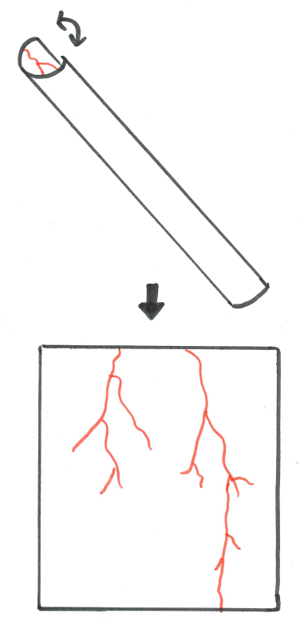
Improvement of data base: Setup of observations
Portable root scanner „CID-602“
Connected to tablet computer
Installation of acrylic glass tubes at start of season
360° scans at 600 dpi in various depths inside the tubes

Slide 7
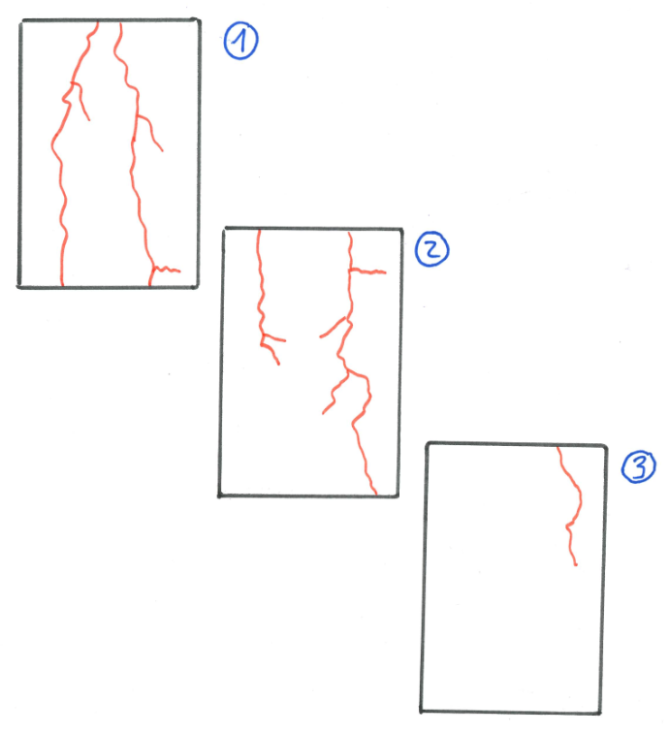
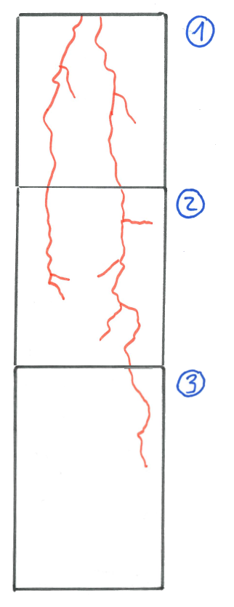
From individual scans to the root profile
Week 1

Slide 8
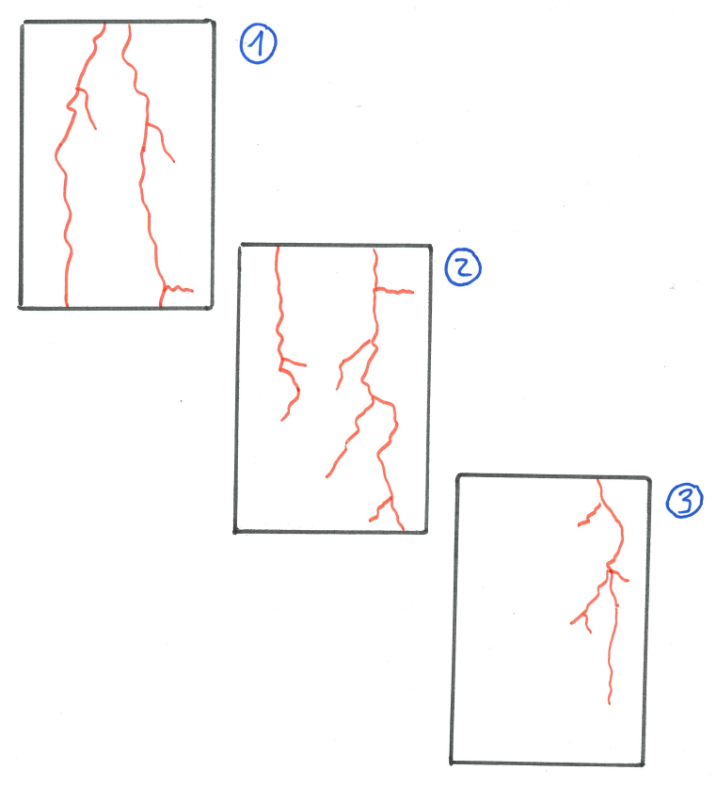
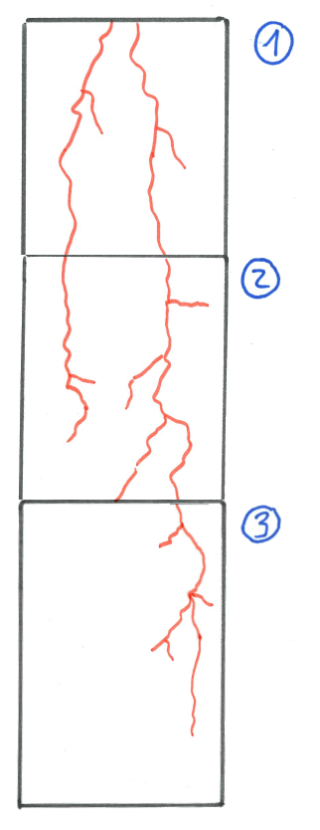
Temporal development of root profiles
Week 2
Week 1
Week 2

Slide 9
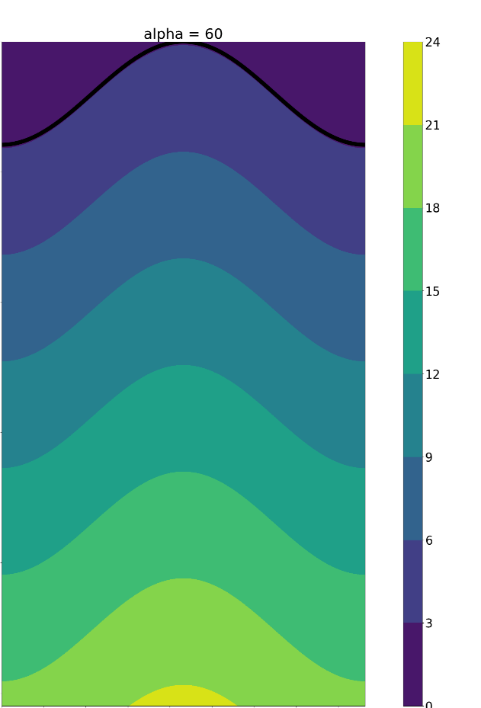
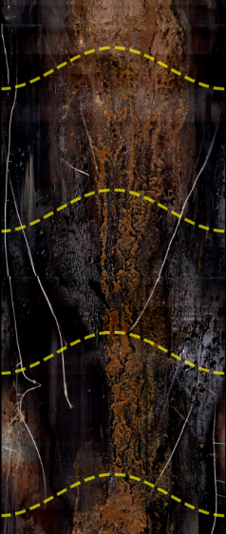

True vertical distribution on 2-D-picture
Depending on installation angle
Important for automatic picture analysis and data processing
Installation angle
α

Slide 10
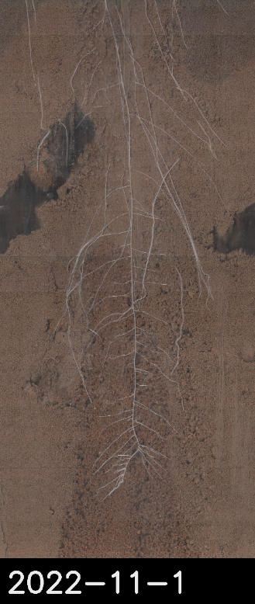
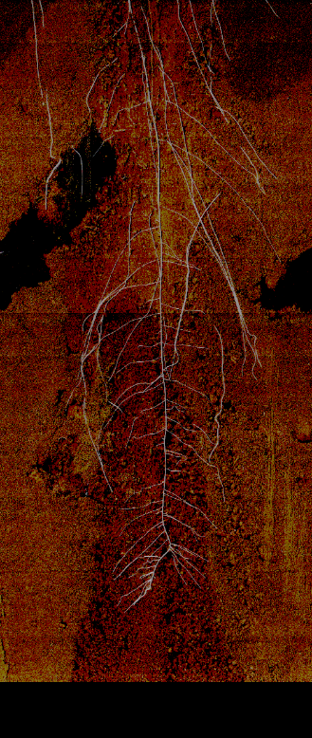
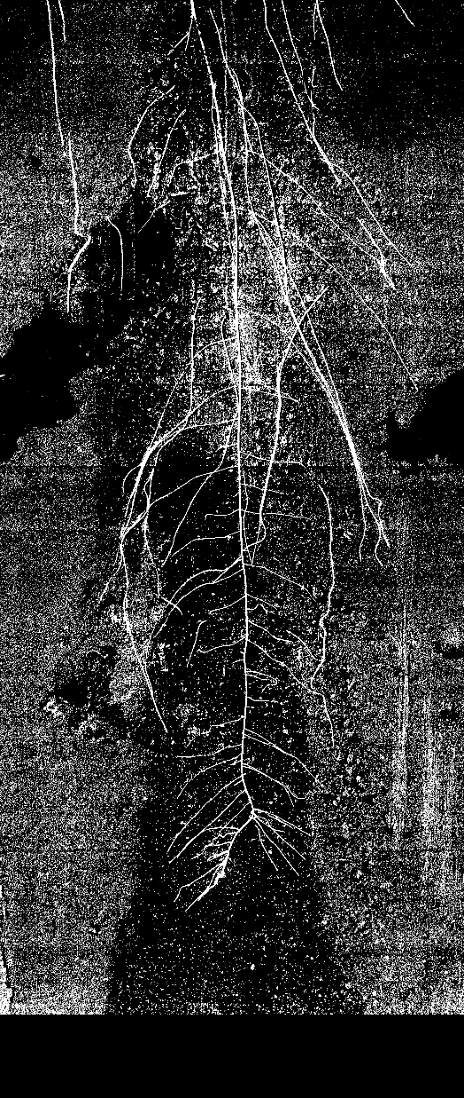
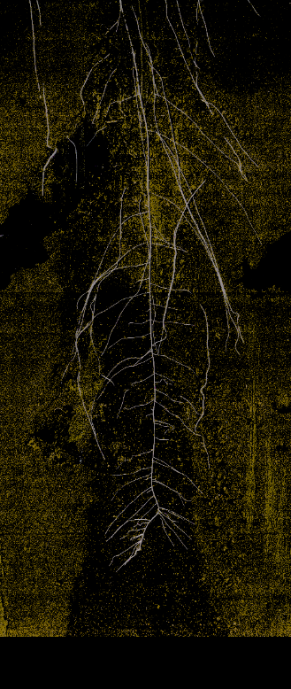
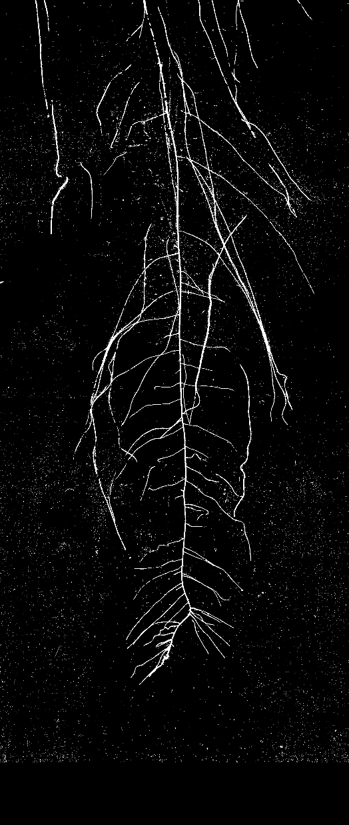
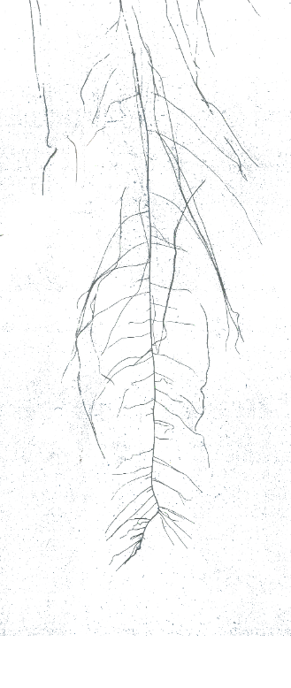
Automatic detection using thresholds und filters
Original
Red-Filter
Yellow-Filter
Result
(plus morphological filters to remove other artefacts and disturbances)

Slide 11
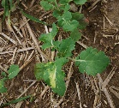
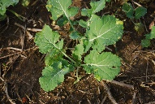
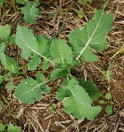
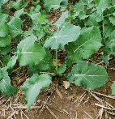
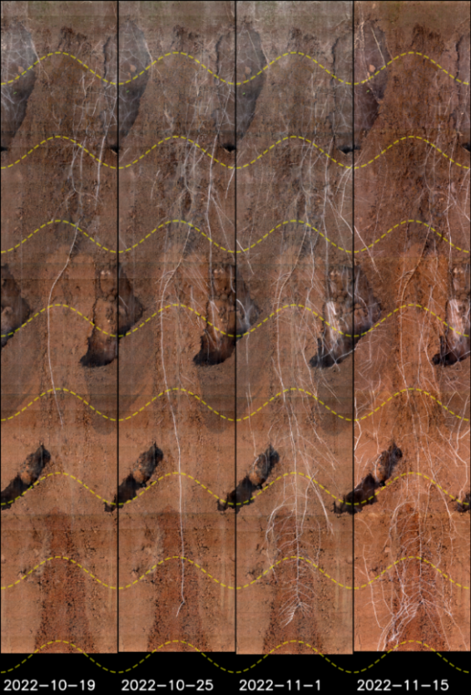
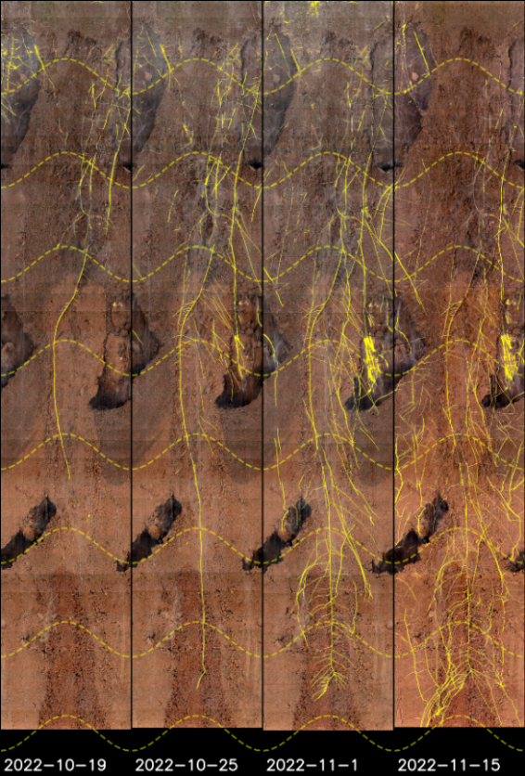
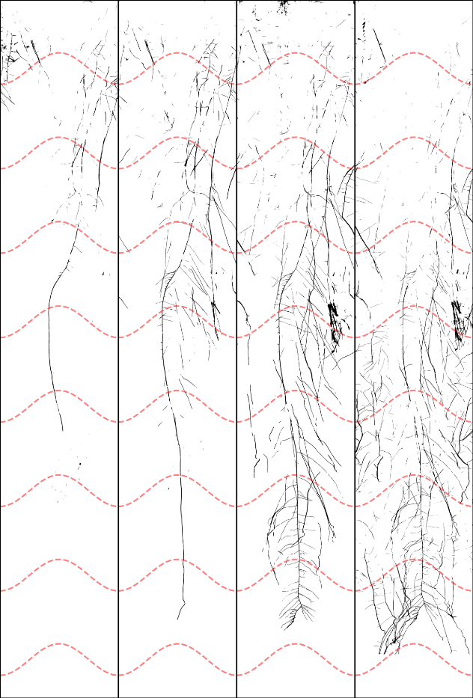
Example Oilseed Rape (Autumn 2022)
Small above-ground, but large below-ground growth:
h = 5 cm,
cf = 0.3
h = 20 cm,
cf = 0.8
0 cm
80 cm
GC-8-Hydro, 12.06.2023

Slide 12
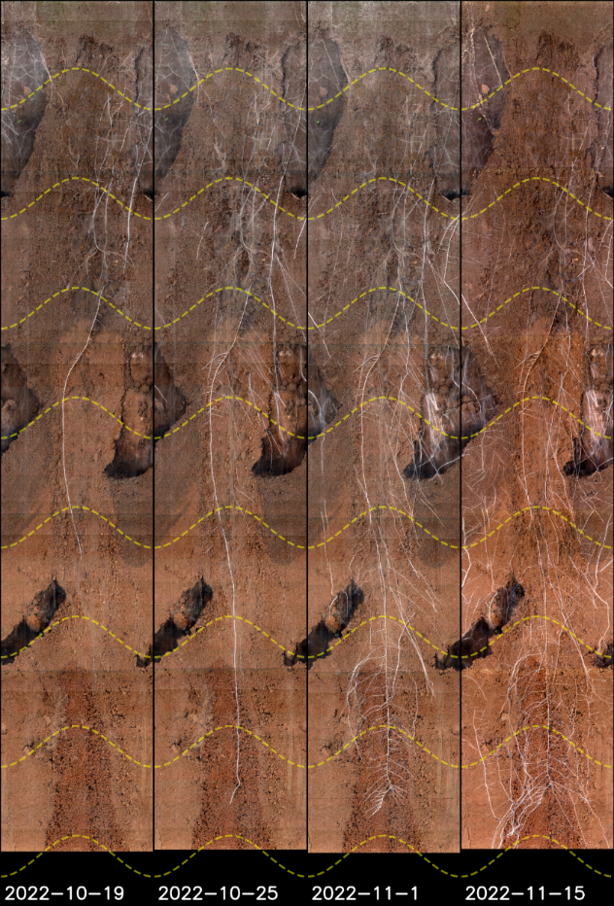
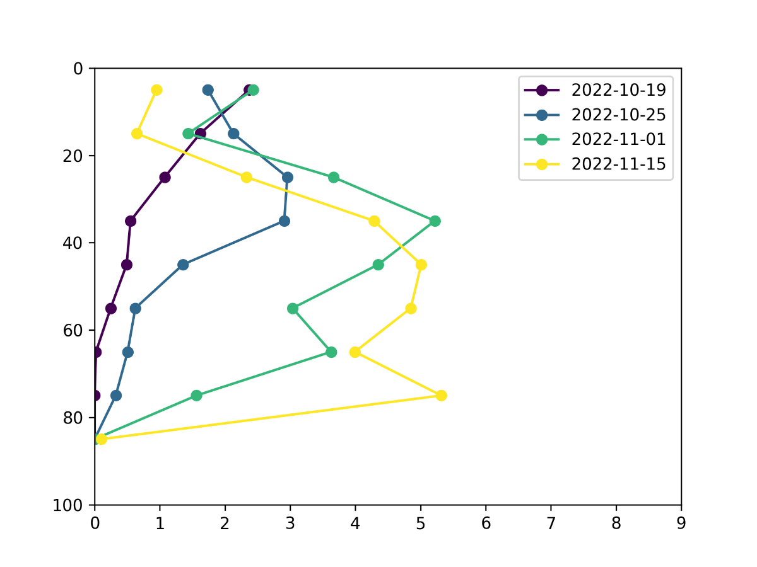
Automatic counting of „root pixels“ in 10 cm layers
0 - 10 cm
10 - 20 cm
20 - 30 cm
30 - 40 cm
40 - 50 cm
50 - 60 cm
60 - 70 cm
70 - 80 cm
Depth
[cm]
„Root pixels“ per Layer [%]

Slide 13
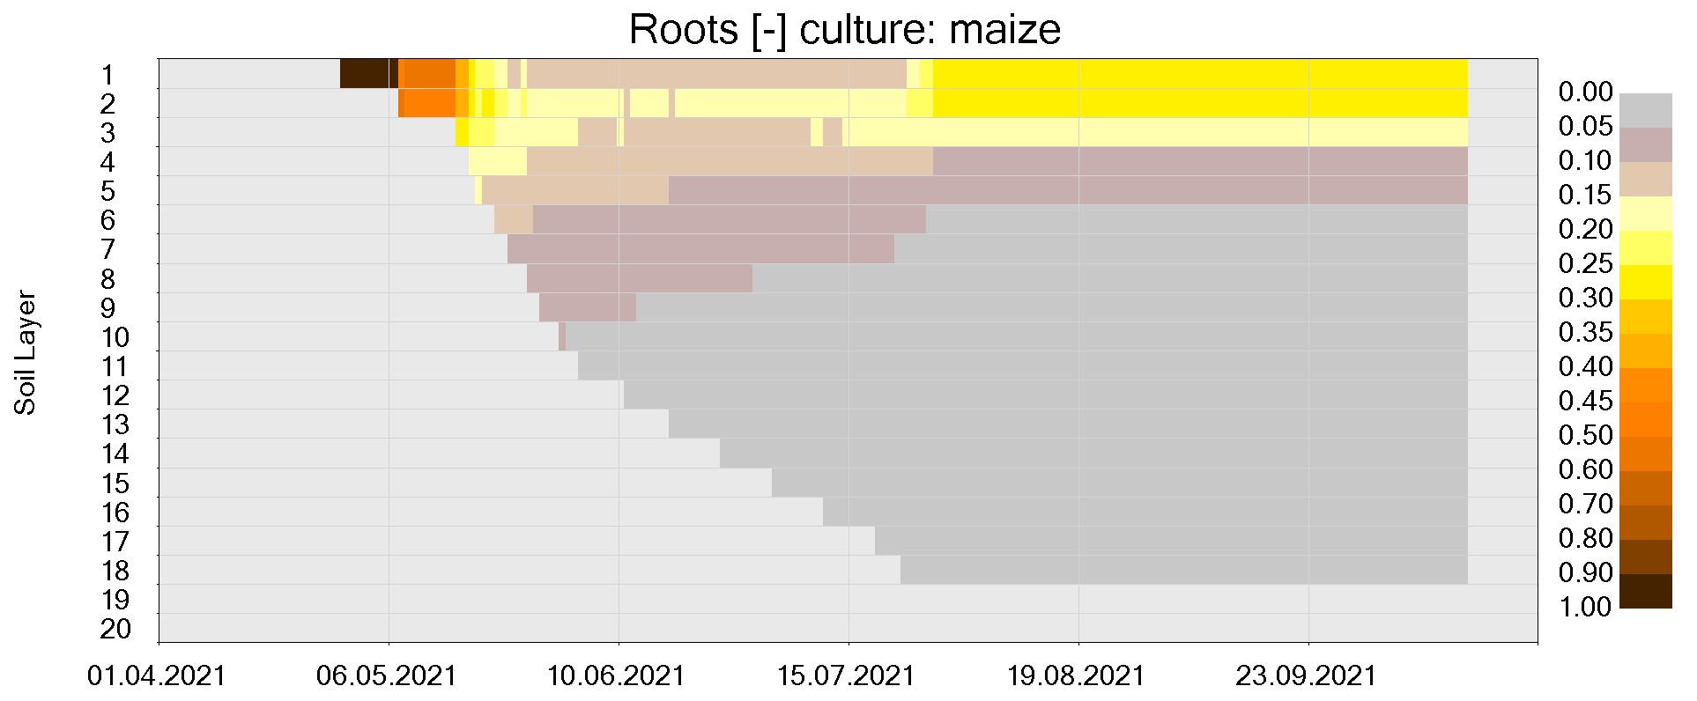
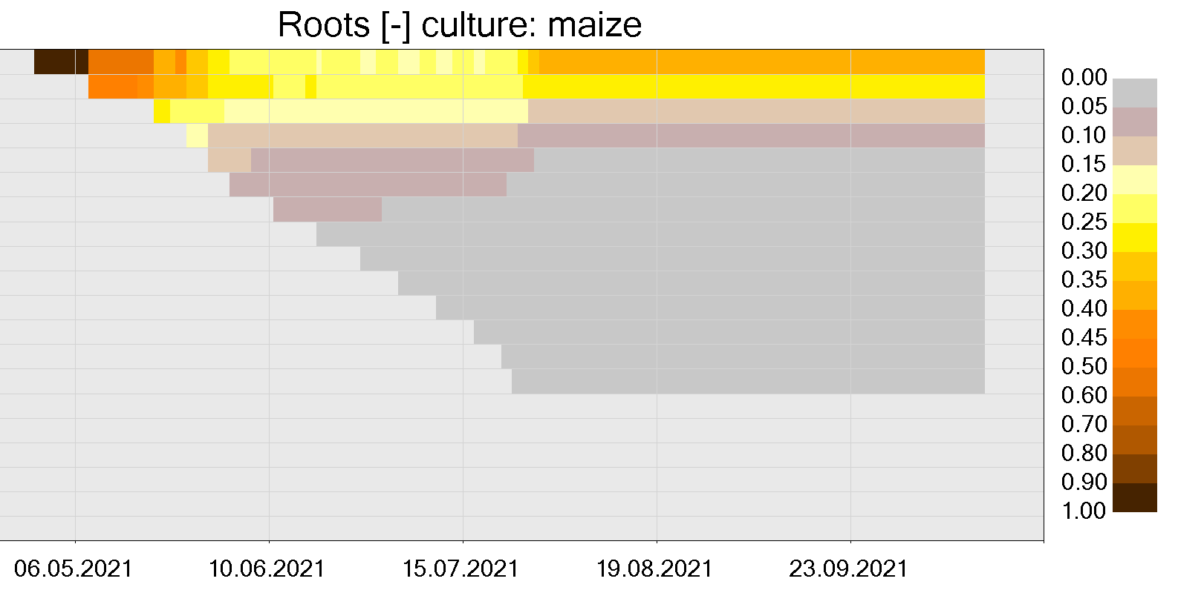
Parameter fitting (example: Maize)
  Modifying default parameters for curvature, maximum depth and corresponding phenological phase to fit the model to the observations:
R1-5
z_{max}
R1-5
z_{max}
z_{max} Nach-installation
z_{max} Nach-installation
Modelled rooting depth and distribution based on literature data (left) and fitted to field observations (right). Shaded areas indicate the maximum depth observed with mini-rhizotrons (5 repetitions).

Slide 14
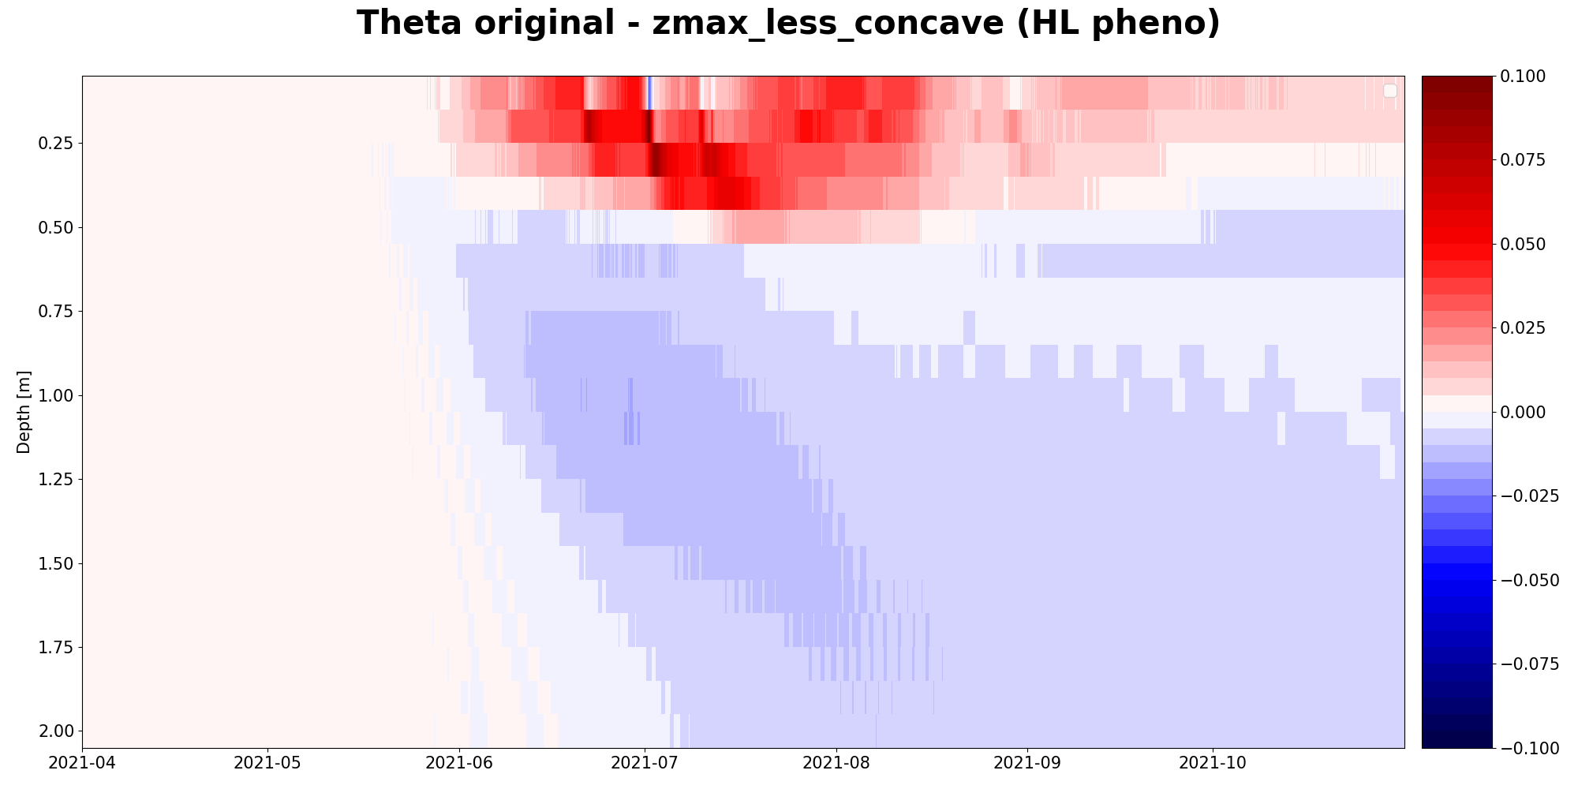
Effect on vertical soil moisture distribution
  Difference in calculated soil moisture (volumetric water content) caused by parameter fitting:
+ 10 %
– 10 %

Slide 15
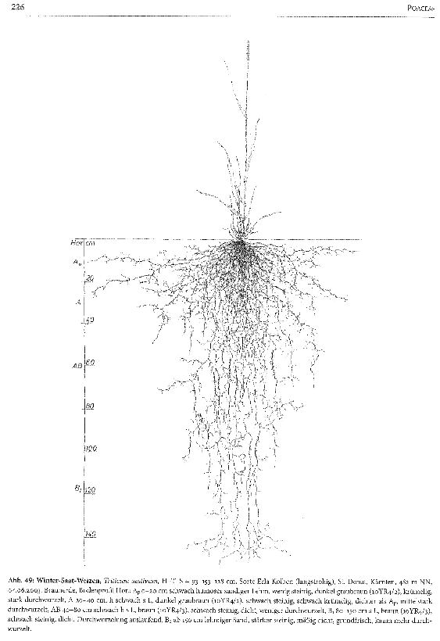
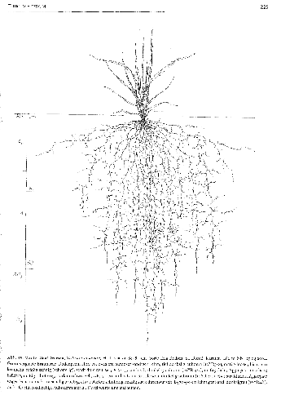
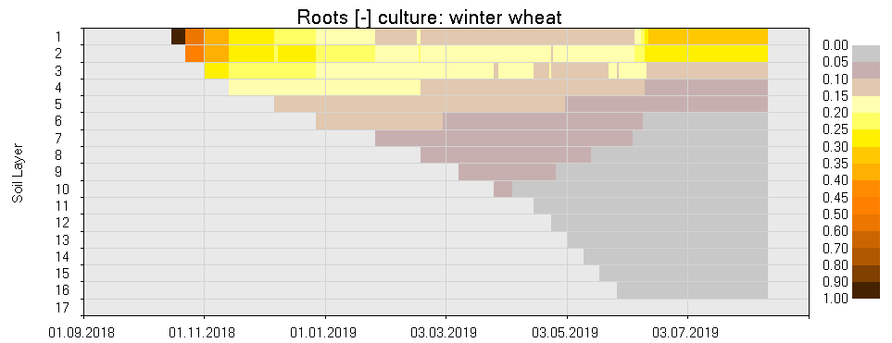
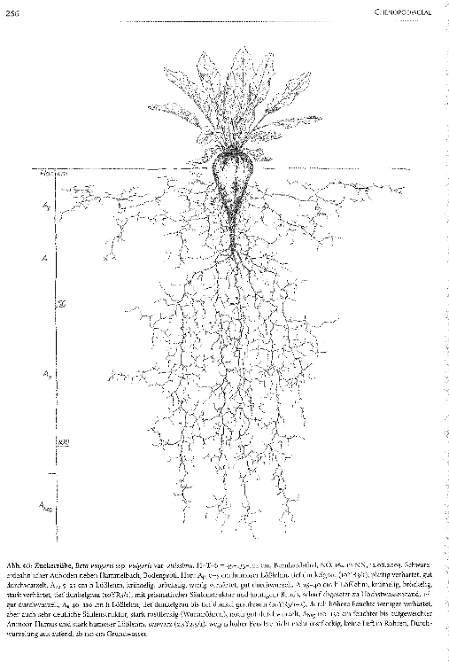
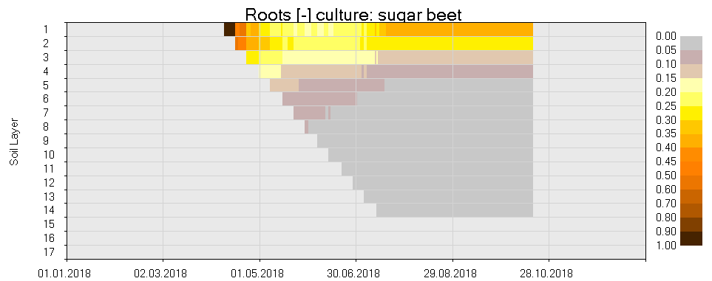
Conclusion
Rooting depth and distribution varies with plant species, soil type etc., and for croplands also with season.
We suggest that more Hydrological Observatories be equipped with rhizotrons to monitor actual rooting depth along with plant phenology.
Improved root parameterization will improve the reliability of hydrological models throughout all seasons.
Winter Wheat
Depth [dm]
NormalizedRoot
Distribution
Sep Nov
Jan Mar May Jul
Sugar Beet
Depth [dm]
Jan Mar May Jul Sep Nov

