Slide 1
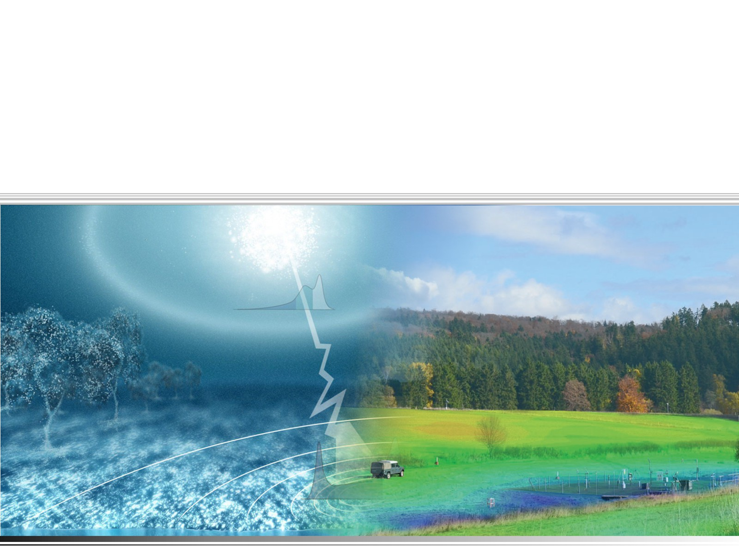


CRNS for remote sensing
soil moisture validation
GC8-Hydro Napoli
Physikalisches Institut
Ruprecht-Karls-Universität
Heidelberg
Jannis Weimar, Markus Köhli
12.06.2023

Slide 2
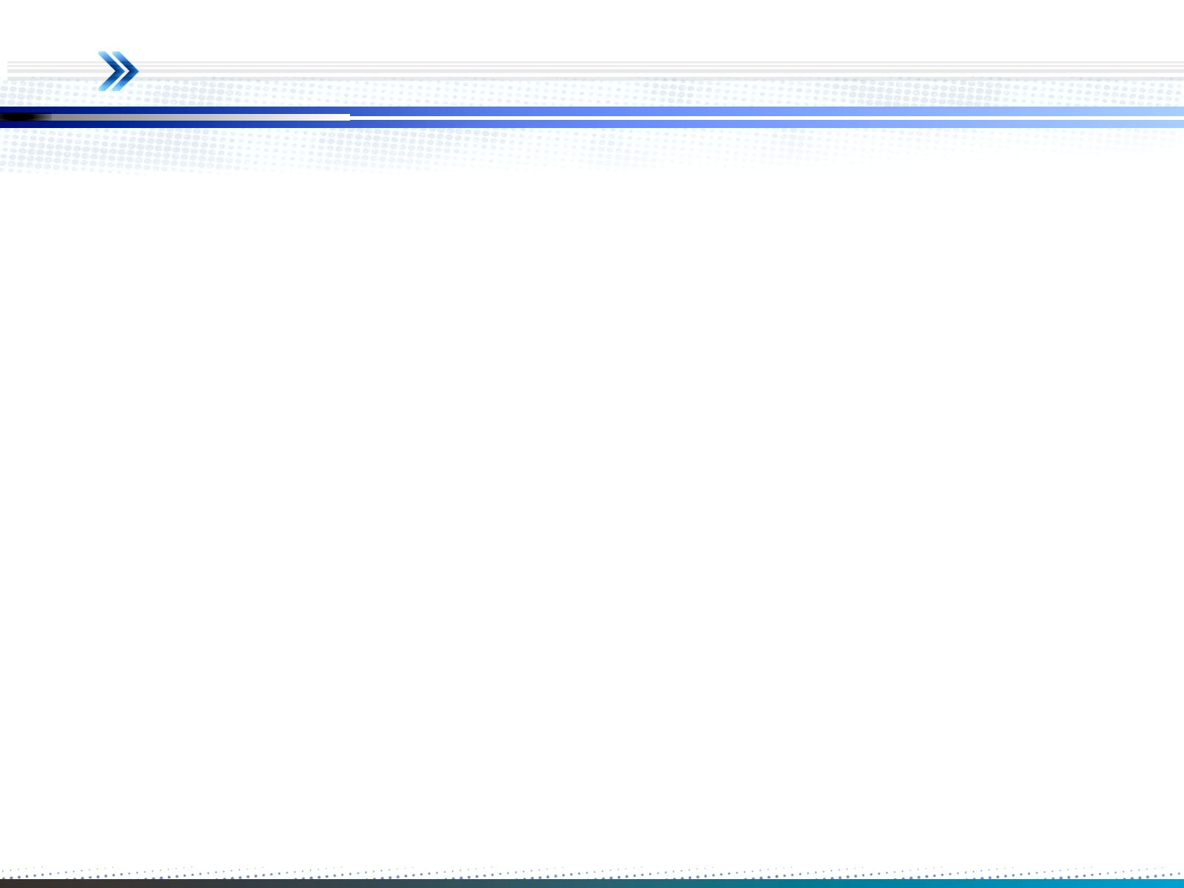
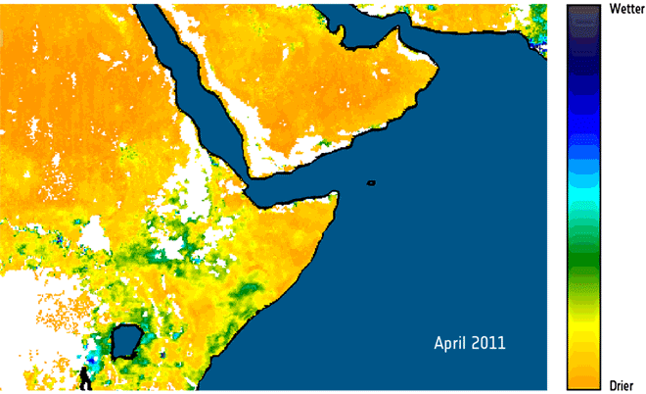
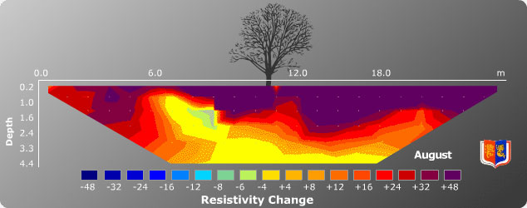
Soil Moisture Measurement Gap
via
satellite remote sensing
(optical, microwave)
> 1 km
[1]
via
local techniques
(electrical resistivity, capacitance, etc.)
< 10 m
[2]
[1] ESA SMOS (http://www.esa.int/Our_Activities/Observing_the_Earth/SMOS/Horn_of_Africa_drought_seen_from_space)
[2] The Clay Research Group (http://www.theclayresearchgroup.org/images/ert.jpg)
Notes:
2

Slide 3
Remote Sensing Upscaling
250 m upscaled
100 m upscaled
Difference between both
Wisconsin, USA
How to validate/calibrate satellite-based soil moisture measurements?
[1] J. Huang, et al. „Retrieving Heterogeneous Surface Soil Moisture at 100 m Across the Globe via Fusion of Remote Sensing and Land Surface Parameters”, Front. Water 28(2) (2020)
Notes:
3

Slide 4
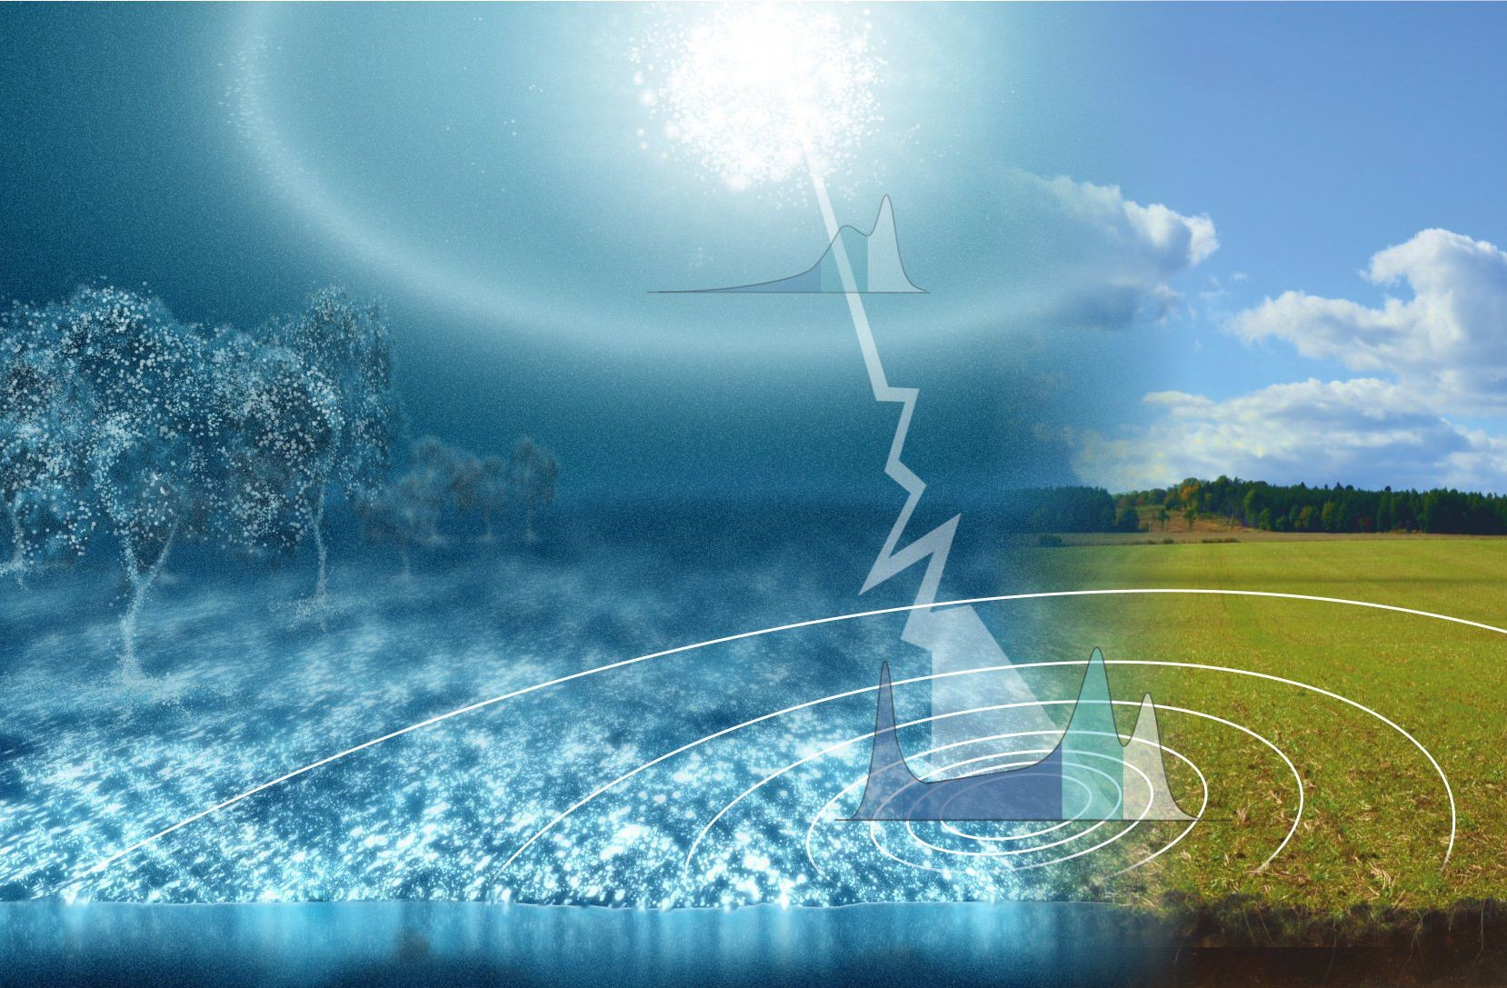
Cosmic Ray Neutron Sensing
.CRNS.

Slide 5
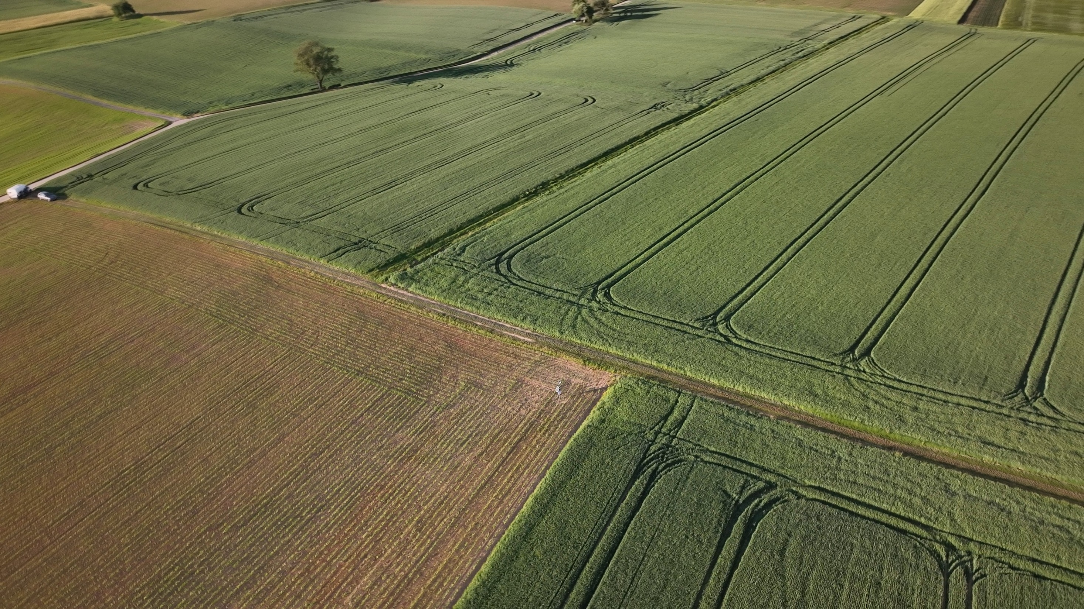
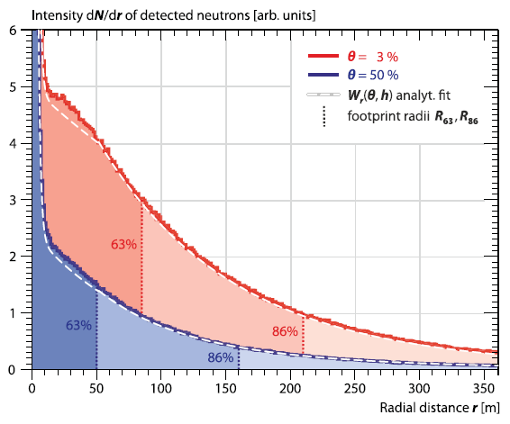
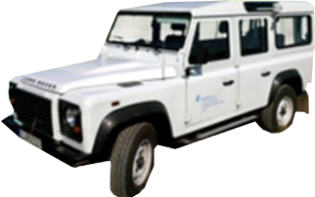
CRNS: Basics
Incoming neutron
Rock
Water
Isotropic Scattering in soil
λ = few cm
Scattering in air
λ ≈ 50 m
Detection
Notes:
5

Slide 6
CRNS: Basics
Cosmic-Ray Neutron Sensing
Only sensitive to hydrogen (soil chemistry plays a minor role)
Non-invasive, autarkic
Large support volume 10 hectare, 0.5 m deep
Can be extended by mobile measurements
Notes:
6

Slide 7
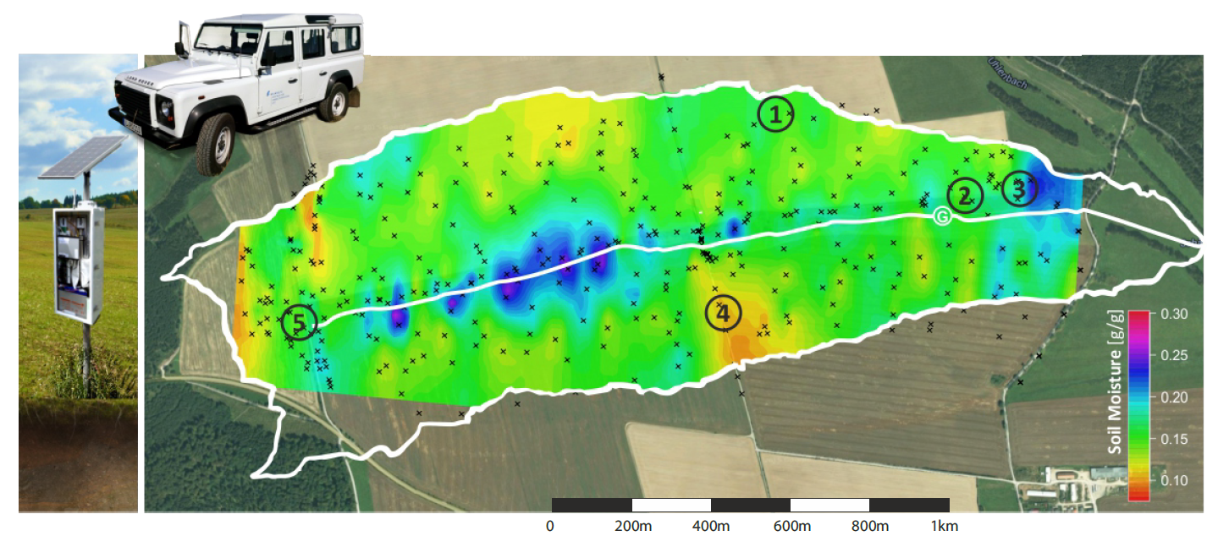
Mobile Measurements – Full Coverage
Courtesy M. Schrön, UFZ Leipzig
Notes:
7

Slide 8
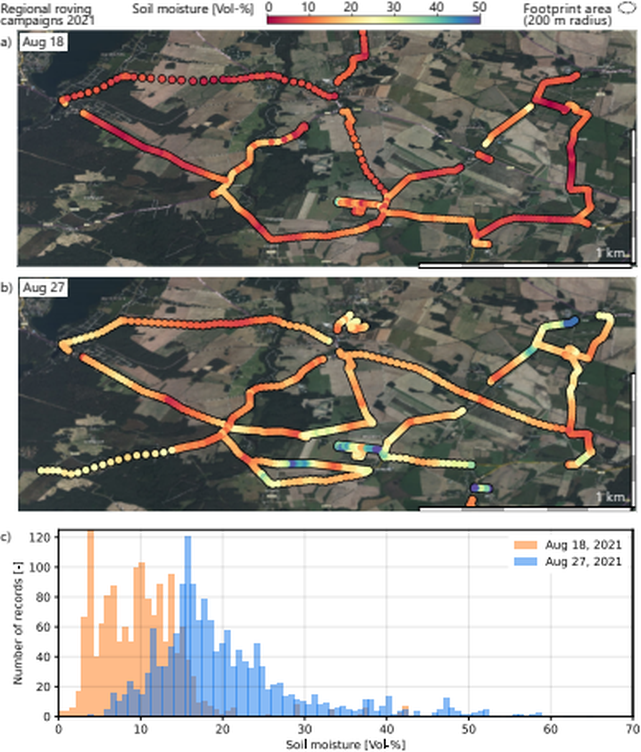
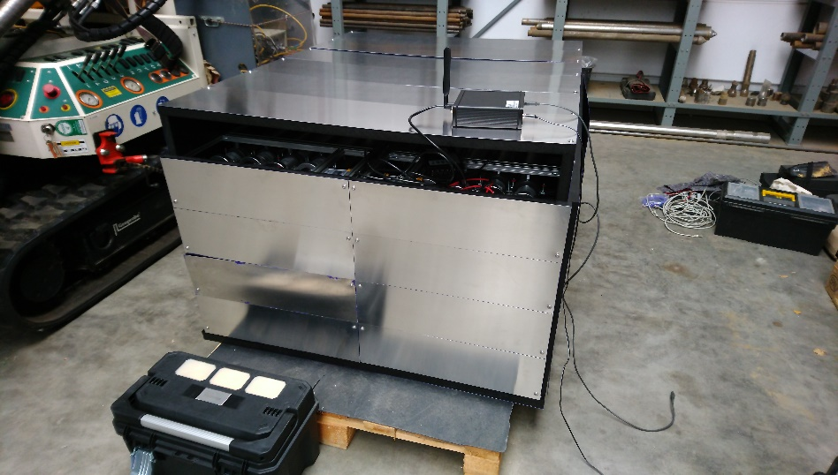
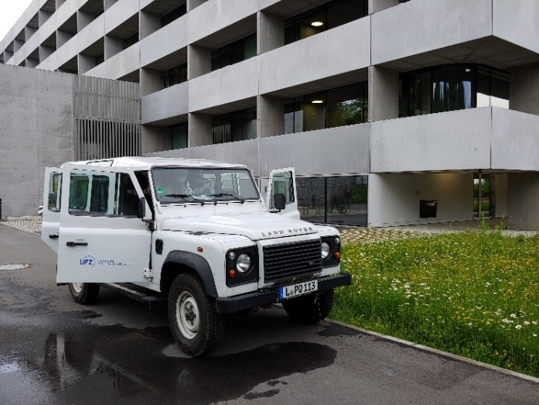
Mobile Measurements Across Scales
StyX Rover
UFZ Leipzig
Courtesy M. Schrön, UFZ Leipzig
Cooperation German Weather Service, F Beyrich, FESSTVal
Preliminary data
Notes:
8

Slide 9
Mobile Measurements
Opportunities
Large area soil moisture measurements:
  Full coverage for 1 km²/day with a resolution of 50 m
  Coarse sampling of larger areas e.g. a whole catchment
Snap-shot data for areas with no other data (e.g. ISMN) available
Challenges
Other hydrogen pools than soil moisture influence the signal (e.g. vegetation, rivers…)
Road effect
Notes:
9

Slide 10
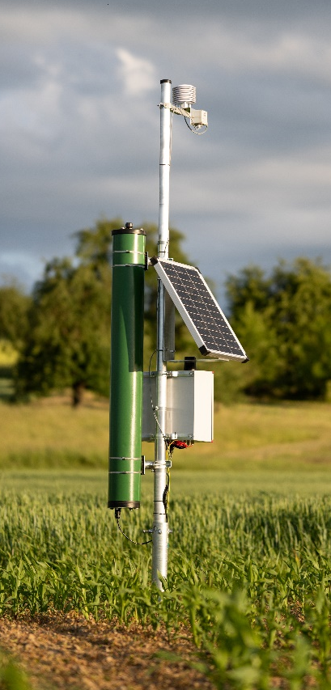
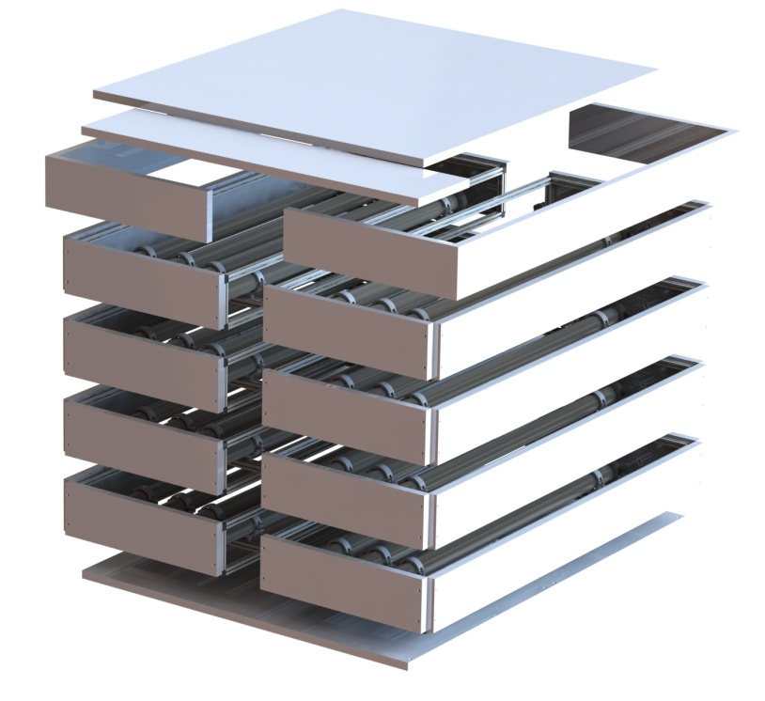

Our contribution
Neutron detectors
Neutron simulation
Notes:
10

Slide 11
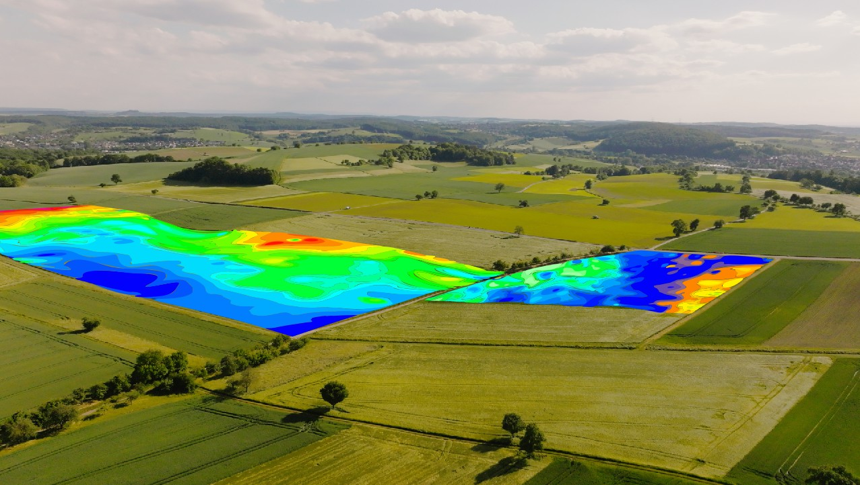
Our Offer
Use CRNS for non-invasive, large area on-demand mapping of soil moisture
Notes:
11

Slide 12
The end
Thanks for your attention
Notes:
12

Slide 13
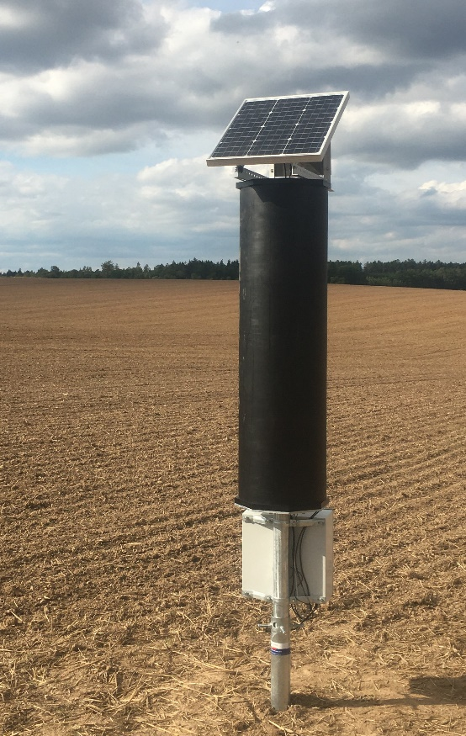
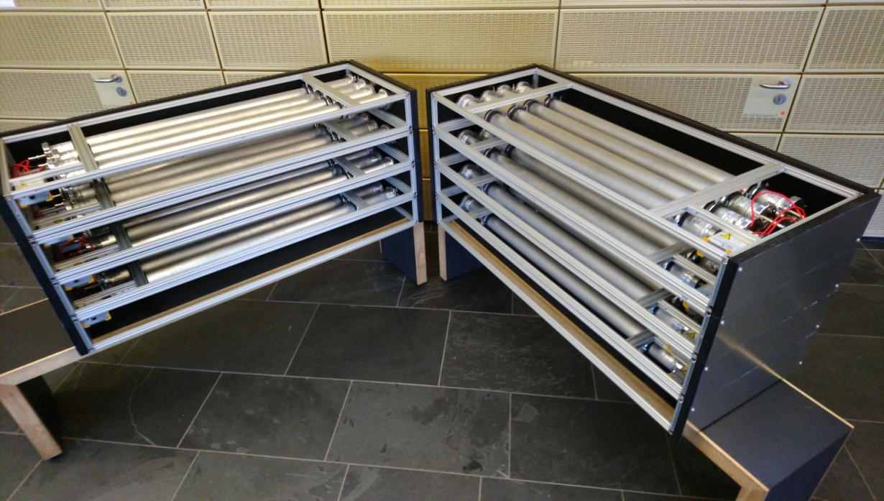
Stationary and Roving Instruments
Stationary
Roving
Notes:
13

Slide 14
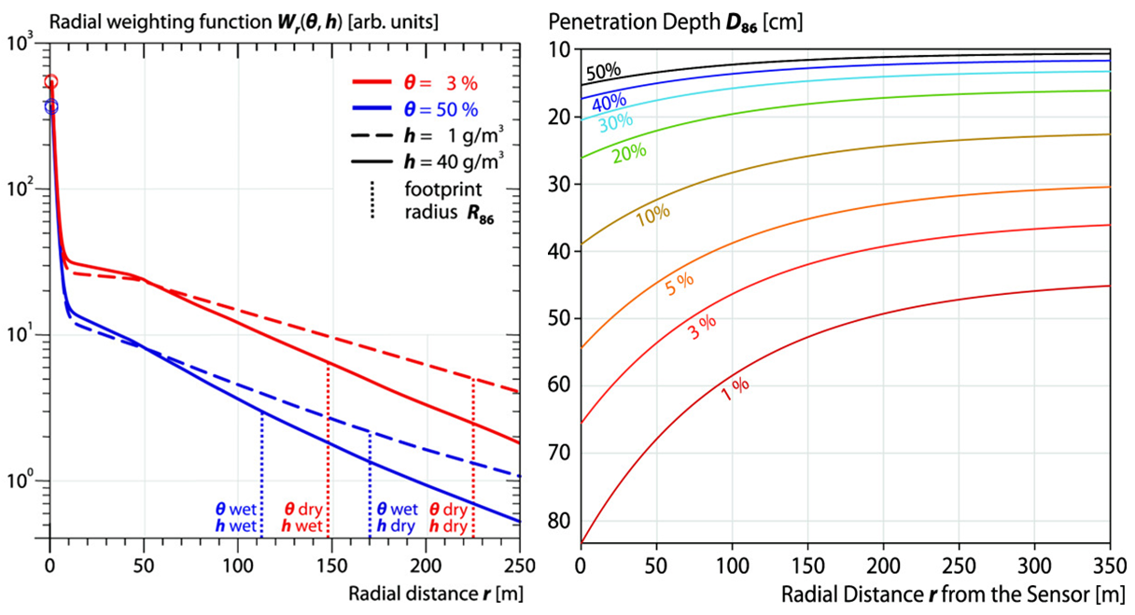
Detector Footprint
horizontal
vertical
Notes:
14

Slide 15
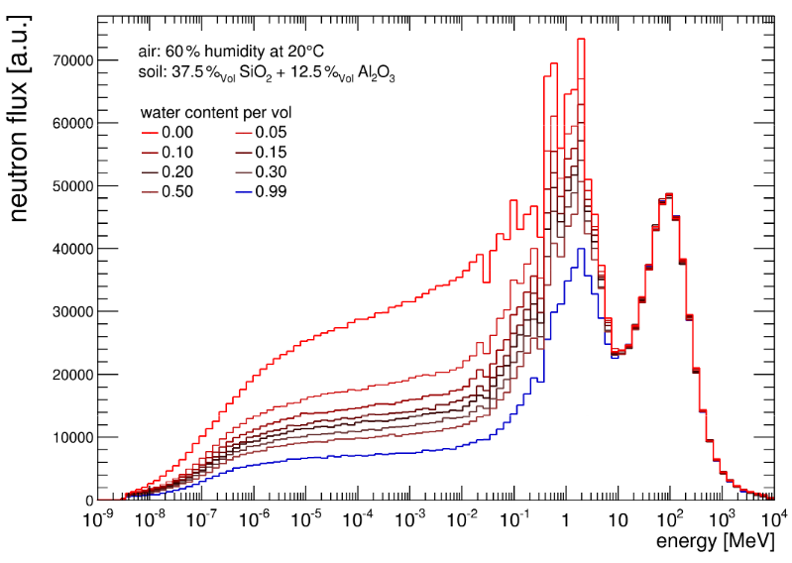
Neutron Energy spectrum
Notes:
15

