Slide 1
Galileo conference: A European vision for hydrological observations and experimentation | GC8-Hydro-53
Identification of hydrological controls of slope response to precipitation using machine learning techniques
June 2023
AUTHORS
Daniel C. Román Quintero, Pasquale Marino, Giovanni Francesco Santonastaso, and Roberto Greco
Università degli Studi della Campania "Luigi Vanvitelli", Department of Engineering, Italy (danielcamilo.romanquintero@unicampania.it)

Slide 2
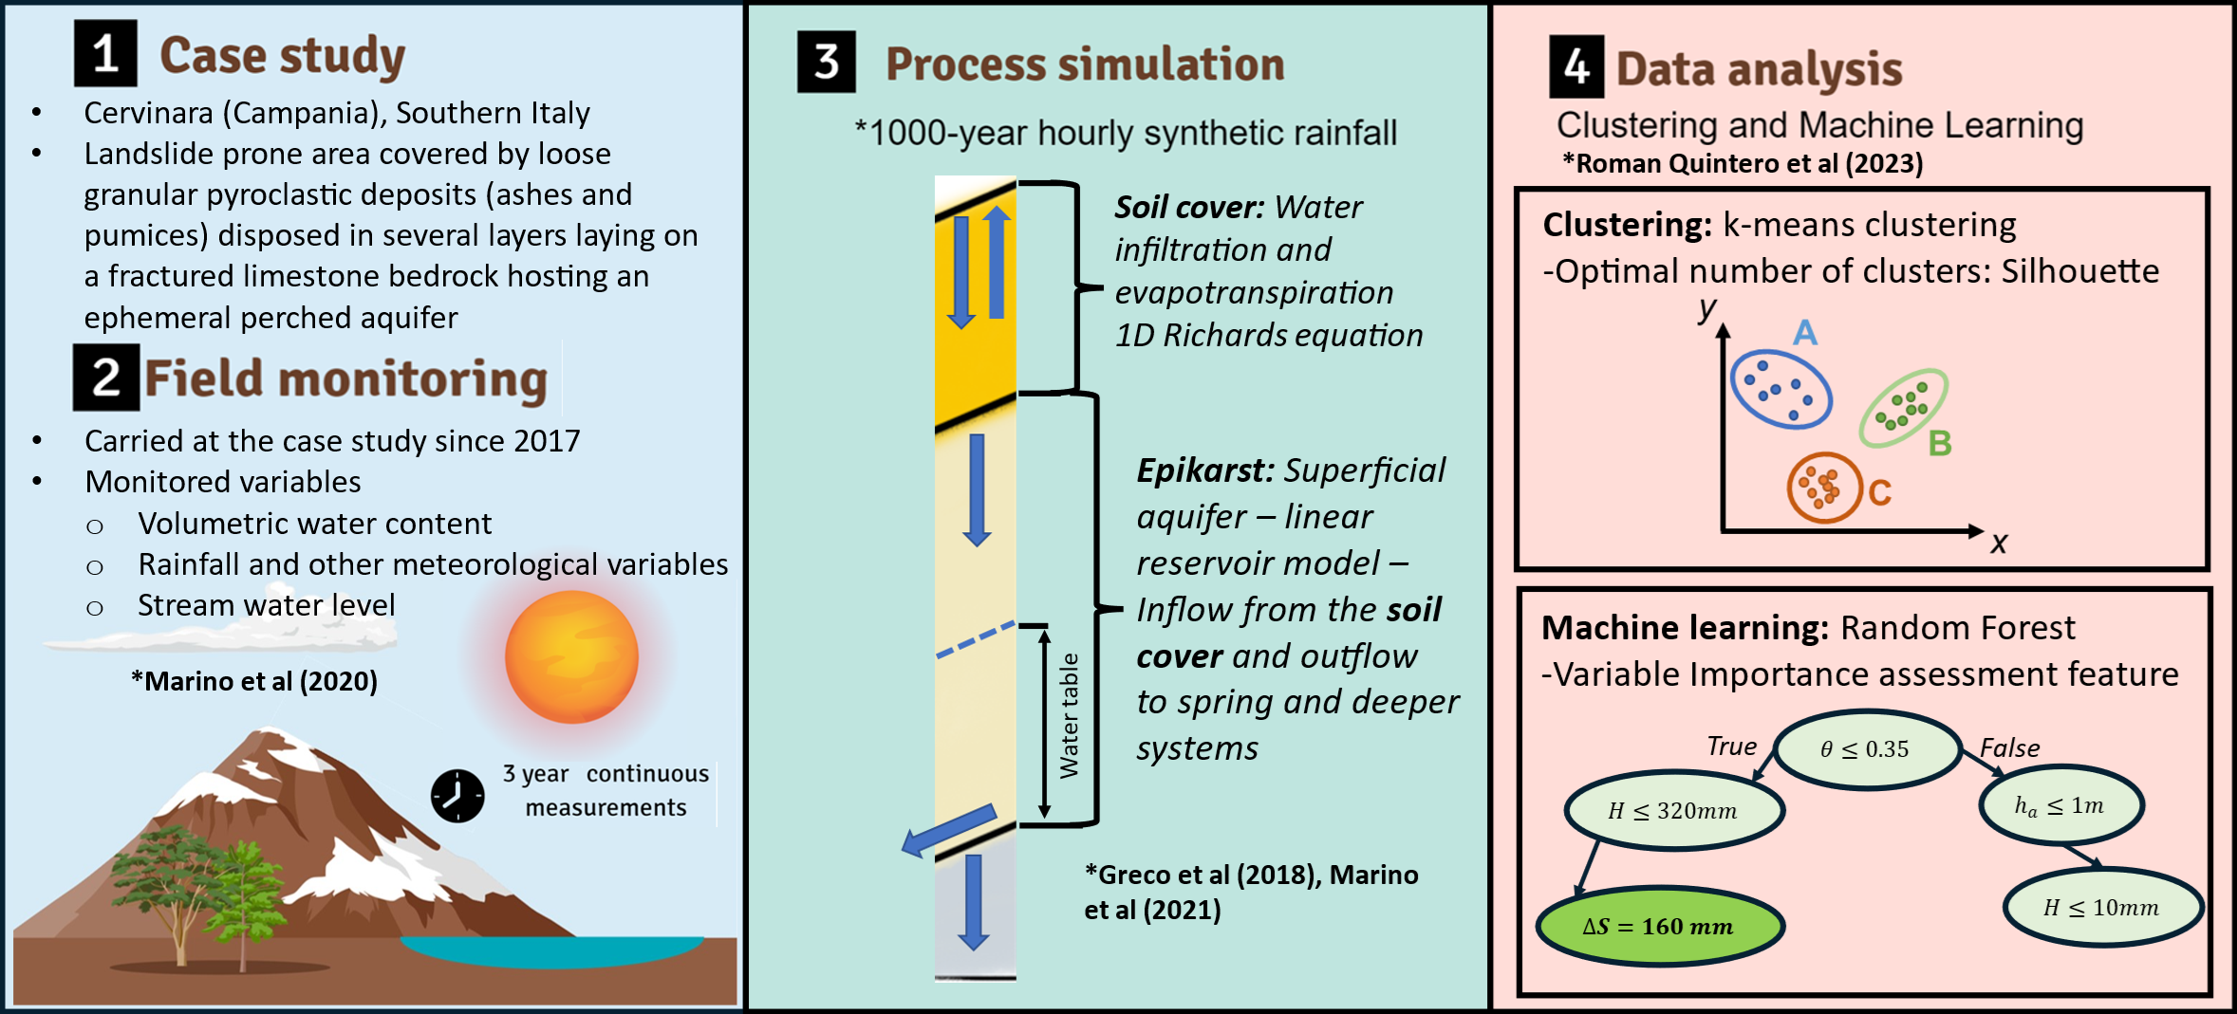
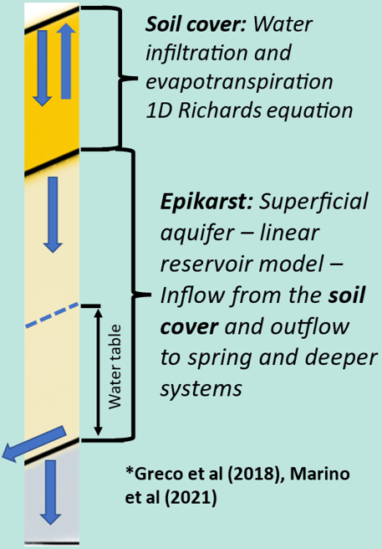
Galileo conference: A European vision for hydrological observations and experimentation | GC8-Hydro-53
01
Methodology
Synthetic data
1000-year synthetic dataset with hourly resolution
Mathematical model reproducing the hydrological behavior observed in the field
Marino et al (2020b)
Greco et al (2018), Marino et al (2020a)

Slide 3
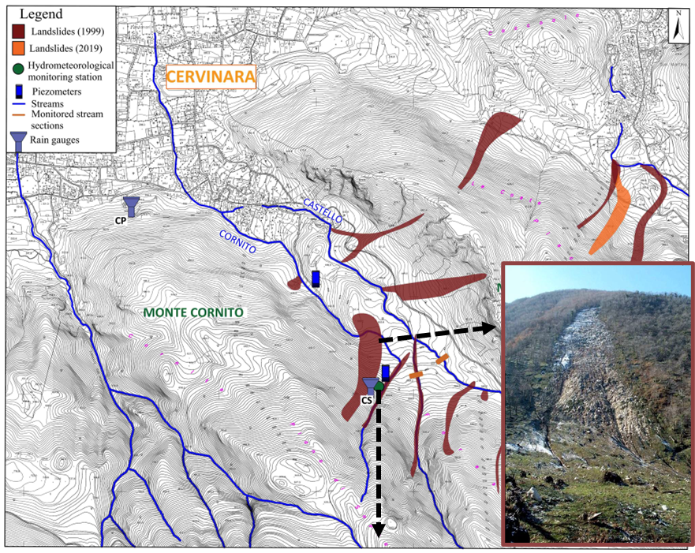
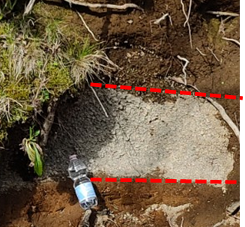
Galileo conference: A European vision for hydrological observations and experimentation | GC8-Hydro-53
02
Case study
Topsoil
Pumices
Ashes
1999
Landslide prone area
40 km away north-east Naples (southern Italy)
Wide areas with uniform geological formations:
Steep slopes covered with loose granular pyroclastic deposits
Hydrometeorological monitoring:
Rainfall and other meteorological variables
Soil moisture and suction at different depths
Piezometric and stream levels

Slide 4
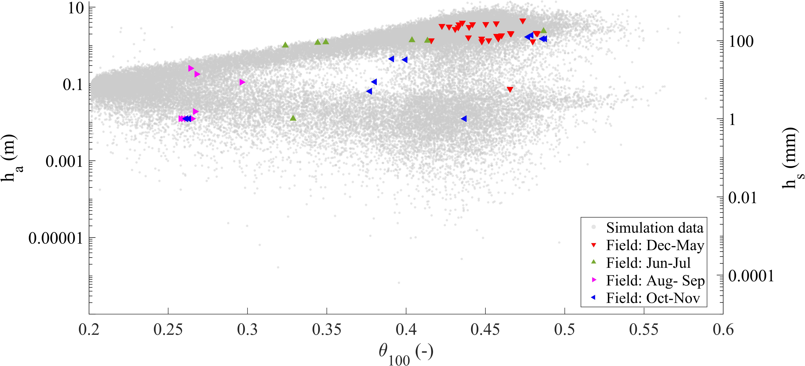
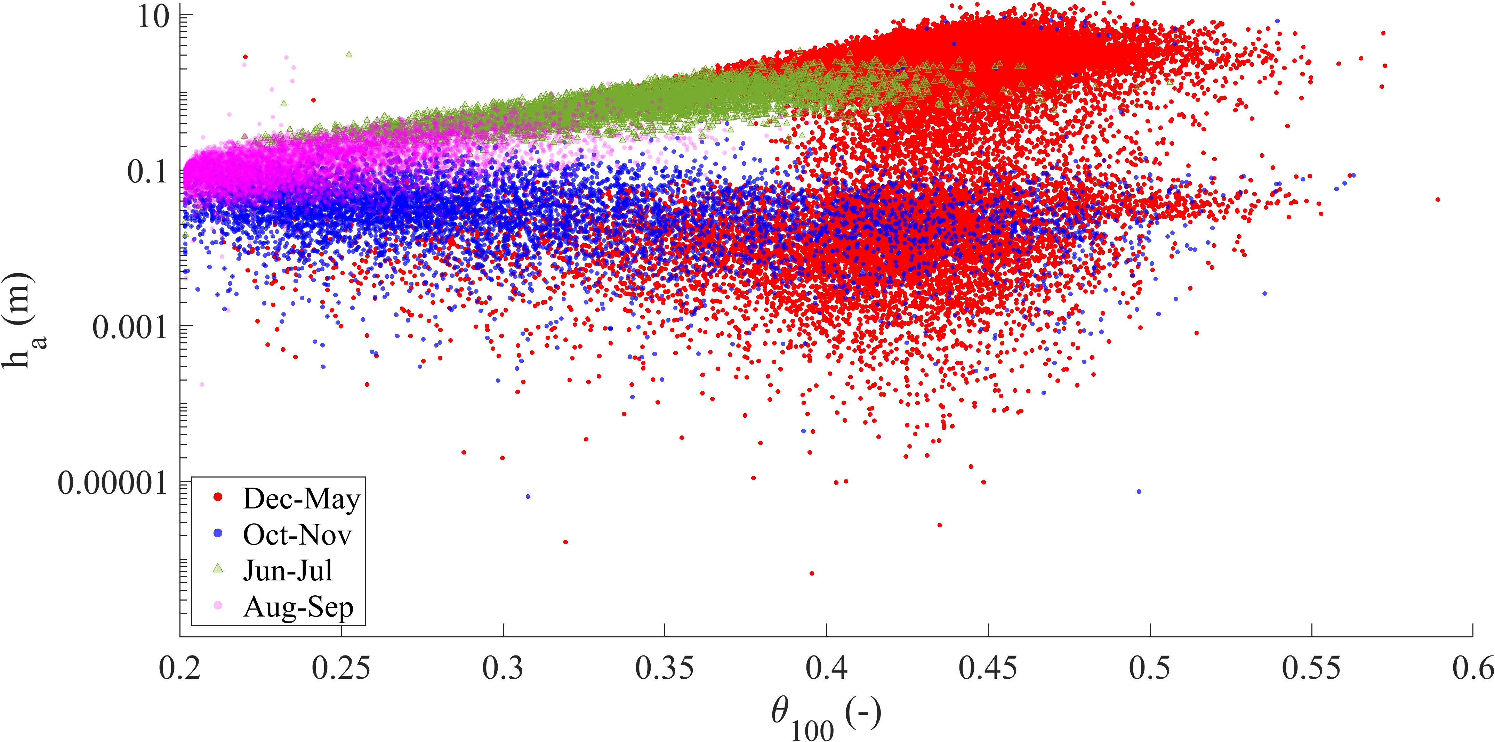
Galileo conference: A European vision for hydrological observations and experimentation | GC8-Hydro-53
03
Field monitoring and synthetic data generation
Field monitored data
Synthetic data
Antecedent conditions
$h_{s}$: Stream water level
$h_{a}$: Ground water level
$θ_{100}$: Mean volumetric water content in the first meter of soil cover

Slide 5
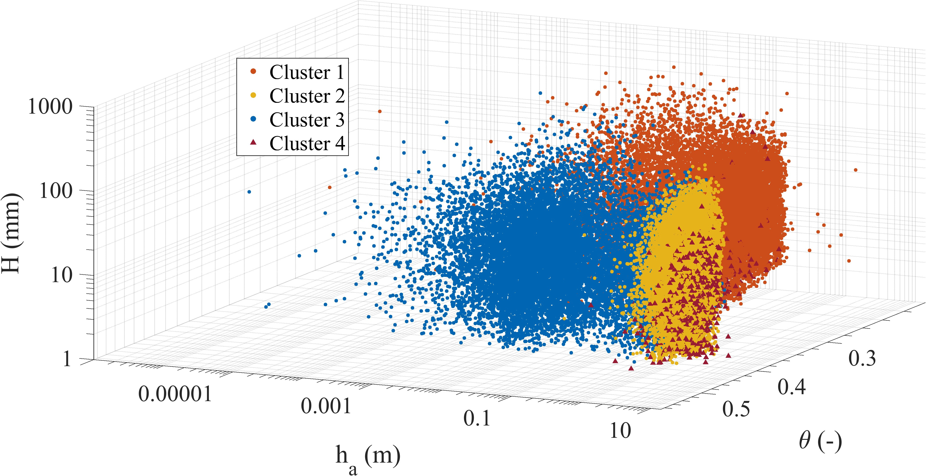
Galileo conference: A European vision for hydrological observations and experimentation | GC8-Hydro-53
04
Data analysis | Variable importance on slope response monitoring
Data clustering: $θ$, $h_{a}$, ${∆S}/{\text{H}}$
 |  | IMPORTANCE (%)
Dataset | RMSE | $$H$$ | $$θ_{6}$$ | $$θ_{100}$$ | $$h_{a}$$
$$〈{H,θ}_{6}, h_{a}〉$$ | 0.213 | 35.2 | 32.9 | - | 31.9
$$〈{H,θ}_{100}, h_{a}〉$$ | 0.197 | 29.3 | - | 40.5 | 30.2
$$〈{H,θ}_{6}, θ_{100}〉$$ | 0.203 | 34.0 | 26.1 | 39.9 | -
$$〈θ_{6}, θ_{100},h_{a}〉$$ | 0.210 | - | 29.2 | 41.4 | 29.3
Antecedent conditions
$h_{a}$: Ground water level
$θ_{6}$: Mean volumetric water content in the uppermost 6 cm of soil cover
$θ_{100}$: Mean volumetric water content in the uppermost 100 cm of soil cover
System perturbation
$H$: Cumulated water during rainfall events
Slope response
$∆S$: Change in water stored in the entire soil cover at the end of rainfall

Slide 6
Galileo conference: A European vision for hydrological observations and experimentation | GC8-Hydro-53
05
Data analysis | Slope response to precipitation
Data clustering: $θ$, $h_{a}$, ${∆S}/H$
Antecedent conditions: Ground water level ($h_{a}$) and Mean volumetric water content in the first meter of soil cover ($θ$)
System perturbation: Cumulated rainfall at any event ($H$)
Slope response: Change in water stored in the soil per total rainfall at the end of any event (${∆S}/H$)

Slide 7
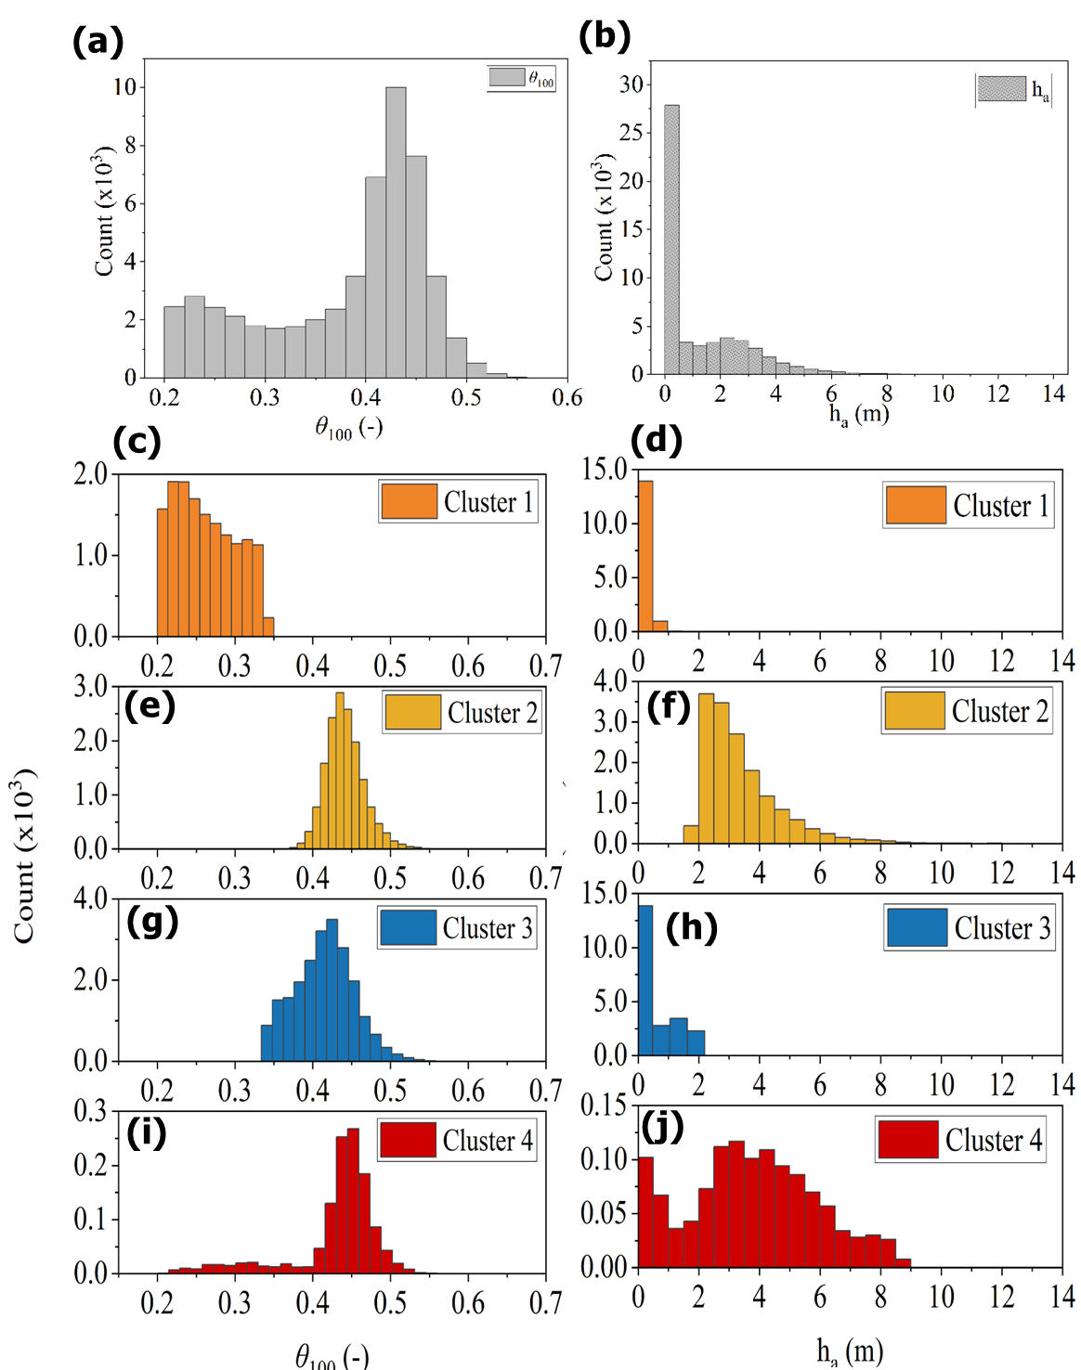
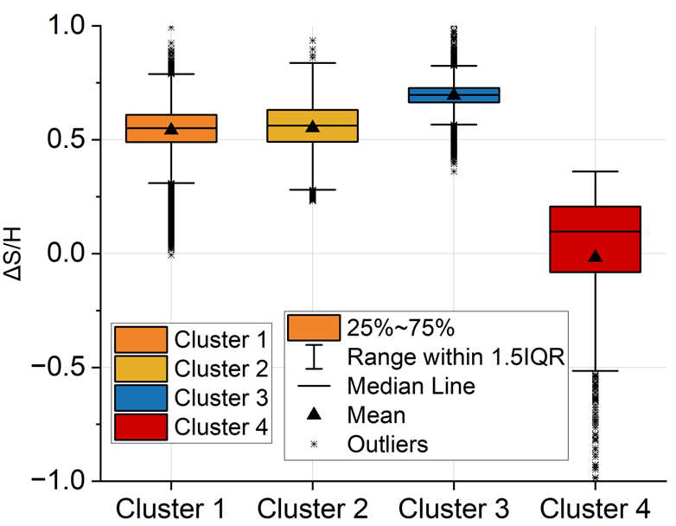
Galileo conference: A European vision for hydrological observations and experimentation | GC8-Hydro-53
06
Data analysis | Slope response to precipitation
Data clustering: $θ$, $h_{a}$, ${∆S}/{\text{H}}$
Slope response within different clusters
Antecedent conditions
$h_{a}$: Ground water level
$θ$: Mean volumetric water content in the first meter of soil cover
System perturbation
$H$: Cumulated water during rainfall events
Slope response
$∆S$: Change in water stored in the entire soil cover at the end of rainfall

Slide 8
Galileo conference: A European vision for hydrological observations and experimentation | GC8-Hydro-53
07
Conclusions
Considering the slope hydrological response as the change in water stored in the soil cover may conceal the main hydrological processes going on the slope. Thus, it is suggested to consider the amount of rainfall water being stored at the end of any event.
The hydrometeorological variables that may lead to a correct interpretation of the processes going on the slope are: The ground water level (or the water level in ephemeral streams in the field), the mean value of volumetric water content in the uppermost part of the soil cover, and the cumulated rainfall at each event.
Dry conditions typical of summer-like seasons appear when soil water content is lower than the field capacity.
When the soil antecedent conditions overcomes the field capacity two different behaviors may be considered:
Low ground water, typical of autumn and winter, indicate an impeded drainage from the soil cover to the Epikarst so all the rainfall water is being accumulated in the soil.
High ground water, typical of late winter and spring, indicate active drainage conditions from the soil cover to the Epikarst leading to less water accumulation or even effective drainage.

Slide 9
Galileo conference: A European vision for hydrological observations and experimentation | GC8-Hydro-53
08
References
Greco R, Marino P, Santonastaso GF, Damiano E (2018). Interaction between perched epikarst aquifer and unsaturated soil cover in the initiation of shallow landslides in pyroclastic soils. Water 10:948.
Marino P, Peres DJ, Cancelliere A, Greco R, Bogaard TA (2020a). Soil moisture information can improve shallow landslide forecasting using the hydrometeorological threshold approach. Landslides 17(9): 2041-2054.
Marino P, Comegna L, Damiano E, Olivares L, Greco R (2020b). Monitoring the Hydrological Balance of a Landslide-Prone Slope Covered by Pyroclastic Deposits over Limestone Fractured Bedrock. Water 12(12): 3309.
Roman Quintero DC, Marino P, Santonastaso GF, Greco R (2023). Understanding hydrologic controls of slope response to precipitations through Machine Learning analysis applied to synthetic data. EGUsphere: 1-41. DOI: 10.5194/EGUSPHERE-2022-1078.

