Slide 1
















“Estimating evapotranspiration by using canopy conductance models with Sentinel-2 data in irrigated crops in California and Australia”
Oscar R. Belfiore, William P. Kustas, D’Urso G, Kyle R. Knipper, Nicolas Bambach-Ortiz , Andrew J. McElrone, Dongryeol Ryu, Sebastian Castro, John H Prueger, Nishan Bhattarai, Lawrence E. Hipps, Joseph G. Alfieri, Maria M. Alsina, Carlo De Michele, Francesco Vuolo, Qotada Alali

Slide 2
Context
The challenge
Deriving evapotranspiration is crucial for determining the water requirements of crops and for efficiently allocating water resources for irrigation
The solution
Earth Observation (EO) is a useful tool for estimating Evapotranspiration (ET) and supporting irrigation and water resource management at different scales.
  EO-driven soil water balance models
  Thermal-based energy balance models:
                i) one source: SEBAL, SEBS, and METRIC
                ii) two source: TSEB and ALEXI/DisALEXI
  Reflectance and vegetation index based models: FAO56 approach
                i) ETo and Kc
                ii) Penman-Monteith (PM) ‘’one-step approach’’

Slide 3
Context
The challenge
Deriving evapotranspiration is crucial for determining the water requirements of crops and for efficiently allocating water resources for irrigation
The solution
Earth Observation (EO) is a useful tool for estimating Evapotranspiration (ET) and supporting irrigation and water resource management at different scales.
  EO-driven soil water balance models.
  Thermal-based energy balance models:
                i) one source: SEBAL, SEBS, and METRIC
                ii) two source: TSEB and ALEXI/DisALEXI
  Reflectance and vegetation index based models: FAO56 approach
                i) ETo and Kc
                ii) Penman-Monteith (PM) ‘’one-step approach’’
                iii) A new framework: modified Shuttleworth-Wallace (SW) model,
                incorporating SWIR observations to modulate substrate and canopy resistances.

Slide 4
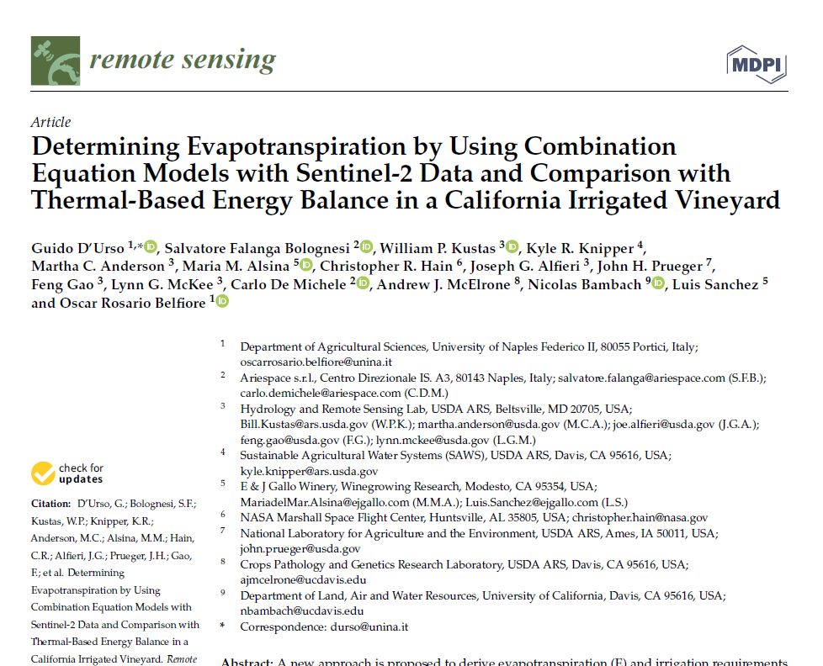
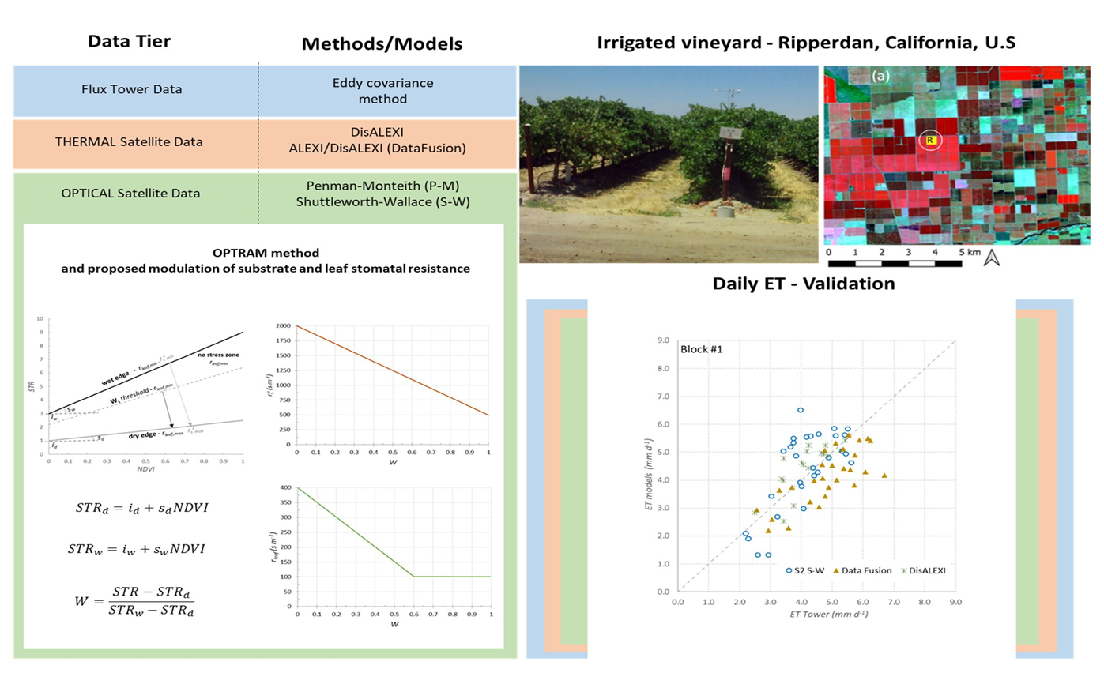
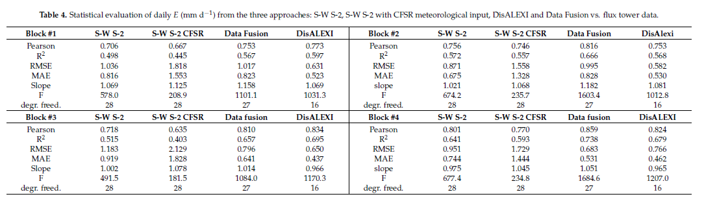
GRAPEX Campaign 2018

Slide 5

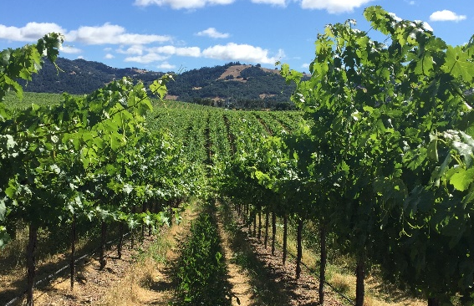
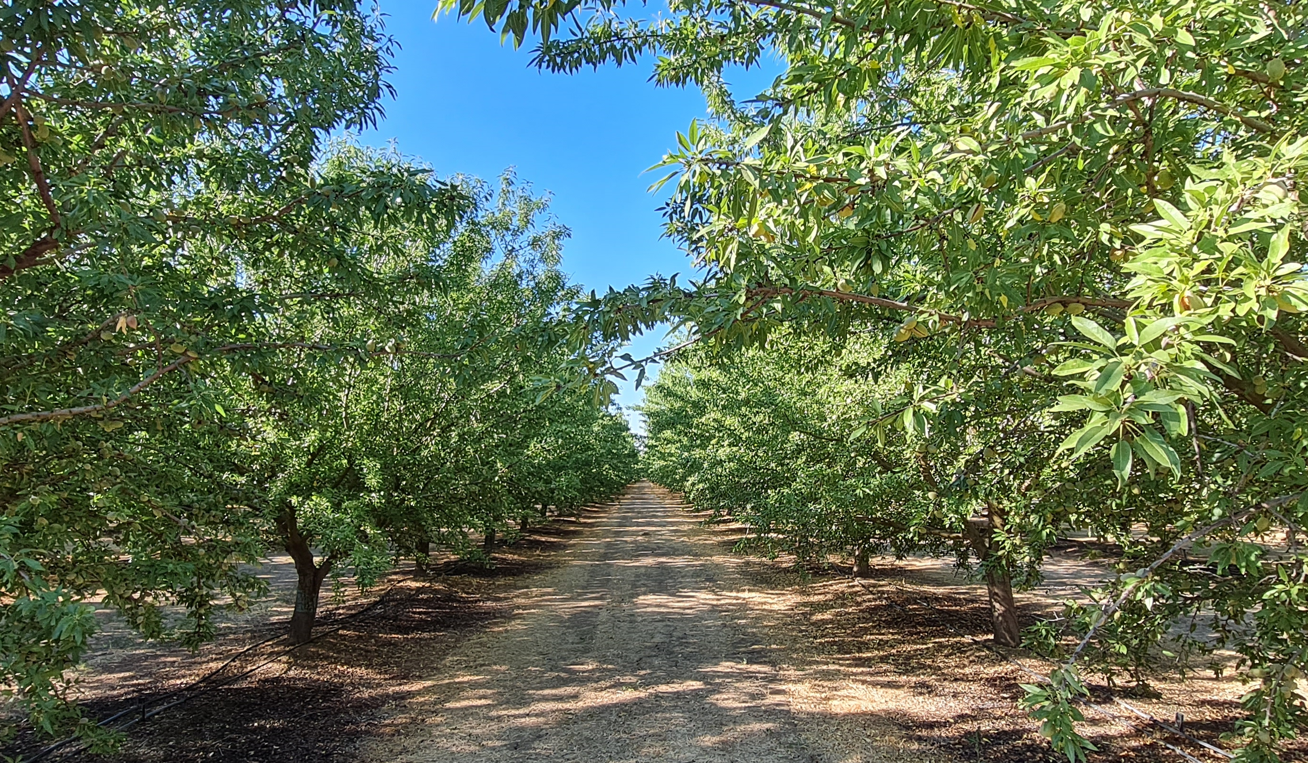
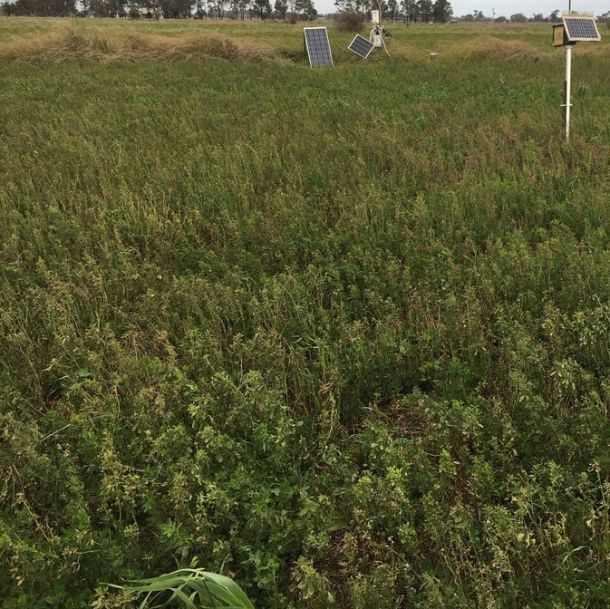
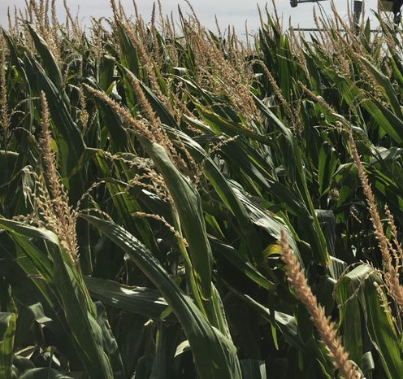

California, USA
NSW and Victoria, Australia
https://youtu.be/_YFmXaroRO8
https://www.youtube.com/watch?v=0SeoyBaDyFA

Slide 6

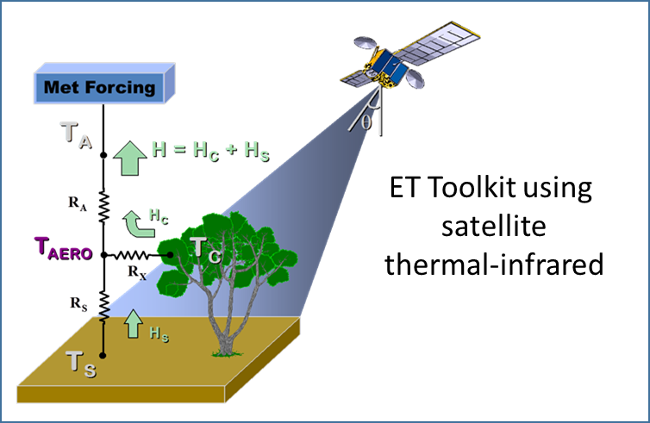
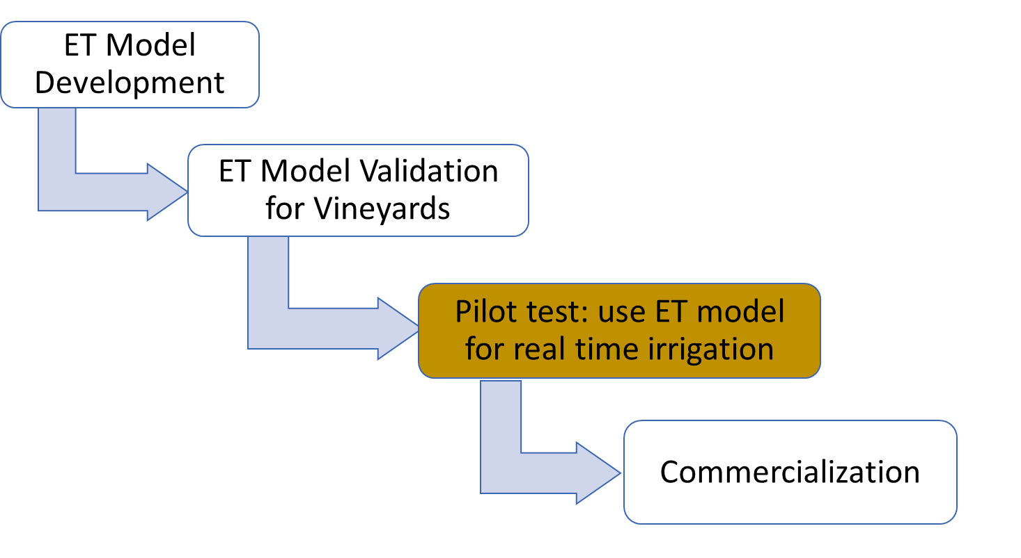
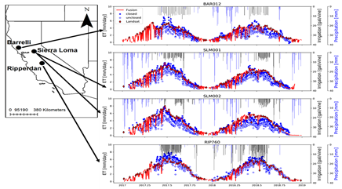
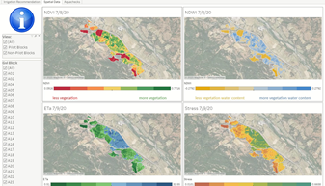
Project Goal:
A remote sensing-based toolkit for monitoring tree crops’ water use (Evapotranspiration, ET) and their water status to efficiently use and conserve water.
Irrigation Dashboard
Source: B. Kustas

Slide 7
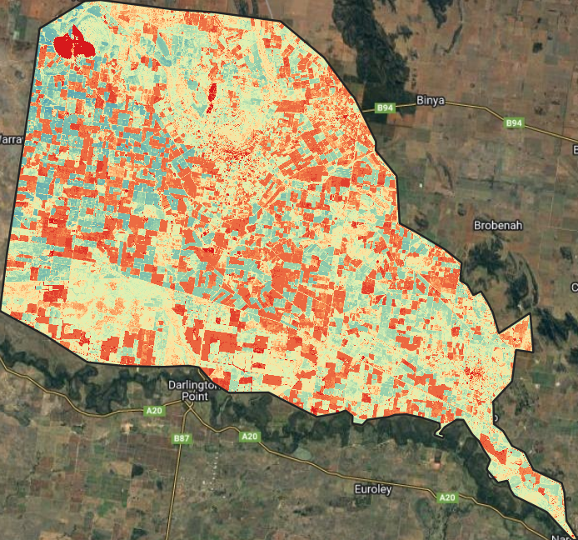
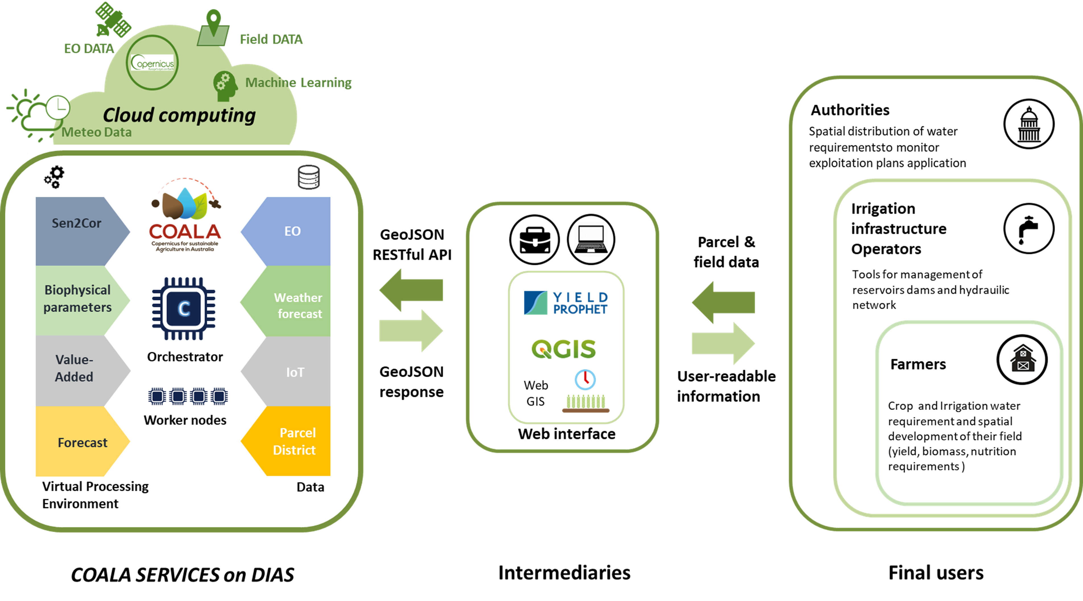
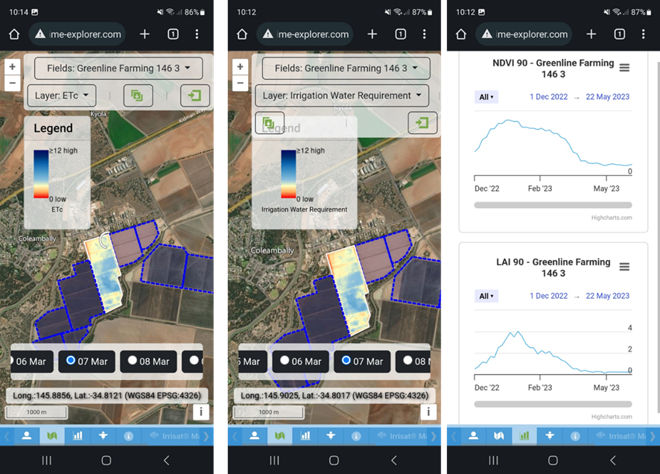
It aims to establish a sustainable supply chain for innovative EO services to improve water and nutrient management and potential yield estimation from Basin scale to farmer scale
Project Goal:
It aims to establish a sustainable supply chain for innovative EO services to improve water and nutrient management from Basin scale to farmer scale
District scale
Farm scale

Slide 8
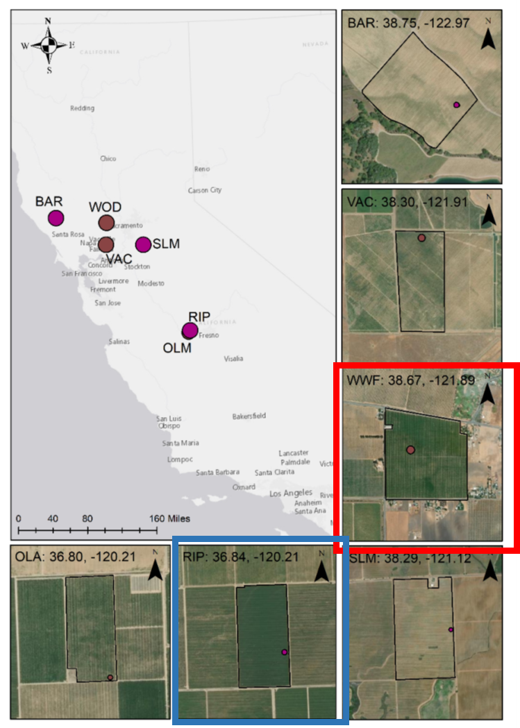
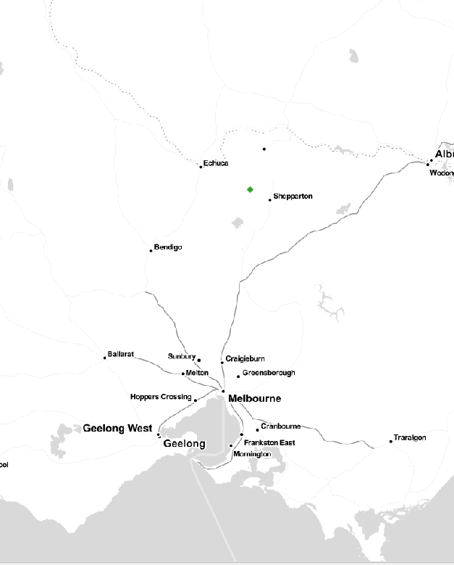
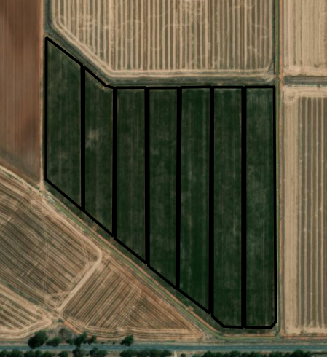
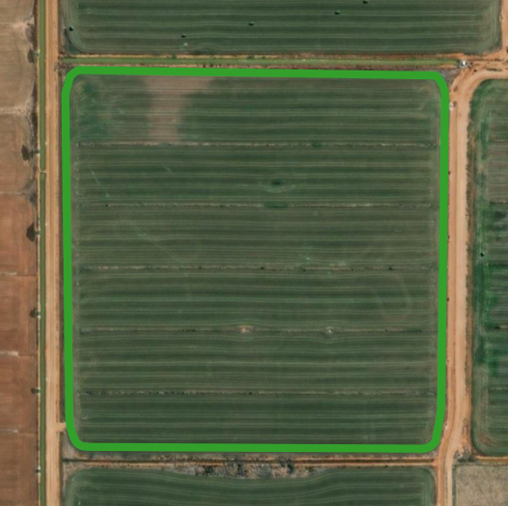

Test cases
Data Tier
Methods/Models
Flux Tower Data
Eddy covariance
method
OPTICAL Satellite Data
Penman-Monteith (PM)
Shuttleworth-Wallace (SW)
1 Irrigation season
2021-2022
2 Irrigation season
2021 and 2022
RT
RT
COALA test site
Maize
WWF
TREX test site
Almond orchard
GVC
RIP760
GRAPEX test site
Vineyard
GVC
COALA test site
Alfalfa

Slide 9
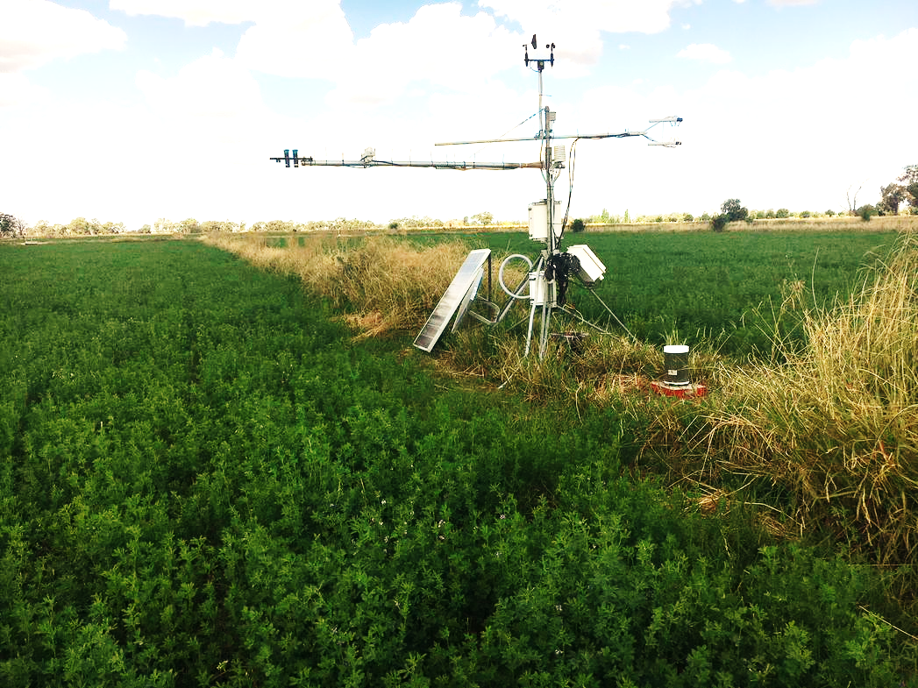
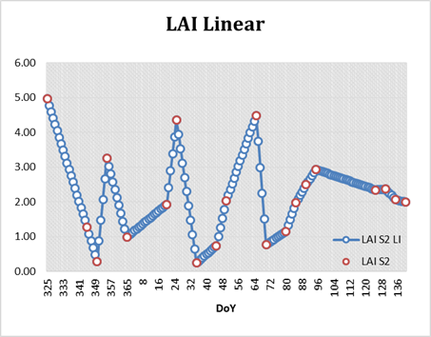

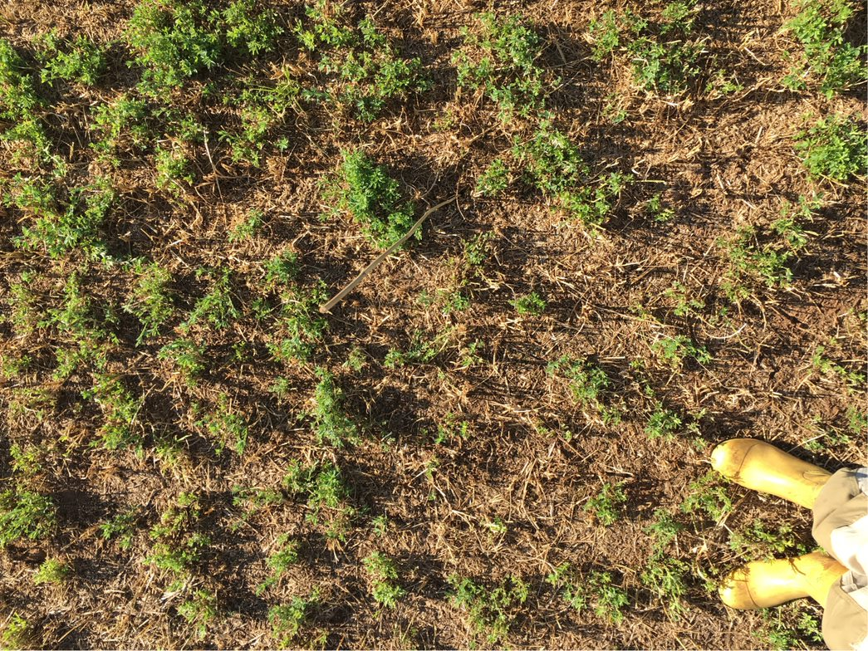

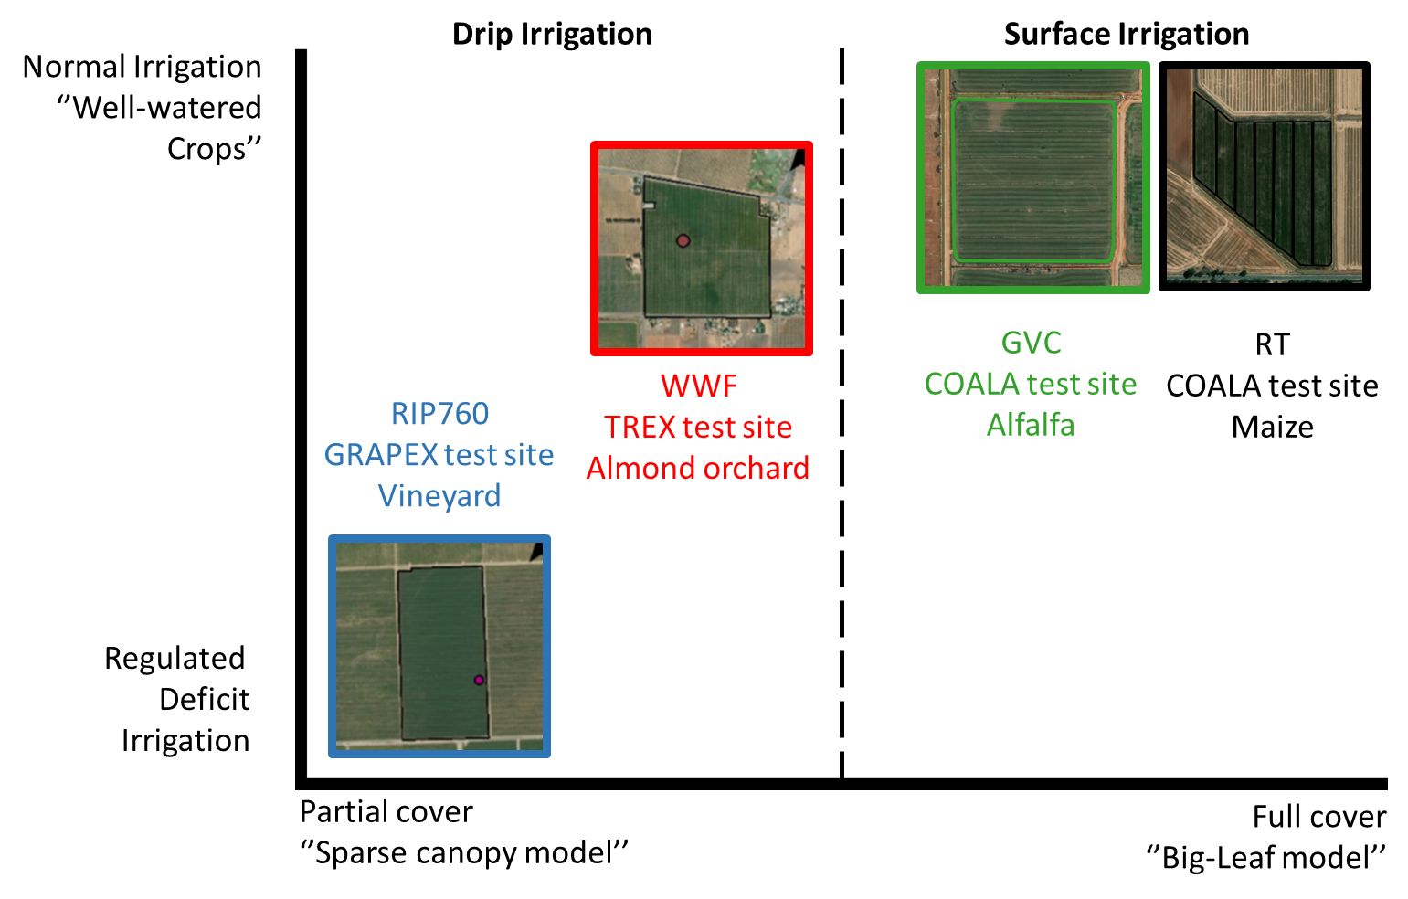
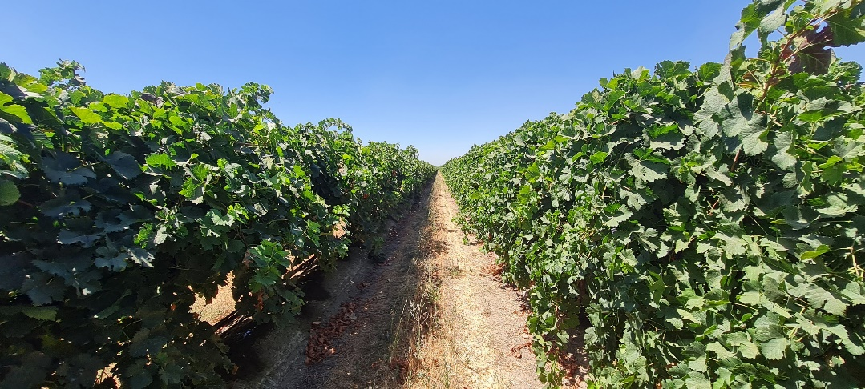
Test cases

Slide 10





Penman-Monteith (PM) ‘’one-step-approach’’
Big-Leaf model
EO Data
Crop Parameters
Meteo Data
Sentinel-2
Leaf
Resistance
Crop
Height
Surface
albedo
ET_{crop}
LAI

Slide 11
Penman-Monteith (PM) + OPTRAM
OPTRAM
model
Big-Leaf model
Relative
WC
Meteo Data
Sentinel-2
Leaf Resistance
EO Data
Crop
Height
Surface
albedo
ET_{crop}
LAI

Slide 12
Shuttleworth-Wallace (SW) + OPTRAM
Sparse-canopy model
OPTRAM
model
Relative
WC
Meteo Data
Sentinel-2
Leaf and Soil
Resistances
EO Data
Crop
Height
ET
Surface
albedo
E_{soil}
LAI
T_{crop}

Slide 13

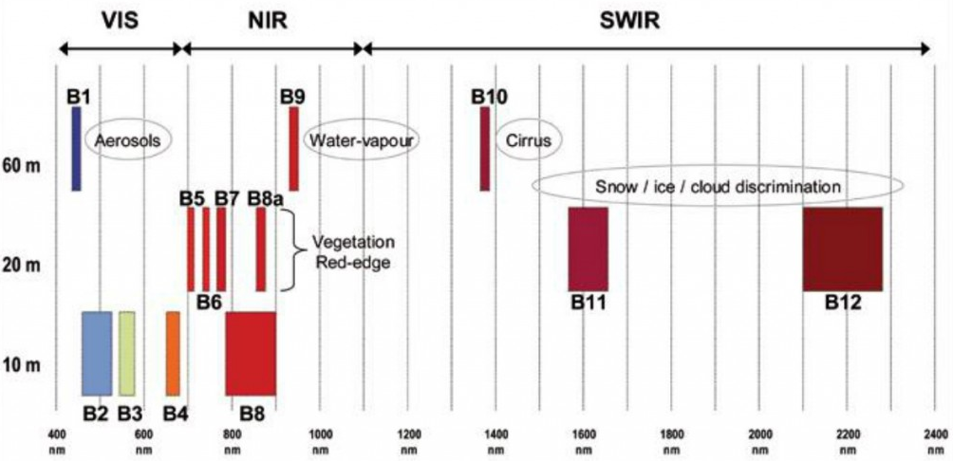
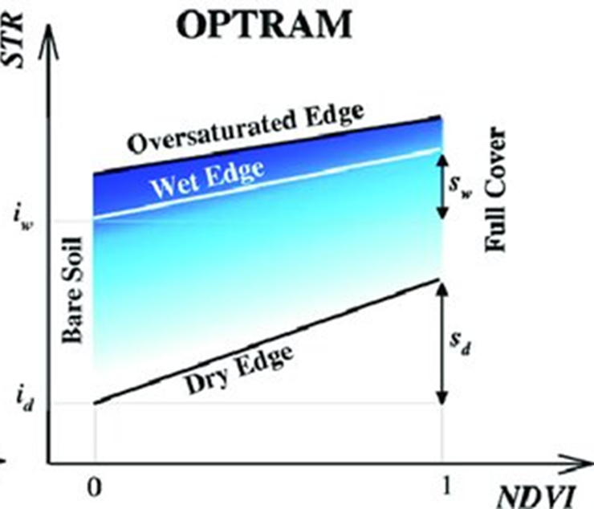

PM and SW models + OPTRAM approach
Linking Substrate and Canopy Resistance with SWIR Observations
VIS-NIR-SWIR domain
OPTRAM Background
Sentine-2 A/B
Spectral bands
Sadeghi et al (2017)*
proposed a physical “OPtical TRApezoid Model”
*Sadeghi, M., Babaeian, E., Tuller, M., Jones, S. B. (2017). The optical trapezoid model: A novel approach to remote sensing of soil moisture applied to Sentinel-2 and Landsat-8 observations. Remote sensing of environment, 198, 52-68.

Slide 14
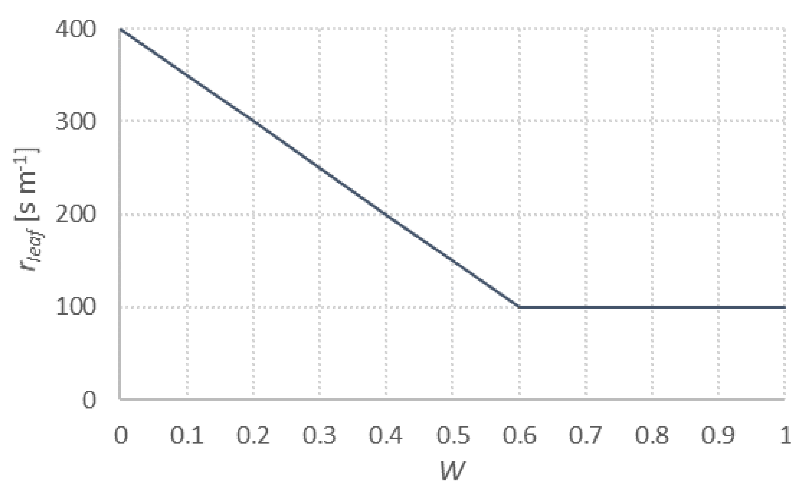
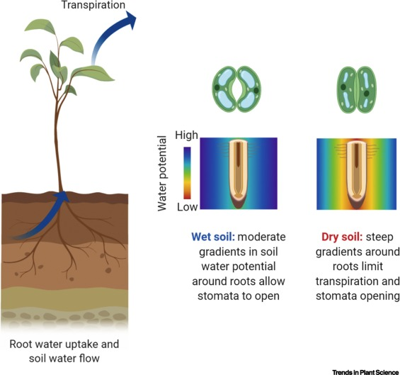
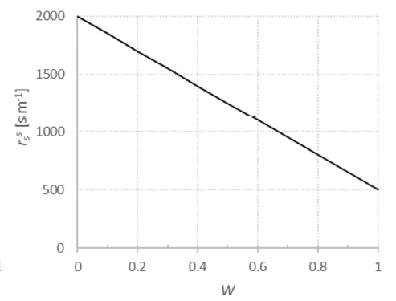


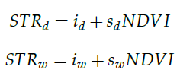
PM and SW models + OPTRAM approach
Linking Substrate and Canopy Resistance with SWIR Observations
W=1
W=0.6
W=0
Only for SW

Slide 15

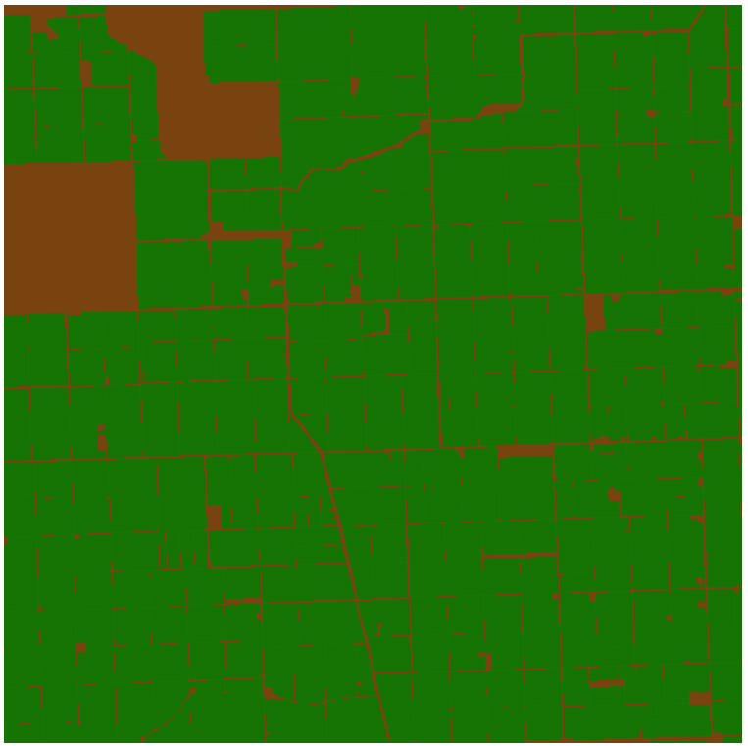
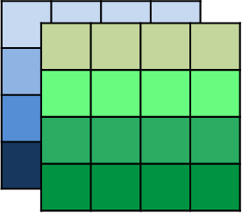
Spatial and Temporal domains - OPTRAM parametrization
Sentinel-2 images
Land cover map
STR
NDVI
Cropland

Slide 16

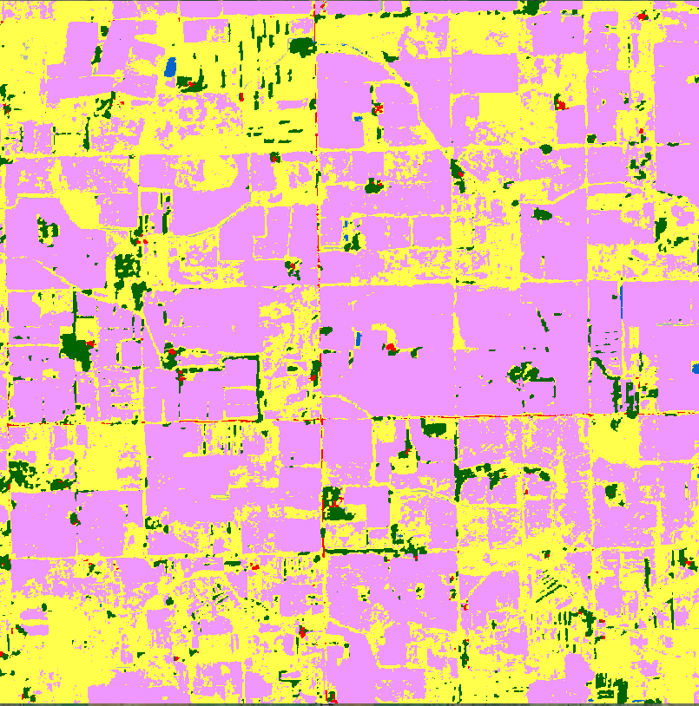
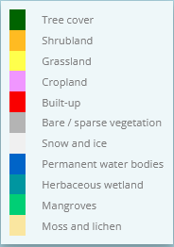
Spatial and Temporal domains - OPTRAM parametrization
Sentinel-2 images
STR
NDVI
Cropland

Slide 17

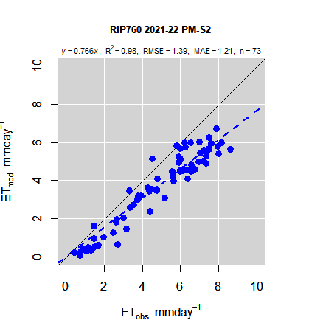
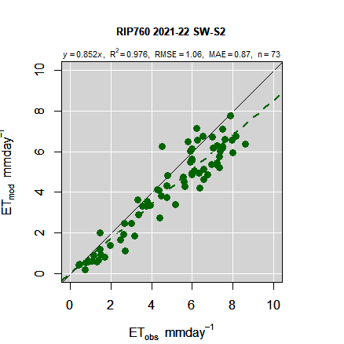
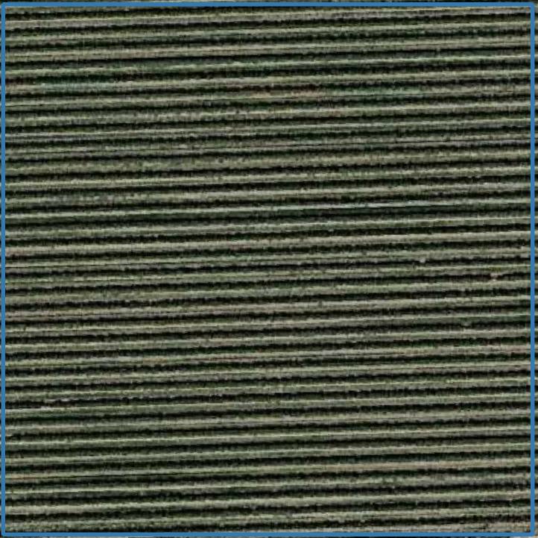
RIP760 - Vineyard
Notes:
PM & SW OPTRAM (parametrizzazione basata sull’intero areale)
GVC– Alfalfa- crop height 0.4 (standard)

Slide 18
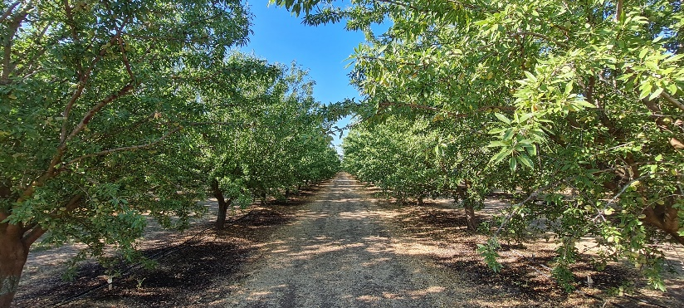
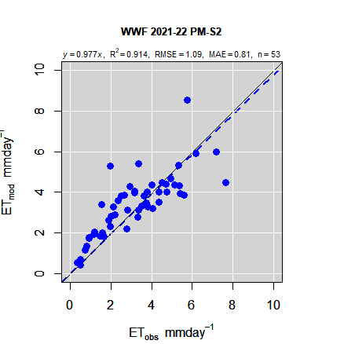
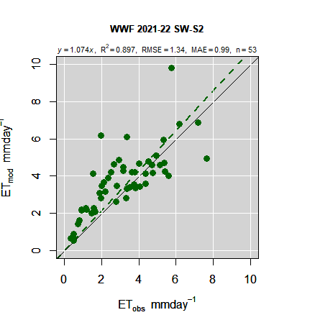
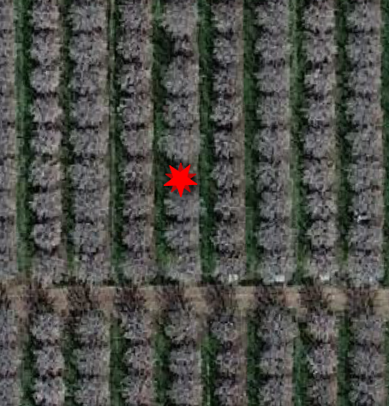
WWF – Almond orchard
Notes:
PM & SW OPTRAM (parametrizzazione basata sull’intero areale)
GVC– Alfalfa- crop height 0.4 (standard)

Slide 19
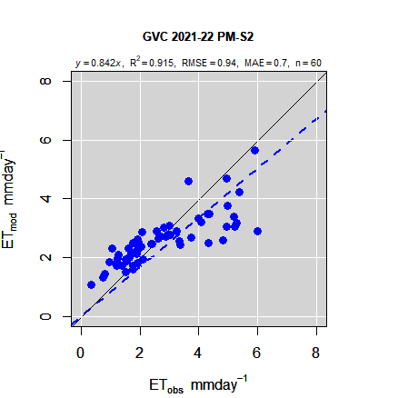
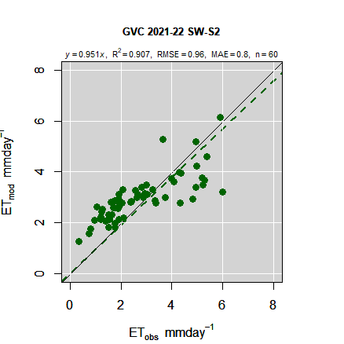
GVC Alfalfa
Notes:
PM & SW OPTRAM (parametrizzazione basata sull’intero areale)
Ray Thornton – Maize- crop height 0.4 (standard)*

Slide 20
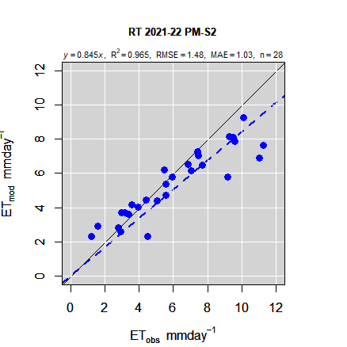
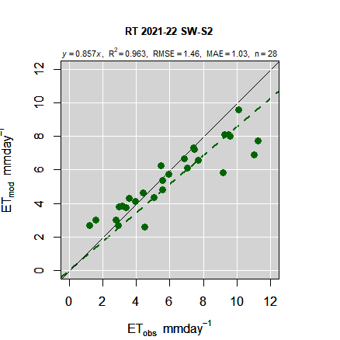
RT - Maize
Notes:
PM & SW OPTRAM (parametrizzazione basata sull’intero areale)
Ray Thornton – Maize- crop height 0.4 (standard)*

Slide 21
Conclusions
The PM and SW models confirm their reliability for the estimation of ET for irrigated crops.
The PM and SW models seem sensitive to the different ground cover conditions.
The PM ~ SW in full canopy conditions.
Further developments
(ongoing tasks)
Improve the E & T partitioning for SW model:
  Sensitivity analysis of OPTRAM model in resistances modulation.
  Comparison with E&T terms derived from Thermal-based models (i.e. TSEB)
Integration of SW and DisALEXI frameworks for the production of daily ET maps in real-time

Slide 22
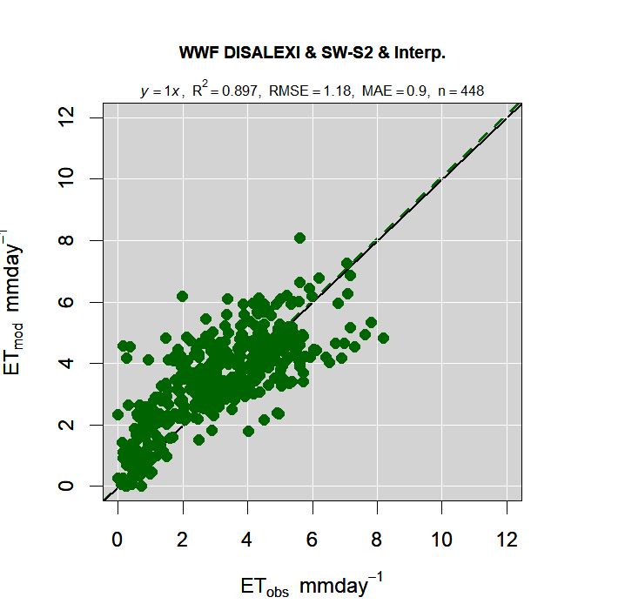
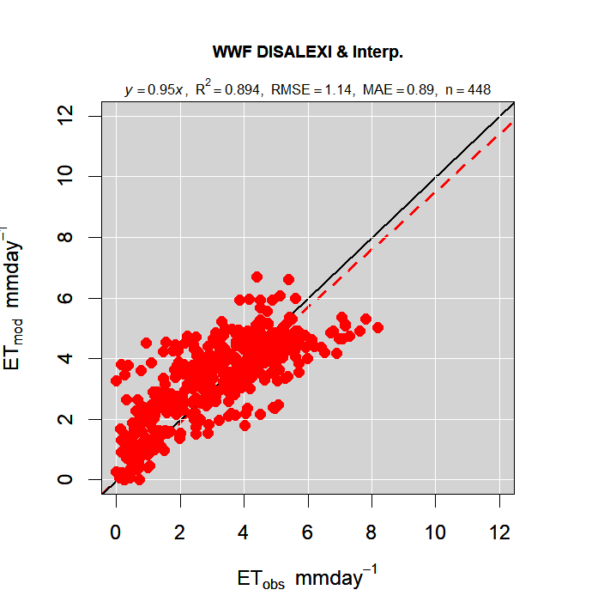
WWF

Slide 23
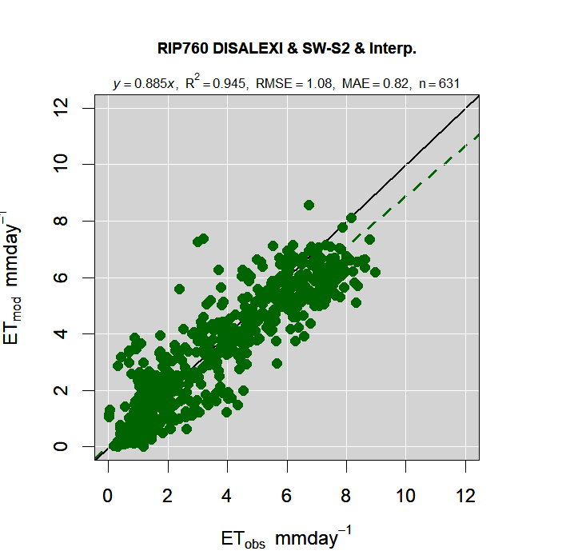
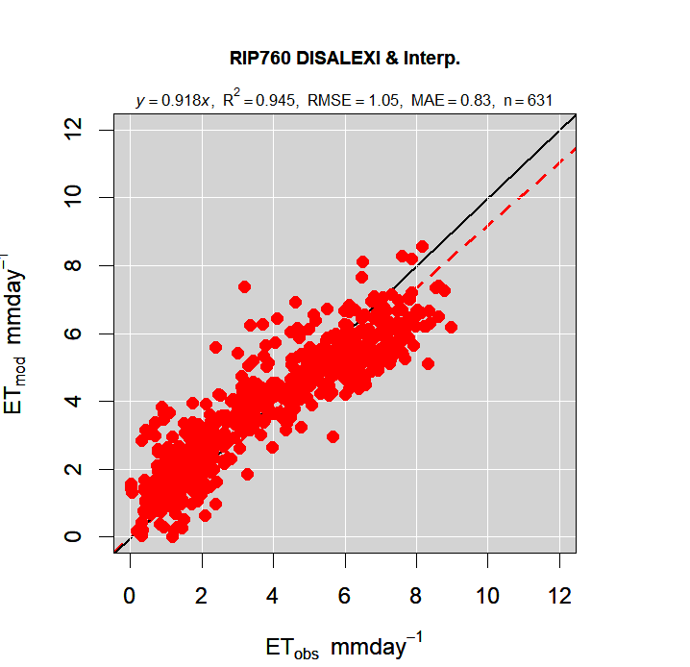
RIP760

Slide 24

Thanks for your attention
oscarrosario.belfiore@unina.it

