Slide 1
Integrating soil structure in hydrologic models of the unsaturated zone
Authors: Efthymios Chrysanthopoulos, Christos Pouliaris, Kostas Markantonis, Ioannis Tsirogiannis and Andreas Kallioras
GC8-Hydro-63

Slide 2
Most hydrologic models of the unsaturated zone to acquire hydraulic properties use the predictions of empirical equations (Pedotransfer functions – PTFs).
Commonly, soil texture is the main characteristic used by PTFs to predict the hydraulic properties of the unsaturated zone.
Furthermore, the samples of the databases used by these models to be trained are predominantly disturbed and only a few of them are undisturbed.
As a result, soil structure is pretty much ignored in hydrologic models of the unsaturated zone.
In this study, we have developed an organized approach to determine the hydraulic properties of the unsaturated zone and finally compare the performance of hydrologic models using predicted and measured hydraulic properties.
Motivation

Slide 3
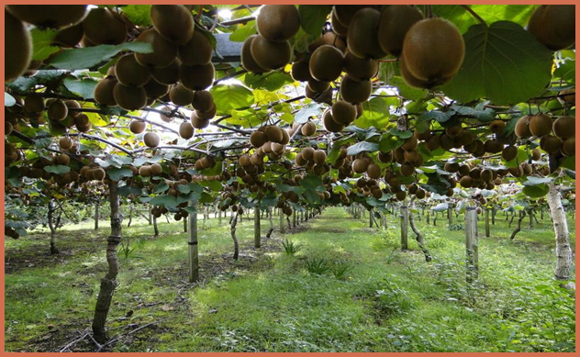
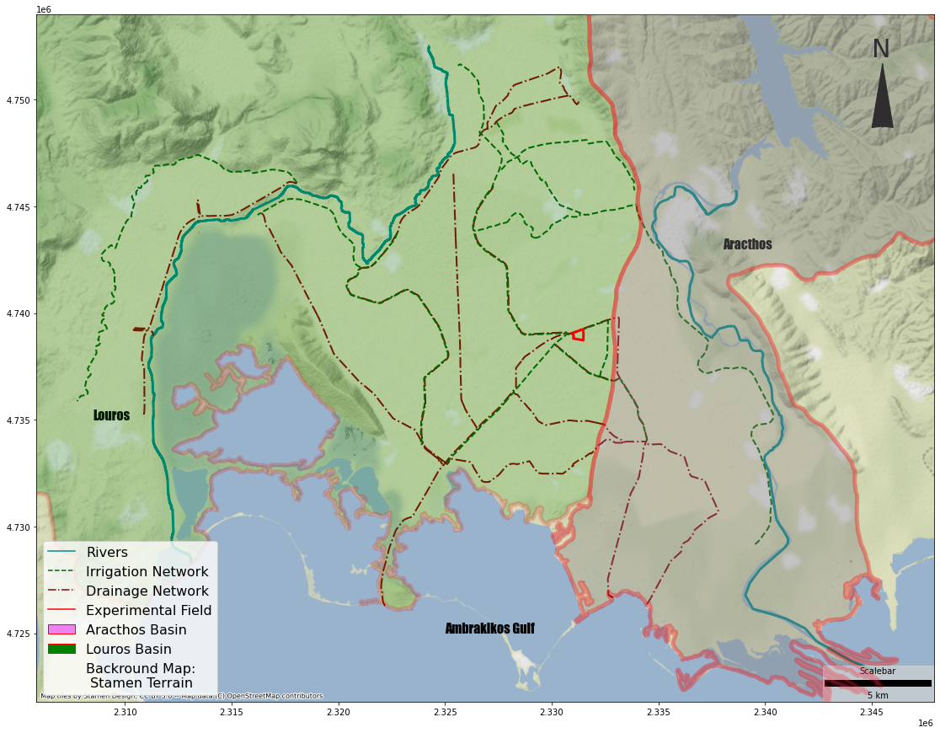
Epirus region –
Westernmost part
of Greece
One of the most productive agricultural areas of Greece. Main cultivation: Kiwi and citrus trees
Distinctive characteristic:
Elevated precipitation height (2000 mm/y)
Frequent flood events
Research Area

Slide 4
In order to manage water resources in the Louros-Aracthos-Amvrakikos system as efficiently as possible, the project e-Pyrros intends to establish an integrated network for monitoring hydro-environmental factors, aiming at:
The improvement of local agricultural ecosystems, the upgrading of the quality of agricultural production, and the monitoring of agricultural substances in all hydrological zones (surface, saturated, and unsaturated).
Research Area

Slide 5
Major goal of the research program: optimization of agricultural production
Kiwi field
Area: 30 acres
Experimental kiwi field

Slide 6
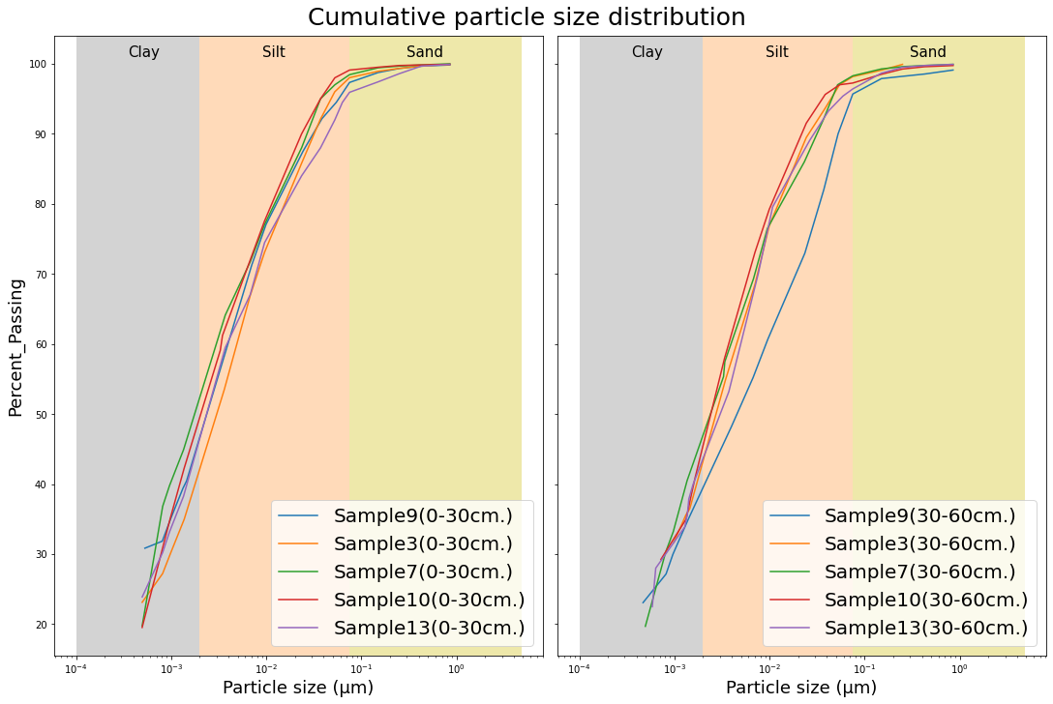
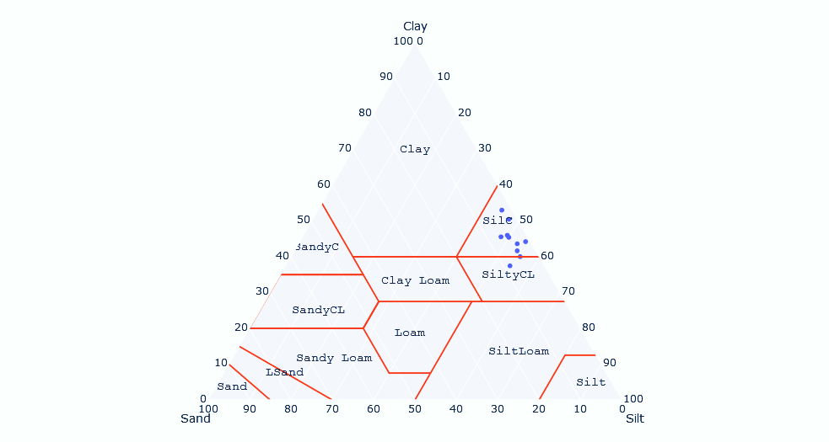
Experimental kiwi field

Slide 7
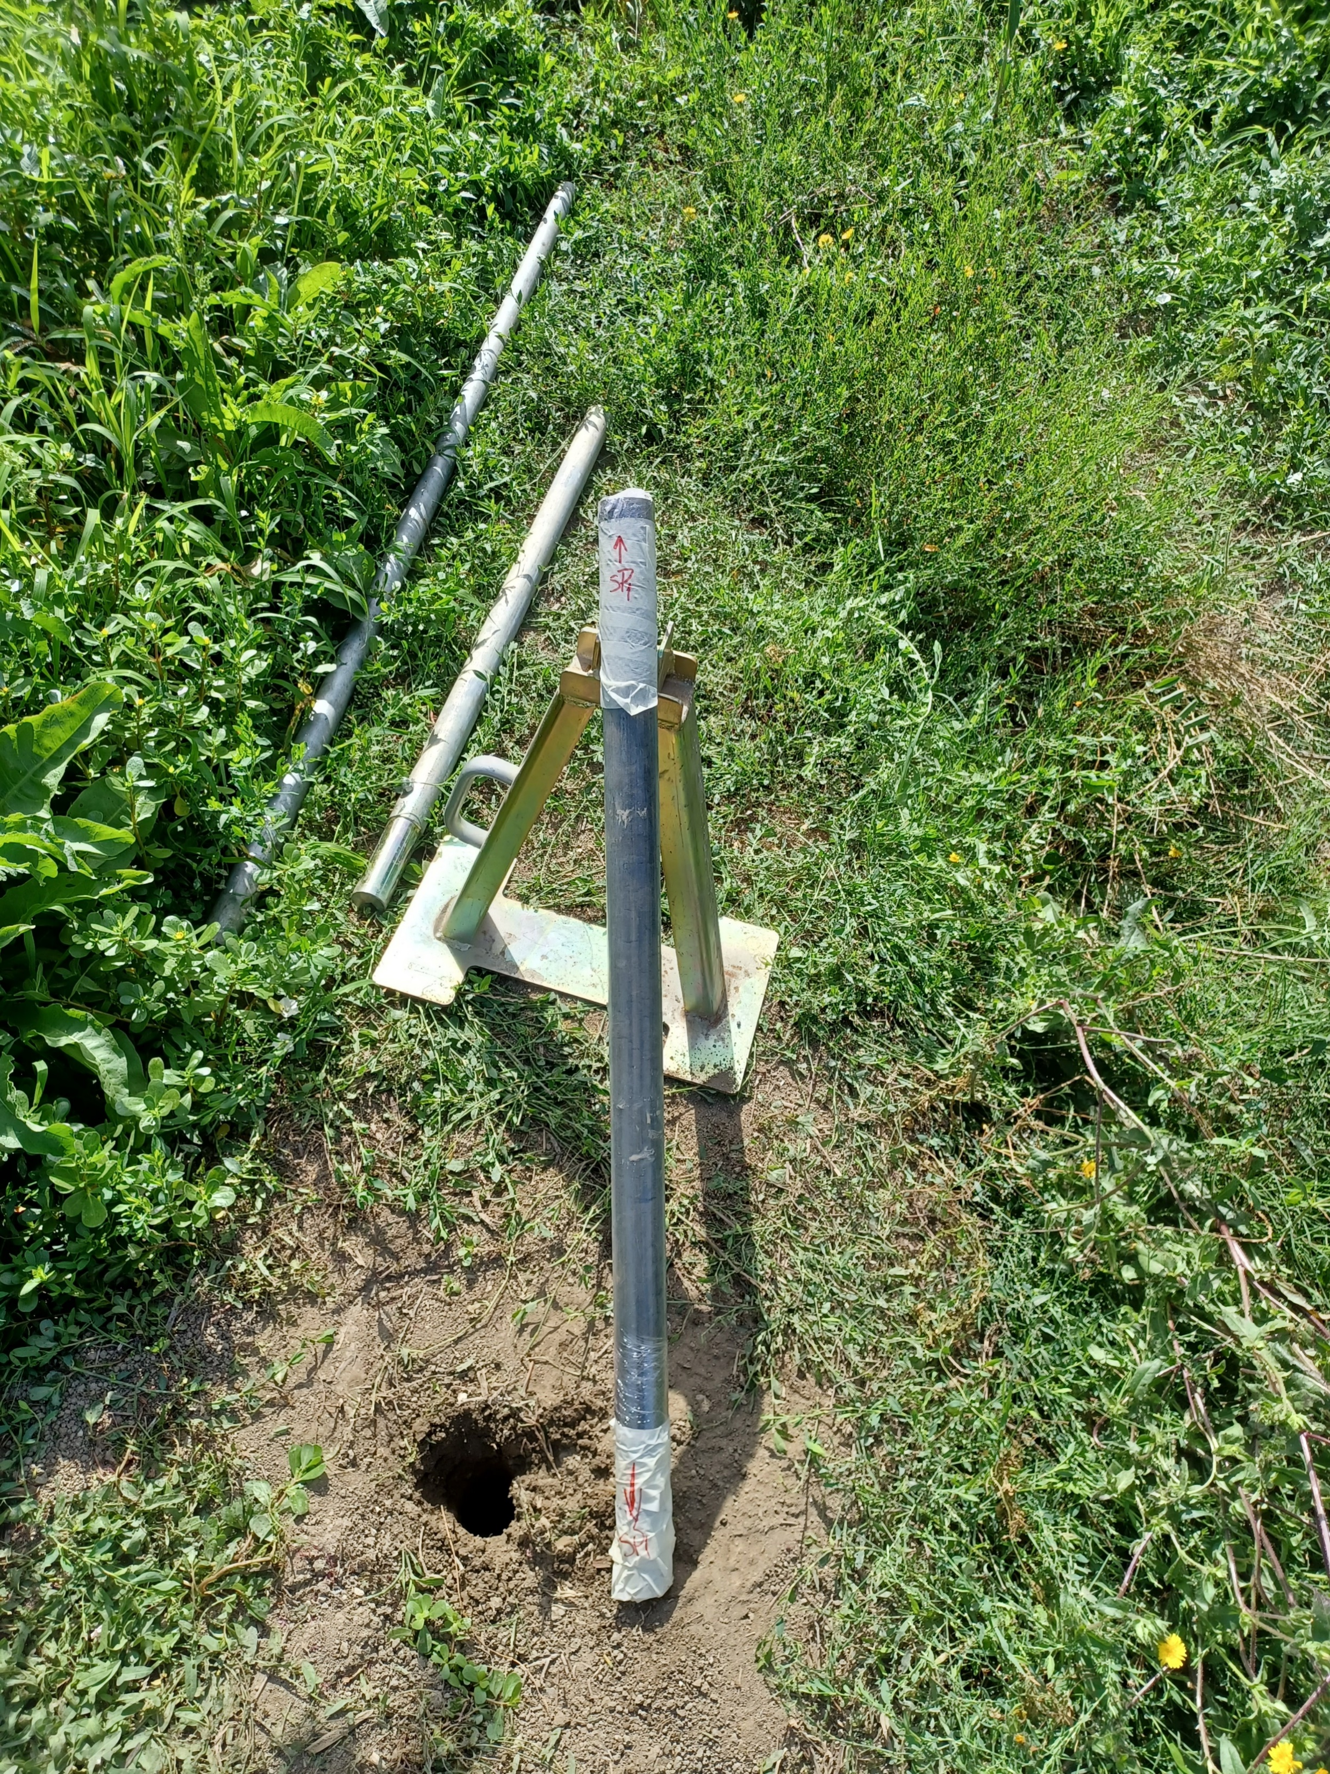
Electrical percussion hammer (Eijkelkamp)
Percussion gouge diameter: 64 mm.
Undisturbed soil samples up to 1 m. below the surface
Samples stored in pvc liner
Undisturbed soil samples

Slide 8
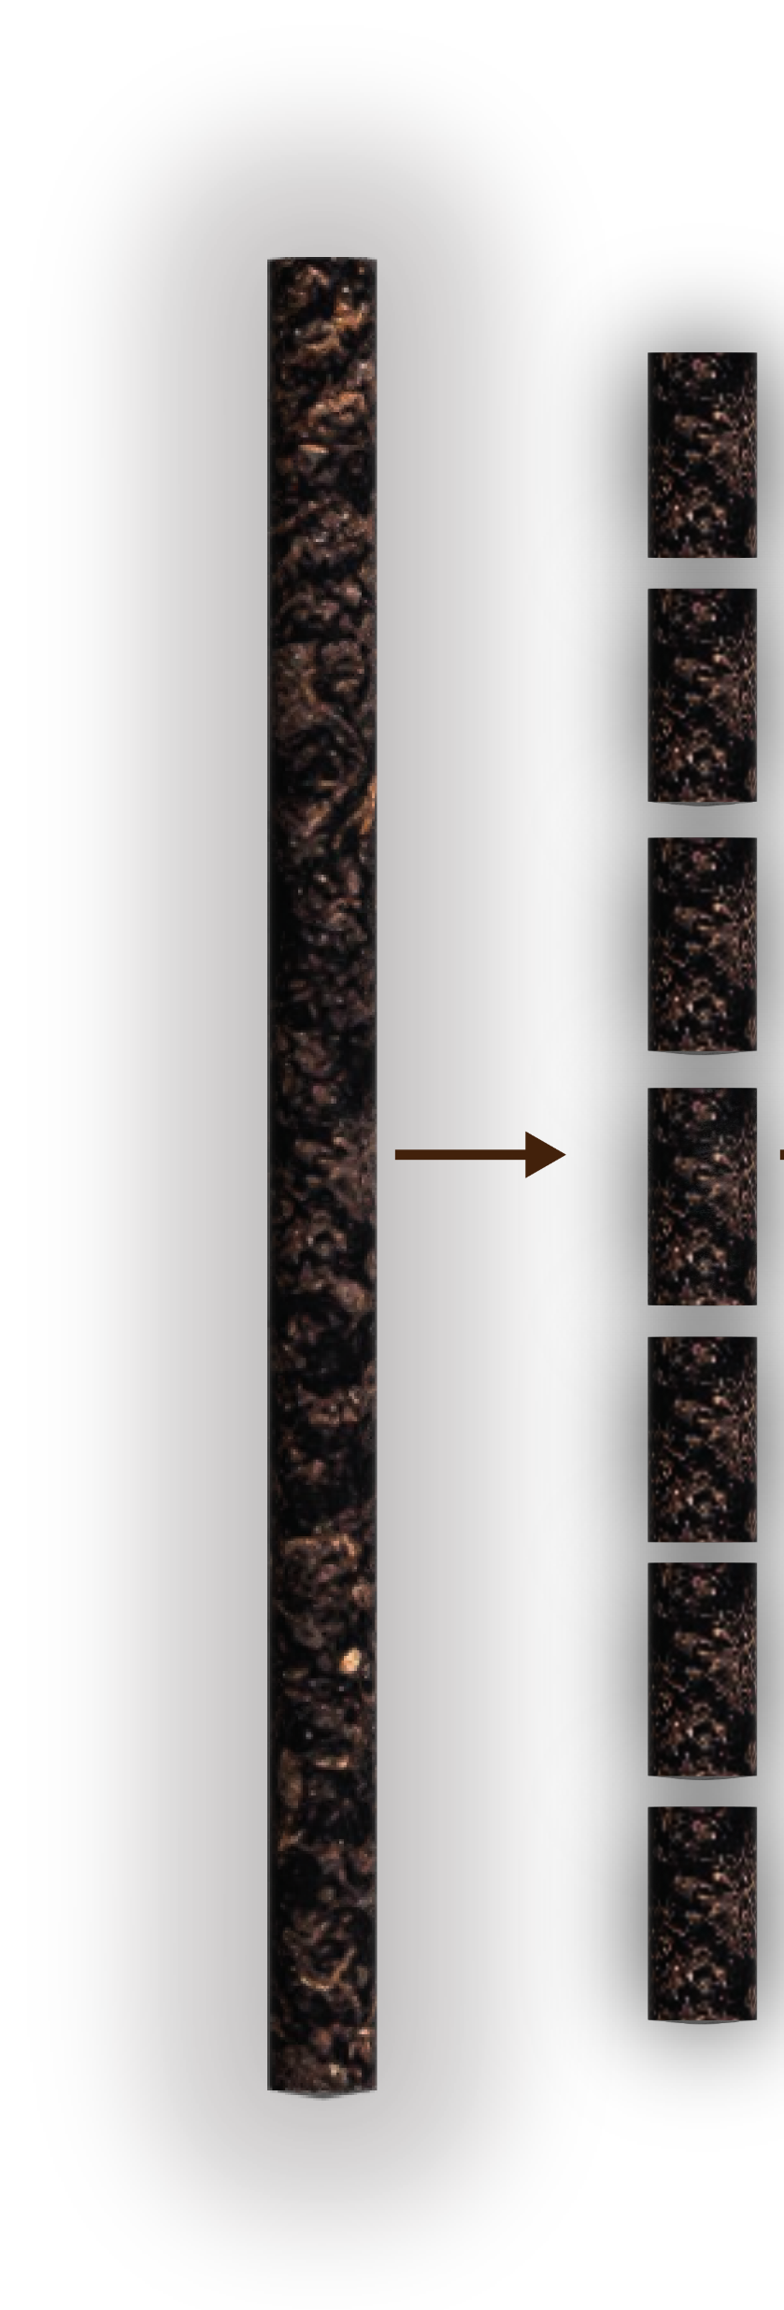
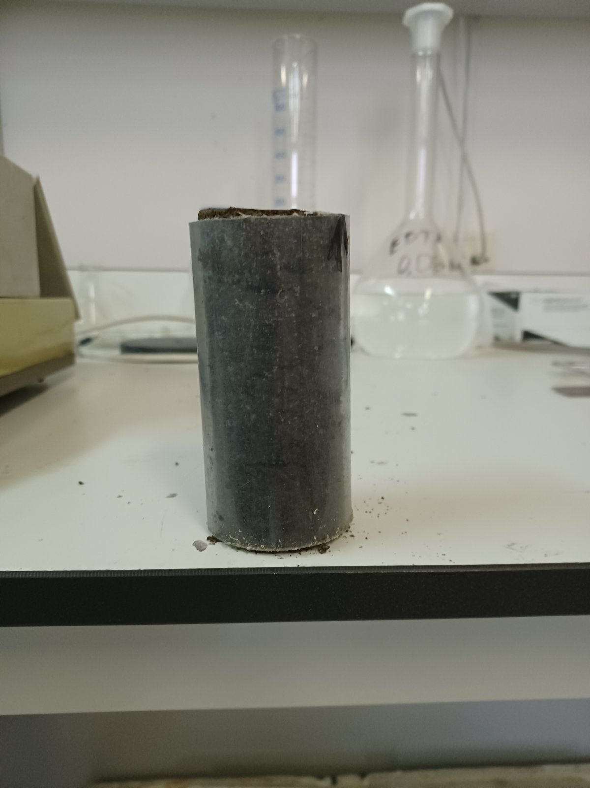
10 cm.
Undisturbed soil samples

Slide 9
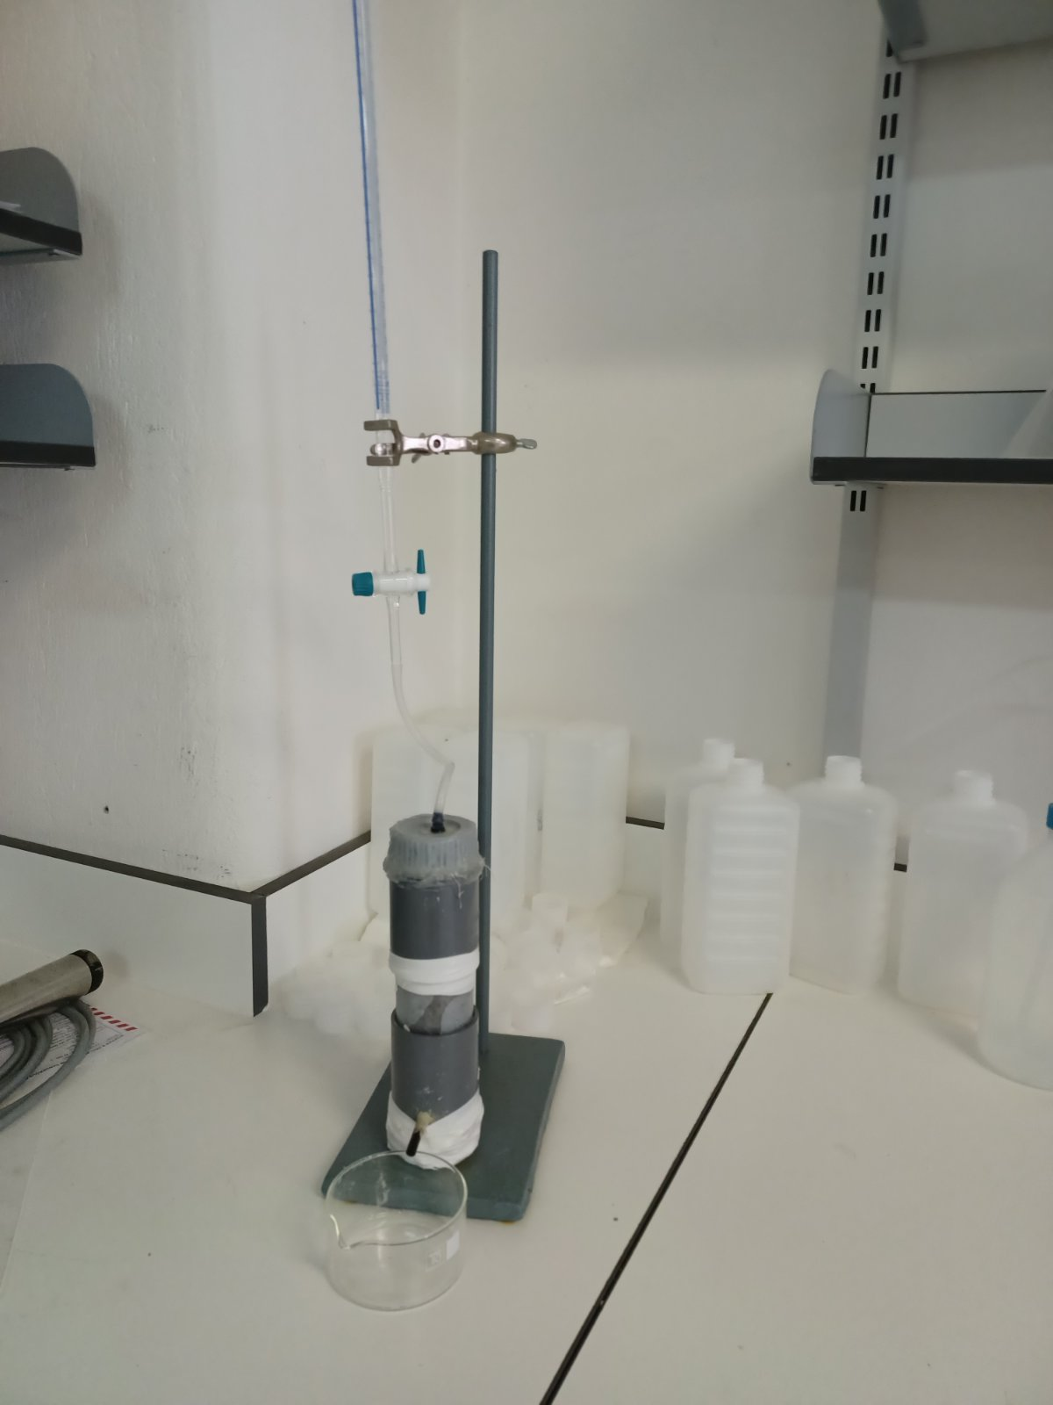
Custom permeameter cell

Slide 10
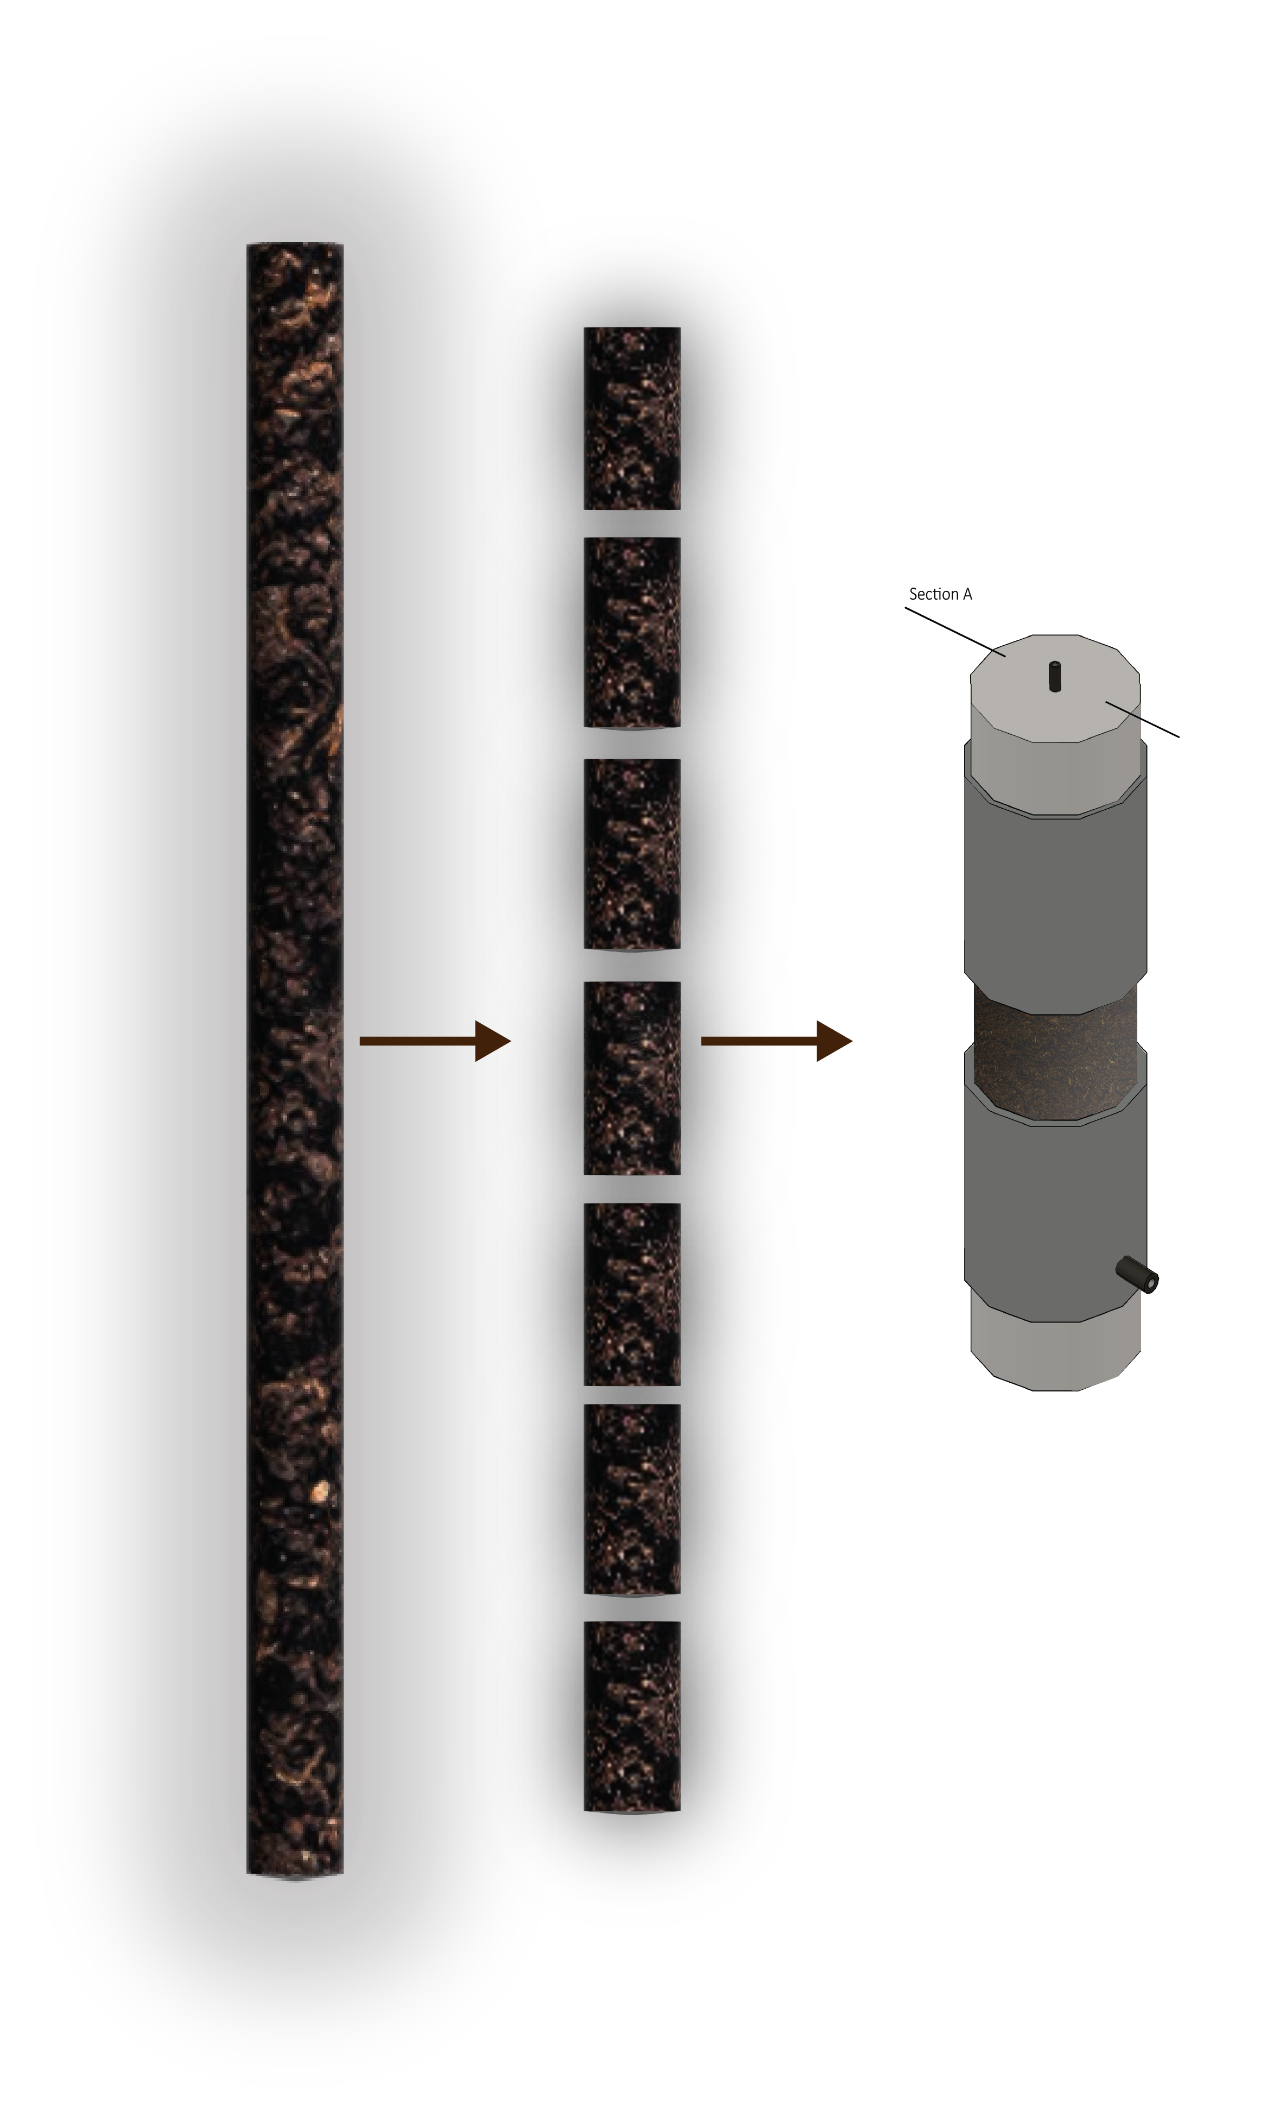
Calculation of saturated hydraulic conductivity (Ksat)
8 cm/day
8 cm/day
7.5 cm/day
2 cm/day
1.5 cm/day
1.4 cm/day
1 cm/day
1 cm/day
1.2 cm/day
Custom permeameter cell
1.2 cm/day

Slide 11
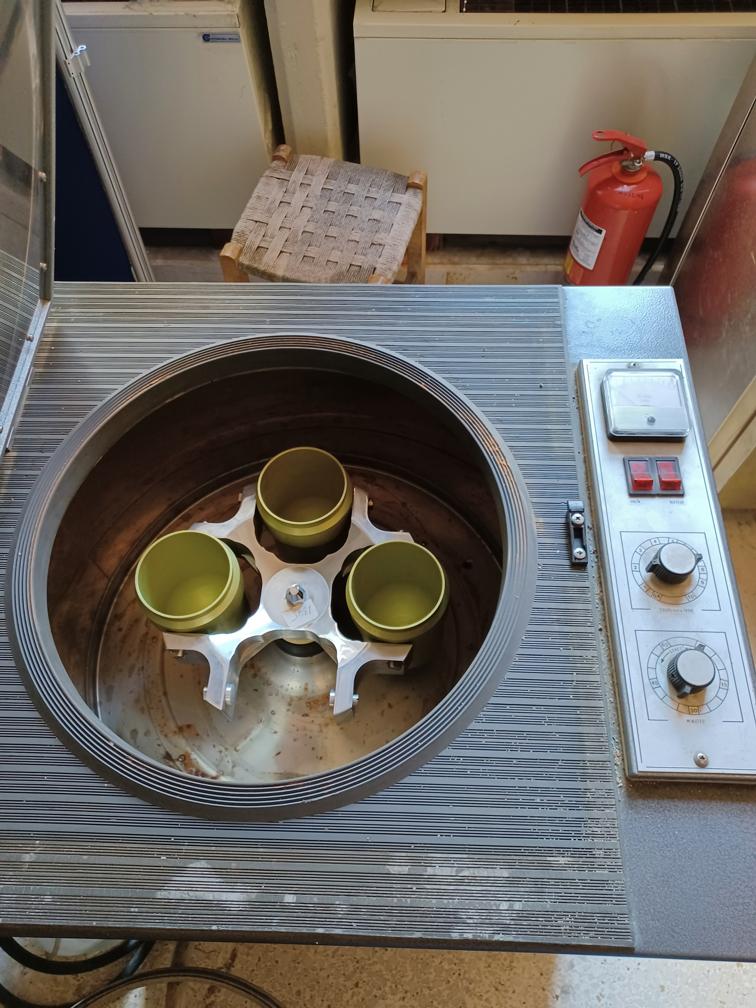
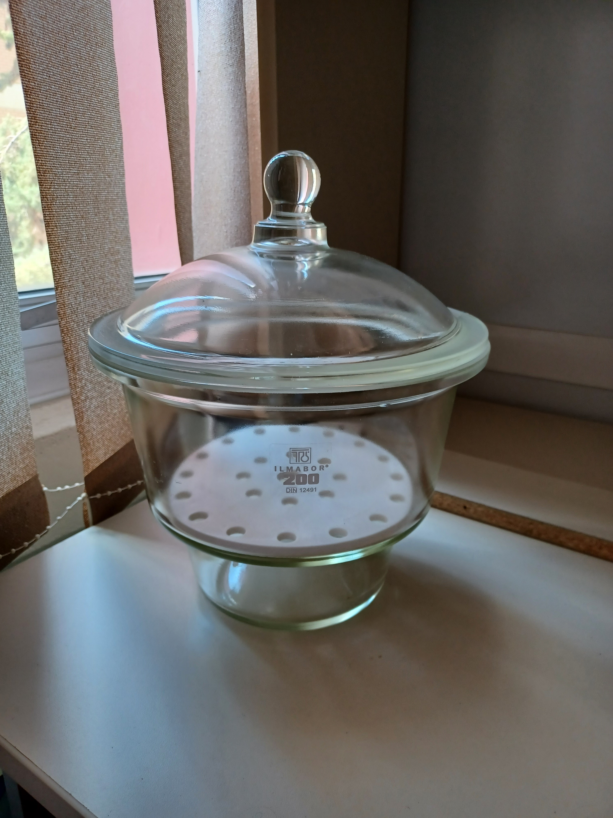
Centrifuge and salt solution method for SWRC estimation
0.01 kPa
100 kPa
500 kPa
2000 kPa
8000 kPa
New
method
Centrifuge
(2 hours in each speed)
Conventional
method
Salt
Solution (~63 days)
$$ψ=\left({r1}^{2} − {r2}^{2}\right)∗ \frac{{(ρ∗ω)}^{2}}{2}$$
$$ψ=4598,95∗1,000122 m$$
Soil Water Retention Curve

Slide 12
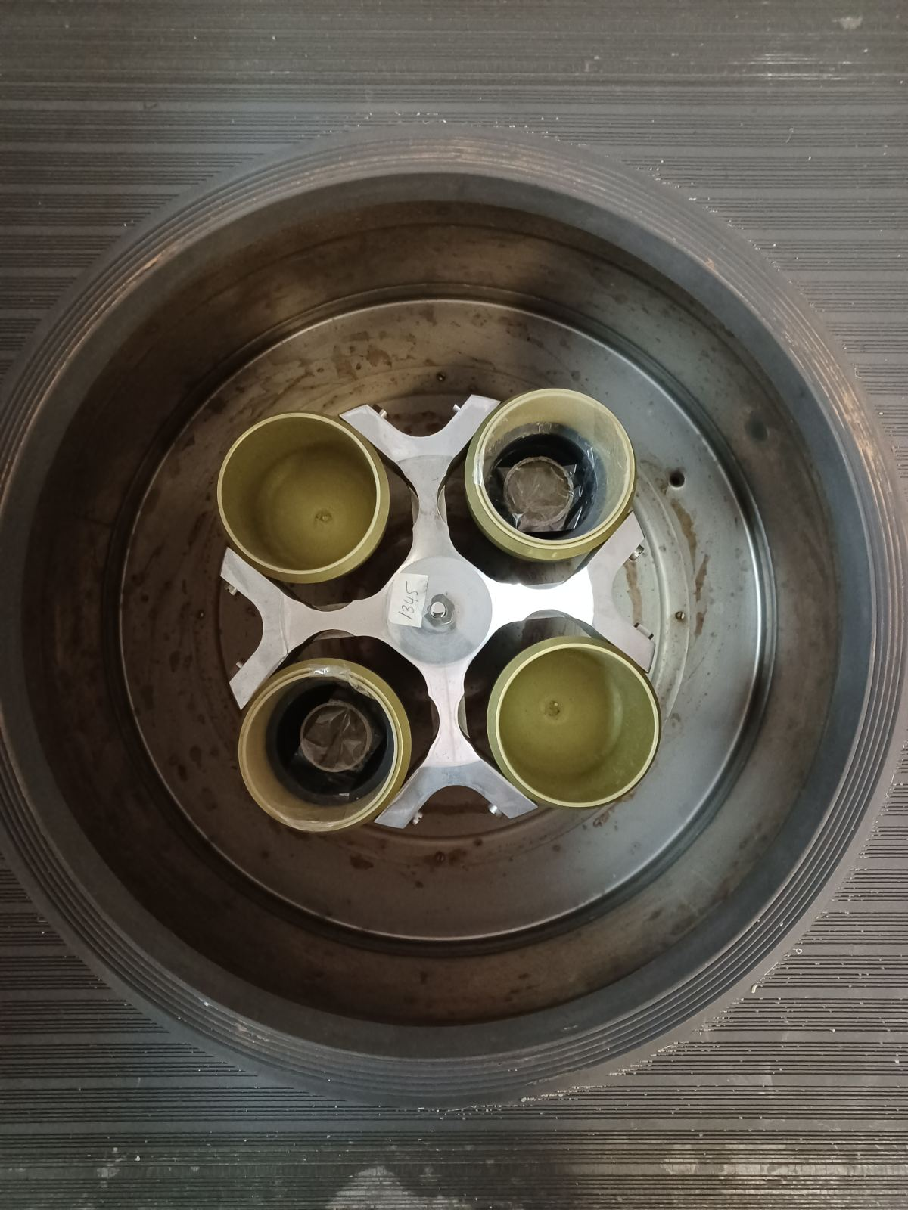
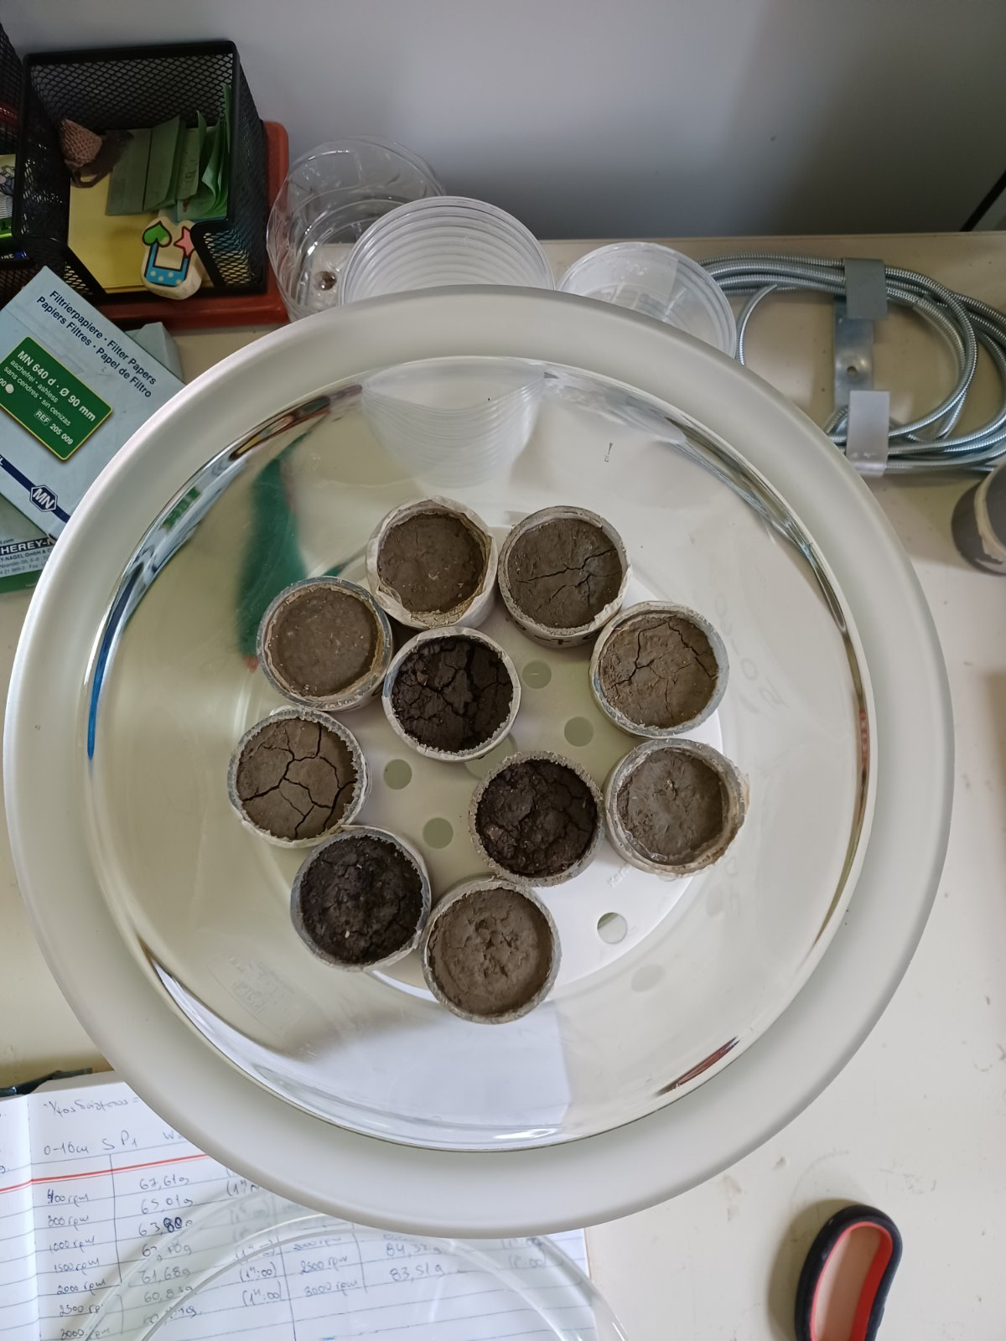
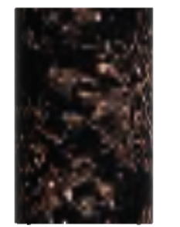
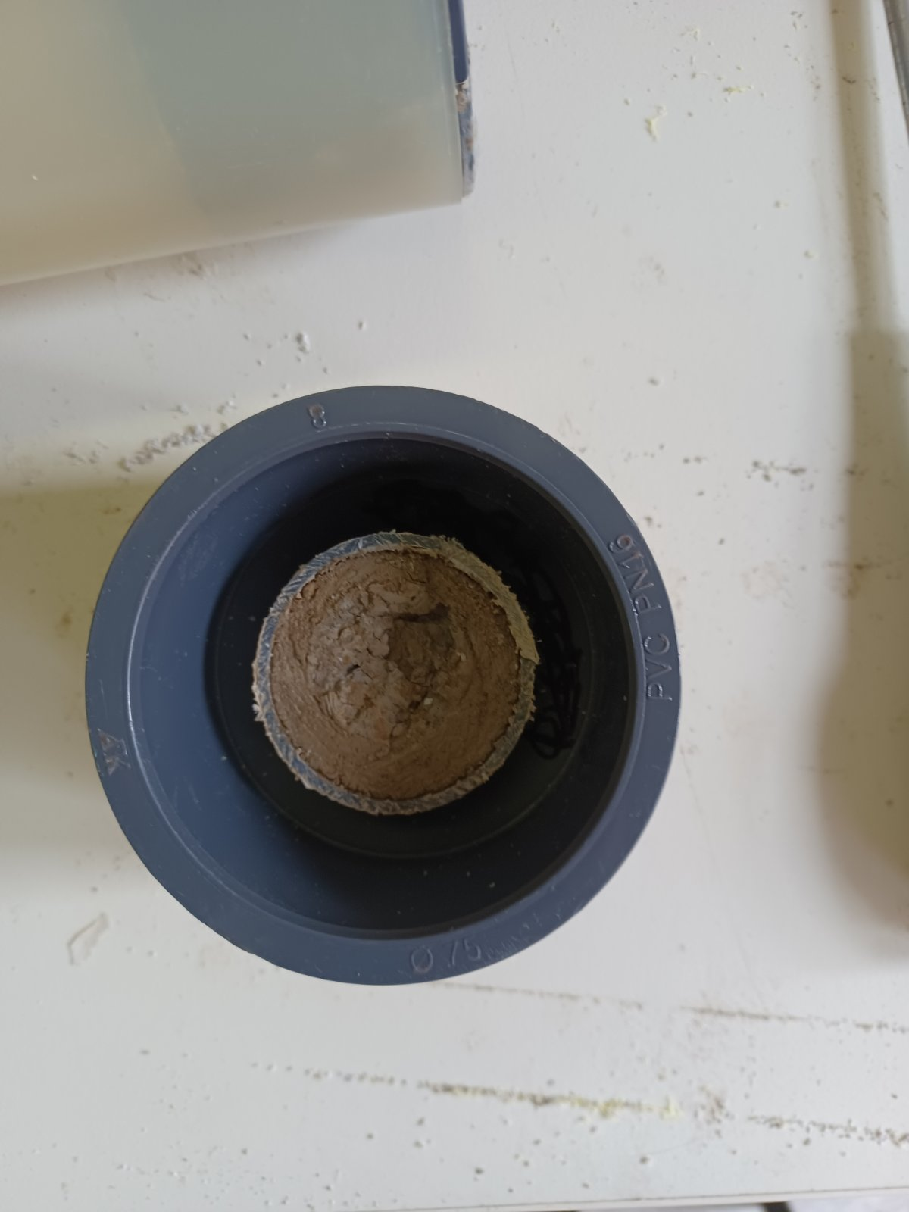
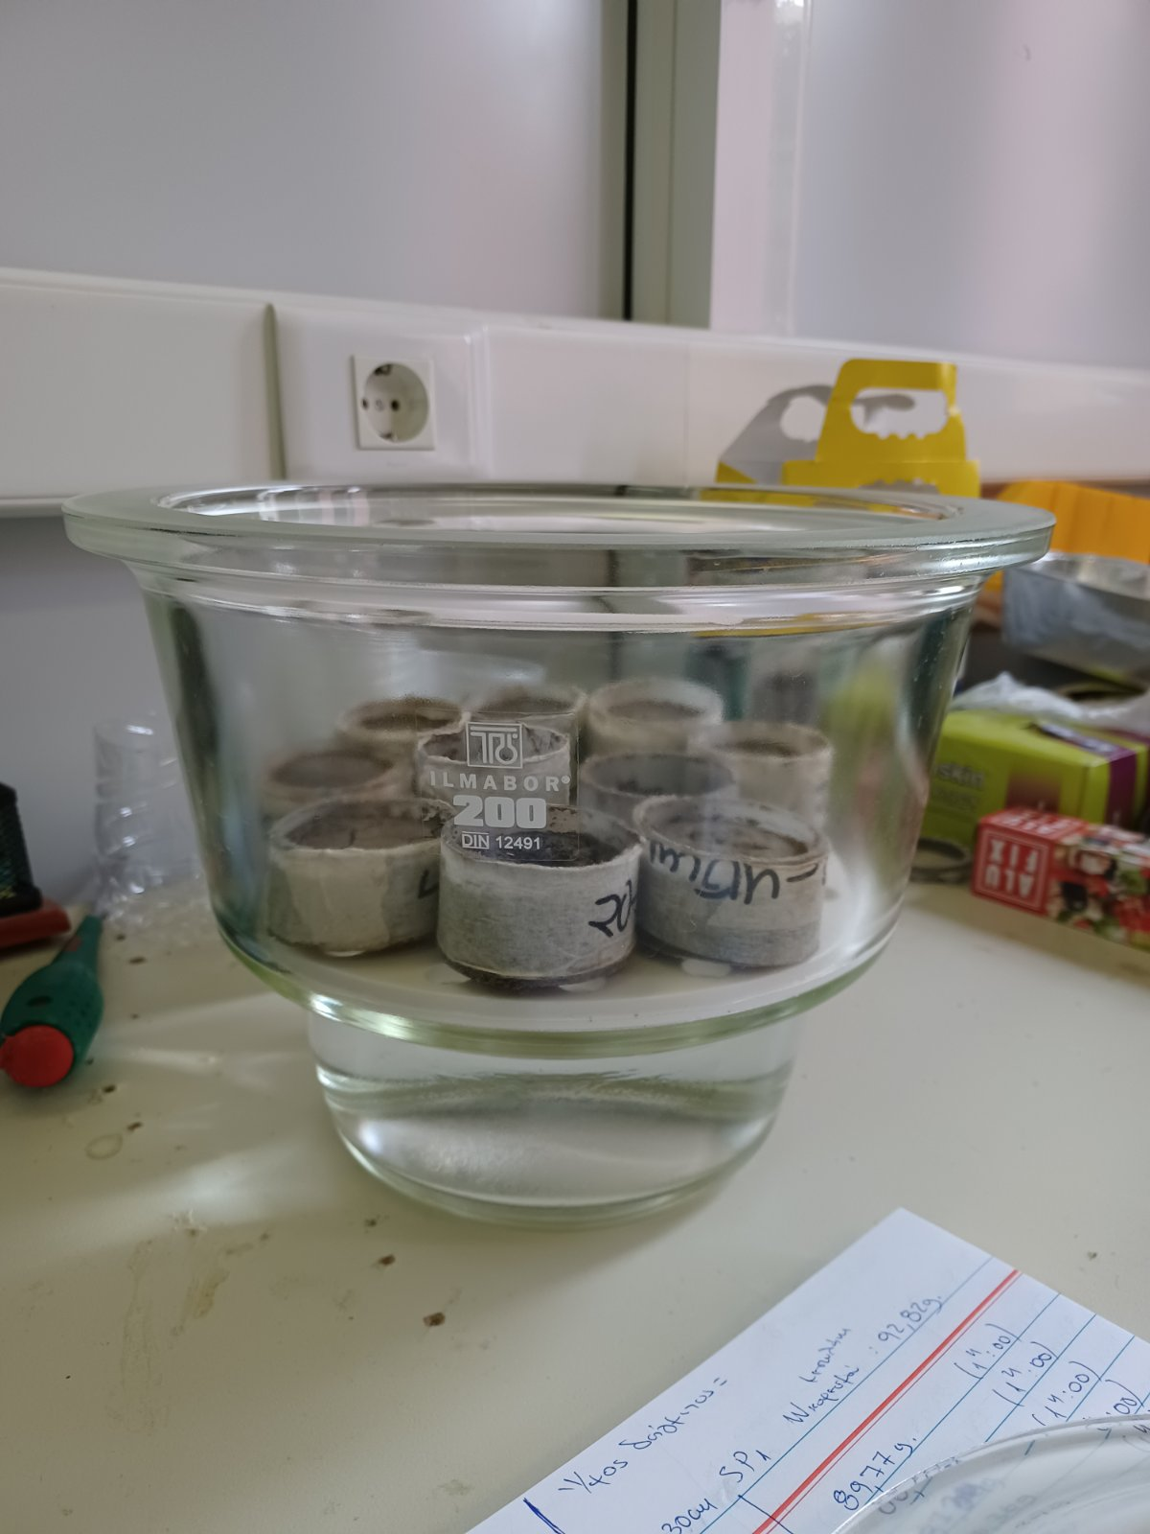
Saturate samples until equilibrium
Soil Water Retention Curve

Slide 13
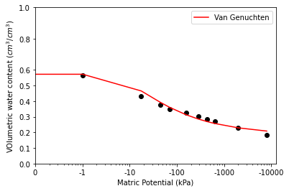
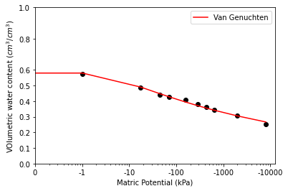
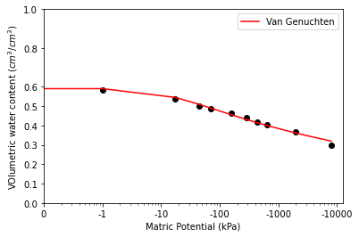
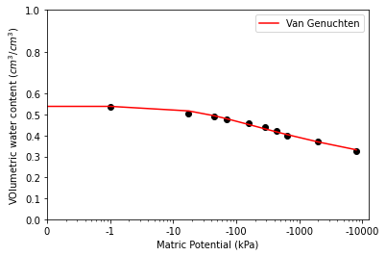
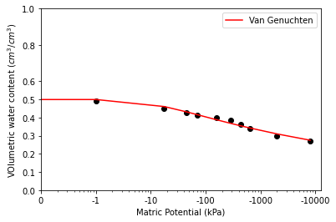
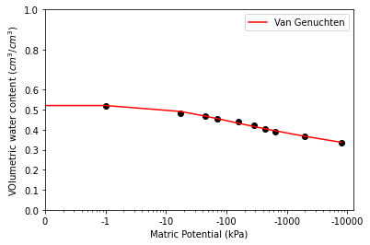
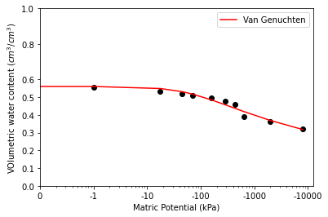
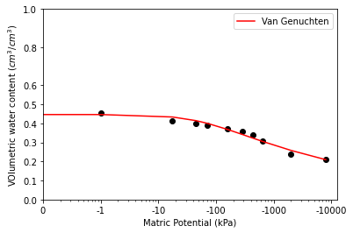
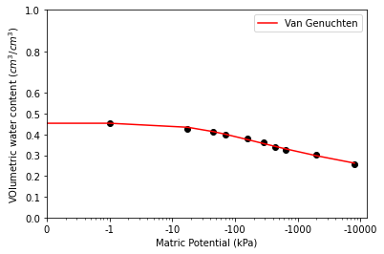
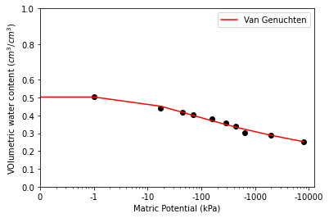
0 -10 cm.
10 -20 cm.
20 -30 cm.
30 -40 cm.
40 -50 cm.
50 -60 cm.
60 -70 cm.
70 -80 cm.
80 -90 cm.
90 -100 cm.
Soil Water Retention Curve

Slide 14
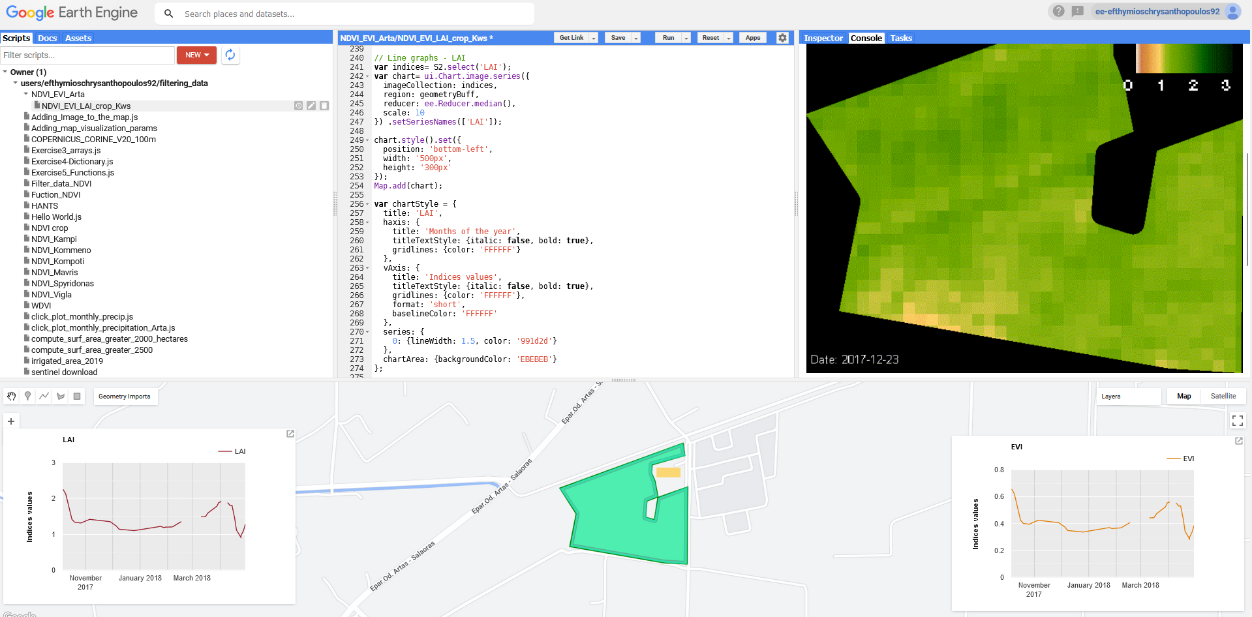
Crop evapotranspiration (ETc) should be divided in potential evaporation (Ep) and potential transpiration (Tp):
Ep = ETc e^{−Kgr ∗LAI}
Tp = ETc − Ep
Evapotranspiration for Hydrus

Slide 15
Harmonic ANalysis of Time Series (HANTS)
Harmonic analysis is a branch of mathematics concerned with the representation of functions or signals as a superposition of periodic functions
Widely used algorithm to reconstruct time series and fill gaps in timeseries from satellite images
Evapotranspiration for Hydrus

Slide 16
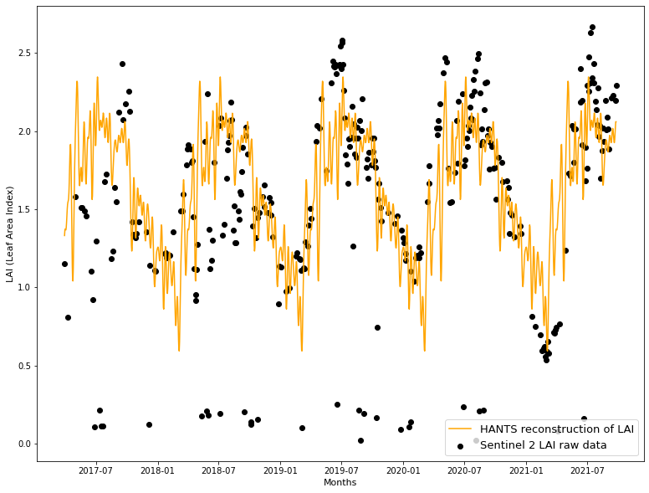
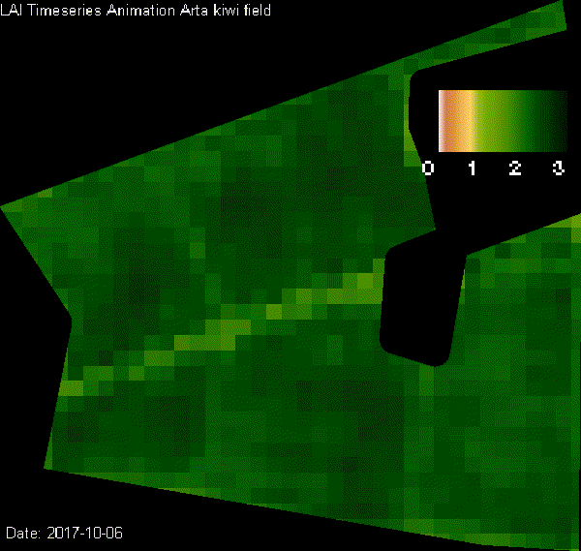
Reconstruction of LAI timeseries
Evapotranspiration for Hydrus

Slide 17
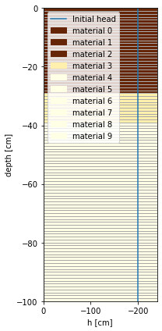
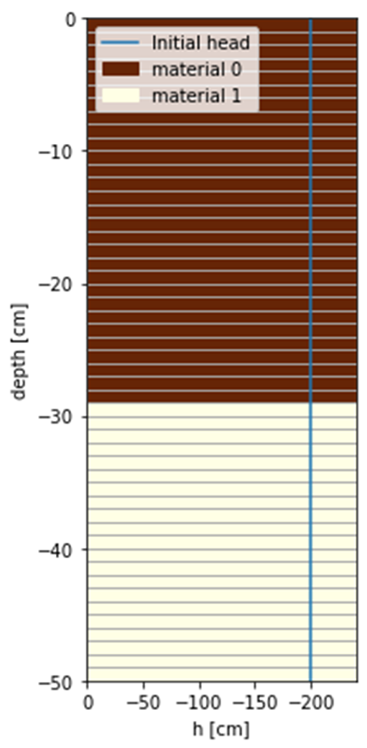
1st model
2nd model
Model period: Two years (2016-2018)
Time step: daily
Hydraulic parameters estimated from soil texture data using Rosetta 3 model
Hydraulic parameters calculated through laboratory experiments
Hydrus

Slide 18
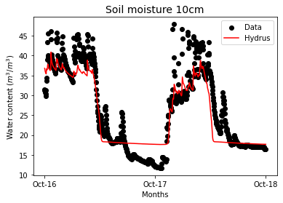
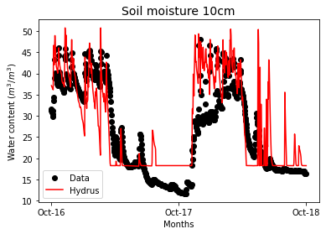
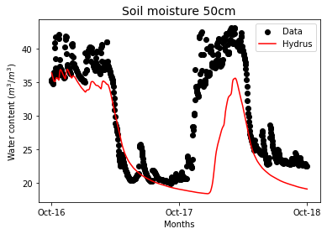
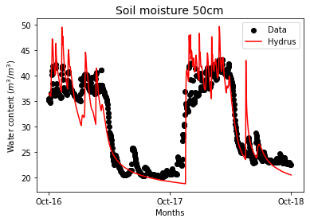
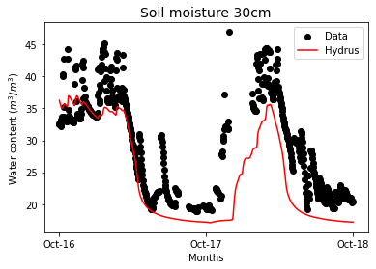
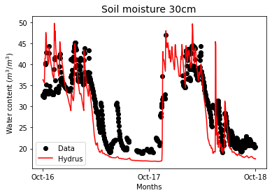
1st model (Results)
2nd model
(Results)
Hydrus

Slide 19
In this study a falling head permeameter for undisturbed soil samples is developed, providing the capability to determine saturated hydraulic conductivity in large depths.
Two methods of measuring Soil Water Retention Curve are used, centrifugal method (rather new and time-efficient) and salt solution method (conventional and time consuming).
The use of undisturbed soil samples within the research framework aims to integrate soil structure in the determined hydraulic properties of the unsaturated zone.
The HANTS (Harmonic ANalysis of Time Series) algorithm is used to fill the gaps in LAI timeseries, providing the capability to increase the time resolution of satellite timeseries.
Finally, Hydrus 1D model (phydrus – python implementation) is employed to compare the performance of two models either with predicted or with measured hydraulic properties.
Take home messages

Slide 20
Acknowledgements:
This research is part of the Project “e-Pyrros: Development of an integrated monitoring network for hydro-environmental parameters within the hydro-systems of Louros-Arachthos-Amvrakikos for the optimal management and improvement of agricultural production” (MIS 5047059) and received financial funding from the Operational Programme “Competitiveness, Entrepreneurship and Innovation 2014-2020 (EPAnEK)”.
GC8-Hydro-63

Slide 21
Thank you for your attention
GC8-Hydro-63

