Slide 1


A novel combined approach for bridging scales in spatiotemporal soil moisture monitoring applying metrological principles
Sascha Oswald, Sebastian Rothermel, Gabriele Baroni, Anna Balenzano, Henrik Kjeldsen, Martin Schrön, and Miroslav Zboril
Acknowledgement:

Slide 2
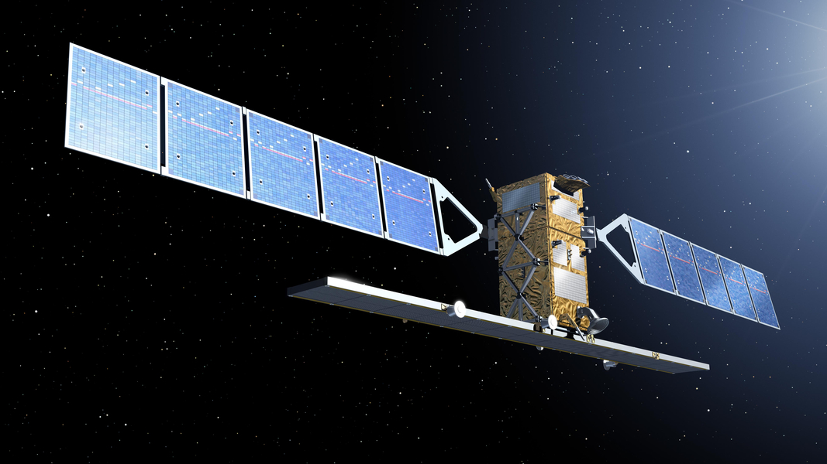
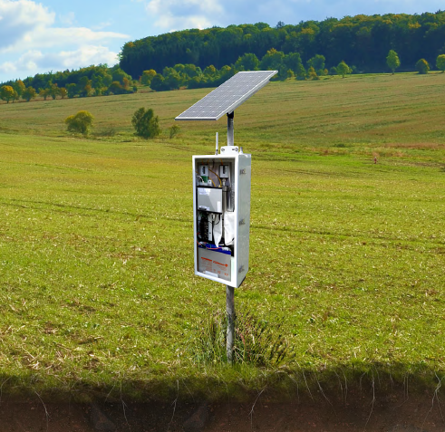
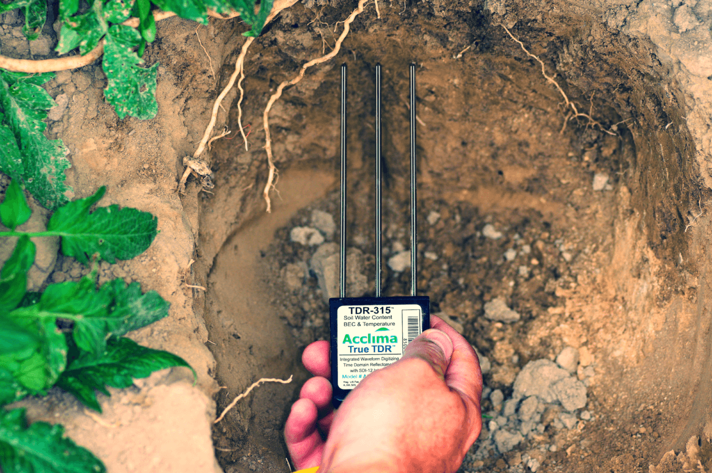
Problem of scales
Horizontal scale
(10⁻¹ – 10¹) m
(10² – 10³) m
(10³ – 10⁴) m
Satellite remote sensing
Cosmic-ray neutron sensing (CRNS)
“ gap ”
[ESA Sentinel-1]
Only topmost soil layer (5 cm)
Validation practices based
on point-scale data
Need for effective, representative ground-based methods
Point-scale in situ measurements
Invasive, affected by immediate surrounding
Sensor networks ➔ maintenance & repair costs
Need for harmonization of methods
Need for metrological transfer standards
[https://soilsensor.com]

Slide 3












SoMMet
SoMMet
UP DE
TUBITAK
UFZ
PoliMi
JV
INRIM
CMI
IAPAN
CTU
CNR
DTI
SMU
PTB
UKCEH
UHEI
IRSN
UNIBO
CIEMAT
„…develop novel metrological tools and establish a metrological foundation for soil moisture measurements on multiple lateral scales, ranging from decimetre to kilometre, ensuring the traceability and harmonisation of the various soil moisture measurement methods.”

Slide 4
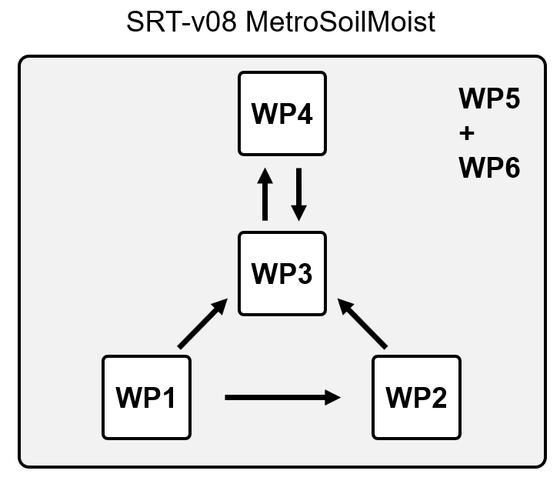
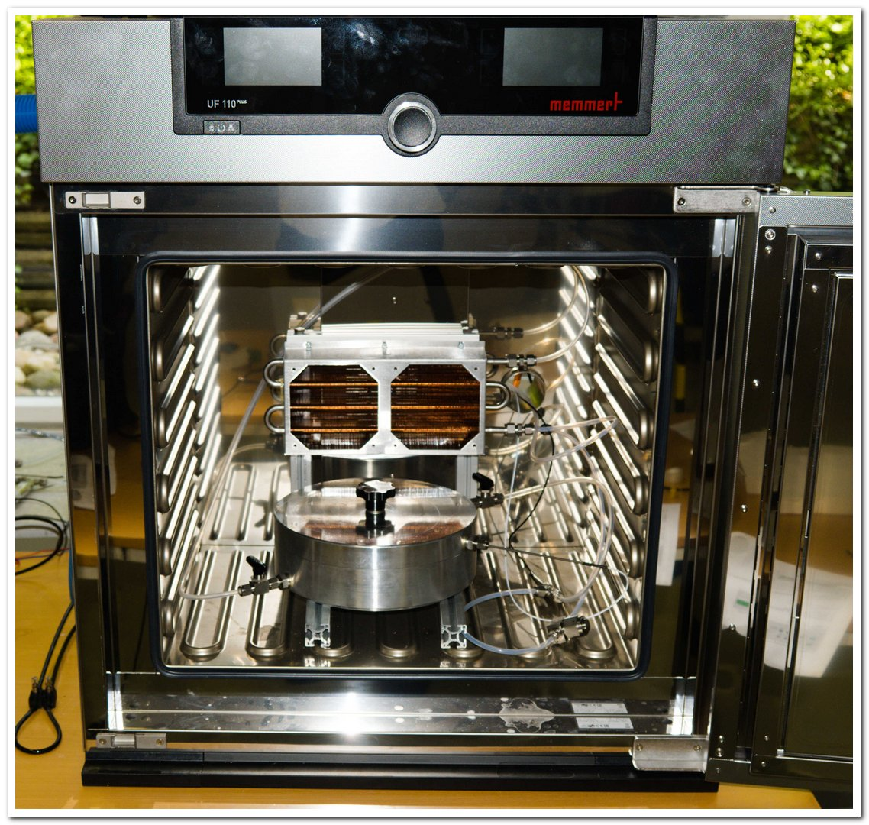
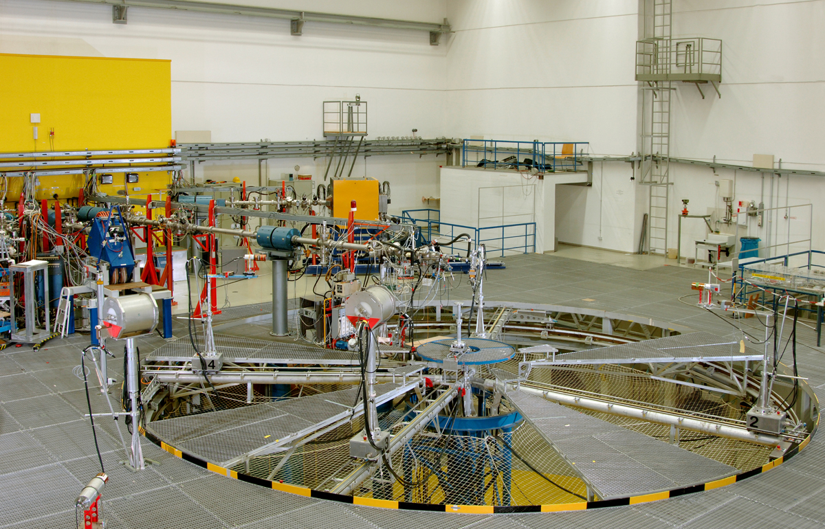
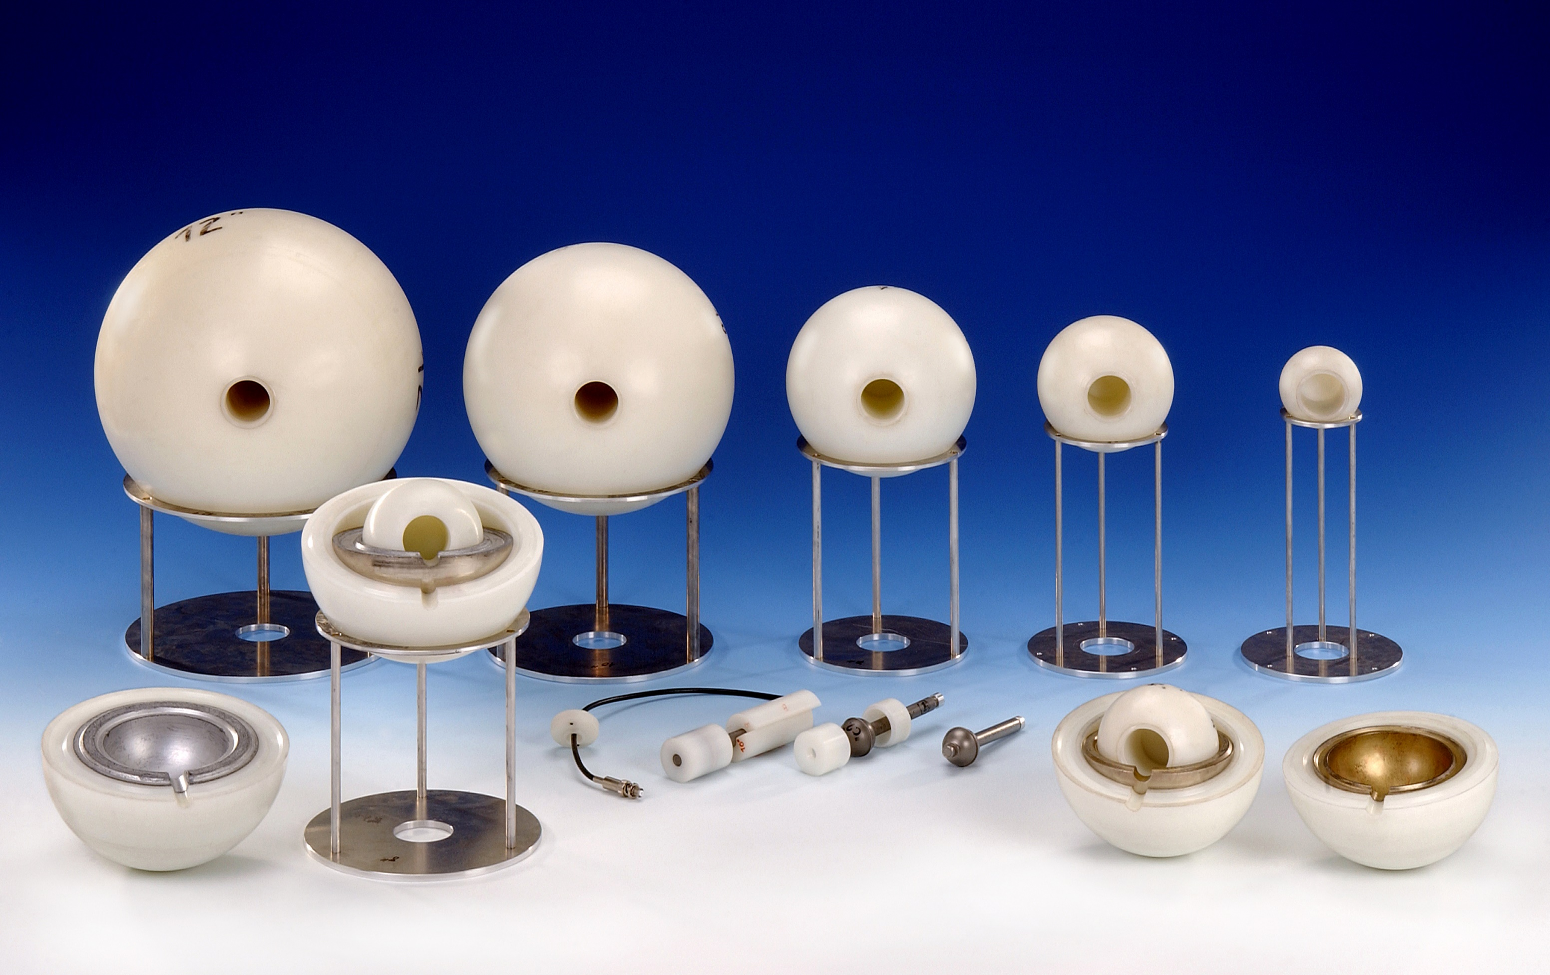
Metrological principles
WP1: Traceability
WP2: Validation
WP3: Harmonization
WP4: Data fusion
Traceability chain
  Primary and secondary transfer standard for point scale calibration
  Traceability across scales from the lab to the outdoors
Metrology of neutron radiation
  Response function modelling
  Validation of multiple CRNS probes in the lab (neutron fields)
  Validation with Bonner Spheres (outdoors)
→ Improvements in CRNS usage
  Metrologically traceable calibration
  Standardised estimates of uncertainty
  → Comparability of CRNS
DTI, Denmark
PTB, Germany

Slide 5
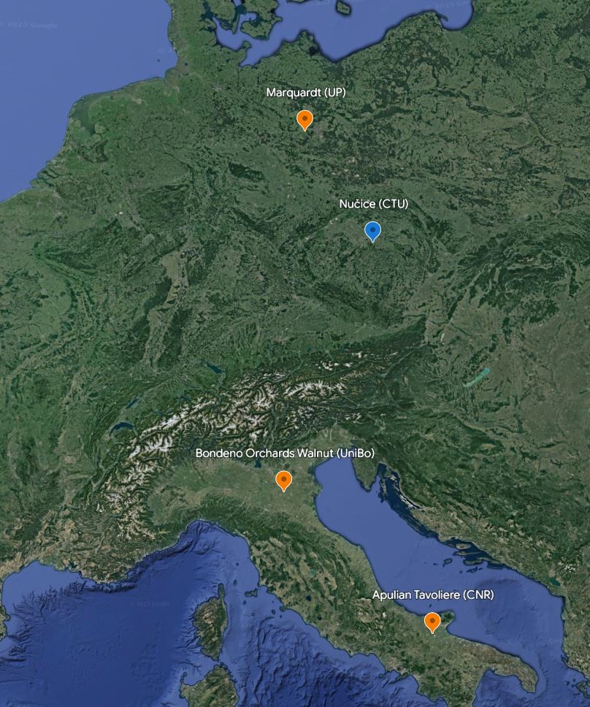
Test sites in SoMMet
Three high level test sites:
  Marquardt
  Bondeno Orchards
  Apulian Tavoliere
  → Three measurement scales
  → North-south gradient

Slide 6
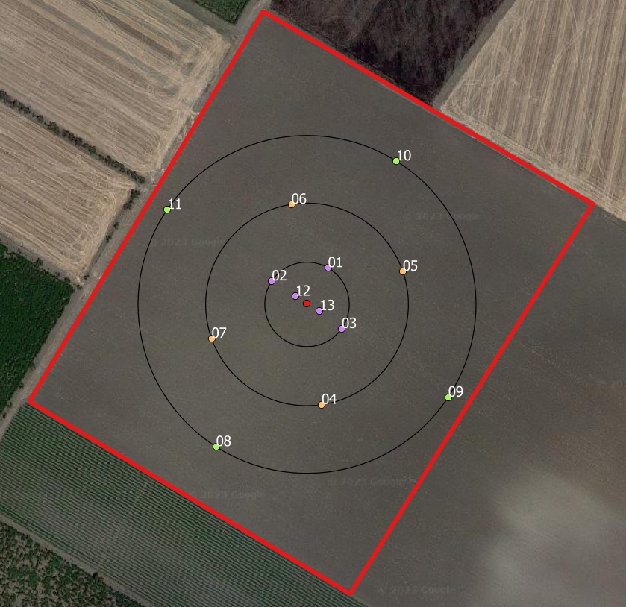
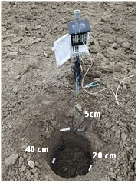
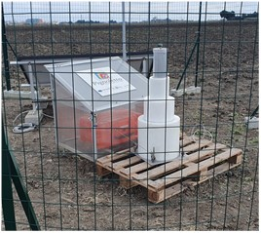
Apulian Tavoliere
Foggia experimental farm
General site info:
  Experimental Farm
  Durum wheat/tomatoes
  Extend: ~3km² (flat)
  Clay loam
  530mm mean precipitation
  15.8° C mean temperature
  13 point scale sensors
  1 CRNS (with multiple energy spectra)
  Well established remote sensing site

Slide 7
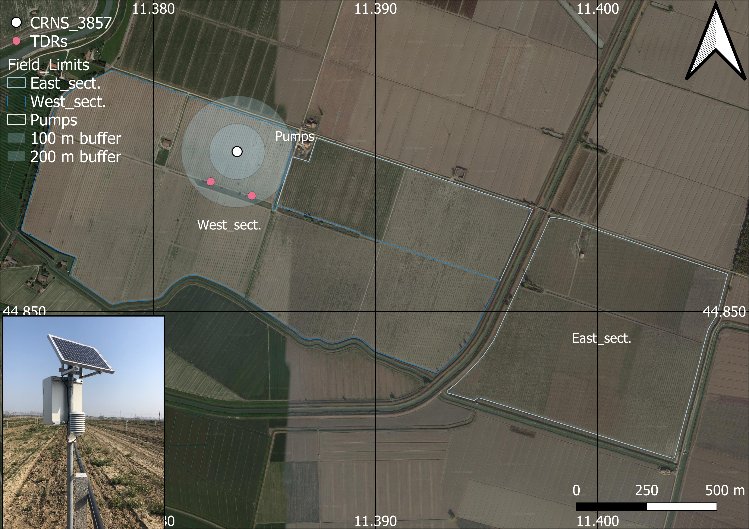
Bondeno Walnut Orchards
General site info:
  Irrigated walnut orchard
  Extend: ~1.5km² (flat)
  Clay loam
  600mm mean precipitation
  14° C mean temperature
  1 CRNS and a few point scale sensors
  Regular manual TDR surveys

Slide 8
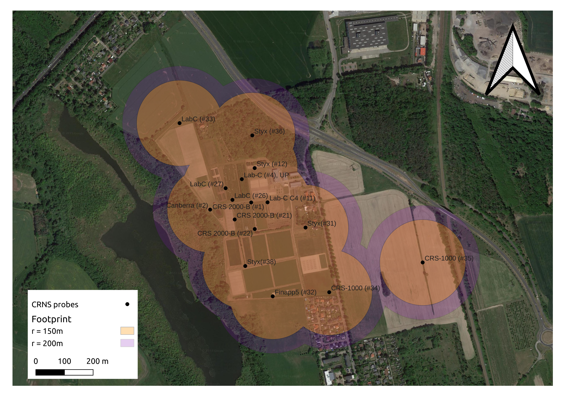
Marquardt
General site info:
  Agricultural research site
  mixed land use
  Extend: ~0.6km² (slightly sloped)
  Loamy sand
  600mm mean precipitation
  11° C mean temperature
  15 CRNS
  27 point scale profiles (10 – 200cm)

Slide 9
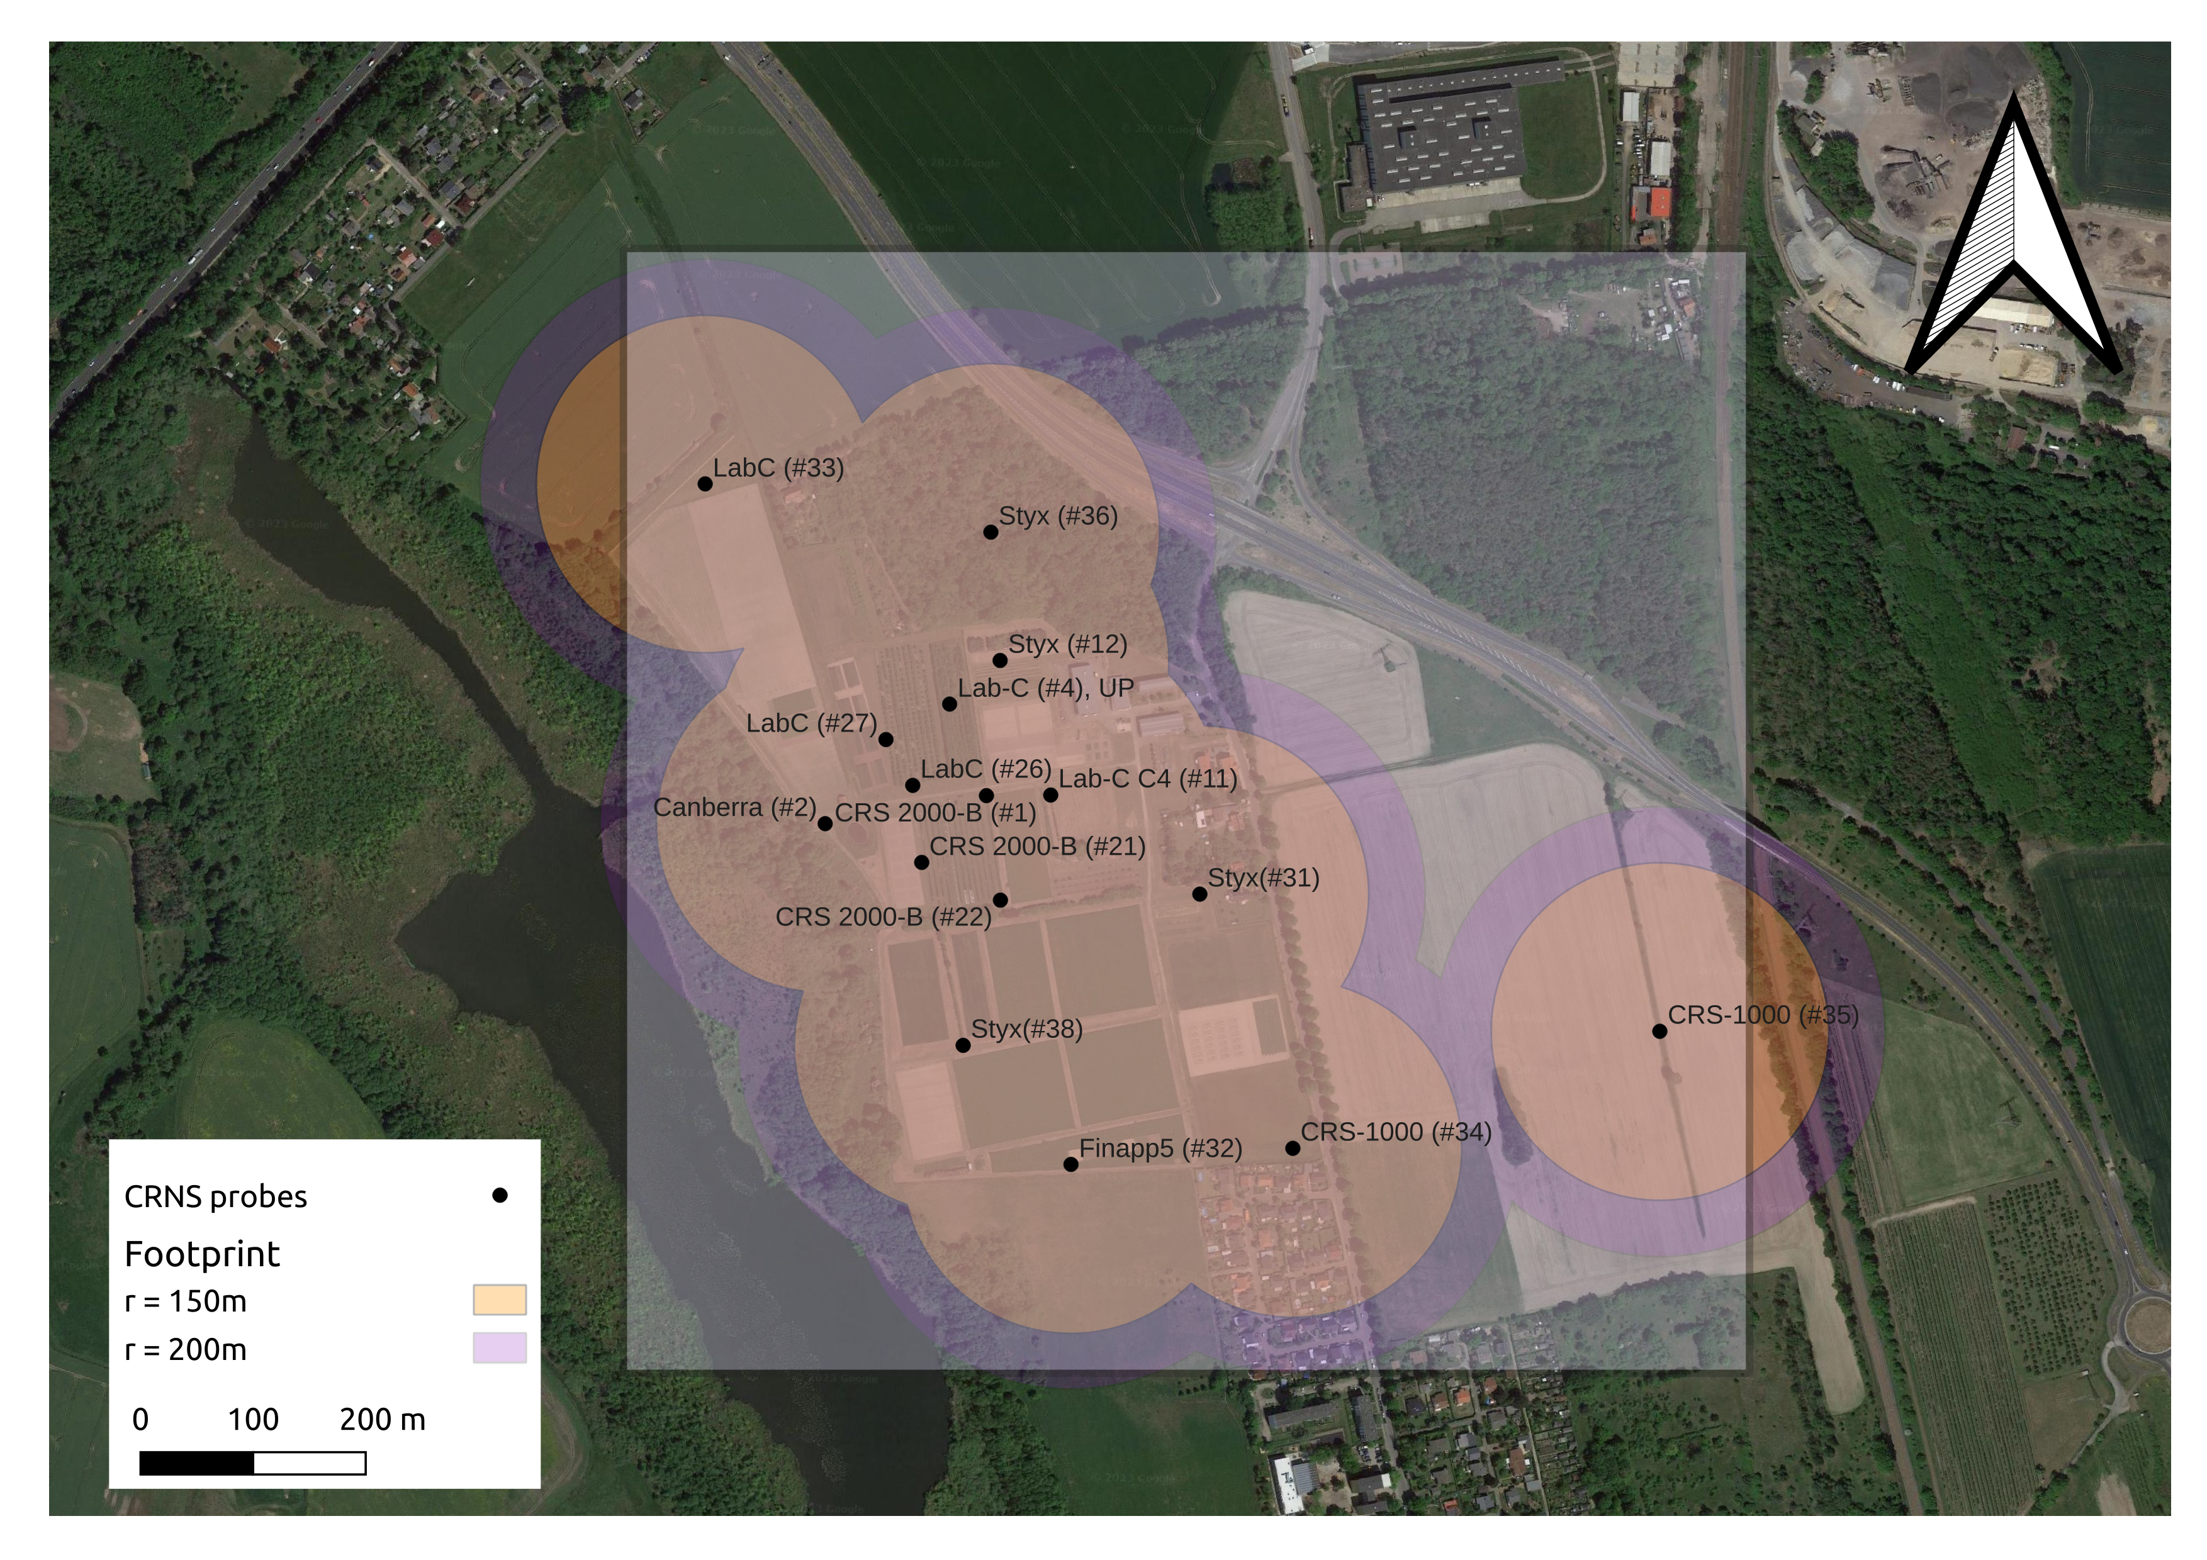
Marquardt‘s new cluster design

Slide 10
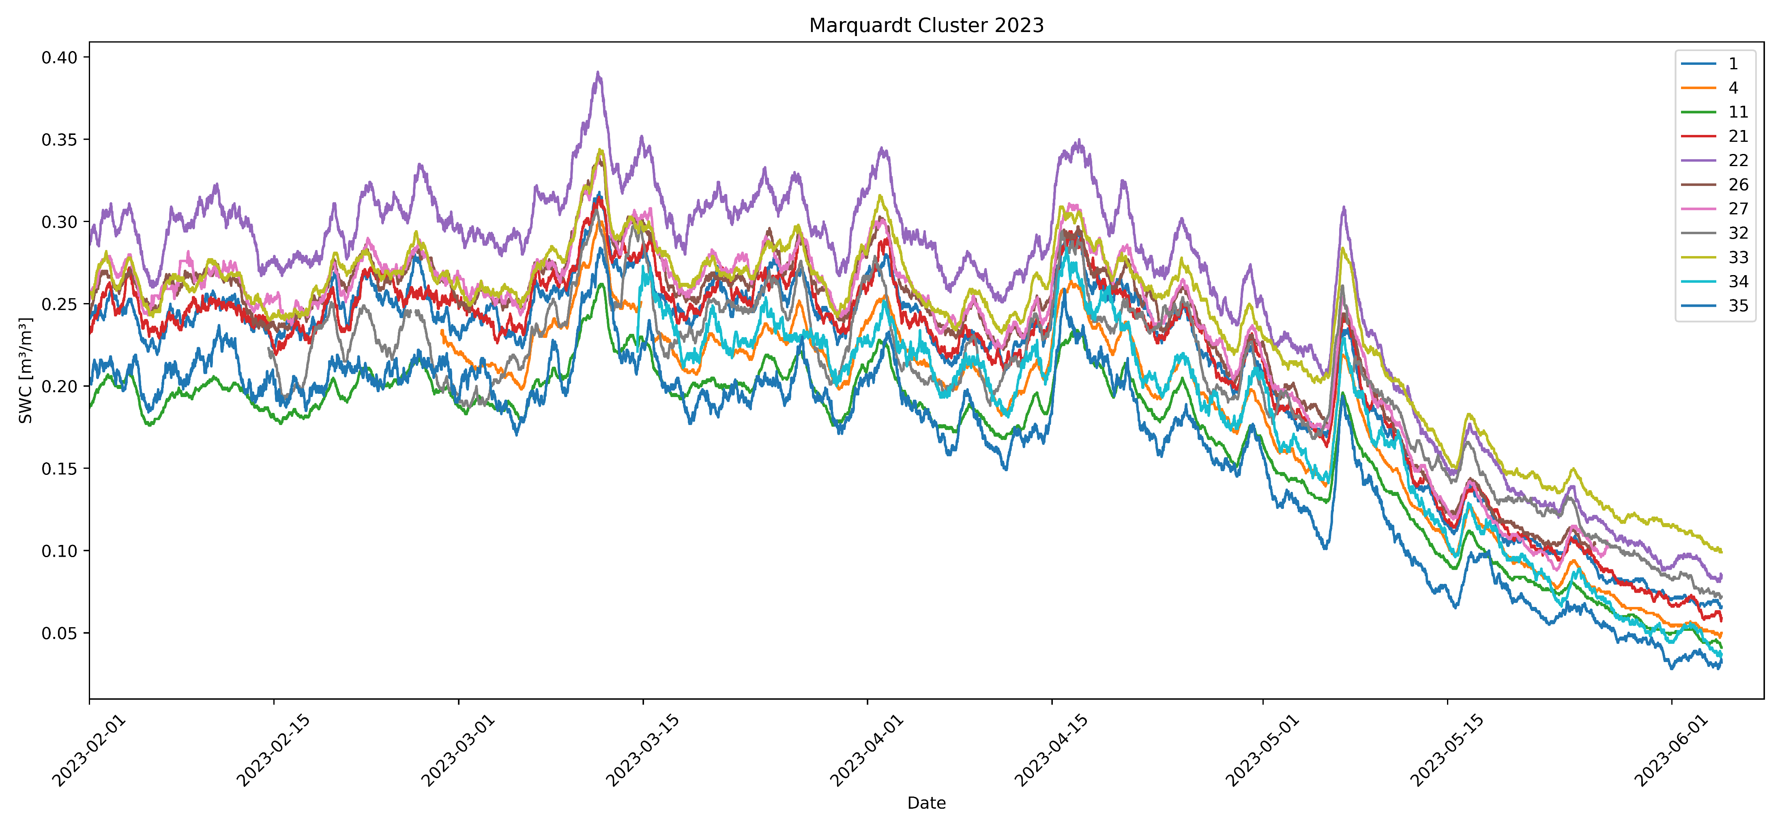
Marquardt: preliminary results

Slide 11
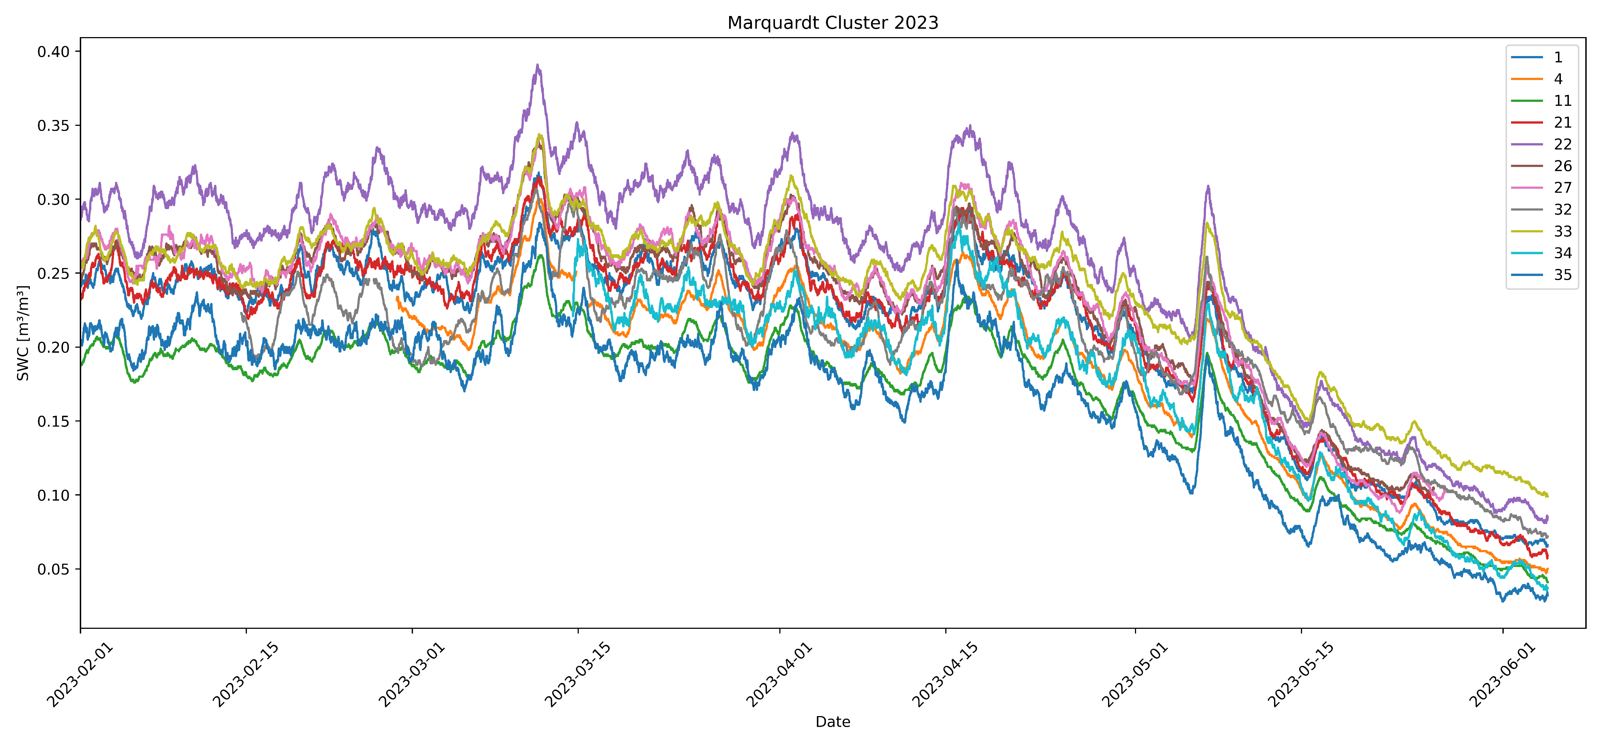
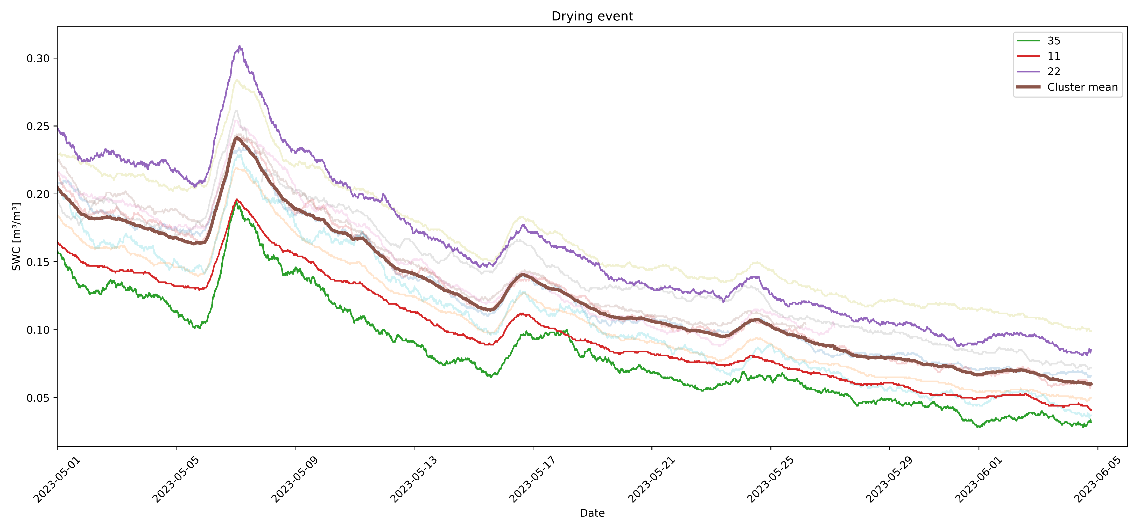
Marquardt: preliminary results

Slide 12
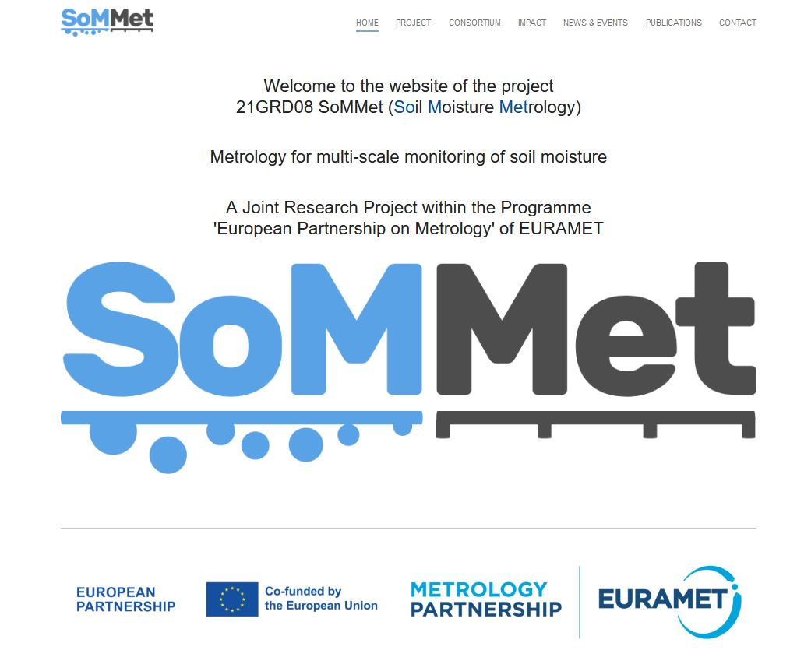
Thank you!
Follow the project progress at: sommet-project.eu

